Slide 1
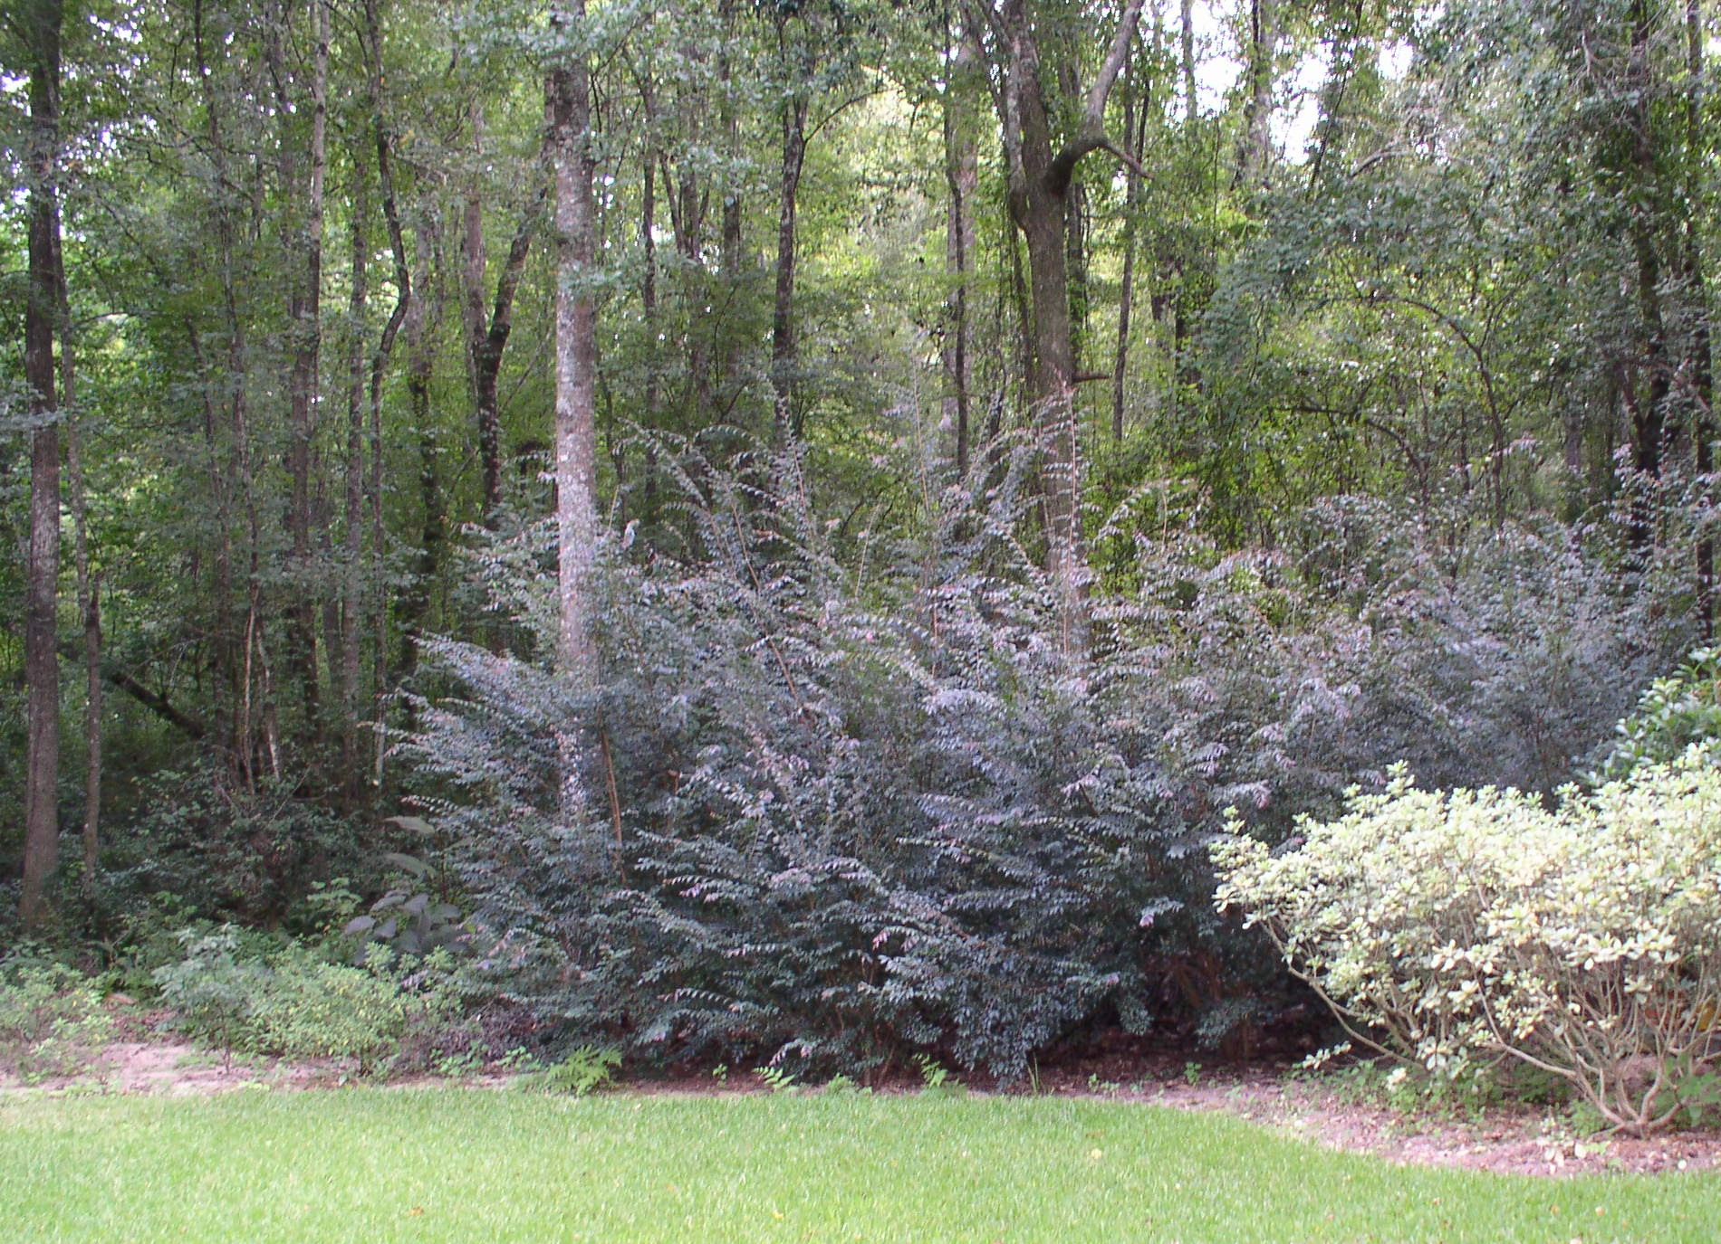
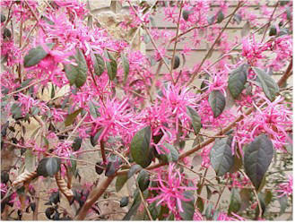
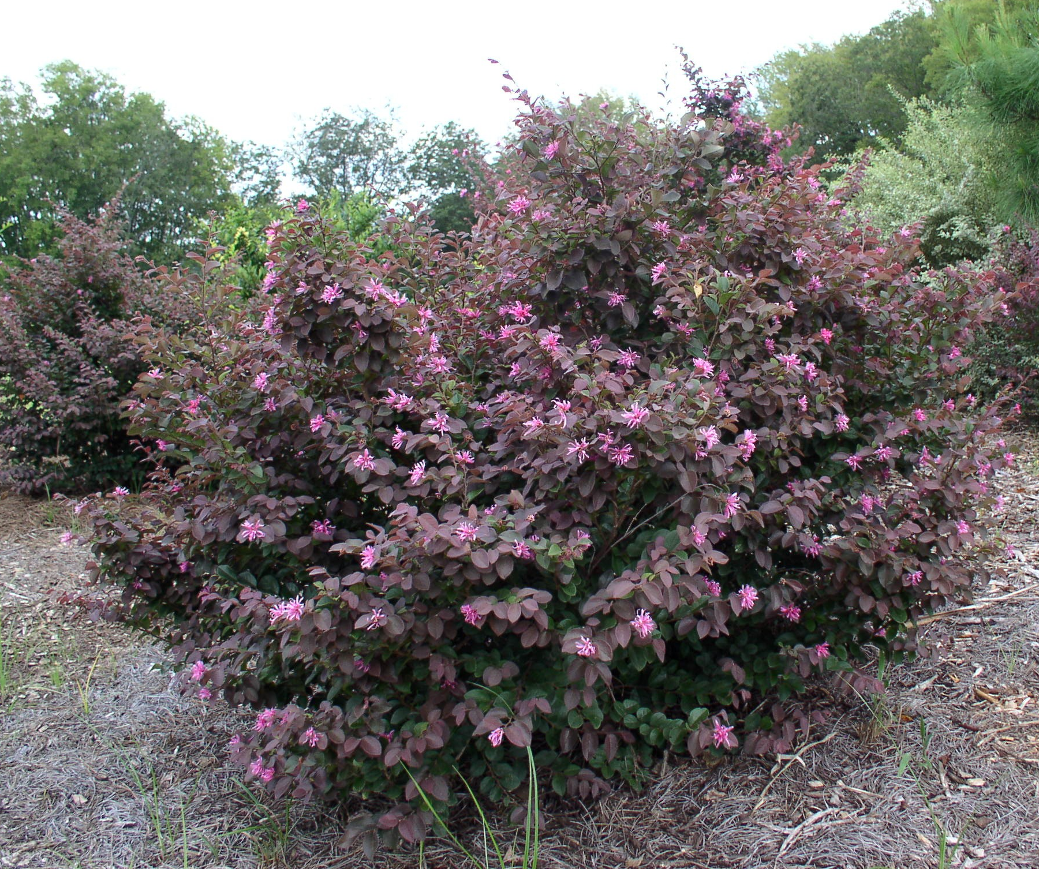
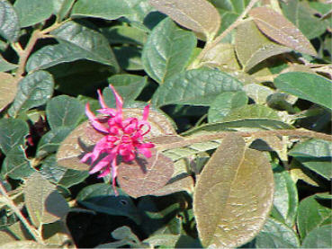
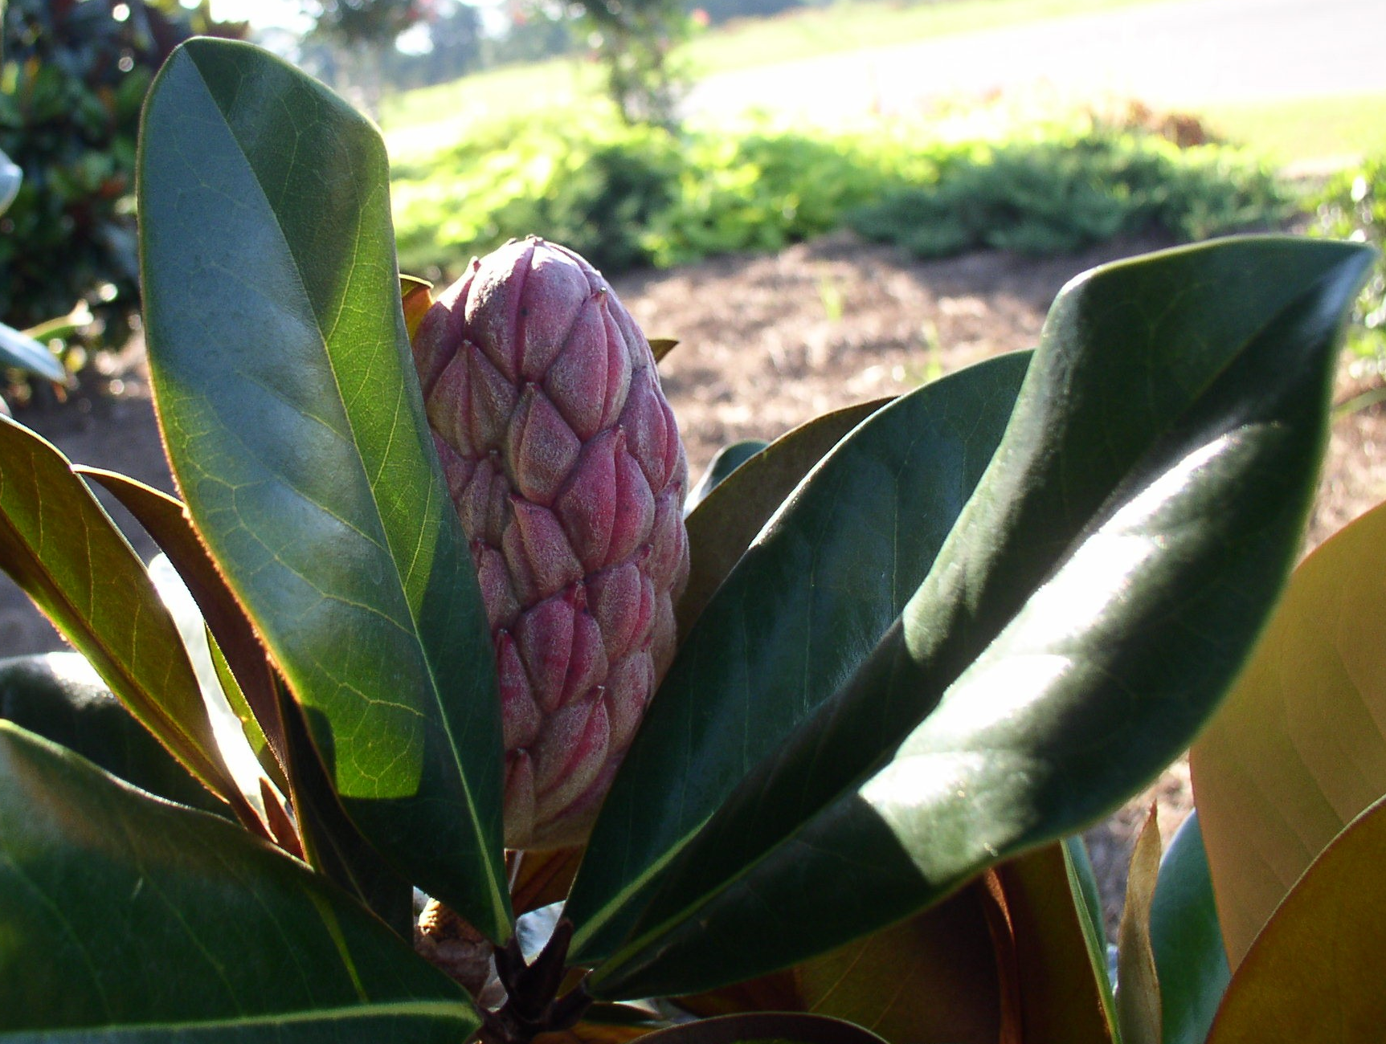
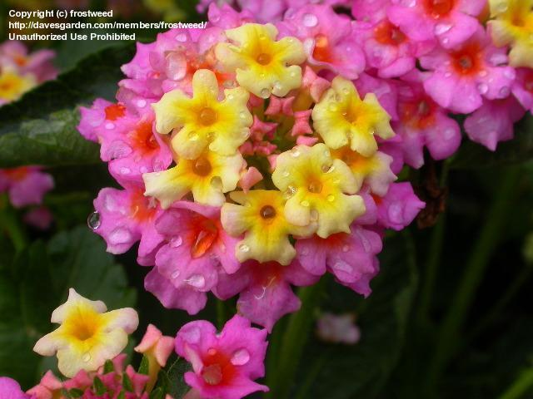
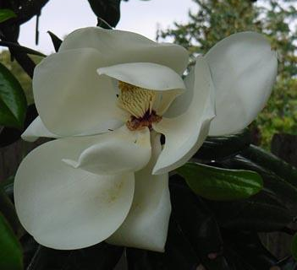
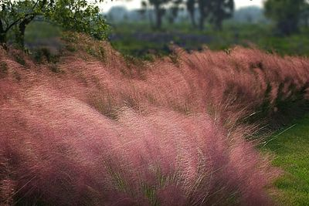
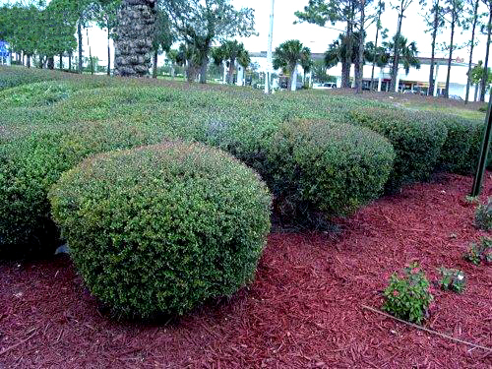
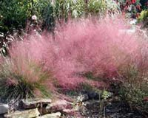
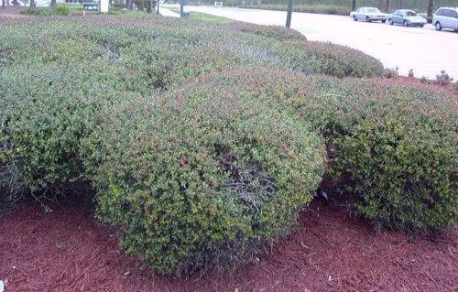
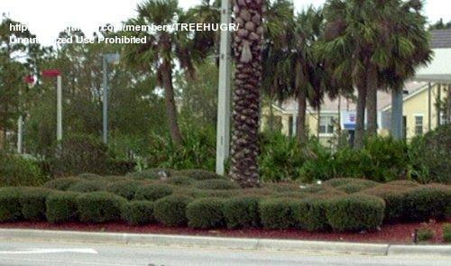
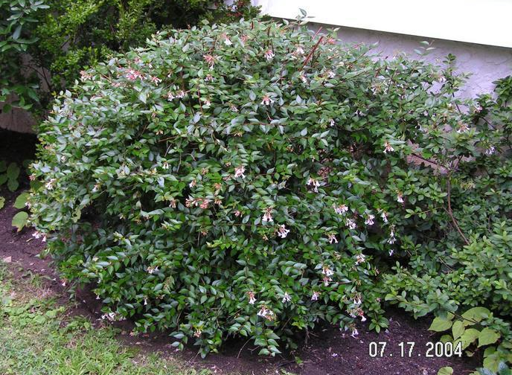
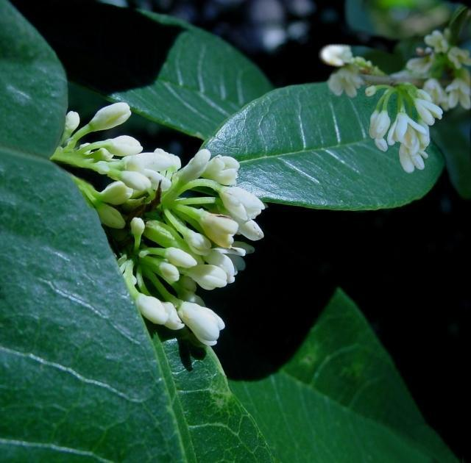
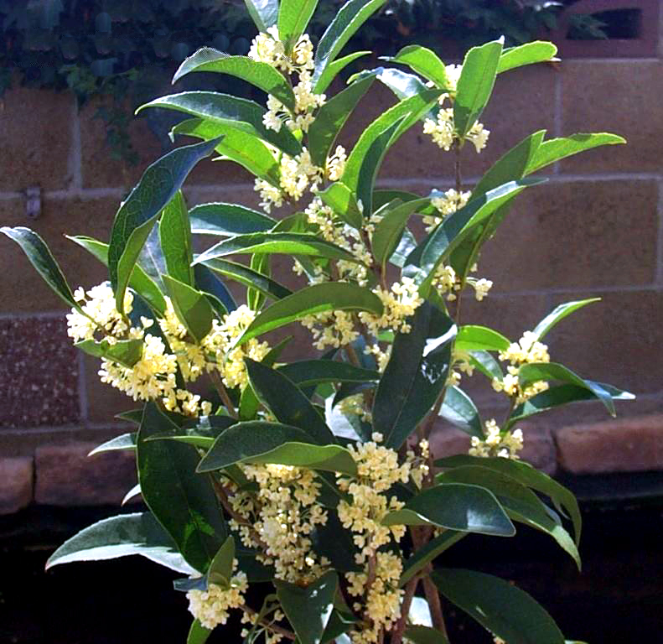
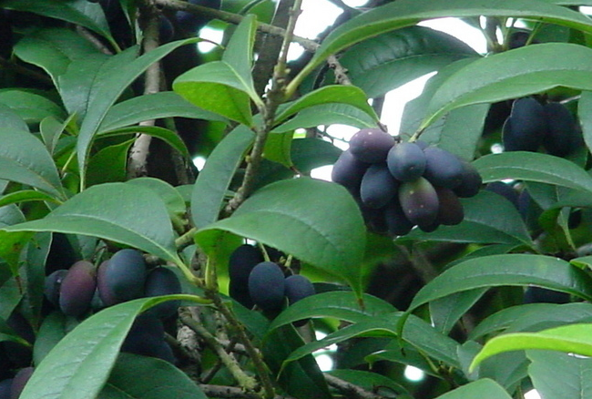
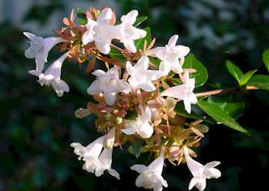
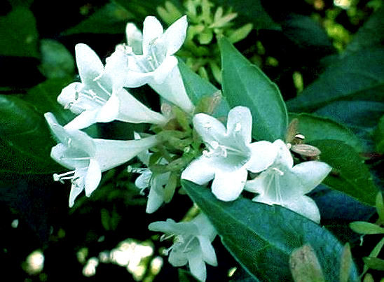
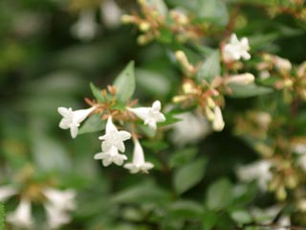
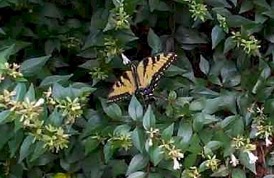
Loropetalum chinense, a finely textured, evergreen shrub belonging to the witch hazel family, grows up to 12 feet tall and 8 feet wide. It has a spreading habit with branches arranged in horizontal layers. Young shrubs have greater spread than height and are densely branched. Loropetalum makes a better hedge than foundation planting. The red, bright pink, or white flowers are arranged in small clusters with each having four narrow petals that droop downward. The flowers bloom prolifically beginning in late winter into spring, but sporadically throughout summer. Loropetalum leaves are oval, long and about one inch wide. Preferring zones 7 – 10, Loropetalum is drought tolerant once established.
Southern Magnolia, Magnolia grandiflora is a broadleaf evergreen native to the Southeast. Trees grow to 80 feet high and 50 feet wide with an upright form. Magnolia has large, lustrous foliage with large, white, fragrant flowers. The flowers bloom from April to June. The cone-like fruit matures from September through late autumn. The trees grow in acidic soil with a pH of 3.5 to 7. They are easy to maintain, but tree litter can be a problem. Magnolia has no insect or disease pests and is resistant to damage by sulfur dioxide. It grows in zones 7-9. Seedlings MUST be
protected from frost damage.
Magnolia prefers full sun,
well drained soil and tolerates
summer droughts.
Lantana camara is a vine-like shrub, useful as a ground cover, border shrub or in hanging baskets and is great in butterfly/ hummingbird gardens. Lantana prefers full sun in zones 8 and higher, tolerates poor soils and is invasive. Its clusters of small bright flowers with a range of color (yellow, orange, white, red, purple or mixed in the same cluster), don’t have a pleasant scent, but the foliage smells like citrus. A great advantage of this plant in a waterSmart garden is that it is drought tolerant once established.
Native to the Southeast, Dwarf Yaupon Holly (Ilex vomitoria nana), is a slow growing, evergreen shrub with dark green oval shaped leaves. Female shrubs bear red, ¼” in diameter fruit in autumn. The more light I. vomitoria receives, the more dense the foliage will become. This is an ideal waterSmart plant, since natural rainfall is sufficient for watering.
Muhly Grass, Muhlenbergia capillaris,
is a knee high purple bunch grass native to the Southeast. It appears as a purple haze from a distance, due to the purple seed heads. Muhly grass forms a
showy bunch of wire like leaves and
unbranched stems, originating from
a dense basal clump, making it an
excellent groundcover for areas with
poor soils. The grass does not grow
from runners, but is easily grown from
seed. Its known for the purplish-red
flowers that are diffuse, silky panicles
up to 18 in. wide that stand above the
leaves and appear in late summer. Once
established, it needs no care.
Fragrant Tea Olive, Osmanthus fragrans, is known best for its powerful sweet scent. This large, slow growing, upright shrub is usually 6-10 feet tall in landscapes but can be 20 feet tall with an 8 foot spread under optimal growing conditions. Tea Olive leaves are shiny and dark green with smooth edges and tend to be at the ends of stems, giving the shrub an airy appearance. In autumn, white flowers cover the shrub, persisting throughout winter and into summer. It prefers good soil, full sun and grows best in zones 7-10.
Abelia is a shrub that grows from 3-20 feet tall. Native to Asia and Mexico, these shrubs are evergreen in warm climates. The leaves are glossy, dark green, and are ½ to 2.5 inches long. Those from colder climates are deciduous with leaves that turn purple in the fall. Scented flowers at the ends of the branches hang bell-shaped either singly or in groups of up to 8. The white to pink flowers are present continuously from late spring to autumn. Abelia is a food plant for some butterflies.

