Slide 1
Notes:
UGA Logo

Slide 2
http://www.caes.uga.edu/extension/
Notes:
UGA Cooperative Extension Web address

Slide 3
Notes:
Georgia Master Gardener Logo

Slide 4
Nuts and Bolts of Water Gardening
Prepared by:
Tony Johnson
Horticulturist, UGA Research & Education Garden
Griffin Campus
With thanks and appreciation to Steven Patrick, CEA
Notes:
Title Slide

Slide 5
Learning objectives
Site evaluation
Pool design - overall landscape design
Basics of water garden installation
Basic pond maintenance
Plant materials for water gardening
Water garden problem troubleshooting
Notes:
Learning Objectives
Understand the importance of site evaluation in planning a water garden.
Understand the effect of pool design on overall landscape design- a formal vs. informal look.
Understand the considerations of volume of water and surface area.
Understand the basics of water garden installation.
Be familiar with basic pond maintenance.
Be familiar with plant materials for water gardening.
Be familiar with basic water garden problem troubleshooting.

Slide 6
The First Three Rules Of Water Garden Installation Are???
Notes:
Ponds, pools and fountains have become popular in recent years as more people look for ways to bring the element of water into the garden. Before you begin to install a water garden there are some rules you should know.

Slide 7
1. Location ! 2. Location ! 3. Location !
Notes:
The location is crucial in planning a water garden and selecting the right location will ensure that your water garden gives you years of enjoyment.

Slide 8
Site Selection
Things to consider when selecting a water garden site.
Sunlight
Elevation and grade
Power and water source
Proximity to outside activity areas
Style
Safety
Notes:
Things to consider when selecting a water garden site are: sunlight, elevation and grade, power and water source, proximity to outside activity areas, style and safety.

Slide 9
Sunlight
6 to 8 hrs
Tree considerations
Full Sun = 8-12 hours direct sun
Part Sun/Part Shade = 4-8 hours direct sun
Shaded = Less than 4 hours direct sun
Notes:
Most blooming aquatic plants need 6 to 8 hrs. to bloom well. If a water garden is located near or under trees care must be taken not to damage the root system. Also the leaves and other debris will have to be kept out of the water garden.

Slide 10
Elevation & Grade
Avoid low-lying areas
Avoid areas where water from the lawn and landscape collect
Notes:
Even though a low area may seem to be a perfect location it is not. A low area will allow water run-off to bring in chemicals, fertilizers and silt into a water garden. In low areas ground water can push the liner out of the ground. Chemicals will be harmful to fish and plants. Fertilizers will feed the free-floating algae and silt and other debris will cause the water to be cloudy.

Slide 11
Power & Water Source
Circuit Breaker
Receptacle
Power source with ground fault circuit interrupter (GFCI)
Convenient water source
Notes:
Water gardens need to be located near a convenient power and water source. Power for pumps and outdoor lights must be protected by a ground fault circuit interrupter (GFCI). A water source will be needed to fill the water garden and to replenish water loss due to evaporation.

Slide 12
Proximity
Locate in areas where you spend time
Consider views
Notes:
It is best to select a site near the area you spend most of your time gardening, entertaining, and relaxing outside. Locating it nearby will make the required tasks to properly maintain it easier. Also consider the views from other areas of your property and from inside of your home.

Slide 13
Style
Personal taste
Style of house & garden
Formal/Informal
Notes:
The style of a water garden is a matter of personal taste, although it will be more attractive if it compliments the style of the house, garden and other existing landscape features like decks and patios. Water gardens are generally classified as either informal (those that imitate nature) or formal (those that reflect a particular architectural style). Whether or not a water garden is considered formal or informal depends largely on its shape and the edging materials used to define and cover the water garden perimeter.

Slide 14
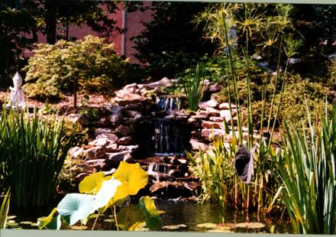
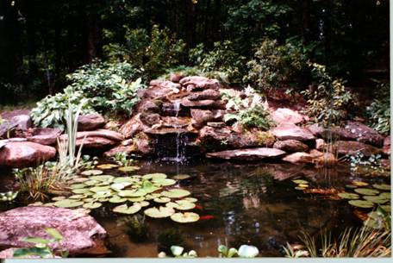
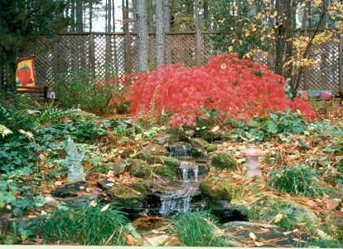
Informal Style
Notes:
Informal water gardens take a cue from the ponds and streams found in nature. They usually have a curvilinear shape and often they incorporate short streams or small waterfalls. They can also wrap around existing landscape features, such as large boulders or a mass of tall plantings. Overhanging rocks and perimeter plantings are used to hide the water garden edges above the waterline. These types of water gardens usually look best in landscapes with informal or natural looking gardens. Informal water gardens must be designed carefully to blend into the surrounding landscape. Once decisions are final on the type of water garden, the proper site can be selected. It is best to select a site near the areas where most of the outdoor time is spent gardening, entertaining, and relaxing. Locating it nearby will make the required tasks to properly maintain it easier.

Slide 15
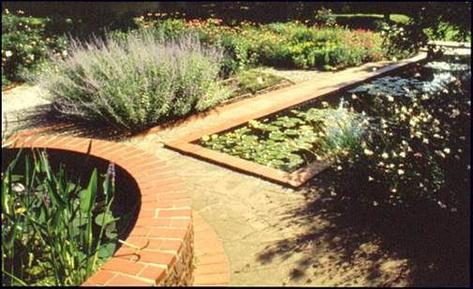
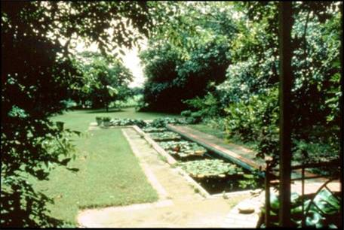
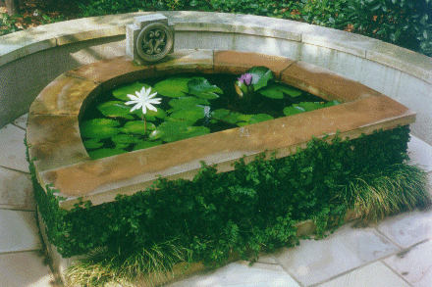
Formal Style
Notes:
Formal water gardens and fountains generally conform to strict geometric shapes such as circles, ovals, squares, rectangles and so on. They may be raised above the ground and contained by a low wall of concrete, brick, cut stone, or stucco. They often include a statuary fountain. They are intended to look man-made and compliment the symmetry of the surrounding garden style and features of the house, patio or deck.

Slide 16
Safety
Check local ordinances
Check homeowners Insurance
Call before you dig ( Better yet, before you select a site)
Notes:
Before you begin construction it is important to check with local or county officials for information on local building codes related to water gardens fountains or ponds. Also check with your insurance agent to see whether your policy covers liability related to water gardens.

Slide 17
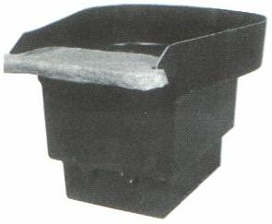
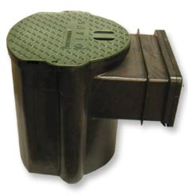
Selecting Materials & Supplies
Notes:
Pond materials and supplies can usually be purchased from garden centers, specialty stores, and catalogs.

Slide 18
Liners
Cost not only consideration
Several options
Fish Safe
Notes:
When you are choosing a liner do not try to get by with the cheapest material. The liner is the most important component in a water garden and you have several options, but only use a liner that is guaranteed fish safe.

Slide 19
Flexible Liners
PVC (poly vinyl chloride)
EPDM (Ethylene Propylene Diene Monomer)
Permalon
Notes:
PVC (poly vinyl chloride) is a relatively cheap liner however; it must be protected from UV exposure from the sun.
EPDM (Ethylene Propylene Diene Monomer comes in various amounts of thickness. It is a superb general-purpose liner material. It is very flexible but large pieces can be very heavy. It must be protected from UV exposure from the sun.
Permalon liner is new and extremely popular, especially for very large ponds. It is lightweight and pricing is very comparable to other liners, often cheaper. It must be protected from UV exposure from the sun.

Slide 20
Underlayment
Recommended for all water garden liners.
Geotextile liner
Builder’s sand
Notes:
Some type of underlayment is recommended for all water garden liners. Geotextile liner underlayment makes liners more puncture resistant and stabilizes ground under the liner to keep pond liners from “over-stretching”.
You may also use a 2” to 3” layer of builder’s sand. The underlayment is preferred because it is quick and easy to install.

Slide 21
Sizing Liner & Underlayment
Length + 2 times Depth + 2’ overlap = Liner Length
Width + 2 times Depth + 2’ overlap = Liner Width
EXAMPLE Water Garden - 14’ (L) X 9’ (W) X 2’ (Depth)
14’ + (2x2’) + 2 = 20’ (length)
9’ + (2x2’) = 15’ (width)
Notes:
To calculate the width and length of the liner and underlayment needed:
Water Garden Length + 2 times Depth + 2 foot overlap = Liner Length
Water Garden Width + 2 times Depth + 2 foot overlap = Liner Width
EXAMPLE Water Garden - 14 feet(L) X 9 feet (W) X 2 feet (Depth)
14 feet + (2x2 feet) + 2 = 20 feet (length)
9 feet + (2x2 feet) = 15 feet (width)

Slide 22
Pre-formed liners
Notes:
Pre-formed liners come in variety of shapes and sizes and have advantage of ready made planting shelves and areas for sitting submersible pumps. They are available in both formal and informal styles.

Slide 23
Pumps
Low Efficiency
Lower initial cost
Uses more electricity
Shorter life expectancy
Notes:
Low efficiency pumps have a lower initial cost but use more electricity and have a shorter life.

Slide 24
Pumps
High efficiency
Higher initial cost
Uses less electricity
Longer life expectancy
Notes:
High efficiency pumps are higher quality, will last longer, and use less electricity

Slide 25
Skimmers
Notes:
A skimmer provides several types of filtration. It mechanically skims large debris form water surface and catches them in a net or plastic basket. Filter mats work to trap small particles. Provides convenient and protected place to house pump.

Slide 26
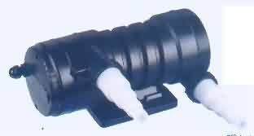
Filters
Notes:
In order to provide good water quality, some form of waste removal must be provided. Two methods of filtration used in water gardens are mechanical and biological. Mechanical filters physically remove solids from the water by trapping the debris in some form of mat, brush, or sponge. Mechanical filters are effective but generally require frequent cleaning to remove the accumulated matter. Most biological filters are also mechanical filters depending on how they are used.

Slide 27
Filters
Mechanical Filtration
Biological Filtration
Ultra-Violet Clarification
Notes:
Mechanical Filtration traps particles in a material of some type for later removal during cleaning. Biological Filtration uses beneficial bacteria to feed on impurities in the water; the bacteria break down fish wastes and other organic matter Ultra-Violet Clarification - by exposing water to ultra-violet light, single-cell algae (waterborne algae) clump together for easier removal by a mechanical filter

Slide 28
Waterfall Filtration Box
Notes:
This system is useful if you want to have a waterfall and or stream. The waterfall filtration box provides three layers of filtration. First, the water flows through the filter media. The filter mats also provide surface area for bacteria, which break down harmful elements in your water garden and keep the ecosystem balanced. It is easily hidden with stones and plant material.

Slide 29
Layout and Installation

Slide 30
Layout
Notes:
The best way to get the shape is to use spray paint or a water hose and lay out the shape on the ground.

Slide 31
Excavation
Notes:
Dig the water garden to the desired shape and dig a shelf around the perimeter about one foot deep and one or more feet wide.

Slide 32
Leveling the Edges
The water will be level.
Make sure the water garden edges are too!
Notes:
The top edges of the pool need to be absolutely level so the liner will not show on any side when it is complete.

Slide 33
Plant Shelves
Notes:
Incorporate plant shelves all the way around the pond to allow maximum flexibility for placing plants. Shelves should be between 6 and 12 inches below the water and 10 - 12 inches wide. The pond should be at least 18 inches deep in most areas of the country, but 2 - 3 feet is better. The recommended depth for ponds that will be home for Koi is 3 feet.

Slide 34
Installing Underlayment & Liner
Notes:
Line the water garden excavation with the underlayment and trim with scissors or a utility knife. Tape any small pieces together to keep them from moving when the liner is installed. Place the liner into the excavation and unfold. Position the liner evenly in the pond. Try to minimize folds and wrinkles but some will be necessary. After the water is added the folds should flatten out.

Slide 35
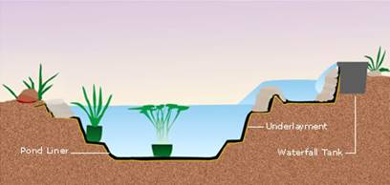
Edging Treatments
Notes:
Besides the traditional method of edging with a thin stone on the edge overlapping the water garden, one or more layers of stone can be built up from the shelf. This provides a more natural appearance and will allow the water to fluctuate without seeing the liner. Or, create a cobblestone beach edging by placing a large stone at the inside of a large shallow shelf and filling the area with gravel and cobbles. Naturalize this area by planting shallow water plants

Slide 36
Installing Stone
Notes:
Place the stone or other coping around the edge of water garden. Arrange the coping stone around the edge and fold the liner up behind the stone to slightly above the water level. It is usually not necessary to mortar the stone into place if it is of sufficient size to be stable. If using small stone or if people will be walking around the edge, then mortaring the stone for stability may be required. Back fill with soil to hold the liner again the stone.

Slide 37
Ready For Fish & Plants
Notes:
Fill the water garden with water to within a few inches from the top and then make corrections if necessary to ensure that the water garden is level. As the water garden is filling, remove wrinkles and make folds as necessary.

Slide 38
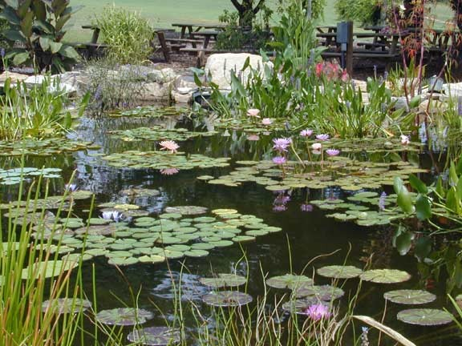
The Well-Planted Water Garden
Notes:
Planting shallow areas with water plants will create a more natural edge with plants partly in and partly out of the water. Bare root plants plant with some soil still attached can be placed directly into the gravel. This will help the plant to become established more quickly.

Slide 39
Aquatic Plants Selection and Care
Aquatic Plant Types
Floating
Surface
Submerged
Marginal
Notes:
Aquatic plants are an important part of a water garden’s ecosystem. They help shade the water garden, thereby reducing algal blooms, provide oxygen for fish and beneficial bacteria, attract aquatic wildlife, and enhance the water garden’s visual appeal.

Slide 40
Floating Plants
Water Hyacinth
Water Lettuce
Duckweed
Notes:
Plants that float freely on the surface of the water with their root system dangling under the water. They provide shade that reduces the light and the root system takes up excess nutrients that algae needs to grow. Some have blooms while others provide different leaf textures. Floaters grow very quickly and need to be thinned periodically
Examples include the following:
Water Hyacinth
Water Lettuce

Slide 41
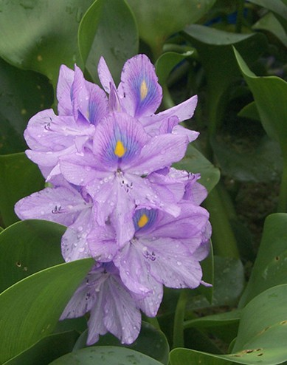
Water Hyacinth Eichhoria crassipes
Notes:
Water Hyacinth (Eichornia crassipes). Grows up to 6 inches above the water. Spreads by trailing. Blue flowers are produced during the summer. Grows well in full sun and is very effective at removing nutrients from the water, and providing shade for fish. Invasive in warm climates.

Slide 42
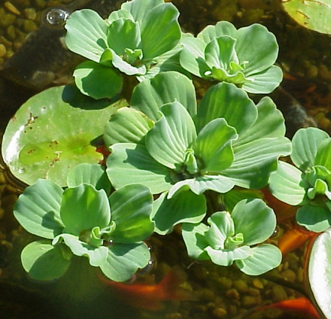
Water Lettuce Pistia stratiotes
Notes:
Water Lettuce (Pistia stratatoides) Grows up to 3 inches above the water. Floating rosettes of green velvety leaves, does well in shade to sun (prefers a little shade). Grows quickly.

Slide 43
Surface Plants
Water Lilies
Lotus
Floating Heart
Water Clover
Water Hawthorne
Notes:
Surface plants have their roots in pots or planting pockets under water. They send stems with leaves to the surface which block sunlight and aides in the control of algae. Many bloom and or have colorful foliage
Examples include the following:
Water Lilies
Lotus
Floating Heart
Water Clover
Water Hawthorne

Slide 44
Water Lilies
Water Lilies
Hardy
Tropical
Tropicals
Day Bloomers
Night Bloomers
Notes:
Water Lilies are divided into to types:
Hardy
Tropical
Tropicals are divided into two types
Day Bloomers
Night Bloomers

Slide 45
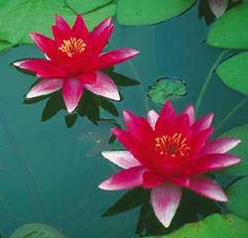
Hardy Water Lily Nymphaea
Notes:
Hardy Water Lily
Perennials, frost tolerant, bloom throughout the summer; each blossom lasts 3-4 days, opens in the morning and closes in the afternoon.
Colors: pink white, yellow, changeable, peach, salmon, red.Blossoms float on the water surface, except were noted, crowded or in shallow water. Most require 5-6 hours of direct sunlight. Require still water 6-18" deep over rootstock. Plant in soil in containers. Fertilize once a month during growing season. Grow in zones 3-11.
Cover 60-70% of your pond's surface with water lilies, as part of your balanced pond formula.
Predators: muskrats, nutria, crawfish, ducks, geese, swans, deer, cattle, fish over 8", turtles.

Slide 46
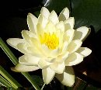
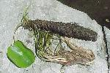
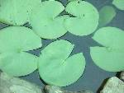
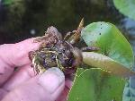
Hardy Lily
Flowers
Growth Habit
A
B
Pads
Propagation
C
D
Notes:
Colors include white, all shades of pink, yellow, autumn, blue, purple and undertones of green. All stand above the water and shapes are usually starry but some varieties are more cupped.
Hardies grow horizontally from and along a fleshy rhizomatous rootstock. "Eyes" at points along the rhizome produce new crowns.
Hardy pads are rather thick and leathery with smooth edges. Most are plain green though many are lightly mottled with maroon when young. The exception is 'Arc-en-ciel' which is green, pink and maroon
From division for exact duplication, from seed for variation

Slide 47
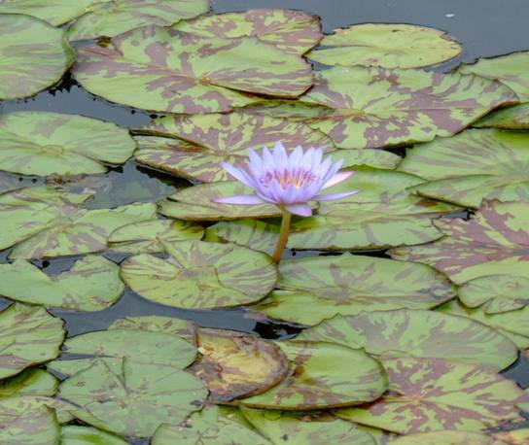
Tropical Water Lily Nymphaea
Notes:
Tropical Water Lily
Tropical lilies come in two categories: Night blooming and Day Blooming Night Bloomers open at dusk and remain open through mid-morning. Day Bloomers open in the morning and remain open until late afternoon. They are the only water lilies available in shades of blue and purple. Grow in USDA Zones 3-11 during the summer, and are frost tender. Treat as a tender perennial in zone 9; they can survive winter in zones 10-11. Require at least 4 hours of direct sunlight (except where noted), and over 2 weeks of air temperature over 80° F. Plant in containers with top soil and fertilize twice per month during the growing season. Like most aquatic plants, they require still water and should be planted at a depth of 6-18" over rootstock.
Are extremely fragrant
Produce showy flowers up to 10" in diameter that stand well above the water's surface.
Bloom throughout the summer; each blossom lasts 3-4 days.
Prolific bloomers! Make beautiful cut flowers.
Preditors: muskrat, nutria, crawfish, ducks, geese, swans, deer, cattle, fish over 8" turtles.

Slide 48
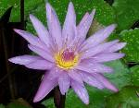
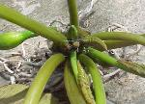
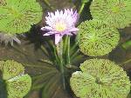
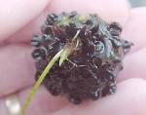
Tropical Lily
Flowers
Growth Habit
A
B
Propagation
Pads
C
D
Notes:
Colors include white, all shades of pink, yellow and changeable autumn. Many, though not all, stand on the surface of the water and many are cup-shaped with some starry.
Tropicals grow from a single central crown. All leaves and flowers radiate from this point and growth is vertical
Tropical pads are usually somewhat thin with edges slightly scalloped or toothy. They can be plain green, flecked, mottled or whorled with maroon or bronze.
From tuber and division for exact duplication, from seed for variation. In some varieties known as "viviparous", from new plants produced on the leaves.

Slide 49
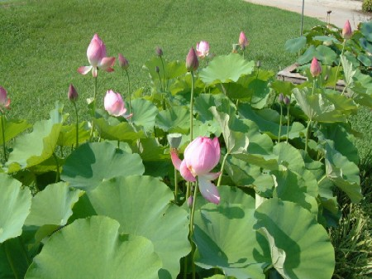
Lotus Nelumbo
Notes:
Hardy Lotus
Incredible blossoms and leaves, standing 1-7 feet above the water, permeate the garden with their heavy perfume. Blossom for 6-8 weeks during mid-summer. After the third day of bloom, the petals fall, revealing another development -- the strong and distinctive maturing seed pod. Winter hardy perennials in USDA Zones 4-11. Lotus grow during the summer in all zones, except the Pacific Northwest and Alaska. Prefer 5 hours of direct sunlight, minimum and require still water 2-4" above soil. Once mature (usually 1-2 seasons after planting the tuber), they can be placed in up to 18" water (above the soil-line).
Colors: white, yellow, pink, rose, red, changeable
Plant in containers and fertilize twice monthly, during the growing season.
Plant in 30 quarts of heavy top soil and fertilize. Small and Dwarf Chinese Lotus Varieties require at least 17.5 quarts of heavy top soil. Once planted, allow one to two years to become established and bloom.
Lotus are invasive in earth bottom ponds, up to 4' in depth.
Over wintering Lotus
In USDA Zones 4-11, lotus are winter hardy. If your pond will freeze to the bottom, lotus will need to be removed and kept in sheltered, dormant storage.
If your pond will NOT freeze to the bottom: Once water temperatures reach 50° consistently, or once lotus stems begin to brown, prune all foliage to approximately 1-2" above the soil line. Place container in the deepest part of your pond. When water temperatures warm to 55° consistently, or your lotus begins to show new growth, bring the container back to the recommended water depth.
If your pond WILL freeze to the bottom: Once water temperatures reach 50° consistently, or once lotus stems begin to brown, prune all foliage to approximately 1-2" above the soil line. Remove the container holding your lotus and place in a large garbage bag. Place damp newspaper over the top of the container and around stems. Loosely tie the garbage bag at the top. Store the garbage bag in a cool (40-45°), sheltered area. Open the bag once a week for 24 hours to let air. Keep the soil moist (with damp newspaper); check for mildew and rot.
When water temperatures warm to 55° consistently, or your lotus begins to show new growth, bring the container back to their commended water depth.

Slide 50
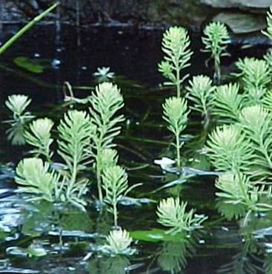
Parrot’s Feather Myriophyllum aquatica
Notes:
(Parrot’s Feather) -This feather-like plant floats over the water. It is hardy zones 6-11.

Slide 51
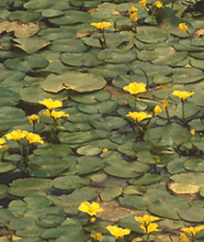
Floating Heart Nymphoides peltata
Notes:
Floating Heart ( Nymphoides peltata) Growth habit resembles pygmy water lilies. Flowers are yellow and poppy shaped with fringed edges, held among brown and green mottled leaves. 2-12in of water in full sun to light shade.

Slide 52
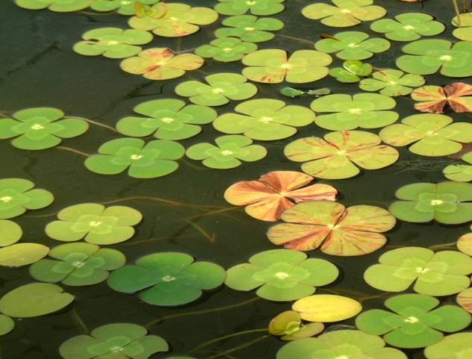
Water Clover Marsilea
Notes:
Four Leafed Clover Cutleaf (Marsilea schelpena) Cutleaf Four Leafed Clover (Marsilea schelpena) Height 4in, spread creeping . Grows well in wet soil to 3in of water in full sun to shade.Green lobed leaves give this plant a unique appearance. Hardy in zone 6.
Four Leaf Clover Variegated (Marsilea mutica) Variegated Four Leaf Clover (Marsilea mutica) Height watersurface, spread creeping. Grows well in wet soil to 12in of water
in full sun to shade. Brown markings on floating green leaves up to3in across. Hardy in zone 6.

Slide 53
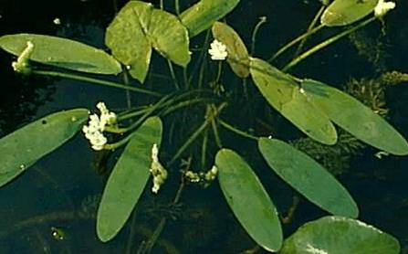
Water Hawthorne Aponogeton distachyus
Notes:
Water Hawthorn (Aponogeton distachyus) Elongated leaves float on the surface of the water with a long narrow white fragrant flower. Good to grow in shady ponds that inhibit lily flowering. Part shade to shade. 6-18in of water. Hardy in zones 5.

Slide 54
Submerged Plants
Anacharis
Cabomba
Hornwort
Vallisneria
Notes:
The leaves of submerged plants remain underwater rarely protruding above the surface. They may root in soil or float freely. Fast growers , they will need thinning in smaller water gardens. They add oxygen to the water and remove excess nutrients which helps control algae growth.
Examples include the following:
Anacharis
Cabomba
Hornwort
Vallisneria

Slide 55
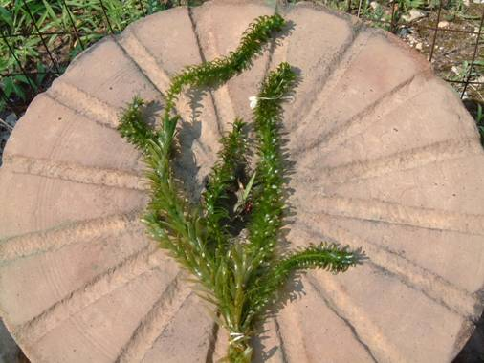
Anacharis Elodea canadensis
Notes:
An easy care Water Oxygenator and Clarifier. It will create a healthy echosystem in your water garden.
Use one bunch of Anacharis per one sq. ft. of surface area for ponds under 50 sq. ft. and one bunch per two to three sq. ft. for ponds over 51 to 200 sq. ft. For ponds over 200

Slide 56
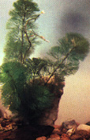
Cabomba Cabomba caroliniana
Notes:
Cabomba (Cabomba caroliniana) Dark green bristles on thin stems. Flowers mid to late summer are white with yellow centers. Hardy zones 6-10

Slide 57
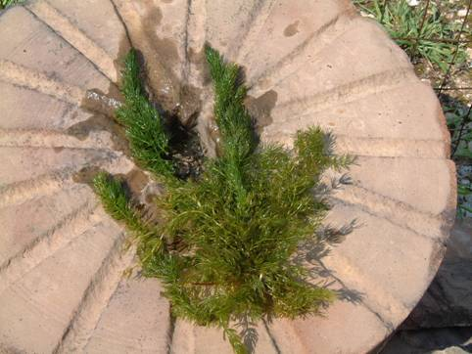
Hornwort (Marestail) Ceratophylum demersum
Notes:
Hornwort (Marestail) Ceratophylum demersum. Dark green, non rooting plant that doesn't float or sink -- just settles in the water. Provides an area for fish spawning. Hardy in zones 8-10.

Slide 58
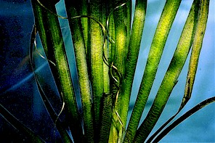
Tape Grass Vallisneria species
Notes:
Tape Grass (Vallisneria species) The flattened, tape-like, bright green leaves grow unbranched and completely submerged. Many varieties are sold commercially. It can be easily propagated by removing and rooting the clustered plantlets which grow from the creeping root system.

Slide 59
Marginal/Bog Plants
Star Sedge | Taro | Umbrella Palm
Sweet Flag | Cattail | Iris
Pickerel Weed | Arrowhead | Lizard’s Tail
Ruellia | Horsetail | Forget-Me-Not
Golden Club | Water Bamboo | Cardinal Flower
Rushes | Bacopa | Chinese Water Chestnut
Notes:
Marginal/Bog Plants grow along the shallow edges of the water garden. Some marginal/bog plants prefer that their crowns (the place where the stems connect to their roots ) be just above the water level and others prefer their crowns submerged.
Examples include the following:
Star Sedge Taro Umbrella Palm
Sweet Flag Cattail Iris
Pickerel Weed Arrowhead Lizard’s Tail
Ruellia Horsetail Forget-Me-Not
Golden Club Water Bamboo Cardinal Flower
Rushes Bacopa Chinese Water Chestnut

Slide 60
Water Irises
I. laevigatae
I. pseudacorus
I. versicolor
I. virginica
I. fulva
I. brevicaulis

Slide 61
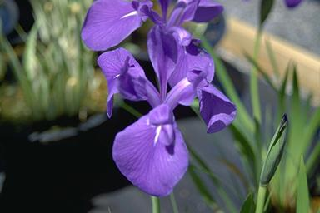
Iris laevigata
Notes:
Iris laevigata has attractive cobalt-blue flowers in May and smooth wide green foliage. Likes lots of moisture and acid soil. Will also grow in water.

Slide 62
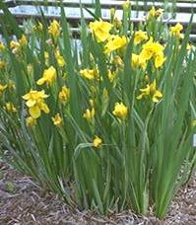
Iris pseudacorus
Notes:
Iris pseudacorus is the common form of the species. Clear bright yellow flowers with brown to black signal veining. Grows in streams, bogs, ponds or in the garden. Very vigorous.

Slide 63
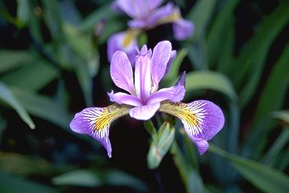
Iris versicolor
Notes:
Iris versicolor is the purple waterside iris. It has excellent branching with numerous beautiful flowers and is a good plant for garden or landscape use.

Slide 64
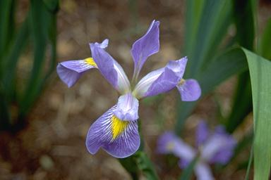
Iris virginica
Notes:
The Blue Water Iris, Iris virginica, has 3-5" flowers. It is vigorous and tolerates shade.

Slide 65
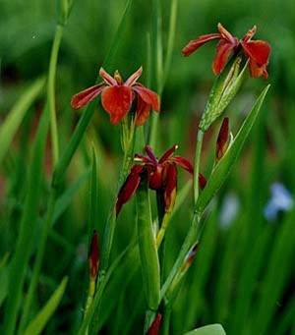
Iris fulva
Notes:
Iris fulva is another native American iris. It is one of the five species of the Louisiana iris group. It is perhaps the closest to red of any species in the entire genus. It can also be found in shades of brown, yellow, white, and even a muddy purple. Like all Lousiana iris, fulva does best in swampy conditions in acid soil during growing season and should be given plenty of fertilizer.

Slide 66
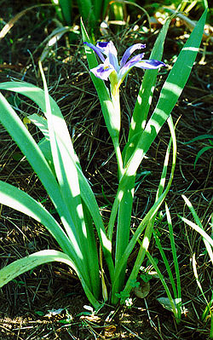
Iris brevicaulis
Notes:
Iris brevicaulis, another native American iris, normally has blue flowers on shorter zig-zag stems. It is one of the five species of the Louisiana iris group.

Slide 67
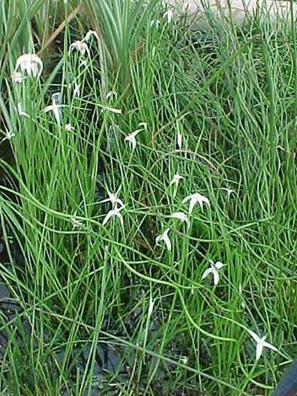
Star Sedge Dichromena colorata
Notes:
Star Sedge looks like a typical sedge until mid summer, when the clusters of foliage at the top of the 15" stems suddenly burst forth with spectacularly curious white bracts. This native from coastal Virginia into Florida is perfect for the bog garden.

Slide 68
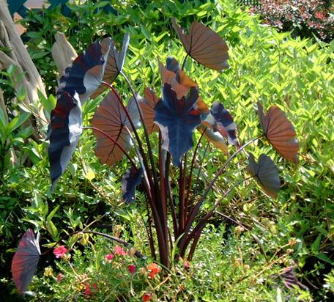
Taro Colocasia esculenta ‘Black Magic’
Notes:
Black Magic Taro (Colocasia esculenta) Incredible dusty charcoal black leaves on dark burgundy/black stems.Tropical Marginal plant. Height: 3-6'. Planting depth: 0-6". Partial shade to shade. Hardy zones 9-11

Slide 69
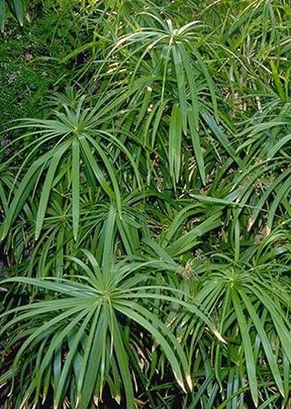
Umbrella Palm Cyperus alternifolius
Notes:
Umbrella Palm (Cyperus alternifolius) 5ft tall, and 5ft spread (vase shaped). Prefers wet soil to 6in of water. Full sun to part shade. Umbrella like green leaves growing high above water surface with green stems. Zones 9-11

Slide 70
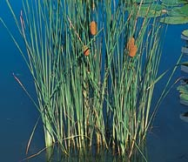
Cattail Typha species
Notes:
Dwarf Cattail- Typha minima. Smaller that Graceful, reaching height of36". Walnut-size catkins. Tolerates up to 6" water depth. Hardy zones 2-9.

Slide 71
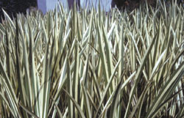
Sweet Flag Acorus calamus ‘Variegated’
Notes:
Dwarf Variegated Sweet Flag (Acorus calamus variegatus) Height 6-10 in, spread 12 in. Prefers full sun to part shade and will grow in wet soil to 6 in of water. Narrow short green and white foliage forming a low compact plant. Hardy in zones 6-10. Zone 5 if below the ice in the winter.

Slide 72
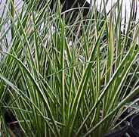
Grassy-leaved sweet flag Acorus gramineus variegatus
Notes:
Grassy-leaved sweet flag (Acorus gramineus variegatus) Height 6-10in, spread 12in. Prefers full sun to part shade and will grow in wet soil to 2in ofwater. Narrow short green and white foliage forming a low compact plant. Hardy in zones 6-10. Zone 5 if below the ice in the winter.

Slide 73
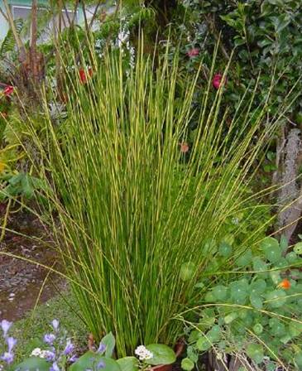
Rush Juncus effusus
Notes:
Soft rush is a true rush. Its pale-green stems are erect and two to five feet tall. Soft rush has no leaves. The inflorescence of soft rush appears to be coming out of the side of the stem. The inflorescence is open and branched. Each branch has 30-100 small flowers, each greenish-brown flower on its own stalk.

Slide 74
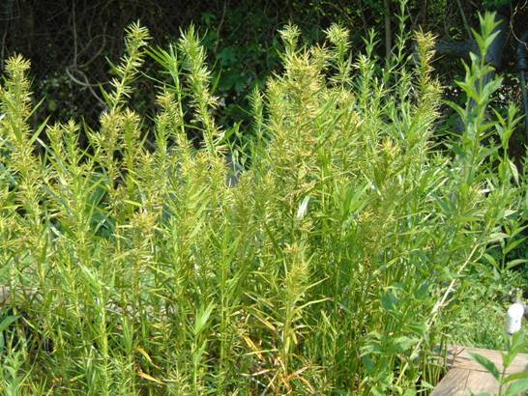
Water Bamboo Dulichium arundinaceum
Notes:
Not really a member of the bamboo family, this plant only looks like bamboo It is not overly invasive. Usually growing up to 18 in. tall, it can grow to 2 ft. or more. Tiny and insignificant flowers appear in summer from among the slender leaves. Good for low screening and as an accent plant in tub gardens. Grow in sun to part shade. Zones 6 - 11
Grow in medium container or larger in up to 4 in. of water

Slide 75
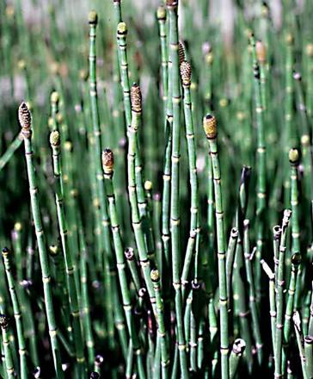
Horsetail Rush Equisetum hyemale
Notes:
Horsetail rush (Equisetum hyemale) is also called "scouring rush“ and has dark green-segmented stalks. Growing to 36" in height, it is a vigorous grower and spreader. Horsetail rush has a history of medicinal use. It tolerates damp soil to 12" water depth.

Slide 76
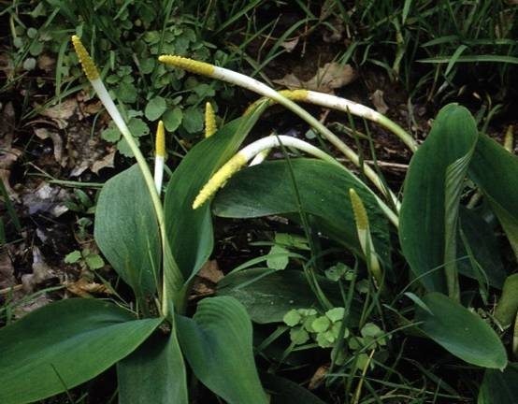
Golden Club Orontium aquaticum
Notes:
Golden Club (Orontium aquaticum) is an easy to grow plant that forms tight clumps 6 inches tall and 12 inches wide. Velvety green foliage with gold spikes shooting up out of the leaves in spring and grows in part to full shade.

Slide 77
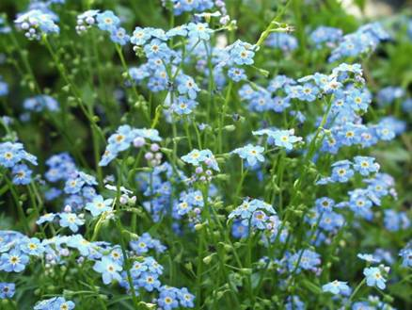
Water Forget-Me-Not Myosotis palustris
Notes:
Forget Me Not (Myosotis palustris) grows to 6 inches tall with a creeping spread. It grows well in wet soil to 2 inches of water. Preferring full sun to part shade, it has green fuzzy leaves below small blue flower clusters. It is particularly impressive on a waterfall or at the ponds edge.

Slide 78
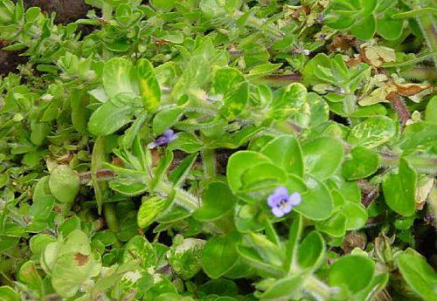
Bacopa Bacopa lenagera variegata
Notes:
Bacopa or variegated water hyssop is a spreading shallow water herb. Hardy to 20-30 degrees.

Slide 79
Cardinal Flower Lobelia cardinalis
Notes:
Cardinal Flower (Lobelia cardinalis) Crimson flowering spikes from mid to late summer. Slender plant. Grows to height of 36". Tolerates 1-2" water depth. Hardy zones2-9.

Slide 80
Bluebell Ruellia brittoniana
Notes:
Blue Bell (Ruellia brittoniana) 24" tall and 24" wide, this plant has long sword like foliage, with summer flowers. Flowers are blue and petunia like. Prefers wet soil to 6 in of water. Full sun to part shade. Hardy in zones 8 -11.

Slide 81
Pickerel Weed Pontederia cordata
Notes:
Pickerel Rush (Pontederia cordata) 1' to 2' A native variety with all the best features. Slick, broad dark green foliage. Bright lavender flowers. Easy to grow. Zone 3 Flowers in June, July, August, September.

Slide 82
Lizard’s Tail Saururus cernuus
Notes:
Lizards Tail (Saururus sp.) Height 12-36in, spread running. Prefers wet soil to 6 in of water and will grow in full sun to part shade. Fragrant creamy white frothy flowers, in drooping clusters held near green heart shaped leaves. Hardy in zones 4-10.

Slide 83
Dividing hardy water lilies
Notes:
Although spring is the easiest time to divide your hardy water lilies, they can be divided anytime during the growing season. After a year or two, your water lilies will become pot-bound and need dividing and repotting. This is a great time to start a few more plants for your pond or share your favorite variety with friends.

Slide 84
The older portion of the tuber has been removed
Notes:
Step one
Remove the pot from the water lily. Using a garden hose, gently wash away the soil to expose the root system.
Step two
Examine the tuber. You will see older growth on one end and newer growth (buds, leaves, roots) on the other end. You can simply snap off and discard a large portion of the old section of the tuber. Growing “eyes” may have formed along the tuber. These may be cut off and potted.
Step three
Using a knife cut back the tuber on the growing portion of the plant. Smaller varieties, like Perry’s Baby Red, can be cut to two inches in length. Larger varieties, like Joey Tomocik, need a five-inch tuber. Many commercial growers trim off all the roots except the emerging new (white) roots. Cut off all new buds and the older leaves. This helps balance the new plant’s energy budget. The plant needs to put most of its effort in developing a new root system, not making leaves and flowers.

Slide 85
Fill the pot with heavy garden soil and add 2 aquatic plant food tablets
Notes:
Step four
Plant the tuber in good garden soil, not commercial potting soil. If there are large holes in the pot, add a layer of burlap or newspaper before adding the soil. Push the cut end of the tuber down into the soil, next to the pot wall. This provides the most room for the new roots to spread out in the soil. Place Aquatic Plant Food Tablets halfway into the soil. Press the soil around the tuber to keep it in place when submerged under water. Next, place a layer of pea gravel over the soil. Pea gravel holds the soil in place and prevents fish from digging in the pots. Do not cover the crown (the growing tip of the tuber).

Slide 86
Now you are ready to gently lower the pot into the pond
Notes:
Unless the pot would be too heavy to lift, fill the pot to the rim with water and gently lower the pot into the pond. This reduces the amount of debris that floats out as the pond water displaces air.

Slide 87
Pond Plants vs. Expensive Weeds
Weed = Plant in the wrong place
Garden pond owners MUST be responsible with seeds and clippings
RESPECT YOUR NEIGHBORS!!
Notes:
Water gardeners can unintentionally spread potentially harmful plants when they share specimens among friends, neighbors, and gardening and aquarium clubs, or dispose of aquatic plants by releasing them into a natural waterway. Invasive plants are also spread when gardeners moving to warmer climates take plants with them that would otherwise have been controlled in colder climates (i.e., killed during winter). Instead, these plants thrive and become invasive in their new warmer habitat.
Dispose of aquatic plants if they are in a habitat where they could spread into nearby waterways, or in a water garden that is being emptied of water. Completely dry or freeze the plants, and then
add them to the household garbage that does not get composted. Composting should be avoided
because many seeds can withstand drying and freezing. An alternative method of disposal is to burn the plants if backyard burning or trash incineration is an option.

Slide 88
Fish
Koi
Comets
Shubunkins
Sarassa
Notes:
Introduce fish only after the plants have started to grow. The bacteria that convert ammonium nitrogen (harmful) from fish waste to nitrate nitrogen (relatively harmless) establish slowly in a pond, so do not introduce lots of fish soon after filling.

Slide 89
Koi
Variety of colors and sizes
Select
A – Grade
B – Grade
Can be pricey
Notes:
Japanese Koi are wonderful fish for water gardens. They are very colorful and swim in a deliberate, leisurely fashion. It is common for them to grow to 24 inches and to live to 60 years of age or more. If they are stocked at a small size, Koi can be used in any water garden. Ponds that are built specifically for Koi, however, are usually at least 3 feet deep, hold at least 500 gallons of water, and have sophisticated filtration systems.

Slide 90
Comets, Fantails, Sarasas, and Shubunkins
Inexpensive
Some with long flowing fins
Full grown at 12”
More tolerant of WQ
Notes:
Comets are single-tailed goldfish and are considered the most hardy of all pond fish. There are three common classifications of the comet, Pond Comet, Sarasa Comet and Shubunkin. The Comet is descended from the common goldfish. Its body is longer and the fin and tail are more elaborately developed. While typically all gold, the Comet may also have markings of white and/or black. A Sarasa Comet is a red and white fish. Many times a sarasa comet will have red spots on a white body. The reds on a sarasa comet tend to be truer than the orange-red of the pond comet. For something with a little more color try the Shubunkin. Similar in form to the Comet, blue is the base color over which patches of red, gold, black and darker blue are laid. Fancy Goldfish is a term used for any variety of goldfish that isn’t single-tailed. They are commonly called "fantails" but come in a slew of varieties. The Japanese Fantail and Calico Fantail are very hardy and elegant additions to the garden pool. Their bodies are gracefully rounded longer, flowing fins and tails. They swim in a slow, graceful and stately manner.

Slide 91
Gambusia – Mosquito Fish
All fish eat mosquitoes and larvae
Small
Inexpensive
Can take over
Notes:
Gambusia Minnow, or Mosquitofish, is a versatile fish for mosquito control. It is an extremely hardy and adaptable fish, known to survive in a wide variety of temperatures and pHs. Females give birth to living young and will produce several broods per summer.

Slide 92
How Many Fish?
Depends on the pond and filtration
Generally 1” of fish per 5-10 gallons with filtration, about half without
Larger fish need more room
Length X Width X Depth in feet X 7.5=
volume in gallons
Notes:
common rule of thumb for the number of fish to stock is 1 to 2 inches of fish for every square foot of surface area of the water garden. However, a much better method is to start with 3 to 5 fish, see how things go, and add more if desired. The fewer fish a water garden has, the easier it is to keep clean. Fish should be at least 2 to 3 inches when they are stocked. Inexpensive “feeder” goldfish are very young and weak, and have often been roughly handled. Their survival rate is typically very low, and they are not suitable for stocking in a water garden.

Slide 93
Selecting Top Quality Fish
Active and energetic
Alert
Full fins
Good color
Clean tanks
Knowledgeable staff
No nicks or scratches
Eats readily
Notes:
When purchasing fish for your pond, look for fish that appear alert, active and energetic. Look at the fins, they should be full and without ragged edges. Fish should have a good color and should not have sores, nicks or scratches. Purchase from a reputable dealer who is knowledgeable about the fish and their care.

Slide 94
Feeding Your Fish Properly
Feed only what is consumed in 3-5 minutes
Limit feeding to once per day or less
More feeding requires additional filtration
Stop feeding at temps under 55 F
Store food in cool dry place
Notes:
Over feeding can lead to water quality problems. If you’ve ever had a goldfish tank you know how much waste a little goldfish can produce. Uneaten food can settle to the bottom of the water garden and contribute to the decomposing matter. Goldfish are cold-blooded, so their rate of metabolism depends on water temperature. Do not feed when the water temperature is below 50̊F. In spring, when water gets above 55 ̊F (sustained and measured in the morning), resume feeding. Goldfish and Koi are omnivorous: they’ll eat almost anything. Packaged fish foods, containing a balance of protein, carbohydrates, and vitamins, are recommended; some Koi foods include spirulina (high-protein algae) or carotene as “color enhancers.”

Slide 95
Nitrogen Cycle
Notes:
Nitrogen Cycle
(Simplified)
The purpose of a filtration system in a closed system such as a pond is to emulate as closely as possible the natural nitrogen cycle of nature.
Fish eat food and create waste. Debris falls into the pond and decomposes. These dissolved waste products, primarily ammonia, meet nitrifying bacteria in the biofilter and their own waste products. are digested, creating their own waste products.
Secondary bacteria then digest this waste product and in turn they produce a waste product: nitrates. Nitrates are far less toxic to the fish population than the original ammonia waste product.
In the natural world, a myriad of other bacteria and countless other microbes would digest this nitrate waste product and therefore consume this nitrogenous waste. Plants also use nitrates as a nutrient source.
In a closed system, such as a fishpond the most typical method of removing this final water changes each month. (This 20% water change water is waste product is by doing 20% great for your garden or house plants, as it is rich in nitrates, a basic plant nutrient.)

Slide 96
Algae
Notes:
Although the water isn’t crystal clear in this photo, it is acceptable. In general, fish don’t mind too much but the owner of the fish certainly does. Algae are simple celled plants containing chlorophyll. Water that is like pea soup is the result of a vast population of green algae feeding off nutrients. The main form of algae that is of concern to pond gardeners is collectively known as unicellular. These consist of free floating cells of algae which make the water look green or brown, depending on the color of the algae. Other forms include filamentous, which are strand-like colonies of algae, which usually form dense mats or clumps.

Slide 97
Dealing with Algae
Algae multiply quickly!
Water change doesn’t work
Notes:
Draining garden ponds and filling with fresh water rectifies the problem only for a very short space of time - until the green algae in fish ponds colonies build up again. Green algae multiply at the rate of 30 times per hour under ideal conditions!! This means clear water one day, green water the next literally.
Changing water is not a good solution for pond algae control problems.

Slide 98
Water Quality
Keep rain run-off out of the pond.
Full sun - shade 50 - 70% of the pond surface.
Use one bunch of Anacharis per sq. ft.
No more than one inch of fish per sq. ft. of surface area
Add biological filtration and ultraviolet sterilizer.
Remove dead organic matter
Notes:
Keep rain run-off out of the pond. It carries with it soil, fertilizers, and chemicals which will prevent the pond from balancing.
If in full sun, shade 50 - 70% of the pond surface. Do this with the leaves of water lilies and floating plants. If your pond is in less than full sun, less surface coverage is acceptable.
Use one bunch of Anacharis per one sq. ft. of surface area for ponds under 50 sq. ft. and one bunch per two to three sq. ft. for ponds over 51 to 200 sq. ft. For ponds over 200 sq. ft. use one bunch for every three to four sq. ft.
Use no more than one inch of fish per sq. ft. of surface area initially. After the pond has fully established or with well filtered water, more fish may be added. Feed only what the fish can eat in 5 minutes. Uneaten food feeds algae.
Add biological filtration and an ultraviolet sterilizer.
Remove any dead organic matter from the pond

Slide 99
MOSQUITOES
Notes:
B.t. is considered ideal for pest management because of its specificity to pests and because of its lack of toxicity to humans or the natural enemies of many crop pests B.t. israelensis (B.t.i.) is effective against mosquitoes, blackflies and some midges. Place the dunks or crystals anywhere you may have a mosquito problem. Kills mosquito larvae before they become adults. Safe for pets, children, and the environment. Degrades completely. Registered with the EPA and all 50 states. Use one dunk per 100 square foot surface area of pond. Each dunk lasts 30 days or longer.

Slide 100
Notes:
Biological Clarifiers help by breaking down the organic material in the water garden, which feed algae. There are other types of products containing bacteria and enzymes that will help in the control of this type of algae. Greenex has proven to be very effective in keeping string algae under control as well as Crystal Clear’s Clarity Max and Ecological Laboratorie’s Microbe-Lift. Microbe-Lift contains nitrifying bacteria as an added bonus. These products help in the control of algae but are not an algaecide.
The use of these products is a process and will not produce results overnight. The bacteria products should still be used to help with the overall water quality and reduce sludge. For a water garden without fish, use fountain chemicals to control the algae. One product that works very well and economically is Fountec. It is safe for plants, birds and other animals but it MUST NOT be used with fish. In a water garden with fish but no plants, use Pond Blocks. This is a slow release algaecide that will kill the algae (both single cell and multi cell algae). One block will last about a month and treat 250 gallons of water. (Remember this is NOT safe for most plants.)

Slide 101
Notes:
Catalogs and specialty suppliers carry a variety of supplies for building and maintaining water gardens that you may find useful including water test kits, dyes, sealers and adhesives.

Slide 102
Notes:
Water garden hobbyists may also find plant baskets, special aquatic pots and fittings useful.

Slide 103
Notes:
With a little planning and by following a few basic rules, you can build a beautiful water feature that will provide many years of enjoyment and satisfaction.

Slide 104
Questions?
Notes:
DISCUSSION QUESTIONS
1. Why is site evaluation important when planning a water garden?
2. Explain the differences between formal and informal water garden designs.
3. Why are volume and surface area important considerations when planning a pond?
4. Why is a complete water change not recommended as a method to get rid of an algae problem?
5. How does overstocking a water garden with fish lead to water quality problems?
6. What are the proper methods of disposing of unwanted aquatic plants?
7. What are the differences between mechanical and biological filtration?

