Slide 1
Notes:
UGA Logo

Slide 2
http://www.caes.uga.edu/extension/
Notes:
UGA Cooperative Extension Web address

Slide 3
Notes:
Georgia Master Gardener Logo

Slide 4
Vegetable Gardening In Georgia
Prepared by Wayne J. McLaurin and George E. Boyhan
Extension Horticulturists
UGA College of Agriculture and Environmental Sciences
Notes:
Vegetable Gardening in Georgia

Slide 5
Learning objectives
Factors in site selection
Benefits of organic matter/soil amendments
Warm and cool season vegetables
Crop rotation
Intercropping
Raised bed and container gardening
Succession planting
Benefits of cover crops
Basic vegetable gardening techniques - transplanting, cultivation, fertilization, harvesting
Vegetables grown in Georgia
Notes:
Learning Objectives
After you complete your study of this chapter you should be able to:
Understand the factors to consider in site selection.
Have an appreciation for the benefits of organic matter/soil amendments.
Understand the difference between warm and cool season vegetables.
Understand the concept of crop rotation.
Understand the concept of intercropping
Understand considerations of raised bed and container gardening, soil mixes, special cultivars, irrigation requirements.
Understand the concept of succession planting.
Understand the benefits of using cover crops.
Become familiar with basic vegetable gardening techniques such as transplanting, cultivation, fertilization, harvesting.
Become familiar with the different vegetables and herbs typically grown in Georgia.
Learn about some new vegetables for Georgia.

Slide 6
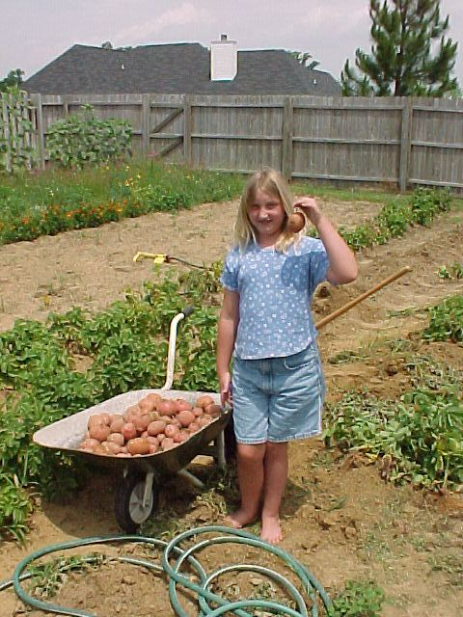
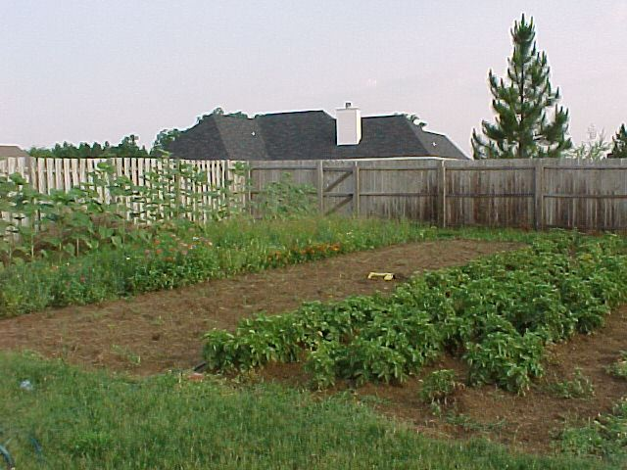
Notes:
The USDA reports that nearly half of American households are involved in home vegetable gardening. The National Gardening Association has indicated the number of gardeners in American households has dropped from 75% in 1992 to 67% in 1997. However in the same time period, spending on gardening has risen by 17% to $26.6 billion.

Slide 7
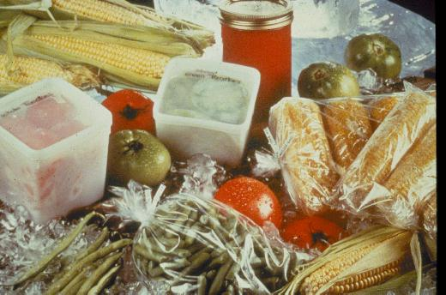
Notes:
Consumption of fresh vegetables is on the rise. Nutrition and health concerns have been responsible for much of this increase. Home vegetable gardens can make vegetables more readily available and economical for people trying to improve their diets. Also, gardens usually increase the consumption of fresh vegetables since home garden vegetables are often more flavorful than those bought in the store. Moreover, the home gardener can plant unusual vegetables like yellow tomatoes, miniature eggplant, and burpless cucumbers to add variety to the diet.

Slide 8
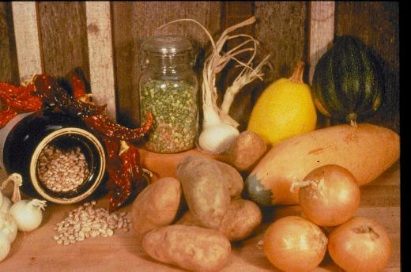
Notes:
Organically grown produce has become more popular in the last few years. Organic production eliminates the use of many pesticides while using organic fertilizer sources.

Slide 9
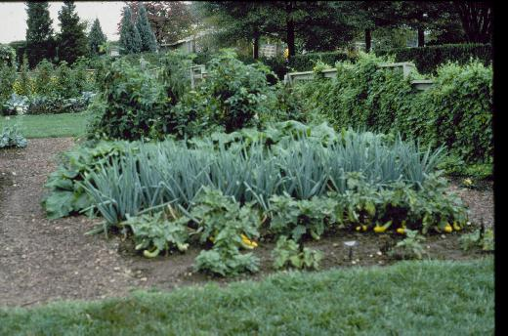
Notes:
It has been estimated that a medium-sized garden will return eight dollars for every dollar invested. Just how profitable the garden is will depend on the size of the garden. A 600 square foot garden is estimated to have a gross return of $600.

Slide 10
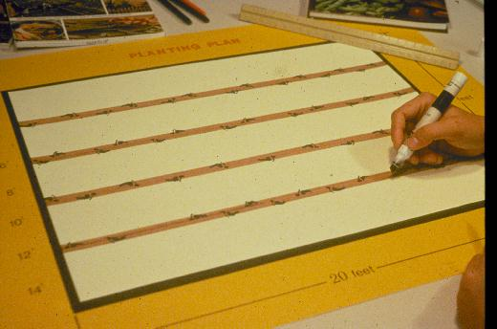
Notes:
The most successful garden is a well-planned garden. Most garden problems are more easily prevented than solved once they occur. Plan the garden in advance of planting to reduce problems and to make the most of your efforts. Decide what crops to plant, how much of each to plant and where and when you will plant before you begin. Even your first vegetable garden can produce a winning harvest if you will take the time to make a plan and follow tried-and-true methods of planting and care.

Slide 11
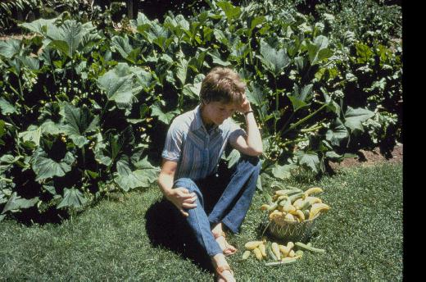
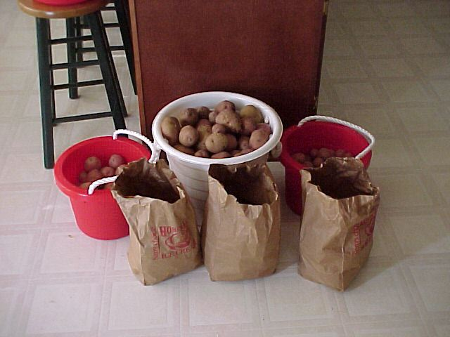
Notes:
Most gardeners plant too much at one time. Decide how much your family will need and when it will be needed. Your Extension agent can help you with your plan.

Slide 12
Continuous Harvest Garden
Succession cropping – Growing vegetables in sequence in the same garden space within one growing season.
-plant at roughly 2-week intervals
-stretches harvest out over longer period
Intercropping - Growing 2 + vegetables or vegetable + non-vegetable in the same garden space during the same growing season.
Plant slow growing plants with faster growing plants
Notes:
Many gardeners plant all of their crops at one time, but this often leads to all of the crops coming in at one time. This method works well if you plan to can or freeze large quantities. But with a little planning you can stretch the harvest season and have a greater variety of produce from your garden. With succession cropping (or succession planting), the plantings are smaller followed by more plantings at about 2 week intervals. Intercropping is a more intensive gardening technique in which two vegetables share the same allotted space. Fast and slow growing plants are planted together with the idea that the faster growing plant will be harvested before the slower growing plant occupies that space. Spinach, lettuce, green onions and radishes are good intercrop choices for cool season gardens.

Slide 13
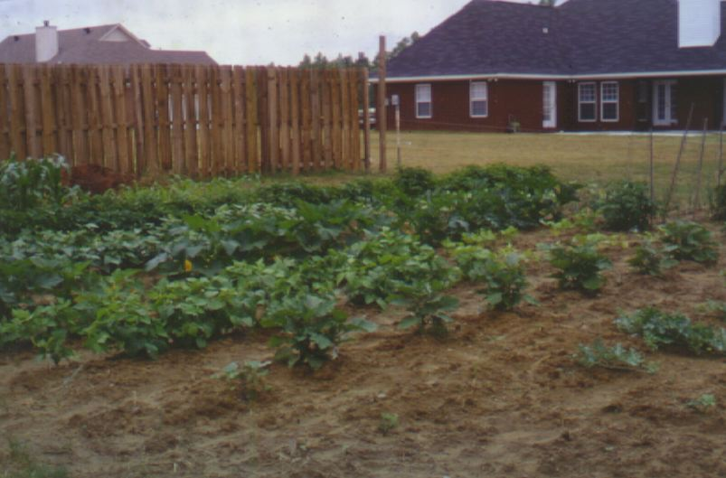
Sun
House
Water
Notes:
Garden location is very important. When planning the garden, find a location that has a loose, friable soil (though less desirable soil can be amended), gets enough sun, and is near a water source. A garden that is closer to the house is easier to maintain.

Slide 14
Selecting a Garden Site
Six hours of daily sunshine are required.
Avoid trees and hedges.
Select medium textured soils.
Select well drained soils.
Avoid frost pockets.
Consider convenience to house and water.
Consider protection from pets and children.
Notes:
As sunlight is absolutely necessary for vegetable production, the garden site should receive a minimum of 6 to 8 hours of sun per day. Other factors to consider include location of trees, ground topology, and children's activities.

Slide 15
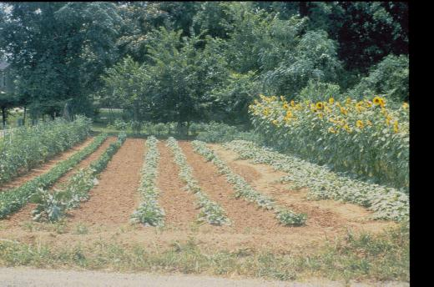
Notes:
Garden rows should run east-west to maximize sunlight. When mapping out the garden, remember to plant the tallest vegetables on the north and west sides of the garden. This will keep them from shading the other vegetables. Certain vegetables, such as corn, should be planted in blocks rather than in long rows to improve pollination.

Slide 16
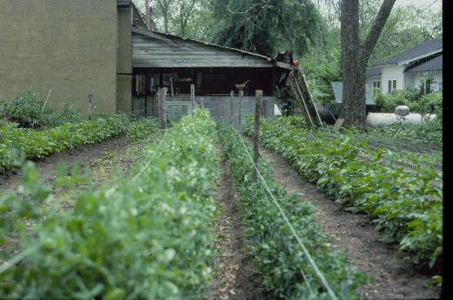
Notes:
Avoid planting near trees and large shrubs. Remember, a tree's roots may extend out from the trunk twice the spread of the branches. These roots compete with the garden for water and nutrients. If shady areas have to be planted, leafy crops like cabbage, turnips, mustard and kale should be chosen. These will do better in shady areas than fruiting crops like tomatoes and corn.

Slide 17
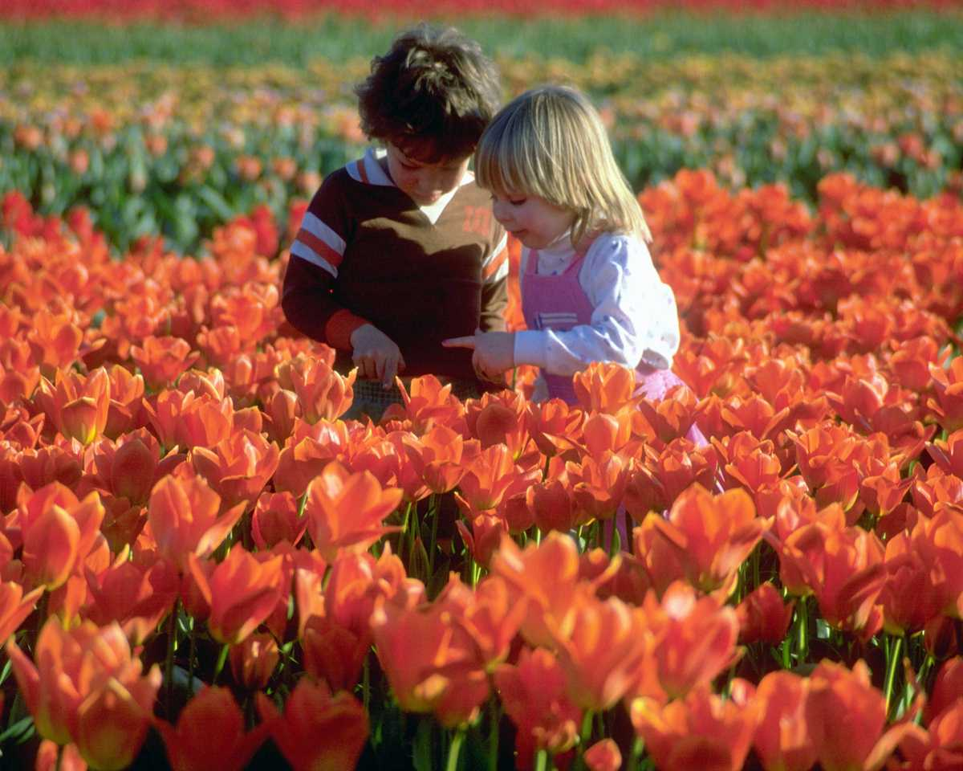
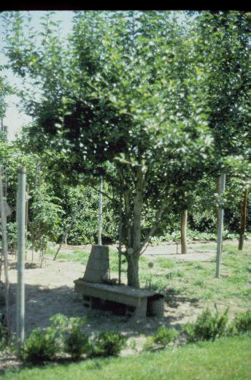
Notes:
The garden should be a place for enjoyment. Provide a sitting area where you can relax and enjoy the fruits of your labor, perhaps under a tree within sight of the garden.

Slide 18
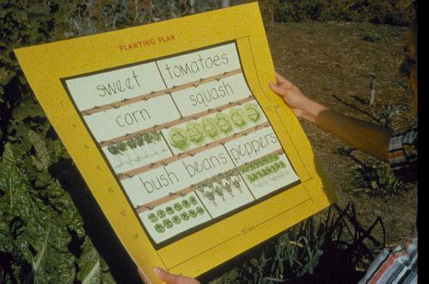
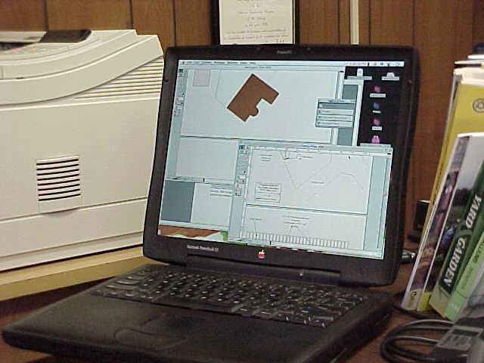
Notes:
Record keeping is an important factor in successful gardening. In the beginning make a list of vegetables to plant and note the varieties and amounts of each to be planted. (Check the Extension office for recommended varieties and other helpful gardening materials.) Plan the garden itself by drawing a map showing where each vegetable is to be grown. As the season progresses, keep records of sprouting dates, fruiting dates, plant performance, and cultural problems to guide gardening efforts for the following year. The availability of inexpensive home computers can be a real aid to keeping garden records. With a digital camera you can even store pictures of your garden successes and problems.

Slide 19
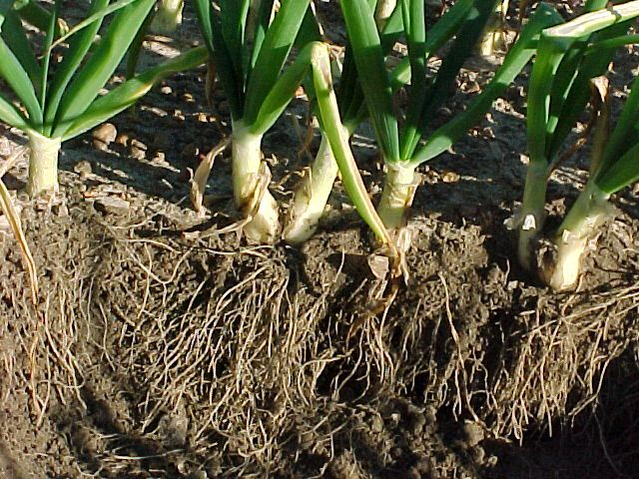
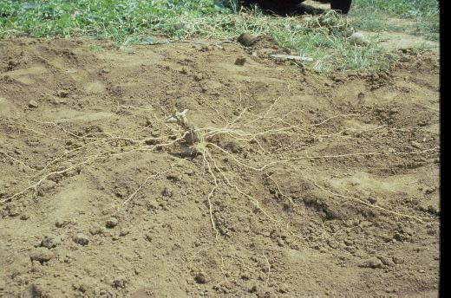
Notes:
To prepare the planting bed, soil should be turned under and dug to a depth of 12 inches. As this cantaloupe root system illustrates, roots need to penetrate the soil widely and deeply. Even onions which are considered weak rooted will have extensive root systems that are aided by well prepared soil.

Slide 20
Fertility Level
Soil Type
Lime
Crop
pH
Soil Testing
Notes:
As the soil is the foundation of the garden, a successful gardening season begins with taking a soil sample. A soil sample will guide the fertilization and liming of the garden to support plant growth while avoiding waste or plant injury.

Slide 21
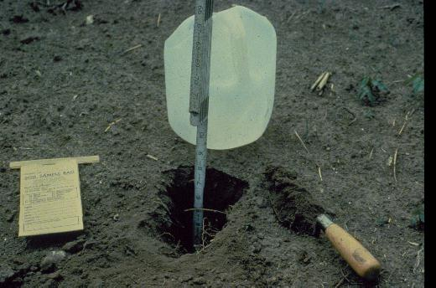
Notes:
Sample to a depth of about 8 inches. Remove a shovel full of soil from each spot and put in a clean bucket. Do not use buckets that have held fertilizer which could contaminate the sample. Take samples from 10 or 12 areas in the garden, thoroughly mix the samples together and take out enough soil to fill the soil test bag. Fill bag to line. Sample bags and sampling instructions are available from the Extension office.

Slide 22
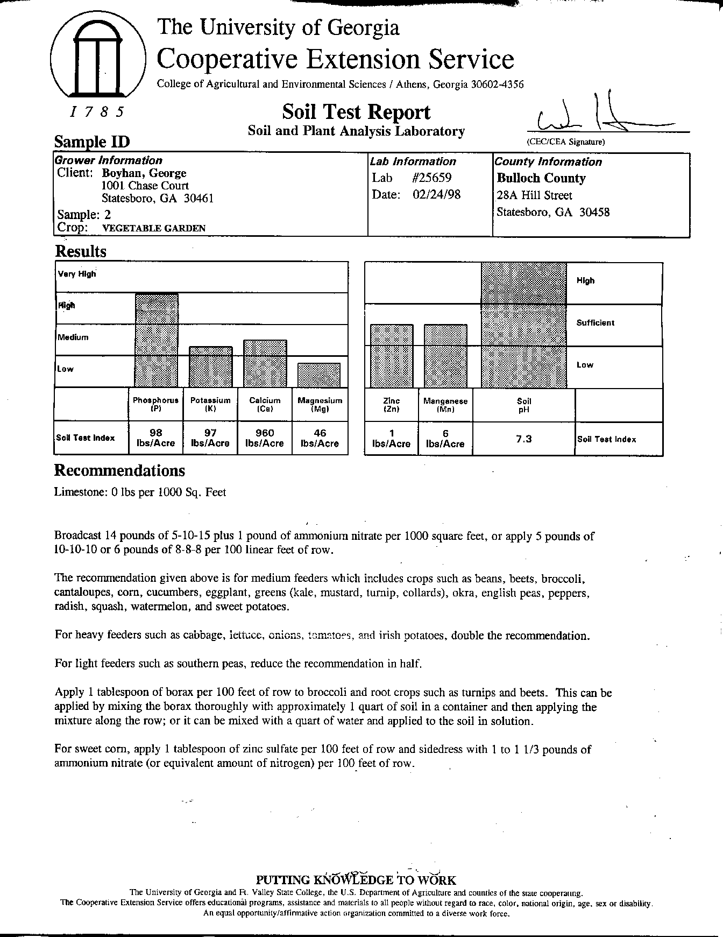
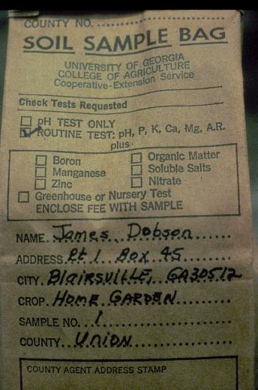
Notes:
Fill out the information requested on the side of the bags before taking the bags to your local Extension office. Extension personnel will send the soil sample to the soils lab which will analyze it. They will send you the fertilizer recommendations via your local county Extension office. The soil test results will also analyze the sample for acidity and make lime recommendations if needed.

Slide 23
SOIL ACIDITY
Decrease major nutrient uptake.
Increase other nutrient uptake.
Notes:
Soil acidity (or soil pH) affects the plant's uptake of nutrients. An acid soil is indicated by a low pH, typically one below 7.0; an alkaline soil has a pH above 7.0. The ideal soil pH for most vegetables is between 6.0-6.5.

Slide 24
pH Level
ALKALINE
8.0
7.0
6.0
5.5
4.0 -
IDEAL
ACID
VERY ACID
Notes:
Plants differ in their needs or tolerance of soil acidity. Unsuitable soil pH can stunt plant growth, cause fruiting problems, necrosis or death of leaves and other plant parts.

Slide 25
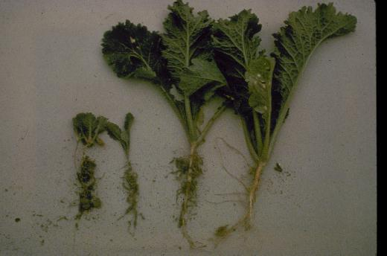
Notes:
The plant on the left was grown with a pH of 4.5, the other at 6.0.

Slide 26
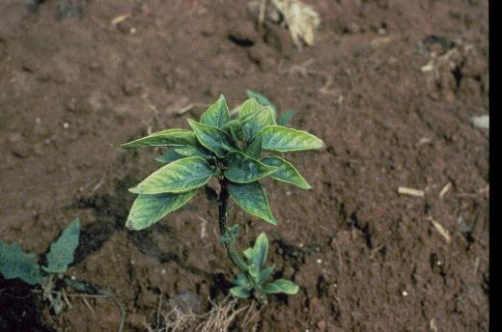
Notes:
(Magnesium Deficiency) This is magnesium deficiency in pepper. It can be caused by very low pH and/or low magnesium levels in the soil. A soil test will tell you which is the cause. A soil test will prevent many problems of this type.

Slide 27
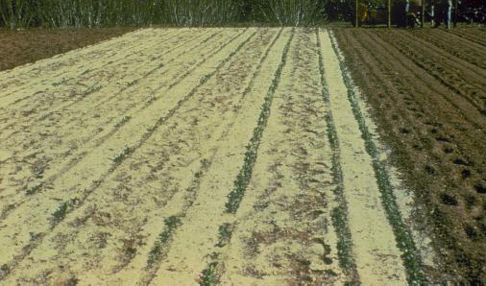
Dolomitic Lime
Notes:
(Dolomitic Lime) Lime may be recommended for acidic garden soils to raise the pH. Dolomitic limestone contains calcium and magnesium, which are essential plant elements.

Slide 28
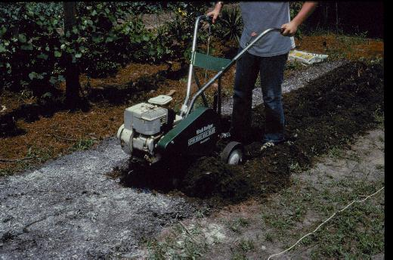
Notes:
(Broadcast Lime) It is best to apply dolomitic limestone 2 to 3 months before planting. It can be broadcast over the soil surface and then worked in with a rototiller or some other implement. Normally, dolomitic limestone reacts slowly in the soil. By mixing the lime with the soil, the reaction is more uniform throughout the root zone.

Slide 29
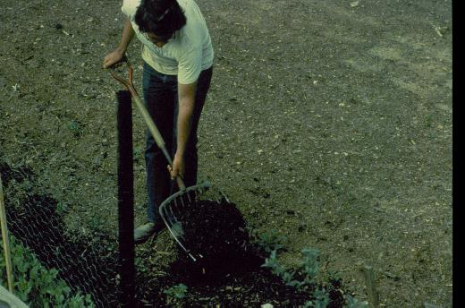
Notes:
(Compost) Almost any soil can be improved by the addition of organic matter. Increasing soil organic matter increases the soil's ability to hold nutrients and water. It also tends to improve soil tilth to improve plant root growth.

Slide 30
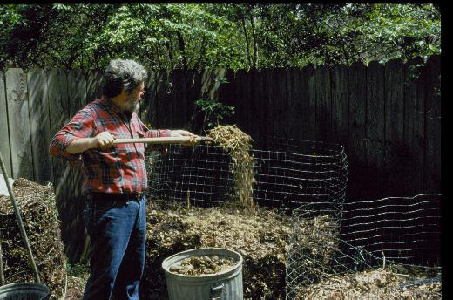
Notes:
(Compost pile) Most home gardeners can have a ready source of organic soil amendment if they will create a compost pile. Compost is decayed plant material. A compost pile can be made using grass clippings, leaves, vegetable kitchen scraps and non-diseased plants out of the garden Once these are well rotted, the compost can be added to the garden as a mulch or worked into the soil. Do not compost fat, bones, or meat products as these components may attract animals to the compost pile. Compost can also be made in bags or in trenches dug in the garden.

Slide 31
Notes:
(Organic Matter Table) Compost is not the only organic matter that can be added to the garden. Many other materials can be used to increase the soil organic matter levels. Here are some sources and the rates at which they can be added to the soil. As organic materials decompose, they use nitrogen. Some sources of organic matter, such as sawdust, can cause nitrogen deficiencies as they decompose. Therefore, avoid using sawdust to prevent this problem. ALL ANIMAL MANURES SHOULD BE PROPERLY COMPOSTED A MINIMUM OF 120 DAYS BEFORE USING TO PREVENT POTENTIAL HUMAN DISEASE TRANSMISSION.

Slide 32
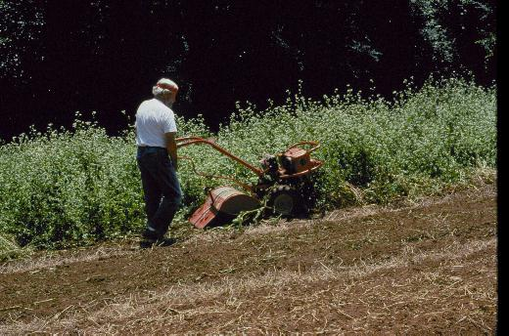
Notes:
(Green Manure) Green manuring is another method of adding organic matter to the soil. A crop is seeded and allowed to grow to maturity. The crop is then either killed with a herbicide and plowed under or just plowed under.

Slide 33
Green Manure Crops
Notes:
Typical green manure crops include vetch, crimson or arrowleaf clover, rye, ryegrass, wheat, and oats. The vetches and clovers can also add nitrogen as well as organic matter; since they are legumes, they can take nitrogen from the air, which returns to the soil when the crop is tilled in.

Slide 34
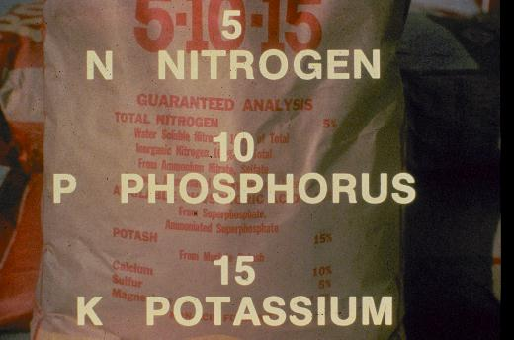
Notes:
(Fertilizer Bag) The nutrient content of fertilizer is printed on the bag. The first number gives the percent nitrogen content. Assuming the fertilizer weighs 100 lbs., 5% or 5 lbs. Is comprised of nitrogen. The second number gives the phosphate level. There is 10% phosphate (P₂O₅) in this fertilizer. The last number gives the potassium oxide level. This fertilizer contains 15% potash or potassium oxide (K₂0). There may also be some other nutrients in the fertilizer. These may be listed in smaller print on the bag.

Slide 35
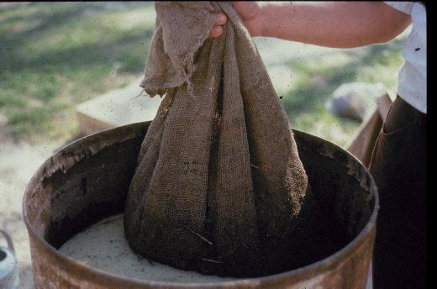
Notes:
Gardeners who prefer organic fertilizers may want to consider manure teas made by soaking manure in water for several hours to one day. This "tea" is an effective "starter solution" for transplants. Nutrients in organic fertilizers are variable, and gardeners should check with their Extension office to determine if nutrient analysis is available for organic materials. USE ONLY PROPERLY COMPOSTED MANURES.

Slide 36
Notes:
(Light, medium, and heavy feeders) Plants vary in their fertilizer needs, especially regarding frequency and amounts. Separating heavy feeders from light feeders and fertilizing accordingly can help the gardener to fertilize more efficiently and cut down on waste in order to save money, avoid plant injury, and help the environment.

Slide 37
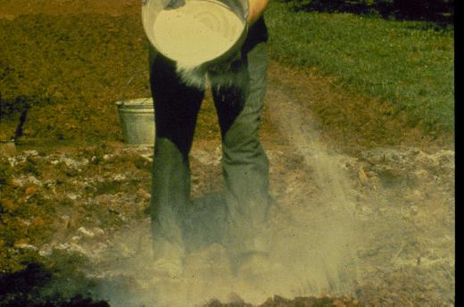
Notes:
(Broadcasting Fertilizer) Fertilizer can be applied in different ways. Broadcasting is one method. The fertilizer is scattered evenly and tilled in. However, this method is less exact and more wasteful.

Slide 38
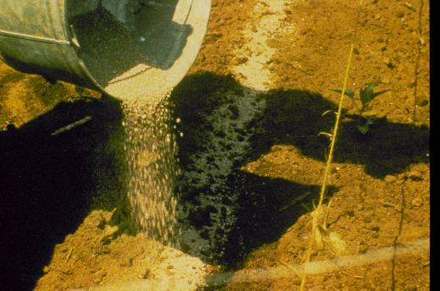
Notes:
(Sidedressing Fertilizer) Banding fertilizer below or to the side of the seed is a more efficient use of fertilizer, as it places nutrients close to the root zone of the plant.

Slide 39
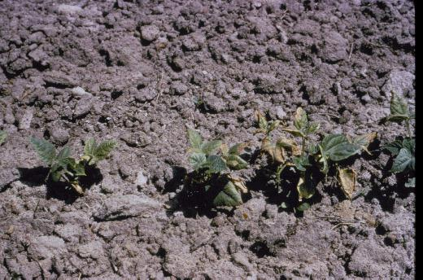
Notes:
However, seedlings and plants can be "burned" if fertilizer is concentrated. Therefore, no more than 1/3 of recommended fertilizer amounts should be banded at one time and placed no closer than 3- 4 inches from the seed or plant. During the growing season, vegetables should be sidedressed by putting fertilizer in a band 3-4 inches to the outside of the foliage of the plant.

Slide 40
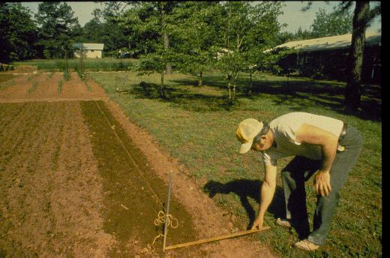
Notes:
Once the ground is prepared and fertilized, it is time to plant. Rows can be laid off by stretching a string between two stakes as a marking line for the row. Distance between rows will depend on the type of cultivation to be used, whether tiller or hoe and the specific vegetable planted.

Slide 41
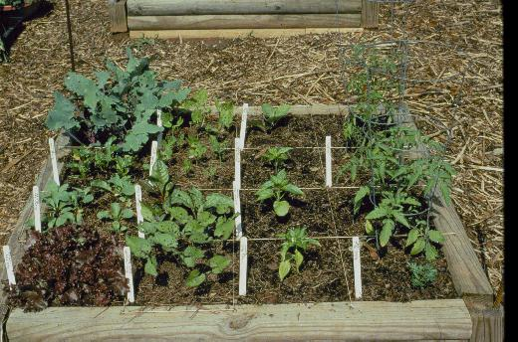
Notes:
(Intensive gardening) Moving rows closer together can help better use available space. Some gardeners prefer intensive, "square foot," or double row gardening methods to conserve space. These methods may require special cultivation practices and usually work best with small plants, such as carrot, radish, some greens, and onions.

Slide 42
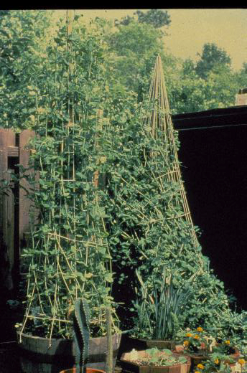
Go
Vertical
Notes:
(Patio) The intensive gardening method can also be carried over into containers. Container vegetables can make a sunny patio into an attractive and productive garden spot. Not much area is needed. Remember, in a square foot of area, you have the option of growing one squash plant, three snap beans, nine mustard greens, 25 English peas or 100 radish or green onions. Intensive planting, with intensive management, can make the most of a small area.

Slide 43
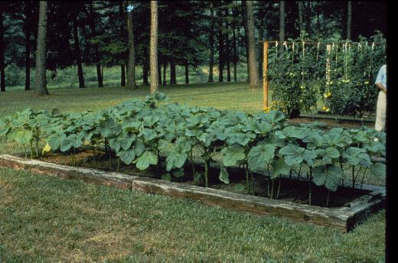
Notes:
(Raised beds) Not all gardens have to be planted in rows. Raised bed gardening has become more popular in the last few years. Raised beds drain more easily and tend to warm more quickly in the spring. Because they have no middles for walking in them, soil compaction is less and vegetables can be planted closer and managed more intensively. Raised bed gardening is also more adaptable for physically impaired gardeners.

Slide 44
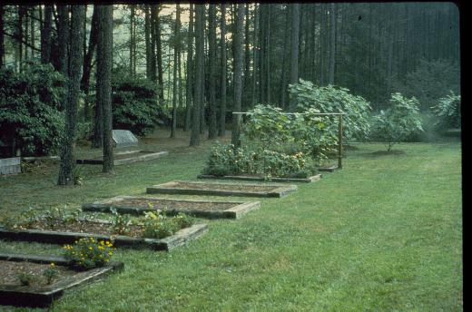
Notes:
(Raised beds) Raised beds are usually 4 to 5 feet wide so they can be worked from both sides. They are usually constructed from railroad ties, rough cut lumber, or concrete blocks and filled with soil amended with organic matter. Root crops should not be grown near treated timbers because they may become contaminated.

Slide 45
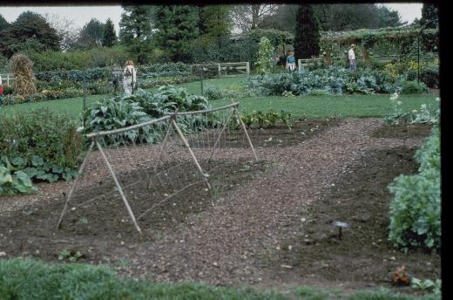
Notes:
For cucumbers, certain varieties of beans, and other climbing or vining vegetables, support structures, such as trellises, should be erected in the garden prior to planting.

Slide 46
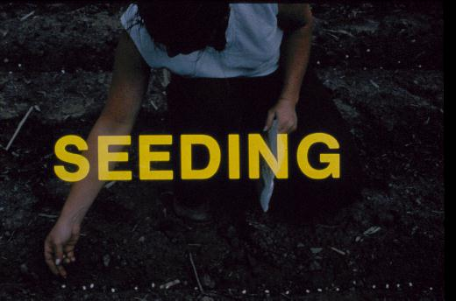
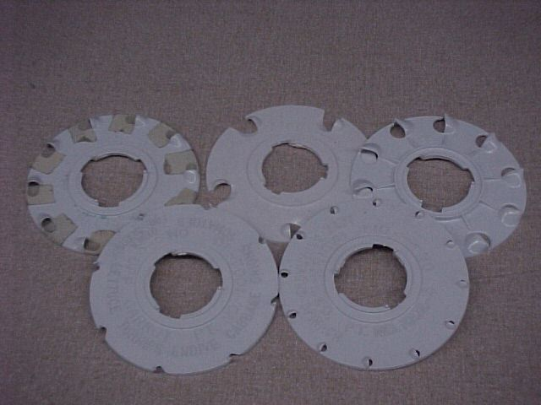
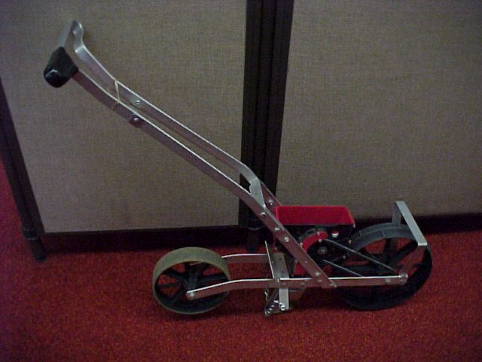
Notes:
(Seeding) Many gardens are planted by direct seeding. Always use fresh, disease-free, western-grown seed. Inexpensive seeders can be used in larger gardens. Various seeding plates are available for different sized seed.

Slide 47
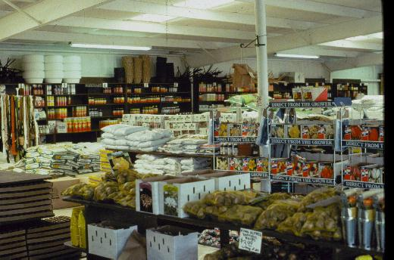
Notes:
Check seed and plant catalogs and visit your local garden centers to become better acquainted with available varieties.

Slide 48
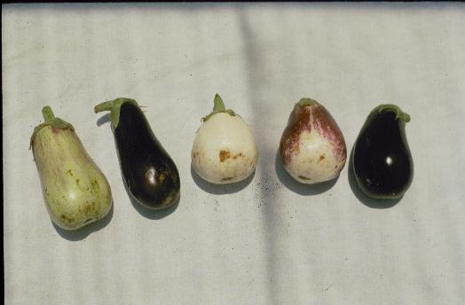
Notes:
(Poor Eggplant) Avoid bargain seed. Such seed may germinate poorly, be off-type such as these eggplant shown in this slide, and yield poor quality produce.

Slide 49
Notes:
Many popular vegetables can be grown from seed. Proper soil preparation and planting depth is important for successful germination.

Slide 50
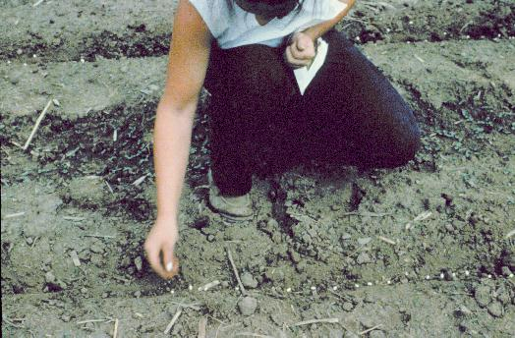
Notes:
(Seeding) Large seeds are easy to sow. Smaller seed can be mixed with sand before sowing, or sown onto a piece of tissue laid in the rows. The tissue makes the seeds easier to see but will decompose rapidly without causing a problem. Some seeds are available in gels or tapes to make sowing easier.

Slide 51
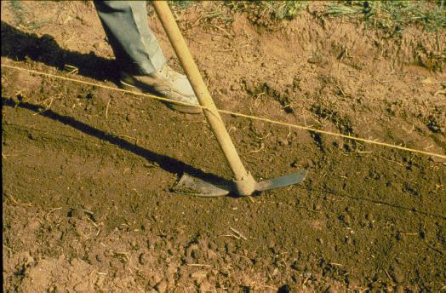
Notes:
(Seed covered) Refer to the seed packet or Extension literature to determine how deeply to plant the seeds, as depth varies with the type of seed. Cover seed well and firm the soil around the seed by pressing the soil down lightly with a garden tool.

Slide 52
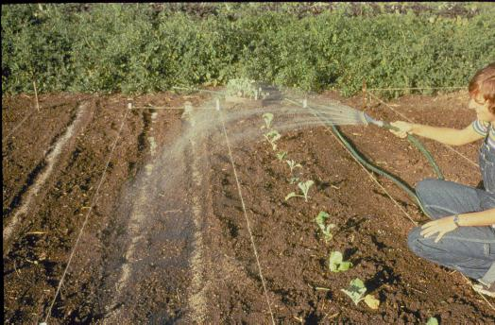
Notes:
Water the seed bed with a gentle spray. Be careful not to wash excess dirt over the seed. A good idea is to wet the seed bed twice daily until germination if rain does not occur.

Slide 53
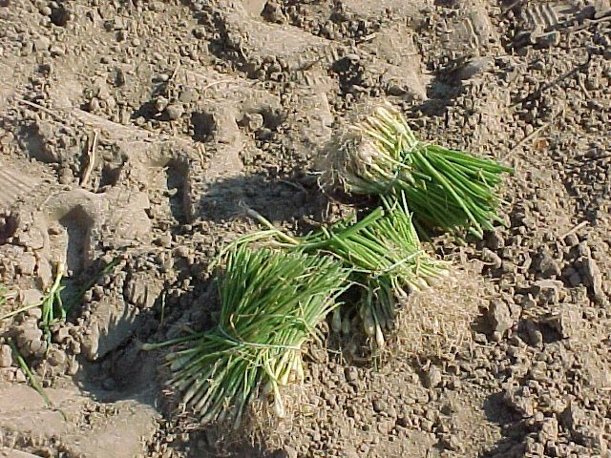
Notes:
(Transplants) Many gardeners prefer to use transplants instead of seed, especially for cabbage, broccoli, tomatoes, and peppers. Transplants are easier to establish and produce earlier crops than direct seeded crops. Although bareroot transplants are still available, transplants grown in soilless mixes are by far the more popular now.

Slide 54
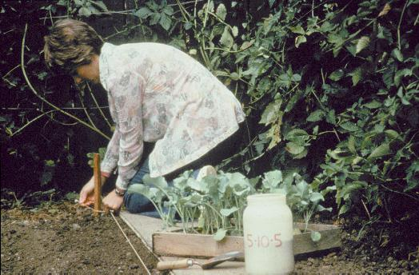
Notes:
Transplants are young plants that have been started from seed indoors or in plantbeds four to eight weeks earlier. Transplants can be bought at local garden centers or grown at home.

Slide 55
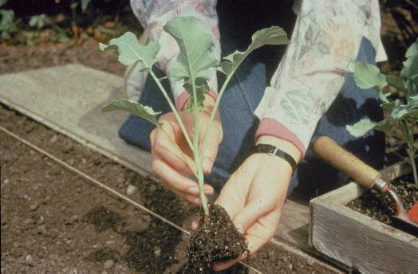
Notes:
This heavy, stocky transplant is an ideal size for planting. It will recover quickly from the shock of transplanting and resume growing.

Slide 56
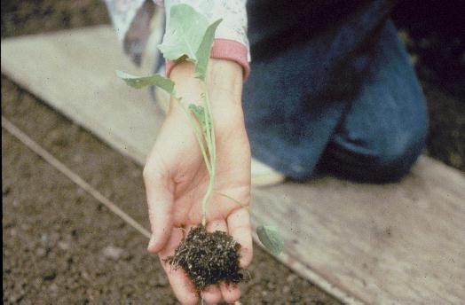
Notes:
Avoid buying leggy plants that have been neglected by the grower and may not grow properly.

Slide 57
Notes:
The advantage of home grown transplants is that you know how they are grown and you can be certain you have the variety that you want. By following Extension recommendations, you can grow your own transplants for your garden.

Slide 58
Notes:
(Potting soil) To avoid disease and encourage root development, seeds for transplants should be sown in a sterile potting media bought from the store or mixed using components purchased at the garden center. Unlike ordinary garden soil, these mixes are generally free of weeds, drain well, and are "cleaner" to use.

Slide 59
Notes:
(Peat pots) Peat pots make excellent containers for growing transplants, as they are compact and inexpensive. For transplanting the peat cup need not be removed; however, it should be cut open slightly to insure roots grow out and its lip should be completely covered by soil so the pot does not wick away moisture.

Slide 60
Notes:
(Broccoli Plant) Many gardeners like to recycle Styrofoam coffee cups as transplant containers. Punch a few drainage holes in the bottom of the cup to allow excess water to drain out the bottom. When ready to transplant, cut the bottom out of the cup and slip the cup up the stem to act as a barrier to slugs and worms before putting the plant in the garden.

Slide 61
Notes:
(Seed Flat) When larger numbers of transplants are to be grown, seeds can be germinated in seed flats. The seed flat that you see here contains approximately 800 small vegetable plants.

Slide 62
Notes:
(Transplanting) With a seed flat, it is necessary to transplant vegetables to a larger container as they grow. Small vegetable plants are removed from the seed flat when they have fully emerged and show the first set of true leaves. They should be replanted into the containers in which they will grow until transplanted to the garden.

Slide 63
Notes:
(Watering) Seedlings survive better when they are planted into a moist soil mix. Also, they should be watered lightly after planting to firm soil around the roots. After a few days the young plants can be watered normally.

Slide 64
Notes:
(Cold Frame) Proper temperatures are important for good growth. Too low temperatures cause stunting and too high temperatures can make the transplants too tall. Proper temperatures for seed germination are higher than the proper temperatures for growing. As soon as seeds germinate, move them to an area of cooler temperatures. A cold frame can be used to harden off transplants before planting in the garden. While full sun is very important for young plants, ventilate the cold frame to prevent overheating.

Slide 65
STARTER SOLUTIONS
Stimulate new root growth.
Increase early and total yield.
Notes:
(Starter fertilizer) Starter fertilizers supply much needed phosphorus, which stimulates root growth and promotes plant establishment. Seedling establishment is especially important when planting into cool soils. You can buy starter fertilizers or make your own by dissolving 1 pound of complete fertilizer in 5 gallons of water. After 24 hours, drain off the solution from the sediment and apply the solution to the base of the plants at the rate of 1 cup per plant.

Slide 66
Notes:
(Transplanting into the garden) Seedlings should be transplanted into the garden ideally on a cloudy, windless day. Small plants should be handled by the leaf; larger transplants can be handled carefully by the stem. Follow Extension office publication recommendations for spacing. For example, cabbage and broccoli plants should be spaced 10" to 12” apart in the row.

Slide 67
Notes:
Transplants should be set so the garden soil comes up to approximately the same level as in the container in which the plant was grown, except for tomatoes, which may be planted deeper.

Slide 68
Notes:
Firm the soil around the roots after planting This keeps plants from toppling over and growing crooked. Also, it helps to remove "air pockets" from around the roots, which may cause wilting.

Slide 69
Notes:
All transplants should be watered thoroughly immediately after planting. If the water soaks in slowly, mound up a low basin of soil around each plant and fill with water. Thorough watering brings the soil and roots in close contact and helps prevent transplant shock.

Slide 70
Notes:
Here is one way to maximize planting areas. Lettuce plants are set between the cabbage plants, and the lettuce will be harvested long before the cabbage fills in the row.

Slide 71
Notes:
During early spring, new transplants can be protected from light frost and wind by cloches or other enclosures. Cloches can be purchased or made from large cans, plastic containers, or cardboard boxes. They should be removed during the day when temperatures increase. Some gardeners use commercially produced floating row covers for both frost and insect protection.

Slide 72
Notes:
(Cultivation) Cultivation destroys weeds and breaks up crusted soils. Cultivation should be as shallow as possible to avoid cutting roots.

Slide 73
Notes:
(Plastic Mulch) Mulches are an important part of a successful garden. They reduce water loss and weed growth, keep fruit cleaner, and help conserve fertilizer. Plastic mulches also promote earliness by warming soils and hastening plant growth. Clear or black plastic mulches may be too hot for mid-summer planted crops. For summer planting, the plastic can be painted white with latex paint to reduce heat buildup. Thin the paint by mixing it one to one with water before painting the plastic.

Slide 74
Notes:
(Mulch) Organic mulches provide the additional benefit of supplying organic matter as they decompose. Organic mulches do tend to cool the soil and may delay maturity of early crops. This problem can be largely overcome by waiting until the plant is well established and the soil is well warmed before applying the mulch. Apply organic mulches 4 inches deep for the initial application. Be careful not to apply mulch next to the stem of the plant.

Slide 75
Notes:
Using leaves or leaves mixed with grass clippings as mulch recycles yard wastes and provides protection to the soil and plant roots.

Slide 76
Notes:
(Pollination) The vine crops like squash, melons, cucumbers, and pumpkins need to be pollinated to produce good quality fruit. Bees pollinate the flowers by transferring pollen from the male flower parts (the stamens) to the female flower parts (stlgma).

Slide 77
Notes:
(Blooms) The male and female parts are most often found in the same flower. This is called a perfect flower. Some have separate male and female flowers on the same plant such as squash and many watermelon varieties.

Slide 78
Notes:
(Poor Pollination) Poor pollination leads to misshapen fruit and poor growth.

Slide 79
Notes:
The average cucumber blossom takes 8-10 or more visits by bees to be fully pollinated. Encourage bee activity by limiting pesticide sprays to time of low bee activity such as late evening. A nearby beehive may also improve pollination.

Slide 80
INSECT & DISEASE CONTROL
Notes:
Insect & Disease Control. Insect and disease control is easier if problems are addressed early. Learn to spot diseases before they become rampant. Watch the garden closely and monitor insect levels.

Slide 81
Notes:
A 'shotgun' approach to insect control seldom works. Don't spray just because you see a bug or a worm. Identify the pest, such as this tomato hornworm, determine if enough are present to be a problem, and then consider various methods of control.

Slide 82
Notes:
(Organic control) Sometimes insects, caterpillars, and other pests can be controlled using non-chemical means. Predatory wasps, praying mantis, ladybugs, and other insects can consume many times their weight each day. Control is sometimes accomplished by simply removing and destroying the pests. Learn to identify insects. Not all bugs are bad. Some, like this hornworm have been parasitized by a braconid wasp, are beneficial. Many other insects are harmless, neither having any benefit to the garden or doing any harm.

Slide 83
Notes:
(Crop Rotation) Many garden problems can be prevented by adequate rotation of crops. It is important to know the members of plant families and to avoid planting related crops in the same spot the following year.

Slide 84
Notes:
(Diseases) Although diseases may be harder to identify than insect damage, use the resources of your Extension office to identify diseases and appropriate controls. Sanitation is probably the number one line of defense. Destroy diseased plants and plants that are not producing. Do not use diseased plants in the compost pile. Rotate crops from one site to another. Clean up garden areas thoroughly in the fall to prevent the overwintering of insects and disease organisms. It is easier to prevent problems than to cure them.

Slide 85
Notes:
If chemical control is necessary, read the label and follow directions carefully. Watch drift and use when bee activity is at a minimum. The Extension office will offer recommendations for appropriate insect control.

Slide 86
Notes:
Companion planting is the planting of one plant type that repels or is toxic to a pest thus helping your crop survive and produce. Many successful home gardeners use companion planting to make pest and disease problems manageable. Though more research is needed, some trials have indicated certain plants discourage pests.

Slide 87
Cool Season Crops
Notes:
Insect & Disease Control. Insect and disease control is easier if problems are addressed early. Learn to spot diseases before they become rampant. Watch the garden closely and monitor insect levels.

Slide 88
Notes:
(Cool season vegetable) Because of its usually mild winters, cool season crops are grown in the deep South from late summer through spring.

Slide 89
VEGETABLES GROWN FR0M VEGETATIVE PORTIONS
Asparagus
Irish potatoes
Onions (sets)
Rhubarb
Sweet potatoes
Notes:
Several important cool season vegetables can be grown vegetatively, that is by planting vegetative parts instead of seed or transplants.

Slide 90
Notes:
(Asparagus) Let us take a look at some of the more common cool season vegetables grown in Georgia gardens. Asparagus is one of the few perennial crops that we grow in the garden, and should be placed where it can remain for several years. Keep asparagus from the middle of your garden because you cannot plow it with the rest of the garden. Asparagus normally is started from rooted one year old crowns. There are also newer varieties available from seed that are also male sterile, thus not producing seed. Don't cut the spear during the first year; let the spears grow and develop a strong root system.

Slide 91
Notes:
(Asparagus) Spears can be harvested for approximately 2 weeks in the second year. Harvest for 4 weeks the third year. The harvest should never exceed 8 weeks in any year. Cut spears when they are 4 inches long. Asparagus is a heavy feeder and will respond to heavy rates of fertilizer and to organic matter if added at the time the crowns are set. A good mulch should be used around asparagus for weed control. Thc tops of the asparagus plant are called ferns, and the ferns that develop after the harvest should be allowed to grow until late fall or winter until the tops turn completely brown. At that time they should be removed and composted.

Slide 92
Notes:
(Rhubarb) Rhubarb, commonly grown in the North, can also be grown in the Southern garden.

Slide 93
Notes:
(English Pea Pod) English peas are one of the earliest crops you can plant. They can be planted in the garden as early as the soil can be worked in the spring. Peas will germinate and come up when soils are quite cold and will stand a considerable amount of cold weather and even light frost.

Slide 94
Notes:
There are different types of English peas. Some varieties have wrinkled seeds while others are smooth. The wrinkled seeded peas have a sweeter taste than the smooth seeded peas, which are starchy. Another distinction for English peas is that some varieties are determinate or low growing and others are indeterminate or tall growing. A real improvement in the English pea occurred a few years ago when edible podded types were developed. These include snap peas and snow peas.

Slide 95
Notes:
(English Pea Vine) This is a determinate type of English pea. The determinate type peas usually set one or two pods at each flower cluster rather than a single pod found on the indeterminate types. The determinate types are less likely to need staking than indeterminate types.

Slide 96
Notes:
(Leaf lettuce. Red Sails) Early spring is the ideal time in the deep South to plant lettuces. While iceberg lettuce is not recommended, many leaf lettuce varieties grow well in cooler spring temperatures.

Slide 97
Notes:
(Buttercrunch) Unusual lettuces and lettuce-like greens such as mesclun, a French lettuce mix, and buttercrunch, shown here as a nearly heading cultivar, add variety to the salad bowl.

Slide 98
Notes:
(Radicchio) Radicchio is a member of the chicory family much in demand in fine restaurants. Varieties include Witloof or Belgium endive that with intensive cultivation practices produce another delicacy served steamed or in salads.

Slide 99
Notes:
(Siberian Kale) Siberian Kale is a coarser green high in vitamins and tasting much like collards. Siberian Kale and its curly leaf cousins are both edible and decorative in the garden.

Slide 100
Notes:
(Red Swiss chard) Red Swiss chard, like kale, is most often eaten cooked. A beautiful plant, it is sometimes used in the landscape as well as the vegetable garden.

Slide 101
Notes:
(Bok choy) The bok choy shown here is but one of numerous leafy cool-weather vegetable plants from the Orient popular in stir fry dishes. Oriental vegetables such as Chinese cabbages, Mitsumi, Pak choy, and others are easy to grow, though they are susceptible to bolting if the weather fluctuates between warm and cool temperatures.

Slide 102
Notes:
(Picking lettuce leaves) Lettuces can be harvested almost continuously during the growing season. Leaves can be picked from various plants rather than harvesting the whole plant.

Slide 103
Notes:
(Irish Potato Seed) Irish potatoes should also be planted early. Irish potato plants will be damaged by frost but can be planted two to three weeks before the last frost date in the spring. In cutting seed potatoes, be sure there is a growing point or an eye on each piece that is cut. They should weigh approximately 1-1/2 ounces each. The seed piece provides the reserve of food supply that will grow the plant until the roots form. Potatoes should be planted 4-5 inches deep. Pull soil to the plants as they grow until 8 to 10 inches of soil is mounded over the seed piece.

Slide 104
Notes:
(Two Onions) Onions should also be started early in the season. They will tolerate a considerable amount of cool weather. Onions come in yellow, white or red varieties. You can start these from plants, from sets, or from seed. Onions planted in the fall and grown over the winter often make the largest onions such as Vidalia onions.

Slide 105
Notes:
(Onion Bulb) Onions generally grow at or near the surface of the ground. Onions that are direct seeded will have more of their bulb exposed compared to those from transplants or sets.

Slide 106
Notes:
(Dug Onions) The best way to store onions is to start pulling them out of the ground when the tops are about 50% dead. Let the onions air cure for a day or two in the garden, protecting them from direct sun. Cut the tops off 1/2 inch from the top of the bulb. Place the bulbs in a mesh-type bag and hang it in a cool, well ventilated, darkened area.

Slide 107
Notes:
(Broccoli Head) Another cool season crop that does well in Georgia is broccoli. Broccoli will tolerate some light frost if the plants are well conditioned. Here is the central head of the plant. Cut heads before any of the blooms start to open up. About 4 inches of stem should be cut along with the head. Once you cut the central head, side shoots will develop in the axis of the leaves and these also can be harvested.

Slide 108
Notes:
(Cauliflower) Cauliflower has a reputation for being difficult to grow. Actually it will grow well if attention is paid to time of planting, nutrition, and water requirements. Tying leaves over the budding head keeps the curd from darkening. Self-blanching varieties are not usually entirely successful.

Slide 109
Notes:
(Cabbage) Cabbage is a cool season crop and should be planted when the nights are fairly cool and days warm but not hot. It should be side dressed with nitrogen as it grows, Cabbage, broccoli, collards and turnips also have a high requirements for boron. Supply it in the fertilizer or apply it as side dressing of 2 teaspoons of Borax detergent per 100 foot of row. This can be dissolved in water and poured over the row.

Slide 110
Notes:
(Collards) Collards are grown for their foliage and can be started from transplants or direct seeded. Set out transplants while weather is cool, spacing plants 12 inches apart in the row. If you want to cut collards fairly small, then the seeding rate can be increased, growing a plant every 6 inches in the row.

Slide 111
Notes:
(Radish) Radishes are one of the most quickly maturing vegetable crops that you can grow in the garden. About 28 days is required from the time you plant the seeds until they are ready to harvest. Once the radish becomes mature, it gets old rapidly, so stagger plantings every week to 10 days to assure a new crop all season.

Slide 112
Notes:
(Turnip Greens) Turnips can be grown for greens or roots. In north Georgia you may have better results growing turnips for greens as a spring crop and growing the turnips for roots as a fall crop.

Slide 113
Notes:
(Mustard Greens) Mustard greens are often grown together with turnip greens as many fine Southern cooks use them interchangeably.

Slide 114
Notes:
(Brussels Sprouts) Brussels sprouts taste a lot like cabbage. The small sprouts are produced in the axils of each one of the leaves. You can keep Brussels sprouts more productive if you prune the leaves off from the ground up to where the sprouts have been harvested. This forces new buds out further up in the top of the plant.

Slide 115
Notes:
(Kohlrabi) This is kohlrabi, it is like an above ground turnip. The leaves can be eaten like collard leaves and the root or bulb can be cooked like turnip or eaten raw. The flavor is better when bulbs are small, 2 to 4 inches in diameter.

Slide 116
Notes:
(Beans) Beans are one type of vegetable that thrives in cool weather but will not tolerate frost. Beans grow as bush type, half runners or climbing types according to the variety and can vary in color appearing green, purple, or yellow. Most of the bush green-podded types if hand picked, will give about four harvests over the season.

Slide 117
Notes:
(Bean Pods) Beside the pole type bean are bush flat beans, such as Roma. Other flat-podded bush beans include Green Crop and Magnum. These beans are very flavorful and of excellent quality.

Slide 118
Warm Season Crops
Notes:
Insect & Disease Control. Insect and disease control is easier if problems are addressed early. Learn to spot diseases before they become rampant. Watch the garden closely and monitor insect levels.

Slide 119
Notes:
(Warm season vegetables) Warm season crops offer a tremendous variety of cultivars.

Slide 120
Notes:
(Southernpea) Southernpeas are a favorite warm season vegetable. There are many types of southernpeas, and you should pick a variety recommended for home garden production rather than commercial production. Varieties for commercial production have been bred to be harvested at one time.

Slide 121
Notes:
(Sweet Potatoes) Sweet potatoes are set out in late spring for harvest in October. Sweet potatoes belong to the morning glory family, unlike yams which are a tropical root crop not usually grown in the U.S.

Slide 122
Notes:
(Tomatoes) Tomatoes are the number one garden crop in the United States. Determinate types are low growing and indeterminate types are tall-growing. If you do not wish to stake tomatoes, then choose a determinate type. It is recommended that tomatoes be staked or trellised to keep plants off the ground. VFN varieties should be selected for the home garden. VFN indicates resistance to Verticilllum wilt, Fusarium wilt and nematodes. The gardener can choose from many varieties of tomatoes including more exotic types such as white, pink, yellow, and pear-shaped tomatoes.

Slide 123
Notes:
(Staked tomato) Always support tomatoes to keep bushes upright and the fruit off the ground. This plant has not been pruned. Pruning will produce fewer but larger fruit. Pruning is done by removing suckers.

Slide 124
Notes:
(Tomato Sucker) Tomatoes produce suckers in the axils of each one of the leaves. If you sucker tomatoes, we recommend that these be removed before they reach 4 inches in length. They can be snapped out; it is not necessary to cut these with a knife.

Slide 125
Notes:
(Bell Pepper) Bell pepper, like other peppers, is a warm season crop requiring high temperatures to grow well. Plant only after the soil has fully warmed up. Dry spells and excessive heat may cause blossom drop and sun scald. Keep peppers well irrigated and sidedress with nitrogen to sustain production through the season.

Slide 126
Notes:
Varieties of bell-type peppers include red, yellow, orange, and even chocolate colored fruit.

Slide 127
Notes:
(Hot peppers) Many gardeners are growing one or more varieties of hot peppers, especially for use in Mexican and Oriental cuisines. Hot peppers vary widely in "hotness," and varieties should be chosen carefully. Hot peppers have much the same cultivation demands as bell peppers, though they are more tolerant of dry weather.

Slide 128
Notes:
(Squash Fruit) Squash are fairly fast maturing when they are in full production. If you allow squash fruit to mature on the plant, you will find that the plant will stop producing new blooms.

Slide 129
Notes:
(Zucchini Squash) There are many different types of zucchini and zucchini bears prolifically. Colorful raw in salads, zucchini varieties taste about the same once they are cooked.

Slide 130
Notes:
(Yellow Pattypan) White and yellow "pattypan” type squash are Southern favorites. Unlike winter squashes, summer squashes have a short growing season. Gardeners should stagger planting to obtain squash throughout the summer.

Slide 131
Notes:
(Sweet Corn) Sweet corn has been much improved over the years. Breeders have developed super sweet varieties which have higher sugar content than standard varieties. In addition, some of these new varieties do not get starchy as quickly as the older varieties. Still, many gardeners prefer the flavor of the older varieties. You should try the supersweets out for yourself. The supersweet seed does not germinate as well and the crop can be harder to grow. Also, some supersweet corn varieties must be isolated from other corn to prevent cross-pollination. Plant supersweets later than normal after soils are fully warmed.

Slide 132
Notes:
(Eggplant) Eggplant varieties now include globe, finger, and oblong fruit as well as purple and white. In the Southern garden flea beetles may be a problem.

Slide 133
Notes:
(Cucumber Fruit) Cucumbers are an insect pollinated crop. It is vital that the cucumber fruit be removed when mature to keep the plants productive. If you don't need the cucumbers, go ahead and harvest them and give them away or put them on the compost pile. Any cucumbers allowed to mature on the plant will cause the plant to stop producing new blooms.

Slide 134
Notes:
(New Zealand Spinach) While head lettuce normally will not grow in the deep South in summer, New Zealand spinach, which is actually not a true spinach, will provide both a salad and a cooked green.

Slide 135
Notes:
Vegetable amaranth is a tropical summer cooked greens crop deserving of a small place in the garden.

Slide 136
Notes:
(Okra Pods) Many times a gardener wonders when harvesting an okra pod if the pod is tender or not. If you snap the tip of the pod off and if it snaps off clean, then the pod is tender all the way down to the stem. If it breaks off jagged, or if it is difficult to break off, the pod is tough. Okra should be harvested every other day after they start producing.

Slide 137
Notes:
Okra Pods. Okra will produce a bloom that in one day will pollinate, fall off, and produce a small pod the next day. The third day that pod is ready to harvest. Sometimes during periods of cloudy weather or high humidity, the bloom will stick to the okra pod and the pod may develop a disease on the tip and start to rot. If this condition occurs with your okra, simply pull the dried blooms off the end of the pod. Okra is one of the few crops that tells us when it is hungry. Late in the season you will notice 8 to 10 small blooms clustered in the top of the plant. This means it is time to sidedress the okra plant with some additional nitrogen. Do not overdo nitrogen applications as too much nitrogen will delay flowering and fruiting.

Slide 138
Notes:
(Italian parsley) The vegetable gardener will also want to consider growing a few herbs for seasoning. Sometimes used to replace salt, herbs can add new flavors to familiar vegetable dishes. Herbs can be grown interspersed with other vegetables and grow well in ordinary garden soil. The Italian flat-leafed parsley here is stronger than the curly leaf parsley.

Slide 139
Notes:
(Basil) Basil is often called the tomato herb as it compliments the flavor of both fresh and cooked tomatoes. The Spicy Globe basil here is only one of over 30 varieties of basil including purple leafed, lemon and anise flavored cultivars.

Slide 140
Notes:
The Fall Garden. Southern gardeners enjoy a long growing season. While temperatures in mid-summer preclude fruiting of a number of favorite vegetables, the Southern gardener can look forward to planting a second crop of cool-season vegetables to enjoy in late fall and early winter.

Slide 141
Notes:
Fall maturing crops such as pumpkins and melons need to be planted in early summer for harvest in August and September.

Slide 142
Notes:
Acorn squash. Hard-rind fall squashes are planted in the early summer, but later than summer squashes. (Check with your local Extension office for the planting date in your area.)

Slide 143
Notes:
Butternut squash. Butternut and acorn squashes keep well sometimes through the winter if care is taken during harvest not to damage the fruit.

Slide 144
Notes:
Spaghetti squash. Spaghetti squash is a hard-rind squash that when cooked yields an interior that breaks apart into spaghetti-like strands. High in vitamins and low in carbohydrates, it is used as a healthy or low-calorie substitute for pasta.

Slide 145
Notes:
(Squash on shelves) Turk's turban, miniature pumpkins, and other hard-shell squashes are often grown primarily for fall decorative arrangements. Under cool, dry conditions they will last several months after harvesting. Fall squashes are large vining plants and need room to spread in the garden. Because of the weight of the fruits, trellising is impractical.

Slide 146
Notes:
(Red and yellow watermelon) Unlike winter squash, watermelon requires a large area in the garden. Recent cultivars include "icebox" melons for smaller servings and 'seedless’ melons, in addition to regular red and yellow cultivars.

Slide 147
1
3
5
2
4
1. Casaba
2. Christmas melon
3. Canary melon
4. Western shipping melon
5. Honeydew
Notes:
Cantaloupes and specialty melons come in a variety of shapes and sizes.

Slide 148
Notes:
(Cantaloupe at slip stage) Cantaloupe, unlike watermelons, have a suture area that ‘slips’ from the vine when they are fully ripe. Here you see a cantaloupe ready to pick at full slip, that is when the stem separates easily from the fruit.

Slide 149
Notes:
(Home gardens are fun for all ages) They provide recreation, exercise, and good nutrition also. However, a poorly planned garden can waste money and effort. Plan ahead, enjoy a bountiful harvest of fresh, nutritious vegetables, and join the thousands of home gardeners who learn more each year from their own home gardening experience.

Slide 150
Any Questions?
Thank you!
Notes:
Any questions?
Review QUESTIONS
Name 2 important criteria in site selection for a vegetable garden?
Why is planning and record keeping so important to successful gardening?
What is the difference between succession planting and rotation?
Name 3 warm season and 3 cool season vegetables for Georgia.
Why are legumes so important to soil fertility?
What part of the vegetable cauliflower, snap bean, cabbage, and watermelon are harvested?
Name a perennial vegetable crop?
What is the final step in producing a quality transplant?

