Slide 1
Urban forestry & Green Infrastructure
An Introduction to the concepts and the connections
Bill Hubbard
Southern Regional Extension Forester

Slide 2
The materials in this slide presentation are largely drawn from a body of work collected by Mark A. Benedict & Edward T. McMahon in their book titled Green Infrastructure: Linking Landscapes and Communities

Slide 3
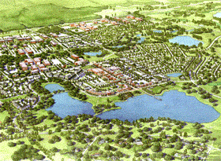
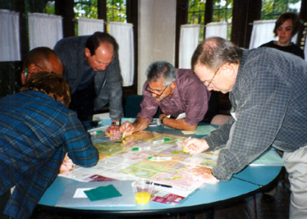
What is Green Infrastructure?
As a noun: the interconnected green space network that is planned and managed for its natural resource values and for the associated benefits it confers to human populations.
As a verb: the process that promotes a systematic and strategic approach to land conservation at the national, state, regional and local scales, encouraging land-use planning and practices that are good for nature and for people.

Slide 4
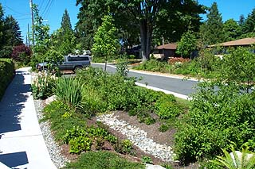
Why Green Infrastructure?
Integrates conservation in concert with land development and man-made infrastructure planning.
Helps communities identify and prioritize conservation opportunities and plan development to meet the needs of people and nature.

Slide 5
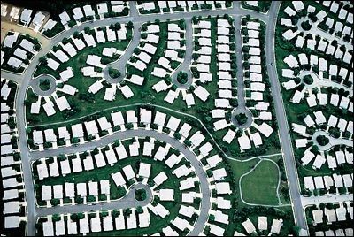
Green Infrastructure
The need for a new approach to conservation & development
Land quantity and quality changes over the years.
Population changes and shifts.
Growth & Development
In the last fifty years, urban land has quadrupled.
From 1982 to 1997 - 680,000 of forestland per year were converted.
Environmental, Social & Economic Impacts of Sprawl
Water quality and wetland functions altered.
Plant and animal habitat destroyed.
Impacts across the landscape are multiplied.
Air quality and climate change impacts.
Costs of utilities
History, continuity and stability are altered.

Slide 6
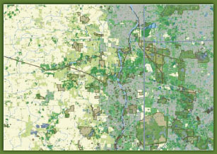
Strategic Conservation Through Green Infrastructure
Smart Growth – development that is economically sound, environmentally friendly, and supportive of healthy communities
State wide green infrastructure assessments to protect the most ecologically sensitive areas.
Smart Conservation – to eliminate haphazard and uncoordinated conservation

Slide 7
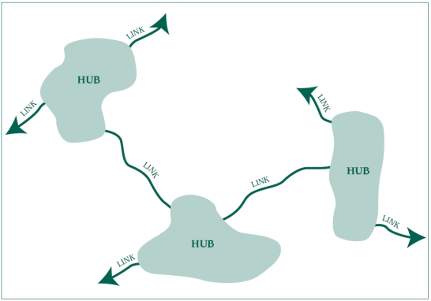
What does Green Infrastructure Look Like?
Network of natural and restored native ecosystems and landscape features.
Network features hubs, links and sites.
Hubs anchor green infrastructure networks
Links tie the system together
Sites are smaller than hubs

Slide 8
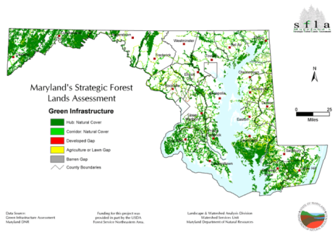
Green Infrastructure in Action: Maryland Greenways
Established in 1991
Purpose:
Statewide system of greenways & trails
Buffer waterways
Protect the Chesapeake Bay
Mid 1990’s state mapped and prioritized its ecological lands
2001 Maryland established GreenPrint to protect its most valuable lands.
This effort has spawned many local efforts

Slide 9
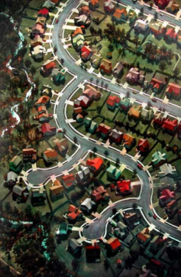
The Green Infrastructure Approach
Connectivity
Context
Sound science & land use theory & practice
Serves as the framework for conservation & development
Planning and protection before development
Funding should be made available up front
Benefits should accrue to nature and people
Needs & desires of landowners & other stakeholders should be incorporated
Within and beyond community connections
Requires long-term commitment

Slide 10
The Benefits of a Green Infrastructure Approach
Human & Social Capital
Natural Capital
Viable Ecosystem
Built
Capital

Slide 11
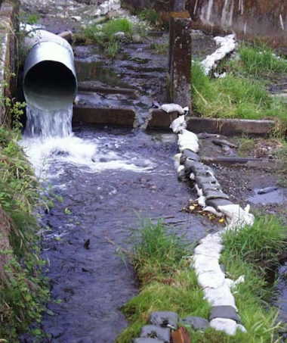
The Environmental Functions of Forests, Wetlands, & Other Open Spaces
Flood Mitigation
groundwater replenishment
shoreline stabilization
storm protection
sediment and nutrient retention
climate change mitigation
water purification

Slide 12
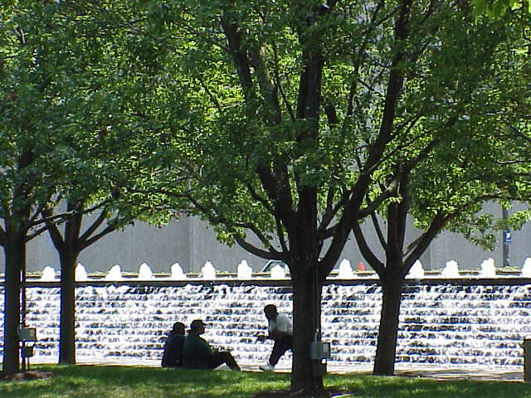
The Environmental Functions of Forests, Wetlands, & Other Open Spaces
Urban Forestry
clean the air
cool parking lots and parked cars
mitigate of urban heat island effects
shade homes and buildings
block winter winds
mitigate storm water run off effects
increase real estate values
economic effects
psychological impacts

Slide 13
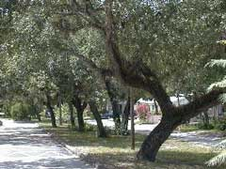
Why Urban Forestry?
Urban forestry has laid the groundwork over the last 20 years:
Provided leadership at the national, state and local levels
Expanded from a single tree perspective to an urban forest perspective and most recently to a green infrastructure perspective
The networks are there and for the most part they are ready to take on the new responsibilities involved with green infrastructure approaches
The urban forest is an excellent foundation from an ecological, social and environmental perspective

Slide 14
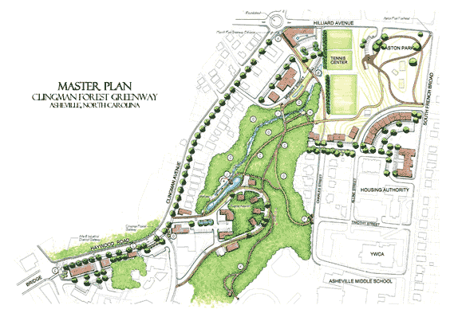
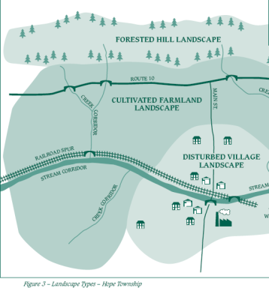
The Basics of Network Design
Develop network design goals & ID features
Gather and process data on landscape types
Identify & connect network elements
Set priorities for conservation action
Seek review and input

Slide 15
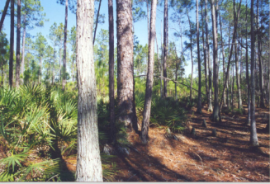
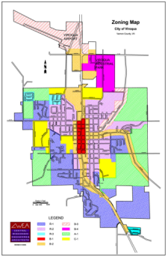
The Implementation Quilt: Matching Available Resources to Network Needs
Implementation Tools
Land acquisition
Fee-simple acquisition
Conservation easements
Regulatory approaches
Zoning
Conservation & mitigation banking
Voluntary Implementation & Financing Tools
Notification & recognition
Tax incentives and tax credits
Technical assistance
Management agreements and leases

Slide 16
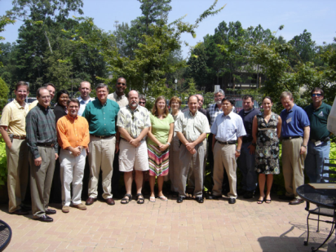
Other Green Infrastructure Tools
Management & Stewardship
Assessing the status of each component
Restoring if and when necessary
Monitoring its status & results of management
Modifying the original management strategy if needed
Building Support for Green Infrastructure
Public information tools and techniques
Citizen engagement
Social capital
Act locally!
Finding volunteers & getting citizens involved

Slide 17
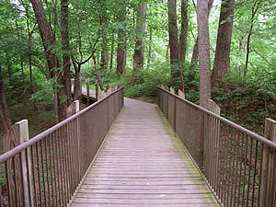
Community Visioning & Green Infrastructure
“A sustainable world can never come into being if it cannot be envisioned. The vision must be built up from contributions of many people before it is complete and compelling.”
Donella Meadows

Slide 18
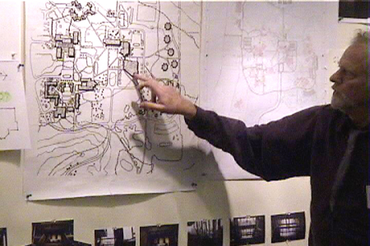
Community Visioning & Green Infrastructure
The mapping “charrette”
The maps
Planning and conducting visioning
Public involvement
Inventory and analysis
Public involvement
Computer generated resource analysis
Public involvement
Green infrastructure vision & recommendations
Public involvement

Slide 19
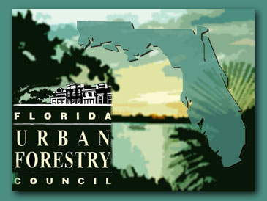
Making it happen
Integrating Urban Forestry & Green Infrastructure into the planning process
Selling Green Infrastructure
Cost of community services studies
Alternative futures
Creating and Sustaining Green Infrastructure Partnerships
Urban forestry networks are excellent places to start!
State councils
State and national grants programs
Educational and technology transfer opportunities abound
Tools and technologies are readily available
Planning tools, websites, software, etc.

Slide 20
Acknowledgements
This publication/training was funded in full or in part by the USDA Forest Service Urban and Community Forestry Program as recommended by the National Urban and Community Forestry Advisory Council (NUCFAC)

