Slide 1
Urban Trees Diseases
Developed by:
Mila Pearce, IPM Diagnostic Lab, Griffin
Gary Peiffer, County Extension Agent, DeKalb
In Cooperation with
The University of Georgia
Cooperative Extension Service
Urban Forestry Issue Team
Notes:
After you have selected the right tree for the right place, using the correct planting methods is very important. Correct planting procedures can determine the trees long term health, increase life expectancy of the tree, reduce the need for corrective tree maintenance, and increase the tree’s ability to become established more quickly and with less stress.
DONT BE FOOLED - DO NOT ASSUME THAT ALL SIGNS AND SYMPTOMS THAT ARE OBSERVED ARE CAUSED BY A DISEASE ORGANISM!
The broad subject of tree diseases is broken down into two subgroups based on the causal agents involved. There are diseases caused by biotic or living organisms. These include: bacteria, virus, fungi and others. Then there are diseases or disease-like symptoms that are caused by abiotic or non-living agents. Abiotic or non-living factors include: light, temperature, water, gases, etc.
Signs of disease are either vegetative or fruiting (reproductive) structures of the organism that is causing the disease. These signs can become apparent either on or near the infected plant especially if it is the plants root system that has become infected.
Symptoms are the plants expressions of disease initiation and it differentiates them from healthy plants nearby. Expressions of symptoms could be: yellowing or chlorosis, root rot, wilting, tip browning, early leaf drop, twig dieback, etc.
ASSUMPTION #2: DO NOT ASSUME THAT JUST BECAUSE YOU FIND AN INSECT OR A DISEASE THAT THEY ARE THE SOLE REASON FOR THE PLANTS DECLINE!
Many organisms are secondary pests that only attack after the plants are weakened or damaged.
It is our job to then determine why the plant was that weak or what damaged the plant? Ask yourself these kinds of questions?
Was the tree planted correctly?
Was the tree pruned and cared for correctly?
What were the environmental conditions over the last 3-4 years? Was there a drought?
Was the tree hit by lightning?
Did the tree get root and/or trunk damage from construction, including home improvement or landscape renovations?
Many of these secondary attackers especially the fungi are weak saprophytes that grow on and secure food from dead or declining plants like our trees. These are decay fungi that are vital to natures recycling process. Other fungi are more aggressive and can become the primary cause of tree decline and they are most often referred to as parasites. The tricky part is that there are also fungi that spend part of their life cycles as saprophytes before they develop a more parasitic phase.
This presentation on tree diseases will emphasize biotic diseases caused by fungi because they are easier to identify (visible signs and symptoms) and there is a greater chance of getting some effective control.
General Background Information: There are over 100,000 species of identified fungi all of which have been separated out into 5 phyla. This separation or classification is based on the type of fruiting body or reproductive organs present. What does the word Phyla mean to you? Nothing, unless you remember back to basic plant and animal classification or taxonomy?
Kingdom Phylum Class Order Family Genus Species
A simple lyric to help you remember is as follows: King Phillip Came Over From Genoa Spain
Take the first letter of each word to develop your classification scheme.
Example: Kingdom - Fungus
Phylum - five - Basidiomycota, Ascomycota, Mycophycophyta, Zygomycota and Deuteromycota
Basidiomycota - 25,000 species that include most of the ones that have large umbrella shaped fruiting structures. Their spores are stored in club-like structures called basidium.
Ascomycota - 25,000 species that include morels, truffles and yeasts. These fungi all produce spores in pods or sac-like structures called asci.
Mycophycophyta - 25,000 species of lichens which are a symbiotic relationship between a fungus and an algae.
Zygomycota - These are called the conjugation fungi and the best known of this group are 600 species of bread molds.
Deuteromycota (Imperfect Fungi) - 25,000 fungi that do not fit in any of the other groups.
This group includes athlete's foot fungus, Penicillium, and Candida that commonly cause yeast infections in humans.

Slide 2
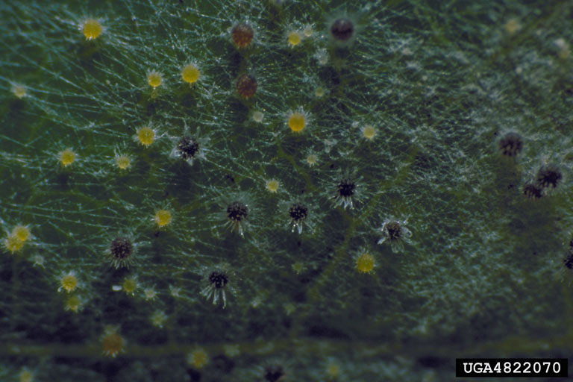
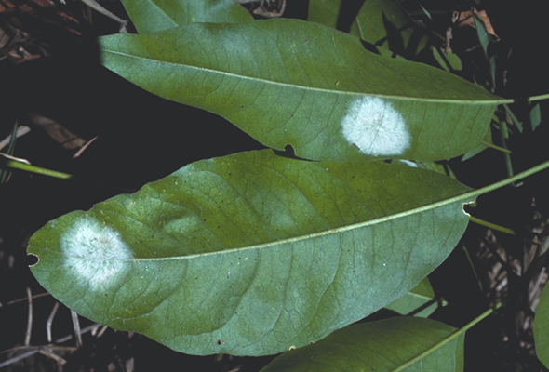
Powdery mildews:
*Found world wide
*Over 7000 species
*Gymnosperms are not infected
*Obligate parasites
Powdery mildews:
Found world wide
Over 7000 species
Gymnosperms are not infected
Obligate parasites
Favorable conditions:
*Dry, warm days
*Cool nights
*Water inhibits germination,
but humidity does not
Notes:
self explanatory

Slide 3
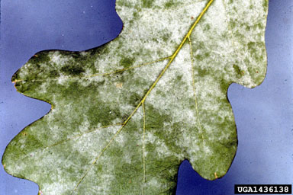
Powdery Mildew –
Fungal disease of leaves of most broad-leaved trees and shrubs causing little lasting damage except possible dwarfing or distortion on heavily infected leaves.
Notes:
Powdery Mildew

Slide 4
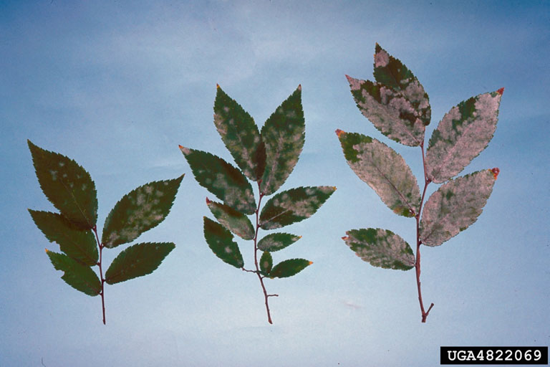
Primary causal agents – Species of Phyllactinia, Erysiphe
Microsphaeria, Uncinula, Podosphaera, and Sphaerotheca
Notes:
Powdery Mildew and the many fungal species that can cause this problem.

Slide 5
Symptomology:
Mid to late summer
Appear dusted with powder
Some chlorosis
In fall, black cleistothecia may be seen
Occasionally, discoloration, dwarfing
and distortion
Symptomology:
Mid to late summer
Appear dusted with powder
Some chlorosis
In fall, black cleistothecia may be seen
Occasionally, discoloration, dwarfing
and distortion
Notes:
Powdery Mildew symptoms and how they progress.

Slide 6
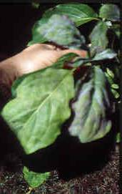
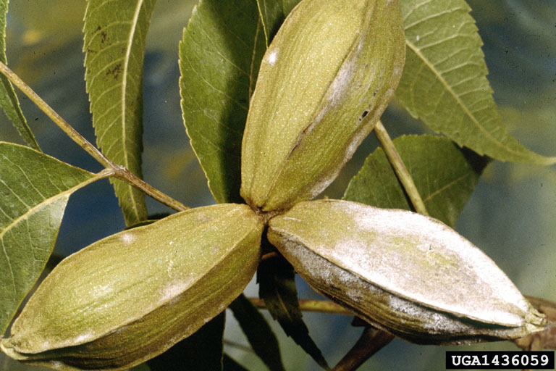
Powdery Mildew of Dogwood and Pecan
Notes:
Powdery Mildew of dogwood and pecan

Slide 7
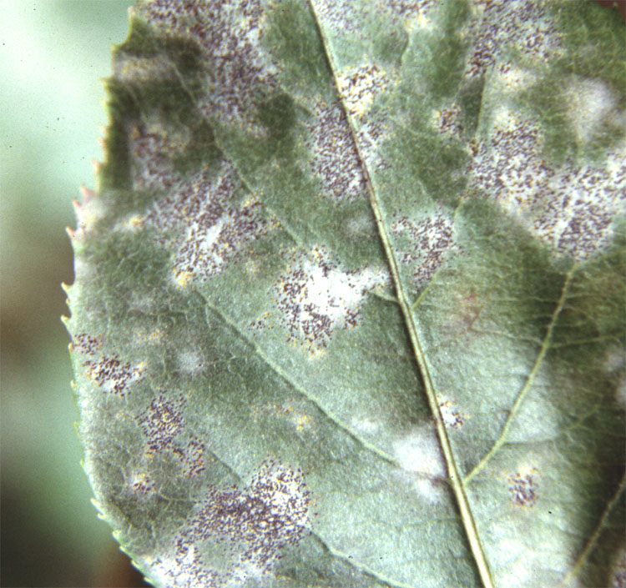
Control: Because damage is usually slight, control is seldom warranted. Destroy fallen leaves, increase sunlight and improve air flow. Surface applications of certain fungicides can be used to control the disease.
Notes:
Powdery Mildew – control methods

Slide 8
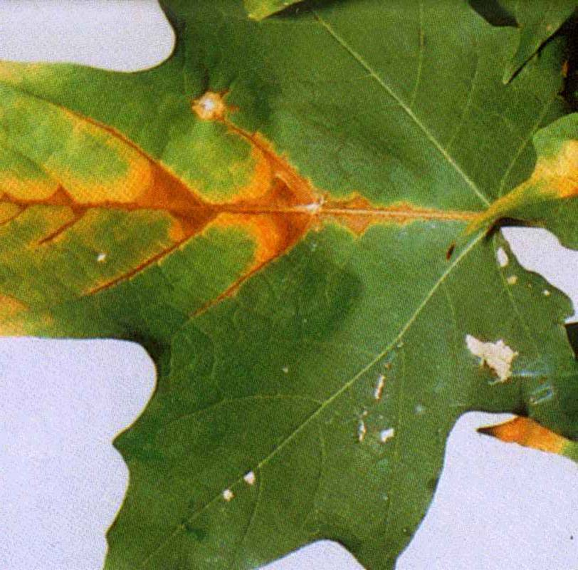
Anthracnose: Fungal disease of a wide
variety of broad-leaved trees causing symptoms
that vary from small necrotic leaf spots to
blight of leaves.
Notes:
Anthracnose – symptoms of these types of fungal diseases

Slide 9
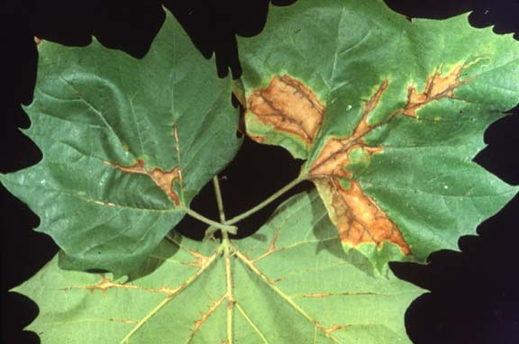
Primary causal agents:
Colletotrichum
Kabetiella
Phyllosticta
Gloeosporium
Discula
many more…..
Notes:
Anthracnose – several fungi that cause similar problems. Some are leaf spots and some are more severe and they cause branch dieback and tree decline.

Slide 10
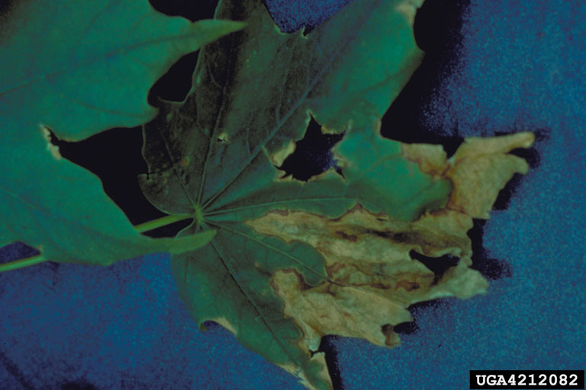
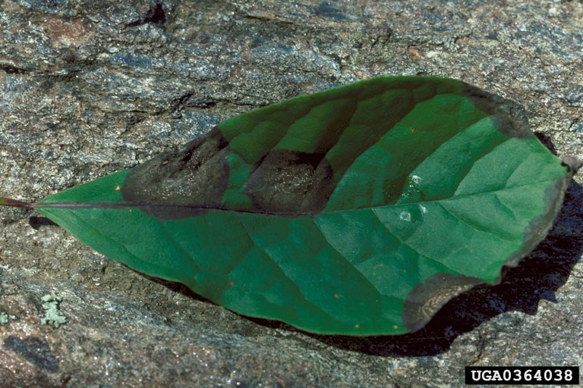
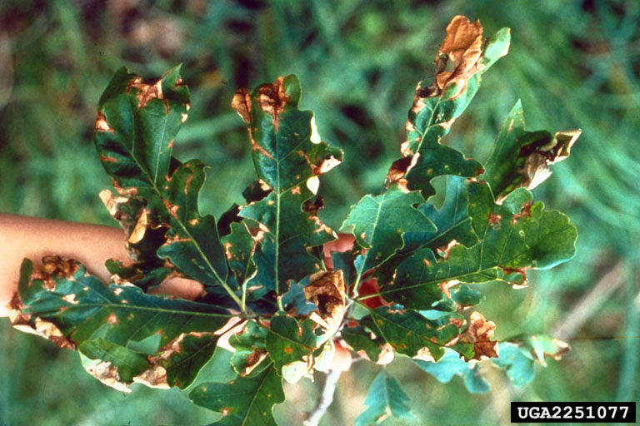
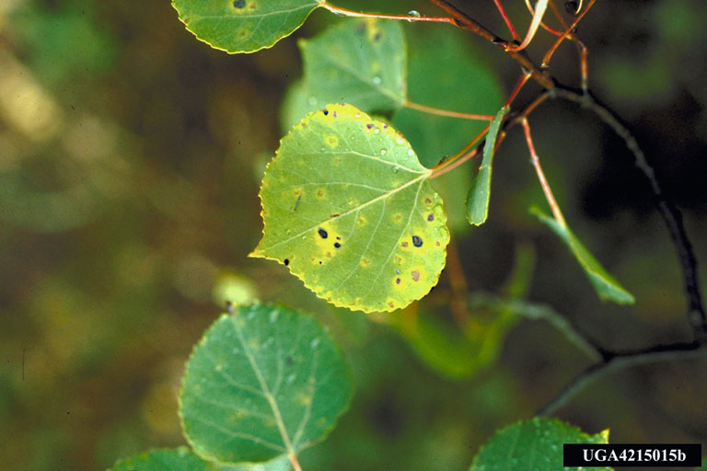
Symptomology
* Small necrotic spots
* Irregular lesions along leaf margins
* Premature defoliation
Notes:
Anthracnose – symptoms seen on leaves

Slide 11
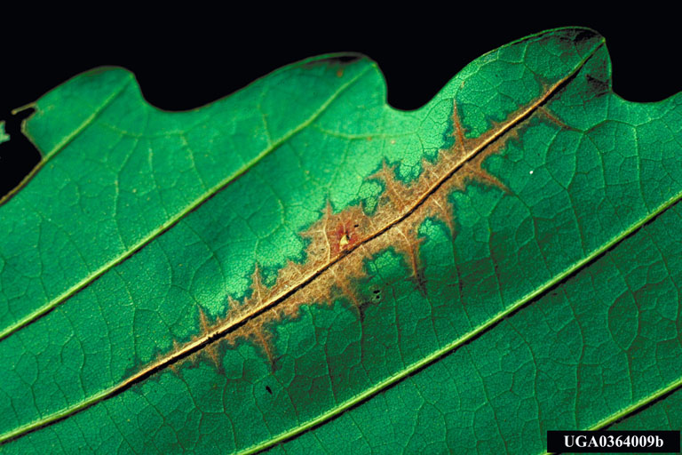
Favorable conditions:
* Warm, wet weather
* High humidity
* Poor air circulation
Notes:
Anthracnose –climatic conditions that favor its development.

Slide 12
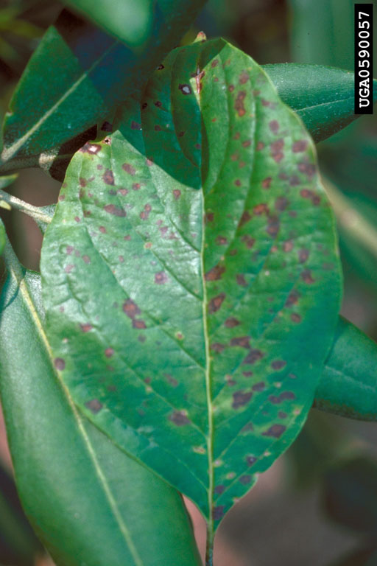
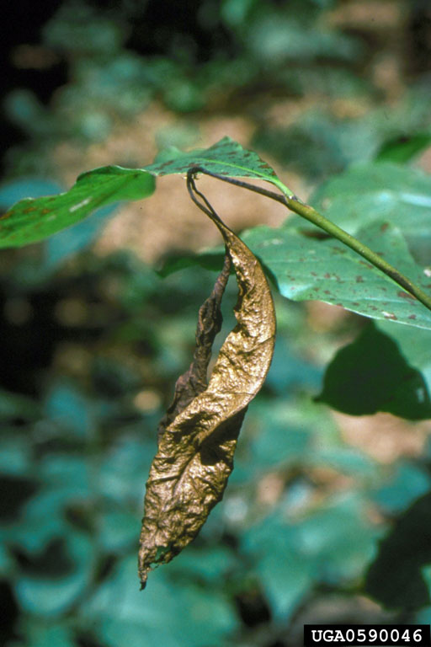
Discula on Dogwood
Notes:
Dogwood Anthracnose also called Dogwood Blight because it causes rapid dieback of twigs and tree decline.

Slide 13
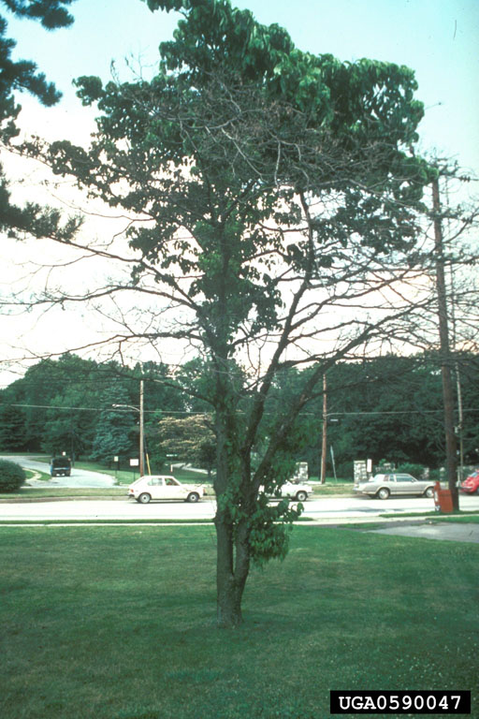
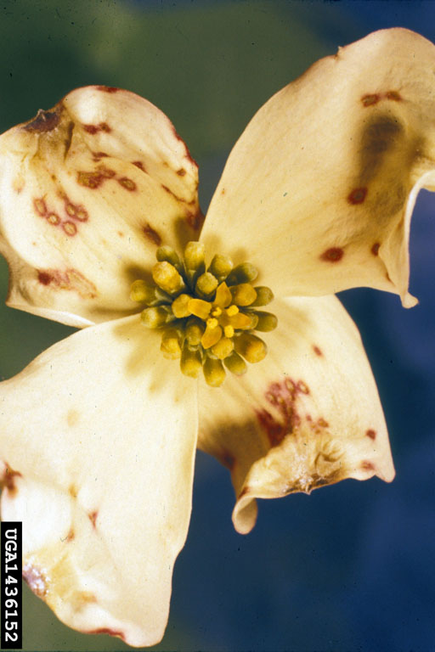
Dieback caused by Discula
Discula petal blight
Notes:
Dogwood Anthracnose symptoms include: leaf spots, petal spots, twig dieback, tree thinning out and death

Slide 14
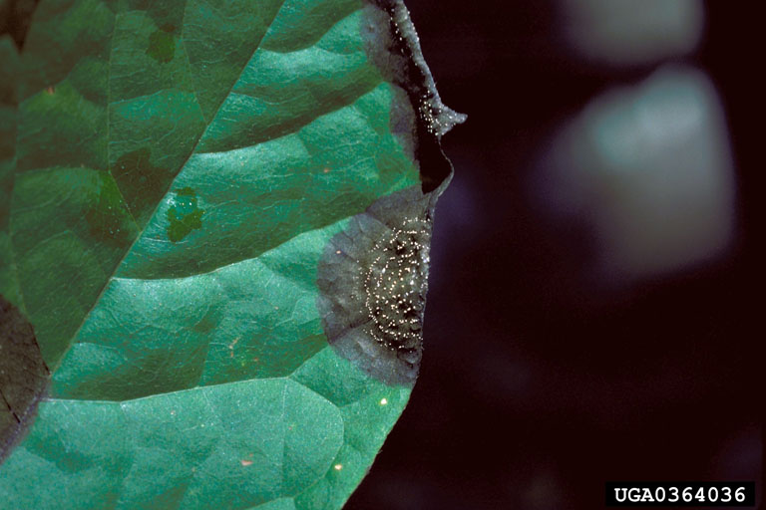
Control: Anthracnose on some species is not warranted because of location or
the disease presents no long term damage. Maintain tree vigor with proper watering, fertilization, good drainage, etc.Valuable shade trees may be pruned to reduce severity and increase life span of the tree.
Notes:
Anthracnose control measures

Slide 15
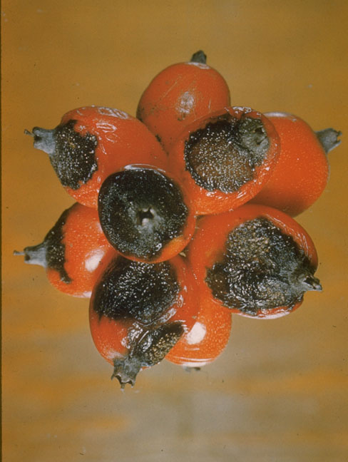
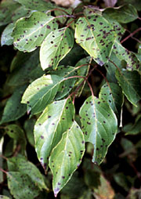
Septoria leaf spot
Notes:
Septoria Leaf Spots are circular spots formed when a fungus attacks at bud break. Control should therefore be attempted at that time. Septoria species attack a wide variety of trees.

Slide 16
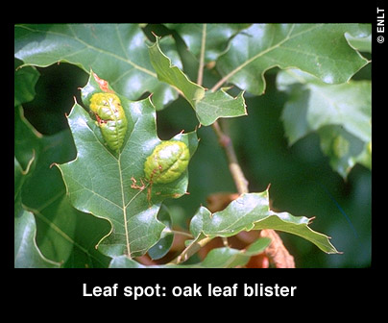
Upper leaf surfaces bubble up to form blisters
Notes:
Oak Leaf Blister (caused by a fungus) and it is much more common during cool, wet springs. It can attack most oak species but the leaves remain attached to the tree so there is little long term effect on tree health.

Slide 17
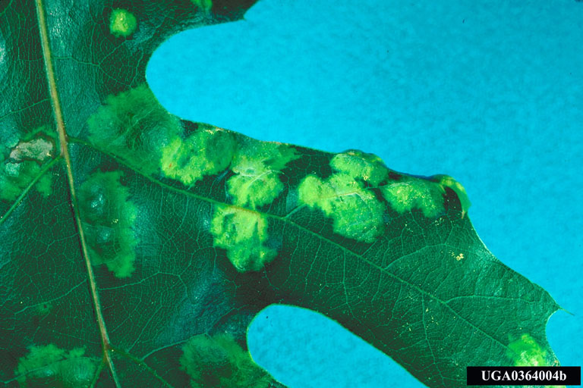
Primary causal agent: Taphrina sp.
Notes:
Oak Leaf Blister – fungal cause

Slide 18
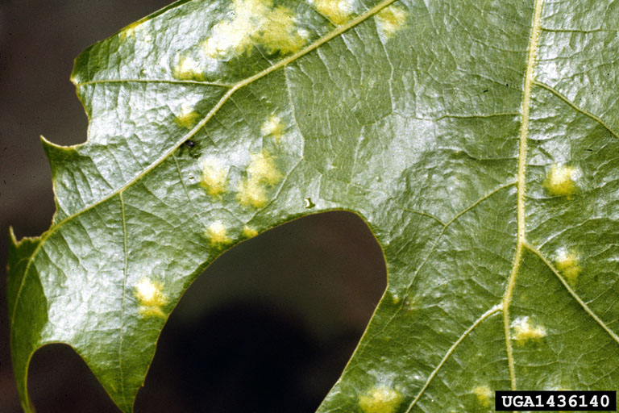
Symptomology:
- distinct local raised lesions
- light green to brown
- lesions may coalesce
- premature defoliation
Notes:
Oak Leaf Blister – symptoms

Slide 19
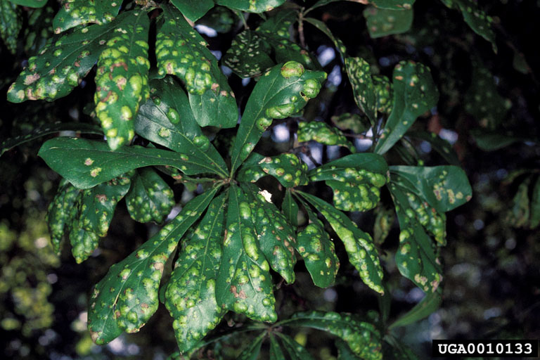
Control:
Chemical control on trees is neither practical nor necessary.
Consider raking and removing fallen leaves and composting.
Notes:
Oak Leaf Blister – control

Slide 20
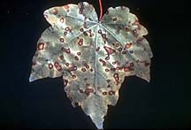
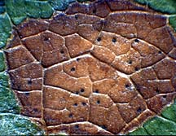
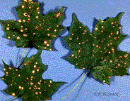
Purple Eye Target Spot
on maple caused by Phyllosticta.
Notes:
Target Spot – these spots cause the leaf tissue to die and it often drops out to form shot holes. Again, this fungus reduces plant health very little. Only time to treat is as the leaves are unfurling (opening) from the buds.

Slide 21
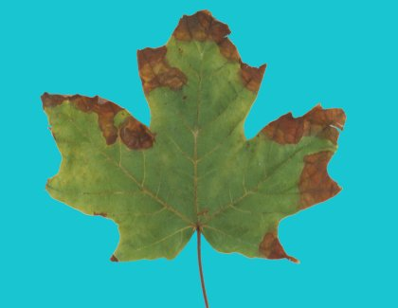
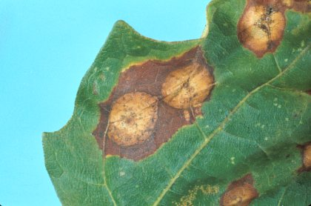
Gleoesporium leaf spot
Maple
Notes:
Gloeosporium also called Maple Anthracnose is a serious problem of sugar, silver maple and boxelder during rainy seasons. It causes symptoms on other maples but less damage.
As the leaf spots expand and run together (in serious cases) the whole leaves may die. Leaves that are only partially killed look scorched. The only effective time to treat is as the leaves first open.

Slide 22
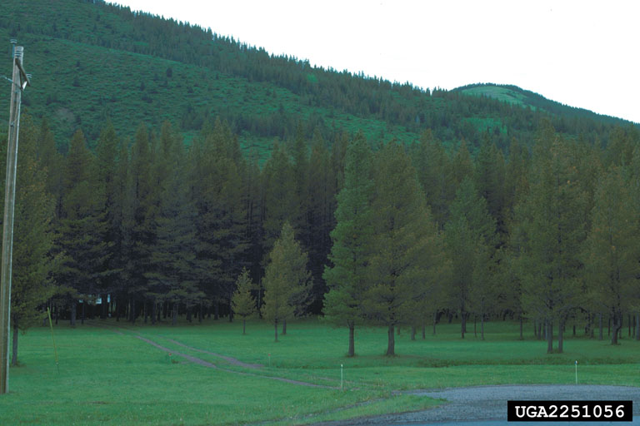
Needle Cast: premature senescence and casting of needle
Causal Agents: Lophodermium and other related genera
Host:
Primarily southern pines
Notes:
Needle Cast caused by fungi rarely cause enough needle drop to warrant protective sprays.
If you do need to treat, it should be accomplished at bud break with two timed applications.

Slide 23
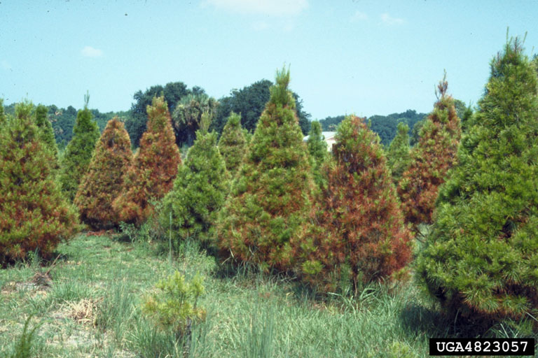
Destructive epidemics are cyclic and appear dependent on climatic conditions that favor both fungal growth during the growing season and inoculum development during the dormant season. This disease is more important in Christmas tree operations.
Notes:
Needle Cast – of pines and only a problem in nurseries or Christmas tree production areas.

Slide 24
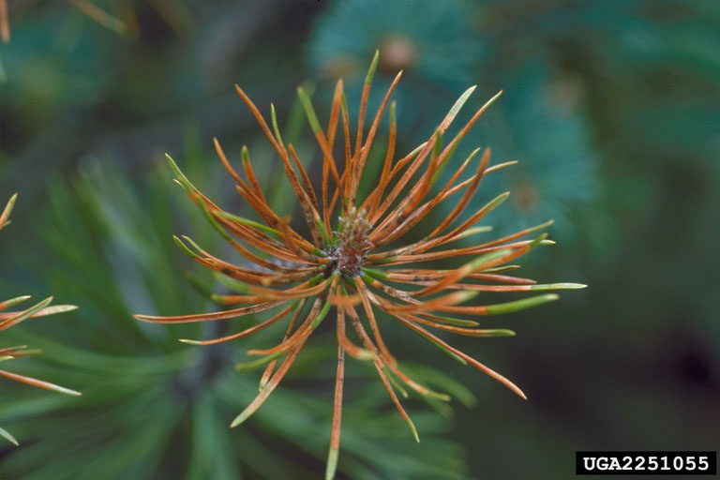
Symptomology:
- light green to red or brown spots
- spots enlarge killing tissue beyond the spots
- shedding usually follows
- tiny elongated fruiting bodies
Control not practical or advised in urban situations.
Notes:
Needle Cast – symptoms to look for.

Slide 25
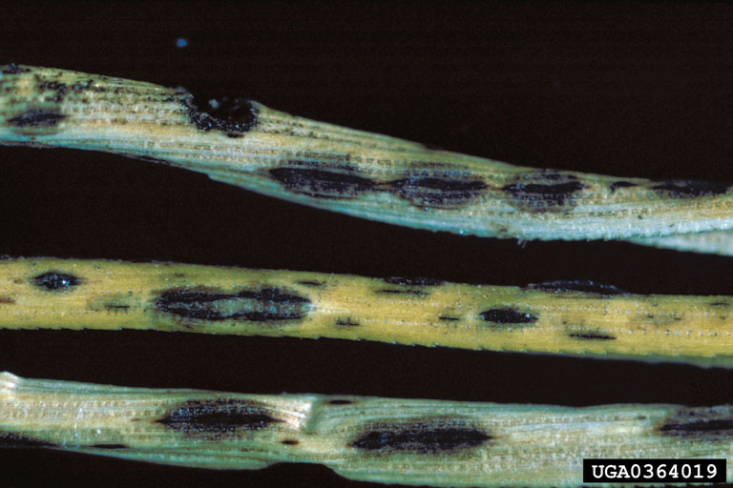
Close up of spotting on needles
Notes:
Needle Cast – close up of fungal spots on needles that result in needle death.

Slide 26
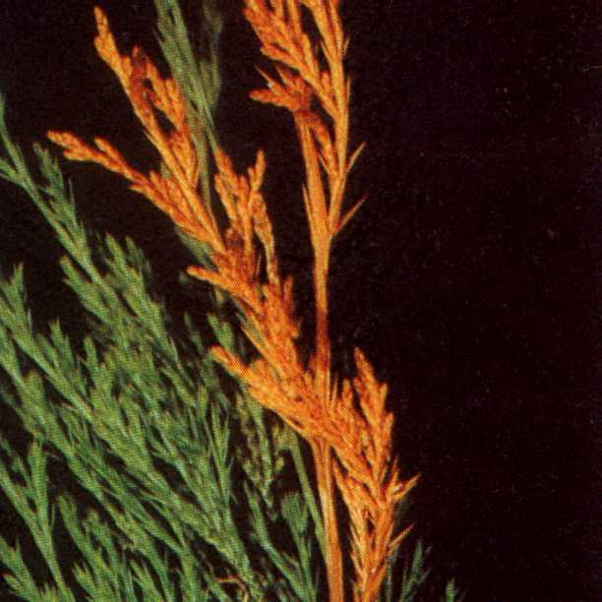
Phomopsis Tip Blight –
Disease of conifers causing
needle cast, dieback, and
death of highly susceptible
trees.
Notes:
Phomopsis Tip Blight is a common fungal disease of conifers.

Slide 27
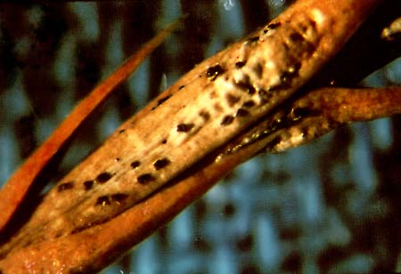
Hosts:
Pine, juniper, leylands, Cryptomeria, etc.
Symptomology:
- discoloration appears in current year needles
- needles droop, shrivel, and cast
- dieback of shoot tips
- black fruiting structures
Notes:
Phomopsis – hosts and symptoms

Slide 28
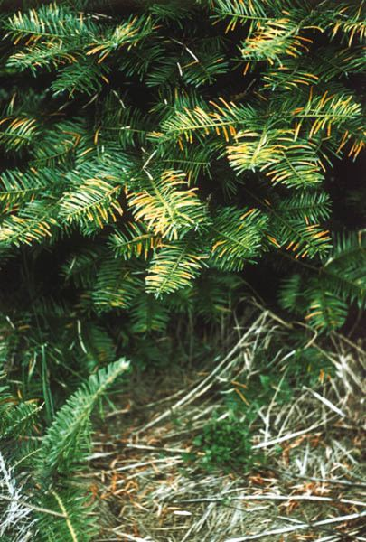
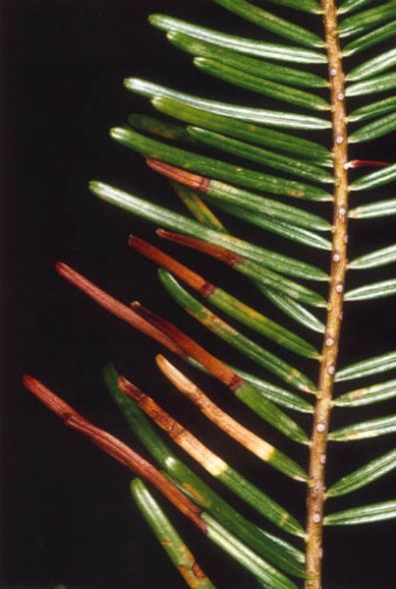
Conidia are spread primarily by water
and germinates on needles. It soon
moves into shoots and stems where
cankers may form.
Notes:
Phomopsis and how it spreads.

Slide 29
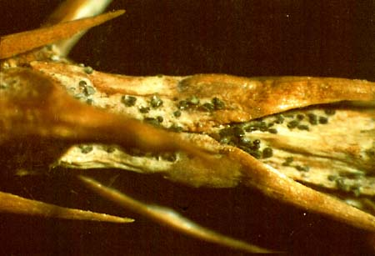
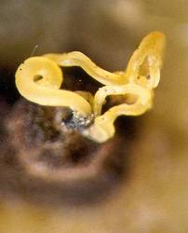
Pycnidia develop releasing conidia in tendrils.
The fungus can remain viable for at least 2
years in dead tissue.
Notes:
Phomopsis

Slide 30
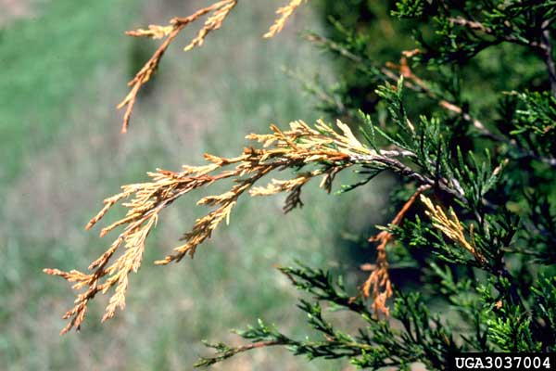
Control:
Fungicides can be effective if
applied according to label directions.
Pruning branches will limit inoculum
build-up.
Notes:
Phomopsis – control measures

Slide 31
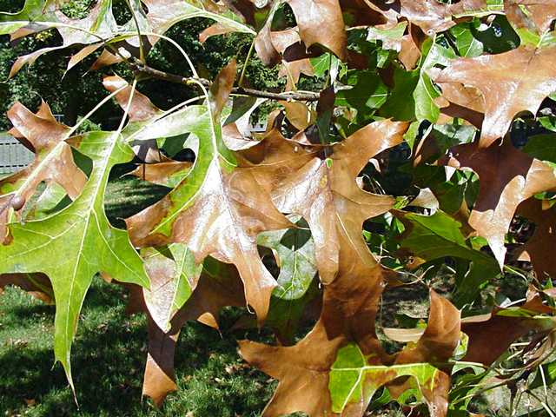
Oak Leaf Scorch
Notes:
OAK LEAF SCORCH (Bacterial Leaf Spot)
Infection occurs in the spring and the bacteria block the plants ability to carry water which results in a wilted and scorched appearance. As more leaf tissue dies the growth of the tree is greatly reduced.

Slide 32
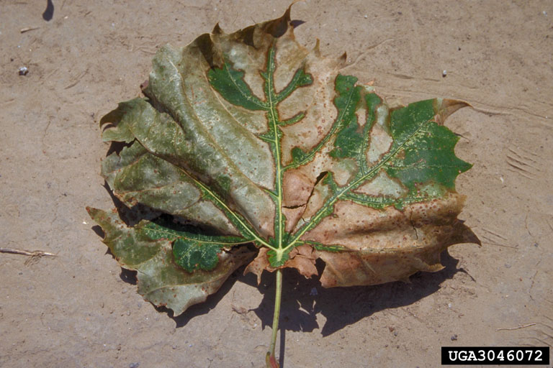
Causal agent : Xylella fastidiosa
Infection through xylem feeding
insects such as sharpshooters
and treehoppers. Adults can infect
Throughout their lives.
Notes:
Oak Leaf Scorch – insects act as the carriers to move it around from tree to tree.

Slide 33
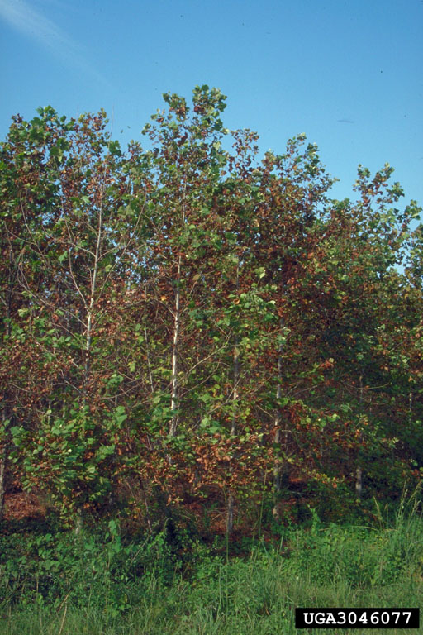
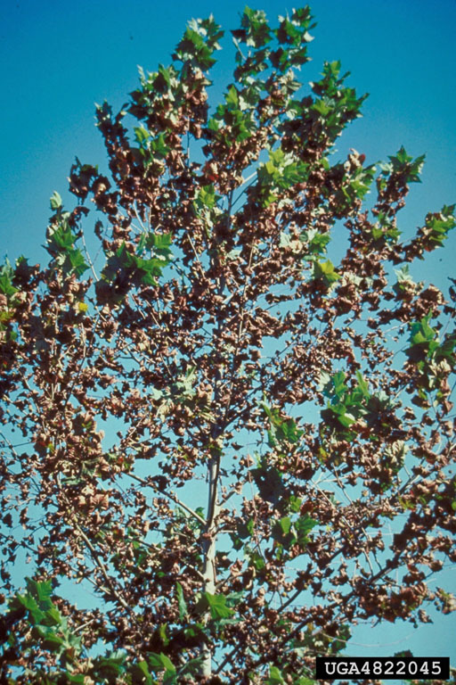
Symptomology:
Dieback and browning due to water stress
Scorching of leaf margins
Notes:
Oak Leaf Scorch – symptoms

Slide 34
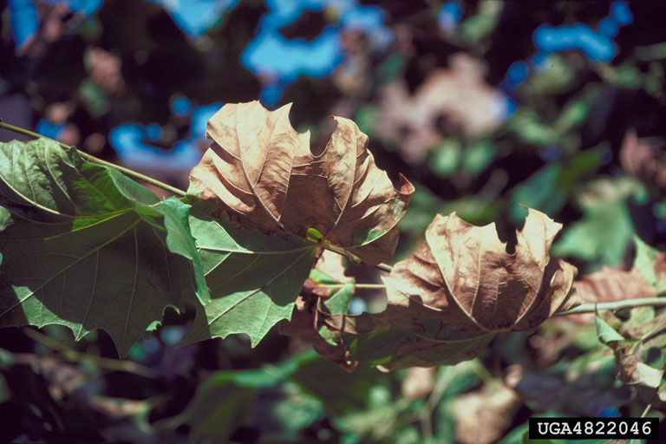
Control:
Maintain plant vigor
Prune infected branches
No chemicals available
Notes:
Oak Leaf Scorch – disease can not be completed eliminated but tree decline and death can be slowed with good care.

Slide 35
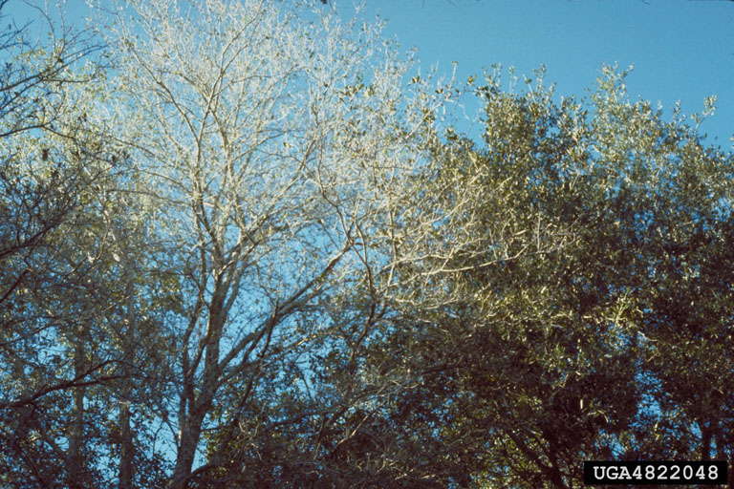
Final stages of decline
Notes:
Oak Leaf Scorch – can result in rapid tree death if not properly diagnosed and good cultural methods are not initiated – pruning, mulching, watering, etc.

Slide 36
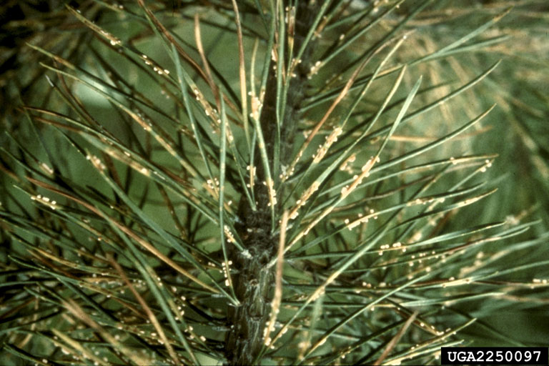
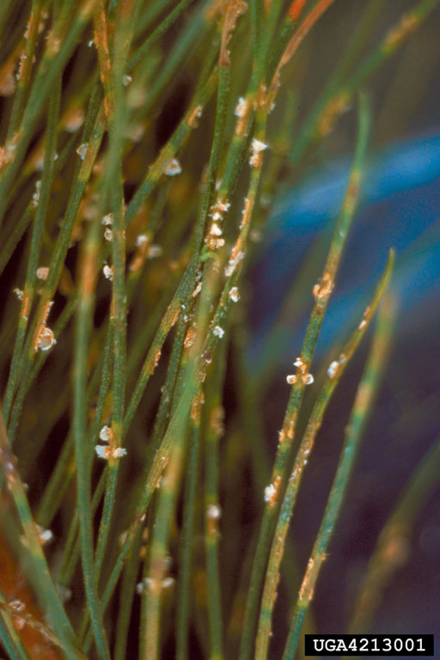
Needle Rust
Common on two to three needle pines
and white pines in N. Georgia.
Notes:
Needle Rust – hosts are most often pitch pines and the alternate hosts are asters and goldenrod. When severely infected it can cause defoliation and branch dieback.

Slide 37
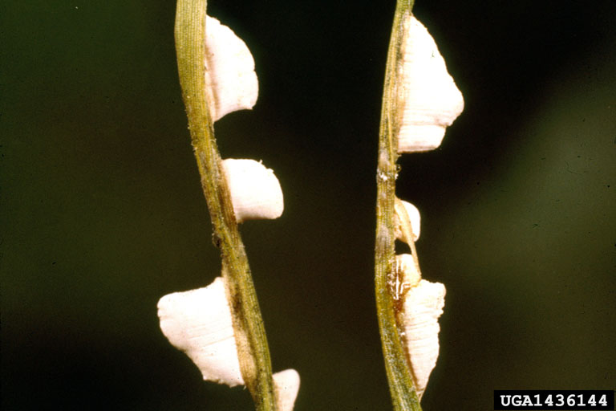
Close up of rust spores.
Notes:
Needle Rust – close up of spores that look like globs of sap or gum attached to the needles.

Slide 38
Branch and/or Trunk:
Fire blight
Notes:
Fire Blight (Bacterial Disease) which is common to several Prunus species but does its greatest damage on apples, crabapples and pears. It is often initiated at the buds and branch spurs

Slide 39
Symptomology:
Sudden blighting, death of blooms
Bacterial ooze may be visible
Blighted leaves stay attached
Forms shepard’s crook
Notes:
Fire Blight – symptoms visible on the plant.

Slide 40
Notes:
Fire Blight – branch dies back to the original point of infection which is often a wound or canker.

Slide 41
Causal agent: Erwinia amylovora
Favorable conditions:
Infection in Spring when there is abundant
moisture and temperatures 65-86 F
Notes:
Fire Blight – favorable conditions like a wet spring enable it to spread around a tree very fast.

Slide 42
Notes:
Fire Blight – life cycle

Slide 43
Control:
Plant tolerant varieties
Prune infected branches
Disinfect pruning tools
Maintain plant vigor
Control insect vectors
Notes:
Fire Blight – controls. Sprayed on antibiotics are also recommended but they are very costly and the coverage and timing are the keys to any success.

Slide 44
Fusiform Rust
Notes:
Fusiform Rust – a disease of Southern pine species.

Slide 45
Fusiform Rust
Causal Agent: Cronartium quercuum
Aecia
Telia
Notes:
Fusiform Rust

Slide 46
Telia on oak
Notes:
Fusiform Rust – how to ID it on the leaves of its alternate hosts (the oaks). Does little to no damage and causes a minor leaf spot.

Slide 47
Alternate hosts:
Red & Black Oaks
Uredinia & telia
Notes:
Fusiform Rust – alternate hosts are all oaks especially the black oaks

Slide 48
Needles and stems are infected in spring by basidiospores released
from telia on oaks.
Galls form 4 – 6 months later
Notes:
Fusiform Rust – from the oaks it spreads back to the pines and enters through trunk openings or wounds.

Slide 49
Most severe on loblolly and slash pine
Pycnidia
Notes:
Fusiform Rust – primary hosts are Loblolly and Slash Pines

Slide 50
Rust over winters in the pine.
One year later, spermagonia form in Oct-Dec.
Yellow aecia break through the bark and infect oaks.
Notes:
Rust – over winters on the pines until they can sporulate in the spring and be dispersed to again attack nearby oaks.

Slide 51
Favorable conditions:
59- 80 F
Wet and humid
18 hours of moisture sufficient for infection
Notes:
Rust – favorable conditions for its growth and spread are…..

Slide 52
Notes:
Rust – review of its life cycle with the two hosts – pine and oak.

Slide 53
Witches’ Broom caused by powdery mildew on Witchhazel
Notes:
WITCHES BROOM – is a growth problem that results when terminal buds are damaged or destroyed and a bunch of lower buds are released. You get a whole bunch of weak shoots sprouting out that resembles a medusa head or a witches’ broom. What kills buds – disease, insects, frost, drought, etc.?

Slide 54
Witches’ Broom caused by
mites and powdery
mildew on Hackberry tree.
Notes:
Witches Broom symptoms expressed on a hackberry that has had mildew and a heavy mite infestation which killed lots of terminal buds.
Witches broom can be commonly seen in many tree species including: cedars, junipers, ash, quince, serviceberry, and hackberry.

Slide 55
Cankers and Galls on trunks/branches - Seiridium Canker
Distinct, sunken lesions which lead to
dieback and death
Notes:
Seiridium Cankers – cause dieback and death of branches and trees of primarily cypress species like the Leyland Cypress.

Slide 56
Flattened cankers are associated with bleeding and resin.
Notes:
Seiridium Canker – symptoms are listed

Slide 57
Spores are dispersed throughout
the summer, but infection periods
are unknown
Dieback is from the inside out
Hosts include :
Oriental arborvitae
Baldcypress
Arizona cypress
Italian cypress
Leyland cypress
Junipers
Notes:
Seiridium Canker causes branches to die from the inside of the plant and progress towards the branch tips

Slide 58
Control:
Remove cankers in winter
Do not prune in May or June
Increase plant health
No chemicals available
Notes:
Seiridium Canker – controls

Slide 59
Cedar Apple Rust
Galls are abnormal growth responses
caused by fungi, insects, and bacteria
Notes:
Cedar Apple Rust is a fungus that attacks Southern Red Cedars and other junipers.
It does very little damage to the cedar but it does lots of damage to its alternate hosts which are apples and crabapples. So much damage, that old fruit orchard recommendations included clearing all cedars away from the nursery area.

Slide 60
Mature gall
Actively sporulating
galls
Notes:
Cedar Apple Rust – mature galls hang on the trees for years.
Young galls produce the long, orange colored horns and spores in the spring.

Slide 61
Alternate host leaf spot.
Most often seen on apples and
crabapples.
Notes:
Cedar Apple Rust – how it looks on apple and crabapple as leaf spots.

Slide 62
Black Knot
Common gall on cherries,
plums, and peaches.
Symptoms include dieback of branches, thin
crowns, and gnarly black galls on trunk
or branches.
Control: Prune branch galls six to eight inches
below infection. It is impractical to remove trunk
galls.
Notes:
Black Knot Fungus or Black Knot Gall
No chemical control.

Slide 63
NECTRIA CANKERS:
Are multi-layered and become weak points on branches and trunks.
Canker wounds are often points where branches or trunks break off in ice and/or wind.
Notes:
Nectria Cankers – target pattern, multi-layered and causes loss of stem or trunk strength.

Slide 64
Nectria Cankers
Hosts:
Oak
Maple
Yellow popular
Cherries
Dogwoods
Elms
Hickory
Redbuds
Notes:
Nectria Cankers - hosts are all hardwoods, conifers are not affected.

Slide 65
Botryosphaeria Canker
on Leyland Cypress
Other hosts include:
Hickory Holly
Lindens Maples
Oak Pecan
Notes:
Botryosphaeria Cankers - list of most common hosts

Slide 66
Control:
Prune branches six to eight inches
below the canker wound.
Notes:
Botryosphaeria Cankers – most effective control is to prune out where feasible.

Slide 67
Pitch Canker
Hosts:
Pinus species
Loblolly
Longleaf
Pitch
Virginia
White
Infection occurs in wounds caused
by various agents on stems of all sizes
at any time of the year.
Notes:
Pitch Canker – a disease of Southern pines caused by the fungus Fusarium.
Control – remove heavily infected or dead trees and prune out diseased branches

Slide 68
Wood Decay Fungi
Ganoderma
Inonotus
Hypoxylon
Hispidus Canker
Irpex Canker
Notes:
Wood Decay Fungi – often attack weakened trees as secondary invaders. Pictured is the Hypoxylon fungus commonly found on declining oaks, beeches, etc. Infected trees should be removed. These types of cankers often kill the host trees within 3-8 years (or less) as the cankers girdle a tree’s trunk and open them up to breakage at these points of decay. Many of these fungi get initiated through branch or trunk wounds.

Slide 69
Hypoxylon Canker
Notes:
Hypoxylon - Attacking weakened trees like ones that have been damaged by drought, ice or lightning.

Slide 70
Symptomolgy:
Slighty sunken irregular areas on bark
Canker becomes blistered with clusters of perithecia
immersed in stromata causing the tree bark to exfoliate.
Colors vary from black, gray to tan.
Notes:
Hypoxylon – symptoms

Slide 71
Hypoxylon canker is most prevalent in
situations of weakened or stressed
hardwoods.
Hosts:
Oak
Beech
Hickory
Maples
Tupelo
Control measures include pruning out branch cankers, surgically removing small trunk cankers, fertilizing and watering to improve tree vigor. These controls can slow disease spread but do not often totally eliminate it!
Notes:
Hypoxylon – common hosts and control.
Controls are stop gap to slow the disease spread and try to increase tree longevity.

Slide 72
Hispidus Canker
Entry point for this fungus is usually through old branch stubs or wounds. Causes a soft, white heart rot.
Notes:
Hispidus Canker - best control is to limit it from getting started by pruning off branch stubs, pruning correctly and by encouraging rapid wound closure.

Slide 73
Hispidus Canker
Primarily found on oak species
Once trunk decay fungi are actively growing, there is no control. Improve tree vigor to add to its lifespan!
Notes:
Hispidus Canker – like other decay fungi once it gains entry into the wood of trunks or stems it is impossible to eliminate.

Slide 74
Vascular Wilts
Diseases that interfere with the
uptake and flow of water
and nutrients.
Notes:
Vascular Wilts – Wilts are caused by fungi that attack trees and get into their vascular systems (xylem and phloem) blocking the movement of water and nutrients. Once this flow is blocked, trees wilt, yellow and die quickly.

Slide 75
Verticillium Wilt
Sample Hosts:
Maple
Ash
Elms
Magnolia
Redbud
Yellowwood
Tuliptree, Yellow Poplar
Symptoms include curling,
drying, interveinal chlorosis or
reddening, defoliation, wilting,
dieback and death.
Infection occurs on stressed
trees and is initiated through the
roots and wounds.
Notes:
Verticillium Wilt – a fungal disease that often gets into trees through damaged or declining root systems. Symptoms and common hosts are listed.

Slide 76
Dutch Elm Disease DED
Yellowing, flagging and
branch dieback
Staining under bark
Notes:
Dutch Elm Disease (DED) is a vascular wilt caused by the fungus, Ceratocystis ulmi.
Symptoms are listed.

Slide 77
Control:
Prune infected branches and monitor insect vectors (elm bark beetles).
Prevent root grafts through appropriate use of trenching methods.
Plant resistant varieties such as Chinese Elms and Zelkova Elms.
Notes:
Dutch Elm Disease – controls are listed but all should involve improving tree vigor.

Slide 78
Wetwood and Slimeflux
Caused by bacteria.
Hosts:
Oaks
Popular
Elms
Other symptoms:
fermentation smell, swarming insects
Notes:
Wetwood/Slime Flux – are trunk and root flare oozing caused by bacterial infection.

Slide 79
Wetwood is a bacterial infection initiated through root and/or trunk wounds. Oozing occurs when bacterial
pressure builds up in the trunk.
Trunk and bark staining usually results.
Wetwood or slime flux weakens trees but does not directly cause their death.
Control:
Cosmetic only.
Use 10-20% solution of bleach
clean the bark surface.
Do not drill to insert drain tubes
because it spreads infection.
Notes:
Wetwood – expensive attempts at control are not warranted

Slide 80
Miscellaneous Trunk Fungi
Secondary fungi you may encounter
Hericium erinaceus
tooth fungus or
hedgehog fungus
In wounds or scars of
oak trees.
Clitocybe sp.
Root and trunk rots of
oak and maple.
Notes:
Other decay fungi that you may encounter and what their fruiting structures look like.

Slide 81
Ganoderma – secondary fungi causing root and butt rot.
Hosts:
Maple
Beech
Hickory
Ash
Walnut
Sweetgum
Sycamore
Oak
Baldcypress
Notes:
Ganoderma sp. – common hosts are listed but it is not usually a problem unless the plant has been weakened by environmental stress and/or wounding.

Slide 82
Annosum Root Rot
PrimaryHosts:
Cedar
Hemlock
Pines
Symptoms include general
tree decline and wind-throw.
Wind throw is blow over due
to heavy wind or ice.
Notes:
Annosum Root Rot – is a common conifer problem that attacks stumps and live trees.

Slide 83
Armillaria sp. Honey Mushroom or Shoestring Root Rot
Rot of roots and lower trunk that makes the trees susceptible to windthrow. They are opportunistic in that they attack already weakened plants. Commonly found on eastern oak species.
Notes:
Armillaria sp. – this fungus lays in wait for weakened trees then it becomes an active parasite.
Symptoms at top of tree include: smaller leaves, fewer leaves and branch dieback.

Slide 84
Wilt Diseases
Using trunk injection control methods should be considered
only as a last option after all other methods have been tried.
Why?
Wounding by these methods may induce disease spread or initiate trunk decay.
Notes:
Wilt Disease – should be aware that there are a variety of treatments including trunk injection and there is still a lot of question as to how effective these treatments are.

Slide 85
Dealing with Trunk and/or Root Decay Problems
In most cases, refer clients to certified arborists for a proper,
on-site evaluation.
Certified arborists can
be located by using the ISA web site:
www.isa-arbor.com
Visual examinations of soft spots, wounds or actual decay fungi are
only indicators. Devices that take actual cores or use other methods to evaluate the extent of fungal damage are preferred.
Notes:
Trunk & Root Problems – once diagnosed these trees pose a great threat or liability to property and lives. Do not stick your neck out and say a tree is healthy unless you know for sure that is a fact. Refer them to certified arborists who can physically examine the trees.

Slide 86
NEW DISEASES ON THE HORIZON Sudden Oak Death, SOD, Phythophthora ramorum
Phythophthora ramorum is a soil-borne fungal pathogen that was accidentally shipped to the Eastern USA in nursery stock from the west (CA, OR, WA). This pathogen has been shown to affect over 60 different ornamental plants. At this point, we are primarily examining and testing camellias, rhododendrons, azaleas, viburnums and mountain laurels all of which seem to be very susceptible to attack.
This virulent pathogen has damaged and/or killed many western tree species but we do not know what it will do to eastern varieties, especially our oaks.
Notes:
New Diseases – Sudden Oak Death, SOD
Resources: Dr. Coder handouts, web site www.suddenoakdeath.org
Provides updates and background on the disease and its spread on the west coast.

Slide 87
Symptoms that Mimic Disease Problems
Ozone damage
Notes:
Pollution Damage

Slide 88
Mechanical damage – weed eaters and lawnmowers
Notes:
Mechanical Damage – that leaves open wounds for decay to later enter these areas.

Slide 89
Bromacil herbicide injury
on willow oak
Notes:
Herbicide Injury

Slide 90
Eastern Mistletoe –
parasitic plants that reduce tree vigor. They are primarily spread from tree to tree by bird droppings.
Hosts:
Ash Dogwood
Elm Maple
Oak Pecan
Walnut River Birch
Notes:
Parasites like mistletoe weaken trees and cause them to thin out and dieback.

Slide 91
Drought Stress –
on Maple and Pine
Notes:
Drought stress causes wilt, early leaf drop and branch dieback just like some diseases

Slide 92
Insect Leaf Galls
Notes:
Insect Galls unless you know what they are can look like a disease problem.

Slide 93
Credits: Bugwood Network for Images
Dr. Jean Williams-Woodward,
UGA, Extension – Pathology
for background research
Notes:
Credits – Thanks to Dr. Jean Woodward, UGA Pathology for allowing me to utilize her base program developed for winter school 2004

Slide 94
Acknowledgements
This publication/training was funded in full or in part by the USDA Forest Service Urban and Community Forestry Program as recommended by the National Urban and Community Forestry Advisory Council (NUCFAC).
Notes:
Special Thanks to Mila Pearce, IPM Lab, for her assistance with slides and the organization of the power point presentation. This was developed through an Urban Forestry Grant submitted through the Urban Ag Center, Griffin.
Scripted by: Gary Peiffer, CEA DeKalb County, 1/12/05
Source of good tree disease images: www.forestryimages.org

