Slide 1
Urban Tree
Biology
Developed by:
Sheldon Hammond, Northwest District ANR Program Development Coordinator
In Cooperation with
The University of Georgia
Cooperative Extension Service
Urban Forestry Issue Team

Slide 2
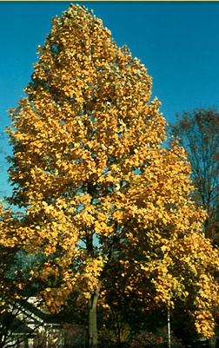
Tree Biology
Tree Anatomy - study of component parts of the tree
Tree Physiology - study of the biological and chemical processes within these structures, providing the basis of function
Notes:
The study of tree biology is the study of structure and function, and the relationship between them. Anatomy is the study of the component parts of the tree (leaves, stem, roots etc). Physiology is the study of the biological and chemical processes within these structures, providing the basis for function (photosynthesis, transpiration etc).

Slide 3
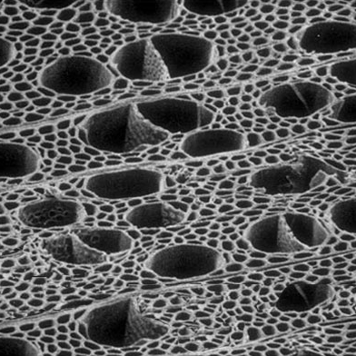
Tree Anatomy
Basic Structures - Cells and Tissues
Trees made up of cells, tissues and organs
Cells come from meristems
  Meristems - undifferentiated tissue where cell division takes place
  Cells then undergo differentiation (development of cells in which they become specialized for various reasons)
Cells similar are arranged into tissues
Tissues are organized into organs (leaves, stems, roots, flowers and fruits
Notes:
All living organisms share a basic organizational theme based upon cells, tissues and organs.
Cells are the basic building blocks of structure. New cells arise from the division of existing cells. In trees this process occurs in specialized zones called meristems.
Following division cells undergo differentiation, which changes their structure and permits cells to assume a wide variety of specific functions.
Cells with similar structure and function are arranged into tissues such as bark or wood. Tissues are then organized into organs, of which trees have five: leaves, stems, roots, flowers and fruit. Finally organs are organized as intact, fully functioning organisms – trees.

Slide 4
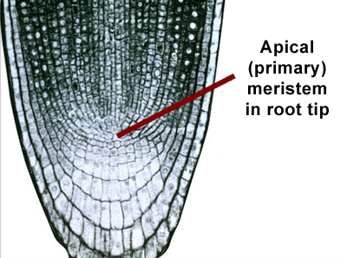
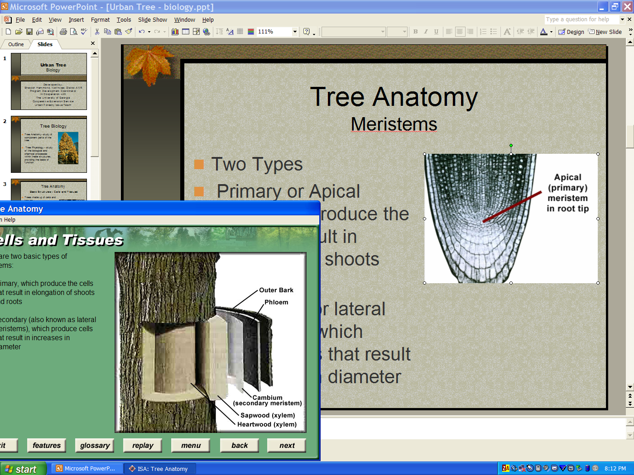
Tree Anatomy
Meristems
Two Types
Primary or Apical meristems- produce the cells that result in elongation of shoots and roots
Secondary or lateral meristems - which produce cells that result in increase in diameter
Notes:
There are two types of meristems:
1). Primary which produce the cells that result in elongation of shoots and roots.
2). Secondary (also know as lateral meristems), which produce cells that result in increased diameter. The presence of secondary meristems, growing within the stems and branches and producing wood, is what allows trees to grow so large.

Slide 5
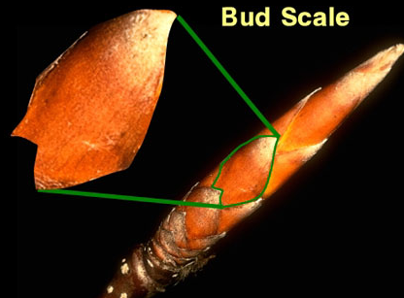
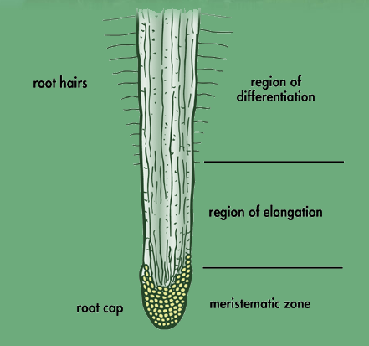
Tree Anatomy
Apical Meristems
Notes:
Meristems located at the ends of shoots and roots are called apical meristems. In shoots they are found inside the buds. In shoots they are found inside buds. The overlapping scales or modified leaves of buds protect both the meristematic region and the newly developed shoot.
In roots, the meristem is protected by the root cap.

Slide 6
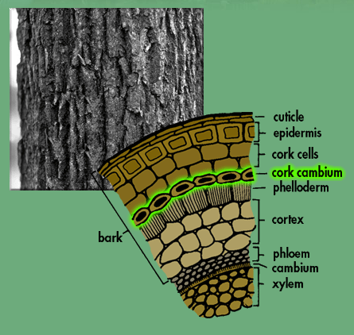
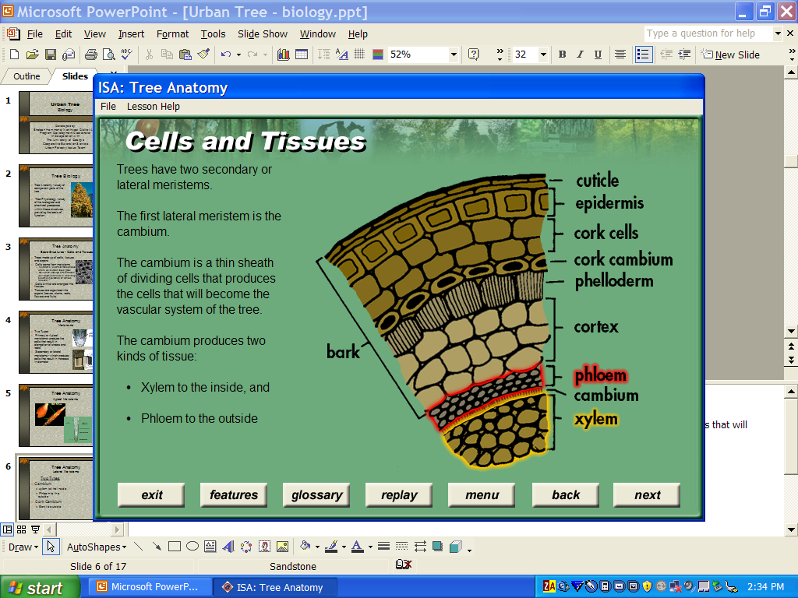
Tree Anatomy
Lateral Meristems
Two Types
Cambium
  xylem to the inside
  Phloem to the outside
Cork Cambium
  Bark to outside
Notes:
Trees have tow lateral meristems.
The first lateral meristem is called the cambium. The cambium is a this, continuous sheath of dividing cells that produces the cells that will become the vascular system of the tree. It produces two kinds of tissue:
Xylem to the inside
Pholem to the outside

Slide 7
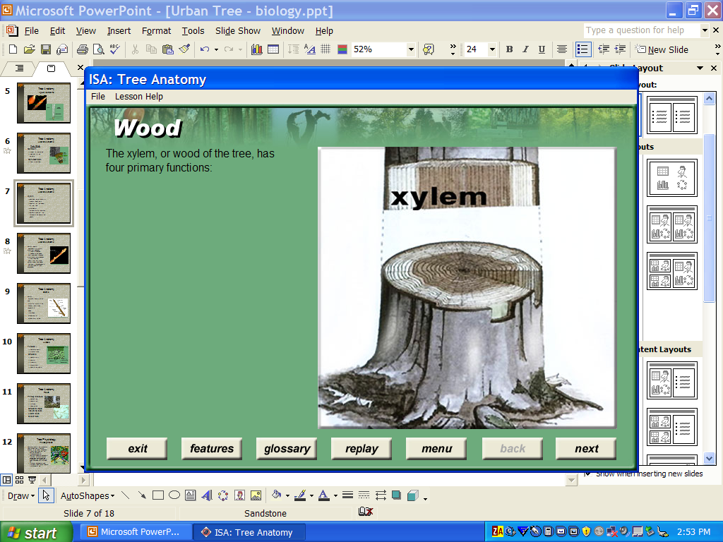
Tree Anatomy
Xylem
Conduction of water & mineral elements
Support of the weight of the tree
Storage of carbohydrate reserves
Defense against the spread of disease and decay
Notes:
The xylem is the wood of the tree, composed of dead and living cells. It has four functions:
Conduction of water and mineral elements
Support of the weight of the tree
Storage of carbohydrate reserves
Defense against the spread of disease and decay

Slide 8
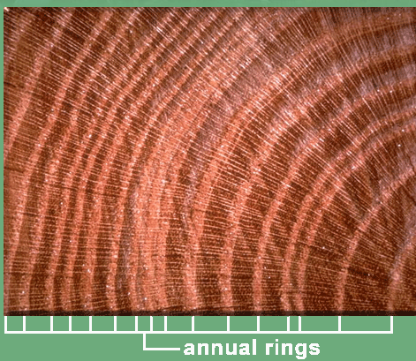
Tree Anatomy
Xylem
Terms
  Growth Rings
    Earlywood
    Latewood
  Sapwood
  Heartwood
Notes:
When a tree has been cut, and can be viewd in cross section, growth rings are visible in the xylem. These rings are the annual production of xylem by the cambium. They are seen as rings because the relative size and density of the vascular tissues change throughout the growing season. As the season progresses, cells become smaller in diameter. A contrast is formed between earlywood (larger cells) and latewood (smaller cells) allowing the diameter increase within an individual year to be seen.
Not all of the conducting elements in the xylem transoport water. In conifers, 8-12 rings may actually conduct water. In trees like elm, only the outermost 1-2 rings do so. Xylem which transports water is called sapwood, non-conducting tissue farther inside the tree is called heartwood.

Slide 9
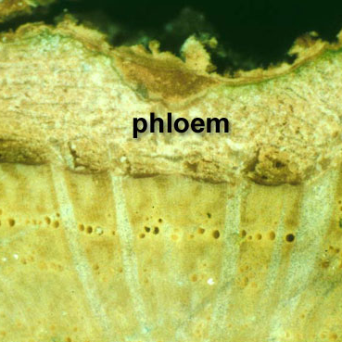
Tree Anatomy
Phloem
Responsible for the movement of sugars, produced in the leaves
Process is slow
Requires energy
Composed of sieve tubes
Incorporated into bark
Notes:
The phloem is responsible for the movement of sugars, produced in the leaves, to other plant parts. The phloem carries sugar to the roots, but also throughout the plant for storage or consumption.
Movement of sugars in the phloem is slow and occurs across pressure gradients.
Also phloem transport requires energy to drive the process.
Unlike the hollow vessel elements of the xylem, the phloem is composed primarily of living cells. These can be sieve cells in conifers and sieve tube elements and companion cells in hardwoods.
And unlike old nonfunctioning xylem, which constitutes the wood of the tree and contributes ot diameter increase, old phloem becomes crushed and may be reabsorbed into the tree or incorporated into the bark.

Slide 10
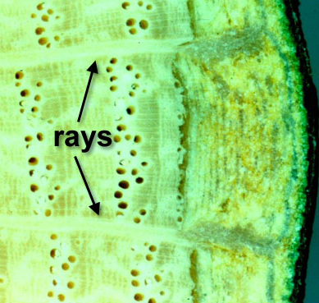
Tree Anatomy
Rays
Transport sugars and other compounds throughout the trunk
Store starch
Aid in restricting decay in wood tissue
Notes:
In addition to the xylem and phloem, the vascular system of the tree also contains ray cells. Ray cells grow in small layers known as rays that cross through several years of phloem and xylem. They function to transport sugars and other compounds through the trunk, store starches and assist in restricting decay in wood tissue.

Slide 11
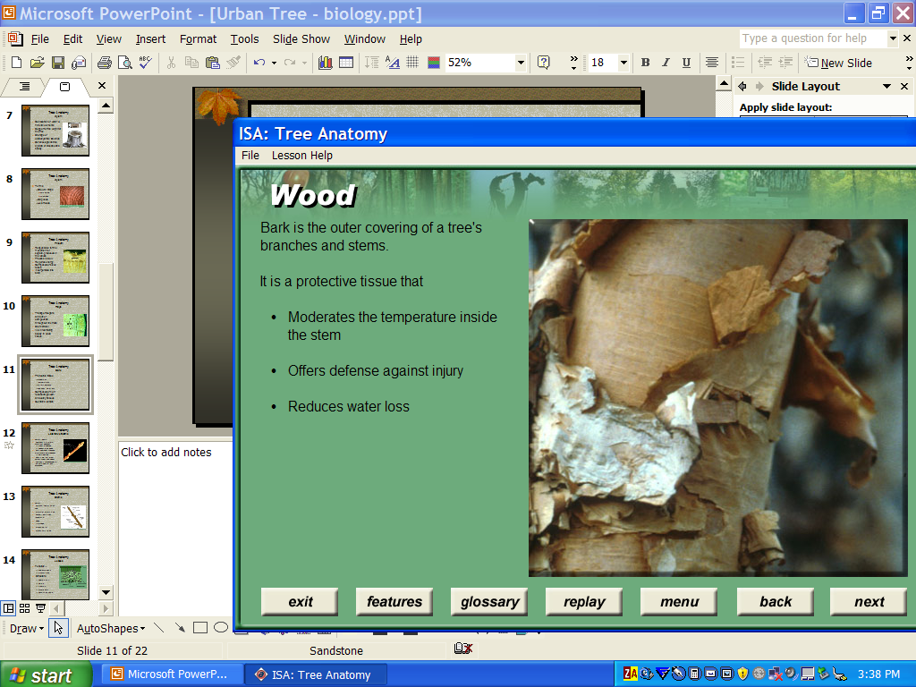
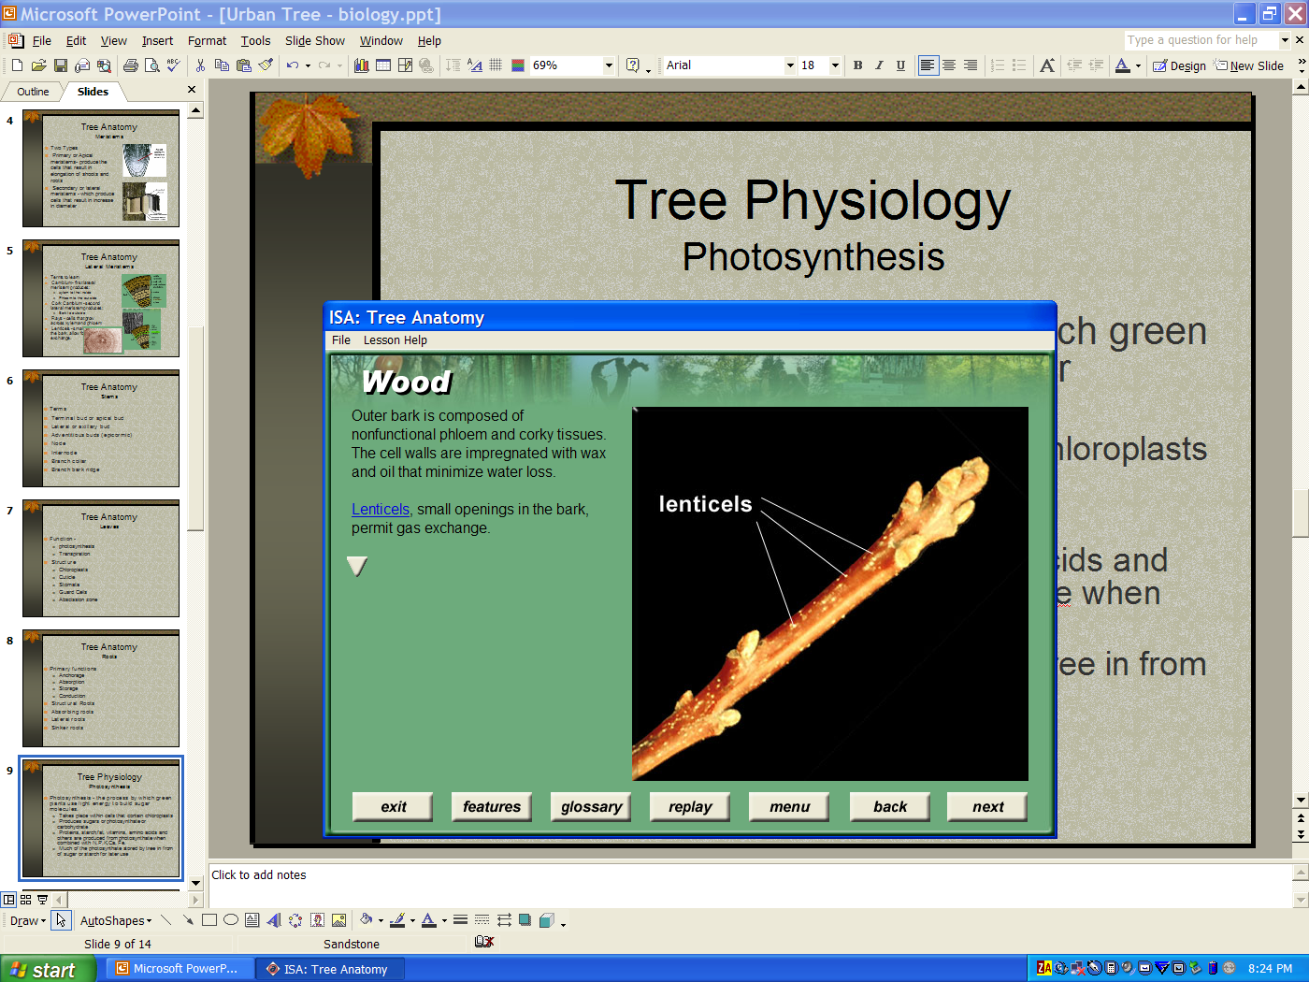
Tree Anatomy
Bark
Protective tissue
  Moderates temperatures
  Offers defense
  Reduces water loss
Composed of non-functional phloem and corky tissues
Contains lenticels
Notes:
The outer covering of a tree’s branches and stems is the bark. It is a protective tissue that moderates temperatures inside the stem, offers defense against injury, and reduces water loss. Outer bark is composed of non-functioning phloem and corky tissues. The cell walls are impregnated with wax and oil that minimizes water loss. Lenticels, small openings in the bark, allow for gas exchange. Many types of bark develop in trees from smooth to furrowed to corky.

Slide 12
Tree Anatomy
Structure
Basic tree structure
  Stems
  Leaves
  Roots

Slide 13
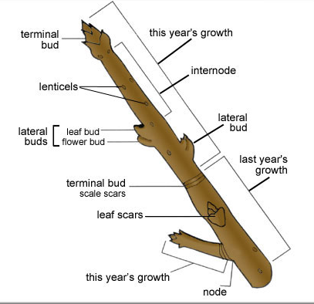
Tree Anatomy
Stems
Twigs, braches, trunk
Twigs
  Terminal bud or apical bud
  Lateral or axillary bud
  Adventitious buds (epicormic)
  Node
  Internode
Notes:
Stems can be broken down into three types: twigs, branches and the trunk. Twigs are small stems that provide support structure for leaves, flowers and fruit. Branches support twigs, and the trunk supports the entire crown.
Buds can occur along the twig, at the base of each leaf, just underneath the bark, or at the tip of each twig. The bud located at the end of a shoot is called the terminal or apical bud. The buds that occur along the stem are called lateral or axillary buds. Normally, the terminal bud is the most active on each branch or twig. Axillary, or lateral buds are often dormant. Their growth may be inhibited by the apical dominance of the terminal bud. That is, the terminal bud inhibits the growth and development of the laterals in the same shoot. Removing the terminal bud in pruning can release dormant buds near the cut, leading to new shoot development.
Adventitious buds are produced along stems or roots where primary meristems are not normally found. They are usually produced in response to the loss of normal buds and the growth regulators they produce. Dormant buds are suppressed beneath the bark until such time as growth is triggered. When adventitious or dormant buds elongate and produce shoots, these shoots are termed epicormic.
A node is a slightly enlarged portion of the twig where leaves and buds arise. The internode is the area between the nodes.

Slide 14
Tree Anatomy
Stems
Branches & Trunk
  similar in structure and function but autonomous
  Each branch self sustaining
  Attachment terms
    Branch collar
    Branch bark ridge
    Included bark
Notes:
Each branch of the tree is similar in structure and function to the entire tree crown. Yet branches are not simply outgrowth of the trunk. Each branch of the tree is autonomous, producing and storing enough carbohydrates to sustain itself and exporting some to the trunk and the roots. Branches normally do not import sugars from other parts of the tree.
Branches and trunks have a unique attachment from, which is critical to the application of arboricultural practices such as pruning. Branches are strongly attached to the wood and bark beneath the branch but weakly attached to the wood and bark above the branch.
The annual production of layers of tissue at the junction of the branch to the stem is apparent, forming a shoulder or bulge around the branch base called the branch collar. In the crotch, the branch and trunk expand against each other. As a result the bark is pushed up forming the branch bark ridge.
If bark in the crotch is surrounded by wood, it is called included bark. Included bark weakens the crotch since the normal branch to trunk attachment is not formed.

Slide 15
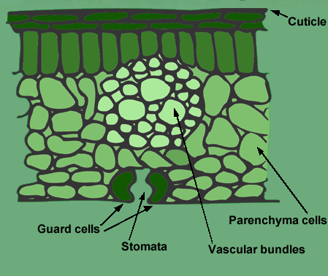
Tree Anatomy
Leaves
Function -
  photosynthesis
  Transpiration
Structure
  Chloroplasts
  Cuticle
  Stomata
  Guard Cells
  Abscission zone
Notes:
Leaves have two main functions. The first and foremost function is photosynthesis. Through photosynthesis leaves become the food producers of the tree. Photosynthesis takes place inside the leave inside cells called chloroplasts.
The second rolew od leaves is transpiration. Transpiration is the loss of water through the foliage in the form of water vapor. The structure of leaves is uniquely adapted to carry out the roles of photosynthesis and transpiration.
The outer surface of the leaf is covered by a waxy layer called the cuticle. The cuticle functions to minimize dessication of the leaf. Stomata, small openings in the leaf surface, control the loss of water vapor and the exchange of gases. Guard cells regulate the opening and closing of the stomata in response to environmental stimuli such as light, temperature and humidity.
Decidious trees generally lose their leaves in the fall. Leaf drop is caused by cell changes and growth regulators that combine to form an abscission zone at the base of the leaf stalk or petiole. The abscission zone has two functions: 1) To enable leaf drop in the fall, 2) to protect the region of the stem from which the leaf has fallen against dessication, insect or disease damage.

Slide 16
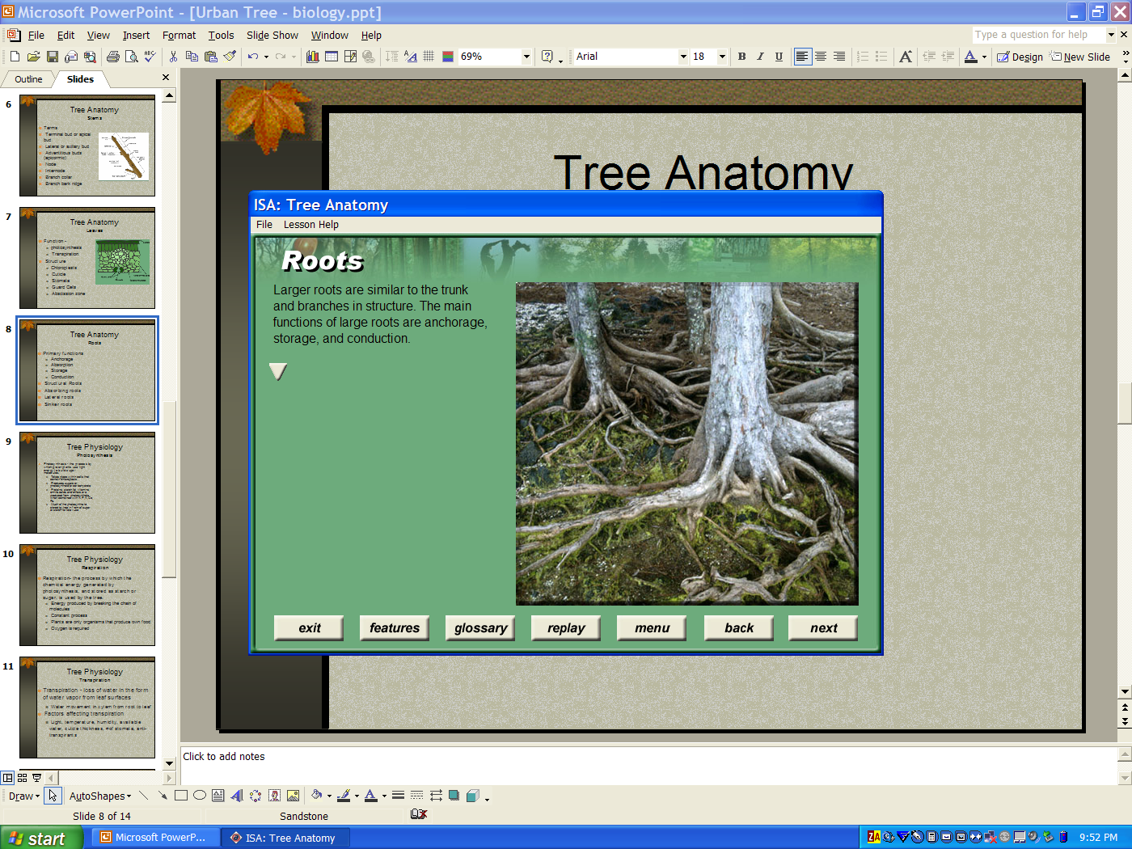
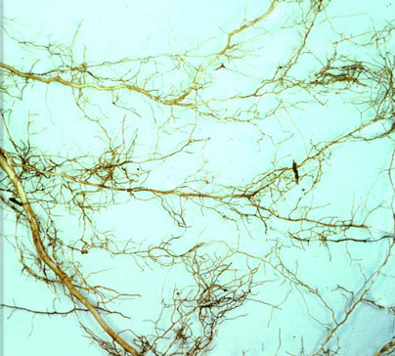
Tree Anatomy
Roots
Primary functions
  Anchorage
  Absorption
  Storage
  Conduction
Structural Roots
Absorbing roots
Lateral roots
Sinker roots
Notes:
The roots of the trees serve four primary functions: anchorage, storage, absorption and conduction. Structural roots are larger roots and are similar to the trunk and branches in structure. The main function of large roots are anchorage and conduction. Absorption roots are the small fibrous, primary tissues that grow at the ends of the main, woody roots. The absorbing roots have epidermal cells that are modified into root hairs, which aid in the uptake of water and minerals. As with shoot tips, root tips and contain a meristematic zone, where the calls divide and grow in length.
Roots grow where moisture and oxygen are available. Most absorbing roots are found in the upper 12 inches of soil. Horizontal, lateral roots are usually near the soil surface. Sinker roots grow vertically downward off the lateral roots, providing anchorage and increasing the depth of soil exploited by the root system. These sinkers are usually found within a few feet of the trunk.
Root of trees may extend laterally for considerable distances, depending upon the plant and soil conditions. Roots of trees grown in the open often extend 2 to 5 times the height of the tree.

Slide 17
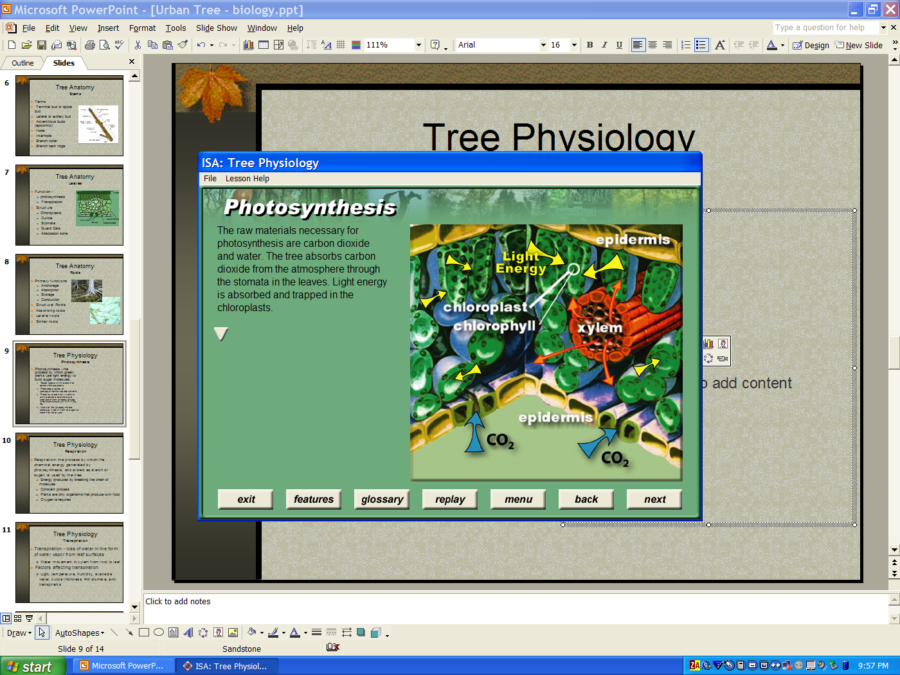
Tree Physiology
Photosynthesis
Photosynthesis - the process by which green plants use light energy to build sugar molecules.
  Takes place within cells that contain chloroplasts
  Produces sugars or photosynthate or carbohydrate
  Proteins, starch,fat, vitamins, amino acids and others are produced from photosynthate when combined with N,P,K,Ca, Fe.
  Much of the photosynthate stored by tree in from of sugar or starch for later use
Notes:
The first of three physiological process in trees is photosynthesis. Photosynthesis is the process by which green plants use light energy to build sugar molecules. Literally, photosynthesis means “putting together with light”.
Photosynthesis takes place within cells that contain chloroplasts. Chloroplasts contain molecules of the light absorbing pigment, chlorophyll. The raw materials necessary for photosynthesis are carbon dioxide and water. The tree absorbs carbon dioxide from thr atmosphere through stomata in the leaves. Light energy is absorbed and trapped in the chloroplasts. The light energy is converted to chemical energy and stored in the form of sugars and starches called photosynthate or carbohydrates.
Photosynthates are building blocks for may other compounds required by the plant. Proteins, starch, fat, vitamins, amino acids and other important compounds are produced from photosynthate when combined with other elements such as nitrogen, potassium, sulfur and iron.
Much of the photosynthate is stored by the tree in the from of sugar or starch for later energy requiements.

Slide 18
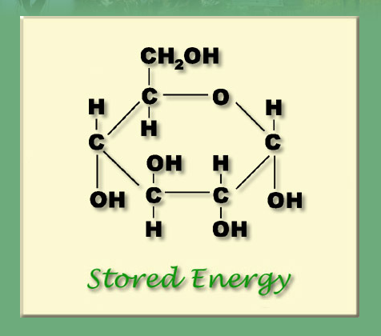
Tree Physiology
Respiration
Respiration- the process by which the chemical energy generated by photosynthesis, and stored as starch or sugar, is used by the tree.
  Energy produced by breaking the chain of molecules
  Constant process
  Plants are only organisms that produce own food
  Oxygen is required
Notes:
Respiration is the process by which the chemical energy generated by photosynthesis, and stored as starch or sugar, is used by the tree. Sugars and starches are actually chains of carbon, hydrogen and oxygen molecules chemically bonded together. When the bonds are broken, energy is released, and carbon dioxide and water are given off. The energy released is used by the tree for biological functions.
Respirations is a constant process of converting food into energy. Only plants produce their own food, however. Thus it is important that the overall photosynthesis exceeds respiration. When respiration takes place in the absence of photosynthesis, the tree must rely on stored energy reserves. If this happens over a extended period of time, the tree will eventually run out of energy and die.
Oxygen is required for normal aerobic respiration. Trees are not capable of respiration in the absence of free oxygen. Under flooded conditions or with soil compaction, oxygen is scarce and respiration can not be completed.

Slide 19
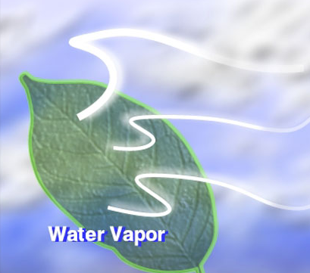
Tree Physiology
Transpiration
Transpiration - loss of water in the form of water vapor from leaf surfaces
  Water movement in xylem from root to leaf
Factors affecting transpiration
  Light, temperature, humidity, available water, cuticle thickness, #of stomata, antitranspirants
Notes:
Transpiration is the loss of water in the form of water vapor from the leaf surfaces. The evaporation of water cools the leaves and creates a “transpirational pull” that moves water up through the xylem from the roots to the leaves.
The rate of transpiration is affected by temperature, humidity and available water. Transpiration is also affected by anatomical features such as cuticle thickness, the presence of hairs on the leaf surface, and the number and location of stomata. Arborists sometimes use antitranspirants to artificially close stomata thus reducing water loss during transplanting or during a drought. However the use of these materials reduces evaporative cooling of leaves and can reduce the rate of photosynthesis.

Slide 20
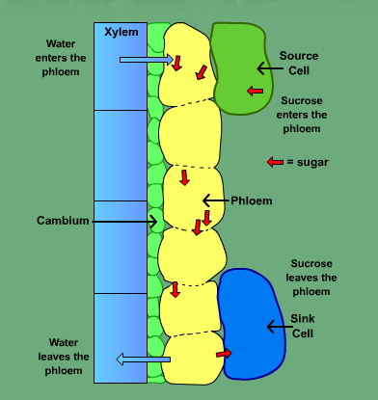
Tree Physiology
Absorption, Translocation, and the Vascular System
Terms
  Osmosis - movement of water from higher concentration to lower concentration
  Phloem transport
  Source and sink
  Longitudinal and axial transport
Notes:
Water enters the roots by a process called osmosis. Osmosis is the movement of water through a membrane from a region of high potential water concentration to a region with lower concentration. Water will normally move into roots where the water potentially is lower than in the surrounding soil.
Phloem transport is the movement of photosynthate and other compounds in the phloem. The phloem is composed of sieve cells and companion cells. The carbohydrate products of photosynthesis are actively pumped through the phloem, a process that requires energy.
In discussing phloem transport the terms source an sink are often used. Leaves are the source of photosynthate. The photosynthate moves through the phloem in a direction from source to sink, from areas high in sugar concentration, to areas where more is required. Sinks are plant parts that utilize more energy than they produce. Almost all plant parts are sinks at some time including young leaves.
The movement of water in the xylem and photosynthate in the phloem are examples of longitudinal or axial transport. Radial transport is the horizontal movement of water and nutrients within the tree between cells of different ages, mostly through ray cells.

Slide 21
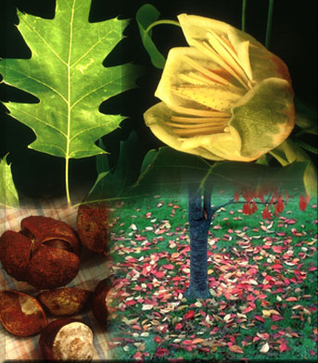
Tree Physiology
Other terms and functions
Hormones
  Auxins, gibberellins, cytokinins, ethylene and abscissic acid
  Control such things as cell division, cell elongation, fruit ripening, leaf drop and root development
Notes:
The coordination of processes in trees is controlled in part by plant growth substances or hormones. Plant hormones are naturally occurring compounds which act in small qualities to regulate plant growth and development. The major hormone groups include auxins, gibberellins, cytokinins, ethylene and abscissic acid. Hormones control such things as cell division, cell elongation, fruit ripening, leaf drop and root development.

Slide 22
Credits
Pictures and diagrams
  Introduction to Arboriculture – Tree Biology CD-ROM; International Society of Arboriculture, 2003.

Slide 23
Acknowledgements
This publication/training was funded in full or in part by the USDA Forest Service Urban and Community Forestry Program as recommended by the National Urban and Community Forestry Advisory Council (NUCFAC).

