Slide 1
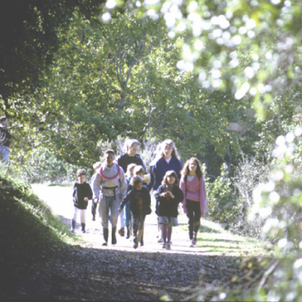
Urban Tree Appraisal
  Concepts and applications used to derive specific dollar values for urban and community trees
Bill Hubbard
Southern Regional Extension Forester

Slide 2
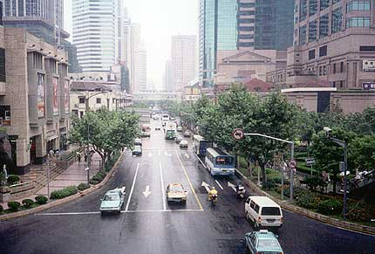
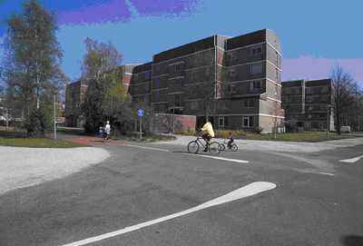
Trees have value
Architectural
Engineering
Environmental
Timber
Fruit and nut production
Wildlife habitat
Recreational
Others (carbon storage, etc.)

Slide 3
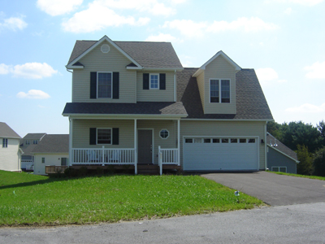
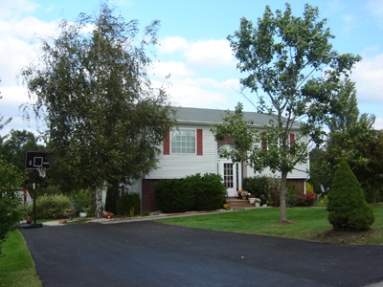
Trees:
Enhance property values
Increase a city’s asset value
Reduce heating and cooling requirements
Enhance human sociability

Slide 4
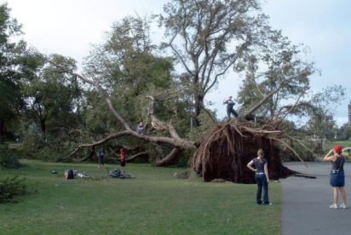
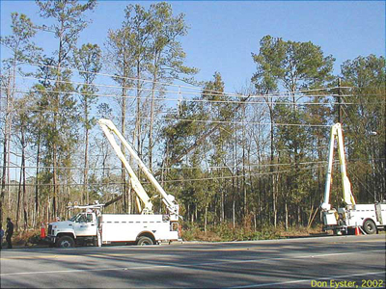
But.......
  Why do we need to quantify these values?
Settlement for damage or death of trees
Insurance claims or direct payment
Loss of property value for income tax deductions
Agency budget justification
Condemnation proceedings
Sale of nursery property
Establish values in case of damage/destruction
Personal satisfaction
Promotion of urban forestry program/tree care

Slide 5
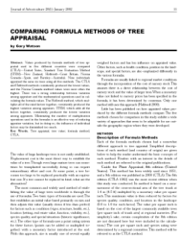
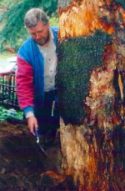
Valuation vs. Appraisal
Valuation: Determining appropriate concepts and methodologies for estimating the values of trees.
Appraisal: The application of these concepts and methods to make a specific estimate of the value of a particular item to a particular individual at a point in time.

Slide 6
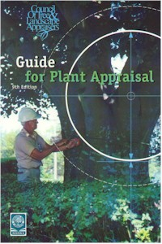
Methods of Appraisal
Replacement cost
Trunk formula
Compounded replacement cost
Linear trunk measurement of palms
Cost of repair
Cost of cure
Crop value
Forest appraisal
Felt-Spicer
Amenity tree valuation

Slide 7
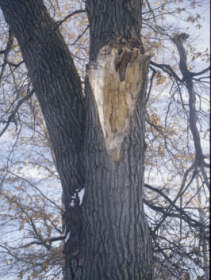
Appraisal procedures and diagnostic tools
A systematic procedure is essential
Need to examine:
  The Canopy
  Trunk
  And Roots
Need to determine presence of insects, disease, deadwood and decay
Need to investigate history of the tree (photos, discussion with neighbors)
Need proper equipment
Need to keep accurate field records
Need to maintain objectivity

Slide 8
Factors in appraisal
These are most commonly used to determine the trunk formula which we will concentrate on from here out.
  Four primary factors that determine the value of landscape trees are:
Size
Species
Condition
Location

Slide 9
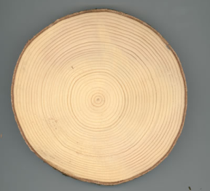
TREE SIZE
  Expressed by the dimension of its above-ground parts
For valuation purposes, size is expressed by trunk area as determined from trunk diameter or circumference (cross-sectional area)
Assumed to be a circle for valuation purposes.
Area of a circle:
. πr² = 3.14r²
. = π((d²)/(2²)) = 0.785d²
. = π(c)²/(2×π)² = 0.080c²
. Where r = radius, d=diameter, and c=circumference
Use this for trunk diameters less than 30 inches

Slide 10
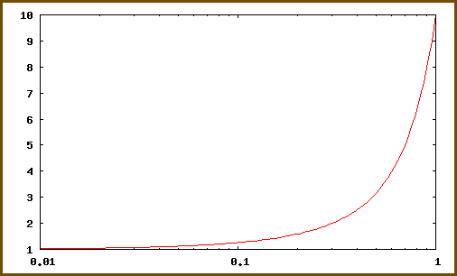
TREE SIZE
  When diameters are greater than 30 inches use an adjusted trunk area formula to bring size more closely in line with value
= -0.335d² + 69.3d - 1087
= -0.0333c² + 221.c - 1087

Slide 11
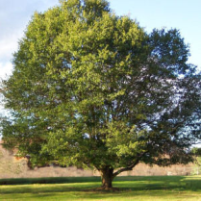
Some examples:
  What is the size of a 14" live oak (Quercus virginiana)
  Area = 0.785(14)² = 153.86 square inches
What is the size of a 35" laurel oak (Quercus laurifolia)
Area = -0.335(35)² + 69.3(35) - 1087 = 928.13 square inches
(Vs. 961.63 “actual” square inches)

Slide 12
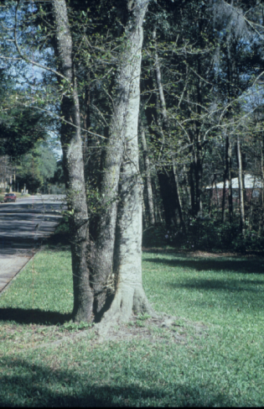
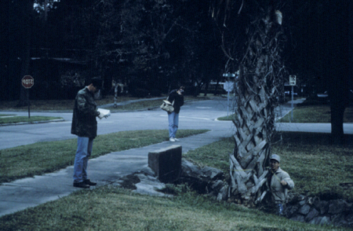
Other size factors to consider
Elliptical Cross Sections: (0.785 × largest d × smallest d)
Bark thickness (may want to reduce based on bark thickness
Leaning trees, trees on slopes
Low branching, multi-stems, excessive trunk flare & trees cut off below 4.5 feet

Slide 13
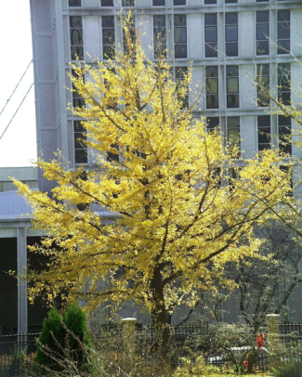
SPECIES
  Some species are more desirable than others:
Aesthetics
Climatic and soil tolerance
Resistance to insects and diseases
Growth characteristics
Maintenance requirements
Allergenic properties

Slide 14
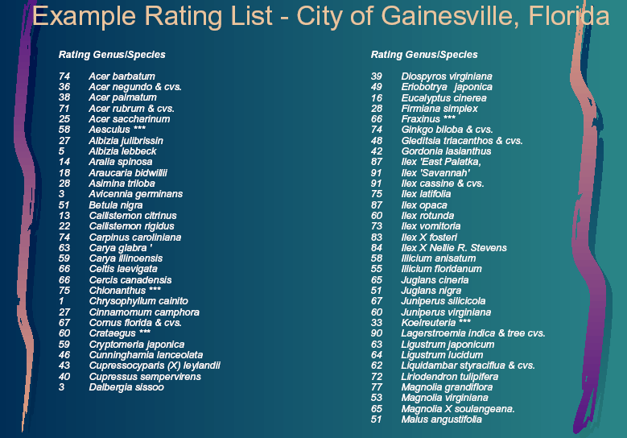

Slide 15
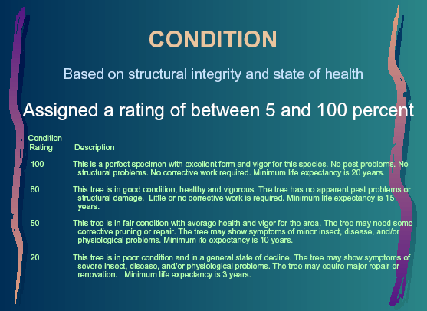

Slide 16
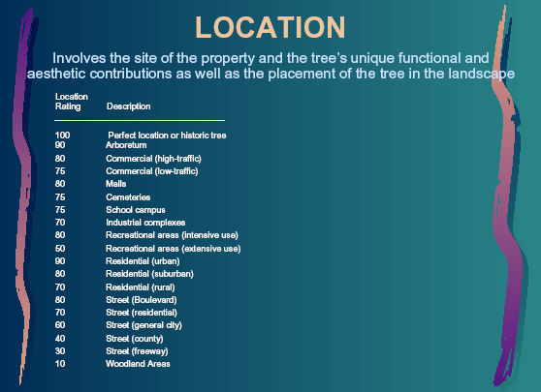

Slide 17
The Trunk Formula Method
  Old method: (Base Price per square inch) x (square inches) x (species rating) x (condition rating) x (location rating)
The size equals 0.785(15)² = 176.6 square inches
The unadjusted value = $4,768.9
The species rating = .55
The location rating = .80
The condition rating = .50
The adjusted value = $4,768.9 x .55 x .80 x .50 = $1,049

Slide 18
The new method:
  Takes into account local prices of largest available transplantable trees and their replacement costs:
Determine replacement cost: $750.00
Determine the basic price per square inch:
  $550.00/28.26 = $19.46 (.785 x 6 x 6 = 28.26)
Determine the difference in trunk areas between replacement tree and original tree
  176 - 28.26 = 148.4 sq. In.
Multiply base price by difference $19.46 x 148.4 = $2,887.2
Adjust for species rating (.55) $1,587.9
Basic value $750 + 1,587.9 = $2,337
.Adjust for condition (.50) $1,168.9
Adjust for location (.80) $935.16 (appraised value)

Slide 19
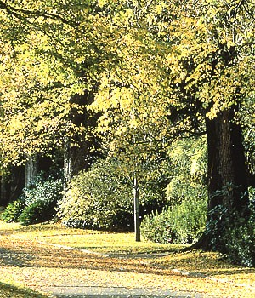
Conclusions
Urban tree appraisal is a difficult assignment
Urban tree appraisal is both an art and science
Professional expertise should be sought
The ultimate value is basically determined by what holds up legally (in court, with the IRS, etc).

Slide 20
Acknowledgements
This publication/training was funded in full or in part by the USDA Forest Service Urban and Community Forestry Program as recommended by the National Urban and Community Forestry Advisory Council (NUCFAC).

