Slide 1
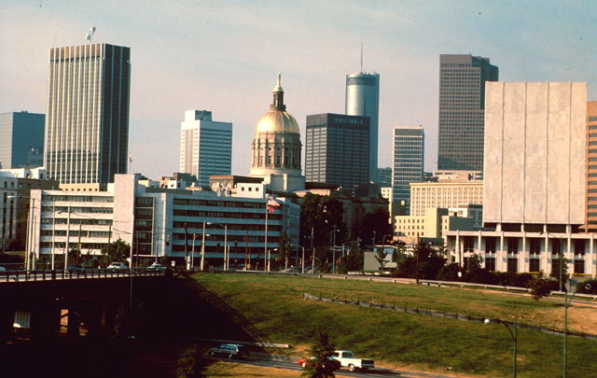
Why do we need to change the way we deliver agricultural and environmental education to urban Georgia?

Slide 2
Georgia’s Horticulture & Turfgrass Industry
Landscape
(Installation & Maintenance)
$3,644,000,000
Golf Courses
and Related Businesses
$2,690,000,000
Retail Garden
Centers
$510,000,000
Floriculture
$413,000,000
Landscape
Architects
$340,000,000
Nursery Farm Gate
$278,000,000
Re-Wholesalers
$105,000,000
Turfgrass Farm Gate
$141,000,000
$8.12 Billion
7,000 Firms
80,000 Employees

Slide 3
Georgia is Growing – But How?
From 2000 to 2005 – population in incorporated areas grew 12.8 % while unincorporated population grew 7.9 %
Metropolitan Areas (MSAs) grew 12.3 % from 6,526,852 to 7,328,309
Total GA population in 2005 (est.) was 8,186,816. 89 % of the population lived in one of the MSAs
Source – The Georgia County Guide

Slide 4
Population is Shifting
Rural Urban
1990 36.8 % 63.2 %
2000 28.3 % 71.7 %
Source – The Georgia County Guide

Slide 5
CAES must be as relevant to the Urban population as it is to the Rural population
We are not just dealing with a population shift! We are dealing with a generational shift!

Slide 6
Our Future Students
http://nkilkenny.wordpress.com/2006/08/30/generational-learning-styles-and-methods/

Slide 7
Understanding the New Student
Computers are not technology – they are a way of life
Internet is better than TV – interactive!
“Reality is not real”
Doing is better than knowing
Learning is more like Nintendo
Multi-tasking is a way of life
Gotta’ stay connected!
Zero tolerance for delays
http://www.educause.edu/ir/library/pdf/erm0342.pdf

Slide 8
Change Teaching Styles for CAES Extension Urban (Future) Learners
Will we make them learn where we want to teach or teach where they want to learn?
Will we teach the way we want them to learn or let them learn the way they want to be taught?
In other words – will we change so as to impact the next generation?

Slide 9
Teaching the Way They Want to Learn!
Feed me the information!
Let me have it when I want it!
Let me have it the way I want it!
Interactive
  (Blogs, Discussions, Wikipedia)

Slide 10
New Clients, New Delivery System
Information delivery 24/7 in the format that works best for them!
traditional media (TV, radio, newspaper)
web or e-newsletter
pod-cast
streaming video
online class
paper copy
or whatever new technology that becomes useful to teaching!

Slide 11
”It is not necessary to change. Survival is not mandatory.”
- W. Edwards Deming

Slide 12

Associations
Current Opportunities
Associations
Colleges and Universities
Colleges and Universities
Govt. Agencies
Govt. Agencies
UGA Extension
Urban Agriculture
Delivery
Agents & Specialists
Agents & Specialists
UGA Media
Sharing
Info.
Collaborative Education
UGA Media
Research & Teaching Faculty
Research & Teaching Faculty
Industry Leaders
Industry Leaders

Slide 13
Capstone article written by a state agency or association eg.
See the New State Water Plan to be Voted on in 2008! - Mary Kay Woodworth, MALTA
Regional Update
(Written by a County Agent eg.)
Chinch Bugs Take Over Central Georgia - Sid Mullis
or
New North Georgia Landscape Association Begins - Billy Skaggs
Industry Update
(Industry specific & written by specialists
or researchers eg.)
New E&SC Rules Affect Landscape
Industry - Dr. Rose Mary Seymour
Research Update!
Finding Pest Resistant Shrubs - Kris Braman
Other Contributions
From other & new partners
Current Topics Podcast
Readers subscribe based upon their specific area of Georgia (north, south, coastal) and their industry (landscape, green house, nursery, golf course, garden center). The newsletter would be tailored to their area and industry.

Slide 14
Get UGA supported gardening information delivered to your computer!
Click on the newsletter closest to your area!
North Georgia - In The Roman Garden from Floyd County Extension
Gardening with the Masters from Cherokee County Master Gardeners
The Paulding Vine published by Paulding County Master Gardeners
The New Leaf published by the Coweta County Master Gardeners
Dibble produced by Cobb County Master Gardeners
Central Georgia – The Garden Bench, published bimonthly in English & Spanish from the Houston County Master Gardeners
South Georgia - Horticulture Depot produced monthly by Dougherty County Extension
Coastal Georgia - Coastal Homeowner Landscape & Turf Update edited by David Linville, Chatham County Extension Agent
All Georgia Gardeners - subscribe to Walter Reeve’s gardening newsletter The Georgia Gardener

Slide 15
Feeding the Commercial Landscape Industry
The Landscape Line, quarterly online newsletter, statewide
Commercial Horticulture Update – Jeff Webb, Coastal Gardens, Savannah
Muscogee Green Industry – Jennifer Davidson, Columbus
West Georgia Green Industry News – Paulding County Extension
The Landscape Alert, central Georgia as needed email updates

Slide 16
Other UGA Extension Newsletters
Georgians need to know about!
Forage Notes – Dennis Hancock
Pecan Newsletter – Dr. Lenny Wells
Homeowner IPM News – Holly Thornton
Georgia Pest Management Newsletter
Bodie Pennisi, Bob Westerfield, Gary Wade, Steven Patrick

Slide 17
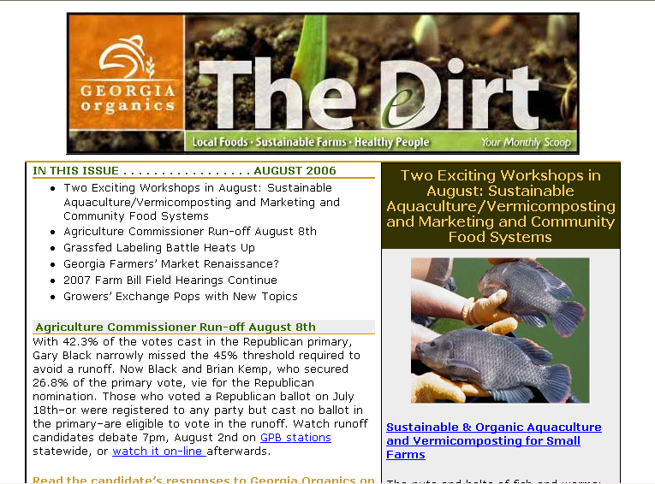
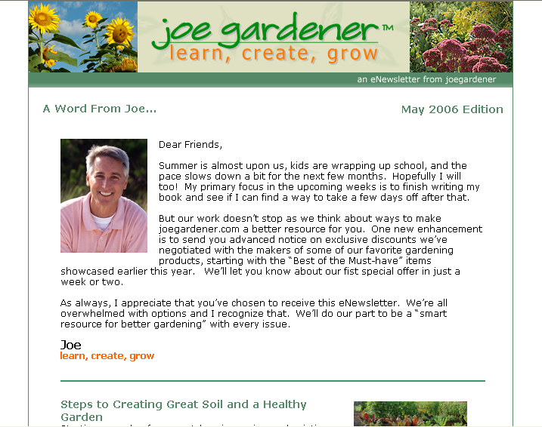
Other Urban Ag Info Sources

Slide 18
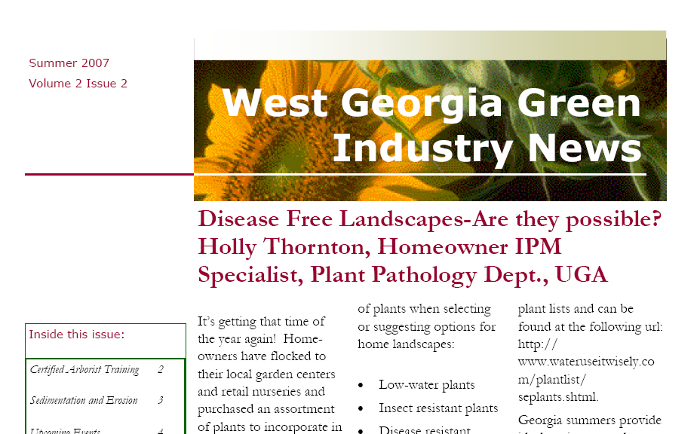
What do we have to offer ?

Slide 19
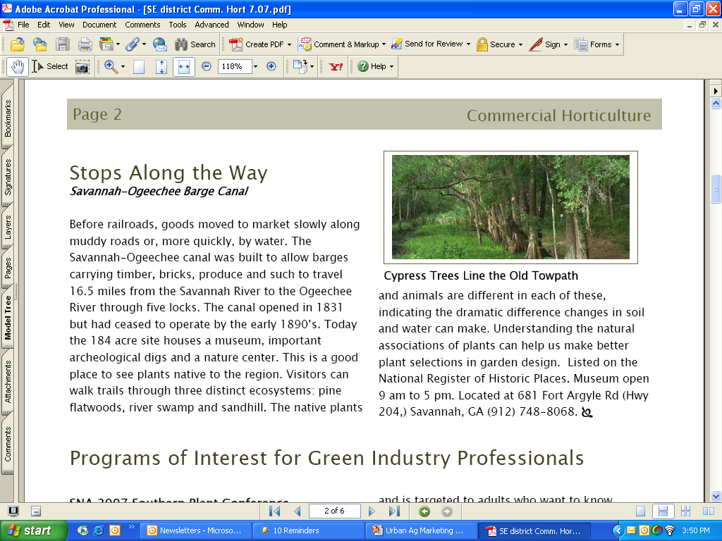

Slide 20
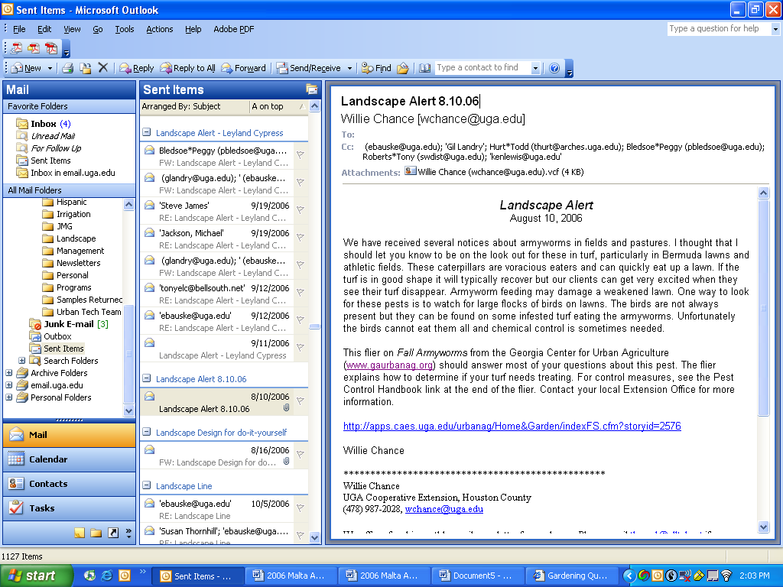
Is There a Need?
“Thank you so much for the e-mails - they are very informative and helpful. The recent ones on army worms came in very handy.”

Slide 21
Impact?
Thanks for this one. I am seeing alot of St. Augustine lawns starting to look bad with the onset of 90 degree plus temperatures and late afternoon showers. Keep on e-mailing me the alerts. I am doing alot of maintenance and need your help.
Mark G. Callahan, Callahan Enterprises, Inc., Hazlehurst, GA 31539

Slide 22
More impact!
This is EXCELLENT information! It is very relevant to the green industry, and I agree with your timing on this. I’m forwarding this to my branches and our other Region Technical Managers, as I’m sure we aren’t the only ones affected. Thanks for this type of support!
Mike Jackson, Region Technical Manager, Southeast Region TruGreen ChemLawn, TruGreen LandCare, Roswell, Ga. 30076
Notes:
Feel like I am feeding a tree chipper. They are sucking the information in! These are nothing but urban farmers!

Slide 23
A plea for help from GTA!
Christy Page - Association Administrator, Georgia Turfgrass Association
“. . . the following topics were suggested by the GTA Board of Directors as article of interest for this time of year:”
Army worms – May/June and/or July/August
Warm season turf aeration – May/June
GCLP – Any time
How to contact your County Extension Agent – any time
How do you get your county agent involved with the homeowner; services provided by county agents, communications offered by county agents – any time
Soil testing – why, how, etc. – May/June or September/October
Any safety articles involving industry – any time, Pesticide safety – anytime
Water saving tips – summer issues

Slide 24
“Don’t let slip an opportunity; it may never come again.”
- Chinese Proverb

Slide 25
GGIA’s BHAG
“Our commitment is to position GGIA as the primary source to which our industry members, legislators, and consumers can turn for information and guidance in every aspect of life that involves horticulture.”

Slide 26
Other Possible Projects
Coordinate CAES faculty to make media appearances—particularly television. Highlight Extension information, programs, the new teaching programs or selected research projects.
Prepare a slick, colorful urban ag impact calendar for policy makers
Engaging urban agents in research projects, grants, etc. with specialists and researchers.
Develop agent skills in using information technology. Form partnerships (EITS, ETTC) to use information technology to educate more efficiently.
Position Extension as an informational resource with professional assocaitions and governmental agencies. Then use this position to collaborate on projects.
Recovering publications lost due to loss of specialists.

Slide 27
Not just communication – Information packaging and delivery
We need to hire a person to . . .
Coordinate CAES teams to better use information delivery
Bringing new technologies to bear on existing successful programs
Facilitating faculty training in information delivery methods
Help to create and cast a vision for what a new urban ag delivery model could do

Slide 28
Mission and Vision
Mission To be the ANR information source for the urban area (for these new learners)
Vision
One article on Brown Widow spiders
  FACES and Georgia Net > Media
  Listservs > Journals
  Podcast > Television media
  Farmer’s & Consumer’s Market Bulletin
  TGCL – 160,000 customers
  Research project > Agents > Posters etc.

Slide 29
Summary
Urban ANR programming is great, but often limited in distribution.
We must package and deliver Extension information so that anyone, at any time can get & use UGA information in the format that works best for them.
Many CAES educators do not have the time or do not perceive that it is worth the time to package and deliver our material in an urban-efficient manner.
We have a phenomenal opportunity now to partner with a rapidly growing industry. This opportunity may not always be here.
We need to hire a person to help us to move forward efficiently in urban ANR education.
This Urban Ag Delivery system can become a conduit for UGA information into the homes, businesses and lives of our urban ag industry and users. It may become a template for FCS & 4-H.

Slide 30
Examples

