Slide 1
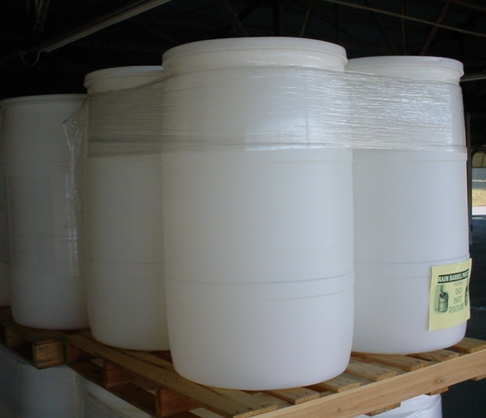
Turning Recycled Barrels
Into Rainbarrels

Slide 2
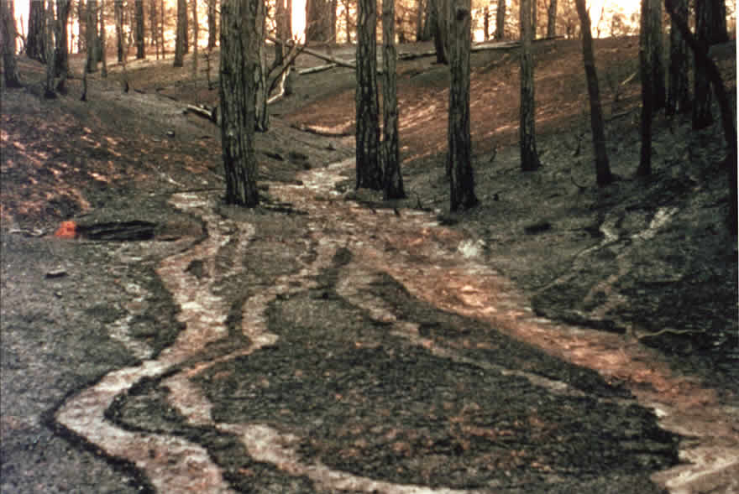
Purpose of a Rainbarrel
Captures water from impervious roof area
Reduce runoff leaving landscape to become stormwater
Reduce household water use

Slide 3
Notes:
PROJECTED WATER DEMAND IN NE Georgia. Increasing water demand is not limited to large urban counties. All counties in Georgia project an increasing demand for water in the years ahead. This graph shows the projected demand for water in Barrow, Clarke, Jackson and Oconee counties in the years 2000, 2020 and 2050. This increasing demand parallels projected increases in population and industrial development.

Slide 4
Rain Facts
The price of water + sewer in Athens-Clarke County
is $5.06/1000 gal.
Since a 1” rainfall = 624 gal./1000 sq. ft., it takes
1,603 sq. ft. of roof area to produce 1,000 gal. water
from a 1” rain (an area 40’ x 40’)
A one inch rain on 1,000 sq. ft. roof
would fill over 11 rainbarrels
One rainbarrel holds 55 gal. of water, with
a value of $0.28
One tenth of an inch of rain on a 1,000 sq. ft. roof
is more than enough to fill a rainbarrel
Notes:
It is probably a good idea to figure out what to do with excess water that ranbarrels will not hold

Slide 5
How much Rainwater can you collect?
Figure out the size of the area that will have runoff going to the rain garden
For a house, draw a footprint
Break whole roof into areas going to each gutter
Figure areas for each gutter
Each Rainbarrel holds
~55 gal.

Slide 6
Calculations
Area = Length x Width
1 inch rainfall = 624 gal./1,000 sq. feet
Example:
A roof area with a length of 50’
& width of 15’ = 750 sq. ft.
624 gal. = X gal.
1,000 ft² 750 ft²
50’
= 468 gal., or enough water
to fill 8½ barrels (468/55)
15’
How much water do you want?
Notes:
You can connect rainbarrels together or simply divert excess water

Slide 7
How to Make a
Rainbarrel
55 gallon barrels (food grade)
Snap-in 4-inch drains (x 2)
Mosquito netting
½ inch plastic hose bibb
½ inch pvc elbow (threaded)
Garden hose washer
½ inch rubber stopper
Clear Lexel caulk/adhesive
Teflon tape
Notes:
Place rubber washer on plastic hose bib, insert bib though sidewall of barrel and screw it into threaded elbow
A small length of pvc pipe inserted into the elbow on the interior side of the barrel will allow water to be siphoned

Slide 8
Snap-in Drains (x 2)
Mosquito Netting
Cut
Insert
Glue
Notes:
Mosquito netting in drains prevent mosquitoes from landing on water to lay their eggs
Drains can easily be removed to clear trash and debris
Snap in drains should be available wherever French drains are sold
Mosquito netting prevents mosquitoes from laying their eggs on water surface

Slide 9
Drains

Slide 10
Hose Bibb
Drill
Tape
Caulk

Slide 11
Install Barrel
Shorten Downspout
Place barrel
Cut overflow notch
Divert excess water

