Slide 1
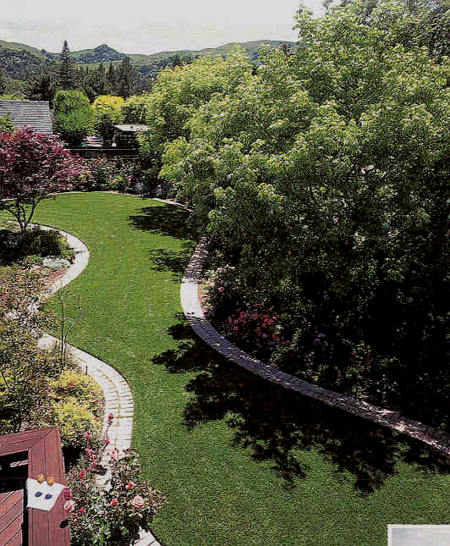
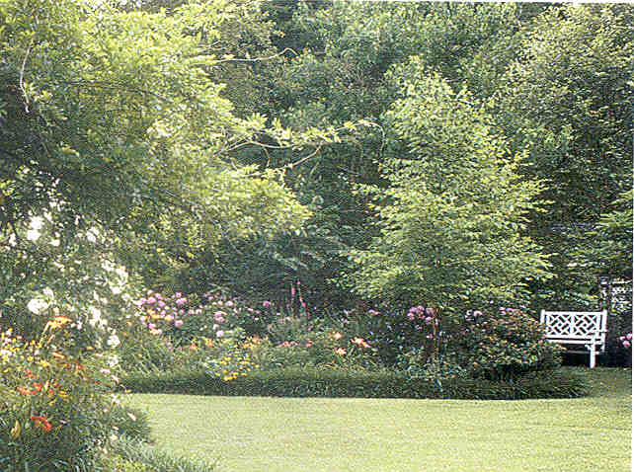
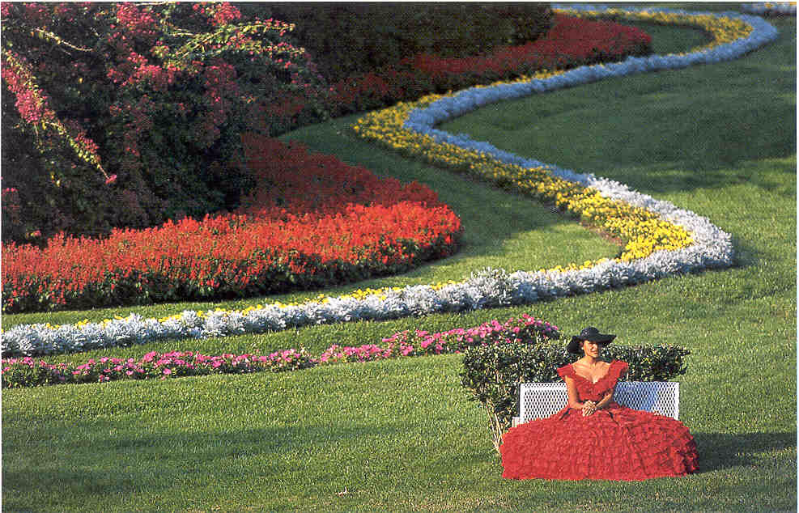
Turf Diseases
Billy Skaggs
County Ext. Agent
Hall County

Slide 2
Cultural Management for Turfgrasses
Cultural Practices for Healthy Turfgrass
Proper Mowing
Fertilizing
Aerating
Remove 1/3 height or less
Not too much or too little. Test the soil every 2 or 3 years.
Irrigation
Wet the soil to just below the root depth.
Dethatching
Don’t let thatch get more than ½ inch thick.
Coring machines
work the best.
Notes:
Too much fertilizer contributes to a thatch problem and disease issues.
Too little fertilizer can leave turf thin and susceptible to weeds.
Low nitrogen levels favor rust and dollar spot problems.

Slide 3
Diseases of Turfgrasses
Integrated Disease Management
Managing the Host
->Select a cultivar that is well-adapted to the site.
->Consider planting a mixture of compatible cultivars.
->Apply fertilizer when needed.
->Use sharp blades & proper mower height.

Slide 4
Diseases of Turfgrasses
Integrated Disease Management
Managing the Environment
Irrigation
-- Deep and infrequent.
Airflow
-- Prune or remove trees.
Drainage
-- Improve water-logged soils.
Compaction
-- Aerify from time to time.
Thatch
-- Half inch or less.

Slide 5
Diseases of Turfgrasses
Integrated Disease Management
Managing the Pathogen
Protectant Fungicides
Broad spectrum and less problems with resistance.
Can be washed off by rain or removed via mowing.
Reapply every 7 to 10 days when conditions are right for disease.
Systemic Fungicides
Longer protection, but resistance problems are more likely.
Notes:
Systemic fungicides act in a very specific way against a pathogen and resistance is likely to develop after repeated use.

Slide 6
Most Common Diseases in Georgia
Brown Patch
Dollar Spot
Pythium Blight

Slide 7
Most Common Diseases in Georgia
Fading Out/Melting Out
Fairy Ring
Centipede Decline
Gray Leaf Spot

Slide 8
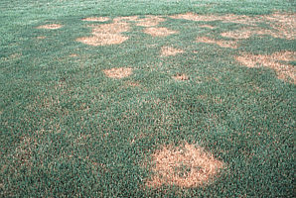
Brown Patch
Caused by the fungus Rhizoctonia solani
Disease symptoms are circular patterns of dead grass
Turf turns brown and grass blades rot off

Slide 9
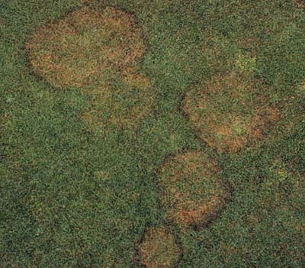
Brown Patch can spread in an area from 1-50'.
New leaves may emerge in the center of the circular patch giving the diseased areas a doughnut-shaped appearance.

Slide 10
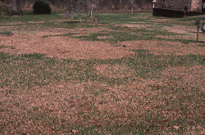
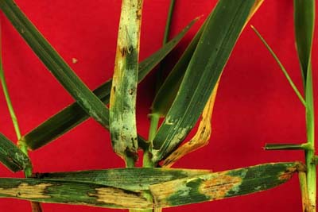
Patches merge to affect
larger areas
Occasionally circular
patterns aren’t evident
Heavy/recent infections
produce foul smell
Leaves/runners
pull out easily

Slide 11
Common in
Bermuda
Zoysiagrass
Fescuegrass
Ryegrass
St. Augustine
“Less common” in
Centipede

Slide 12
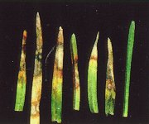
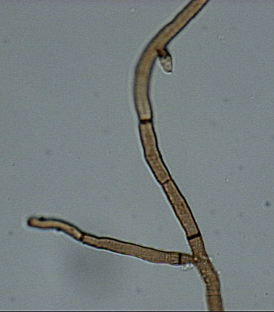
Infection requirements
--Brown Patch occurs from late Spring through Early Fall (temperatures between 65-85ºF)
--High humidity contributes to rapid disease spread
--High Nitrogen

Slide 13
IPM Practices
1) Scout: Early detection is key for disease prevention/control
Look closely for early symptoms/ signs of the disease
Note weather patterns
Keep notes of site changes
History of problems in the site
2) Avoid excessive Nitrogen fertilization
Maintain adequate Nitrogen levels)
3) Water Timely and Deeply (After midnight/before 8 AM)
5-6 inches

Slide 14
4) Avoid frequent light irrigation to reduce humidity
Allow time during the day to allow plant canopy to dry
5) Increase air circulation
Shrub and tree barriers contribute to shade
and lack of air circulation
6) Reduce thatch (no more than 1 inch thick)
Excessive thatch: restricts water and air movement
Promote shallow root growth
Promotes an ideal environment for pathogens

Slide 15
Fungicides for Brown Patch Control
Azoxystrobin
Buscalid
Chlorothalonil
Fenarimol
Flutolanyl
Iprodione
Maneb; Mancozeb
Myclobutanil
PCNB
Propiconazole
Pyraclostrobin
Thiophanate methyl
Triadimefon
Trifloxystrobin

Slide 16
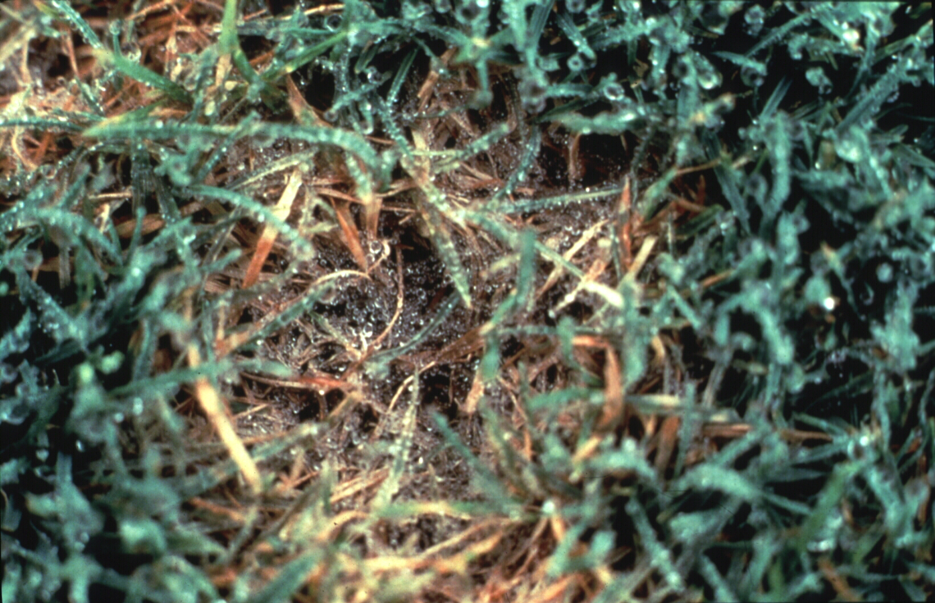
Dollar spot
Causal agent is Sclerotinia homoeocarpa
White patches up to 2 inches in diameter

Slide 17
Infection requirements
50ºF - 80ºF (Early Spring Late Fall)
Cool nights/Warm days
>10 hrs leaf wetness/day
Dry Soils
Low Nitrogen promotes growth of the fungus

Slide 18
IPM Practices
Maintain adequate Nitrogen levels (Low Nitrogen)
Avoid drought stress (dry soils promote the disease)
Water deeply (….holding the hose for a few minutes in not watering appropriately)

Slide 19
IPM Practices (continued)
Avoid extended moisture on leaves /remove dew in morning
Increase air circulation
Mow at recommended height

Slide 20
Fungicides for Dollar Spot Control
Azoxystrobin
Buscalid
Chlorothalonil
Fenarimol
Flutolanyl
Iprodione
Maneb; Mancozeb
Myclobutanil
PCNB
Propiconazole
Pyraclostrobin
Thiophanate methyl
Triadimefon
Trifloxystrobin

Slide 21
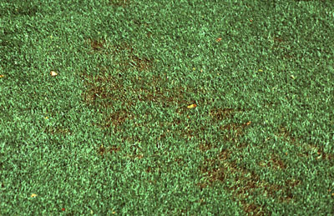
Pythium blight
Causal agent Pythium spp
Disease is characterized small, irregular water-soaked areas. Brown, orange/bronze, light/tan
Numerous spots, merge in wettest areas

Slide 22
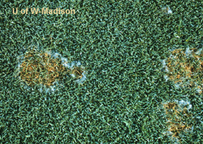
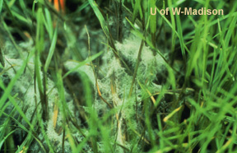
Turf dies rapidly, collapses and appear matted
Infected tissue feels oily to touch
If high humidity present fluffy, cottony white mycelium present (can be seen early in the morning)

Slide 23
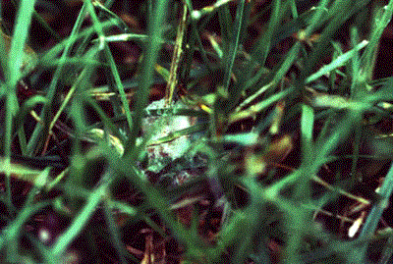
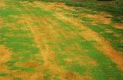
IPM Practices for Pythium Blight
Water management is essential
Correct over watering/drainage
problems
Avoid pockets of excessive humidity
Do not over fertilize with Nitrogen

Slide 24
Fungicides for Pythium Blight Control
Azoxystrobin
Chloroneb
Chlorothalonil
Etridiazole
Fosetyl Al
Fluoxastrobin
Mefanoxam
Propamocarb
Pyraclostrobin

Slide 25
‘Fading’ and ‘melting out’ Curvularia and Helminthosporium sp.
Both fungi are common thatch and soil inhabitants
Can cause disease when K is low and drought stress occurs
Bermudagrass, zoysiagrass, centipedegrass
Common during the past 2 to 3 years

Slide 26
Curvularia:
large overall decline
Helminthosporium:
light colored spots
dark edges

Slide 27
Factors that promote disease incidence
High Temperature
Drought stress
Low aeration
Low light intensity
Excessive Nitrogen

Slide 28
Management for Curvularia
and Helminthosporium diseases
Prevent drought stress to the turf
Water properly
Soil test/insure adequate K
Address excessive thatch
Protectant fungicides available

Slide 29
Fungicides for
Fading/Melting out Control
Azoxystrobin
Chlorothalonil
Iprodione
Maneb; Mancozeb
Myclobutanil
PCNB
Propiconazole
Thiophanate methyl
Trifloxystrobin

Slide 30
Fairy ring
Different Basidiomycetous fungi
Mushroom (basidiocarp) producing fungi
In Nature, wood-rooting
Circular or semi-circular band

Slide 31
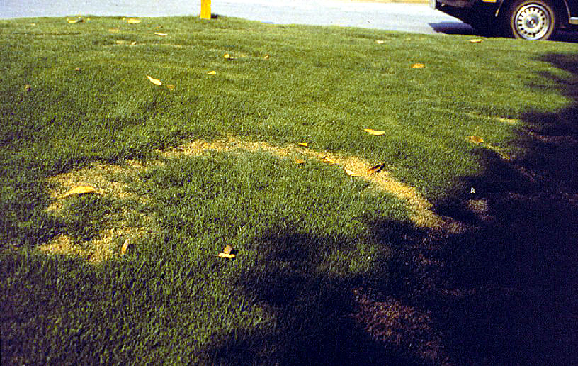
Affects all turf types
Most common and damaging on Centipede, Zoysiagrass and St. Augustinegrass.
Most on sandy soils of low fertility
Also favored by heavy thatch
Sometimes associated with buried debris

Slide 32
Management for fairy ring
Spike or aerate affected areas
If necessary for aesthetic purposes Water heavily
Extra fertilizer where appropriate
Soil replacement
Fungicide treatment

Slide 33
Fungicides for fairy ring control
* Flutolanyl (Prostar)
* Azoxystrobin (Heritage 50WG)
* Pyraclostrobin (Insignia)

Slide 34
Centipede decline
Disorder not a disease
Improper and excessive fertility
>Light green color
>Cannot tolerate high N
>Low maintenance
High pH

Slide 35
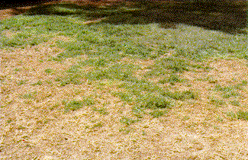
Centipede decline
Heavy thatch
Compacted soils
Nematodes

Slide 36
Management for centipede decline
Soil test
Avoid over or improper fertilization
Use 3-1-2 fertilizer ratio
Aerate to improve root growth
Dethatch

Slide 37
Gray leaf spot Pyricularia grisea

Slide 38
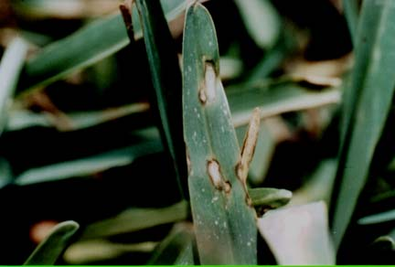
Leaf spot disease
Straw-gray lesions
with purple/brown margins
Rapid spread
Severely affected leaf blades wither and turn brown

Slide 39
Gray leaf spot
Affects St. Augustinegrass and Tall Fescue
Favored by high N and excess moisture
Optimal temps 77 to 86˚F

Slide 40
Management for gray leaf spot
Avoid excessive applications of N
Proper watering practices
Reduce thatch when excessive
Reduce shade
Avoid herbicide use above 85 ˚ F
Protectant fungicides available

Slide 41
Fungicides for gray leaf spot control
Azoxystrobin
Chlorothalonil
Fluoxastrobin
Propiconazole
Pyraclostrobin
Thiophanate methyl
Trifloxystrobin
Zineb

Slide 42
Nematodes
Microscopic round worms
Thrive in living tissue
They can live inside the plants and roots (Endoparasitic)
or in the outside (Ectoparasitic)
Spear-like structures (stylet) in their mouths
Feed on roots (or crown) and extract nutrients
Several species
Different species from nematodes
used to control insects

Slide 43
Symptoms
Chlorosis
Declining growth
Thinning
Irregular patches (some circular)
Most evident on hot weather, drought or low fertility
Turf sensitive to wilting

Slide 44
Turf does not respond to fungicide applications, irrigation, fertilization
nor to aeration or watering.

Slide 45
Control
Management
Soil Test (Nematodes) ($ 8.00)
Avoid any turf stress
Water deeply and less frequently
Avoid excessive nitrogen fertilizer
Do not mow too short (root stress)
Nutrient deficiencies inhibit root development
Soil amendment (Nematode damage
is more common on sandy soils)
Aeration

Slide 46
Nematicides
CURFEW
TELONE II
Use only permitted on golf courses, sod farms and
maybe in industrial grounds
*** NOT FOR HOME LAWNS

Slide 47
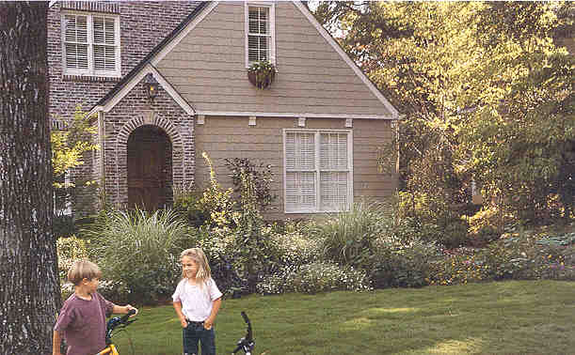
Most of the diseases in turf can be avoided using proper management strategies:
REMEMBER
-Water Properly
-Proper Fertilization
-Aeration
-Proper Light
-Scout
-Record weather conditions
-Keep notes of any site changes
-Note occurrence of problems and history

Slide 48
Any questions?
Billy Skaggs
Hall County Extension Agent
www.hallcounty.org/extension
www.ugaextension.com
www.georgiaturf.com
Notes:
117. CREDIT SLIDE: Thank you for your attention. Now do you have any final questions on anything covered today?????

