Slide 1
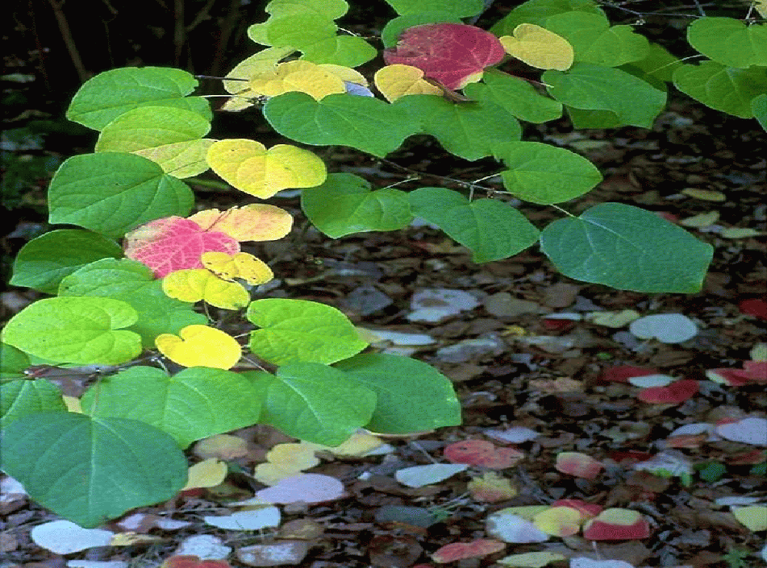
Trouble-shooting
Ornamental Plant
Problems
Notes:
1. TITLE SLIDE: In the landscape, problems frequently occur when a plant has a difficult time adapting to its environment or when we use inappropriate cultural practices. In this program, you will learn how to recognize and avoid many landscape problems.

Slide 2
Five Steps to Trouble-shooting Ornamental Plant and Site Problems
Notes:
2. FIVE STEPS TO TROUBLE-SHOOTING ORNAMENTAL PLANT AND SITE PROBLEMS: First, let’s look at a simple five-step approach to trouble-shooting ornamental plant and site problems that may help you in analyzing problems you encounter.

Slide 3
Step #1
Identify the Plant
Notes:
3. STEP 1: IDENTIFY THE PLANT: First, identify the plant. You don’t have to know the botanical name of the plant, just the type of plant it is. Then you can key in on specific problems the plant has.

Slide 4
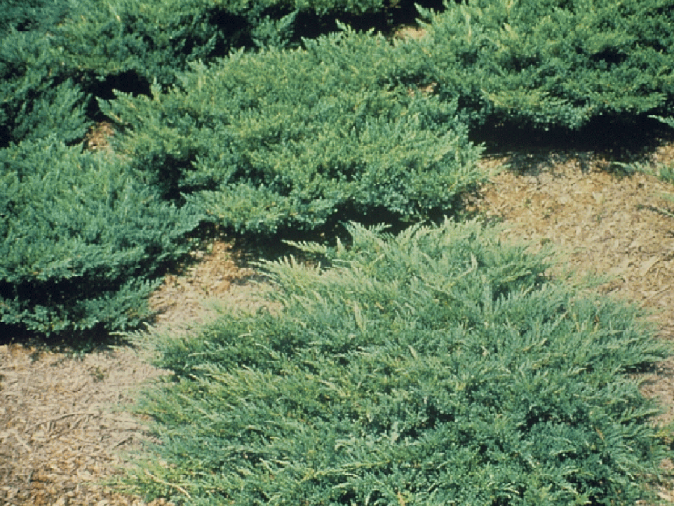
Junipers
Spider mites
Phomopsis and kobatina blight
Notes:
4. JUNIPERS: Junipers, for instance, are extremely drought tolerant plants when established, but they often stress in poorly-drained soils. When stressed, they become more susceptible to pests, such as spider mites and diseases like phomopsis or kobatina blights.

Slide 5
Step # 2
Learn About the Site
Weather records
Observe other plants in the neighborhood
Structure/texture of the soil
Drainage
Soil pH and nutrients
Notes:
5. STEP 2: LEARN ABOUT THE SITE: Consider the recent weather pattern. Is this a problem affecting plants throughout the area? If so, it may be a weather related problem. Look at other plants in the neighborhood. Are many plants showing the same symptom, or is this an isolated case? Look at the drainage pattern of the site, the structure and texture of the soil and the pH and nutrient content of the soil.

Slide 6
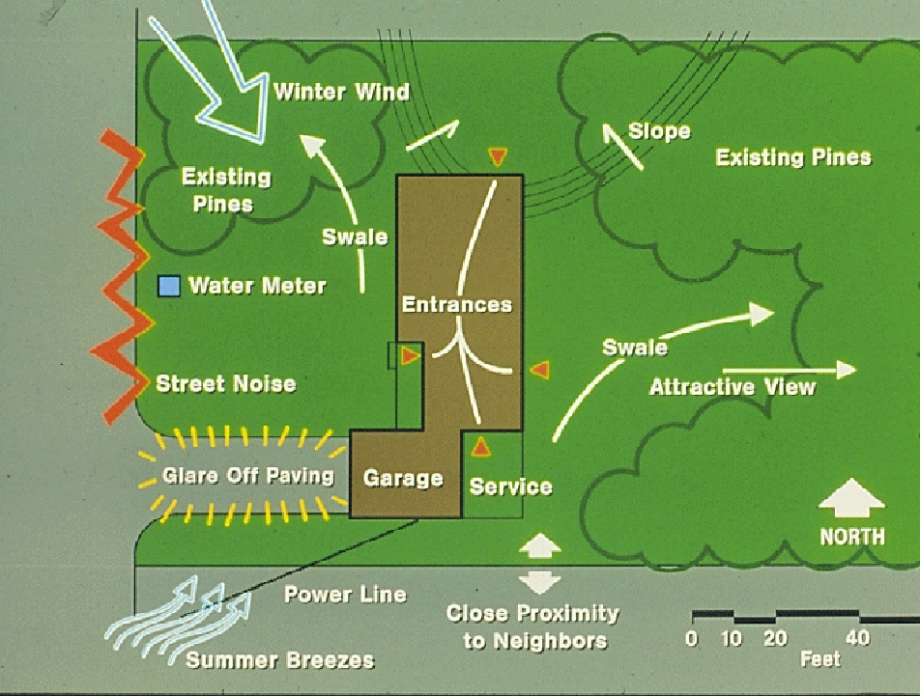
Notes:
6. SITE PLAN: Consider the layout of the site. Look at the sun light pattern throughout the day. Shade loving plants should be on the eastern exposures where they are shaded from the afternoon sun by the building or adjacent plants, while sun-loving plants are best for the western exposures. Look at the slope of the property and drainage patterns. Look at the direction of the cold winter winds and the summer breezes. Locate more cold hardy plants on the northwest side of the property and cold sensitive plants in protected areas on the southeast side of the property where they are shielded from the cold northwest winter winds.

Slide 7
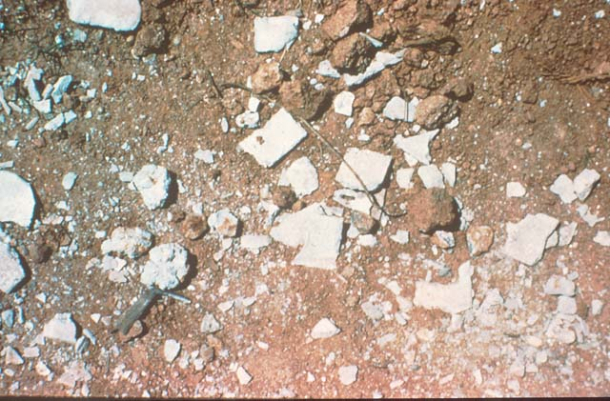
New Construction Sites
Left-over debris - chunks of concrete, tar paper, roofing shingles, sheetrock, etc.
Compaction from construction equipment
Hidden oil, gasoline and other chemical spills
Notes:
7. CHUNKS OF CONCRETE LEFT AFTER CONSTRUCTION: O new construction sites leftover debris, such as concrete, tar paper, roofing shingles and sheetrock can cause problems with plant growth. Concrete and sheetrock, for instance, can elevate the pH of the soil and cause problems with acid-loving plants like azaleas. Compaction is sometimes a problem on new construction sites where the weight of heavy equipment machinery compacts the soil. Then there are all sorts of hidden dangers that are not obvious, such as oil or gasoline spills.

Slide 8
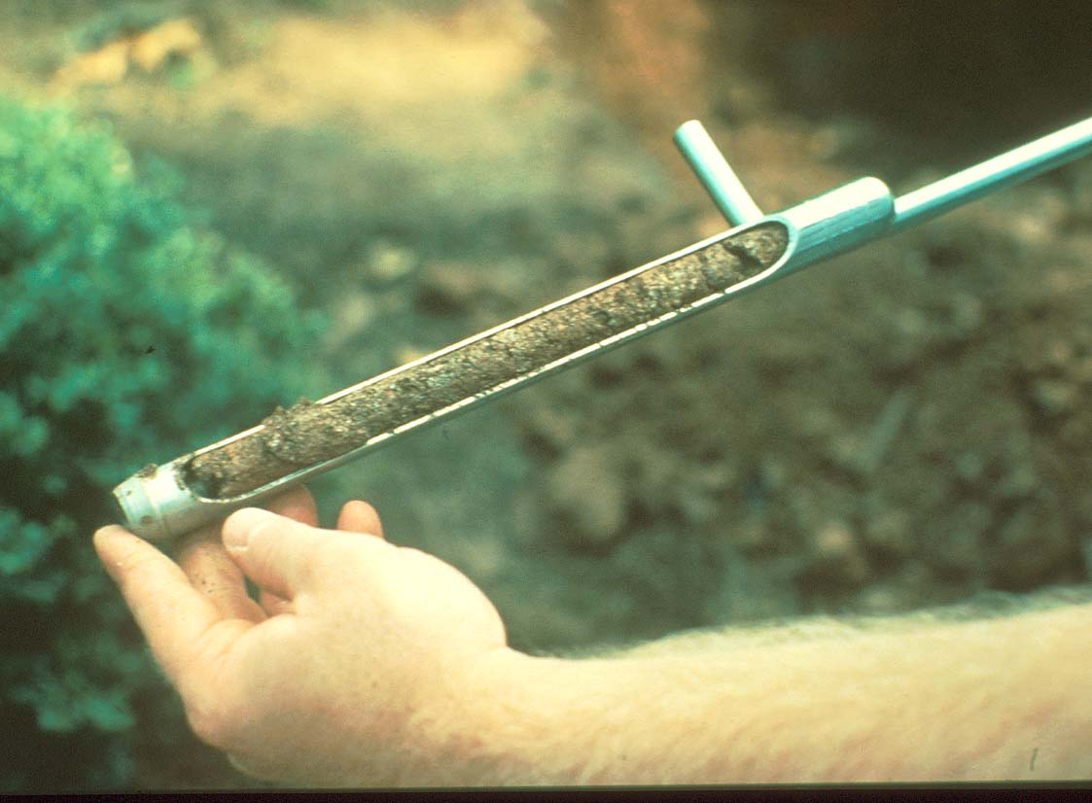
Analyze the structure and texture of the soil, it’s drainage characteristics, and it’s pH and nutrient content
Notes:
8. ANALYZE THE SOIL: It’s very important to analyze the structure and texture of the soil as well as the chemical composition of the soil, including the pH and nutrient content.

Slide 9
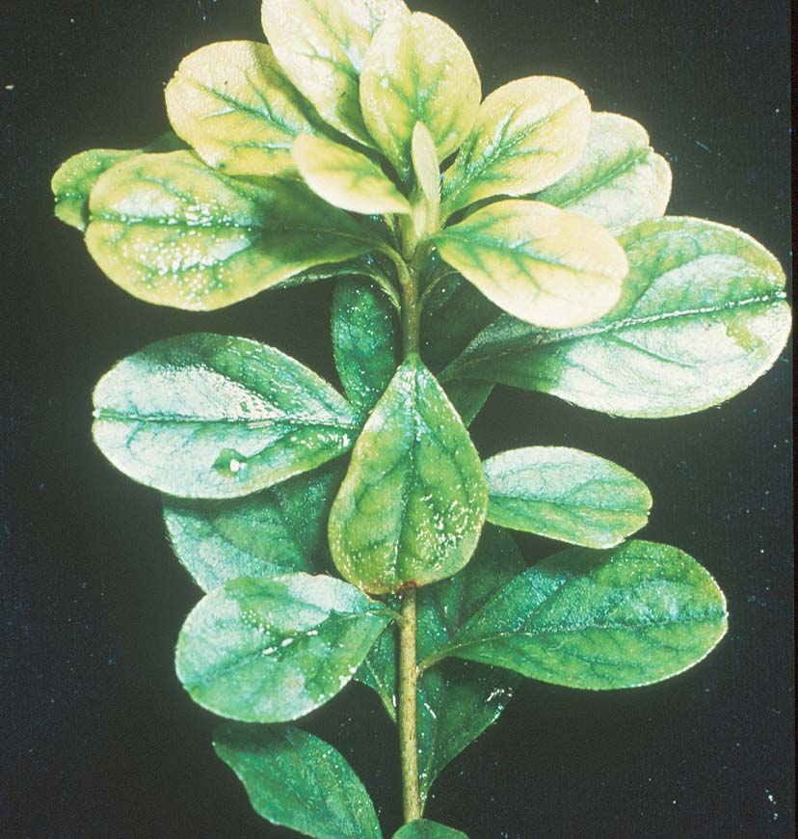
Most Ornamental Plants Prefer a Soil pH Between 5.2 and 6.5
Prefer an Alkaline pH
(6.5 to 7.5)
Barberry
Ornamental Cherry
Honeysuckle
Mulberry
Virginia Creeper
Lilac
Wisteria
Notes:
9. PH REQUIRMENT OF PLANTS: Soil pH affects nutrient uptake by the plant. Most ornamental plants prefer a pH between 5.2 and 6.5. However, some ornamental plants, such as barberry, ornamental cherry, honeysuckle, etc. prefer a more alkaline pH in the range of 6.5 to 7.5. It’s important to know soil pH and adjust it accordingly for optimum plant growth.

Slide 10
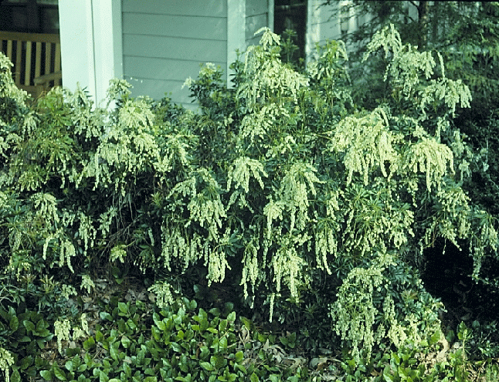
Japanese Andromeda
(Pieris japonica)
Notes:
10. FINICKY PLANTS: Certain plants are very exacting in their growth requirements and location in the landscape. Japanese Andromeda, for instance, is very site specific. It needs morning sun, afternoon shade, and moist, well-drained soils.

Slide 11
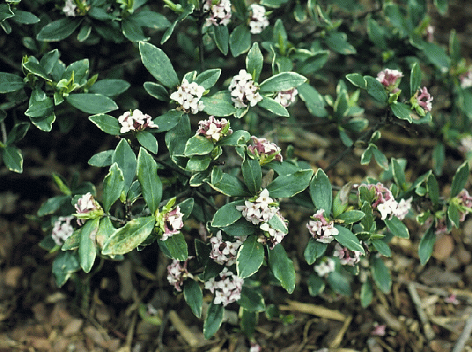
Winter Daphne
(Daphne odora)
Notes:
11. FINICKY PLANTS: Winter Daphne must have afternoon shade and does not tolerate wet sites or fluctuations in soil moisture (very dry then very wet).

Slide 12
Step # 3 Ask Questions
Never insult the client
Never make rash statements until you have all the facts
Take the lead during the conversation
Notes:
12. STEP 3: ASK QUESTIONS: You need to ask several questions and be willing to listen. Ask when the damaged appeared and see if there are any uniform patterns to the damage. You can learn a lot about previous cultural practices by asking good questions. However, never insult the client, never make rash statements until you have all the facts. Take the lead in the conversation by asking pertinent questions.

Slide 13
Step #4 Be Prepared to Ask for Samples
Helpful Diagnostic tools:
Hand lens
White paper
Pocket knife
Zip-lock plastic bag
Container for insects
Soil Bags
Notes:
13. STEP 4: BE PREPARED TO ASK FOR SAMPLES: You can’t always do a site visit, so ask the client to bring in samples if you can’t solve the problem over the phone. Explain how to take good samples and package them for possible shipment to the Plant Diagnostic Clinic at The University of Georgia. If you make site visits, have the necessary diagnostic tools to take a good sample.

Slide 14
Step #5 Focus on the Plant
Above ground symptoms
Leaves:
Leaf spots – possibly caused by
diseases, spray damage or chemical injury
Marginal burn – drought or excess
fertilizer
Shot Hole – insect feeding, disease
Yellowing – deficiency, spider mites,
lace bugs or root problems
Notes:
14. STEP 5: FOCUS ON THE PLANT: LEAVES: Look at the above-ground symptoms. Look at the leaves for leaf spots, scorch, holes or yellowing. Leaf spots may be caused by diseases, spray damage or chemical injury, marginal leaf burn may be due to drought or excess fertilizer, holes in the leaves may be caused by insect feeding or disease, and foliar yellowing may be due to nutrient deficiency, spider mite or lace bug feeding or root problems.

Slide 15
Step #5 Focus on the Plant
Above ground symptoms
Stems:
Cankers
Mechanical injury
Insect wounds
Borers
Internal decay fungi
Animal browsing
Notes:
15. STEP #5: FOCUS ON THE PLANT: STEMS: Look for signs of damage to the bark, stems and twigs. You may need to use a knife to examine the internal stem area for possible insects, cold damage or disease symptoms. Is wildlife browsing a problem in the area?

Slide 16
Step #5 Focus on the Plant
Below ground symptoms
Roots:
Are they healthy white or dark brown?
Rotted, decayed appearance?
Planted too deep?
Internal bark browning?
Notes:
16. STEP #5: FOCUS ON THE PLANT: ROOTS: Are the roots white or light brown and healthy looking, or black and decayed? Notice if the plant was possibly set too deeply or too shallow. Also notice if the roots have grown outside the original root ball or are still in the shape of the pot. Use a knife to examine the roots for possible fungal growth just under the bark.

Slide 17
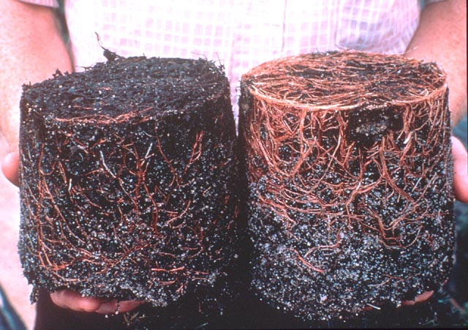
Left: Unhealthy Right: Healthy
Notes:
17. DAMAGED VS. HEALTHY ROOTS: The root system on the left is unhealthy. The roots are dark and decayed. They were damaged from some type of environmental problem, such as too much moisture, too little moisture or freeze injury. The plant on the right shows a healthy root system with light brown and white roots.

Slide 18
80% of Plant Problems Result from the Inability of the Plant to Tolerate or Adapt to the Environment
Notes:
18. 80% OF PLANT PROBLEMS RESULT FROM THE INABILITY OF THE PLANT TO TOLERATE OR ADAPT TO THE ENVIRONMENT. At least 80% of the problems that come into the Plant Diagnostic Clinic at The University of Georgia can be related back to some type of environmental problem. Insect and diseases observed on plants often attack secondarily after plants are stressed by the environment.

Slide 19
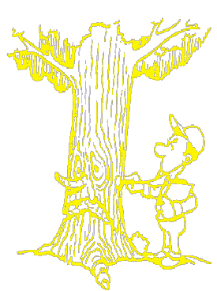
Avoiding Plant Stress
It’s a Killer!!!
Notes:
19. AVOIDING PLANT STRESS: IT’S A KILLER. Out goal should be to provide plant their proper growing environment in the landscape so we can avoid plant stress. When we’re stressed, we can always change our environment or take medication, but plants are forced to cope with their environment. If they are provided improper care or forced to grow in an unfavorable environment, they will show stress symptoms.

Slide 20
Two Kinds of Plant Stress
Environmental Stress
Cultural Stress
Notes:
20. CAUSES OF PLANT STRESS: There are two main causes of plant stress: Environmental stress and cultural or man-made stress. . Let’s look at possible problems under each of these main categories

Slide 21
Environmental Stress
Too dry
Too wet
Fluctuations in soil moisture
Too much sun
Too much shade
Cold injury
Heat tolerance
Notes:
21. ENVIRONMENTAL CAUSES OF PLANT STRESS: Environmental stress most often results from putting the wrong plant in the wrong place or from a failure of the plant to adapt to a specific microclimate. Sometimes the growing environment is too dry or too wet, or the site undergoes extreme fluctuations in soil moisture from time to time - very wet to very dry. Sometimes shade-loving plants are forced to grow in too much sun-loving plants in too much shade. Some plants are unable to adapt winter cold while others can not take extreme summer heat.

Slide 22
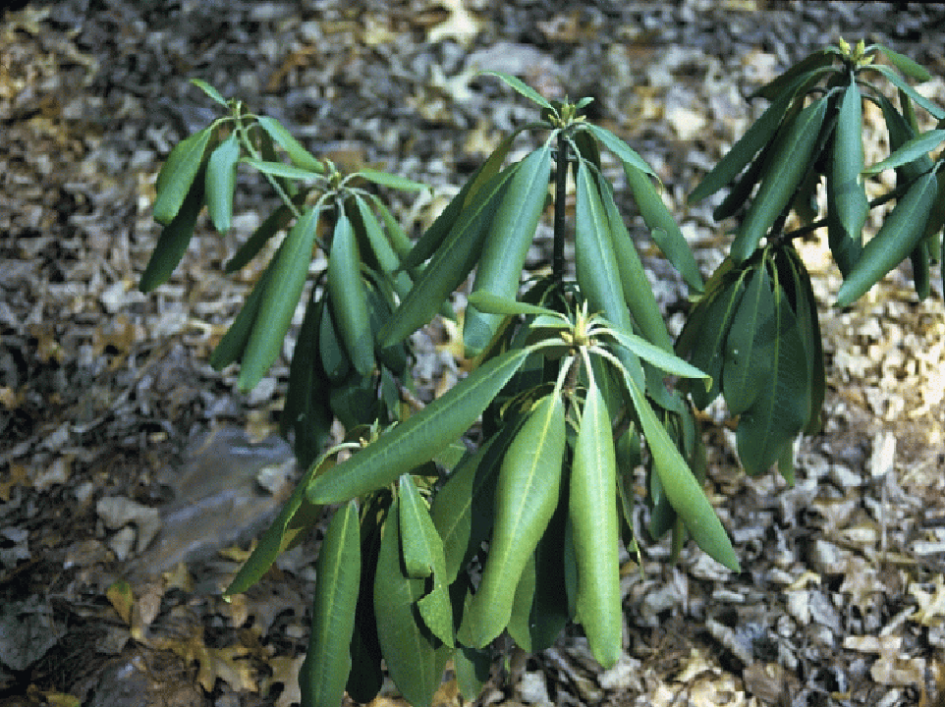
Notes:
22. RHODODENDRON UNDER STRESS: At first glance, you’d suspect this rhododendron to be suffering from drought stress. But look closely and you’ll see clear plastic was placed under the mulch. The plant was suffering from lack of oxygen and excessively wet soils.

Slide 23
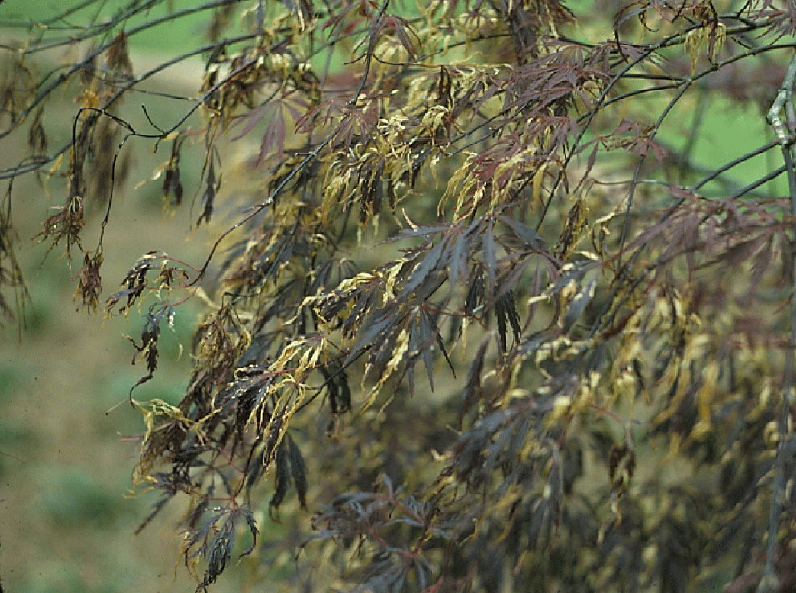
Notes:
23. JAPANESE MAPLE UNDER STRESS: Japanese maple is a good indicator plant for environmental stress. Frost often damages the newly emerging leave. The leaves will also scorch from excess fertilizer, over-watering, drought, very high humidity and/or too much sun.

Slide 24
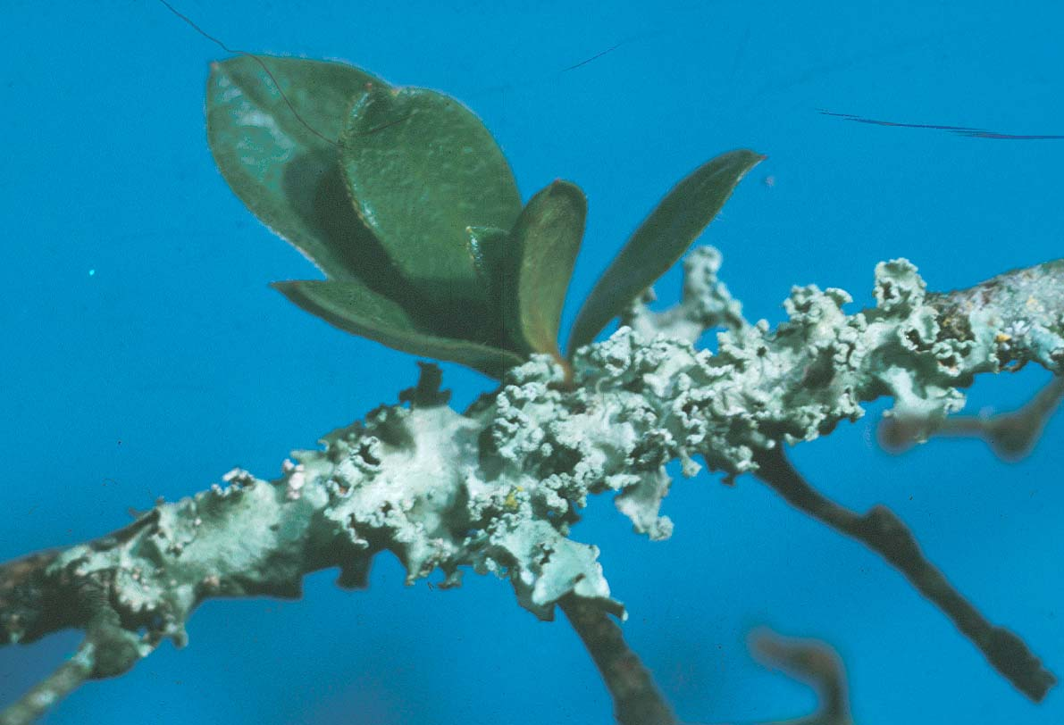
Lichens
Notes:
24. LICHENS ON PLANT: Lichens, an algae/fungus combination that feeds on dead tissue, attack plants under stress. Lichens are a good indication that the plant is not happy in its growing situation.

Slide 25
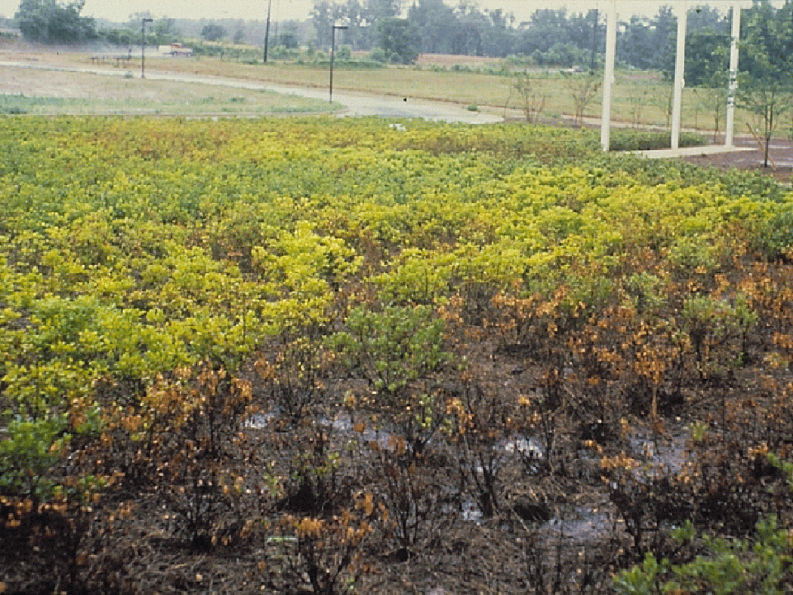
Notes:
25. AZALEAS SUFFERING FROM TOO MUCH WATER: Azaleas can not tolerate wet sites. This site was being over-irrigated and had poorly drained soil. The plants were also being forced to grow in full sun, another environmental stress. This sometimes results in serious problems for commercial landscape firms and contractor/client disputes.

Slide 26
More plants are killed in Georgia from too much water than from the lack of water
Notes:
26. MORE PLANTS ARE KILLED IN GA FROM OVER-WATERING THAN FROM THE LACK OF WATER: Irrigated areas are often over-watered and watered too frequently. When the soil is water-logged, roots die and decay and the top declines.

Slide 27
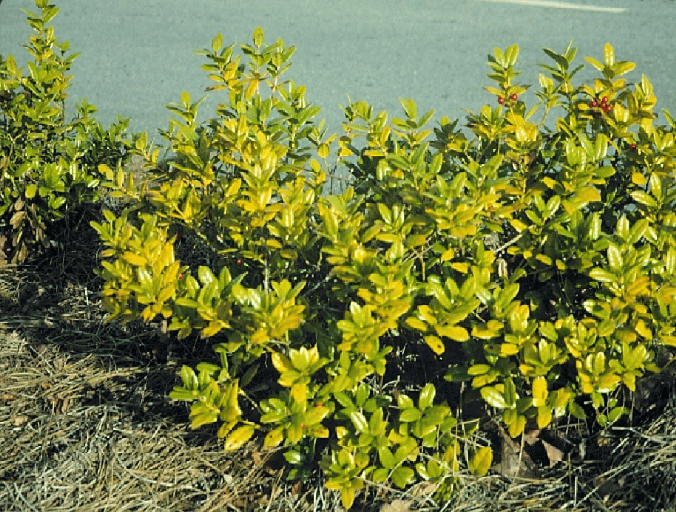
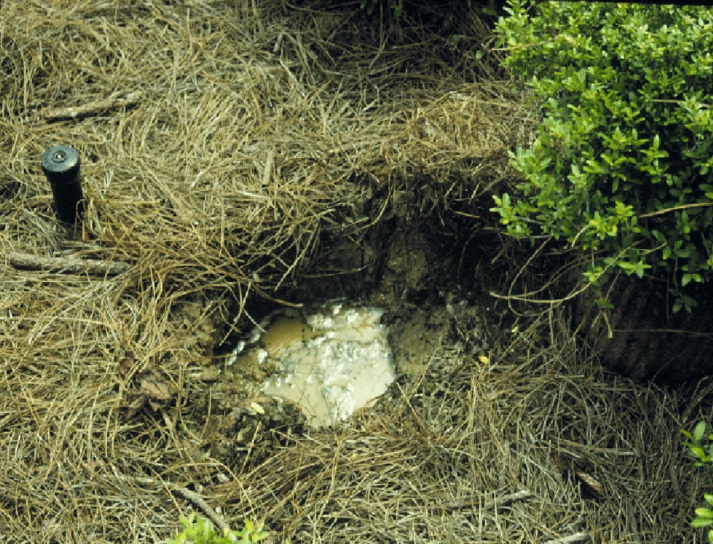
Notes:
27. CHLOROTIC HOLLY /WATER IN HOLE AFTER PLANT REMOVED: A classic symptom of moisture stress is anemic-looking leaves and smaller leaves. You can not fertilize the plant and solve this problem. Often fertilization of a plant under moisture stress will make the problem worse. There is an inadequate root system to absorb the nutrients you apply. In this case, the water table was a few inches under the surface and remained high for hours after irrigation or rainfall, resulting in root rot. The best long-term solution is to remove the plant, change the site, and re-plant a more adapted species.

Slide 28
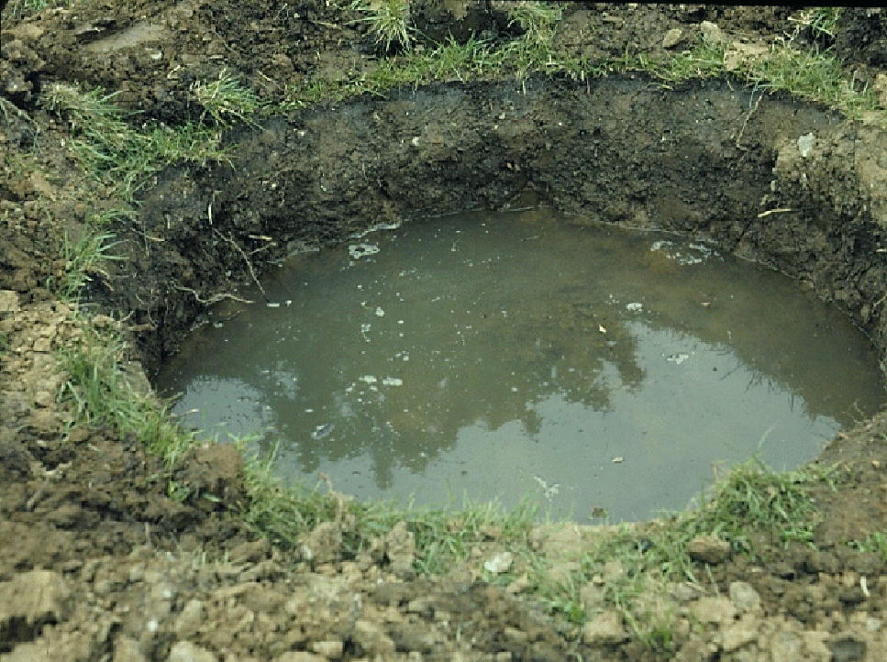
Notes:
28. PERCOLATON TEST: A test for soil percolation, particularly before planting, is recommended. Simply dig a hole and fill it with water and observe the drainage over an 8-hour period. If water remains in the hole after 8 hours, the soil is likely to be poorly drained.

Slide 29
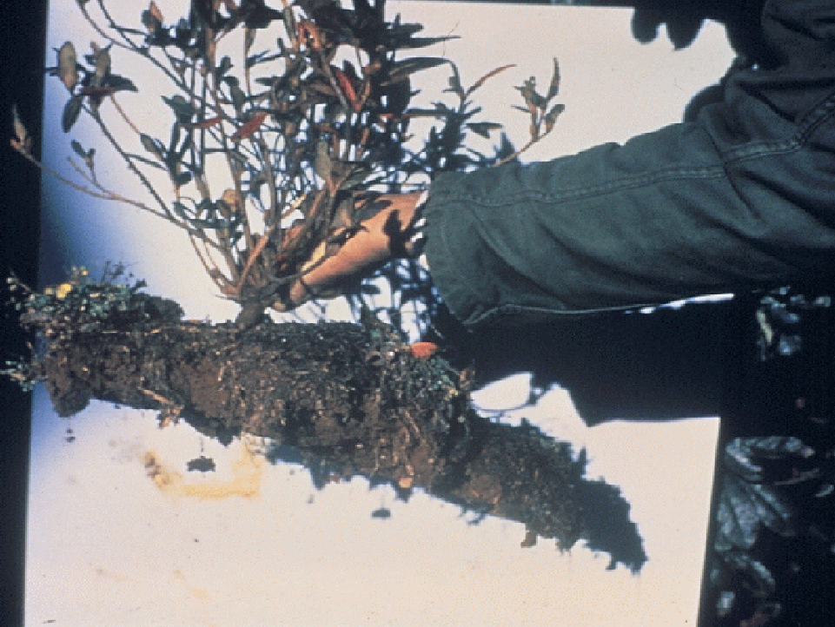
Pancake-like root system resulting from poorly drained soils
Notes:
29. PANCAKE ROOT SYSTEM RESULTING FROM POORLY DRAINED SOIL: A pancake type root system is a classic symptom of plants growing in poorly-drained soil. Frequent, shallow watering or improper planting will also cause this problem.

Slide 30
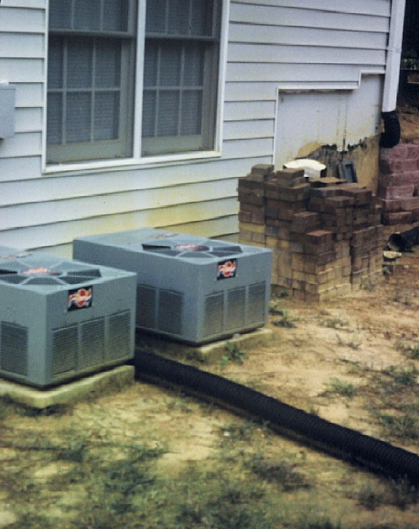
Water draining from air-conditioners can puddle and cause problems. Run drain lines away from ornamental plantings.
Notes:
30. DRAIN FROM COOLING SYSTEM: Cooling systems remove water from the interior portions of the home and drain it through a tube adjacent to the outdoor air-conditioning unit. This can cause problems for nearby plants unless the water is routed away or captured and applied elsewhere. Heavy, compacted soils compound the problem.

Slide 31
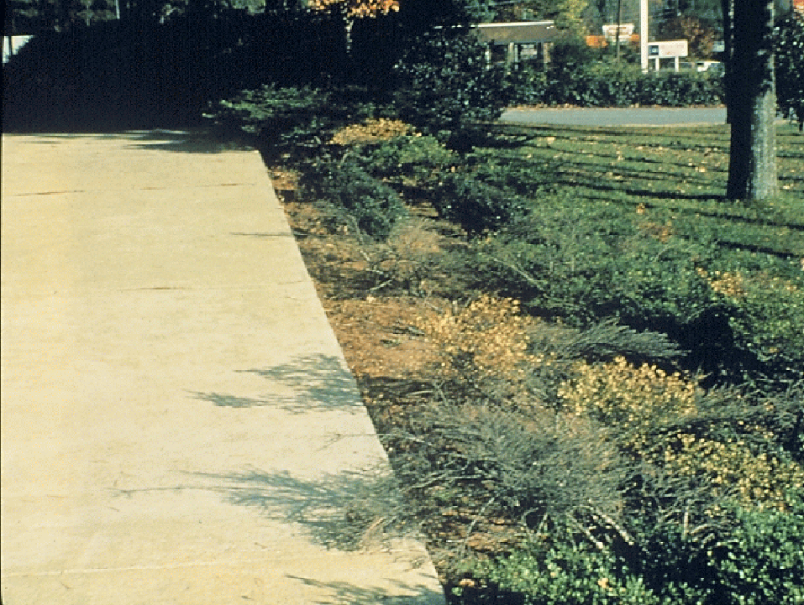
Notes:
31. SIDEWALK DRAINAGE: These Helleri Hollies went through extreme fluctuations in soil moisture as water drained off this parking lot onto the bed after rains. Helleri holly can not tolerate extreme fluctuations in soil moisture and will show stress over time. In this case, the plants were removed and replaced with dwarf yaupon holly which were much more tolerant of moisture extremes. Another possible solution would be to install a drain adjacent to the concrete to route the water away from the plants

Slide 32
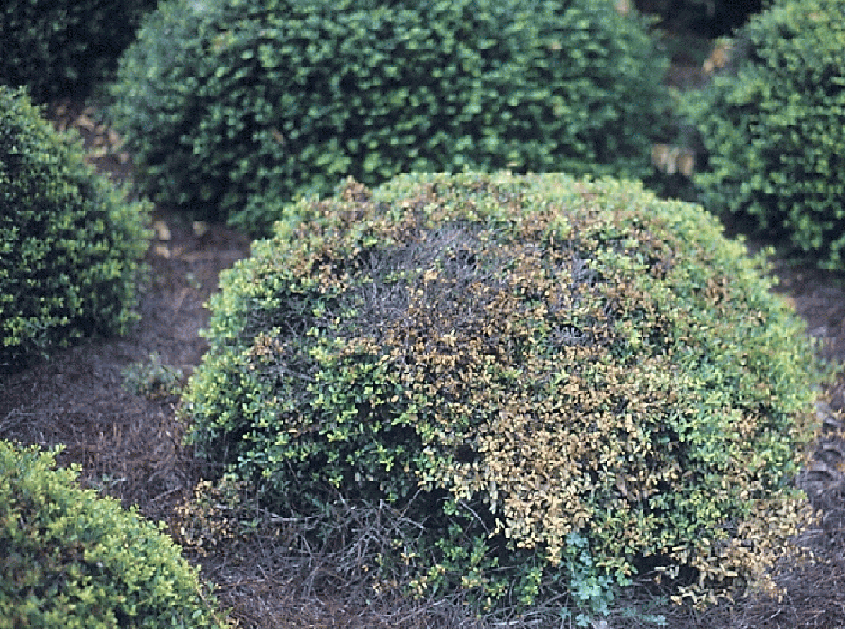
Notes:
32. HELLERI HOLLY UNDER STRESS: This is a typical stress symptom of Helleri Holly. In this case, the plant was affected by drought stress. Mulching to conserve moisture and irrigation during dry periods would have helped prevent the problem.

Slide 33
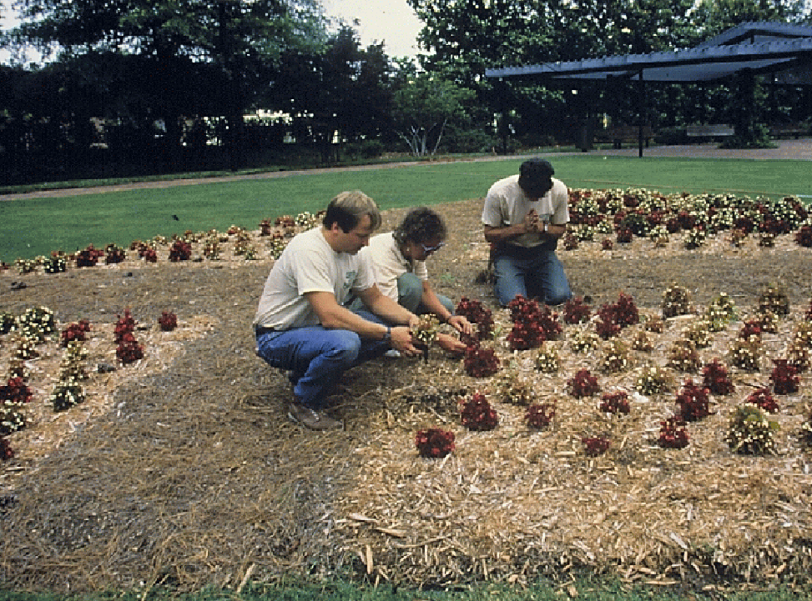
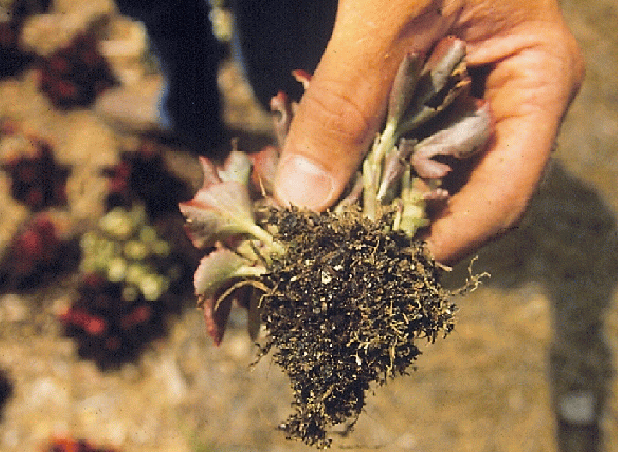
Notes:
33. ANNUALS IN A COMMERCIAL PLANTING BED: Most bedding plants can note tolerate heavy, poorly drained soils and wet feet for any length of time. These begonias were planted in a poorly drained soil and were also heavily mulched. The root systems rotted. This problem could have been avoided by site analysis and careful bed preparation to assure good drainage.

Slide 34
Solutions to Wet Sites
Plant on elevated beds
Break apart a hard-pan layer
Select adapted plants
Install Sub-surface drainage
Notes:
34. SOLUTIONS TO WET SITES: Possible solutions to wet sites include elevating the planting bed 6 to 12 inches above grade by incorporating some well-drained top soil, breaking up a possible hard pan layer under the soil, selecting plants better adapted to the site, and/or installing a sub-surface drainage system.

Slide 35
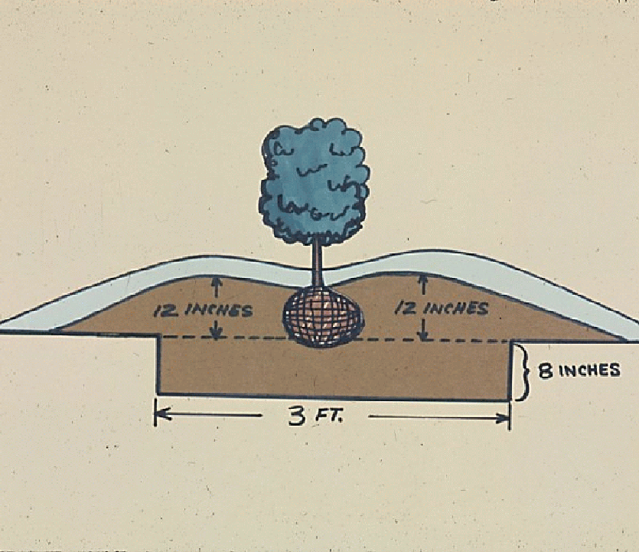
Notes:
35. ELEVATING BED: When elevating the bed for woody ornamentals, the grade should be at least twelve inches above the soil level to get the root system out of the poorly drained soil. Eighty percent of the root system of most woody ornamental trees and shrubs is within the top 12 inches of soil.

Slide 36
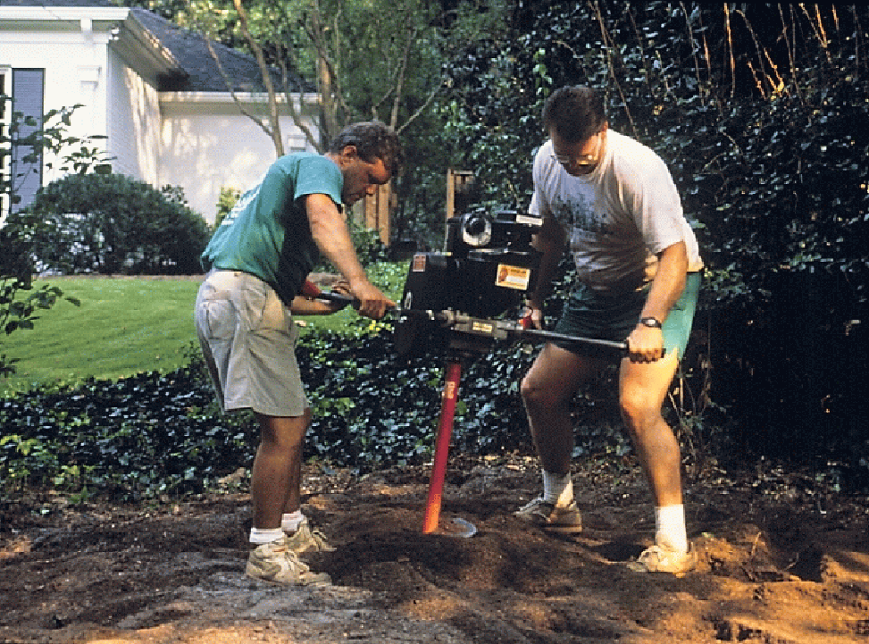
Notes:
36. SUB-SOILING: A soil auger is sometimes used to break apart a hard, compacted soil and to improve drainage.

Slide 37
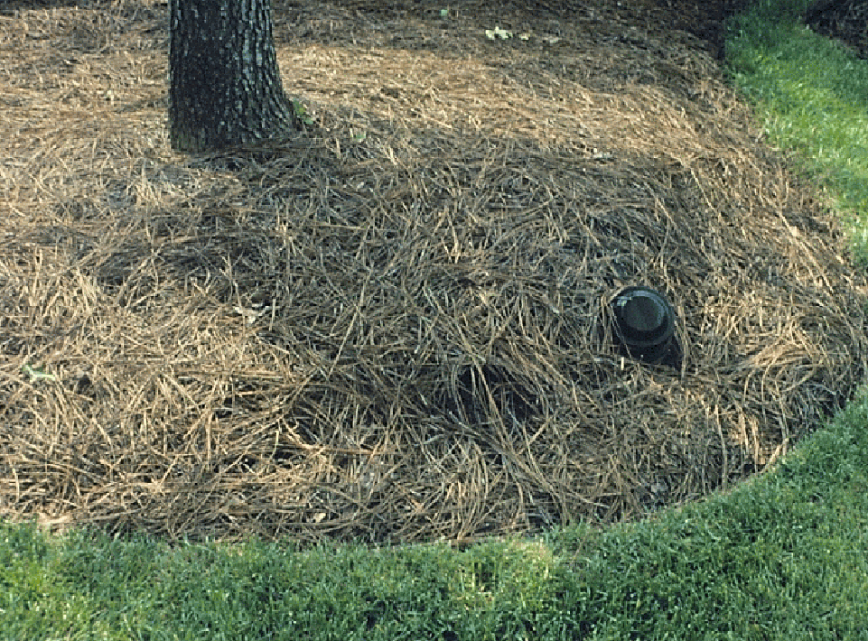
Notes:
37. SUB-SURFACE DRAINAGE: In some poorly drained sites, the only solution is to install sub-surface drain pipe to carry water off the site. In this case, a porous drain pipe was used to collect water, then the water table was lowered by pumping water out of the pipe. Note the cap on the pipe at the soil level that could be removed for monitoring the water level and for pumping water out of the ground.

Slide 38
Stressed plants are generally more prone to insect and disease problems.
Notes:
38. STRESSED PLANTS ARE GENERALLY MORE PRONE TO INSECT AND DISEASE PROBLEMS: Most pest problems in landscapes are secondary. They attack after the plant is under stress from environmental and/or cultural problems.

Slide 39
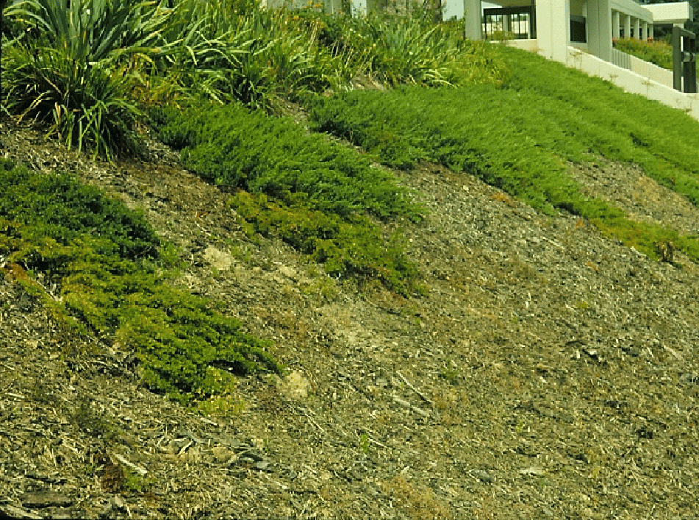
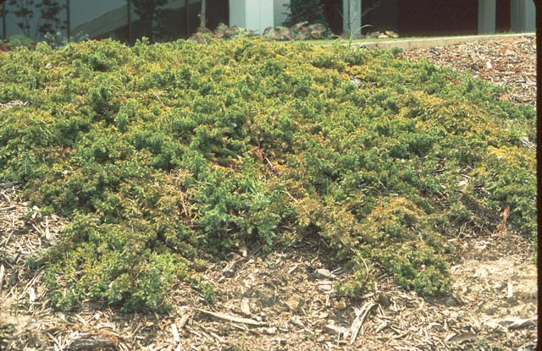
Spider mites and diseases often attack stressed plants
Poor plant selection for
this heavy clay soil
Notes:
39. JUNIPERS ON A BANK/CLOSE UP SHOWING FOLIAR PROBLEMS: These juniper plants were growing in poorly drained clay and were getting too much water after rain or irrigation, particularly on the lower part of the bank. The plants were dying from the bottom of the bank upward. This problem is also encouraged by planting too close. The plants overgrew each other, became thick and dense and the foliage took a long time to dry out after rain or irrigation. Secondary pests, such as spider mites and diseases were attacking the plants, but they were not the main cause of the problem. Simply spraying for pests is not a solution to this problem.

Slide 40
Suggestions
Instead of shore juniper, plant groupings of Siberian iris, ornamental grasses, daylilies, dwarf wax myrtle, asiatic jasmine, or Carolina jessamine. Red maple and/or hibiscus for height
Select adapted plants when you
can’t change the site
Notes:
40. SUGGESTIONS FOR CORRECTING THIS PROBLEM: Planting more adapted plants or better soil preparation are the best long-term solution to this problem. In this case, we suggested the client remove the juniper and replace them with groupings of Siberian iris, ornamental grasses, daylilies, dwarf wax myrtle, asiatic jasmine, or Carolina jessamine. Red maple and/or hibiscus were suggested for height.

Slide 41
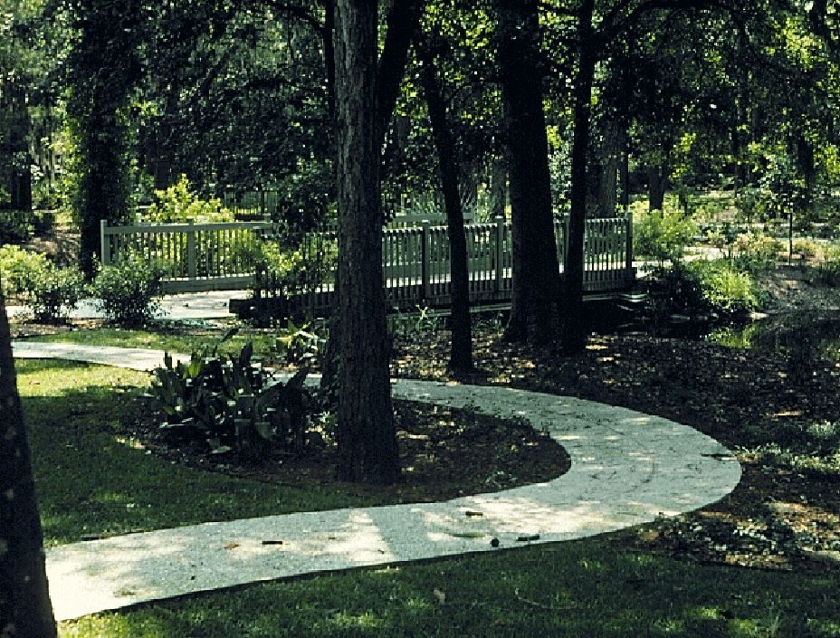
Notes:
41. SHADE: Shade is another environmental factor that sometimes causes problems with ornamental plants. Plants that require full sun for flowering, for instance, do poorly in the shade. Select plants adapted to the sun and shade patterns of the localized site.

Slide 42
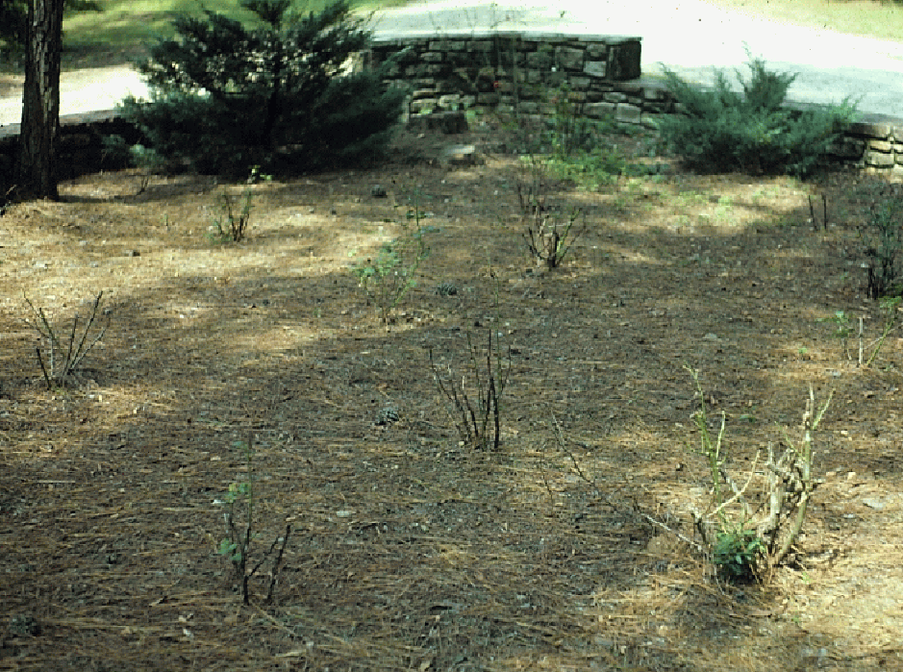
Notes:
42. ROSES IN SHADE: It is a serious mistake to attempt to grow roses in full shade without irrigation (shown here). Roses require 6 to 8 hours of full sunlight each day and moist, well-drained soils to flower well.

Slide 43
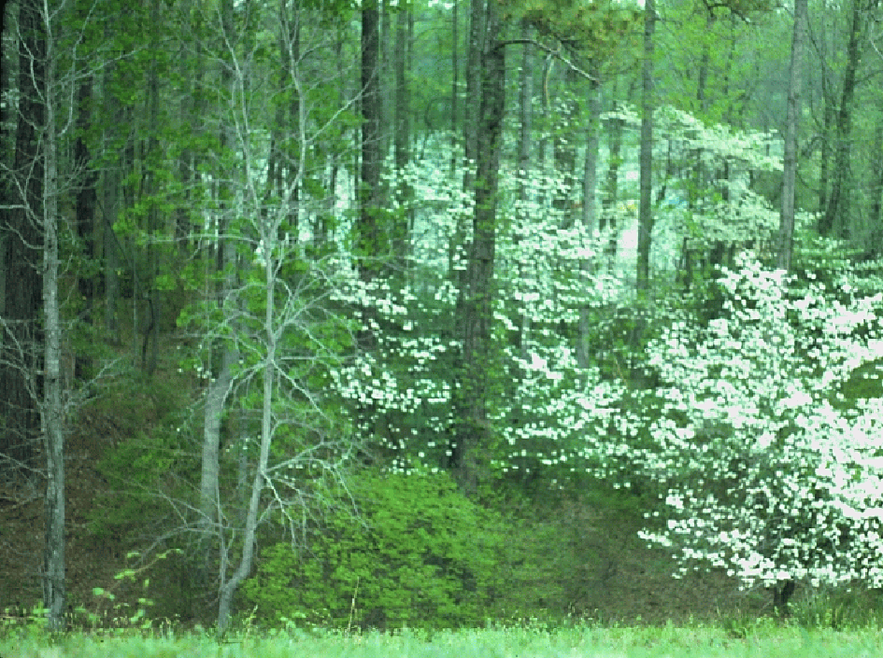
Notes:
43. DOGWOOD IN WOODED AREAS: Certain native plants, like the flowering dogwood, grow as understory plants in wooded areas. For best results, plant dogwoods in a similar location in the landscape

Slide 44
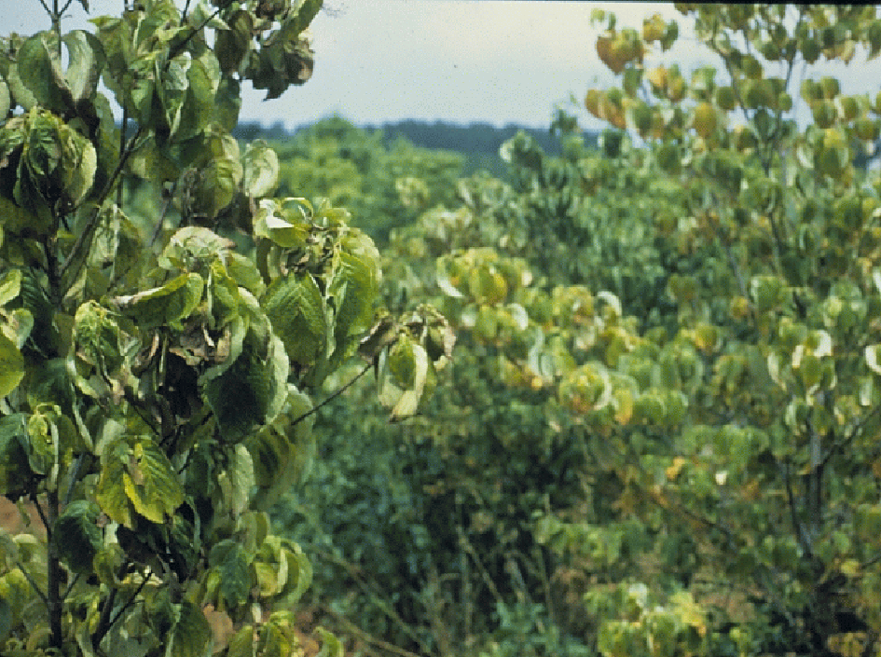
Dogwood Twig Borer
Ambrosia Beetle
Spot Anthracnose
Dogwood Anthracnose
Notes:
44. DOGWOODS IN FULL SUN: When planted in full sun without irrigation, dogwoods often stress during drought and become more prone to insect and disease problems, such as dogwood twig borer, ambrosia beetle, spot anthracnose and dogwood anthracnose.

Slide 45
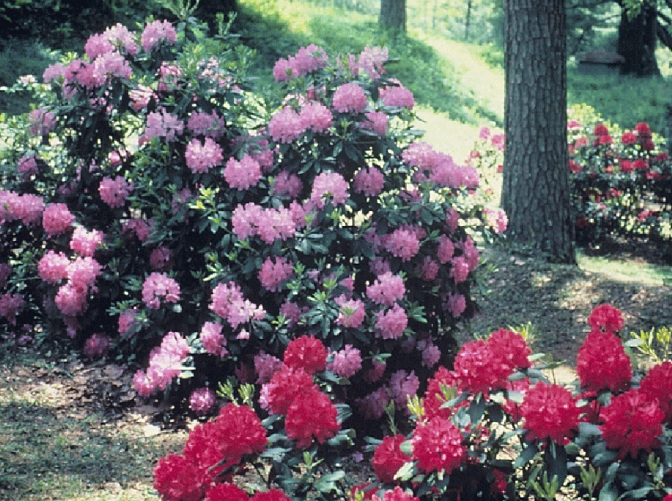
Notes:
45. RHODODENDRON: Rhododendrons are native to moist, shaded areas in mountainous regions of the eastern U.S. For success with this plant in the landscape, provide an environment similar to their native habitat - moist, well-drained soils, filtered shade and rich organic matter.

Slide 46
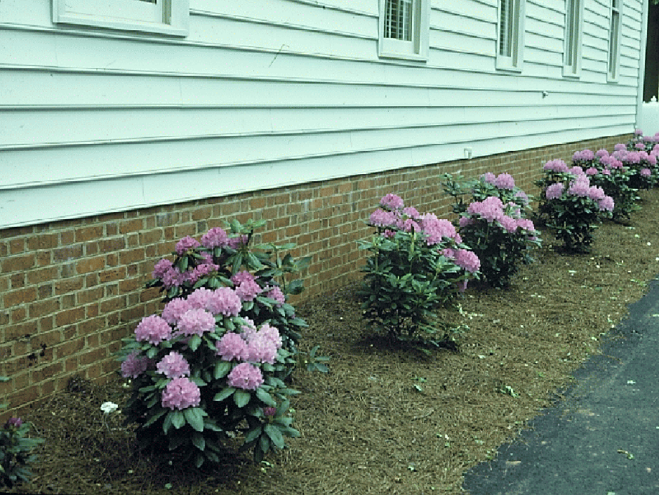
Notes:
46. RHODODENDRON IN FULL SUN: These rhododendron were planted on a hot western exposure without irrigation. They survived about six months and were replaced with a better adapted species.

Slide 47
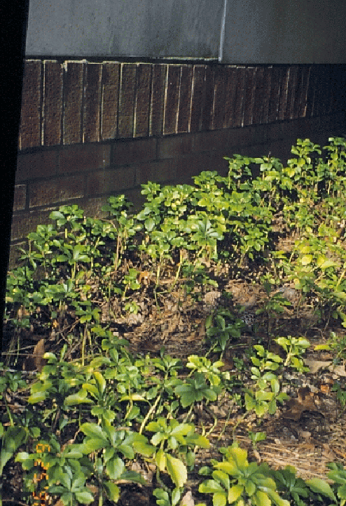
Sun/drought effects on
Japanese Pachysandra
Notes:
47. SUNBURN ON PACHYSANDRA: Pachysandra is a groundcover for shady, moist sites. It does not like full sun and dry soils as this slide shows.

Slide 48
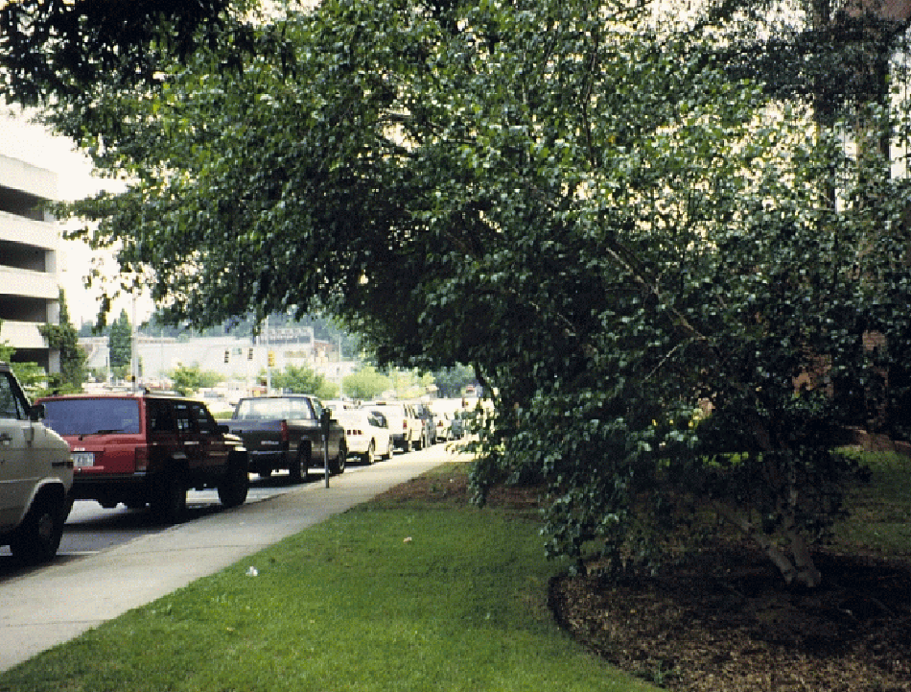
Notes:
48. RIVER BIRCH IN SHADE: This river birch began leaning out from under two large oak trees in an attempt to capture sunlight. With time, the plant will become a liability and possibly fall on cars or pedestrians

Slide 49
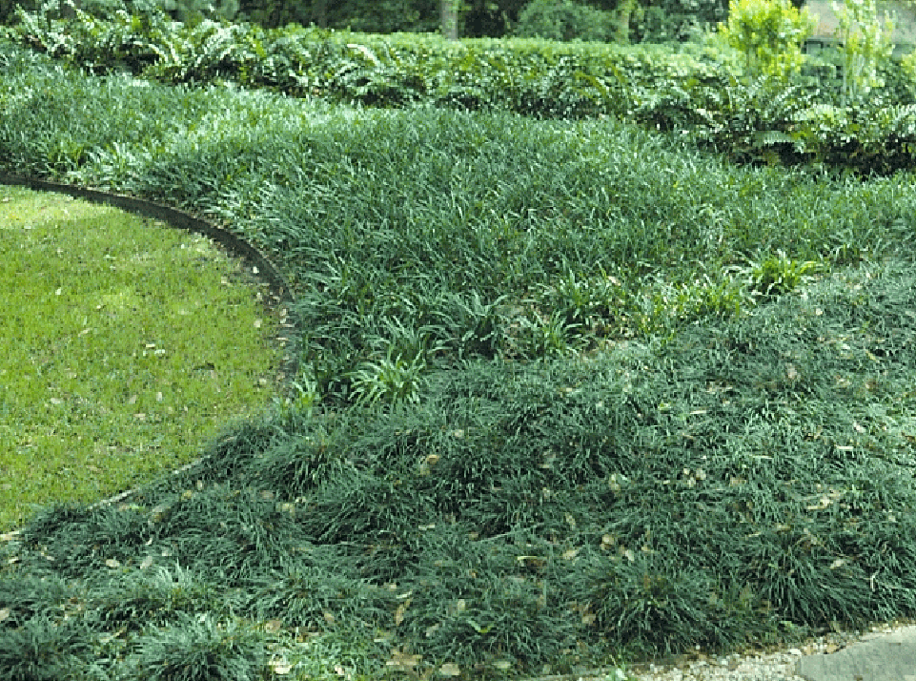
Notes:
49. LIRIOPE IN SHADE: So when shade is a factor, select plants adapted to the site, such as this liriope, mondo grass and holly ferns.

Slide 50
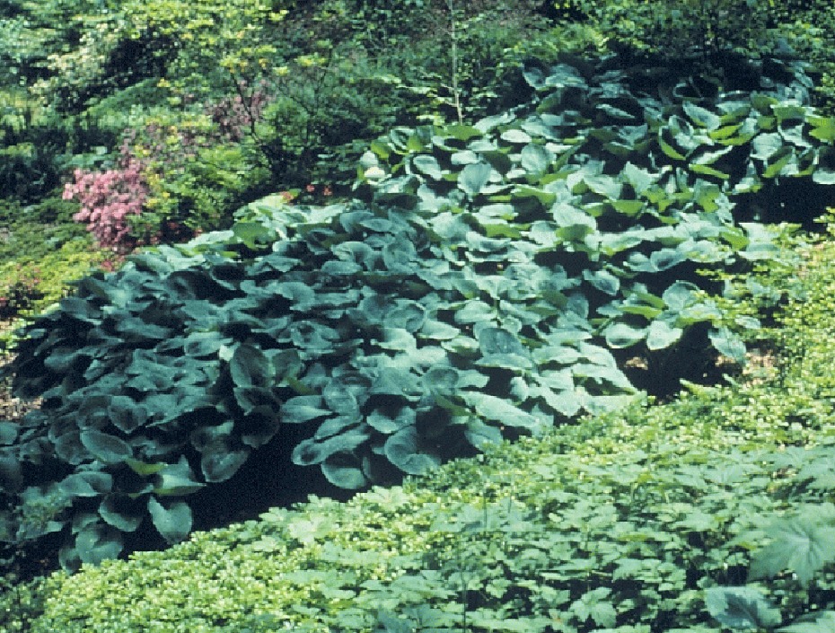
Notes:
50. SHADY SITE: In this shady site, hosta, pachysandra, azaleas and helleborous were excellent choices and are thriving.

Slide 51
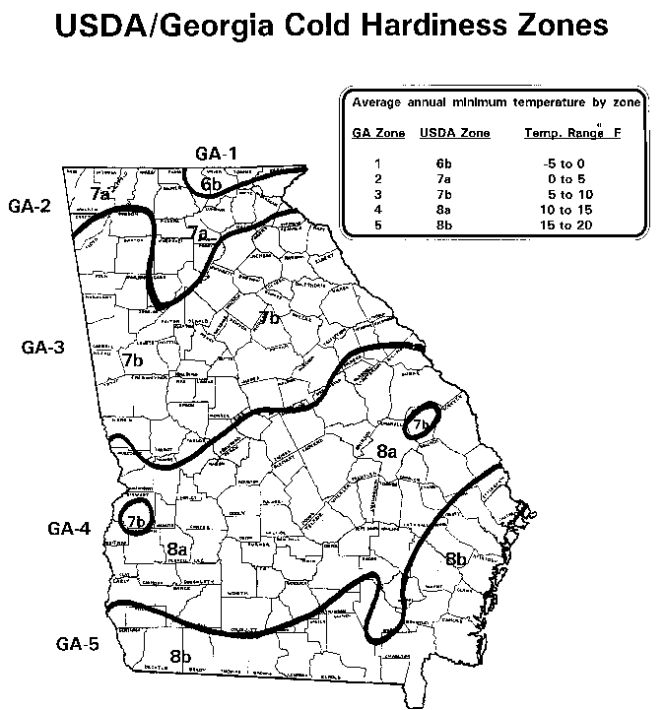
Notes:
51. COLD HARDINESS MAP: Temperature extremes are another very important environmental factor that influences plant adaptability. In Georgia we have five cold hardiness zones, ranging from an average minimum temperature of -5 ºF in the mountains to 15 ºF in south Georgia. It’s important to select plants that can tolerate the minimum temperatures in your area. However, that does not mean that you should select plants listed just for your zone. A plant listed for hardiness zone 6 should certainly be able to withstand the minimum temperatures in zone 8. On the other hand, it would not be wise to plant a zone 9 plant in zone 8.

Slide 52
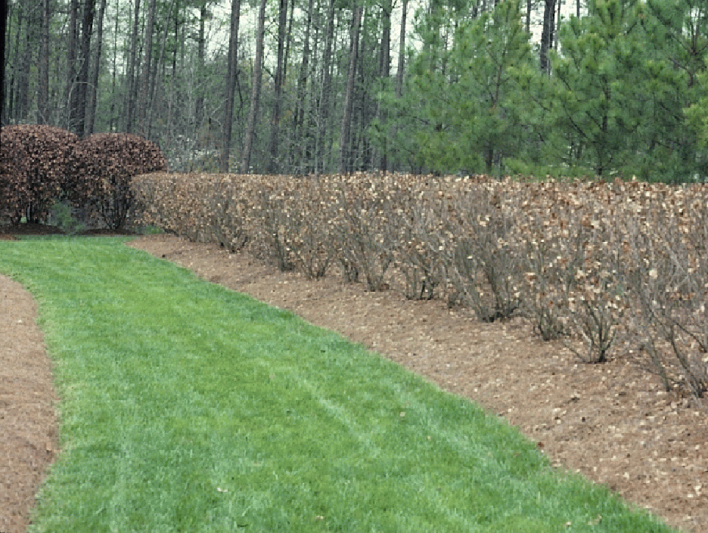
Select Plants Adapted to Your Hardiness Zone
Notes:
52. COLD DAMAGE LIGUSTRUM: These wax-leaf ligustrums were killed to the ground in the big freeze of 1985 when temperatures dipped to 6 above zero with a chill factor of -30 ºF. Select plants with cold hardiness in mind.

Slide 53
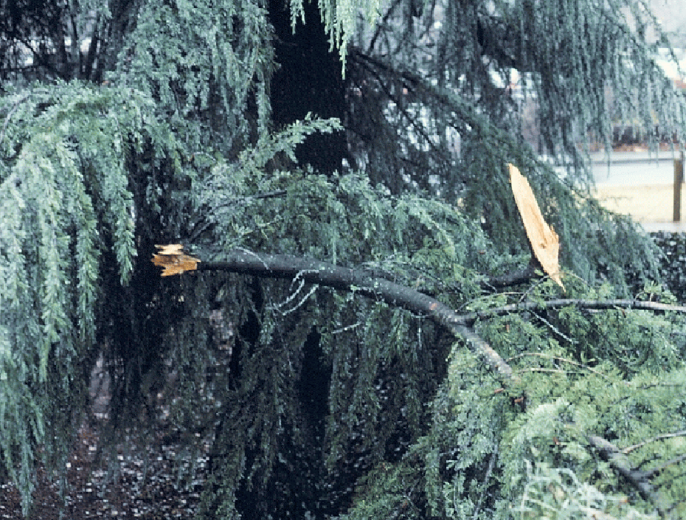
Notes:
53. DEODAR AFTER ICE STORM: In north Georgia, ice storms often cause limb damage to ornamental plants, particularly conifers. The weight of the ice is more of a problem than the actual temperature. We have no control over this environmental factor.

Slide 54
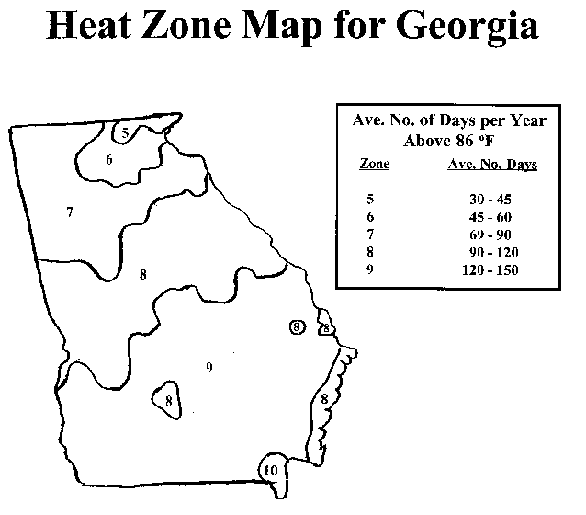
Notes:
54. HEAT ZONE MAP: Heat hardiness should be considered when selecting ornamental plants. Heat hardiness zones have recently been established based on years of climatic data from the USDA. In Georgia, we have five heat hardiness zones, listed according to the average number of days per year above 86ºF. Some new plant books list the heat hardiness zones for a plant as well as the cold hardiness zones. Heat hardiness is important because our hot days and warm nights in summer result in high respiration rates that deplete a plant’s food reserves. Plants not adapted to our southern heat become stressed when the rate of respiration and break-down of food substances exceeds the rate of photosynthesis and food manufacturing.

Slide 55
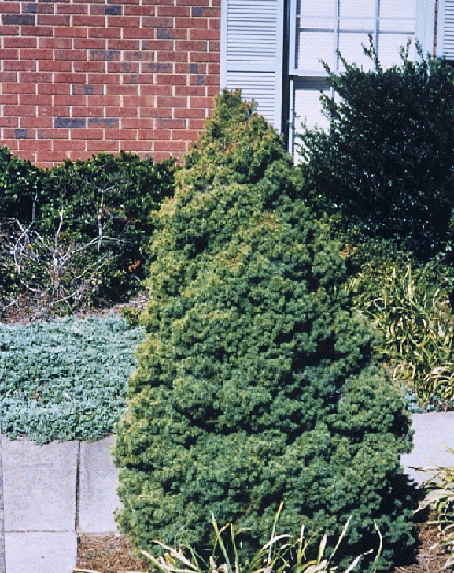
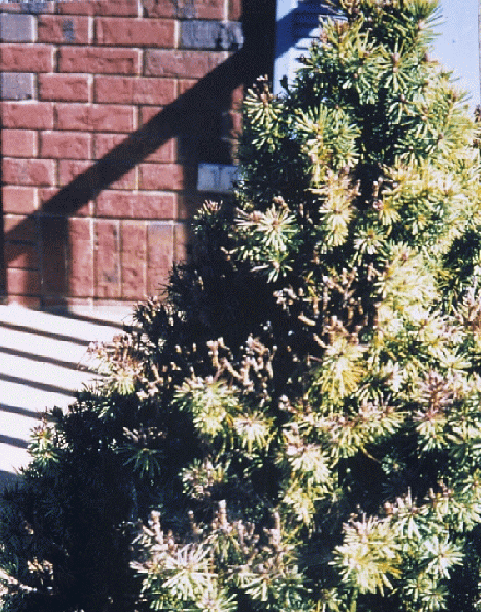
Heat stress on Alberta Spruce
Spider Mites attack
Notes:
55. ALBERTA SPRUCE UNDER STRESS: This Alberta Spruce is growing in full sun, compacted soil without irrigation in Atlanta. This is a Canadian tree that is not well adapted to Georgia’s heat and humidity. Close examination of the plant shows it has spider mites, but they are attacking the plant because it is stressed by its growing environment.

Slide 56
Some plants are less tolerant of stress than others and therefore more prone to problems when the environment isn’t perfect
Notes:
56. SOME PLANTS ARE LESS TOLERANT OF STRESS THAN OTHERS AND ARE THEREFORE MORE PRONE TO PROBLEMS WHEN CONDITIONS ARE NOT PERFECT. Learn to recognize plants that seem to be more prone to problems in the landscape and avoid planting them when possible.

Slide 57
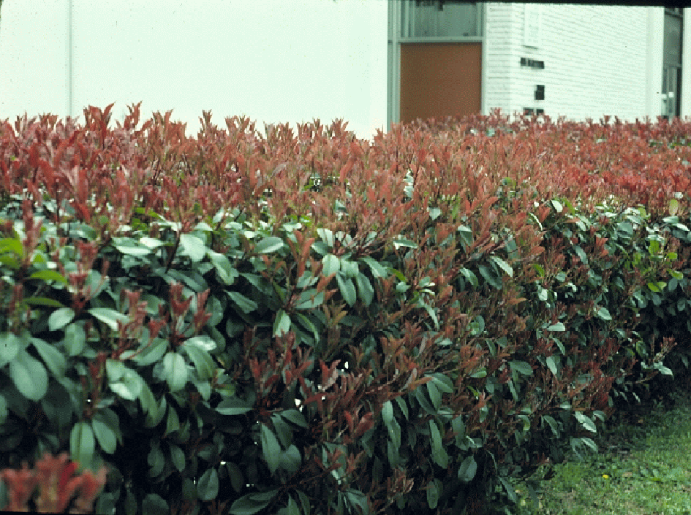
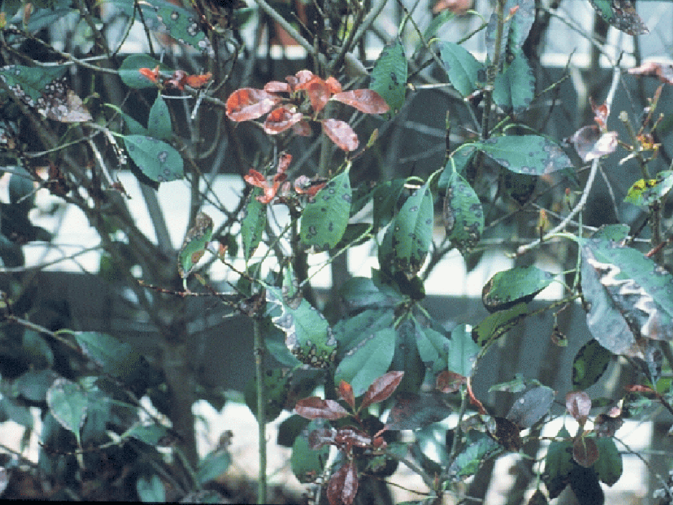
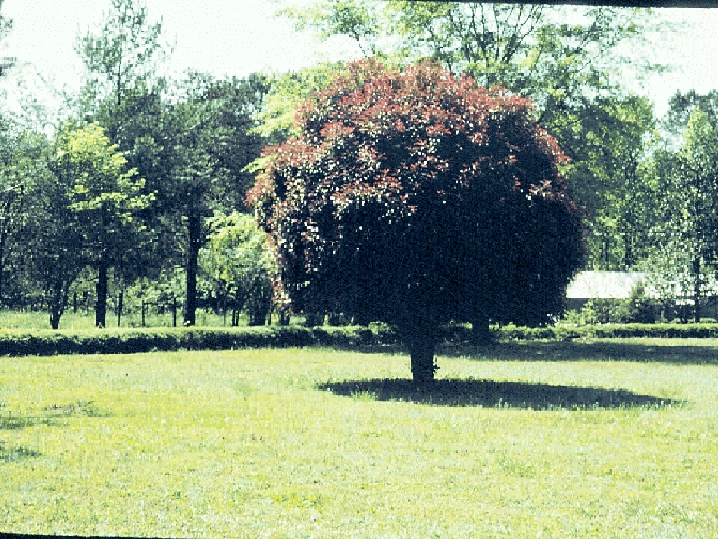
Red-tip photinia
(Photinia x fraseri)
Entomosporium leaf spot
Notes:
57. RED-TIP PHOTINIA: For years, Red-tip Photinia was the hedge plant of choice. Then a serious leafspot disease developed, infecting plants and defoliating them. Entomosporium leafspot disease is not easily controlled and easily re-infects new growth, particularly during moist, humid weather. Environmental stress, such as poorly drained soils, encourages the problem. Raising the canopy of a Red-Tip Photinia and shaping the plant into a tree-form will provide a barrier between the soil or mulch and the plant canopy and will reduce the likelihood of the disease. Thinning out the branches to improve air circulation will also help. Better yet, don’t plant Red-tip Photinia.

Slide 58
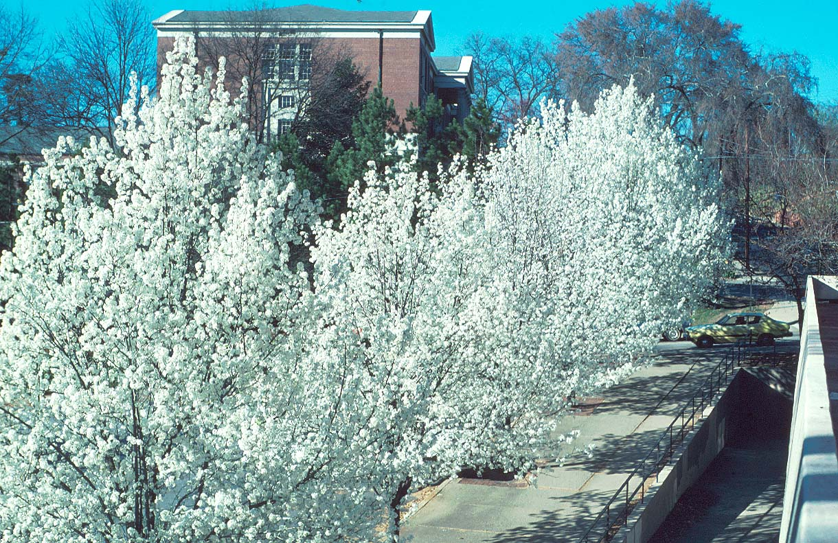
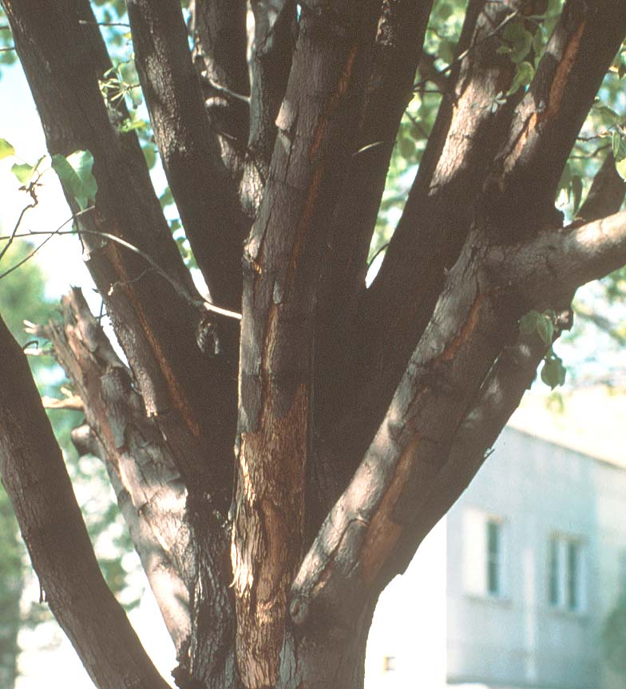
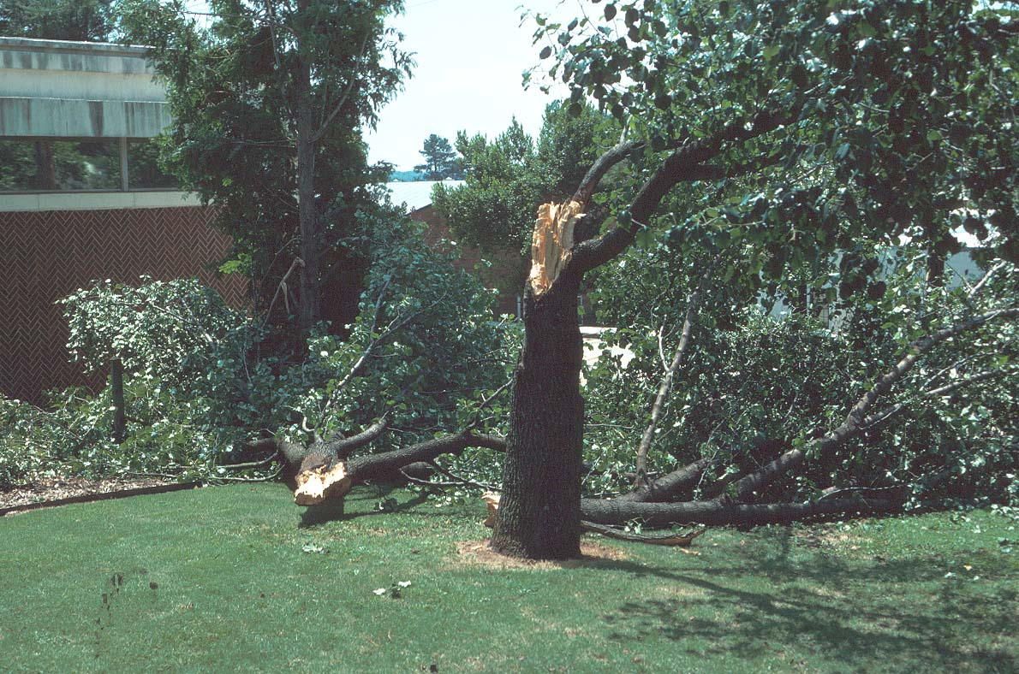
Notes:
58. BRADFORD PEAR: Bradford pear is one of the most widely planted flowering trees. However, aside from about 5 days of pretty flowers in the spring, the plant has few merits. It is susceptible to fireblight, a bacterial disease and canker diseases. But its main problem is its branching structure. Theses narrow crotches are weak and break easily in ice storms and heavy winds. The plant will literally self-destruct when it reaches 15-20 years of age.

Slide 59
Boxwood
(Buxus sempervirens)
Notes:
59. BOXWOOD: Boxwoods under stress are prone to a multitude of problems, including cankers, blight, leafspots, root rot, winter injury, sunscald, mealybugs, scales, boxwood leaf miner, boxwood psyllid, giant hornet, boxwood webworm, nematodes and boxwood mites. The combination of these problems is often referred to as “boxwood decline”

Slide 60
Manhattan Euonymus
(Euonymus kiautschovicus
‘Manhattan’)
Notes:
60. MANHATTAN EUONYMUS: Manhattan Euonymus is a great plant for shady, moist alkaline areas (upper left). But when planted in full sun without irrigation, Manhattan Euonymus looks like this during the summer growing season (lower right).

Slide 61
Phomopsis Blight on Dwarf Japanese Garden Juniper
Notes:
61. DWARF JAPANESE GARDEN JUNIPER: Dwarf Japanese Garden Juniper is a great plant for rock gardens, but when grown under stressful environmental conditions, like extreme fluctuations in soil moisture, it becomes susceptible to a foliar disease called Phomopsis Blight. This is a serious problem of Japanese Garden Junipers under stress. Pruning and frequent pesticide sprays are required to keep the disease in check. A better adapted plant is the best long-term solution.

Slide 62
Andorra Compacta Juniper
(Juniperus horizontalis ‘Plumosa’)
Notes:
62. ANDORRA COMPACTA JUNIPER: Andorra and Andorra compacta junipers are, for some reason, very susceptible to spider mites.

Slide 63
Pfitzer juniper
Spider mites on
Andorra juniper
Parson’s juniper
Notes:
63. ANDORRA ATTACKED BY SPIDER MITES: These Andorra Junipers (center) were literally destroyed by spider mites while the Parson’s Juniper along the outside and the Pfitzer Junipers in the background were unaffected

Slide 64
Canna leaf roller
Notes:
64. CANNA LEAF ROLLER: Canna lilies are susceptible to a leaf-roller caterpillar that rolls together the newly expanding leaves and chews holes in them. The leaves appear burnt and shriveled as they expand. Pesticides can be used to control the pest, but good growing conditions (ie. moist well-drained soils) that prevent plant stress will help avoid the problem.

Slide 65
Bot Canker
on Leyland Cypress
Notes:
65. BOT CANKER OF LEYLAND CYPRESS: Environmental stress on Leyland Cypress makes them prone to two serious fungal cankers called Botryosphaeria canker or ‘Bot’ canker and Seridium Canker. These diseases can not be controlled with pesticides because symptoms are not noticed until they are within the systemic system of the plant. The fungi enter through stress cracks in the bark brought on by cold damage, drought stress or mechanical injury. Plants infected with ‘Bot’ Canker will have sunken cankers along the infected branch with gummy dark-colored sap oozing from them.

Slide 66
Bagworms on Leyland Cypress
Notes:
66. BAG WORMS ON LEYLAND CYPRESS: Bagworms are another problem on Leyland Cypress.

Slide 67
The Ideal Landscape Plant
Requires no pruning
Requires no supplemental fertilizer
Requires no irrigation
Has no known pests
Tolerates extreme heat and cold
Thrives on neglect
Notes:
67. THE IDEAL LANDSCAPE PLANT: Does anyone know the ideal landscape plant?

Slide 68
Kudzu
Notes:
68. KUDZU: Kudzu is well adapted to many parts of Georgia, but it is not recommended as a trellis plant on the side of your home.

Slide 69
Notes:
69. PLASTIC PLANTS: One service station in Athens planted plastic plants in the landscape, but even they defoliated during a summer drought. Notice how they were keeping them irrigated too.

Slide 70
Notes:
70. FOGGY SCENE: By now you are probably in a fog, so let me pause here and see if you have any questions about anything covered so far. (QUESTIONS????)

Slide 71
Let's Take a Break!
Notes:
71. LET’S TAKE A BREAK: If there are no further questions, let’s take a break.

Slide 72
Cultural Causes of Plant Stress
Planting too deep
Planting too shallow
Excess water ring
Too much mulch
Planting too close
Over-watering
Improper pruning
Chemical injury
Mechanical injury
General plant abuse
Notes:
72. CULTURAL CAUSES OF PLANT STRESS: The next major category of plant stresss are cultural problems brought on by such things as planting too deep, planting too shallow, excess water ring, too much mulch, planting too close, over-watering, improper pruning, chemical injury, mechanical injury or simply general plant abuse.

Slide 73
Notes:
73. PLANT SET TOO DEEP: This plant was planted too deeply in the soil and developed a secondary or “adventitious” root system further up on the stem in an effort to survive. This stresses the plant and causes long-term problems or death.

Slide 74
Notes:
74. PLANT SET TOO SHALLOW: Planting too shallow causes plant stress by exposing the roots, causing them to dry out. You’ll also note in this case that the burlap was not removed from the top of the root ball.

Slide 75
Notes:
75. EXCESS SOIL RING: Soil rings, also called saucers or berms, are often put around newly planted trees and shrubs to direct water to the roots. Sometimes these rings are built too high along the perimeter of the planting hole. As a result, soil erodes over the root ball of the plant with time, causing root suffocation. Soil rings should be only 3 to 4 inches high and should be raked outward and leveled away from the planting hole 6 to 8 weeks after planting.

Slide 76
Notes:
76. EXCESS MULCH: Excess mulch around the plant will suffocate roots and will cause roots to grow out of the soil and into the mulch layer in an attempt to obtain moisture and oxygen. This results in root stress. Mulch piled on the lower trunk will also encourage trunk decay and pest problems, such as voles.

Slide 77
Sun-scald
on red maple
Notes:
77. SUNSCALD: Sunscald is sometimes a problem on trees, particularly when the sap is flowing and they are leafing out in spring. These maple trees were laid on their side exposed to the hot sun several days before planting. The result was severe bark splitting from the base to the main branches. The trees should have been kept in the shade or had their trunks shielded from the hot sun.

Slide 78
Plants should fill the space…
not compete for space
Notes:
78. PLANTS SHOULD FILL THE SPACE...NOT COMPETE FOR SPACE.

Slide 79
Improper Spacing
Poor air circulation
Encourage insects and diseases
Plants loose individuality
Shear plants as one mass
Notes:
79. DWARF YAUPON HOLLY PLANTED TOO CLOSE. These dwarf yaupon hollies were planted on about 15-inch centers. The plant eventually grows 5 to 8 feet wide and 8 to 10 feet tall and need to be planted on 6 to 8 feet centers. When plants are planted too close to each other, they grow together, lose their individuality and become thick and dense and more prone to insect and disease problems. They also become a maintenance problem and have to be sheared as one large mass or removed to improve air circulation.

Slide 80
Notes:
80. OVERGROWN PLANTS: These plants were poorly selected in terms of size and location and became overgrown, blocking doorways and sidewalks. Routine pruning is required to keep the plants in bounds, and pest problems are more likely to occur as a result of the poor air circulation. This maintenance problem could have been avoided in the design and plant selection phases of the landscape.

Slide 81
Notes:
81. ENGLISH LAUREL SET TOO CLOSE: These English Laurel plants were being planted on about 3 feet centers. They need to be planted at least 5-feet apart. When English Laurel is planted to close and becomes thick and dense, it becomes more susceptible to a fungal leafspot disease called “Shothole” that causes holes in the leaves and defoliation. Proper plant spacing improves air circulation, reduces the moisture on the foliage, and limits the chances of shot-hole disease development

Slide 82
Notes:
82. JUNIPERS PLANTED TOO CLOSE: When horizontal junipers are planted to close together they will overgrow their neighboring plant and become thick and dense and more susceptible to insect and disease problems. They become a maintenance nightmare. Plants will have to be thinned out to increase air flow within the canopy to minimize mites and disease. Plants are also difficult to treat with pesticides because of foliage density.

Slide 83
Consider the mature size and shape of ornamental plants when determining their location and spacing in the landscape
Notes:
83. CONSIDER THE MATURE SIZE AND SHAPE OF PLANTS: When selecting plants, consider how large they will grow in 5 to 10 years and select them for the space so they do not overgrow the site and become a problem

Slide 84
Dwarf Burford Holly: 15-20 ft.
Notes:
84. DWARF BURFORD HOLLY: Dwarf Burford Holly will grow to 15- to 18 feet tall with about a 20 feet spread. This is dwarf compared to its counterpart, Burford Holly, which grows to 35- to 40 feet in height.

Slide 85
Dwarf Chamaecyparis
Notes:
85. DWARF CHAMAECYPARIS: Don’t be mislead by the name “dwarf”. It often means the plant is simply a slow grower. This 30 year old “Dwarf Chamaecyparis” is about 50 feet tall.

Slide 86
How large does Leyland Cypress grow?
Notes:
86. HOW LARGE WILL LEYLAND CYPRESS GROW?

Slide 87
100+ feet tall
Notes:
87. LARGE LEYLAND CYPRESS: Leyland Cypress will eventually grow 120 feet tall. They will dwarf a one story home in about 10 years and a two story home in about 20 years. One day soon you won’t see homes in Georgia for all the Leyland Cypress.

Slide 88
Notes:
88. STREET TREE WELL: This willow oak was planted as a street tree in a small planting pit, approximately 2 ½ feet by 4 feet in size. The result will be a long-term stunting of growth from the insufficient root system, stress problems and increased liability problems.

Slide 89
Notes:
89. TREE ROOT GROWING INTO STREET: The roots of this mature oak protruded into this paved area, causing problems with parking, potential root damage and above-ground stress.

Slide 90
Notes:
90. PINE LOCATED TOO CLOSE TO HOME: Which came first - the house or the tree?

Slide 91
Select plants adapted to the site and the local environmental conditions
Notes:
91. SELECT PLANTS ADAPTED TO THE SITE AND THE LOCAL ENVIRONMENTAL CONDITION:

Slide 92
Above-average Tolerance to Moist Sites
Weeping willow
Red maple
Bald cypress
Yaupon/dwarf yaupon holly
Sweetbay magnolia
Wax myrtle
Virginia sweetspire
Clethra
Iris
Ornamental grasses
Notes:
92. PLANTS FOR WET SITES: Good plant books and Extension publications often list plant adaptability to different sites. If the site is moist, for instance, select plants tolerant of that growing condition. Some good choices would include........

Slide 93
Plants Not Tolerant of Wet Sites or Extreme Fluctuations in Soil Moisture
Juniper
Azalea
Camellia
Cryptomeria
Leyland cypress
Ornamental cherries
Helleri holly
Winter daphne
Notes:
93. PLANTS NOT ADAPTED TO WET SITES: On the other hand, there are a number of plants not tolerant to wet sites. These are few you would not want to consider planting in moist areas.

Slide 94
Avoid Planting Plants with Similar Pest Susceptibility Side by Side
Notes:
94. AVOID PLANTING PLANTS WITH SIMILAR PEST SUSCEPTIBILITY SIDE BY SIDE.

Slide 95
Possible Plant Combinations to Avoid
Marigolds/daylilies/junipers – spider mites
Iris/junipers – spider mites
Spirea/crape myrtle – aphids
Lantana/ornamental sweetpotato –whiteflies
Camellia/burford holly – scale insects
Azaleas/ornamental cherries
Notes:
95. AVOID CERTAIN PLANT COMBINATIONS: Due to similar pest problems brought on by plant stress, certain types of plants should not be located adjacent to each other. (Go through list). Ornamental cherries and azaleas are not good companion plants because cherries require an alkaline pH about 7.0 while azaleas require and acidic pH around 5.0. If you lime the cherries, the azaleas will stress. If you fertilize the azaleas with an acid-type fertilizer the cherries will be stressed.

Slide 96
Look for
Pest-resistant
Alternatives
Notes:
96. LOOK FOR PEST RESISTANT PLANTS: Some plants are naturally resistant to pest problems.

Slide 97
Chaste Tree
Ornamental grass
Loropetalum
Notes:
97. EXAMPLES OF PEST TOLERANT PLANTS: Ornamental grasses are excellent examples of pest tolerant plants. They seldom have insect or disease problems and are very adapted to a wide range of growing conditions. Chaste tree, or Vitex, is another good pest tolerant plant also having good drought tolerance and durability to a wide range of soils and climates. Loropetalums are popular plants in the landscape trade. So far they are showing good pest tolerance and durability.

Slide 98
Native Plants are
Not Always
the Answer
Notes:
98. NATIVE PLANTS ARE NOT ALWAYS THE ANSWER. Native plants, like introduced species, should have a growing environment similar to that of their native habitat.

Slide 99
Notes:
99. FERNS IN WOODED AREA: Wood ferns, for instance, grow as under-story plants in rich, moist organic soils. They require these same growing conditions in the landscape.

Slide 100
Fertilizer burn on azaleas
Avoid this problem by never broadcasting fertilizer on wet foliage
Notes:
100. FERTILIZER BURN: Now let’s look at a few problems caused by poor management. Too much fertilizer placed around ornamental plants will damage roots. Fertilizers are chemically salts and can damage roots when applied in excess. Too much fertilizer dehydrates roots and causes above-ground foliar scorching like this. Broadcasting fertilizer onto wet foliage can also cause this symptom as water droplets dehydrate and concentrate the fertilizer on the foliage. You can avoid this problem by applying fertilizers at the recommended rate and by keeping granular fertilizers off wet foliage.

Slide 101
Many of the problems we encounter in landscapes are out own fault
Poorly designed irrigation is
a leading cause of plant stress
Notes:
101. OVERHEAD IRRIGATION: Irrigation systems should be zoned according to the water needs of specific plants. All the plants in this landscape are receiving the same amount of water from this overhead irrigation system. Poorly designed irrigation systems are a leading cause of plant stress.

Slide 102
Botrytis blight on begonia caused by frequent overhead irrigation.
Could be avoided by using drip irrigation or ooze hose to avoid wetting foliage
Notes:
102. BEGONIA BLIGHT: Botrytis blight, sometimes called ‘melting out’ disease is causing stem decay on these begonia plants. It was brought on by frequent overhead irrigation and poor air circulation. It could have been avoided by using drip irrigation instead of overhead irrigation.

Slide 103
Notes:
103. PRUNING NEAR SIDEWALK: Pruning to keep a plant within bounds is very stressful to the plant. It also indicates a poor selection of plants for the space.

Slide 104
Crape Murder!!!!
Notes:
104. CREPE MURDER: Crepe murder is a common problem throughout Georgia. It results in thick, dense growth, decaying older stems and makes the plant more susceptible to aphids and powdery mildew in the spring. Avoid cutting the plants back to the same woody nubs each year.

Slide 105
Notes:
105. FORMER FOSTER HOLLIES: These Foster Hollies were the wrong plant for the site and had to be butchered to keep them within bounds. This is very stressful to the plant and is a maintenance problem.

Slide 106
Lawnmower blight/spouse damage
Mulching will avoid this problem
Notes:
106. EQUIPMENT DAMAGE: Damage from weed eaters or lawn mowers to the trunk of trees causes severe stress, weakening the tree and making it more susceptible to borers and decay. If girdling occurs, the tree will die. It could be avoided by placing mulch around the base of the tree to keep equipment away from the trunk

Slide 107
Pyracantha not pruned – pedestrian problem
Notes:
107. LACK OF PRUNING: This pyracantha was not pruned and allowed to grow out over a walkway, causing problems with pedestrian traffic and becoming a liability problem.

Slide 108
Herbicide/Chemical Damage
Serious Plant Stress
Notes:
108. HERBICIDE DAMAGE: Herbicide injury from materials like “Weed and Feed” fertilizers is a common problem in residential landscapes. 2,4-D type compounds should not be used around broadleaf ornamental plants, particularly newly planted plants.

Slide 109
Round-up Damage
Notes:
109. ROUND-UP INJURY ON CRAPE MYRTLE: A common problem on crape myrtle is Round-up injury. Some Round-up was sprayed accidentally on suckers under this plant. Although the concentration was insufficient to kill the plant, it was enough to cause severe growth distortion the following year. It may take two or more years for a plant to grow out of this injury.

Slide 110
Notes:
110. GUY WIRE DAMAGE: Guy wires are often used on newly planted trees to hold them in place during establishment. However, if not removed when the tree is established, severe damage to the tree trunk may result. When a tree is girdled by wire, the flow of food substances within the tree is blocked, and the tree may decline or die.

Slide 111
Notes:
111. TREE GRATE ENGULFING TREE: Street tree neglect caused this problem as the tree grate punctured the tree bark and caused growth problems. The grate should have been removed years before this photo

Slide 112
Notes:
112. BURNING UNDER TREES: Burning brush under trees can cause severe damage to roots, trunk and leaves. This fire under these pine trees was killing the root system, making the plants more susceptible to pest problems, such as Southern Pine Beetles. Never burn brush near trees.

Slide 113
Be a Detective When Analyzing Ornamental Plant Problems
Notes:
113. BE A DETECTIVE WHEN ANALYZING ORNAMENTAL PLANT PROBLEMS:

Slide 114
Plant Stress Can Be Avoided Most of the Time
Thoroughly analyze the site
Select plants best suited to the site
Make changes to the site to fit plants
Minimize stress from maintenance practices
Notes:
114. PLANT STRESS CAN BE AVOIDED MOST OF THE TIME: Look at the environment, not only the current situation but the past history of the site. Make certain the plants are good choices for the site. Make changes to the site when possible to improve growing conditions. Examine the cultural practices used during establishment, and ask questions about maintenance. By being a detective and putting the pieces of the puzzle together through close examination, careful sampling and utilization of appropriate references, you may not be correct in your diagnosis all of the time, but you will be correct MOST OF THE TIME.

Slide 115
Diagnostic Resources
A compilation of Low-maintenance Plants for Georgia Landscapes
UGA Web Site:
www.uga.edu
Click on departments, then horticulture, then publications
Notes:
115. DIAGNOSTIC RESOURCES: There are many resources available to assist you with trouble-shooting and correcting plant problems. UGA has a number of publications that can help you. For instance.......

Slide 116
Notes:
116. PANSY GROWING IN CRACK IN SIDEWALK: Finally, we leave you with a classic example of plant adaptability - a single pansy plant making the best of a bad situation and blooming despite the harsh environment. Unfortunately, the weed eater got this plant a couple of days after this photo....it was a plant out of place.

Slide 117
Authors:
Gary L. Wade
Extension Horticulturist
and
Gary R. Peiffer
DeKalb Co. Extension Agent
The University of Georgia
College of Agricultural and Environmental Sciences
Notes:
117. CREDIT SLIDE: Thank you for your attention. Now do you have any final questions on anything covered today?????

