Slide 1
TREES AND CONSTRUCTION
By: Gary Peiffer
County Extension Agent
DeKalb County, Georgia
In Cooperation with
The University of Georgia
Cooperative Extension Service
Urban Forestry Issue Team

Slide 2
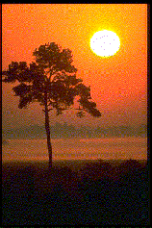
WHY TREES – WHO CARES?

Slide 3
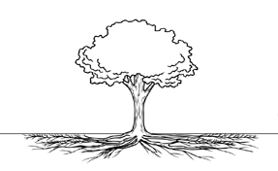
Tree Roots – where they are?
Notes:
No they are not that deep – often only 12 to 18 inches deep or less in Piedmont clay soils.
Yes – they spread out far – don’t stop at the drip-line can be 3-5 times the length of the branch spread and on out into the neighbor’s yard.

Slide 4
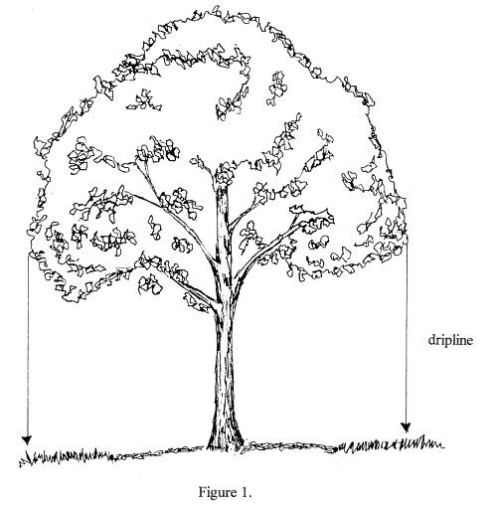
Drip-line?
Notes:
Drip-line was once considered the magical term for where you need to protect tree root areas. It is easily visible and easily determined because it is located at the farthest extensions of the branches.

Slide 5
What is CRZ?
CRZ or the critical root zone is the area under the tree where roots must be protected to insure its future survival. The area where no construction activities are allowed.
Different states and cities specify different minimum CRZ’s so be sure you refer to local ordinances before initiating a tree protection plan.
Examples:
- Some consider the CRZ to be the soil area from the drip-line to the trunk.
- Another says to protect a root area equal to 1 foot out for every 1 inch of trunk d.b.h. Therefore, a 60 inch d.b.h. tree would have a CRZ out 60 feet.
- Dr. Coder from UGA recommends we protect a root area 2 ½ times the diameter at breast height.
ex. 60 inch dbh means the CRZ would be 150 ft. out.
BEST IDEA – protect the maximum root area allowed!

Slide 6
Benefits of Trees
Provide shade for homes and commercial development.
Reduce heat island effect and reduce cooling costs in our buildings.
In winter, they shield against cold winds and reduce heating costs.
Leaves filter out dust and air pollutants.
Trees shelter wildlife, muffle noise, provide aesthetic beauty.
There are many more so please add your own!

Slide 7
TYPES OF CONSTRUCTION DAMAGE
Physical Wounds
Environmental Changes
        Soil compaction
        Excessive thinning
        Moisture stress
        Soil fill
        Soil cuts
Notes:
Physical wounds can be caused by personnel or equipment working on the site. The larger they are the more damage they cause and the slower they are to close.

Slide 8
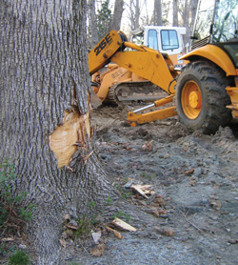
Physical Wounds
Removal of large areas of bark and cambium reduces tree vigor.
Large wounds seal or close very slowly and are open to insects and/or disease.
Improper pruning or branch breakage also lead to open wounds.

Slide 9
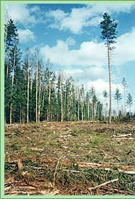
Excessive Tree Thinning
Reduces protection from winds.
Damages root areas because roots are all inter-twined.
Produces weaker trees with thin trunks and small crowns.
Leaves trees vulnerable to wind throw or breakage.

Slide 10
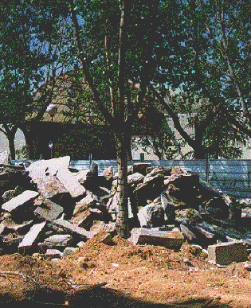
Soil Compaction
Causes:
    Running of heavy equipment over root zones
    Piling of debris on top of tree roots
    Parking the construction trailer under a tree

Slide 11
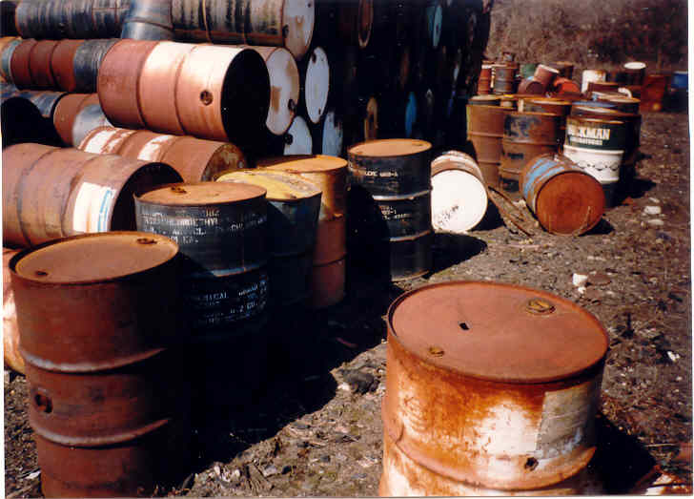
Soil Contamination
Prevent soil contamination
that can damage or kill trees!
- Watch out for fuel leaks.
- Do not allow on-site
paint dumping.
- Plan for cement or mortar wash out areas.
Is this a good home building site?

Slide 12
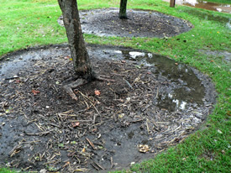
Moisture Stress
May be from changes in the soil grade, cut outs or soil fills.
Could be from soils being too compacted.
Could be from changes in drainage and grading.
Either way - trees can end up too wet or too dry and not be able to adapt.

Slide 13
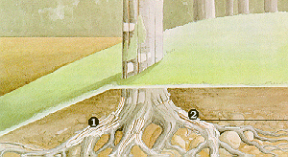
Soil Fills
Soil fill over tree root areas does what?
What’s a large amount of soil fill?
Can we work with fill areas to salvage trees and how would it be done?
Notes:
Soil fill over the CRZ or the critical root zone which is to at least the drip-line, usually results in gradual or speedy death. How much is a large amount of soil fill? Anything more than an inch to three inches of well drained soil mix per growing season. What do soil fills do – damage trunks, reduce soil oxygen, change the water table.
Methods of working with soil fills – tree wells if there is sufficient space to put them out towards the drip line and to salvage sufficient root area. 1 – is where original soil level was. 2 is damaged roots from fill and wounding

Slide 14
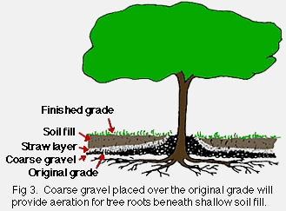
Making Grade Changes
Notes:
Porous fill can also be used if you are making additions of 1-3 inches over the root zone.
Porous fill would be a mixture of one part loam, one part coarse sand (like granite sand) and one part shredded pine bark.

Slide 15
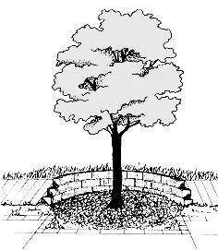
Tree Wells
Tree wells can be effective if you have enough space to get them in.
They should ideally be located at the drip-line or beyond to protect the critical root zone (CRZ).

Slide 16
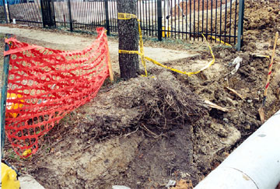
Soil Cut Outs
Remove vital feeder roots that pick up nutrients and water.
Eliminate the nutrient rich topsoil.
Damage major roots and opens them to pest entry.
Often lower the water table.

Slide 17
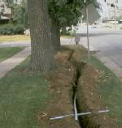
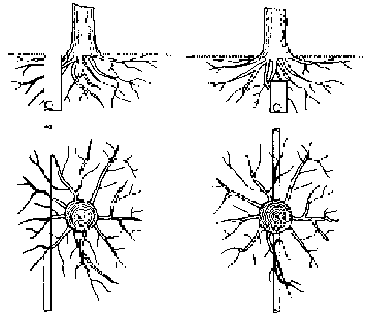
Excavation for Utility Lines
Often the last thing installed.
Often not considered in poor tree protection plans.
Can be added with minimal tree damage.
A.
A.
B.
Notes:
What is usually done – roots are trenched right through killing roots and reducing tree support.
B. What could be done – tunneling if there was a real plan to save trees. Reduces tree root damage by 25% or more.

Slide 18
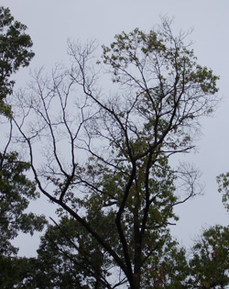
Symptoms of Construction Damage
Trees with fewer and smaller leaves
Trunk sprouts
Visible wounds or decay fungi on trunks, and branches
Yellowing or browning leaves
Denuded branches and dead trees
Damage can occur quickly or over a number of years (5-7 years).

Slide 19
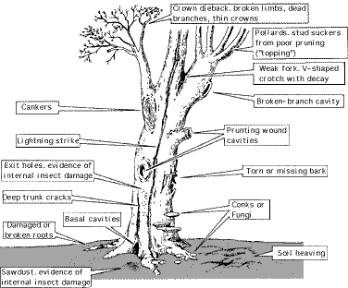
Deciding which trees to save?
Should be done in preliminary protection plan.
Based on location, health, size, species, etc.
Plan developed by a registered forester or certified arborist – a professional.
THIS ONE WORTH SAVING?

Slide 20
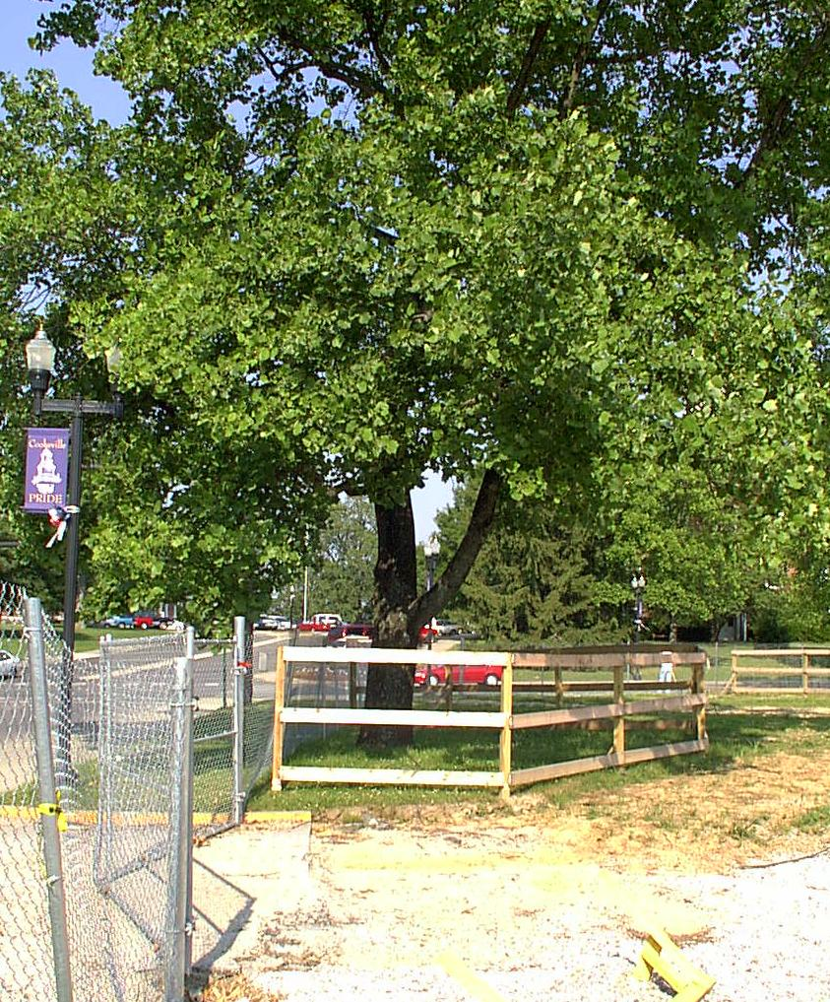
Tree Protection Plan preventing damage to saved trees
Protect desirable trees – good species, large specimens, historic trees etc.
Protect the critical root zone which runs from the base of the trunk at least to the drip line if not beyond.
What’s involved in protection?
Notes:
Protection means an impenetrable barrier – concrete wall, metal fence, etc. is set in place at the outer boundary of the root area to be protected. Then there are no construction activities allowed in this protected root zone – no driving equipment, no parking trailers, no fires, no paint or concrete washout, no cuts, no fills and no cutting of utility lines – NOTHING. If there is any construction in these areas often penalties ($) are assigned.

Slide 21
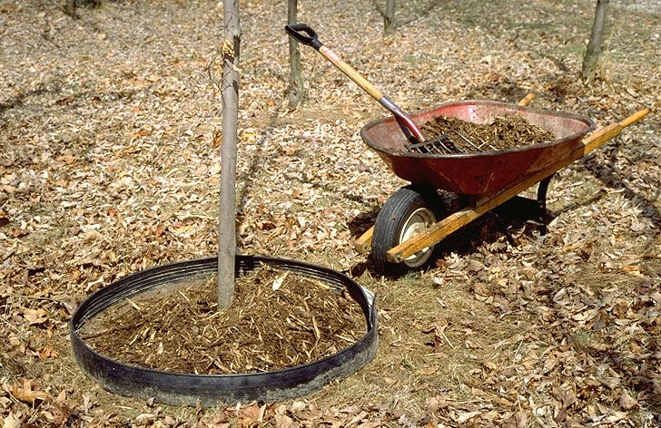
Other protection methods:
If roots have to be cut they should be cut clean and not torn.
Tunneling should be done under more valuable, older specimens.
Unwanted trees are removed carefully so nearby trees are not damaged.
Mulch and plywood can be placed over root areas to reduce soil compaction even in some traffic areas.
Tree trunks can be wrapped with fabric or other materials.
Others?
Notes:
Still another would be to build a bridge – concrete or wood walk way over larger exposed roots so they do not have to be cut for walkways or driveways.

Slide 22
Tree Care after Construction
Aerate or use other soil alteration methods to re-introduce oxygen and reduce compaction.
Water deeply – to encourage new root development and reduce tree stress.
Inspect frequently – look for visible signs of insect or disease attack.
Mulch – them well but correctly!
Fertilize – in a year or two after they have recovered from construction stress.
Notes:
Mulch – a couple inches from trunk, 3-4 inches deep, and all the way to the drip-line if feasible.

Slide 23
CLOSING:
PLAN first!
Set up adequate protection areas and try to protect groups of trees rather than one individual specimen tree.
Enforce protection rules and guidelines.
Follow through on after-care suggestions.
YES – tree protection is feasible and well worth the initial investment in time and money!

Slide 24
Acknowledgements
This publication/training was funded in full or in part by the USDA Forest Service Urban and Community Forestry Program as recommended by the National Urban and Community Forestry Advisory Council (NUCFAC).

