Slide 1
Tree Protection During Construction and Landscaping Activities
Welcome to the Center for Urban Ag Web CT Classroom
Feel Free to press talk to check your voice connection.
Remember to print off the ISA CEU sign in sheets and return to Todd.
The Workshop will begin promptly at noon.
Remember to use the raise hand function to ask questions at the end of the lecture.

Slide 2
Tree Protection During Construction & Landscaping Activities
Bob Westerfield UGA Extension Consumer Horticulturist
Todd Hurt Center for Urban Agriculture, Training Coordinator
Funds for this project were provided by the Urban and Community Forestry Grant Program administered by the Georgia Forestry Commission.

Slide 3
Tree Protection
Bob Westerfield will cover:
Tree Biology and Function
Impact of Damage
Physical
Compaction
Cut
Fill
Todd Hurt will cover:
Pre-Construction assessment
Tree Protection Plans
Assessment of damage
Critical rooting distance
Remediation

Slide 4
Understanding Tree Biology
How does a tree actually grow?
What are the affects of heavy equipment to tree roots?
What about damage to the trunks and limbs of trees?

Slide 5
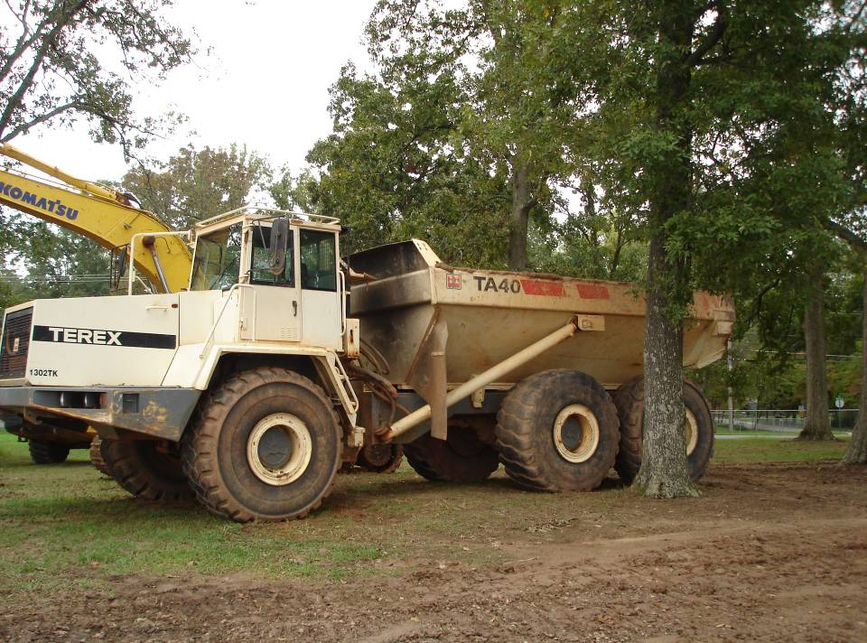

Slide 6
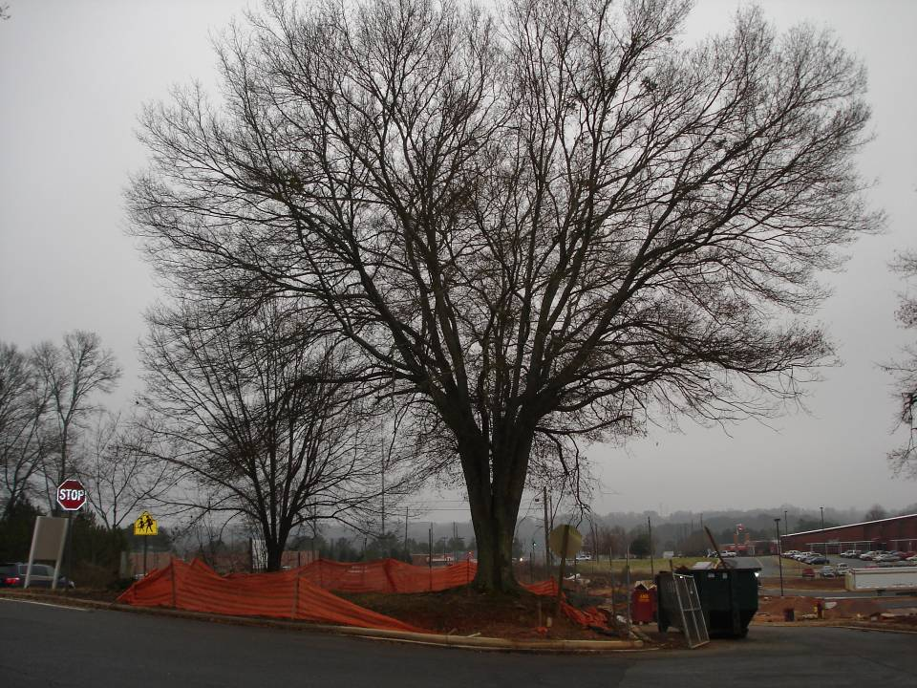

Slide 7
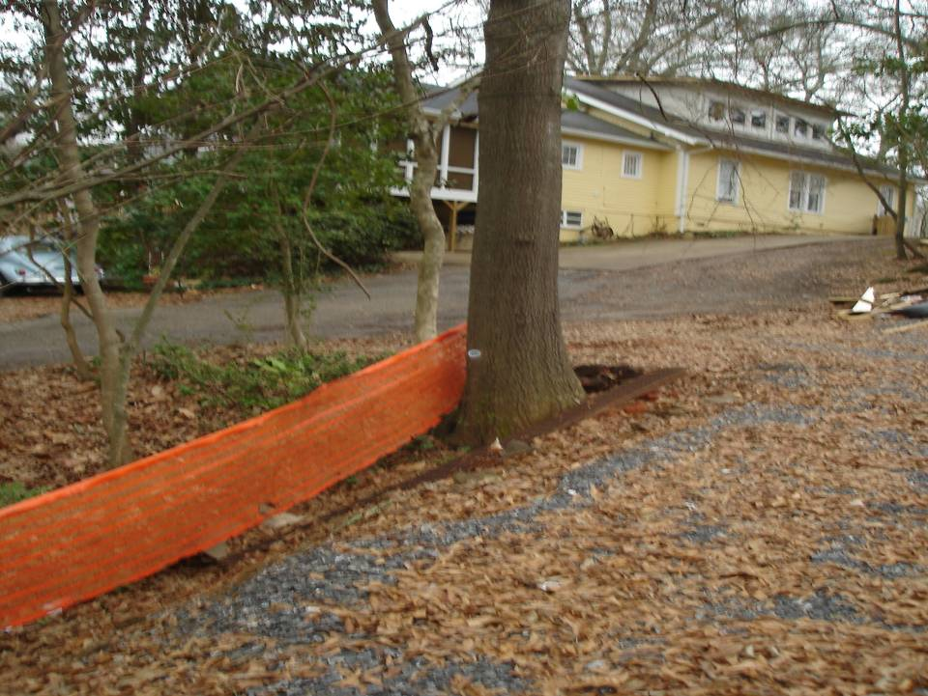

Slide 8
What’s in a Root System?
The Most Vital part of the Plant.
As the roots go, so does the tree.
Protection and care are needed to protect them.
While they are amazingly strong, they are also vulnerable.

Slide 9
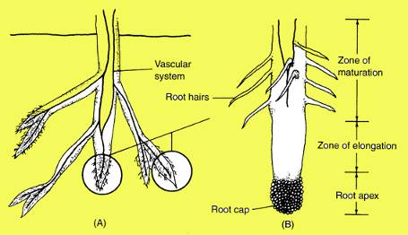
Root Form & Function
Root Tips
The root cap protects the meristem, the area of cell division at the root tips
Root hairs absorb most of the water and are concentrated in the maturation zone
Roots transport water & nutrients in their vascular system
Notes:
Root Form & Function
The end of root tip is covered with a root cap, that protects the meristem. The meristem is the area where cells divide and increase in number. These cells increase in length in the zone of elongation, pushing the root tip through openings in the soil.
The root hairs are very small, composed of only a single cell. They effectively adsorb most of the water taken up by the plant. They are concentrated in the zone of maturation. They are easily lost under adverse conditions.
The vascular system of the roots work to move water and soil nutrients from the root tips up to the stems vascular system.

Slide 10
Is this what tree roots look like?

Slide 11
The Real Story…..

Slide 12
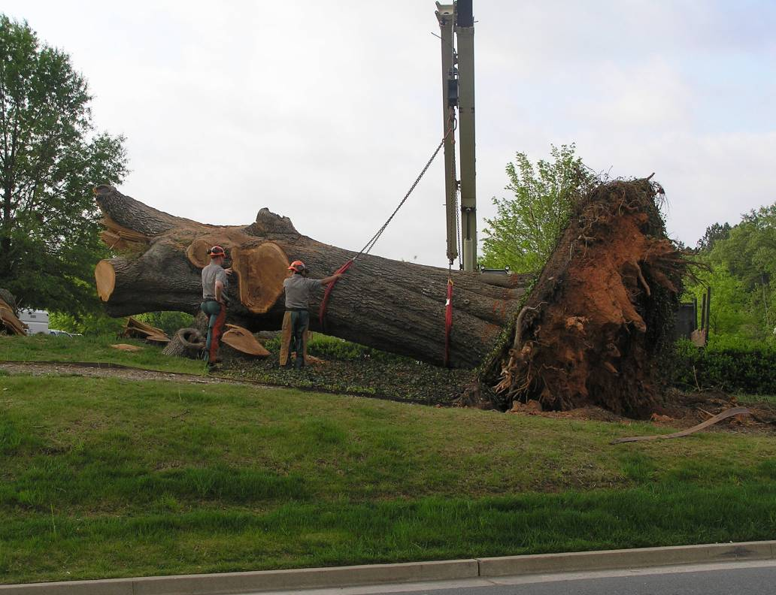
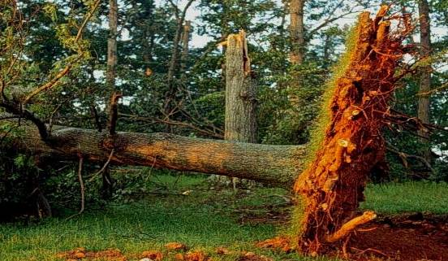

Slide 13
How far do roots extend?

Slide 15
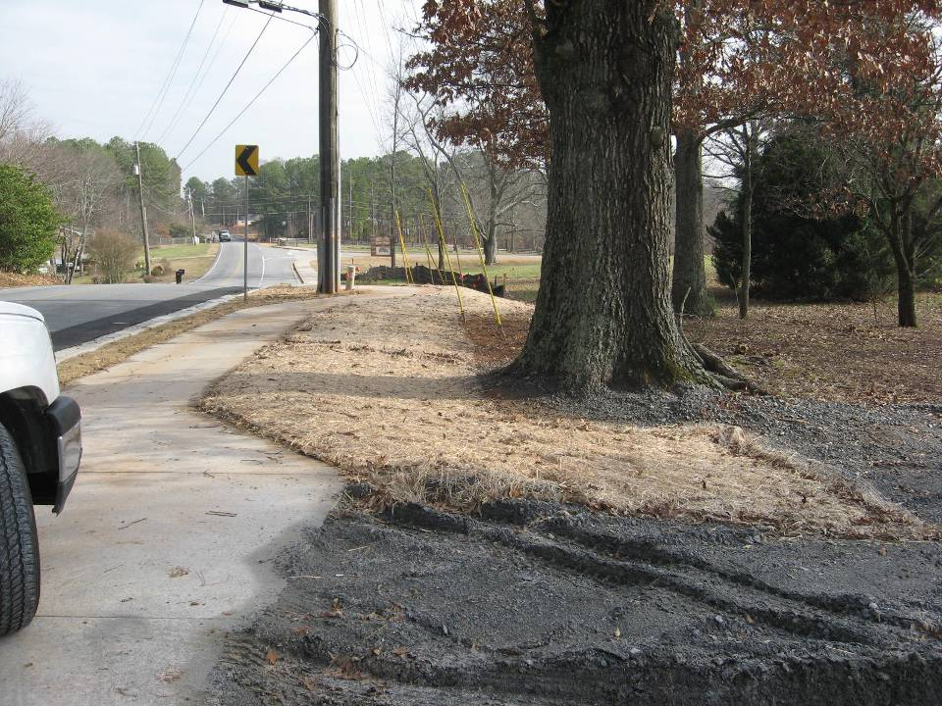

Slide 16
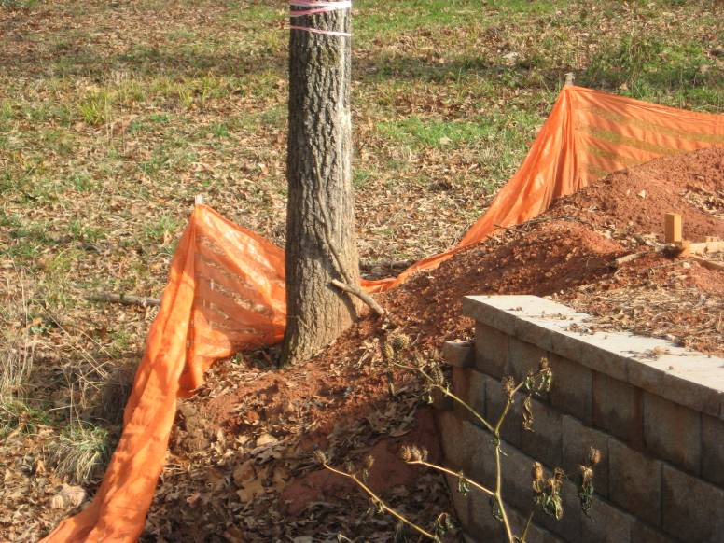
Air exchange?

Slide 17
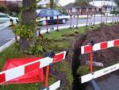

Slide 18
Alternatives…

Slide 19
What about the trunk and branches of the Tree?
They are the support and transport system for water and food.
The feeding factory pipeline for the plant.
Potential for disease, insects or girdling if injured.

Slide 23
Effect of broken branches.

Slide 24
Compartmentalize damage.

Slide 25
Losing a main trunk.

Slide 28
Leaves

Slide 29
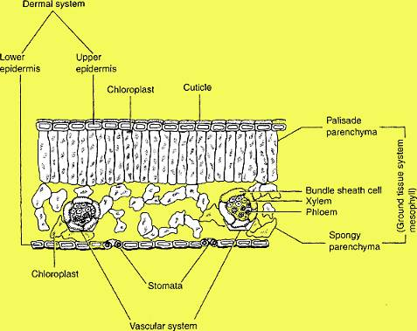
Leaf Form & Function
Cuticle is waxy & holds moisture in
Chloroplasts intercept light and make plant food (Photosynthesis)
Stomata open to let oxygen out and CO₂ in
Vascular system moves food & water
Leaf Cross Section
Notes:
Leaf Form & Function
A cross section of a typical leaf shows all the internal cells. The upper layer of cells is the epidermis which is covered with a waxy cuticle which functions to help keep moisture inside the plant.
The parenchyma cells, both the palisade parenchyma and spongy parenchyma, contain chloroplasts that intercept light and manufacture carbohydrates (photosynthesis), the food of plants that supports all plant cells.
The stomata are found on the bottom of the leaf. They open and close to regulate air and moisture exchange. Oxygen, a by product of food production, is let out while carbon dioxide, a resource needed for food production, is let in. The release of moisture (transpiration), helps to cool the leaves.
The xylem and phloem make up the vascular system, and functions to move water and food through the plant. This vascular system in the leaves are called veins and they are visible on the upper and lower surface of the leaf.

Slide 30
The absence of leaves…..

Slide 31
The Value of a Tree?

Slide 32
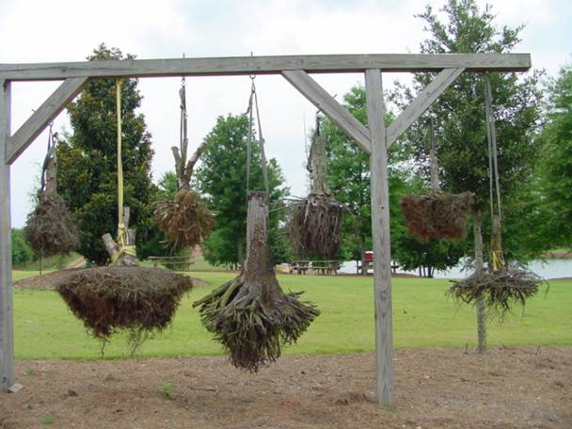
How do we save our trees from the gallows?

Slide 33
Before Construction Begins
Meet with Contractor
Determine which trees are possible to save
Not every tree can be saved
Determine parking and supply routes
Concrete wash out area

Slide 34
Before Construction Begins
Evaluate Trees on the Property
Create a tree inventory
Remove weak trees
Notes:
Removal of bad trees at time of construction saves major money

Slide 35
Tree Inventory
Cultivar Selections

Slide 36
Tree Inventory
Physical or Environmental Damage

Slide 37
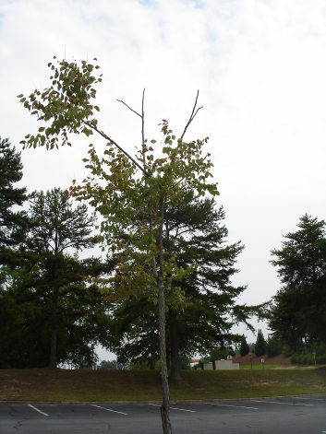
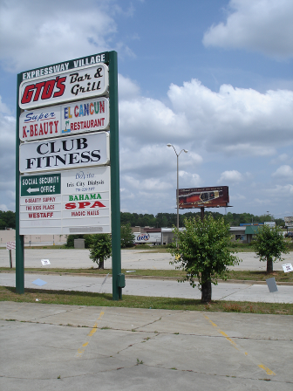
Tree Inventory
Urban Stress

Slide 38
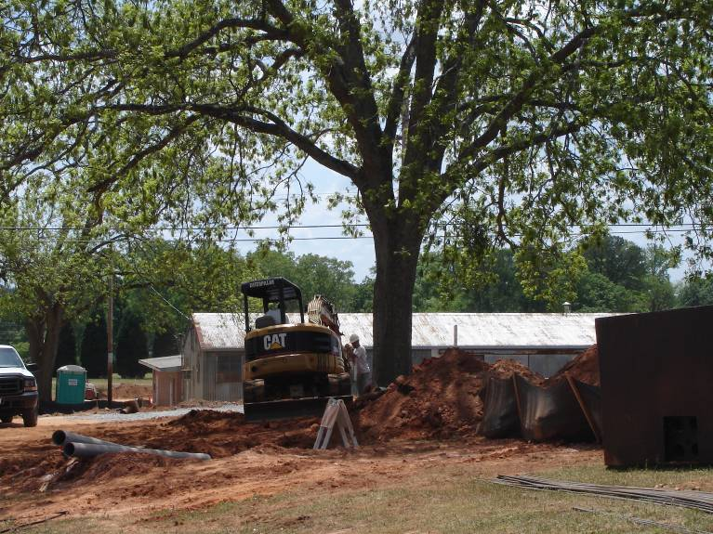
Tree Inventory

Slide 39
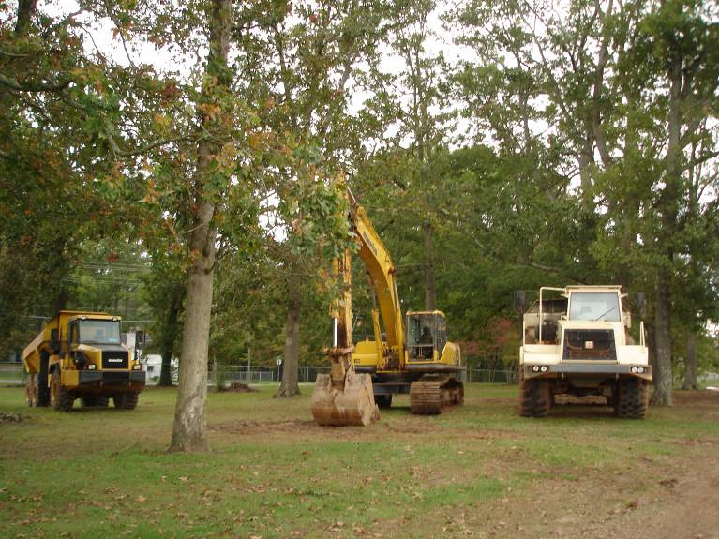
Tree Inventory

Slide 40
Soil Compaction Values (Coder 1996)
% Compaction
Number of passes over the same area

Slide 41
Soil Compaction (Coder 1996)
Soil Texture | Root-limiting % Pores normally filled with air
Sand | 24%
Fine sand | 21%
Sandy loam | 19%
Fine sandy loam | 15%
Loam | 14%
Silt loam | 17%
Clay loam | 11%
Clay | 13%
Root growth is limited by <15% porosity

Slide 42
Cut and Fills

Slide 43
Soil Fills (Coder 1996)
Soil Texture of Fill Soil | Root damage starts | Massive root Damage
Sand | 8 inches | 24 inches
Fine sand | 6 inches | 18 inches
Sandy loam | 4 inches | 12 inches
Fine sandy loam | 3 inches | 9 inches
Loam | 2 inches | 6 inches
Silt loam | 1 ½ inches | 4 ½ inches
Clay loam | 1 ½ inches | 4 ½ inches
Clay | 1 inch | 3 inches

Slide 44
Soil Cuts (Coder 1996)
Soil Texture | Significant root damaging soil removals
Sand | 10 inches
Fine sand | 8.5 inches
Sandy loam | 7 inches
Fine sandy loam | 5.5 inches
Loam | 4 inches
Silt loam | 3 inches
Clay loam | 3 inches
Clay | 2 inches

Slide 45
Setting up Tree Save Zones
DBH and Critical Rooting
Fencing Choices
Planning and Root Pruning
Minimizing Soil Compaction
Remediation and Recovery Times

Slide 46
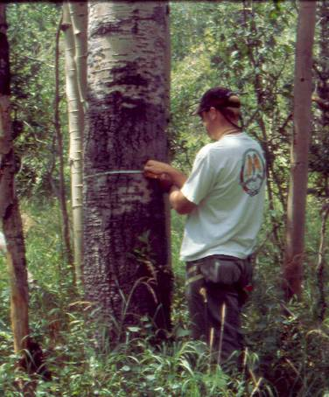
Determine the Critical Rooting Distance
Diameter Breast Height is the diameter of the trunk in inches at 4.5 feet from the ground.
Photo Courtesy of Colorado State Univ.

Slide 47
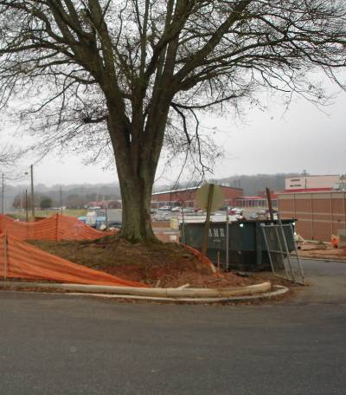
Critical Rooting Distance
1.25 times the DBH in inches is the distance from the trunk in feet (radius) that must be protected.
20-30% disturbance into critical root zone is an impacted tree.
24”
DBH
30 feet

Slide 48
Tree Save Fencing

Slide 49
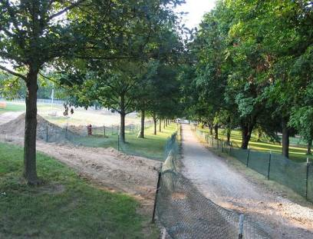
Zone must be maintained
Number of passes over the same area

Slide 50
Spreading the Load
Human on Snowshoes: 0.5 psi
Human Male ( medium build): 8 psi
M1 Abrams tank: 15 psi
Adult horse (1250 lb): 25 psi
Passenger car: 30 psi
Wheeled ATV: 35 psi
Mountain bicycle: 40 psi
Racing bicycle: 90 psi
Weight and Ground Contact

Slide 51
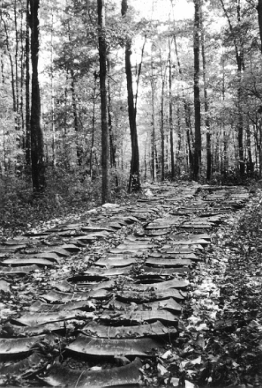
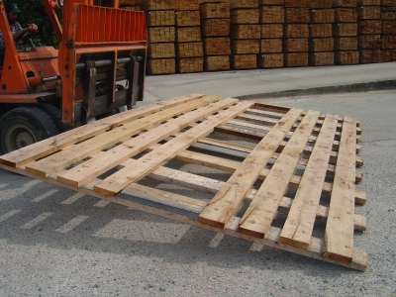
Spreading the Load
Logging Mat
(Photo courtesy of CarolinaMat.com)
Terra Mat –US Forest Service
4 inches of wood mulch

Slide 52
Prepare the Trees for Construction Disturbance
Water as necessary to keep trees out of drought stress
Fertilize according to soil test and tree need
Prune and dead wood or limbs that will be in the way of construction activity
Root prune at edge of the protected zone to minimize tearing by construction equipment.

Slide 53
Recovery Times and Remediation
Season of Construction
Winter
1 year
Spring
3-4 years
Summer
3 years
Fall
2 years
Air Spade

Slide 54
Post-Construction Care
Remove any excessive mulch used for protection
Inspect for cut and fill changes
Prune out and damaged limbs
Water and fertilize as needed.

Slide 55
Special Thanks To:
Joan Scales, Partnership Coordinator, GFC
Spence Rosenfeld, Arborguard
Sam Geer, Geer Tree Specialists
Robert Brettschneider, Geer Tree Specialists
Kim Coder, PhD. UGA Warnell School of Forest Resources
Dexter Adams, UGA Grounds

Slide 56
Funds for this project were provided by the Urban and Community Forestry Grant Program administered by the Georgia Forestry Commission.
The U.S. Department of Agriculture (USDA) prohibits discrimination in all its programs and activities on the basis of race, color, national origin, gender, religion, age, disability, political beliefs, sexual orientation, and marital or family status. (Not all prohibited bases apply to all programs.) Persons with disabilities who require alternative means for communication of program information (Braille, large print, audiotape, etc.) should contact USDA’s TARGET Center at 202-720-2600 (voice and TDD).
To file a complaint of discrimination, write USDA, Director, Office of Civil Rights, Room 326-A, Whitten Building, 14th and Independence Avenue, SW, Washington, DC 20250-9410 or call 202-720-5964 (voice or TDD). USDA is an equal opportunity provider and employer.

