Slide 1
Tree Nutrition & Fertilization

Slide 2
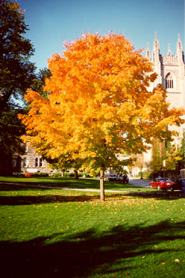
Objectives of Fertilization
Maintain health & vigor
Increase growth
Replace minerals
Rescue declining tree
Cure specific deficiencies

Slide 3
Forest Soils

Slide 4
Urban Soil

Slide 5
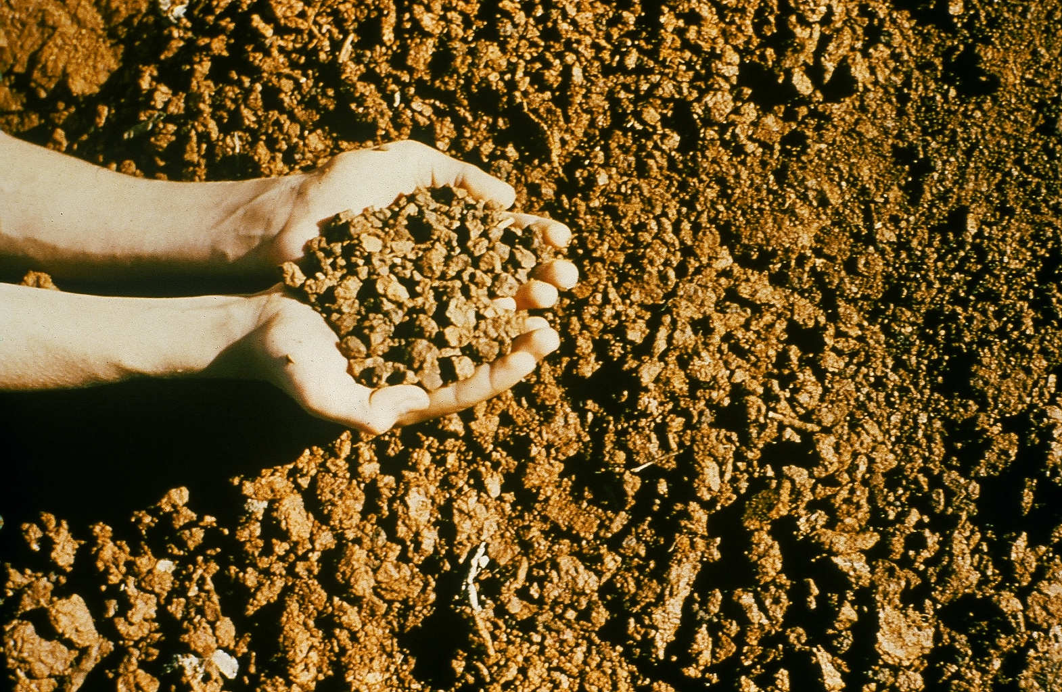
What’s
Missing?
Organic Matter
Nutrients
Soil Organisms

Slide 6
Organic Matter
- Improves physical condition
- Supplies nutrients
- Improves water infiltration
- Increases CEC
- Food for soil organisms

Slide 7
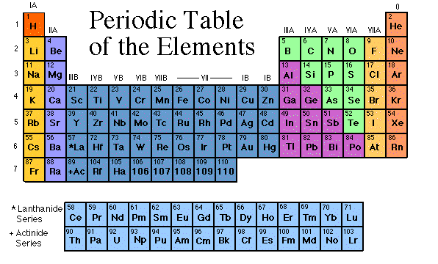
17 Essential Elements
Macronutrients
C,H,O (atmospheric)
N,P,K,S
Secondary
nutrients
Ca, Mg
Micronutrients
B,Cl,Cu,Fe,
Mn,Mo,Ni,Zn

Slide 8
C H O P K N S Ca Fe Mg B Mn Cu Zn Mo Cl Ni
Essential Elements
Necessary to complete life cycle
C H O P K N S Ca Mg Fe B Mn Cu
Zn Mo Cl Ni
Atmoshperic
Macronutrients
Secondary Nutrients
Micronutrients

Slide 9
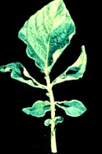
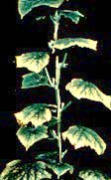
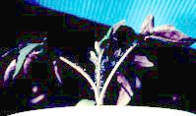
Nutrient Deficiencies
Nitrogen
Potassium
Phosphorus

Slide 10
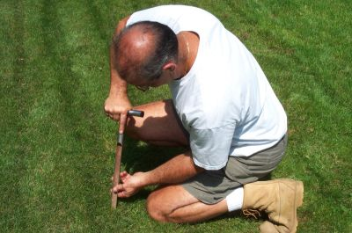
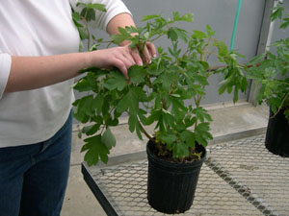
Prescription Fertilization
- Supply nutrients determined to be deficient
Soil analysis
Tissue analysis
Soil nutrients, pH
CEC, Salt, OM
Plant nutrients

Slide 11
Soil Testing
Representative sample (core or slice)
10 – 20 places
6 – 8” deep
Cost: $6

Slide 12
Tissue Analysis
Upper recently mature leaves
20 – 30 leaves
Paper, not plastic
Deficiency - toxicity
$15

Slide 13
What’s in your barrel?
Nutrients
pH
Water
Salt
Light
Oxygen
Pore space

Slide 14
Lime

Slide 15
Soil pH is expressed logarithmically
pH |  | times as strong
10.0 |  | 1000
9.0 | Alkalinity | 100
8.0 |  | 10
7.0 | Neutral
6.0 |  | 10
5.0 | Acidity | 100
4.0 |  | 1000

Slide 16
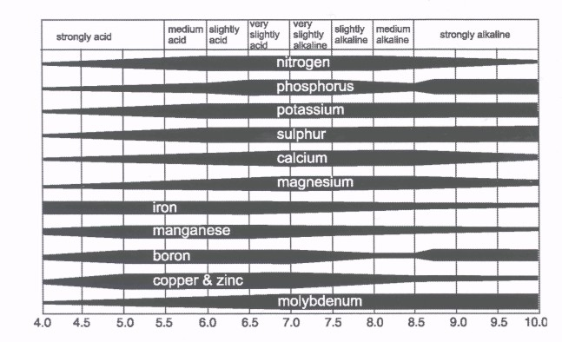
pH and Nutrient Availability

Slide 17
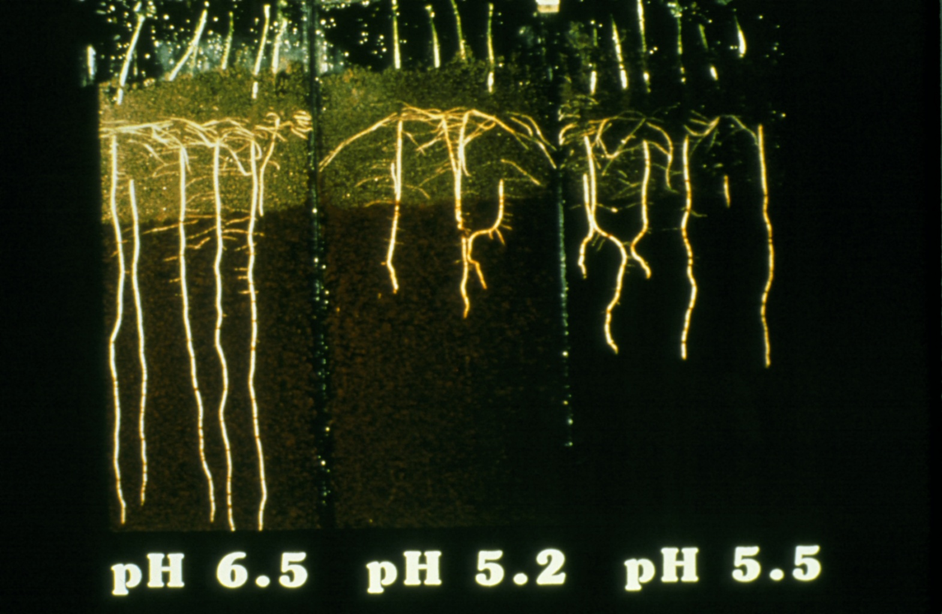

Slide 18
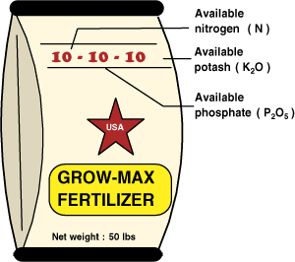
Fertilizer Analysis
% by weight N, P₂O₅, K₂O
Complete fertilizer

Slide 19
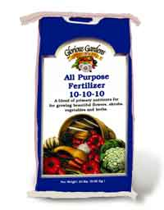
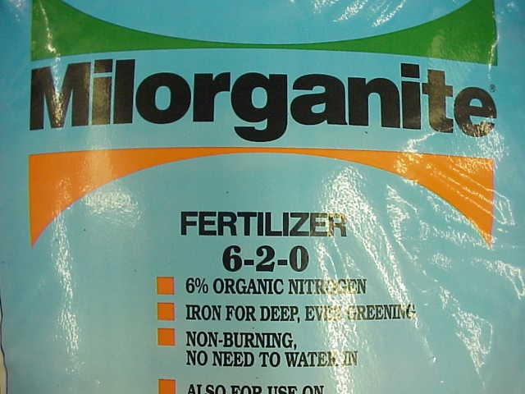
Inorganic
Organic
Nitrate
Ammonium
Phosphate
Potash
Not bound to Carbon
No other options
Urea
IBDU
Urea formaldehyde
Manure
Blood & Bone Meal
Biosolids
Preferred

Slide 20
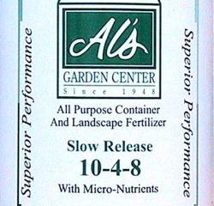
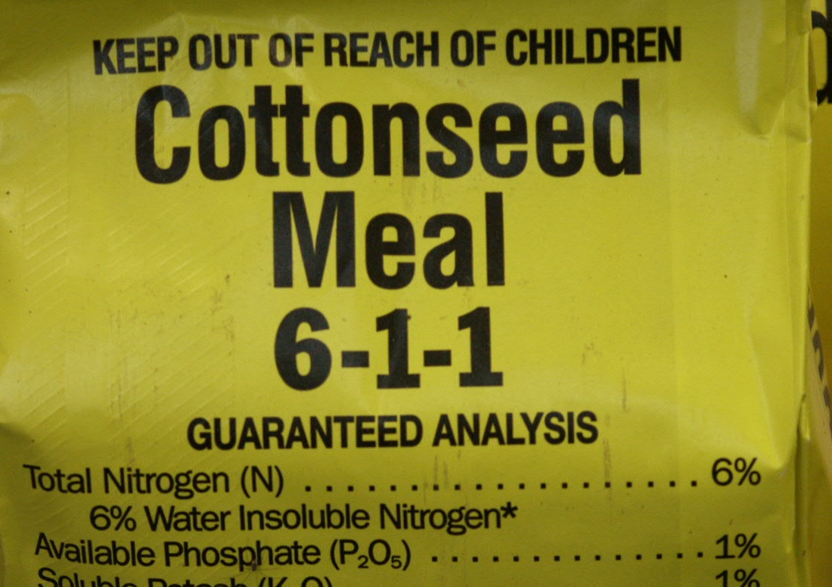
Slow Release
Water Insoluble N
Manure
Sulfur coated Urea
Urea formaldehyde

Slide 21
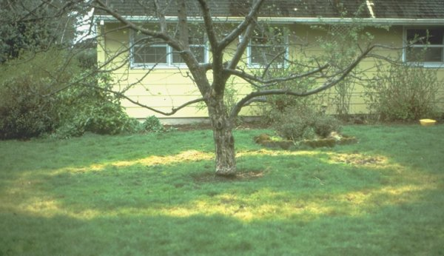
“If fertilizer is not needed or not applied correctly,
it may not benefit the tree at all.” ANSI A300

Slide 22
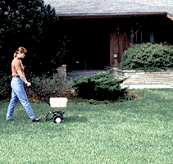
Fertilizer Application
Heavily fertilized turf
Turf vs. no turf
Steep slopes
Insect infestation

Slide 23
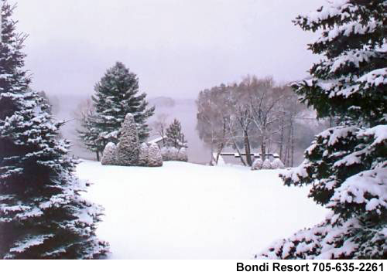
Fertilizer Timing
Roots growing
Cold hardiness
Well watered plants

Slide 24
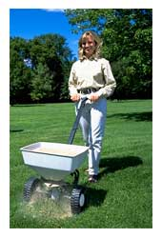
Fertilizer Application Rate (ANSI A300)
Rate per 1,000 square feet
Slow Release
2 - 4 lbs N/ application
6 lbs N annually max
Quick Release
1-3 lbs / application
4 lbs annually max
Use 3:1:1 or 3:1:2 ratio
Salt index < 50
Surface application

Slide 25
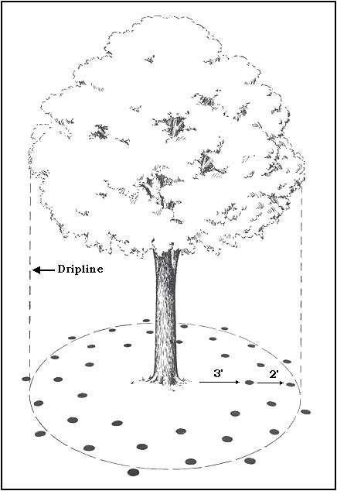
Fertilizer Application Area
Standard Canopy
Measure distance out to dripline
Area = 3.14 * r²
Example:
3.14 * 10² = 314 ft²

Slide 26
Fertilizer Application Area
Narrow or Pruned Trees
Measure DBH
Area = 3.14 * (DBH * 1 or 1.5)²
Example: 10” caliper tree
3.14 * 10² = 314 ft2
3.14 * (10 *1.5)² = 706.5

Slide 27
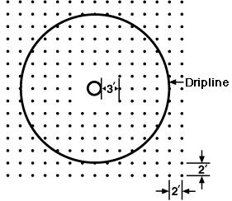
Example: Apply 2 lbs of N per 1,000 ft2 using 15-5-10 fertilizer
314 ft² * 2 lbs N
1,000 ft₂ * 0.15
= 4.19 lbs of fertilizer

Slide 28
Subsurface Application
Drill Hole Method
Holes 2 – 4” diameter
4 – 12” deep
Spaced 12 – 36” apart
Fertilizer should not be
closer than 2” to surface
Auger not punch

Slide 29
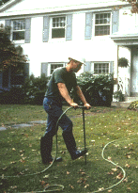
Subsurface Fertilization
Liquid Injection

Slide 30
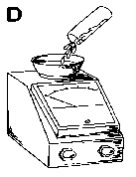
Salt Problems

Slide 31
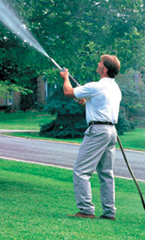
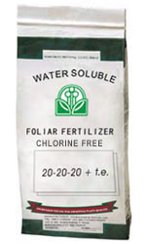
Foliar Fertilization
Urea
Iron
Zinc

Slide 32
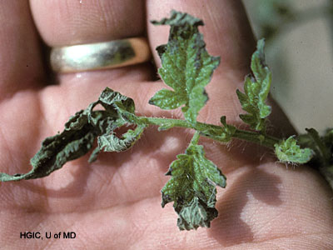
Fertilizer Burn

Slide 33
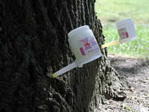
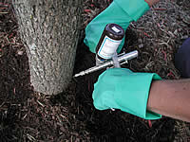
Trunk Injection
Microinjection
Implants
Injections

Slide 34
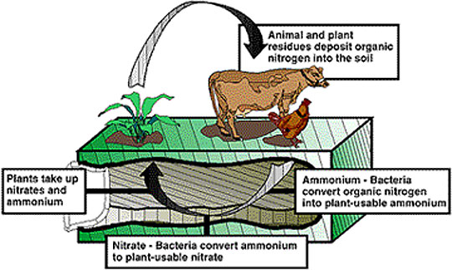
Nitrogen Cycle
(NH₄)
)
(NO₃)

Slide 35
Cation Exchange
NH₄⁺
NO₃⁻
Leaching

Slide 36
Nitrogen

Slide 37
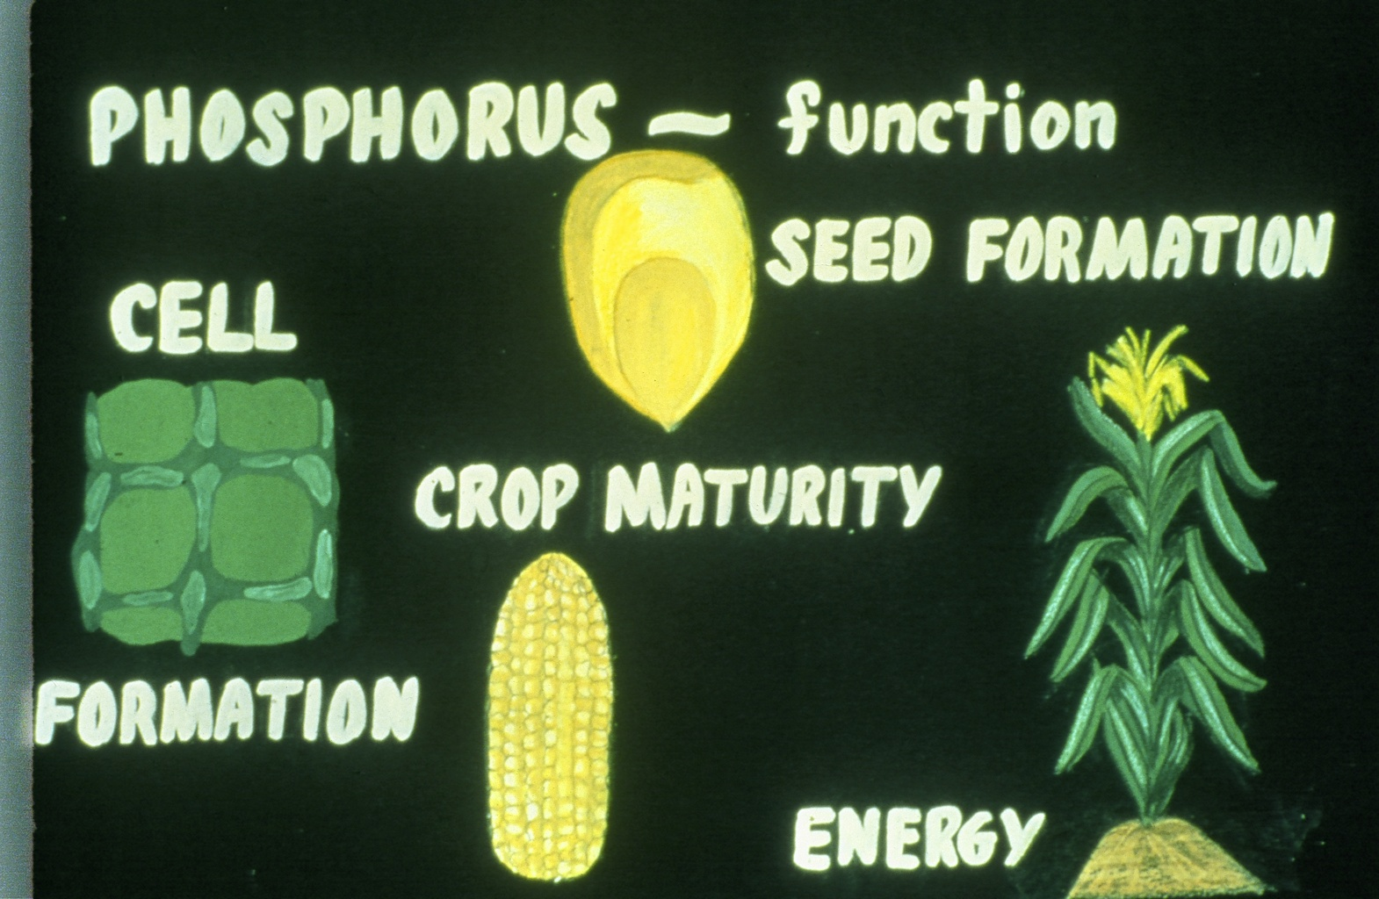

Slide 38
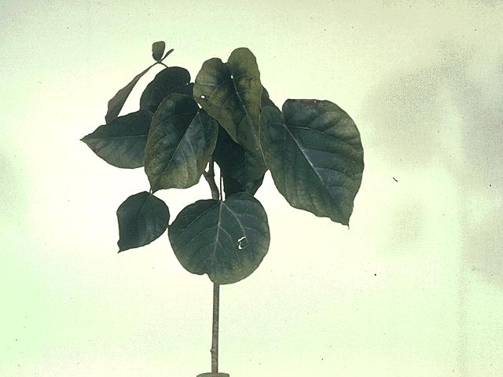
Potassium Deficiency (K)
<>

Slide 39
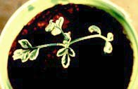
Calcium Deficiency

Slide 40
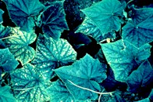
Magnesium Deficiency

Slide 41
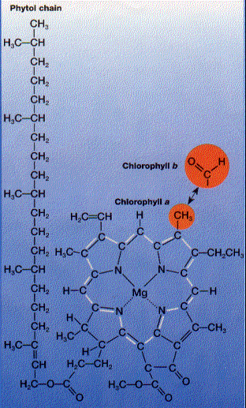
Chlorophyll

Slide 42
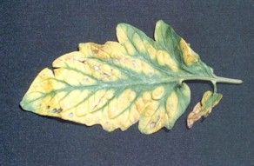
Manganese Deficiency

Slide 43
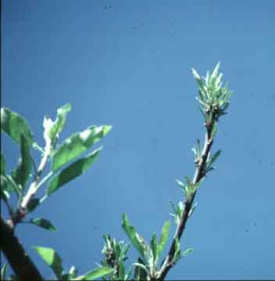
Zinc Deficiency

Slide 44
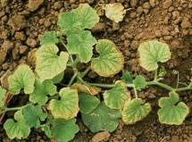
Molybdenum Deficiency

Slide 45
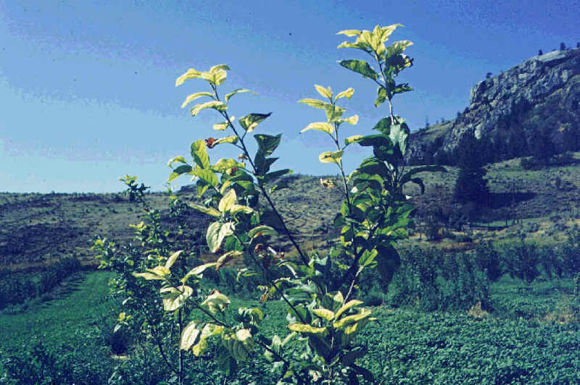
Iron Deficiency

Slide 46
Key Terms
ANSI A300 Macronutrients
Complete fertilizer Microinjection
Controlled release Micronutrients
Drill hole method Organic
Drip line Prescription fertilization
Essential elements Secondary nutrients
Fertilizer analysis Slow release fertilizer
Fertilizer burn Soil analysis
Foliar analysis Subsurface application
Foliar application Surface application
Implants Water insoluble N (WIN)
Inorganic
Leaching
Liquid Injection

