Slide 1
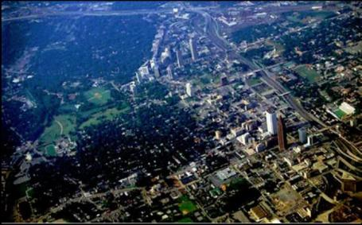
The Urban Forest Management Plan
taking the urban forest to the next level
Bill Hubbard
Southern Regional Extension Forester

Slide 2
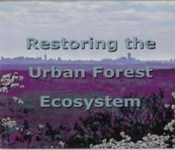
Materials in this presentation
Have come primarily from the following sources:
Developing an Urban Forest Management Plan for Hurricane-Prone Communities by F. Escobedo, R. Northrop, and W. Zipperer (University of Florida) (in review).
And
Developing a Restoration Plan that Works by William G. Hubbard in Restoring the Urban Forest Ecosystem (University of Florida).

Slide 3
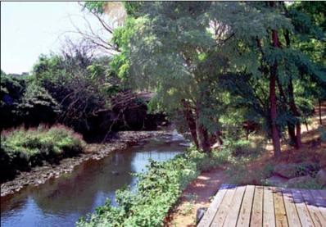
Introduction
A plan can be considered as a predetermined course of action.
All plan have similar components
Vision or desired future condition
Goals and objectives
Guiding principles
Identify and involve stakeholders
Framework for identifying & resolving issues
Gathering and analyzing information
Action plan with a timeline
Monitoring, evaluation and a feedback loop

Slide 4
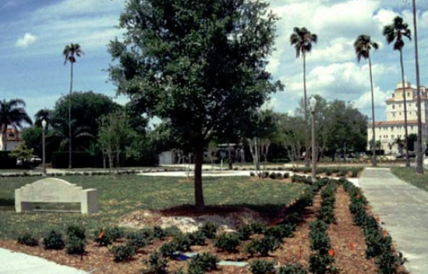
What are your communities’ urban forestry goals and objectives?
Create a safe and attractive environment
Maintain or enhance urban forest cover
Respond to the community’s needs and requests
Maximize the well-being of residents and visitors
Minimize hazards to life and property
Improve coordination of management activities with other associations, neighborhoods, departments or offices.
Establish measurable and long-term goals and objectives

Slide 5
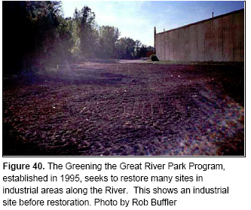
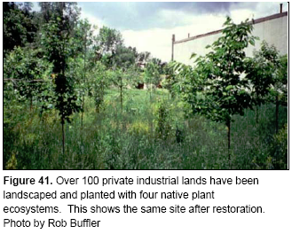
Why develop an urban forest management plan?
By developing a plan and a vision, a community can guide and monitor its activities to determine if a sustainable urban forest is being achieved

Slide 6
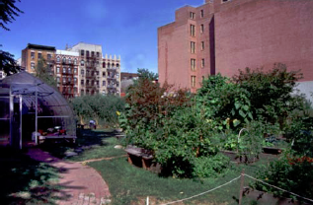
Community Vision – Step 1
What does the community want from its urban forest?
Who makes up our community?
What should the urban forest look like and provide for the community?
How much urban forest do we want and need, present and future?
Why should we manage the urban forest?
How do we manage the urban forest?
When will the next natural disaster affect my community?

Slide 7
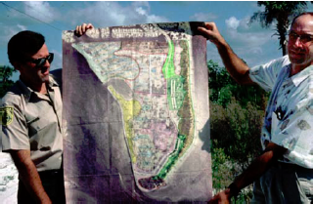
Outcomes for Step 1
Get the issue(s) down on paper (one page or less), so that it can be used to gather support, and be critiqued within the community
List the vision statement and a broad list of goals and objectives
Identify the planning team, scale of work, and outside partnerships

Slide 8
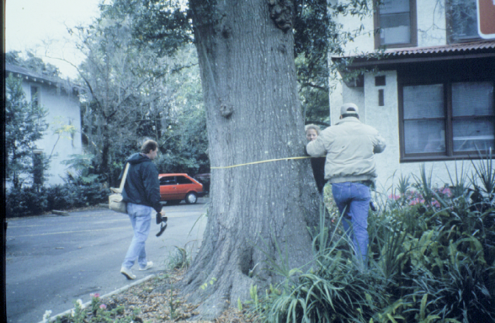
Assessing the Urban Forest Resource- Step 2
Assess your people, funding and time
Determine the scope of the assessment based on the communities vision and objectives.
The urban forest resource (via the urban forestry inventory)

Slide 9
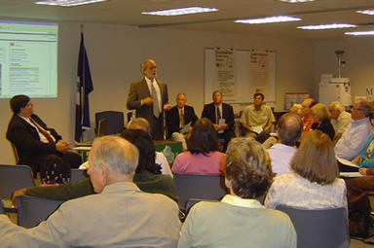
Outcomes for Step 2
Community consensus of goals and objectives,
The scope of work and the project timeline,
Potential funding opportunities
Data from your resource assessment that supports your goals and objectives could be in the form of :
Maps
Planting sites and their attributes (Location, size, utility conflicts, soil ph, etc.)
Hazardous trees
Trees requiring maintenance: pruning, staking, mulching, watering, removal
List of potential resources: (community volunteers, government and private technical assistance, grants, etc.)

Slide 10
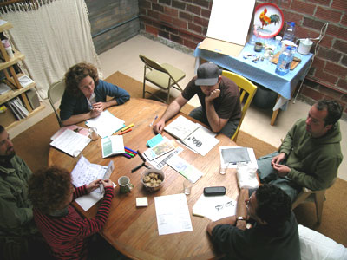
Managing the Urban Forest – Step 3
Share the plan with the community
Prioritize which objectives and options need to be achieved first
Develop action items and specific steps to support goals and objectives

Slide 11
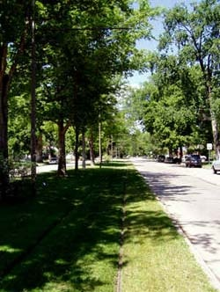
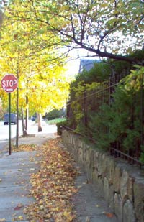
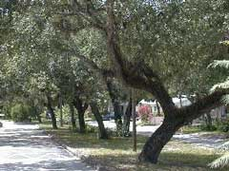
Outcomes – Step 3
Set priorities for work projects based upon information generated by the inventory, recommendations from technical advisor, and available funding,
Apply for grants where appropriate, or ear mark community funds for specific projects
A work agenda based on community agreement that is reasonable and feasible

Slide 12
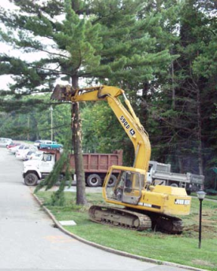
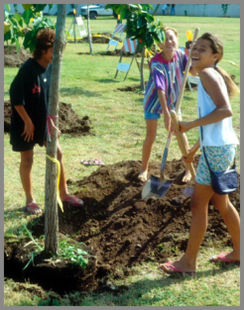
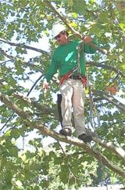
Implementing Your Plan – Step 4
Examples include:
Tree and Stump Removal
Maintenance
Planting
Administrative Support
Time, responsibilities & budget
Justification of recommendations

Slide 13
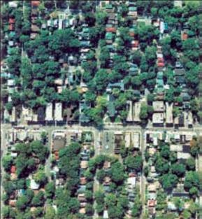
Outcomes Step 4
Management of critical tree attributes that support sustainability and resilience such as stable canopy cover, trees of various ages, and a diverse species composition, will help assure that the tree cover and canopy remains relatively constant over time.

Slide 14
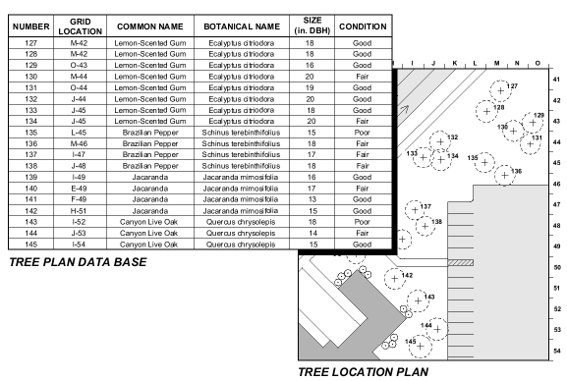
Monitoring the Plan – Step 5
How effective is the plan?
Collection of information to determine whether objectives are meeting goals.

Slide 15
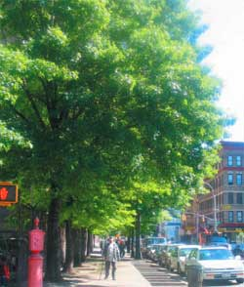
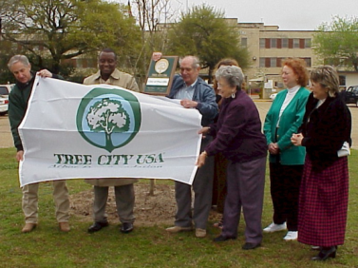
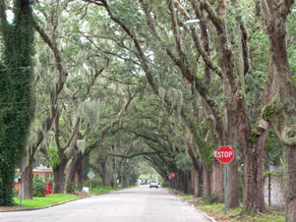
Outcomes- Step 5
Management is a continual process of learning and adapting to change.
Reviewing the vision, goals, objectives, and actions are a necessary part of any management plan.
Adaptive management enables the management team to respond to environmental or biotic influences.
The process combines monitoring, planning, science, and management in a “learn by doing” manner

Slide 16
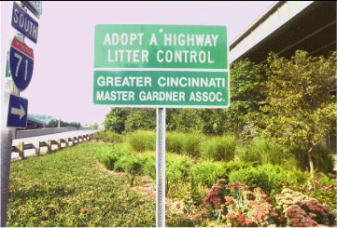
Summary & Conclusions
Conservation and planning is not a discrete event, but a long-term process.
Success will require the individuals of a community to cooperate with, each other, public agencies, businesses, institutional landowners, green industry contractors, and emergency management services.
Such cooperation will be based upon a continuing understanding of the value of urban forests

