Slide 1

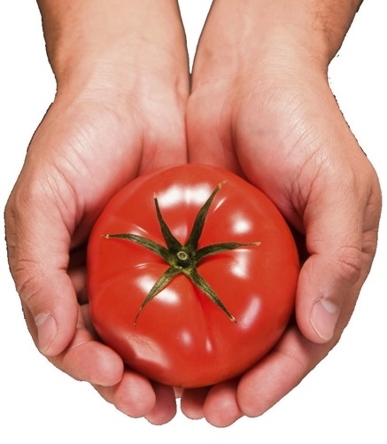

Terrific Tomatoes
Robert Westerfield- University of Georgia Horticulture

Slide 2
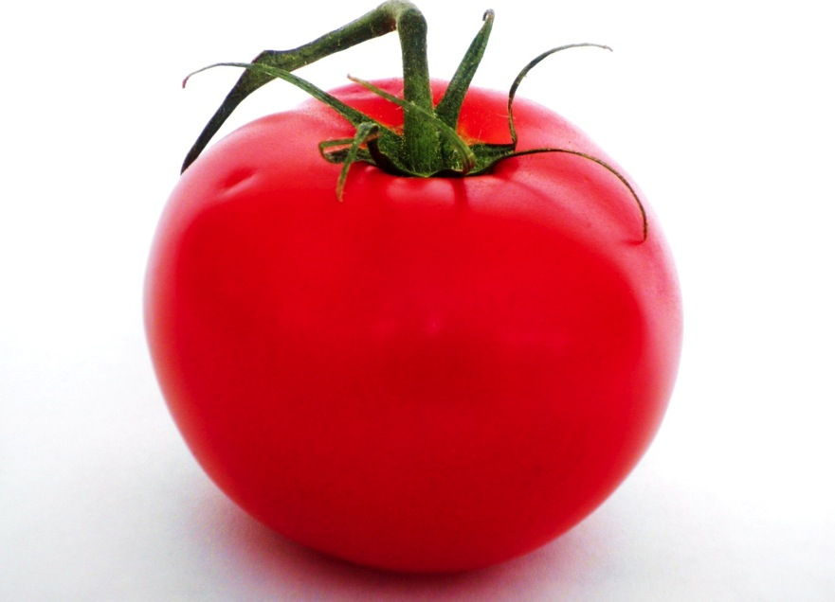
Common Problems Encountered
Notes:
There are several things to consider when troubleshooting tomato problems. Is the plant suffering from a nutritional disorder, disease, insects, virus or some cultural problem.

Slide 3
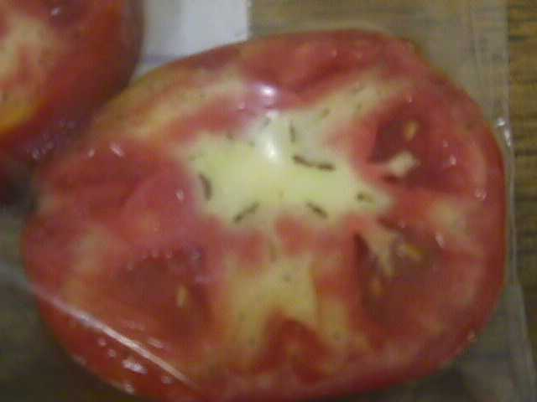
Physiological Disorders
Environmental Disorders

Slide 4
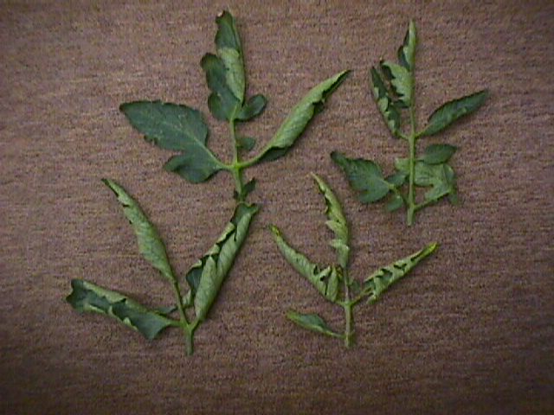
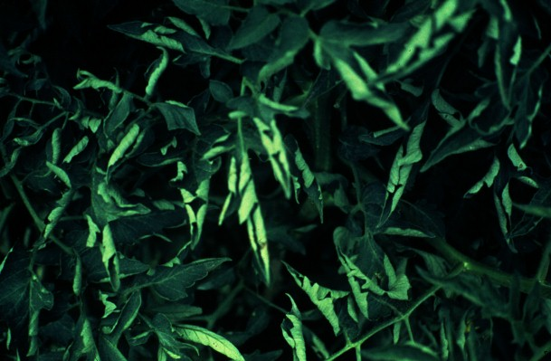
Tomato Leaf Roll
Usually caused by conditions of stress. These may be brought
about by drought, heat, cold or simply having a large fruit load
on the plant. Usually not a limiting condition.

Slide 5
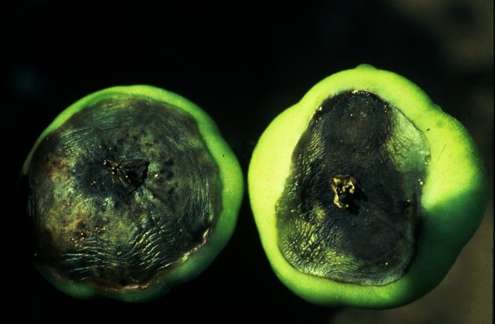
Blossom End Rot

Slide 6
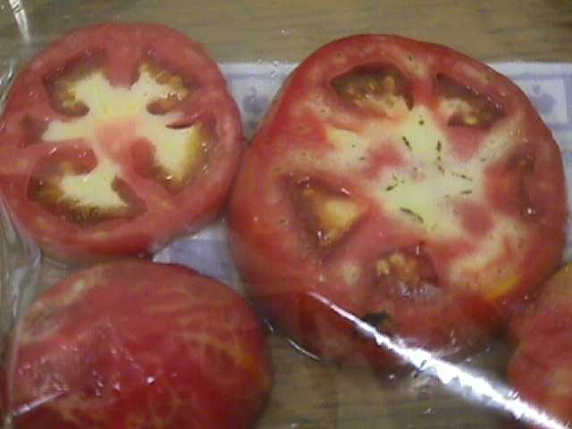
Blotchy Ripening
This condition is more prevalent in older varieties and can
be caused by excess water or drought conditions.

Slide 7
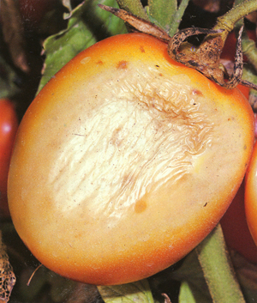
Sun Scald

Slide 8
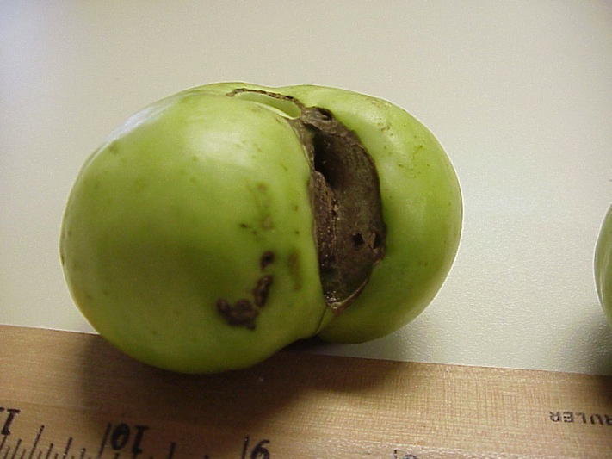
Catfacing
Catfacing is usually the result of blooms sticking to the
fruit and producing an enlarging scar. This is usually
aggravated or caused by cool weather.

Slide 9
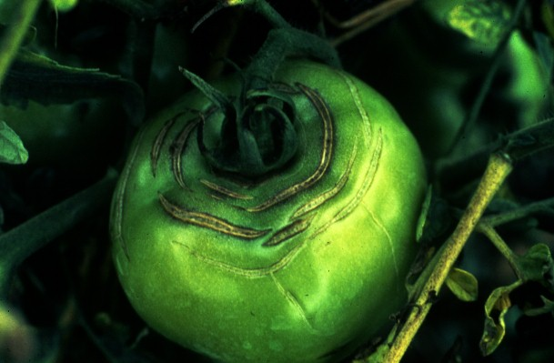
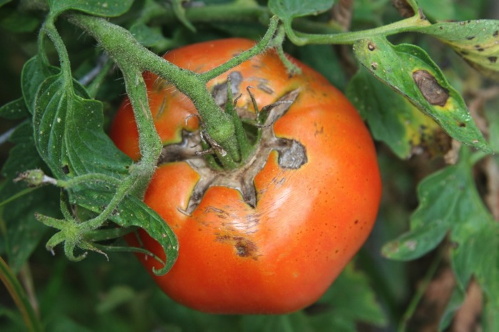
Fruit Cracking
Fruit cracking in tomatoes is variety related. It can also be
caused by sudden wet conditions after a drought.

Slide 10
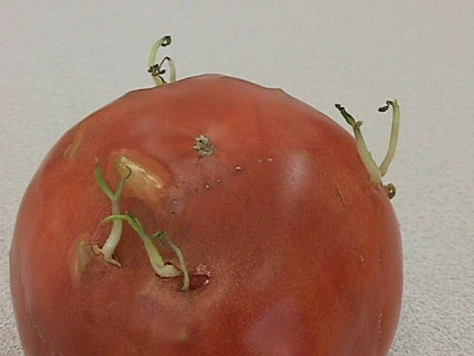
How about this one?
Notes:
This is an unusual situation where the seeds inside the tomato have actually germinated. This can occur when over ripe tomatoes are left in a warm, humid environment.

Slide 11
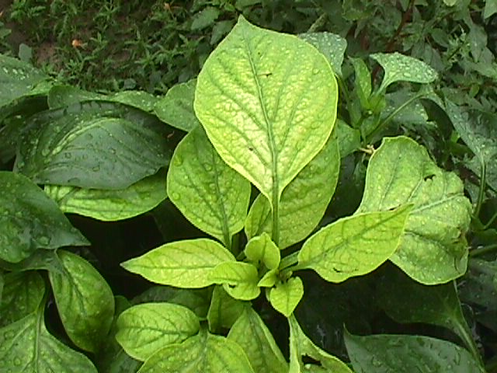
Review of Nutritional Disorders
Notes:
Let’s take a look at nutritional problems to start with.

Slide 12
pH Level
ALKALINE
8.0
7.0
6.0
5.5
4.0 -
IDEAL
ACID
VERY ACID
Notes:
Plants differ in their needs or tolerance of soil acidity. Unsuitable soil pH can stunt plant growth, cause fruiting problems, necrosis or death of leaves and other plant parts. Tomatoes and other vegetables prefer a pH that is slightly acidic in the 6.0-7.0 range.

Slide 13
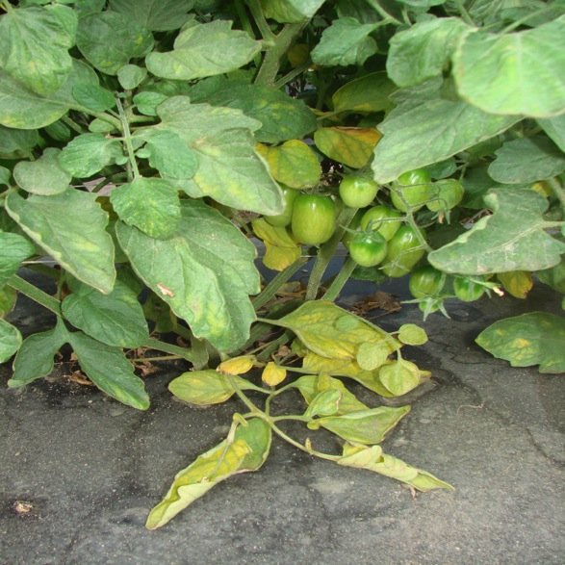
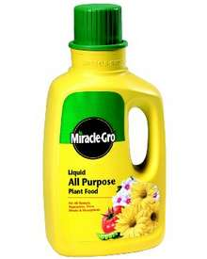
Nitrogen
Deficiency is characterized by a pale color of the
leaves. Usually the lower leaves will be more pale
than upper leaves.
Too much nitrogen is a common problem in Georgia.
Use of liquid soluble fertilizers are often the problem.
Notes:
Nitrogen deficiency is fairly common and appears in the lower leaves first. The leaves look pale when in color compared to the upper leaves. Too much nitrogen produces a dark green, tall plant with few blooms.

Slide 14
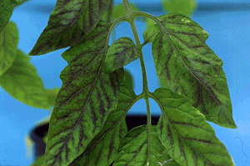
Phosphorous Deficiency
. Phosphorous deficiency occurs very frequently during the
spring and winter months when soils are cold and
Phosphorous is less available.
pH that is either too low or too high can also cause
Phosphorous to be limiting.

Slide 15
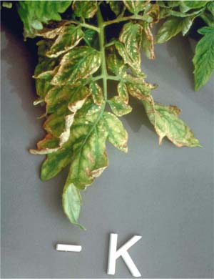
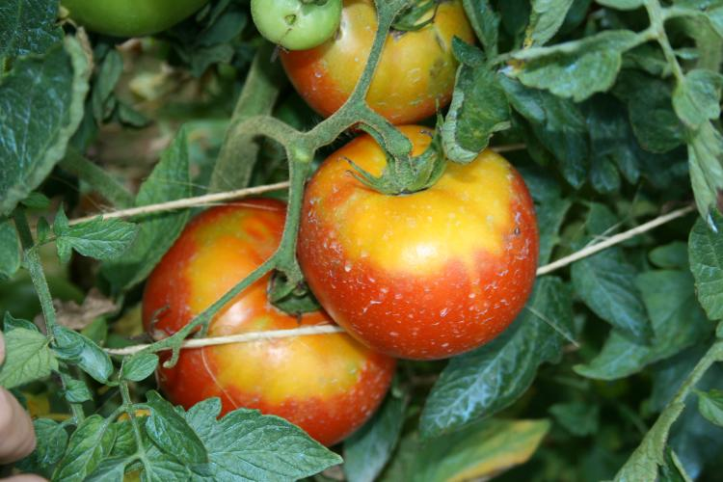
Potassium Deficiency
Occurs mostly on upper leaves.
Can be brought on by excess
rains and leaching.
Necrotic areas close to tips and
margins between veins.

Slide 16
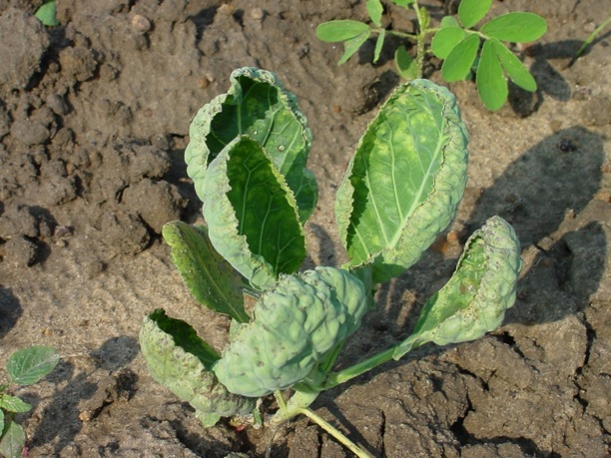
Calcium Deficiency
Calcium deficiency is almost always characterized by
cupping of the youngest leaves. Ca deficiency can also
lead to Blossom end rot, a physiological disorder.
Drought or poor moisture management can lead to this.
Notes:
Cupping of upper leaves and a slight off- color can indicate calcium deficiency. Poor moisture management can cause plant to be deficient in available calcium.

Slide 17
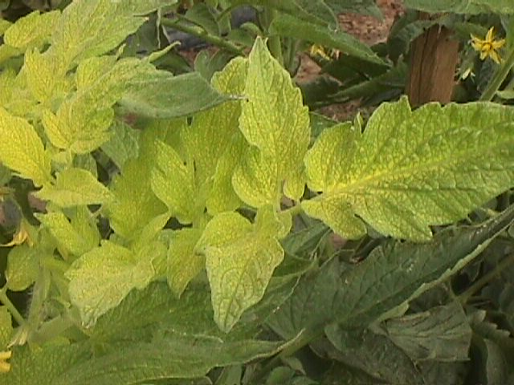
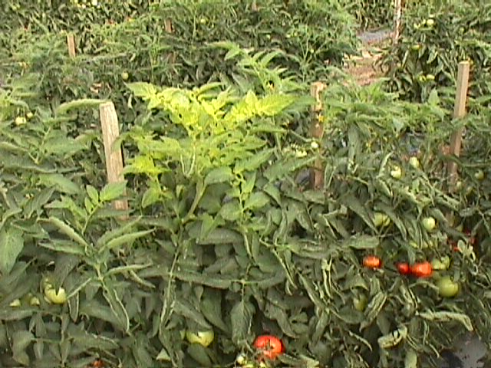
Iron Deficiency
Iron deficiency is characterized by pale color in the
uppermost youngest leaves. Fe deficiency can be seen
particularly on sandy soils with higher pH and in
cold, wet, poorly aerated soils.
Notes:
Iron deficiency looks like about the opposite of nitrogen deficiency with the symptoms appearing in the uppermost leaves first. Sometimes the leaf veins will stay dark green while the rest of the leaf turns pale yellow.

Slide 18
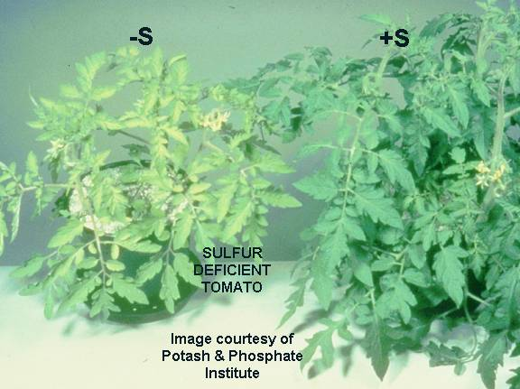
Sulfur Deficiency
Sulfur deficiency is often confused with Nitrogen
deficiency. However, sulfur deficiency is seen
first on younger tissue, not older tissue.
Sulfur deficiency can usually be readily corrected
with foliar applications of magnesium sulfate.
Notes:
Sulfur deficiency occurs more often on sandy soils. Younger leaves are affected first and turn light green to yellowish in color.

Slide 19
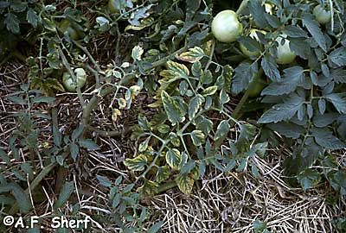
Magnesium Deficiency
Magnesium deficiency can occur with low pH, but it is not
always the case. Occurs frequently on coarse-textured
soils.

Slide 20
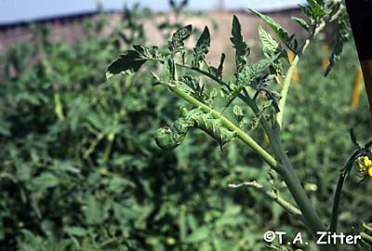
Insects

Slide 21
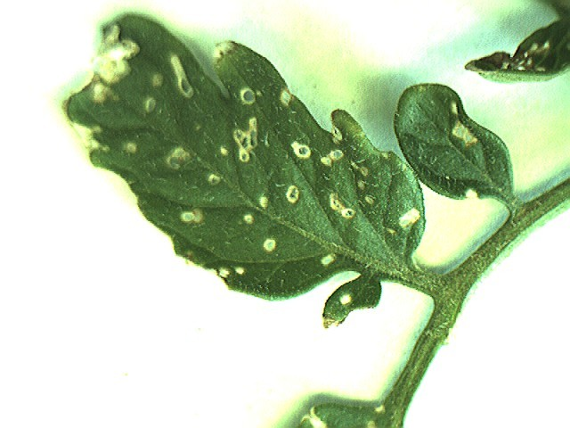
Flea Beetle Damage
Notes:
Flea Beetles are tiny black insects that hop from plant to plant and cause damage to the leaves. Damage appears as small brown spots and holes. Heavy infestations can lead to reduced yield.

Slide 22
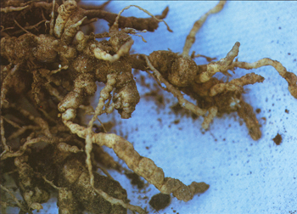
Root Knot Nematode

Slide 23
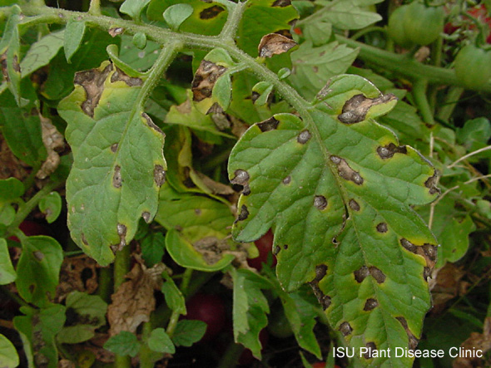
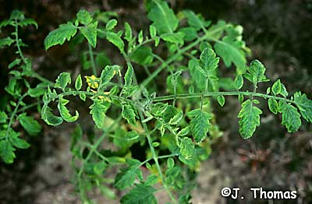
Disease and Virus Control
Notes:
Several viruses can attack tomatoes including Cucumber Mosaic, Tobacco Mosaic and Spotted Wilt Virus. Symptoms typically include distorted foliage and discoloration or mottled leaves. Viruses are usually spread by insects or animals or humans moving through or touch plants while they are moist. Viruses can severely weaken and even kill infected plants. There are no sprays or cures to combat viruses and infected plants should be removed and destroyed immediately. Avoid using tobacco in or near the garden and walking in the gardren while it is wet. Resistant varieties are available to help prevent viruses.

Slide 24
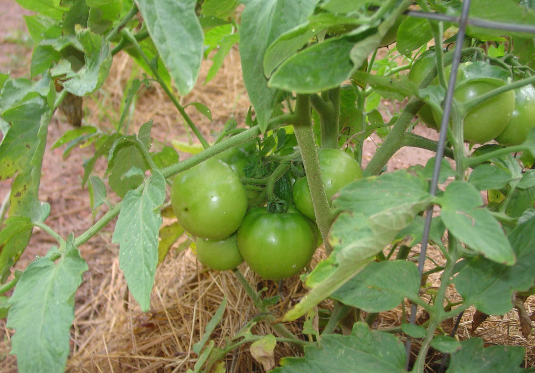
Resistant Varieties

Slide 25
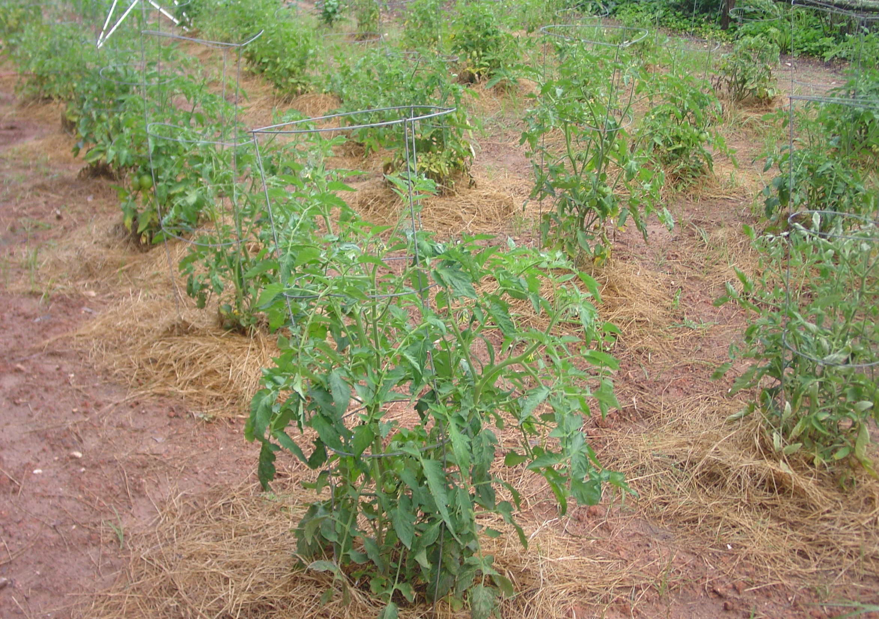
Ventilation
Notes:
Good ventilation is essential to help prevent disease problems from starting. Allow 4 to 5 feet between plants for maximum air flow.

Slide 26
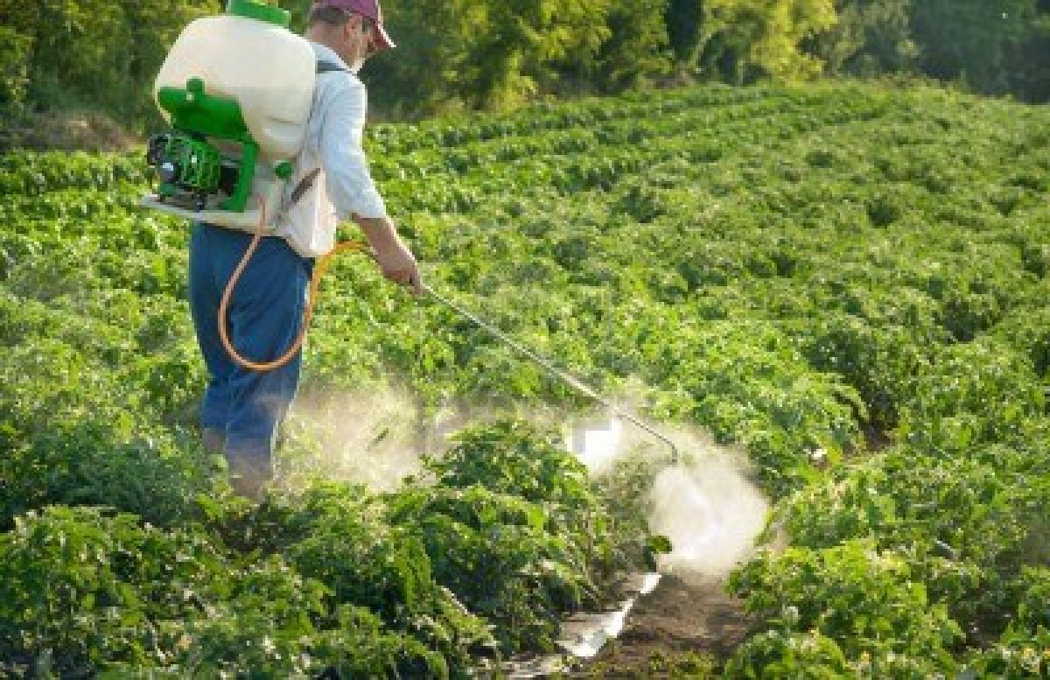
Herbicide Damage

Slide 27
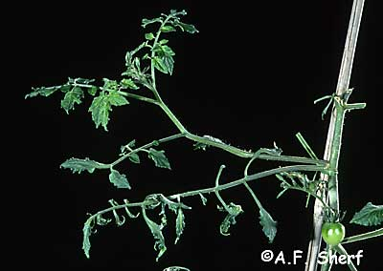
2,4-D Damage

Slide 28
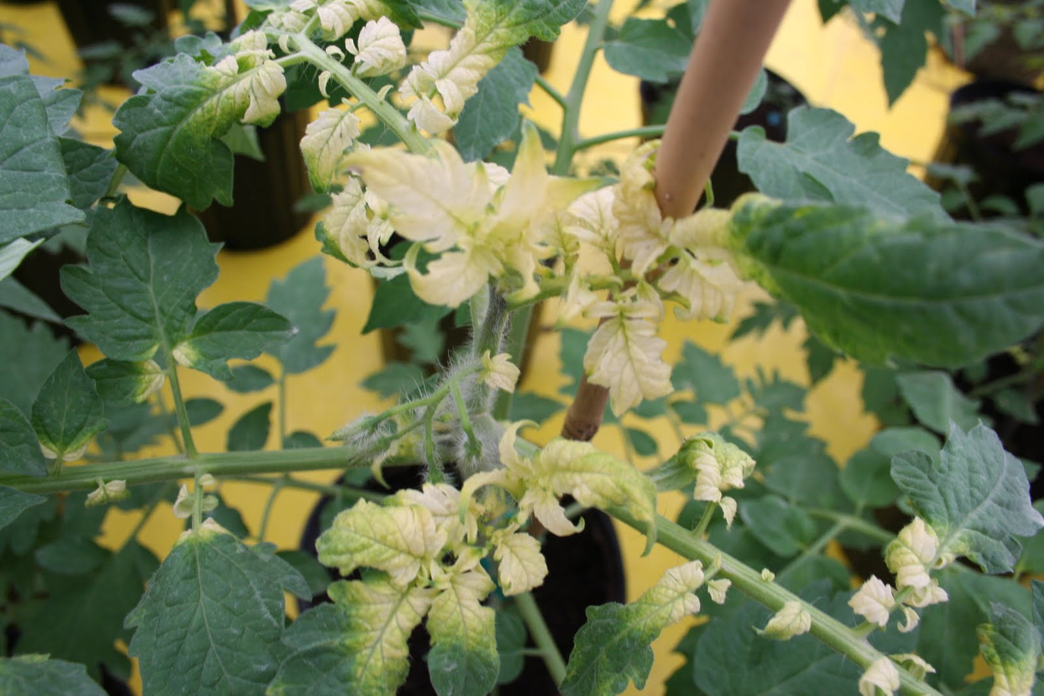
Round-up

Slide 29
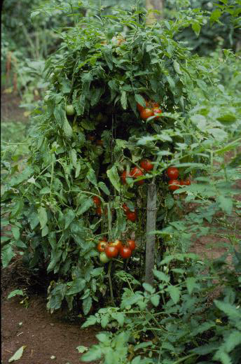
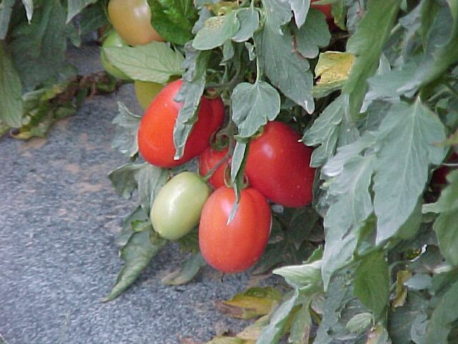
Selecting the Best Variety!
Notes:
Always support tomatoes to keep bushes upright and the fruit off the ground. This plant has not been pruned. Pruning will produce fewer but larger fruit. Pruning is done by removing suckers.

Slide 30
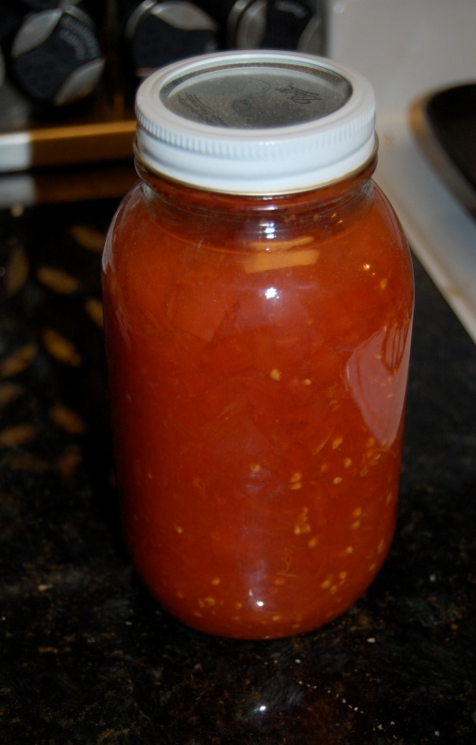
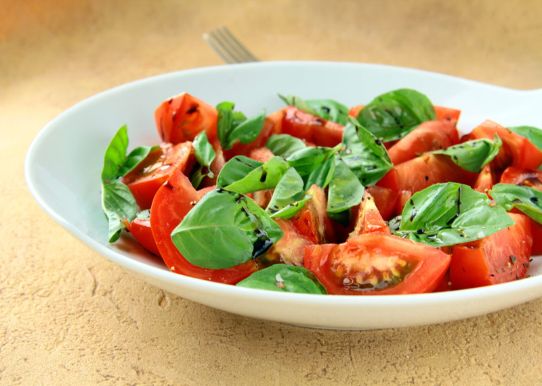
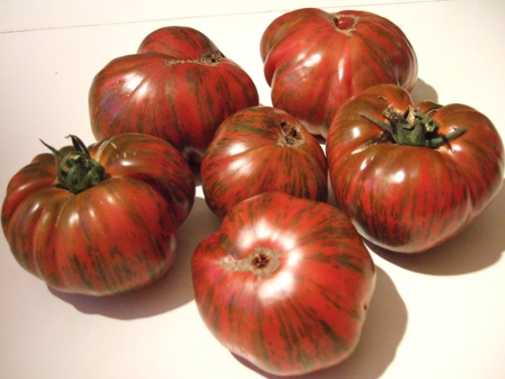
Depends on the specific needs of the grower
Canning
Fresh eating/salads
Flavor Size and color

Slide 31
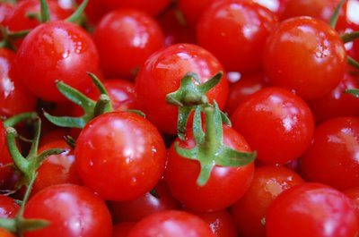
Supersweet 100 salads

Slide 32
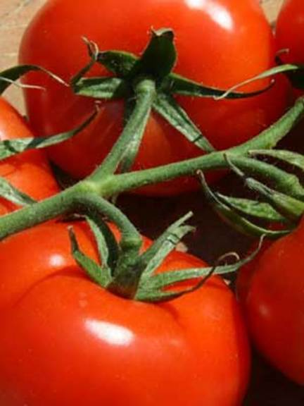
Rutgers Select (Determinate) canning

Slide 33
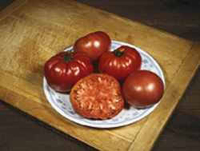
Brandywine- (Heirloom) flavor

Slide 34
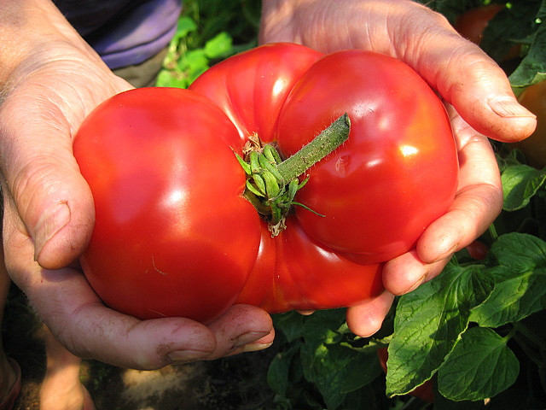
Big Beef- (Indeterminate) size

Slide 35
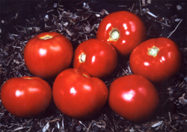
Amelia-(Spotted wilt. resis.) disease resistant

Slide 36
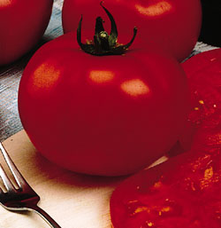
Park’s Whopper - (Indeterminate) sandwiches or fresh slicing

Slide 37
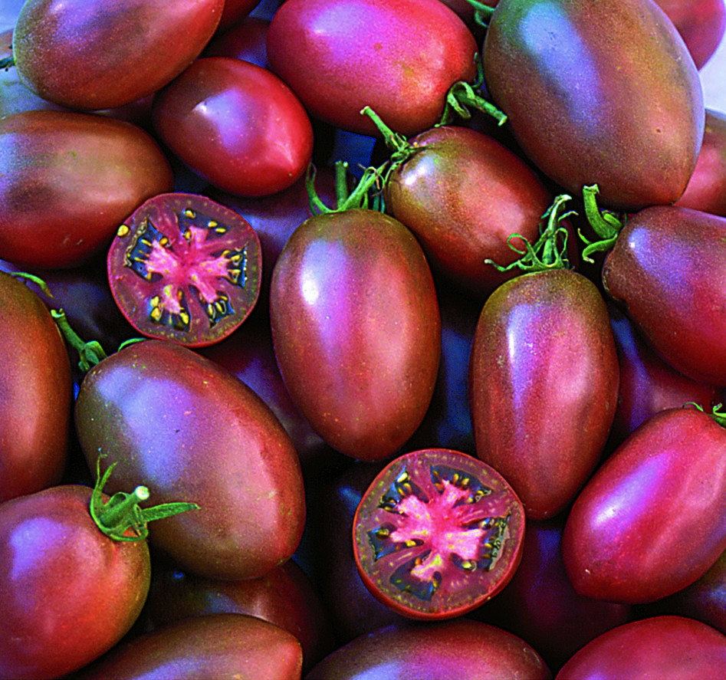
Purple Russian
color

Slide 38
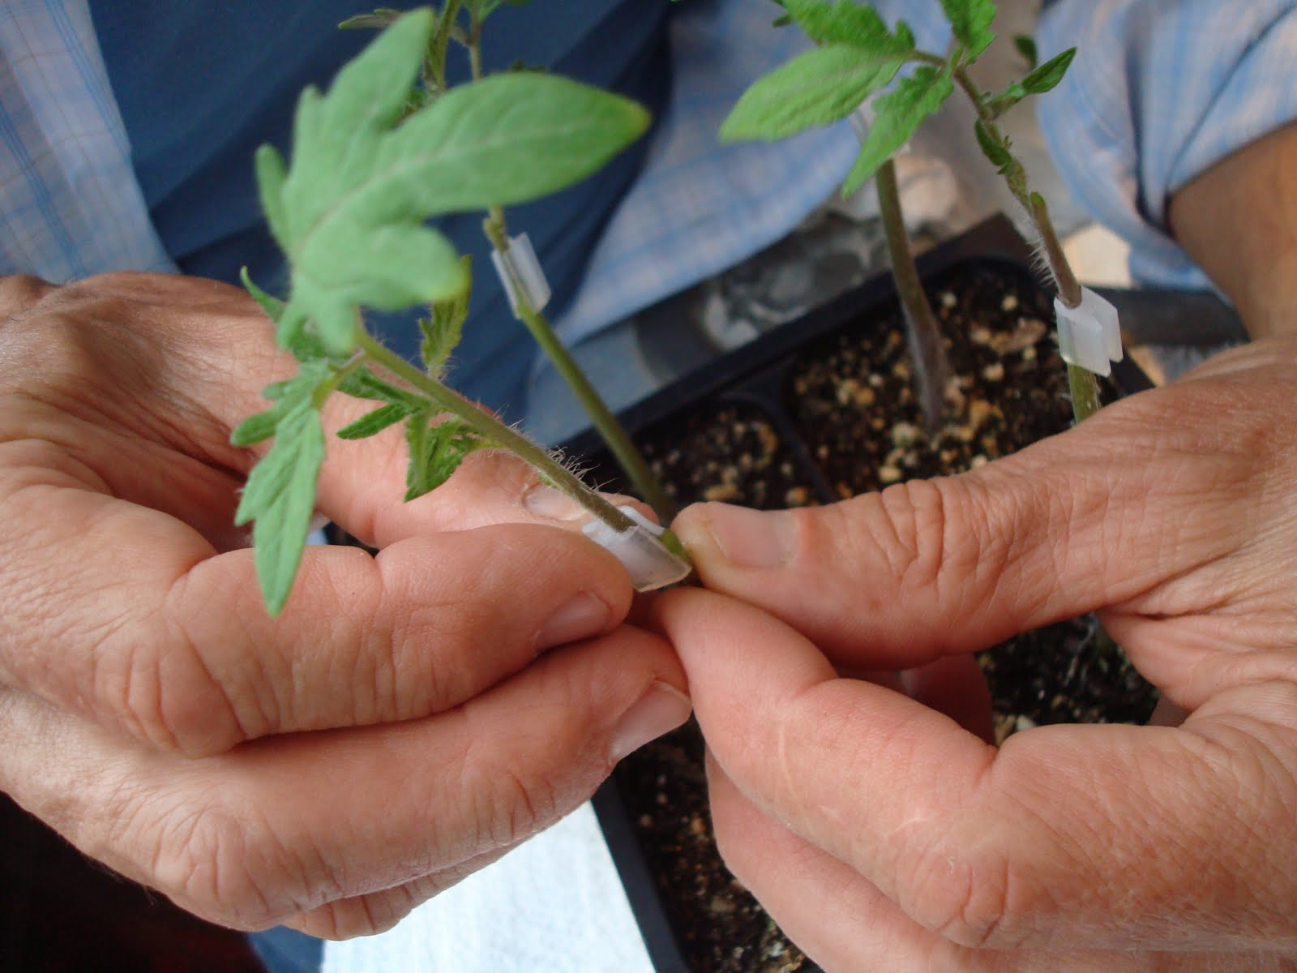
Grafting Tomatoes
http://www.youtube.com/watch?v=tHnOYcI6B44

Slide 39
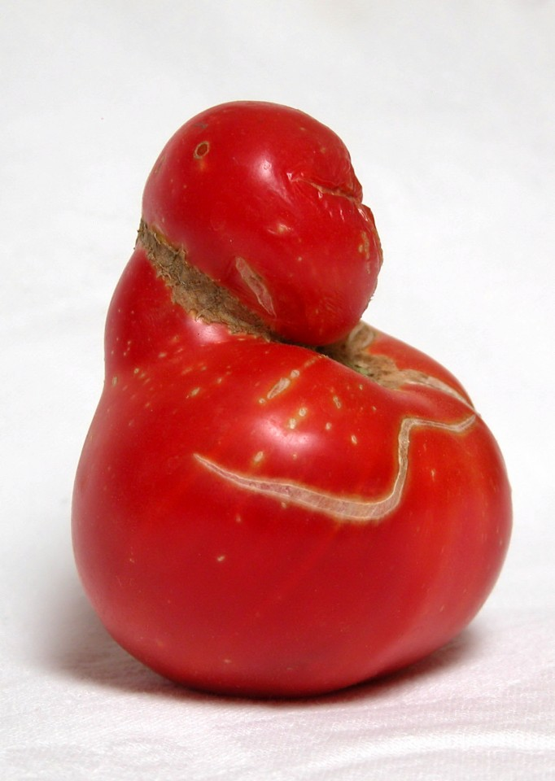
Questions?

