Slide 1
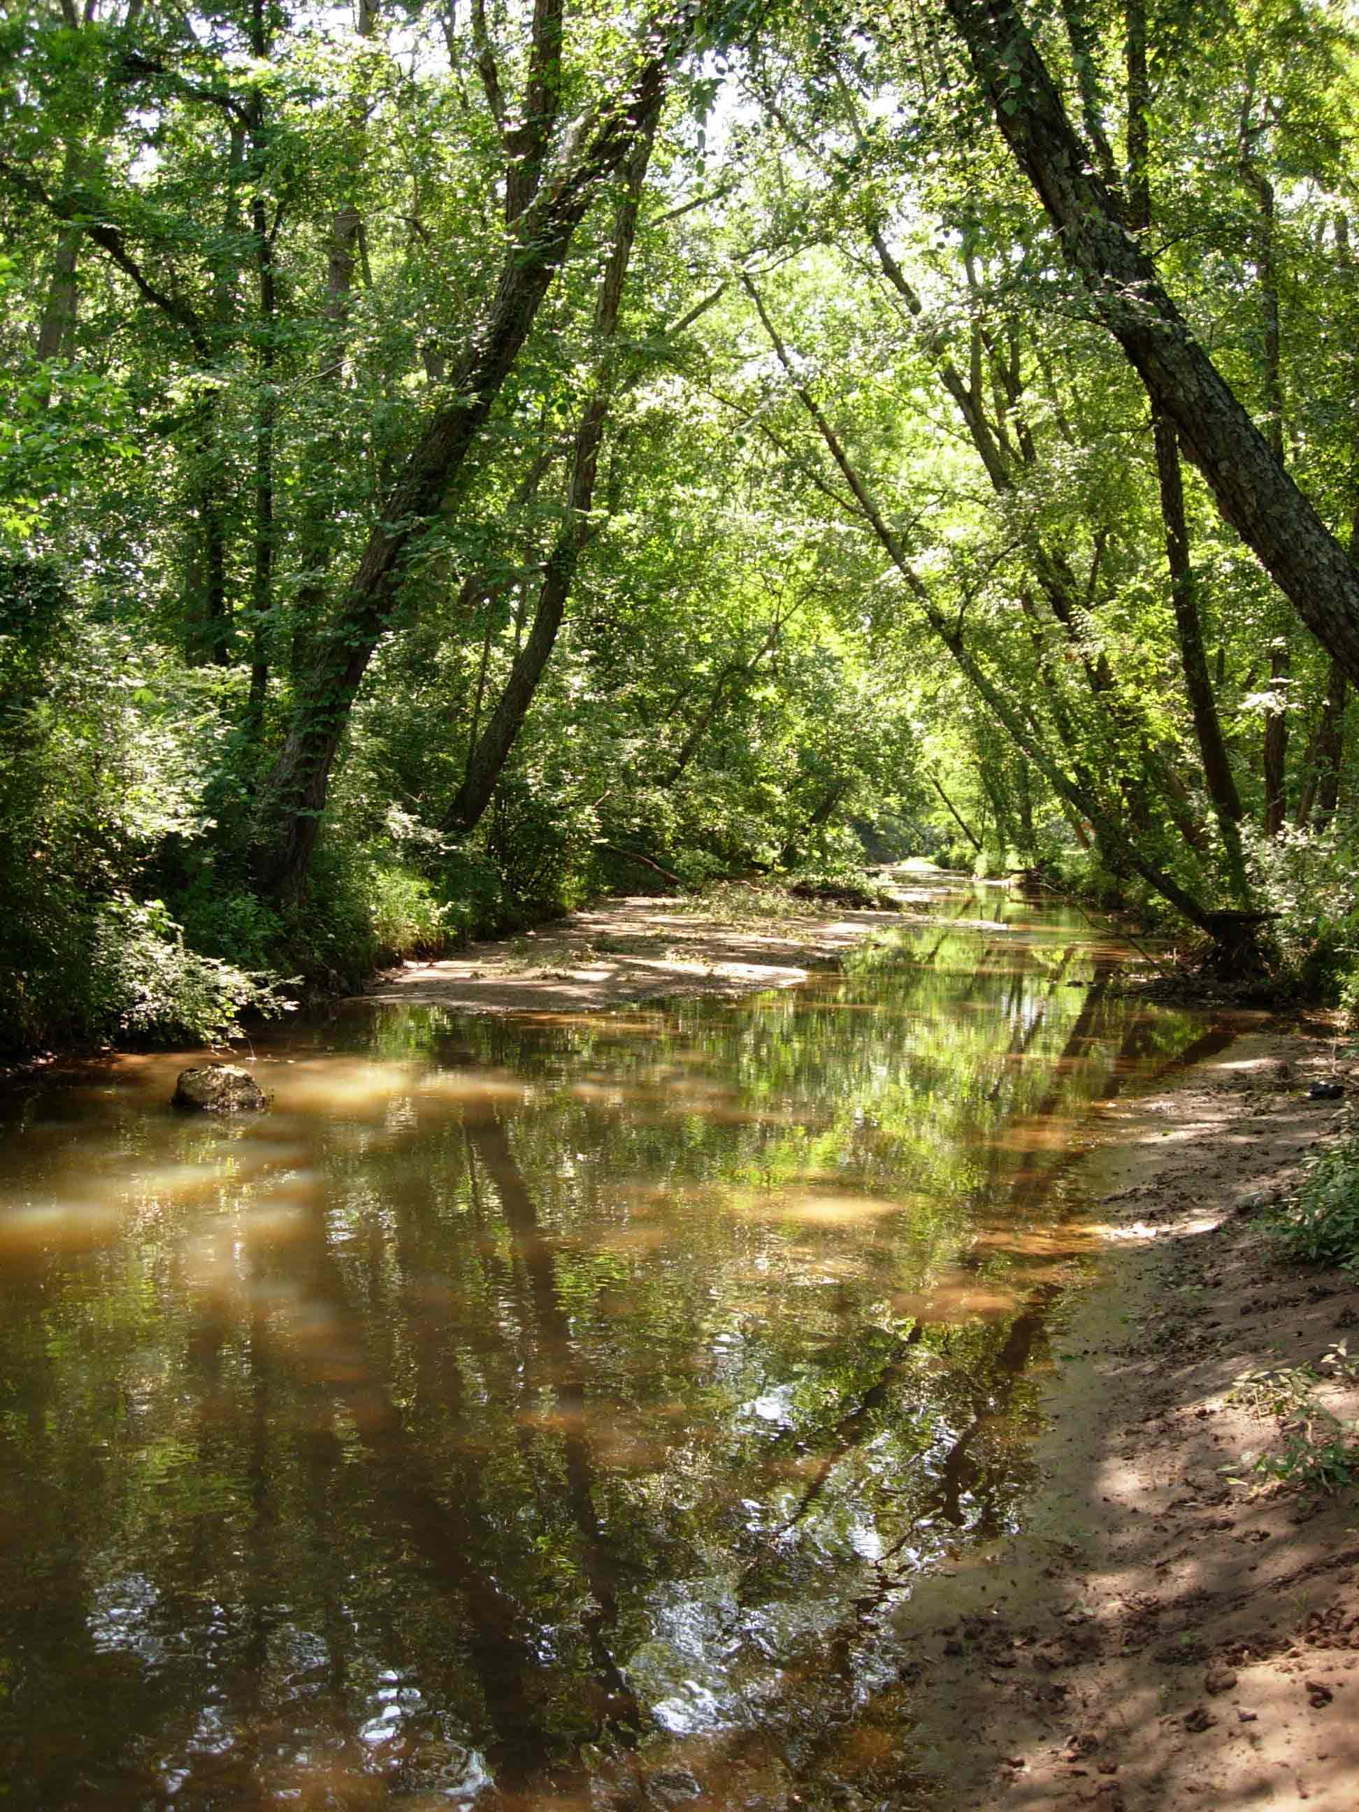
TMDL – Fecal coliform
Frank Henning
UGA Watershed
Extension Agent

Slide 2

What is a TMDL
Calculation of the maximum amount of a pollutant that a water body can receive and still meet water standards set by EPD (designated use)
Includes a margin of safety
Designed to help improve
water quality
Why bother?

Slide 3
305 (b) Report
Navigable waters
Published by EPD every
two years
List available online:
http://www.gaepd.org/Documents/305b.html

Slide 4
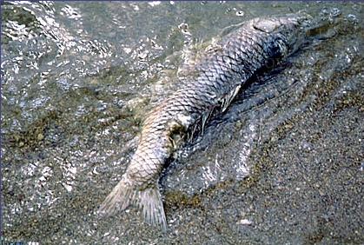
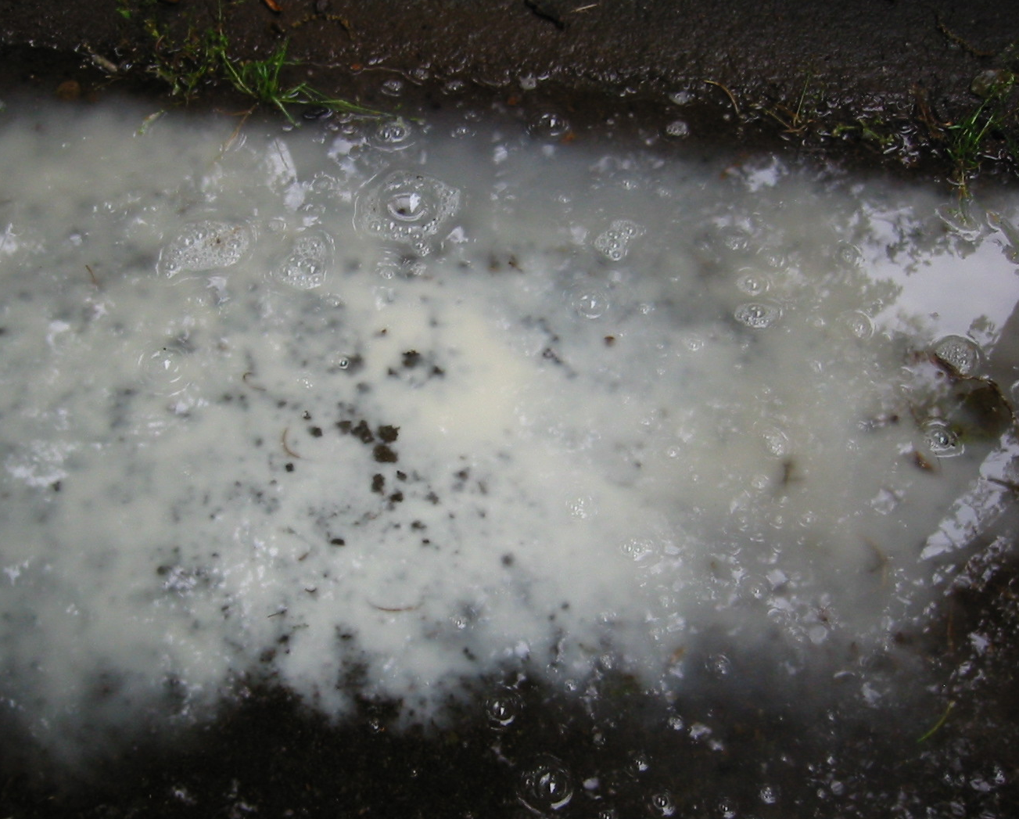
303(d) List
Subset of 305(b) list
Lists waters that do not meet state water standards
Not supporting or Partially supporting designated use
Delist = change listing to supporting

Slide 5
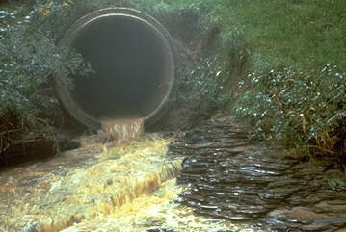
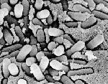
Fecal coliforms
Broad group of bacteria (most nonpathogenic)
Indicator for fecal matter
Correlated with pathogens (illness)
Laboratory test
Regulated by Georgia EPD

Slide 6
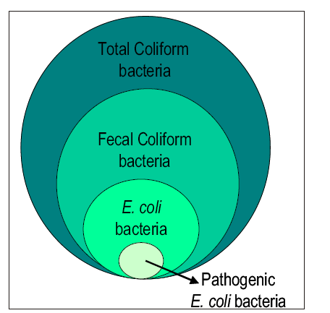

Slide 7

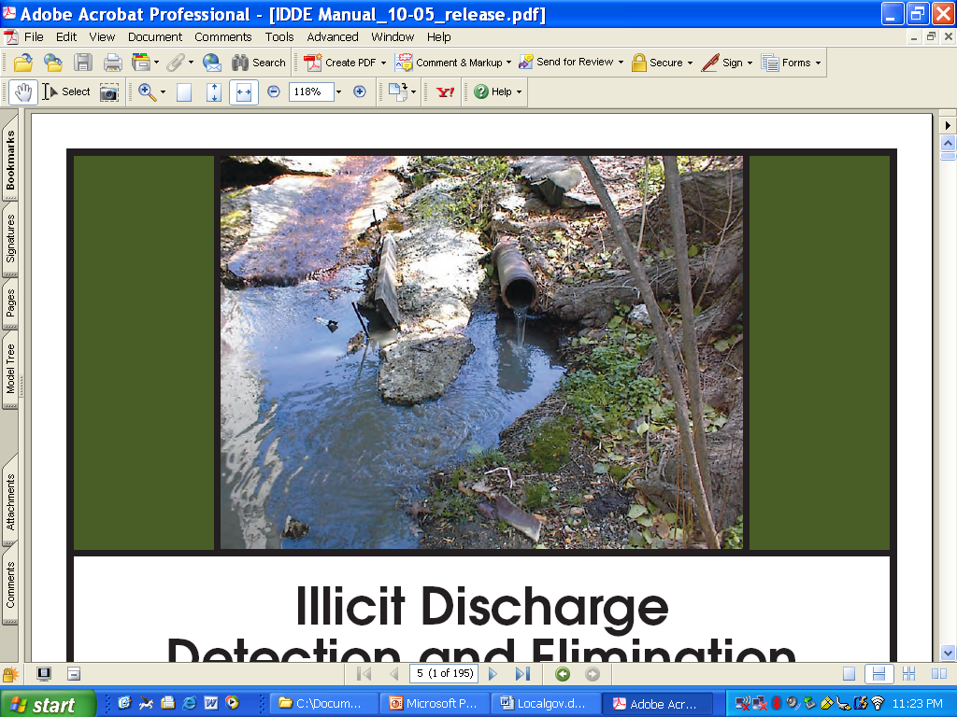
Common Sources of
Fecal coliform Contamination
Ag runoff
Domestic animal waste
Urban runoff
Illicit discharges
Leaking & overflowing sewer lines
Treatment plant bypass
Failed septic systems
Wildlife

Slide 8

Designated use standards for FC
Recreation (swimming):
100 counts/100 ml for coastal
200 counts/100 ml for other recreation waters
Drinking Supplies:
May – Oct. 200 counts/100ml
Nov. – April 1,000 counts/100ml
Maximum of 4,000 counts/100 ml
Fishing and Coastal Fishing:
same as drinking
Wild River and Scenic River:
No alteration of natural water quality

Slide 9
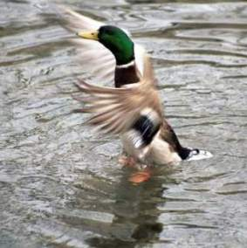
Wildlife Provision
For recreation, drinking and fishing waters, should water quality and sanitary studies show fecal coliform levels from non-human sources exceed 200 counts/100ml (Geometric Mean) occasionally, then the allowable geometric mean fecal coliform…
shall not exceed 300 /100 ml for lakes and reservoirs
shall not exceed 500 /100ml in free flowing freshwater streams
(GA EPD, 2004)

Slide 10
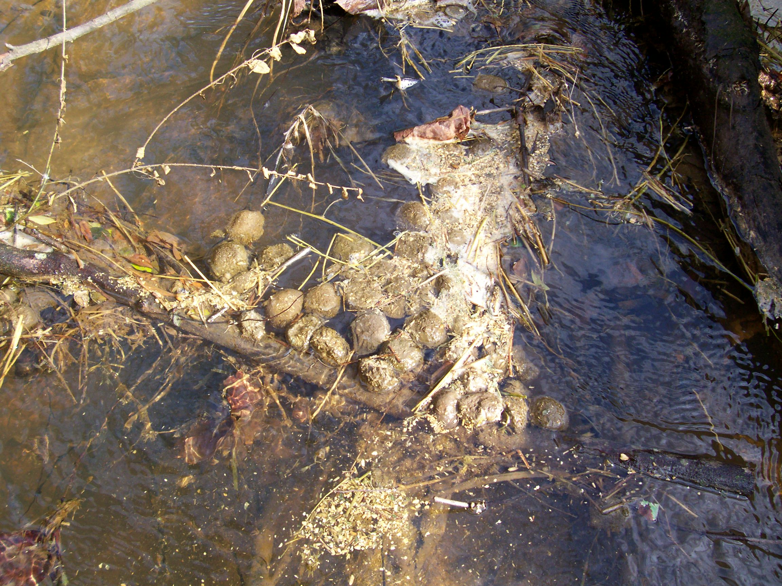
Fecal Geometric Means
Collected quarterly (4 GMs/year)
Each quarterly GM consists of at least 4 samples collected within a 30 day period
Samples collected at least 24 hours apart
GM = (Y1*Y2*Y3*Y4) ^{¼}

Slide 11
Example Geometric Means
Stream A
25, 25, 25, 925 counts/100ml
Avg. = 250
GM = 61.66
Stream B
200, 200, 200, 400 counts/100ml
Avg. = 250
GM = 237.84

Slide 12
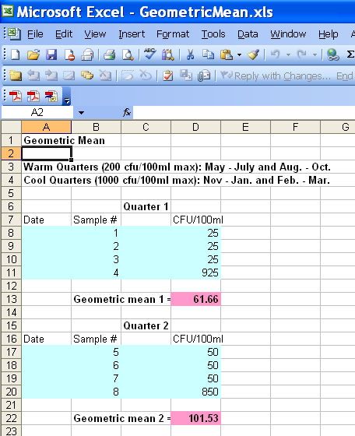

Slide 13
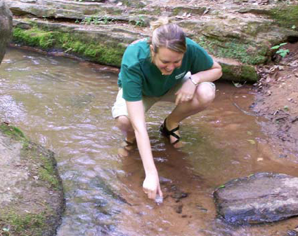
Sample Timing
Warm Quarters: May - July, Aug. - Oct.
(more human contact and more stringent FC standards)
Cool Quarters: Nov.- Jan., Feb. - April
(less human contact and less stringent FC standards)

Slide 14
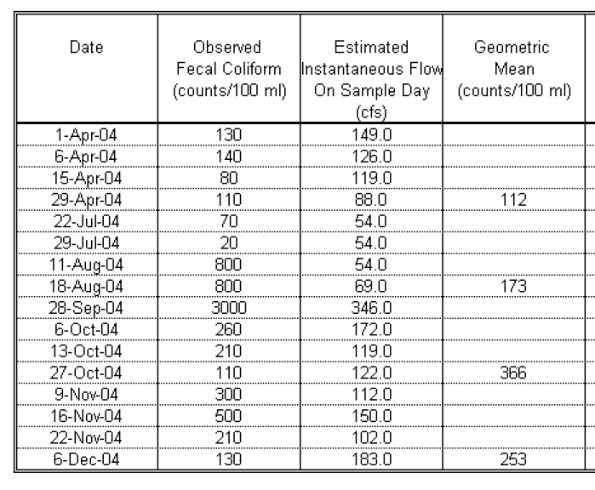
Target a stream
Cool (1,000)
Warm (200)
*Warm (200)
Cool (1,000)

Slide 15
Target Sampling
Baseflow conditions – fecal bacteria levels
may increase 10 – 100X in storm flow
Talk to people with local knowledge & identify potential sources of coliforms
Collect samples from tributaries. Identify sample locations with map GPS or map (zillow.com)
Place bacteria data on a map or GIS database to identify hotspots
Repeat target sampling at hotspots

Slide 16
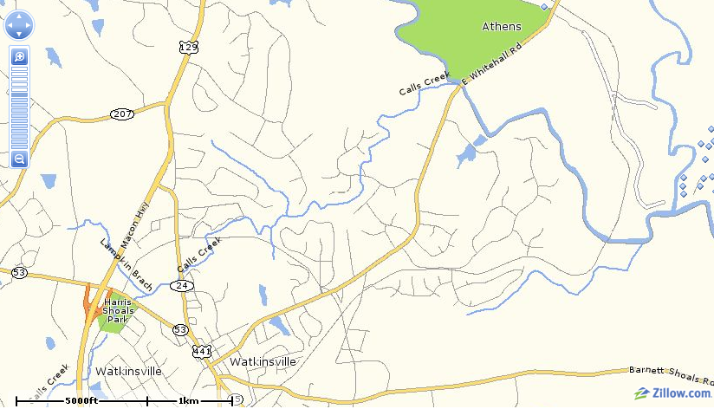
Example TMDL Stream

Slide 17
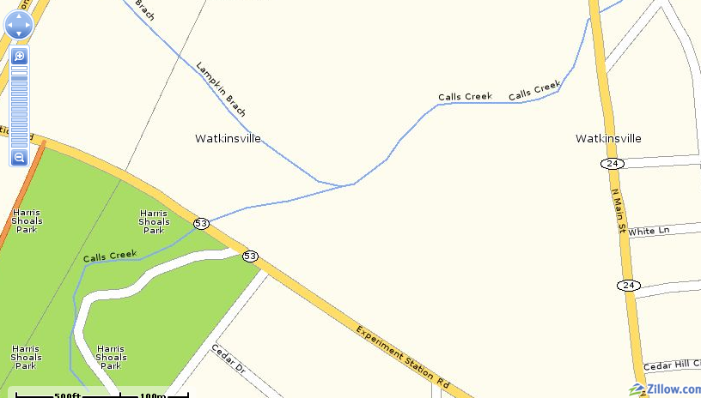
3
2
1

Slide 18
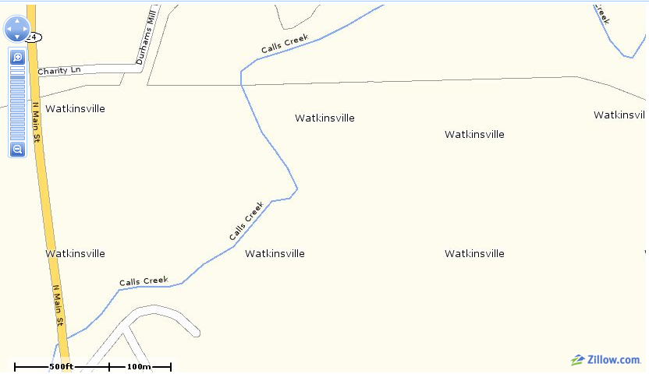
4

Slide 19
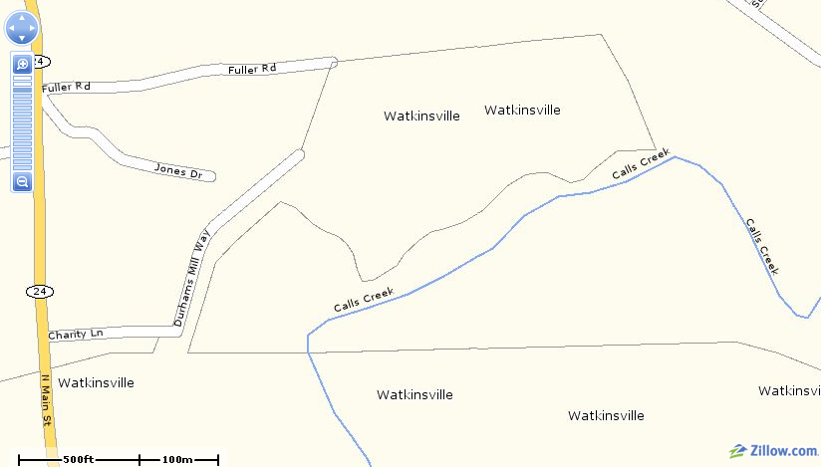
Trt. Plant
6
5

Slide 20
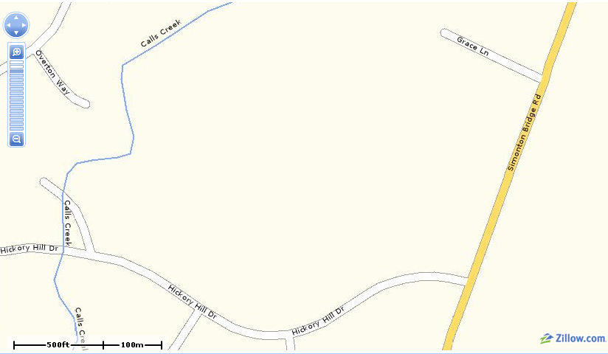
13
12*

Slide 21
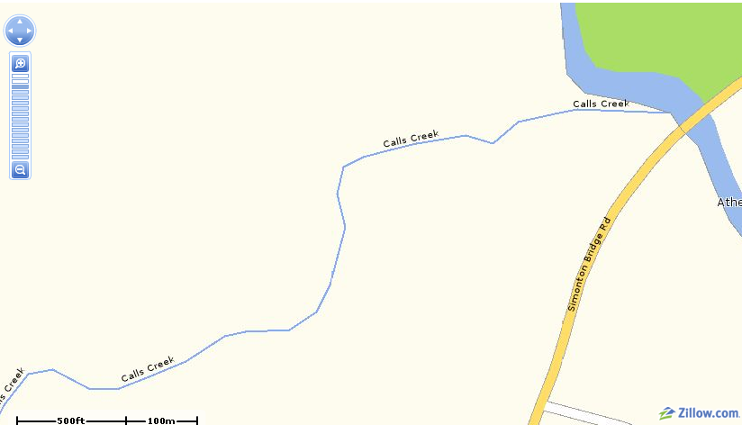
15

Slide 22
Idexx E. coli Sampling Equipment
Idexx Colilert 18 or 24
Quanti-tray 2000 (up to 2,419 cfu.100 ml
Sterile bottles
Pipette and pipette tips
Sterile water
Incubator
Gloves
Cost ~ $5 - $10 per sample
http://www.idexx.com/water/colilert/index.jsp

Slide 23
Fecal vs. E. coli
Fecal Coliform counts/100ml | Estimated E. coli counts/100 ml
GA Standard | Georgia Data | EPA Data
200 | 145 | 126
1000 | 727 | 629
E.coli to Fecal coliform multiplier
E.coli * 1.38 (Vendrell, UGA, 2005)
E.coli * 1.59 (USEPA, 1986)

Slide 24
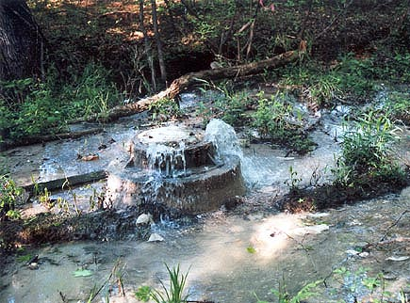
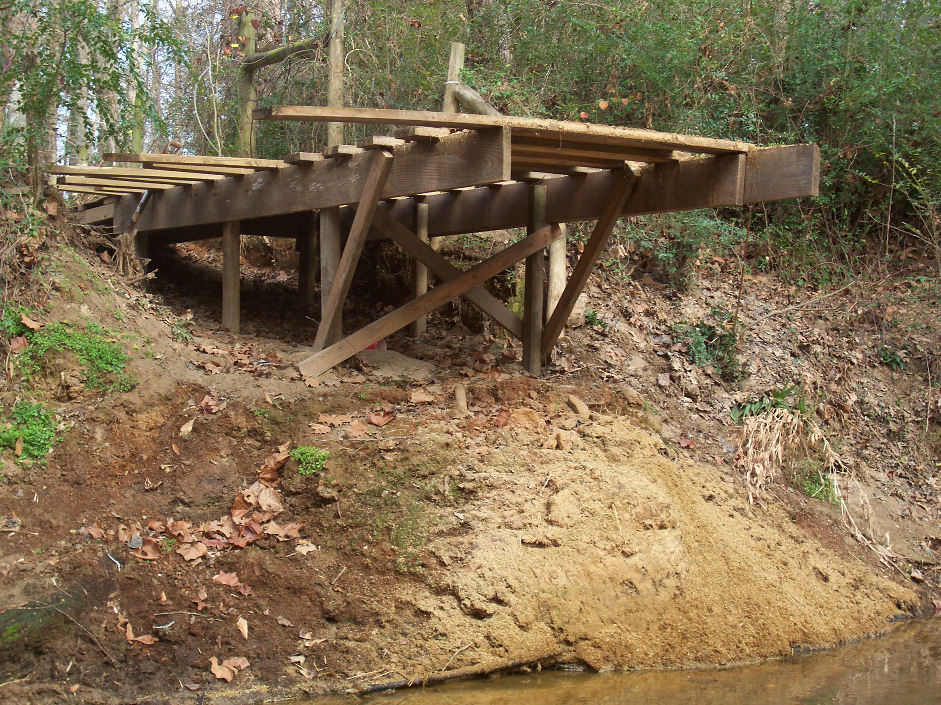
Correcting Bacteria Problems
Decrease source (Edu., Maintenance, Reg.)
Reduce transport/conveyance (filter/disconnect)
Increase mortality (time and distance)

Slide 25
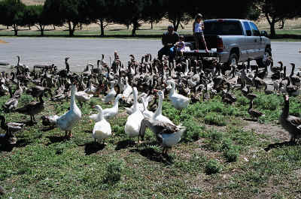
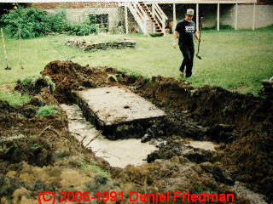
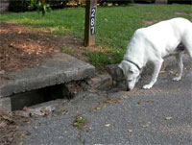
Identify Bacteria Hotspots

Slide 26
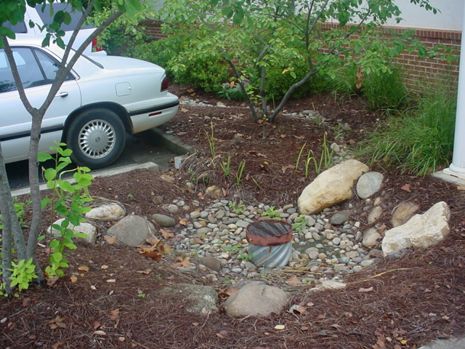
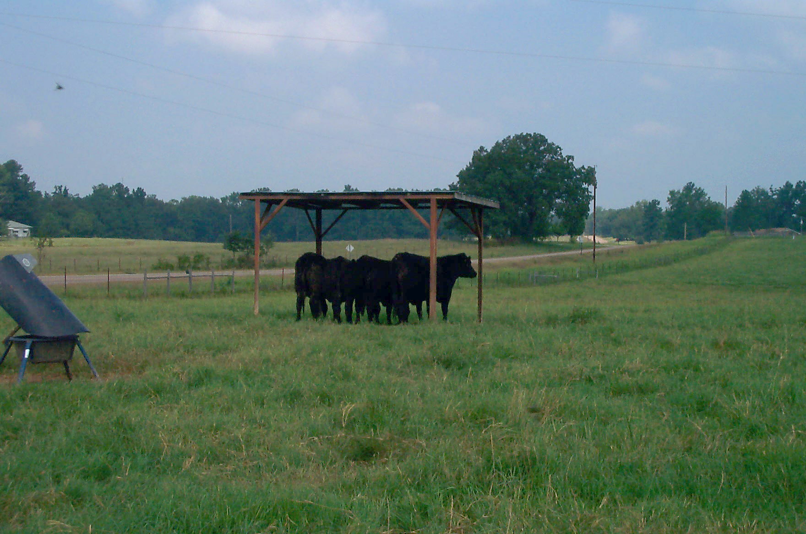
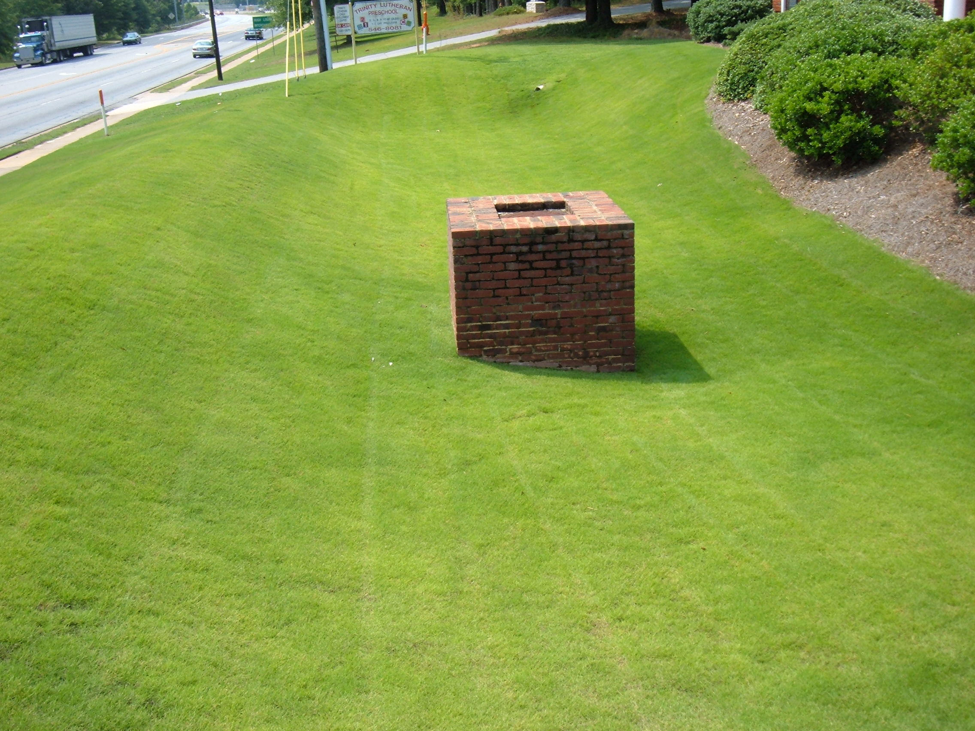
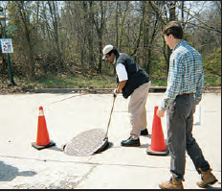
Corrective Actions

Slide 27

Submitting Water Quality Data for use by Georgia EPD
http://www.gaepd.org/Files_PDF/techguide/wpb/SQAP-gwf_1.pdf

Slide 28
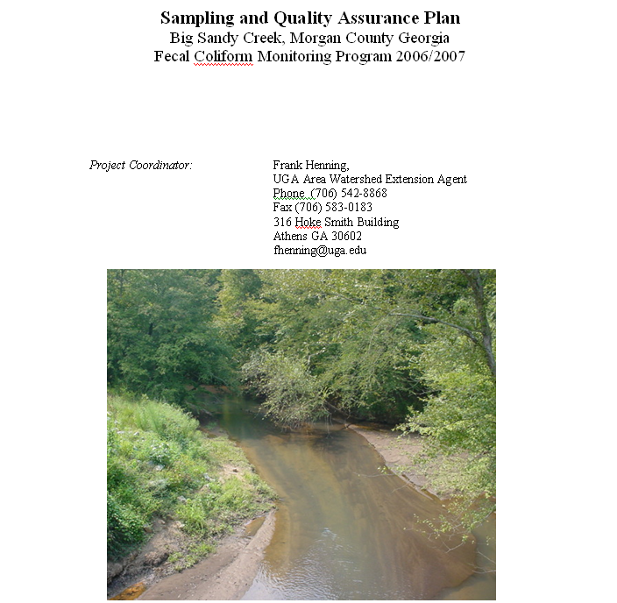

Slide 29
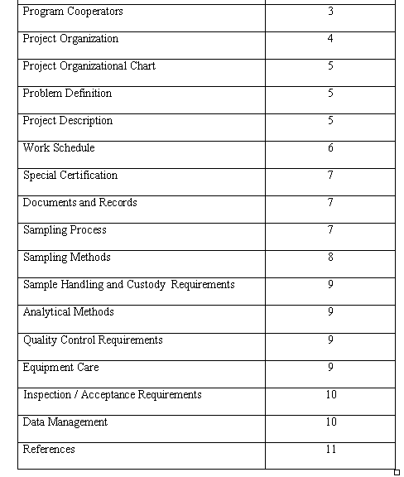
Sampling &Quality
Assurance Plan
Who is involved
Qualifications
Describe problem
Why should listing
be changed?
How and when will
project be done
How can EPD be sure
that data is reliable?

Slide 30
Sample Collection
Collection schedule – 16 samples
Trained sampling personnel (methods)
GIS Map of sample location
Proper containers, storage and holding time
Duplicates (1 for every 10 samples)

Slide 31
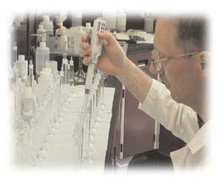
Fecal coliform analysis
Certified Laboratory Analyst (city/county)
Accredited laboratory
Quality Assurance/Quality Control
  Chain of custody
  Record keeping
  Plus others

