Slide 1

Notes:
1. UGA Logo

Slide 2

http://www.caes.uga.edu/extension/
Notes:
3. UGA Cooperative Extension Web address

Slide 3

Notes:
3. Master Gardener Logo

Slide 4
Multimedia presentation prepared by:
Daniel R. Suiter, Ph.D. and Lisa M. Ames, M.S.
Department of Entomology
University of Georgia’s Griffin Campus
Griffin, GA 30223
Structural and Household Pests
Notes:
4. Title Slide Structural and Household Pests

Slide 5
Learning Objectives
Common nuisance pests & serious structural pests
Distinguish a termite alate from an ant
Methods of controlling fleas and ticks on pets
Notes:
5. Learning Objectives
After you complete your study of this chapter you should be able to:
Be familiar with common nuisance pests and serious structural pests.
Be able to distinguish a termite alate from an ant.
Know methods of controlling fleas and ticks on pets

Slide 6
Preventing and controlling ants & roaches
Stored product & pantry pests and their control
Occasional household invaders and stinging pests in the home and landscape
Notes:
6. Learning Objectives Continued
Know techniques for preventing and controlling ants and roaches.
Be familiar with stored product and pantry pests and their control.
Be able to identify occasional household invaders and stinging pests in the home and landscape.

Slide 7
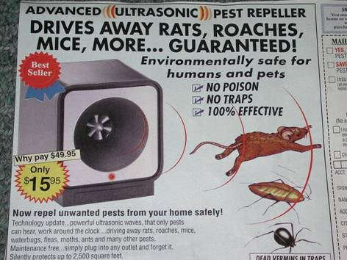
Ultrasonic Devices Do Not Repel Pests!
Huang, F., B. Subramanyam, and J. Clark. 2002. Laboratory and field trials with commercial ultrasonic devices against three ant species (Hymenoptera: Formicidae). J. Agric. Urban Entomol. 19: 25-28.
“The three commercial devices used in our study failed to repel C. festintatus, C. pennsylvanicus, and F. pallidefulva in laboratory and field trials. Similar negative findings with ultrasound have been reported against corn earworm adults (Shorey et al. 1972), cockroaches (Koehler et al. 1986), mosquitoes (Sylla et al. 2000), and fleas and ticks (Hinkle et al. 1990, Brown & Lewis 1991, Dryden et al. 2000).”
Notes:
7. Scientific studies show that ultrasonic devices, often sold in magazines and newspapers are not effective in repelling pests. According to a 2002 ant study, “The three commercial devices used in our study failed to repel C. festintatus, C. pennsylvanicus, and F. pallidefulva in laboratory and field trials. Similar negative findings with ultrasound have been reported against corn earworm adults (Shorey et al. 1972), cockroaches (Koehler et al. 1986), mosquitoes (Sylla et al. 2000), and fleas and ticks (Hinkle et al. 1990, Brown & Lewis 1991, Dryden et al. 2000).”

Slide 8
Hiring a Professional Pest Control Company
Customer Service
Friends, neighbors, co-workers (reputation)
No “yellow page” selections; be careful of exceedingly low prices
Questions to Ask:
  Does the company perform in-house training?
  Is the company a member of their State and/or National Pest Control Association?
Notes:
It is often best to hire a professional pest control company to tackle pest control problems. If a company is hired, it is important to select a company committed to customer service, especially if the homeowner is considering entering a long-term service contract. Some tips on hiring a pest control company include:
• Ask friends, neighbors, and co-workers about their experiences and interactions with pest control companies. Selecting a professional pest control company is not unlike selecting other service providers, such as electricians and plumbers. Consistently good recommendations are still the most reliable means of selecting a quality pest control professional.
• Avoid going to the yellow pages and selecting a company based solely on an advertisement. Furthermore, do not hire a pest control company based on treatment price alone. A variety of factors should be considered when making a decision on which company to hire.
• Ask prospective companies to describe their commitment to the continuing education of their pest control technicians. Although all technicians in Georgia are required to attend State-approved continuing education seminars, some companies provide in-house training or send their employees to University- or State-sponsored training programs and workshops that are above and beyond that required by the State.
• Ask prospective companies whether they are a member of their state and/or national pest control organization(s). Membership in these organizations suggests that the firm is well-established, and that the owners are active in their profession. Membership also suggests that owners and managers attend national and state conferences where insight into key issues facing the pest control industry are highlighted and discussed, and the most recent findings on pest control research and application technology are presented.

Slide 9
Product Types
Key Steps in Pest Control
  Pest Identification
  Inspection
  Control Options: Chemical, Non-Chemical, Both
Product Formulations
  Baits-for cockroaches and ants; use indoor and outdoor
  Granulars-for crawling insects; use outdoor only
  Dusts-for crawling insects; use in voids only
  Aerosols-do not use
  Liquid Sprays-for crawling insects; use outdoor only as perimeter or spot
Notes:
There are a number of approaches that can be utilized for the treatment of existing pest infestations, but no single chemically-based approach is completely effective. An integrated approach, therefore, that incorporates both chemical and non-chemical techniques is best suited for the long-term management of urban pests.

Slide 10
Baits
Baits are combinations of small amounts of pesticide with a food palatable to the target insect. Baits can be packaged as granules, pellets, gels, pastes, liquids, or ready to use stations.
Notes:
Over-the-counter bait products are generally limited to ant, cockroach, rat, and mouse control, and can be used both inside and outside the home. Baits are available in the form of gels/pastes, granules, liquids, stations, or blocks, and most come ready-to-use. Baits are products that kill pests only after being consumed. As such, they are comprised of a toxicant (i.e., active ingredient) incorporated into a food source (i.e., the bait material) that is both palatable and preferred by the target species. Baits are effective against ants because they share food among nestmates in a process called trophollaxis.
Since baits contain food materials, they are susceptible to spoilage; read the product’s label do determine if the bait has an expiration date. Baits are target-specific, and considered more environmentally-sensitive, than the other chemically-based control tactics discussed hereafter.

Slide 11
Granulars
Granulars are formed by coating or impregnating coarse particles of a substance (e.g., clay pellets, limestone chips, corn cob) with pesticide to obtain a certain percentage concentration.
Notes:
Granulars are formed by impregnating or coating insecticide onto a small granule of non-active carrier (e.g., clay, corncob, sand, silica, clay, sawdust, etc.). Granules are applied only on the outside, and are used to control a wide variety of crawling pests by application to places pests live—that is mulch, leaf litter, lawn, etc. Granular products are sometimes purchased in large bags (pounds) as a ready-to-use product.
After application, the insecticide must be released from the granule by allowing water to wash over it. Thus, granular ‘activation’ requires lawn-watering or natural rain. Unlike liquid sprays (discussed below), granular products may remain active for as long as six to eight weeks. Like liquid sprays, granular products act by contact (killing) and by keeping foraging pests out of treated areas (repellency).
Granular products exhibit one distinct advantage over other formulation types—their weight. The weight of the granule allows the chemical to reach deeper into treated areas than would be expected from a liquid spray treatment (discussed below) applied directly to the surface of the same substrate. It is important to note that pests do not eat granular products, as they do some baits that are delivered as small granules. In fact, a granular product is never a bait, but bait can be delivered in the form of a granule.

Slide 12
Dusts
Dusts are made by combining a small amount of insecticide or insecticide concentrate with an inert diluent, such as powdered clay or talc.
Notes:
Dust products have the consistency, look and feel of powder and are purchased ready-to-use. They are not mixed with water, and are applied dry. Dusts are comprised of small particles of active ingredient mixed with equivalently small particles of an inactive carrier material such as talc or clay. Most dusts work because insects pick up the minute particles and ingest them, while others severely desiccate the insect, causing it to dehydrate and die.
Generally, dusts should be used only in dry voids such as behind brick veneer, drywall, electrical switch-plates, and synthetic stucco to remedy existing pest problems indoors and to prevent the reinvasion of pests into voids from the outside. For example, if ants can be seen coming from an electrical switch-plate a small quantity of dust can be applied behind the plate.
Many homeowners make the mistake of over-applying dust. Too much can be repellent, causing insects to avoid dusted areas. Apply dusts so that a very thin film settles in treated voids and on treated surfaces. Ideally, the quantity of dust applied should be only slightly visible in comparison to undusted areas. Some dusts never degrade, while others remain effective for up to a year.
Some dusts contain a high concentration of active ingredient, and should never be applied where or when they can injure or sicken non-target organisms—including the applicator. Misapplication of dusts can result in accidental inhalation and thus unnecessary exposure. Since dusts become airborne very easily, it is advisable to always wear a protective mask and preferably eye protection when applying them.

Slide 13
Emulsifiable Concentrates
Technical grade material is dissolved in petroleum-based solvents, and an emulsifier is added to facilitate mixing of solvent and water, forming a milky-white emulsion.
Notes:
Emulsifiable concentrates are composed of an insecticide dissolved in a petroleum-based solvent which, when mixed with water, forms a milky-white emulsion that can be sprayed. Wettable powders are created by impregnating or coating an inactive material (clay or silica) with an insecticide. The resultant dust-like powder can then be mixed with water and sprayed. Emulsifiable concentrates do not require agitation (shaking) while wettable powders do because the powder will settle to the bottom of the spray tank.
The main hazard with undiluted emulsifiable concentrates is that they are readily absorbed should the material come in contact with unprotected skin. They do, however, protect against inhalation hazard. Since wettable powders are dry and the particles small, accidental inhalation may result if precautions are not taken when mixing. To avoid inhalation, always wear a mask when working with wettable powders and dusts.
Emulsifiable concentrates are readily absorbed by porous materials, making them fairly unsuitable for treating concrete, brick, unpainted wood, mulch, and other porous substrates. Wettable powders, on the other hand, are readily available on these substrates because the powder remains on top of the treated surface after the water evaporates. As such, they are excellent for use on porous materials, and are generally better than emulsifiable concentrates when treatment of porous, outdoor substrates is needed.

Slide 14
Moisture Management
Persistent moisture attracts pests and allows them to thrive.
Manage Moisture:
  ground covers
  mulch
  surface water drainage
  gutters and downspouts
Notes:
Moisture Management—Homeowners should make every attempt to limit the occurrence of excessive moisture in and around their home. It is the most important condition conducive to pest infestation. Since all life forms are dependent upon moisture, its excess not only attracts pests but allows them to thrive. Some common reasons for excessive moisture in and around homes include improper grade/drainage; misdirected sprinklers; clogged gutters and downspouts; and downspout exhaust(s) within five feet of the structure. The property owner should ensure that water flows away from structure, that grade is appropriate, and that gutters and downspouts are operating properly.

Slide 15
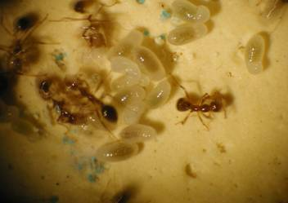
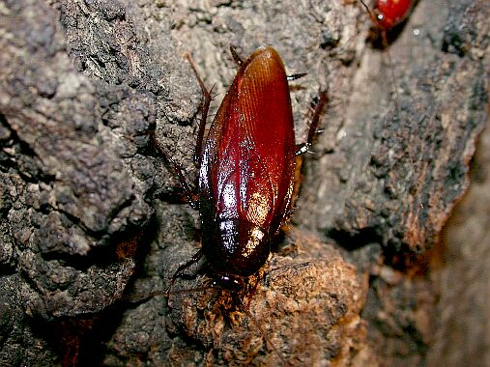
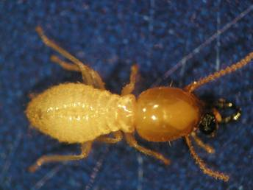
Factors that Limit the Growth of Pest Populations
Water
Food
Warmth
Notes:
Excessive moisture also leads to abundant new plant growth, which in turns leads to high populations of honeydew-producing insects, which in turn supports large populations of ants.

Slide 16
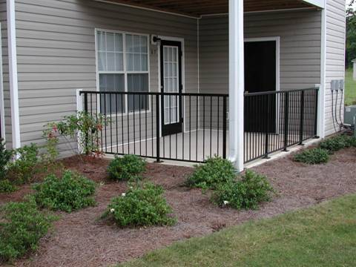
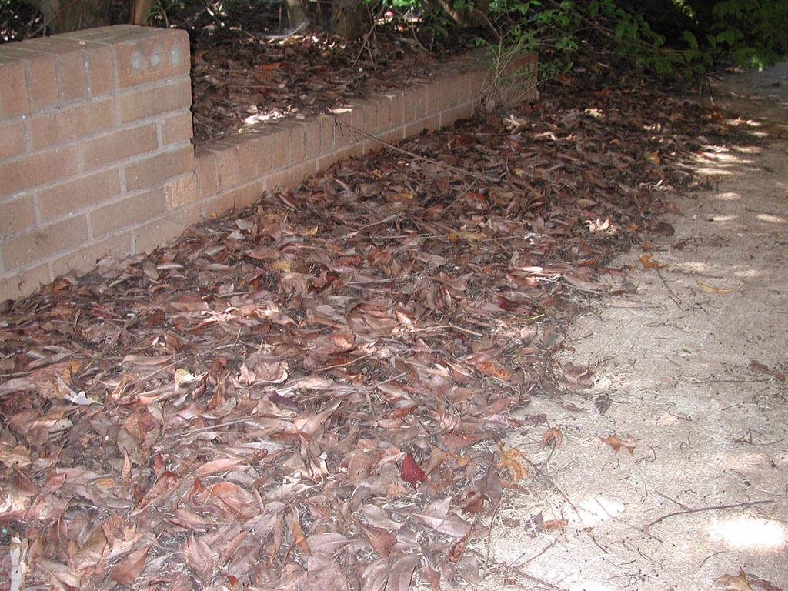
Excessive Moisture and Harborage
Leading to Perimeter Pests
...and leaf litter. Why?
Perimeter pests live in mulch…
Notes:
Property owners should especially keep groundcovers, shrubs, vines, and mulch several feet away from outside foundation walls as these horticultural practices often help retain moisture. Mulch retains moisture in the soil thereby creating zones that provide conditions (high moisture) pests need to explore and thrive in an area. Although no scientific data specifically address the affect that mulch has on pest infestation rates, it is known that mulch placed against a structure’s outside walls allow some pests easy access.

Slide 17
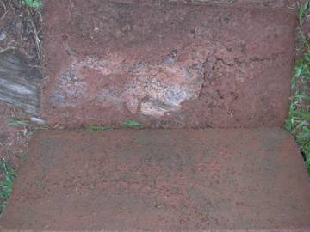
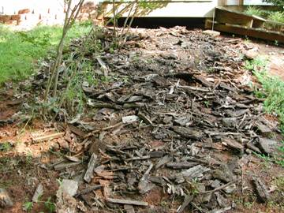
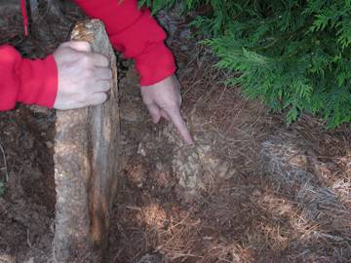
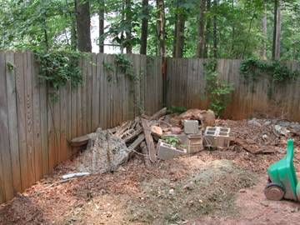
Inspect Under and in Debris for Pests
Moisture and Harborage
Look for pests
under and in debris
Look for pests
under rocks
Notes:
Before selecting chemically-based pest control measures, a thorough inspection of the outdoor and/or indoor premises should be conducted to determine the extent of the infestation and to highlight those areas where control approaches should be focused. Many indoor infestations of urban pests can be tracked to areas of pest activity (harborage) on the outside of the structure, while still other pests are found only indoors.

Slide 18
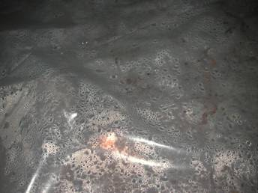
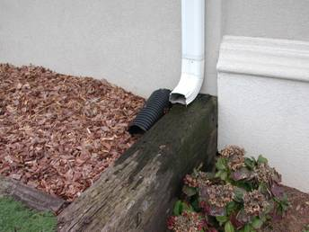
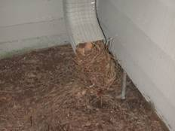
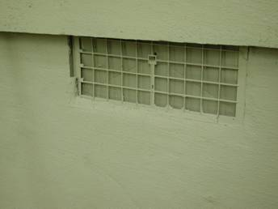
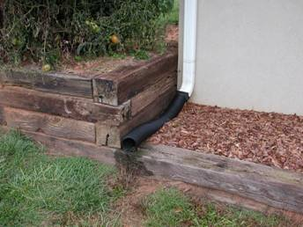
Waterproofing is Important
Vapor Barrier
No!
Yes!
Vents
Notes:
Some common reasons for excessive moisture in and around homes include improper grade/drainage; misdirected sprinklers; clogged gutters and downspouts; and downspout exhaust(s) within five feet of the structure. The property owner should ensure that water flows away from structure, that grade is appropriate, and that gutters and downspouts are operating properly.

Slide 19
Wood Destroying Insects

Slide 20
Subterranean Termites
Native Species
  Eastern ST, Reticulitermes flavipes (most common)
  Light southeastern ST, Reticulitermes hageni
  Southeastern ST, Reticulitermes virginicus
Introduced Species
  Formosan ST, Coptotermes formosanus (most destructive)
Occurrence: Termites are Everywhere! But, this does not necessarily mean infestations are inevitable.
Susceptibility of home to attack
  Construction type
  Conditions in and around structure (moisture)
Notes:
Subterranean termites cost the American public over one billion dollars each year to repair the damage they cause and to hire termite control companies to treat infested structures. In the United States subterranean termites are most abundant, and thus cause more structural damage, in the south and southeast. In the southeast, any yard in a suburban neighborhood will likely have a resident population of subterranean termites that can be found feeding on wood fence posts, garden stakes, railroad crossties, tree stumps, fallen limbs, firewood, etc. While subterranean termites are obviously common around homes, structural infestations are not necessarily inevitable. A home’s susceptibility to termite attack is dependent upon a number of things, including building construction type and perhaps conditions in and around the structure that favor the growth and survival of local termite populations.
Subterranean termites are soft-bodied insects that dehydrate easily, so they must have access to a moisture source. This is usually accomplished by maintaining contact with the soil, but moisture can be obtained from a variety of aboveground sources such as leaky roofs, rain gutters, and condensation from air conditioners. Subterranean termites will eat nearly anything that contains cellulose (e.g., wood and wood products, books, boxes, wicker, paneling, drywall, some carpets, wood cabinets, furniture, mulch, wood flooring, etc.), but prefer to eat softwoods such as pine or fir. Unfortunately for property owners, softwoods are commonly used in structural components such as wall studs, sill plates, joists, headers, window frames, and sub-floors.

Slide 21
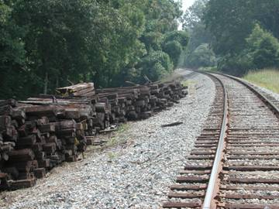
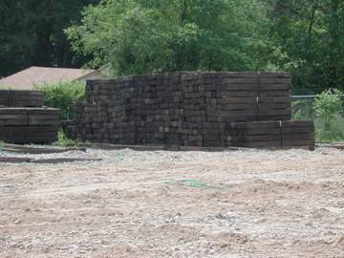
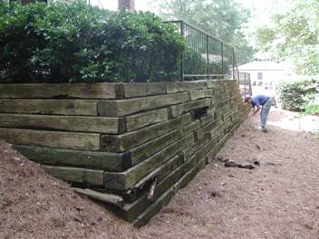
Formosan Termite Spread
Railroad Crosstie Retaining Walls
First
Second
Third
Notes:
Since 1993 Formosan subterranean termite infestations have been found in a number of communities in Georgia. All infestations have been associated with railroad crossties purchased and placed around buildings in 1989 and 1990. Genetic analysis of termites collected at four of the Atlanta sites indicated that the termites had originated in New Orleans. The infestations in the Atlanta area likely came from shipments of used railroad crossties obtained from New Orleans. Still, Formosan termites remain extremely rare in Georgia, and the presence of railroad crossties in the landscape in no way implies the presence of Formosan subterranean termites on one's property.

Slide 22
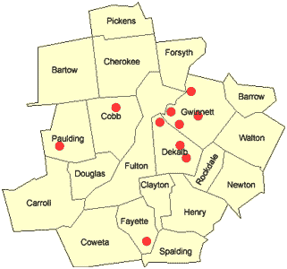
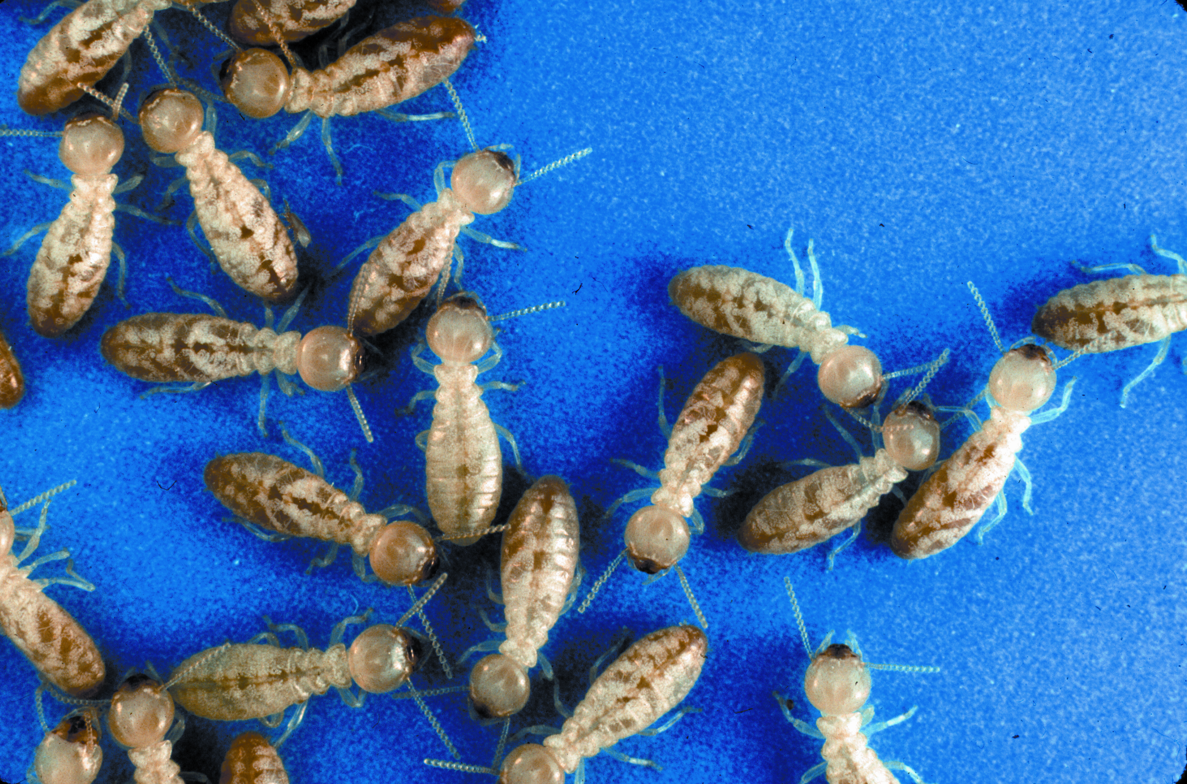
Formosan Termites in Georgia
Why the Fuss?
Formosan termites are more destructive than Georgia’s native subterranean termites.
Formosan termites are not native to the United States. Human commerce has resulted in their worldwide distribution. Perhaps the first introduction into the U.S. was in New Orleans, LA shortly after WW II.
Within the U.S., they continue to be introduced into un-infested areas, from infested areas, via decorative railroad crossties.
Growing communities are of particular concern.
Notes:
Formosan termites are more destructive than Georgia’s native subterranean termites.
Formosan termites are not native to the United States. Human commerce has resulted in their worldwide distribution. Perhaps the first introduction into the U.S. was in New Orleans, LA shortly after WW II.
Within the U.S., they continue to be introduced into un-infested areas, from infested areas, via decorative railroad crossties.
Growing communities are of particular concern.

Slide 23
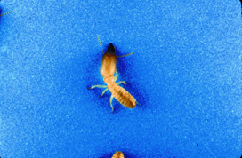
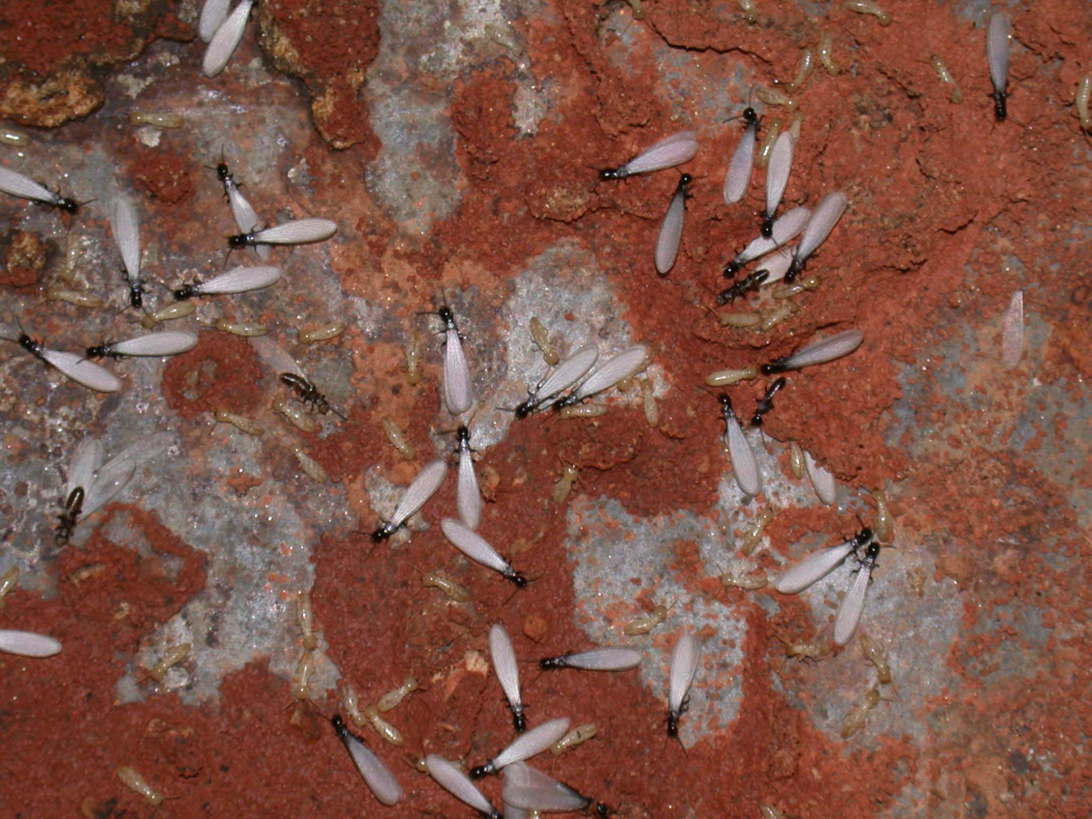
Subterranean Termites
The Caste System of Colony Organization
  Worker caste (A)
  Soldier caste (B)
  Reproductive caste (C)
A
B
C
Notes:
Termites exhibit a caste system of organization, wherein physically distinct individuals perform different tasks. Generally, three castes are recognized. Worker termites are physically and sexually immature males and females and are the most numerous caste. These wingless, white insects are typically the first termites seen when an active shelter tube, infested log, or piece of infested structural wood is breached. Workers destroy wood because they consume it. They are called workers because they perform most of the labor associated with colony maintenance. Soldier termites are physically and sexually immature males and females whose primary function is colony defense. Soldiers are easily identified by their enlarged, yellowish to yellowish-brown head and long, hard black mouthparts that they use to ward off enemies, primarily ants and termites from other colonies. Reproductive termites, called swarmers, have two pairs of long, narrow wings of equal size. Swarmers are male and female adults produced by mature termite colonies in an attempt to establish a new breeding population

Slide 24
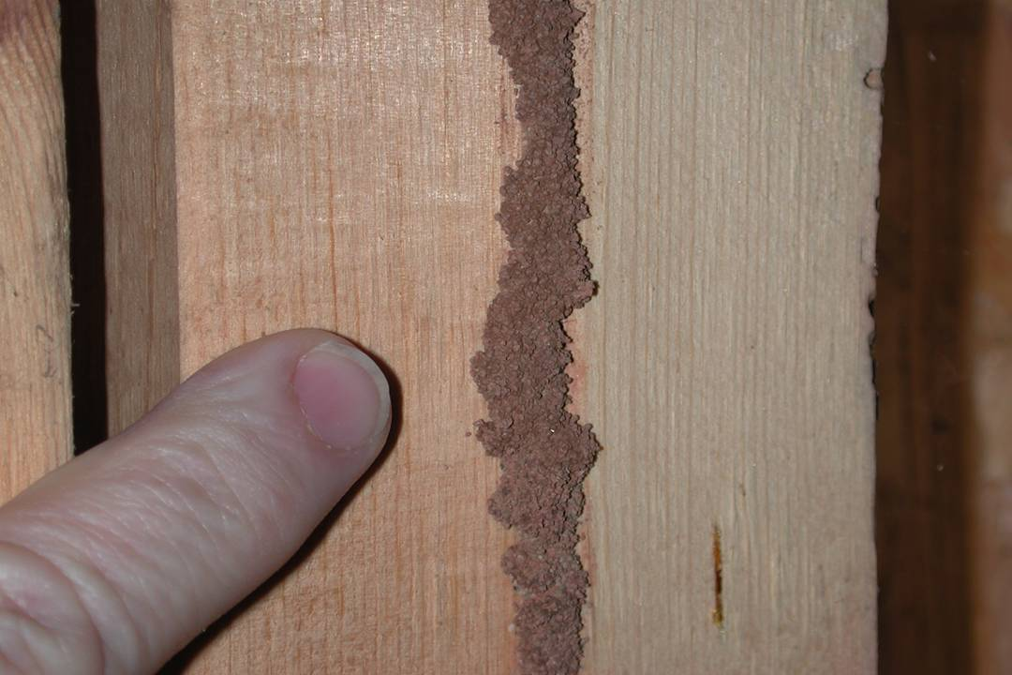
Subterranean Termites
Shelter tubes
  Protect termites from predators
  Maintain high humidity inside the tube
Notes:
Shelter tubes are composed of soil particles and other debris bound together by termite saliva and fecal secretions. Shelter tubes protect termites from predators and help prevent moisture loss from these soft-bodied insects, and are often constructed on the surface of concrete and other non-food substrates. For a more complete discussion of the biology of structure-infesting subterranean termites, see University of Georgia Extension bulletin #1209, Biology of Subterranean Termites of the Eastern United States.

Slide 25
Subterranean Termites
First Sign of Infestation: The Swarm
  Thousands of winged termites (reproductives) appear suddenly
  Swarms are common outdoors in spring
Ant versus Termite Swarmer
  Antennae: Ants are elbowed, termites are straight and beaded
  Waist: Ants have one, termites do not
  Wings: Ants have two pairs where first pair is larger than second pair, termites have two pairs but all four wings are the same size
Notes:
First Sign of Infestation: The Swarm—Most often, the first sign of termite infestation that a property owner experiences is the sudden presence of winged termites (reproductives) inside the home, a phenomenon commonly referred to as swarming. During a swarming event hundreds, if not thousands, of winged termites emerge within a very short period of time—usually just minutes. Fortunately, winged termites that emerge indoors are not usually a threat to the structure because they are not likely to find a suitable location to establish a new nest site due to the inhospitable indoor environment. Furthermore, winged termites do not bite or sting, and can be easily removed with a vacuum.
A termite swarm inside the home, or from a structural component outside, is generally accepted as evidence of a structural infestation, and should be considered as such. A swarm observed outside the home from, for example, firewood, stumps, mulch, or railroad crossties is not indicative of a structural infestation. Swarms that occur outdoors simply indicate that a mature termite colony is in close proximity to the site of the flight, but not necessarily one that has or will infest the structure. In this case, however, property owners should consider having their building inspected for termites.
When swarming, winged termites disperse by flying—usually a short distance because termites are poor flyers—land on the ground, and lose their wings almost immediately. Soon thereafter, females emit a pheromone that attracts male termites for the purpose of mating. After pairing, the termites search for a location to begin a new colony. The most suitable location is one that contains adequate cellulose (a food source) and moisture (for survival), and is protected from natural enemies such as ants, birds, lizards, and frogs. The majority of winged termites die within a day or so of swarming. Many settle in areas void of moisture and die of dehydration or are consumed by predators. However, if a suitable site is identified, the pair will excavate a small depression and create a closed cell, where they mate. The newly mated pair are now the king and queen of a new termite colony.
A single colony may swarm more than once a year, but second and later swarms often do not match the intensity of the first swarm. It is common for termite colonies in the same area to swarm on the same day, making it difficult to pinpoint the source of the winged exodus.
Depending on the species, winged termites can be black, brown or caramel in color and can be distinguished from winged ants by:
• The presence of straight, bead-like antennae (winged ants have elbowed antennae),
• The lack of a “waist” (winged ants have a distinct constriction between body regions), and
• The presence of two pairs of wings, where all wings are the same size (winged ants have two pairs of wings but the front pair is larger than the hind pair).
It is important that insects suspected of being termites be properly identified. Consider the consequences of an incorrect identification. Any insect misidentified as a termite might result in an unnecessary treatment and needless financial costs and property owner worry. A termite misidentified as any other insect might result in a prolonged infestation, resulting in otherwise avoidable structural damage.

Slide 26
Subterranean Termites
Homeowners and Termite Control
  Don’t do it!
Termite Control Service Contracts
  Retreat only
  Retreat and Repair
The Annual Inspection
Some Factors That May Affect Contracts
  Type of Construction
  Wood to Ground Contact
Termite Control Services: Information for the Georgia Property Owner (UGA Extension Service Bulletin 1241)
Notes:
Homeowners and Termite Control—Although tempting, it is not recommended that property owners treat their own structure for an existing termite infestation. The treatment techniques, products, and equipment needed to rid a building of termites are available only by hiring a professional. One of the most important challenges confronting anyone attempting to control termites lies in locating and properly treating the area(s) where termites are entering the structure. This goal can best be accomplished by a professional.

Slide 27
Homeowners and Termite Control
Termite Control Contracts
Renewable annually, after receipt of a fee.
Retreat Only Contract. Provides for retreatment of a recurring infestation ONLY.
  if problem persists, request different treatment techniques (e.g., foaming in voids).
Retreat and Repair Contract. Provides for retreatment of a recurring infestation and the repair of damage caused by termites.
  Be aware of contract’s terms, especially exclusions (e.g., alterations to structure, wood-to-ground contact, disruption of barrier, old versus new damage, who will conduct repairs if needed).
  Most contracts exclude Formosan termites.
Select contracts that provide for an annual inspection.
Notes:
Contracts offered by termite control companies are typically renewable annually for a set number of years—i.e., the contract’s term. Many companies offer a 5-year annually renewable contract term, but shorter and longer terms are also available from some companies. The term for many termite bait contracts has no maturity date, and may remain open-ended for as long as the customer continues to pay the annual renewal fee.
The cost of the initial treatment typically covers the contract for the first year. At the beginning of the second year, and each year thereafter until the contract term expires, an annual renewal fee must be paid. Each year, the contract is considered renewed and thus its active status continued only upon receipt of the annual renewal fee. Most companies may cancel the contract if the annual renewal fee is not paid by its due date.
The Annual Inspection—Inspections are the cornerstone of prevention and control of termite infestations, and thus the property owner’s first line of defense against damage. However, determining a structure’s infestation status is often difficult because most wood components are hidden from view and thus not accessible during inspection. Generally though, a cessation or lack of termite activity following treatment is widely regarded as evidence of termite control, and thus structural protection.
Most termite control contracts provide for periodic inspections, whether automatic or when requested by the property owner. If an automatic inspection is not included in the contract’s terms and conditions the property owner should request one, in writing, each year at the time the annual renewal fee is paid. Annual inspections usually occur on or around the date of the initial treatment, and are performed only after the annual renewal fee is paid.

Slide 28
Homeowners and Termite Control
Termites and Public Attitudes:
A University of Kentucky Survey
(http://www.pctonline.com/articles/article.asp?ID=975&AdKeyword=Potter)
Only 19% knew that shelter tubes and mud found inside galleries were telltale signs of termite infestation; less than 10% could differentiate between winged ants and winged termites.
92% believe that termites eat wood quickly, and can cause extensive damage to a house in a short period if not stopped.
60% believe that treatment of a home for termites costs $500 or less; only 13% thought it would cost $1,000 or more.
65% believe that if termites return following treatment that the company was obligated to return and retreat the structure and repair any damage caused by the termites.
Notes:
A recent University of Kentucky survey provided some interesting insights into how much homeowners know about termites and their control. For example, only 19% knew that shelter tubes and mud found inside galleries were telltale signs of termite infestation and less than 10% could differentiate between winged ants and winged termites.
92% believe that termites eat wood quickly, and can cause extensive damage to a house in a short period if not stopped.
60% believe that treatment of a home for termites costs $500 or less; only 13% thought it would cost $1,000 or more.
65% believe that if termites return following treatment that the company was obligated to return and retreat the structure and repair any damage caused by the termites.

Slide 29
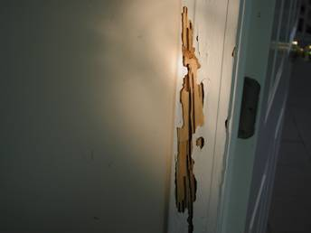
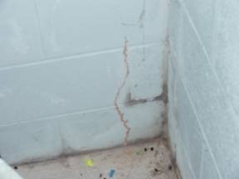
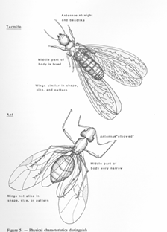
Homeowners and Termite Control
Diagnosing a Termite Infestation
Termite-damaged wood
  age of damage?
  chew wood with grain
  mud in galleries
Winged termites
  the consequences of mis-ID
  not harmful, and most die
  inside versus outside swarms
Shelter tubes
  active (moist)
  inactive (dry, brittle), but…
Notes:
Termite-Infested Wood or Wood Products. Structural wood, especially wall studs, door and window frames, and headers, joists, and sills may be infested with live termites or show damage from prior feeding. It is common to find
damaged, but now abandoned (i.e., no live termites), wood where termites had once fed but are no longer feeding.
Unlike other wood-destroying insects, subterranean termites damage wood by feeding along the grain while consuming the soft, spring growth. Subterranean termites will also consume or damage non-structural, cosmetic building materials such as molding, paneling, drywall paper, some carpets, wood flooring,
linoleum, wood baseboards, etc.
Soil within damaged wood typically indicates the presence or past presence of subterranean termites because other common wood-destroying insects, such as carpenter ants, wood-infesting beetles, and drywood termites, do not transport soil into excavated wood. Subterranean termites transport soil into wood to keep it moist. Soil is also used in the construction of shelter tubes that may connect additional feeding sites within and between wooden structural members.
Winged Termites. Often, the first sign of termite infestation is the sudden presence of winged termites inside the home, a phenomenon commonly referred to as swarming. Winged termites are male and female adults produced by mature termite colonies in an attempt to establish a new breeding population. During a swarming event hundreds, if not thousands, of winged termites emerge within a very short period of time—usually just minutes. Fortunately, winged termites that emerge indoors are not themselves a threat to the structure because they are unlikely to find a suitable location to establish a new population due to the inhospitable indoor environment (generally too dry).
Furthermore, winged termites do not bite or sting, and can be easily removed by vacuuming and properly disposing of the vacuum bag (the act of traveling through the vacuum usually kills the termites). A termite swarm inside the home, or from a part of a structure, represents the immediate proximity of a mature termite population either within elements of construction or beneath or next to the building’s foundation. A swarm observed outside the home from firewood, stumps, mulch, railroad crossties, etc. is not necessarily indicative of a structural infestation. Swarms that occur outdoors simply mean that termites are living near the site of the flight, not necessarily
that the structure is infested or even likely to be infested in the future. However, property owners should consider having their building inspected for termites if an outdoor swarm occurs.
Shelter Tubes. Shelter tubes are composed of soil particles and other debris bound together by termite saliva and fecal secretions. Shelter tubes protect termites from predators and help prevent moisture loss from these soft-bodied insects. They are built by termites to connect feeding sites, and are often constructed over the surface of concrete and other substrates. Since subterranean termites follow physical guidelines when searching for food, it is common to find shelter tubes following the interface between wood beams and along other structural guidelines such as sill plates, window and door frames, and cracks in concrete slabs and walls. The presence of termite shelter tubes is always evidence of termite activity, but is not always indicative of a current or previous infestation. Sometimes termites build shelter tubes that are exploratory only. In these situations, the presence of tubes indicates that termites are (were) active and in search of food. Shelter tubes on wood or soil inside wood should be considered evidence of a past or present infestation. When shelter tubes are broken live termites can often be seen following the path delineated by the damaged tube. Sometimes, however, shelter tubes appear dry, and apparently inactive—that is, live termites are not found inside the dry shelter tube. Dry, brittle shelter tubes generally signify
that termites have vacated that particular route to a feeding site, yet they may have found another “highway” to other feeding sites—-within or outside of the structure. Therefore, dry shelter tubes that are devoid of termites does not necessarily indicate wood that is free of termite activity.

Slide 30
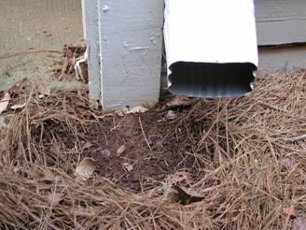
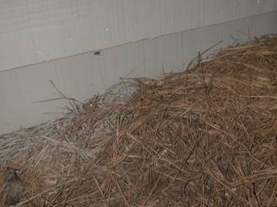
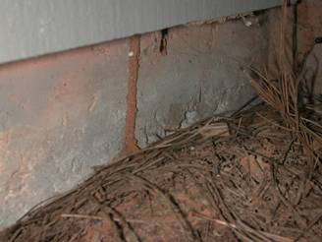
Wood-to-Ground Leads to
Termite Infestation
Notes:
Wood-to-Ground Contact—Perhaps the most common, yet avoidable, condition that can be linked to termite infestation is wood-to-ground contact. Wood-to-ground contact allows termites their easiest access into untreated wood and from there to the remainder of the structure. Other forms of wood-to-ground contact that may enhance termite survival and growth include wood debris close to the structure and in contact with the soil—e.g., wood and wood products on the ground in a crawlspace, firewood piled on the ground and next to the structure, stumps, wood fences, etc.

Slide 31
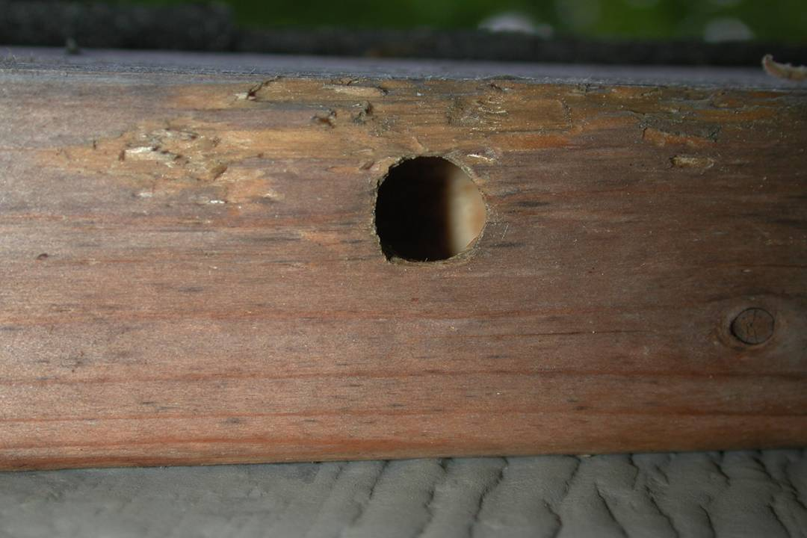
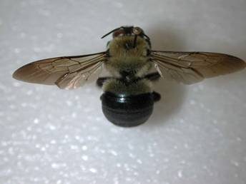
Carpenter Bees
Life cycle
  April-adults chew wood to lay eggs
  Mid-Summer-new adults emerge
  Fall-adults return to birthplace to overwinter
  Spring (next year)-overwintered adults emerge, mate, and process renews.
Control
Notes:
Carpenter bees get their common name because they borrow into wood to create nest sites, sometimes referred to as galleries. Carpenter bees are approximately one-inch long and similar in appearance to bumblebees. Both are hairy, however the abdomen of carpenter bees is naked where the abdomen of bumblebees contains fine hairs. The abdomen of carpenter bees is also shiny blue to black or green. If carpenter bee problems are not addressed, damage to wood can become significant since bees return to the same nesting area year after year. Sites have been known to have been used by carpenter bees for as long as 14 years.

Slide 32
Wood Destroying Beetles
Powderpost Beetle (Lyctidae)
Deathwatch Beetle (Anobiidae)
Old House Borer (Cerambycidae )
Notes:
Several kinds of beetles damage stored wood, structural timbers and other wood products. These beetles come from at least 12 families and vary greatly in size, wood preference, nature of damage and other habits. The tunneling activities of larvae and emergence of adults can weaken the structural strength of wood and may destroy its appearance. Proper identification of beetles or beetle damage is extremely important, because control measures vary according to species. Preventing beetle infestations is desirable, but once infestations are found, control measures are available.

Slide 33
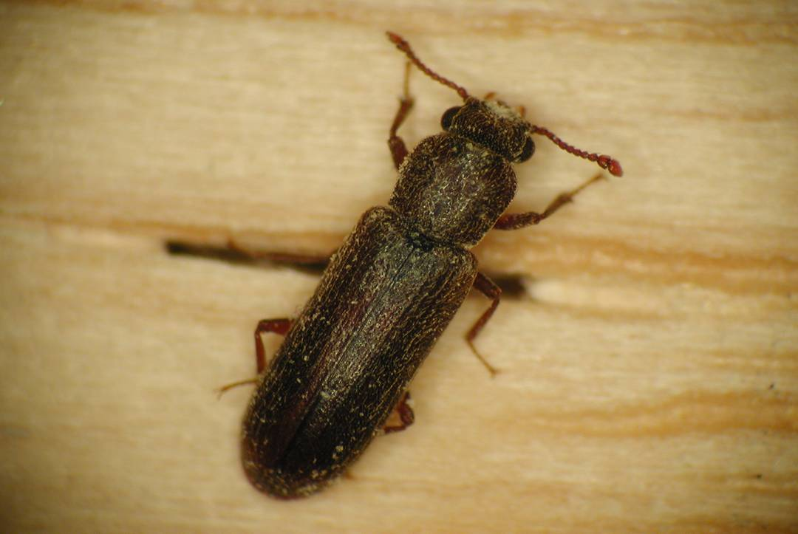
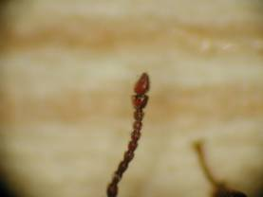
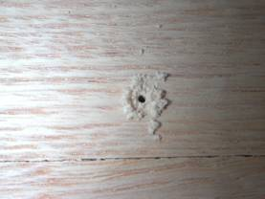
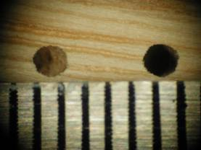
Lyctid Powderpost Beetles
Infest young hardwoods only (floors)
Most common emergence is winter
Eggs laid on unfinished wood.
Typical life cycle is one year or more.
Control is expensive
1/32 to 1/16 inch
in hardwood only
Notes:
Lyctid powderpost beetles infest only hardwoods and mainly those less than 10 years old. This beetle is not a pest of structural wood, but is common in decorative hardwoods found in, but not limited to, staircase banisters, wood floors, doors, gun stocks, picture frames, and hardwood bowls and plates. Adult beetles are 3 to 7 millimeters long, long-bodied, have two-segmented, clubbed antennae, are brown to reddish-brown, and their head is visible from above.

Slide 34
Generalized PPB Life Cycle
Eggs laid in wood pores & cracks, mainly at night.
Larvae tunnel through wood (powder like frass)
Pupate just below wood surface
Adult beetles emerge (shot holes)
Mating and reinfestation of unfinished wood
Life cycle 1-3 years; can take longer
Notes:
Well before the wood is made into a purchasable product the female beetle must lay her eggs on an unfinished (no paint, varnish, wax or similar finish) wood surface. She typically deposits up to 50 eggs into the pores that result from the cutting of the hardwood. In fact, the female beetle will not deposit eggs on a finished surface because no pores exist. Therefore, finished pieces of hardwood in the home are not generally susceptible. After egg laying, the larvae hatch, burrow into the wood, and spend the next year (sometimes longer, depending on sapwood content, beetle species, wood species, temperature, moisture, etc.) inside the wood before the adult emerges. The hardwood is nearly always infested well before it makes it into the home. While inside the wood, the larvae molt several times. It is during this time that they consume the sapwood as their sole food source. After some time, the last instar larva migrates to the edge of the wood where it pupates. The adult beetle then emerges from its pupal case. To free itself, the adult chews a small, almost perfectly round hole (1-3 mm in diameter) in the wood and emerges to the outside air. It is the chewing of the hole in the wood that results in the piles of fine, powder-like frass—thus the name, powderpost beetle. This is typically the first sign of powderpost beetle infestation, and when the homeowner first takes note.

Slide 35
Lyctid PPB
Feeding Preferences
Newly cut (1-3 year old), kiln-dried hardwoods with 10-20% moisture (oak, hickory, ash, walnut, pecan, poplar, sweetgum, and black cherry)
Wood is often infested in the lumber yard before it ever makes it into the home.
Picture frames, paneling, furniture, flooring, tool handles, gun stocks.
Frass is fine, flourlike and loosely packed into tunnels.
Shot holes are round and 1/32 to 1/16 inch diameter.
Rafters, joists, studs and other structural timbers are not attacked as they are typically softwoods.
Notes:
Lyctid PPB
Feeding Preferences
Newly cut (1-3 year old), kiln-dried hardwoods with 10-20% moisture (oak, hickory, ash, walnut, pecan, poplar, sweetgum, and black cherry)
Wood is often infested in the lumber yard before it ever makes it into the home.
Picture frames, paneling, furniture, flooring, tool handles, gun stocks.
Frass is fine, flourlike and loosely packed into tunnels.
Shot holes are round and 1/32 to 1/16 inch diameter.
Rafters, joists, studs and other structural timbers are not attacked as they are typically softwoods.

Slide 36
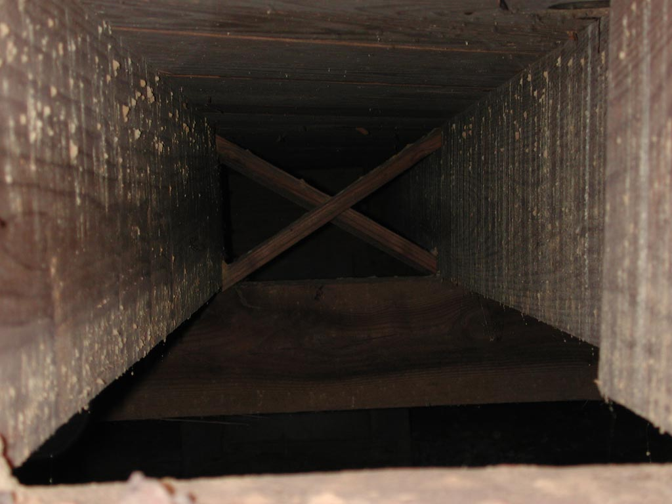
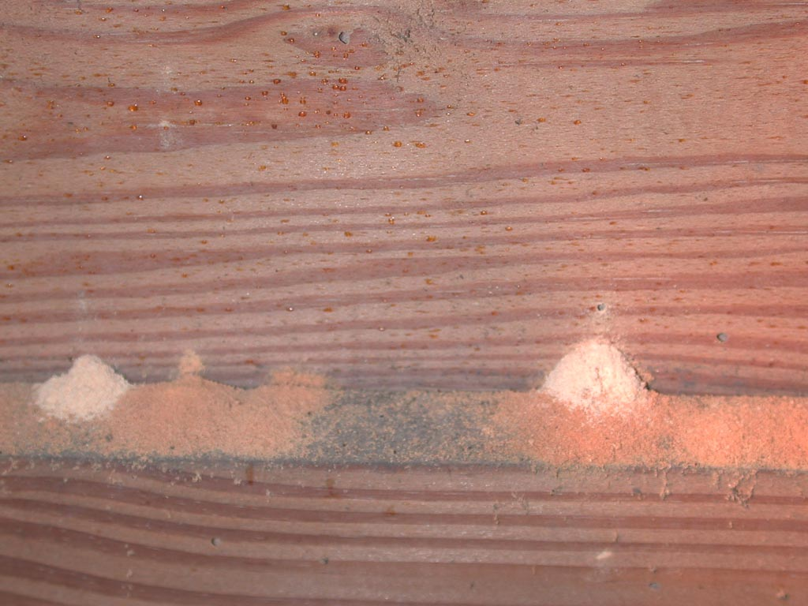
Anobiid (Deathwatch) Beetles
Infests softwoods (mostly) and hardwoods
Common in structural softwoods of older homes (high moisture content)
Will re-infest
Control:
  Wood treatment, fumigation or wood replacement
  dry the crawlspace (vents, vapor barrier)
Notes:
Anobiid powderpost beetles and old house-borers are both pests of structural wood, but are not as destructive as subterranean termites. Homeowners diagnosed with an infestation of either species should seek advice and help from a County Extension Agent and/or a pest management professional. Both beetles infest structural wood and are commonly found in sills, headers, and joists in crawlspaces. Wood suffering from excessive moisture (e.g., result of no vapor barrier in the crawlspace) is most susceptible to attack. Evidence of Anobiid beetles are perfectly round shotholes in wood approximately 1.5 to 3 mm in diameter, with small piles of dust (powder) directly underneath each hole. Anobiid beetles are one-eighth to one-quarter of an inch long, elongate and cylindrical, brown to black, and their head is not visible from above.

Slide 37
Anobiid (or Deathwatch) Beetle Feeding Preferences
Hardwoods AND softwoods.
Prefers moisture-laden wood (e.g., crawl spaces with softwood beams and moisture problems). Infestations are rare in well-ventilated homes with few moisture problems.
Prefers both freshly seasoned and older wood
Maple, beech, poplar, and pine are especially susceptible.
Hardwood picture frames, paneling, furniture, flooring, tool handles, gun stocks, as well as rafters, joists, studs and other softwood structural timbers.
Notes:
Hardwoods AND softwoods.
Prefers moisture-laden wood (e.g., crawl spaces with softwood beams and moisture problems). Infestations are rare in well-ventilated homes with few moisture problems.
Prefers both freshly seasoned and older wood
Maple, beech, poplar, and pine are especially susceptible.
Hardwood picture frames, paneling, furniture, flooring, tool handles, gun stocks, as well as rafters, joists, studs and other softwood structural timbers.

Slide 38
Distinguishing Wood Boring Beetles
Beetle | Ballpoint pen test | Frass test
powderpost beetles (Lyctids) | only tip of pen fits in exit hole | feels like talc
deathwatch beetles (Anobiids) | the tip and part of the angled face fits in exit hole | feels gritty
Wood-Boring Beetles in Homes UC ANR Publication 7418
Notes:
Two quick diagnostic tests, the ballpoint pen test and the frass test, can help distinguish betweentwo important groups of wood-boring beetles. Insert the tip of a click-type refillable ballpoint pen into the exit hole of the beetle. If the wood is infested with powderpost beetles (Lyctids) only tip of pen fits in exit hole. If the wood contained deathwatch beetles (Anobiids), the tip and part of the angled face fits in exit hole. Another method of determining which beetle it is by the frass. To determine the texture of frass, a mixture of feces and food fragments, rub the frass between your fingers. The frass of powderpost beetles (Lyctids) feels like talc while the frass of deathwatch (Anobiids), beetles feels gritty.

Slide 39
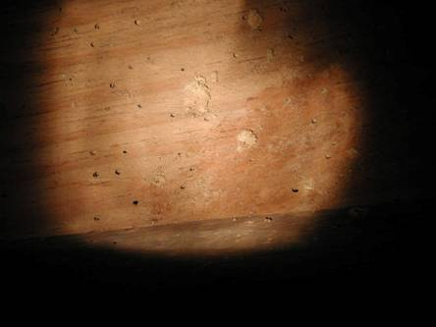
Anobiid Powderpost Beetles in Crawlspaces: Is the Infestation Active?
Frass and Shot Holes
Shot Holes
1/16 to 1/8 inch in
softwood
Infestation
Old vs New Frass
Notes:
If beetle larvae are active in the wood, their frass (which looks like fine sawdust) may fall from the exit holes, forming small piles on the floors or surfaces below the wood. Pale-colored, fresh-looking frass around or under an exit hole indicates a relatively recent emergence. If sawdust (frass) piles are swept away or vacuumed up and more appear in a week or two, the infestation is still active.

Slide 40
Diagnosing Anobiid Infestations:
Is the Infestation Active?
Stethoscope
Acoustic Emissions Detector
Sweep up frass and reinspect
  fresh frass is light colored
“New” holes are light in color; “old” holes take on color/appearance of surrounding wood.
Paint over or draw a circle around shot holes and reinspect to see if new ones have appeared.
Notes:
Perhaps the most important task during inspection for either beetle species is to determine the status of the infestation—i.e., whether it is active or not. Treatment for both species involves wood replacement, and/or wood treatment, and/or fumigation, and installation of a vapor barrier and an appropriate number of crawlspace vents.

Slide 41
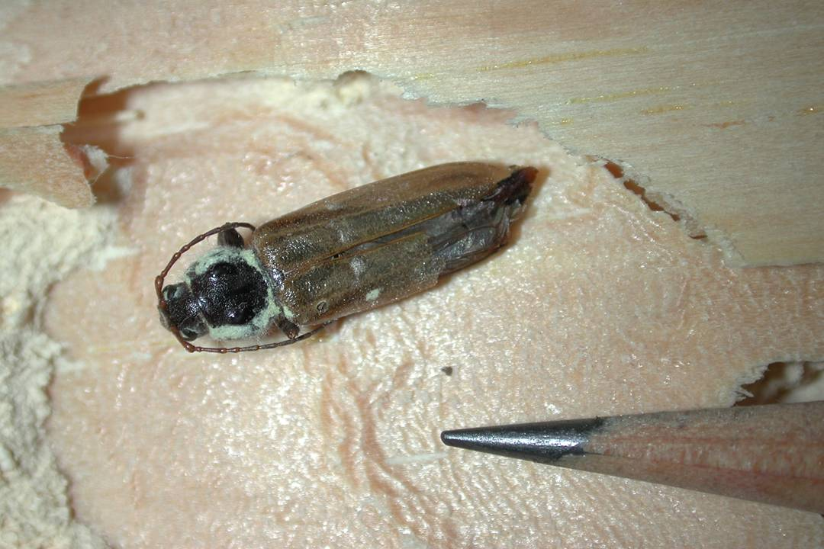
Wood-Destroying Insects
Old House Borers
Infests softwoods only
Common in structural softwoods of older homes (high moisture content)
Will re-infest
Control:
  Wood treatment, fumigation or wood replacement
  dry the crawlspace (vents, vapor barrier)
Notes:
The old house borer beetle, also known as the long-horned beetle (Hylotrupes bajulus), normally infests homes that are less than 10 years of age, preferring timbers of pine, spruce, hemlock, and fir. Successive generations of beetles often reinfest wood in the same area. The wood-eating larva or beetle grub is cream colored with dark mandibles. Mature larvae are approximately 1 1/4inches (20 to 40 millimeters) long. On each side of the head is a distinctive row of three dark-colored eye spots. The adult old house borer beetle is 5/8 to 1 inch (15 to 25 millimeters) long. Its black or brownish-black body is slightly flattened

Slide 42
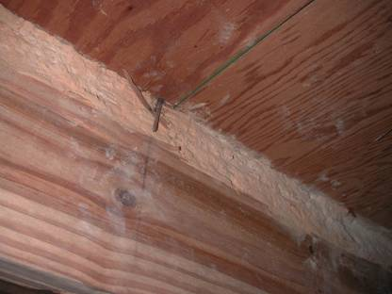
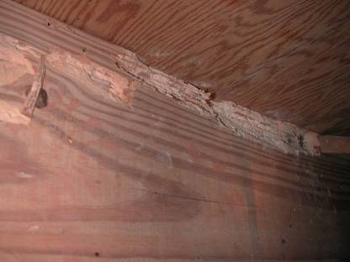
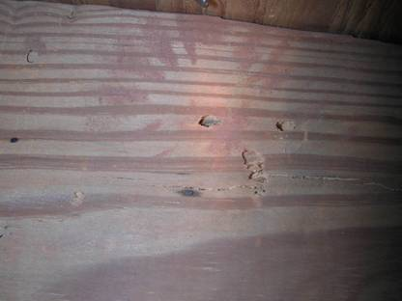
Old House Borer
Damage and Exit Holes
Powdered, packed frass
Wood is rippled
Oval exit holes; ragged edges
Notes:
Evidence of old house borers are football, or oval, shaped holes with ragged edges that are approximately 6 to 10 mm long from end to end.

Slide 43
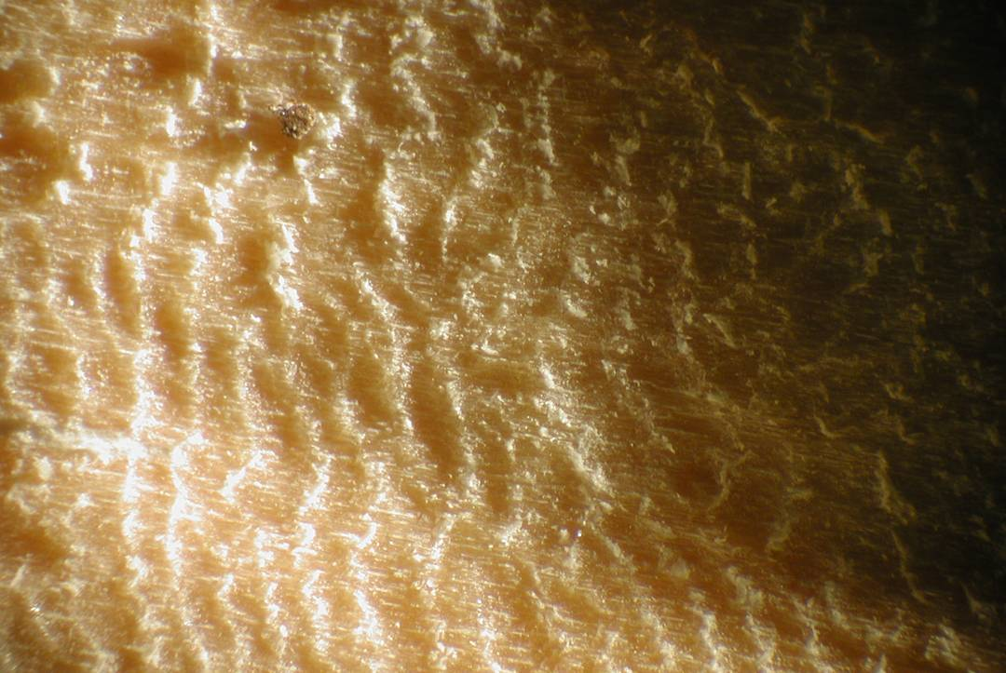
Wood-Destroying Insects
Old House Borers
Larval feeding creates ruffles
and ridges in chewed wood

Slide 44
Ants and Cockroaches

Slide 45
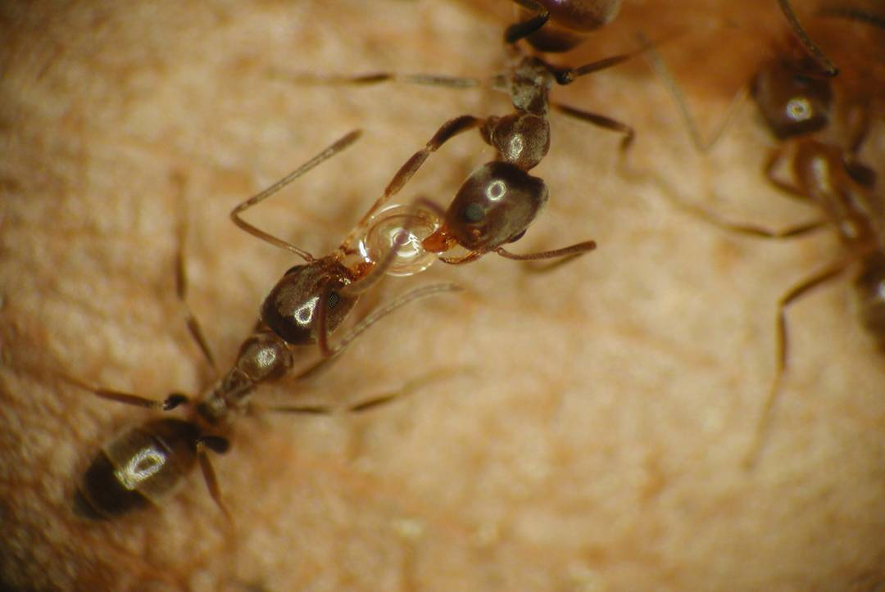
Argentine Ants
Known as “sugar ant’ in Georgia
Introduced into New Orleans in 1890s
Southeast, California, Hawaii
Nests in mulch, leaf litter (moisture); moves indoors in winter to survive cold
Millions of workers and thousands of queens; long foraging trails (at least 350 feet)
Control
  Remove mulch; remove vegetation contacts
  Baits (liquid and gels and stations)
  Liquid sprays (spot treatments) or granulars to mulch
Notes:
Argentine Ants—Argentine ants are one of the most common nuisance insect pests encountered by property owners and pest management professionals in the southeastern United States. They are native to South America, and were accidentally introduced into the U.S. in one or more New Orleans, LA coffee shipments in the late 1800s. Argentine ants are three-sixteenths of an inch long (4 mm), monomorphic (i.e., all ants are the same size), and dull or flat brownish-gray in color. Argentine ant colonies are large, and may consist of tens, if not hundreds, of thousands of individuals.

Slide 46
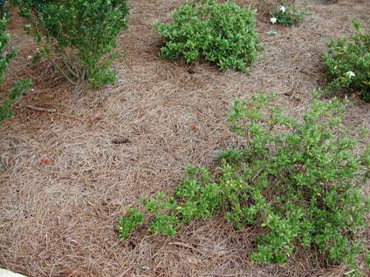
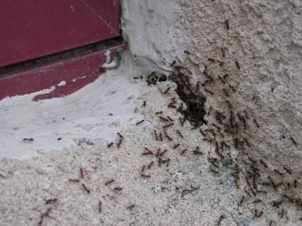
Management of Argentine Ants
Habitat Manipulation
Avoid Overuse
of Mulch
Seal Gaps
with Caulk
Avoid Leaf Litter
Accumulations
Notes:
Argentine ants are opportunistic nesters, and outdoors are most commonly found in mulch, in leaf litter on the ground, in the litter of unmaintained rain gutters, in compost piles, in rotted logs, and under rocks, patio stones, potted plants, etc. In buildings, Argentine ants commonly seek nest sites in the voids between block and brick veneer (via weep holes), behind synthetic stucco, in wall voids under window sills, and other warm, protected environments.

Slide 47
Argentine Ants
Argentine ants nest in mulch and leaf litter
because they retain moisture.
Notes:
In Georgia, pine straw is commonly used as a mulch in flower beds and landscaped areas around the outside perimeter of homes. Mulches are beneficial because they prevent the loss of soil moisture, and thus reduce plant stress, during periods of drought and extreme heat. Unfortunately, pests such as ants, termites, cockroaches, millipedes, pillbugs, and springtails are attracted to mulched areas because of their high moisture content and abundance of hiding places. Pine straw not only provides adequate moisture for survival, but the spaces between the pine needles provide an unlimited, protected habitat for ants and other household pests to nest. Collections of leaf litter and various other organic yard debris behave like mulch by hindering loss of soil moisture, and are likewise excellent nest sites for Argentine ants and other household pests.

Slide 48
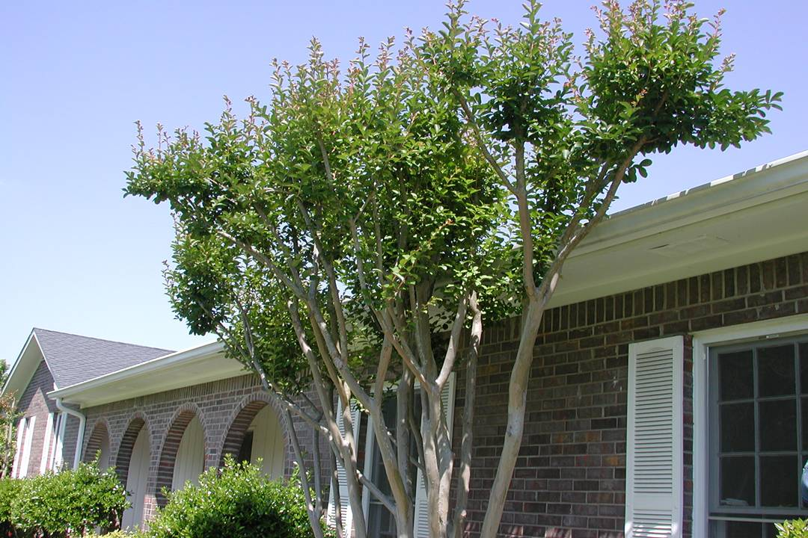
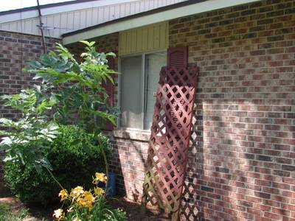
Argentine Ants
Keep vegetation and other items from
touching the structure, and serving as
a bridge for ants.
Notes:
When baiting for Argentine ants, place baits where ants are seen foraging (inside and/or outside structures) and if possible always in the shade when baiting outdoors. Most ants do not forage in the direct sun or during the heat of the day, but may be found foraging in the same area in shaded locations. During drought or extended periods of moisture stress liquid baits may be used to take advantage of the ants’ natural propensity for sweet liquids (i.e., honeydew). Second, it is often advantageous to use several different baits simultaneously to discover one that ants will readily consume since no single bait is consistently eaten by Argentine ants. Try switching baits periodically to provide ants a variety of food materials and the constant presence of “new” food items in their foraging territory. This activity may help sustain bait intake by the treated Argentine ant colonies. Third, it will be advantageous to place a large number of baits or bait placements (at least several dozen) throughout the entire area(s) where Argentine ants have been found. Larger numbers of workers spread throughout large ant colonies will mean that bait material will be diluted throughout potentially tens of thousands of workers. Finally, when applying granular baits (use them only outdoors), they should be delivered from a number of small piles (about the size of a quarter) placed on the ground in areas where ants have been found. Ants collect more food when they recruit to a single site than if they have to forage for every granule—i.e., when bait granules are scattered.
Granular products should be applied only on the outside of structures for Argentine ants by direct application to ant nest sites such as mulch beds, leaf litter, etc. noted earlier. Most dusts work because the Argentine ants pick up the minute particles and ingest them. Generally, dusts should be used only in voids such as behind brick veneer, drywall, electrical switch-plates, and synthetic stucco to remedy existing Argentine ant problems indoors and to prevent the reinvasion of ants into voids from the outside. To treat with dusts, small holes may be drilled into drywall in areas where ants are suspected of nesting, dust placed into the void and the hole patched with drywall cement. From the outside, mortar joints between bricks or blocks may be drilled and dust injected into the void, or the weep holes in brick veneer can be used to introduce dust into voids. Remember that dusts become airborne very easily. It is advisable to always wear a protective mask and preferably eye protection when applying them.
Liquid spray treatments are commonly applied to the outside of infested homes in areas where Argentine ants might enter the structure, such as around doors and windows, inside and around weep holes, and inside and around plumbing and exhaust pipe penetrations.
Spot treatments are less intrusive than perimeter treatments because they are limited only to those areas where Argentine ants are found nesting during inspection. When spot treating, only ant nest sites or areas where ants are found entering the structure require treatment. Nest sites should be exposed prior to treatment. For example, exposure of nest sites in mulch can be accomplished by pulling back the mulch with a rake or similar instrument held in one hand while treating exposed nest sites with the other.

Slide 49
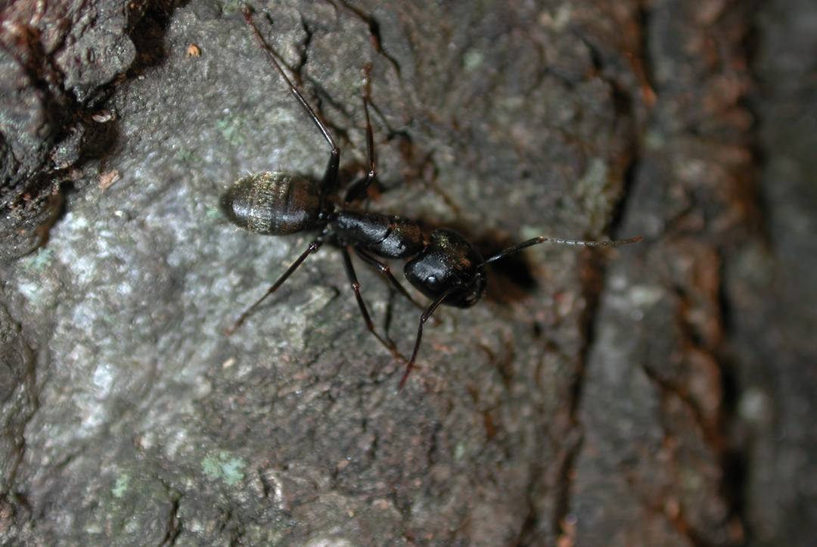
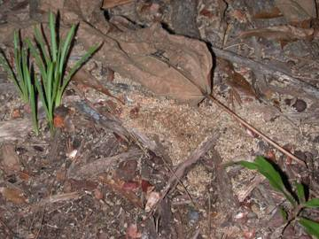
Carpenter Ants
Chews wood, but does not eat it (sawdust)
Outdoors, nests in trees; creates permanent trails
Active at night
Control
  Find colony while looking at night; provide gel and/or liquid bait
“Sawdust” from nest cleaning
Notes:
Carpenter Ants—Carpenter ants are the largest of the pest ants found in Georgia. They do not eat wood, like termites, but excavate it with their strong, serrated jaws to create random galleries where they nest. Because they do not eat the wood they chew, it is common to find sawdust-like wood shavings below an area(s) where carpenter ants nest. To learn more about carpenter ants and their control, see Georgia Cooperative Extension Service bulletin #1225, Biology and Management of Carpenter Ants.

Slide 50


Carpenter Ants
Outdoors, carpenter ants nest
mainly in large, hardwood trees.
Carpenter ants make
permanent foraging trails
between trees
Notes:
Outdoors, nests are most commonly found in hardwood trees containing treeholes. Most large hardwood trees contain a treehole or other imperfection where ants might nest. In treeholes, ants find an environment that is ecologically stable (consistent humidity and temperature) and protected from adverse environmental conditions and natural enemies. There they chew dead wood to create galleries for nest sites. Colonies are less commonly found in stumps, logs, railroad ties, or similar large pieces of wood.

Slide 51

Carpenter Ants May Forage
Well-Over 120 Feet

Slide 52
Carpenter Ants Forage Mainly at Night
Notes:
Finding Nests is the Key to Eliminating Carpenter Ants— The key to eliminating carpenter ant infestations is to find the nest and remove it, either physically (e.g., by vacuum) or by treating it with an insecticide. Inspect all locations listed as indoor and outdoor nest sites. To find nest sites indoors, follow a few foraging ants to learn where they might be nesting. Tap the void suspected of harboring the nest. Look for sawdust at the base of trees. Since carpenter ants must excavate wood to expand their galleries, it is common to find piles of sawdust on the ground at the base of a tree where carpenter ants nest. As mentioned previously, carpenter ants do not consume wood but must chew it to build and expand nest galleries. Galleries are created by biting off small pieces of wood and disposing of it to the outside. The small bits of wood often pile up at the base of a tree and take on the appearance of sawdust.
Carpenter ants found in the home often times can be found nesting outdoors in trees. To find outdoor nest sites inspect each large tree (greater than 6 inches in diameter), beginning 15 to 20 minutes after sundown, by walking around it while shining a flashlight up and down the trunk. If a nest is present, ants will be seen moving up and down the trunk as they leave from and return to the nest with food.

Slide 53

Red-Imported Fire Ants
Accidentally introduced into U.S. in 1930s in Mobile, Alabama.
Southeast, California, Australia
Painful sting
Pest of yard; rarely invades home
Control: Texas Two Step
  Bait in afternoon
  10 days later, treat individual mounds
Notes:
Red-Imported Fire Ant—The red-imported fire ant is not native to the U.S. It was accidentally introduced into Mobile, AL in the 1930s from South America, and can now be found throughout Georgia as well as the rest of the southeastern U.S. Fire ants are not typically considered a structural pest as much as they are a pest of the yard. They are pests, of course, because of the painful sting all worker ants can deliver when their nest is disturbed and they are forced to protect it. This section will concentrate on the existence, and what can be done about it, of fire ants in home lawns.

Slide 54

The “Two-Step” Method of Fire Ant Control
Step One: Bait Treatment
Broadcast granular bait in late afternoon,
when it is dry and cool, and ants are
actively foraging.
Notes:
Control of fire ants in the home lawn can be best achieved via a two-step method. When using this method, fire ant baits are first broadcast over the entire lawn. This is followed by treating individual mounds a period of time later.

Slide 55


The “Two-Step” Method of Fire Ant Control
Step Two: Mound Treatment
One week after bait treatment,
locate active mounds…
…and treat with liquid or
dust insecticides.
Notes:
When applying a granular bait for fire ants, a few recommendations should be followed. First, use a bait labeled specifically for fire ant control, and apply it over the entire yard with the aid of a newly-purchased spreader—i.e., one that has not been previously used. DO NOT use an old fertilizer spreader to spread bait. Ants are notoriously finicky in deciding what they will and will not collect and return to the nest for consumption. Bait contaminated by any foreign smell, including fertilizer, may be avoided by foraging ants. Secondly, apply fresh bait, preferably from a newly-opened bag. Bait from a bag that has been opened and that may be rancid (see directions of bait handling and storage) will likely not be collected by foraging fire ants. Third, baits should be applied in the late afternoon when it is dry and ants are active. Fire ants, as mentioned previously, do not forage in the heat of the day but will forage in the late afternoon and at night. Bait should be applied when fire ants are actively looking for food—i.e., late in the afternoon when it is cool. To determine whether ants are active and foraging, a nugget of hard dog food can be placed on the ground. If fire ants are actively foraging, the food should be covered with ants within 30 minutes. Baits should also be applied when it is dry outdoors (i.e., later in the afternoon) so that the attractive nature of the granules will not be compromised by excessive wetting. Lastly, bait should be applied when rain is not expected for at 6 to 8 hours following treatment. Following bait application, most of the bait will be picked up by foraging fire ants within an hour. Fire ants do not collect bait over a lengthy period.
The second step involves treatment of individual, active fire ant mounds starting about two weeks after broadcast bait application. Treatment of individual mounds is best conducted with a liquid insecticide drench, a dust, or a granular insecticide. When using a liquid drench at least one gallon of diluted insecticide should be poured directly onto each active mound. It is important that enough liquid be used so that it drains down into the nest and contacts all ants, including the queen. As a non-chemical alternative, extremely hot water may also be used to drench fire ant mounds. Dusts, especially those containing the active ingredient acephate, can be applied directly to the top of each active mound. Granular insecticides, especially those containing fipronil, can be applied directly to the top of each active mound, but must be ‘activated’ by watering-in the granules. Rain or some type of artificial irrigation (1 gallon from a watering can) must be performed following the application of the granules.

Slide 56
Non-Chemical Ant Control
Manage moisture around the home
Hot water will kill fire ants (also grass)
Grits, mixing ants, etc. does nothing to fire ant colonies
Sanitation in General
  Rinse containers containing sweets
  Remove garbage regularly
  Keep branches from touching the house
  Choose plants that are not fed upon by aphids
Notes:
Non-Chemical Ant Control—Some non-chemical practices may make properties not only more inhospitable for ants to nest but may make it more difficult for them to enter the home and allow chemical controls to be more effective. It is advisable to commit to these practices early, and to use these measures in combination with chemical inputs since these measures alone will not rid the home of ants or prevent their infusion from nearby areas. In addition to those general recommendations for managing moisture around the home (see previous section), some specific non-chemical actions can be taken for ant control, including:
• Since ants are attracted to sweets, thoroughly rinse all empty containers (e.g., soda cans) before placing them either in the garbage or in the recycle bin.
• Do not let garbage sit for long periods of time, keep garbage cans away from the structure, and do not let them touch the structure. Ants will establish foraging trials to garbage retention areas. If those areas are near the house, the chance of infestation increases.
• Since ants commonly forage into shrubs and trees to look for food (especially honeydew), keep all vegetation (limbs, branches) from touching the outside wall of the home. Branches in contact with outside walls allow ants easy, direct access into the home.
• Since ants readily consume honeydew, seek the advice of extension horticulturists in selecting species and strains of plants that are less susceptible to aphids, scales, whiteflies and other honeydew-producing insects. Honeydew is nearly pure sugar, and is excreted by aphids and scale insects in large quantities during the spring and summer months. Many ant species, including Argentine, odorous house, and carpenter ants, depend on honeydew as a stable, predictable source of food throughout the warm season

Slide 57
German Cockroach
Obligate indoor pest; kitchens, bathrooms, bedrooms
Spread by “hitchhiking”
Control
  Sanitation
  Gel baits (spray if only if population is large)
  Bait stations
  Sticky traps and jar traps
Notes:
Cockroaches are one of the most despised pests in and around homes. They are generally associated with unsanitary conditions, and are a leading cause of allergies indoors. Only 10 or so of the 4,500+ known species are considered pests, and most of those were accidentally introduced into the U.S. from tropical regions of the world.
German Cockroach—Adults are about five-eighths of an inch long, winged, and easily recognized by the two dark stripes on the shield covering the top of the head. Immature German cockroaches are black with white bands and are up to three-eighths of an inch long, but are not winged. Originally thought to have evolved in southeast Asia (Vietnam, etc.), aided by human commerce the German cockroach has spread throughout the world.
It is not unusual to see an occasional German cockroach even in homes considered clean and sanitary, since German cockroaches are “hitchhikers”—that is, they hide inside grocery bags, drink cartons, boxes, used appliances and furniture, TVs, radios, etc. that are brought into the home from infested sources (restaurants, neighbors, grocery stores, etc.). Once infested articles are stored, stowaways begin exploring their new home for food and water. Most die while looking, but some survive if food and water are available. Water is much more critical to cockroach survival than is food. German cockroaches can live for just 12 days when provided food but no water; 42 days when provided water but no food; and 13 days when provided no food or water.
German cockroaches are normally found in kitchens, and in cases of extreme infestation in bathrooms, bedrooms and living rooms. Conditions favoring the growth of cockroach populations are abundant food, water, and harborage combined with an optimum growing temperature. When all conditions are present and abundant, German cockroach populations quickly expand to fill all available harborage. Populations of German cockroaches in unsanitary, low-income apartments have been estimated at 13,000.

Slide 58


Smokybrown Cockroach
Primary large, outdoor cockroach pest in Georgia
Lives in treeholes, attics, crawlspaces, and other protected environments
Most active at night
Control
  Gel baits (primary)
  Liquid sprays (secondary)
Baits Conserve Cockroach Natural Enemies
Egg capsule (ootheca)
Notes:
Smokybrown Cockroaches—Throughout the southeastern U.S., smokybrown cockroaches are considered the primary peridomestic cockroach pest in suburban neighborhoods. Smokybrown cockroach populations in suburban areas can be high. Researchers have removed nearly 2,500 cockroaches from individual homes in the southeast. Smokybrown cockroaches generally do not forage more than a few feet from their harborage, but have been known to move up to 100 feet in search of food, water, and mates. As expected, smokybrown cockroaches are most active at night when it is not uncommon to see large nymphal and/or adult cockroaches crawling on trees, on hollow(ed) retaining walls, and on the outside walls of structures. Since small nymphal cockroaches are not as mobile as adults and large nymphs, continued sightings of small nymphs in the same area of the home may indicate a nearby breeding population.

Slide 59





Smokybrown Cockroach Habitat
Treeholes, Crawlspaces, Attics, Wall Voids, Crossties
Notes:
Smokybrown cockroaches live and breed primarily outdoors, but may invade and form breeding populations indoors in attics, wall voids and basements. Breeding sites of smokybrown cockroaches are those locations characterized by a protected, moist environment—typically crawlspaces or attics with a moisture problem, or outdoors in clogged rain gutters, treeholes, wood & trash piles, underneath wood shingles and wood decks, within weathered decorative crossties, hollow(ed) retaining walls, and similarly protected habitats. Smokybrown cockroaches are very susceptible to desiccation. As such, harborage sites are typically those areas where relative humidity is high (moist areas) and the desiccating effects of wind are minimized—attics and crawlspaces with moisture problems fit this description.

Slide 60

Use Baits Instead of Sprays for Cockroach Control in Treeholes
Sprays: Kill cockroach egg case parasites and contaminate parasite attractants, thereby disrupting natural controls.
Gel Baits: Conserve cockroach egg case parasites and prevent contamination of attractants.
Notes:
To control smokybrown cockroaches, specific harboring sites should be identified and treated—preferably with bait. Treatment should be made in early and late summer to prevent the large population buildup that normally occurs from mid-summer to early-fall. Baits provide long-term control while at the same time reducing the amount of insecticide applied to the environment. For smokybrown cockroaches, use mainly gel/paste baits. Place bait wherever cockroaches are seen foraging (see above), particularly at night. Concentrate bait application to these areas, and be liberal with the quantity of bait applied. Again, it is most advantageous to introduce a large number of small bait placements since smokybrown cockroaches generally do not move very far from the area(s) where they live.
Baits Conserve Smokybrown Cockroach Natural Enemies—The application of liquid sprays to smokybrown cockroach harborage sites kills cockroach natural enemies such as spiders, centipedes, ants, earwigs, parasitic wasps, etc. Baits not only eliminate cockroach populations for a long period, but conserve cockroach natural enemies that would be killed with a spray. Research has shown that smokybrown cockroach populations can be reduced by 90 percent for six months with the targeted placement of bait in locations identified as smokybrown cockroach harborage. Long-term control is directly related to the lengthy generation time of smokybrown cockroaches—one year or more, depending on environmental conditions. Once initial populations are reduced they will not rebound for a long period.

Slide 61
Biting & Stinging Pests
Notes:
Pests that bite or sting come from many different groups, including insects, spiders, centipedes, and scorpions. Some of these groups are discussed in other sections (spiders and occasional invaders). This section will focus mainly on insects that bite or sting. These include the various species of wasps and bees. Insects that bite humans, with the exception of the predatory bugs, generally bite to acquire nutrition in the form of blood. Control is dependent on the type of biting or stinging insect and its association with the home.

Slide 62



Biting and Stinging Pests
Paper Wasps
Predators on insects, especially caterpillars
Open comb nests
May build nests in eaves of homes
May defend their nest aggressively
Notes:
One of the stinging pests of greatest concern are the semi-social wasps, such as the paper wasps (family Vespidae, genus Polistes). Vespids are medium size (5/8- ¾ inch) and are generally brownish with yellow markings. They build distinctive, open comb nests which several wasps share and use to raise young. When paper wasps build nests on structures, they often build them under the eaves of buildings where the nest is protected from the elements. Many species will defend their nest if it is threatened, some so more aggressively than others.
Paper wasps are predators, and are especially beneficial in removing pest caterpillars from vegetable gardens. However, homeowners may wish to remove nests near and on structures or in frequently traveled locations if there is a threat of injury. Nests should be treated in the early morning or in the evening when a majority of the adult wasps are present. A 20 foot jet spray aerosol pyrethrin or pyrethroid works best, and homeowners should stand back from the nest when treating. It may be necessary to spray “straggler” wasps that return to the nest following its treatment. Following treatment, the nest should be removed to discourage other wasps from returning and to prevent existing pupae from further development.

Slide 63



Other Wasps
Potter wasp
Potter wasp pots
Solitary
Predatory
  Insects
  Spiders
Not aggressive
Sphecid wasp
Notes:
There are several types of wasps that homeowners may encounter. Many are solitary, including the mason and potter wasps (family Vespidae), the mud daubers (family Sphecidae), the digger wasps (family Scoliidae), the spider wasps (family Pompillidae), and the cicada killers (family Sphecidae, genus Sphecius). Most wasps are beneficial predators of insects and/or spiders and are generally not aggressive. Mason, mud dauber, and potter wasps sometimes build their nests on structures and become a nuisance. An aerosol sprayed into their mud nests can be effective. Digger and spider wasps are solitary wasps that excavate nests underground, usually in sandy areas. If problematic, a light dusting with an appropriate dust is effective.
Cicada killers are predators of cicadas, but often worry homeowners because of their large size (1- 1 5/8 inch). They will sting if molested, stepped on, or handled. Cicada killers also excavate holes underground. They can be treated with a granular insecticide if needed. Be cautious when spraying directly with an aerosol.

Slide 64
Hornets
Bald faced Hornet
  Black and white in color
  Active in the day
  Can be aggressive
European Hornet
  Brown and tan in color
  Active at night
  Usually live near woods
  Generally not aggressive, even at their nest
Notes:
There are two main species of hornets that homeowners may encounter: the baldfaced hornet (Dolichovespula maculata) and the European hornet (Vespa crabro). The baldfaced hornet gets its name from its mostly black color and a contrasting white face. It is the smaller of the two hornets (5/8- ¾ inch+) and the most likely to be associated with homes. The European hornet is somewhat larger (3/4- 1 3/8 inch), and will more often be associated with wooded areas. These brown and yellowish striped insects get their name from their native continent of Europe. Like many Hymenoptera, hornets are beneficial predators, feeding on many pest insect species, including caterpillars, grasshoppers, and flies.

Slide 65

Yellow Jackets
Social
Predatory
Ground Nesting
Aggressive at their nest site
Prey item
Notes:
Yellow Jackets—These yellow and black striped social insects belong to the genera Vespula and Dolichovespula. Adult workers are medium in size (3/8- 5/8 inch). Like many Hymenoptera, yellow jackets are beneficial predators of many types of insects. They do, however, defend their underground nests aggressively, and when nests are located in areas where people often pass, control is usually warranted. Yellow jackets may also build nests within the exterior walls of structures, and again, should be removed. Worker yellow jackets may also become a nuisance in the autumn when resources become reduced and wasps begin to actively search for food. Treating a yellow jacket nest can be a dangerous undertaking. If control is attempted by a homeowner, ground nests should be treated at night and with an appropriate fast-acting insecticide, such as a pyrethrin or a pyrethroid. Homeowners may wish to seek professional advice and/or help before treating a yellow jacket nest, especially one that is located within the walls of a structure.

Slide 66



Bees
Beneficial pollinators
Can be solitary or social
Bumble bee
Solitary Bees:
-Non aggressive
-Often nest in bare ground
Social bees:
-May sting if nest is threatened
Digger bee
Honey Bee
Notes:
There are a few different species of bees that homeowners may encounter including the bumblebee (Bombus spp.), the carpenter bee (Xylocopa spp.), the ground nesting bees (Andrenidae, Collectidae, Anthophoridae, and Halictidae), and the honey bee (Apis mellifera). Most bees are beneficial, either as predators or as pollinators. Bumblebees are rarely a problem, but if a nest is located in a high traffic area, it can be treated much like that of a yellow jacket. Carpenter bees are rarely aggressive and are more of a problem in wood structures. Please see the wood destroying organism section for information on carpenter bee biology and control.
Ground nesting bees are different than the above-mentioned bees in that they are solitary, rather than social. Though many ground-nesting bees might build their underground nests in one area, each is an individual nest without the cooperation found in social bees. Ground-nesting bees are usually small to medium in size (1/8- ¾ inch) and vary in color from brownish to metallic green. They are similar in that they excavate tunnels underground to store pollen and nectar for their developing larvae. Many ground-nesting bees are useful pollinators, and are thus seldom aggressive. Often they can be discouraged from building nests by reducing areas of bare ground. Planting grass or ground cover, or covering bare areas with mulch will often discourage bees from nesting. Seldom is treatment needed, but if it is, lightly dusting nest entrances or broadcast application of a granular insecticide are effective.
Honey bees are beneficial insect pollinators. They can be a problem, however, when they nest in a structure’s walls. This situation usually requires professional advice and help to properly extract the bees, especially if they have stored honey. If the problem is a group of swarmers in the yard, a local Extension Agent may be able to provide advice on bee removal.

Slide 67

Bed Bugs
Feed on blood
May travel some distance for a meal
Flattened to hide in cracks and crevices
Can be difficult to get rid of
Notes:
Bed Bugs—Bed bugs are Hemipterans that belong to the family Cimicidae. The typical species that a homeowner might encounter is Cimex lectularius, an oval, flat insect about 3/16 of an inch at maturity. They have vestigial wings that are reduced to wing pads and are not used for flying. They are most often rusty brown at maturity and often have a somewhat sticky appearance. Bed bugs are secretive, nocturnal insects that can sometimes travel long distances to find a blood meal and then scurry back to hiding before being seen. These habits sometimes make it difficult to diagnose bed bugs as the cause of bites. Homeowners can pick up bed bugs as hitchhikers in their suitcases when they travel without being aware of them. The bugs then crawl out and inhabit a new location, often the homeowner’s dwelling.

Slide 68
Bed Bug Control
Find all hiding places
  Mattress seems
  Behind the headboard
  In switch plates and electrical sockets
  Behind picture frames
  Behind baseboards
Treat all hiding places or vacuum those that can’t be treated
May require professional help
Notes:
Bed bug control depends on a proper diagnosis and a subsequent inspection of all potential hiding places. Cracks and crevices where bedbugs hide should be treated with an appropriately labeled insecticide. If all potential harborage places are covered, one application should be sufficient for control. Bed bug harborages include: crevices between the mattress and bed frame, the space behind the headboard, cracks beneath baseboards near the bed, spaces behind picture frames, and spaces inside switchplates and electrical outlets near the bed. Care should be taken if treating switch plates and electrical outlets. Vacuuming these harborage areas carefully is preferred to insecticide treatment. All bedding should be thoroughly washed and mattresses and box springs treated when needed. After treatment, mattresses, box springs, and bed frames should be allowed to air before use. Vacuuming and/or steam-cleaning are also effective.

Slide 69

Biting and Stinging Pests
Fleas
Obligate blood feeders (pets)
Adults live entire life on animal
Attracted to carbon dioxide
Control
  On animal
  Animal bedding/resting areas
  Vacuum
Notes:
Fleas—Fleas belong to the family Pulicidae, and the most common species that homeowners encounter is the cat flea (Ctenocephalides felis), even when found on dogs. Fleas may bite humans when they walk on or near flea cocoons, causing the fleas resting inside to emerge and jump onto the nearby warm body. Fleas are attracted to carbon dioxide released as a result of breathing. They may also be attracted to blinking lights.

Slide 70


Biting and Stinging Pests
Fleas
Flea eggs, larvae (and their food), and pupae are found wherever pets spend time.
Notes:
Flea control involves first finding the most common places a pet sleeps, because this will also be the most likely place that flea eggs, larvae, and flea food are most concentrated. Flea larvae eat debris, but their main food source is dried blood provided by adult fleas. In order for this to be available, a host is needed, and a sleeping or resting pet is ideal for providing dried blood droppings. Frequent vacuuming of pet resting areas is helpful in reducing larval food source, but treating the areas after vacuuming is also an option. Another important aspect of flea treatment is treating your pet. This is best done with advice from your veterinarian. Cats especially are sensitive to some flea control chemicals that dogs are not, and a cat’s health can be severely compromised if the wrong product is used on them. Flea control is often an ongoing process, and vigilance is important to keep the pests from coming back. Outdoor treatments may also be necessary if pets spend a significant amount of time outdoors.

Slide 71

Biting and Stinging Pests
Fleas
Notes:
In some cases, pets might not be involved, but fleas might still be in a home. In these unusual cases, wildlife may be the culprit, either nesting in the attic or in a chimney. An apartment renter might also encounter fleas left behind by a previous resident if carpets were not sufficiently cleaned. In such cases, generally a good vacuuming and a spot treatment should take care of the problem. In the first case, however, the wildlife must also be excluded so that there is no further influx of fleas.

Slide 72


Ticks
Blood feeders
Live in tall grass and brush
Control
  Keep grass shorter than 3 inches
  Wear repellent and appropriate clothing
  Check for ticks after walking in affected areas
    Most tick-borne diseases require several hours to days for transmission
Notes:
Ticks—Ticks that homeowners are likely to encounter belong to the family Ixodidae, including the American dog tick (Dermacenter variabilis), the deer tick (Ixodes scapularis), the brown dog tick (Rhipicephalus sanguineus), and the lone star tick (Amblyomma americanum). Prevention is the most important means of preventing bites. Habitat modification, such as mowing grass to 3” or less and reducing brush, can help, but for areas where ticks are plentiful, repellents and vigilance are most important. Homeowners that walk in areas where ticks are plentiful should wear appropriate clothing (long pants tucked into socks, for example) and use repellents. Checking for ticks is also important. Most diseases that ticks transmit, including Lyme disease, require the tick to feed on a person for several hours to a day or two before the disease can be transmitted, so the quicker a tick is found, the better. Checking frequently for ticks after being in an area that might have ticks is important.
If a tick is found biting, it should be removed carefully so that the head is not left behind. Tweezers work best, and removed ticks should be flushed or burned to make sure they can’t escape from a drain or waste basket. Most tick bites leave a mark that is visible for up to a few days, but if unusual marks, such as a large “bullseye” develop around the area, or if there are strange symptoms or a rash, consult a doctor.

Slide 73



Predatory Bugs
Predatory stinkbug
Prey on insects
Can be solitary or gregarious
May bite if mishandled
Wheel bug
Spiny Soldier bug
Notes:
Predatory Bugs—Unlike the more familiar stink bug, these Hemipterans are beneficial insect predators. Like many insect predators, however, the same things that make them good predators, like their large “beak”, can also mean that they can bite if mishandled. The main types of predatory Hemipterans that homeowners are likely to encounter are the ambush bugs (family Phymatidae), the predatory stink bugs (family Pentatomidae), and the assassin bugs and wheel bugs (family Reduviidae). Most of these species are small and will in most cases cause very little problem if they bite. The wheel bug, however, can be rather intimidating, mostly due to its size. Adults are over an inch long, sometimes reaching 1 ½ inches in length. They are also stout bodied with a large “beak”. They are beneficial predators of caterpillars and other large pest insects in gardens, but if mishandled, these bugs may sometimes bite painfully. Wheel bugs have an enzyme that they use to subdue prey, that will cause a stinging sensation that may last up to 10 days if not treated. Swabbing ammonia on the bite can reduce this significantly, generally reducing the pain to a few hours or less.
Control is rarely necessary. The bugs are not aggressive, and most are solitary predators, so wide-scale pesticide application to control them is not practical. Checking plants placed outdoors before bringing them inside should keep wheel bugs out of the house, and wearing garden gloves should prevent bites from occurring while working among the plants.

Slide 74
Stored Product Pests
Control
Locate the source(s) of the problem
Freeze or discard infested items
Clean up spilled material
Store susceptible materials in the refrigerator, freezer, or in sealed containers and use items on a first in first out basis
Notes:
Locate the source(s) of the problem
Freeze or discard infested items
Clean up spilled material
Store susceptible materials in the refrigerator, freezer, or in sealed containers and use items on a first in first out basis

Slide 75

Common Sources of Stored Pests
Bird Seed
Dried dog or cat food
Processed foods
  Cereals
  Flour and cake mixes
  Crackers and pastas
Dried fruits and nuts
Notes:
Bird Seed
Dried dog or cat food
Processed foods
Cereals
Flour and cake mixes
Crackers and pastas
Dried fruits and nuts

Slide 76

Unusual Sources
Chocolate
Tobacco
Dried Peppers
Dead insects
Rat bait
Notes:
Chocolate
Tobacco
Dried Peppers
Dead insects
Rat bait

Slide 77
Freeze or Discard
Freeze in non-frost free freezer if possible
Freeze for at least a week to be safe
Discard items outside the home and away from other susceptible items
  Bird seed
  Rat baits
  Dog food or Cat food
Notes:
Freeze in non-frost free freezer if possible
Freeze for at least a week to be safe
Discard items outside the home and away from other susceptible items
Bird seed
Rat baits
Dog food or Cat food

Slide 78
Clean up spilled material
Sweep up crumbs
Vacuum spilled material from cracks and crevices
Spilled food can be a reservoir for larvae
  Stored product pest larvae are small and don’t require a lot of food to develop
Notes:
Sweep up crumbs
Vacuum spilled material from cracks and crevices
Spilled food can be a reservoir for larvae
Stored product pest larvae are small and don’t require a lot of food to develop

Slide 79
Storage of Stored Products
Sealed containers should have tight lids
  Many stored product pests are small and/or flattened
Older items should be used first
  Items allowed to sit unused provide ideal harborage
    Dark
    Larvae can multiply unobserved
Notes:
Sealed containers should have tight lids
Many stored product pests are small and/or flattened
Older items should be used first
Items allowed to sit unused provide ideal harborage
Dark
Larvae can multiply unobserved

Slide 80


Stored Product Pests
Beetles
Sawtoothed grain beetle
Drugstore beetle
Notes:
Flour beetles and the sawtoothed grain beetle do not infest whole or undamaged grains but will feed on a wide variety of processed grains (flour, meal), as well as dried fruits, dry dog food, dried meats, candy bars, drugs, tobacco, and a variety of other products. Drugstore beetles and cigarette beetles attack almost any household food and spice and leather articles.

Slide 81

Weevils
Rice or maize weevils
  Feed on grains like corn or rice
  Require whole kernels for larvae to develop
Cowpea weevils
  Feed on legumes such as dried beans and peas
  Require whole legumes for larvae to develop
Notes:
Weevils are 1/8- to 1/4-inch long, reddish brown to black snout beetles. Adults can live for 6 to 8 months and may be found some distance from infested articles. The larval stage is a legless grub that develops inside kernels of peas, wheat, corn, rice or other whole grains or caked materials. Development from egg to adult takes as little as 1 month.

Slide 82



Moths
Indian meal moths
Indian meal moth larvae
Notes:
The Indian meal moth is a common household pest. The distinctive 1/2-inch long adult is easily recognized by the pale gray and coppery brown front wings. The dirty white to pink larval stage is a caterpillar that crawls away from the infested products to find a place in which to transform to the adult. The caterpillars feed on the surface and produce silk webbing throughout the food source. The life cycle can be as short as 25 days. They can feed in dried fruits, powdered milk, chocolate, flour, meal, dried dog food, bird seed and a variety of food stuffs. They prefer coarse flours and corn meal.

Slide 83
Spiders
Notes:
Spiders found in homes generally fall into two categories: 1) occasional invader spiders such as wolf spiders, jumping spiders, and the less common trap-door spiders, wandering spiders, and orb weaver spiders, and 2) peridomestic spiders such as comb-footed spiders, cellar spiders, filistatids, sac spiders, brown recluse spiders, and occasionally selenopid crab spiders.

Slide 84
General Spider Characteristics
Class Arachnida
Eight legged
Two main body parts
  Cephalothorax
  Abdomen
Predatory
Notes:
Class Arachnida
Eight legged
Two main body parts
Cephalothorax
Abdomen
Predatory

Slide 85
Spider Types
Occasional Invaders
  Enter by accident
  Enter due to environmental conditions
“Domestic” Spiders
  Seem quite at home in your home
  Some species can be difficult to remove
Notes:
Occasional invader spiders, with the exception of orb weavers, don’t use webs to trap prey. They hunt mostly on the ground or on foliage, sometimes using ambush techniques. These usually enter homes accidentally through spaces beneath doors and can be managed by installing doorsweeps and by reducing insect and prey populations near doors.

Slide 86


Spider Lifestyles
Hunting Spiders
  Actively hunt or use ambush techniques
  Don’t spin webs to catch prey
Web Spinners
  Generally stationary
  Use webs to catch and store prey
Notes:
Spider Lifestyles
Hunting Spiders
Actively hunt or use ambush techniques
Don’t spin webs to catch prey
Web Spinners
Generally stationary
Use webs to catch and store prey

Slide 87
Occasional Invaders
Most are hunting spiders
Many are seasonal invaders
Many are often noticed due to their roaming activity
Some can also be large

Slide 88



Wolf Spiders
Often large
Fairly good eyesight
Carry egg sac
Carry spiderlings on their back
Notes:
Wolf Spiders—Wolf spiders belong to the family Lycosidae. Some species are large, measuring an inch or more. Wolf spiders hunt by crawling over the ground as they search for prey - typically crickets or cockroaches. The females often carry their egg sac attached to their abdomen by a silken snare. When the spiderlings hatch, they piggy-back on their mother’s body until they get a little larger and can venture off on their own.

Slide 89

Trapdoor Spiders
Live underground in burrows
Males may wander after a rain
May cause concern because of their large size
Notes:
Trap-Door Spiders—These large spiders are in the family Ctenizidae. Their body size can reach 1 1/2 inches in length. Trap-door spiders excavate subterranean tunnels which serve as both a hiding place and a place from which to ambush insects, spiders, and other small animals. When prey approaches, the spider will pop out of its burrow, grab it, and take it into the tunnel. There is usually a “door” that the spider makes out of silk and debris that will fall back into place as the spider returns to its burrow. A few species use the back of their abdomen in place of a door. Because of their subterranean life-style, trap-door spiders usually go unobserved by most homeowners. Male spiders sometimes leave their burrow and wander, especially after a rainstorm. Wandering spiders may be found indoors, and in carports, garages, etc.

Slide 90




Jumping Spiders
Generally small (1/8 – ¾ of an inch)
Generally prefer to hang around sunny areas such as windows
Use webbing only as a retreat and for protection of egg sacs
The more domestic species may spin these in curtain folds or over door frames
Notes:
Jumping spiders belong to the family Salticidae. Most are small (1/8- ¾ inch). They typically have a set of large eyes that they use to visually locate prey. Most species are active during the day and prefer sunny areas when found indoors. They eat a variety of insects including flies and moths which they pounce on to capture. Most jumping spiders have a silken “retreat” which they retire to at night. The more domestic species may spin these in curtain folds or over door frames, but most outdoor species hide them under loose bark, logs, rocks, or any convenient crevice. Females lay eggs inside these retreats and often guard the young spiders after they hatch.

Slide 91




Orb Weavers
More often found in garages, carports, around doors, etc.
Build large, “wheel-shaped” webs
Many, diverse species
Notes:
Orb Weavers—The members of this family of webspinners belong to the Araenidae. They come in many shapes and sizes (1/16- 1 1/8 inch in body size), including the familiar garden spider, and are usually found in garages indoors. They spin large, elaborate webs shaped like a wheel. They can be vacuumed up or removed to outdoors when found. Generally no pesticides are needed for control. If orb weavers are causing problems outdoors in carports, porches, etc., spot treatments are effective. Changing exterior lighting to yellow bug lights will also help by reducing insect prey.

Slide 92
Occasional Invader Control
Door sweeps to prevent spider entry
Spray thresholds with residual chemicals
Reduce humidity
Reduce outdoor lighting and/or use yellow bug lights
Remove spiders to outdoors or crush
Chemical control often not needed

Slide 93
“Domestic” Spiders
Web-spinners are most common
More abundant in winter, but can take up residence at any time
Most are stationary
Some are reluctant to move once they have chosen a spot
Notes:
Unlike the spiders we previously mentioned, peridomestic spiders often find themselves at home indoors. The most common of these spiders build the familiar “cobwebs” often seen in corners indoors. These webs are used to catch and store insect prey. These can be vacuumed or spot treated when necessary. Doorsweeps may help to exclude these spiders, but other means of entrance like vents leading outdoors may also be an avenue for their entrance.

Slide 94


Cellar Spiders
Sometimes confused with harvestmen
Have “site fidelity”
Can spin large webs
Will vibrate their web when disturbed or to catch prey
Will drop if threatened
Notes:
Cellar spiders are another domestic spider that prefer damp, more humid areas of homes such as basements and crawl spaces. The body of these spiders is small (1/16- 5/16 inch), but they have very long legs. Because of their long-legged appearance, they are often confused with harvestmen which are actually not spiders, but a member of the order Opilones. Harvestmen, unlike cellar spiders, only have one body part. Both creatures share the nickname “daddy-long legs.”
Like house spiders, cellar spiders can be a nuisance due to excessive webbing. They continually build on to a web without removing the old webbing, a behavior which can quickly result in a large network of strands. When prey falls into the web of a cellar spider, it often shakes in a rotary motion, which helps to further snare the prey. It will also do this when disturbed, vibrating so quickly that it will blur. If overly disturbed, the spider will drop and may run away.

Slide 95
Comb-footed Spiders
Family Theridiidae
Spin “messy webs”
Generally do better in areas of high humidity such as basements or crawl spaces
Will use their web to store prey
May make multiple webs – no site “fidelity”
Notes:
Comb-Footed Spiders—Several members of this family, the Theridiidae, are species often associated with dwellings. Two of the more common genera found in homes are the Arachaearanea (house spiders), and the Steatoda (the false black widow is S. grossa).

Slide 96




House Spider
Will move their nest until successful
Wrap their prey and “save” it for later
Can build large webs
Notes:
Even though the house spider is small (3/16- 5/16 inch body length), its presence can be conspicuous because it uses a trial and error approach when hunting. The spider will abandon a web and build a new one if the first web doesn’t catch prey. When these abandoned webs pick up dust and debris, they can become an annoyance. When a house spider finds a successful hunting location, it will stay. Generally this will be an area of high humidity, suitable air currents, or near a consistently open door, all of which have a higher probability of bringing in prey. When prey falls into the web, the spider will often rush down to throw more silk onto the prey, wrapping it up and pulling it upwards into the web. In modern homes, house spiders are generally found in basements, crawl spaces, etc. where humidity may be high and chances of finding prey are better. One genus of this family, the widow spiders, will be discussed separately later.

Slide 97



Spiders confused with the Black Widow
Genus Steatoda
Somewhat resemble black widows
May prey on widow spiders
Crescent band
Male false black widow
Notes:
Steatoda does not have the reddish orange
hourglass shape on the ventral side of the abdomen and the shape of the
abdomen is more oval and not as globose as in Latrodectus. It does however
have an outline that resembles an hourglass on the ventral side of the abdomen.
Steatoda is further distinguished from the widow in that it bears a light-colored
crescent or band on the leading edge of the dorsal abdominal surface. Some
Steatoda have been reported to actually prey on black widow spiders and
cockroaches. A major food source is sowbugs.

Slide 98




Widow Spiders
Genus Lactrodectus
Black widow and brown widow are most common
Are more often found in sheds, warehouses, garages
venomous
Brown widow spider
Egg case
Immature black widow spider
Notes:
Widow Spiders—Though part of the comb-footed spider family, the genus Lactrodectus deserves special mention because the members in it are poisonous. The females and males greatly differ in size with the female body length reaching ½ inch while the male is about half the size. With legs outstretched, the female spider will be about 1 ½ inches. There are a few species that can be found in the southern states: the black widow (L. mactans), the northern widow (L. various), and the brown widow (L. geometricus). The black widow is the most recognizable with its shiny black body and distinctive red hourglass on the underside of the abdomen. The northern widow is similar but has a divided hourglass and red circles and white markings on the upper side of the abdomen. The brown widow has an hourglass that is yellow or orange, and its body is a matte, mottled, brownish color rather than shiny black. Its egg case is also distinctive in that it bears spiny projections rather than the usual smooth shape of most spider egg sacs.
Unlike the other comb-footed spiders mentioned previously, the widows are less domestic. They are more likely to be found by homeowners in rock piles, wood piles, weedy brush, barns, and building exteriors than inside homes. They may occasionally show up in garages. In most cases, widow spiders are not aggressive, but if they are protecting an egg case, they are more likely to bite. This is truer of the northern and black widows. Brown recluse are a more docile species and are more likely to drop when threatened. In most cases, widow bites are not fatal if treated promptly. Whenever possible, if a bite is suspected, the spider should be carefully collected to confirm the species involved.

Slide 99


Filistatids
Family Filistatidae
Often confused with brown recluse
Build concealed webs
Spider stays hidden
Notes:
Filistatids—Like the funnelweb spiders, the Filistatidae build webs wherein the spider is usually hidden from view in a crevice. They are medium sized (1/2 – ¾ inch). In the southern region, filistatids are one of the more common domestic spiders. The species Filistada hibernalis may live several years. They are mostly nocturnal, remaining hidden in their refuge at the center of their web during the daytime. In appearance, they somewhat resemble the brown recluse spider and are often confused with this less common species. Unlike the brown recluse (discussed below), filistatids have eight eyes which are all grouped together in the center of their head. This contrasts with the distinctive three sets of two eyes that are found on the brown recluse. Also unlike the brown recluse, filistatids are not poisonous.

Slide 100


Funnel Web Spiders
Webs have a “funnel”
Spiders are usually in a hidden crevice
Spiders will run out to grab prey then return to the retreat
Notes:
Funnelweb Spiders—Funnel web spiders are small to medium sized (1/16- ¾ inch). The webs of these spiders often originate out of a crevice such as beneath a window frame. Unlike cobweb spiders, the spider is usually hidden and only part of the web is visible. The web may be vacuumed up, but a spot treatment into the crevice in which the spider is hiding may be necessary.

Slide 101


Sac Spiders
Some species are venomous
Generally use webs only as retreats
Retreats are often located at ceiling/wall junctions
Aggressive
Notes:
Sac spiders belong to the family Clubionidae. They are small (3/16- 3/8 inch in body length). Unlike many of the other domestic spiders, sac spiders do not build traditional webs. Also, unlike most of the other domestic spiders a few species of this family are likely responsible for a great many biting incidents. One species in particular, the yellow sac spider (Chiracanthium mildei) has been known to be somewhat aggressive. These spiders build retreats in which they hide, and are generally located in upper corners and ceiling/wall junctions. At night, they leave the retreat to hunt along walls and ceilings. Bites occur most often when the spiders take refuge in clothing and then become trapped against a person’s skin. Generally, the effects of the bite are temporary, lasting only a couple of days, but some people have a more severe reaction.

Slide 102




Brown Recluse
Do not spin webs
Hide in and under items on the floor
When present, they can be very numerous
Venomous
Filistatid eyes
Brown recluse eyes
Notes:
Brown Recluse Spiders—Brown recluse spiders are will bite if provoked, and their venom is necrotic. They belong to the family Loxoscelidae and are a special case in Georgia. They are medium sized spiders (1/4- ½ inch in body length).

Slide 103
Brown Recluse Control
Carefully place sticky traps beneath beds, couches, etc. to find the most active hiding places
Move beds away from the wall
Remove dust ruffles from beds
Decrease items on floor
Examine items on floor before using – such as slippers, socks, etc.
Professional help might be needed for chemical application
Notes:
The brown recluse is not widespread in Georgia. Populations in homes where they are found can be high, and professional assistance is often needed for their control. If brown recluse spiders are confirmed in a home, homeowners can reduce the chances of interacting with the spiders by removing items from the floor that spiders can use for harborage, removing dust ruffles from the bed, and moving the bed several inches from the wall so that spiders are not able to bridge from the wall to the bed. Homeowners can also place sticky traps under beds, dressers, sofas, etc, to help reduce the population and to locate those areas where spiders are most abundant. Professional help in controlling brown recluse spiders is recommended.

Slide 104

Giant Crab Spiders
No webs
Actively hunt for prey
Nocturnal hunters
Menacing appearance
Often scuttle sideways like a crab
Notes:
Giant Crab Spiders—Like the recluse spiders, these medium sized spiders (3/8- 1 inch in body length) of the family Sparassidae do not spin a web to capture prey. Unlike the recluse, however, the giant crab spiders are harmless. They hide in cracks and crevices and come out at night to hunt. They get their common name from their somewhat crab-like appearance and their habit of scuttling sideways when disturbed. They have no webbing to catch dust, so their main concern to homeowners is their appearance. Often no control is needed for this mostly solitary spider.

Slide 105
Domestic Spider Control
Reduce humidity
Use doorsweeps
Vacuum webs and/or spiders
Usually chemicals are not needed, but spiders can be sprayed directly
Notes:
Webs can be vacuumed or spot treated when necessary. Doorsweeps may help to exclude these spiders, but other means of entrance such as vents leading outdoors may also be an avenue for their entrance.

Slide 106
Occasional Invaders
Control
Moisture management
Decrease leaf litter, mulch and hiding places
  Potted plants
  Log piles
  Landscape bricks and rocks
Install doorsweeps
Insecticides if needed
  Across the threshold
  Granulars for outside
Notes:
Occasional invaders are pests that enter a home by accident or in an attempt to get away from a negative environmental condition (too much water, too little water, decreasing temperatures). They often enter homes, garages, and basements through spaces beneath exterior doors. General management measures include:
1) implementing good moisture management around the structure
2) decreasing leaf litter, mulch, and hiding places such as rocks, potted plants, and landscape elements around the foundation and especially around exterior doors, and
3) installing doorsweeps beneath exterior doors, especially those that have no accompanying storm door.
4) Alternatively, temporary control can be implemented by treating door thresholds with a residual insecticide. The insecticide won’t necessarily prevent the pests from entering, but should kill those pests that do enter for as long as the pesticide remains active. Dead pests can be vacuumed up with a vacuum cleaner.
For cases of extreme outbreaks of most occasional invaders, granulars, spot treatments, or perimeter sprays can be applied to areas where the pests are proliferating for a temporary control measure. Formulations that do not break down under moist conditions are likely to be the most effective.

Slide 107



Omnivores
Millipedes
Springtails
Feed on organic debris
Prefer moisture and harborage
Can build up in large numbers when conditions are favorable
  May migrate when conditions become less favorable
Scuds
Notes:
Many of the occasional invaders that enter homes are omnivores. They usually feed on decaying organic matter such as dead plant material, dead insects, and fungus. Most of these omnivores are attracted to areas where there is available moisture and harborage. In many cases, these same conditions will also promote the availability of the decaying organic matter on which they feed. Leaf litter and mulch, for example, not only provide moisture and cover, they often promote the growth of fungus, bacteria, and other decaying matter that the omnivores eat. In general, the key to managing omnivorous occasional invaders is to reduce areas around the foundation that attract them. This is especially true of areas near exterior doorways, which are generally the most common means of entrance for occasional invaders.

Slide 108




Omnivores
Camel cricket
House cricket
Sowbug
Pillbug
Notes:
Crickets—The three most common types of crickets that enter homes are the camel cricket (family Gryllacrididae), the field cricket (family Gryllidae, species Gryllus spp.) and the house cricket (family Gryllidae, species Acheta domesticus). Most crickets enter homes seeking moisture. Of the three types, the field cricket is the least likely to survive for long periods indoors, and the camel cricket does best in areas of higher humidity such as basements and crawl spaces. The house cricket, on the other hand, is fairly adaptable and can live for long periods of time inside dwellings. Once they have come indoors, house crickets may feed on a variety of fabrics including cotton, wool, silk, and various synthetic fibers such as acetate.
In addition to the usual harborages that attract occasional invaders, camel crickets especially may sometimes use drainage culverts or the area beneath outside air conditioners as harborage. Both field crickets and house crickets are attracted to lights, so changing outdoor lighting to less attractive, yellow bug lights will make the home less attractive to them.
Pill Bugs and Sow Bugs —These members of the Crustacea are related to crabs and aquatic arthropods. They belong to the order Isopoda. Pill bugs and sow bugs are relatively similar except that pill bugs are capable of rolling into a tight ball for protection whereas sow bugs are not. Sow bugs also have two protuberances called uropoda that can be seen projecting from the tail end of their bodies when they are viewed from above. Adults of both can reach 5/8 of an inch in length. The habits of these two creatures are similar. Their preference for decaying materials often makes them beneficial, because they will “clean up” fallen leaves and debris in gardens. They may even climb onto a plant to feed on dead flower heads while leaving the living plant parts untouched. In times of water stress, however, they might curl up in damage holes left by other pests and therefore get blamed for the damage. Rarely, if populations are large enough, they might do a little grazing themselves in times of water stress, but generally only to plant parts which lie on the ground.
When isopods invade homes, it is often due to moisture stress. In most cases, unless there are places inside the home with leaks or high humidity, the wandering isopods die fairly quickly. They can then be vacuumed up. In severe cases of invasion, a perimeter treatment concentrating on areas around exterior doors should help temporarily until the proper management steps can be taken.

Slide 109



Predators
Are usually present because prey is available
Generally fast moving
Can often sting or bite
Notes:
Centipedes belong to the order Chilopoda. The most common species invading homes is the house centipede (Scutigera coleoptrata). It has unusually long legs and is very fast. They may be found anywhere in a house, but prefer the more humid areas such as basements and crawl spaces where they can find insects and spiders to eat. Another common genus of centipedes, the Scolopendra, has members which can get quite large. Unlike the house centipede, these have shorter legs which are positioned more laterally to the body. They are also more likely to inflict a painful bite if mishandled, so as with all centipedes, removal should be conducted cautiously.
Outdoors, most centipedes will be found in areas such as wood or stone piles, beneath bricks, rocks, or boards in the landscaping, in debris or mulch piles, under fallen logs, or in leaf litter. When working in the garden where many of these conditions may exist, it is a good idea to wear garden gloves to protect against centipede bites.
Scorpions—Like the centipedes, scorpions (order Scorpiones), may be found anywhere in a home, but are partial to areas that provide prey. They may also seek water, and sometimes end up in bathtubs or sinks, because they entered but could not crawl out again. Scorpions have a habit of crawling into the first available harborage area they can find when the sun rises. This sometimes puts them into contact with humans if that first available location is a shoe, folded clothing, or a convenient blanket. Outdoors, scorpions may be found in many of the same situations as centipedes. In the southeast, most scorpion stings result in only a temporary discomfort, much like a bee sting, but in some cases people may have an allergic reaction to the venom. As with the centipedes, scorpions should be removed cautiously.
In cases of severe scorpion problems, pesticide applications may be needed. Void areas of walls may even have to be treated with residual materials or dusts if the population is especially severe.
Ground Beetles are members of the family Carabidae. They, too, are predacious, especially on insects. They are less likely to inflict damage than many other predators, but they do have powerful jaws and may potentially bite if molested. These beetles do not, however, have venom like scorpions and centipedes.
In most cases, ground beetles worry homeowners, because some species can be rather large bodied and look intimidating. Some species measure over an inch long. They can usually be escorted out of a home with little incidence if they are caught, though many species are very fast and able to avoid capture. Chemical control is not needed for ground beetles, as they pose little threat and are generally not abundant in number

Slide 110




Predators
Earwig
Centipede
Land Planaria
Notes:
Centipedes—These multi-legged and fast creatures belong to the order Chilopoda. The most common species invading homes is the house centipede (Scutigera coleoptrata). It has unusually long legs and is very fast. They may be found anywhere in a house, but prefer the more humid areas such as basements and crawl spaces where they can find insects and spiders to eat. Another common genus of centipedes, the Scolopendra, has members which can get quite large. Unlike the house centipede, these have shorter legs which are positioned more laterally to the body. They are also more likely to inflict a painful bite if mishandled, so as with all centipedes, removal should be conducted cautiously.
Earwigs—Like ground beetles, earwigs (order Dermaptera) look more intimidating than they are. Most are medium sized, but some species can reach an inch in length. The large “pinchers” on the rear of their body can pinch, but they do not have any venom. In addition to the usual conditions which attract occasional invaders, earwigs are attracted to lights or to the insects attracted by lights.
Centipedes--Outdoors, most centipedes will be found in areas such as wood or stone piles, beneath bricks, rocks, or boards in the landscaping, in debris or mulch piles, under fallen logs, or in leaf litter. When working in the garden where many of these conditions may exist, it is a good idea to wear garden gloves to protect against centipede bites.
Land Planaria—There are two species of land planaria that are the most likely to be found around homes, Dolichoplana striata and Bipalium kewenese. B. kewenese is the most common, and colorful, of the two. Both species can grow to several inches in size. Land planarians feed on earthworms and are found most often beneath rocks and landscape objects. They occasionally invade structures, carports, or garages after a heavy rain. Despite their appearance, they are harmless to humans and pets

Slide 111
Seasonal Invaders
Generally become a pest only during certain season
May require special precautions
May require professional help or advice
Notes:
Seasonal invader are a bit different from the previous pests mentioned. These pests often require some special precautions when they occur in order to reduce the chances of subsequent invasions. Exclusion is important for all of them, but is sometimes difficult to achieve depending on how they enter a structure. Pesticide applications for control can also be difficult, depending on the situation. The three most common seasonal invaders will be discussed in more detail below.

Slide 112

Clover Mites
Usually enter homes in fall
  Spring entry may occur with new mulch
Feed only on plants
  Clover
  Black medic
Can be reduced by 90% with a grass free border of 18 inches around the foundation
Perimeter treatments should reach up the foundation at least two feet for control
  Treatments shouldn’t be made in hot weather
Notes:
Clover Mites—These members of the Acari (mites) belong to the family Tetranychidae. They are red in color and larger-sized than many mites, although they still measure only 1/64 inch long. The mites feed only on plants, but that includes more than 200 different plant species. The most preferred plants are white clover and black medic. Slightly less favored are Kentucky bluegrass, bentgrass, chickweed, and red fescue. Other types of flowering plants and ornamentals are less desirable hosts.
Clover mites usually enter structures when vegetation dies off in the autumn, but may also enter structures during the spring, especially if new mulch is added to plant beds around the foundation. The mites generally enter through cracks in the foundation or around windows and doors. They may also crawl up behind siding until they find a way inside. Once the mites are inside, indoor pesticide applications will only provide temporary relief if conditions conducive to mite invasion remain and outdoor control measures are not conducted. Squashing the mites may result in red stains, so removal via vacuum is a better option.
Outdoors, one of the most effective control measures for clover mites is to leave an 18 inch grass free band around the perimeter of the home. In most cases, this will reduce the number of invading mites by 90%. A perimeter treatment coupled with this physical barrier is even more effective. The perimeter treatment should reach up the foundation about two feet and encompass the soil/grass junction at the structure’s foundation. Timing of the pesticide application is crucial, however, because the mites are only active in cooler weather. They become dormant once the weather gets hot, and perimeter treatments made during their dormancy will not be effective.

Slide 113

Lady Beetles
Beneficial insects
Come indoors in Fall to hibernate
Once inside, lady beetles shouldn’t be sprayed
  Dead lady beetles may attract secondary pests such as carpet beetles
Physical exclusion is best
  Exclusion should be done before fall: June or July
  Homeowners may wish to consult an extension agent or a pest professional
Notes:
Ladybugs—Ladybugs are actually not bugs, but beetles of the family Coccinellidae. A large majority of the species are beneficial, though some have the nuisance habit of overwintering in structures, including homes. Because they are beneficial and pose no health or structural threat, direct control is generally not recommended. It is also a bad idea to trap and/or treat the ladybugs once they have entered wall voids. Dead ladybugs will attract even more undesirable pests such as dermestid beetles which prefer to feed on dead insects and have the habit of wandering around (often into the home) when they are ready to pupate.
Physical exclusion is generally the recommended management option, but timing is critical. Exclusion must be done before the beetles start to enter to structures to overwinter, so June or July is the best time. Unfortunately, exclusionary measures for ladybugs are quite detailed, including using 16 mesh screen on roof vents, caulking around utility entrances, and installing chimney caps. Homeowners should consult their local extension agent and/or a pest control company for help with the necessary exclusionary measures.

Slide 114


Clothes Moths
Prefer to feed on wool, fur, or feathers
Prefer dark, undisturbed, and hidden areas
Control:
  Inspection to find sources
  Store infested items in closed containers with suitable repellent or freeze
  Periodically inspect and air out susceptible items
Notes:
There are two main species of clothes moths that are of concern to homeowners, both in the family Tineidae. They are similar in size (3/8- ½ inch) and both are a streamlined shape and are dull in color. The main difference is that the larvae of the casemaking clothes moth (Tinea pellionella) will be partially covered by a silken case that has bits of material incorporated into it from its surroundings, usually the material it has been feeding on. The larvae of the webbing clothes moth (Tineloa bisselliella) also build similar silken tubes, but they do not carry these tubes around with them. Though the diet of the casemaking clothes moth is a bit more diverse and includes some plant materials (tobacco, various spices, hemp) both prefer materials such as wool, feathers, and fur. The webbing clothes moth may also feed on meat and fish powders and milk related products.
To manage clothes moths, finding the infestation is important. Clothing or stored items that haven’t been disturbed for a while are often the most likely places to find the secretive clothes moth. Both species prefer to feed from hidden areas such as under collars or underneath rugs. Susceptible items should be inspected carefully, especially tight hidden spaces. Infested items can be washed when possible. Surrounding susceptible items could be stored in containers with an appropriate repellent/insecticide such as moth balls until the infestation is under control. In cases where pesticide applications are needed, the application should be made to cracks and crevices in the closet or area surrounding the infestation.

Slide 115


Boxelder Bugs
Feed on Boxelder Trees
Shouldn’t be killed inside wall voids
Not considered beneficial – population reduction is a viable control option
The equipment and chemicals involved may require a professional
Notes:
Boxelder bugs are Hemipterans of the family Rhopalide and the genus Boisea. The primary host for these bugs is the fruit bearing-boxelder tree. They will also feed on fruit-bearing silver maples. They main problem these bugs cause however, is their habit of overwintering in structures in large numbers.
As with ladybugs, boxelder bugs should not be killed once they have entered a structure, because they too, will provide a preferred meal for dermestid beetles which may then later infest the home. Since these insects are not beneficial, however, well-timed chemical measures may be used to reduce populations before they can come indoors. This includes targeting both the bugs on the trees themselves, preferably when they are in younger nymphal life stages, and the outside surfaces of the home where the bugs might congregate before entering. Unfortunately, treating the host trees for boxelder bugs often requires specialized equipment and chemicals, so often a professional must be employed. Effective treatment of the outside surfaces of the home depends on critical timing to coincide with the emergence of the last adults of the season. A local extension agent should be consulted for advice on when this occurs in the homeowner’s particular area of the country. Exclusionary practices similar to those used for ladybugs are also suggested.

Slide 116




Carpet beetles
Prefer to feed on wool, silk, fur, feathers, or dead insects
May also feed on stored products or abandoned rat bait
Like Spireae plants
Control:
  Find the source(s) of the infestation
  For clothing, treat similarly to clothes moths
Notes:
There are several species of carpet beetles, but the two most common are the black carpet beetle (Attagenus unicolor) and the varied carpet beetle (Anthrenus verbasci). All are in the family Dermestidae.
The black carpet beetle adult is a uniform black and measures about 1/8 to ¼ inch long. The larva somewhat resembles a silverfish. It has a similar carrot-shaped appearance with the tail region narrower, but is instead gold in color and has one uniform tuft of hairs protruding from its posterior end. It also lacks the long antennae of the silverfish.
The varied carpet beetle adult is smaller (1/16 to 1/8 of an inch) with a multicolored pattern of black, white, and brown. This pattern may vary from beetle to beetle which is where the varied carpet beetle got its common name. The larvae are stouter in appearance than those of the black carpet beetle with a widened posterior region and longish hairs all over their body rather than only predominant at the end. They do, however, have distinctive tufts on their posterior, but these do not stick out far from their body as they do with the black carpet beetle.
Both species have a wide variety of materials that they will eat, but in general, dead insects and fabrics such as wool, silk, fur, and leather are preferred. Both will also feed readily on abandoned rat baits and various types of stored products. Controlling carpet beetles often depends on finding the primary feeding source. Until the source or sources are found, the larvae will continue to feed and more adults will emerge.

Slide 117

Carpet Beetle Damage
Work Boot
Undisturbed area in closet
Notes:
Clothing and fabrics should be inspected first, followed by stored products. If carpet beetles larvae or damage is not located in these areas, a more unusual source such as abandoned rat bait or dead insects in the wall voids may be involved.
When carpet beetles have infested fabrics, they should be cleaned – either through washing or dry cleaning. Some smaller items could be frozen if possible. The homeowner may wish to store other susceptible items, such as wool sweaters, wool blankets, fur coats, etc. in sealed containers with an appropriate repellent (such as moth balls) until the beetles have been found and cleaned out. Outdoors, carpet beetle adults often feed on the pollen of flowers. Both species are especially attracted to the flowers of Spireae, so homeowners that have these shrubs nearby a home may want to be extra vigilant about periodically inspecting for carpet beetles indoors.

Slide 118


Silverfish
Prefer humid areas
Eat organic debris, paper, and wool
Some species are long-lived: up to seven years
Control
  Reduce debris
  Reduce humidity
Notes:
Silverfish and firebrats belong to the order Thysanura, family Lepismatidae. They are similar in size (1/2 to ¾ inch long), though silverfish tend to be a little larger. Both have a long slender body, that is shaped somewhat like a carrot that tapers towards the tail end. They have long antennae up front and three bristled appendages that protrude from their posterior. The main difference in their appearance is that silverfish have a distinctive silvery sheen whereas firebrats are covered with mottled markings and lack the silvery sheen.
Both silverfish and firebrats generally prefer areas of high humidity, but firebrats prefer areas of high temperatures (90- 106̊ F), whereas silverfish prefer room temperatures (70- 85̊F). A few species of silverfish, however, can survive even without high humidity. Two of these that can be found inside dwellings are the fourlined silverfish (Ctenolepisma lineata) and the gray silverfish (C. longicaudata).They also vary slightly in their preferred diets, but most will feed on wool, various kinds of paper, wheat flour, and beef extract.
There are some interesting facts of note for silverfish and firebrats that impact control endeavors. Both are fairly long-lived species (1 to 8 years in some species) that can often go for long periods of time without food or water. They also continually molt throughout their lifetimes, even after reaching the adult stage. This is of interest, because when an insect molts, it is generally able to repair damaged and missing limbs. Most adult insects are not able to regrow missing legs or antennae if they lose them, but because silverfish continue to molt, they are able to replace any damaged or missing appendages throughout their lifetime.
As with most fabric pests, finding the material the insects are feeding on is important. Many silverfish and firebrat infestations are localized, and with the case of the firebrats they are usually restricted to areas of high temperature. Microencapsulated pesticides and inorganic dusts generally work best, especially for firebrats, where the pesticide may have to hold up to high temperature conditions. For many silverfish species, reducing humidity will also help in control.

Slide 119

Booklice
Control:
  Inspect to find sources
    Old books
    In new homes, source may be still damp sheetrock
  Decrease relative humidity
    Fix leaks
    Increase ventilation
    Use a dehumidifier
Feed on Fungus
Need a relative humidity of greater than 50% to survive and proliferate
Notes:
Booklice belong to the order Pscoptera. Most are relatively small (1/32 – 1/16 of an inch). The species found indoors are wingless and somewhat resemble very small termite workers. Most species are susceptible to water loss and require a high relative humidity (> 50%) to survive and proliferate. They feed on fungus that grows due to high humidity.
Most booklice populations can be significantly reduced or eliminated by decreasing relative humidity to below fifty percent. Some methods to help achieve this are: correcting water leaks, increasing ventilation, and using dehumidifiers in trouble areas. Special attention should be paid to areas where books are stored, because booklice are especially fond of grazing on the sizing and glue found in old books. In newer homes booklice may sometimes be associated with plaster or sheetrock walls that are still drying. This generally will be a temporary situation, and decreasing humidity will again help to dry out the area and discourage pscocopteran growth.

Slide 120
Questions?
Notes:
DISCUSSION QUESTIONS
1. Why is it important to correctly identify a pest before treating it?
2. Why are baits a good pest-control tool?
3. Liquid spray products are most commonly available to homeowners in what formulations?
4. What should a homeowner do if a termite swarm appears in the home?
5. Tell how preventative practices can be effective in controlling wood boring insects in the home.
6. Why is moisture management important in keeping a home pest-free?
7. What are the key features in identifying whether an insect is a termite or an ant?
8. What is the best method for controlling a smoky brown cockroach infestation in the home?
9. What are the steps for controlling a stored product pest infestation such as Indian meal moth?
10. What should be the first step in controlling fleas?

