Slide 1
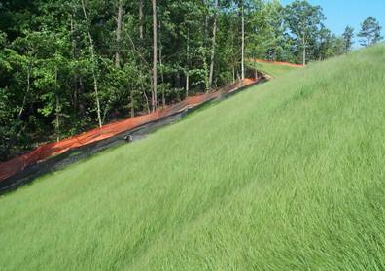
Vegetation Establishment
Intercepts raindrops
Reduces detachment
Slows runoff
Cleans runoff
Reduces runoff
Increases infiltration
Protects structures, rivers, streams, and ponds
Reduces maintenance of storm water ponds
Improves aesthetics, soil quality, and wildlife habitat
Notes:
Vegetation provides many benefits.
The main benefit is to intercept the raindrops and prevent them from causing detachment, the first step in the soil erosion process.

Slide 2
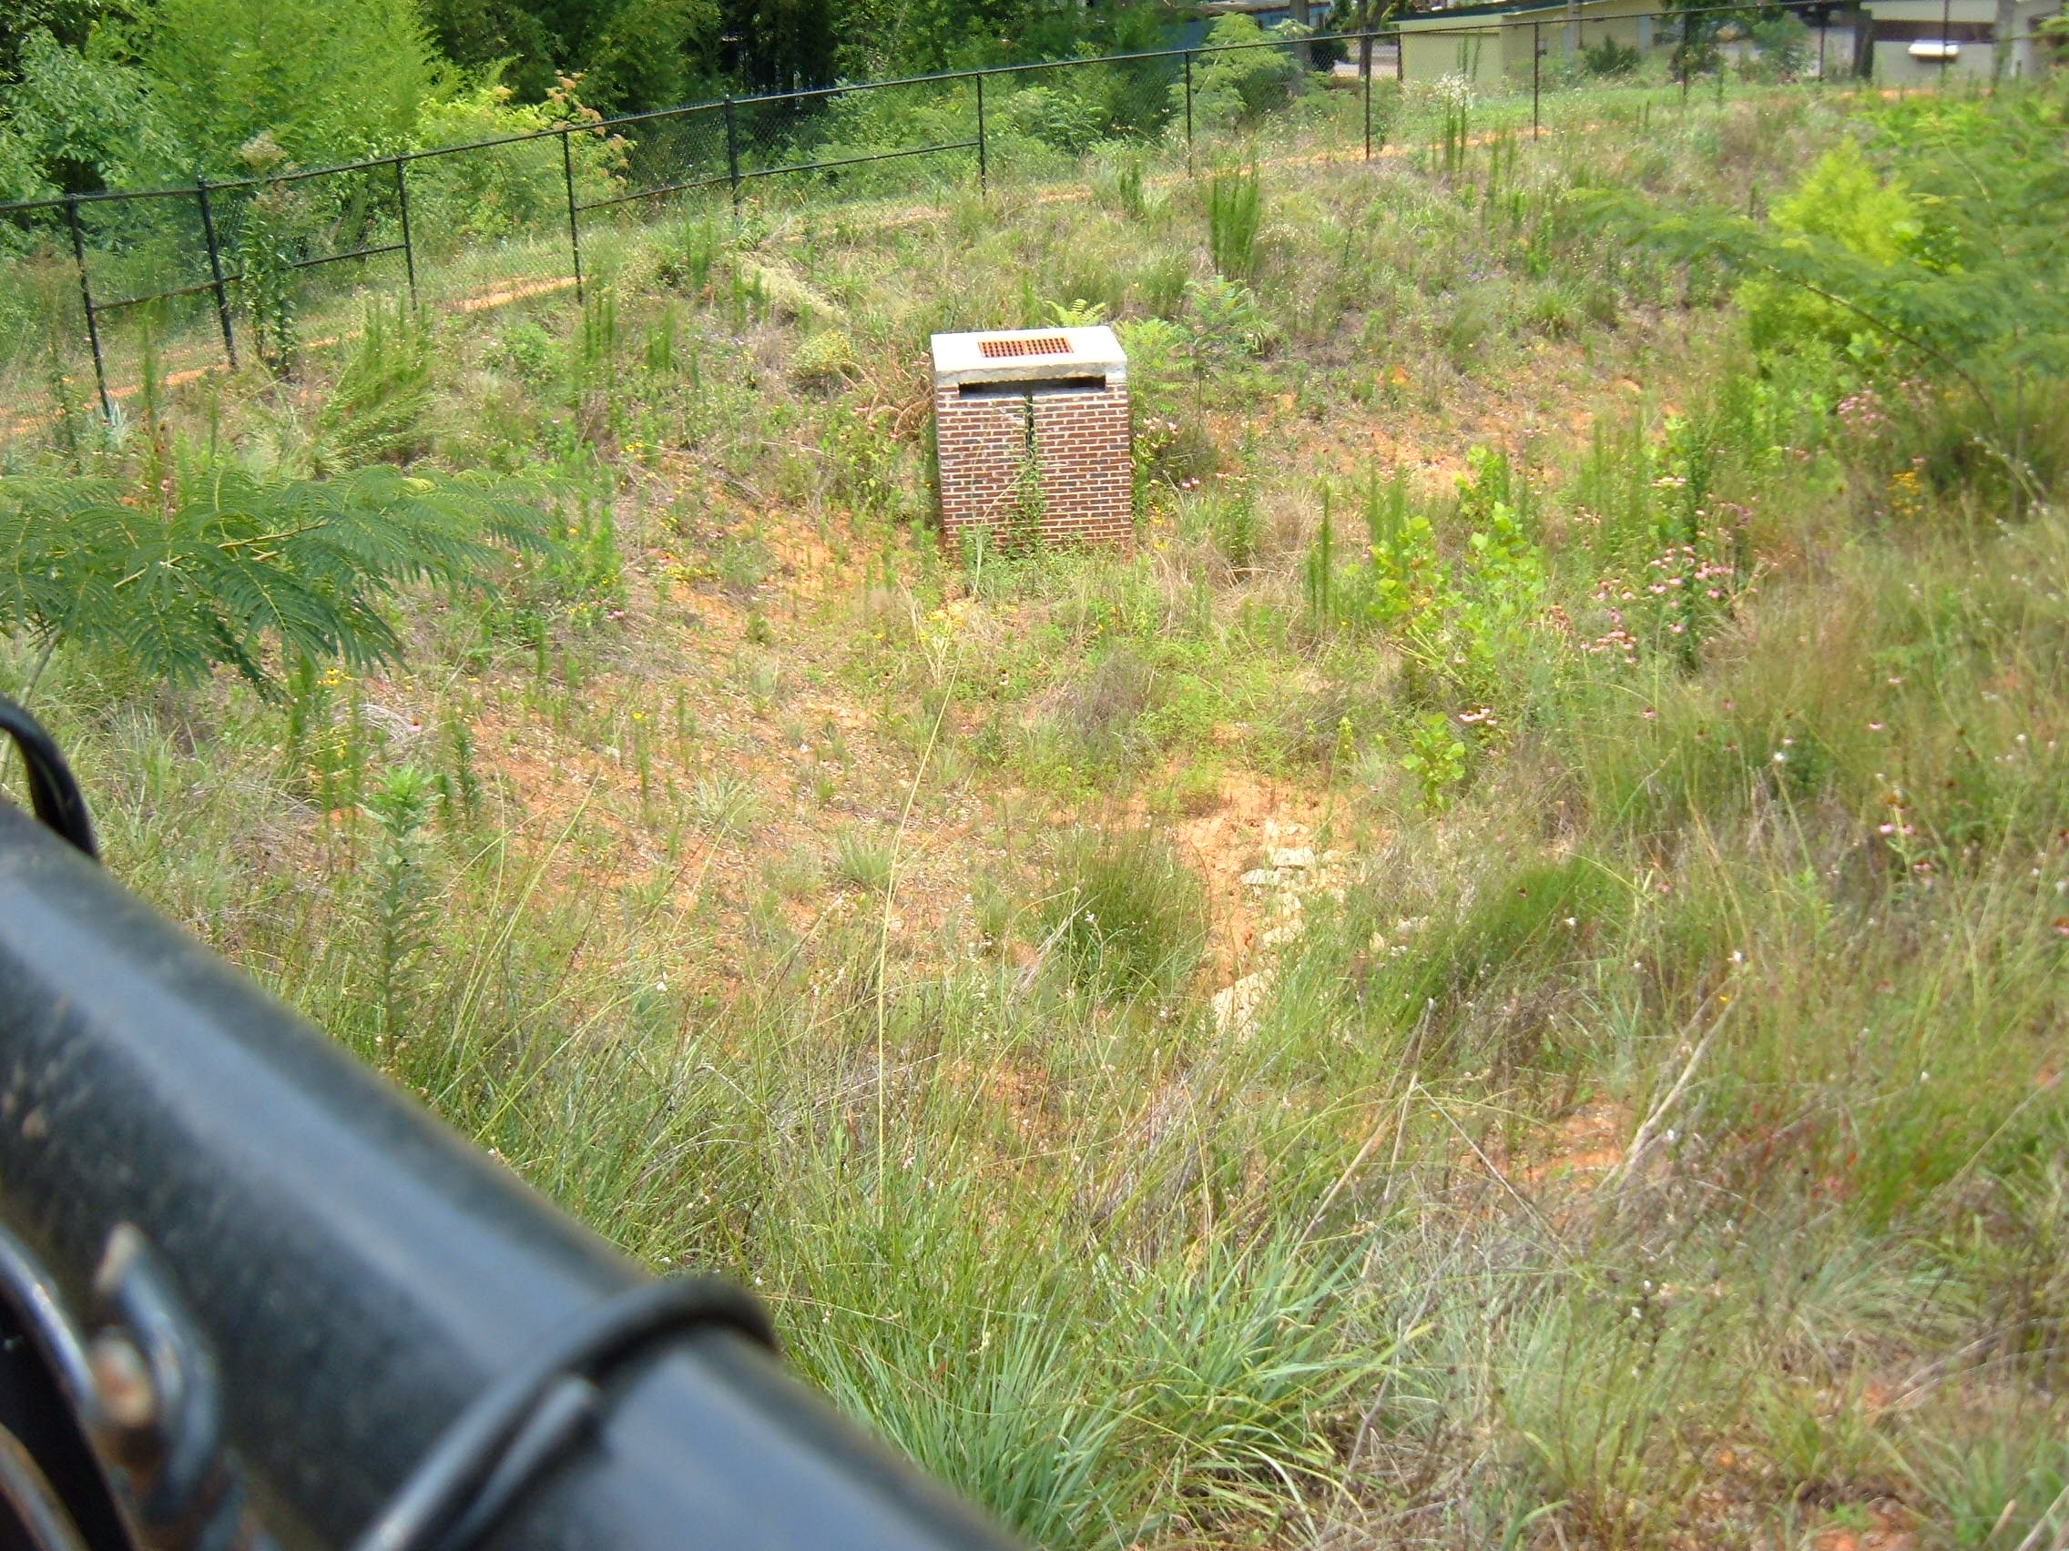
Storm water ponds may be inhospitable sites for vegetatation
    Topsoil is removed
    Steep slopes
    Low soil fertility
    Acidic soils
    Concentrated flow
    Compacted soils
    Wet & dry conditions
Intensive treatment is needed
Notes:
Most times we are not dealing with flat, fertile land.
Intensive planning, application, and maintenance are needed.

Slide 3



Management Resources
Field Manuel
UGA Extension
Green Book
www.gaswcc.org
www.caes.uga.edu/extension

Slide 4
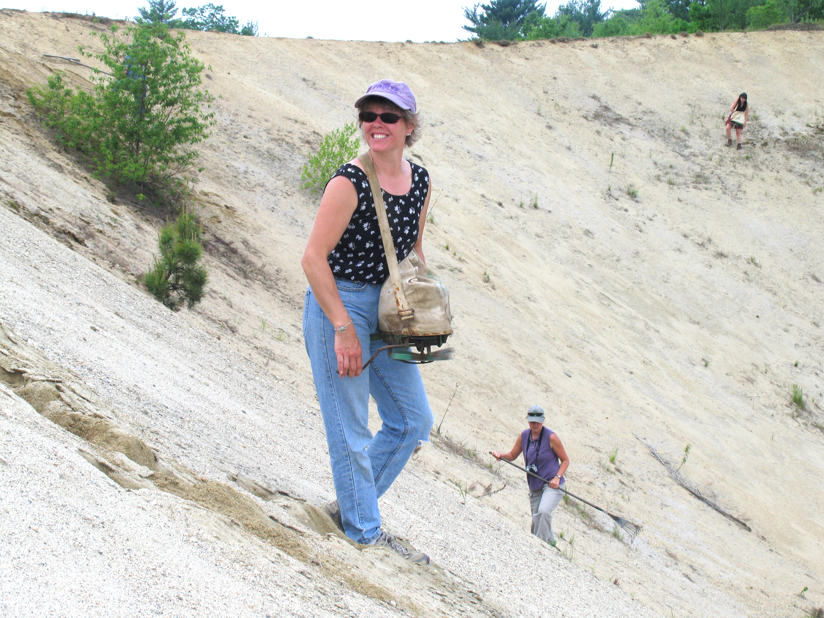
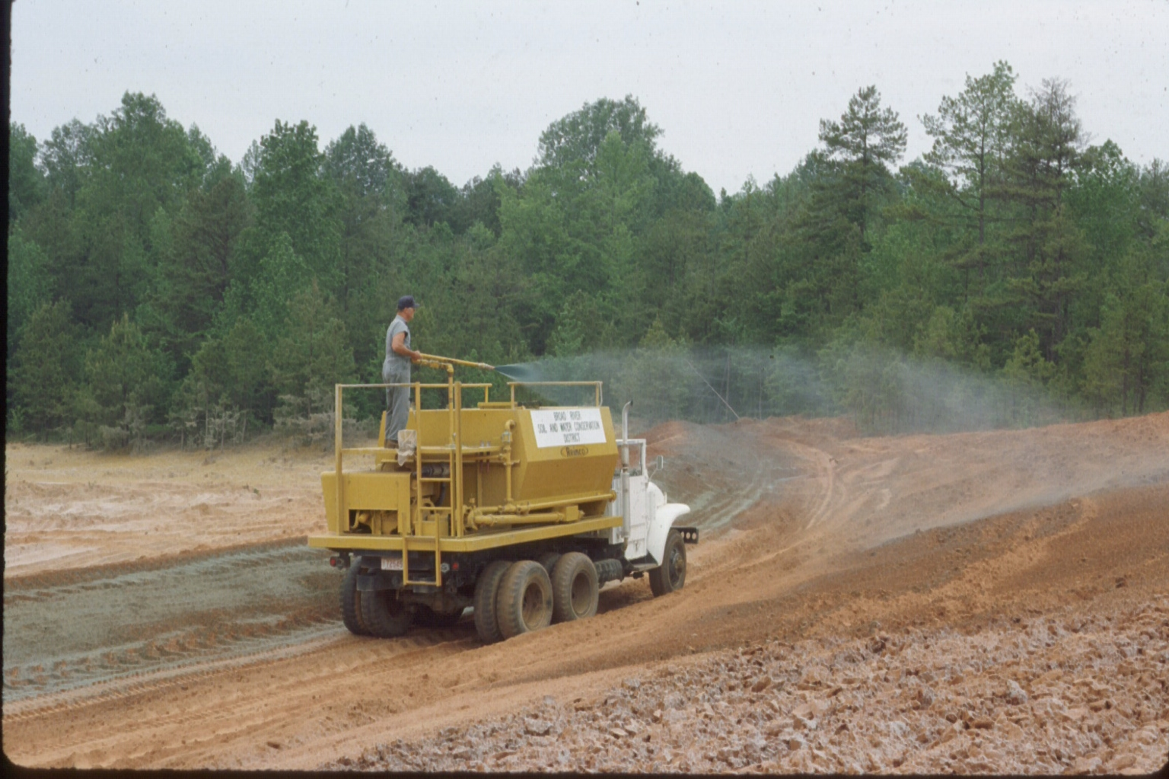
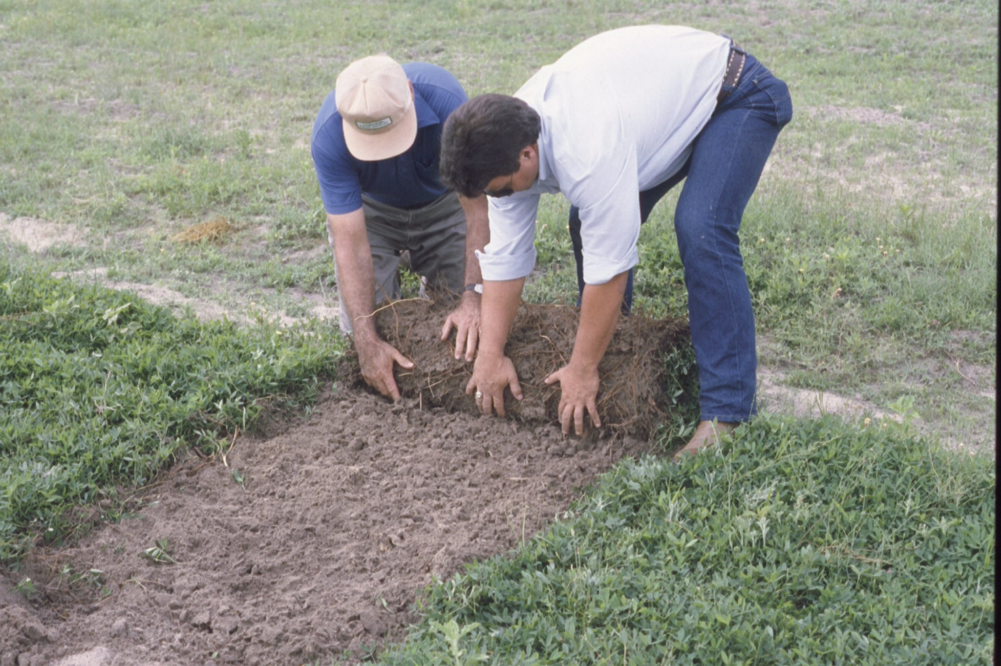
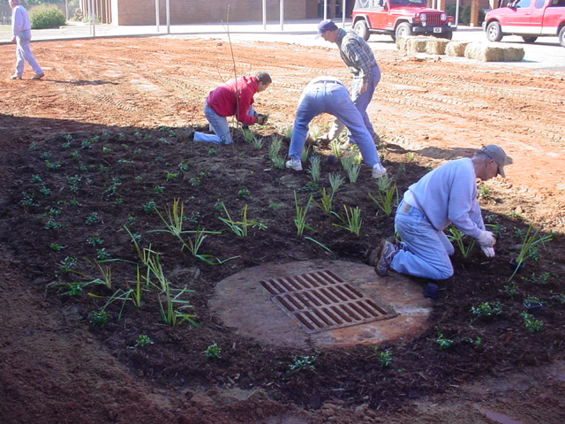
Planting Methods
Notes:
Conventional seeding should be the first choice because it:
prepares a seedbed
incorporates lime and fertilizer into the soil
ensures good seed-to-soil contact
most times is cheaper

Slide 5
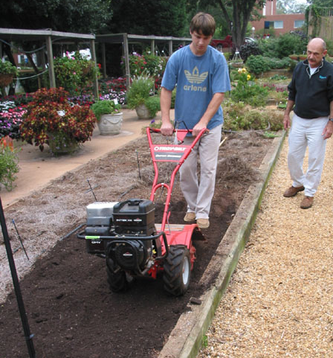
Seedbed Preparation
Provides good growing medium
Critical for good plant growth
Not as critical for hydroseeding
Incorporate lime and fertilizer 4 to 6 inches
Notes:
Too often, seed are thrown on the top of compacted soil.
Young plant seedlings are fragile and need all the help we can give them to survive.
Seedbed preparation provides many benefits to young plants.

Slide 6
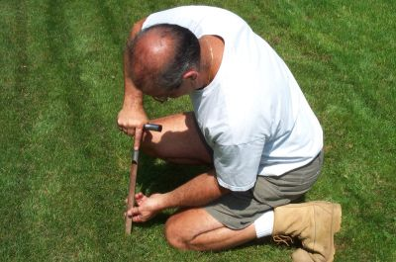
Soil Tests and Nutrient
Management
Determine soil acidity and fertility
Provide ample nutrients for plants
Protect the environment
Notes:
The soil on most construction sites has low pH and low fertility.
Inadequate plant nutrients will prevent good plant growth.
And, excess nutrient applications can harm the environment.
Soil tests and nutrient management plans tell (1) the existing soil pH and fertility and (2) how much lime and fertilizer should be applied to the target plant species for good growth.

Slide 7
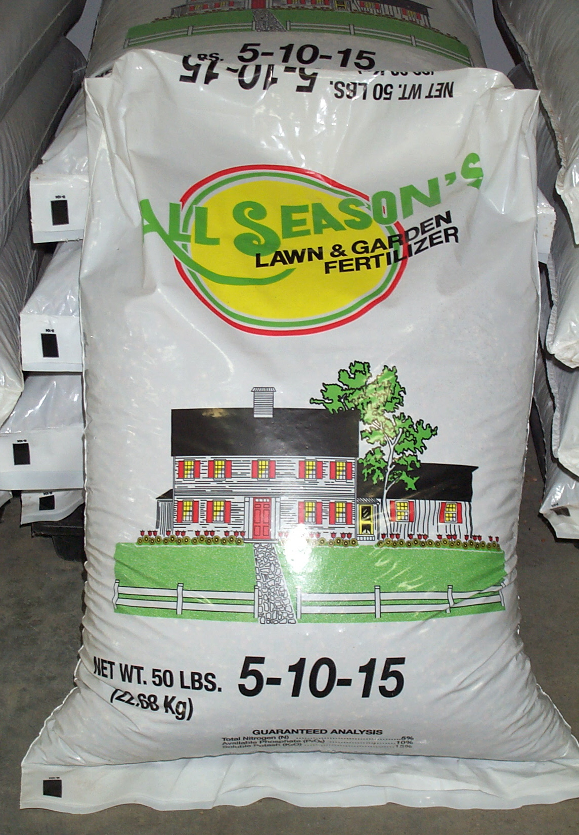
Fertilization
Initial – immediately before or at planting
Topdressing – 6 to 8 weeks after planting
2nd year – the year after planting
Maintenance – each year
Fertilize based on target species
Don’t “plant it and forget it”
Notes:
Fertilizer is one of our best conservation tools.
The initial fertilizer is not all that is needed. Topdressing, 2nd year, and maintenance applications are very important also.

Slide 8
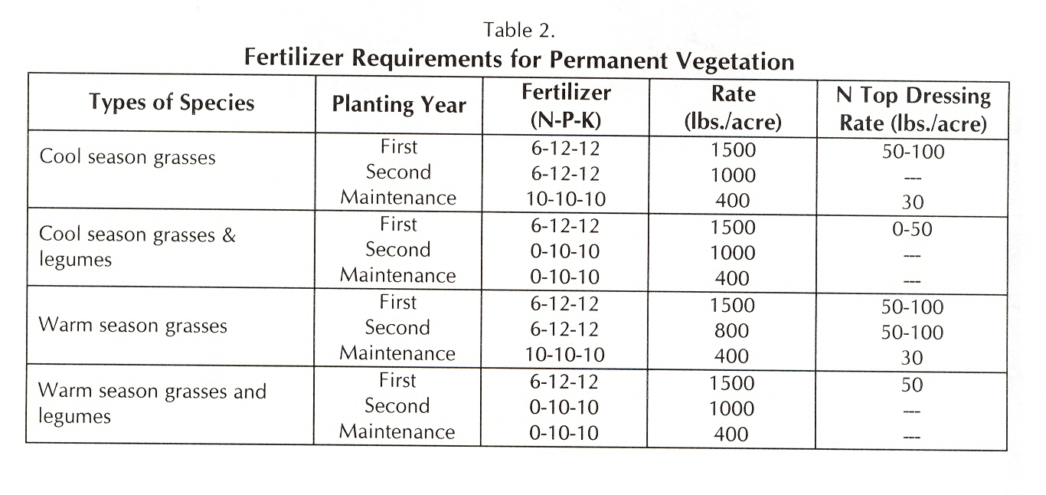
Erosion and Sediment Field Manuel
Fertilizer Recommendations
Notes:
Fertilization recommendations are provided in the “Manual”.

Slide 9
Planting Dates for
Warm Season Plants
Plant common bermuda and weeping lovegrass in the early spring:
April 1 - May 15
This permits germination, plant growth, and root
development prior to the hot and dry summer.
Notes:
All plants need to be planted at the proper time.

Slide 10
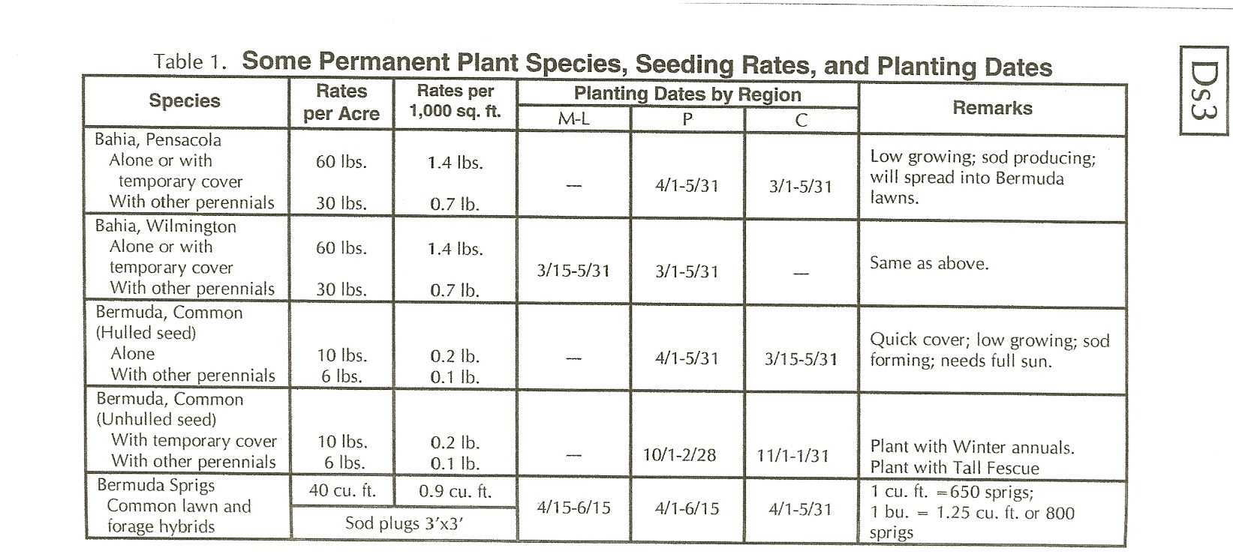
Seeding Rates & Dates
(warm season plants)
Notes:
Plant selection tables for permanent plant species are provided in the “Manual” also.

Slide 11
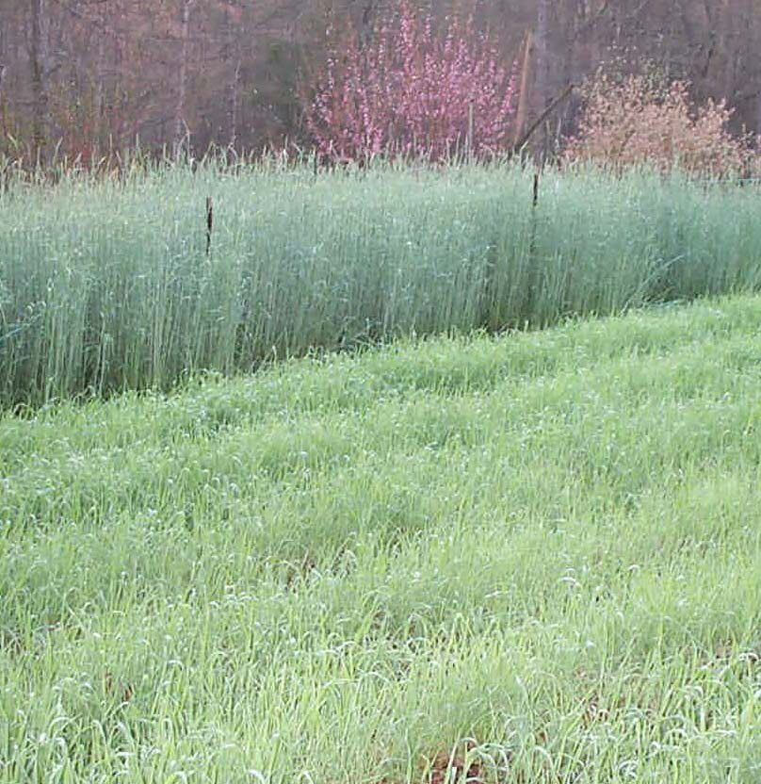
Optimum Planting Dates for
Cool Season Plants
Plant rye, ryegrass, and tall fescue in early fall:
September 1 - October 15
This permits germination, plant growth,
and root development prior to the
winter cold and spring drought.
Notes:
The rye in the background was planted on October 1.
The rye in the foreground is from the same sack of seed and received the same fertilization. It was planted in December.
The date of planting greatly affects the growth of all plants used for erosion control on construction sites.

Slide 12
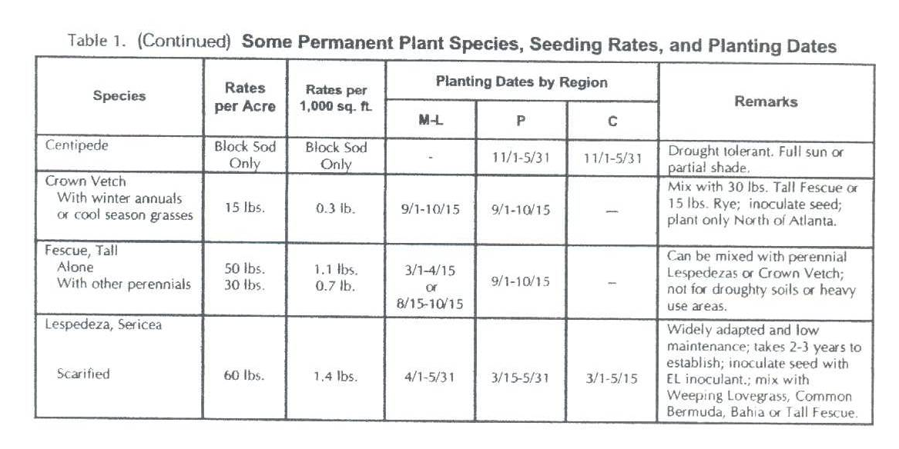
Seeding Rates & Dates
(cool season plants)

Slide 13
Seeding Rates for a Quality Stand
Under-seeding reduces the stand
Over-seeding creates excessive demand for moisture, nutrients, light, and space
More is not always better
More seed will not overcome soil preparation and poor planting techniques
Notes:
Good seed planted at the proper rate is necessary.
Both too little seed or too many seed can result in inadequate cover.

Slide 14
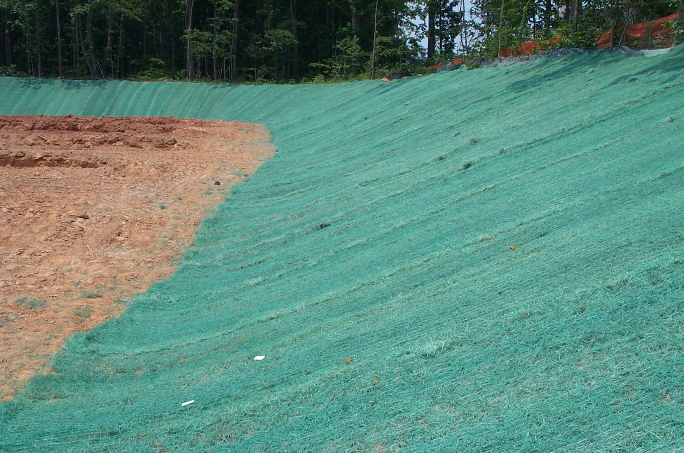
Mb
Erosion Control Matting and Blankets
Protective coverings used to establish permanent vegetation
Protects young plants
Promotes plant establishment
Helps reduce erosion
-Temporary and permanent blankets
-All must be approved by GDOT
Notes:
These materials are required on some areas.

Slide 15
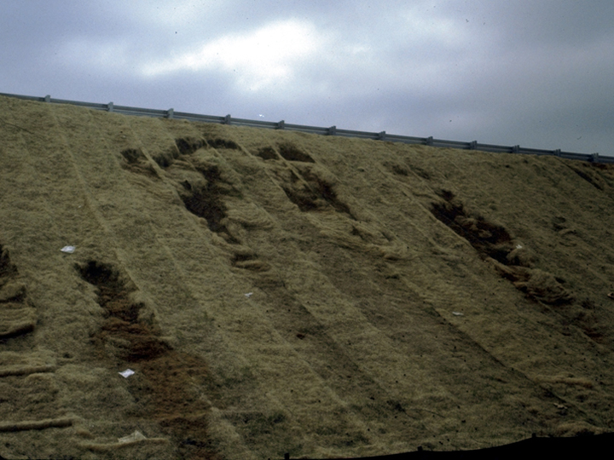
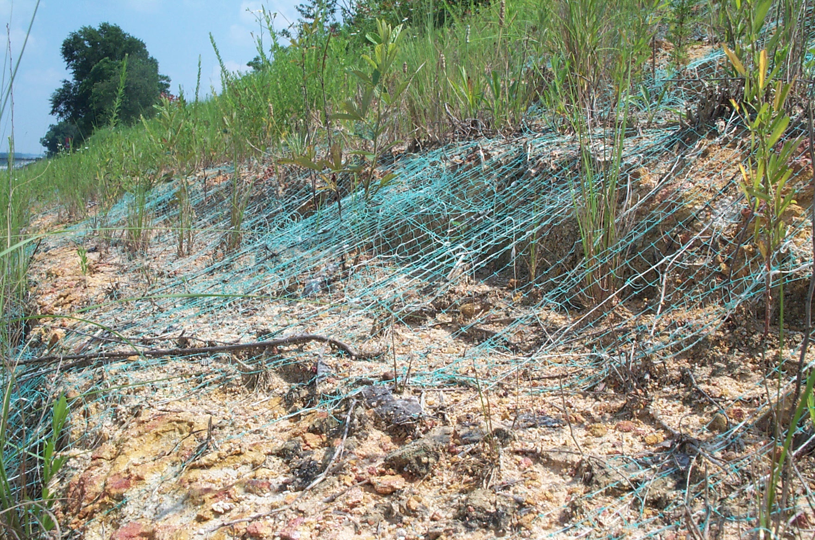
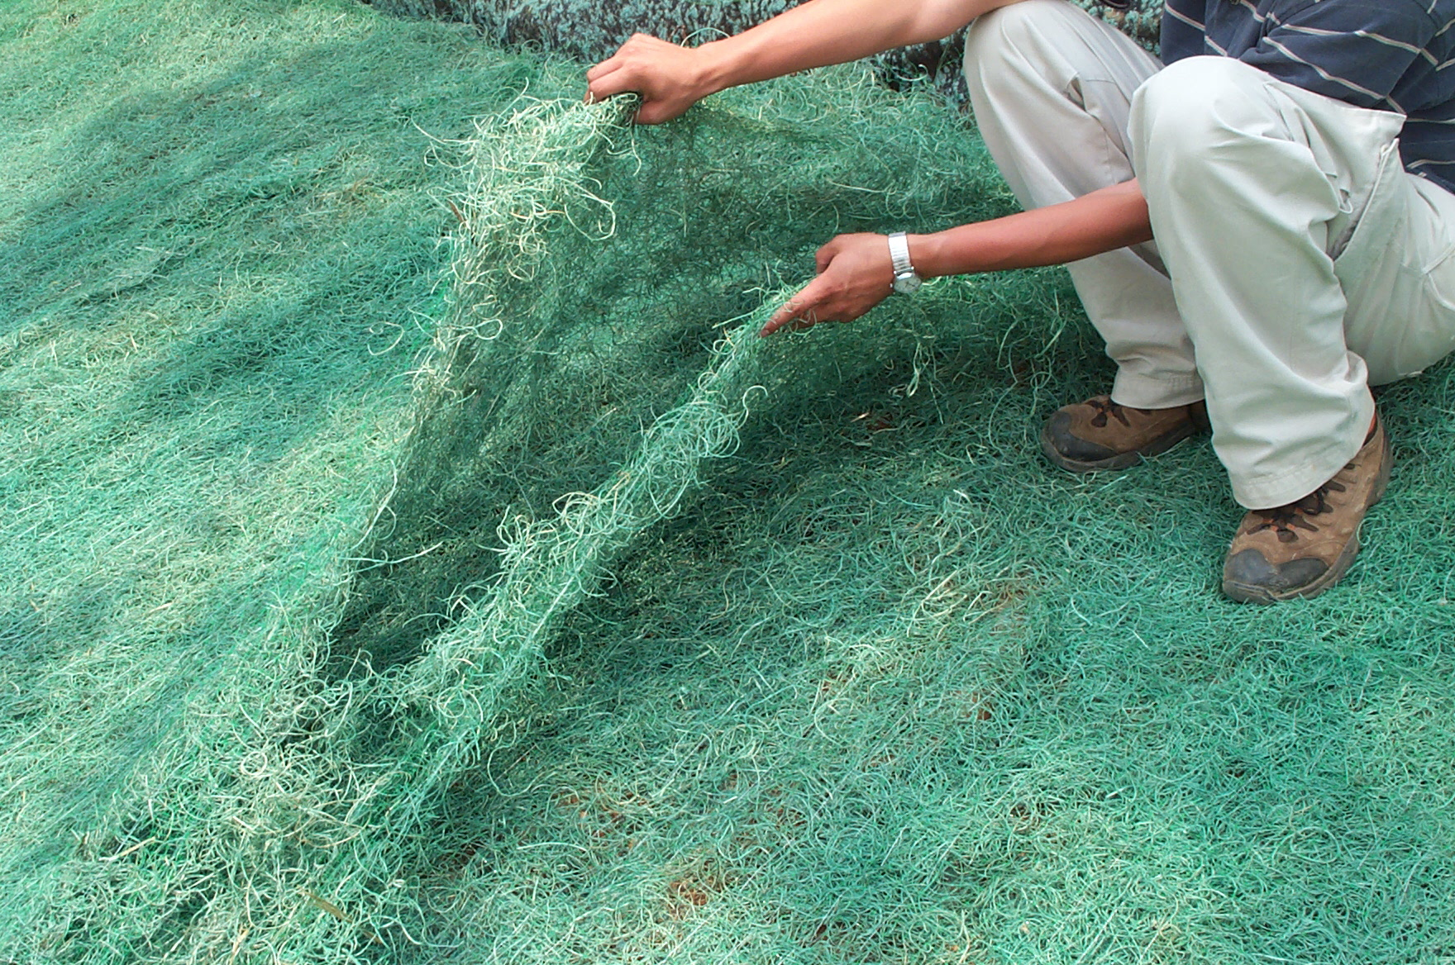
Blankets must be applied correctly
Notes:
They will fail if not applied and anchored correctly.
The soil should be smooth underneath them.
One layer, applied correctly, should be sufficient. Follow the manufacturer’s recommendations.

Slide 16
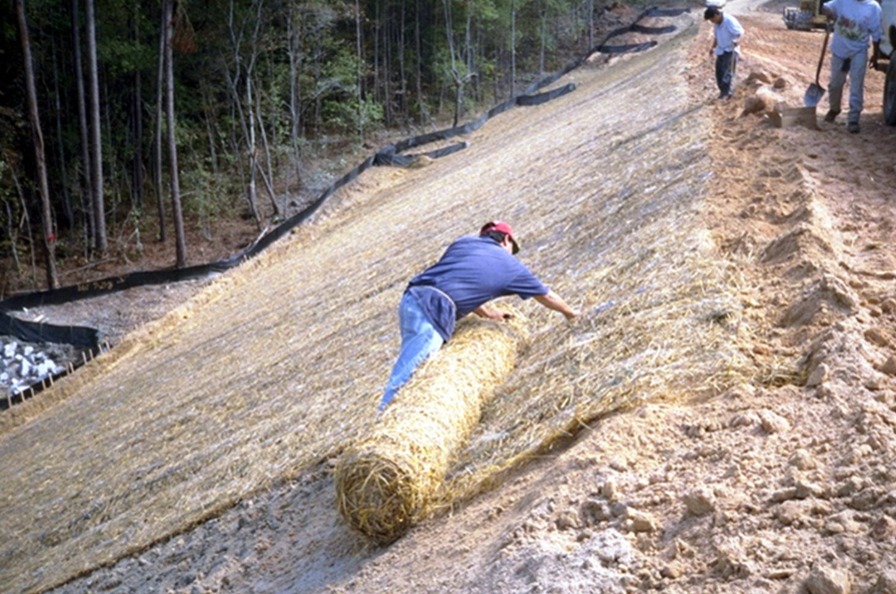
Blankets & sod must be anchored.
Start at top of slope and work down.
Notes:
They must be anchored properly.

Slide 18
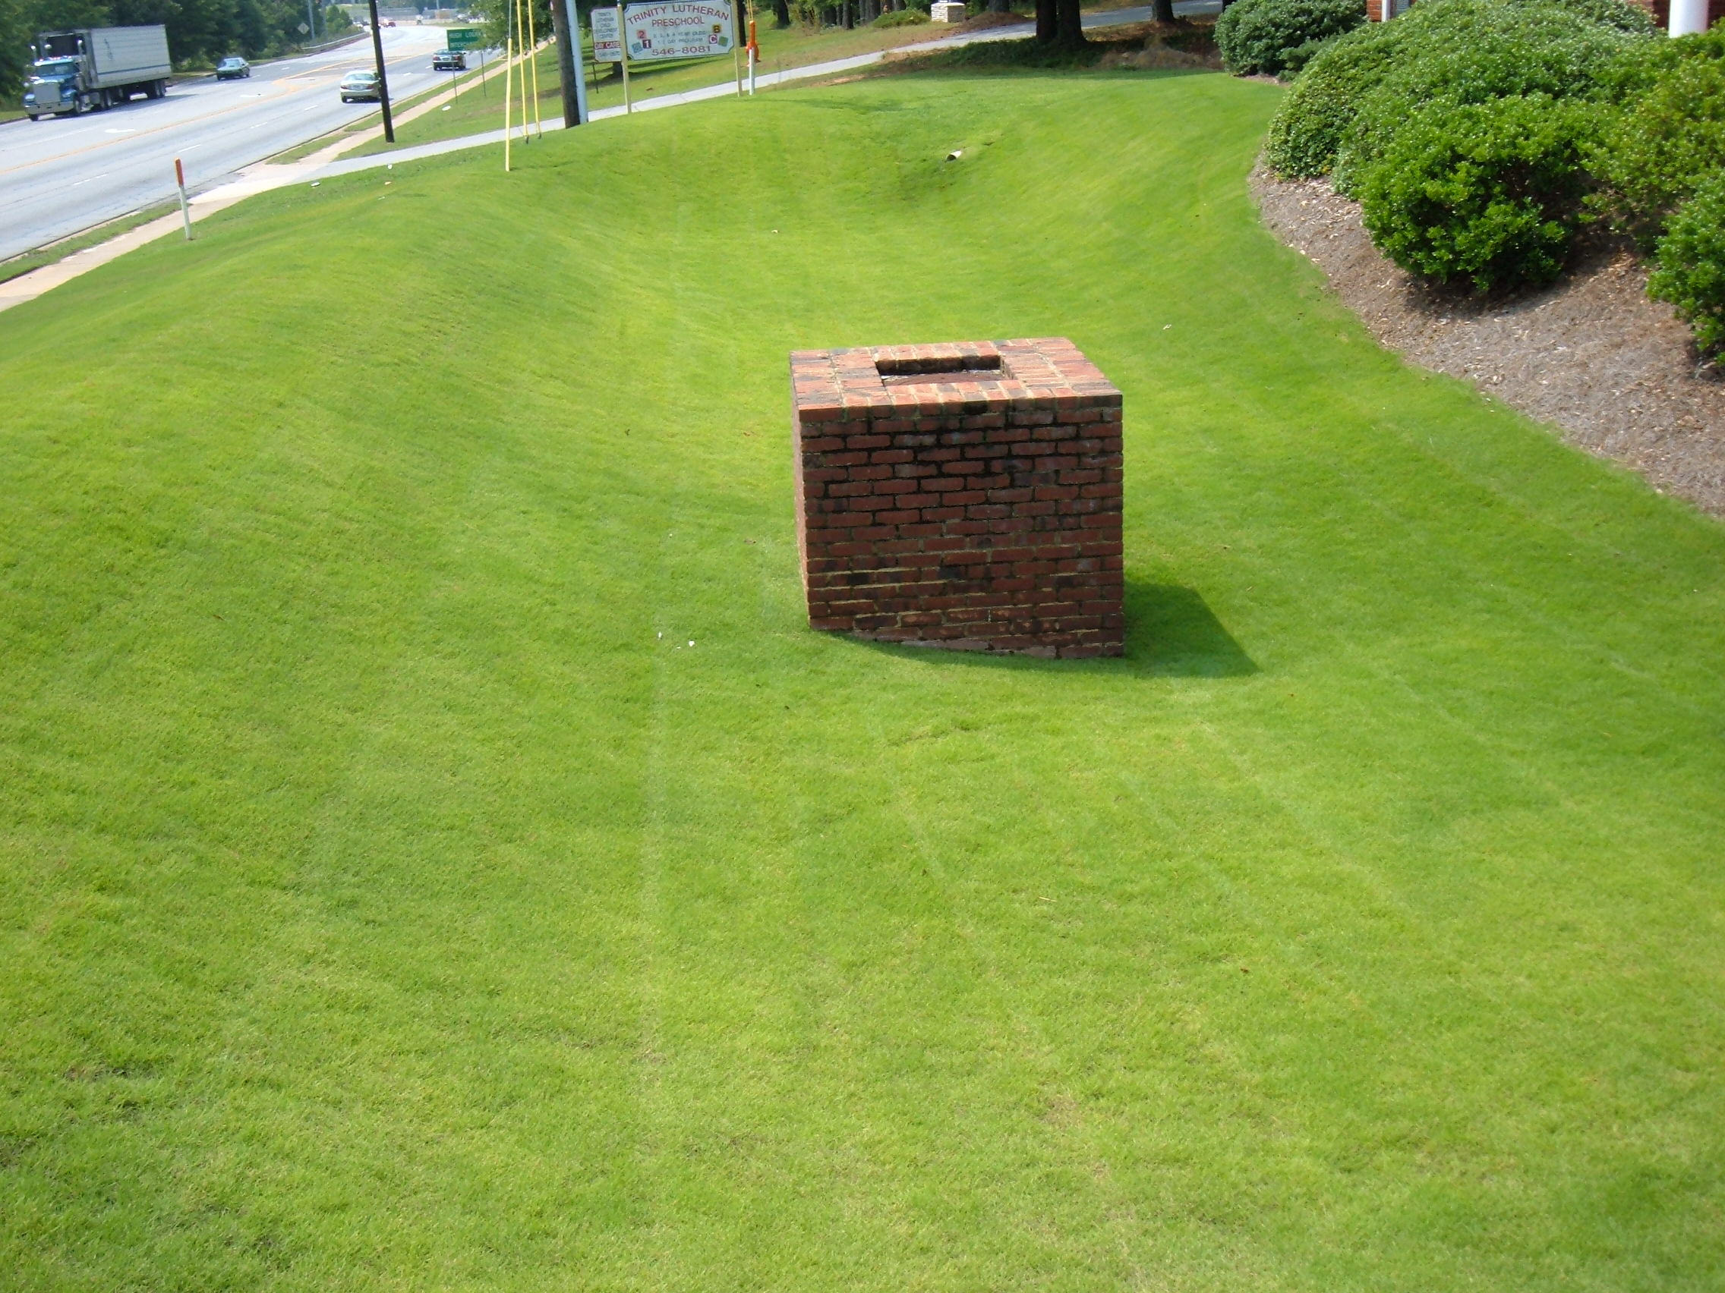
Turf Maintenance
Mowing
- Remove ⅓ – ½ top growth
Fertilizer
Apply 400 lbs 10-10-10 per acre
(10 lbs/1000 square feet)
In 6 – 8 weeks apply an additional
90 lbs of 34-0-0 per acre
(2 lbs/ 1000 square feet)
Lime
- Apply 1 ton every 4 – 6 years or as per soil test

Slide 19
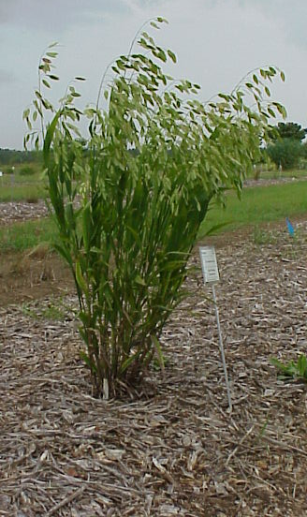
Ornamental Grasses
River Oats (Chasmanthium latifolia)
Maiden grass (Miscanthus spp.)
Muhly grass (Muhlenbergia capillaris
Panic grass/Switch grass (Panicum virgatum)
Indian grass (Sorgastrum nutans)

Slide 20
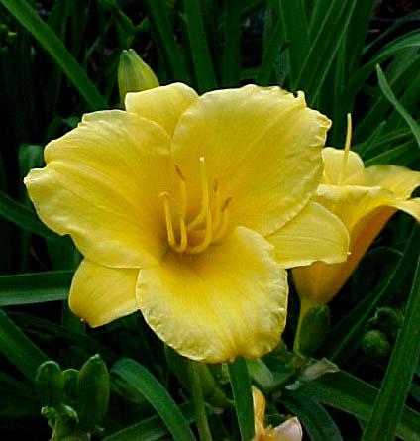
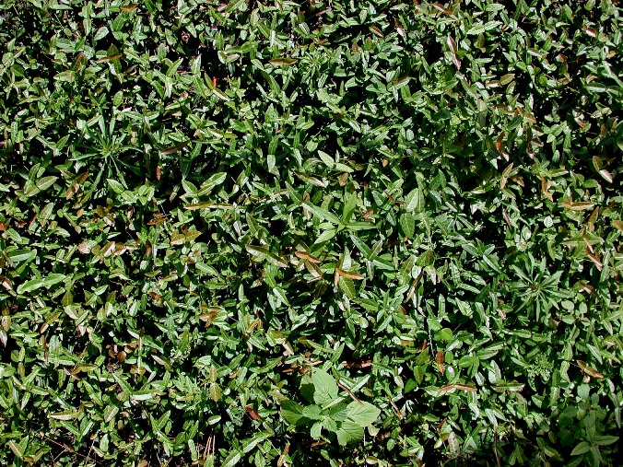
Ornamental
Groundcovers
Daylily
Asiatic jasmine
Liriope
Big periwinkle (Vinca major)
Thrift (Phlox subulata)
Iris

Slide 21
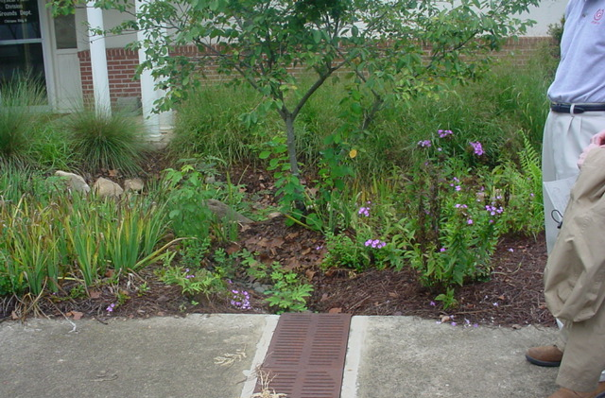
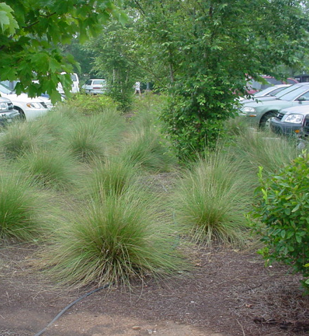
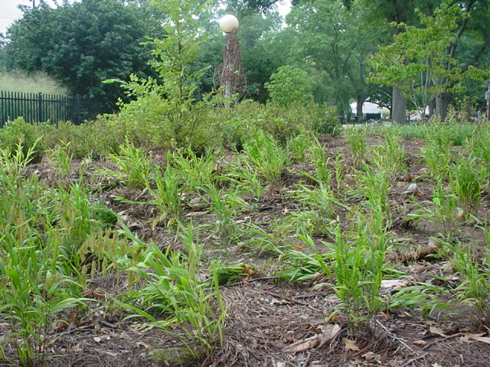
Herbaceous Ornamentals
- Use plants suited to wet and dry conditions
- Base planting on mature plant size
- Plant in fall or early spring
Fertilize in early spring
May need water during
establishment

Slide 22
Ornamental Maintenance
Turf:
Establishment
Plant in fall or early spring
Spacing depends on size of mature plant
Fertilizer
Apply 400 lbs of 10-10-10 per acre per year
(10 lbs per 1000 square feet)
Herbaceous Ornamentals
Lime
- Apply 1 ton every 4 – 6 years or as per soil test Lime

