Slide 1
Herbicide Use In Stormwater Management Ponds
Dan McMillan and Beau Long
UAP Distribution, Inc.

Slide 2
Recommended Herbicides
Glyphosate (Rodeo, Pondmaster, Aquaneat, Aquamaster, etc.)
Triclopyr (Renovate, etc.)
Imazapyr (Habitat, Polaris, etc.)
Clopyralid (Transline)

Slide 3
Glyphosate
Contact herbicide
(Roundup-for aquatic use)
Controls grasses and weeds
Roundup labeled for terrestrial
Rodeo and Pondmaster labeled for aquatic
No Soil residual

Slide 4
Triclopyr
Systemic Activity
Controls BLW’s
Very little soil activity
Avoid using in high temperatures
Garlon labeled for terrestrial
Renovate cleared for aquatic use

Slide 5
Imazapyr
Contact and systemic activity
Control of grasses, blw’s and hardwoods
Does have soil activity
Arsenal labeled for terrestrial
Habitat cleared for aquatic use

Slide 6
Clopyralid
Systemic Herbicide
Control of legumes
(kudzu, locust, etc.)
*Transline can be used up to waters edge

Slide 7
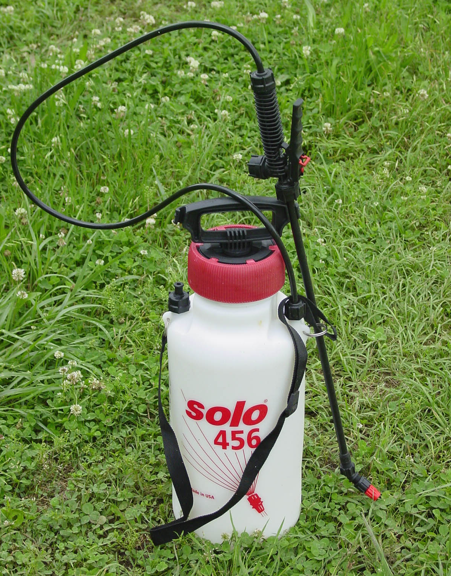

Slide 8
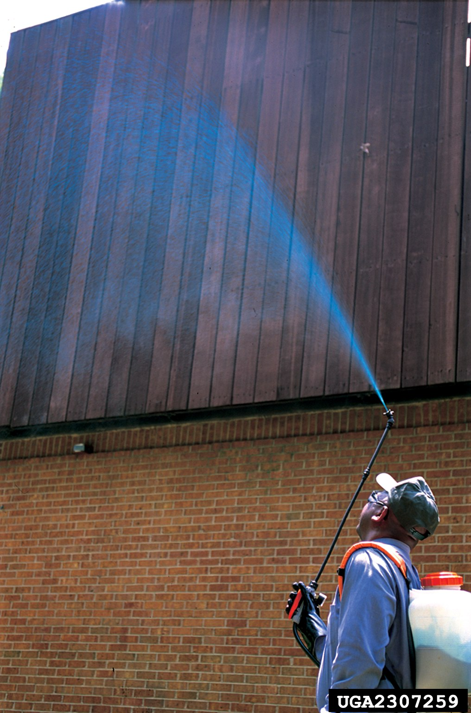

Slide 9
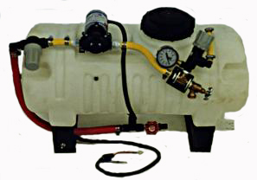

Slide 10
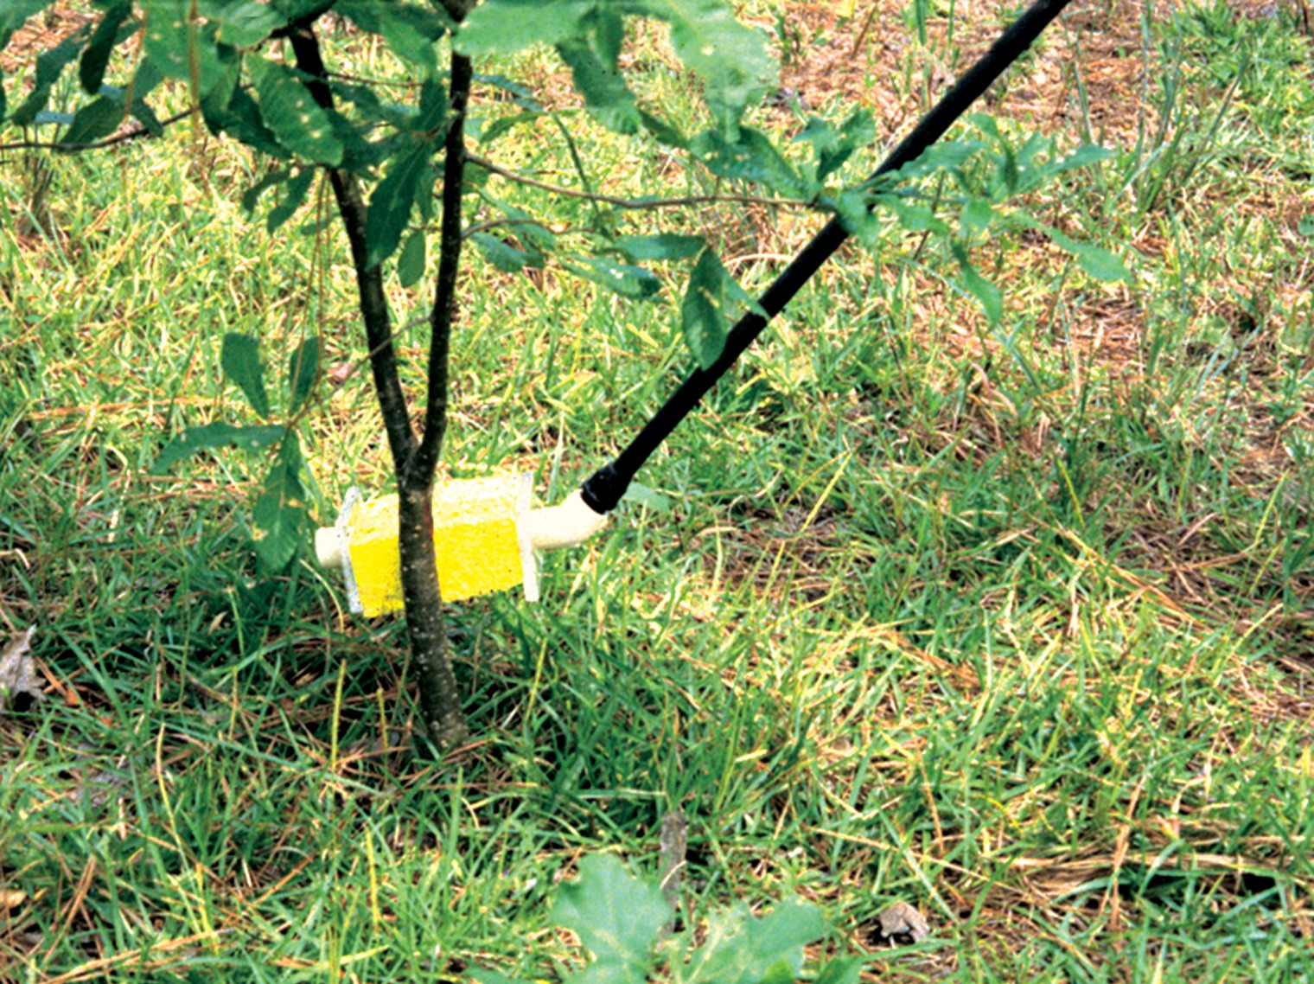

Slide 11
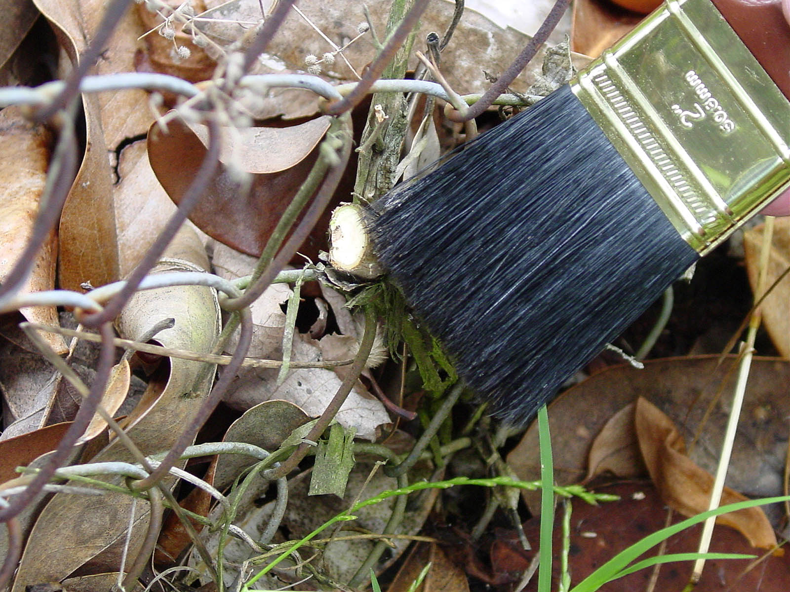

Slide 12
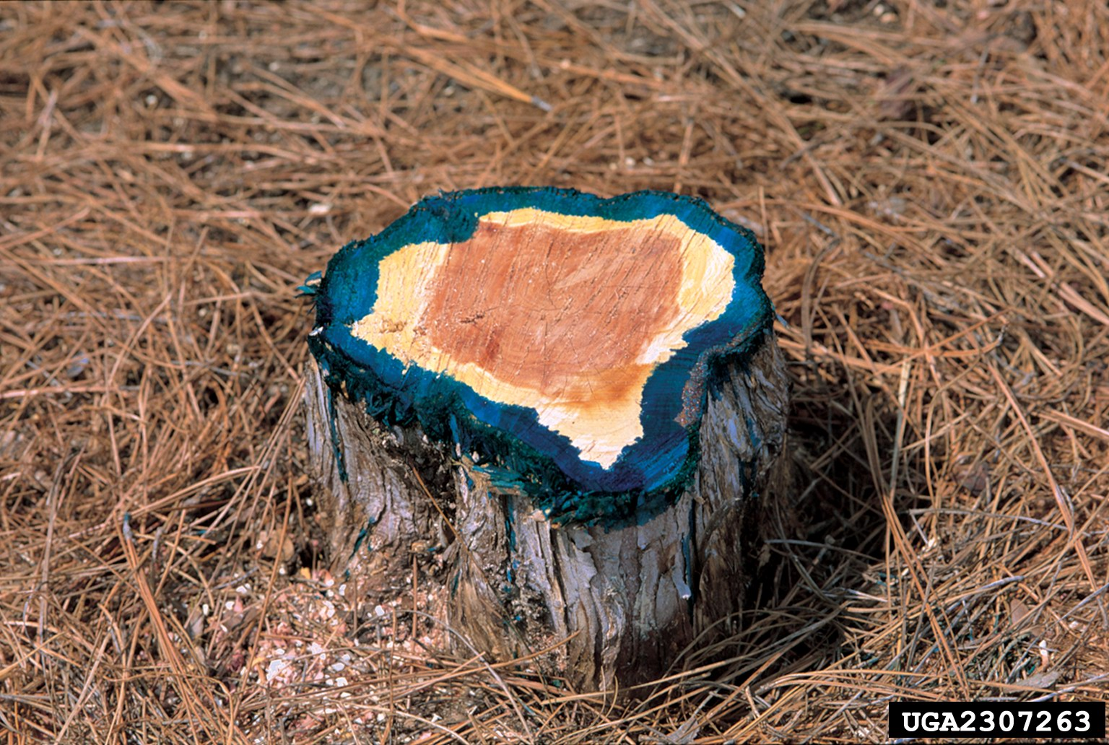
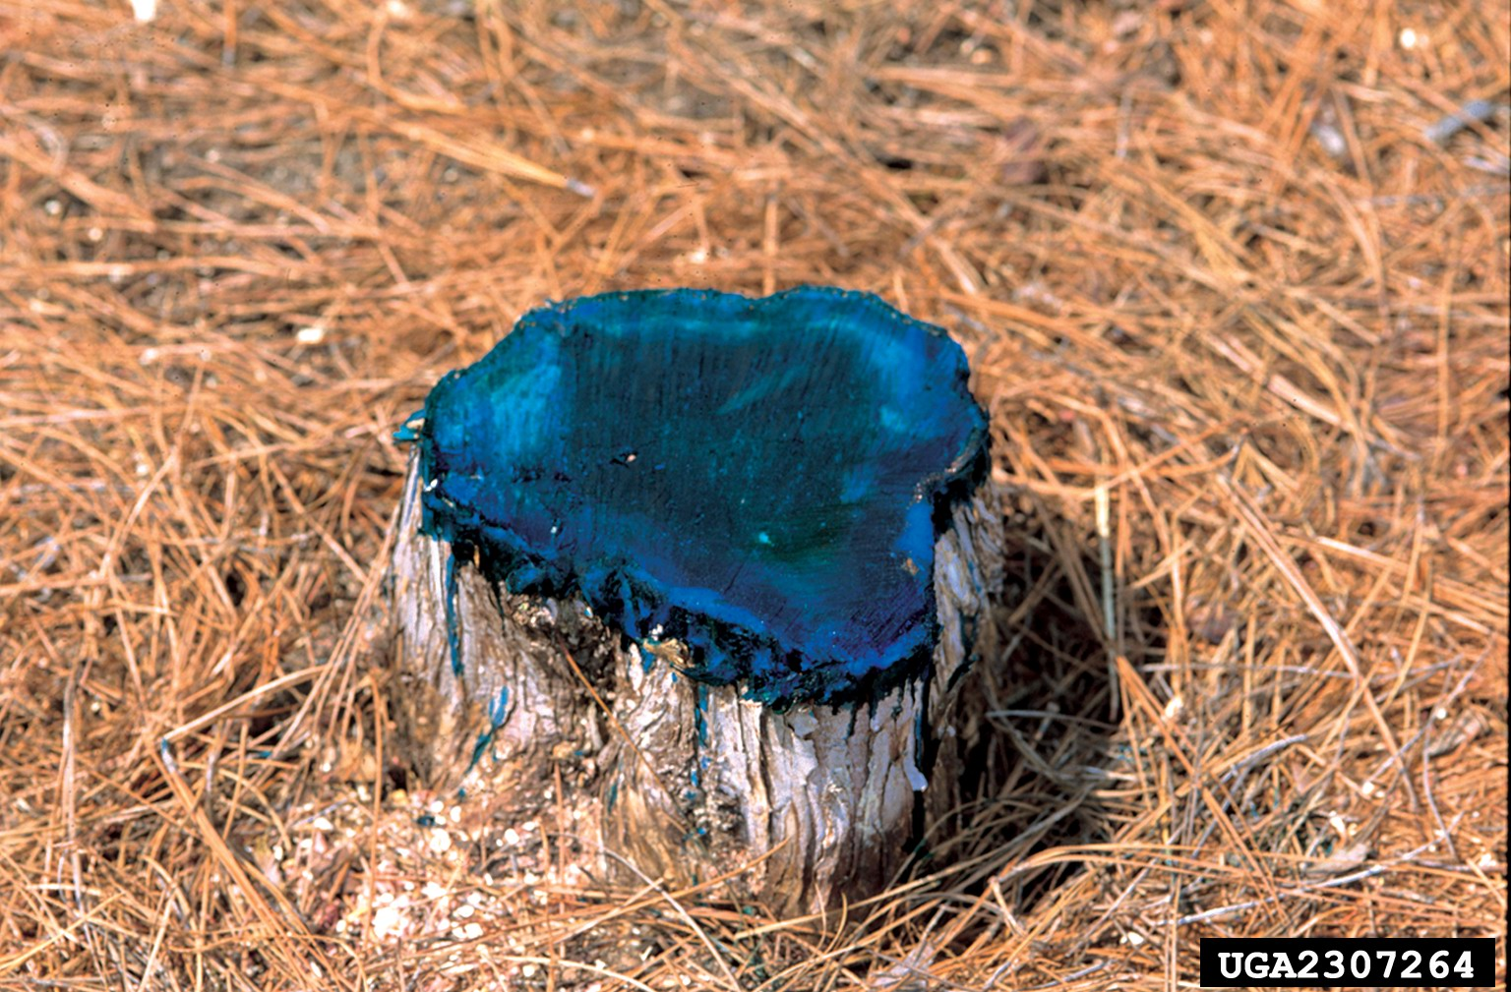

Slide 13
