Slide 1
Status of the Invasive Kudzu Bug, Megacopta cribraria , in Georgia and North America
Presentation to:
Georgia Center for Urban Agriculture Update for County ANR Agents – 13 March 2013
Wayne A. Gardner, Professor
Department of Entomology
University of Georgia
Griffin Campus
Griffin, Georgia 30223 USA
770-228-7341
wgardner@uga.edu

Slide 2
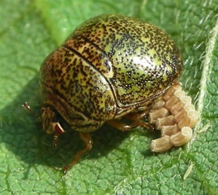
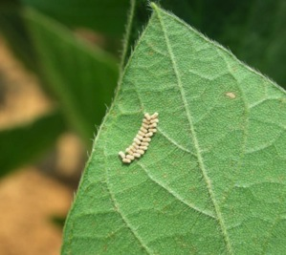
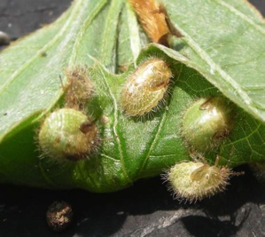
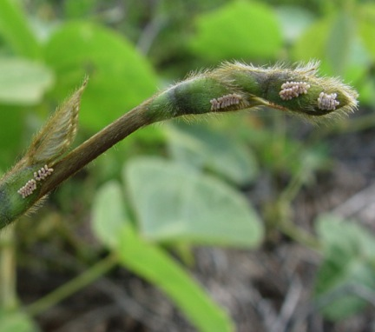
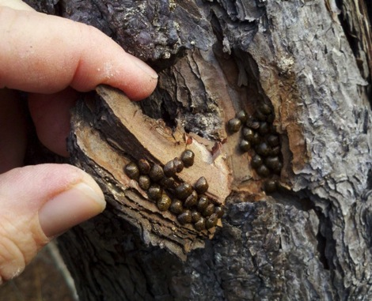
The Insect Megacopta cribraria Hemiptera: Plataspidae
2 to 2.5 overlapping generations observed in Georgia.
Overwintering adults emerge in spring when they become a nuisance pest and eventually move into kudzu (March-May).
First generation adults are produced in kudzu (and early-planted soybeans). These adults move to later-planted soybean while also re-infesting kudzu (June-July).
As soybeans and kudzu senesce in the fall, the 2nd-generation adults become nuisance pests.
Overwinter as adults in groups usually under debris or under bark.
Upper images provided by Jeremy Greene, Clemson University
Eggs masses on kudzu
plant stipules
Image provided by Phillip Roberts
University of Georgia
Image provided by John Ruberson
University of Georgia

Slide 3
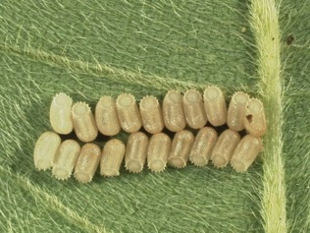
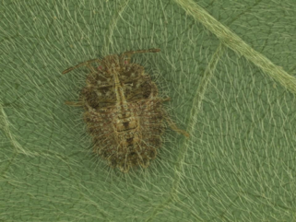
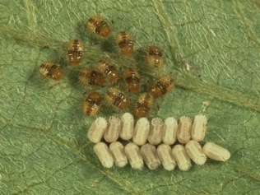
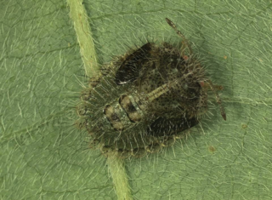
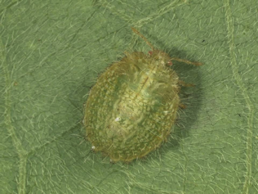
Development of Megacopta cribraria
Numbers of eggs produced per female = 26 to 274 with 15 eggs per egg mass.
Eggs usually deposited in 2-3 parallel rows stuck in black substance deposited by female.
First instars consume symbiont capsules after eclosion.
Five nymphal instars.
Symbiont capsules
Fourth instar
First Instars
Fifth instar
Third instar
Adult

Slide 4
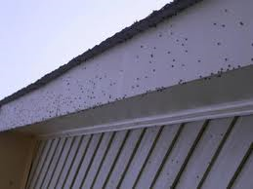
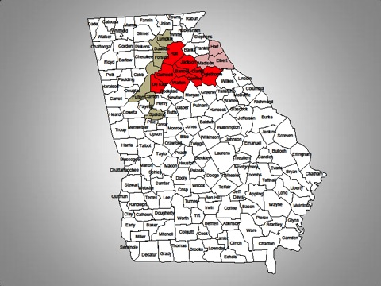
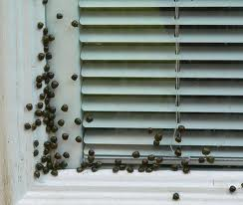
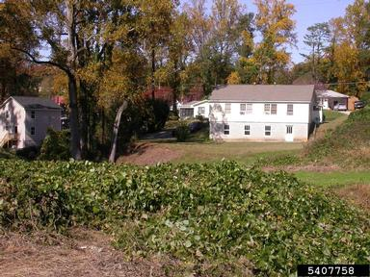
Initial Discovery October 2009
Samples submitted to the UGA Homeowner Insect & Weed Diagnostics Laboratory.
October 28, 2009: Site visit to Jackson Co., GA, thousands of adult kudzu bugs on homes.
Kudzu growing 30 m from homes harbored large numbers of adults and some late-instar nymphs.
Adults seeking overwintering sites at the homes.
Megacopta cribraria deemed “a serious home invader and potential legume pest.”
Confirmed in 9 counties covering 7050 km²
A
Images by and courtesy of Daniel R. Suiter & Lisa Ames (University of Georgia) & Center for Invasive Species and Ecosystem Health, UGA (www.insectimages.org)

Slide 5
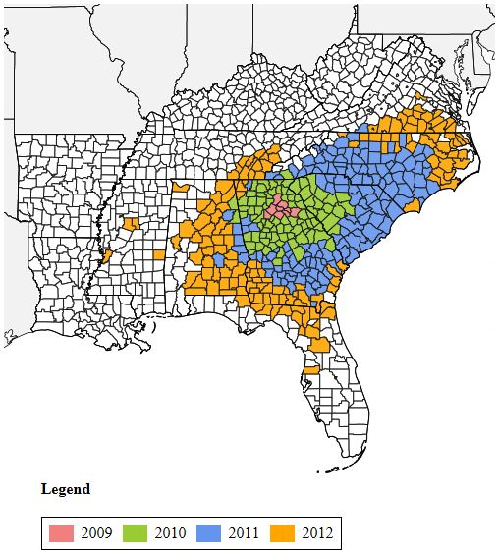
Range Expansion 2009 - 2012
Megacopta now confirmed in 8 states: Alabama, Florida, Georgia, Mississippi, North Carolina, South Carolina, Tennessee, Virginia .
Area Infested by Year:
2010: 91,786 km² (13x increase)
2011: 189,238 km² (27x inc)
2012: 209,765 km² (29x inc)
Total Area Infested:
497,819 km²
75% of additional area reported in 2011 was in a northeasterly direction; likely affected by weather (La Niña).
2012 reports from Mississippi and northwest Alabama likely due to hitchhiking.
Map compiled by Wayne A. Gardner, University of Georgia

Slide 6
Origin of Introduction
Native Range: Southeast Asia, China, Japan, India, northern Australian, Malaysia, etc..
Genetic analyses (mtDNA) show that insects in expanded range are from SINGLE FEMALE ANCESTOR (GA1).
Genetic analyses of gut endosymbionts show similar genetic relationships.
Genetic comparisons indicate source of origin is Japan.
Likely will NEVER know mode of introduction.

Slide 7
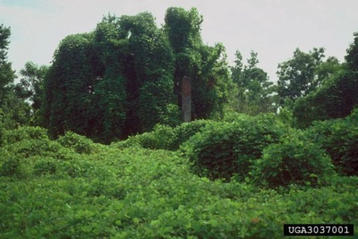
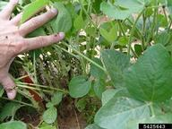
Reported Host Plants in Expanded Range
Legumes
Non-Legumes
Kudzu
Soybean
Lima Bean
Pole/String/Green Bean
Lablab Bean
Pigeon Pea
American Wisteria
Chinese Wisteria
Japanese Wisteria
American Yellowwood
Lespedeza
Peanut
Crimson Clover
Clover
Alfalfa
Sicklepod
Black Locust
Alligatorweed
Black Willow
Banana
Cocklebur
Cotton
Fig
Loquat
Muscadine Grape
Pecan
Pine Trees
Potato
Satsuma Mandarin
Tangerine
Wax Myrtle
Wheat
Wild Blackberry
Images courtesy of Center for Invasive Species and Ecosystem Health, UGA
www.insectimages.org

Slide 8
Host Preference Testing
Choice and No-Choice Preference Testing in 2012 conducted by Blount and Buntin (UGA)
No Adults – No Nymphs – No Oviposition
Peanut, Snap bean, Pinto bean, Winter pea
Few Adults (1-3 per 10 sweeps) – No Nymphs – No Oviposition
Lima bean, Black bean, Black-eyed pea, Azuki bean
Low Number Adults (10-15 per 10 sweeps) – No Nymphs – No Oviposition
Lablab, Mung bean
Reproductive Hosts
Soybean, Kudzu

Slide 9
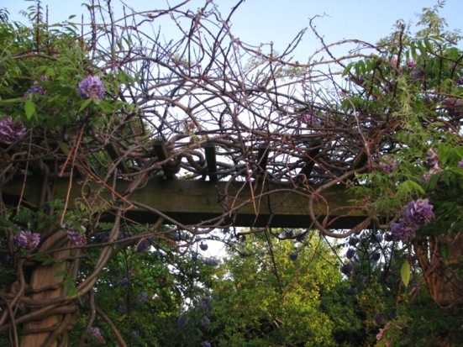
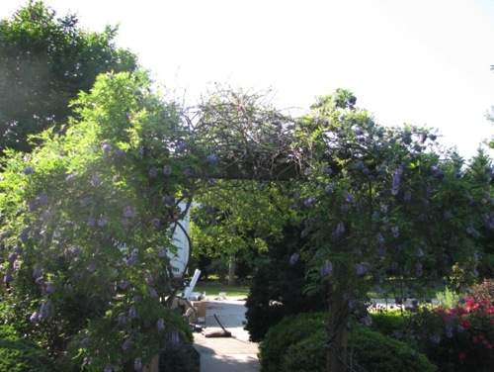
Impact of Adult Feeding on Nonreproductive Hosts
In Spring 2012, large numbers of adults were observed feeding on backyard arbor of wisteria before American wisteria had leafed out.
Wisteria was treated with an insecticide which eliminated the adults.
The host plant was clearly affected by adult feeding as seen once the vine leafed out.
No egg-laying or nymphs were observed.

Slide 10
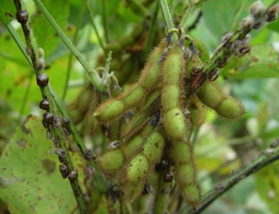
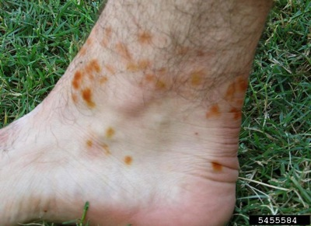
Impacts
Kudzu Biomass Reduced (33% in one year’s growth).
Soybean Yield reduced an average of 18% over 19 tests conducted in GA and SC in 2010-2011.
Edible Bean Yield
Nuisance Pest in urban areas – abundance and activity of adults, staining, odor.
Localized Skin Reactions for some individuals.
International Trade

Slide 11
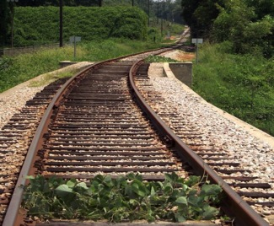
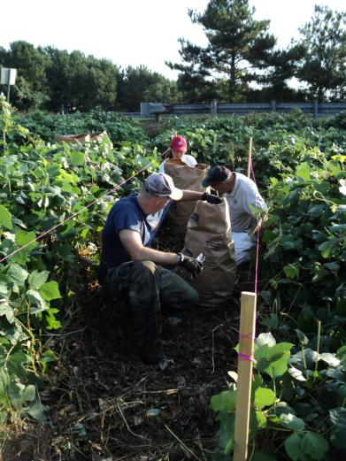
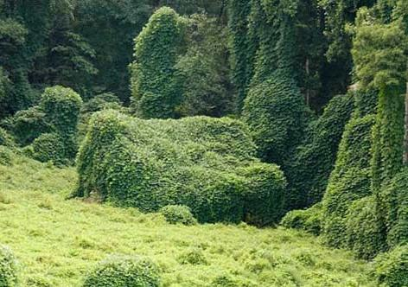
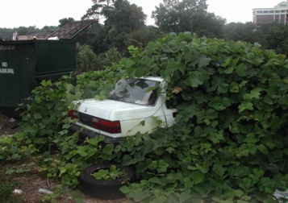
Biocontrol agent for kudzu?
Megacopta cribraria reduced kudzu biomass by 33% in replicated tests in 1 year.
M. cribraria reduced biomass by 50% over 2 years.
Heavily-infested kudzu appear less vigorous after 2 or 3 years of M. cribraria pressure.
Other plants (weeds) appear in kudzu patches after 2 to 3 years of M. cribraria pressure, suggesting reduced competition of kudzu with weed species.
Zhang et al. 2012. Environ. Entomol. 41(1): 40-50.

Slide 12
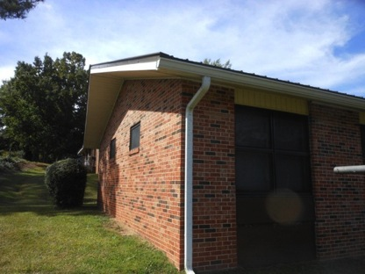
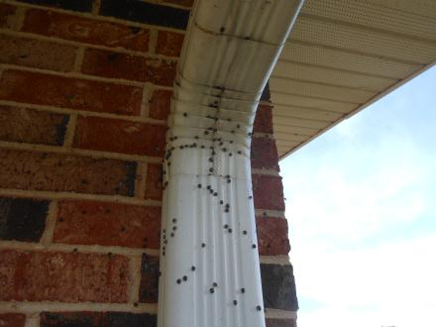
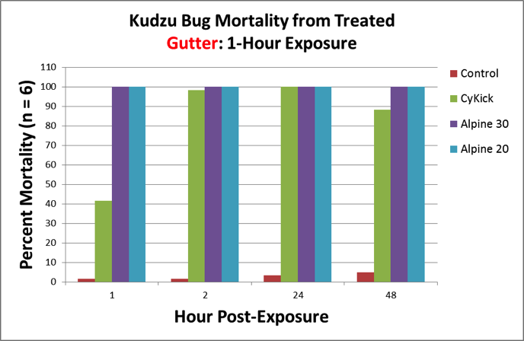
Megacopta cribraria as a Nuisance Pest
Adults attracted to light-colored surfaces but NOT to lights.
Homeowner complaints require action by PCO’s.
Daniel R. Suiter (UGA) efficacy and residual testing on various surfaces indicate excellent knockdown and residual control of adults up to 48 hours of treatment of surfaces with Alpine.
Alpine = dinotefuran (neonicotinoid insecticide labeled for indoor use, leafy vegetables, etc.)

Slide 13
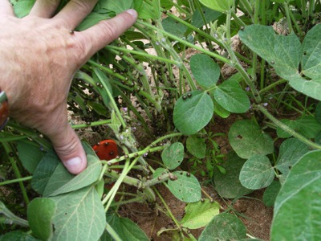
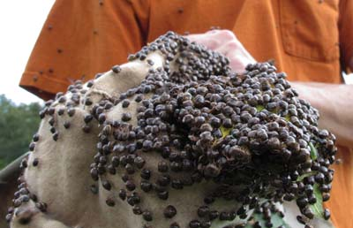
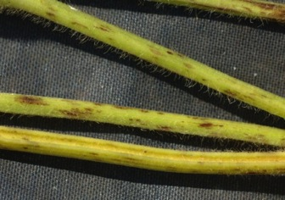
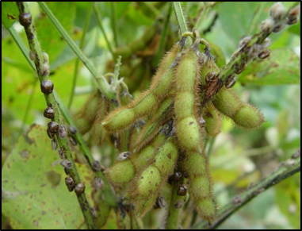
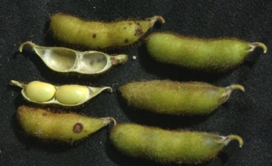
Megacopta cribraria Impact on Soybean
Yield loss averaged 20% (range 0%-60%) in untreated beans in 25 tests conducted 2010-2012 in Georgia.
Yield reduction due to indirect injury (stress) with reduction in seeds per pod and seed weight.
Eggs oviposited on leaves. Nymphs and adults feed primarily on stems, sometimes on petioles and undersides of leaves.
Adults and nymphs rarely seen feeding on pods.
Infestations are higher in field edges.

Slide 14
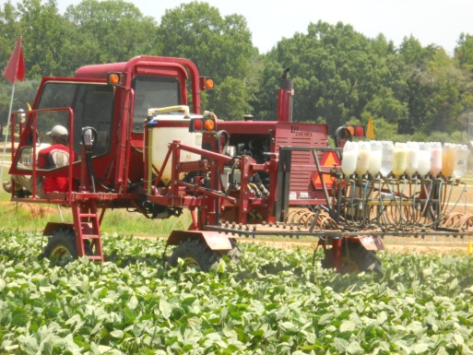
Megacopta cribraria Management in Soybean
M. cribraria easily killed with a variety of insecticides, but re-infestation of treated areas occurs quickly.
Planting Date: M. cribraria risk April > May > June > July.
Threshold: One nymph per sweep (single application may be sufficient to eliminate yield loss).
Endigo (λ cyhalothrin, thiamethoxam) and Brigade (bifenthrin) are among best performers in efficacy trials.

Slide 15
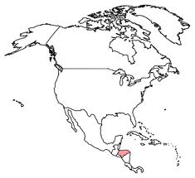
Exporting Megacopta
11 February 2012:
Honduran inspectors discover 7 dead Megacopta adults in the bottom of a shipping container of poultry meat products from Georgia. Inspectors had previously found 2 dead adults in a container shipment of fertile chicken eggs from same Georgia facility.
27 February 2012:
Honduran Servicio de Proteccion Agropecuaria (SEPA; Agricultural Protection Service) halted all agricultural imports from Georgia, Alabama, and South Carolina citing 11 February discovery. North Carolina was added to the ban 2 days later.
01 March 2012:
Honduran officials ease restrictions to begin inspecting and unloading individual containers (primarily cotton) to support local industries. But, authorities continue to inspect 10% of arriving containers at ports in Central America.
Airline Travel:
Live adults have been intercepted in passenger compartments of jets outbound from Atlanta; dead adults have been intercepted in luggage compartments.

Slide 16
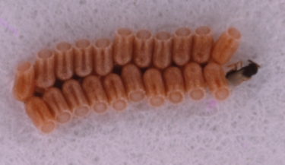
Potential for Biological Control
Some generalist predators prey upon nymphs and adults, but overall impact is negligible.
Entomogenous fungus Beauveria bassiana found naturally infecting adults.
No known parasitoids.
Best candidate for importation:
Egg parasitoid Paratelenomus saccharalis
Wide distribution in native range (Japan)
Strong knowledge base
High host specificity
Currently in quarantine in Stoneville (USDA ARS)
Release permit in development
Paratelenomus saccharalis (Hymenoptera: Scelionidae)

Slide 17
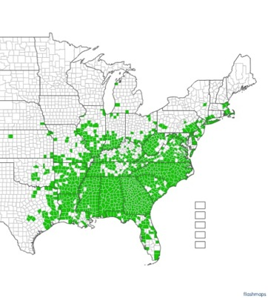
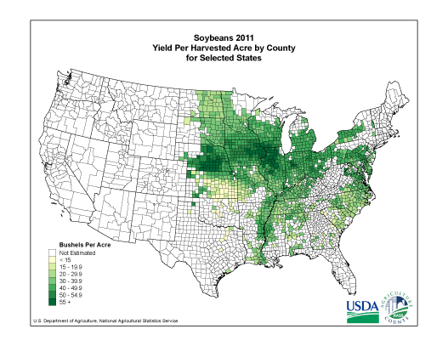
Potential Range Expansion
Kudzu Distribution by County
Only reproductive host plants observed thus far in the U.S. are kudzu and soybean.
Will M. cribraria expand its range with either soybean distribution, kudzu distribution, or both?
Soybean Yield per Harvest Acre by County

Slide 18
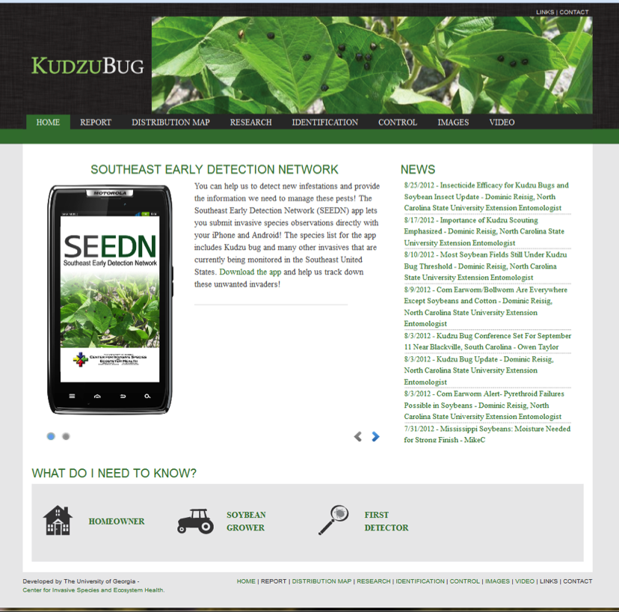
Visit and Use Our Website
Our website was developed and is maintained by the University of Georgia Center for Invasive Species and Ecosystem Health
http://www.kudzubug.org
New detections can be submitted on the website or via your smartphone with the free app SEEDN – Southeast Early Detection Network.

