Slide 1
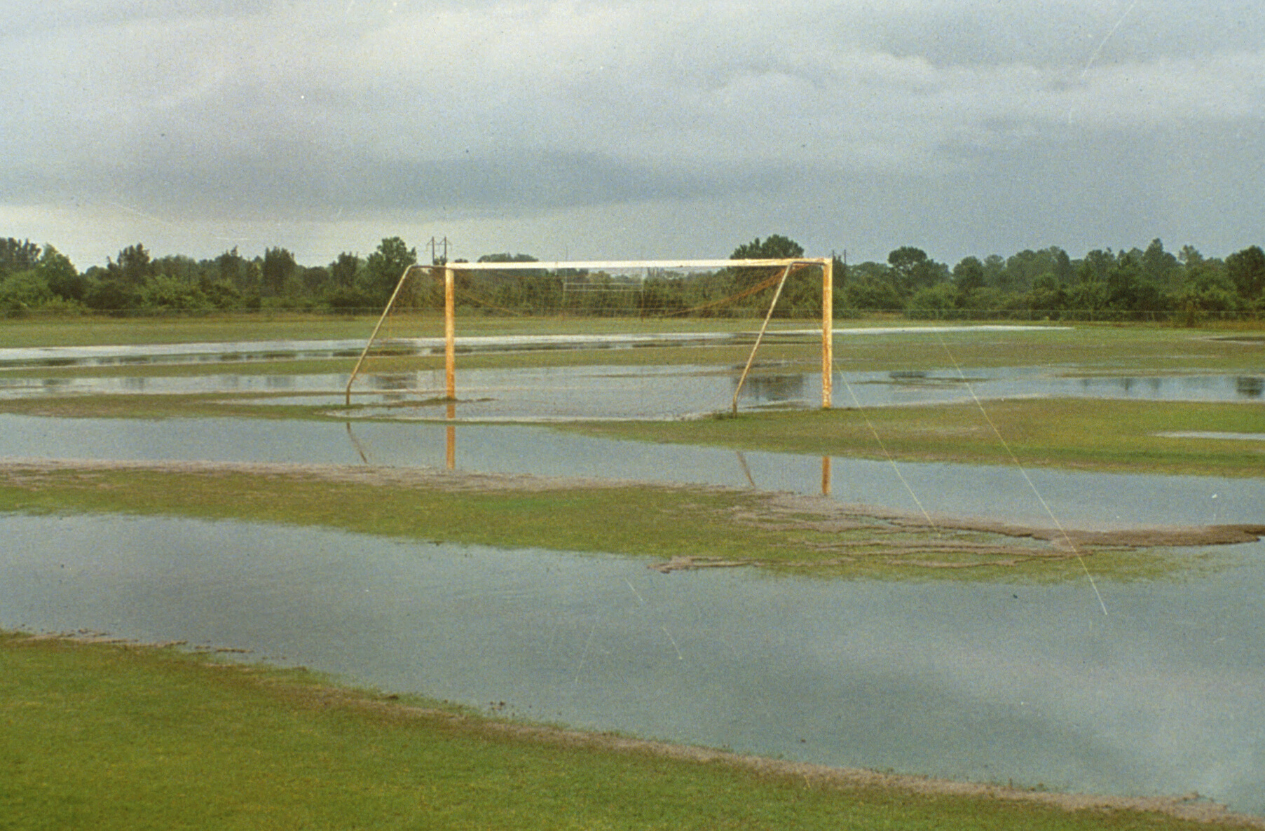
Maintaining Soccer and Softball Fields
Todd Hurt
Training Coordinator
GA Center for Urban Agriculture

Slide 2
Slides Courtesy of:
Gil Landry, Ph.D.
Clint Waltz, Ph.D.
Extension Turfgrass Specialists
UGA - Griffin

Slide 3
Athletic Field Management
Proper Design v/s Maintenance
Establishment & Fertilization
Aeration
Misc Problems
New Turf Products 2006

Slide 4
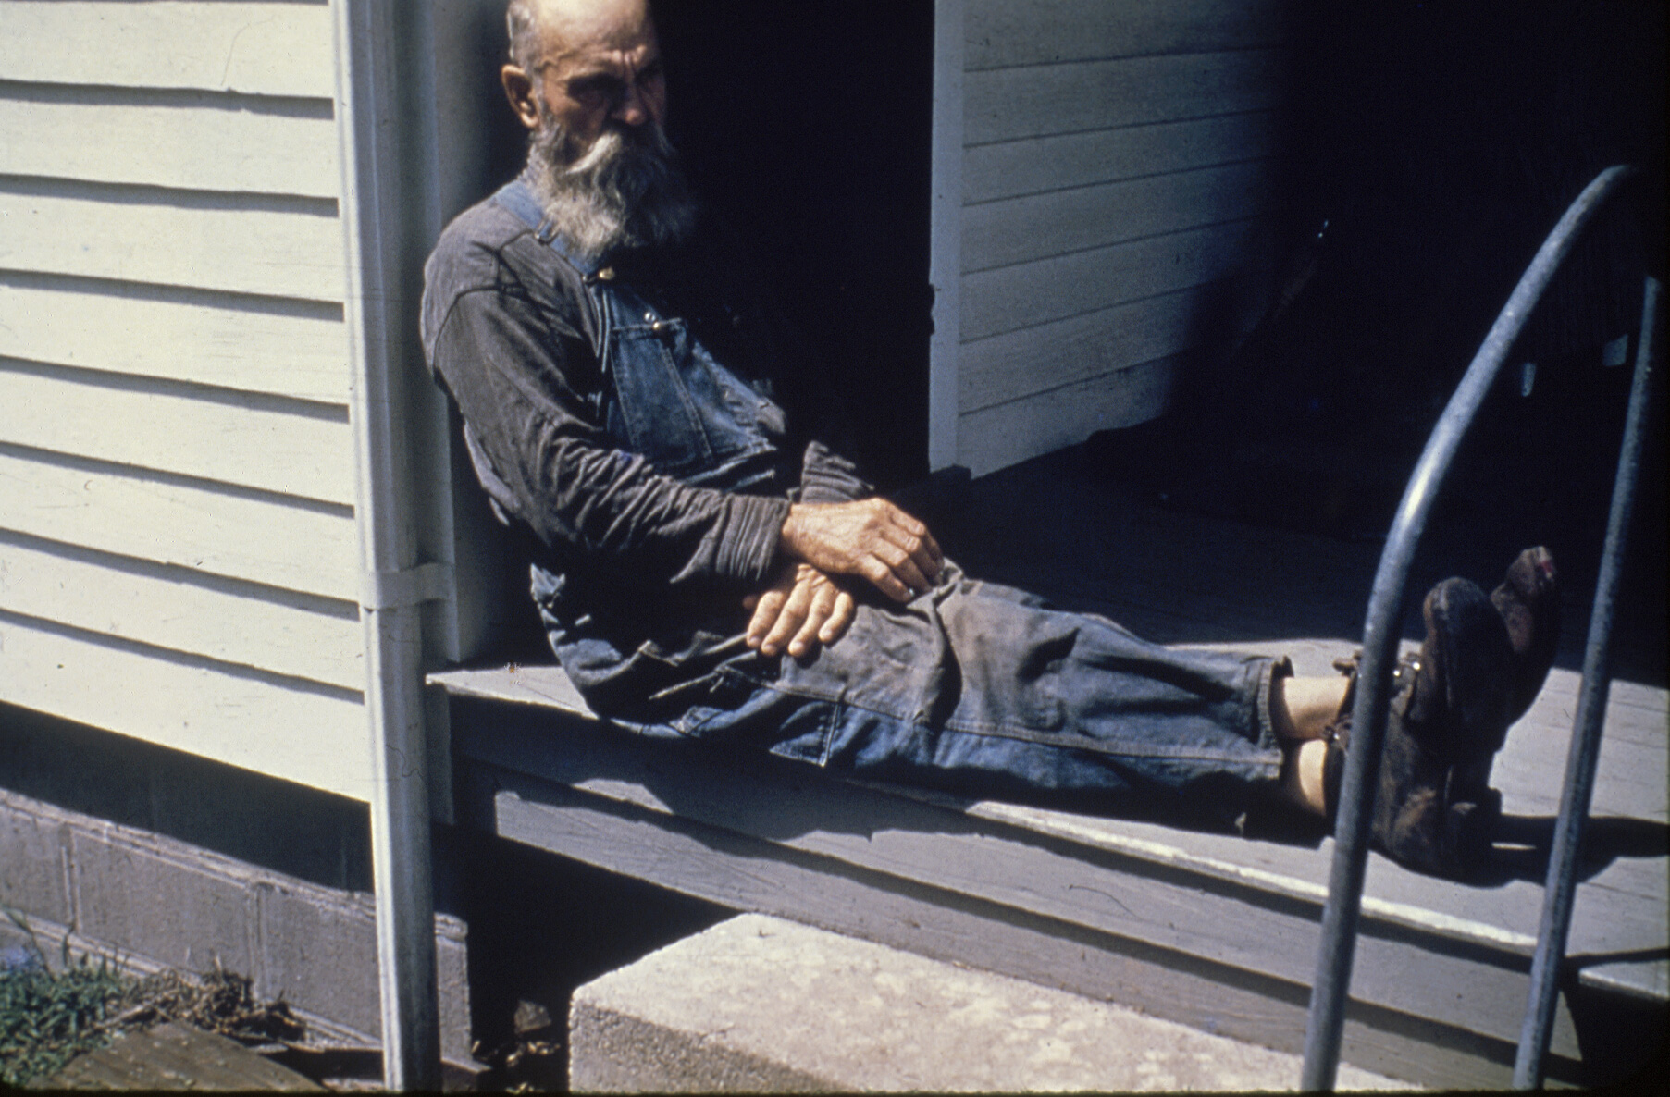
Proper Design

Slide 5
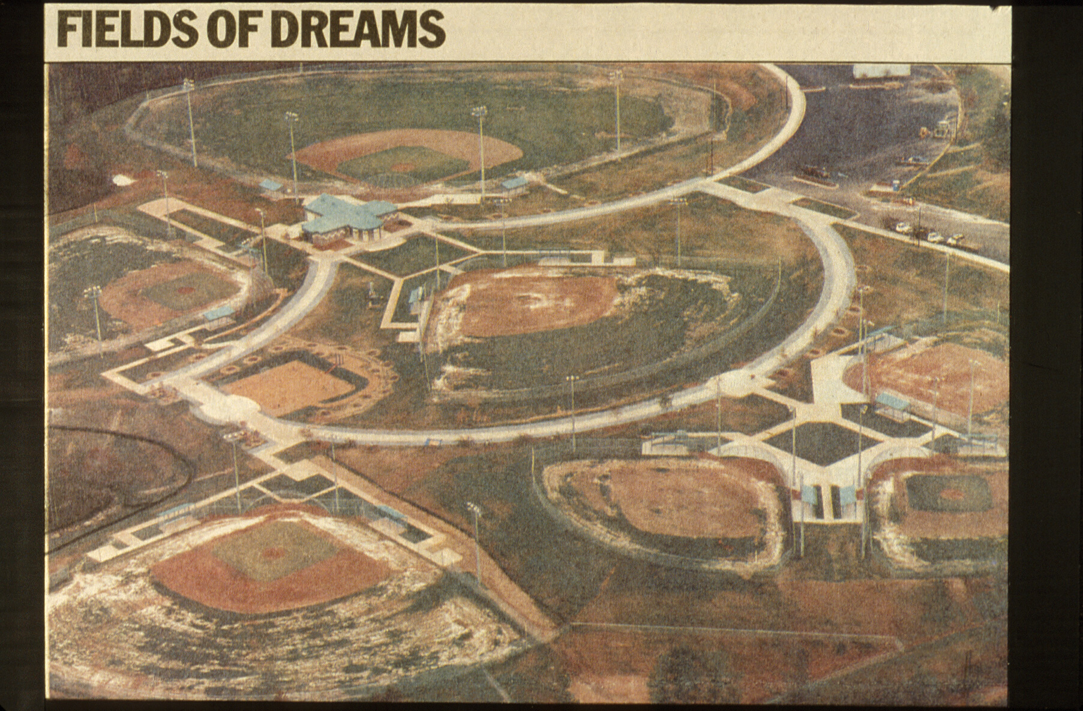

Slide 6
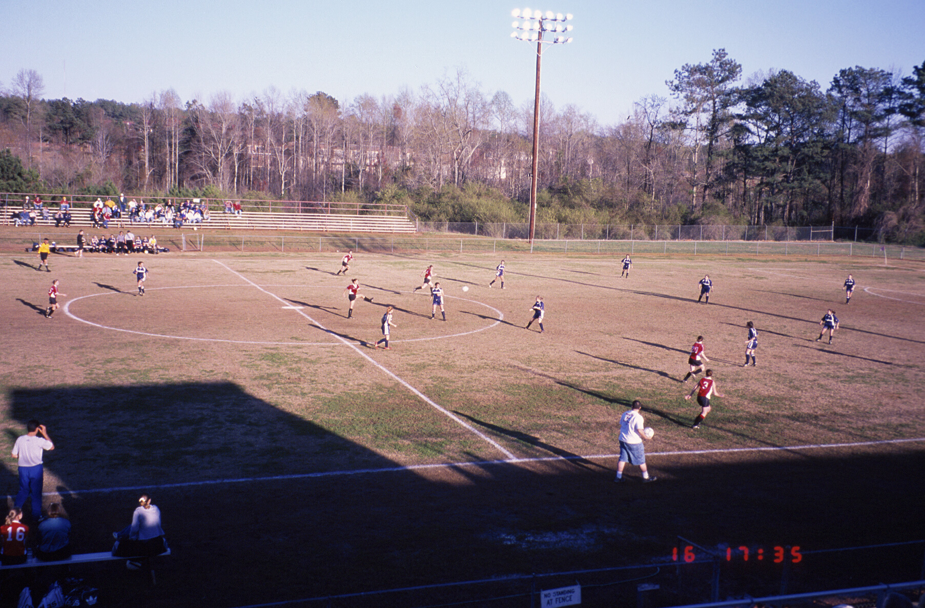

Slide 9
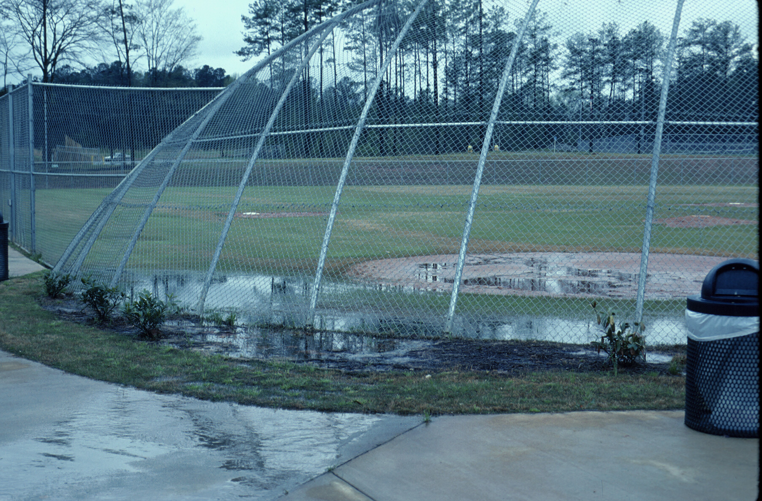

Slide 10
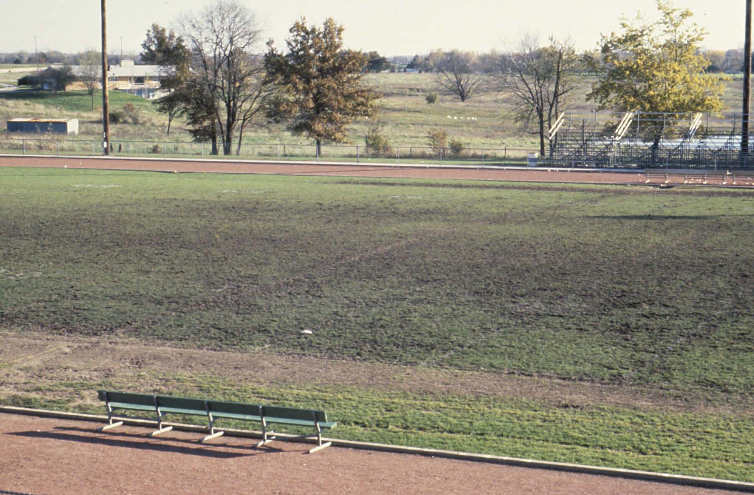

Slide 11
Establishment

Slide 12
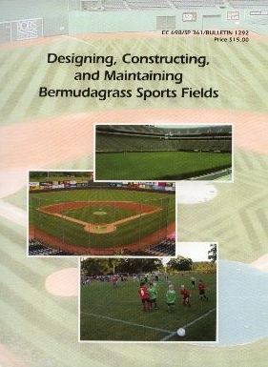
Designing, Constructing, & Maintaining Bermudagrass Sports Fields
For Sale Publication
Ag. Business Office Room 215, Conner Hall Athens, GA 30602 (706) 542-8999 or 8575 www.caes.uga.edu/publications/for_sale.html

Slide 13
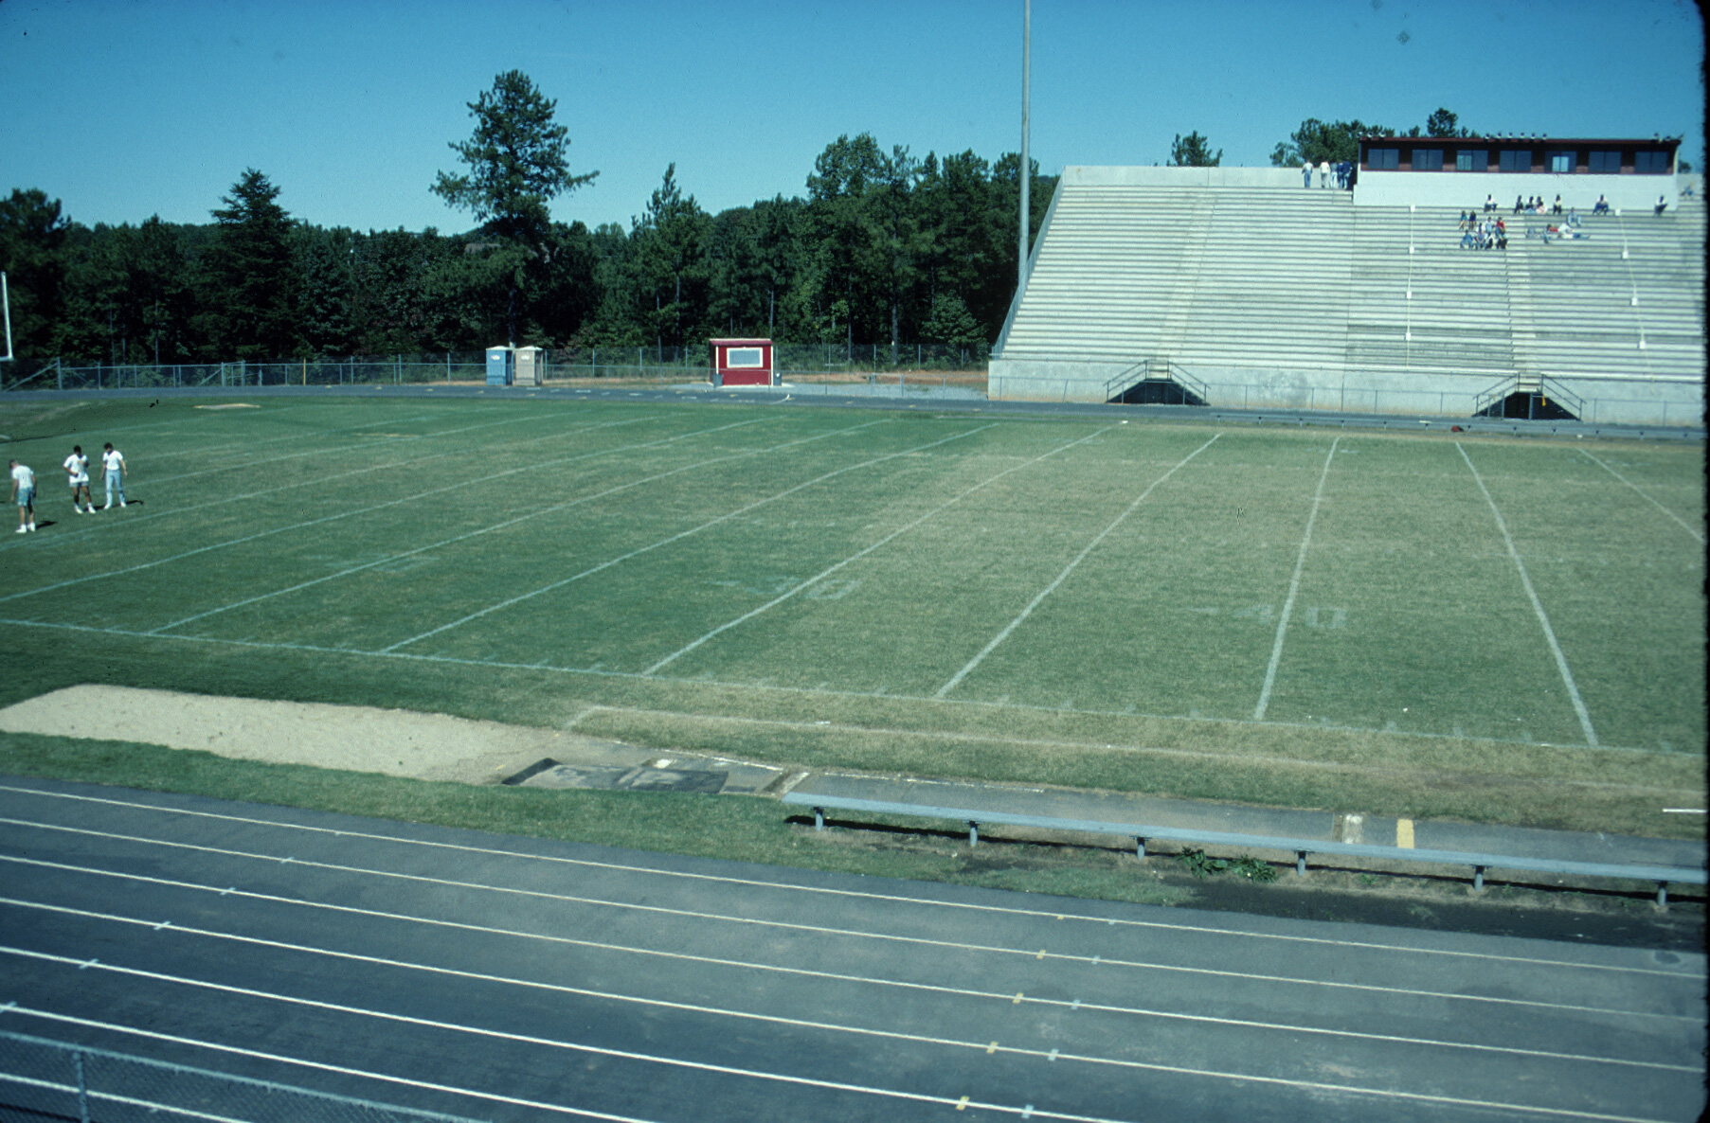

Slide 14
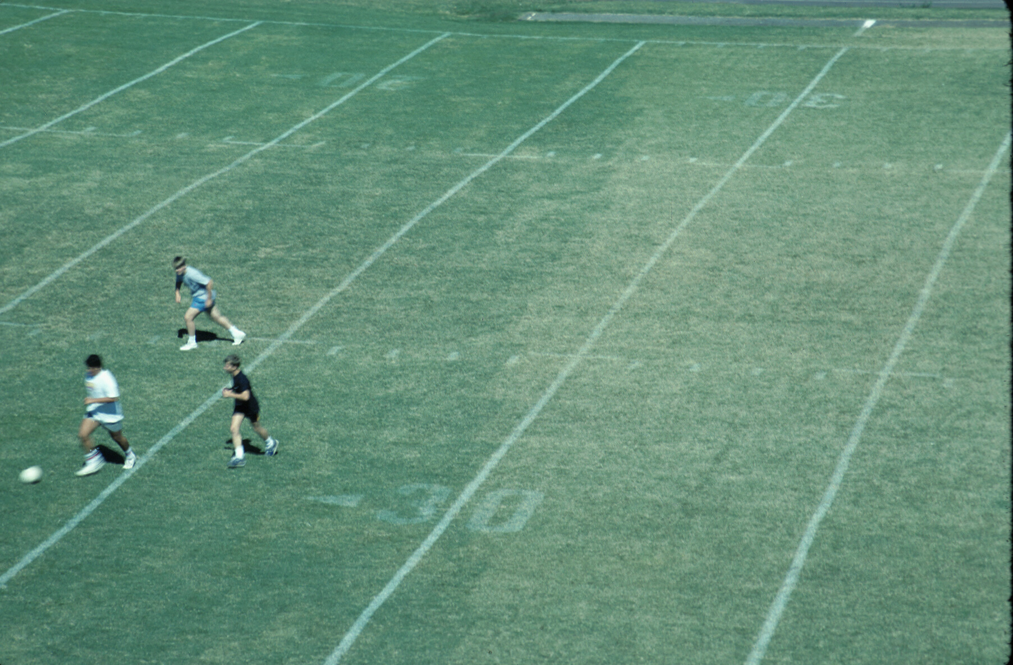

Slide 15
Bermudagrass Cultivars
Vegetative
‘Tifway’ / 419, ‘TifSport’ & ‘Tifton 10’
Shade – ‘Celebration’
Certified grass
encourage the consumer
Putting green cultivars
‘Tifdwarf’, ‘TifEagle’, ‘Mini Verde’

Slide 16
Bermudagrass Cultivars
Seeded
‘Princess 77’, ‘Riviera’, ‘Sahara’
Availability
Seeding rate – 1 lb / 1000 ft²
Cost
$30 / lb for 1000 ft²
$75 / pallet for 500 ft² pallet = $150 / 1000 ft²

Slide 17
Turfgrass Cultivars
New or Old
Supply
Find local grower
costs – drop charges, fuel sur-charge
www.GeorgiaTurf.com

Slide 18
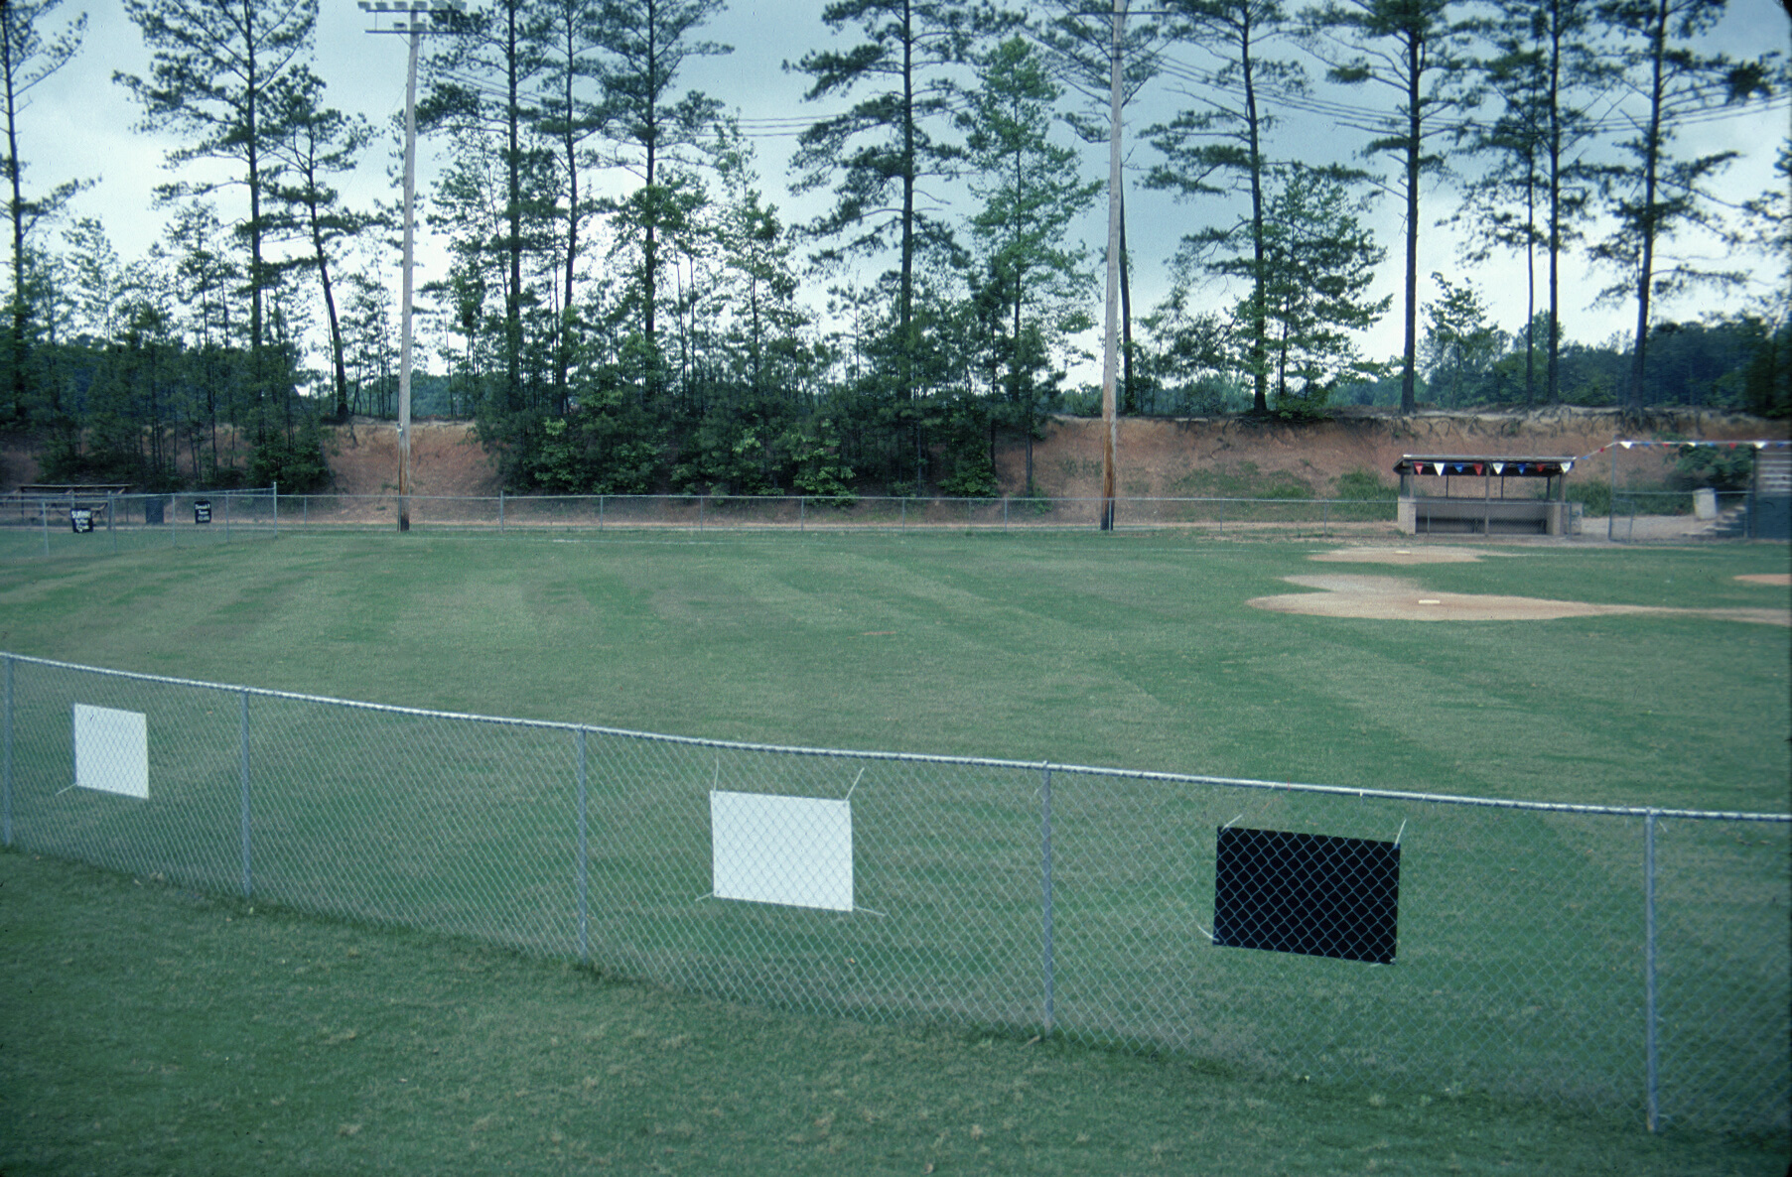

Slide 19
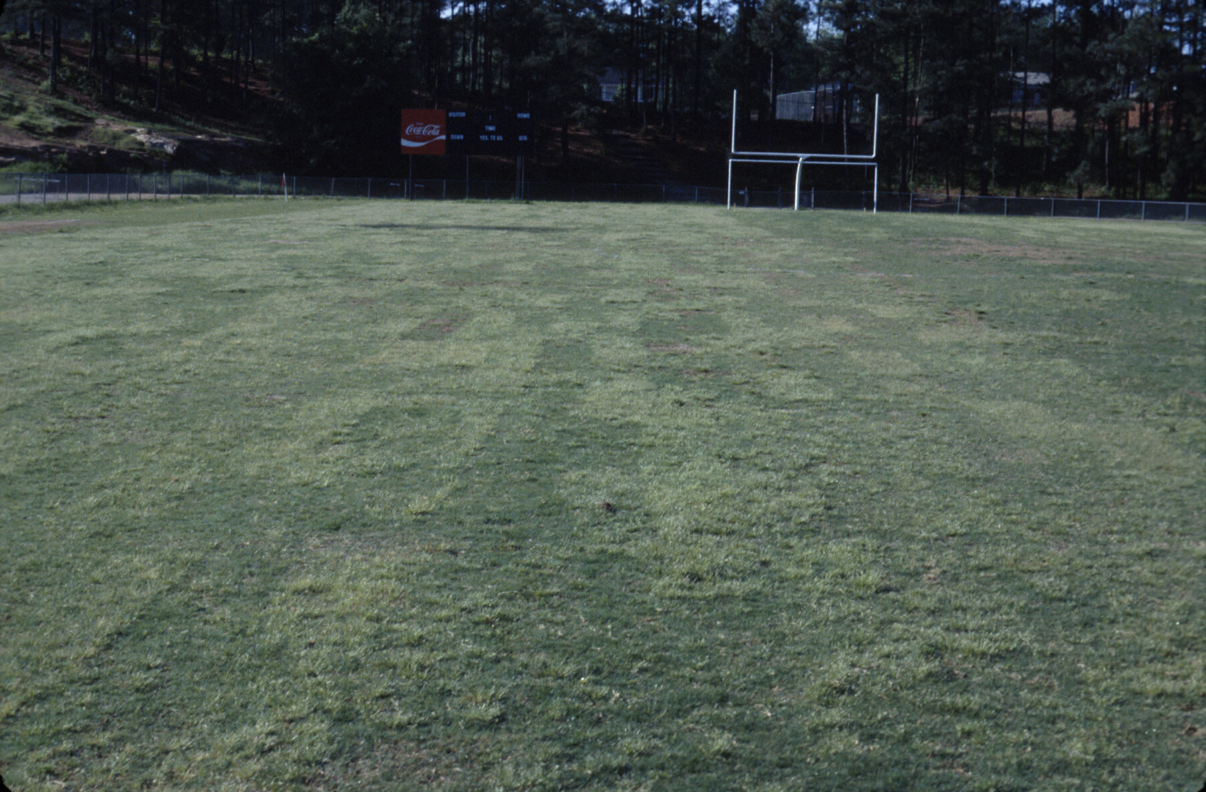

Slide 20
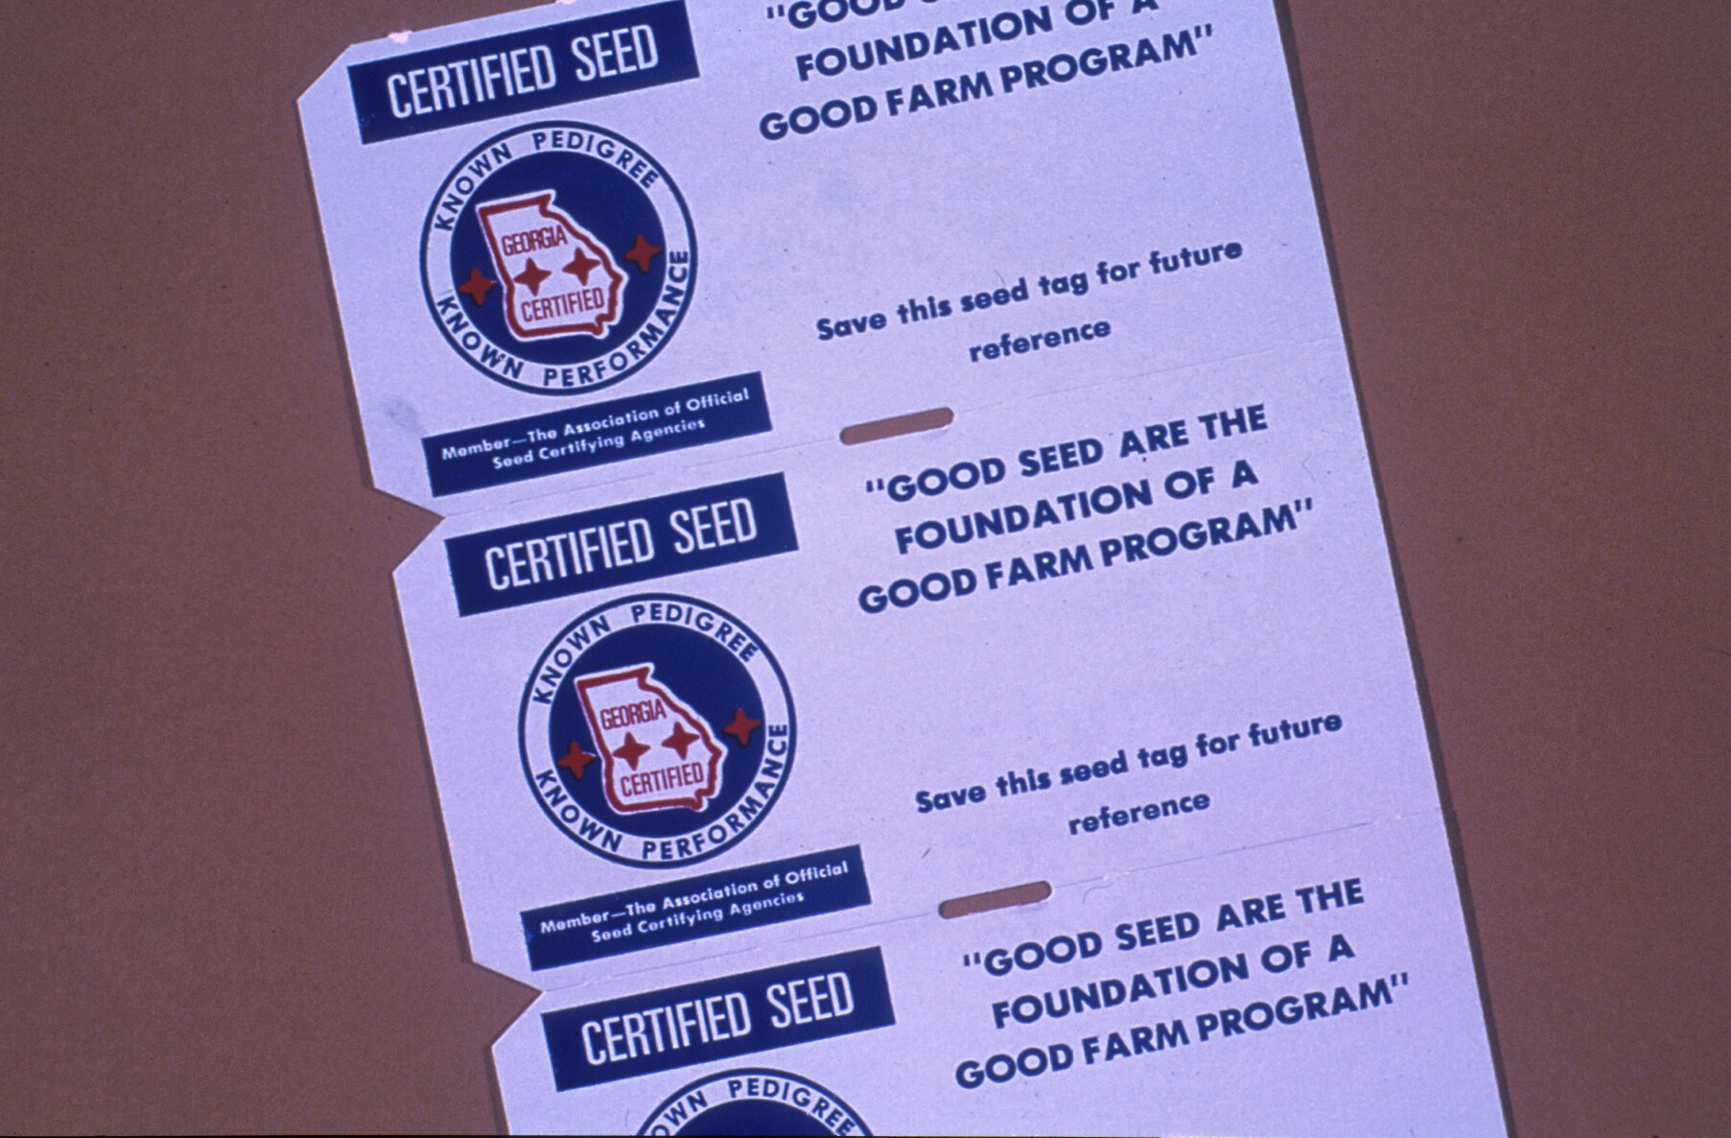

Slide 21
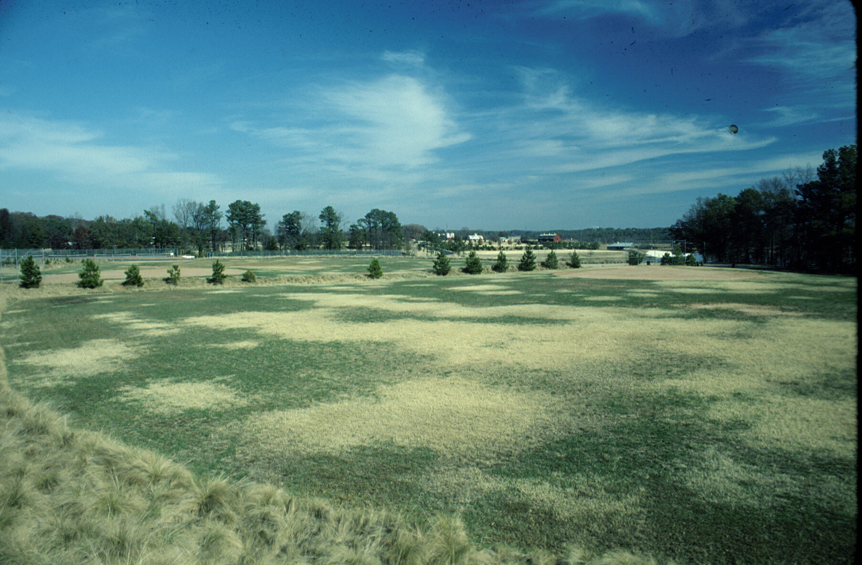

Slide 22
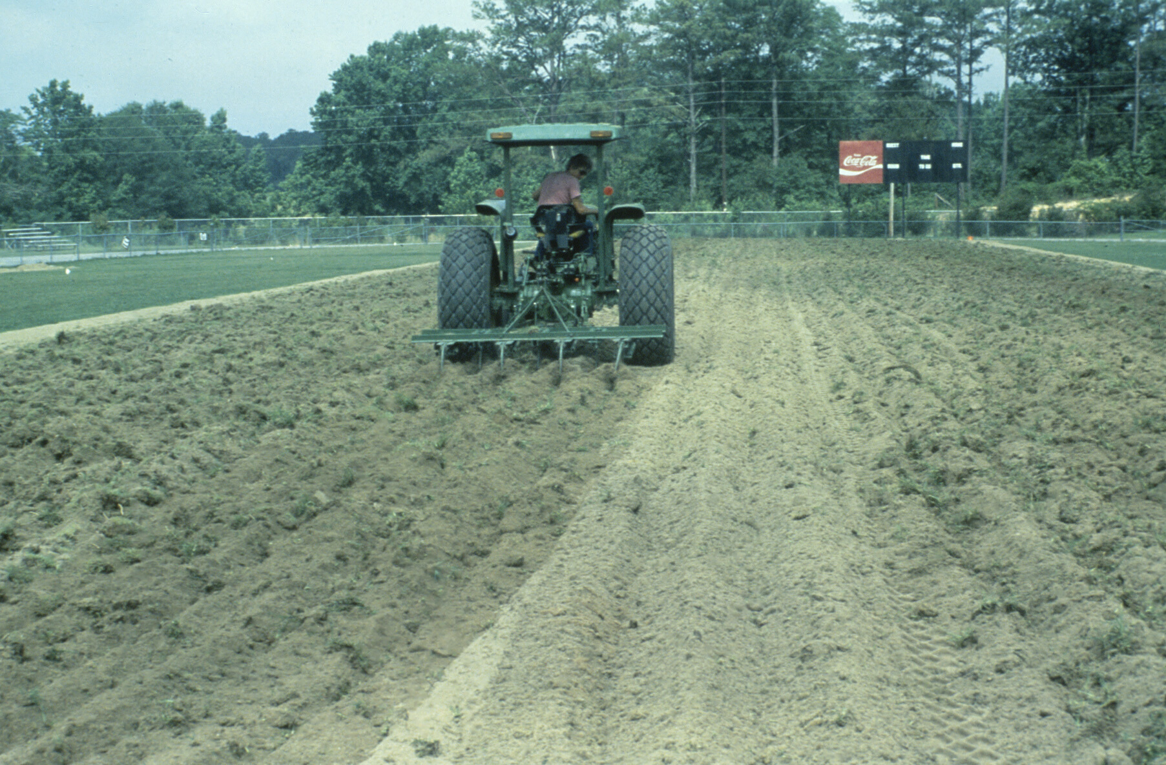

Slide 23
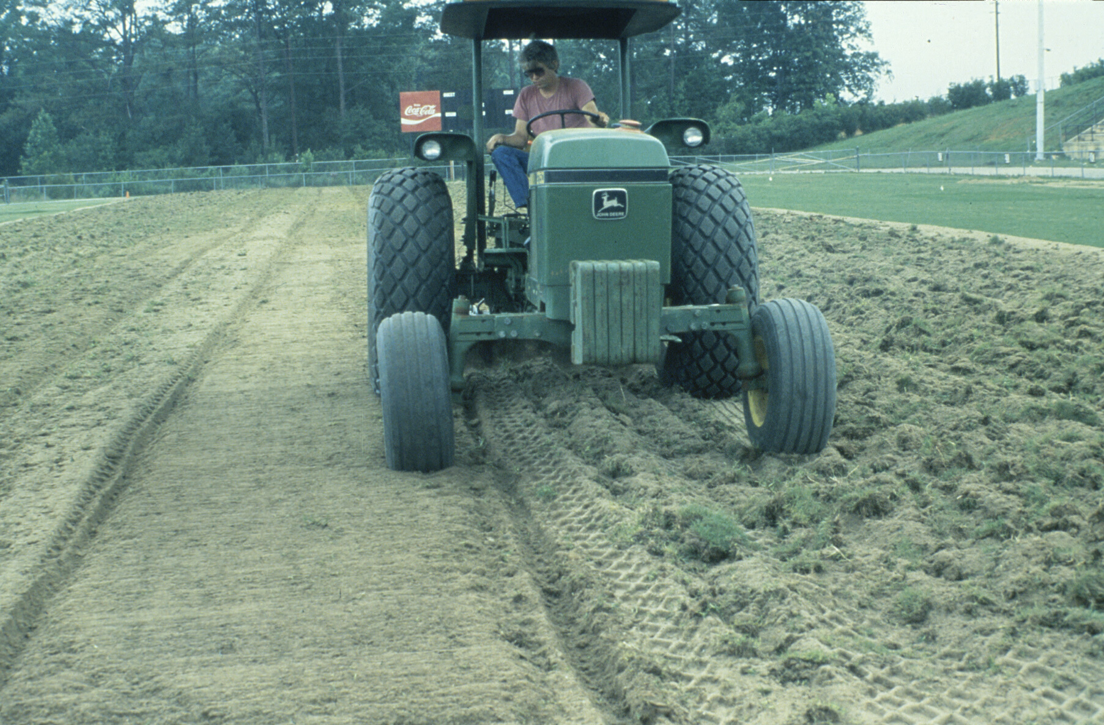

Slide 24
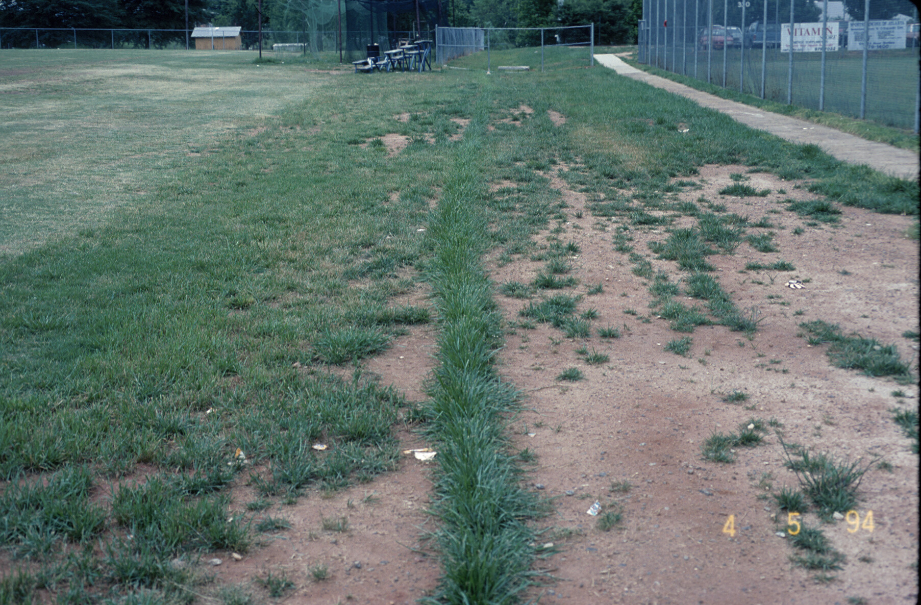

Slide 25
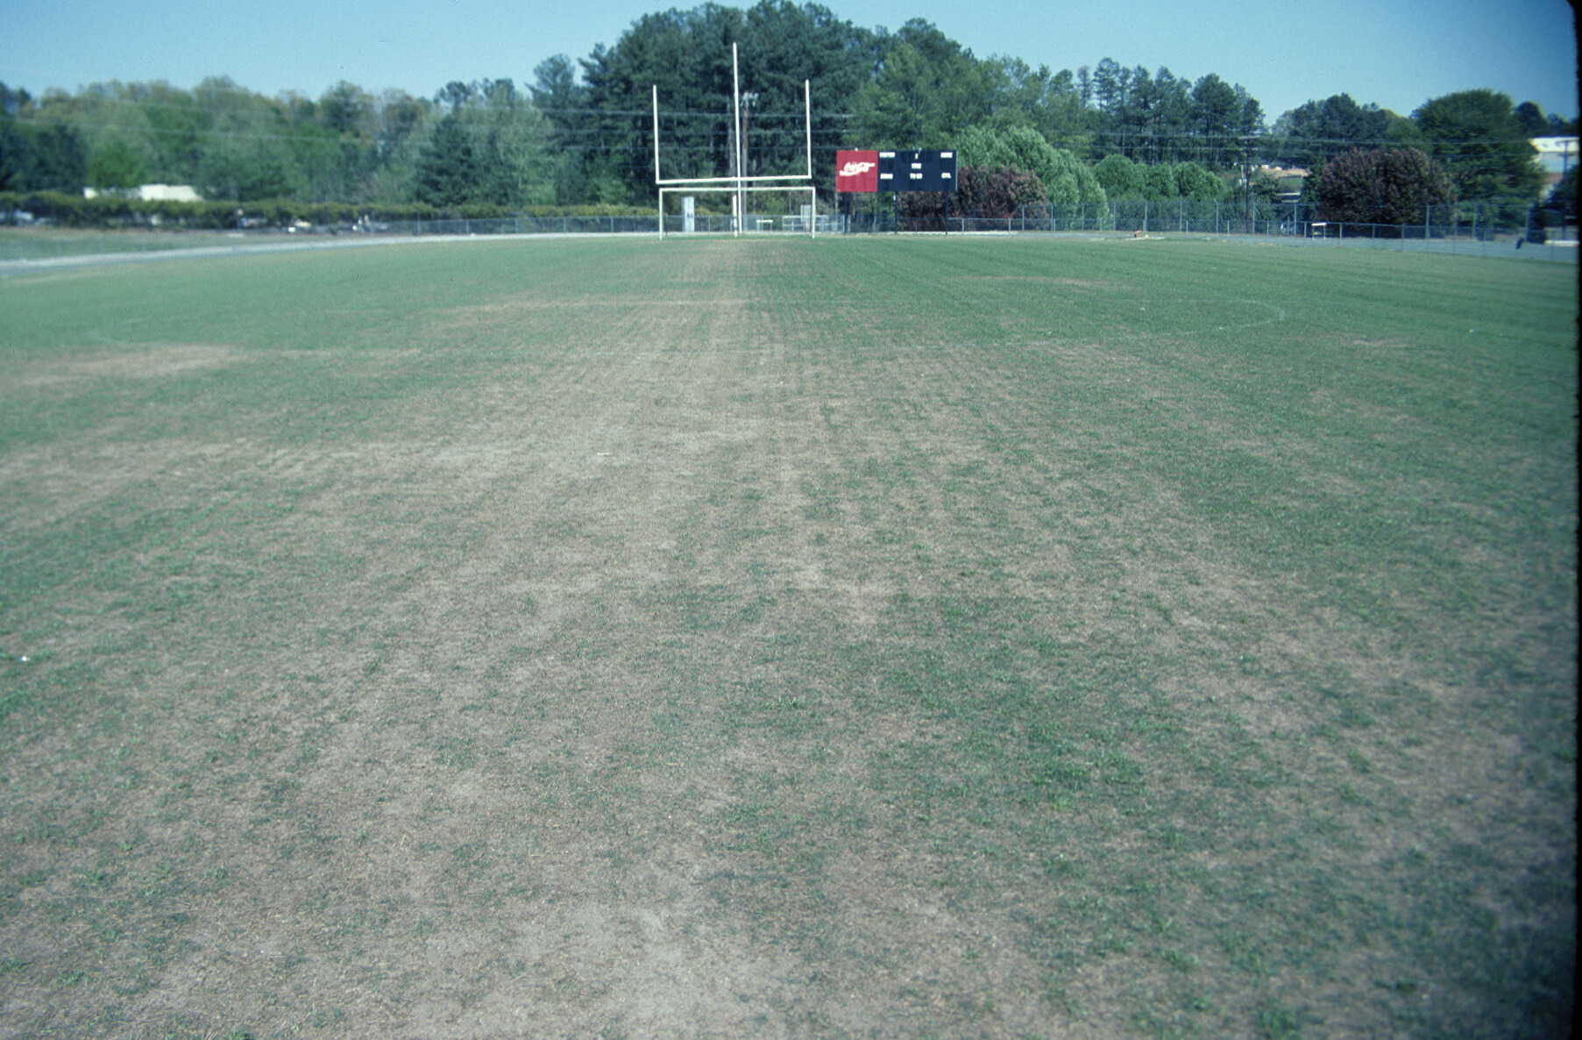

Slide 26
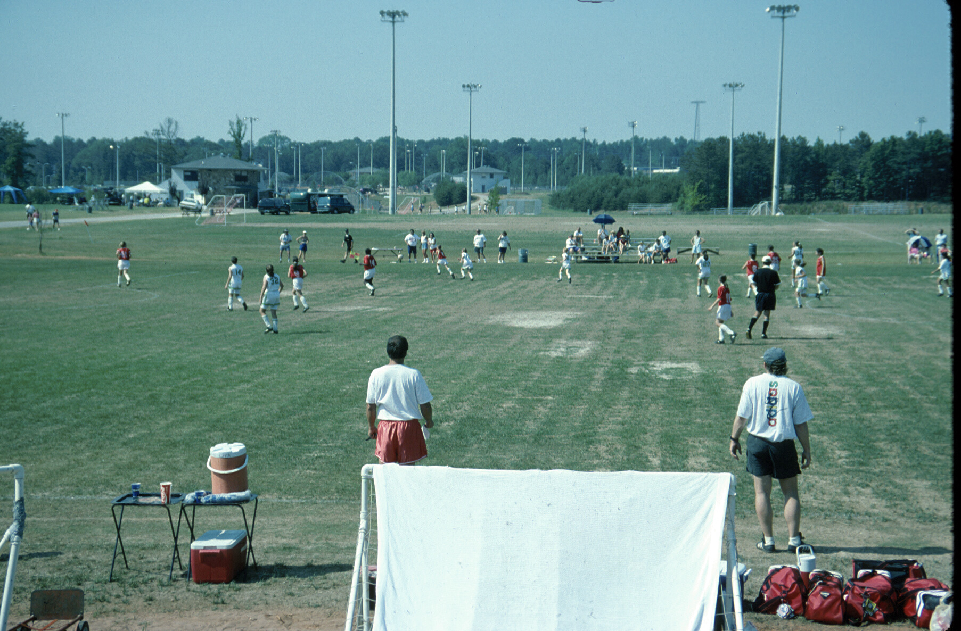

Slide 27
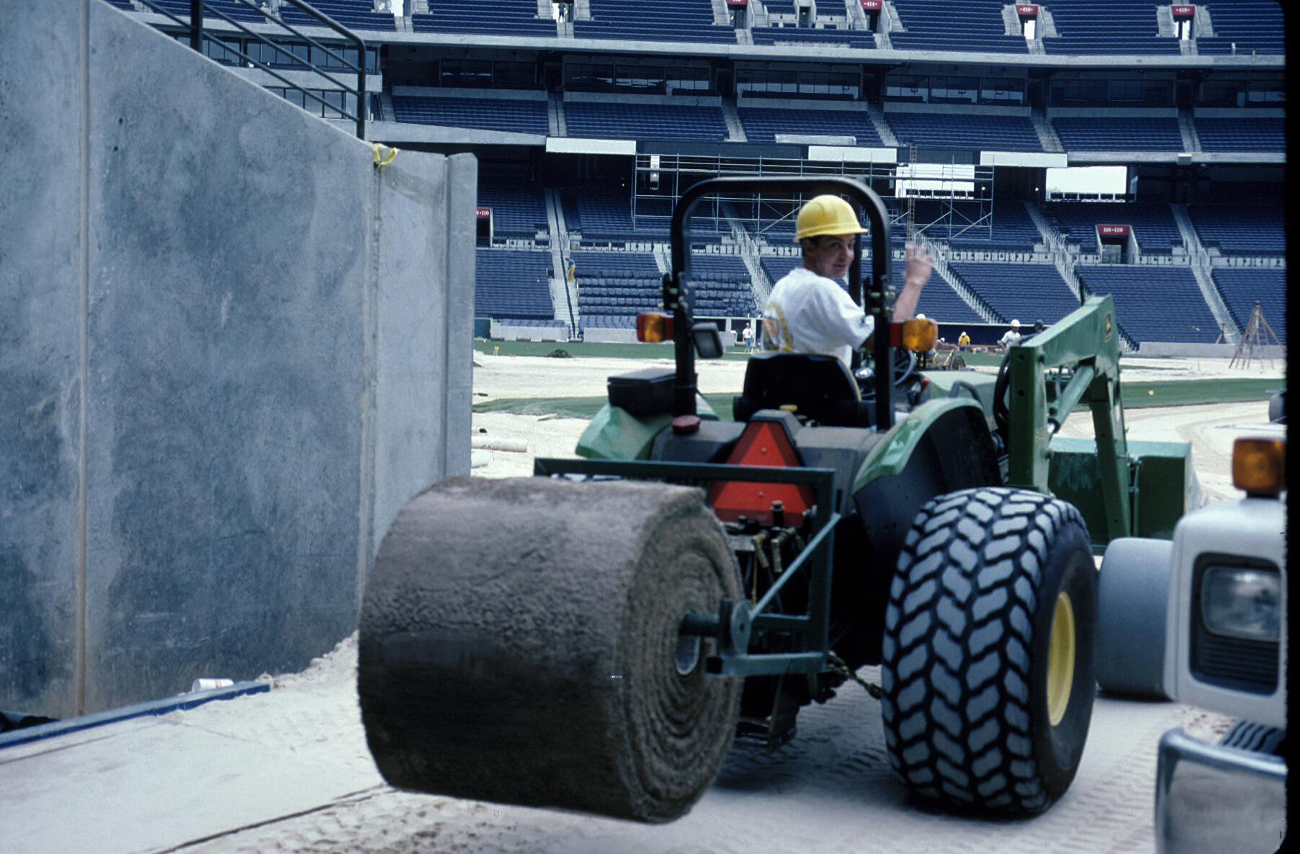

Slide 28
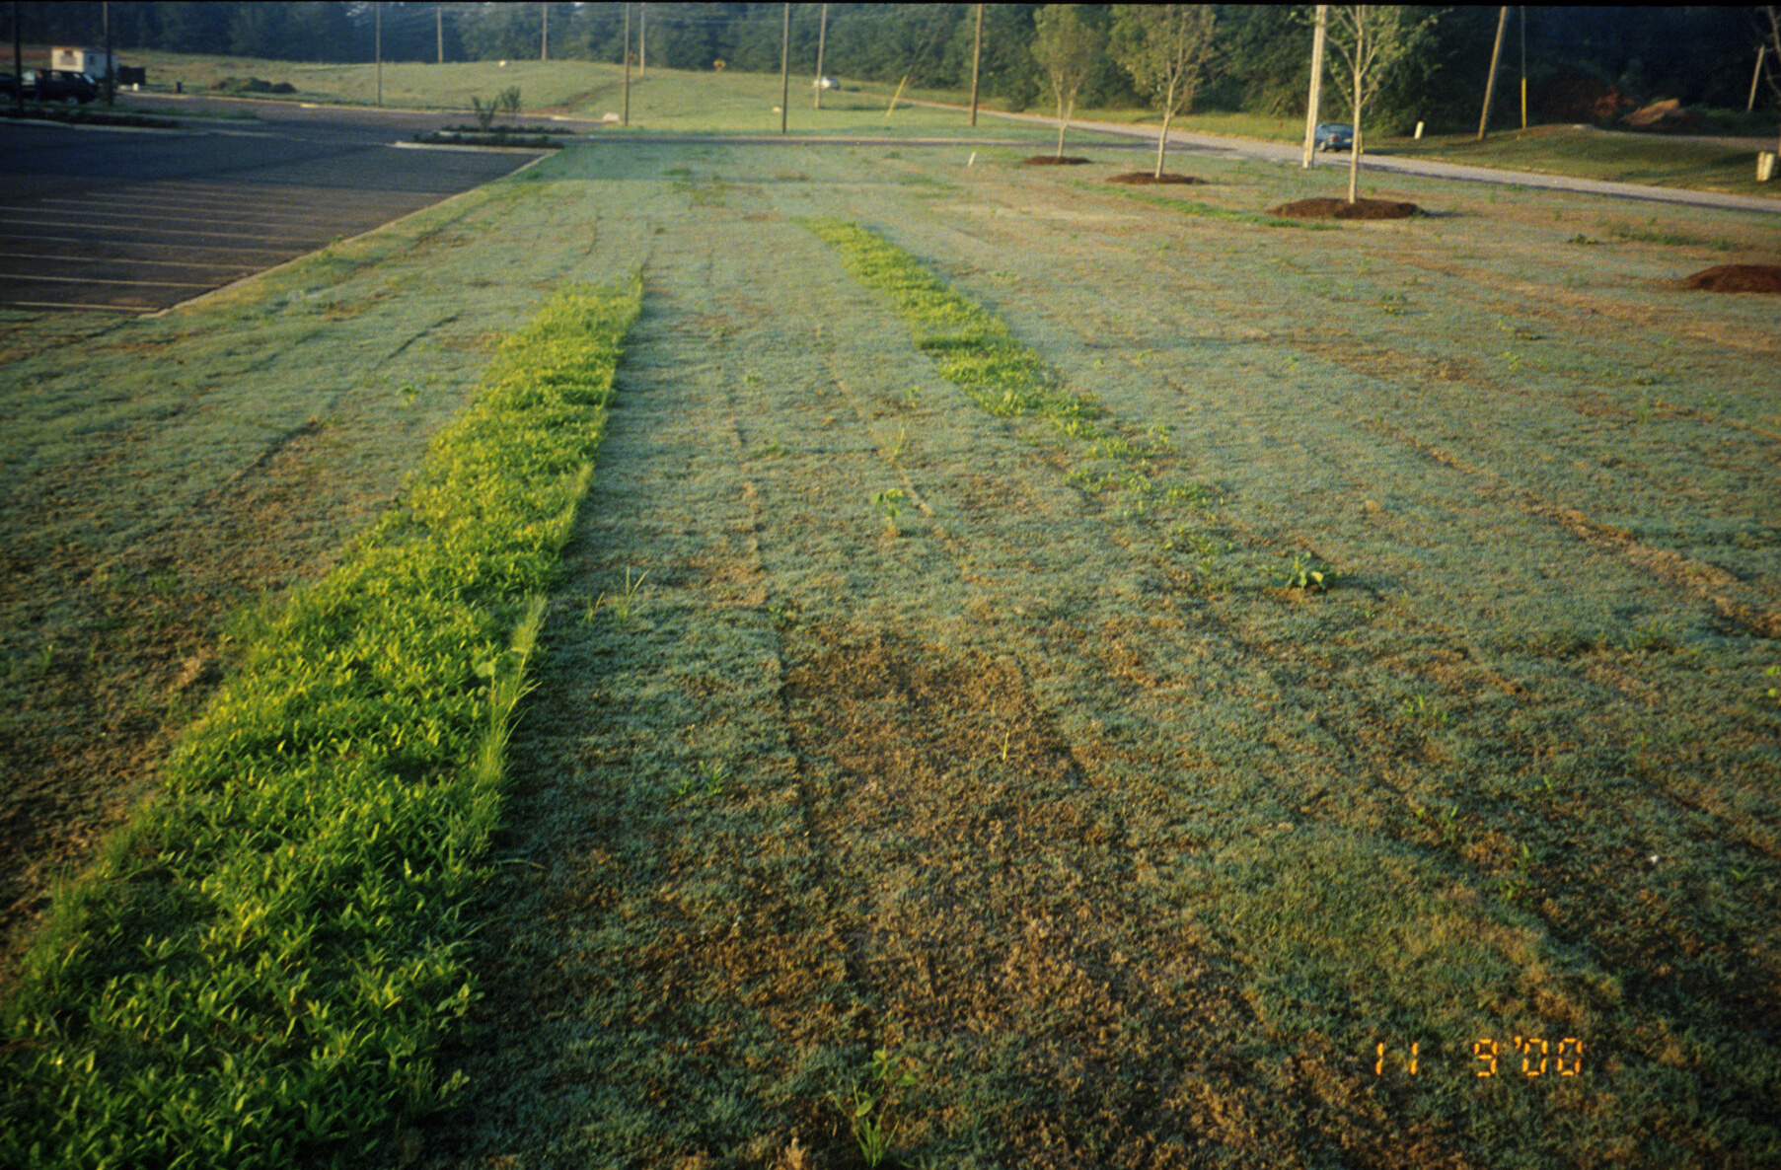

Slide 29
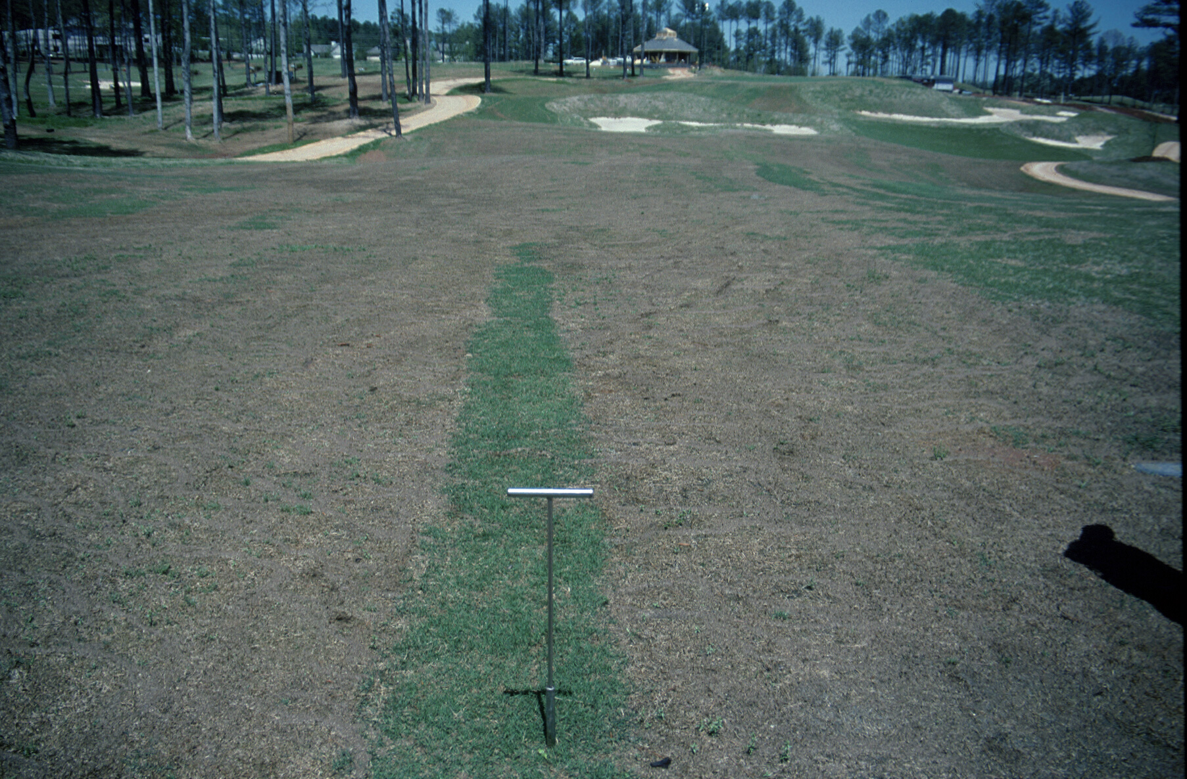

Slide 30
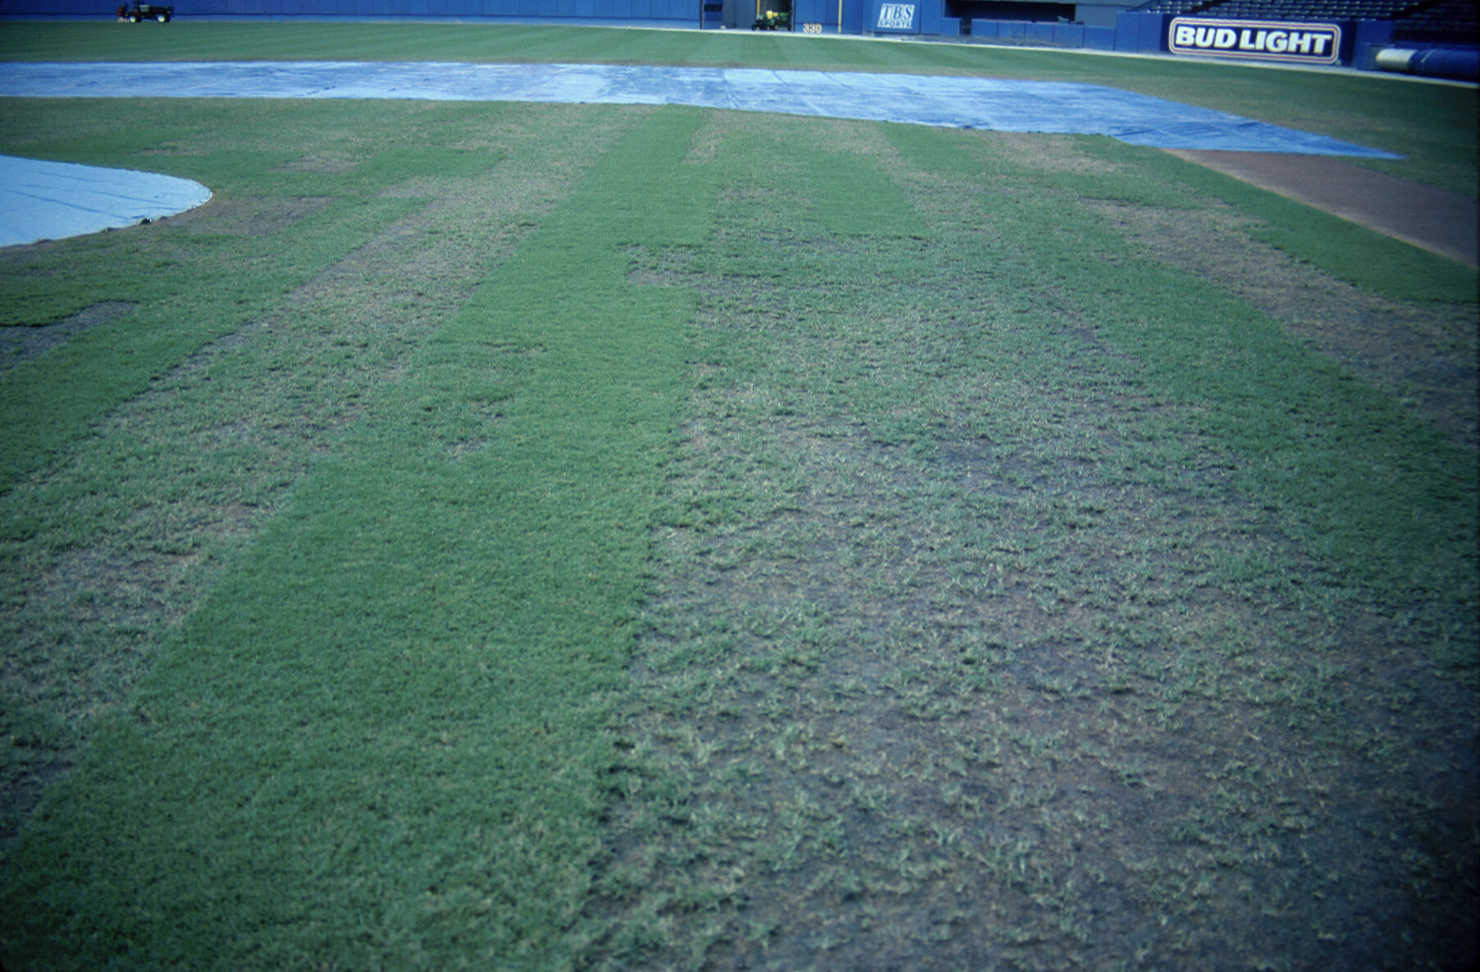

Slide 31
Aeration

Slide 32
How do fields become hard?
Traffic
Wear - removes biomass that provides cushion and impact absorption
Compaction - packing of soil particles into a given volume, resulting in a denser soil with decreased pore space

Slide 33
Wear: Usage Maxims (200 – 400 – 600 Rule)
200 – to sustain good field conditions use should not exceed 200 hours / year
400 – some fields can handle between 400 to 600 hours of use / year
600 - 600 hours / year is extreme and poor conditions can be expected

Slide 34
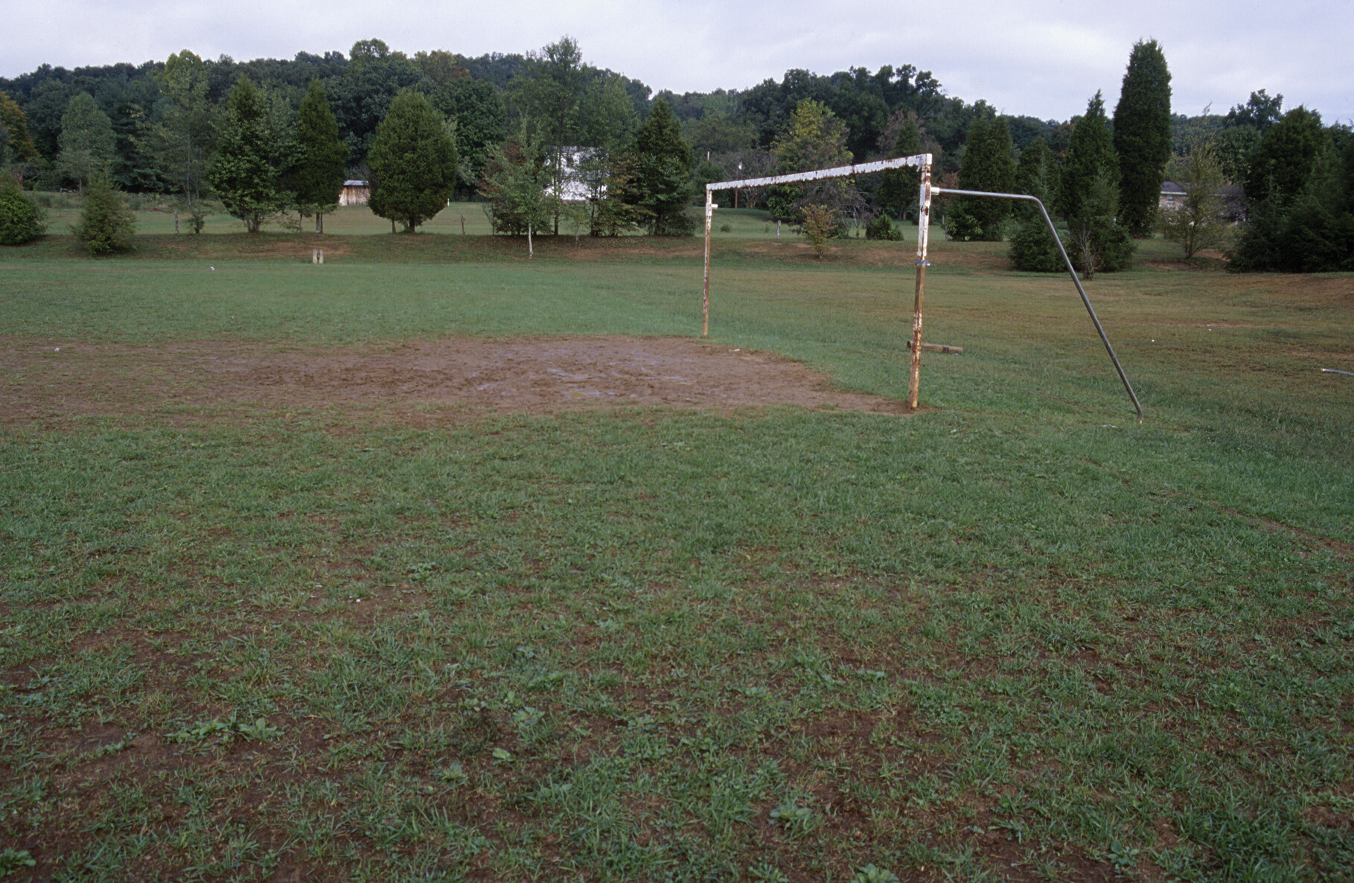

Slide 35
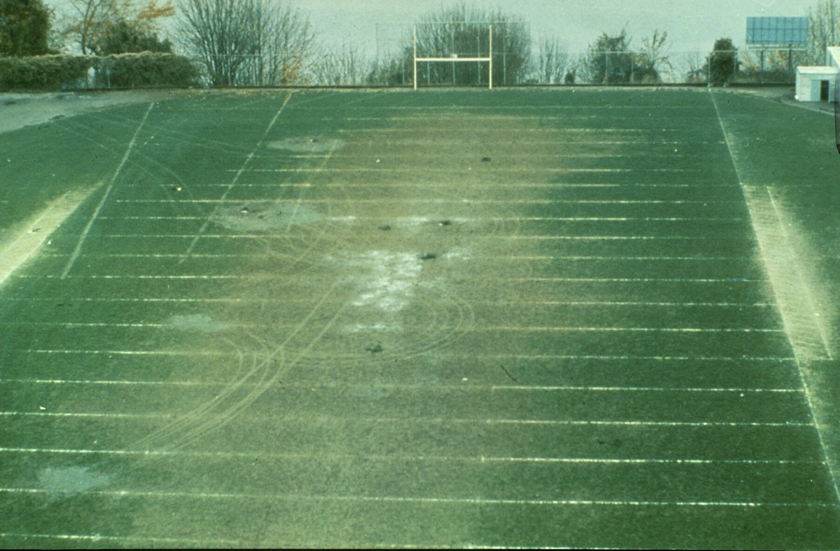

Slide 36
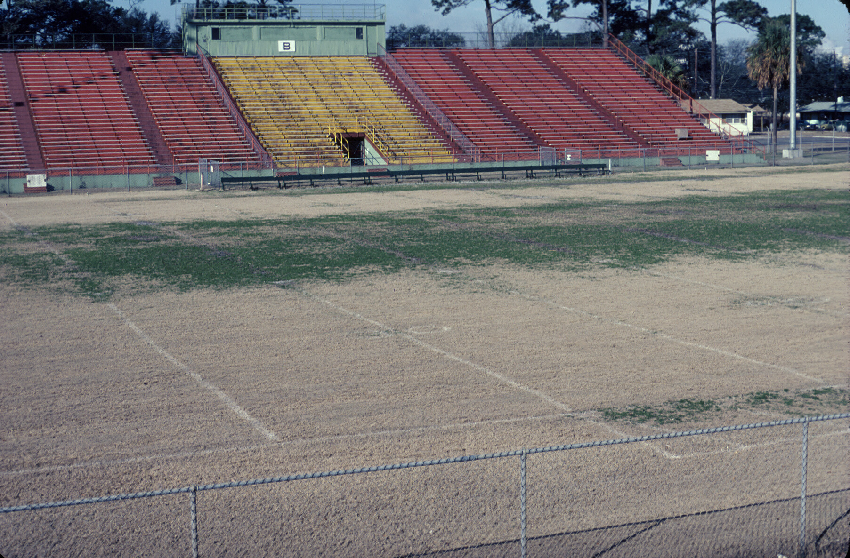

Slide 37
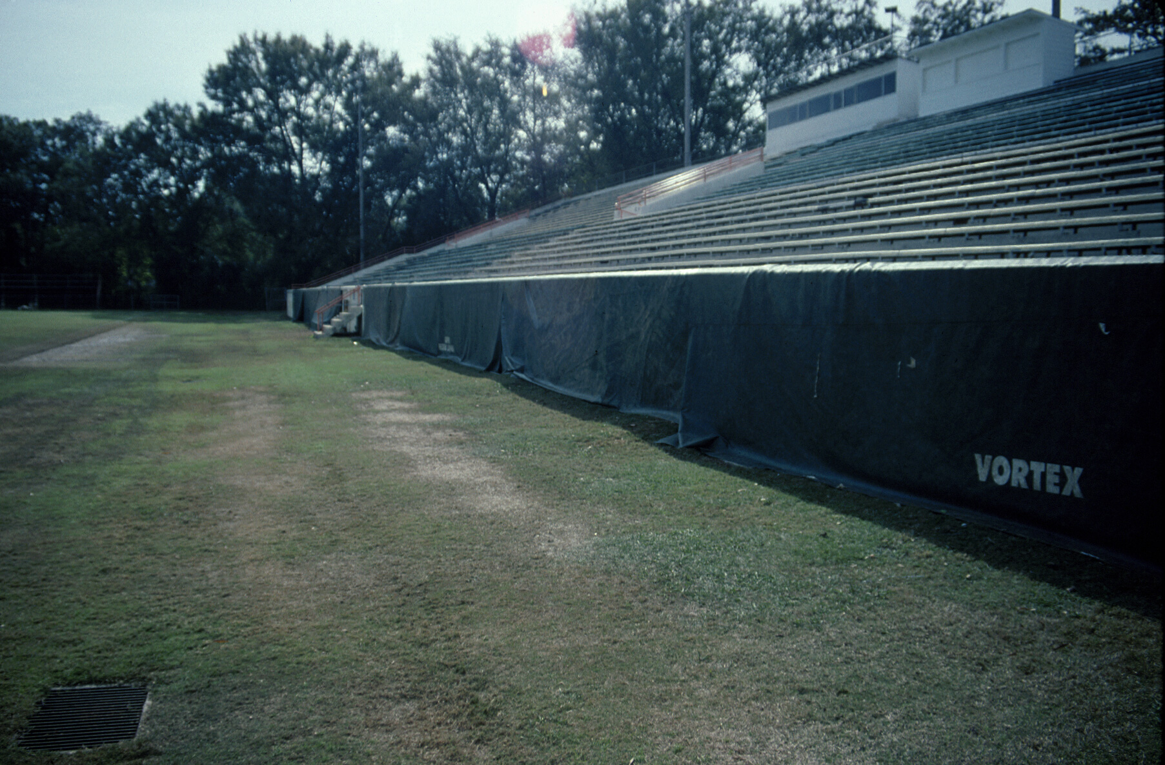

Slide 38
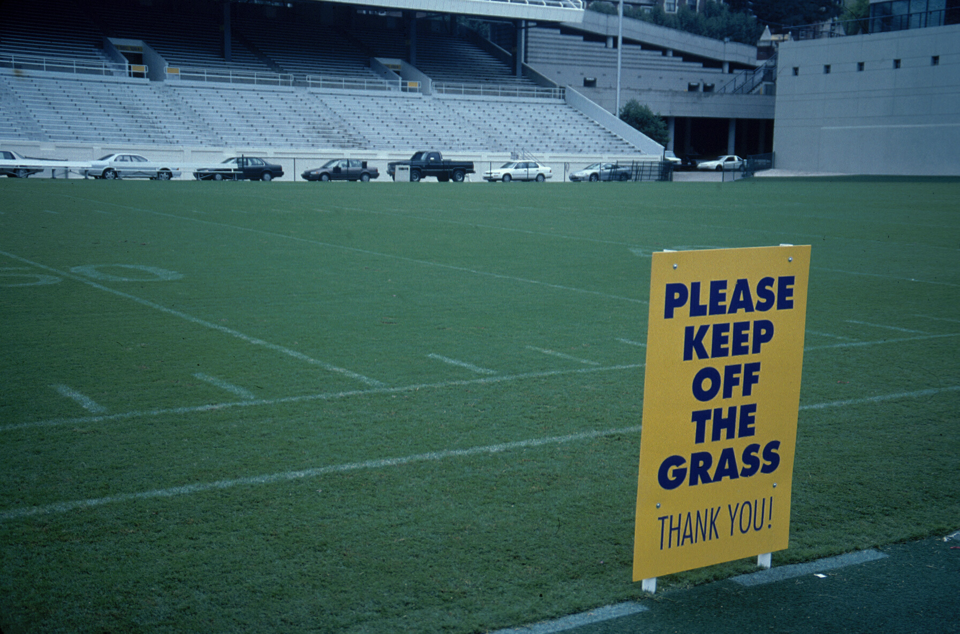

Slide 39
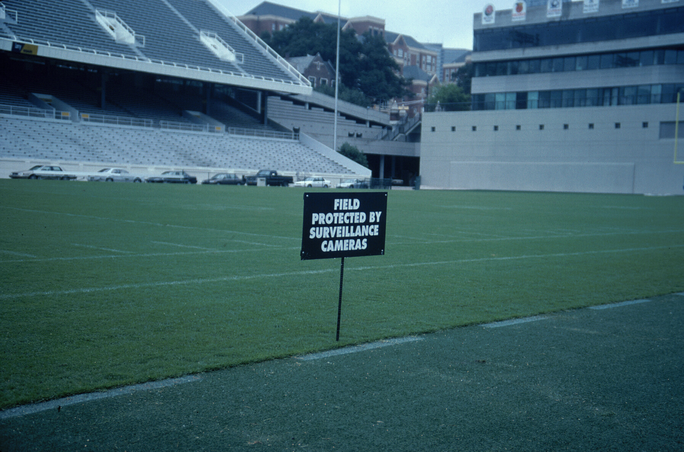

Slide 40
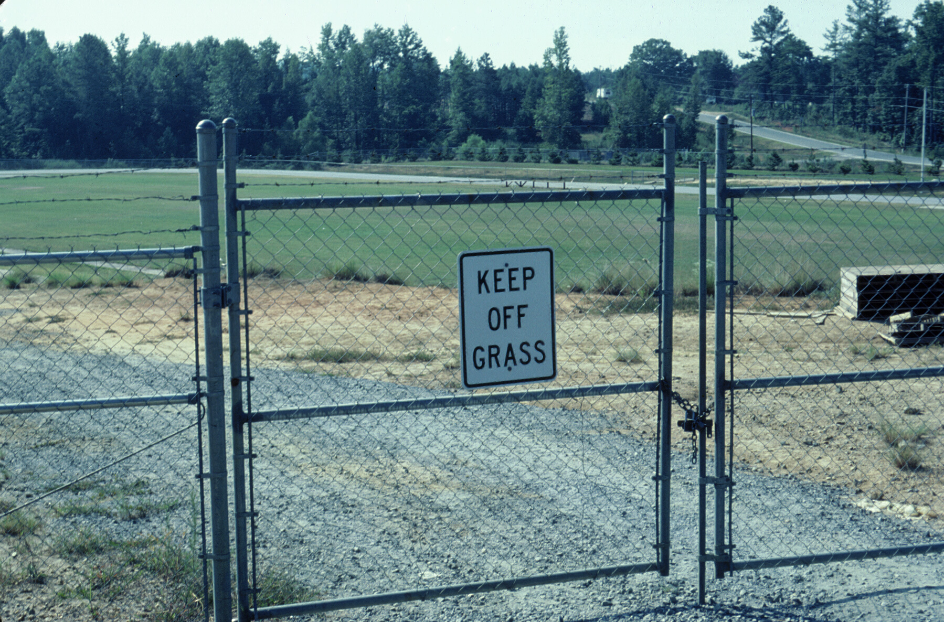

Slide 41
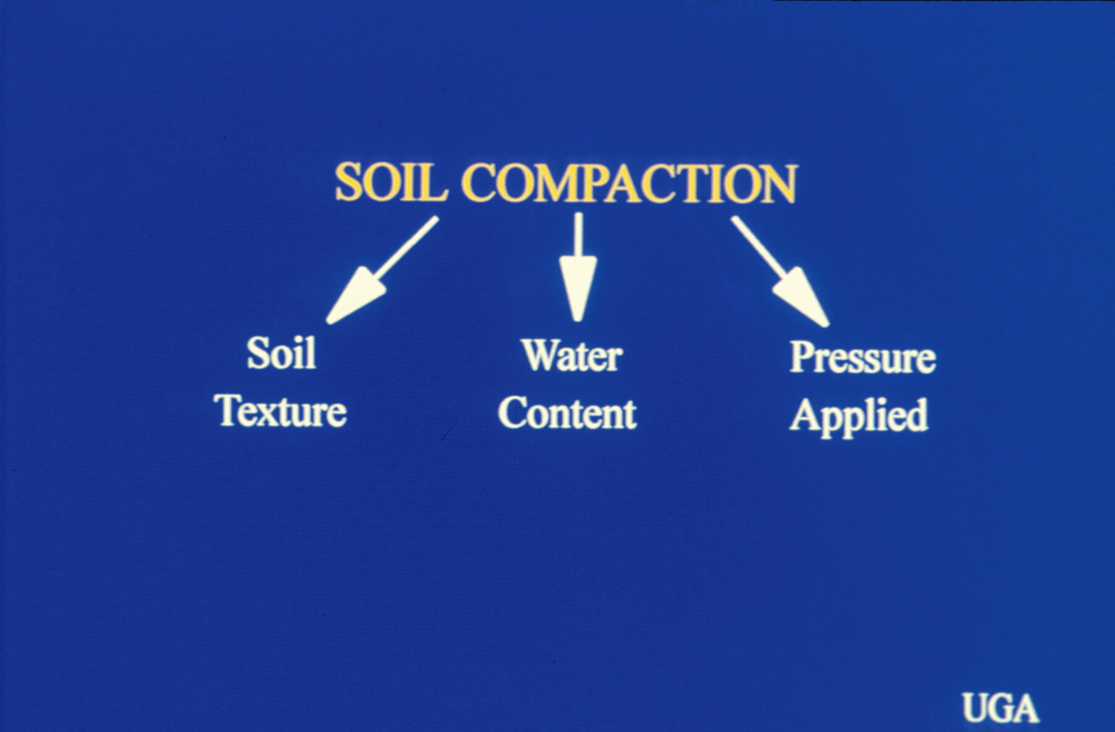

Slide 42
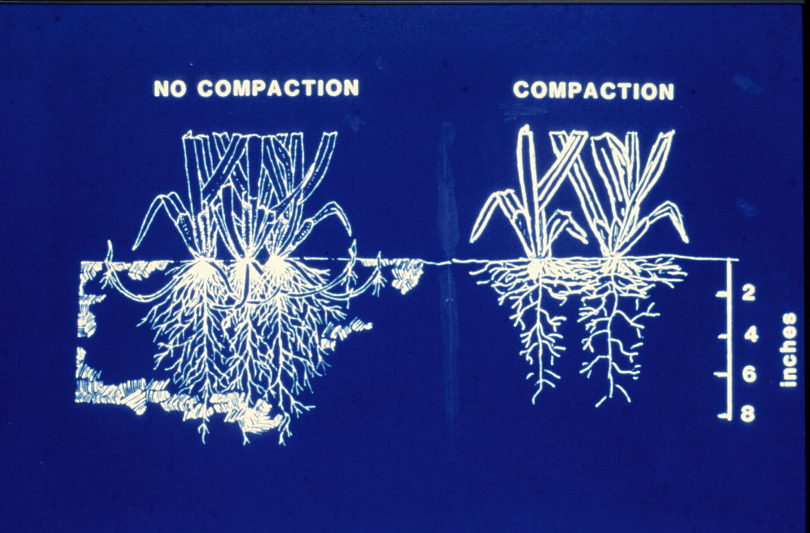

Slide 43
Benefits of Aerification
Increase pesticide effectiveness
Reduce runoff & puddling
Increase soil temperature
Reduce effects of localized dry spots
Reduce surface hardness
Stimulate new growth
Improve heat & drought tolerance

Slide 44
Drawbacks to Aerification
Turf injury increasing potential for turf loss during stress
Disruption of the turf surface
Increase desiccation and/or injury
Reduced soil strength
Creation of a localized soil compaction zone
Greater potential for water loss

Slide 45
Principles of Aerification
Step One:
Identify Problem Correctly
Step Two:
Determine most effective means of alleviating problem

Slide 46
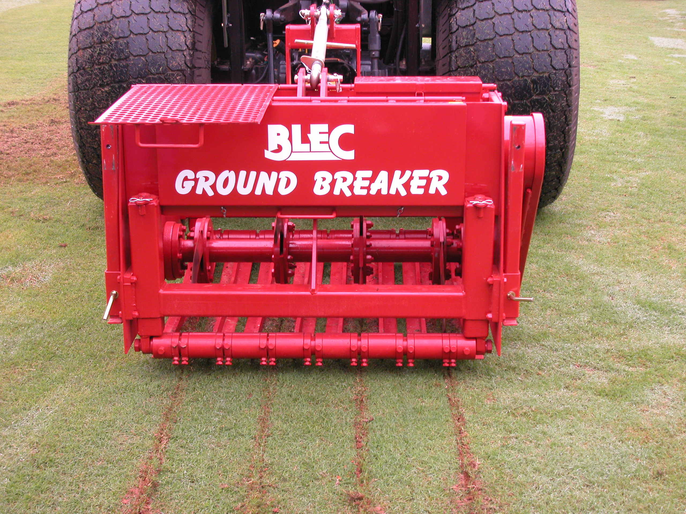
Aeration Methods
Core
Solid Tine
Deep Time
Deep Drilling
Grooving
Slicing
Continuous Grooving

Slide 47
Core Cultivation
One of the most important management practices for maintaining high quality playing fields, and often one of the least appreciated or used practices.
If used correctly, core cultivation truly relieves soil compaction, other cultivation practices are generally for thatch control and establishment.

Slide 48
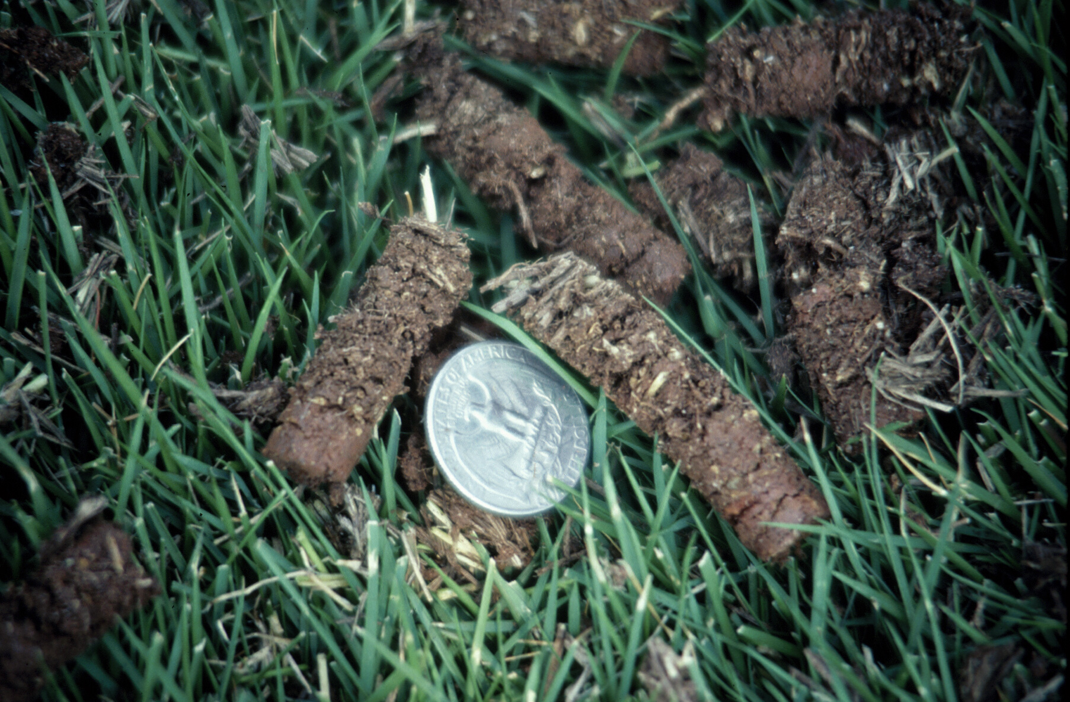

Slide 49
Penetration Factors
Soil Type
Soil Moisture
Tine Diameter
Weight & Power of Aerator

Slide 50
Scheduling Factors
Considerations
Location
Species/Cultivar
Intensity of Use
Timing - prior to or during early season root growth

Slide 51
Timing Factors
Stage of plant growth
Effect on playing surface
Scheduling
Remember:
The larger the space (core hole) the longer the growing period needed for recovery

Slide 52
Scheduling Factors
Caution:
Avoid coring if possible when grasses are dormant because this may encourage cool-season weed competition.
Remember:
Repeated aeration to the same depth can cause a “Cultivation Pan”.

Slide 53
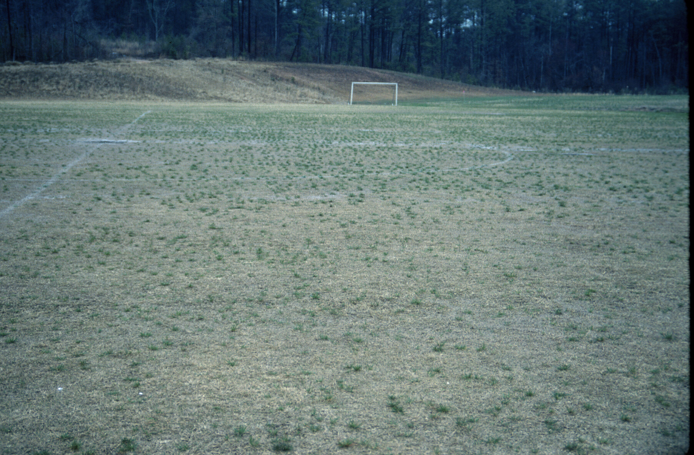

Slide 54
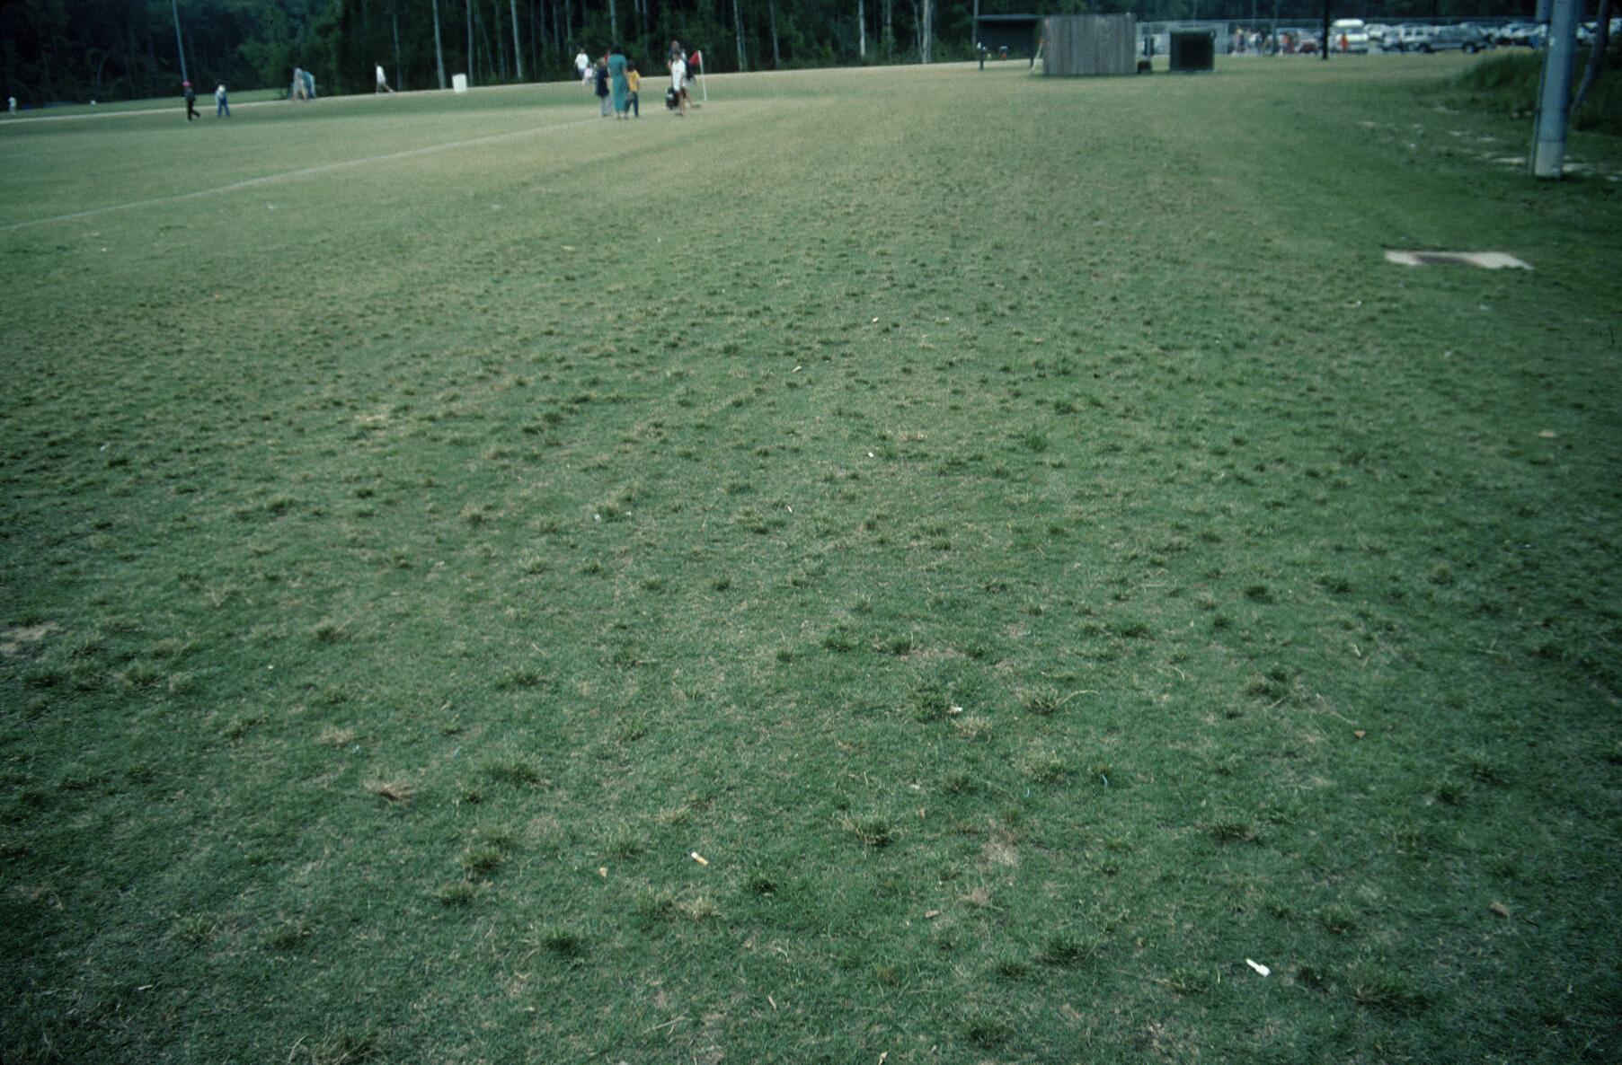

Slide 55
Cultivation Time Frames
Cool-season
Mid Spring
To
Late Fall
Warm-season
Early Spring
To
Mid Summer

Slide 56
Tine Types
Type Action
Hollow Removes
Open/Spoon Divots
Solid Lifts, Cracks, & Shatters

Slide 57
Tine Size & Surface Area
Tine Size (in) | Spacing (in - sp) | Holes / ft² | SA / Tine (in²) | SA Affected (%)
1/4 | 1.25 | 100 | 0.049 | 3.41
1/4 | 2.5 | 25 | 0.049 | 0.85
1/2 | 1.25 | 100 | 0.196 | 13.64
1/2 | 2.5 | 25 | 0.196 | 3.41
5/8 | 2.5 | 25 | 3.07 | 5.33
Oatis, 2003

Slide 58
Mowing, Fert., & Coring
Mow | Fert. | Coring | % Turfgrass Cover |  |  | Cost
(x/wk) | (lbs. N) | (x/yr) | Oct. 1 | Oct. 15 | Nov. 16 | (season)
1 | 5 | 0 | 75 | 78 | 33 | $2,716
2 | 5 | 2 | 87 | 83 | 45 | $5,207
1 | 7 | 0 | 80 | 85 | 37 | $2,886
2 | 7 | 2 | 88 | 88 | 50 | $5,377
Michigan State Univ., 2002

Slide 59
Best Practices
Twice a Year - minimum
late-spring
early-fall
Water 12 to 24 hours Before
Remove Cores
Topdress

Slide 60
Aeration Methods
Spiking
Sub-Aerification
High pressure water/air injection
Aerify & Backfill in one process

Slide 61
High Pressure Injection
Minimal surface disruption
Often as possible
Opens the soil
Original HPI: Hydroject

Slide 62
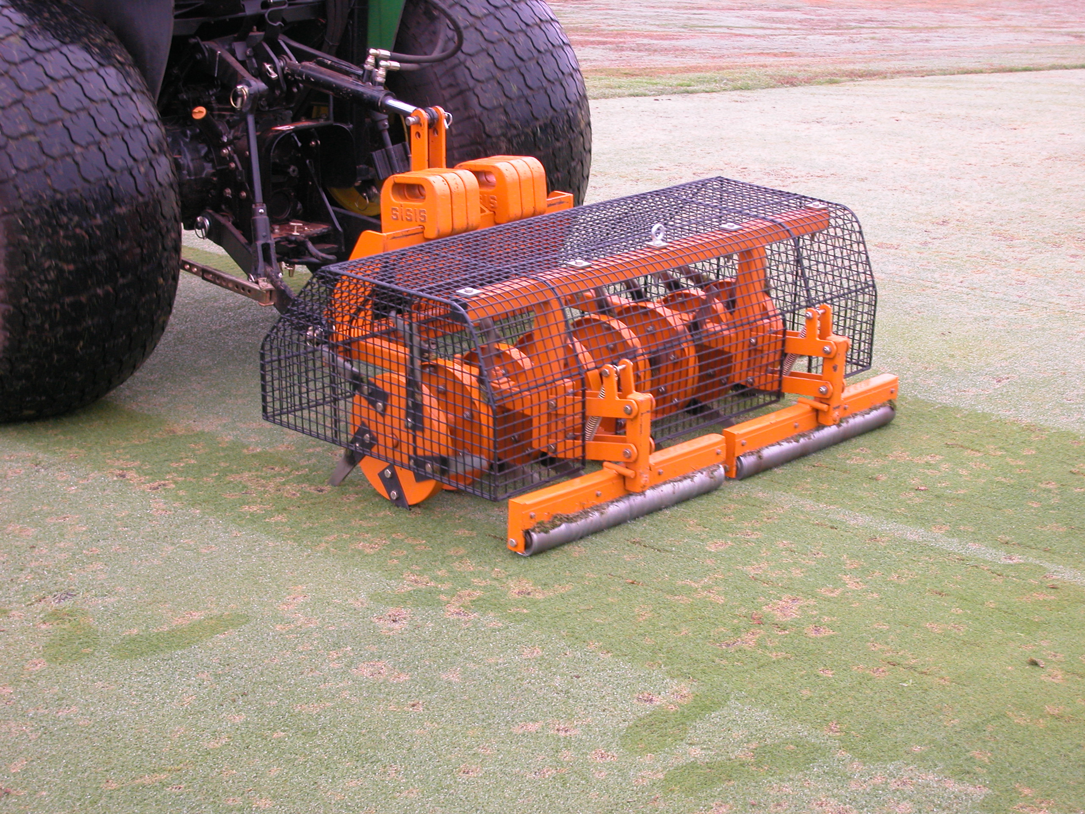
Slicing / Spiking
Forgotten practice
Often as possible
Opens the soil
Infiltration
Gas exchange
stimulates growth
soil-to-seed contact

Slide 63
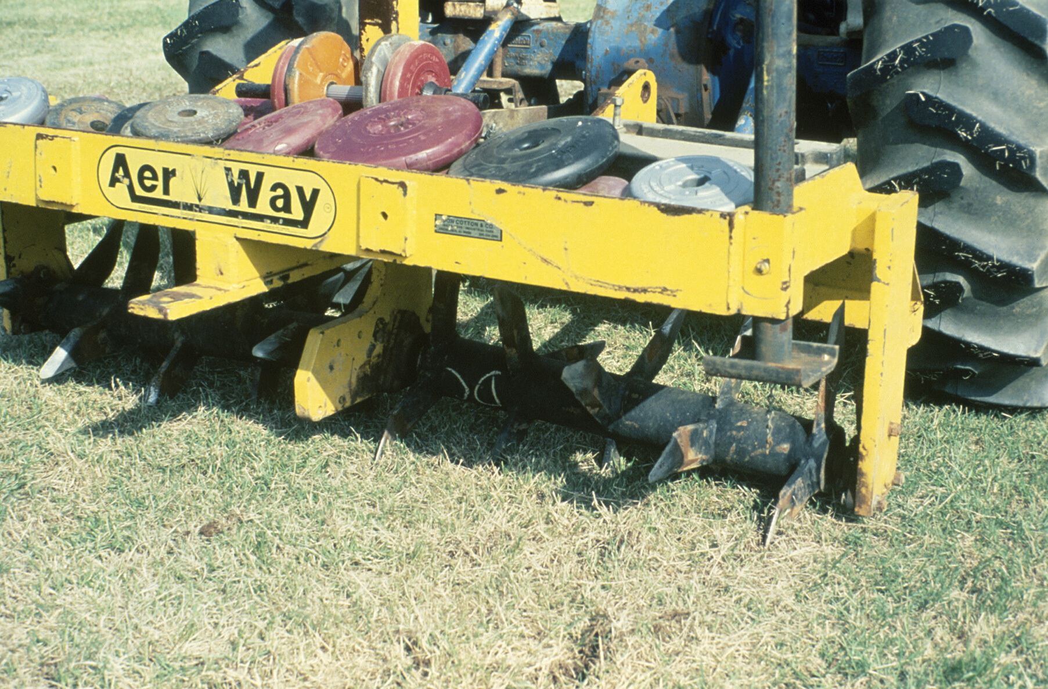

Slide 64
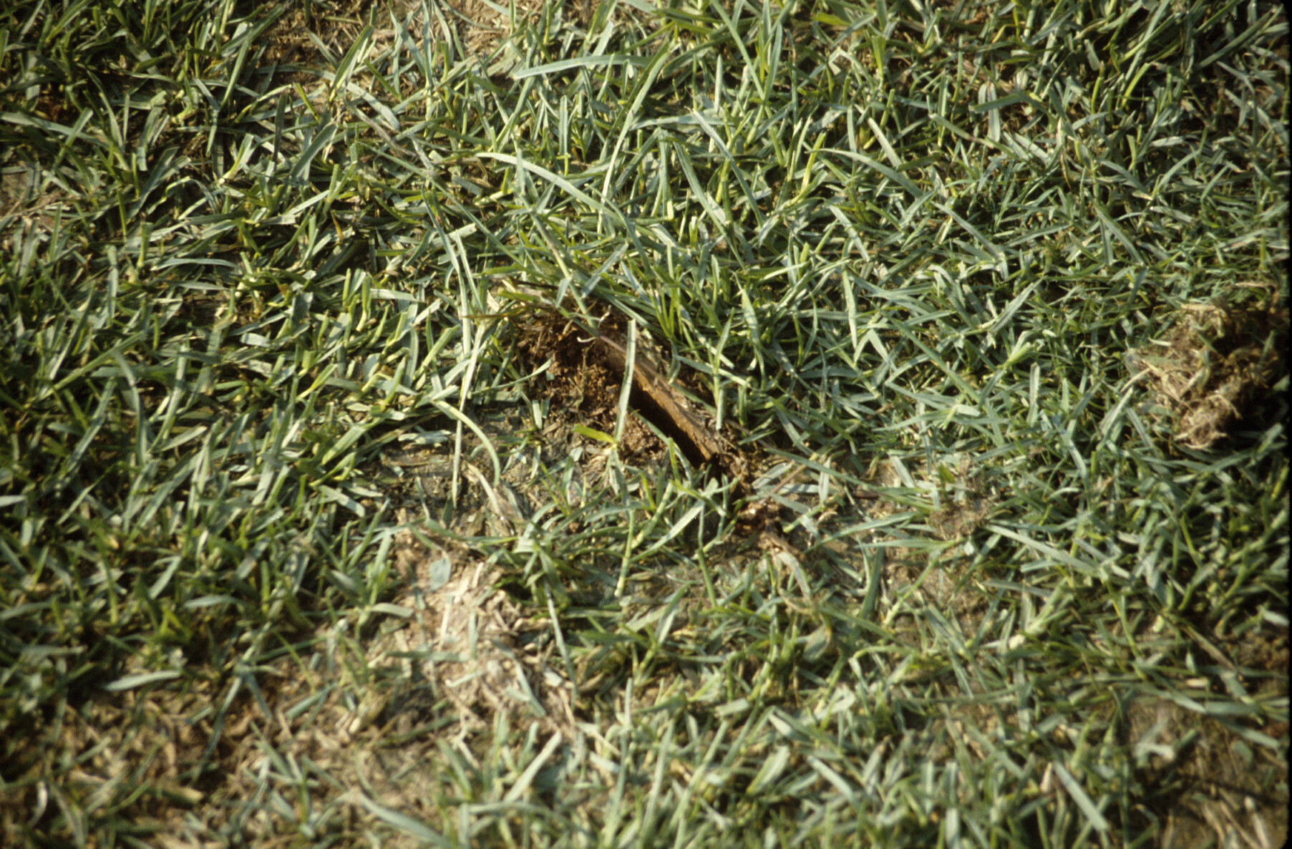

Slide 65
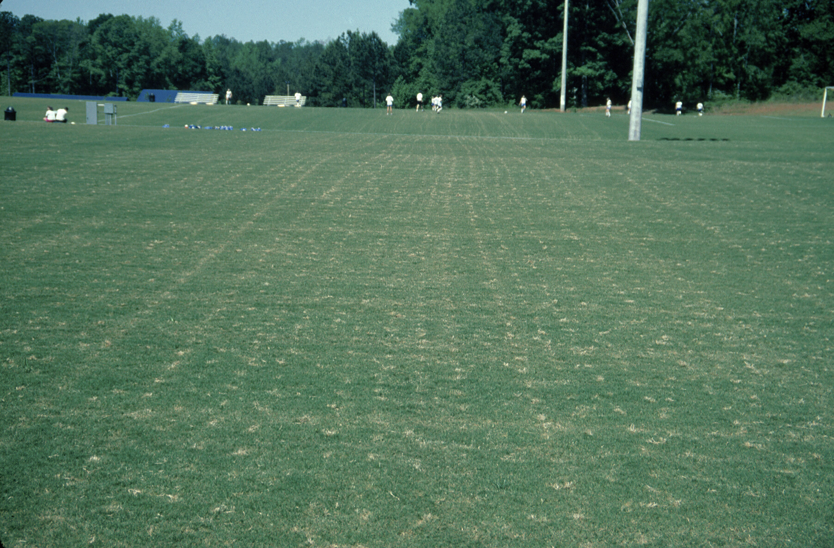

Slide 66
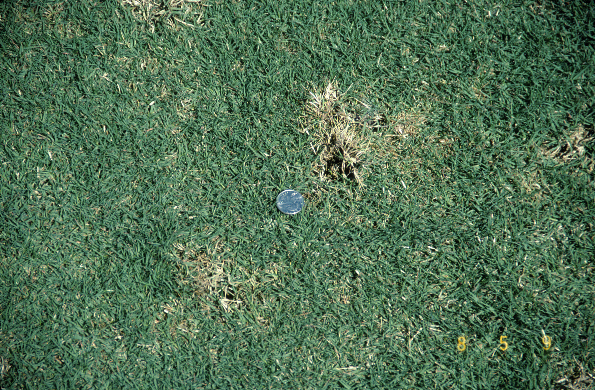

Slide 67
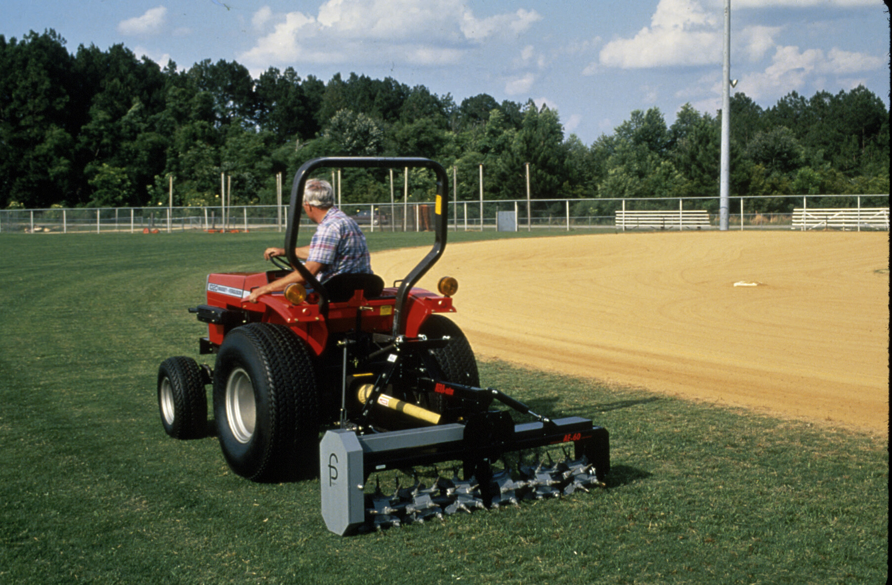

Slide 68
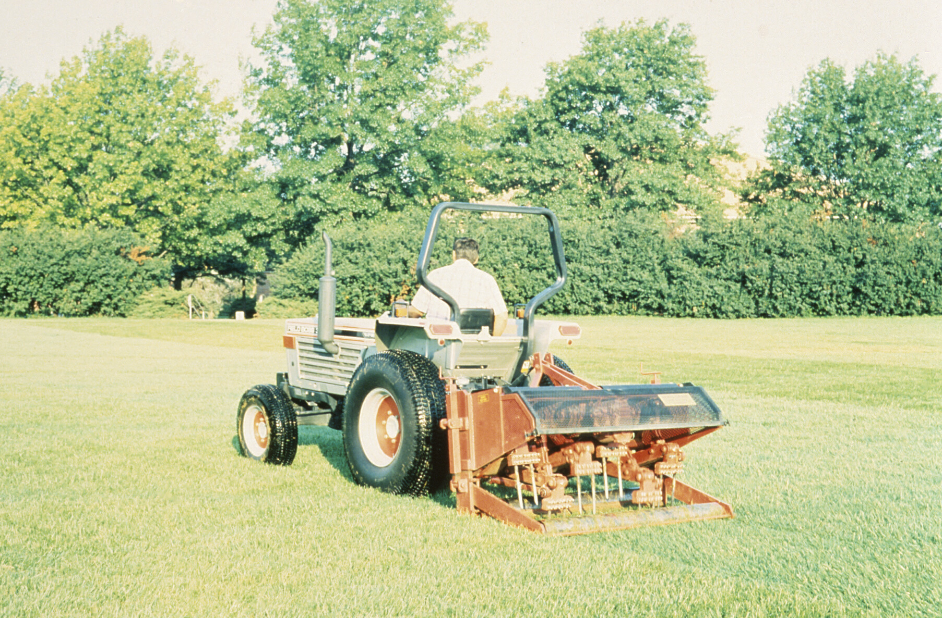

Slide 69
Fertilization & Irrigation

Slide 70
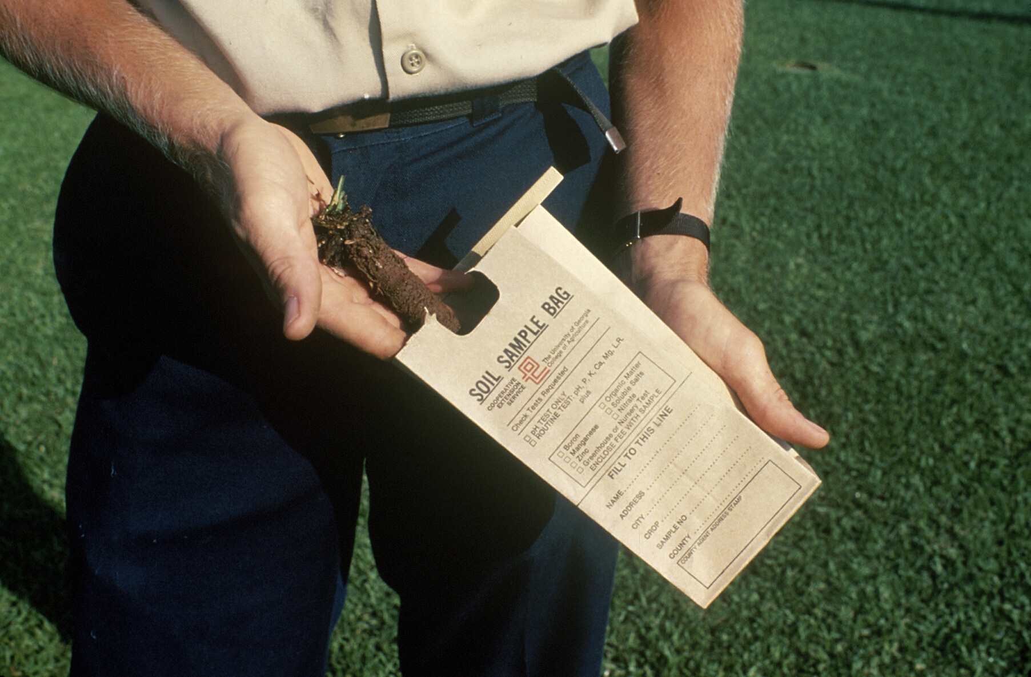

Slide 71
Timing N Fertilization
Warm-season Grasses
Soil Temperatures
Active root growth & activity
65° F
Consistently – multiple days
4-inch depth
www.GeorgiaWeather.net
Combination products

Slide 72
Bermuda Fertilization
Traditional Beliefs
Don’t fertilize late in the season!
succulent turf
winter injury
delay spring green-up
susceptible to fall diseases

Slide 73
Bermuda Fertilization
New Thoughts
Fertilization
balanced ratios of N & K
late season applications do not affect freeze tolerance
Caveat
soluble N at 0.5 to 1.0 lb N / 1000 ft²
2 to 4 weeks prior to hard frost
not in areas with historical SDS

Slide 74
Bermuda Fertilization
 | Turf Color
N Rate | (1-9, 6=acceptable) |  | GH Regrowth
(lbs N / 1000 ft²) | Oct. 16 | Oct. 23 | (%)
NTC | 4.4 b | 4.3 c | 28.6 a
2.5 | 5.3 a | 4.9 b | 24.7 a
5.0 | 5.3 a | 6.3 a | 26.1 a
N applied Aug. 30 & Sept. 27 in Blacksburg, VA. (Ervin et al., 2004)

Slide 75
Bermuda Fertilization
 |  | Turf Color |  |  |  | Rhizome TNC
N Rate |  | (1-9, 6=acceptable) |  |  |  | (g/kg)
(lbs N / 1000 ft²) |  | Oct. 17 | Oct. 31 | Apr.6 |  | Dec. | Mar
NTC |  | 5.3 | 5.8 | 6.3 |  | 14.2 | 14.6
1.0 |  | 6.2* | 7.1* | 6.9* |  | 14.4 | 14.2
2.0 |  | 6.3* | 7.3* | 6.8* |  | 13.2 | 13.6
N applied 2nd week Oct. in Starkville, MS. (Ervin et al., 2004)

Slide 76
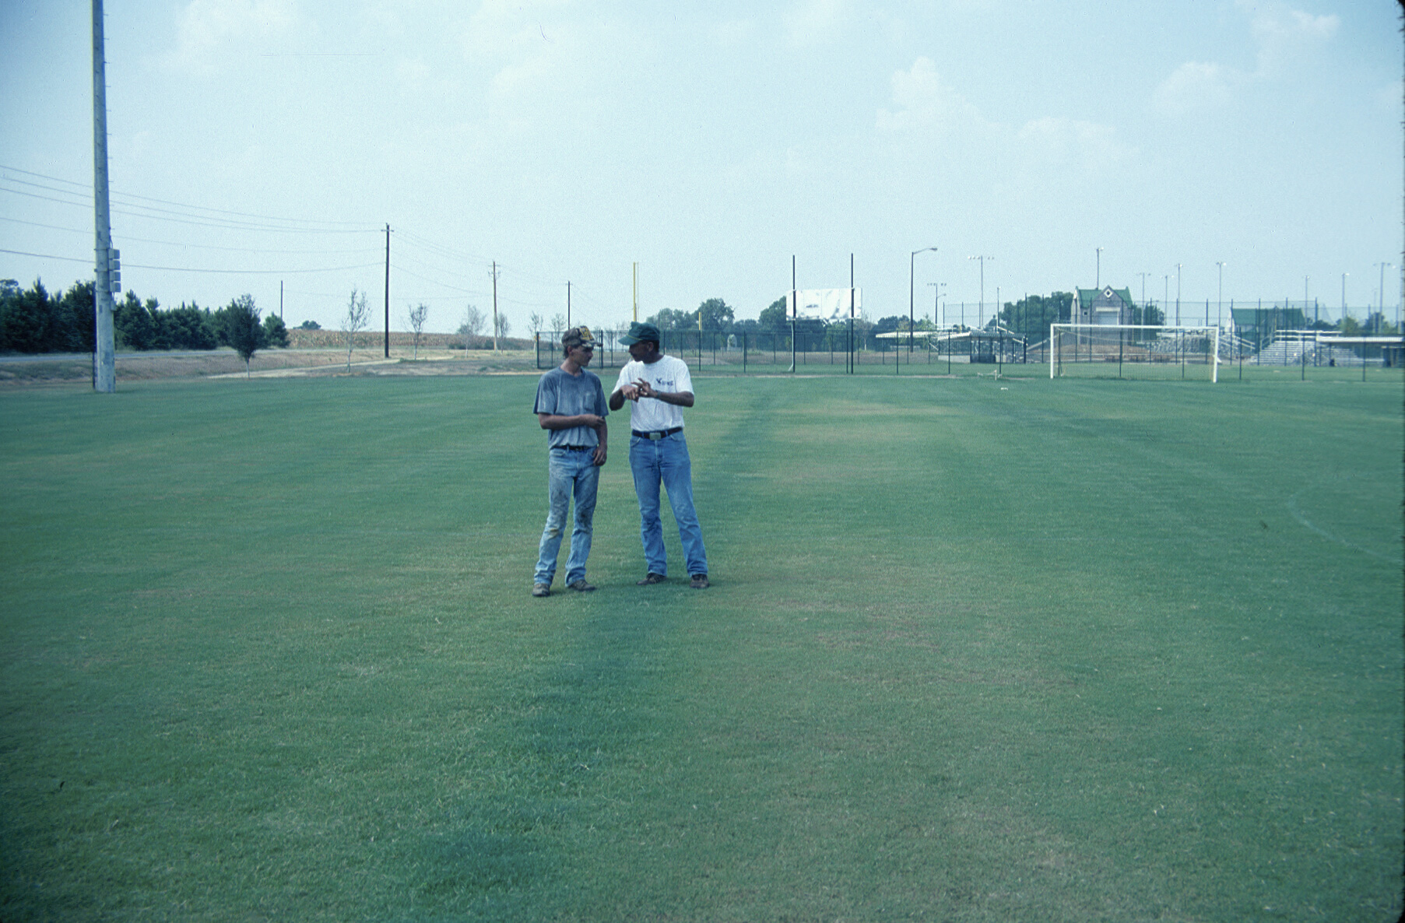

Slide 77
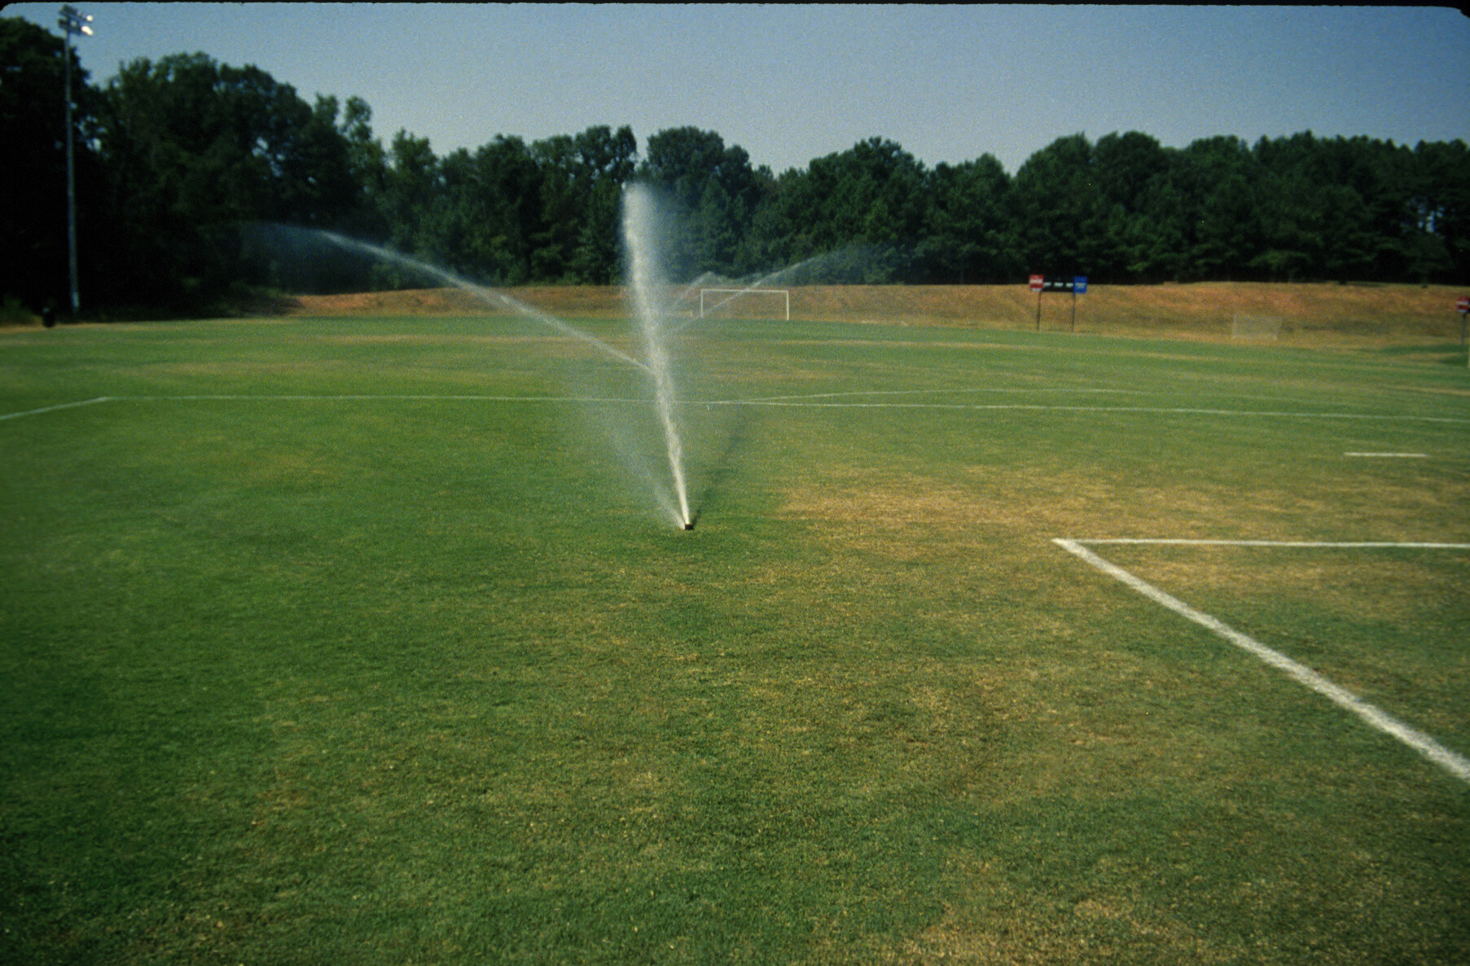

Slide 78
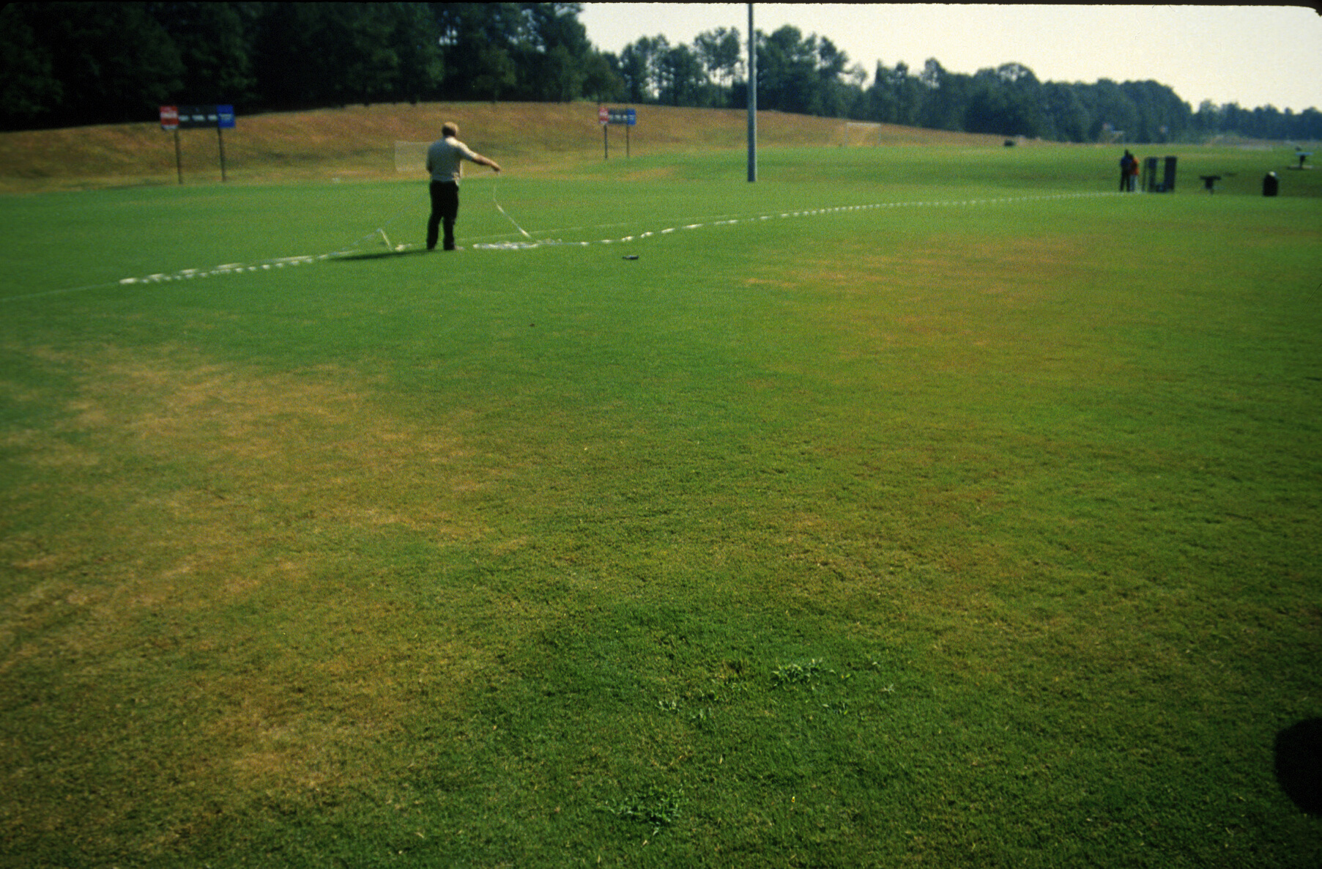

Slide 79
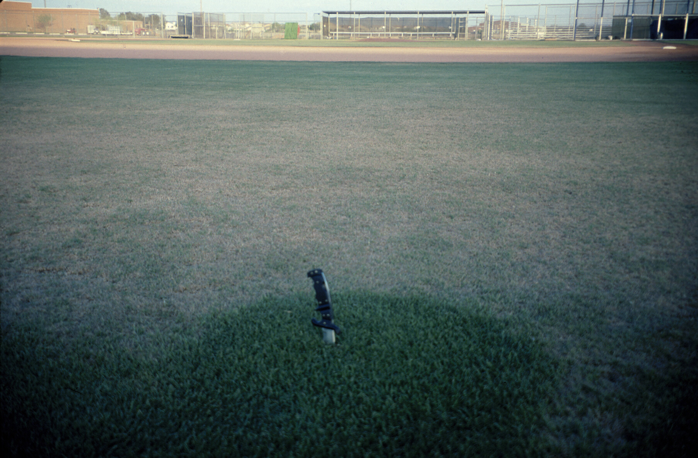

Slide 80
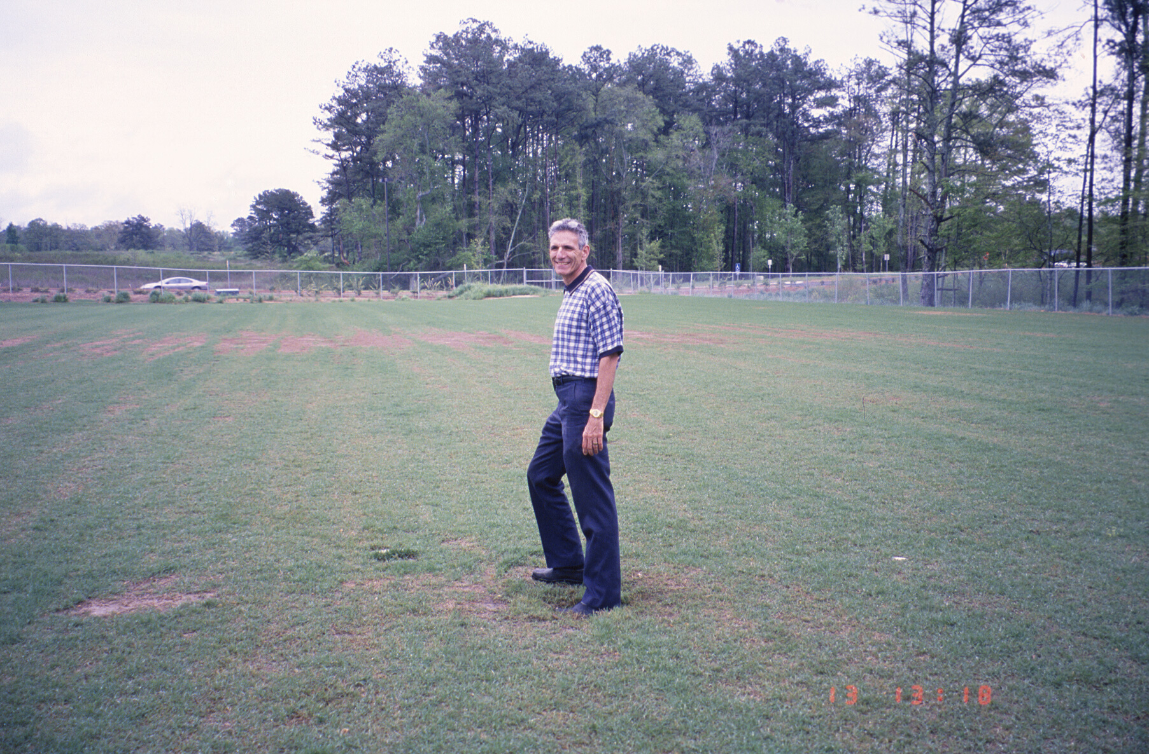

Slide 81
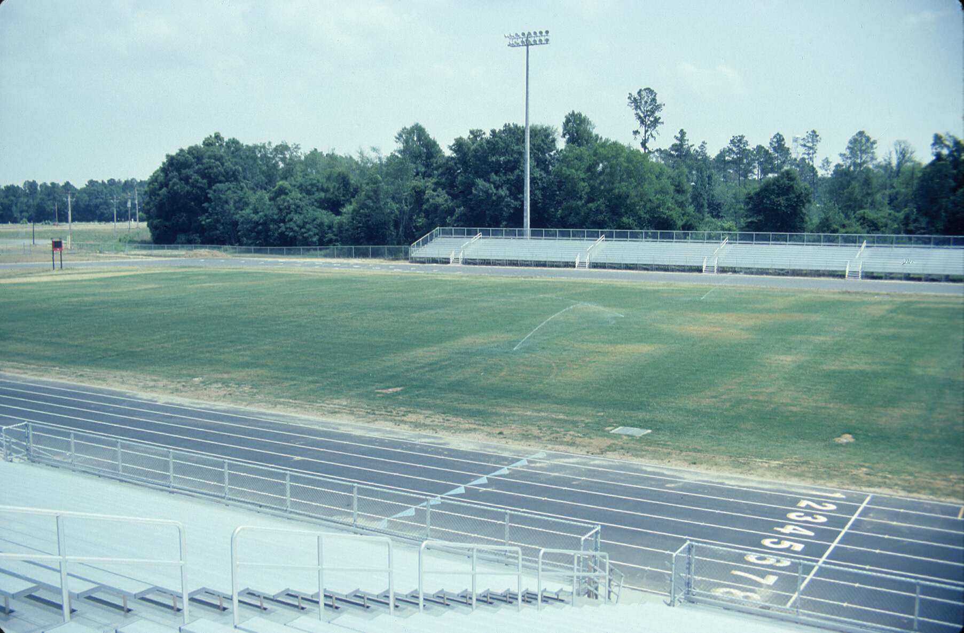

Slide 82
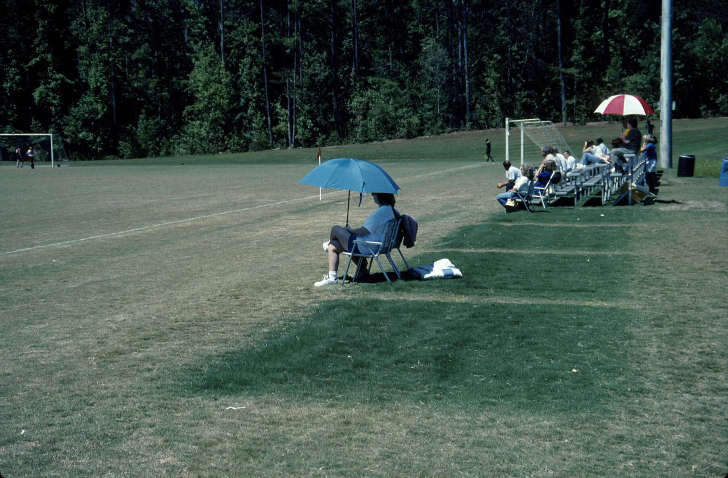

Slide 99
Miscellaneous Problems

Slide 101
Black Algae
“Black algae”
Acts as a barrier to water and nutrient flow
Exacerbates the environmental problem, not a result

Slide 102
Black Algae
Favorable Conditions
High moisture
Full sun
seen in shade
Compacted soils
on sand greens
Low areas
Open, thin canopy
High fertility
high phosphorus
High OM
Native soils

Slide 103
Black Algae
Management - Cultural
Create good growing conditions
Raise mowing height
Dry-out
adjust irrigation practices
Break-up mat

Slide 104
Black Algae
Management - Cultural
Sand topdressing
Soil test
upper 1-inch
Desiccant – be careful
hydrated lime / quicklime
calcium hydroxide - Ca(OH)₂
classified as an algaecide

Slide 105
Black Algae
Management - Chemical
Chlorothalonil
1.8 - 3.25 oz / 1000 ft²
7 - 14 day re-applications
mancozeb
Fore, Manzate, Dithane
80 WP – 6 oz / 1000 ft²
4 F – 9.6 fl oz / 1000 ft²

Slide 106
Black Algae
Management - Chemical
Junction
mancozeb + CuOH
2 to 4 oz / 1000 ft² at > 86 gpa
contact & residual control
7 - 14 day re-applications
phytotoxicity & soil copper accumulation
avoid application during hot weather

Slide 107
Black Algae
Management – Not recommended
QuickSilver
carfentrazone
moss not algae
Micronutrients
Cu, Zn, Mn, etc.
phytotoxicity & soil copper accumulation
Bleach & Soaps

Slide 108
Black Algae
Management – Current Research
Tupersan
siduron
MOA – photosynthesis inhibitor
4 – 24 lbs / acre
not labeled for algae control
bentgrass greens
Simazine - home aquariums for algae control

Slide 109
Black Algae
Management – Current Research
Drive 1 lb/a
Tupersan 12 lb/a
McElroy, Univ. of Tennessee

Slide 110
‘Emerald Zoysiagrass’

Slide 111
‘Emerald’ Zoysiagrass
Whose problem?
Home owner
Purchase from retailer
Several growing seasons
Don’t know producer
Landscaper
Spray application
Costly to correct
‘Emerald’ zoysiagrass ?

Slide 112
‘Emerald’ Zoysiagrass
How widespread?
Atlanta
Observed for several years
Retailer, landscaper
Producer in Alabama
Augusta
Spring 2005
Producer in Alabama
‘Emerald’ zoysiagrass ?

Slide 113
‘Emerald’ Zoysiagrass
What’s going on?
Varietal differences
Plant collections
Known ‘Emerald’
DNA fingerprint
Source
Retailer / broker
Producer
DNA Fingerprint

Slide 114
‘Emerald’ Zoysiagrass
E
E
L
L
p
Recourse
Certified grass
GCIA
Identify Georgia Producers
Plant sampling
www.GeorgiaTurf.com
Re-establish from within lawn
Plugs or Sprigs
DNA Fingerprint

Slide 115
Overseeding

Slide 116
Overseeding Transition
Transition early
Improved bermudagrass cover
Consecutive years
Herbicide aids
sulfonylureas
pronamide - restricted
Revolver – 17 fl oz / A
Gelernter and Stowell, 2005

Slide 117
News for 2006 Pesticides

Slide 118
2006 Pesticide Update
Fungicides
Endorse (polyoxin D)
Rhizoctonia spp.
brown patch
large patch
zoysia patch
Anthracnose
Gray leaf spot
Large patch disease on common bermudagrass

Slide 119
2006 Pesticide Update
Fungicides
Medallion (fludioxonil)
Protectant
Brown patch
Yellow patch
Take-all
Leaf spot
Spring dead spot on hybrid bermudagrass

Slide 120
2006 Pesticide Update
Fungicides
Emerald (boscalid)
Dollar Spot
Bentgrass Dead Spot
Signature, Magellan, Vital, & Alude (phosphite)
Pythium
Fairy Ring on common bermudagrass

Slide 121
Armada
(triadimefon + trifloxystrobin)
ARMADA GREEN
ARMADA
Dollar spot injury and active dollar spot
ARMADA GREEN

Slide 122
2006 Pesticide Update
Nematicides
Nemacur (fenamiphos)
20% less till May 31, 2007
Curfew (1,3-dichloropropene)
Golf Courses & Athletic Fields
Methyl Bromide
Slit Injection

Slide 123
2006 Pesticide Update
Herbicides
Velocity 80 WSP (bispyribac-sodium)
Chemical Family: pyrimidunyloxybenzoics or triazolopyrimidines
Absorption and Translocation: Absorbed by roots and leaves, translocated via the phloem
MOA: Inhibits acetolactate synthase (ALS), an enzyme necessary for the production of branch-chain amino acids – leucine, isoleucine, and valine

Slide 124
2006 Pesticide Update
Herbicides
Velocity (bispyribac-sodium)
Poa annua
Overseeded ryegrass
bentgrass fairways
Annual Bluegrass

Slide 125
Velocity 80 WSP Herbicide

Slide 126
Velocity 80 WSP Herbicide
Poa annua Control in Overseeded Ryegrass Fairway
Untreated
1.3 oz/a INT, 14, 28 DAI
May 4 , 2004

Slide 127
Velocity 80 WSP Phyto on Ryegrass

Slide 128
2006 Pesticide Update
Herbicides
Revolver (foramsulfuron)
Fall – Poa annua
Spring – transition
Summer – goosegrass
2 apps. @ 7 – 10 d splits
Dallisgrass control
mix with MSMA
2 apps @ 3 – 4 wk splits
Goosegrass

Slide 129
2006 Pesticide Update
Herbicides
Certainty (sulfosulfuron)
Warm-season grasses
Sedge control
Tall fescue control
Non-ionic surfactant
SedgeHammer (halosulfuron)
rename of Manage

Slide 130
2006 Pesticide Update
Herbicides
Spotlight (fluroxypyr)
reduced rates for bermudagrass & St. Augustinegrass
Sethoxydim G-Pro – 1.0 lb / gal
ProClipse (prodiamine)
Goose / Crab Control (oxadiazon + benefin)
Berm. & bent greens

Slide 131
Important Dates in 2006
Winter Green – Jan. 25 - 28
Green-up 2006 – Feb. 16
Southeastern Turf Conference – May 1 & 2
UGA Turfgrass Field Day – August 15

Slide 132
Important Dates in 2006
GCSAA Conference & Show – Feb. 6 – 11
Atlanta – www.GCSAA.org
TPI Midwinter Conference – Feb. 13 – 17
Savannah – www.TurfGrassSod.org

Slide 133
Thank You
Visit
www.Georgiaturf.com
and
www.Turfgrasswater.com

