Slide 1
Southern Arborist Trees

Slide 2
Simple Tree Key
Conifers
Pines
Other conifers
Opposite simple leaves
Opposite compound leaves
Alternate simple leaves
Smooth margins
Serrate margins
White oak
Red oak
Alternate compound leaves

Slide 3
Conifers
Pines
Other Conifers

Slide 4
Pines

Slide 5
Eastern White Pine (Pinus strobus)
Notes:
5 needles in each fasicle

Slide 6
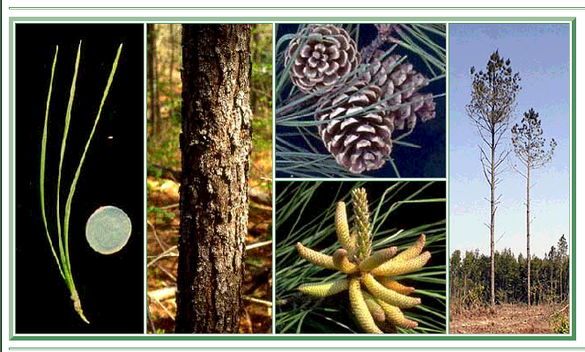
Loblolly Pine (Pinus taeda)
Notes:
L’s have 3 needles to a fasicle, S’s have 2-3. 3 needles to a fasicle, 6 – 9 inches long, cones are 2 – 6 inches long

Slide 7
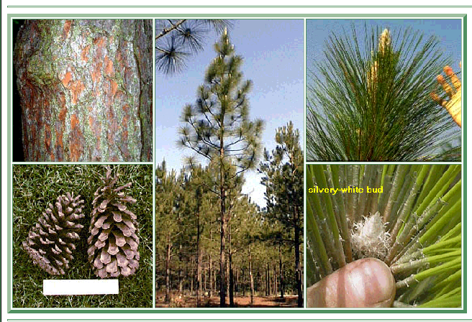
Longleaf Pine (Pinus palustris)
Notes:
3 needles per fasicle, needles are 10 – 18 inches long, cones are 6 – 10 inches

Slide 8
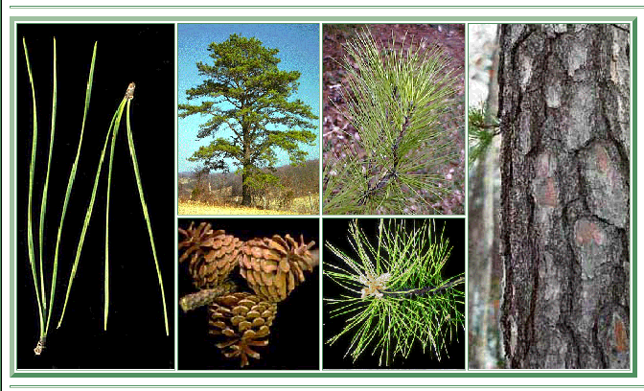
Pitch Pine (Pinus rigida)
Notes:
3 needles to a fasicle, 3 – 5 inches long and usually perpendicular to stem.
Cones are 1 – 3 ½ inches and stuck directly on the stem. Sometimes there will be sticky white pitch near branch tips.

Slide 9
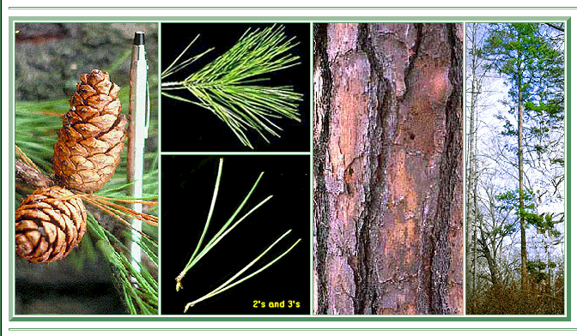
Shortleaf Pine (Pinus echinata)
Notes:
S’s have 2 – 3 needles per fasicle, needles are 3 – 5 inches long. Cones are 1 ½ - 2 ½ inches on a short stem

Slide 10
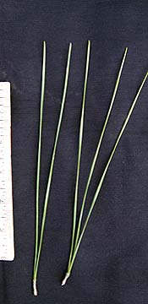
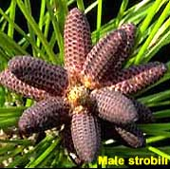
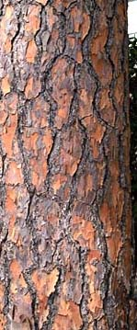
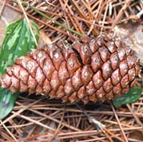
Slash Pine (Pinus elliotti)
Notes:
S’s have 2 –3 needles per fasicle. Needles are 8 – 12 inches long, cones are 3 – 6 inches long

Slide 11
Virginia Pine (Pinus virginiana)

Slide 12
Other Conifers

Slide 13
Atlantic White-cedar (Chamaecyparis thyoides)

Slide 14
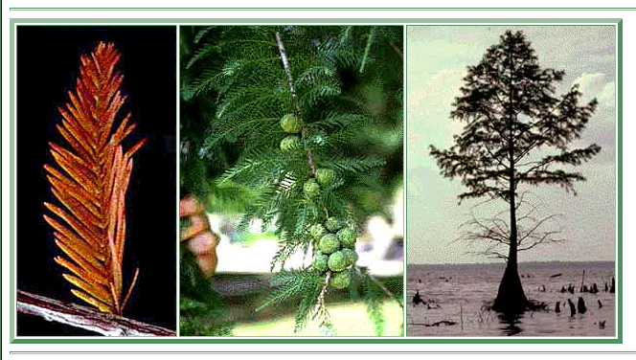
Baldcypress (Taxodium distichum)

Slide 15
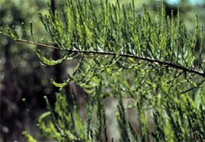
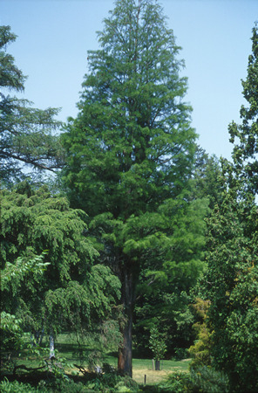
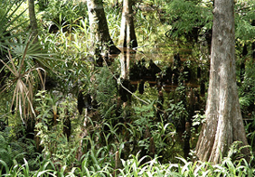
Pondcypress (Taxodium distichum var. nutans)

Slide 16
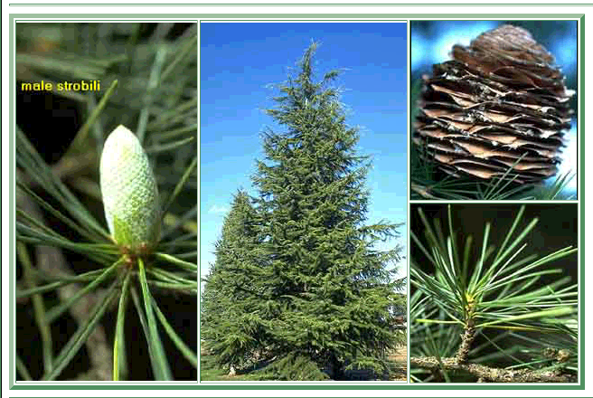
Deodar Cedar (Cedrus deodara)

Slide 17
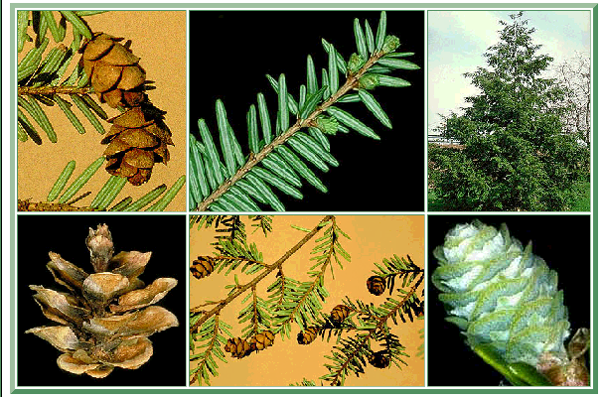
Eastern Hemlock (Tsuga canadensis)

Slide 18
Eastern Redcedar (Juniperus virginiana)

Slide 19
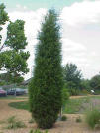
Southern Red Juniper (Juniperus silicicola)

Slide 20
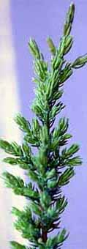
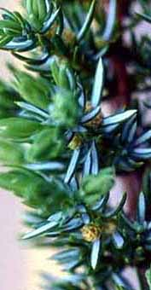
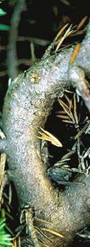
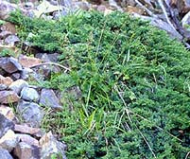
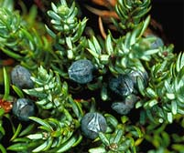
Common Juniper (Juniperus communis)

Slide 21
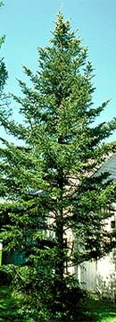
Fraser Fir (Abies fraseri)

Slide 22
Opposite Simple Leaves

Slide 23
Flowering Dogwood (Cornus florida)

Slide 24
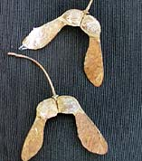
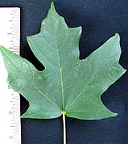
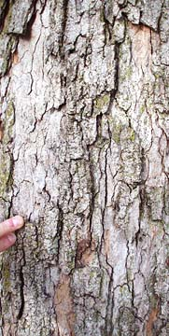
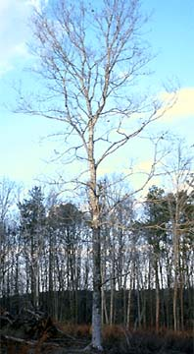
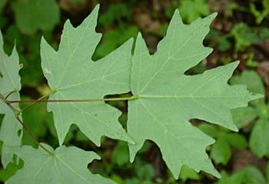
Florida Maple (Acer barbatum)

Slide 25
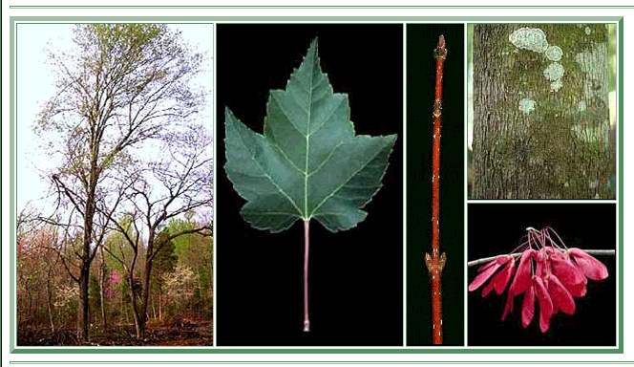
Red Maple (Acer rubrum)

Slide 26
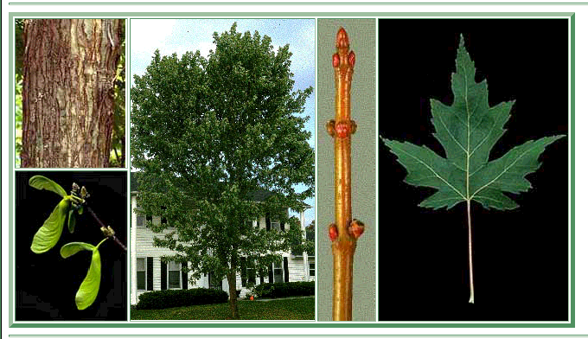
Silver Maple (Acer saccharinum)

Slide 27
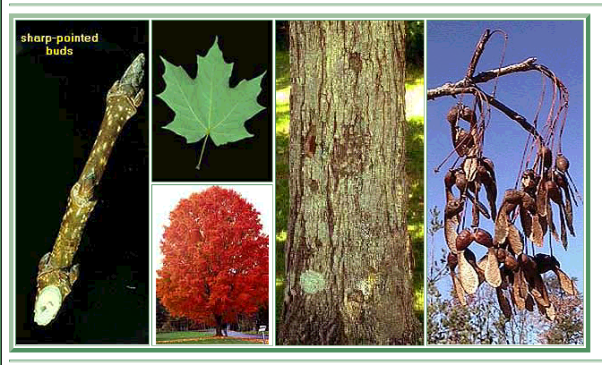
Sugar Maple (Acer saccharum)

Slide 28
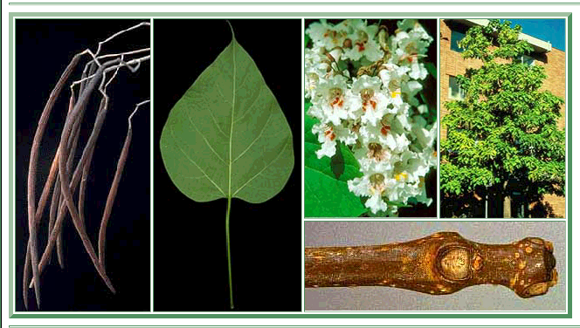
Southern Catalpa (Catalpa bignonioides)

Slide 29
Opposite Compound Leaves

Slide 30
Boxelder (Acer negundo)

Slide 31
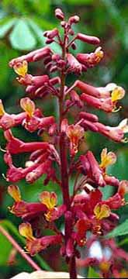
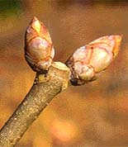
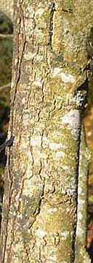
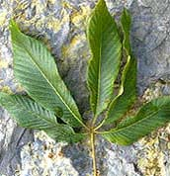
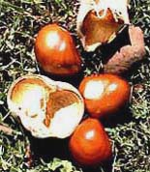
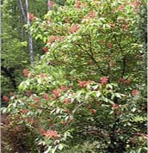
Red Buckeye (Aesculus pavia )

Slide 32
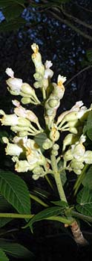
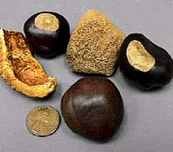
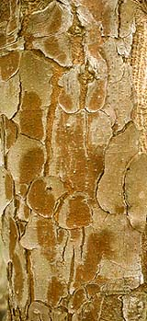
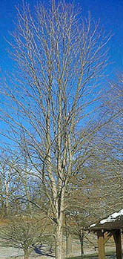
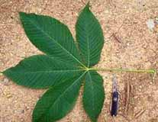
Yellow Buckeye (Aesculus octandra)

Slide 33
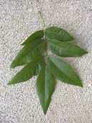
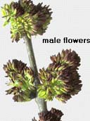
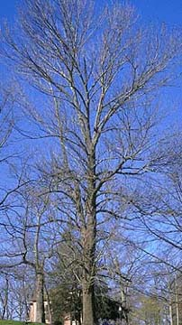
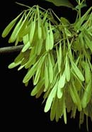
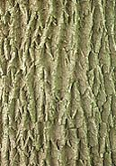
Green Ash (Fraxinus pennsylvanica)
Notes:
6-9” long, 7-9 leaflets

Slide 34
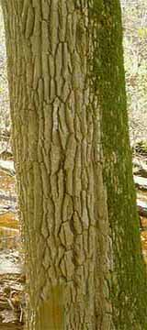
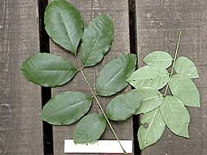
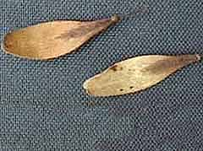
Pumpkin Ash (Fraxinus profunda)
Notes:
9-18” long 7-9 leaflets

Slide 35
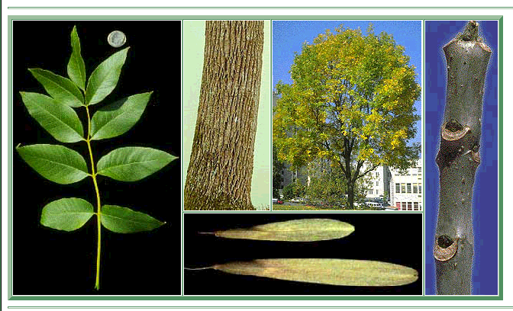
White Ash (Fraxinus americana)
Notes:
Leaves 8-12”, 5-9 leaflets

Slide 36
Alternate Simple
Smooth margins

Slide 37
Bigleaf Magnolia (Magnolia macrophylla)

Slide 38
Black Willow (Salix nigra)

Slide 39
Black Gum (Nyssa sylvatica)

Slide 40
Carolina Silverbell (Halesia carolina)

Slide 41
Cucumbertree (Magnolia acuminata)

Slide 42
Coastal Plain Willow (Salix caroliniana)

Slide 43
Mountain Laurel (Kalmia latifolia)

Slide 44
Persimmon (Diospyros virginiana)

Slide 45
Redbud (Cercis canadensis)

Slide 46
Sassafras (Sassafras albidum)

Slide 47
Southern Magnolia (Magnolia grandiflora)

Slide 48
Sweetbay (Magnolia virginiana)

Slide 49
Two wing silverbell (Halesia diptera)

Slide 50
Water Tupelo (Nyssa aquatica)

Slide 51
Yellow Poplar (Liriodendrom tulipifera)

Slide 52
Alternate Simple
Serrate margins

Slide 53
Allegheny Chinquapin (Castanea pumila)

Slide 54
American Chestnut (Castanea dentata)

Slide 55
American Beech (Fagus grandifolia)

Slide 56
American Elm (Ulmus americana)

Slide 57
American Holly (Ilex Opaca)

Slide 58
American Hornbeam (Carpinus caroliniana)

Slide 59
American Sycamore (Platanus occidentalis)

Slide 60
Apple (Malus spp.)

Slide 61
Black Cherry (Prunus serotina)

Slide 62
Carolina Basswood (Tilia caroliniana)

Slide 63
Carolina laurel Cherry (Prunus caroliniana)

Slide 64
Downy Serviceberry

Slide 65
Eastern Cottonwood (Populus deltoides)

Slide 66
Eastern hophornbeam (Ostrya virginiana)

Slide 67
Georgia Hackberry (Celtis tenuifolia)

Slide 68
Hackberry (Celtis occidentalis)

Slide 69
Hawthorn (Crataegus spp.)

Slide 70
Red Mulberry (Morus rubra)

Slide 71
River Birch (Betula nigra)

Slide 72
Sugarberry (Celtis laevigata)

Slide 73
Sourwood (Oxydendrum arboreum)

Slide 74
Sweetgum (Liquidambar styraciflua)

Slide 75
Winged Elm (Ulmus alata)

Slide 76
Yellow Birch (Betula alleghaniensis)

Slide 77
Alternate Simple
White oaks

Slide 78
Chestnut Oak (Quercus prinus)

Slide 79
Chinkapin Oak (Quercus muehlenbergii)

Slide 80
Overcup Oak (Quercus lyrata)

Slide 81
Post Oak (Quercus stellata)

Slide 82
Swamp Chestnut Oak (Quercus michauxii)

Slide 83
White Oak (Quercus alba)

Slide 84
Alternate Simple
Red oaks

Slide 85
Black Oak (Quercus velutina)

Slide 86
Blackjack Oak (Quercus marilandica)

Slide 87
Cherrybark Oak (Quercus falcata var. pagodaefolia)

Slide 88
Laurel Oak (Quercus laurifolia)

Slide 89
Live Oak (Quercus virginiana)

Slide 90
Northern Red Oak (Quercus rubra)

Slide 91
Pin Oak (Quercus palustris)

Slide 92
Scarlet Oak (Quercus coccinea)

Slide 93
Southern Red Oak (Quercus falcata)

Slide 94
Water Oak (Quercus nigra)

Slide 95
Willow Oak (Quercus phellos)

Slide 96
Alternate Compound Leaves

Slide 97
Black Locust (Robinia pseudoacacia)

Slide 98
Black Walnut (Juglans nigra)

Slide 99
Butternut (Juglans cinerea)

Slide 100
Honeylocust (Gleditsia triacanthos)

Slide 101
Mimosa (Albizia julibrissin)

Slide 102
Bitternut Hickory (Carya cordiformis)

Slide 103
Mockernut Hickory (Carya tomentosa)

Slide 104
Pignut Hickory (Carya glabra)

Slide 105
Shagbark Hickory (Carya ovata)

