Slide 1
Notes:
1. UGA Logo

Slide 2
www.ugaextension.com
Notes:
3. UGA Cooperative Extension Web address

Slide 3
Notes:
3. Master Gardener Logo

Slide 4
Introduction to Soils
C. Owen Plank
Extension Agronomist
The University of Georgia
Notes:
4. Title Slide Introduction to Soils
By: C. Owen Plank, Extension Agronomist.
The University of Georgia. College of Agricultural and Environmental Sciences Cooperative Extension Service

Slide 5
Learning Objectives
Soil components and their relative proportion in soils
Texture of a soil & influence of texture on plant growth
Soil compaction, how to alleviate it, & how compaction affects plant growth.
Notes:
5. Learning Objectives
Identify the different soil components and their relative proportion in soils
Know what parameters determine the texture of a soil and the influence texture has on plant growth
Understand the common factors contributing to soil compaction, how to alleviate it, and how compaction affects plant growth

Slide 6
Soil organisms & effect on the chemical and physical properties of soil
Importance of soil organic matter
How different soil amendments affect the structure, texture, and pH of soils
Notes:
6. Learning Objectives Continued
Be familiar with soil organisms and their effect on the chemical and physical properties of soil
Recognize the importance of soil organic matter
Understand how different soil amendments affect the structure, texture, and pH of soils

Slide 7
Colloids, CEC, cations, and anions and how they affect plant nutrition
Why pH is such an important factor in nutrient uptake and plant nutrition and how changing pH affects different soil properties
Essential elements required for plant growth and the different inorganic and organic fertilizer sources of each.
Notes:
7. Learning Objectives continued
Know what colloids, CEC, cations, and anions are and how they affect plant nutrition
Understand why pH is such an important factor in nutrient uptake and plant nutrition and how changing pH affects different soil properties
Understand the essential elements required for plant growth and the different inorganic and organic fertilizer sources of each.

Slide 8
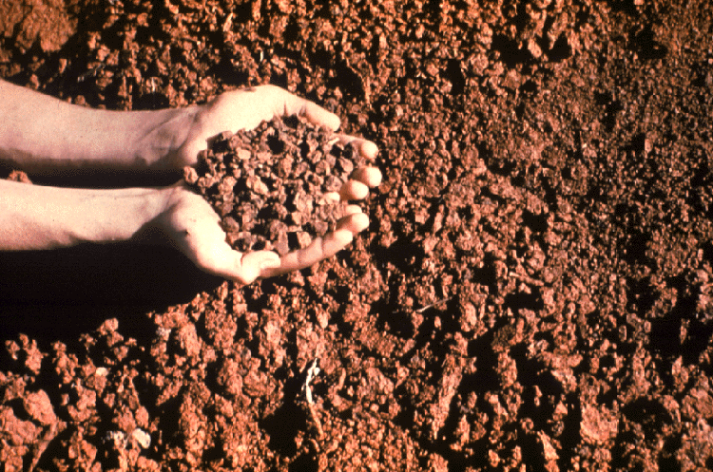
What Is Soil?
Notes:
8. Our topic today deals with one of our most important natural resources, SOIL. It’s a natural resource many of us take for granted. It is abused by man in many ways...can you name a few? But when well managed it can be very productive for growing plants and well suited for many other uses.

Slide 9
Webster Defines Soil As…..
The upper layer of the earth that may be dug or plowed and in which plants grow
However, to soil scientists the definition is more complex
It may have different meanings to different people
Notes:
9. What is soil? Webster defines soil as "the upper layer of earth that may be dug or plowed; the loose surface material of the earth in which plants grow". To soil scientists the definition is much more inclusive and complex. However, depending upon how it is used, the term "soil" may have different meanings for different people.

Slide 10
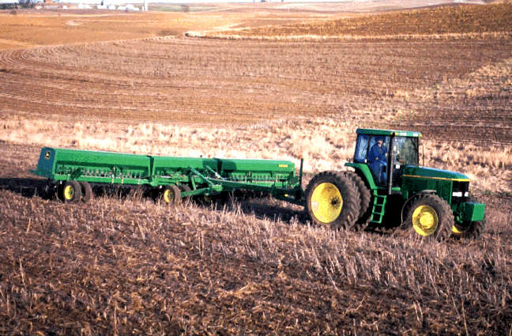
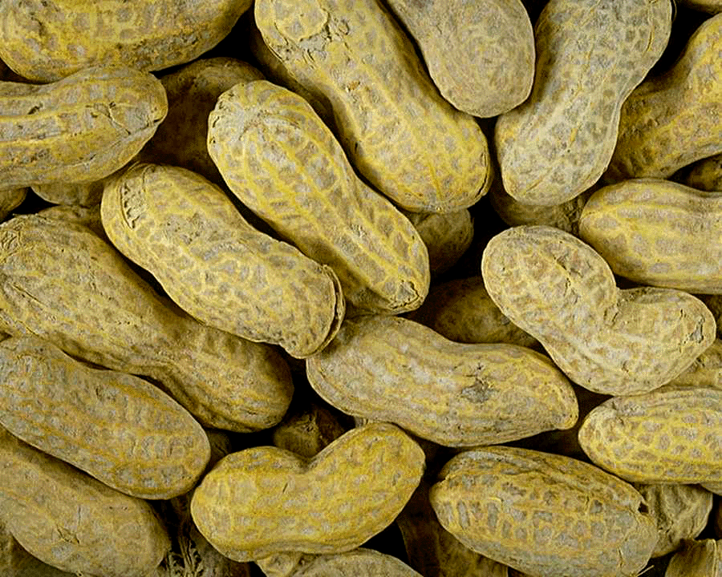
Farmer
Notes:
10. To the farmer it may mean the medium on which to grow crops.

Slide 11
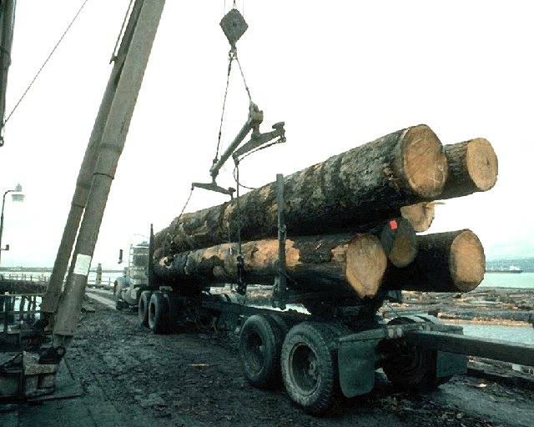
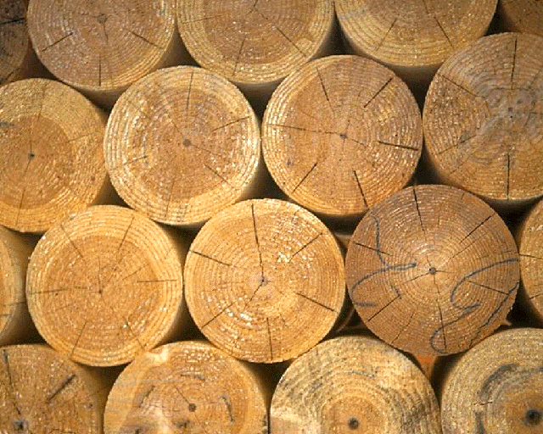
Forester
Notes:
11. To the forester it is a medium on which to grow trees.

Slide 12
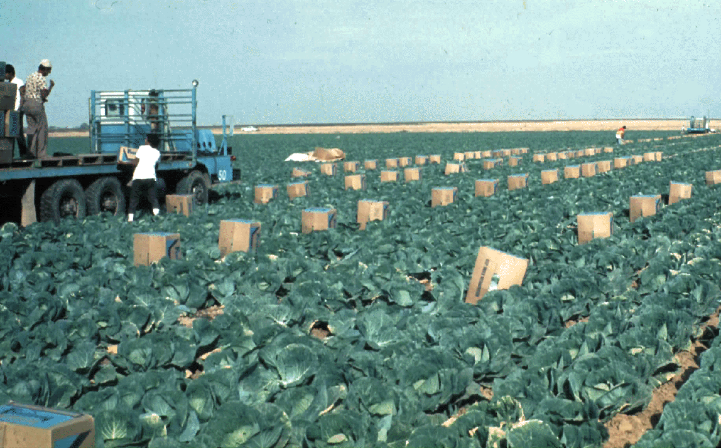
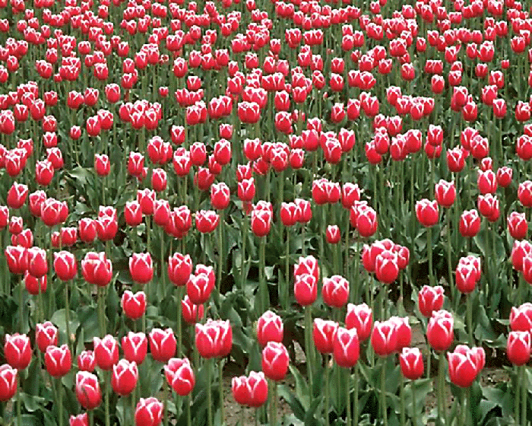
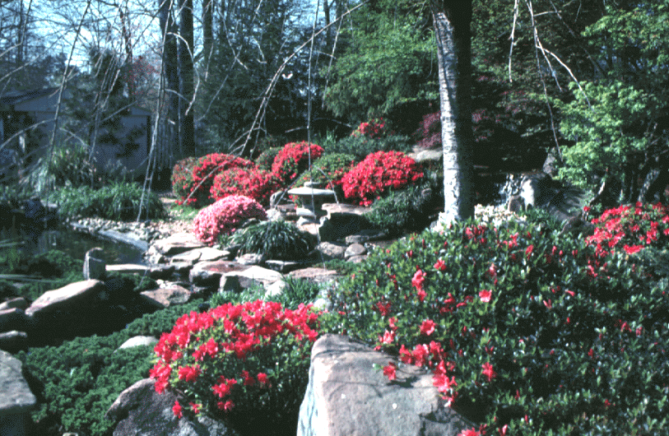
Horticulturist
Notes:
12. To the horticulturist it is a medium to grow vegetable crops, flowers, and ornamentals.

Slide 13
Golf Course
Superintendent
Notes:
13. To the golf course superintendent it is a medium on which to construct golf courses, and to grow highly maintained grass for recreational purposes.

Slide 14
Engineer
Notes:
14. To the engineer, it is a medium on which to construct roads and buildings.

Slide 15
Know Your Soil!
Notes:
15. Regardless of how we may define soil it is a complex mixture of air, water, organic matter, microorganisms and mineral matter. In order to properly manage soil, you must know the soil - its physical and chemical properties and its biological nature. Know it’s potential and limitations.

Slide 16
Soil Composition - Volume Basis
Notes:
16. Soils are made up of approximately 45% mineral matter, 5% organic matter, 25% air, and 25% water. It should be noted that air and water inversely proportionate to each other; as water content in the soil increases air decreases, etc.

Slide 17
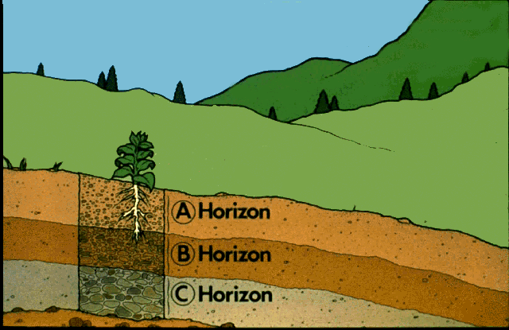
Soil Profile
Notes:
17. A well developed soil will consist of different layers, referred to as "horizons" (denoted here by A, B, & C). Each horizon has its own particular characteristics and is a result of several soil forming processes. The A horizon, generally referred to as topsoil, is the zone of maximum biological activity. This is where 80% of plant roots occur; where the majority of microorganisms, earthworms, etc. occur; and where accumulation of organic matter occurs. The B horizon, subsoil, is the zone of maximum accumulation. Over time clay particles and nutrients from the A horizon leach downward and accumulate in the subsoil. It is generally redder in color and more sticky and more acidic than the A horizon. On many of our old eroded sites the topsoil we utilized today was at onetime the subsoil. The next layer is the C horizon or parent material. This is the material from which the A and B horizons formed. It may consist of limestone, micas, feldspars, or clays and sand that were deposited by oceans millions of years ago. The parent material is what determines to a great extent the potential fertility of a soil. Soil scientists refer to the vertical section of the soil as the "profile".

Slide 18
Permanent Soil Properties
Texture
Thickness of topsoil
Thickness of subsoil
Certain Chemical Properties
Notes:
18. Soil properties are made up of relatively permanent and relatively changeable properties.
Permanent soil properties are listed for discussion including texture, thickness of topsoil and subsoil and certain chemical features (relative cation exchange capacity, type colloids, etc.).

Slide 19
Changeable Soil Properties
Soil Structure
Soil Organic Matter
Soil Color
Soil pH (Acidity)
Soil Nutrient Levels
Notes:
19. Changeable soil properties include structure, organic matter content, color, pH(acidity), and soil nutrient levels (fertility).

Slide 20
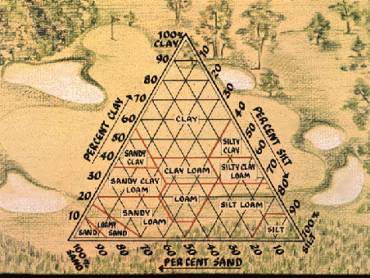
SOIL TEXTURE
Notes:
20. Soil texture is a very important soil feature. It is a property that does not change with time.

Slide 21
Soil Texture
Soil texture refers to the relative proportions of sand, silt, and clay in a soil
12 textural classes
Loam is considered to be ideal texture for growth of plants
Difficult to alter soil texture on large scale
Notes:
21. Soil texture refers to the relative amounts of sand, silt, and clay present in a soil. The three fractions (sand, silt, and clay) are sometimes referred to as soil separates. The three separates are classified based on size: Click Link Sand particles may range in size from 2.00 to 0.05 millimeters in diameter, silt from 0.05 to 0.002 millimeters in diameter, and clay less than 0.002 millimeters in diameter (clay particles cannot be seen with the naked eye or ordinary light microscope. An electron microscope must be use to see them). Click Slide. In the field texture is determined by feel.
There are 12 different textural classes of soils. They vary widely in the amount of sand, silt and clay contained. Note how the percentages of sand, silt, and clay vary in the textural classes shown. Clay soils can even contain appreciable quantities of sand and. silt, but the predominant fraction is clay (60%). A loam soil is made up of approximately equal parts of sand, silt, and clay and is considered to be ideal the ideal texture for growth of plants.
It is difficult to change the texture of a soil on a large scale. It would be very expensive!! For example to change the texture of a soil from clay to a clay loam it would take 400,000 pounds of sand per acre. Bought any sand lately?

Slide 22
Importance of Soil Texture
Influences pore size and pore space
- large pores - air
- small pores - water
- sandy soils have larger pores, less surface area, and water drains more freely compared to clay soils
Influences a soils water holding capacity
- fine textured soils have more and smaller pores
- hold more water than sandy soils
- also hold water more tightly
Notes:
22. Soil texture refers to the relative amounts of sand, silt, and clay present in a soil. The three fractions (sand, silt, and clay) are sometimes referred to as soil separates. The three separates are classified based on size: Click Link Sand particles may range in size from 2.00 to 0.05 millimeters in diameter, silt from 0.05 to 0.002 millimeters in diameter, and clay less than 0.002 millimeters in diameter (clay particles cannot be seen with the naked eye or ordinary light microscope. An electron microscope must be use to see them). Click Slide. In the field texture is determined by feel.
There are 12 different textural classes of soils. They vary widely in the amount of sand, silt and clay contained. Note how the percentages of sand, silt, and clay vary in the textural classes shown. Clay soils can even contain appreciable quantities of sand and. silt, but the predominant fraction is clay (60%). A loam soil is made up of approximately equal parts of sand, silt, and clay and is considered to be ideal the ideal texture for growth of plants.
It is difficult to change the texture of a soil on a large scale. It would be very expensive!! For example to change the texture of a soil from clay to a clay loam it would take 400,000 pounds of sand per acre. Bought any sand lately?

Slide 23
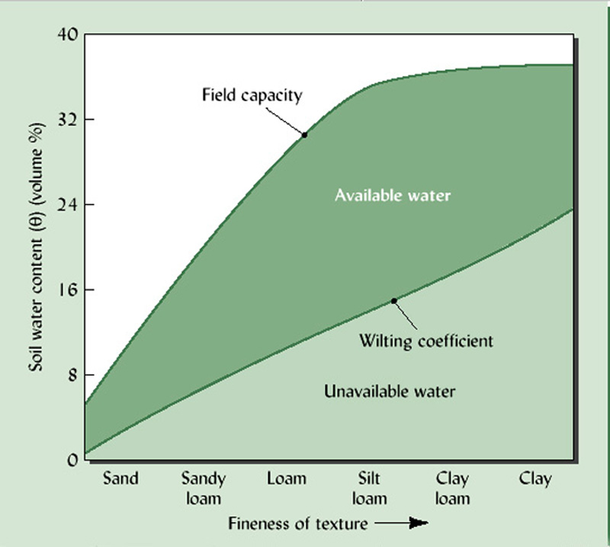
Source: Brady & Weil
Notes:
23. Discuss Water Content vs Texture in Soils. This should include: Field Capacity - the amount of water remaining in a soil after downward movement has ceased. Following a rain this may take 7-8 hours. Wilting Coefficient - the amount of water remaining in a soil when plants become permanently wilted-the plants cannot be revived by addition of water. So the biological classification of water held in the soil at tensions greater than the wilting coefficient is Unavailable Water. Available Water is the amount of water in a soil held at tensions between Field capacity and the Wilting coefficient. Note the width of the dark green band for a sandy loam soil and a silt loam!!! Which one would have to be irrigated most frequently?

Slide 24
Soil Structure
Manner in which soil particles are arranged together
Particles in sandy soils may remain independent of each other
- single grain texture
Particles in fine textured soils are arranged in a definite manner to form stable aggregates
Notes:
24. Soil Structure - the manner in which soil particles are arranged together.
Particles in sandy soils may remain independent of each other - single grain texture
Particles in fine textured soils are arranged in a definite manner to form stable aggregates.

Slide 25
Notes:
25. Soil Structure - 4 Types of Aggregates
Granular- this is one of the most desirable textures for plants. Found in soils with high amounts of organic matter - organically amended garden soils, soils receiving annual applications of organic matter.
Prismatic - not found in our soils. Mostly in the B horizons of Midwestern soils.
Blocky - Widely distributed in subsoils of southeastern soils; can also be found in the A horizon.
Platy - Very undesirable structure. Visualize the movement of water into and through a layer of soil with this structure. Compare the movement of water through this structure with that of PRISMATIC structure.

Slide 26
Importance of Soil Structure
Improves air & water relationships
Improves root penetration
Improves water infiltration
Reduces erosion
Ease of tillage
Reduces crusting
Notes:
26 .Importance of Soil Structure
-improves air & water relationships
-improves root penetration
-improves water infiltration
-reduces erosion
-makes tillage operations easier
-reduces crusting on the soil surface

Slide 27
Maintaining Soil Structure
Add Organic Matter
Till Soil When Moist
Not Too Wet or Too Dry
Grow Grasses
Grow Cover Crops
Keeps Soil Protected from Rain, etc.
Restrict Traffic
Notes:
27. Maintaining Good Soil Structure
-add organic matter - annually gives best results
-till soil when moist (not too wet or too dry)
-grow grasses
-grow cover crops (keeps soil protected from impact of rain drops
-restrict traffic

Slide 28
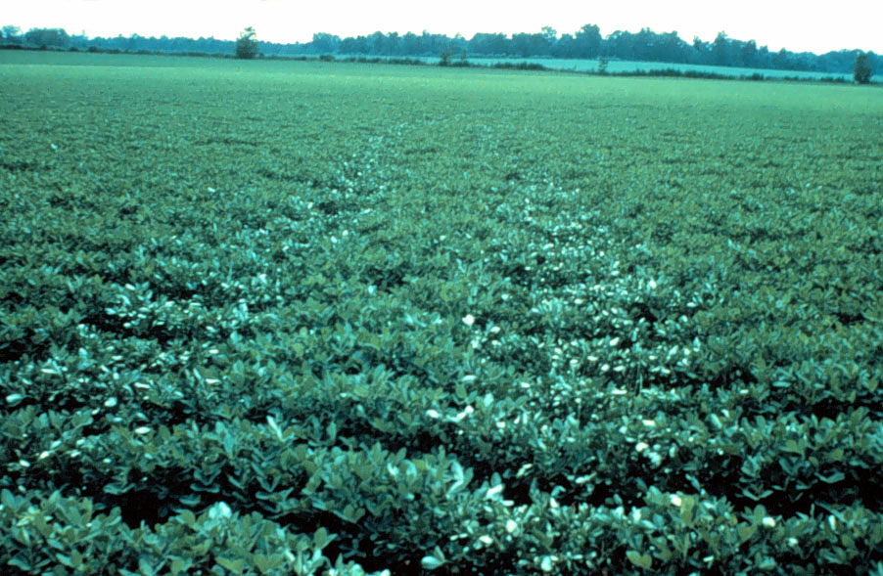
Notes:
28. Note the soil compaction areas (reduced growth) in this field caused by a truck three years ago.

Slide 29
Notes:
29. Good soil structure is very important in crop production. Compacted layers in the soil restrict root development. Note the root growth on the left versus that on the right where an in-row subsoiler was used at planting.

Slide 30
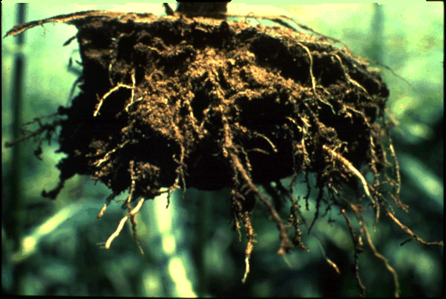
Notes:
30. Here’s another example of restricted root growth as a result of compaction.

Slide 31
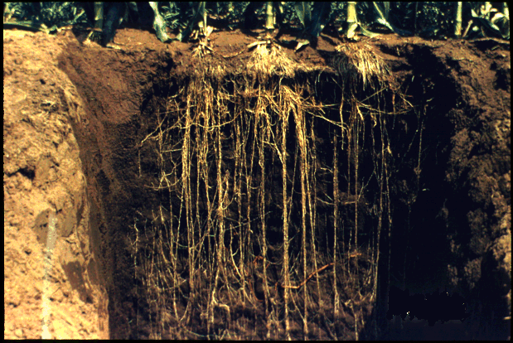
Notes:
31. This shows root development in corn in soils with no restrictive layers.

Slide 32
Relative Compacting Effects of Soils by Different Agencies
Pressure, Lb.
Item Per Sq. Inch
Man (150 pounds) 6
Crawler Tractor 12
Farm Tractor 20
Cattle 24
Trucks 50 –100
Rototiller (garden) 107 – 750
Notes:
32. This shows the relative compacting effect of various agencies. Figures are somewhat surprising aren't they?

Slide 33
Soil Color
Many different soil colors
Give important clues about soils chemical and physical environment
Notes:
33. Due to the variability in clay, and humus (organic matter) content, soils vary considerably in color, chemical, and physical properties.
It is not uncommon to find different soil types within a given field. For example, in this field we find soils ranging in texture from sands to clay. Colors ranging from black to brown, red, gray, and beige.
Color is important because it gives clues about the soils chemical and physical environment.
.

Slide 34
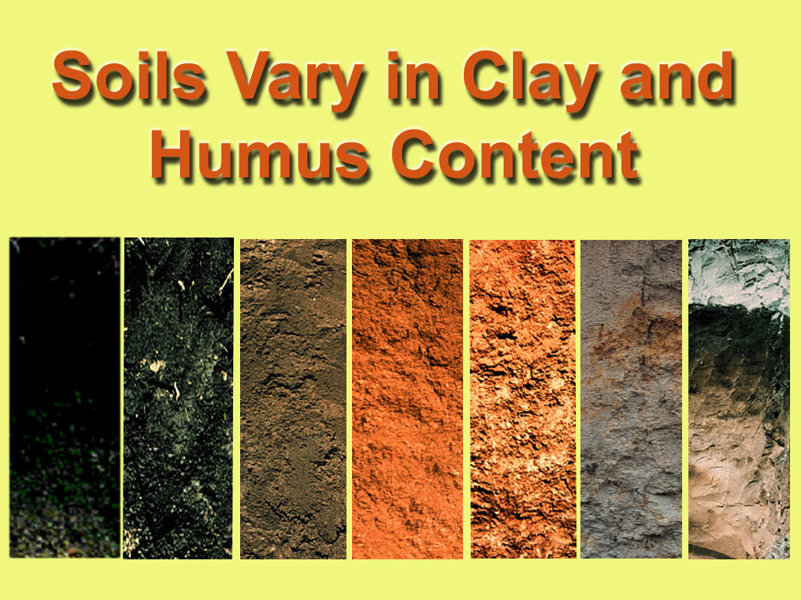
Notes:
34. For example, what about the organic matter in the three soils on the left - high or low organic matter content? Rank them.
Soil color gives us clues about soil aeration and water movement. When water movement and aeration are good soil colors are bright. When they are restricted for varying periods of time soils, especially in the B horizons, emit yellowish, light gray to gray colors. Now which of these soils would indicate the soil had been saturated long periods of time? (Second from right) Now what about for sometime? (Third from right) Would you want to build a house or plant some expensive shrubs on the second soil on the right side of the screen?

Slide 35
Organic Matter
Improves soil physical condition
Reduces erosion
Improves water infiltration
Improves water holding capacity
Increases soil cation exchange capacity
Source of nutrients
Notes:
35. Organic matter is very important in soils.
-it improves the physical conditions
-reduces erosion
-improves water infiltration
-improves water holding capacity
-increases soil cation exchange capacity (will talk about this later)
-source of plant nutrients

Slide 36
Organic Matter
Contains varying amounts of all the essential nutrient elements
- e.g. ~ 5% Nitrogen
Serves as important storehouse of elements such as nitrogen and sulfur
Nutrient elements contained in freshly added organic matter are not immediately available to plants
Residues must be decomposed into humus, and nutrients released in ionic form
Notes:
36. Contains varying amounts of essential nutrient elements.
- ~ 5% Nitrogen
-storehouse of elements such as nitrogen and sulfur
-Nutrients in freshly added organic matter are not immediately available to plants
-residues must be decomposed into humus and nutrients released in ionic form (having and electrical charge (+ , -).

Slide 37
Humus Formation
Carbohydrates
Cellulose
Proteins
Lignin
CO₂
Protein
Lignin
Humus
Residues
Notes:
37. Humus Formation

Slide 38
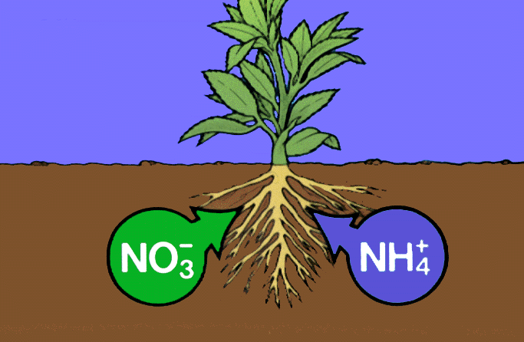
Nitrogen
Uptake
Notes:
38. Nitrogen Uptake - Following the breakdown of organic residues by microorganisms nitrogen is released into the soil as ammonium (NH4+) and nitrates (NO3-), which can be taken up by plants.

Slide 39
Soil
Microorganisms
Bacteria
Fungi
Actinomycetes
Algae
Notes:
39. Microbial activity is very important in soils. The soil is teeming with microorganisms, such as bacteria, fungi, actinomycetes, and algae. Protozoa and nematodes are also present.

Slide 40
Major Roles of Bacteria in Plant Nutrition
Fixation
Symbiotic ( with legumes )
Nonsymbiotic ( without legume )
Transformation
Mineralization (organic N to NH₄+ )
Nitrification (NH₄+ NO₂- NO₃-
ammonium nitrite nitrate
Denitrification(NO₃- N₂O- or N)
nitrate nitrous nitrogen
oxide
Oxidation
Elemental and organic S
S SO₄2-
_{sulfur sulfate}
Notes:
40. The importance of microorganisms is illustrated by this listing of the major roles of bacteria.
Fixation- symbiotic and nonsymbiotic;
Transformations of nitrogen - mineralization, nitrification, and denitrification;
Oxidation - Elemental and organic sulfur. Keep in mind that organic matter and certain elements are a source of energy for microorganisms.
So as long as an ample supply of organic matter is available the potential for a flourishing microbial population exists.

Slide 41
Regular Additions of Organic Residues Must Be Made to Maintain Soil Organic Matter Levels
Notes:
41. However, in our region regular additions of organic residues must be made to maintain soil organic matter levels

Slide 42
Notes:
42 .The amount of organic matter in soil depends on (1) the mean annual temperature, (2) mean annual rainfall, (3) and the amount of residue added. Where temperatures are high and rainfall is adequate, most organic residues break down fast. This is why most Georgia soils contain low amounts of organic matter (generally less than 1-1 ½%).

Slide 43
Soil Colloids
Notes:
43. SOIL COLLOIDS

Slide 44
Soil Colloids
Chemically active fraction
Made up of colloidal & colloidal-like particles
organic matter
clay
Colloids and clays develop electrical charges (+,-) as they are formed
Predominant electrical charge most clays and organic matter is negative (-)
Notes:
44. The chemical nature of soils is determined largely by the colloidal fraction. It is the chemically active fraction.
This is the smallest soil fraction and may be either colloidal (decomposed organic matter) or colloidal like particles (clay particles). Note all clay particles are not colloidal. Clay particles less than 0.001 mm in diameter are considered colloidal; clay particles less than 0.002 mm but greater than 0.001 mm in diameter are not colloidal but because they possess electrical charges they are colloidal-like.
Colloids and clays develop electrical charges (+ , -) as they are formed.
The predominant electrical charge on most clays and organic matter is negative (-).

Slide 45
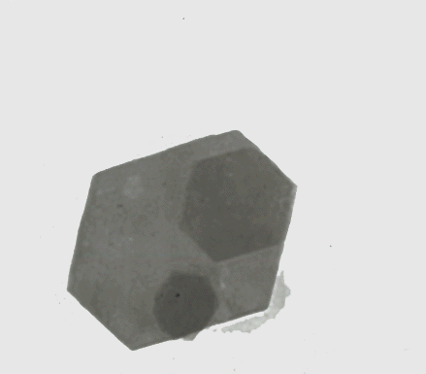
Notes:
45. This slide shows an electron micrograph of a kaolinite particle. This is the predominant clay mineral in our soils. Note its shape. You can also see the shadow of another kaolinite particle and a montmorillonite or mica particle.

Slide 46
Soil colloids may be envisioned
as a huge anion
Kaolinite Particle
Ca2+
K+
Mg2+
Al3+
Mg2+
K+
Ca2+
Notes:
46. Soil colloids may be envisioned as a huge anion. The soil colloids are the seat for practically all chemical reactivity. Colloids have a net negative (-) charge and attract cations (+) such as K+, Ca++, and Mg++.

Slide 47
Notes:
47. Remember that unlike charges attract each other and like charges repel each other. If were not for this phenomena, attraction of unlike charges, nutrients added in the form of fertilizers such as potassium (K+) and magnesium (Mg2+) would be free to leach from the soil. Sandy soils do not possess many negative charges, therefore, this is why potassium and magnesium leaches out of a sandy soil quicker than a from a clay soil. Additions of organic matter, in most cases, will alleviate this problem to a great extent, because organic matter is a major source of negative charges in our soils. Keep in mind though that negative charges from organic matter are not permanent. Additions of organic matter need to be made on a regular basis to maintain the organically derived negative charges.
We noted that like-charges repel each other. So when nitrogen is added to the soil a large portion is converted to the nitrate form (NO3_). Since clays and organic matter are predominantly negatively charged and since like charges repel each other, nitrate nitrogen leaches readily from the soil. This is why in many situations multiple applications of nitrogen must be made to crops during the growing season. Sulfate-sulfur (SO42-) reacts much in the same manner

Slide 48
Cation Exchange
Ca
+
2H+
H
+
Ca2+
H
Notes:
48. Cations adsorbed onto colloids can be exchanged by other cations that are in soil solution. Also cations adsorbed onto colloids are "available" when the plant needs them.

Slide 49
Cation Exchange Capacity of Clays & Organic Matter
Notes:
49. This slide shows the cation exchange capacity of some important clay minerals. It is important to note the higher the exchange capacity, the more positively charged nutrients a soil can hold, thus the higher the fertility level. Compare kaolinite (Georgia soils) with montmorillonite (Illinois soils). Which would be the more fertile? Now look at the exchange capacity of organic matter, 200-400 cmol(+)/kg. So for each 1% organic matter present in a soil it adds 2-4 cmol(+)/kg, almost as much as from kaolinite.

Slide 50
Soil pH
Notes:
50. Another important aspect of soils is "soil pH" or "soil reaction".

Slide 51
pH is a term used to describe the H ion (H⁺) activity and/or concentration in solution
pH = -log (H⁺)
Notes:
51. Soil pH is a term used to express the relative acidity or alkalinity of a soil. It is expressed on a logarithmic basis as pH = -log(H+).

Slide 52
Notes:
52. The pH scale is divided into values ranging from 0 to 14.

Slide 53
pH Expressions
pH of Solution | Hydrogen ion activity, g/liter
9.0 (strongly alkaline) | 10⁻⁹ (0.000000001)
8.0 (moderately alkaline) | 10⁻⁸ (0.00000001)
7.0 (neutral) | 10⁻⁷ (0.0000001)
6.0 (moderately acidic) | 10⁻⁶ (0.000001)
5.0 (strongly acidic) | 10⁻⁵ (0.00001)
4.0 (very strongly acidic) | 10⁻⁴ (0.0001)
Notes:
53. pH expressions. pH of soil or solutions can be rated as to the degree of acidity or alkalinity. Also note from this slide that the hydrogen ion activity at any given pH is quite small. For example, at pH 6.0 the activity is ten to the minus 6 grams/liter. However, it doesn’t take much hydrogen to have a big impact on chemical reactions, etc. ....

Slide 54
Soil pH Reflects Hydrogen Ion Activity
Alkalinity
Acidity
Notes:
54. Using the logarithmic approach, each single unit pH change represents a ten fold change in hydrogen ion activity. Thus, a soil with a pH of 6.0 has 10 times the hydrogen ion activity as a soil with a pH of 7.0; a soil with a pH of 5.0 has 100 times more hydrogen ion activity as a soil with a pH of 7.0, etc.

Slide 55
pH of Common Products & Soils
Range found in
common products
Range found
in various soils
pH scale
Milk of
magnesia
10
Sodic
soils
9
Bicarbonate
of soda
8
Calcareous
soils
Pure water
Milk
7
Humid
region
arable
soils
6
Natural rain
5
Forest
soils
Beer
Coffee
4
Notes:
55. Different substances have different degrees of acidity and alkalinity (see slide).

Slide 56
Soil pH is one of the most important chemical reactions that occurs in soils
Why?
Notes:
56. Soil pH is considered by some soil chemists to be one of the most important soil reactions. Why?

Slide 57
It affects so many reactions and activities that occur in soils
Notes:
57. Because it influences so many reactions and activities that occur in soils. Some of these factors are shown in the next 6 Slides.

Slide 58
Chemical Reactions
Notes:
58. Chemical Reactions - Generally the more acidic a medium the faster a chemical reaction occurs.

Slide 59
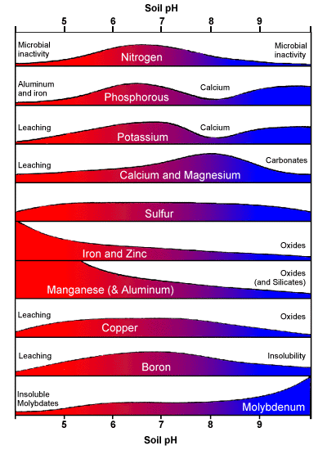
Nutrient
Availability
disk 10
Notes:
59. Nutrient availability. Note differences in Mn and Zn availability at low pH compared with that of N, P, and K. Micronutrients are generally more available at low pH’s except for molybdenum which is more available at high pH.

Slide 60
Toxic Elements in Soils
Al and Mn
Notes:
60. Toxic elements in soils.

Slide 61
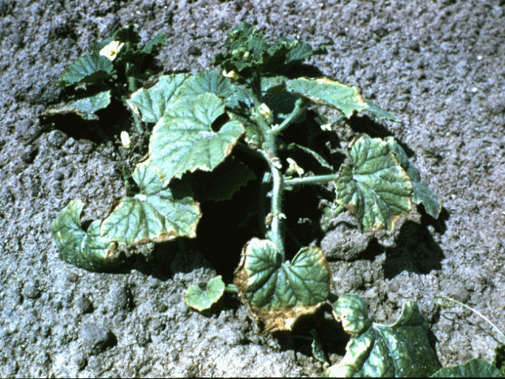
Toxic Elements in Soils
Al and Mn
Disk 11 Gary
Notes:
61. Toxic elements in soils. The cantaloupes show signs of manganese. The bare area in the lower picture shows aluminum toxicity in cotton.

Slide 62
Notes:
63. Low soil pH (high acidity levels) affects root development in plants. Here you see the effects of high manganese and aluminum on root development of cotton roots at different pH’s.

Slide 63
Notes:
60. This slide shows the effect of soil pH on nitrification in soils by bacteria. The ideal range in pH is from about 5.5 to 7.0 (this would be equivalent to CaCl2 values of 4.9 to 6.4) with the maximum rate occurring at pH 6.5 (equivalent to CaCl2 value of 4.9).

Slide 64
Notes:
64. We saw earlier that pH affects nutrient availability in soils. pH also affects the relative efficiency of applied fertilizers. Here we see that the efficiency of applied nitrogen is 53% at pH 5.0 as compared to 100% at pH 6.5. So if one applies 100 lbs of nitrogen to a soil with a pH of 5.0, they lose 47 lbs of nitrogen compared to the same amount applied to a soil with a pH of 6.5!!

Slide 65
Notes:
65. Here we see the relative efficiency of applied phosphorus. Very similar to that of nitrogen except pH exerts a more negative influence on the availability of applied phosphorus at pH 6.0.

Slide 66
Notes:
66. And finally we see the influence of pH on applied potassium. As you can see here pH does not reduce the efficiency of applied potassium until the pH drops to approximately 5.0.

Slide 67
Soils Become Acid Because-
Developed in areas with high rainfall, resulting in:
a. leaching and plant uptake of base forming cations (Ca²⁺, Mg²⁺, and K⁺)
b. rapid reaction of water with Al & Fe, which produces H ions
Application of acid forming fertilizers
mostly those containing ammonical (NH₄⁺) nitrogen
Decomposition of organic matter
Microbial activity
Notes:
67. Soils become acid because
-developed in areas with high rainfall, resulting in:
-leaching and plant uptake of base forming cations (Ca2+, Mg2+, and K+).
-rapid reaction of water with Al & Fe, which produces H ions
-application of acid forming fertilizers - mostly those containing ammonical (NH4+) nitrogen.
-decomposition of organic matter
-microbial activity

Slide 68
Nitrogen Conversion in the Soil Produces Acidity
Organic Matter
Manure, etc.
2 NH₄+ + 4O₂ Bacteria 2NO₃- + 2H₂O + 4H+
NH₄ - N Fertilizer
Sources
Note: The H+ is the
acidity component
Notes:
68. Nitrogen conversions in the soil produce acidity. When organic matter decomposes, one of the first products formed is ammonia. In the presence of oxygen and bacteria, nitrates and hydrogen ions are produced. The latter increases acidity (lower soil pH). A similar effect occurs when ammoniacal nitrogen fertilizers are applied to the soil.

Slide 69
Determining Soil Acidity
pH Kits
pH Meters
Notes:
69. Determining soil acidity levels. Two methods that are used most often are soil pH kits (indicator dyes) and pH meters. Indicator dyes are sometimes used in the field to make rapid pH determinations. They must be used with extreme care to avoid errors - not generally recommended for use. Numerous studies have shown that the kits only give approximations and sometimes they are not even close. So if you have plants that you value send your samples off to a soil testing laboratory for analysis. Laboratory results are generally reported to the nearest 0.1 unit., if limestone is needed the laboratory will give a recommendation. You can not determine the limestone requirement with a soil testing kit!!!

Slide 70
Determining Soil pH & Limestone Requirement at UGA Laboratory
Automated soil pH analyzer (130 samples can be analyzed per hour)
Two analyzers operational gives the Lab capacity to analyze 260 samples/hour for pH and lime requirement
Soil pH is recorded on soil test report as pH_{CaCl2} and Equivalent Water pH along with the lime buffer capacity.
Notes:
70. Measuring the soil's pH is the first step in determining its lime requirement. However, liming needs cannot be solely assessed on the basis of soil pH measurement. A soil's lime buffering capacity - its ability to resist a change in pH when limestone is applied - must be measured. The lime buffer capacity (LBC) is now reported on the new University of Georgia soil test reports. The LBC and the soil pH determined in a dilute solution of calcium chloride (CaCl2) are then used to determine the limestone recommendation. This is accomplished by placing the soil in a dilute calcium chloride (CaCl2) solution and recording the reading. After a 30 minute period the sample is then titrated with a dilute solution of calcium hydroxide (Ca(OH)2) to neutralize the soil acidity. Using the amount of calcium hydroxide required to neutralize the exchangeable acidity the desired pH, and the pH in the CaCl2 solution the Lime Buffer Capacity that appears on your soil test report is determined.

Slide 71
Desired pH
6.0 - 6.5
Note these pH values are equivalent to 5.4 and 5.9 for pH determined in calcium chloride
Notes:
71. For most garden soils, a soil pH between 6.0 to 6.5 is desirable. Note that this is equivalent to a calcium chloride pH of 5.4 to 5.9.

Slide 72
Desired pH for Some Crops
5.0 – 5.5* | 5.5 – 6.0* | 6.0 – 6.5*
Blueberries | Sweet Potatoes | Sweet Corn
Irish Potatoes | Lawn Grasses | Tomatoes
Azaleas | Annual Flowers | Onions
Rhododendrons | Perennial Flowers | Cabbage
 | Spring Flowering Bulbs | Watermelon
*pH_{w} Values
Notes:
72. However, with certain crops, there are exceptions. Some plants requiring different soil pH's are shown here and also listed in the "Master Gardener Handbook". Note: When comparing these values with the CaCl2 pH values from the University of Georgia Soil Test Laboratory deduct 0.6.

Slide 73
How Can We Reduce Soil Acidity?
Apply Liming Materials
Notes:
73. How can we reduce soil acidity?
-apply liming materials

Slide 74
Lime Sources and Their Relative Neutralizing Values
*Calcium Carbonate is used as a standard with a neutralizing
value of 100
Notes:
74. Here is a listing of some lime sources and their relative neutralizing values. The more commonly used liming materials in Georgia are dolomitic and calcitic limestone. If soil test results indicate that magnesium is low, dolomitic limestone is the preferred source. If magnesium is medium or high, calcitic or dolomitic limestone can be used. When quick increases in soil pH are required, hydrated (slaked) lime or burned lime are often used, however, they must be used with extreme care to avoid excessively high soil pH's. Also, if they come in contact with wet foliage leaf burn may occur. Note that their neutralizing values are higher than either dolomitic or calcitic limestone which means less has to be applied to achieve the same results.

Slide 75
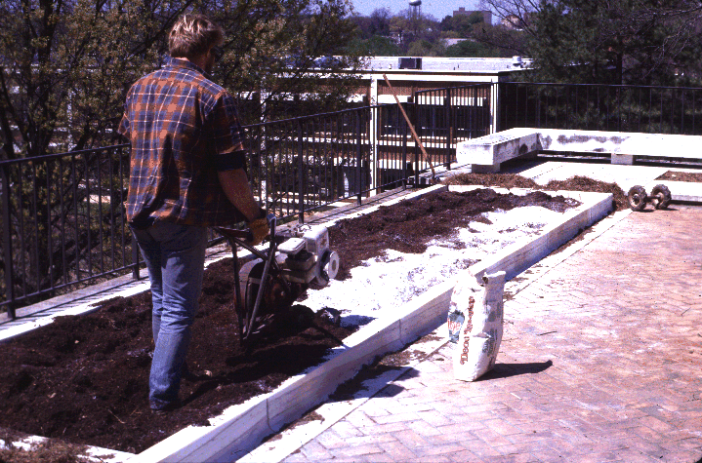
Incorporate Lime for Best Results
Notes:
75. Keep in mind that once the need is arrived at one of the most important factors determining the effectiveness of lime is placement. Make sure it is thoroughly mixed within the plow layer. Other considerations are: (1) particle size of the limestone, (2) neutralizing value, (3) moisture content (Not too much of a problem with homeowners).
Remember, however, the danger of over liming can be as great as not liming at all. You have to know when to start and when to stop.

Slide 76
FREQUENCY AND RATE OF LIMING DEPENDS ON:
SOIL pH
SOIL TEXTURE
NITROGEN FERTILIZATION RATES
REMOVAL OF Ca AND Mg BY PLANTS
AMOUNT OF LIME PREVIOUSLY APPLIED
SOIL pH RANGE DESIRED
Notes:
76. It is almost impossible to determine how often and how much limestone should be applied without the aid of a soil test. The frequency of liming acid soils depends on: (1) soil pH, (2) soil texture (3) nitrogen fertilization rates, removal of calcium and magnesium by crops, (4) amount of lime previously applied, (5) soil pH range desired. Check by our office or I will pass out information on how to get a soil test run on your garden or lawn.

Slide 77
Acidifying Soils
Acidifying soils is frequently required in nursery and horticultural situations.
Notes:
77. Acidifying soils is frequently required in nursery and horticultural situations.

Slide 78
Materials Used for Acidifying Soils
Elemental sulfur
Aluminum sulfate (Alum)
Iron sulfate
Notes:
78. Materials used for acidifying soils
-elemental sulfur (S)
-aluminum sulfate (alum)
-iron sulfate

Slide 79
Reducing Soil pH with Sulfur or Aluminum Sulfate
5.5 |  |  |  | 6.0
Initial Soil pH_{w} | Textural Classification
 | Sandy | Loamy | Clayey | Sandy | Loamy | Clayey
 | Sulfur Required, lbs per 1000 ft^{2**}
5.5 | 0 | 0 | 0
6.0 | 4 | 10 | 16 | 0 | 0 | 0
6.5 | 8 | 20 | 32 | 4 | 10 | 16
7.0 | 12 | 29 | 47 | 8 | 20 | 32
7.5 | 15 | 38 | 61 | 12 | 29 | 47
**Aluminum sulfate rate = lbs. Sulfur x 6
Notes:
79. The following 2 slides show the amounts of aluminum sulfate and/or sulfur to apply to a given soil to reduce the pH to the desired level. Note that if aluminum sulfate is used the acidifying agent the Sulfur values in the tables must be multiplied by 6.

Slide 80
Reducing Soil pH with Sulfur or Aluminum Sulfate
4.5 |  |  |  | 5.0
Initial Soil pH_{w} | Textural Classification
 | Sandy | Loamy | Clayey | Sandy | Loamy | Clayey
 | Sulfur Required, lbs per 1000 ft^{2**}
5.0 | 4 | 10 | 16 | 0 | 0 | 0
5.5 | 8 | 20 | 32 | 4 | 10 | 16
6.0 | 12 | 29 | 47 | 8 | 20 | 32
6.5 | 15 | 38 | 61 | 12 | 29 | 47
7.0 | 19 | 48 | 77 | 15 | 38 | 61
7.5 | 23 | 57 | 92 | 19 | 48 | 77
**Aluminum sulfate rate = lbs. Sulfur x 6
Notes:
80. Reducing soil pH with sulfur or aluminum sulfate

Slide 81
Elemental sulfur and sulfur compounds are the most popular acidifying materials.
Bacteria are required for this process to occur.
2S + 3O₂ + 2H₂O → 2H₂SO₄ (Thiobacillus)
Notes:
81. Elemental sulfur and sulfur compounds are the most popular acidifying agents. However, when sulfur is applied to cold soils very little if any acidification will occur until the soil warms up. The reason is the process requires bacteria (Thiobacillus) and their activities are diminished in cold soils.

Slide 82
Aluminum and iron sulfates can also be used
These materials are very effective but are sometimes difficult to find
They react quicker and do not require microbial oxidation
Acidity is result of hydrolysis reaction:
Al₂(SO₄)₃ + 6H₂O ↔ 2Al(OH)₃ + 6H⁺ + 3SO₄⁼
Fe₂(SO₄)₃ + 6H₂O ↔ 2Fe(OH)₃ + 6H⁺ + 3SO₄⁼
Notes:
82. As noted earlier aluminum and iron sulfates can used to acidify soils. They react quicker and are dependent upon microorganisms to generate acidity. They are sometimes hard to find.

Slide 83
Questions?
Notes:
83. DISCUSSION QUESTIONS
1. What are the four major components of soil?
2. The amount of water a soil contains after plants are permanently wilted is called what?:
3. The total amount of exchangeable cations a soil can hold is called its:
4. The relative acidity or basicity of a substance, or a measure of hydrogen ion activity expressed in logarithmic terms is a definition of:
5. For best results, when should limestone be applied and why?
6. What is meant by the term soil texture?
7. What are the three macroelements and how do they affect plant growth?
8.Name three secondary elements.
9. Which materials are used to increase the pH of an acid soil?
10. A soil pH of 6.0 indicates the soil is:

Slide 84
The End
Thank You
Notes:
83. DISCUSSION QUESTIONS
1. What are the four major components of soil?
2. The amount of water a soil contains after plants are permanently wilted is called what?:
3. The total amount of exchangeable cations a soil can hold is called its:
4. The relative acidity or basicity of a substance, or a measure of hydrogen ion activity expressed in logarithmic terms is a definition of:
5. For best results, when should limestone be applied and why?
6. What is meant by the term soil texture?
7. What are the three macroelements and how do they affect plant growth?
8.Name three secondary elements.
9. Which materials are used to increase the pH of an acid soil?
10. A soil pH of 6.0 indicates the soil is:

Slide 85
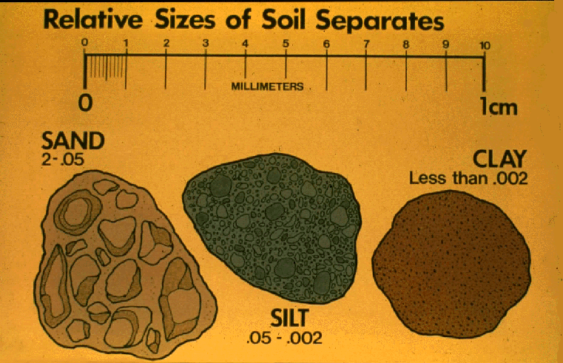

Slide 86
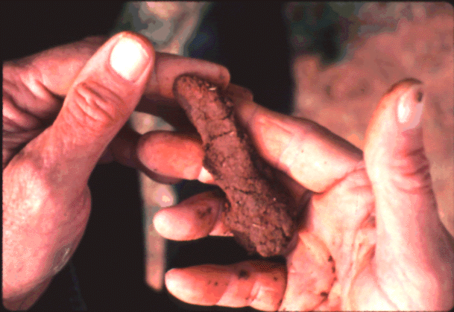
In the field, texture is determined by “feel”
Texture - 1 Disk 3

Slide 87
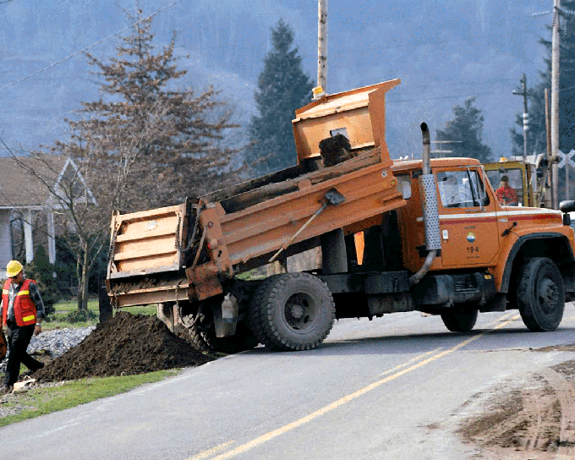
Clay → Clay loam
400,000 lbs Sand Per Acre

Slide 88
WATER HELD BY DIFFERENT SOILS
INCHES PER
5 FT. OF SOIL
KIND OF SOIL
LOAMY SAND (LAKELAND etc.)
3.0
SANDY LOAM (NORFOLK, TIFTON)
7.0
SANDY CLAY LOAM
(CECIL, GREENVILLE)
7.8

Slide 89
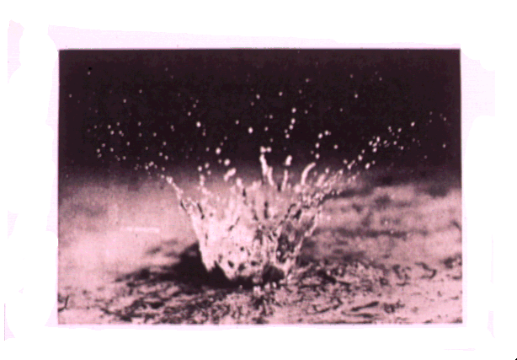
Raindrop Disk 5

Slide 90
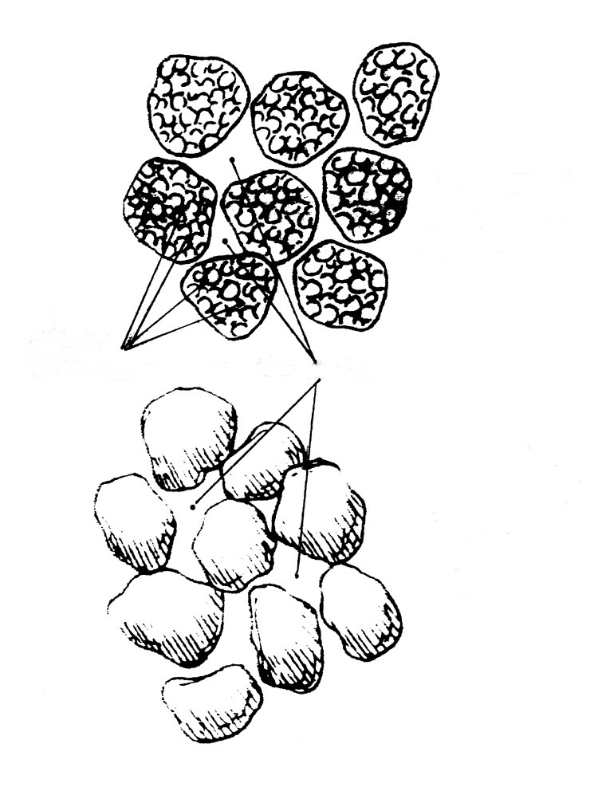
Loamy
aggregates
Intrapped
micropores
Macropores
Coarse sand
grains

Slide 92
Soil pH
&
Liming

Slide 93
pH Scale
9.0
Strong
pH Value Defines Relative Acidity or Alkalinity
Alkalinity
8.0
Medium
Slight
7.0
Neutrality
Slight
Moderate
6.0
Medium
Acidity
5.0
Strong
Very
Strong
4.0

