Slide 1
SMALL TREES for SMALL SPACES
Dr. John M. Ruter
Professor - Nursery Crops
University of Georgia
Department of Horticulture
Tifton Campus
Keith Mickler
County Extension Agent
University of Georgia
Cooperative Extension
Floyd County

Slide 2
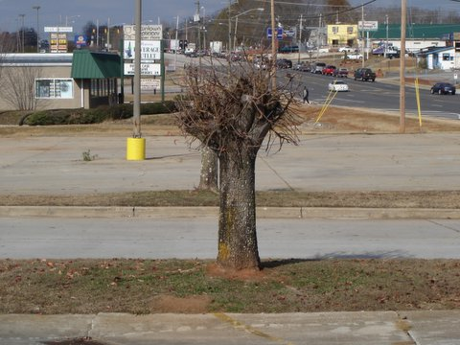

Slide 3
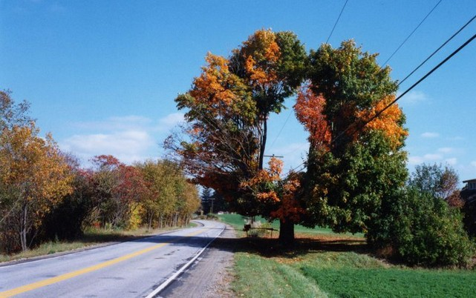

Slide 4
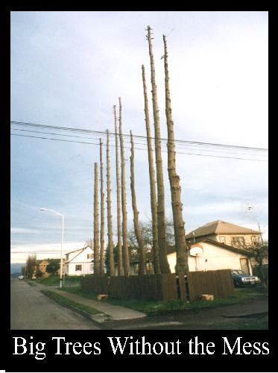
Skinny Tree for Skinny Space

Slide 5
Acer buergerianum Trident Maple
deciduous tree reaching 20-30’ tall
three-lobed leaves are dark green in summer and provide some fall color
does well in full sun and small planters
heat and drought tolerant

Slide 6
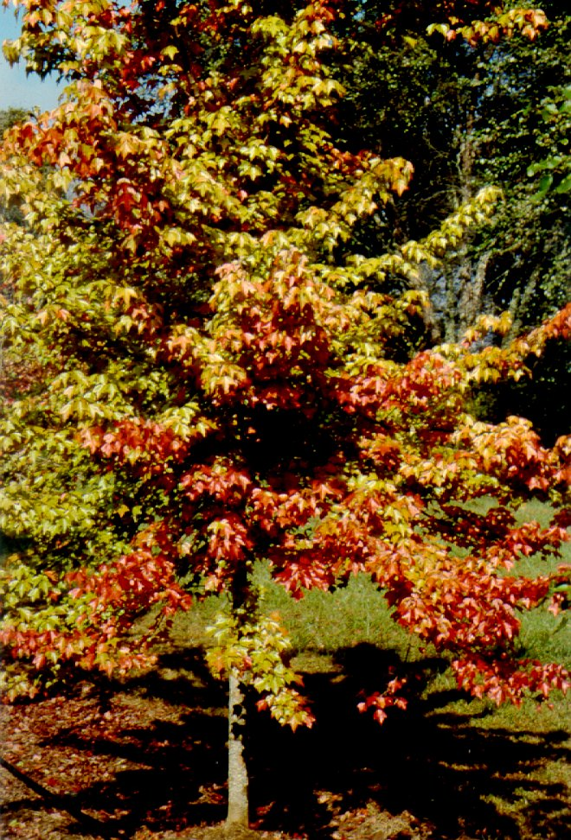
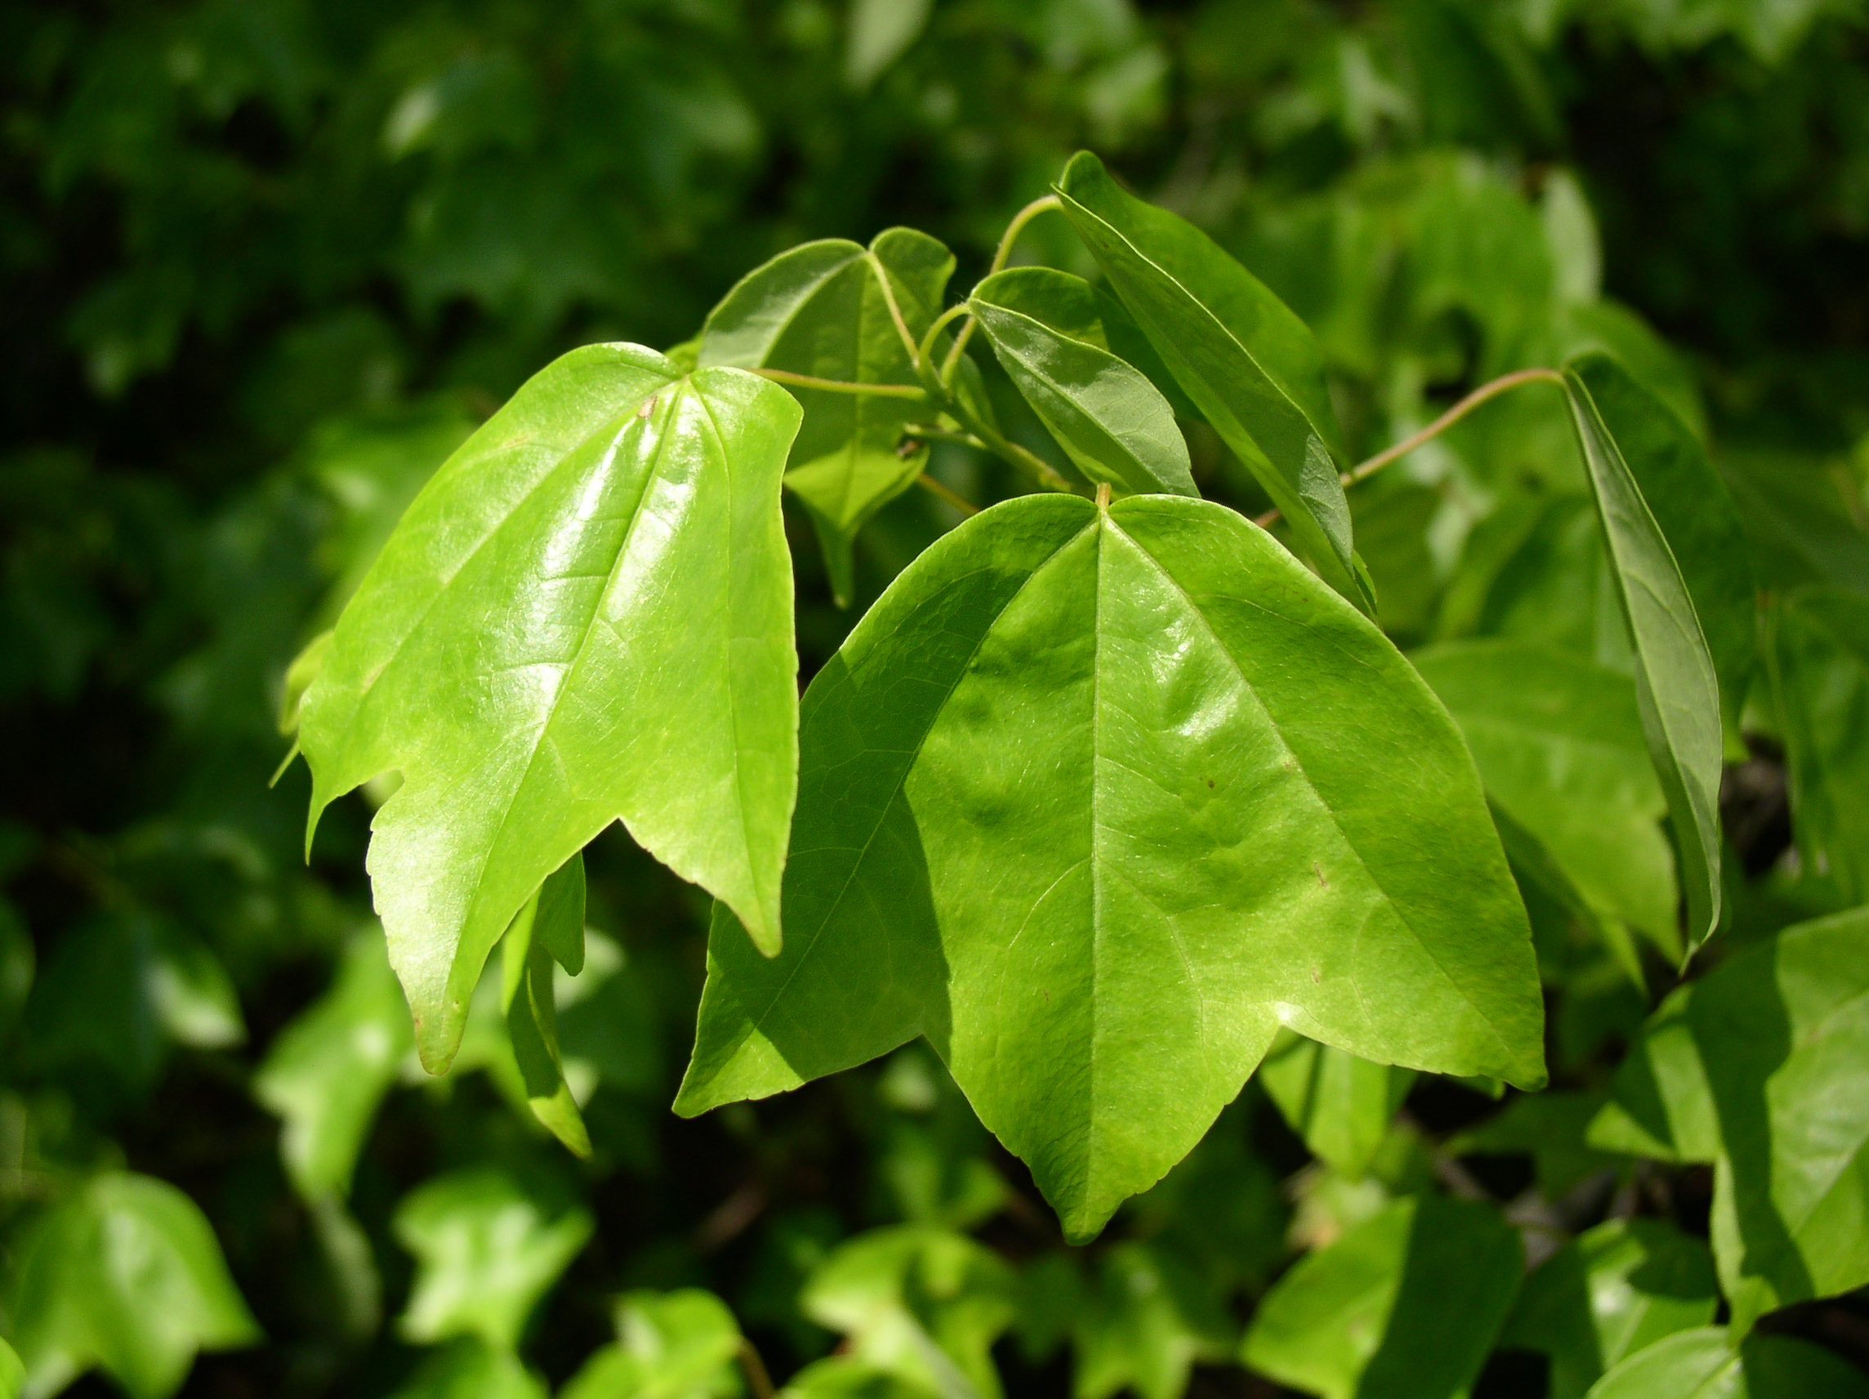

Slide 7
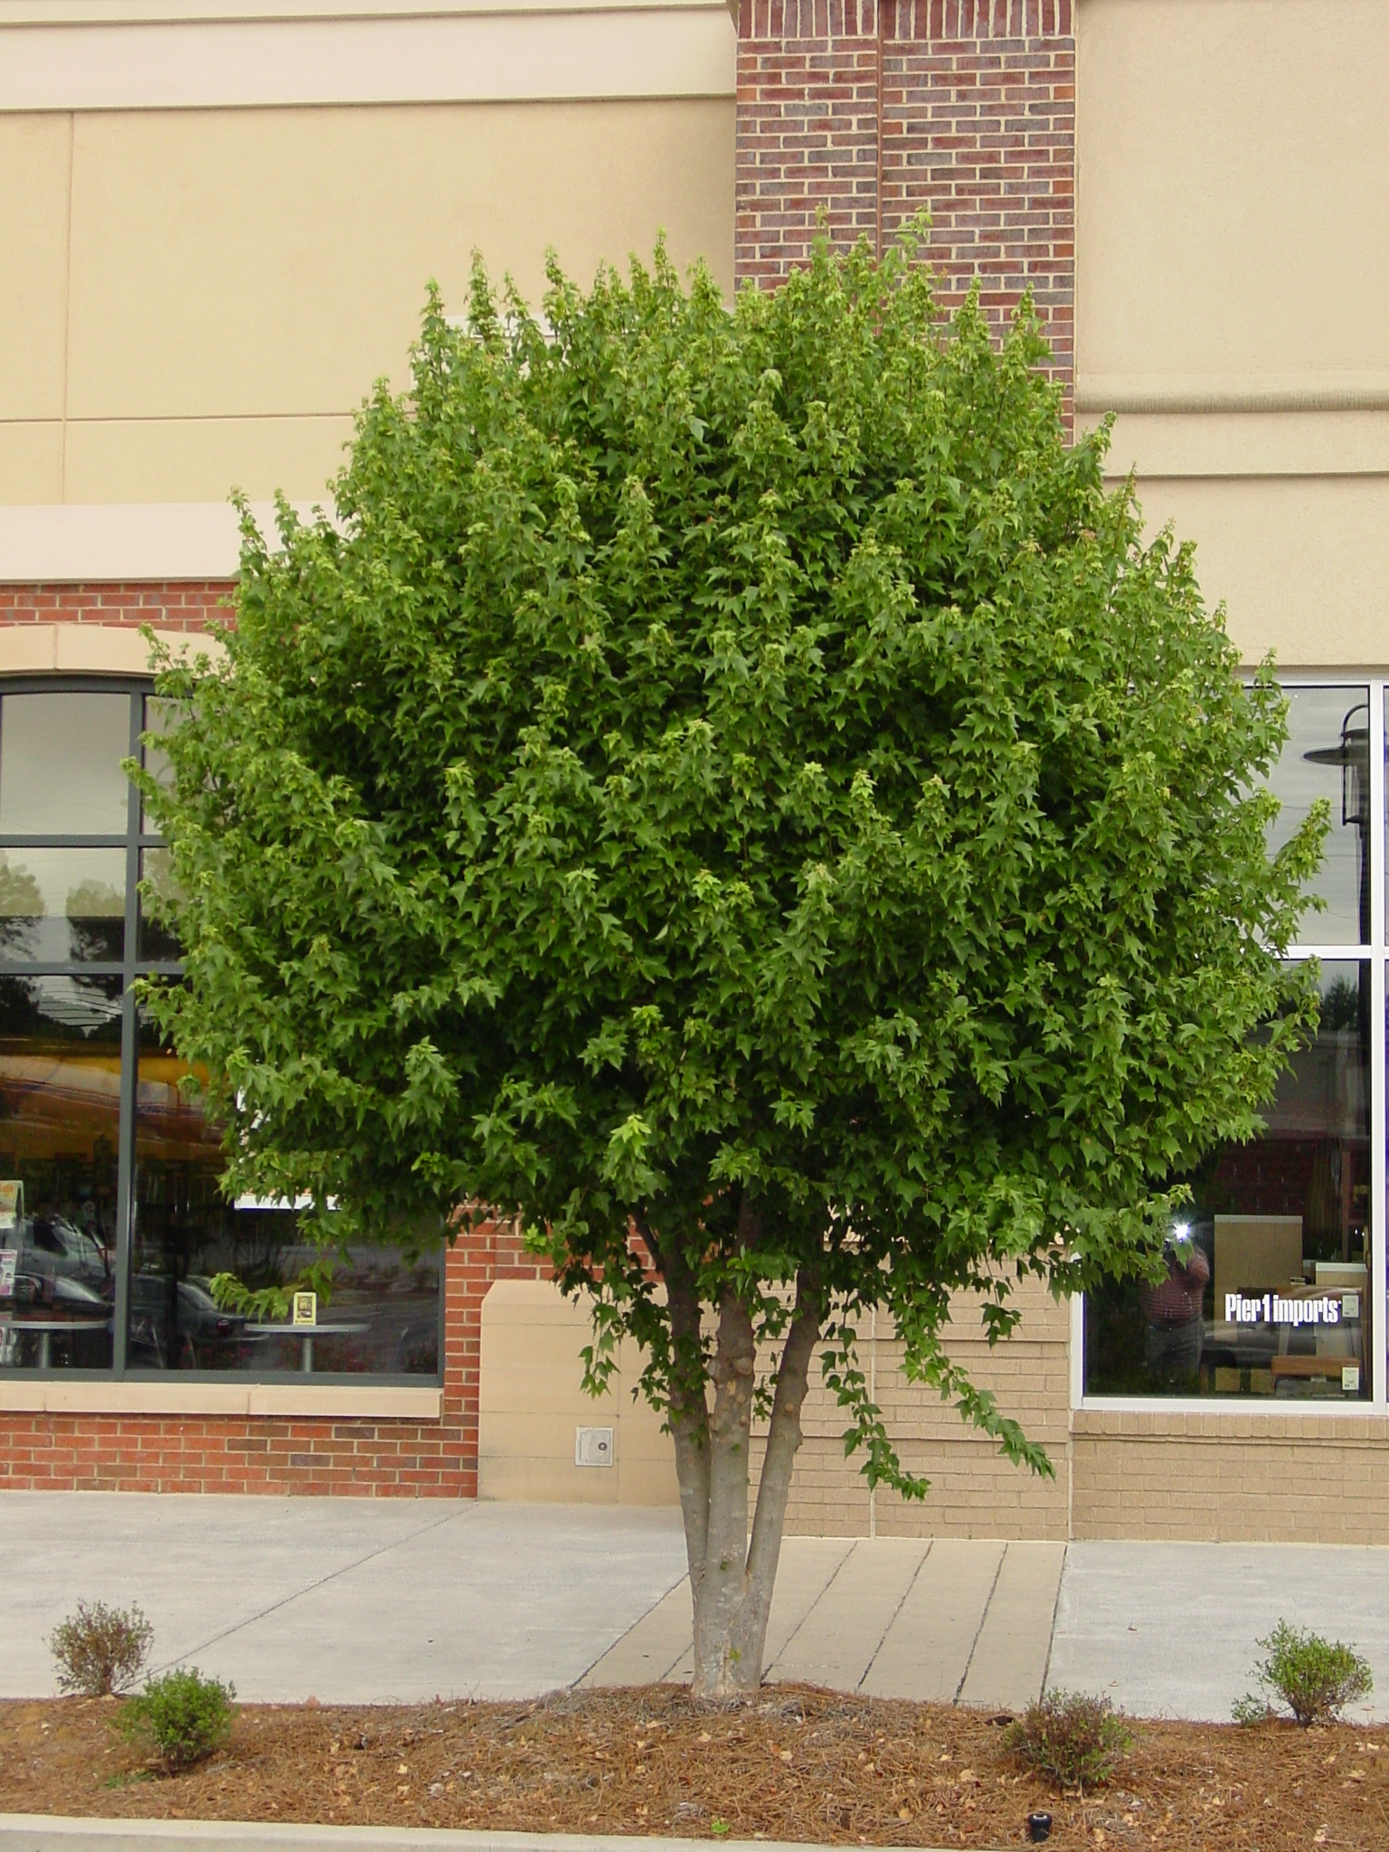
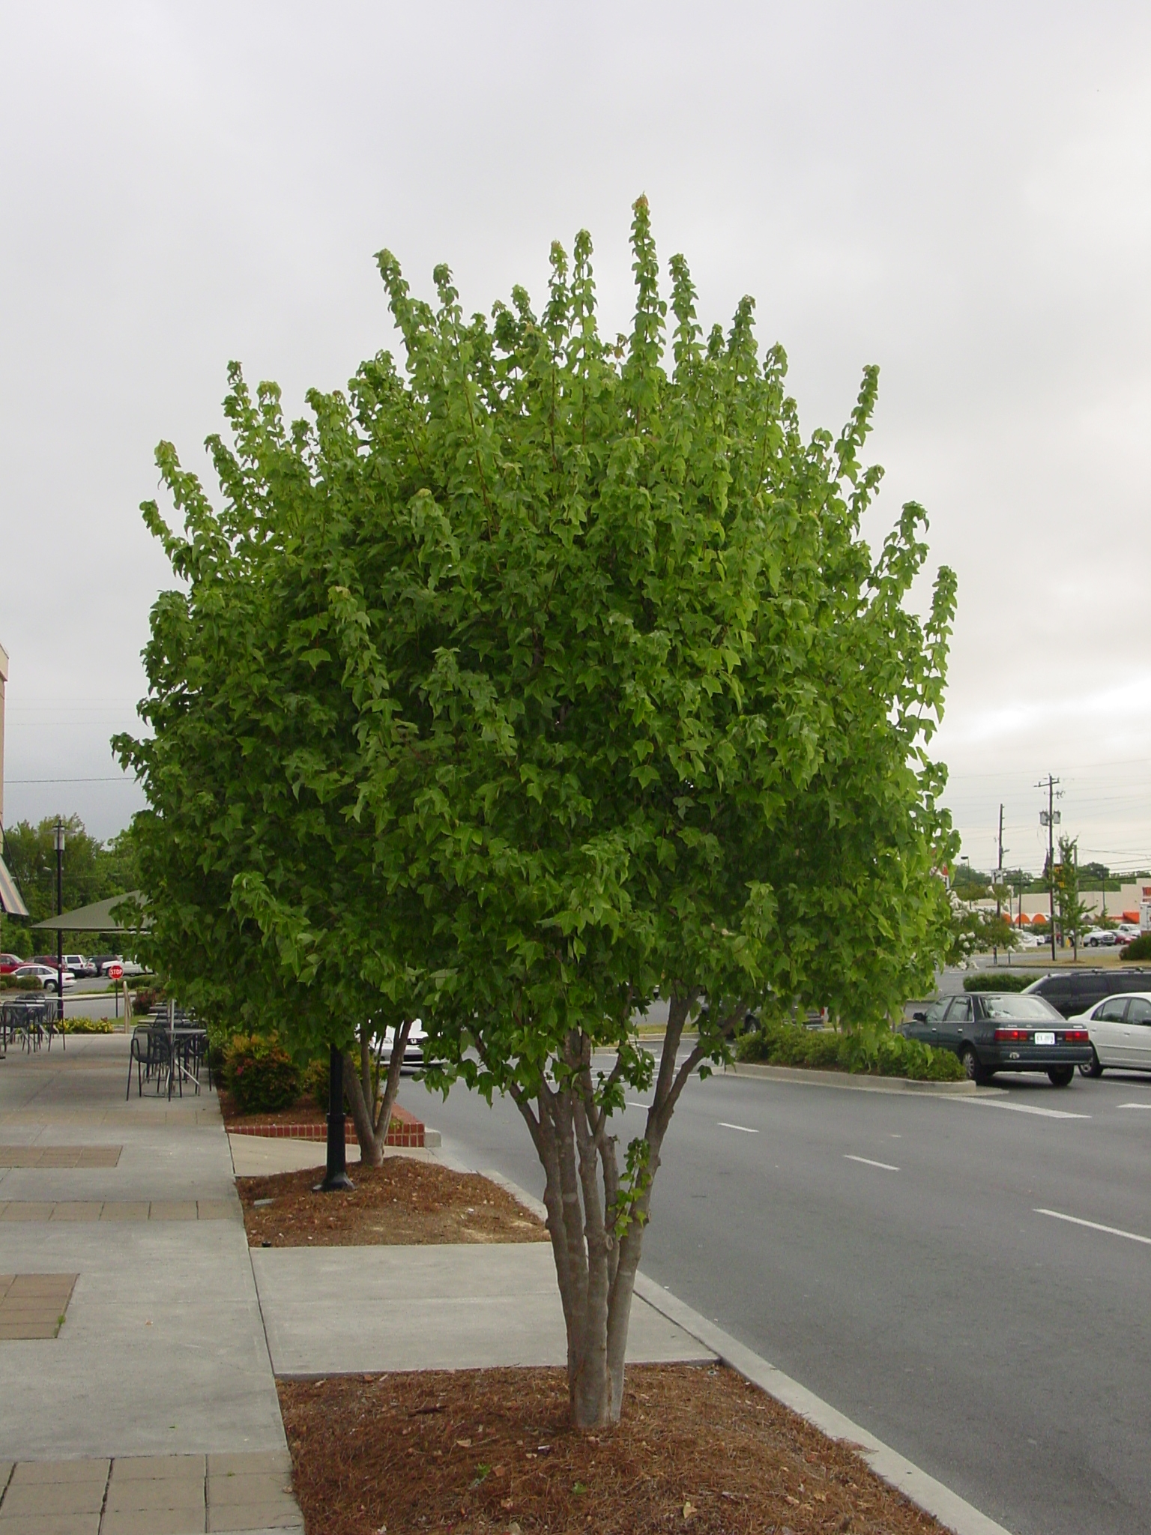

Slide 8
Acer palmatum Japanese Maple
striking small trees known for red-leaved cultivars
most selections have green leaves
reach 15-20’ in height, although dissectum cultivars are much smaller
grow well in full sun, although in So. Georgia, afternoon shade is preferred
requires adequate moisture and does not tolerate drought

Slide 9
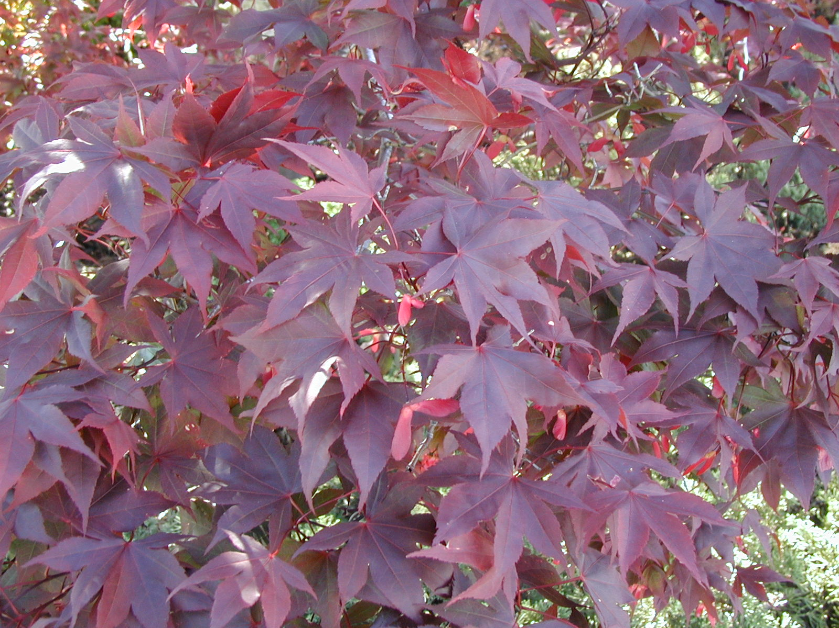
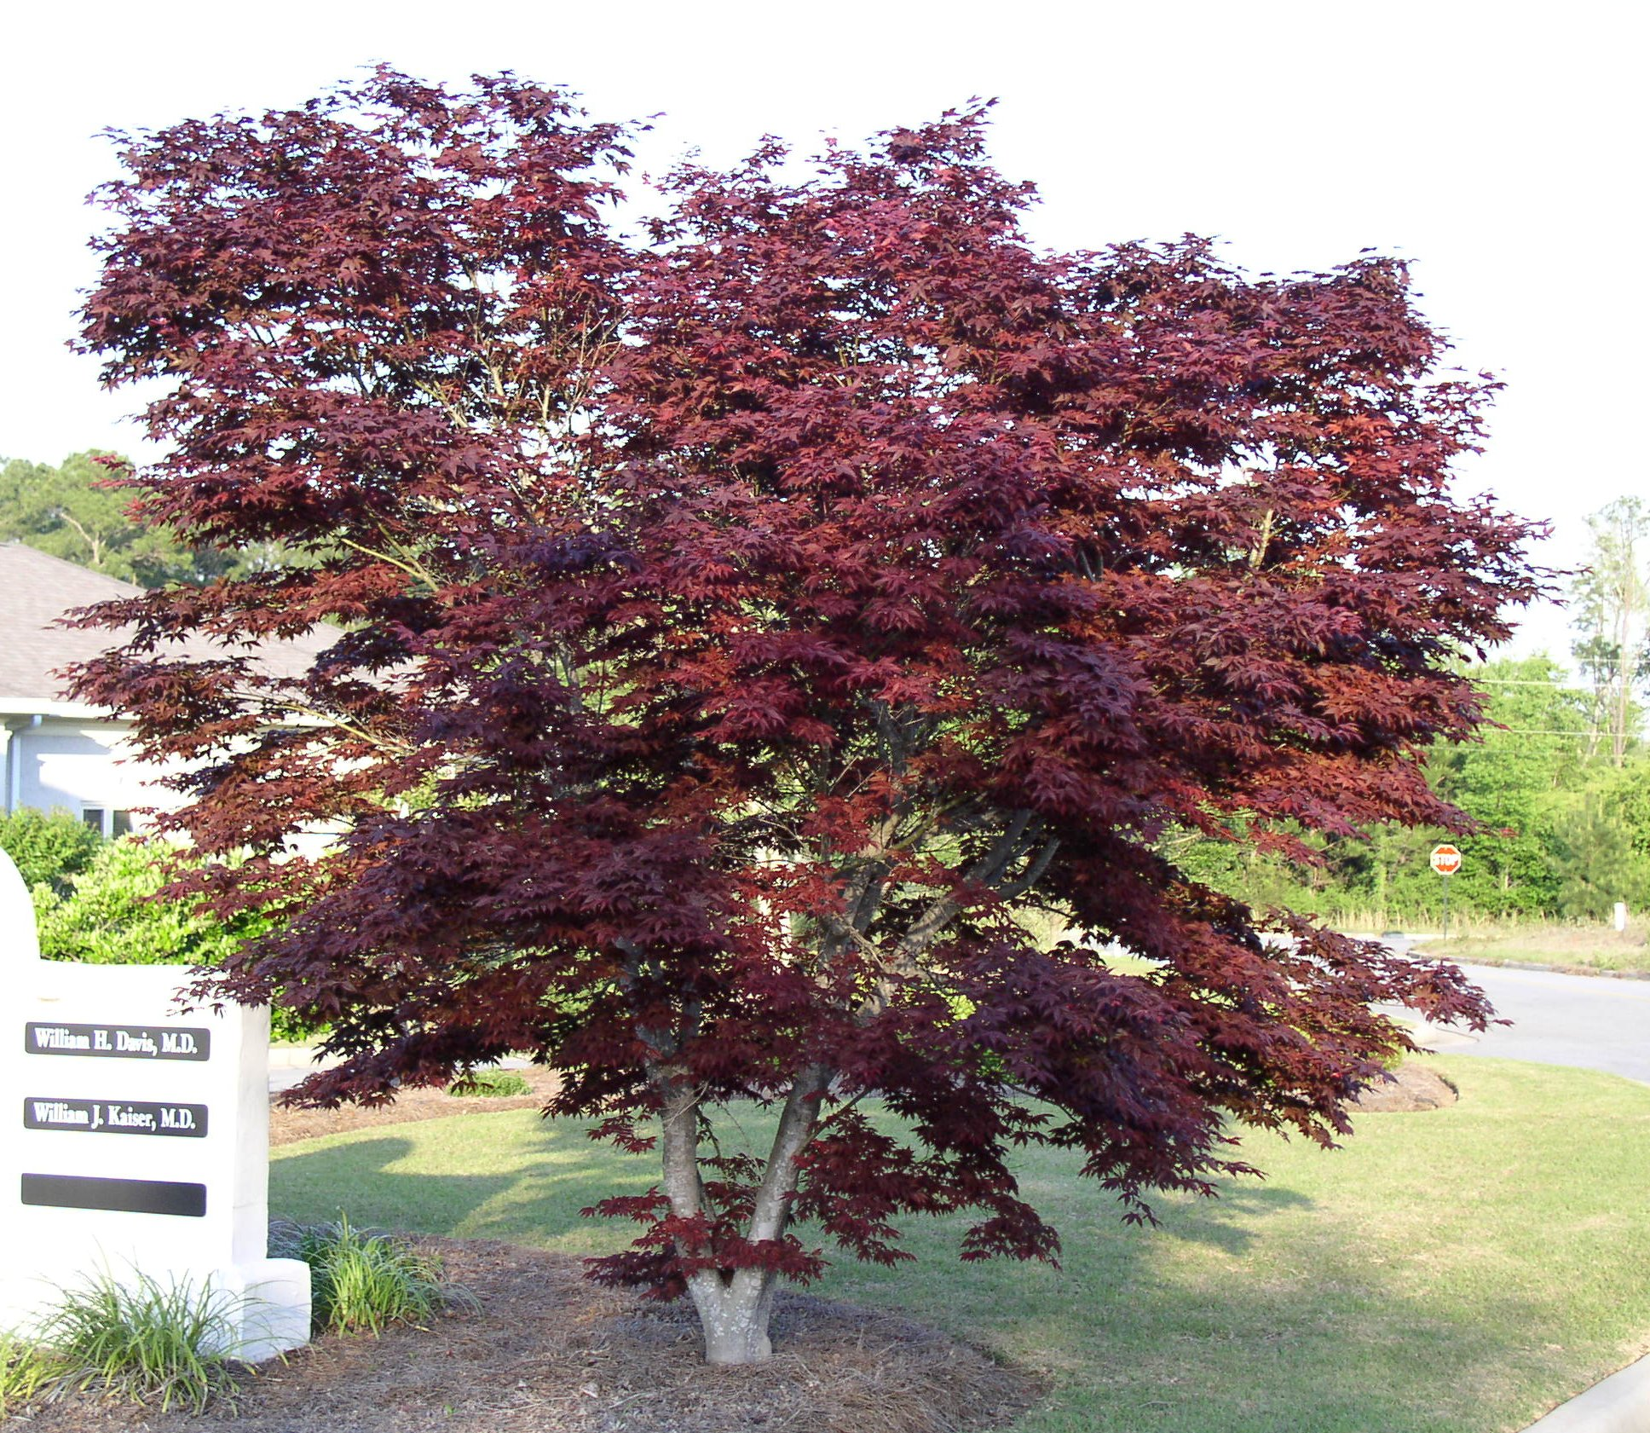
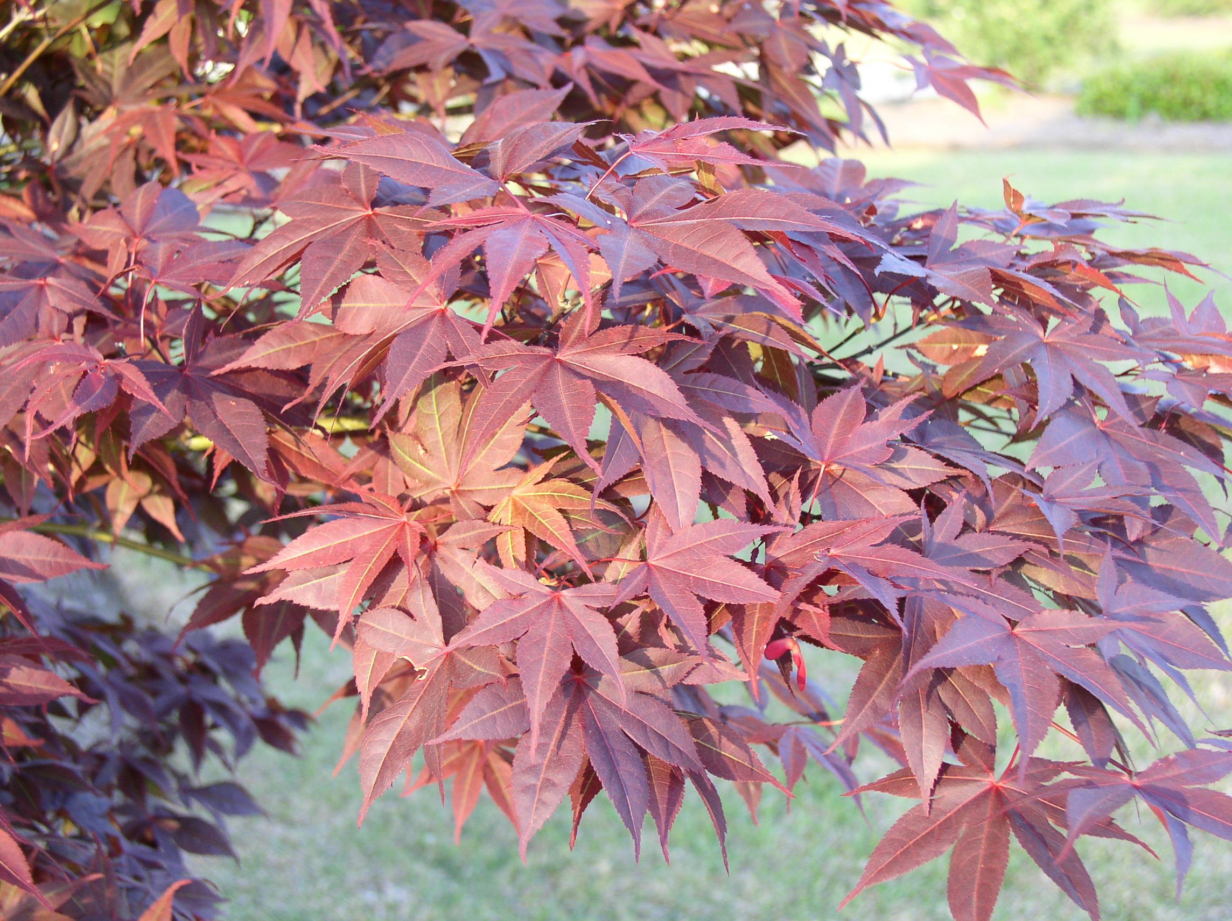

Slide 10
Chionanthus retusus Chinese Fringe-tree
Deciduous multi-stem tree reaching 15-25’ tall
best known for the showy white flowers in late spring
fall color is usually a good yellow

Slide 12
Cornus florida Flowering Dogwood
flowering tree reaches height of about 25’ and width of 25’
heavily branched multi-stem tree that blooms in early spring
northern seedlings or selections perform poorly in So. Georgia
performs best as under-story trees (grown in shade) but tolerates full sun
beware of dogwood anthracnose (north Georgia) and powdery mildew (statewide)

Slide 13
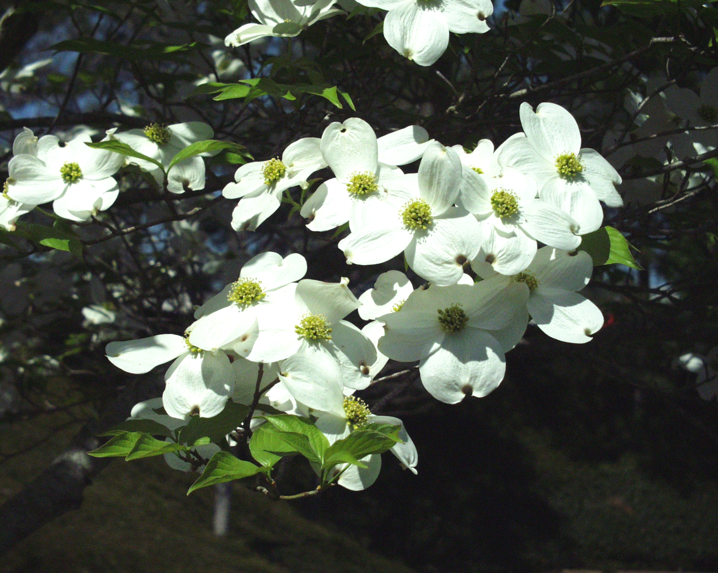
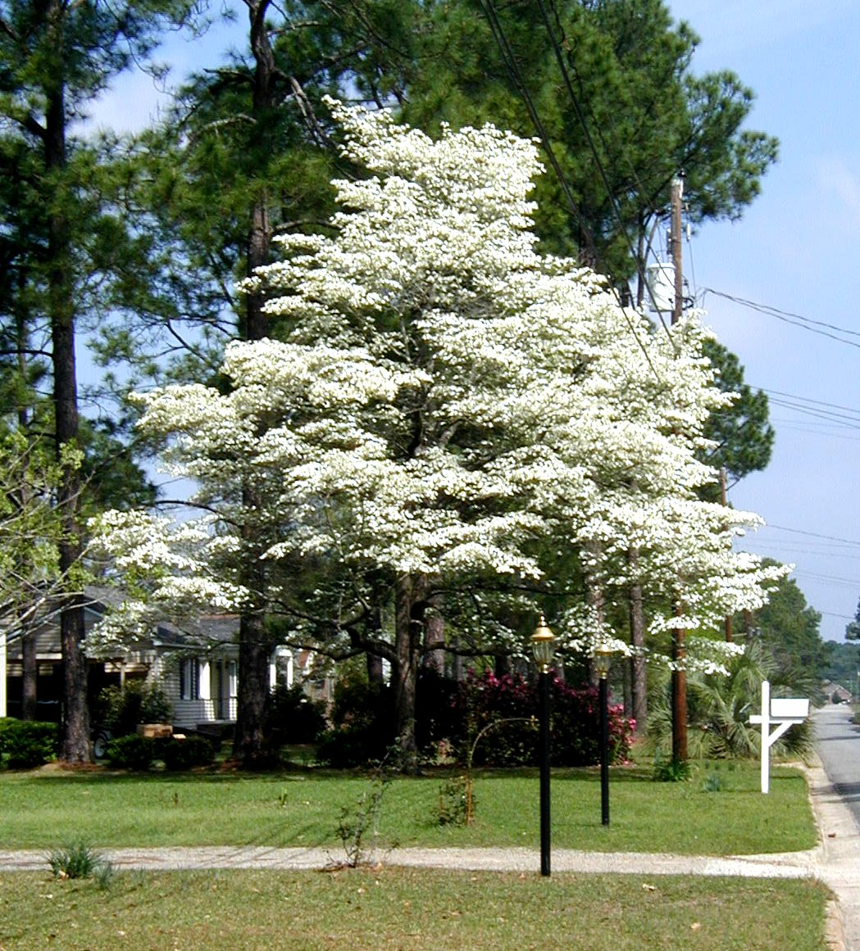
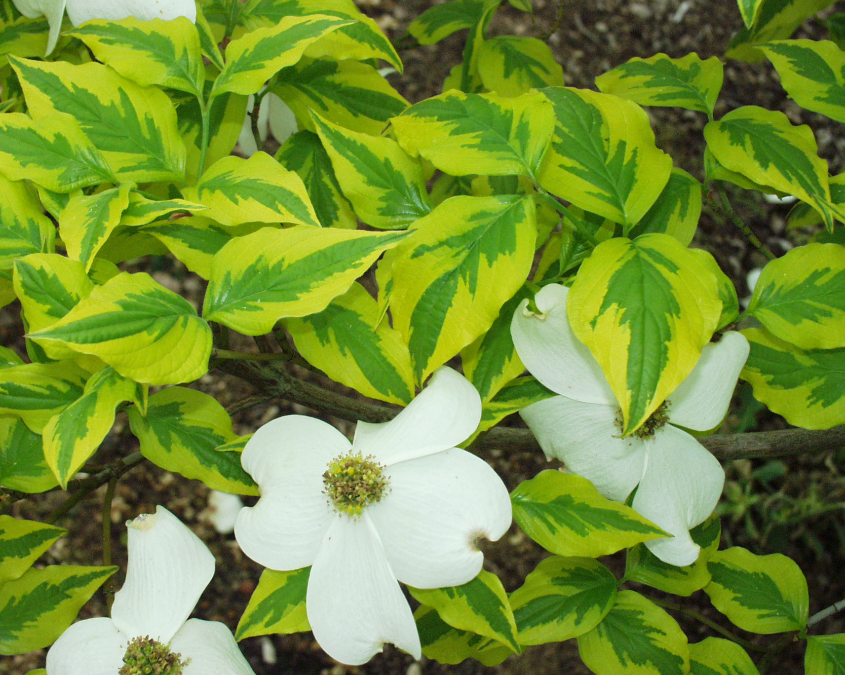

Slide 14
Eriobotrya japonica Loquat
evergreen tree that produces abundant, edible fruit, which is a hit with wildlife
dark green leaves and reaches height of 15-25’ tall
does well in full sun but tolerates afternoon shade
tough tree with colorful fruit and year round glossy foliage
only hardy in the southern half of Georgia
susceptible to fireblight if conditions are favorable

Slide 15
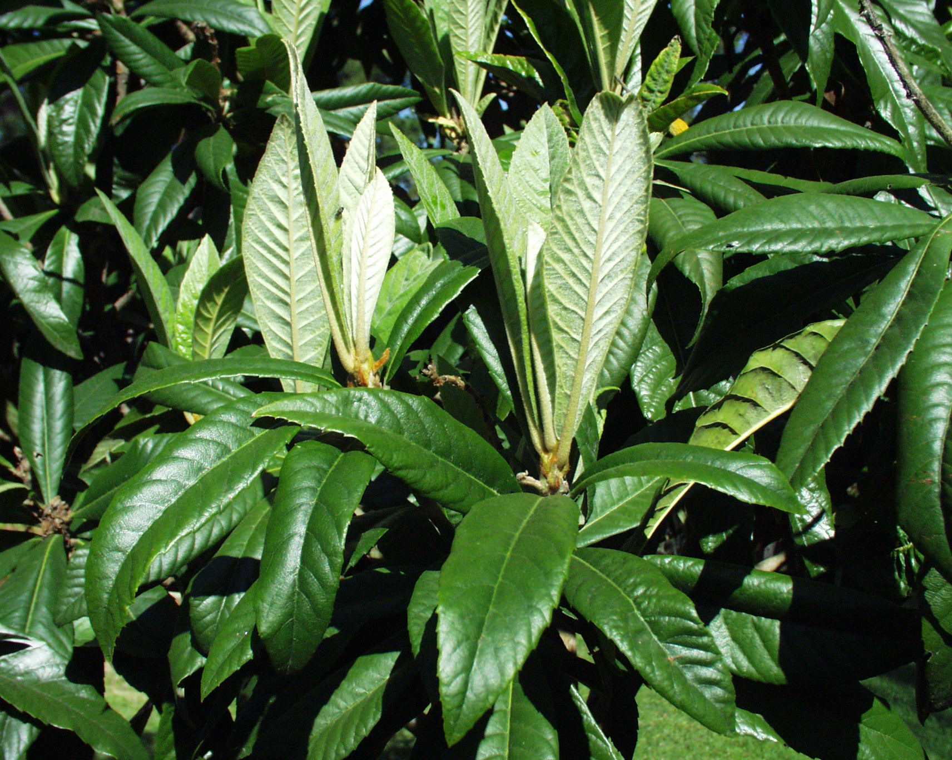
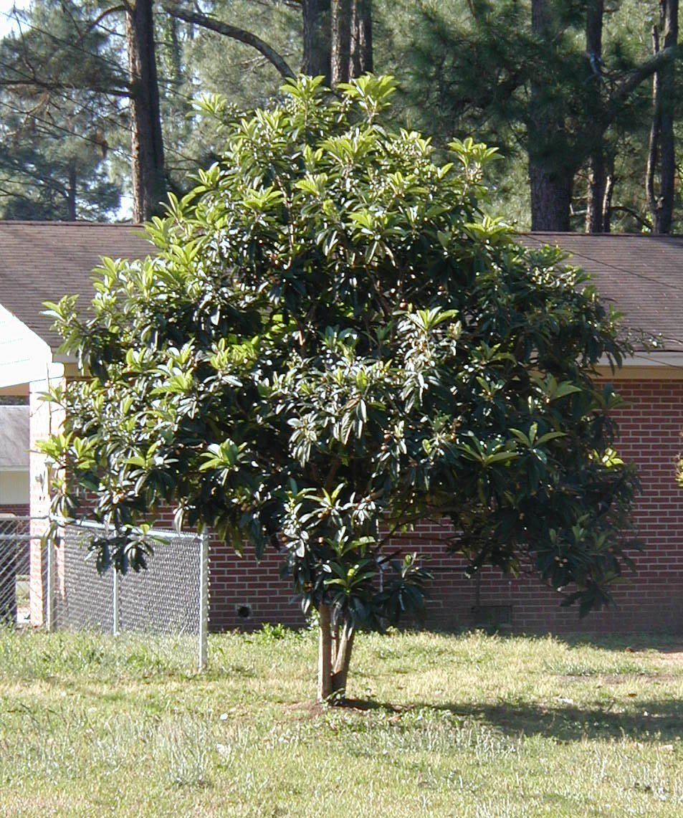
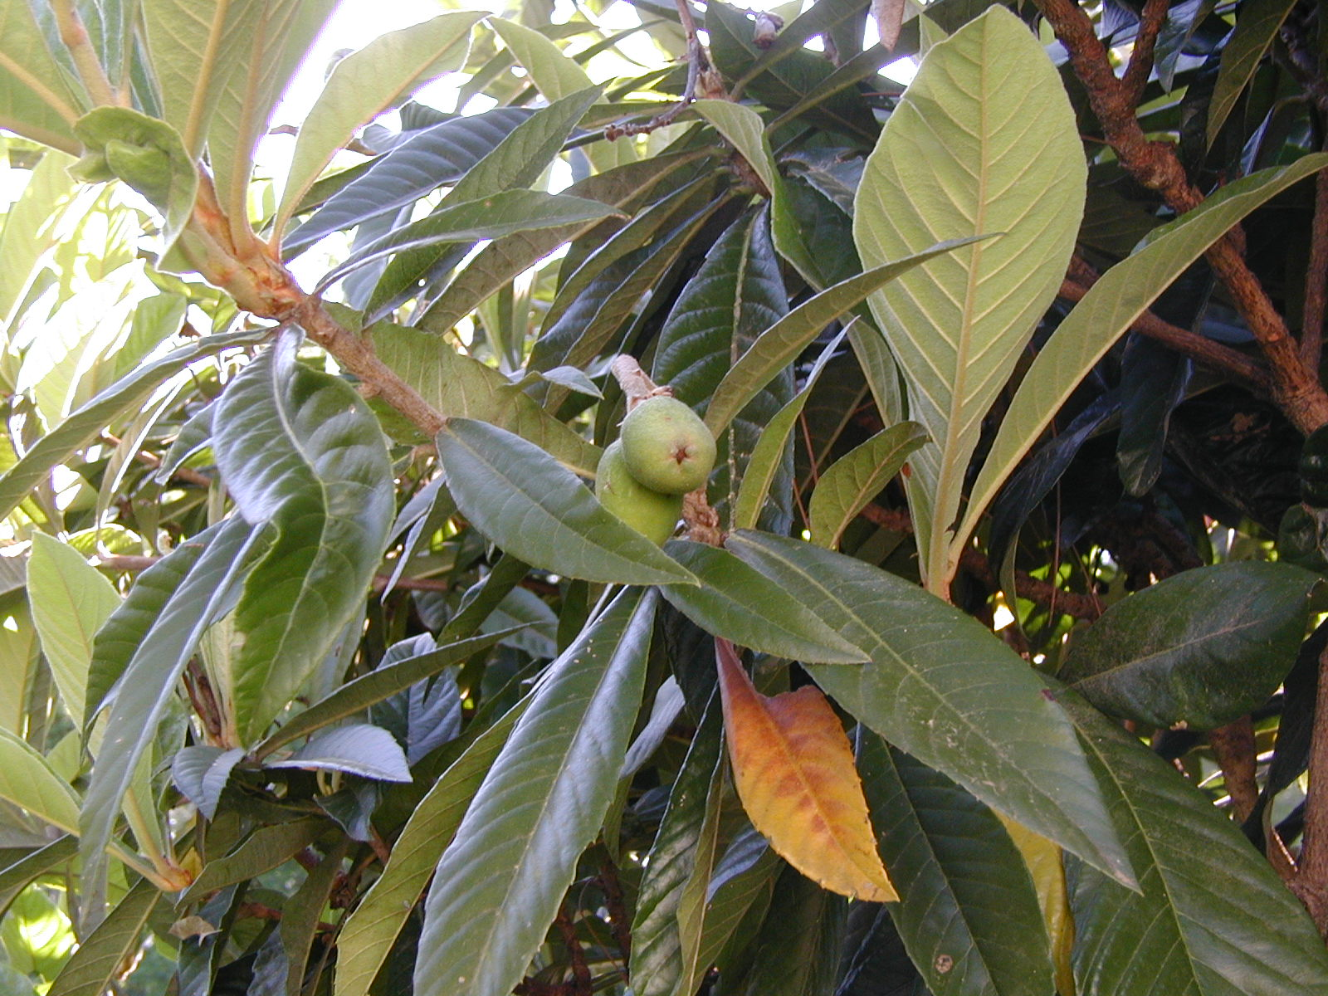

Slide 16
Halesia diptera var. magniflora Two-Winged Carolina Silverbell
little-known native tree that reaches about 25’ tall and about 20’ in width
smaller relative of native Halesia tetraptera, which reaches 30-40’ in height
multi-stem, low, branched tree
should be used in filtered shade conditions only, not full sun
beautiful white bell-shaped flowers hang from the branches in early spring
leaves turn a bold yellow color in the fall

Slide 17
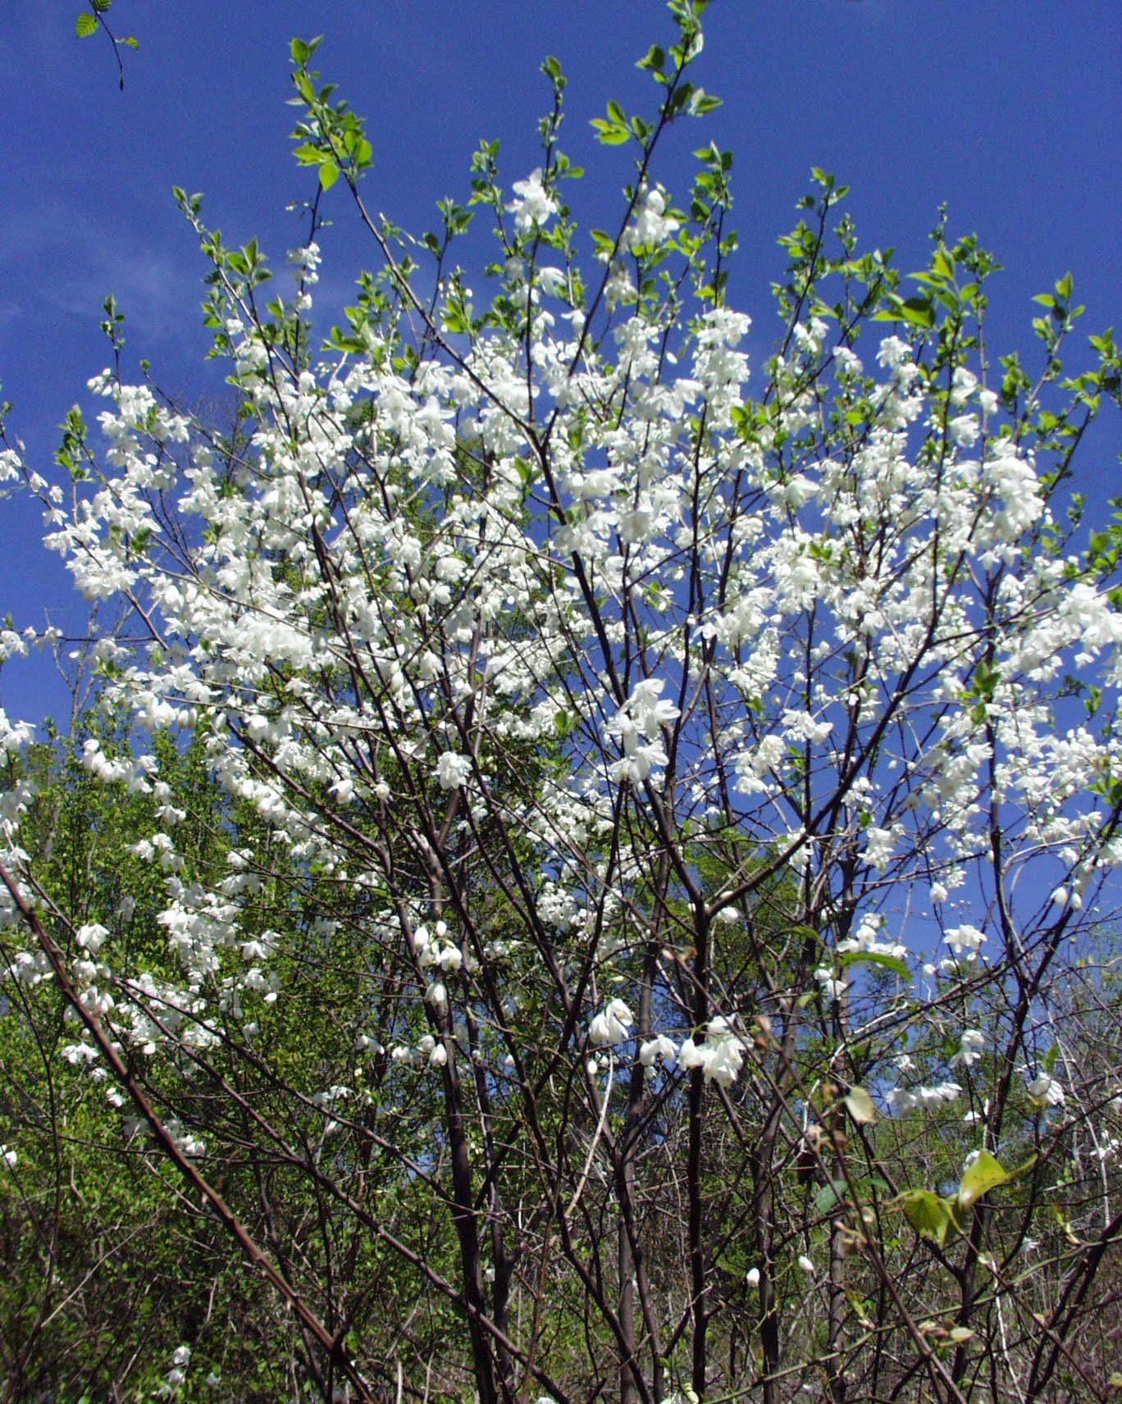
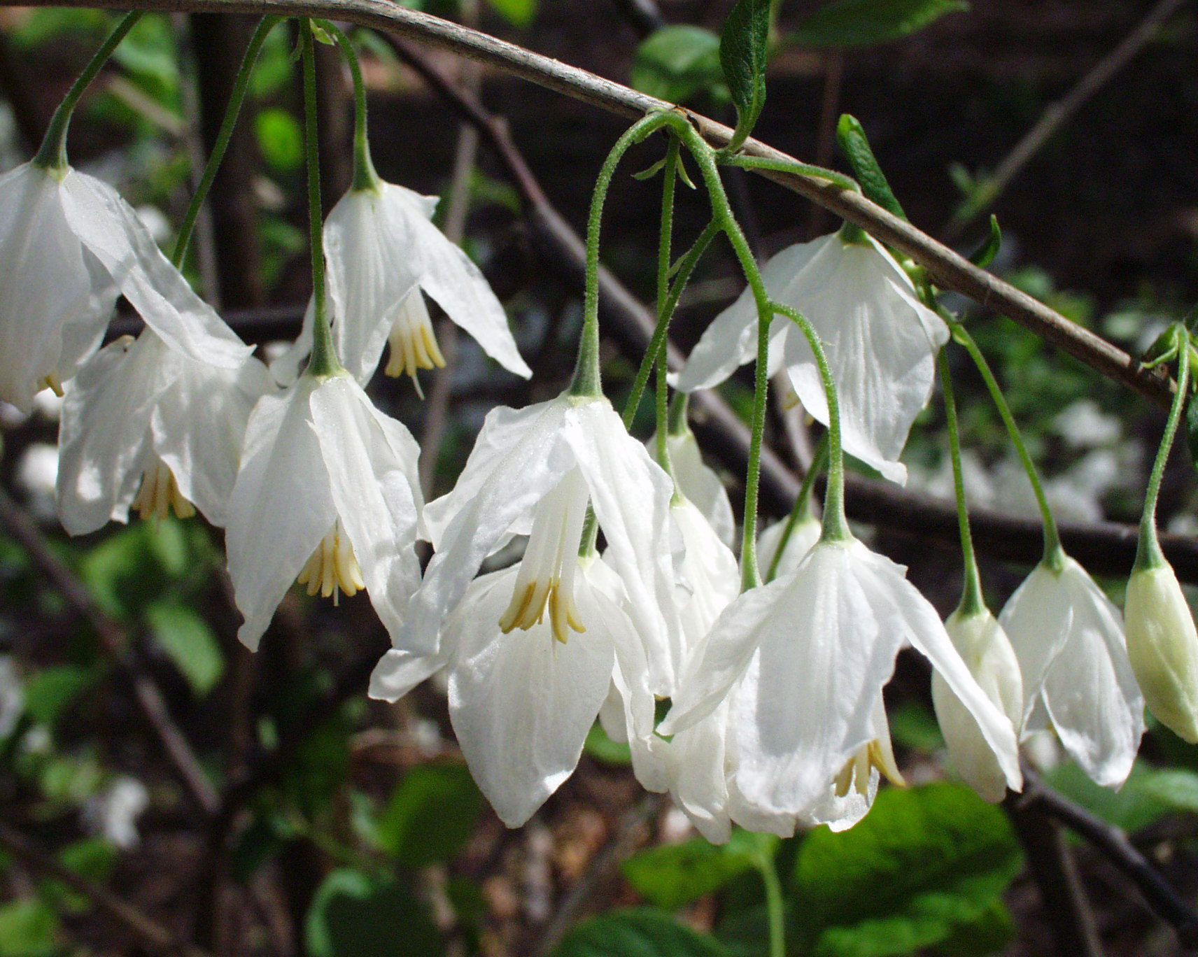

Slide 18
Ilex species, cultivars & hybrids Holly
generally shrubs, several hollies can be used as small trees for sun or shade locations
Savannah Holly has upright, pyramidal growth habit with light green leaves
a. does well in tough sites and usually
has abundant fruit
b. benefits from nitrogen fertilizer when
under heavy fruit load

Slide 19
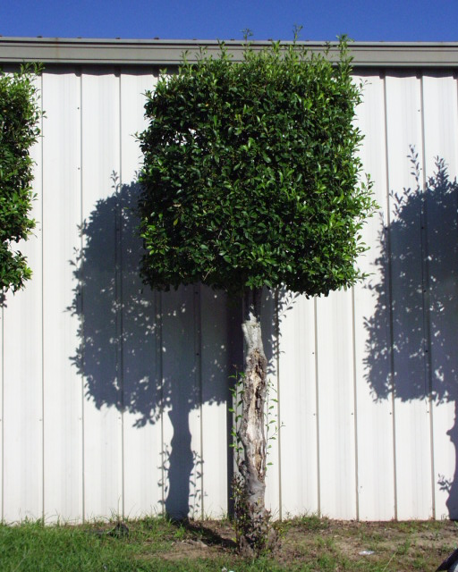
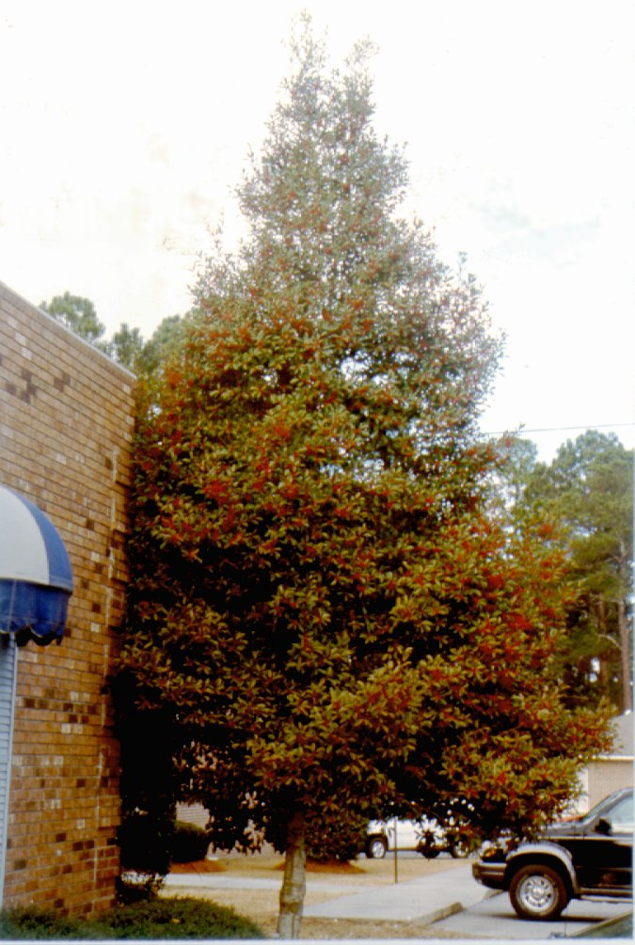
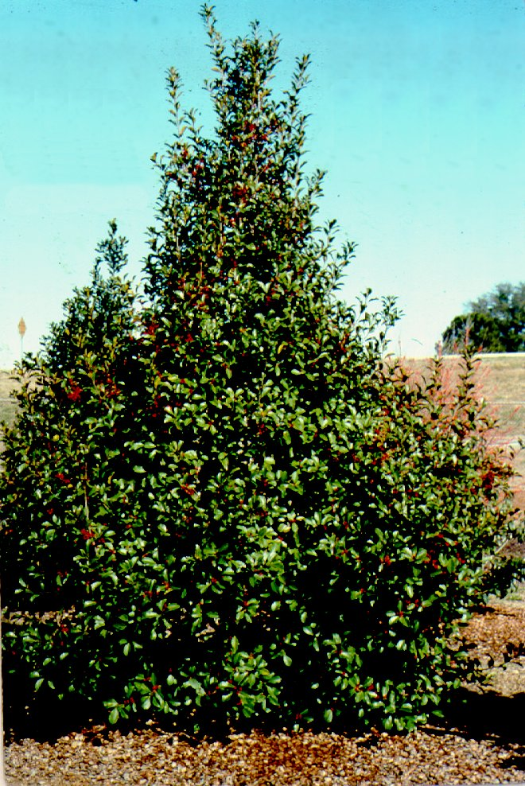
Savannah Holly

Slide 20
Ilex species, cultivars & hybrids Holly
Nellie R. Stevens, an upright hybrid with dense branching
a. dark green high-gloss leaves
b. can be shaped with light pruning

Slide 21
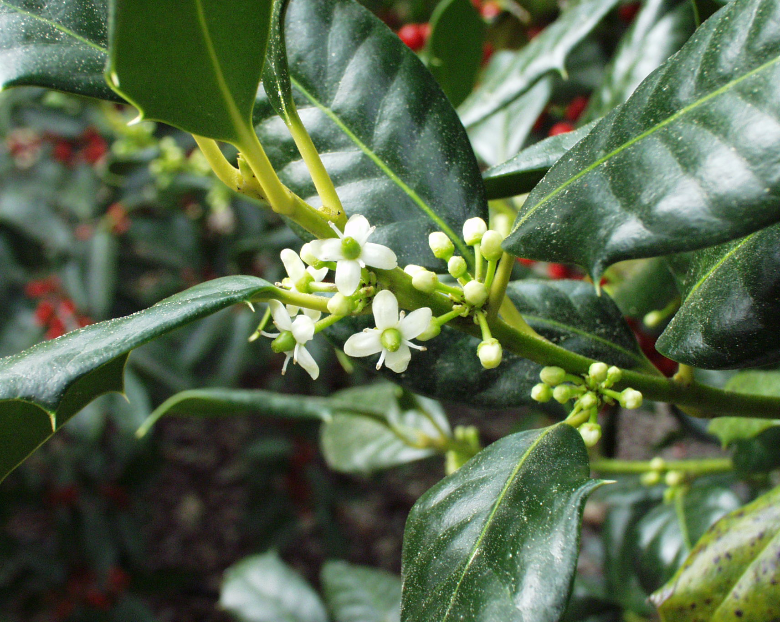
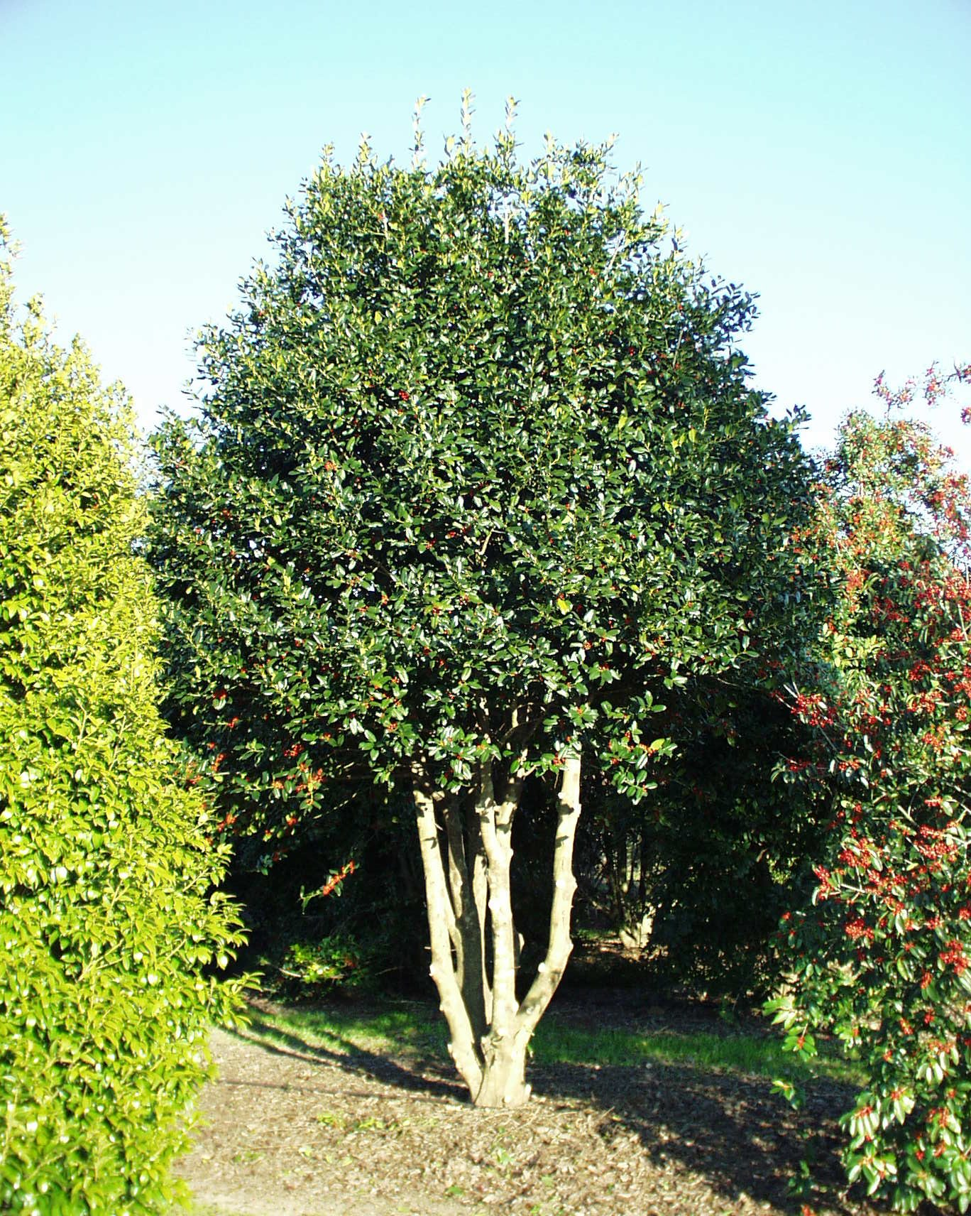
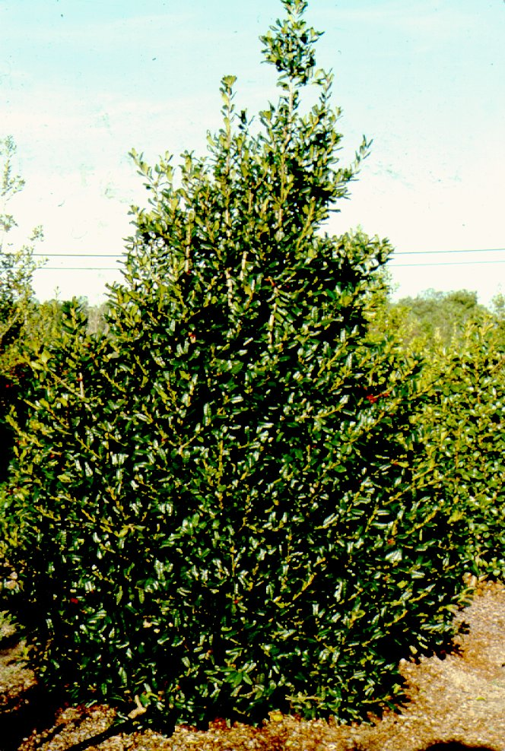
Nellie R. Stevens

Slide 22
Ilex species, cultivars & hybrids Holly
East Palatka holly, similar to Savannah holly but has darker green leaves and more open growth habit

Slide 23
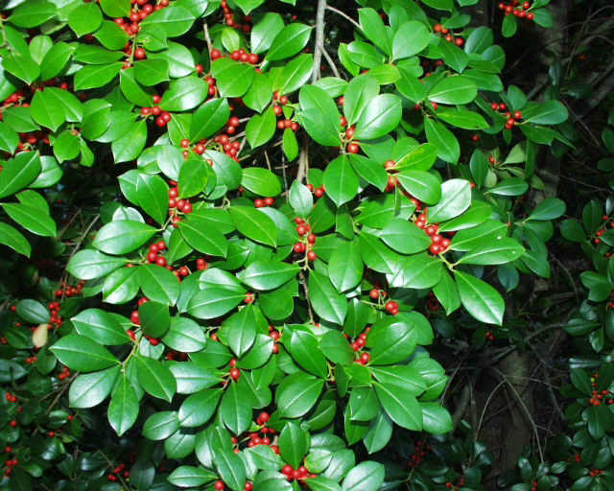
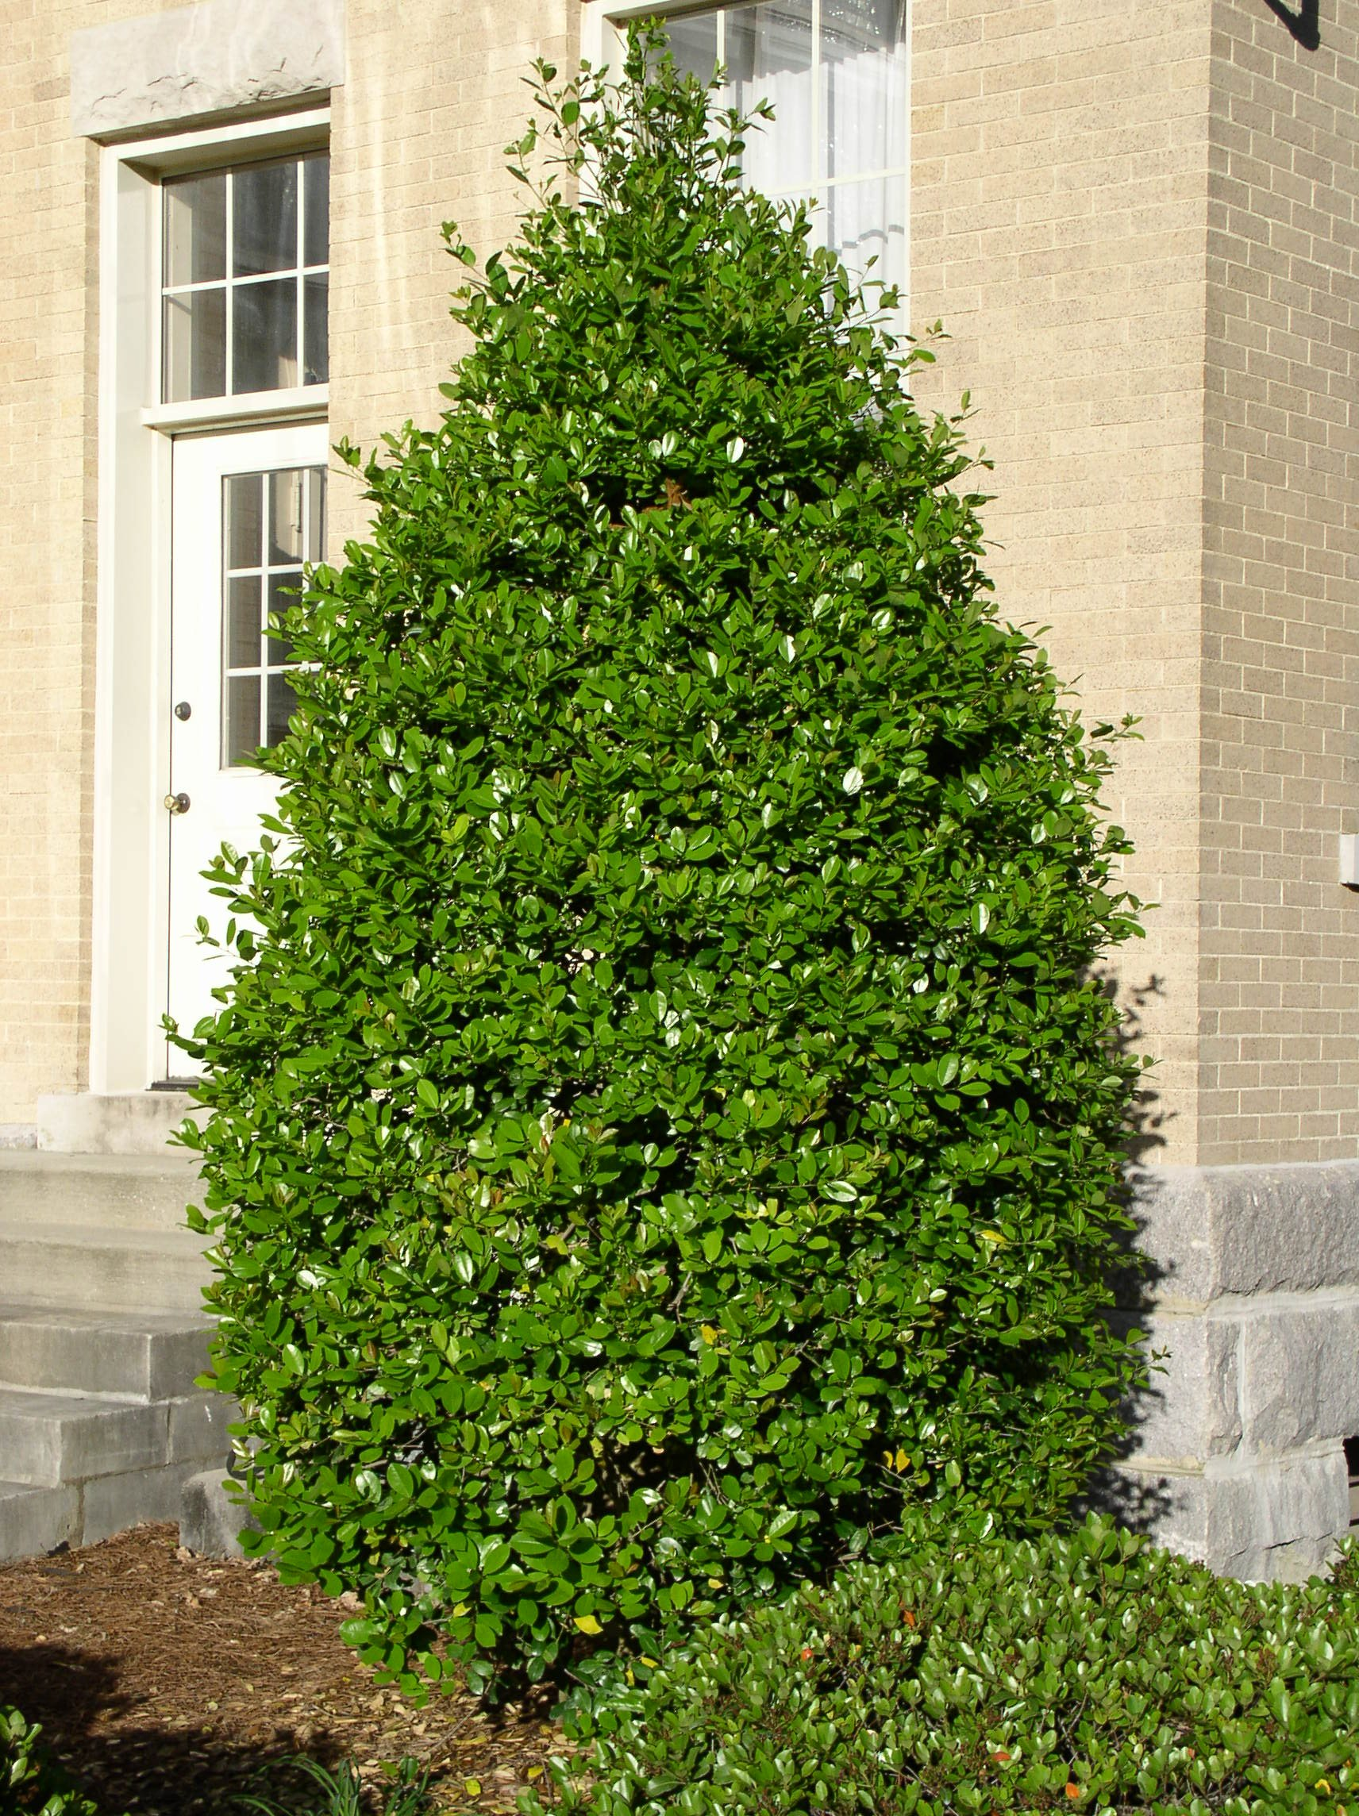
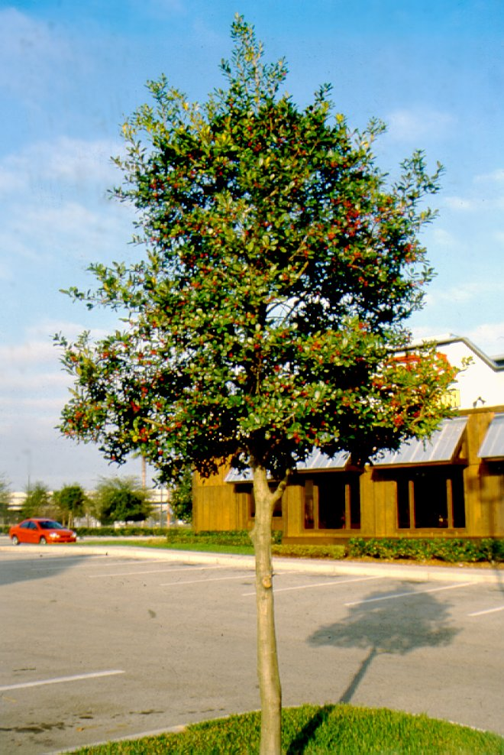
East Palatka

Slide 24
Ilex species, cultivars & hybrids Holly
Yaupon holly (Ilex vomitoria), excellent native holly under a variety of conditions
multi-stem small tree that usually grows about 15-20’ tall
can create an effective screen between properties
produces copious quantities of reddish berries that last into spring
cultivars available, some with different color fruit (yellow and orange)
tolerant of coastal conditions

Slide 25
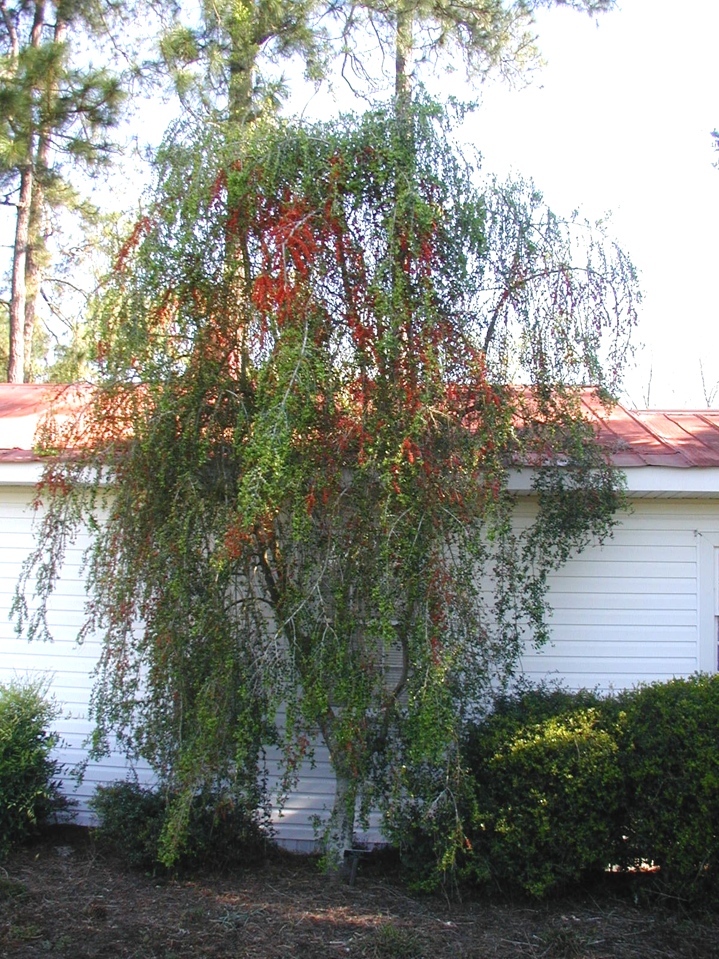
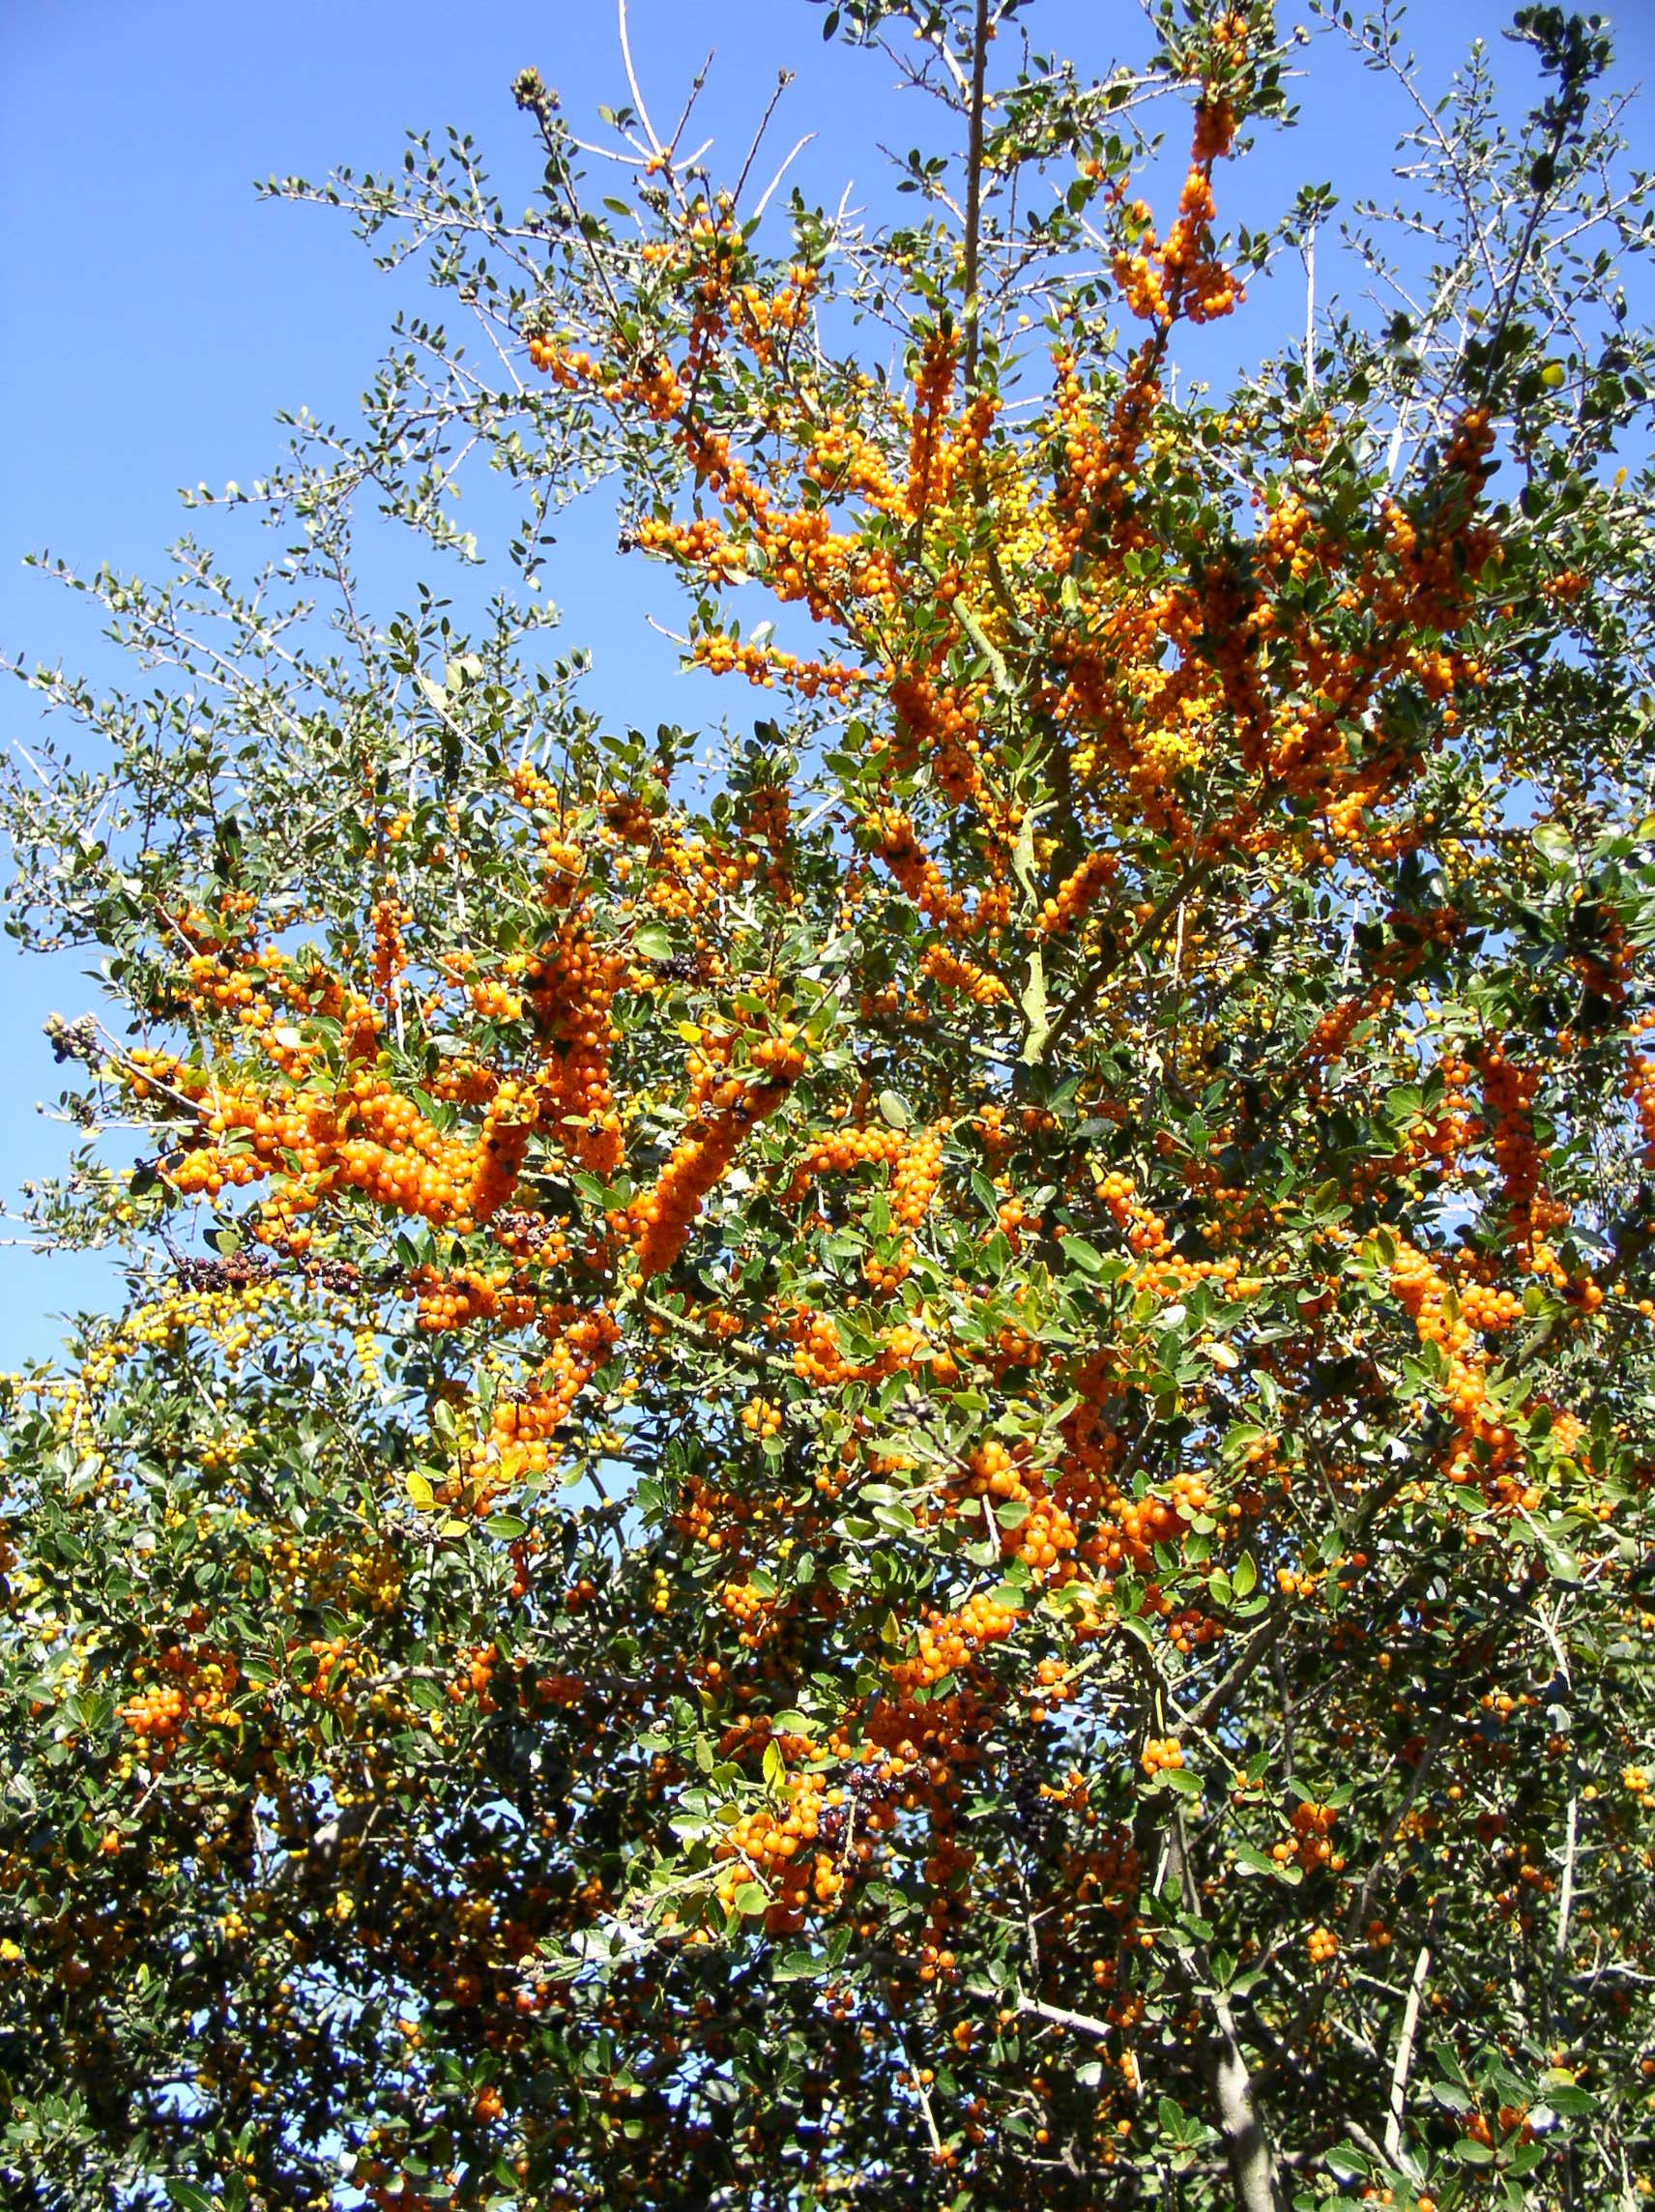
Yaupon holly

Slide 26
Lagerstroemia sp. Crape Myrtle
one of the most commonly used small trees
valued for consistency of summer flowers when few other plants are in bloom
wide selection of flower color and plant size
range from the mounding dwarf forms to medium size trees of 20-30’
cultivars with Indian names are generally resistant to powdery mildew

Slide 27
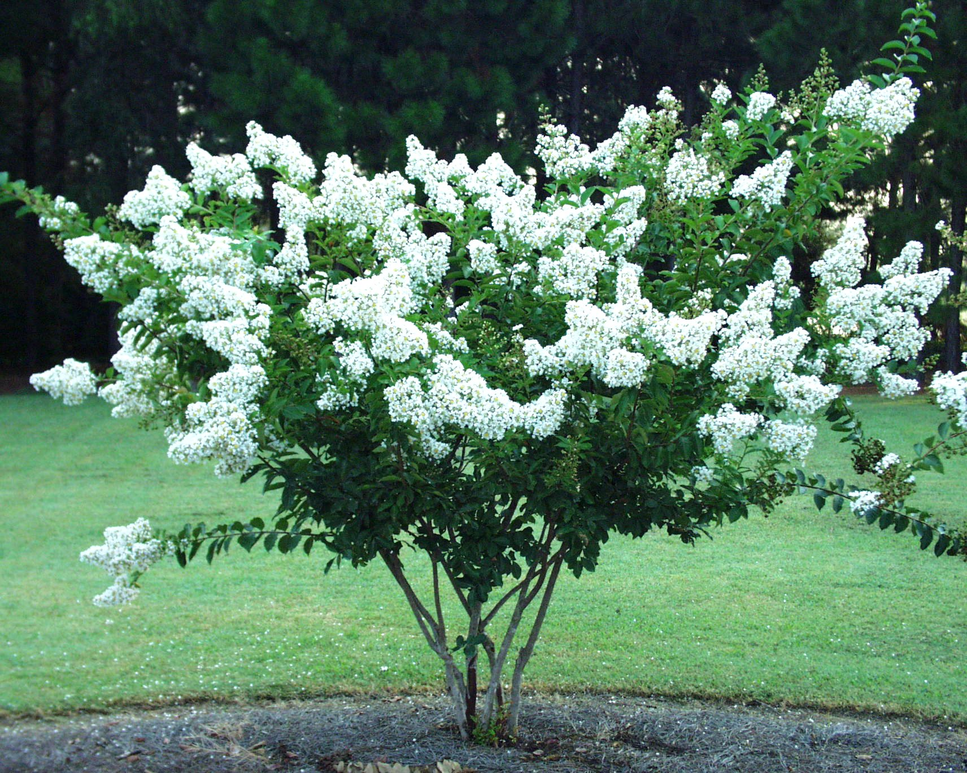
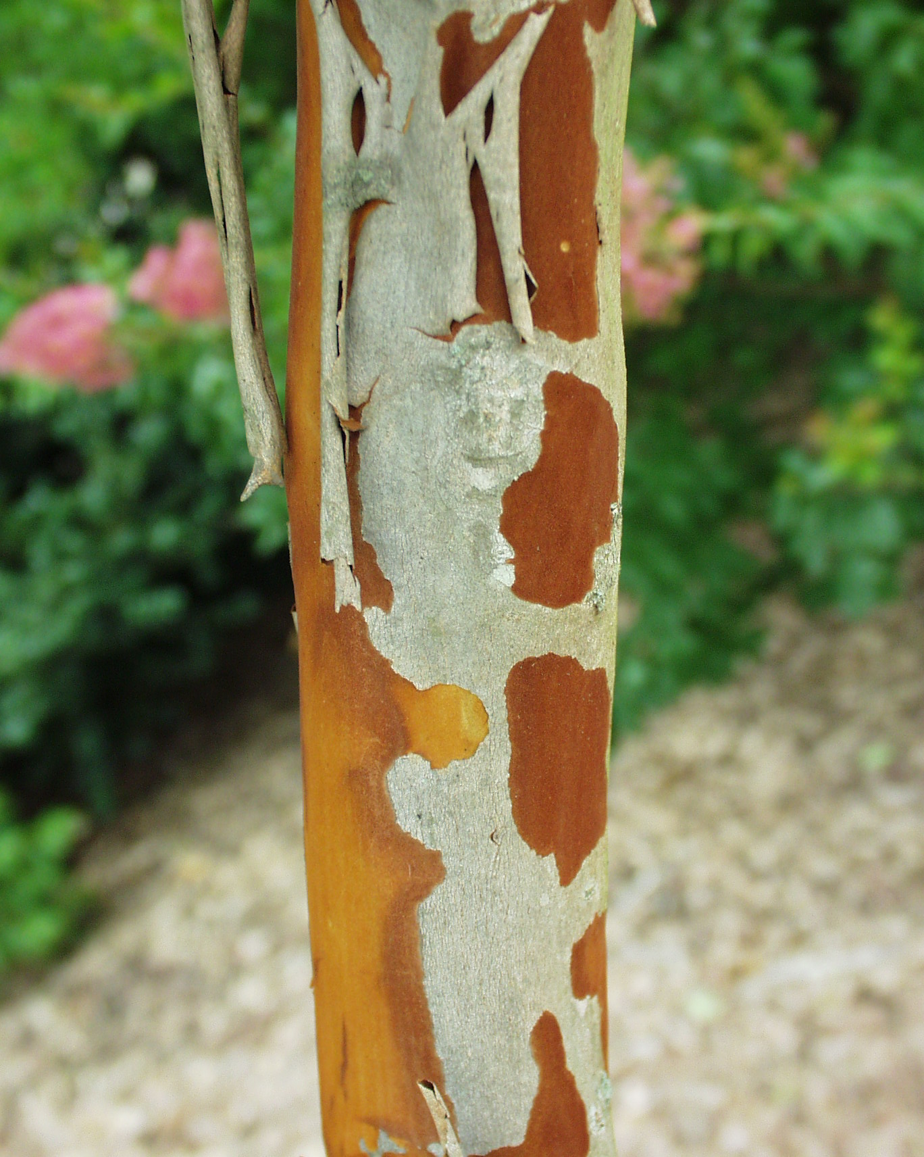
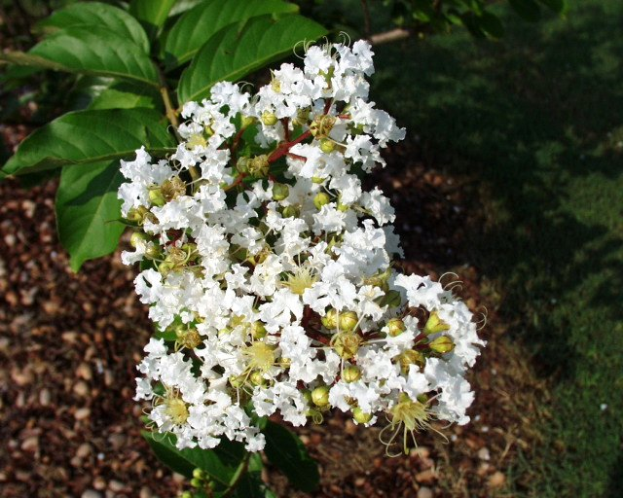

Slide 28
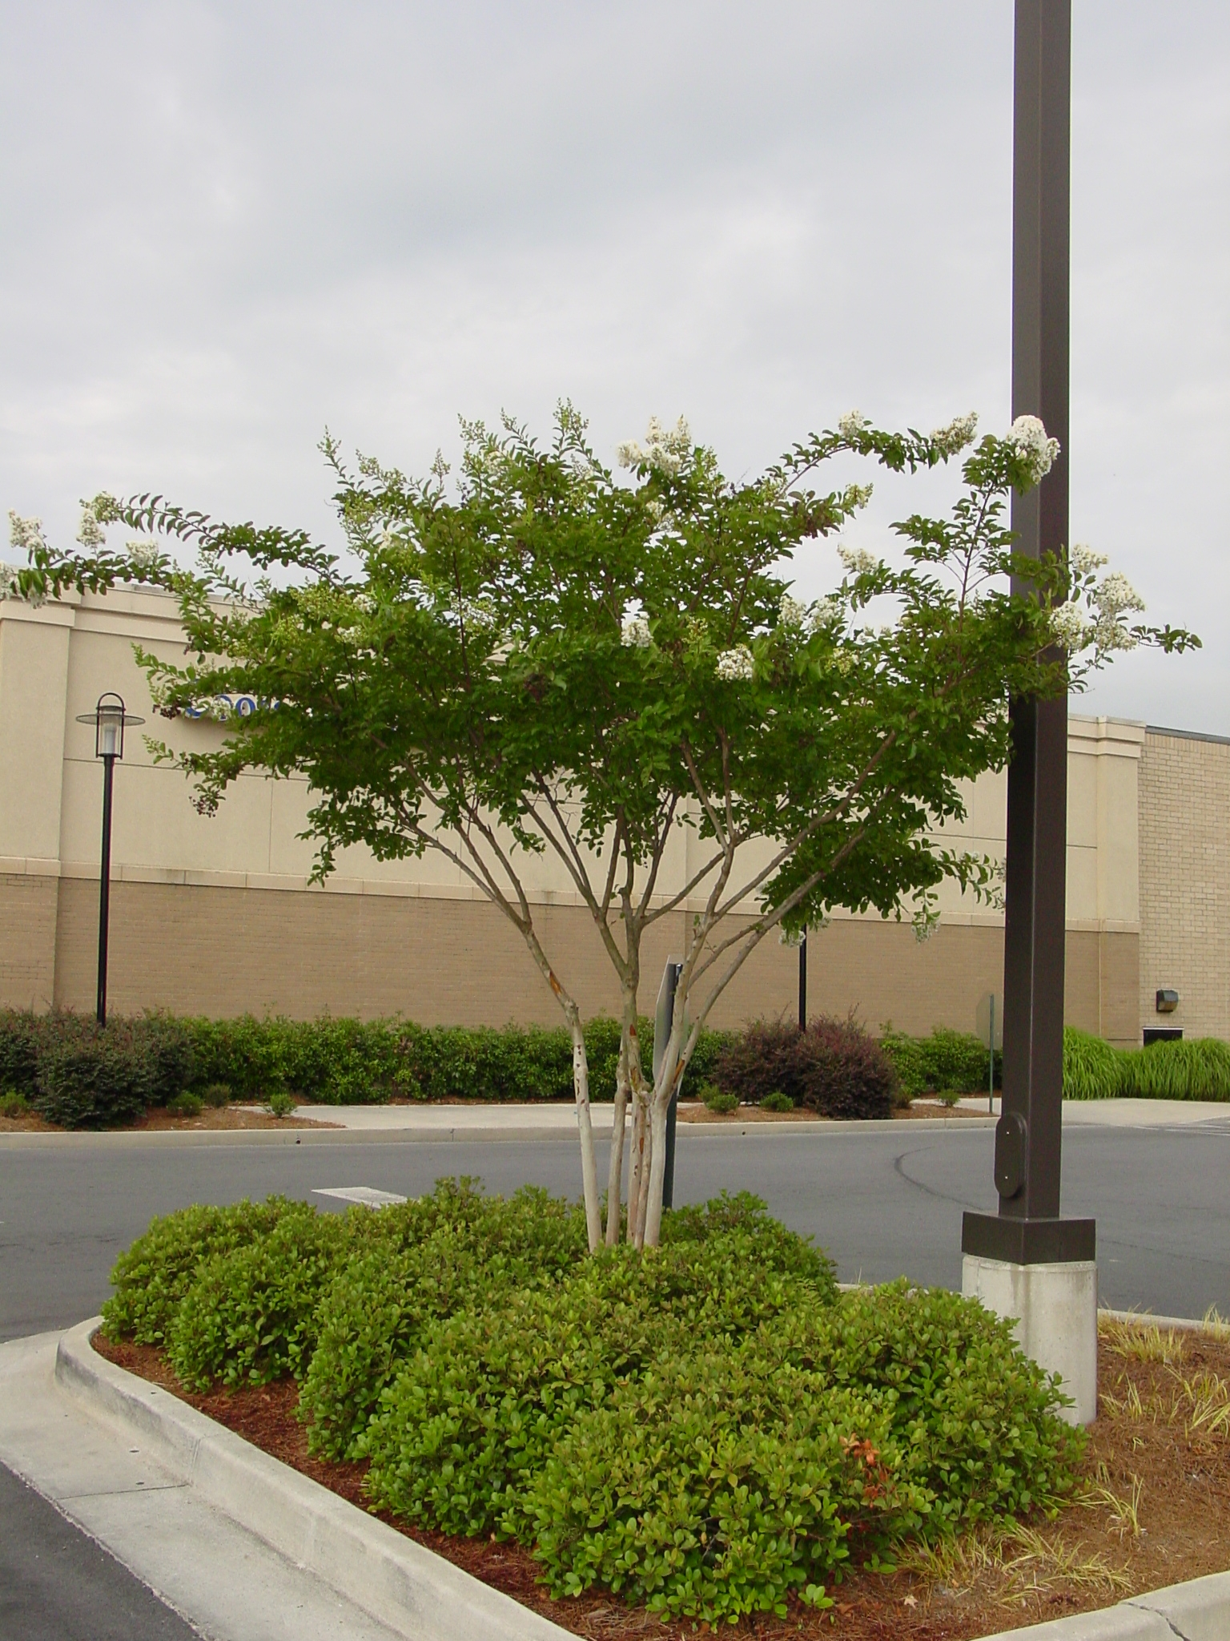
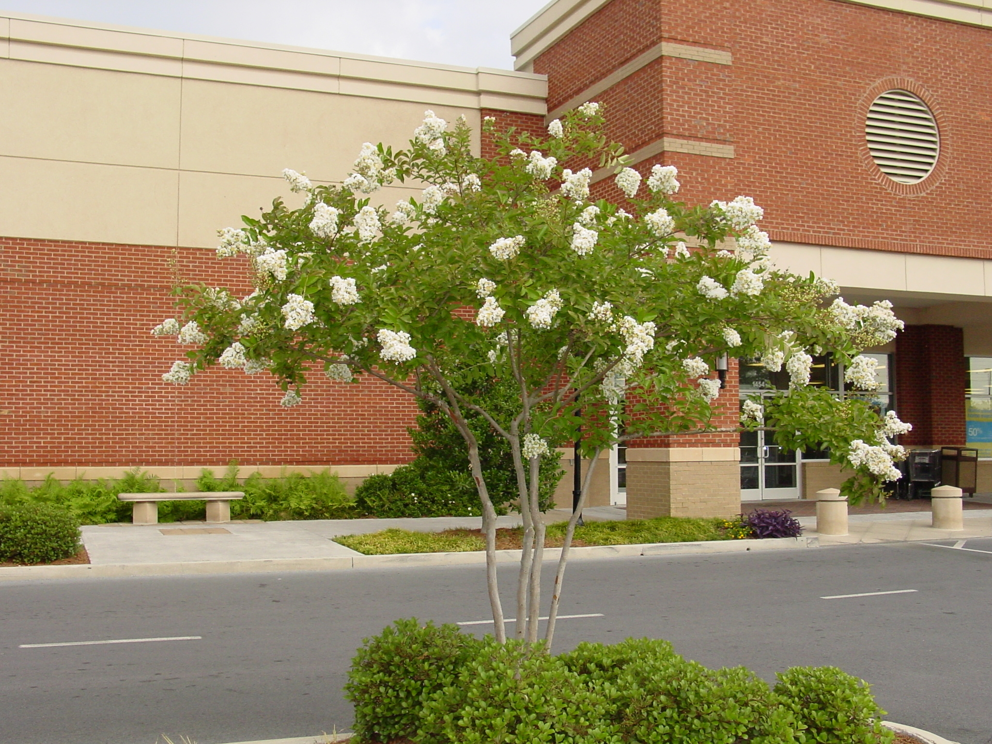

Slide 29
Ligustrum japonicum Japanese Privet
shrub or trained as a small tree about 15’ in height
evergreen tree with high-gloss leaves and white flowers

Slide 30
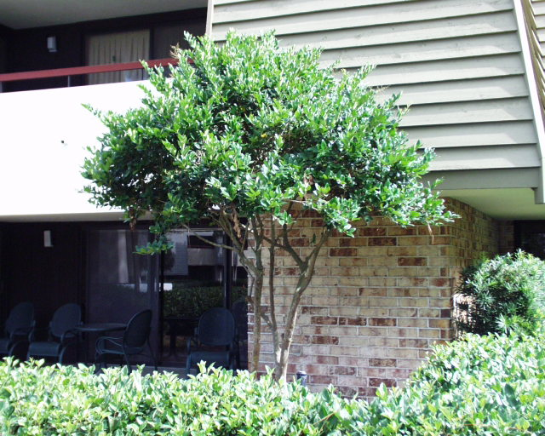
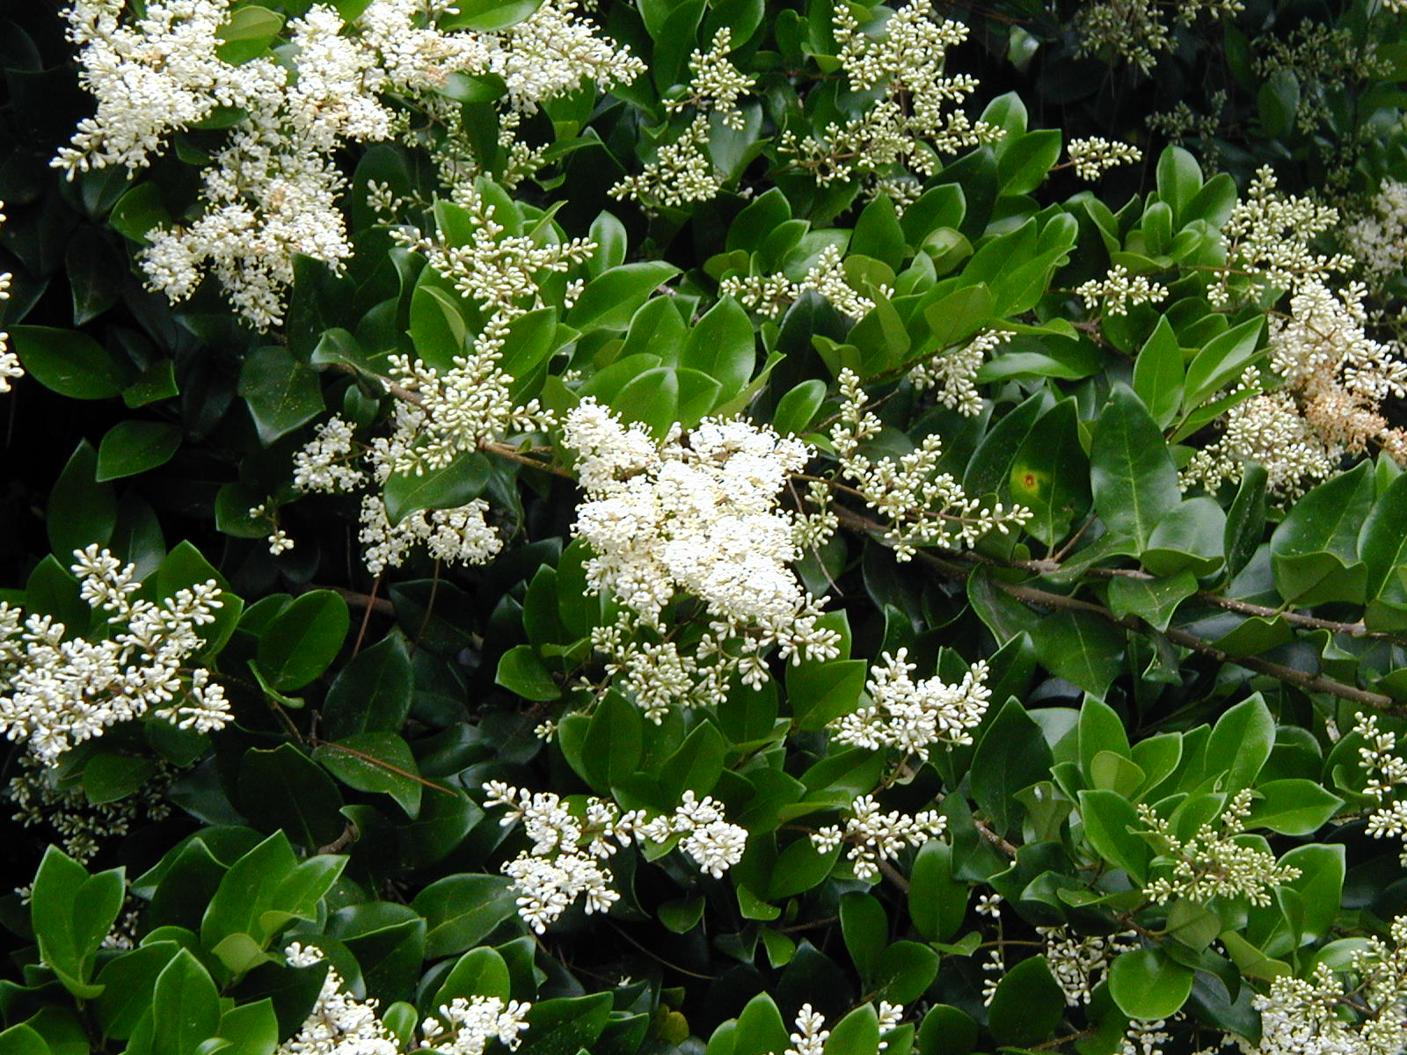
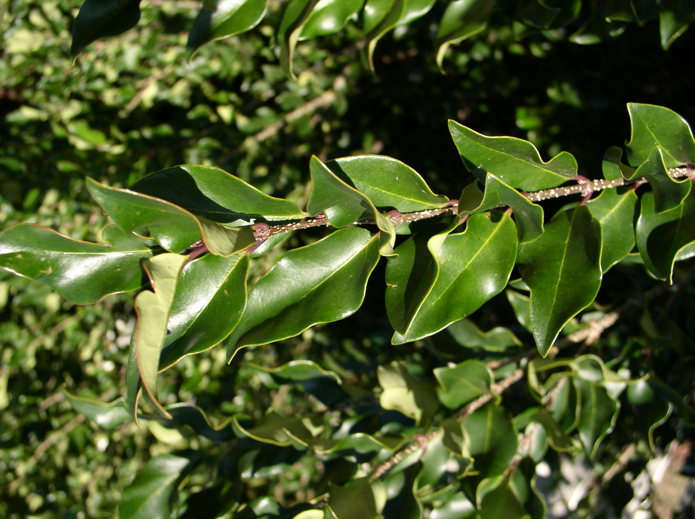

Slide 31
Magnolia grandiflora Little Gem
evergreen tree grows to about 20’ tall
cultivar of more common large southern magnolia
flowers at small size (3-4’) and has blooms scattered through the summer
flowers only slightly smaller that full size and hence showy on the smaller trees
does best in full sun but will stay fairly dense under shade
can be successfully pruned to increase density and refine shape
similar selections include ‘Hasse’ and ‘Alta’

Slide 32
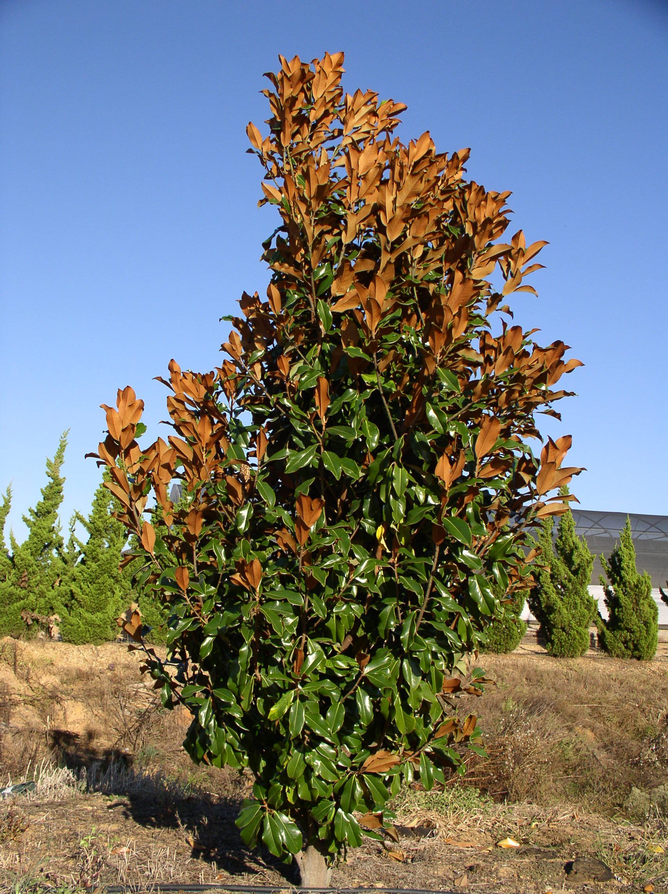
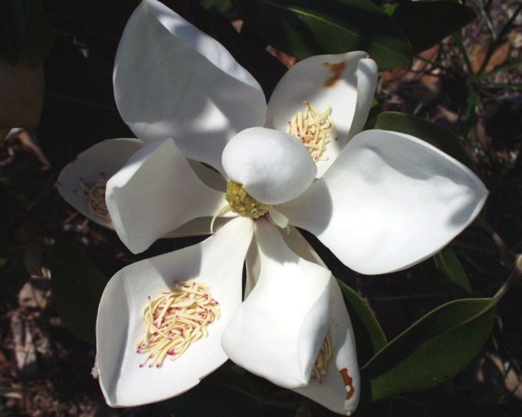

Slide 33
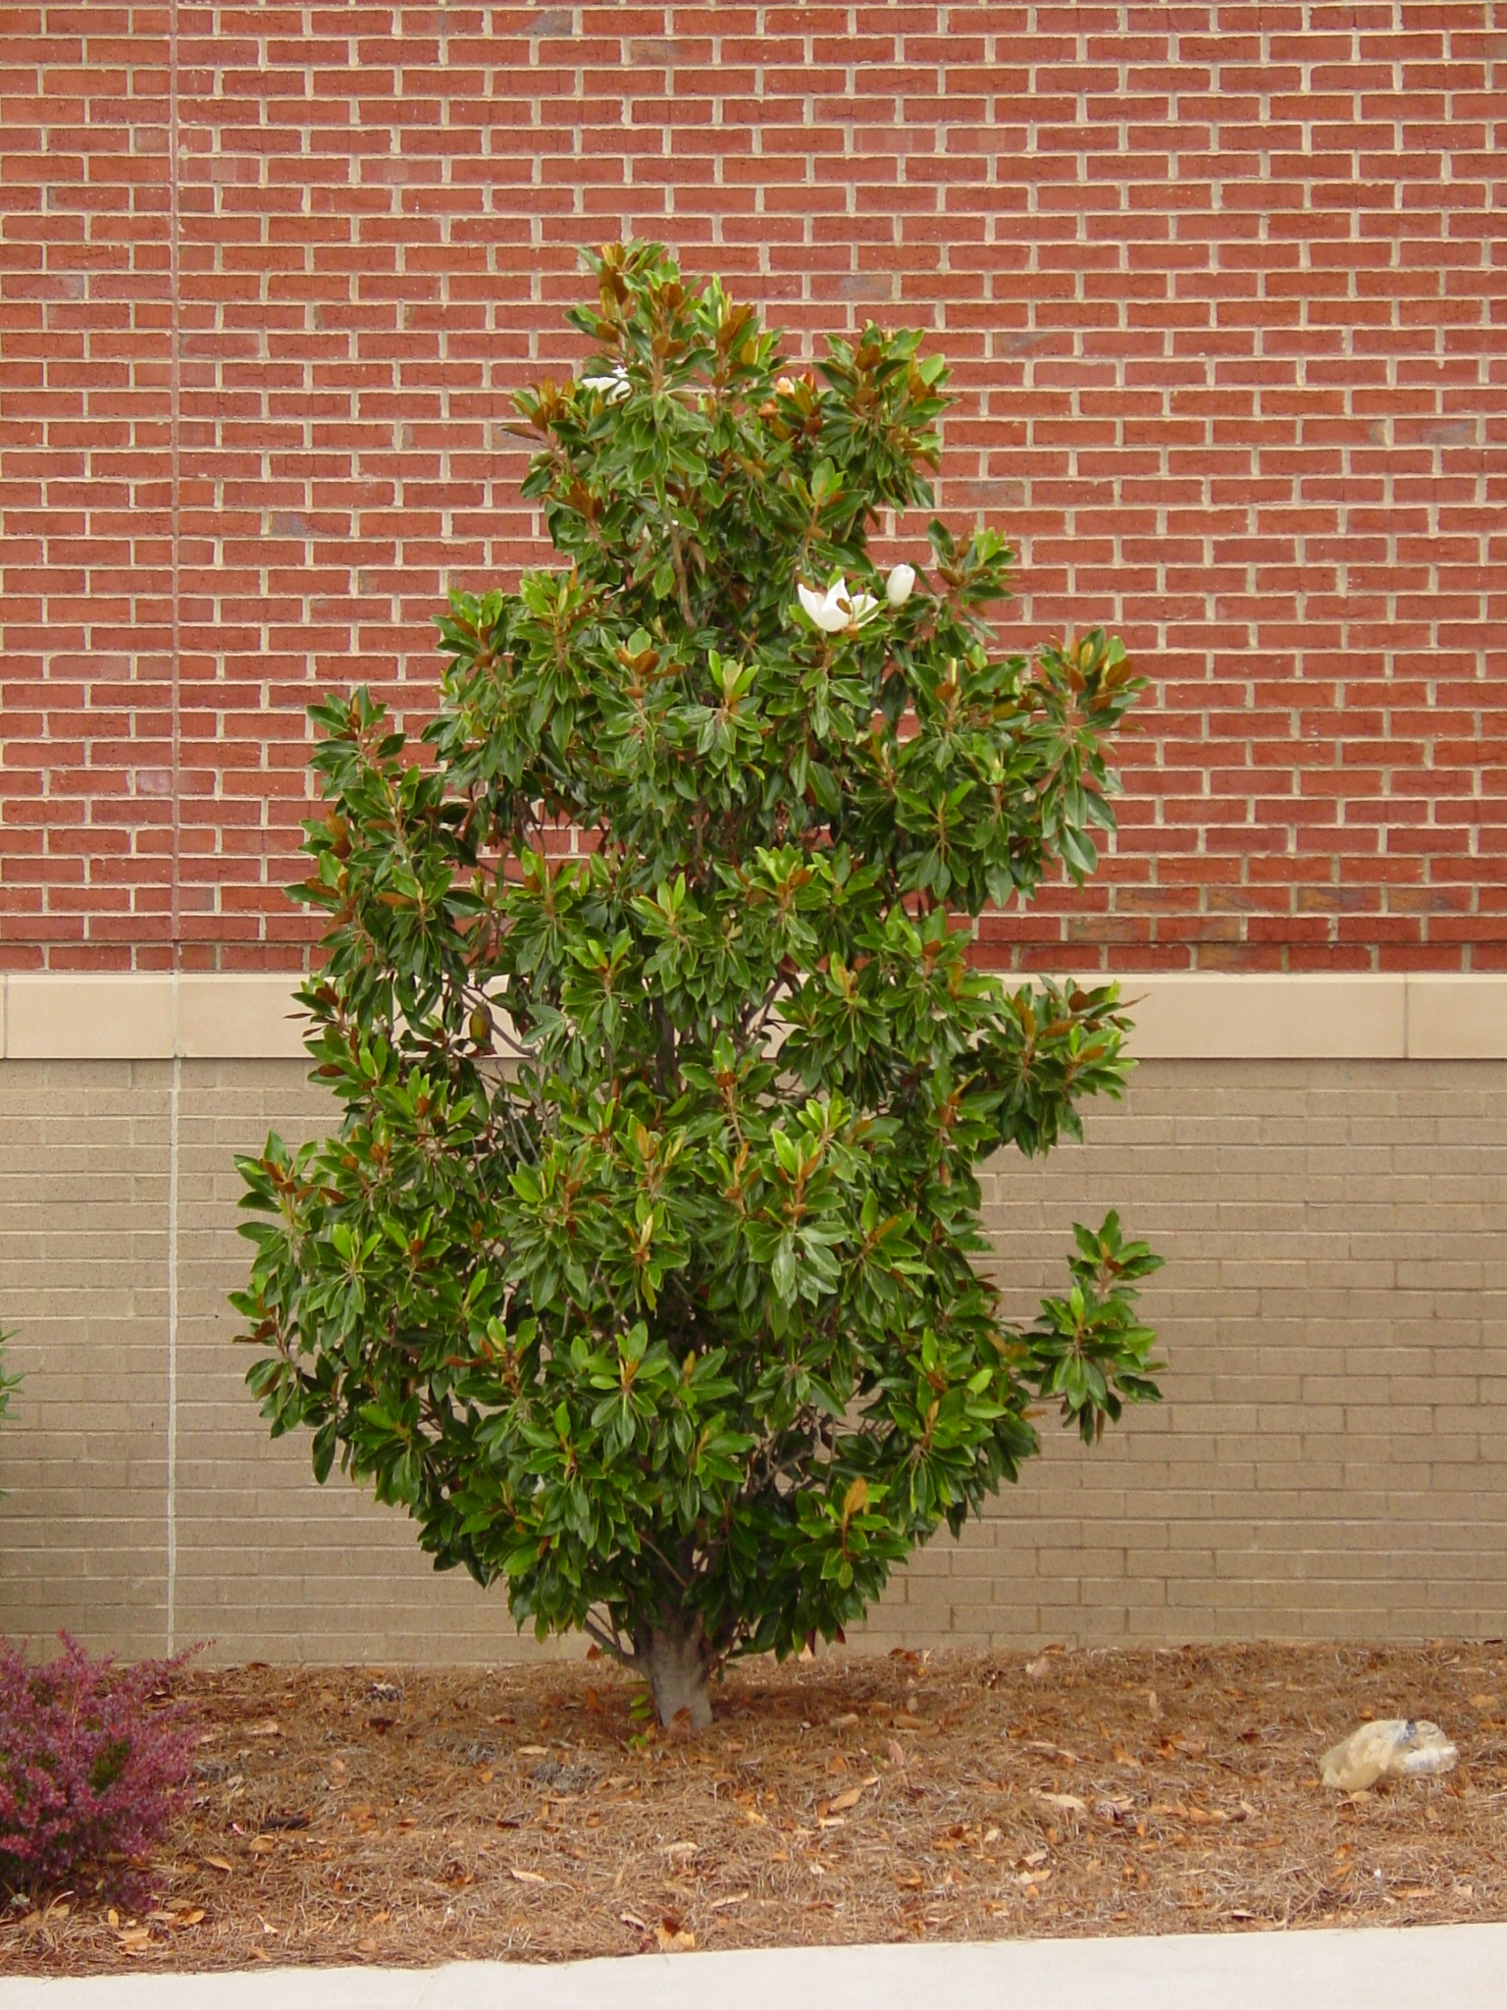

Slide 34
Magnolia stellata Star Magnolia
slow growing, deciduous tree reaching 15-20’ tall
white fragrant flower during winter in
So. Georgia
grown in full sun for best flowering
performs well in partial shade, especially in
So. Georgia
cultivars available with different shades of pink to lavender flowers

Slide 35
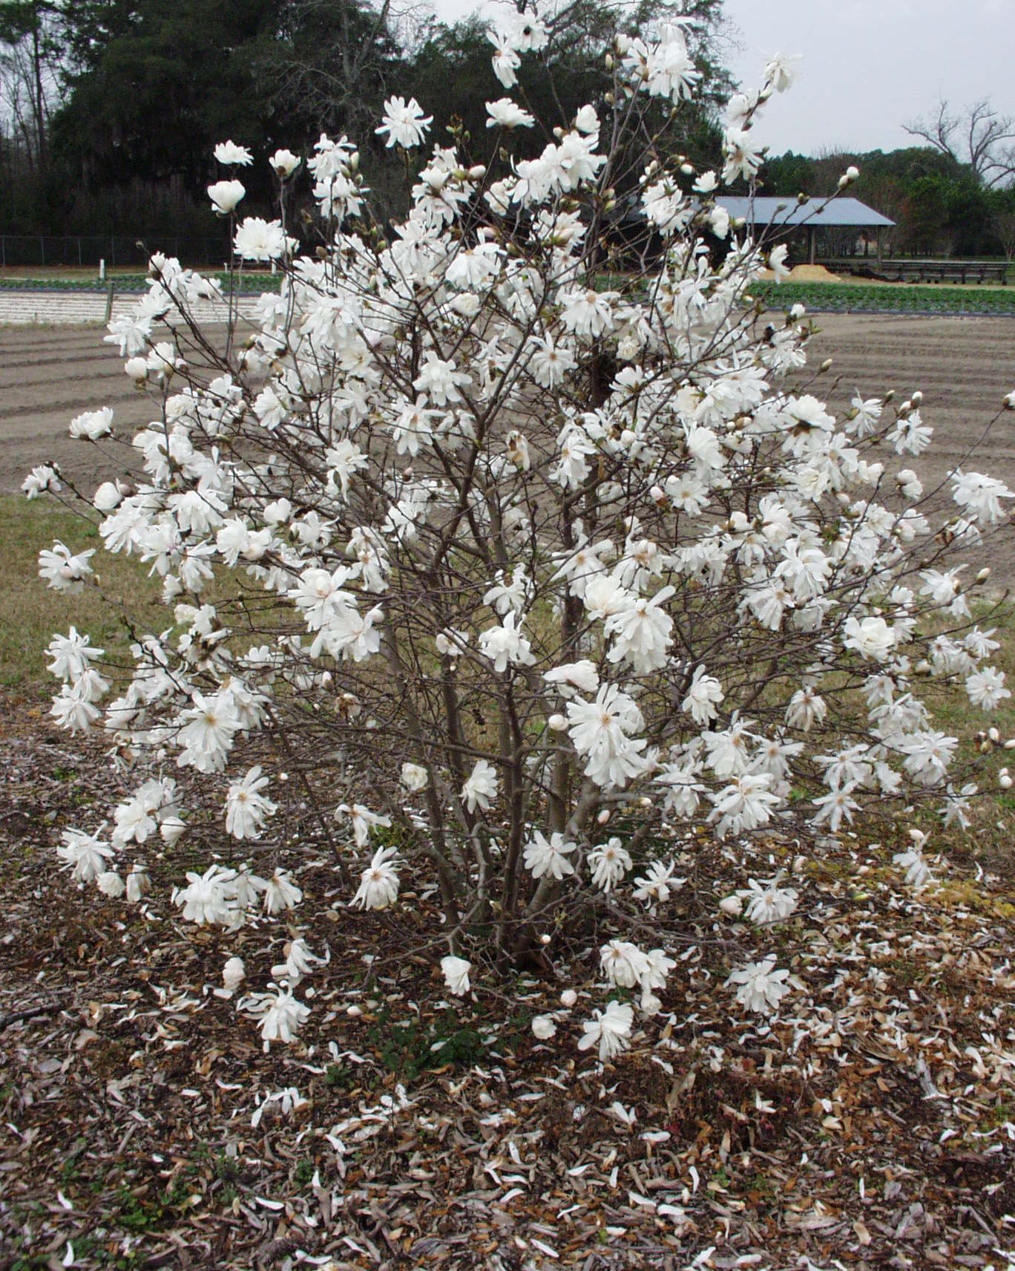
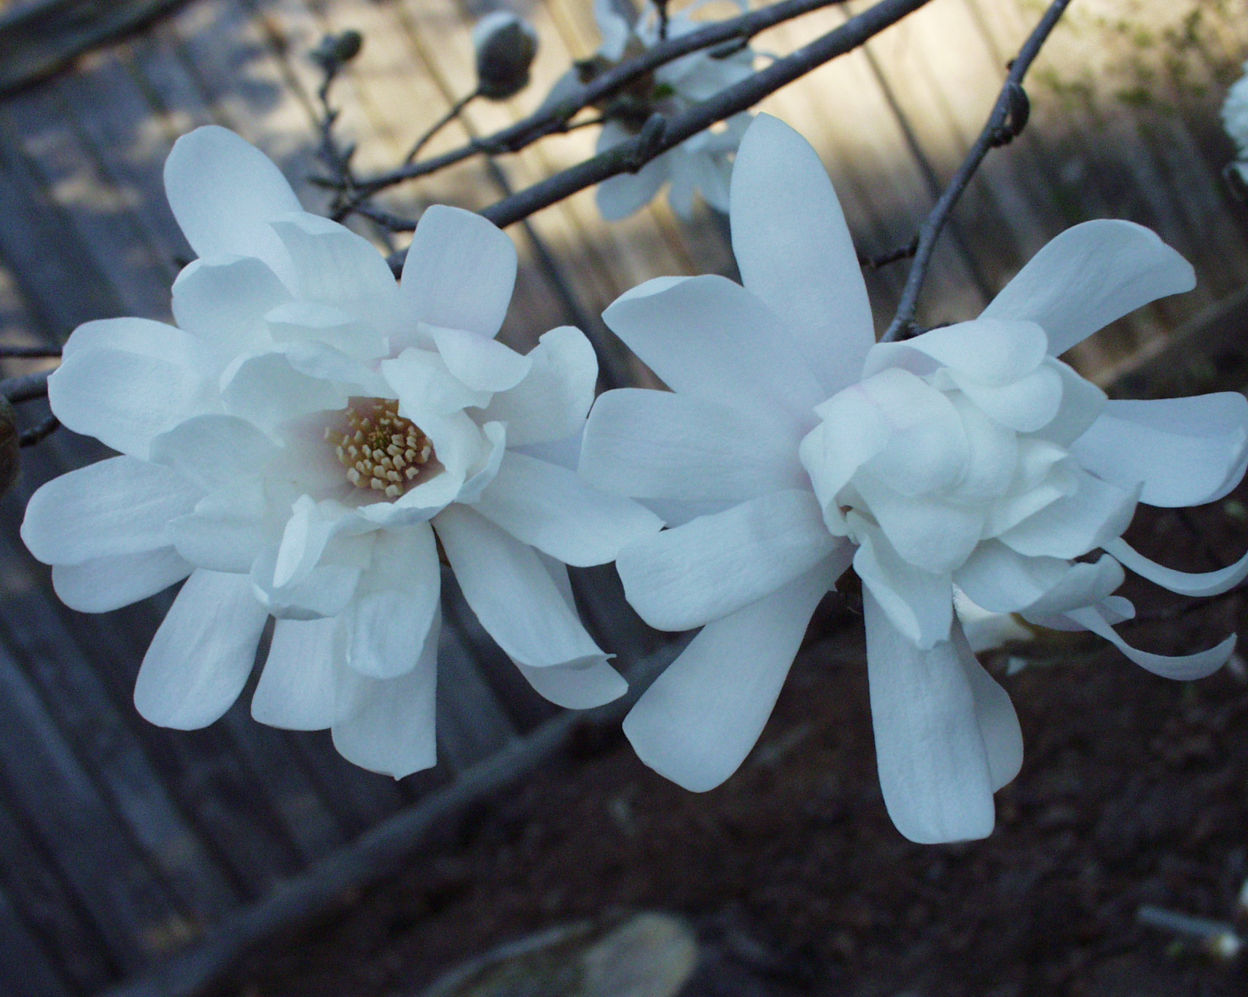

Slide 36
Myrica cerifera Southern Waxmyrtle
versatile evergreen plant grown as a large shrub or small tree
reaches 10-15’ height
grown in full sun or shade and in wet or dry areas

Slide 37
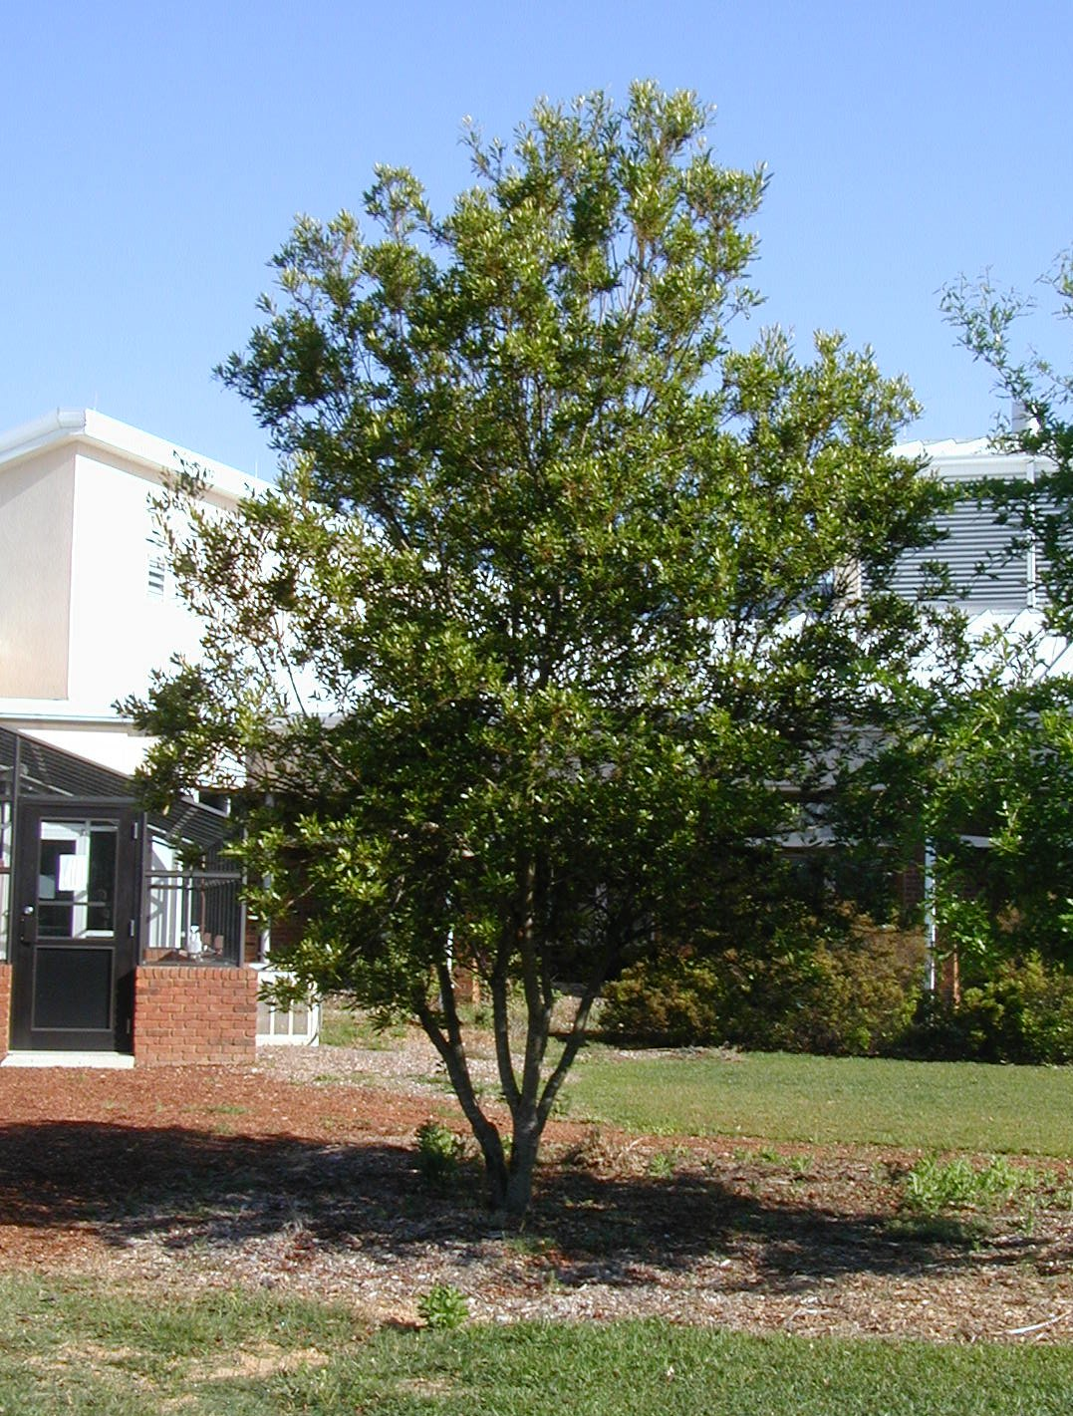
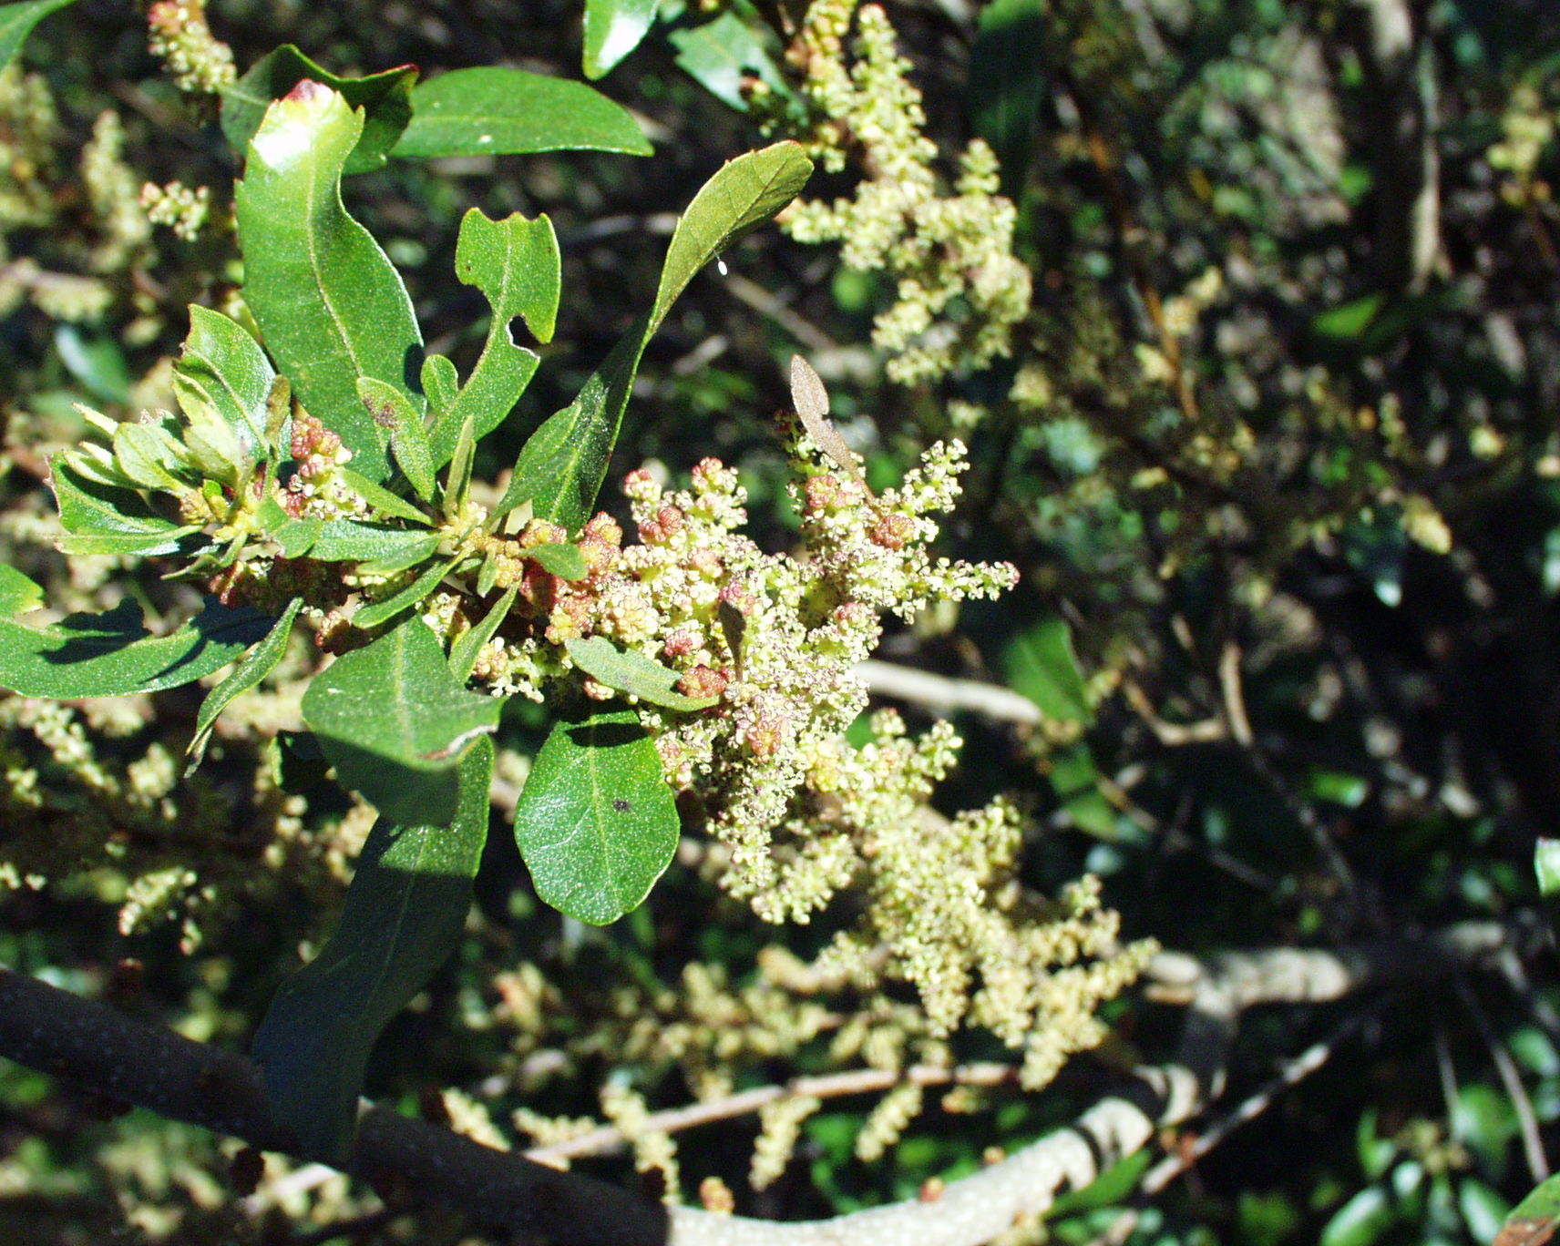

Slide 38
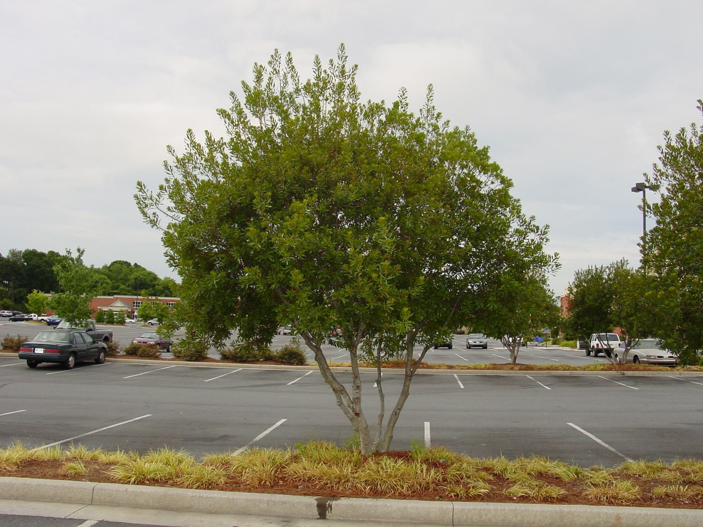

Slide 39
Osmanthus americanus Devilwood or Wild Olive
evergreen tree with open and loose growth habit, reaching 15-25’ tall
grown in sun or shade but best leaf color obtained with some shade
white-yellow, fragrant flowers in spring followed by dark purplish fruit
may be difficult to locate but worth the effort

Slide 40
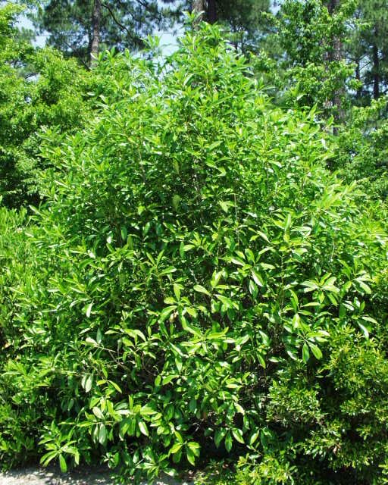
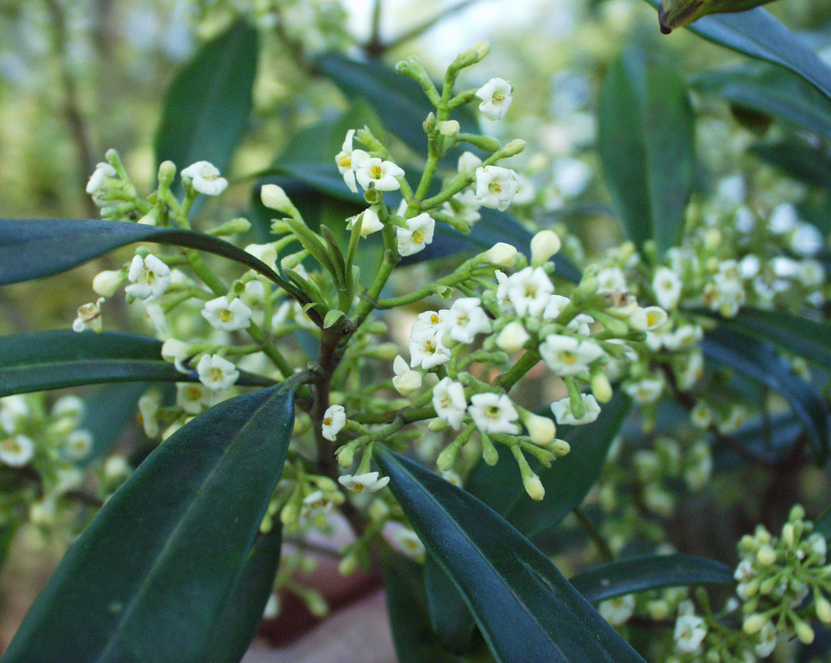

Slide 41
Ostrya virginiana American Hophornbeam or Ironwood
deciduous trees reach 25’ to 40’ height
performs well in the urban environment but can look tattered late in the season
interesting hop-like fruit
showy catkins in spring
attractive flakey bark on trunk

Slide 42
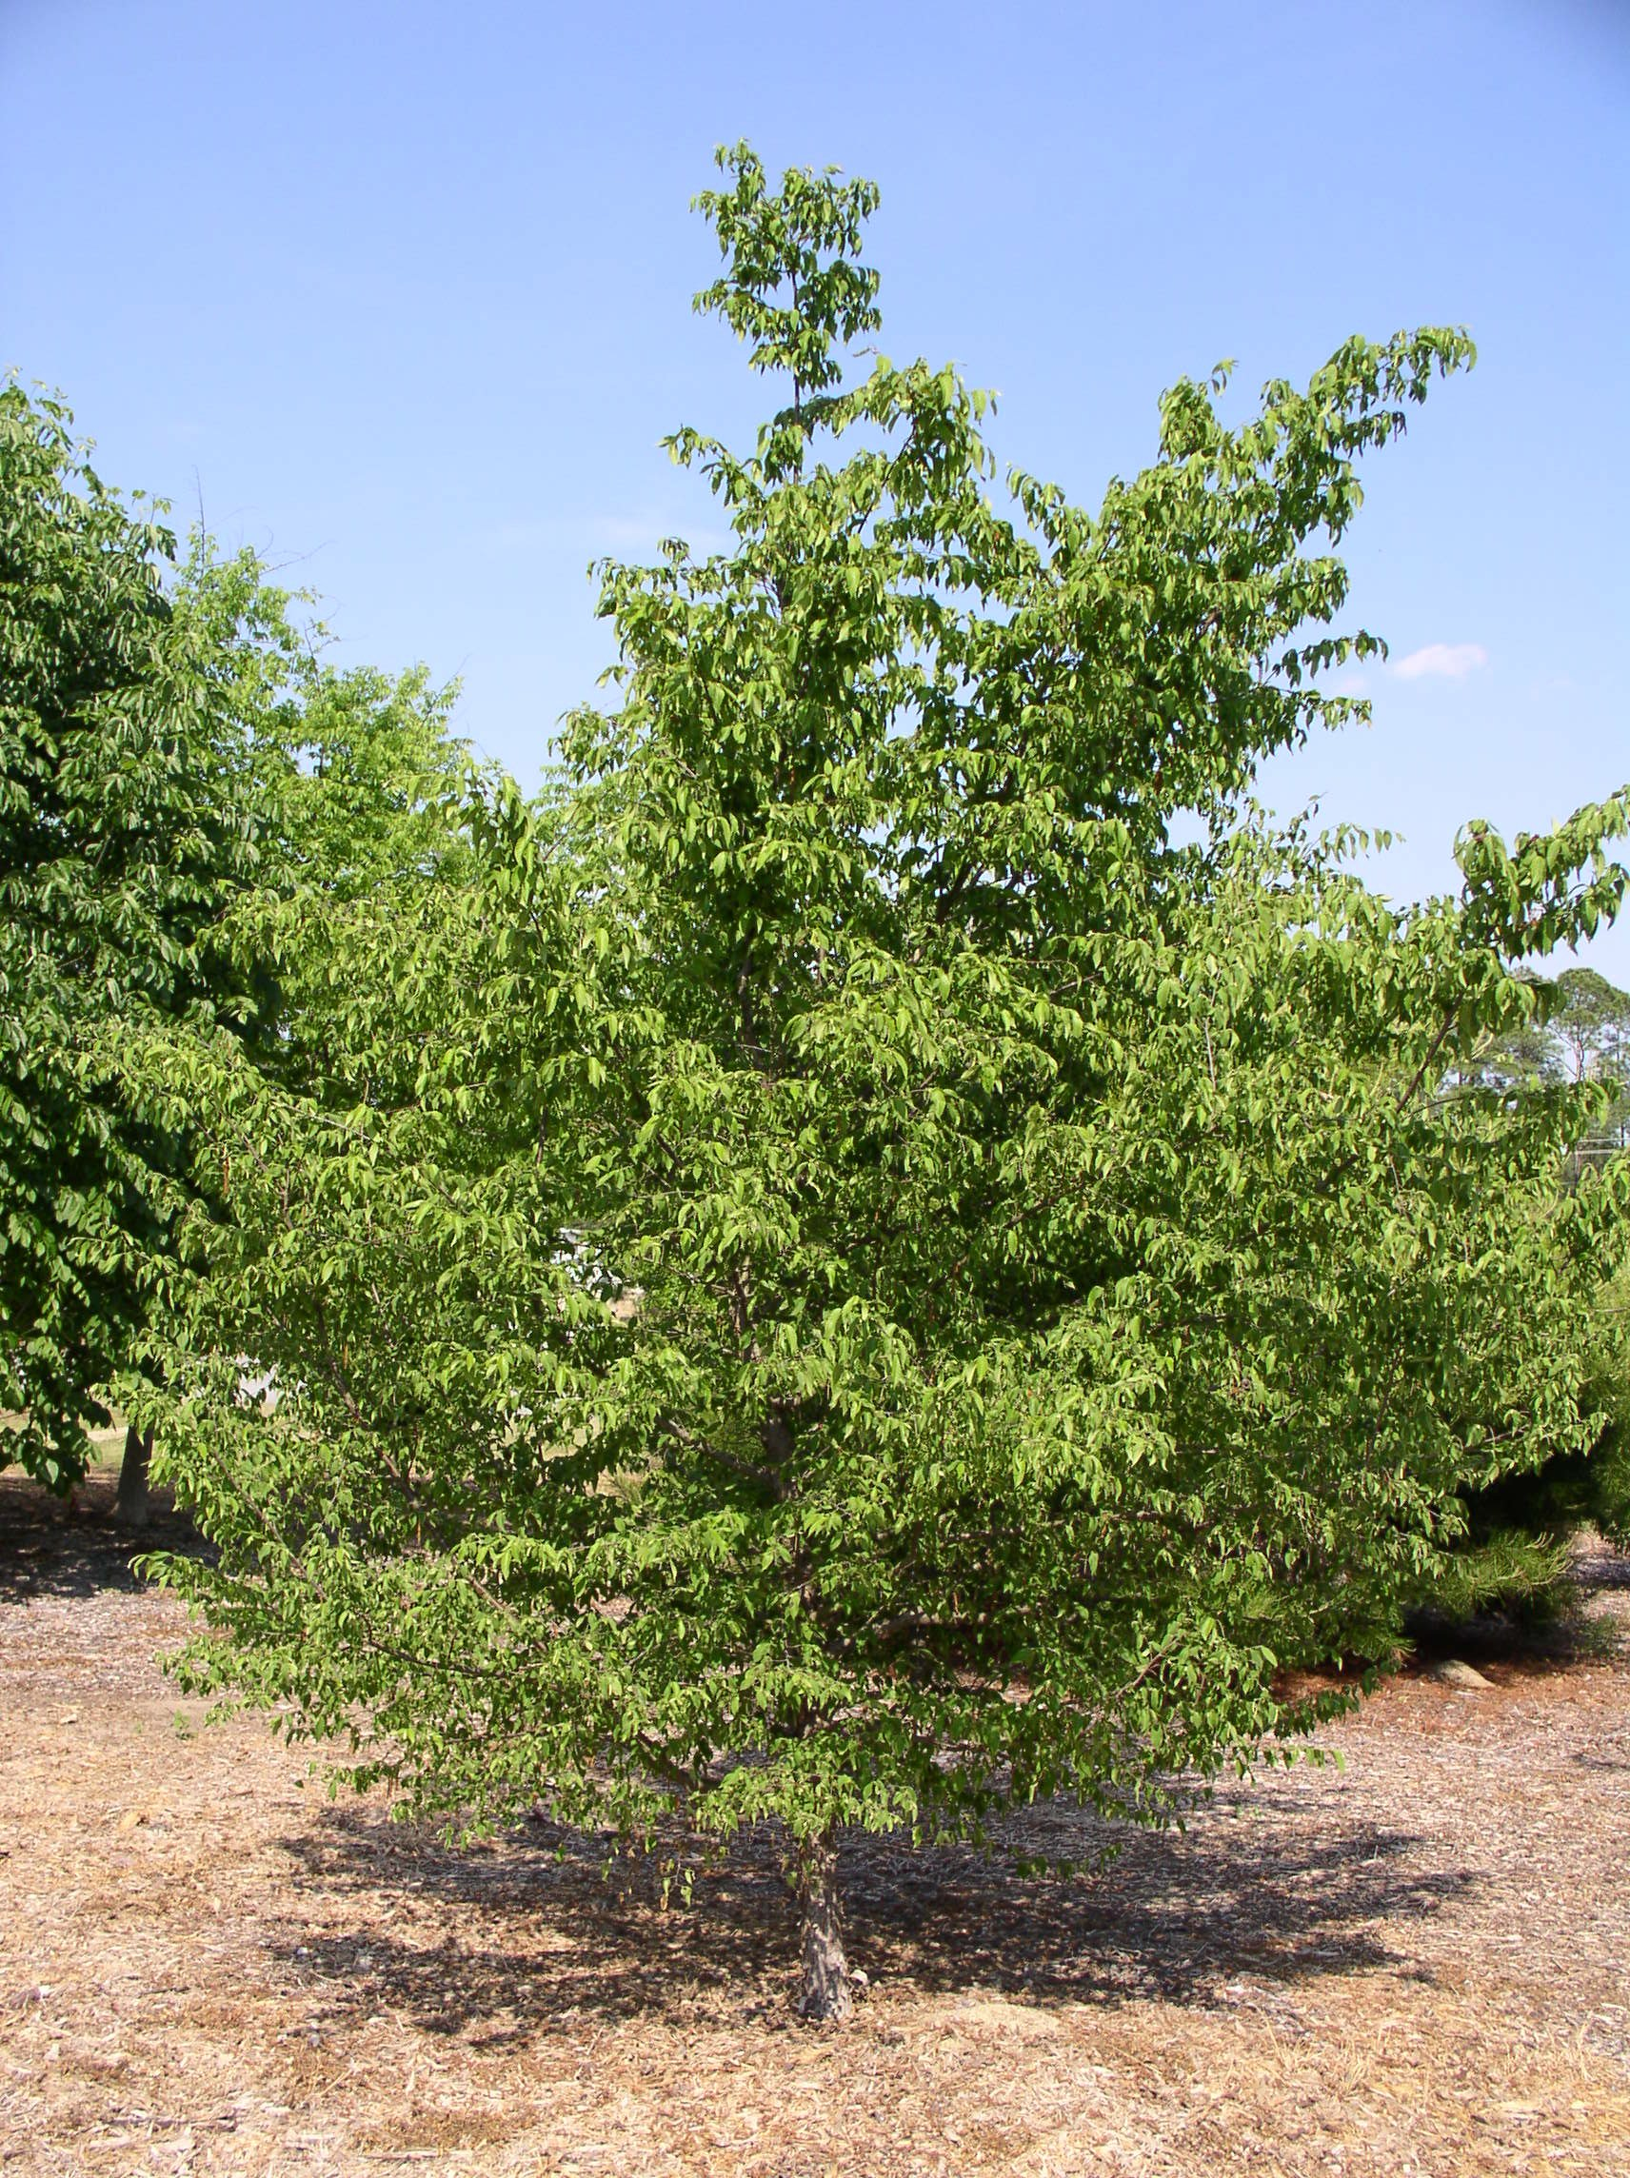
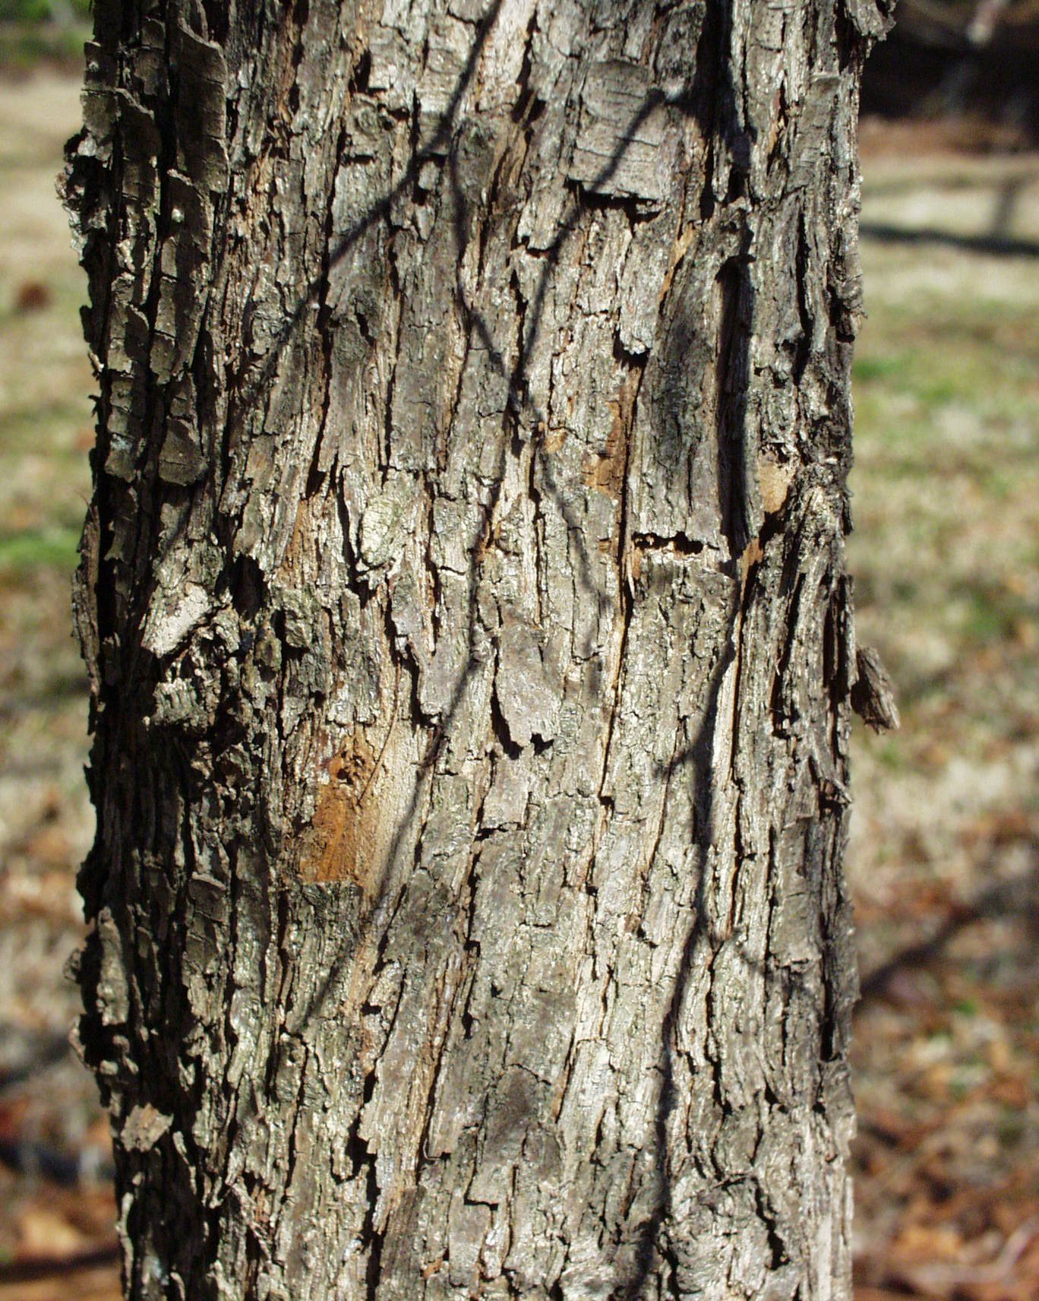
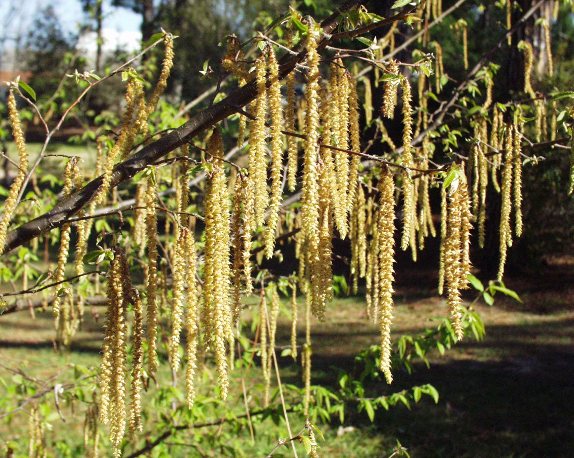

Slide 43
Photinia serratifolia Chinese Photinia
evergreen relative of the more common Photinia xfraseri
unlike Fraser photinia, less susceptible to the dreaded entomosporium leaf spot
reaches about 20-25’ in height and about two-thirds that in spread
can be used as a large hedge (great for screening) or small tree
very showy white blooms followed by small red fruit in the fall

Slide 45
Prunus x incamp Okame Cherry
matures about 20’ in height with a similar spread
best flowering cherry for the heat of
So. Georgia
pinkish flowers striking in early spring
foliage can provide good bronze to orange-red fall color
performs well in a sunny, dry location during hot, dry summers

Slide 47
Prunus mume Japanese Apricot
early season flowering (January) with size similar to Okame Cherry
range of flower colors available (white, pink, red) depending on the cultivar
flowers are double or single
some selections are very fragrant

Slide 49
Sabal palmetto Cabbage Palm
relatively cold hardy (zone 8)
native along the coast from southern North Carolina to North Florida
mature height in Georgia is about 30’
large, blue-green palmate-type leaves with threadlike strands of fiber
prefers light (sandy) soil
full sun to partial shade
tolerant of salt spray and is insect and disease resistant

Slide 51
Vaccinium aboreum Farkleberry
semi – evergreen to deciduous plant reaching 15-20 feet tall
dark green leaves turn striking red to crimson in fall
white flowers appear in early spring with leaf flush
pronounced black inedible berries, good wildlife plant
heat and drought tolerant
striking cinnamon – colored bark a plus

Slide 53
Vitex agnus-castus Chastetree
grows about 10-15’ in height and can be trained as a multi-stem standard
deciduous tree without prominent fall color
tree produces abundant lilac, pale violet, or white terminal flowers in the summer
removal of flowers after bloom can increase period of bloom
tolerates dry conditions

Slide 56
For Further Information:
Natural Resource Conservation: Small Trees for the Landscape Ordinance http://pubs.caes.uga.edu/caespubs/horticulture/H-01-061.htm

