Slide 1
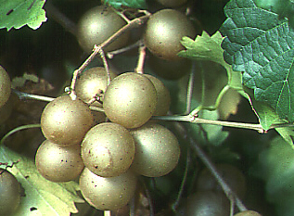
Small Fruits in Georgia
Grape
Strawberry
Blueberry
Brambles
Misc

Slide 2
Grapes
European or wine grape – Vitis vinifera
American or Concord grape – V. labrusca
Muscadine grape – V. rotundifolia

Slide 3
Grapes
Training and pruning:
Head vs Cordon
Spur vs cane

Slide 4
Grapes
Young vines: cordon, spur

Slide 5
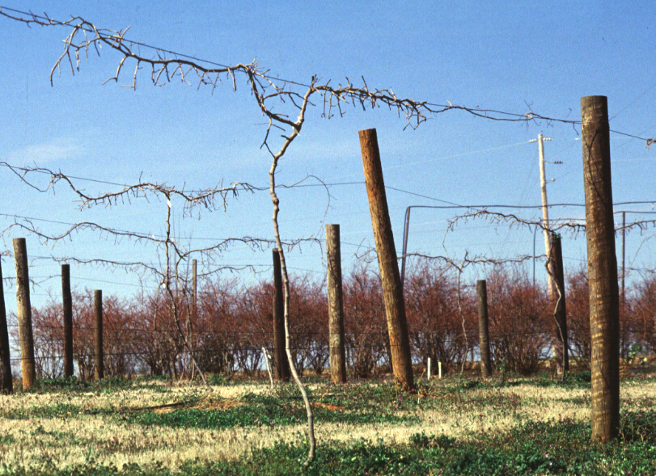
Grapes
Pruning established vines: every year!
Space spurs 6-12” apart on cordons, leave 2-6 buds

Slide 6
Grapes
Muscadines: turn into kudzu if not pruned

Slide 7
Grape pollination
Concord and vinifera grapes are self pollinating
Muscadines: some varieties need cross pollination
Scuppernong, Fry, Noble, Nesbitt, Jumbo, Hunt
Self-fruitful: Carlos, Cowart, Dixiland, Southland

Slide 8
Muscadine pest management
Black rot, bitter rot | Fungicide | Spray post bloom (black), preharvest (bitter)
Angular leaf spot | Fungicide | Spray midsummer
Grape berry moth, June beetle, grape curculio | Insecticide | 6-8 weeks pre-harvest
Grape root borer | Mound soil 1’ on trunk in early June | Remove mound at thanksgiving

Slide 9
Strawberry
Herbaceous perennial
June-bearing and Everbearing types
Annual hill vs matted row culture
Many pest problems
Frost prone

Slide 10
Strawberry
Buy bare-root or “plug” transplants from northern nursery source
Anthracnose!
Plant in Sept (annual) or Feb (matted row)

Slide 11
Strawberry
Annual hill or “plasticulture”
Commercial and PYO production
High yields, good quality, avoids many pest problems
More expensive and time consuming

Slide 12
Strawberry
Annual hill or “plasticulture”

Slide 13
Strawberry
Matted row (bed)
Processing or backyard
Yield & quality decline each year
More pest problems
Less expensive and time consuming

Slide 14
Strawberry
Matted row (bed)

Slide 15
Strawberry pest management
Botrytis rot or gray mold | Fungicide | Spray as growth commences through harvest; spraying for this eliminates need to spray for other fungi
Strawberry weevil (clipper) | Insecticide | Spray prior to and just after bloom
Weeds | Hand pull in matted, or use landscape fabric in annual hill | All the time!
Soil fungi, root rots | Cultural controls | Solarize soil in summer; use sandy, light, well-drained soil in bed

Slide 16
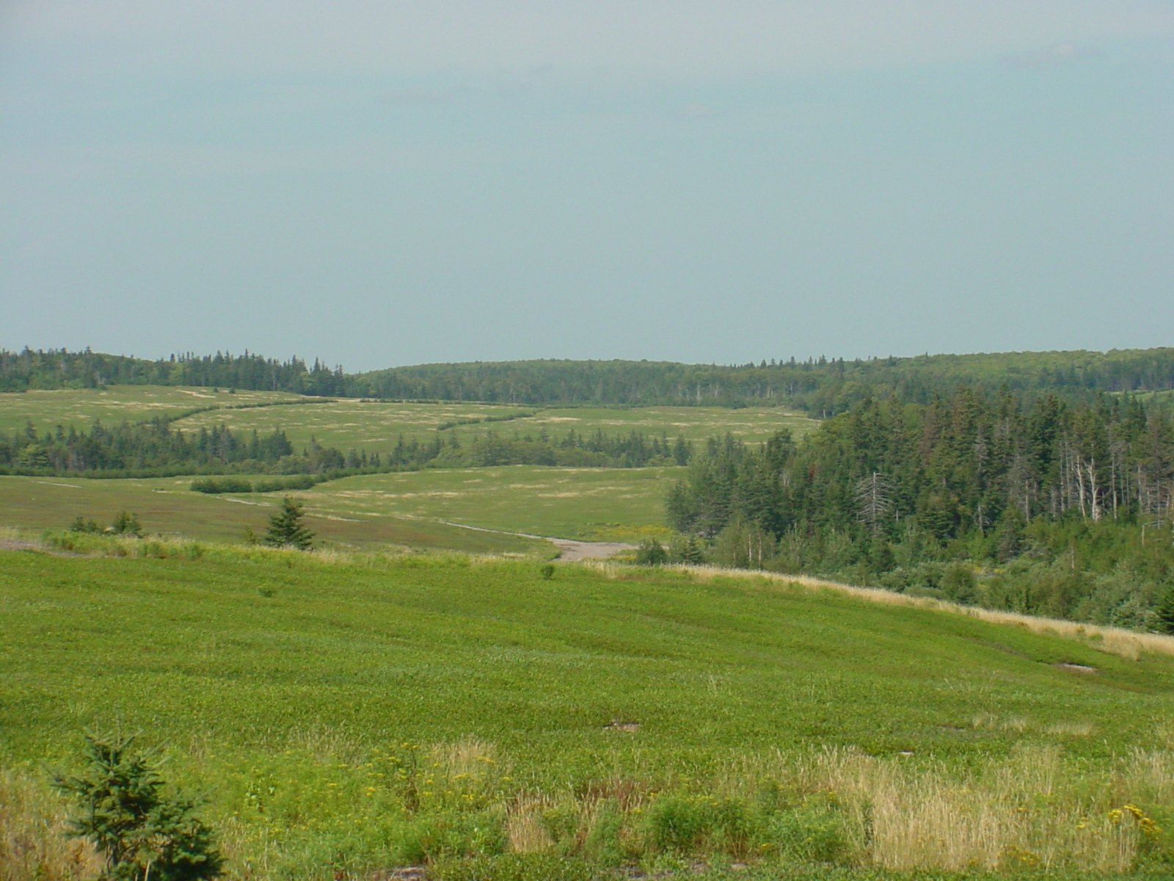
Blueberry
Rabbiteye – Vaccinium ashei
Northern Highbush – V. corymbosum
Lowbush – V. angustifolia
Southern Highbush – hybrids of V. corymbosum and southern species

Slide 17
Blueberry
Low maintenance
Minimal pruning or training
Minimal pests
Need cross-pollination
Need acidic soil (pH = 4.5) with high organic matter
Need special fertilizer (ammonium sulphate)
Benefit from mulch

Slide 18
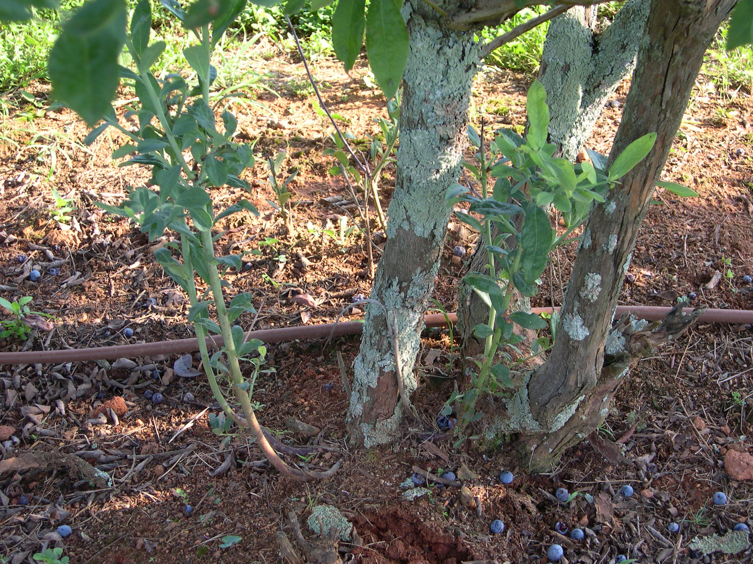
Blueberry
Pruning:
Remove flowers in first year
Cut out 1 old cane per year at maturity, and allow 1 new can to replace it

Slide 19
Blueberry
Pollination:
Rabbiteye – long bloom period; use 3 different varieties for best results
Southern highbush – 2 varieties OK
Northern highbush – self fruitful

Slide 20
Blueberry soil management
Soil test site
Low Ca, pH of 4.5
Dig large hole, back-fill with composted organic matter (pine bark, peat, leaf litter)
AVOID nitrate forms of N fertilizer
Apply Sulfur if Fe deficiency occurs (yellowing of uppermost leaves)
Use azelea or rhododendron fertilizer (ammonium sulfate)

Slide 21
Blueberry pest management
Botrytis rot and mummy berry | Fungicide | Spray from budbreak until first bloom, only if a problem previous year
Cranberry fruit worm | Insecticide | Spray just after bloom
Weeds | Heavy, organic mulch | All the time!
Leafminers, blueberry maggot, other insects | Insecticide | Spray if needed in summer through harvest
Most years, you won’t need to spray

Slide 22
Brambles
Members of the genus Rubus; blackberries, raspberries, black raspberries, and hybrid berries
Blackberries best for GA; all raspberries more suited to cooler summers

Slide 23
Blackberries
Low maintenance
Thornless, high quality, adapted varieties
Moderate pruning or training
Minimal pests
Self-pollinating
No special soil or fertilizer, but benefit from mulch

Slide 24
Blackberries
Brambles have biennial canes
Primocanes and floricanes

Slide 25
Blackberries
Erect and trailing types:
Only trailing types need a trellis

Slide 26
Blackberries
Pruning or training:
Topping
Thinning primocanes
Dead floricane removal

Slide 27
Blackberry pest management
Anthracnose | Fungicide | Spray from budbreak until first bloom, only on susceptible varieties (thornless = resistant)
Leaf and cane spots, rusts | Fungicide | Spray from budbreak until first bloom
Weeds | Heavy, organic mulch | All the time!
Strawberry weevil, Red necked cane borer, other insects | Insecticide | Spray if needed from bloom through May
Most years, you won’t need to spray

Slide 28
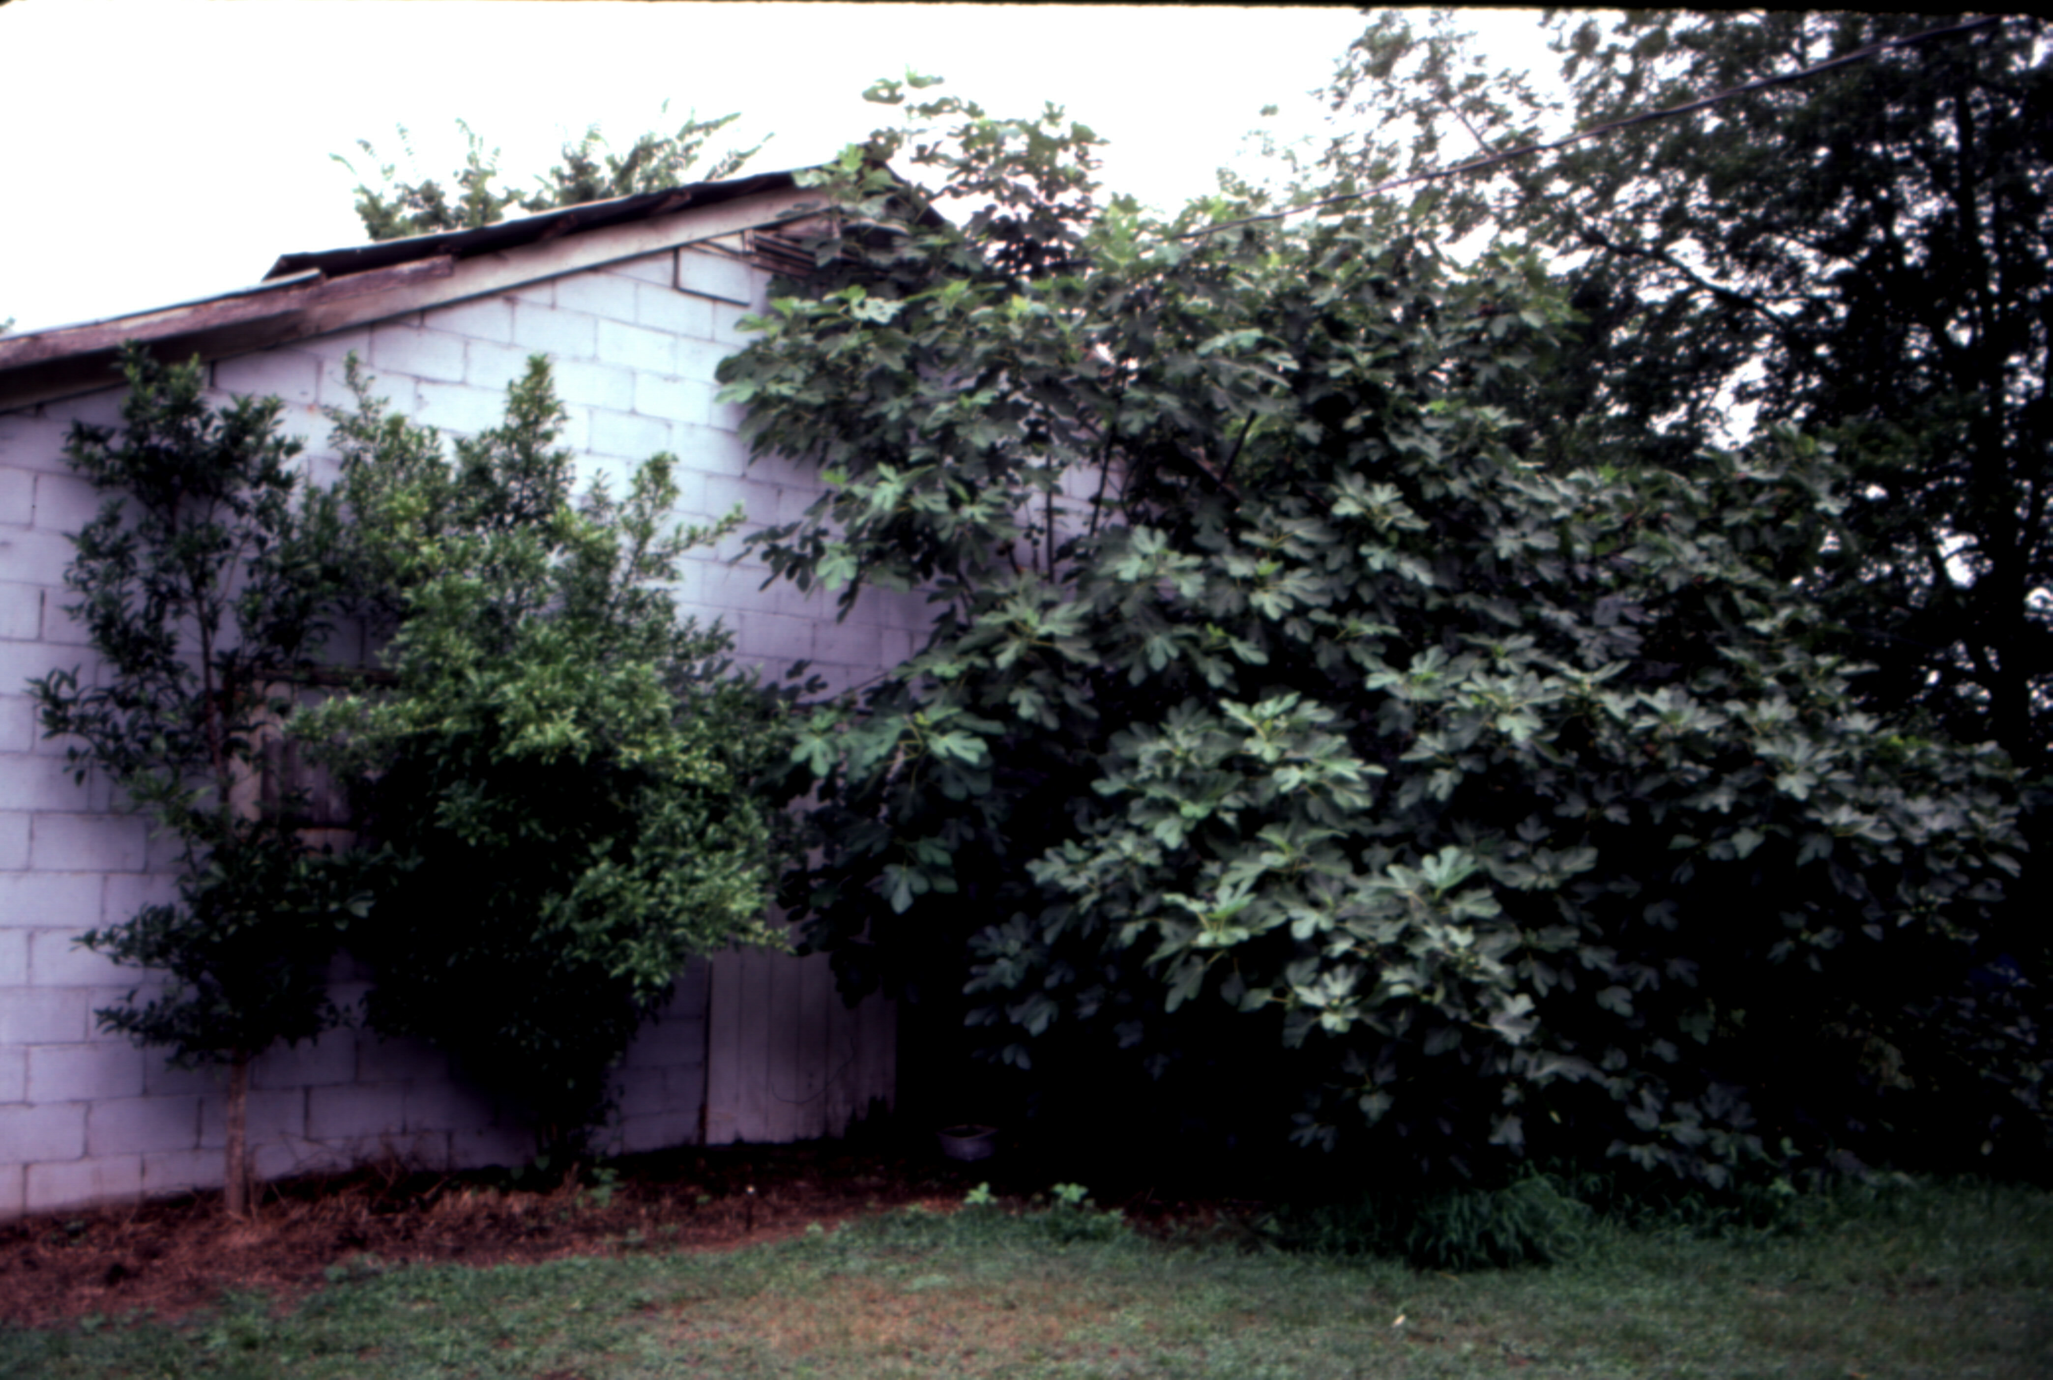
Figs
Great fruiting ornamentals
Almost no maintenance
NOT COLD HARDY

Slide 29
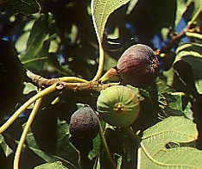
Figs
Do not use California types
Common figs: ‘Brown Turkey’, ‘Celeste’, ‘Alma’, ‘LSU Purple’

