Slide 1
Notes:
1. UGA Logo

Slide 2
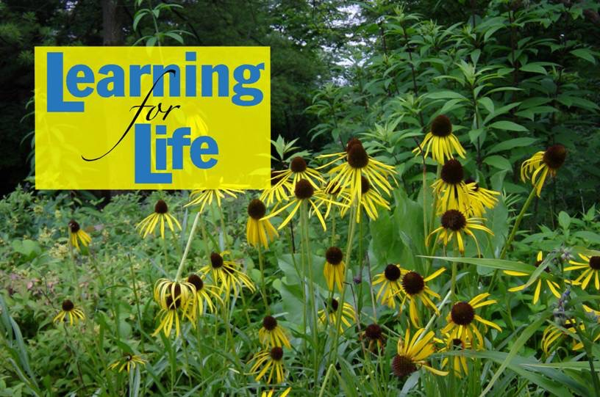
http://www.caes.uga.edu/extension/
Notes:
2. UGA Cooperative Extension Web address

Slide 3
Notes:
3. Georgia Master Gardener Logo

Slide 4
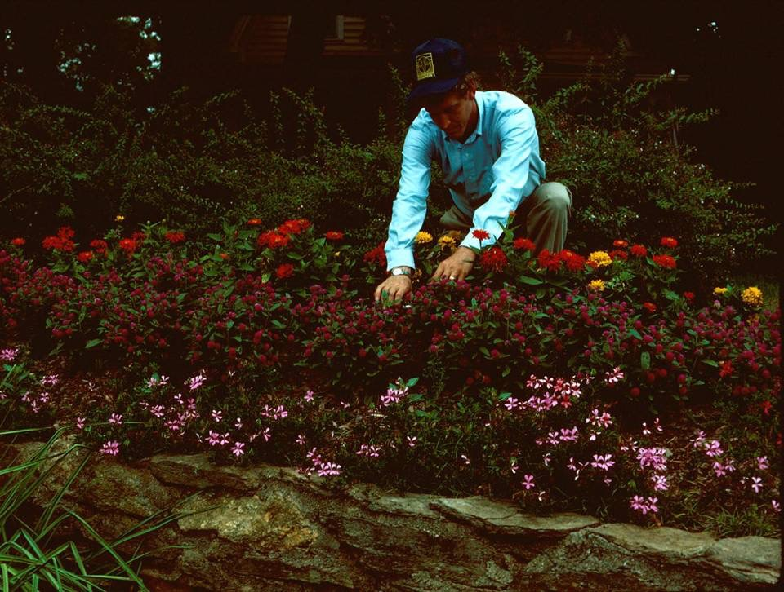
Part 1: Site Analysis
Planting
and
Management
of
Ornamental Plants
in the Landscape
Notes:
4. Today we’re going to discuss Site Analysis, Planting, and Management of Ornamental Plants in the Landscape.

Slide 5
Outline of Presentation
Site Analysis
New and existing sites
Physical and chemical properties of the soil
Soil drainage, sunlight exposure
Options for avoiding site problems
Planting
Step by step procedures for best results
Notes:
5. In the first half of this presentation, (#) we are going to discuss site analysis, a critical step before planting. Whether you are planting a new site or an existing site, analysis of the site criteria is important, including the physical and chemical properties of the soil, soil drainage, and sunlight exposure. Next we’re going to discuss the various options for avoiding site-related problems. (#) Then we’ll discuss planting and the step-by-step procedures, based on research, that will assure best results when planting ornamental plants.

Slide 6
Outline of Presentation
Management
Fertilization
Selecting fertilizers
When to fertilize
How much to apply
How to fertilize
Irrigation: Making Every Drop Count
Pruning
Tools, technique, and timing
Notes:
6. (#) In the second half of this presentation, we’ll focus on landscape management.(#) First, we’ll discuss fertilization and guidelines for selecting fertilizers, knowing when to fertilize, calculating the amount of fertilizer to apply, and the technique for applying fertilizers. (#) Then we’ll look at irrigation, another important element of landscape management, and look at efficient use of irrigation so that every drop counts. (#) Last, we’ll review recommended pruning procedures and the importance of having the appropriate tool for each pruning task, using the appropriate pruning technique to accomplish your desired goal, and pruning flowering ornamental plants at the right time so you don’t interfere with their flowering cycle

Slide 7
Site Analysis
A Critical Step in Landscape Development
Before pen goes to paper
Before the first plant goes in the ground
Before you begin managing the site
Notes:
7. Site analysis is a critical step in landscape development (#). It should be done before pen goes to paper and you begin the design, before the first plant goes into the ground, and certainly before you begin managing the site. In other words, site analysis will determine the types of plants you can grow, changes that need to be made in the site in order to grow the plants you want to grow, and the amount of management required to keep the plants looking their best.

Slide 8
80% of plant problems result from the inability of the plant to tolerate or adapt to the local environment
Notes:
8. Site analysis will help avoid problems later. At the University of Georgia’s Plant Diagnostic Clinic, at least 80% of the plant problems submitted for analysis result from the inability of the plant to tolerate or adapt to the local environment. In other words, the site is just not suitable for the plant, or the plant selected is not able to adapt to the site.

Slide 9
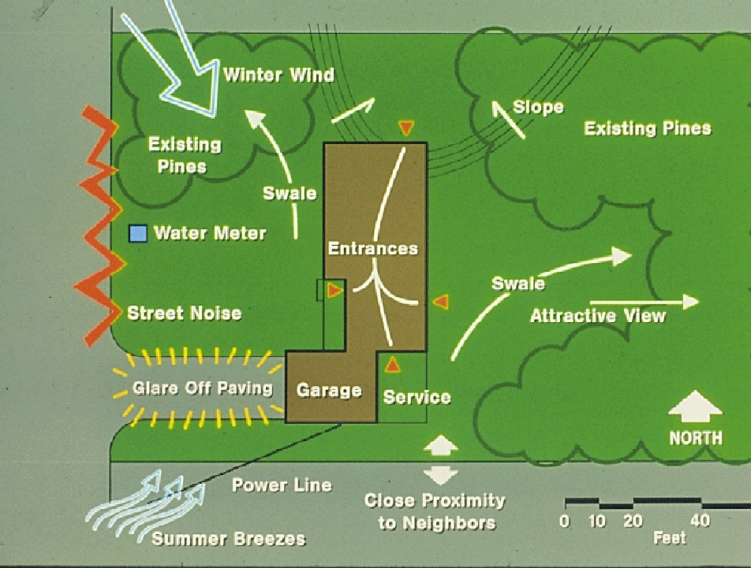
Notes:
9. There are a number of items to catalog when analyzing the site. Learn about the orientation of the site and which direction is north, south, east and west. Study the sunlight pattern on the site throughout the day and catalog how long various locations are in sun or shade. Note the areas that have filtered shade throughout the day. Sunlight patterns also change with the seasons. Examine soil drainage and note if there are any low spots where water might stand after heavy rains. Look at the site after rain to determine if there are any poorly drained areas. Pay particular attention to the area adjacent to the building and make certain the soil slopes away from the building and that there are no low spots where water might stand. Identify which side of the building faces the north and northwest and which side faces the south. More cold-hardy plants would be placed on the north and northwest side of the property, while tender plants would be located on the south and southeast side, preferably close the building where they are shielded from the cold northwest winds in winter. Unsightly views that need to be screened or noise that needs to be abated are other important items to note. The location of any underground utilities, such as electric, water, cable and phone, is also critical to know before any digging occurs.

Slide 10
Once you catalog the site criteria, you can better select plants adapted to each location in the landscape
East-facing exposure, morning sun, well-drained soil
Azaleas
West-facing exposure, shade from nearby tree, moist, well-drained soil
Azaleas
Notes:
10. Once you analyze the site, you can better select plants adapted to each location in the landscape. (#) For instance, an east-facing exposure getting morning sun, afternoon shade and having well-drained soil (#) might be a good location for azaleas. (#) On the other hand, a west-facing exposure shaded by a nearby tree and having moist, yet well-drained soil (#) would also be a suitable location for azaleas. If the soil was poorly drained or the site was exposed to the hot afternoon sun, azaleas would not be a good choice.

Slide 11
Change the Site to Fit the Intended Plants
Introduce shade for shade-loving plants
Thin out existing vegetation to accommodate sun-loving plants
Add topsoil or compost to improve soil structure
Change the grade to influence drainage
Install drainage pipe to carry water off the site
Notes:
11. If the desired plants are not suited for existing site conditions, then the other option is to change the site to fit the intended plants. (#) For instance, you might introduce shade to the site by building a structure or by planting a tree adjacent to the site to protect the plants from the hot afternoon sun. (#) If sun-loving plants are intended for a shady site, then an option might be to thin out the canopy of existing vegetation to allow more sunlight to reach the plants. (#) In other areas, topsoil or compost might be necessary to improve water and nutrient-holding capacity of the soil so plants that are not drought tolerant can be successfully grown in the area. (#) Other areas may require grading changes to influence drainage and moisture patterns. (#) Still other sites might require sub-surface drain pipe to carry water off a poorly-drained area so that plants that can not tolerate wet feet can be grown. As you might expect, these types of site changes are easier to do in new landscapes than in established landscapes.

Slide 12
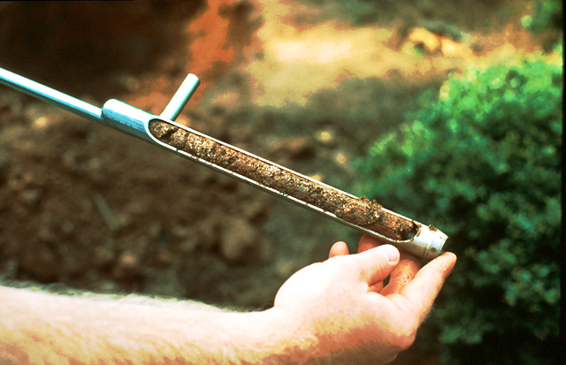
Analyze the Structure and
Texture of the Soil
Notes:
12. During site analysis, it’s very important to examine the structure and texture of the soil. Use a soil probe or shovel to examine the soil in several locations to a depth of at least 12 inches. Look for any evidence of hard, compacted soils or rock that may result in poor drainage. A soil profile will also help you determine whether there is existing topsoil and the type of amendments that may need to be added

Slide 13
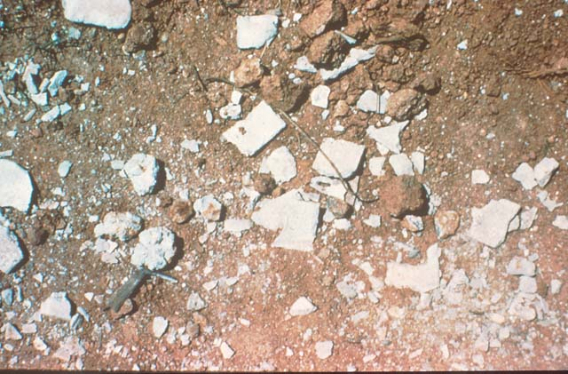
New Construction Sites
Left-over debris - chunks of concrete, tar paper, roofing shingles, sheetrock, etc.
Soil compaction from construction equipment
Hidden oil, gasoline and other chemical spills
Notes:
13. On new construction sites, there are often all sorts of debris left in the soil by builders, including chunks of concrete, tar paper, roofing shingles, sheet rock etc. Soil compaction resulting from construction machinery running over the site can cause poor drainage and plant problems. And there may be all sorts of chemical contamination of the soil that may not be evident, such as oil, gasoline spills or other substances that may have been spilled or disposed of on the site.

Slide 14
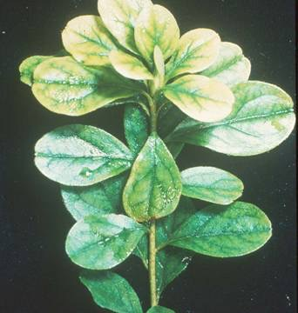
Most Ornamental Plants Prefer a Soil pH Between 5.2 and 6.5
Prefer an Alkaline pH
(6.5 to 7.5)
Barberry
Ornamental Cherry
Honeysuckle
Mulberry
Virginia Creeper
Lilac
Wisteria
Iron deficiency of azalea at pH > 7.0
Notes:
14. Soil pH influences the availability and uptake of nutrients by plants. Most ornamental plants prefer a soil pH between 5.2 and 6.5. However, there are a few ornamental plants that prefer a more alkaline pH, between 6.5 and 7.5, such as Barberry, Ornamental Cherry, Honeysuckle, Mulberry, Virginia Creeper, Lilac and Wisteria. A soil test, available for a nominal fee from your local County Extension Office, will determine your soil’s pH. Soil pH can be raised by applying dolomitic lime, or lowered by applying acidic fertilizers, such as ammonium sulfate or wettable sulfur.

Slide 15
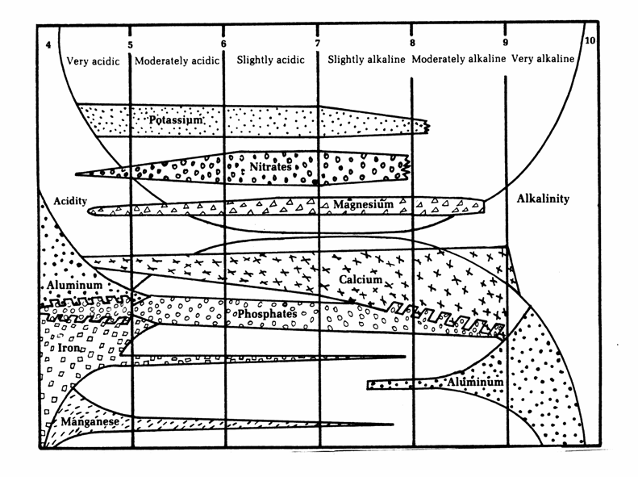
pH Effect on Nutrient Availability
Notes:
15. There are sixteen nutrient elements essential for plant growth. Soil pH determines how soluble they are in the soil and how available they are for uptake by roots. All essential elements are readily available in moist soils when the pH is between 5.2 (#) and 6.5 (#). Above and below this range, nutrient deficiencies sometimes occur and cause plants to appear chlorotic. Some elements may also reach toxic levels when their level rises or falls too far out of the desirable range.

Slide 16
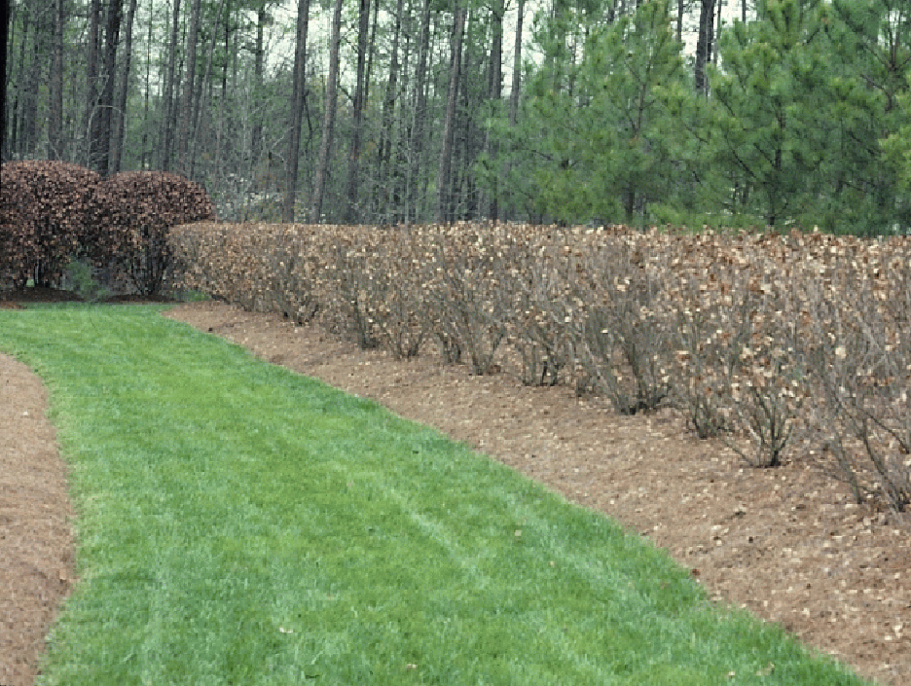
Cold Damage
Notes:
16. Cold damage sometimes occurs on ornamental plants which are not hardy or adapted to the average minimum temperature of the area. Cold damage may be particularly severe on ornamental plants when a sudden and severe freeze occurs after several weeks of warm weather.

Slide 17
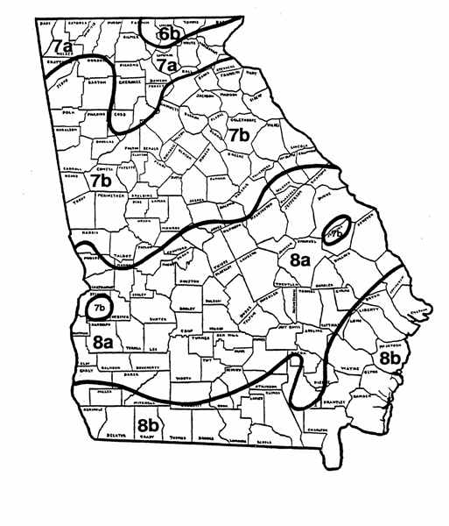
^{Cold} ^{Hardiness Zones}
Range of Average Annual Minimum Temperatures for Each Zone
^{Zone Range in Degrees F}
^{6b -5 to 0}
^{7a 0 to 5}
^{7b 5 to 10}
^{8a 10 to 15}
^{8b 15 to 20}
Notes:
17. In Georgia, we have five hardiness zones, ranging from 6b in the north Georgia mountains to 8b in southern Georgia. Most plant books give the cold hardiness zone for the plant. It’s important to select plants adapted to the average minimum temperature of your region. Some plant books list only the coldest zone the plant will tolerate and not the range of zones. Ginkgo, for instance, is sometimes listed for zone 4, but it will grow as far south as zone 8. Pittosporum is a zone 8 plant. It should not be grown in zones 7 and 6 unless it is provided winter protection.

Slide 18
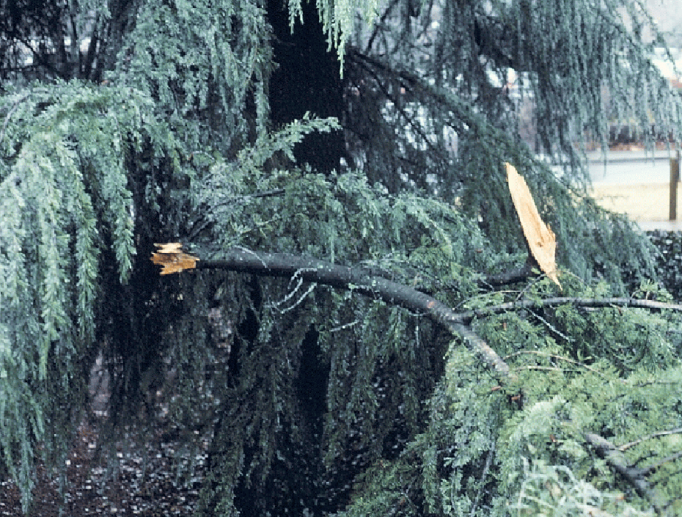
Notes:
18. Ice storms are a common event in north Georgia and an environmental effect we have no control over. Ice storms often cause severe damage to conifers, like this Deodar Cedar.

Slide 19
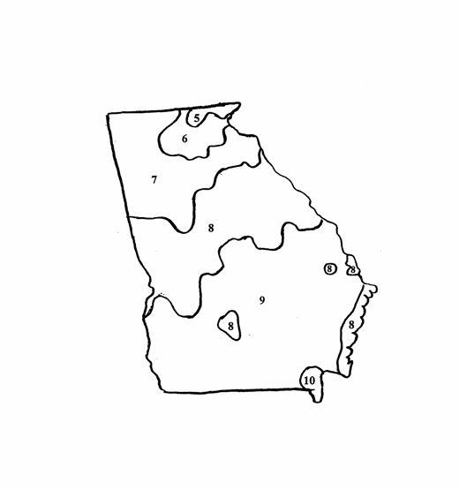
^{Heat Zone Map For Georgia}
Ave. no. of days per year above
^{86 degrees F}
^{Zone Ave. No. Days}
^{5 30 – 45}
^{6 45 – 60}
^{7 69 – 90}
^{8 90 – 120}
^{9 120 – 150}
Notes:
19. Recently, a Heat Zone Map for the United States has been released, showing the average number of days in summer when the temperature of various regions is above 86 degrees Fahrenheit. There are five heat hardiness zones in Georgia. Eventually, plant books will rate plants according to both their cold and heat hardiness, allowing us to fine tune our plant selections.

Slide 20
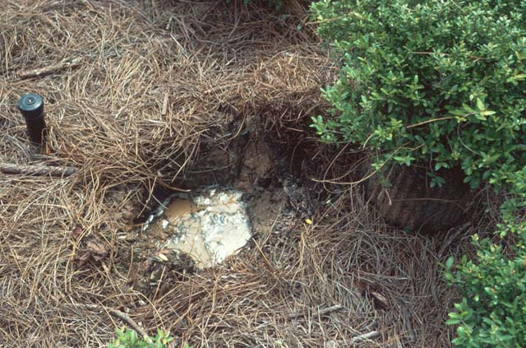
More plants are killed each year from over-watering than from the lack of water
Drainage Problem
Notes:
20. Poor drainage is one of the leading causes of ornamental plant problems. Root systems suffocate in poorly drained soil.

Slide 21
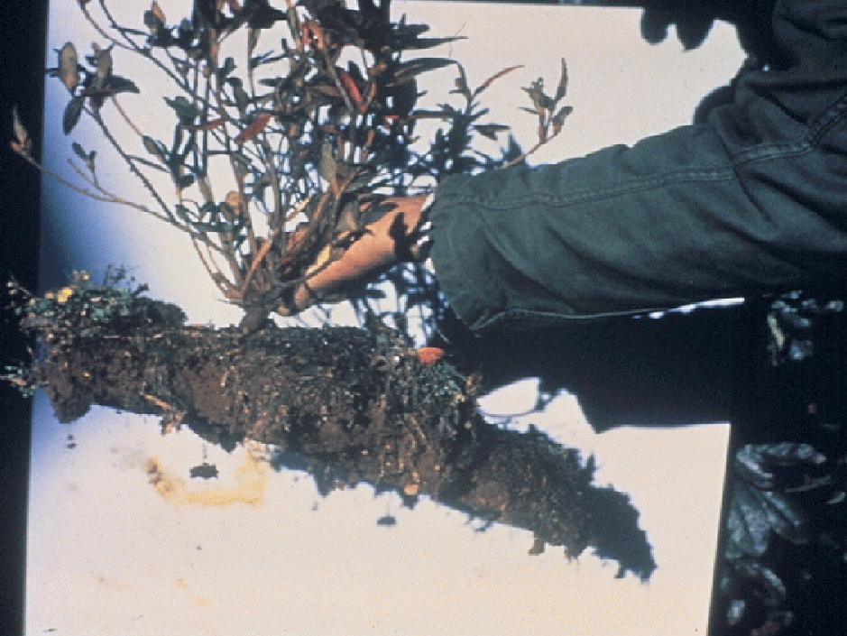
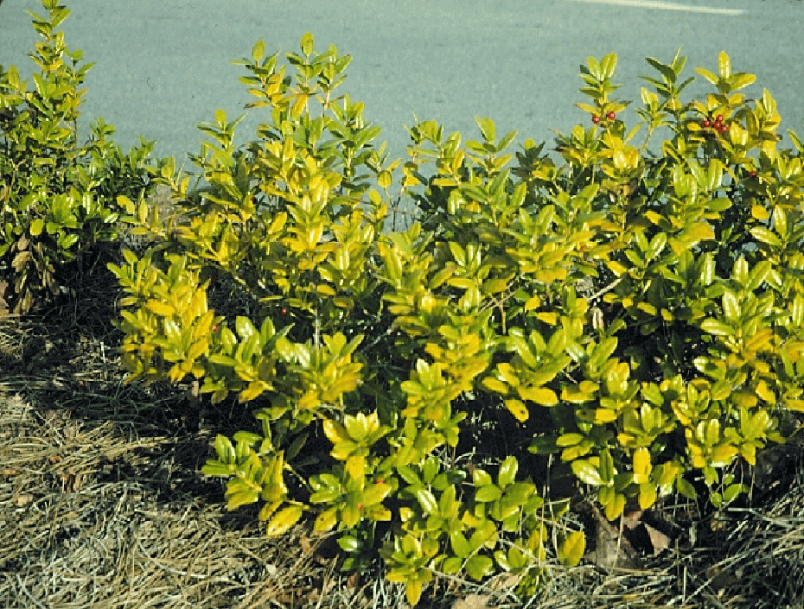
Notes:
21. Plants growing in poorly drained soil develop a shallow, pancake-like root system as their roots, submerged in water, suffocate and die. Above-ground symptoms of poor drainage include yellowing leaves and abnormally small new growth. Plants appear anemic and are nutrient deficient as their roots fail to take up sufficient nutrients to support the top.

Slide 22
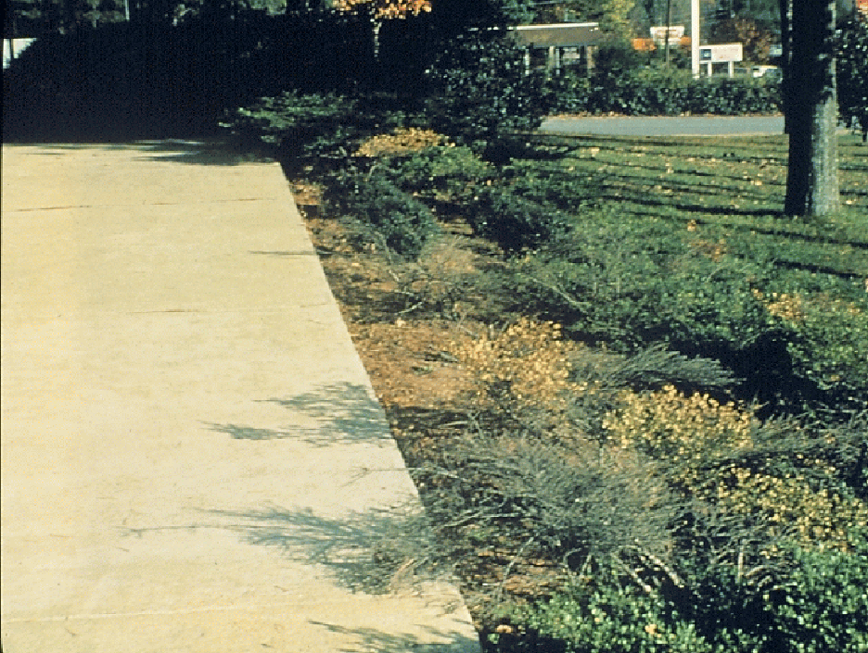
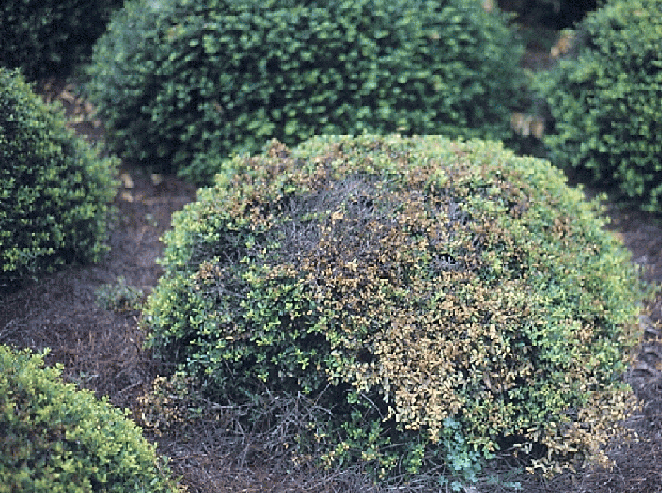
Wet/dry fluctuations in soil moisture
Notes:
22. Some ornamental plants, such as this ‘Helleri’ Holly, a cultivar of Japanese Holly, are unable to tolerate extreme fluctuations in soil moisture. In this case, water would flow off the parking lot after rains and flood the plants. Then they would dry out before the next rain. ‘Helleri’ Holly cannot tolerate these extreme variations in soil moisture. (#) As a result, branches begin to die back and the plants look unsightly

Slide 23
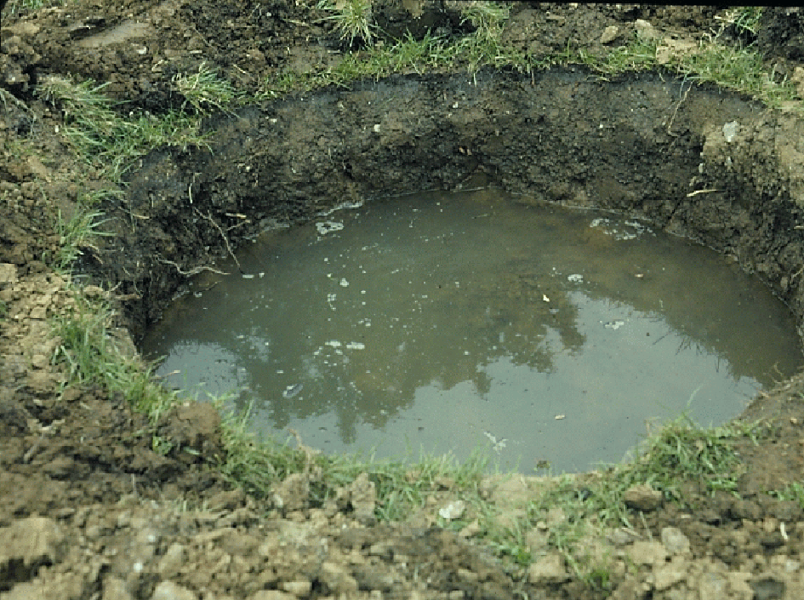
Perc Test
Notes:
23. Poor soil drainage is not always obvious at first glance. A simple Perc Test will help detect and avoid drainage problems. Simply dig a hole as if you were planting a tree or shrub and fill it with water. If most of the water has drained out of the hole within an hour, drainage is good. However, if a considerable amount of water remains in the hole several hours after application, a drainage problem is likely. Several Perc Tests may be needed at different locations in the landscape because soil type and drainage may vary a great deal in an individual landscape.

Slide 24
Possible Solutions to Wet Sites
Plant on an elevated bed at least 12- inches above grade
Sub-soil to break up a hard-pan layer
Select plants adapted to wet soils
Install sub-surface drain pipe
Move away and avoid the problem
Notes:
24. There are a number of possible solutions to poorly drained sites. (#) One is to plant on an elevated bed at least 12-inches above grade. You may need to purchase some well-drained topsoil if there is no other soil on the site you can move for this purpose. Since at least 80% of the root system of woody ornamental plants is in the top 12 inches of soil, elevating the grade at least 12 inches will help get the roots above the water-logged soil. (#) Another possible solution is to do some sub-soiling if a hard-pan layer exists under the soil. (#) Another option is to select plants you know are tolerant of wet sites. (#) In some situations, it may be necessary to install sub-surface drain pipe, such as 4-inch perforated PVC, to help carry the water off the site. (#) or you may choose to move away to avoid the problem.

Slide 25
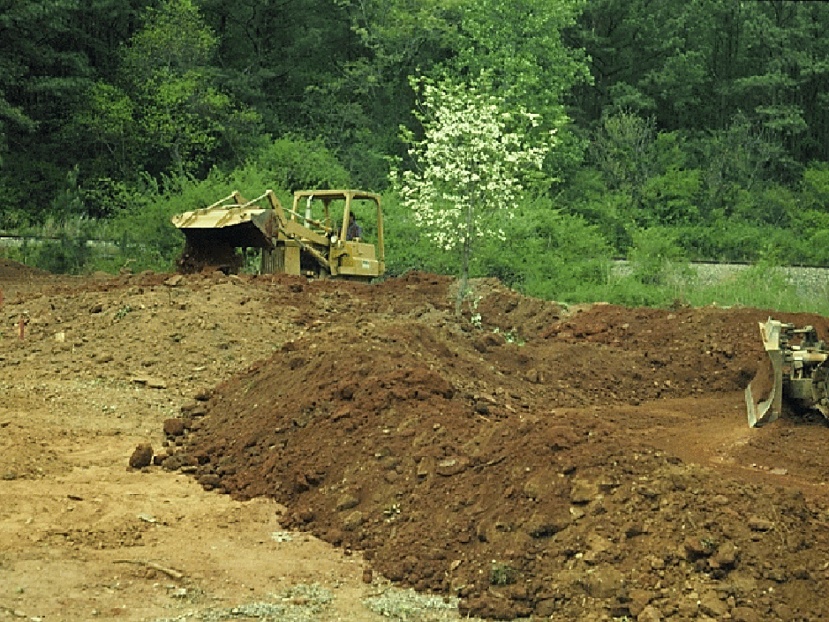
Notes:
25. You can significantly influence the drainage on a site by changing the grade during construction. Drought tolerant plants can be planted at the higher elevations and more moisture loving plants at the lower elevations.

Slide 26
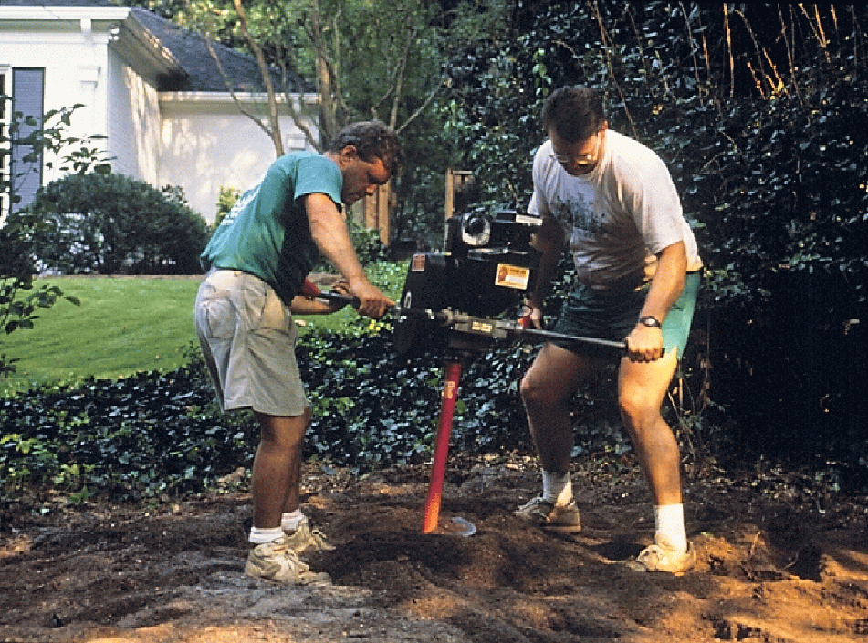
Notes:
26. Some soils may have a hardpan layer (a layer of hard, compact soil) beneath the surface that can be broken up with an auger or by deep cultivation with a rototiller. On large commercial sites, soil compaction, resulting from trucks, tractors and other construction equipment driving over the site, is a common problem.

Slide 27
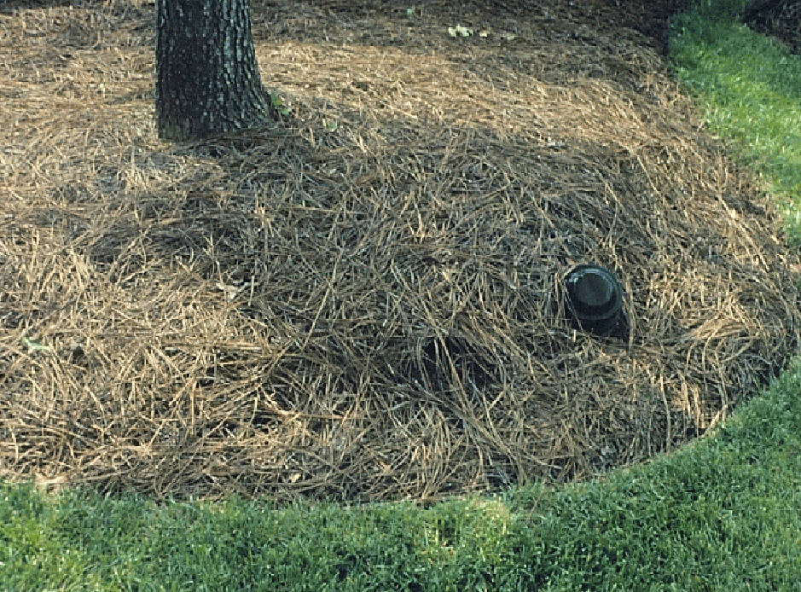
Notes:
27. During the site analysis phase of this large commercial site in Atlanta, Perc Tests showed that the soil was poorly drained, so an extensive sub-surface drainage system using porous PVC pipe was installed before the landscape was installed. An access pipe was extended above ground so the maintenance personnel could monitor the water table with a dip stick. After heavy rains, the cap on the pipe is removed and water is pumped out to keep the water table at least 12 inches below the surface.

Slide 28
Plants with Above-average
Tolerance to Moist Sites
Weeping Willow
Red Maple
Bald Cypress
Yaupon Holly
Sweet Bay Magnolia
Wax Myrtle
Virginia Sweetspire
Summersweet
Notes:
28. In addition to the physical changes to the site to assure good drainage, selecting plants adapted to moist conditions will also help prevent problems. This lists shows plants known to have an above-average tolerance to moist sites. Some reference books, such as Michael Dirr’s Manual of Woody Landscape Plants, contain lists of plants adapted to various site conditions. Your local nurseryman can also guide you in selecting the right plant for the site conditions.

Slide 29
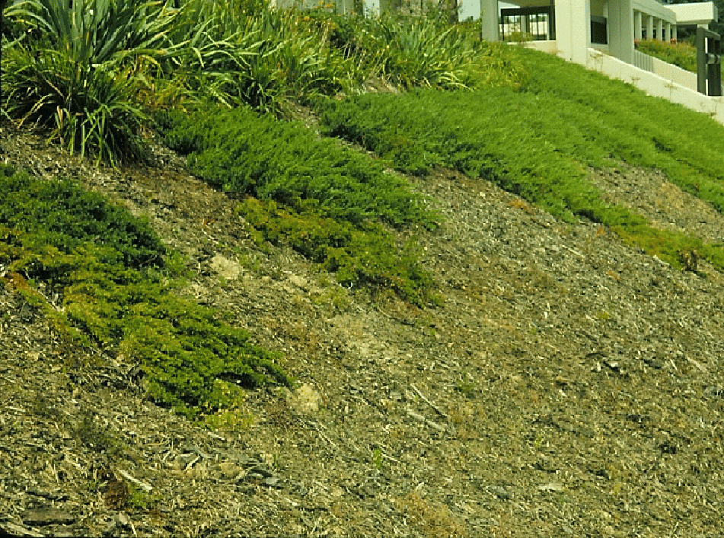
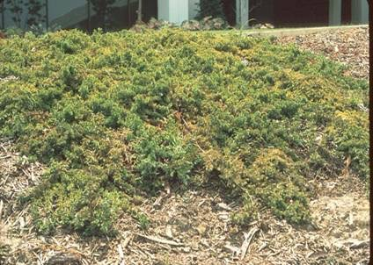
Spider mites and diseases often attack stressed plants
Poor plant selection for
this heavy clay soil
Notes:
29. Here is good example of poor plant selection for the site conditions. This slope around a large commercial building was built from poorly drained clay subsoil. Although you would expect it to be well-drained, the gummy clay stayed wet for days after rain. Junipers planted on the slope could not tolerate the wet soil and began dying from the bottom of the slope upward. (#)(#) On close examination, the plants were infested with spider mites and disease, but spraying the plants with pesticides is not the solution to this problem. The plants simply could not tolerate the wet growing environment and became stressed and susceptible to attack from insects and diseases. Junipers were the wrong choice for this site.

Slide 30
Suggestions
Instead of shore juniper, plant groupings of Siberian iris, ornamental grasses, daylilies, dwarf wax myrtle, Asiatic jasmine, or Carolina jessamine. Red maple and/or hibiscus for height
When it’s not economically practical to change the site, select adapted plants
Notes:
30. Since it was not practical in this situation to remove and replace all the soil on the site, the best solution was to select plants more adapted to the poorly drained site conditions. Instead of the shore juniper, we suggested some sweeping beds of Siberian iris, ornamental grasses, daylilies, dwarf wax myrtle, Asiatic jasmine or Carolina jessamine arranged in groupings so they would be visually attractive. For height, we suggested red maple or hibiscus at the higher elevations. All these plants are much more tolerant of moist conditions than juniper. (#) So when it’s not economically practical to make changes to the site, select adapted plants.

Slide 31
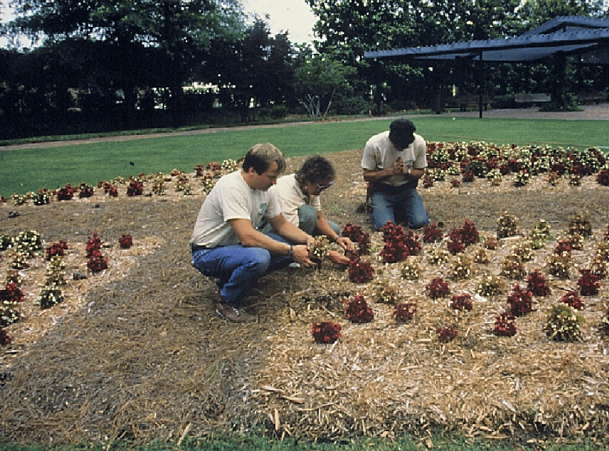
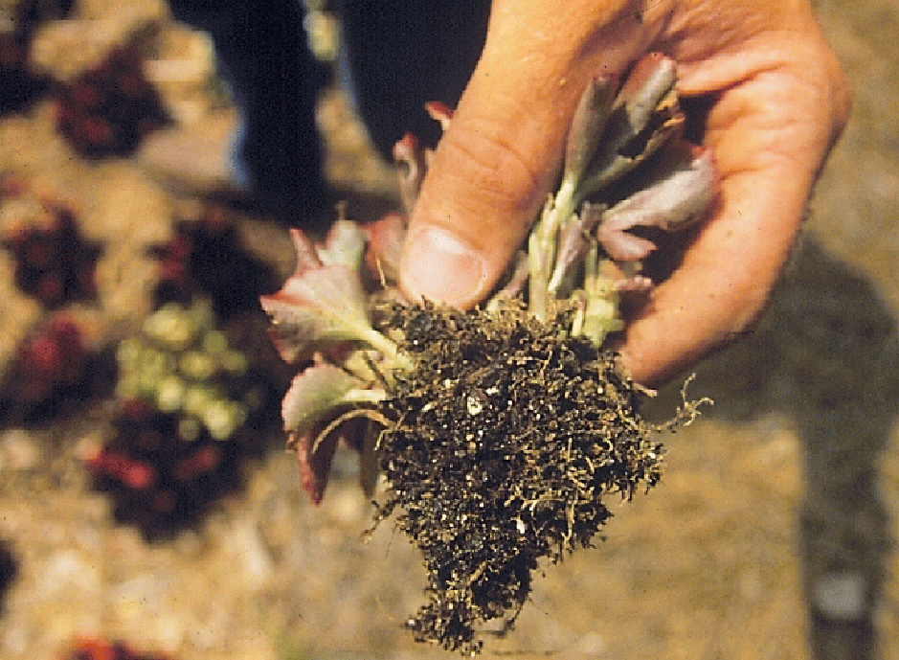
Notes:
31. Annual flowers must have well-drained soil for best performance. These begonias were planted in poorly drained clay. They appeared stunted and bloomed poorly. Even prayer seemed to provide little relief to the situation. (#) The roots were rotted and decayed and would never recover when grown under these site conditions.

Slide 32
Avoiding Moisture Stress of Annuals
Plant on an elevated bed – 12-inches above grade
Slope beds to allow for good drainage away from the plants
Select adapted plants: Canna Lilies, Ornamental Sweet Potato, Baby’s Breath, Lythrum, Swamp Sunflower
Notes:
32. Once again, if a thorough site analysis had been done before planting, a number of decisions could have been made to avoid moisture stress on the annuals. (#) A raised bed, at least 12 inches above grade, could have been prepared for the annuals to allow root growth above the poorly drained soil. (#) The beds could have been sloped to help carry water away from the plants, (#) and plants adapted to the moist site conditions could have been selected.

Slide 33
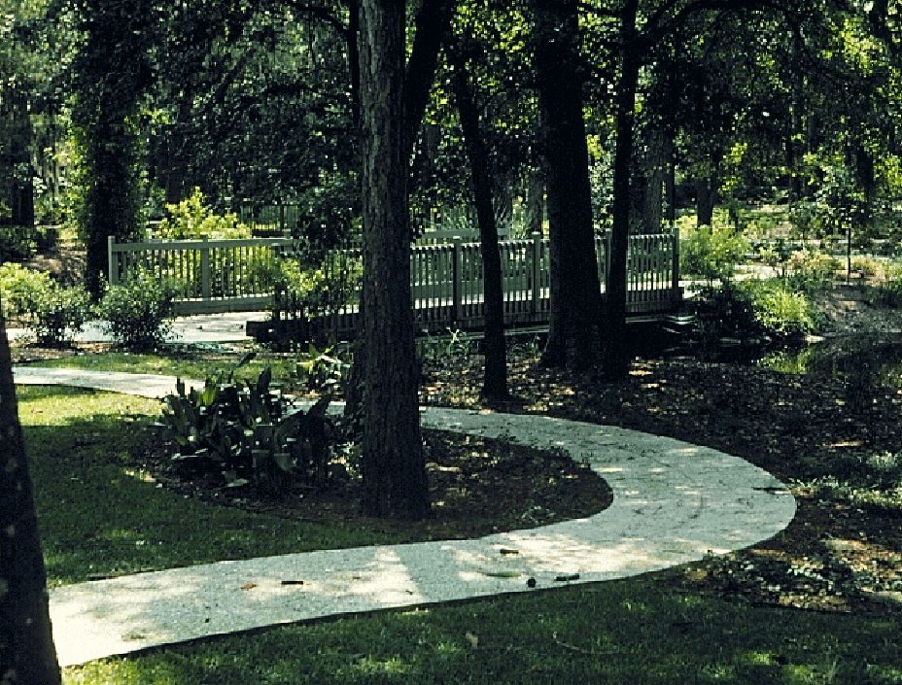
Consider the sunlight patterns throughout the day
Notes:
33. It would be a mistake to select flowering plants that require 6 to 8 hours of direct sunlight for a heavily shaded landscape like this.

Slide 34
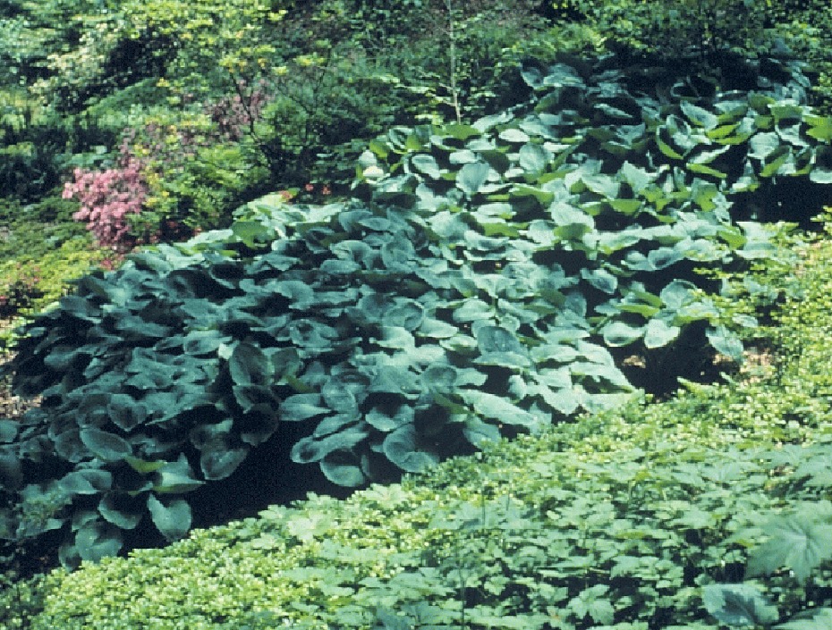
Azaleas
Hosta
Foamflower
Pachysandra
Notes:
34. For shaded areas, select shade-loving plants, like hosta, pachysandra, foamflower or azaleas.

Slide 35
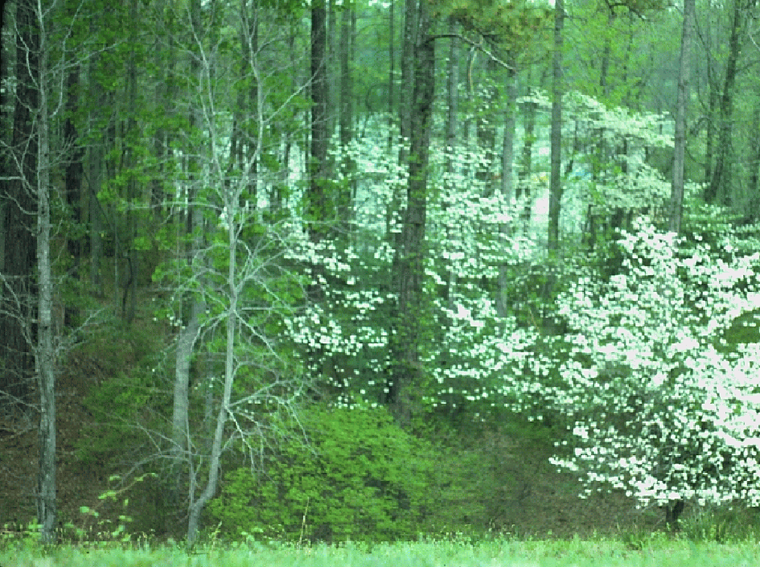
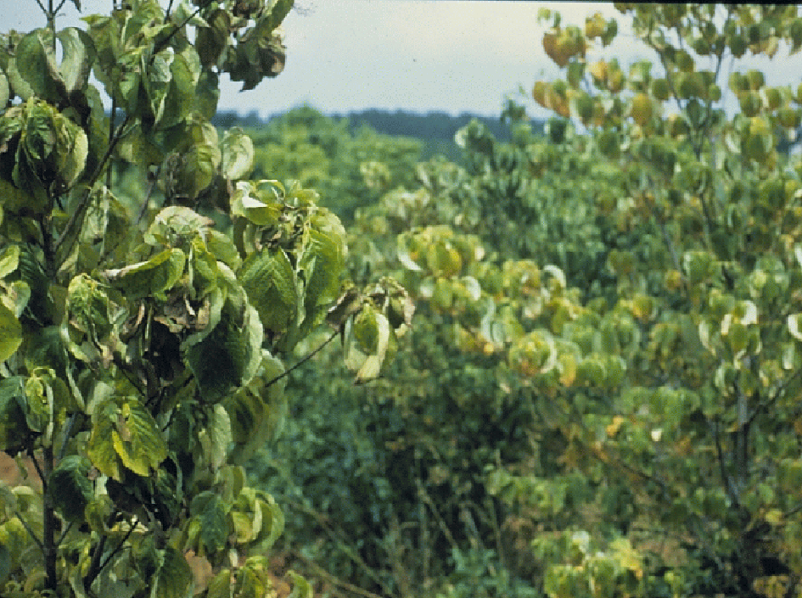
Dogwood Twig Borer
Ambrosia Beetle
Spot Anthracnose
Dogwood Anthracnose
Notes:
35. When planting native plants in the landscape, try to simulate their native environment. Dogwood, for instance, grows as an understory plant in woodlands throughout the eastern U.S. (#) When grown in full sun sites, without the benefit of irrigation, it often experiences environmental stress. (#) As a result, it becomes more prone to insect and disease problems, like dogwood twig borer, ambrosia beetle, spot anthracnose and dogwood anthracnose.

Slide 36
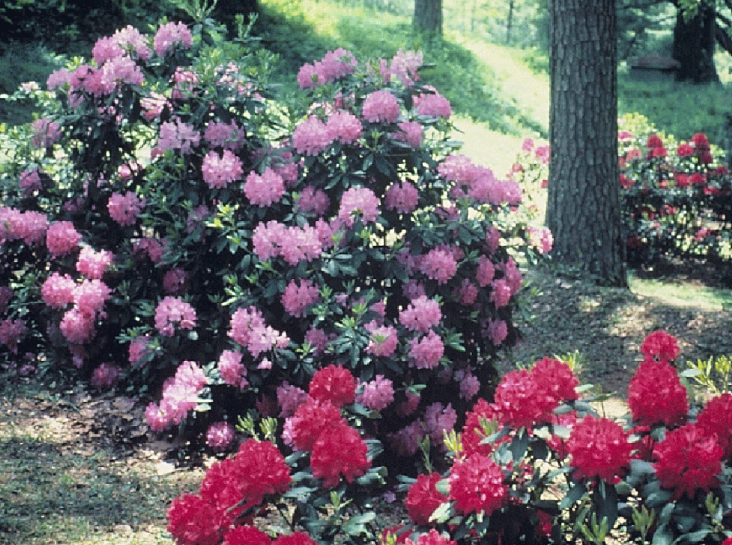
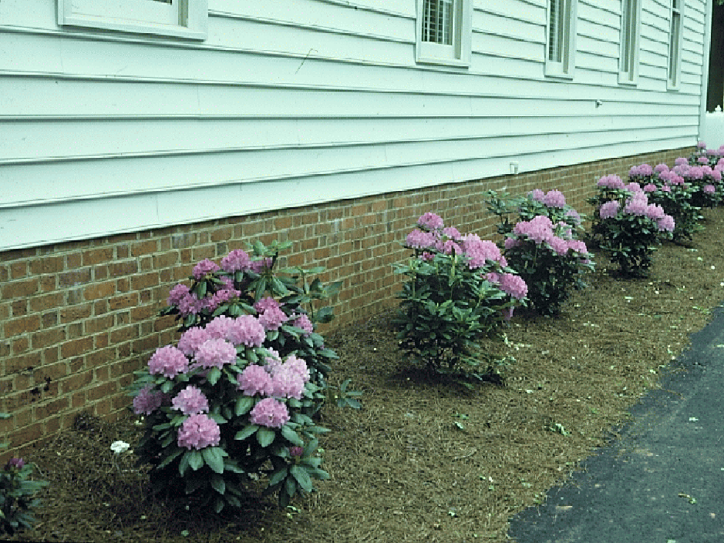
Notes:
36. Rhododendron is found throughout the north Georgia mountains, growing in rich organic soils and moist, shaded sites. It’s a mistake to plant rhododendron on a west-facing exposure in full sun without the benefit of irrigation, as the slide in the lower right shows. These plants had been recently installed, and they declined rapidly on the hot, dry site

Slide 37
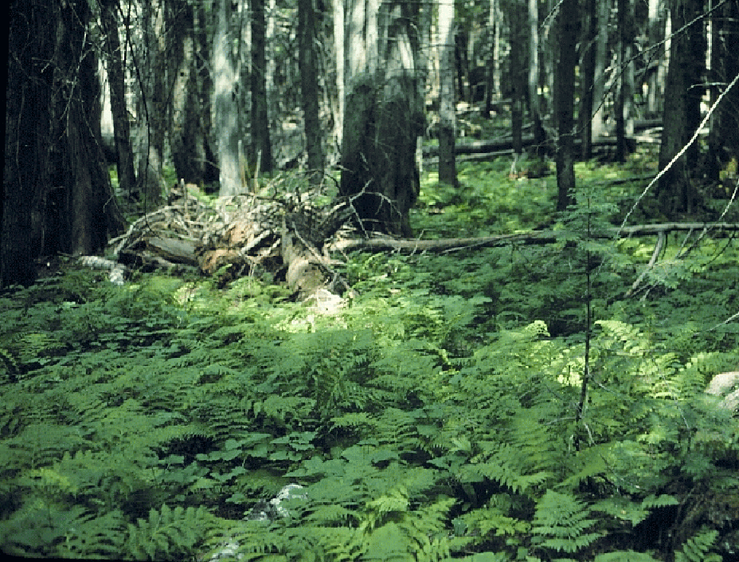
Select Plants Adapted to the Site and the Stresses of the Local Environment
Notes:
37. Native plants may be regionally adapted to your area, but they can be a high-maintenance nightmare if you can’t approximate their native environment. (#) The key in plant selection is to select plants that are best adapted to the site conditions and the stresses of the local environment.

Slide 38
What is the Ideal Landscape Plant?
Requires no pruning
Requires no supplemental fertilizer
Requires no irrigation
Has no pest problems
Tolerates extreme heat and cold
Thrives on neglect
Notes:
38. At this point we might ask what is the ideal landscape plant? (#) Well, it may be one that requires no pruning, (#) one that requires no supplemental fertilizer, (#) one that requires no irrigation, (#) one that has no pest problems, (#) one that tolerates extreme heat and cold, (#) and one that thrives on neglect. If you know a plant that fits all of these criteria, we’d like to patent it at the University of Georgia

Slide 39
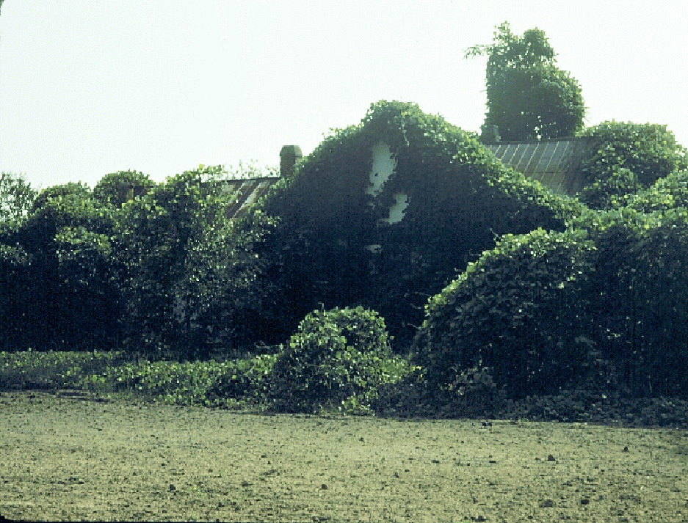
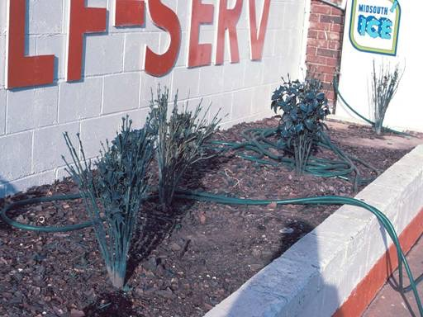
Notes:
39. Perhaps kudzu fits these criteria. It definitely thrives on neglect. (#) One business in Athens planted plastic plants in its landscape thinking these were the perfect solution, but even they defoliated in the summer heat, even though they were watered regularly.

Slide 40
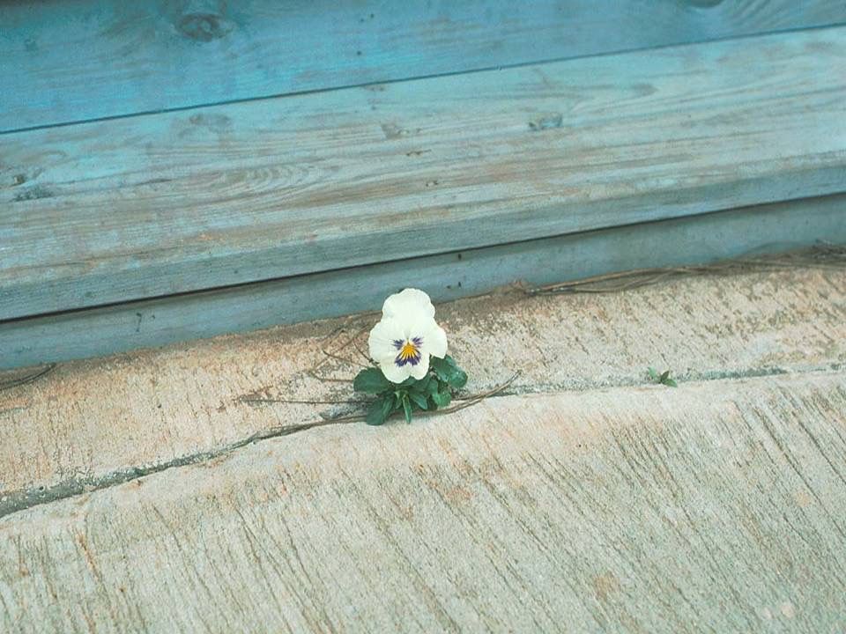
Notes:
40. This picture illustrates just how adaptable ornamental plants can be. A single pansy plant growing in a crack in a sidewalk, thriving on neglect. What a great example for us - sometimes we have to cope with harsh surroundings and make the best of a bad situation. Unfortunately, this little pansy fell victim to the weed eater shortly after this picture was taken. It was a plant out of place.

Slide 41
Questions?
Notes:
41. Let’s pause here and see if you have any questions or comments about anything that has been discussed so far.

Slide 42
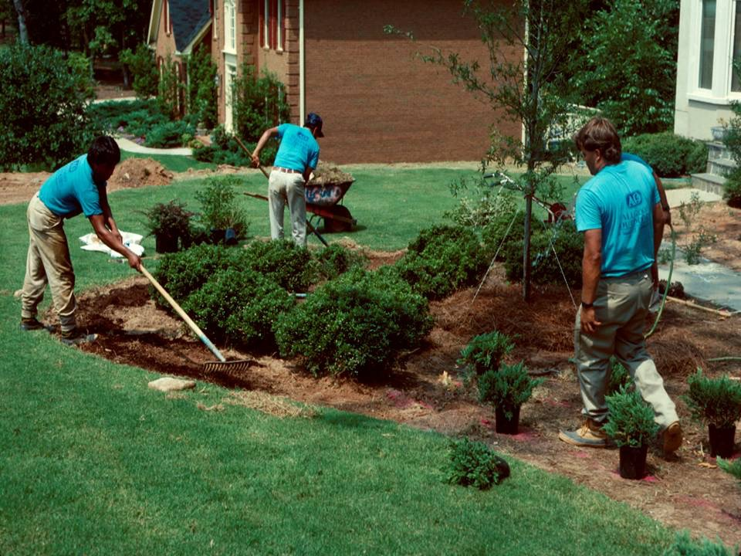
Planting Procedures
Notes:
42. Now let’s review proper planting procedures. Once you select plants adapted to the site, it’s critical that you plant them properly to assure continued success

Slide 43
When to Plant Trees and Shrubs?
Fall is the Best Time of Year to Plant
Container-grown ornamentals can be planted throughout the year
Balled-and-burlapped and bare- root plants should be planted when dormant (Nov. – Feb.)
Notes:
43. The first question we should answer is “when is the best time to plant trees and shrubs in the landscape?” (#) The very best time of year to plant is during the fall. (Ask the audience for feed-back as to why they think this is so). Answer: Because during the fall, the top of the plant is beginning to go dormant for winter, tapering off in its growth cycle and is less demanding on the roots for water and nutrients. However, roots do not go dormant - they continue to grow throughout the fall and winter. During the fall, the plant’s energy can be directed to root growth instead of top growth, so by spring a well developed root system is ready to support the new season’s growth. (#) Although fall planting is best, Container-grown plants can be transplanted successfully throughout the year, provided they can be watered during establishment. (#) Balled and burlapped and bare-root plants are best transplanted when they are dormant.

Slide 44
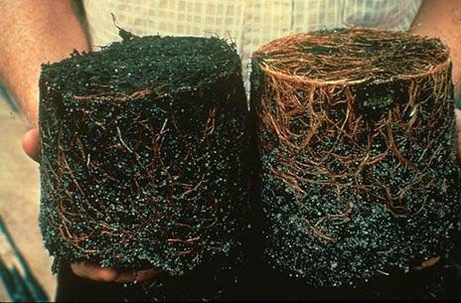
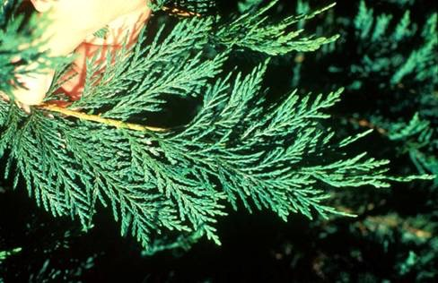
Notes:
44. Before purchasing container-grown shrubs, make certain their roots are healthy. The plant on the left has rotted and decayed roots while the one on the right has healthy, light brown roots. Carefully invert the pot, remove the plant and look at the root system before making the purchase. (#) Also, look closely at the branches to make certain they are healthy and free of insects and diseases.

Slide 45
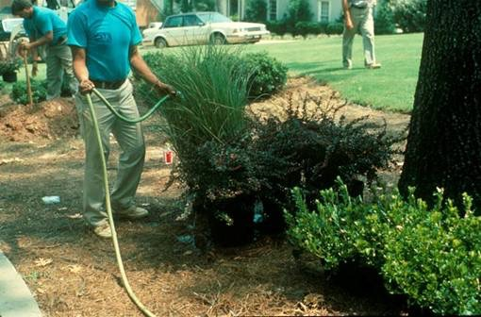
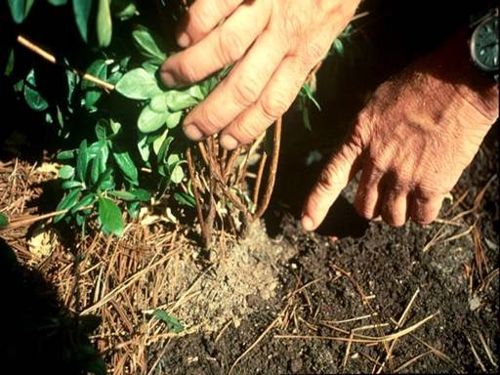
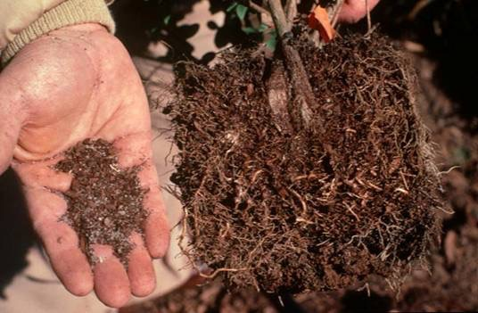
Notes:
45. When holding plants for later planting, put them in the shade and keep them moist. Before planting, water them thoroughly. (#) It is difficult to re-wet a dry root ball once it is in the ground due to the textural difference between the native soil and the growing media the plant was grown in. Plants having a fibrous root system, such as azaleas, are also difficult to re-wet once they are dry. The root ball of this azalea plant was dry when planted and remained dry for several days after planting even though the surrounding soil was wet. (#) When removed from the soil a week after planting and examined, the soil within the root ball was very dry and the top was wilting, even though the native soil was watered regularly

Slide 46
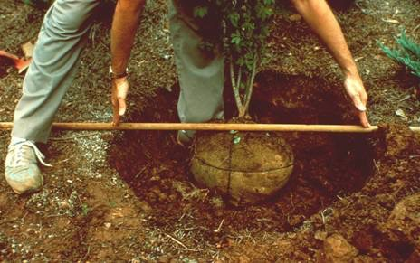
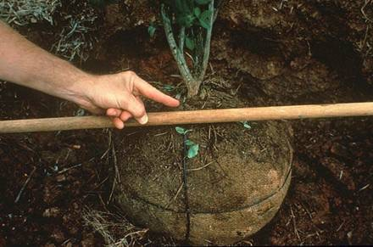
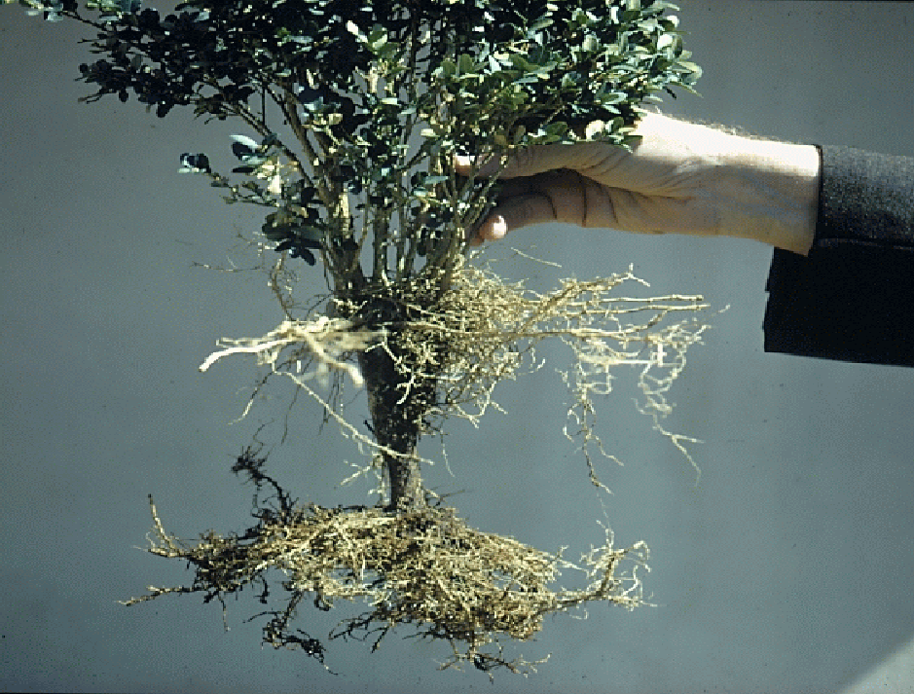
Notes:
46. When planting just one tree or shrub in native, undisturbed soil, dig the planting hole at least two times wider than the root ball of the plant and to the depth of the root ball. (#) Make certain the top of the root ball is level with the soil surface, or slightly above the surface if you know the soil is prone to settling. (#) This ornamental shrub was planted too deep. The main root began to decline due to the lack of oxygen, and a secondary (adventitious) root system began to form from the stems near the soil surface. The plant struggled to survive.

Slide 47
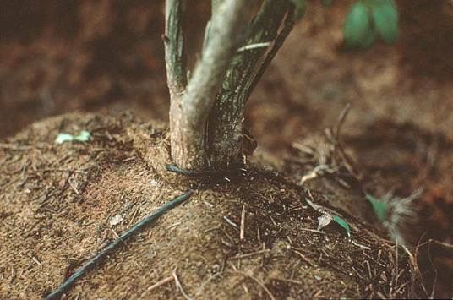
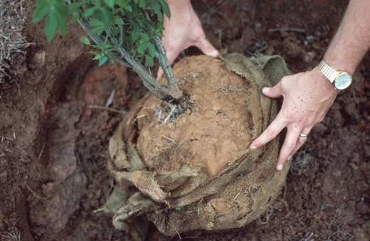
Notes:
47. When planting balled and burlapped plants, be certain to cut the wire or cord from the base of the trunk. If it is not removed, it will eventually girdle the stem, and the plant will die. (#) Pull back the burlap from the top 1/3 of the root ball, if possible, or remove it entirely if you can. Some burlap contains nylon and is slow to decompose. Removing it will prevent it from becoming an impediment to root growth. However, it may not be possible to remove the burlap from some large trees in wire baskets. Use wire snips to cut the wire from top to bottom, loosen the basket and remove the burlap from the top third to half of the root ball. The more you can do to prevent impediments to root growth, the better.

Slide 48
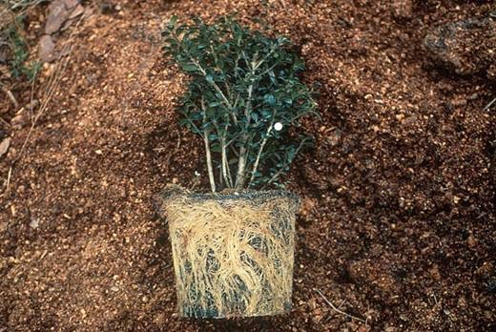
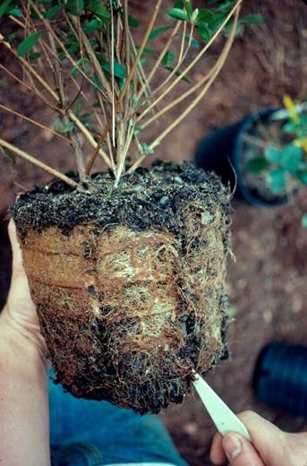
Notes:
48. Some container grown shrubs develop a fibrous root system and a thick mat of roots along the outside of the root ball. This may act as an impediment to new root growth and plant establishment. (#) When a plant has obviously been growing too long in the container and appears “pot bound”, use a knife to make four to six slices 2 to 4 inches deep around the root ball and from top to bottom. This will open the root system, allow water to penetrate and encourage new roots to grow outward.

Slide 49
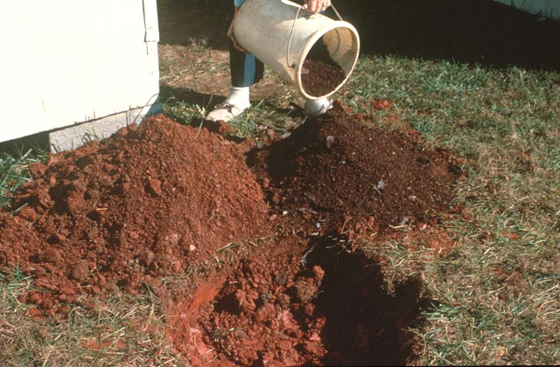
Notes:
49. A common recommendation when planting an individual tree or shrub is to mix compost, peat moss or some other organic matter with the native soil. However, research in Georgia and other states has shown that organic matter added to individual planting holes may be detrimental to plant growth in some instances. (#) Therefore, we don’t recommend it.

Slide 50
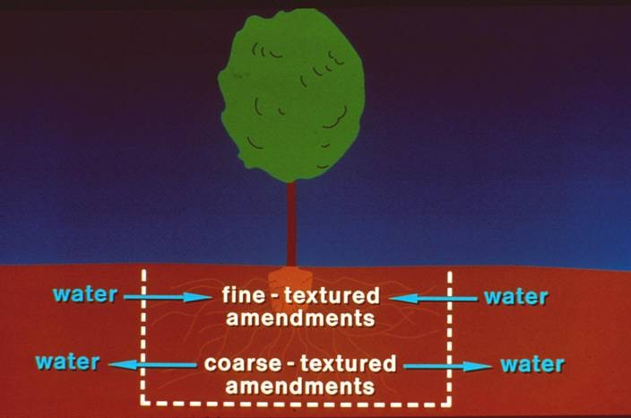
Notes:
50. Here’s why. Adding fine-textured, organic amendments, like compost or peat moss, to the planting hole can act like a sponge in a bath-tub, holding too much water in the hole. Organic amendments also enrich the soil and encourage the roots to remain within the hole instead of exploring the surrounding native soil. Coarse-textured amendments added to the planting hole in an effort to improve drainage may have just the opposite effect. The soil in the hole may dry out quicker than the surrounding native soil. Amendments change the structure and texture of the soil in the planting hole and affect the water equilibrium between the surrounding native soil and the soil in the planting hole.

Slide 51
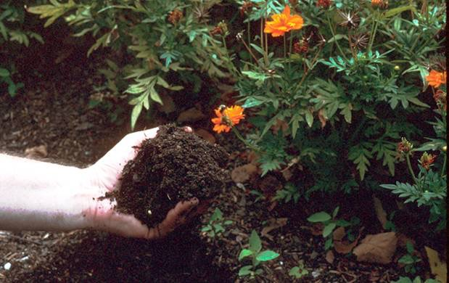
Incorporate amendments uniformly
to a 8-inch depth
Notes:
51. That does not mean that organic matter amendments are not beneficial. On the contrary, they are like black gold - loosening and improving clay soils and helping soils hold water and nutrients in the root zone. However, it’s best to incorporate amendments uniformly into the top 8 inches of soil instead of placing them into individual planting holes.

Slide 52
How Much Amendment to Use?
25% by Volume
3 inches incorporated to a 12 – inch depth
1 cu. yd. / 100 sq. ft. = 3 in. on soil surface
1 cu. yd. = 27 cu. ft. = 9 – 3 cu. ft. bags or 13 – 2 cu. ft. bags / 100 sq. ft.
Notes:
52. How much amendment should be used? (#) Generally, at least 25% by volume is necessary to provide a significant benefit to the soil. (#) This is equivalent to placing 3 inches of the amendment on the soil surface and incorporating it to a 12-inch depth. (#) One cubic yard of amendment per 100 square feet will provide approximately 3 inches on the soil surface. (#) Since 1 cubic yard equals 27 cubic feet, nine 3-cubic feet bags or thirteen 2-cubic feet bags will be needed per 100 square feet. A 40 lb. bag is equivalent to approximately 2 cubic feet. Avoid using high rates of organic matter amendments (greater than 50% by volume) because humic acids released by the organic matter may be detrimental to plant growth.

Slide 53
Use only decomposed organic material (right) as a soil amendment
Notes:
53. When using organic matter as an amendment, make certain the material is well-decomposed, like that shown on the right. Fresh, undecomposed organic matter, like that on the left, should not be incorporated into the soil because the micro-organisms in the soil will deplete nitrogen as they feed on the fresh organic matter and break it down. When soil nitrogen is lowered, plants will begin to look anemic. Therefore, use freshly ground woody materials on the surface as a mulch, but avoid using them as an amendment in the soil

Slide 54
If a water saucer is used, rake it outward and away from the planting hole 2 to 3 months after planting to keep it from eroding over the roots
Notes:
54. It’s a common practice in the landscape industry to place a ring of soil around the perimeter of the planting hole to create a saucer that will help direct water to the roots of the plant during establishment. However, this practice sometimes causes problems when the soil in the ring gradually erodes over the planting hole and suffocates roots. For this reason, the National Arborist Association no longer recommends water saucers when planting trees. (#) If a water saucer is used, it’s important to rake it outward, away from the planting hole 2 to 3 months after planting.

Slide 55
Notes:
55. When planting trees larger than 2 inches in trunk diameter, guy wires may be necessary to hold the tree in place during establishment. (#) Three guy wires per tree are usually sufficient. Loop the wire just above the lowest scaffold branches and place it inside a section of old garden hose or rubber tubing to prevent it from injuring the bark. Anchor the other end of the wire securely to the ground

Slide 56
Remove guy wires two to three months after planting
Notes:
56. Guy wires are only temporary and should be removed as soon as the tree is established, usually within 2 to 3 months after planting. In this photo, the guy wires were left too long on the tree and injured the bark.

Slide 57
Best Mulch Organic Fine-textured Non-matting
Notes:
57. The next step in the planting operation, and one of the most important, is to apply mulch to the soil surface. Mulches not only help conserve moisture in the soil but also help insulate plant roots from extreme heat and cold. They also act as a barrier to certain soil-borne diseases and inhibit the germination of some weed seeds. (#) The best mulch is one that is organic, fine-textured and non-matting, such as pine straw, pine bark mini-nuggets and shredded hardwood mulch. Inorganic mulches, like marble, gravel or rock, tend to absorb and re-radiate heat back to the plant canopies, increasing moisture loss from the foliage and encouraging plant stress. On a hot summer day, temperatures above the rock mulch may soar to over 100 degrees Fahrenheit.

Slide 58
How Much Mulch To Apply?
3 to 5 inches is sufficient
1 bale of pine straw covers 50 – 80 sq. ft., depending on the size of the bale
9 – 3 cu. ft. bags of pine bark mulch will cover 100 sq. ft. to a 3-inch depth
Notes:
58. How much mulch should you apply? (#) Generally, 3 to 5 inches is sufficient. (#) One bale of pine straw will cover approximately 50 to 80 square feet, depending on the size of the bale. (#) If you prefer bagged mulches, you’ll need nine 3-cubic feet bags for each 100 square feet of landscaped area to provide 3 inches of mulch on the surface.

Slide 59
Notes:
59. Many municipalities are grinding yard trimmings and offering it to citizens for use as mulch. This material makes an excellent mulch for use around ornamental plants.

Slide 60
Newspaper placed under mulch, 2- to 3-sheets thick, helps provide an added barrier to moisture loss.
Notes:
60. Two to three sheets of newspaper, placed under mulch during planting will help hold moisture in the soil. The newspaper also will gradually decompose and add organic matter to the soil. The newspaper will stay seated on the bed better if you will moisten it in a bucket of water before placing it over the planting bed.

Slide 61
Notes:
61. The final step in the planting operation is to water thoroughly to settle the soil in the planting hole and to eliminate air pockets that may cause the roots to dry out. A thorough watering once or twice a week, in the absence of rainfall, will be necessary during the establishment period.

Slide 62
Planting Trees and Shrubs
When planting individual plants, dig the hole 2-times wider than the root ball.
When planting a group of plants, cultivate the planting area to a 12-inch depth.
Do not add amendments to individual planting holes. Instead, incorporate amendments uniformly into the top 12 inches of the soil.
Remove the wire or cord from around the stem of B&B plants.
Notes:
62. Now let’s review the step by step procedure for successfully planting trees and shrubs. (#) When planting individual plants, dig the planting hole 2-times wider than the root ball. (#) When planting a group of plants, cultivate the entire planting area to a 12-inch depth. (#) Do not add amendments to individual planting holes. Instead, incorporate amendments uniformly into the top 12 inches of soil. (#) Remove the wire or cord from around the stem of B&B plants.

Slide 63
Planting Trees and Shrubs
Slice or break apart the root ball of
pot-bound container-grown plants.
Install guy wires on trees, if necessary, but remove them after establishment.
A water saucer may be used to help direct water to the roots, but it is only temporary.
Mulch.
Water to settle soil.
Notes:
63. Slice or break apart the root ball of pot-bound container-grown plants. (#) Install guy wires on trees, if necessary, but remove them when the tree is established. (#) A water saucer may be used to help direct water to the roots, but it is only temporary and should be pulled away from the planting hole 2 to 3 months after planting to prevent it from eroding over the roots. (#) Then apply mulch, (#) and water to settle the soil. Proper planting is crucial to future success of the ornamental plant in the landscape.

Slide 64
Planting Seasonal Color
Remove old plants
Re-work the planting bed
Add organic amendments
Add slow-release fertilizer
Notes:
64. Seasonal color is a high cost investment in any landscape and must be planted properly to assure success. Let’s look at how the professionals do it by following a work crew as they change a bed from winter pansies to summer annuals. The first step is to remove and dispose of the old plants so there is no carry over of insects or diseases to the new plants. (#) Next, the planting area is thoroughly cultivated. (#) Additional organic matter, such as compost or rotted animal manure, is added to the bed and tilled into the soil. New beds will require more organic matter than existing beds. (#) Then a slow-release type fertilizer, like Osmocote, is added to the surface.

Slide 65
Planting Seasonal Color
Lay out planting design
Lay out plants
Remove container as you plant
Mulch
Notes:
65. Once the bed is prepared and ready to plant, the planting design is laid out according to a previously determined plan. (#) Next, the plants are laid out on the bed, in their pots, at the proper spacing. This assures that all plants are at the proper spacing and that there are enough plants for the space. A diagonal planting pattern, instead of straight lines, makes the bed appear more full. (#) Once the workers are satisfied with the spacing and planting pattern, the plants are removed from their pots and planted. (#) The next step is to apply mulch over the surface. Pine bark mini-nuggets are often used to add contrast to the bed if the surrounding area is mulched with pine straw.

Slide 66
Planting Seasonal Color
Water with liquid fertilizer
The finished product
Notes:
66. Finally, a liquid fertilizer, such as 20-20-20 or 15-30-15, is applied to water in the plants and to give them a little nutrient boost while the slow release product is kicking in. This is followed with a hand-held hose and water breaker to thoroughly water the bed. (#) The finished product gives a sense of satisfaction and pride to the work crew and is ready to provide its summer show of color

Slide 67
Notes:
67. We’ve covered a lot of ground and you’re probably in a fog, so let me pause here and ask if you have any questions on anything we have covered thus far in today’s program.

Slide 68
Let's Take
A Break!!!!
Notes:
68. Now we come to your favorite part of today’s program - it’s time to take a break.

