Slide 1
Shrubs for Georgia
Susan Franklin
Cherokee County Master Gardener

Slide 2
Shrubs for Georgia
Forms
Rounded
Oval
Upright
Weeping
Spreading
Irregular
Evergreen or Deciduous
Mature Size

Slide 3
Evergreen Shrubs
Foliage Year Round
Provide Structure
Most Noticeable in Winter
Provide Screens
Generally, Not as Tolerant to Extremely Wet Conditions

Slide 4
Deciduous Shrubs
Provide Seasonal Interest
Flowers
Berries
Fall Color
More Natural Growth Form
Majority of Wetland Plants are Deciduous

Slide 5
Small Shrubs
2 to 5 feet tall

Slide 6
Landscape Shrubs
Small 2-5 feet tall
Medium 5-8 feet tall
Large 8 feet and up

Slide 7
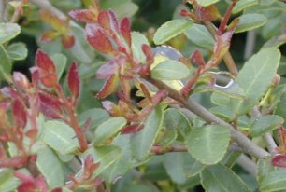
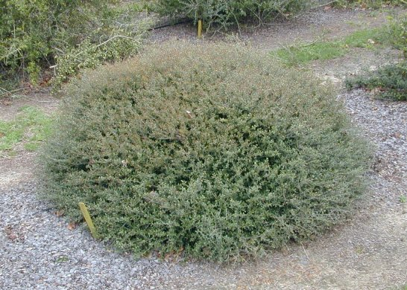
Dwarf Yaupon Holly
Ilex vomitoria var. nana ‘Bordeaux’
3-4 ft
Rounded
Sun or shade
Evergreen

Slide 8
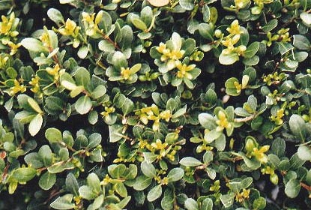
Compacta Holly
Ilex crenata ‘Compacta’
3-4 ft
Rounded
Evergreen
Sun to semi-shade

Slide 9
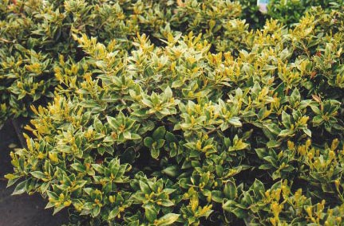
Carissa Holly
Ilex cornuta ‘Carissa’
3-4 ft
Rounded
Sun to
semi-shade

Slide 10
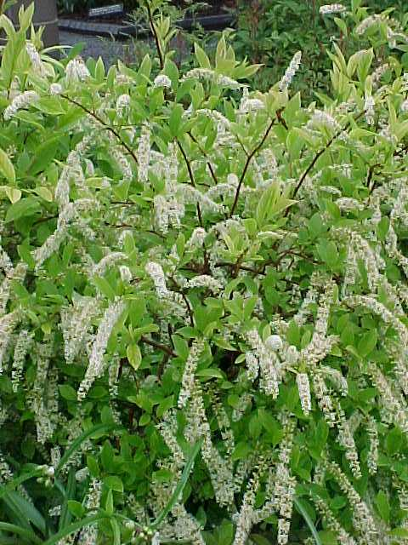
Virginia Sweetspire
Itea virginica
4-5 feet tall and wide
Great burgundy fall color
May-June white fragrant flowers resembling fluffy caterpillars

Slide 11
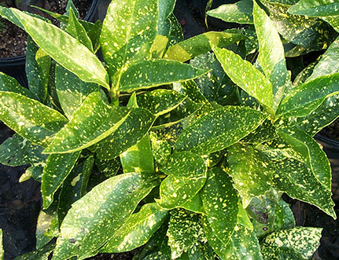
Dwarf Acuba
Acuba japonica
‘Nana’
3-4 ft
Species can be 6-8 ft.
Oval
Shade to semi-shade
Evergreen

Slide 12
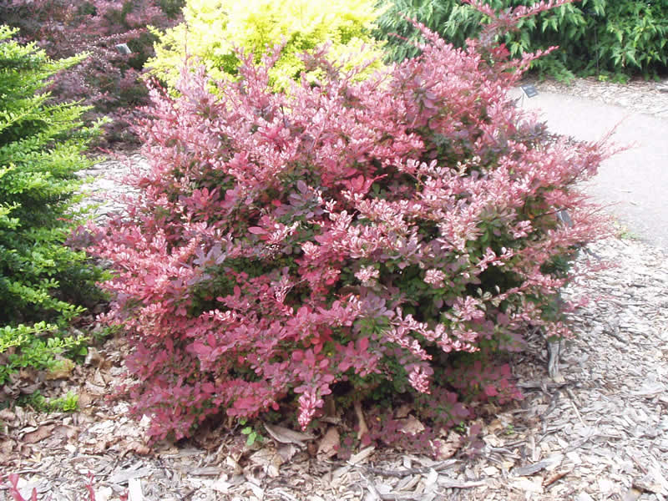
Japanese Barberry
Berberis thunburgii
3-4 ft
Oval
Sun semi-shade
Deciduous

Slide 13
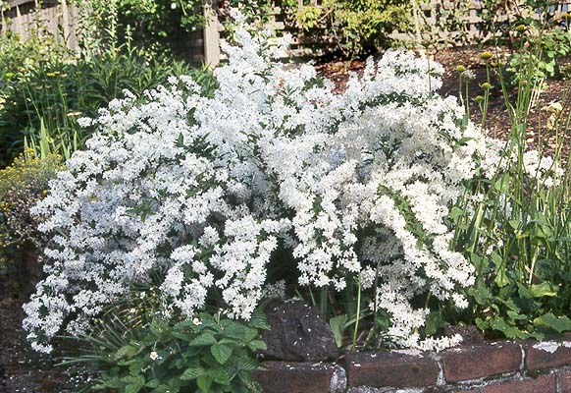
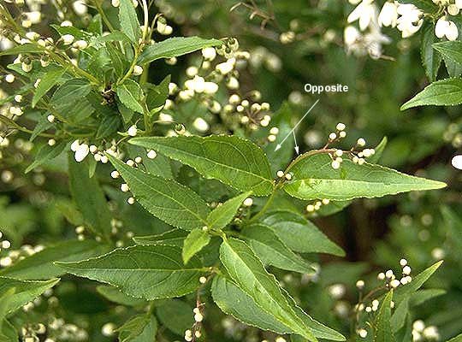
Slender Deutzia
Deutzia gracilis
2-4 ft
Mounded
Sun- semi-shade
Semi-evergreen

Slide 14
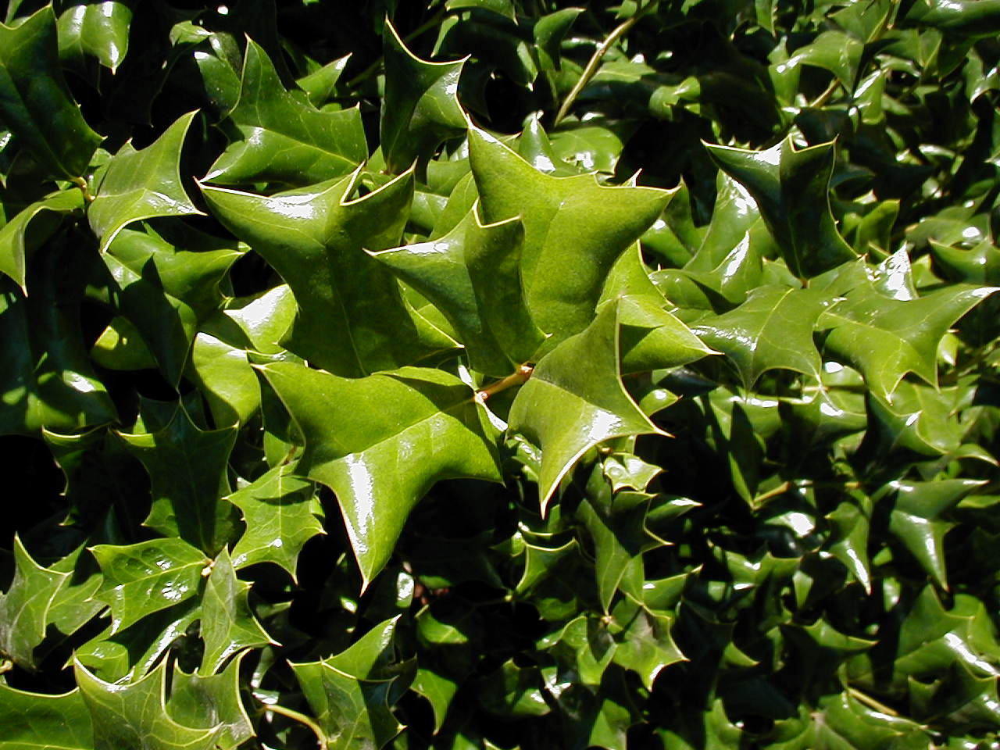
Dwarf Chinese Holly
Ilex cornuta ‘Rotunda’
3-4 ft
Rounded
Evergreen
Sun to semi-shade

Slide 15
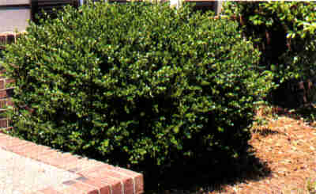
Helleri Holly
Ilex crenata ‘Helleri’
2-3 ft
Spreading
Semi-shade
Evergreen

Slide 16
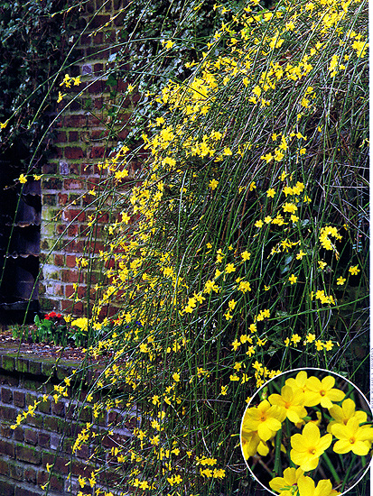
Winter Jasmine
Jasminum nudiflorum
3-4 ft
Spreading
Sun to shade

Slide 17
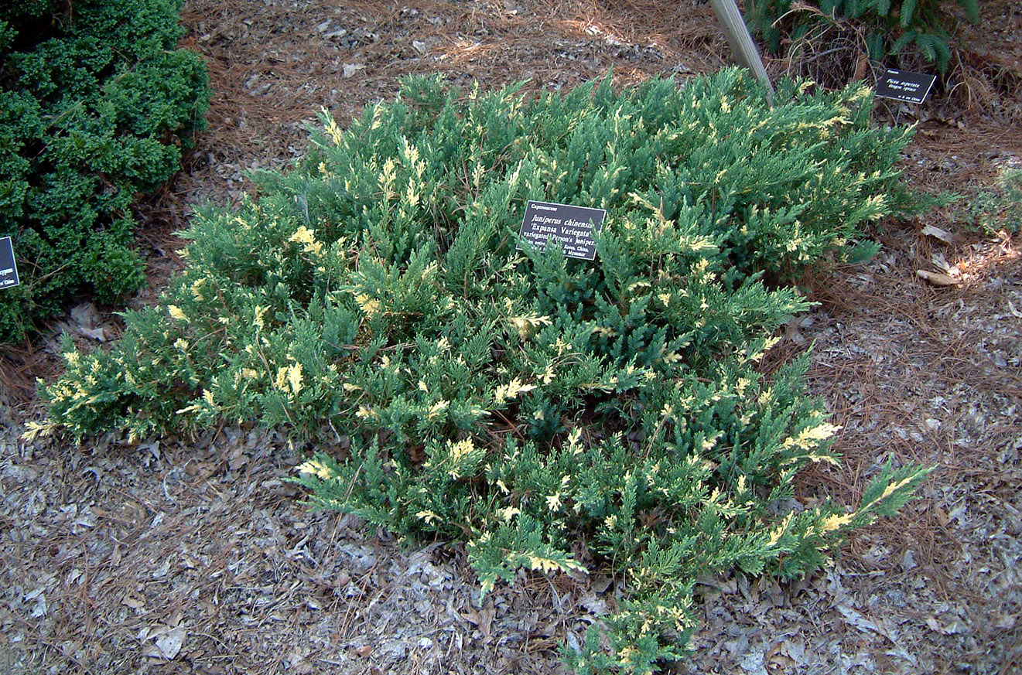
Parsons Juniper
Juniperus davurica ‘Expansa’
2 ft
Spreading
Sun
Evergreen

Slide 18
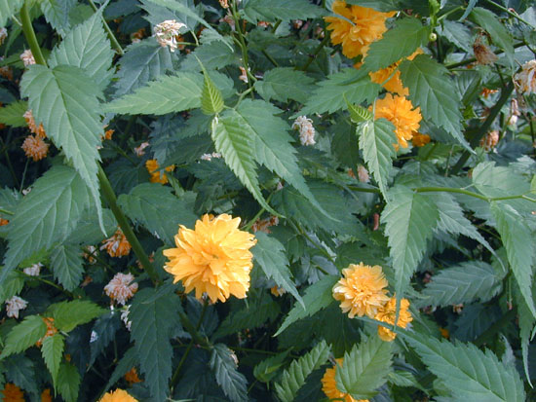
Japanese Kerria
Kerria japonica
4-6 ft
Upright arching
Sun
Evergreen

Slide 19
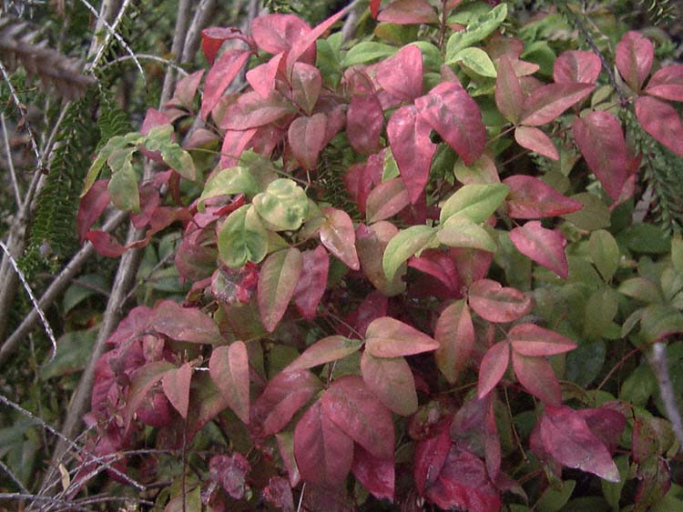
Nandina
Nandina domestica ‘Firepower’
2 x 2 ft
Upright
Sun to semi-shade
Evergreen
Brilliant red winter color
Does not produce berries like species

Slide 20
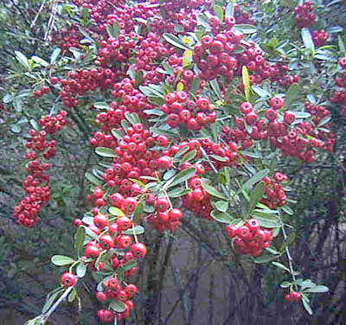
Firethorn
Pyracantha koidzumii ‘Santa Cruz’
2-3 ft
Prostrate Spreading
Sun
Evergreen
Unable to find cultivar photo

Slide 21
Indian Hawthorne
Raphiolepis indica
2-4 feet
Spreading
Sun
Evergreen
Entomosporium leafspot, Deer

Slide 22
Entomosporium Resistant Indian Hawthorn Cultivars:
Gulf Green
Olivia
Georgia Charm
Georgia Petite
Janice
Eleanor Taber
Dwarf Yedda
Indian Princess

Slide 23
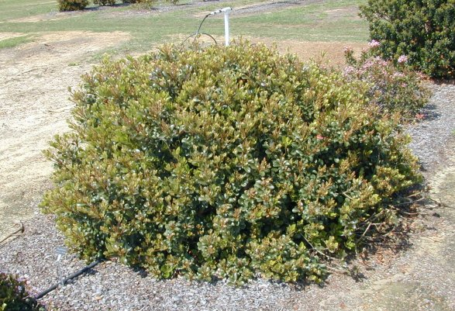
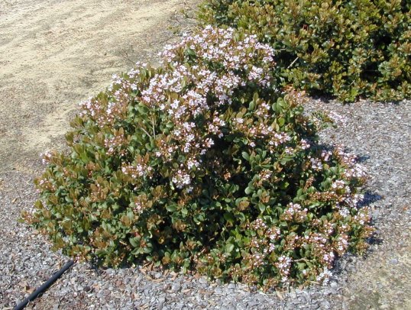
Raphiolepis
‘Georgia Charm’
Raphiolepis
‘Eleanor
Taber’

Slide 24
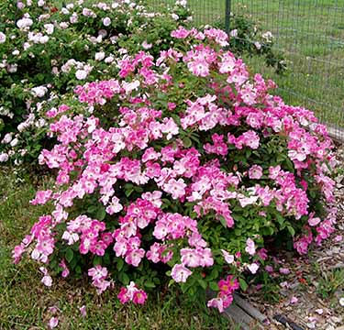
Roses
Rosa spp.
3 x 3 ft. dependant on cultivar
Sun
Spreading
Deciduous
Black Spot disease
‘Nearly Wild’

Slide 25
Black Spot Resistant Roses:
Nearly Wild
Happy Trails
Knock Out
Petite Pink Scotch
The Fairy
Rosa banksia
Rosa chinensis ‘Old Blush’
Rosa ‘Mutabilis’

Slide 26
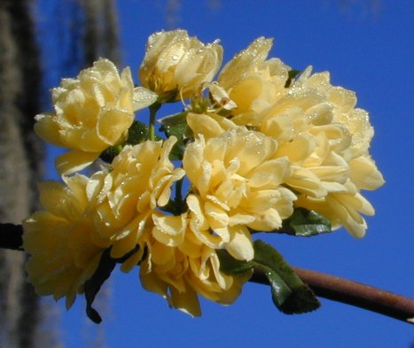
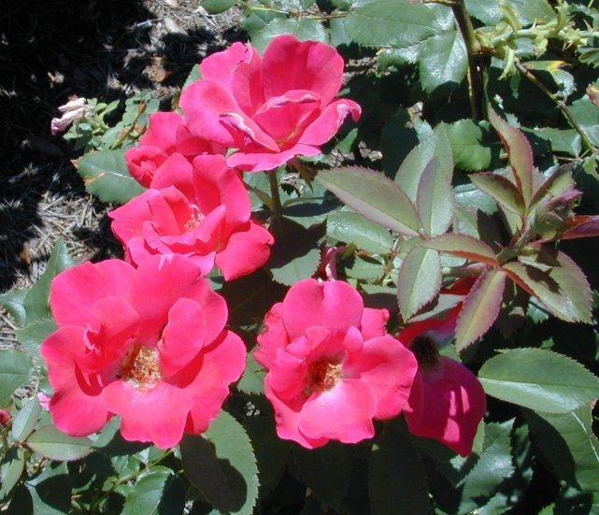
Rosa banksia
‘Lutea’
Rosa
‘Knock
Out’

Slide 27
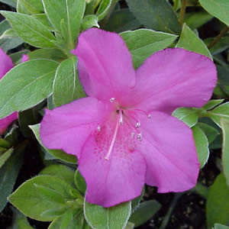
Evergreen Azaleas
Rhododendron spp.
1-8 ft cultivar dependant
Semi-shade
Rounded
Evergreen
R. Indica ‘Formosa’

Slide 28
Evergreen Azaleas
Hundreds of cultivars often classified by Hybrid Type
Southern Indica Hybrids
Larger plants, vigorous i.e. ‘Formosa’
Smaller Hybrids
Krume Hybrids – ‘Coral Bells’
Satsuki Hybrids – ‘Eikan’
Gumpo Hybrids – ‘Pink Gumpo’

Slide 29
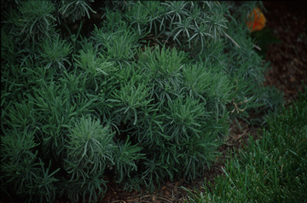
Lavender Cotton
Santolina chamaecyparissus
2-4 ft
Low spreading mounds
Sun
Evergreen

Slide 30
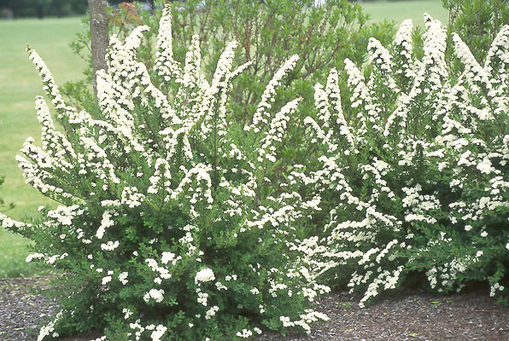
Spirea
Spirea nipponica ‘Snowmound’
3-5 ft
Mounded
Sun to semi-shade
Deciduous
Snowmound
Anthony Waterer

Slide 31
Medium Shrubs
5 to 8 feet tall

Slide 32
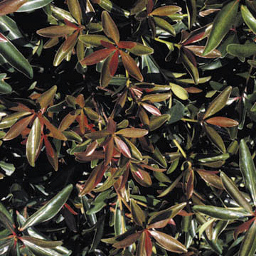
Cleyera
Cleyera japonica
6 x 6 ft
Spreading
Sun to semi-shade
Evergreen

Slide 33
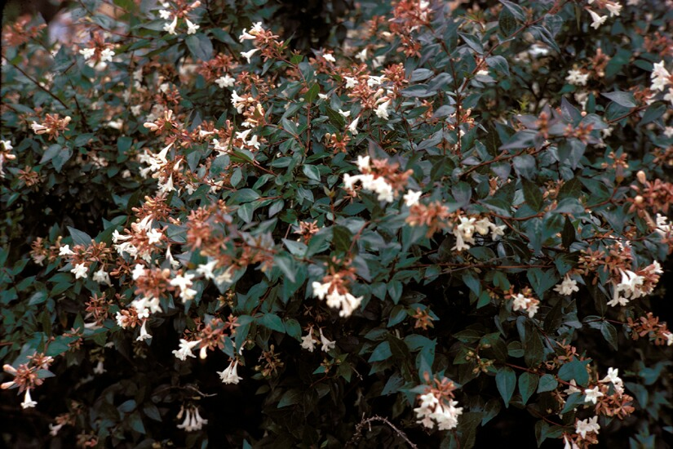
Abelia
Abelia x grandiflora
4-6 ft
Oval to irregular
Sun to semi-shade
Evergreen

Slide 34
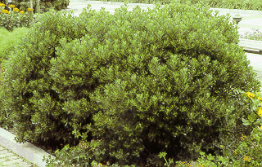
Inkberry
Drought Tolerant
5' x 5'
Withstands Heavy Pruning
Adapted to Various Soil Types

Slide 35
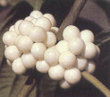
American Beautyberry
6' x 6'
Drought Tolerant
Sun to semi-shade
Rounded
Deciduous
Berries for Wildlife
White Berry Forms Exists

Slide 36
Loropetalum
Loropetalum chinese var. rubrum
Ht. Varies greatly with cultivar
Spreading
Sun
Semi-evergreen

Slide 37
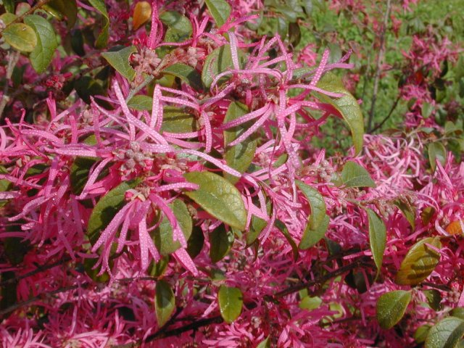
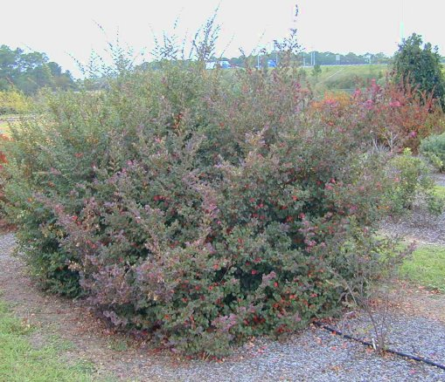
Loropetalum
chinense
‘Burgundy’
Loropetalum chinense
‘Plum Delight’

Slide 38
Loropetalum chinense var. rubrum cultivars:
Suzanne 3-4 ft
Ruby 3-5 ft
Plum Delight 4-6 ft
Blush – 6 ft
Burgundy 14 ft

Slide 39
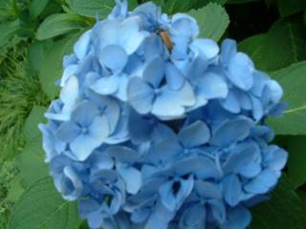
Bigleaf Hydrangea
Hydrangea macrophylla
5-8 ft.
Rounded
Sun
Semi-evergreen
‘Buttons and Bows’

Slide 40
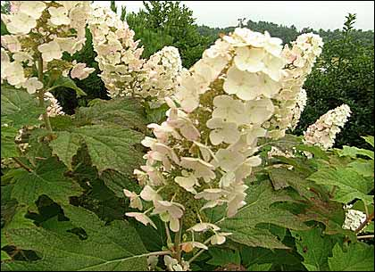
Oakleaf Hydrangea
Hydrangea quercifolia
6-8 ft
Sun to semi-shade
Upright irregular
Deciduous
Burgundy fall color

Slide 41
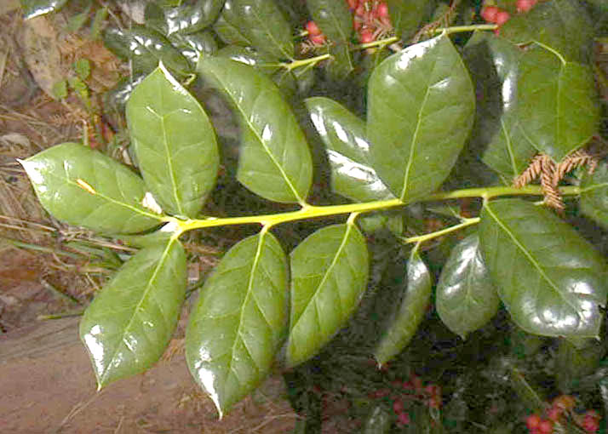
Dwarf Burford Holly
Ilex cornuta ‘Burfurdii’
5-8 ft
Rounded
Sun to semi-shade
Evergreen

Slide 42
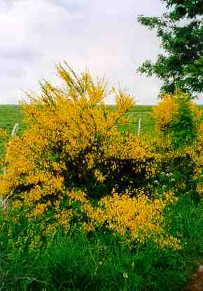
Scotch Broom
Cytisus scoparius
5-6 feet
Upright, open
Sun
Evergreen

Slide 43
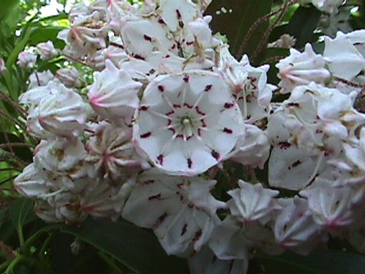
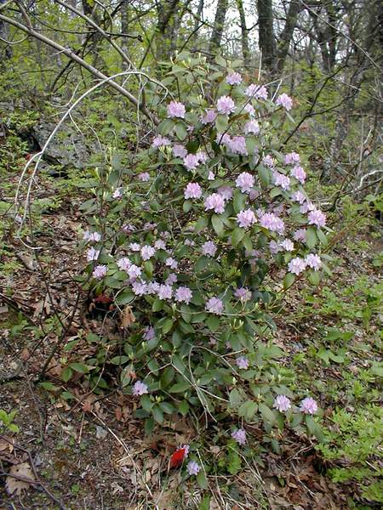
Mountain Laurel
Kalmia latifolia
5-8 ft
Semi-shade
Upright
Evergreen

Slide 44
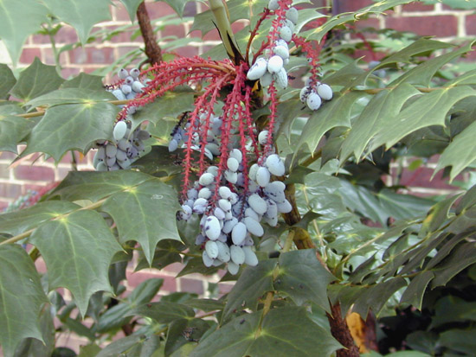
Leatherleaf Mahonia
Mahonia bealei
6-7 ft
Upright
Shade
Evergreen

Slide 45
Large Shrubs
8 feet and taller

Slide 46
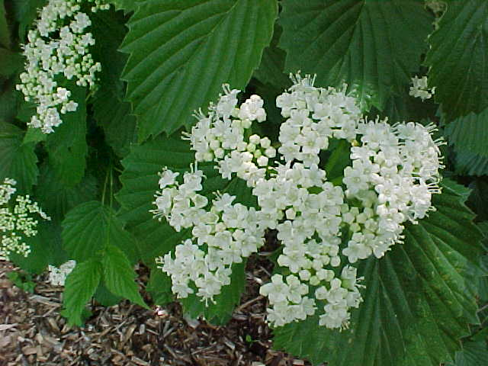
Arrow wood
Viburnum dentatum
8 ft tall x 6 ft.
Sun to Part Sun
Fruit eaten by birds
Fall color red to reddish purple
Needs well drained soil

Slide 47
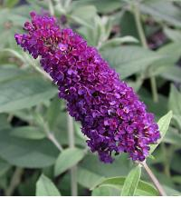
Butterfly Bush
Buddleia davidii
10-15 feet
Upright oval
Sun
Deciduous

Slide 48
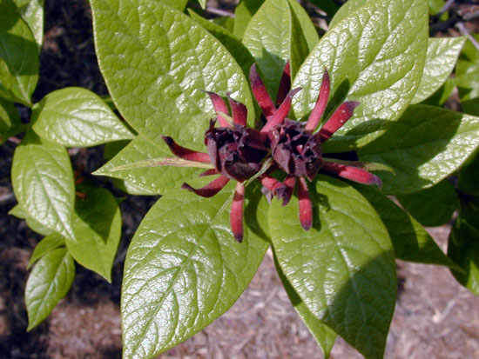
Sweetshrub
Calycanthus floridus
8-12 ft.
Broad rounded
Sun or shade
Deciduous

Slide 49
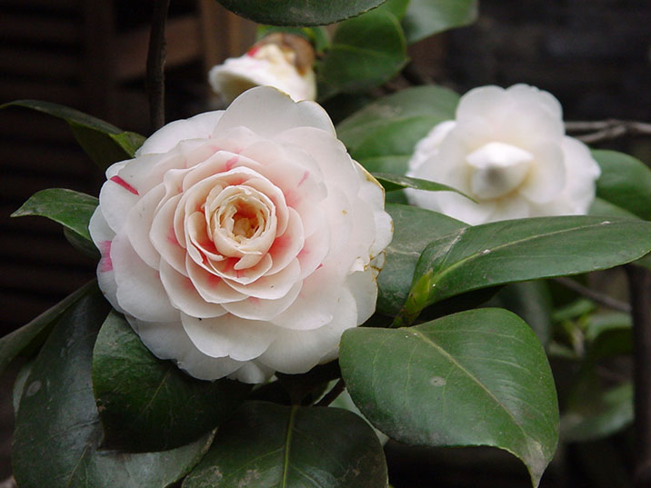
Camellia
Camellia japonica
Flowers Jan-Feb
Camellia sansanqua
Flowers Dec.-Jan
Sun to semi-shade
8-10 ft.
Rounded
Evergreen

Slide 50
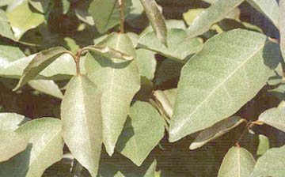
Silverthorn
Elaeagnus x pungens
10-15 ft.
Irregular
Sun to semi-shade
Evergreen

Slide 51
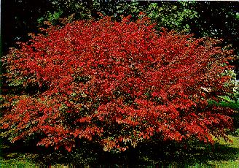
Burning Bush
Euonymus alatus
10-15 feet
Mounded
Sun or shade
Deciduous

Slide 52
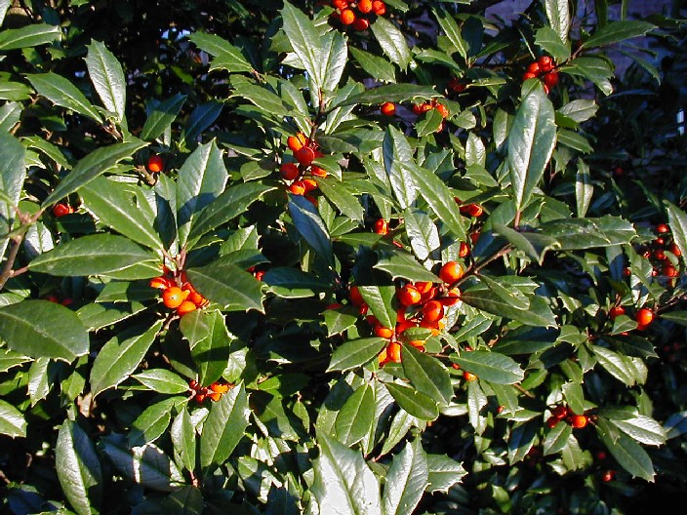
Foster Holly
Ilex attenuata ‘Fosteri’
10-20 feet
Upright
Sun to semi-shade
Evergreen

Slide 53
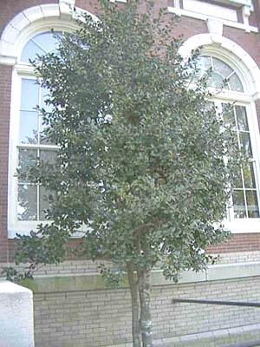
Burford Holly
Ilex cornuta ‘Burfordii’
10-20 ft
Upright
Sun to semi-shade
Evergreen

Slide 54
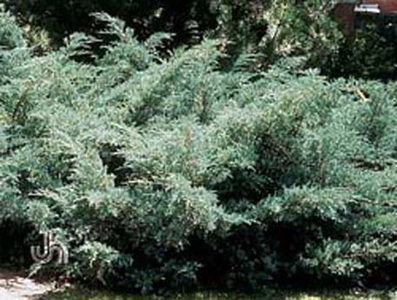
Pfitzer Juniper
Juniperus chinensis ‘Pfizeriana’
8-10 ft.
Broad upright
Sun
Evergreen

Slide 55
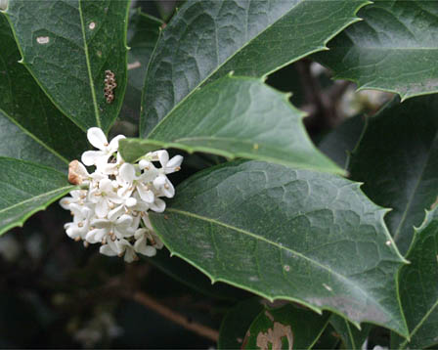
Tea Olive
Osmanthus fortunei
8-10 ft.
Upright
Semi-shade
Evergreen
Fragrant White flowers in October

Slide 56
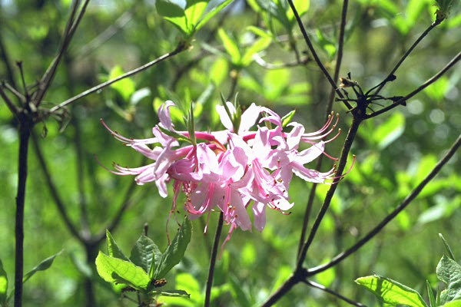
Piedmont Azalea
Rhododendron canescens
10-15 ft
Rounded
Shade to semi-shade
Deciduous

Slide 57
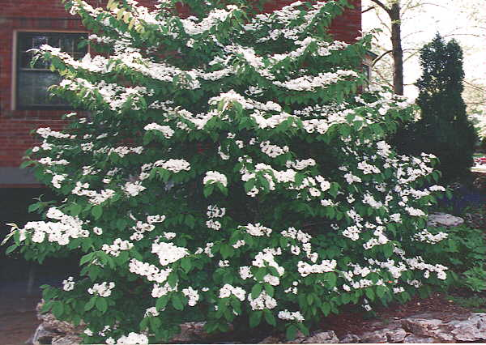
Doublefile Viburnum
Viburnum plicatum tomentosum
8-10 ft
Round spreading
Sun to semi-shade
Deciduous

Slide 58
Bottlebrush Buckeye
Aesculus parviflora
8-15 ft.
Upright spreading
Sun to part shade
Deciduous
8-12 inch flower stalk in June

Slide 59
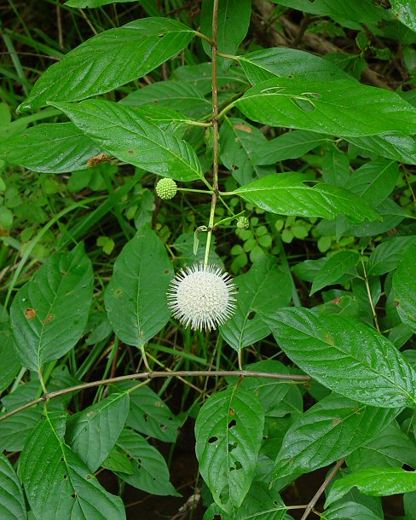
Buttonbush
Cephalanthus occidentalis
3-6 ft occasionally 10-15 ft.
Bees and butterflies
Fragrant
Dried flowers often remain through winter
Sun to part shade
Deciduous
Tolerates wet soils

Slide 60
Sweet Pepperbush (Summer Sweet Clethra)
Clethra alnifolia
10 ft.
Sun or shade
Flowers June-July
Tolerant of drought or wet soils
Yellow Fall Color
Fragrant

Slide 61
Questions ?

