Slide 1
Made in the Shade “plants for sunlight-challenged landscapes”
Billy Skaggs
UGA Cooperative Extension – Hall County

Slide 2
Made in the Shade
"Nothing will grow under the trees in my front yard!" Sound familiar? If you’re blessed with trees, don’t look at it as a liability. Instead, use it as an asset to enhance your landscape.
Most shade complaints stem from the fact that grass will not grow well in dense shade. This is particularly true for areas under evergreen trees such as pines and magnolias. Even deciduous trees with large leaves, like oaks, can have such dense canopies that little sunlight penetrates to the ground.

Slide 3
Made in the Shade
Rather than curse the shade, be thankful for the cooling benefit your trees provide. Without it, your electric bill would be substantially higher and it would be much more unpleasant to venture outside in the heat of summer.
There are many plants that are adapted to shady sites. If you are struggling, trying to grow a lawn under a grove of trees, consider a different approach by adding variety and class to your lot with plants that thrive in the shade.

Slide 4
Use of foliage texture and differing shades of green
Green is the basic color you will work with in developing a shade garden since most flowering plants do best in partial or full sun. But, that doesn't mean your garden needs to be dull!
Varying leaf textures, from the refined look of ferns, to the bold, broad leaves of elephant ears and cast iron plant, help make an ordinary garden bed look special.
And there is more than one shade of green. Variegated leaves add cream, yellow or white to the basic green color palate. Plus, there is a good selection of shade-loving plants for adding color through beautiful blooms.

Slide 5
Degrees of Shade
Partial Shade: brightest & easiest to garden in; receives three to six hours of direct sun per day (morning or afternoon); can also mean dappled sunlight all day long.
Light Shade: exists under trees with small leaves and branches high off the ground, or under immature trees with a light canopy; may get full sun for a couple of hours per day with the rest of the day being bright, but not glaring.

Slide 6
Degrees of Shade
Medium Shade: occurs under mature trees with branches at least 20 feet above the ground and moderate-size leaves; may even get some sun in the morning or afternoon, but shaded during the four to five brightest daylight hours.
Full Shade: found beneath deciduous trees that have large leaves (ex. maples and oaks) or under smaller trees whose branches are lower to the ground.

Slide 7
Dealing with Tree Roots
Most trees do not have a tap root; their root systems form a wide shallow disk that can extend twice as far as the tree’s canopy.
80% of the feeder roots are in the upper six to eight inches of soil.
Try to protect the roots as much as possible, including keeping major soil disturbances >15 ft from the trunk.
Avoid adding soil over the root area – adding only a few inches of soil on top of tree’s root system can cause slow irreversible decline.
If you must dig around the roots, always use hand tools (no augers or tillers).

Slide 8
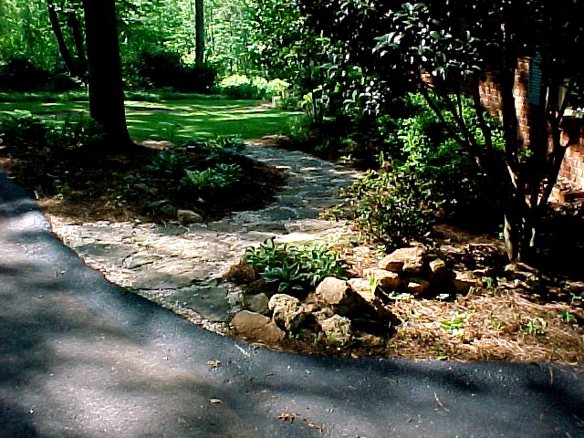
Annuals For Shady Location
Imagine What Shade-Tolerant Annuals Could Do For This Site!
Notes:
Annuals For Shady Areas

Slide 9
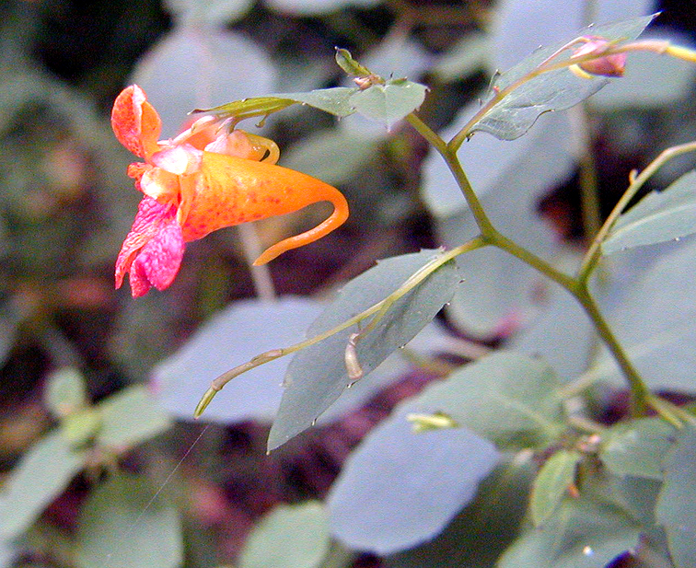
Native Impatiens
Characteristics:
Nectar source
Mounding habit
36 – 56 inches tall
Location:
Full/part shade
Plant Spacing:
8 inch centers
Random seeding
Care and Feeding:
Low fertility
No drought
Bloom Period:
June – July
Culture Concerns:
Reseeds
Needs moist Soil
Impatiens capensis
Notes:
Impatiens capense: Native impatiens is not related to the common impatiens cultivars we use in shade, so we have separated them in this presentation. When grown in very wet or moist shady areas, it can fill in beautifully. For example, it grows well under air conditioners where condensate drips continuously. It requires little fertility if planted in organic soils, and it is relatively pest free. I. capense forms a beautiful bush!

Slide 10
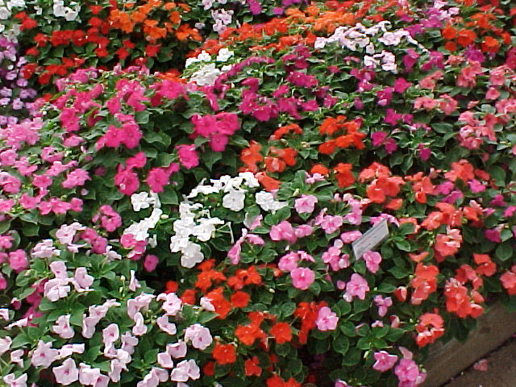
Impatiens
Characteristics:
Nectar source
Floriferous
18 –36 inches tall
Location:
Full shade
Partial shade
Full sun (if moist)
Plant Spacing:
8 - 12 inch centers
Care and Feeding:
Moderate fertility
No drought
Bloom Period:
June – August
Culture Concerns:
High organic soils best
Impatiens hybrida

Slide 11
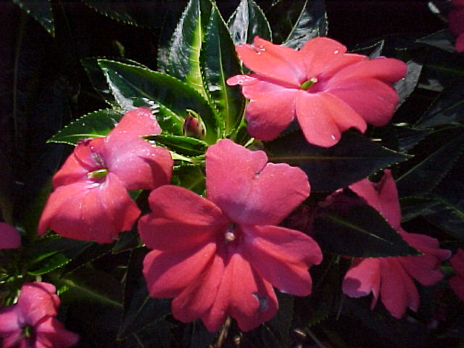
New Guinea Impatiens
Characteristics:
Nectar source
14-28 inches tall
Location:
Partial shade
Plant Spacing:
12 inch centers
Care and Feeding:
Heavy fertility
No drought
Organic soils
Bloom Period:
June – August
Culture Concerns:
Botrytis
Absolutely must be kept moist.
Impatiens hawkerii

Slide 12
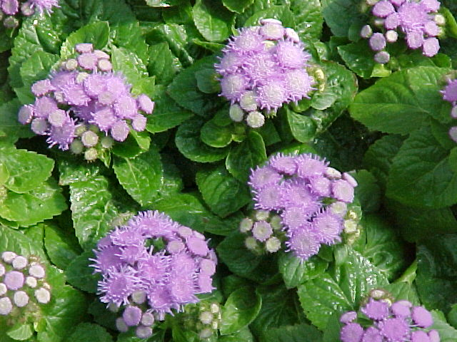
Floss Flower
Characteristics:
Nectar source
Location:
Full - part shade
Plant Spacing:
4 - 8 inch centers
Care and Feeding:
Moderate fertility
No drought
Bloom Period:
June – October
Culture Concerns:
Bleaches in sun
Botrytis
Ageratum houstonianum

Slide 13
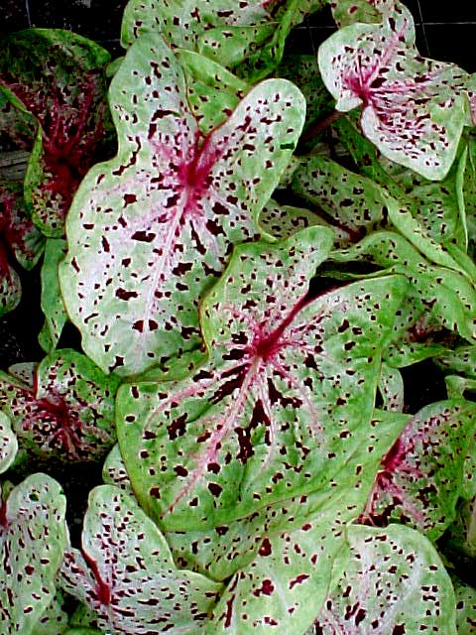
Caladium
Characteristics:
Colorful foliage
28 – 36 inches tall
Location:
Full / part shade
Plant Spacing:
6-8 inch centers
Care and Feeding:
Heavy fertility
No drought
Bloom Period:
Inconspicuous
Culture Concerns:
Well drained soils
Dig tubers in fall
Caladium ‘Miss Mofett’
Notes:
Caladium hybrida: Caladiums have been used for decades as shade-tolerant bedding plants. They prefer warm, high organic soils that are well-drained, yet moist. The tubers can be lifted in fall after first nip of frost. They can be dried and stored in paper bags in a dry, cool (55oF) storage area. In spring, if one removes the central new growing point from the tuber with a sharp knife, the tuber will produce several new growths and make a much nicer plant once replanted.

Slide 14
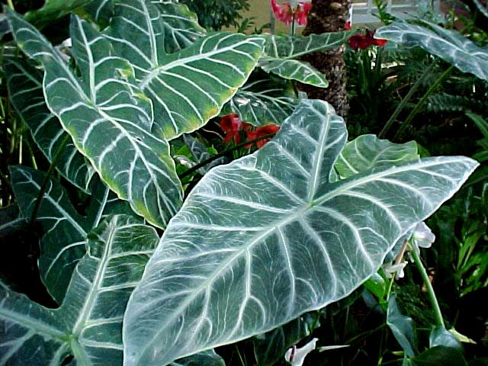
Elephant Ears
Characteristics:
Full/part shade
Tolerates wet soils
36 - 78 inches tall
Location:
Full/part shade
Plant Spacing:
24 inch centers
Care and Feeding:
Moderate fertility
No drought
Bloom Period:
Inconspicuous
Culture Concerns:
Dig tubers in fall
Alocasia micholitziana ‘Maxkowskii’
Notes:
Alocasia micholitziana: Elephants ears are fast becoming a popular specimen plant due to its huge colored leaves and its rapid growth when placed in fertile and moist soil. This plant will tolerate full shade and look great. Depending on the cultivar, they can get quite large. The tuber can also be lifted in fall and stored for next year, or brought indoors as a houseplant in winter. It makes a fantastic colony or group planting of 12 to 25 plants.

Slide 15
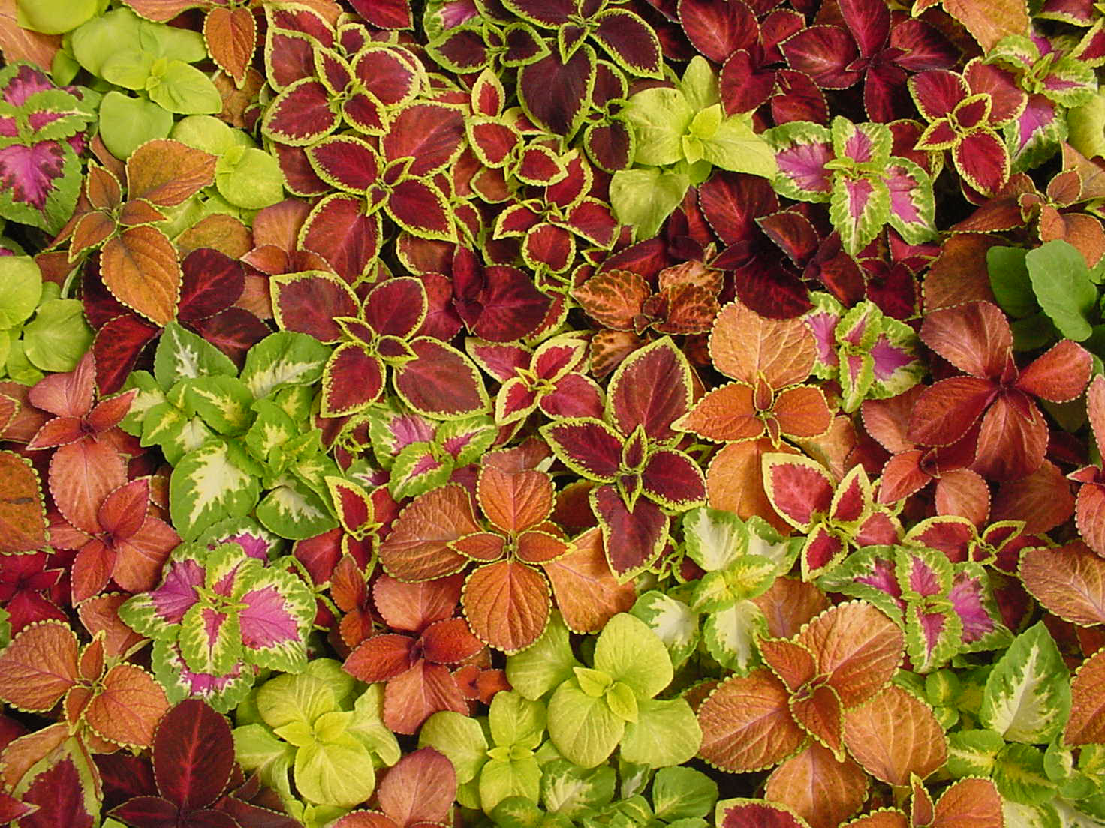
Coleus
Characteristics:
Tolerates wet soils
24 – 30 inches tall
Location:
Shade/part shade
Plant Spacing:
8 - 10 inch centers
Care and Feeding:
Moderate fertility
No drought
Bloom Period:
Must deadhead
Culture Concerns:
Pinch at transplant
Mildew
Coleus “Wizard Mix’
Notes:
Coleus hybrida: There are two forms of coleus on the market: sun loving and shade loving. This slide shows a shade loving variety, represented by the now universally used >Wizard= mix. These coleus are easy to grow in semi-shade or full shade, but require dedicated removal of flowers. By removing flowers before they open, the plant stays vegetative, and leaf color remains excellent.

Slide 16
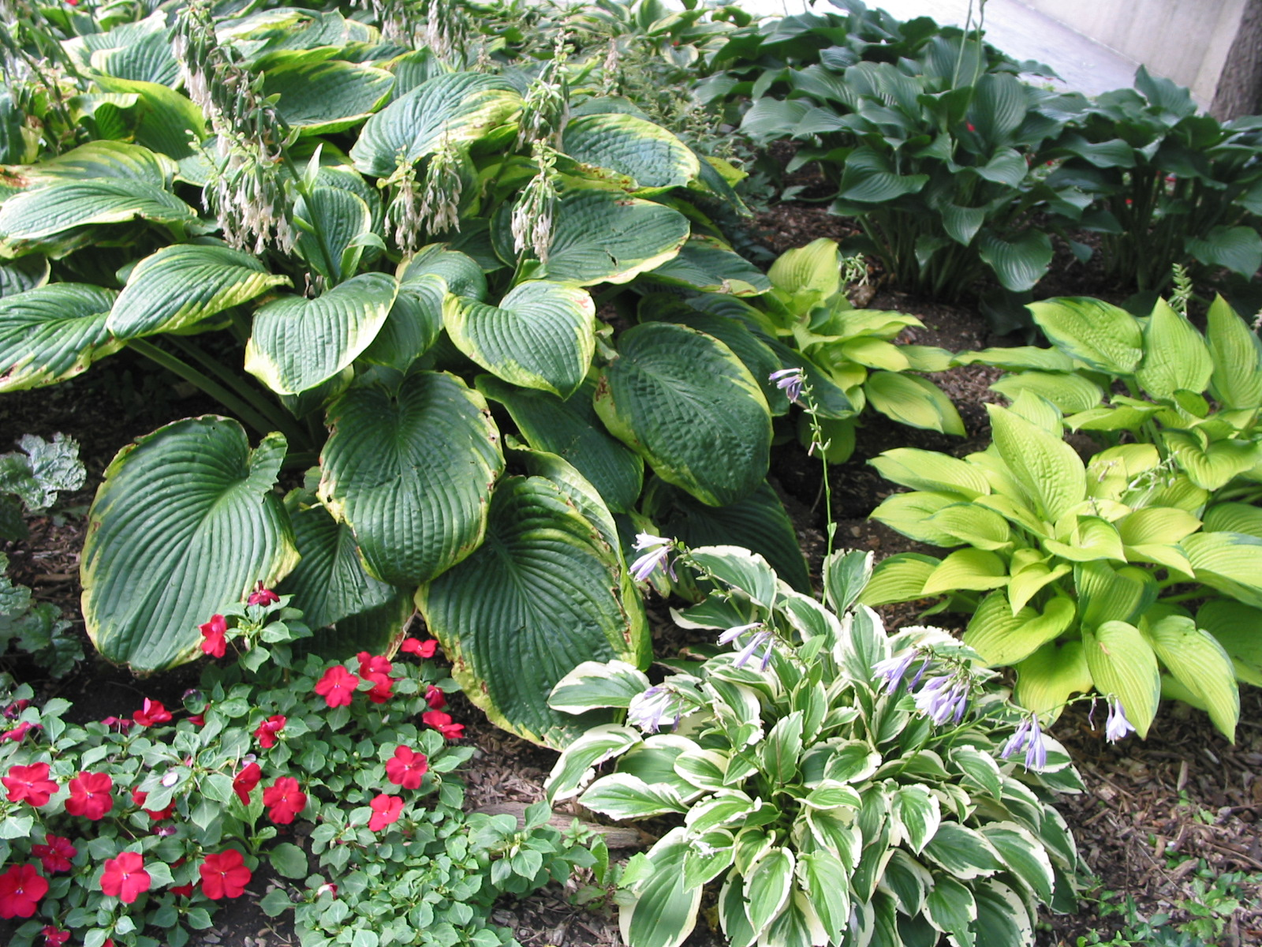
Perennials for Shade
Notes:
The End Results: The resulting additional plants will provide an endless supply of new material to keep your perennial garden fresh and healthy.

Slide 17
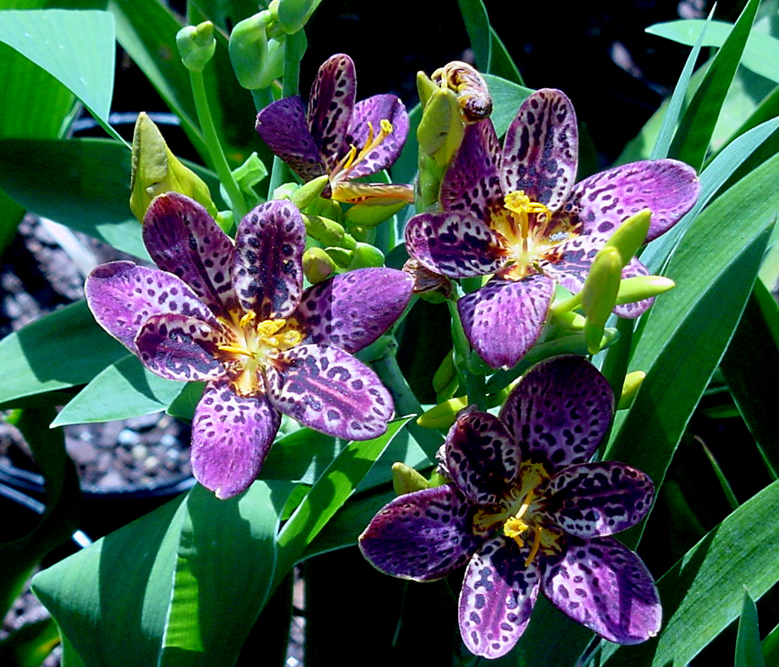
Blackberry Lily
Characteristics:
Nectar source
Drought tolerant
18 - 28 inches tall
Location:
Partial shade
Plant Spacing:
8 inch centers
Care and Feeding:
Moderate. fertility
Deer tolerant
Bloom Period:
July– August
Culture Concerns:
Reseeds
Bellamcanda chinensis
Notes:
Bellamcanda chinensis: The Blackberry Lily is a naturalized plant from China that does well here at the edges of woods. It prefers highly organic soils and full sun. It is drought tolerant and tough. It re-seeds well, and if planted in dense groups, it can be very attractive by mid-summer. It has few pests and is deer tolerant. Butterflies love the flowers. The term Blackberry Lily comes from the seeds, which are revealed when the seedpod opens and the seeds are literally turned outside the pod shell. The seed cluster looks like a blackberry fruit. Plant seeds immediately upon harvest.

Slide 18
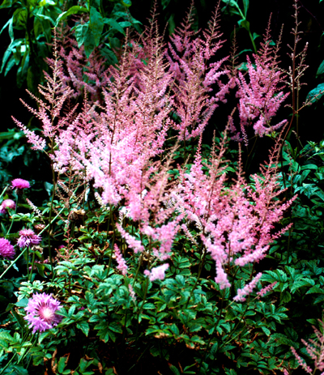
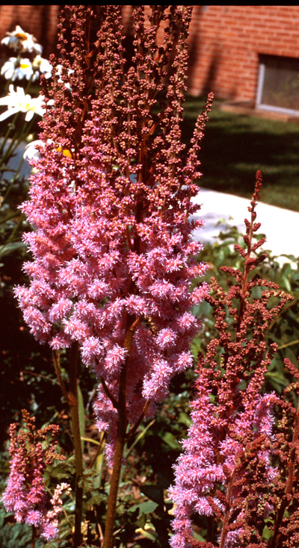
False Spirea
Characteristics:
Nectar source
24 - 30 inches tall
Location:
Partial shade
Plant Spacing:
12 - 18 inch centers
Care and Feeding:
Moderate fertility
No drought
High organic soils
Bloom Period:
May – June
Culture Concerns:
Mulch heavily
Keep moist
Astilbe x ardensii

Slide 19
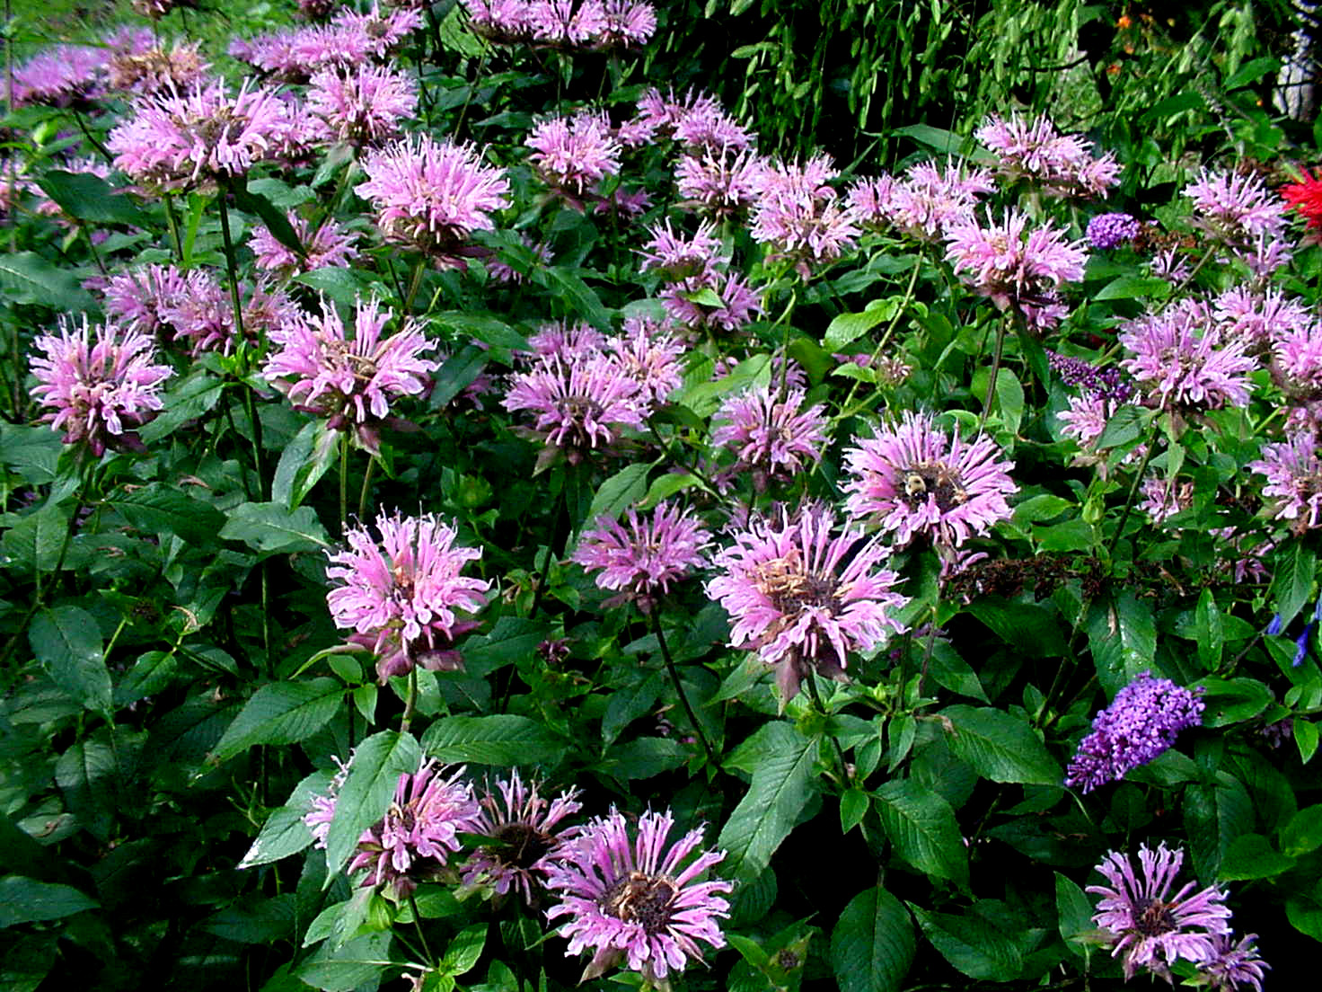
Bee Balm
Characteristics:
Nectar source
Drought tolerant
18 - 36 inches tall
Location:
Partial shade
Full sun if moist
Plant Spacing:
10 - 12 inch centers
Care and Feeding:
Moderate fertility,
Deer tolerant
Bloom Period:
June – August
Culture Concerns:
Spreads quickly
Mildew
Monarda didyma
Notes:
Monarda didyma: Bee Balm is a good garden plant that can be gorgeous if planted in partial sun, watered, and fertilized in early spring. It is a good butterfly and hummingbird plant, and attracts bees as well. However, it has a bad reputation for running rampant in any garden and becoming a pest. Unless you have a lot of time to remove mats of runners, you may want to consider purchasing barriers or placing the plants in areas where it can spread without causing problems. Mildew is a problem with most cultivars.

Slide 20
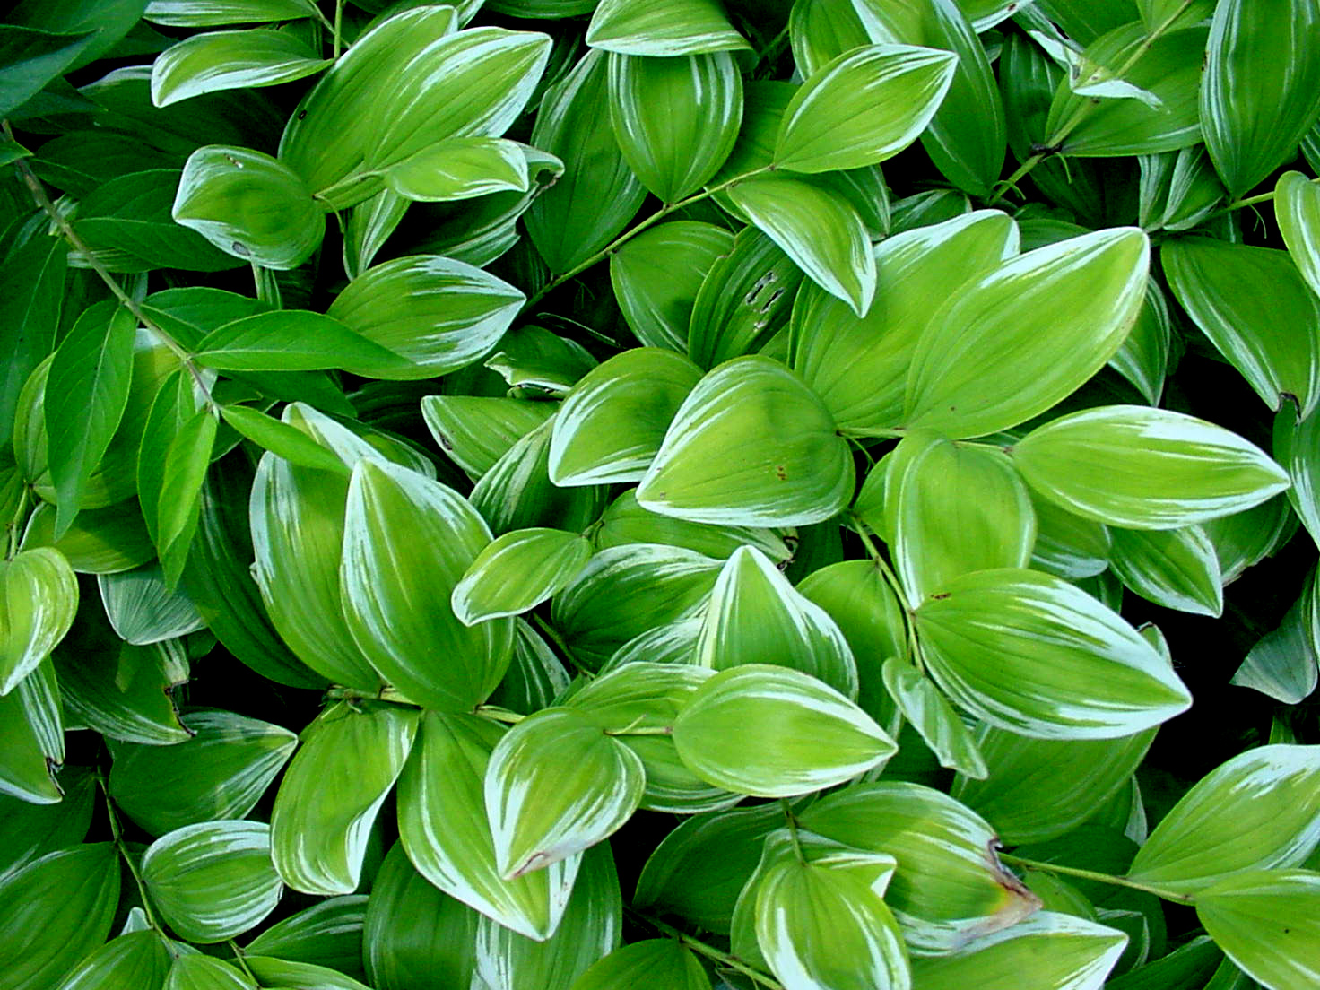
Fragrant Solomon’s Seal
Characteristics:
Nectar source
20 - 24 inches tall
Location:
Full shade
Plant Spacing:
12 inch centers
Care and Feeding:
Moderate fertility
Deer tolerant
Bloom Period:
June – August
Culture Concerns:
Scalds in full sun
Polygonatum odoratum variegata
Notes:
Polygonatum odoratum: Solomon’s Seal is wonderful in the garden. It is tough, spreads slowly, and makes a nice colony of upright foliage. Most cultivars have fragrant flowers that appear in May or June. If given shade, the foliage stays beautiful all summer and fall. The variegated form adds color to an otherwise dark green area.

Slide 21
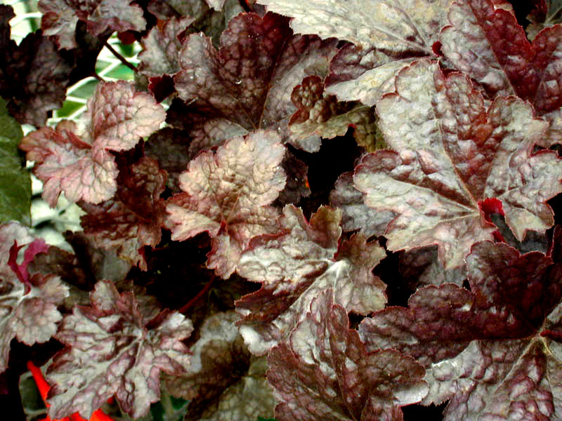
Coral Bells
Characteristics:
Purple foliage
15 - 20 inches tall
Location:
Full / partial shade
Plant Spacing:
12 inch centers
Care and Feeding:
Moderate fertility
No drought
Bloom Period:
June
Culture Concerns:
Bleaches in sun when dry
Heuchera americana ‘Purple Palace’
Notes:
Heuchera americana ‘Palace Purple’: Coral Bells is one of the perennial plants of the year. It has deep purple foliage when grown in shade. It forms a wonderful groundcover if planted on 12-inch centers. It requires frequent watering and organic soils to do well. If grown in a sunny location, the leaves tend to fade out, and the plant may fail to survive to the next spring. Drought is the enemy, especially if grown under trees. Fertilize in March and again after bloom in June.

Slide 22
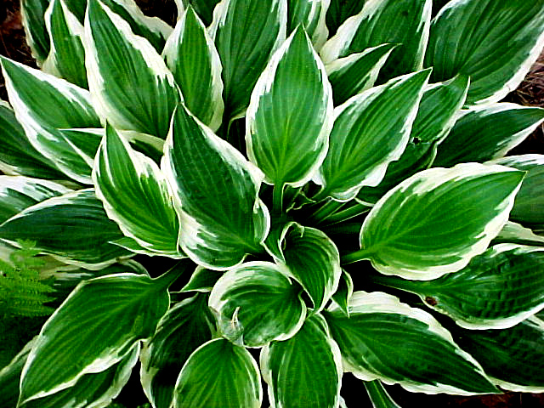
Hosta
Characteristics:
Foliage effect
15 - 28 inches tall
Location:
Full shade
Plant Spacing:
15 - 18 inch centers
Care and Feeding:
Moderate fertility,
High organic soils
Bloom Period:
June – August
Culture Concerns:
Deer food!
Divide @ 5 years
Hosta ‘Patriot’

Slide 23
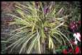
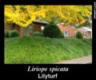
Liriope
Liriope is a grass-like perennial that grows in dense, low clumps in full shade or partial sun and bear lilac colored flowers which are followed by black fruit.
There are several varieties, including giant and variegated liriope.

Slide 24
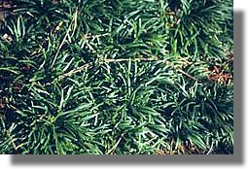
Mondo grass Ophiopogon
A close relative to liriope is mondo grass (Ophiopogon) which forms dense clumps that spread by underground stems.
The foliage of common mondo grass is dark green, and there is a variety with almost black leaves.
Dwarf mondo grass is a very low growing variety, suitable for growing between the cracks in stepping stones.

Slide 25
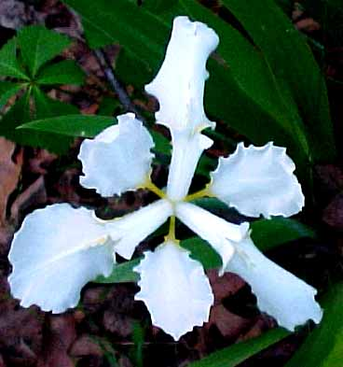
Rooftop Iris
Characteristics:
15 - 18 inches tall
Location:
Full shade
Plant Spacing:
12 inch centers
Care and Feeding:
Moderate fertility
No drought
Deer tolerant
Bloom Period:
May-June
Culture Concerns:
High organic soils
Iris tectorum
Notes:
Iris tectorum: The beauty of this iris in May is something to behold. It grows in deep to partial shade, and can turn a dark corner of the woods into a sparkling field of white. It will grow happily in Piedmont clay with no fertility and withstands drought and cold. Fertilize this plant, and it will multiply and increase the joy. The flowers are short-lived but worth having in the garden. It does well under trees if established with care.

Slide 26
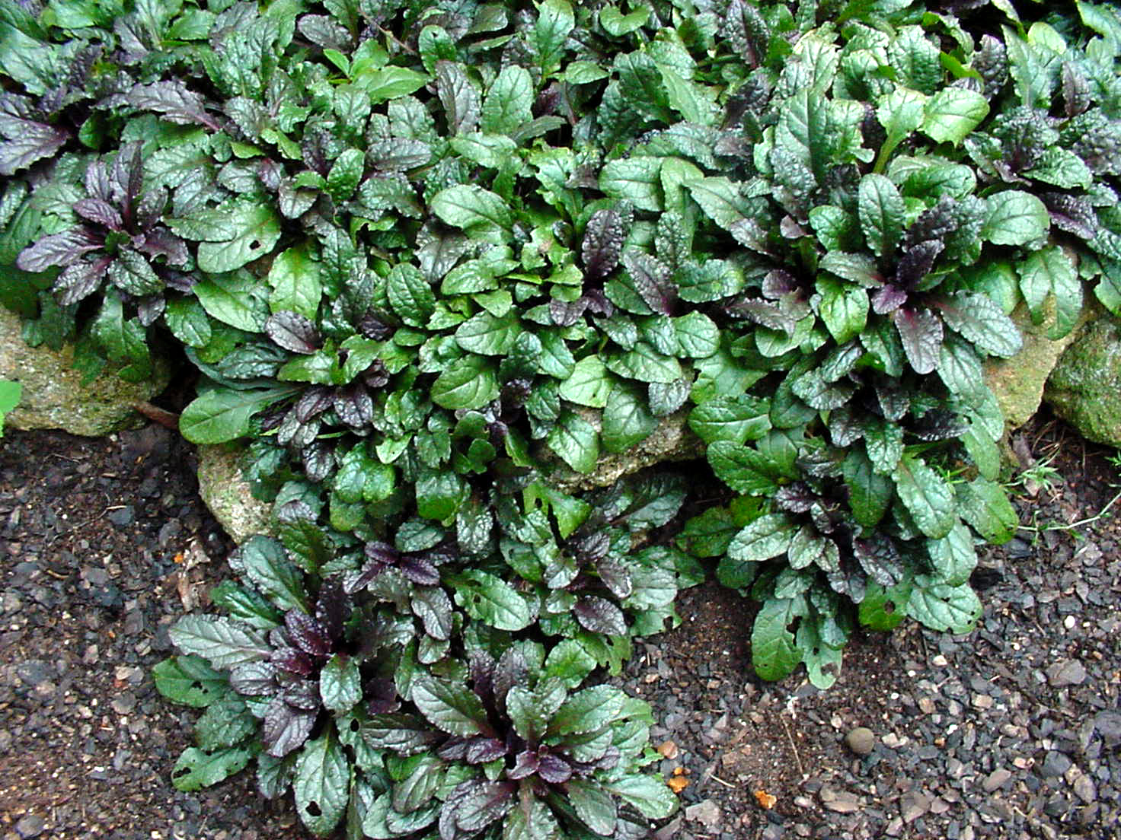
Bugle Weed
Characteristics:
Nectar source
Spring flowers
Location:
Full sun to
Full shade
Plant Spacing:
4-6 inch centers
Care and Feeding:
Low fertility
No drought
Deer tolerant
Bloom Period:
April-May
Culture Concerns:
May melt out in summer heat
Ajuga repens
Notes:
Ajuga repens: Bugle Weed is an heirloom plant that spreads rapidly and has few problems over-coming Georgia’s environmental challenges. In March and April, it bursts forth with sky blue flowers that Swallowtail butterflies love. The foliage of the cultivar ‘Bronzed Beauty’, shown here, is typical of the nice rosettes that form. It is easily propagated and maintained if watered and fertilized during the hot mid-summer.

Slide 27
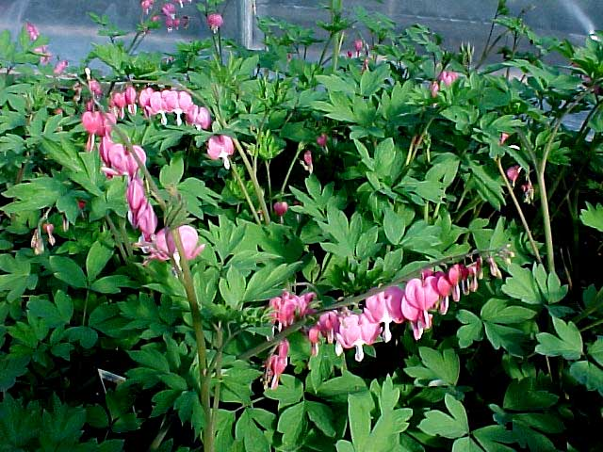
Bleeding Hearts
Characteristics:
Spring flower
Unusual flowers
18 to 30 inches tall
Location:
Full shade
Plant Size:
12 inch centers
Care and Feeding:
Moderate fertility
No drought
Bloom Period:
June – August
Culture Concerns:
High organic soil
Keep moist
Dicentra spectabilis

Slide 28
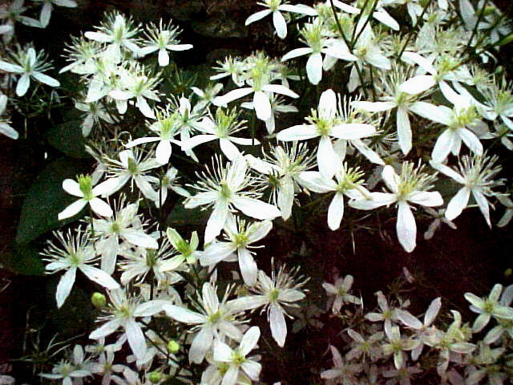
Summer Sweet Clematis
Characteristics:
Nectar source
Drought resistant
10 - 12 feet/season
Location:
Full sun to
Full shade
Plant Spacing:
24 inch centers
Care and Feeding:
Low fertility
Deer tolerant
Bloom Period:
August-September
Culture Concerns:
Cut back to thumb wood each winter
Clematis paniculata
Notes:
Clematis paniculata: Deer hate it. This is a long-lived native vine that is everything a hybrid Clematis is not. It is an aggressive vine that spreads 10-12 feet in a season. Summer Sweet blooms in late August. It is so easy to establish, that some gardeners literally rip the large roots out of the ground and transplant them with the cut end exposed to sun. New shoots emerge quickly. It is a pleasant green vine throughout most of the summer. Flowers are borne so profuse that they hide the vine. The plant is tough as nails. It can be cut back to within a foot of the ground and will spring back each year as if nothing happened. Re-seeding can be an issue, making the plant quite invasive if not carefully tended. Aphids, when they find it, are a problem unless the lady bugs get there too.

Slide 29
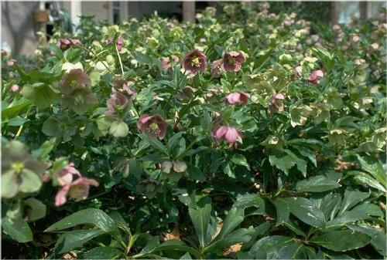
Lenten Rose
Height 15-18”
Spread 24”+
Clumping, spreading
growth habit (share with friends)
Winter/spring blooms
Prefers fertile, slightly alkaline soil and partial shade
Dislikes heat, intense sunlight
Dark green foliage is evergreen
Helleborus orientalis

Slide 30
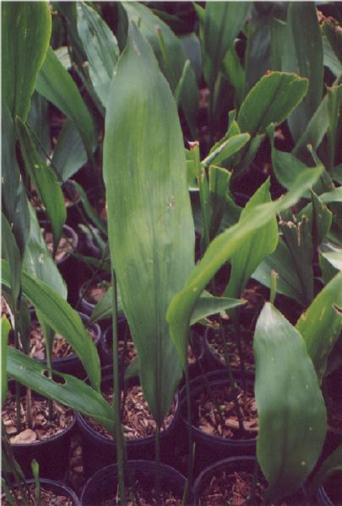
Cast Iron Plant
Height 2-3’
Spread 2-3’
Rhizomatous plant with lance-shaped,
Glossy, dark green leaves
Erect, broad, bell-shaped creamy
flowers borne in early summer
‘Milky Way’ has white-speckled foliage
and ‘Variegata’ has creamy white stripes
Caterpillars can be problematic
Aspidistra elatior

Slide 31
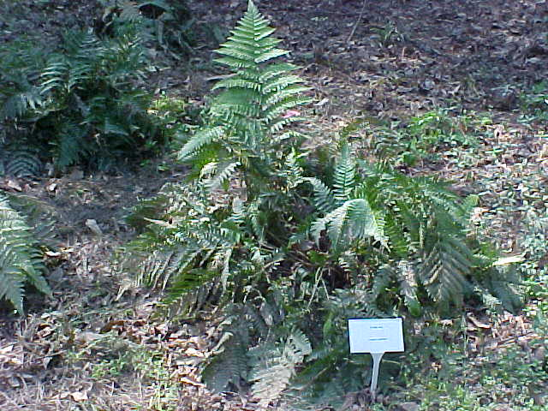
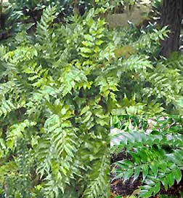
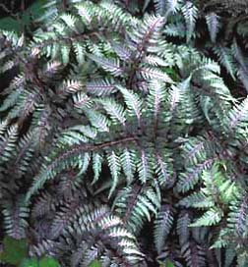
Ferns
Holly Fern
Autumn Fern
Ferns are classic plants for shade. There are many species of ferns to select from - both native and exotic. Most ferns prefer a moist environment and are perfect for the woodland garden. Their light, airy texture provides an excellent contrast to the broad leaves of most plants.
Japanese Painted Fern

Slide 32
Shrubs for Shade

Slide 33
Beautyberry (Callicarpa dichotoma)
Deciduous shrub 4’-6’ h/w
Graceful, trailing branches with berry clusters encircling stem
Fruiting occurs Aug – Nov
Provides interest when most summer flowering plants have faded
Inconspicuous blue-pink flower
Looks great in natural areas under pines; also used as background in perennial bed
Blooms on new growth, so thinning of old branches in winter is OK
Sun to part shade

Slide 34
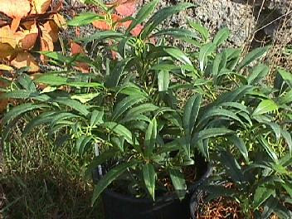
Sarcococca Sweet Box
Useful evergreen shrub providing sweet fragrance during the winter. Native to Asia, the common name is "sweet box", although most people refer to it simply as sarcococca.
Two types are most commonly grown, both having shiny dark green leaves: S. hookeriana humilis and S. ruscifolia. The first is a lower growing (1 to 2 feet) shrub which produces blue-black fruits. The latter grows from 2 to 4 feet and its fruits are reddish.
Sarcococca is ideal for shady parts of the garden, and its fragrant white flowers makes it especially nice near an entryway.

Slide 35
Japanese Plum Yew (Cephalotaxus harringtonia)
Low growing evergreen shrub maintaining deep green color year round
Tolerant of sun or shade; a great substitute for junipers in shade
Not a stand-alone plant, looks best in groups of three or more
Adapted to most soils, but does need good drainage
Deer resistant
Plant on 4 foot centers
Requires little or no pruning

Slide 36
Annabelle Hydrangea (Hydrangea arborescens ‘Annabelle’)
A favorite among beginning and experienced gardeners
Deciduous shrub grows 5’ h/w
Forms a nice spreading mound and is great for shady areas
Looks good in groups of 3-5
White flower heads range from six to twelve inches in diameter
Prefers A.M. sun / P.M. shade
Set about six feet apart and allow room it room to grow; few pest problems
Thin out old, woody stems in March, then shape it up as needed

Slide 37
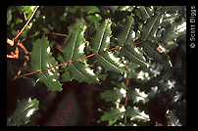
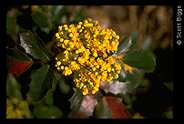
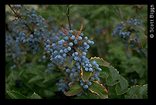
Mahonia
Mahonia is a small, evergreen, bold-textured shrub. Often has bronze winter foliage and reddish juvenile foliage.
Grows to 5' tall x 3' wide, upright oval growth habit, usually planted in groups, with several stems emerging from each plant.
Does best in partial shade to full shade in moist, well-drained, acidic soils.

Slide 38
Hydrangea quercifolia Oakleaf hydrangea
Height: 4-6 ft; Width: 3-5 ft.
Spreading & irregular in shape
Panicle flowers 4-12”
Fall color: Orange-red
Needs highly organic soil with decent drainage
Can be used as a specimen or planted in multiples in naturalized areas

Slide 39
Sweetshrub (Calycanthus floridus)
Native deciduous shrub often found along stream banks and damp woods
Valued for fragrant flowers and foliages (foliage is aromatic when crushed)
Species produces reddish flowers in May –June which have a strawberry aroma (‘Athens’ yellow)
Grows best in moist fertile soil; prefers sun to partial shade
Plants grow 8’-10’ tall and are best used in natural, unclipped borders

Slide 40
Virginia Sweetspire (Itea virginica)
Native deciduous flowering shrub w/ spreading habit
Prefers moist soil; sun to partial shade
Ideal for naturalizing in moist areas of the garden
Spreading growth habit with white fragrant flower spikes in April & May
Looks best as a mass planting
Foliage often persist well into winter
‘Henry’s Garnet’ has great reddish purple fall color

Slide 41
Rhododendron
Rhododendrons generally mature from 4' to 10' in height and width; upright clumping growth habit in youth, becoming rounded to spreading w/ age
Fairly slow growth rate
Performs best in partial shade in moist, well-drained, acidic soils.
Keys to successful growth:
well-drained soil that is moderately high in organic matter (amend with topsoil, peat moss, minipinebark chips, leaf compost, and/or sand)
Acid soil (pH 5.0 to 6.5; amend with aluminum sulfate or very small amounts of crushed elemental sulfur),
Adequate moisture, avoiding long periods of Summer drought
Avoid wet or poorly drained soils

Slide 42
Winterberry (Ilex verticillata)
Native deciduous holly growing 6’-10’ high, tolerant of soggy soils
Extremely hardy (Zone 4-9)
Great plant for natural shrub borders
Deep rich green in summer
Male/Female flowers located on different plants
Females set bright red berries in pairs; fruit ripens in Aug/Sept, berries persist winter
Full sun to partial shade; prefers moist acidic conditions
Varieties include: Jolly Red, Red Sprite, Sparkleberry, and Winter Red

Slide 43
Trees for Shady Sites

Slide 44
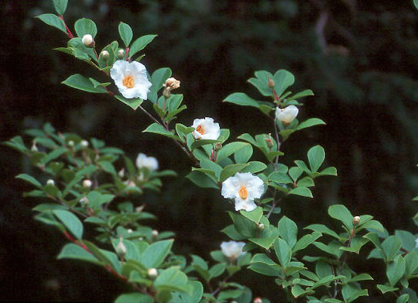
Japanese Stewartia (Stewartia pseudocamellia)
Excellent small to medium-sized tree growing to 30-35’ tall and up to 25’ wide
Provides season-long interest with distinctive branching pattern in winter, camellia-like flowers in summer, and bright yellow and red foliage in fall

Slide 45
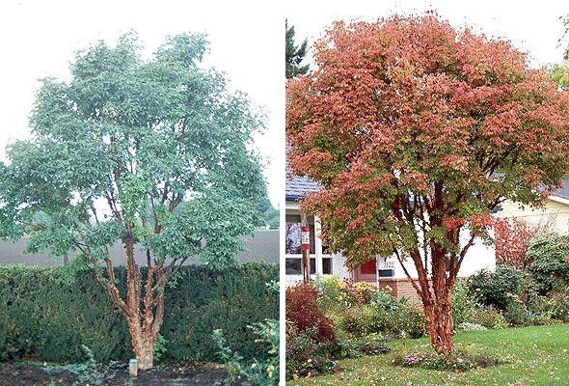
Paperbark Maple (Acer griseum)
Unique slow-growing tree with olive to grayish green foliage
Very nice fall color – a mixture of orange, red & brown
Outstanding interest in the landscape with peeling chocolate brown bark revealing a golden-brown underskin
Mature height around 20 -30’, but be patient as this one doesn’t have the growth rate of most maples

Slide 46
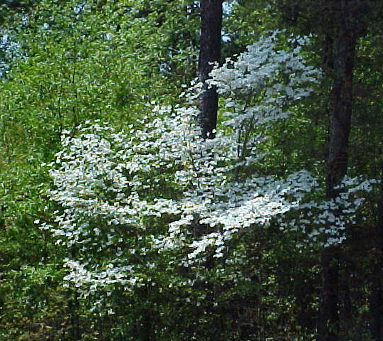
Cornus florida Flowering Dogwood
Native understory tree growing to 30’ tall & almost as wide
Graceful horizontal branch structure
Scarlet fall color and red berries in winter
Varieties include White Cloud, Cherokee Princess, and Cloud Nine

Slide 47
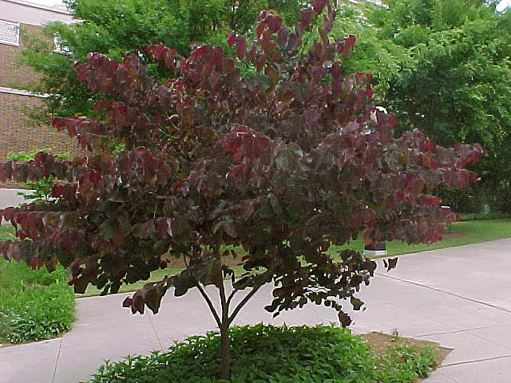
Forest Pansy, Oklahoma and Texas White Redbuds
(Cercis canadensis)
Deciduous flowering tree reaching 15-25’ at maturity with an equal spread
Prefers full sun to partial shade and moist, well-drained soil.
Prune early to develop the desired shape, then prune as necessary -- after flowering -- to thin unnecessary branches.
Forest Pansy has heart-shaped leaves which emerge a shimmering red-purple in spring, fading to a deep plum-purple as the season progresses with rose-pink flowers.
Oklahoma has glossy, leathery green leaves with wavy margins and magenta-rose flowers.
Texas White has glossy green leaves similar to those of Oklahoma, but it bears milky-white flowers.

Slide 48
Lacebark Elm
Deciduous tree 40’-50’
Tough, durable shade tree
Dark green leaves with yellow or reddish purple fall color
Outstanding feature is the mottled bark with gray, green, orange and brown coloration
Easily transplanted
Tolerant of poor soils
Adds winter interest
Excellent shade or street tree

Slide 49
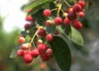
Downy Serviceberry (Amelanchier arborea)
Deciduous native flowering tree 15’-30’ high and about half as wide
Graceful habit easily trained to a multi-trunk specimen
2-4 inch white flower clusters occur in April (typically just before dogwood)
Purplish-blue fruit in early summer
Excellent in the landscape and along wooded areas
Prefers well-drained acidic soil
Grows best as an understory tree

Slide 50
Any Questions?
For more information, visit the UGA Cooperative Extension website at
www.ugaextension.com

