Slide 1
ARCSA Tapping Into Rainwater Rainwater Treatment & Sanitation

Slide 2
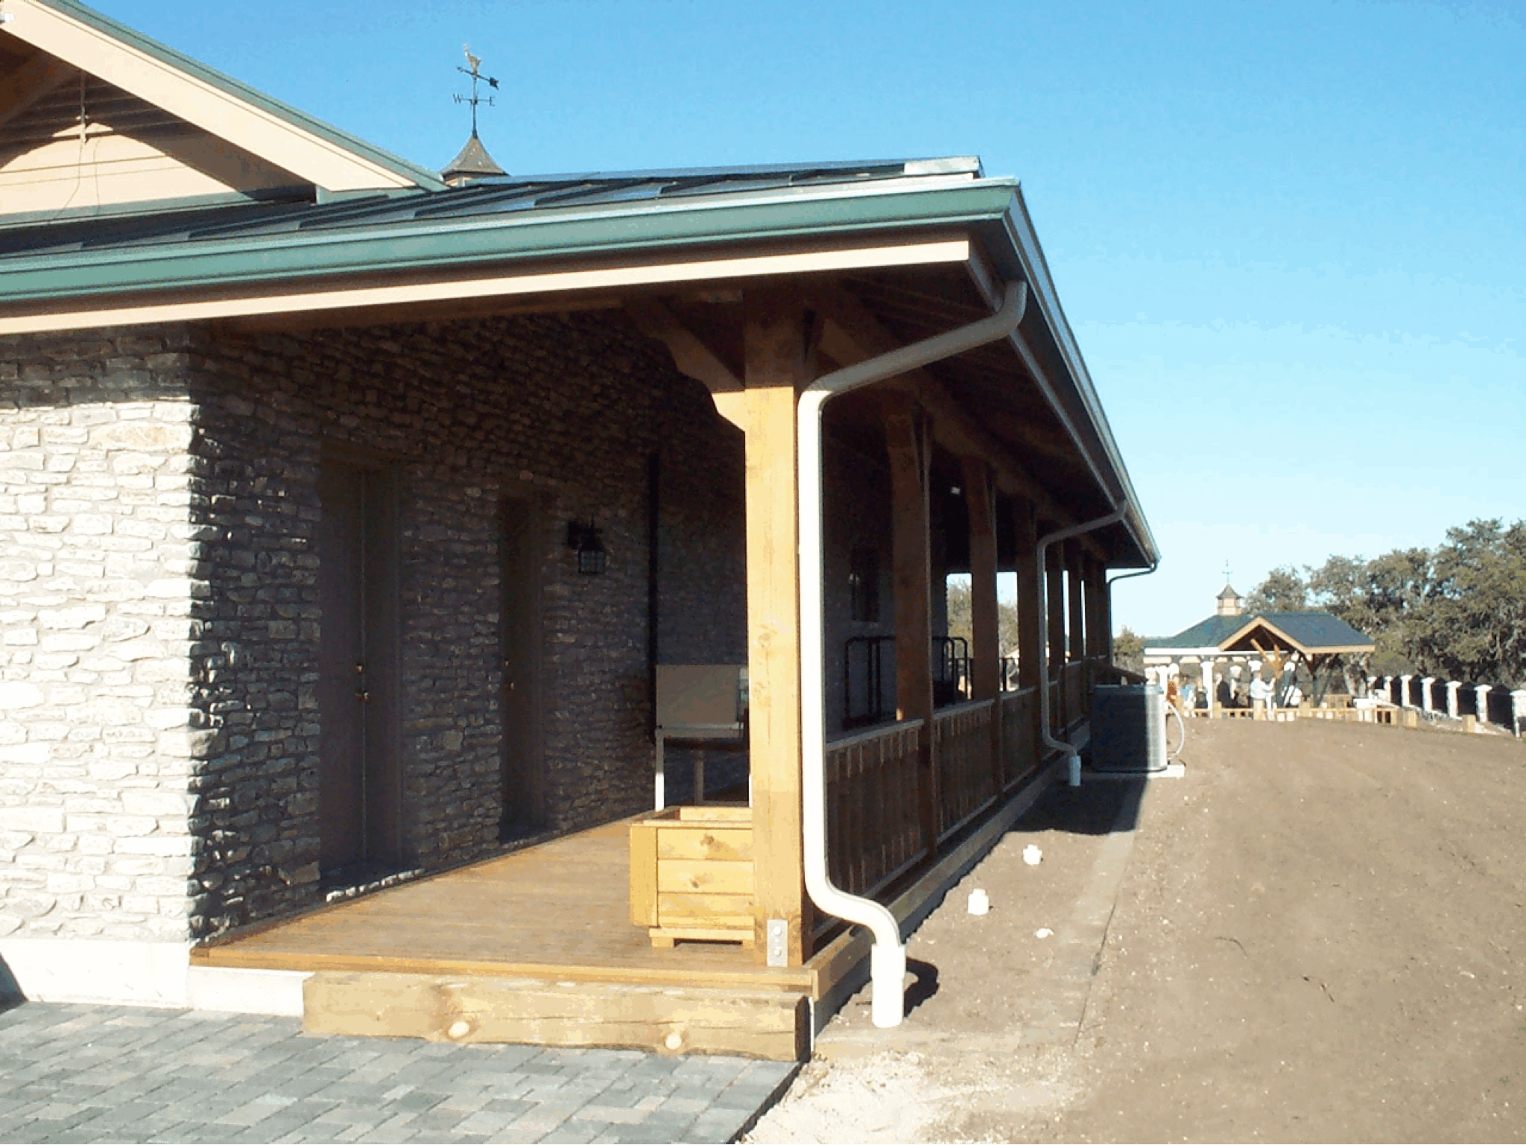
What kinds of contaminants can be found in rainwater?
Rainwater: Pure, Universal solvent
Air, Roof, Collection Containers
Debris - solids
Chemical Contaminants
Volatile Organic Chemicals (VOCs)
Synthetic Organic Chemicals (SOCs)
Minerals
Metals
Microbiological Contaminants
Parasites
Bacteria
Virus
Notes:
Pathogenic microbes pose a greater health threat to rainwater users than most
chemical contaminants, for a number of reasons, including:
• Pathogens can cause disease after a single exposure, while most chemical contaminants may
require months or even years of exposure before causing a health effect.
• Pathogens do not affect the taste, smell, or appearance of the water. Many chemical
contaminants, on the other hand, make the water taste, smell, or look different, especially if the
chemicals are present at levels that would pose a short-term risk.
• Pathogen levels can rise very quickly, while chemical levels tend to remain fairly constant.
Consequently, it is relatively easy (though somewhat costly) to periodically test for chemical
contaminants, while it is both difficult and costly to continuously test for most pathogens.
• A disease caused by pathogens can usually be passed from person to person, while the health
effects caused by chemicals affect only those that actually consume the contaminated water.
• Waterborne illnesses caused by pathogens can be a serious health risk for the elderly, infants,
chemotherapy patients, and other individuals with a delicate or weakened immune system.

Slide 3
Pharmaceuticals in Drinking Water
A recent AP investigation reported that at least 41 million Americans in 24 major metropolitan areas receive their drinking water from public supplies containing trace amounts of a variety of human and veterinary drug compounds.

Slide 4
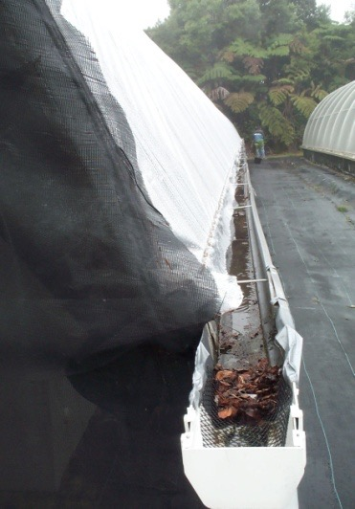
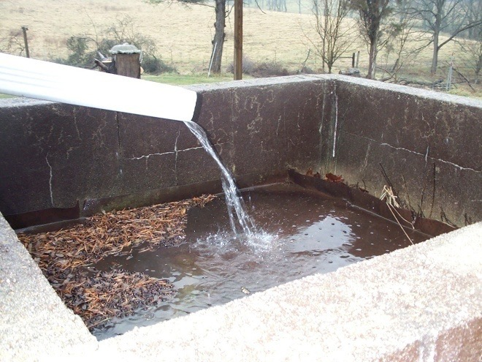
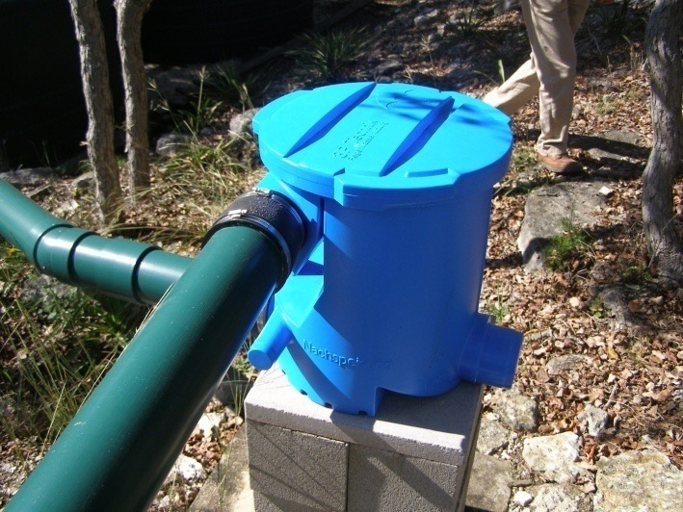
Solids: Suspended & Dissolved
Total suspended solids are the part of the sample that may be caught with a 1.5 µm filter (micrometer)
Total dissolved solids are the part of the sample that will pass through the filter
Measurement: concentration, mg/L or ppm
Notes:
Total suspended solids are the part of the sample that may be caught with a 1.5 µm filter
Total dissolved solids are the part of the sample that will pass through the filter

Slide 5
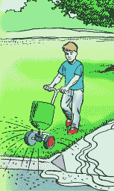
Nutrients
Essential for growth of living organisms
Major nutrients
N, P, K
Secondary nutrients
Mg, Ca, S
Measurement: concentration, mg/L or ppm
Notes:
Nutrients are elements essential for the growth of living organisms. However, humans do not utilize all of the nutrients that we consume and residual nutrients become a potential contaminant. Of particular concern are nitrogen and phosphorous, two of the three major nutrients.
Some of these needed for cell production and metabolism, and some passes through living organisms and into wastewater stream.

Slide 6
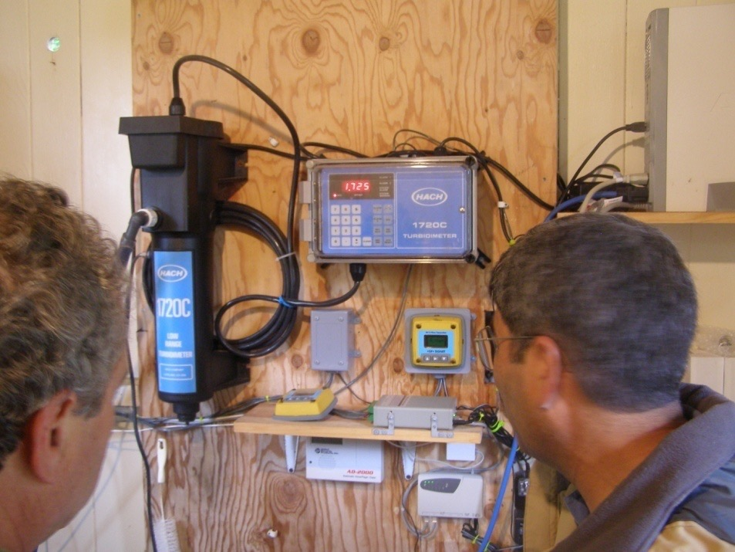
Turbidity
Turbidity is a measure of the clarity of water.
Turbidity is influenced by the number of insoluble particles present
Measurement: NTU
Notes:
Turbidity is a measure of the clarity of water.
Turbidity is influenced by the number of insoluble particles present

Slide 7
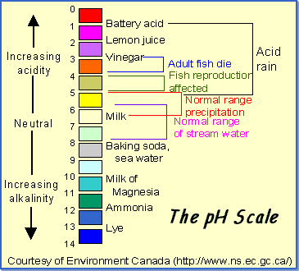
pH
pH is the negative log of the hydrogen ion concentration
Solubility of constituents
Corrosive nature of water
Measurement: scale of 1 to 14 with 7.0 as neutral
Notes:
pH is the negative log of the hydrogen ion concentration
It can have a major impact on biological and chemical reactions

Slide 8
Alkalinity
Alkalinity is the capacity of water to absorb hydrogen ions without significant pH change
Bicarbonates, carbonates, and hydroxides are the three chemical forms that contribute to alkalinity
Notes:
Alkalinity is the capacity of water to absorb hydrogen ions without significant pH change
Bicarbonates, carbonates, and hydroxides are the three chemical forms that contribute to alkalinity

Slide 9
Metals
Problems associated with excess metals:
Can make water taste and smell bad
Can stain fixtures
Metals in sufficient concentrations are pollutants and can be serious health risks.
Measurement: concentration, mg/L or ppm
Notes:
Problems associated with excess metals:
Can make water taste and smell bad
Can stain fixtures
Metals in sufficient concentrations are pollutants and can be serious health risks.

Slide 10
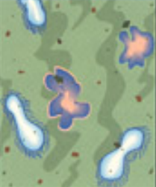
Pathogenic Organisms
Disease-causing organisms
helminths (worms), protozoa, bacteria, viruses
Comfortable in warm blooded animal digestive system
Conditioned to living in low oxygen
Difficulty surviving in air-filled environments
Notes:
Septic worms can be seen with the naked eye. Parasites would also be included in this list. Viruses are very small in size, but potentially very problematic because they can be persistent and travel long distances.
These organisms are generally happy in our digestive track, which is anaerobic. That’s why the anaerobic environment of a septic tank will effectively treat these.

Slide 11
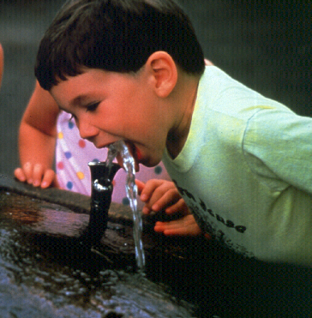
Drinking Water Standards
Notes:
In order to determine if your water has a problem, results from you water sample must be compared to water quality standards. We will now discuss drinking water quality standards and their impact on water quality.

Slide 12
U. S. Drinking Water Standards
1974 Safe Drinking Water Act
Amended 1986 and 1996
EPA sets limits to protect
Standards are regulations
Primary Standards - toxic pollutants
Secondary Standards - nuisance contaminants
Notes:
The Safe Drinking Water Act was first established by the United States Congress in 1974. It has been amended a couple of times and is designed to allow the US Environmental Protection Agency to develop water standards for a variety of contaminants (over 90 and counting). These standards provide a method of regulating those who supply water to the general public. Primary standards are set for contaminants that cause health effects, whereas, secondary standards are for contaminants that impact aesthetic qualities of water such as color, taste, and odor.

Slide 13
Water Supplies Impacted by Standards
Public Water System – serves piped water to minimum 25 people or 15 connections for 60 days/year
Community Water System – same people year round
Non-transient, Non-community Water System – same individuals for > 6 months but < 12 months (schools)
Transient Non-community Water System – serves public but not the same individuals for > 6 months (campgrounds)
Notes:
A public water supply that is regulated is one that serves at least 25 people or 15 connections (taps) for a minimum of 60 days per year. These systems are categorized as 1) a community system – one that supplies the same people year round; 2) a non-transient, non-community system that supplies water to the same individuals for greater than 6 months but less than 12 months( for example a school); or 3) a transient non-community water system that supplies water to the public but not the same people for more than 6 months (campgrounds). At the current time, water from private wells and rainfall harvested supplies intended solely for private use are not regulated by the US-EPA or the state regulatory agency, the Texas Commission on Environmental Quality (TCEQ).

Slide 14
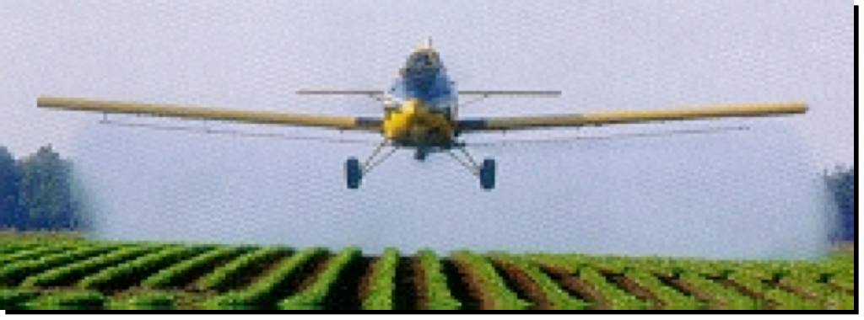
Examples of Standards
Primary standards
Inorganics
Lead - .005 mg/L nervous system & kidney (children)
Nitrate (as N) - 10.00 mg/L methemoglobinemia
Organics
2,4-D - .10 mg/L nervous system, kidney, liver
Atrazine - .003 mg/L reproductive & cardiac
Borden County – Gail-
Floride and Atrazine
Notes:
Here are a few examples of primary (ones that cause a health effect) drinking water standards. These standards reflect a concentration that is the amount of a substance in a volume of water. For lead, nitirate-nitrogen, 2,4-D, and atrazine, the concentrations are in milligrams per liter or parts per million (ppm). A complete list of contaminants is , again, available in the TCE bulletin on drinking water standards.

Slide 15
Secondary Standard Examples
Chloride - 250 mg/l - taste
Total Dissolved Solids – 500 mg/L taste
pH 6.5 - 8.5
low pH - bitter taste
high pH - soda taste, slippery feel
Notes:
Secondary standards as referred to earlier, do not cause a direct health effect but affect the taste, color, smell, etc. of the eater.

Slide 16
Potable Water Definition:
Government agencies are going to use a very specific definition of "potable water". This definition states that
"potable water" shall contain zero amounts of coliforms, viruses, giardia, and cryptosporidium.
There may be many other definitions of potable water but this is the definition that will be used for purposes of safety.
Dennis J. Lye - Research Microbiologist – EPA
(513) 569-7870

Slide 17
Microbiologists have no evidence suggesting that all of these organisms may or may not be present in collected rainwater.
The important point here is that we cannot assume that these organisms will not be present.
Because each collection system is unique, we will probably never assume that these organisms are not present.
This leaves us with the assumption that all collected rainwater must be treated to levels that would result in removal of these microorganisms.

Slide 18
Coliforms
A general indicator of "bad" bacteria.
These can be reduced with a variety of treatments.
There are relatively simple/inexpensive tests that can be performed.

Slide 19
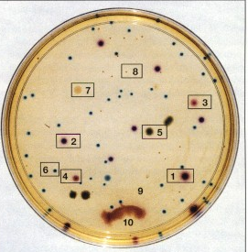
Fecal Coliform & Total Coliform
Indicator microorganism
Cultured in standard tests to indicate contamination
Measurement: colony forming units (CFU) / 100 mL
Notes:
Commonly referenced as cfu = colony forming units
Fecal coliform historically used as an indicator organism, that other more potentially harmful disease-causing (pathogenic) organisms are present.

Slide 20
Viruses
There is general consensus among microbiologists that a single treatment process will not remove all types of viruses.
Chlorine treatment alone or UV treatment alone will not remove all the types of viruses that are commonly transmitted by water.
Testing for the different viruses is expensive.
There are no simple/inexpensive tests for viruses in water.

Slide 21
Giardia/Cryptosporidia Protozoans (in cyst form)
Chlorine treatment alone will not remove all of these organisms.
UV treatment alone will not remove all of these organisms.
Testing for these organisms is expensive.
There are no simple/inexpensive tests for these types of parasites in water.

Slide 22
The TCEQ publication mentions guidelines for "Heterotrophic Bacteria". This a relatively simple/inexpensive treatment and test procedure as well.
It is a useful test because it helps in determining the integrity of the system (in this instance a rainwater collection system).
Dennis J. Lye - Research Microbiologist
(513) 569-7870

Slide 23
How do city distribution water suppliers produce "potable" water but also reduce costs?
They pay the money for the expensive tests for viruses and parasites once to show that these organisms are not present.
Then they use multiple treatments that are accepted by microbiologists as the best available process for producing water with reduced levels of these organisms.

Slide 24
A treatment process for rainwater that may be acceptable to a community distribution system and local health agency is the following multiple treatment option:
(1) a 3-5 micron pre-filter followed by
(2) a ANSI/NSF standard 53 filter (physical removal, 0.5 micron or 1.0 absolute micron filter)
followed by
(3) a ANSI/NSF standard 55, class A UV system.
The homeowner must use this type of multiple treatment process.

Slide 25
Chlorine treatment alone or UV treatment alone will not stand up in a court of law as being able to deliver "potable water“
The homeowner will have to pay one-time expensive laboratory costs to prove that their particular system is reducing the levels of microbial contaminants.
However, this initial one-time analysis can then be used to provide evidence that the system is working properly.
The homeowner should not have to test "quarterly" after this initial test for the expensive tests. The inexpensive Heterotrophic Bacteria test can be used as evidence that the system is working properly thereafter (probably on an annual basis).
The cheaper Heterotrophic Bacteria test can then be used to show that the integrity of the system has not been compromised.

Slide 26
HB 4 - Sec. 341.042. STANDARDS FOR HARVESTED RAINWATER.
(a) The commission shall establish recommended standards relating to the domestic use of harvested rainwater, including health and safety standards for treatment and collection methods for harvested rainwater intended for drinking, cooking, or bathing.
(b) The commission by rule shall provide that if a structure is connected to a public water supply system and has a rainwater harvesting system for indoor use:
(1) the structure must have appropriate cross-connection safeguards; and
(2) the rainwater harvesting system may be used only for nonpotable indoor purposes.
(c) Standards and rules adopted by the commission under this chapter governing public drinking water supply systems do not apply to a person:
(1) who harvests rainwater for domestic use; and
(2) whose property is not connected to a public drinking water supply system.

Slide 27
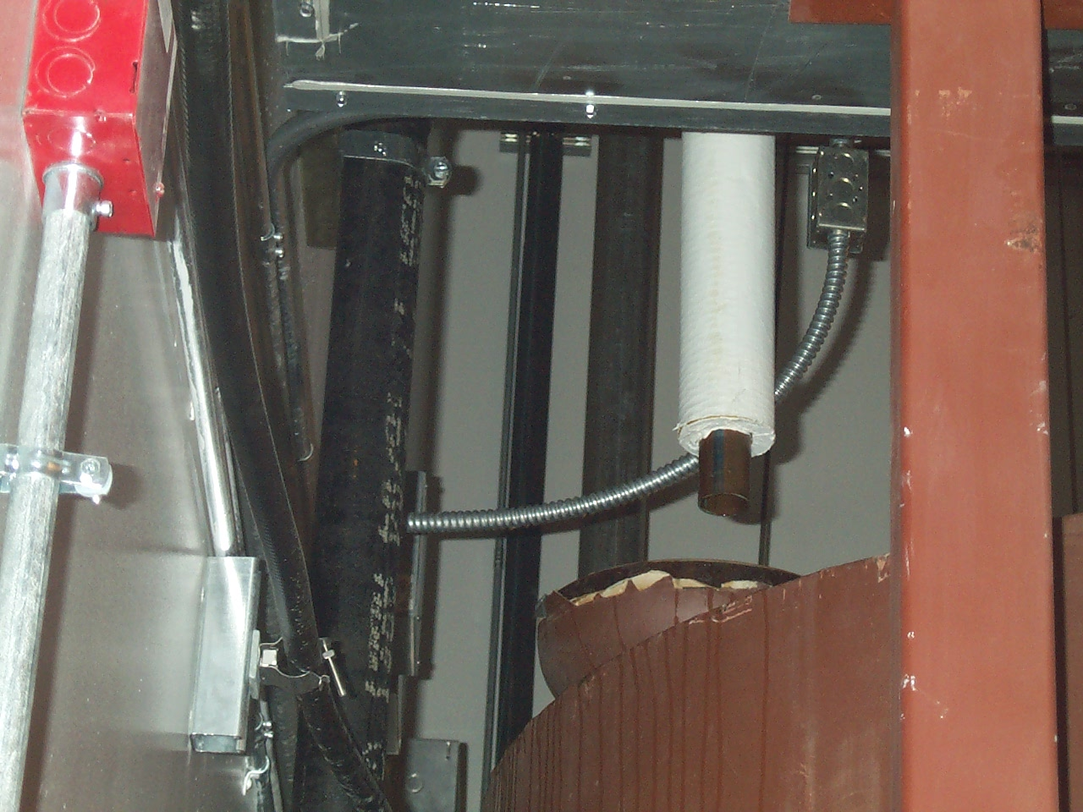
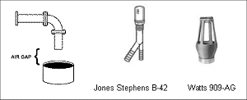
Air Gap Is needed If You Add Water Other Water Source

Slide 28
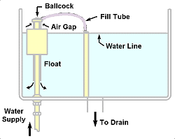
Reduced-Pressure Back Flow Assembly (RPBA)
Public water Systems
May Require air gap,
Require RPBA or both

Slide 29
Disinfectants
Chlorine – kills slime bacteria - adheres to organic matter to produce chlorine gas? trimethalchloride – carsogenic
Reverse Osmosis
Ozone – eats copper and steel – oxidizer/disinfector
Zenon – discards 10-12g/d uses potassium chloride in water softener

Slide 30
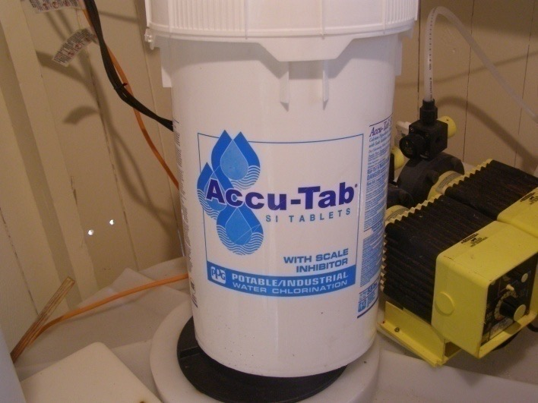
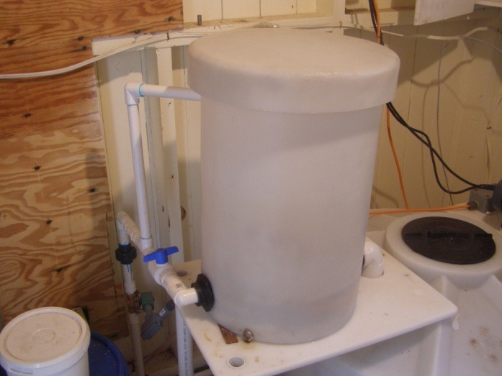
Chlorination

Slide 31
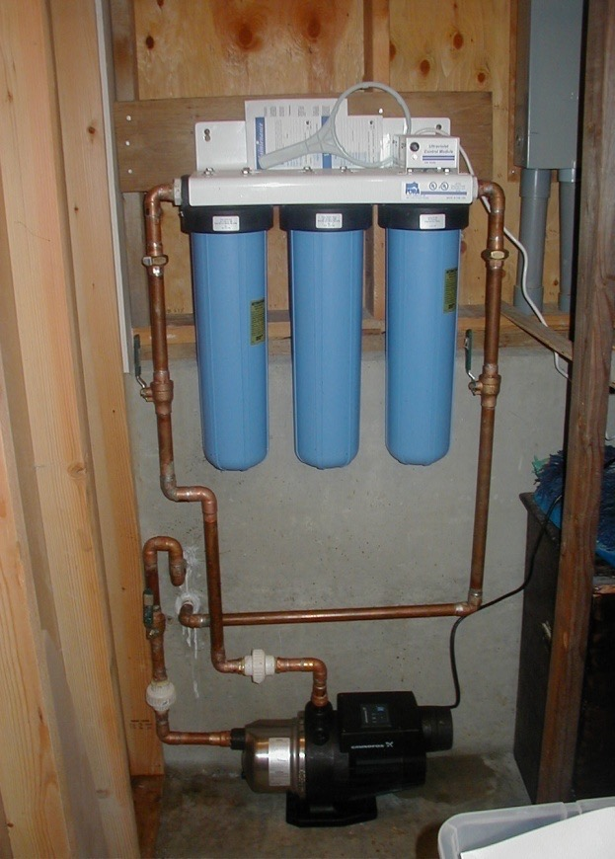
ANSI/NSF Standard 53 and Standard 61
Series of Filters – 80 – 20 – 5 – 1 micron
Membrane filter or cartridge filter 3-5 micron or smaller
Carbon Filter to remove taste and odor
Ultraviolet light

Slide 32
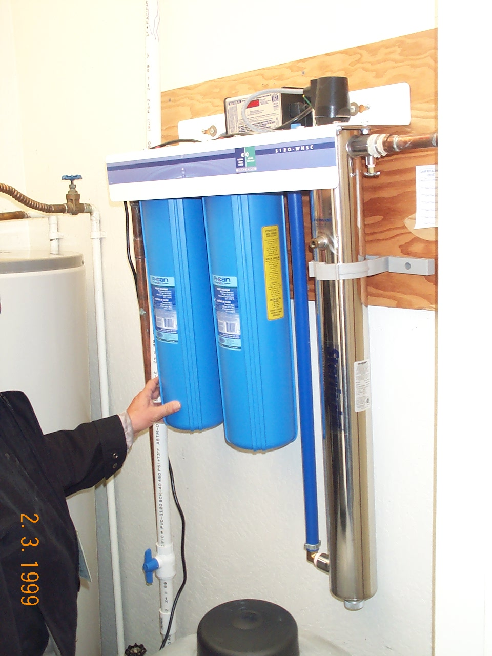
Combination of Filtration and UV Light

Slide 33
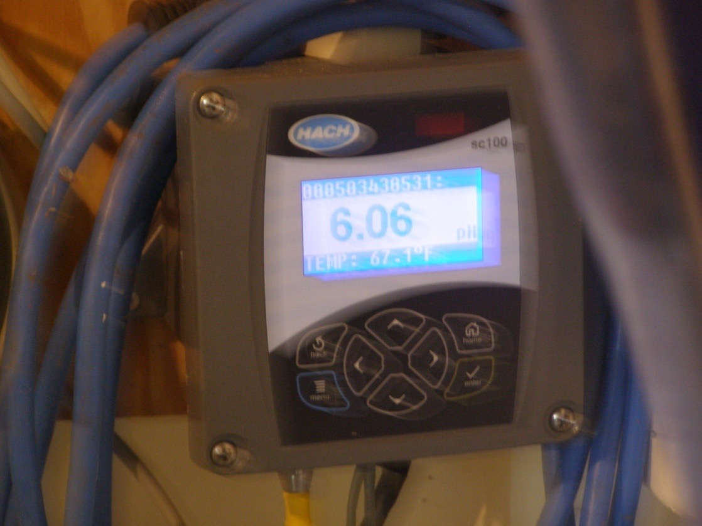
pH and Turbidity

Slide 34
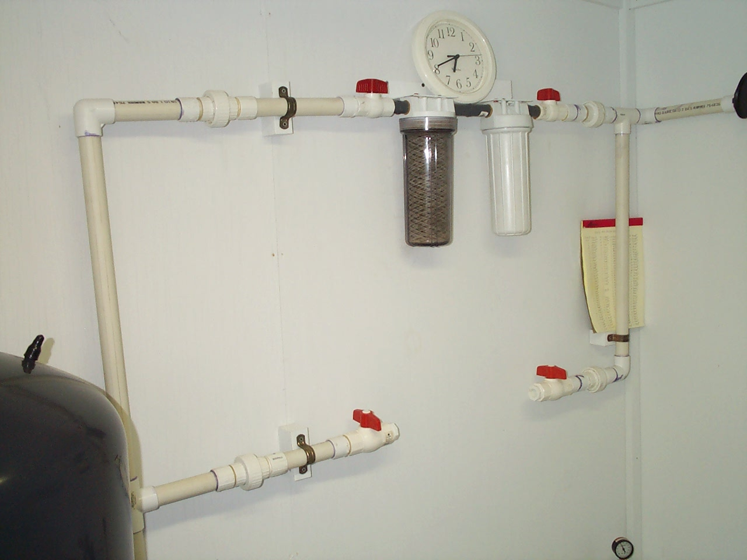
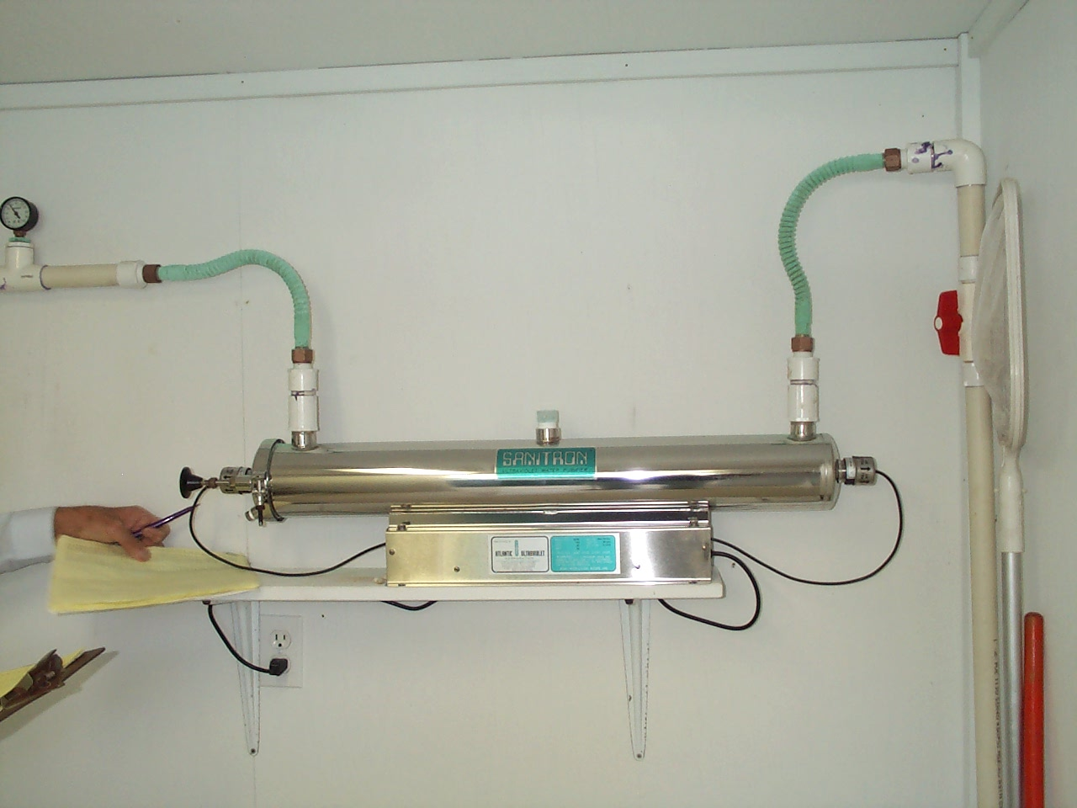
Charcoal Filters

Slide 35
Present Uniform Color Code
 | RED Electric Power Lines, Cables, Conduit and Lighting Cables
 | YELLOW Gas, Oil, Steam, Petroleum or Gaseous Materials
 | ORANGE Communication, Alarm or Signal Lines, Cables or Conduit
 | BLUE Potable Water
 | GREEN Sewers and Drain Lines
 | PURPLE Reclaimed Water, Irrigation and Slurry Lines
 | PINK Temporary Survey Marking
 | WHITE Proposed Excavation

Slide 36
UNTREATED RAINWATER DO NOT DRINK
On White PVC or other Pipe
Label every 2 feet down the pipe between the untreated-water storage tank and the last treatment unit
And every non-potable facet

Slide 37
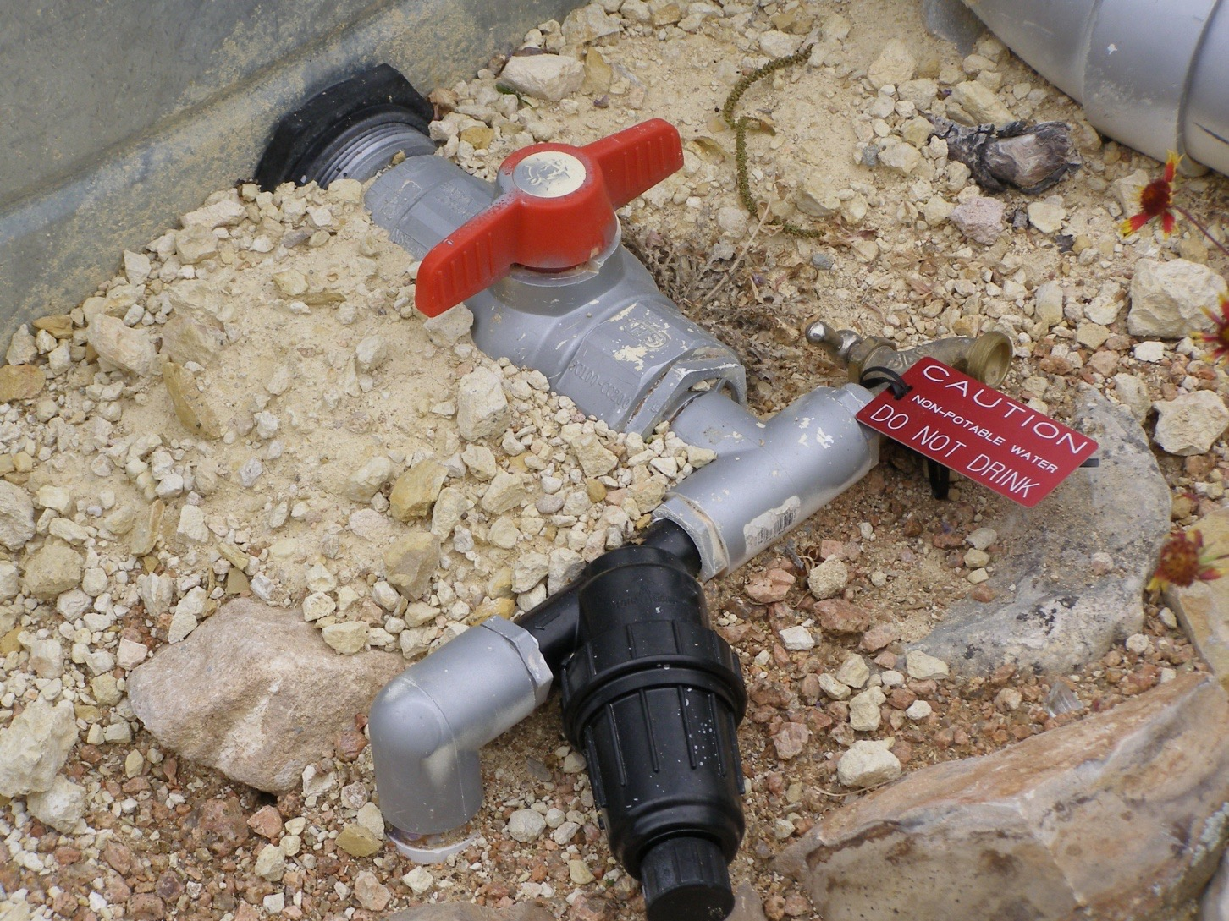

Slide 38
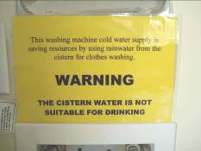
Yellow Labels on White pipe, facets etc.

Slide 39
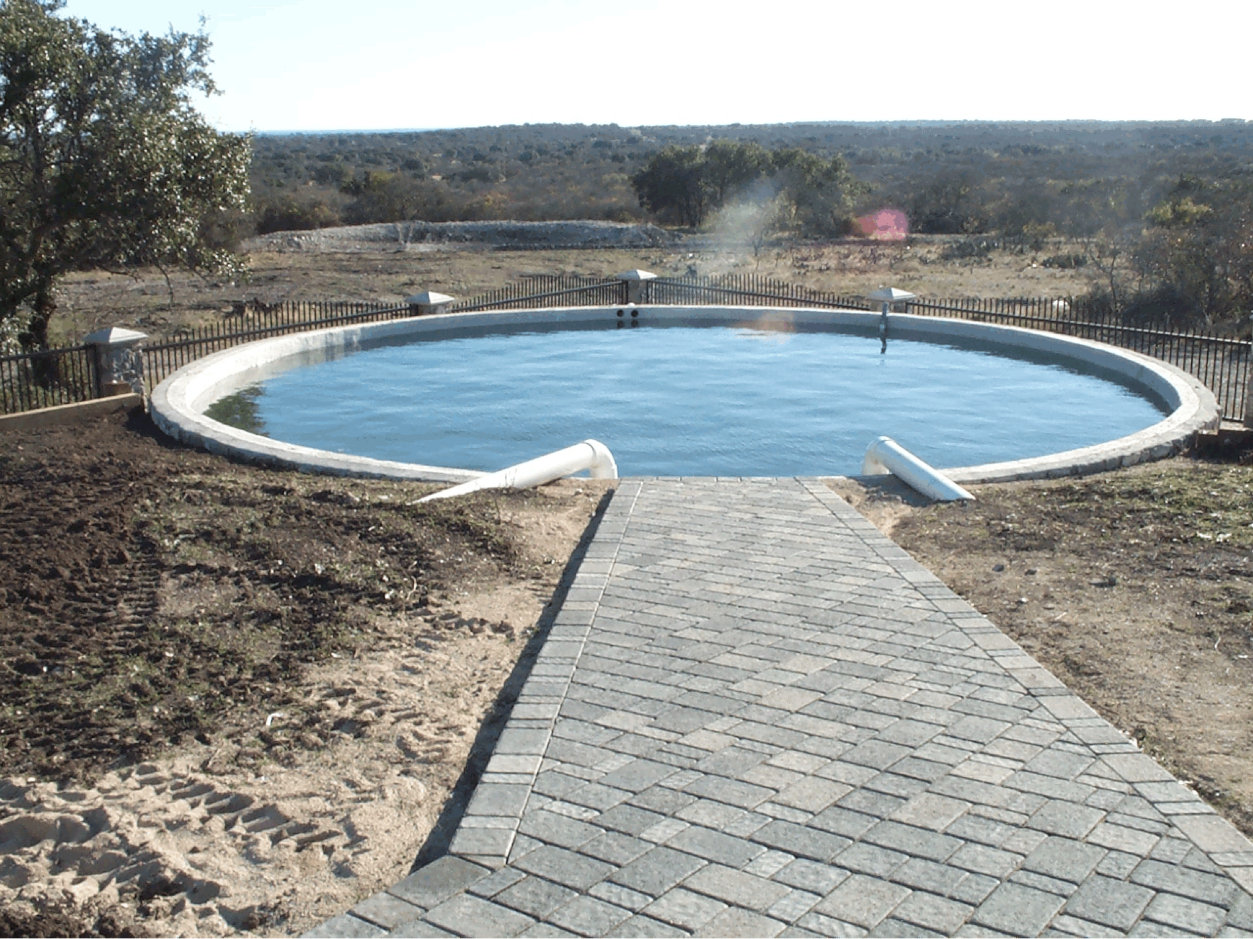
Definitions
ANSI
American National Standards Institute
NSF
NSF International

Slide 40
Potential Treatment System
Filtration
Disinfection
Corrosion control

Slide 41
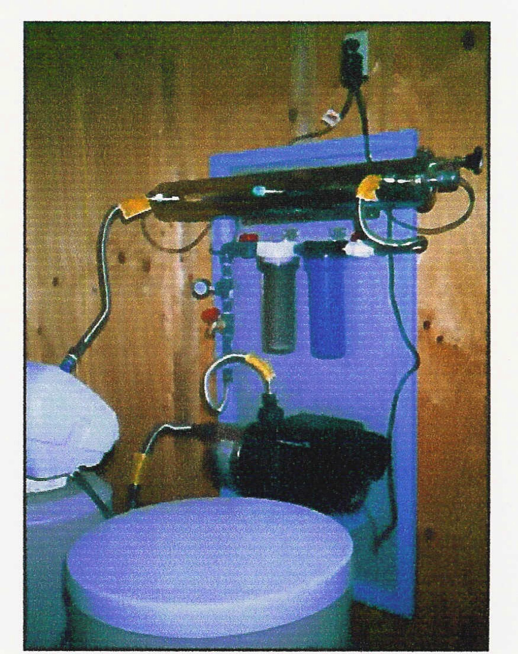
Picture of System
The Texas Manual on Rainwater Harvesting, 3rd Ed.; TWDB
Notes:
Here is a picture of such a system. The green arrow points to the on-demand pump, the brown arrow points to the micron filters, and the white arrow points to the UV light. The Texas Water Development Board (TWDB) has a publication entitled, “The Texas Manual on Rainwater Harvesting, 3rd Ed.” THis is a great resource on rainwater collection and treatment and is available at the TWDB website to be given at the end of this presentation.

Slide 42
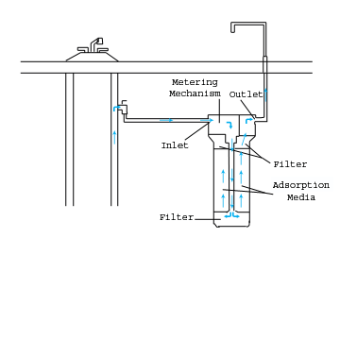
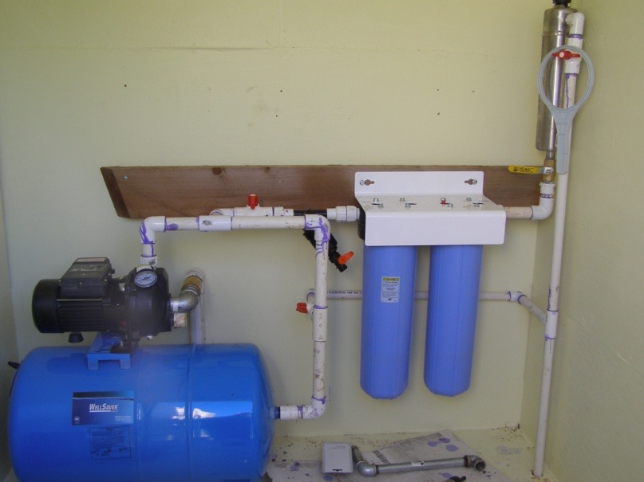
Treatment Approaches
Point of use
Single source treatment
Small under-the-counter footprint
Point of entry
Whole house
All water is treated
Source separation
In-home vs landscape
Notes:
Water Treatment Devices
Water Softeners
Reverse Osmosis
Other?
Other Flow
Condensate
Ice Machines
Basement drains
Footing drains

Slide 43
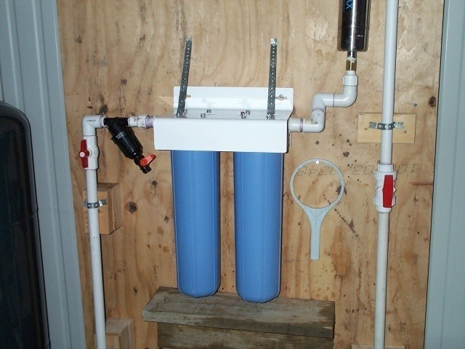
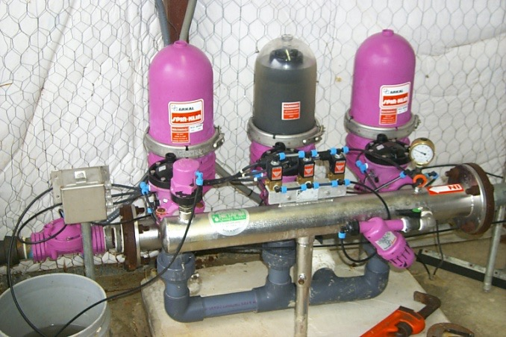
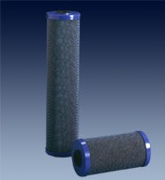
Filtration
80 Micron Filter
2 Nylon Filters
Coarse solids
Screen
Disk
Sediment filter – 1, 3- to 5- micron
Bag filter
Cartridge filter

Slide 44
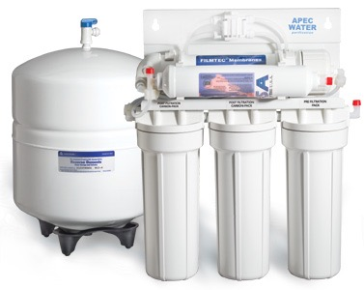
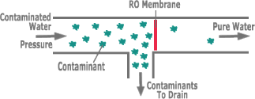
Reverse Osmosis
Remove very small particles (molecules) from water
Polymer membrane
Dissolved salts and solids
Brine disposal

Slide 45
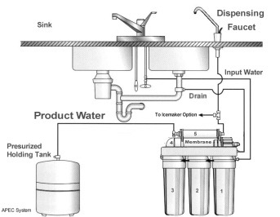
Reverse Osmosis
Typically needs additional filtration
Solids removal
Chlorine removal
Additional pressure tank to store RO treated water
May be best as point of use
Apec filter

Slide 46
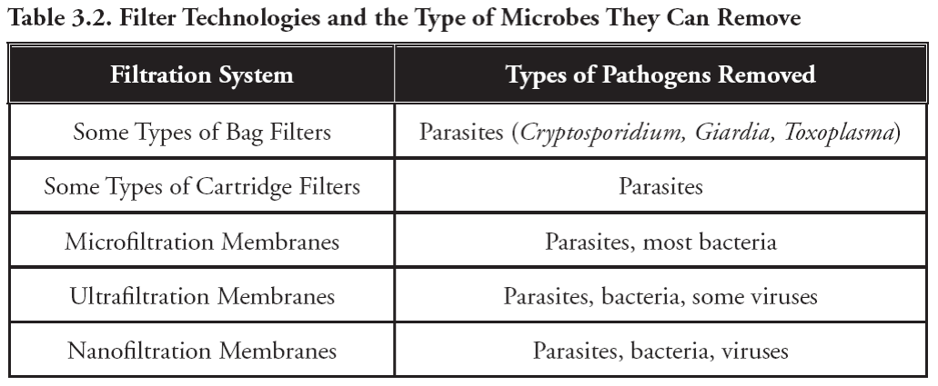
Filter Technologies and Treatment Potential

Slide 47
Disinfection
Chlorination
Ultraviolet light – UV
Ozone

Slide 48
Disinfection,
not Sterilization
The goal of disinfection
is to rid the water stream
of organisms capable of causing infection
Sterilization is freeing
the wastewater stream of ALL LIFE.
Notes:
Let’s start off with a basic definition of disinfection. Disinfection rids the wastewater stream of organisms that are capable of causing infection. It is not to be confused with sterilization, which rids the wastewater stream of all life.
Some examples of sterilization include heat pasteurization, irradiation with ionizing radiation, and incineration. Generally, disinfection is similar to cleaning, and may be as simple as washing with clean water to wash away potential pathogenic organisms.

Slide 49
Chlorine Treatment
Destroys target organisms by oxidation of cellular material.
Some organisms are resistant to low doses of chlorine
Oocysts of Chrytosporidium parvum
Cysts of Endamoeba histolytica
Cysts of Giardia lamblia
Eggs of parasitic worms
Notes:
Chlorine works by oxidizing the cellular material of the targeted organisms.
Chlorine appears to react strongly with lipids in the cell membrane, and membranes having high lipid concentrations appear to be more susceptible to destruction. For this reason, viruses, cysts, and ova are more resistant to disinfectants than bacteria.
Chlorination is an effective process, but it may not disinfect some of the protozoa and helminths that can cause disease.

Slide 50
Chlorine Dosing
Dose = Concentration x Contact Time
Increasing either dosage or contact time, while decreasing the other, can achieve the same degree of disinfection.
Breakpoint- the process where sufficient chlorine is added to the system to obtain a free chlorine residual
Notes:
Dosing is a factor of concentration and time. Increasing either dosage or contact time, while decreasing the other can achieve the same degree of disinfection.
It is important to have an appropriate holding time to allow the chlorine to react with the microorganisms. The length of contact time necessary for proper treatment decreases as the chlorine concentration increases. Generally, 30 to 60 minutes of contact time is required for typical wastewater strengths and chlorine concentrations.
Breakpoint- the process where sufficient chlorine is added to the system to obtain a free chlorine residual
You see- when chlorine is added to wastewater- it will first react with organics, ammonia, BOD and so forth to produce chloramines (which remember are not as effective for treatment) and other chlorine compounds.
As more chlorine is added, the residual chloramines and chloro-organic compounds are reduced to a minimum value and free chlorine residuals result.

Slide 51
Chlorine Interferences
TSS | Shielding of embedded bacteria.
Ammonia | Combines with chlorine to form chloramines.
BOD, COD, etc. | Organic compounds that make up the BOD and COD can exert a chlorine demand. The degree of interference depends on their functional groups and their chemical structure.
Hardness | No or minor effect.
Humic Materials | Reduce effectiveness of chlorine.
Iron | No or minor effect.
Nitrite | Oxidized by chlorine.
Nitrate | No or minor effect.
pH | Affects distribution between hypochlorous aced and hypochlorite ion.
Notes:
Until nitrogen compounds are completely reacted with chlorine no “free” Cl2 will appear.

Slide 52
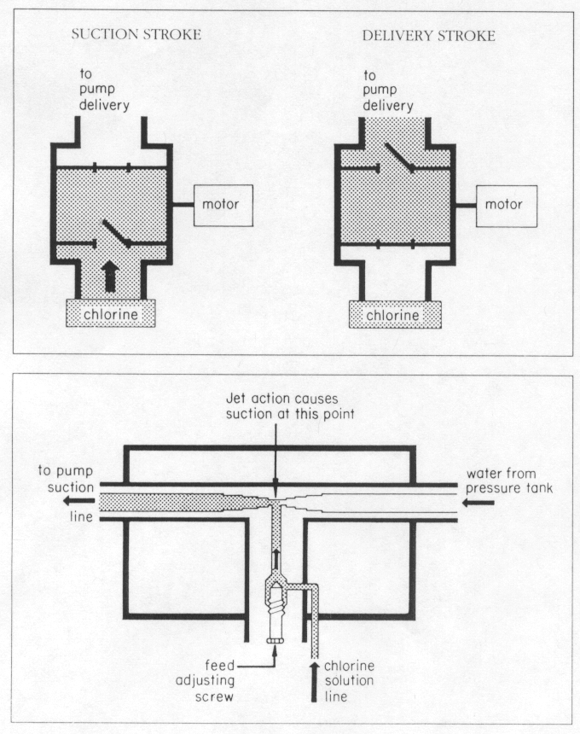
Chlorination System
Pump System
Positive displacement
Chemical feed
Specific quantity can vary with flow
Aspirator
Simple & inexpensive
Line from chlorine tank to water line
Variable (less accurate) based on pressure & flow
Wilkes University

Slide 53
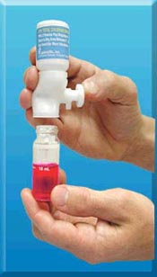
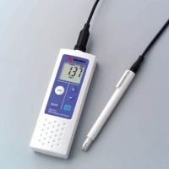
Measuring Chlorine residual
Notes:
Chlorine residual is monitored in the effluent. Chlorine can be read as total or free residual. Record the method of testing used
Measuring residual: Either free or Total- whichever is required.
Colorimetric DPD method: remember that testing materials are heat and light sensitive.
The pic on the right is a chlorine meter, while the one on the left is the colorimetric method.

Slide 54
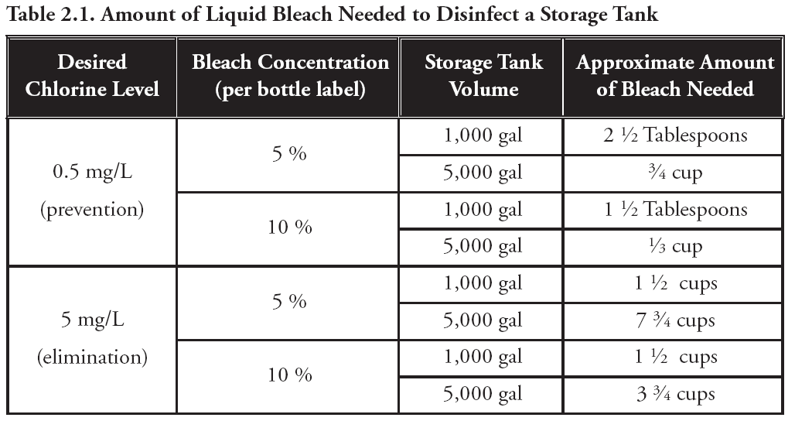
Quantity of Bleach to Disinfect a Storage Tank

Slide 55
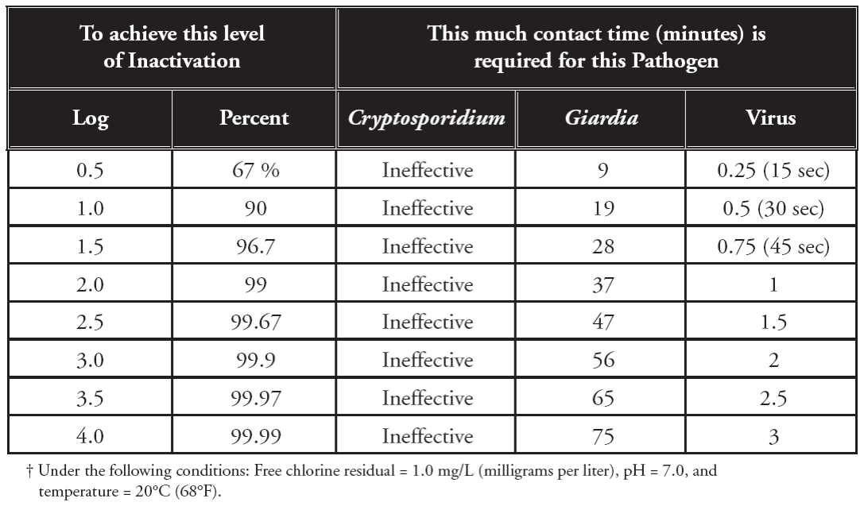
Examples of Chlorine Contact Time

Slide 56
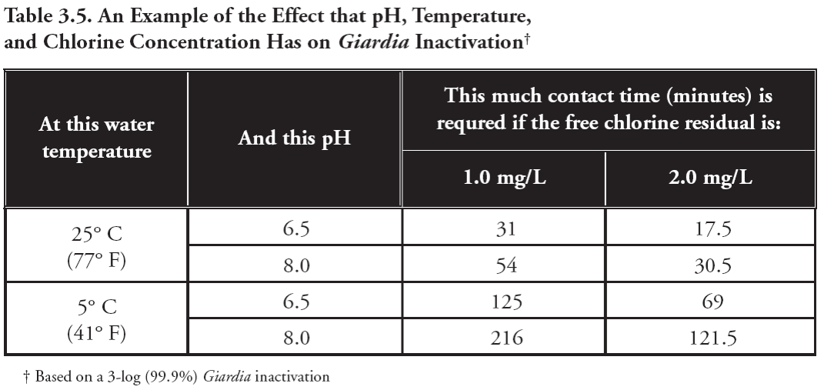
Example of Chlorine Contact Time and Water Quality

Slide 57
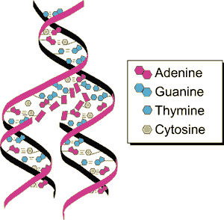
Ultraviolet Light Treatment
UV light destroys microorganisms by altering their genetic material and / or retarding their ability to reproduce
Notes:
Destroys DNA
Breaking genetic make-up of pathogens, so they no longer live/reproduce

Slide 58
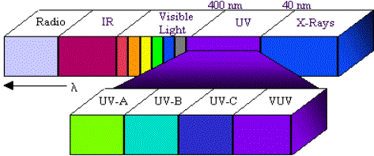
Disinfection using Ultraviolet Light
UV light is in the wavelength range of about 40nm to 400 nm.
The most effective wavelength is 254 nm.
Notes:
For UV disinfection to be effective, the light must pass through the UV lamp and must pass through the wastewater to reach the pathogenic organisms. A thin flow path is desirable for UV disinfection. Some of the commercially-available products allow the wastewater to flow around the lamp and some products direct the UV light through the wastewater in a clear flow path.
Germicidal in the wavelength range of 250 to 270 nm.
Since the passage of the light at the proper intensity is important, the wastewater should be treated to a high quality with low turbidity (low suspended solids) for UV disinfection.

Slide 59
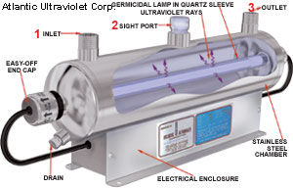
Ultraviolet Light Disinfection Units
Electromagnetic energy (UV light) from source lamp is emitted into a chamber through which water passes
Notes:
Electromagnetic energy (UV light) from source lamp is emitted into a chamber through which effluent passes

Slide 60
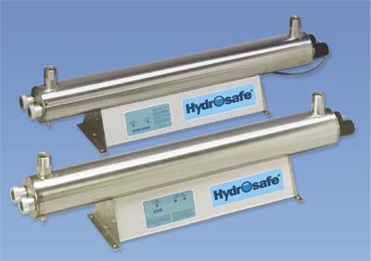
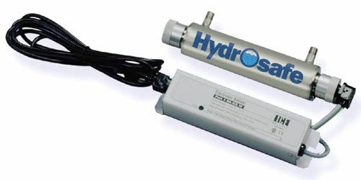
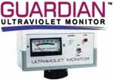
Ultraviolet Light
Light required for treatment
Replace light when intensity decreases
Follow manufacturers guidance, every 1-2 years

Slide 61
Ozone Treatment
Powerful disinfectant
Strongest oxidant of the commonly used disinfectants
Destroys Microorganisms through
Oxidation/destruction of the cell wall
Oxidation of cellular constituents including nucleic acids
More effective on viruses than Chlorine
Can remove odor and total organic carbon
Notes:
Because it is such a powerful oxidant, there are definite safety issues for the O&M Service Provider.

Slide 62
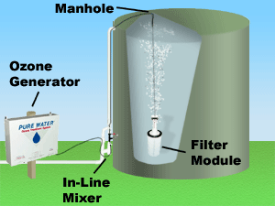
Ozone Disinfection
Unstable colorless gas produced by discharging electricity in dry air
Generated at the point of use (not shipped in gas cylinders)
Produced by discharging electricity in dry air (corona discharge)
Soluble in water up to about 5 mg/L
Notes:
Checking the function of the alarm is done by introducing an outside source of ozone into the air space to see if the alarm activates.
Make sure the ozone sensor is functioning. Record the ozone detection reading. If a safety alarm is present, make sure it is operating properly. This is done by introducing an outside source into the air space to see if the alarm activates.
If a control panel is used, it should be watertight with all connections sealed to prevent moisture or sewer gases from entering. Check the function of the alarm test switch. The presence of a control (HAND-OFF-AUTO) switch allows the service provider to check pump function without activating a float or program. Note the position of the control switch, keeping in mind that under normal operating conditions it should be in the AUTO position. If the panel has a cycle counter and/or an hour meter (elapsed time meter), record the present and last readings. If there are no meters, they are strongly recommended as an upgrade to facilitate O&M activities.

Slide 63
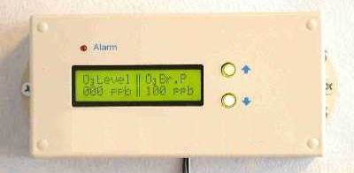
Ozone Caution!
Service Providers who operate and maintain systems that include ozone generators require specific safety training from equipment manufacturers to ensure that their risk is minimized.
Ozone is a toxic gas and can cause illness if inhaled in sufficient quantity.

Slide 64
Corrosion Control
Rainwater characteristics:
slightly acidic,
contains very few dissolved minerals, and
can be very corrosive
Plastic pipe tends not to be an issue
Metal fixtures: need to flush first water
Thin-walled copper very susceptible to pin-hole leaks

Slide 65
Corrosion Control
Sodium bicarbonate (baking soda)
Periodically add to increase alkalinity
pH of 7.4
Blend with municipal water keep below 7.7
Alternative: in-line filter
Calcium carbonate (limestone) pellets
Calcium oxide (lime) pellets
Sodium carbonate (soda ash) pellets
Must be downstream of UV units

Slide 66
VOC/SOC Adsorption
Volatile Organic Chemicals (VOC)
Synthetic Organic Chemicals (SOCs)
Granular activated carbon (GAC) filter
Typically up stream of chlorination
Chlorine removed by GAC
ANSI/NSF Standard 53
Notes:
Water Treatment Devices
Water Softeners
Reverse Osmosis
Other?
Other Flow
Condensate
Ice Machines
Basement drains
Footing drains

Slide 67
Water quality goal driven by use
Outdoor use
Landscape
Ag. production crops
Pets
Wildlife
Livestock
In-home
Non-potable
Potable
Caution- Health Issues
Notes:
The effect of contaminants on water quality is not only determined by the concentration of a contaminant in the water but also the intended designated use of the water. For example, water used for human consumption must be of better quality than water used for irrigation.

Slide 68
Materials of Construction
Non-potable System
Potable water certification not needed
Thin-wall copper should not be used
Potable System
Materials should be (when available) certified for potable water applications under ANSI/NSF std 61
Thin-wall copper tubing and materials containing lead or biocides should not be used

Slide 69
Rainwater Treatment Options: Non-Potable
Pre-treatment
Leaf screen
Roof washer
First flush
Treatment
Additional filtration and disinfection
Bag or cartridge filter with a 5-micron sediment filter and periodic chlorination with household bleach
Notes:
Just like other water supplies, one must determine the designated use of rainwater to determine the quality and, therefore, the level of treatment required to meet the use goal. For non-potable water such as water designed for irrigation use only, leaf screens and roof washers should be sufficient. If you intend to use the collected rainwater for human consumption (potable water) then additional treatment is required to remove sediment and pathogens. The most common potable water treatment setup includes a 5 –micron filter followed by a 3-micron filter for the removal of sediments followed by a UV-light capable of treating 12 gallons per minute for the treatment of pathogens. These filters and the UV light are in the distribution system after the pressure tank or on-demand pump.

Slide 70
Rainwater Treatment Options: Potable
Pre-treatment
Leaf screen, Roof washer, or First flush
Other filtration method
Treatment
Filtration with an ANSI/NSF Std 53 filter followed by disinfection with ANSI/NSF Std 60 chlorine or an ANSI/NSF Std 55, Class A UV unit
Or
Filtration with a 3- to 5- micron ANSI/NSF Std 61sediment filter followed by disinfection with ANSI/NSF Std 55, Class A UV unit
Notes:
Just like other water supplies, one must determine the designated use of rainwater to determine the quality and, therefore, the level of treatment required to meet the use goal. For non-potable water such as water designed for irrigation use only, leaf screens and roof washers should be sufficient. If you intend to use the collected rainwater for human consumption (potable water) then additional treatment is required to remove sediment and pathogens. The most common potable water treatment setup includes a 5 –micron filter followed by a 3-micron filter for the removal of sediments followed by a UV-light capable of treating 12 gallons per minute for the treatment of pathogens. These filters and the UV light are in the distribution system after the pressure tank or on-demand pump.

Slide 71
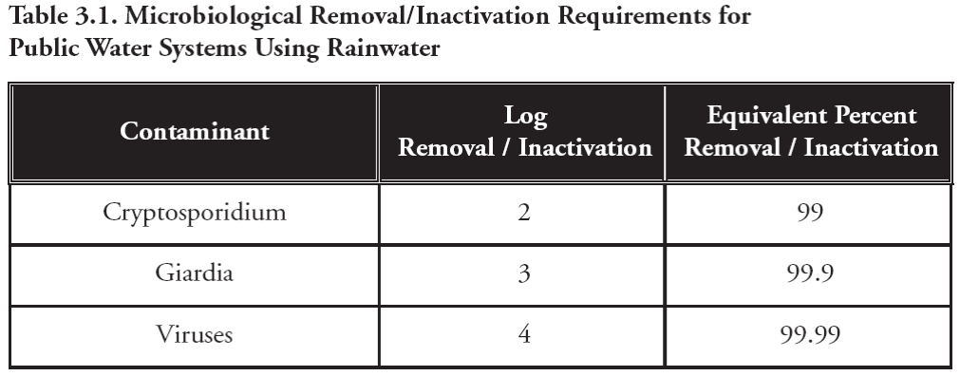
Microbiological Removal/Inactivation Requirements for Public Water Systems Using Rainwater

Slide 72
Treatment Goal for Non-Potable In-home Use
Total Coliform: < 500 CFU / 100 mL
Fecal Coliform: < 100 CFU / 100 mL
Turbidity: < 10 NTU
Water should be tested annually

Slide 73
Treatment Goal for Potable In-home Use
Total Coliform: 0
Fecal Coliform: 0
Protozoan Cysts: 0
Viruses: 0
Turbidity: < 0.3 NTU
Water should be tested every three months

Slide 74
Selecting a Treatment Unit
Find a system that will treat the constituents in the water
Consider co-treatment compatibility if more than one constituent is present
Notes:
Selecting a water treatment device takes a lot of consideration. The first thing that you want to do before purchasing a system is get your water tested by a certified third-party lab that will test for all constituents. You may run across free water tests being offered by treatment unit distributors. These tests often only test for superficial things in the water such as salt and hardness, and don’t include many potential contaminants that pose health effects. You want your results to come from an unbiased lab that is giving you the information that you really want and need, not from someone who is trying to sell you a unit. A list of labs certified by the Texas Commission on Environmental Quality (TCEQ) for the testing of public drinking water supplies can be found at: http://www.tnrcc.state.tx.us/permitting/waterperm/pdw/chemlabs.pdf
Once you know what is in your water, you must select a treatment unit or combination of units that will remove those contaminants.
If you have multiple contaminants of concern, then you need to look at the system’s ability to remove all of them. We mentioned the ion exchange process earlier as a system that you must be cautious using if more than one chemical is present. For most systems, prefilters help remove pollutants such as solids that may disrupt the removal process in the main treatment unit.

Slide 75
Selecting a Treatment Unit
Compare
Initial cost
O&M costs
O&M requirements
Contaminant removal efficiency
Warranties
Life expectancy
Company reputation
Notes:
Upon investigating potential treatment options, you will want to compare the initial cost of the unit and other operation and maintenance costs. You’ll want to consider the operation and maintenance requirements to keep the system running as it should and also how long the system is expected to last (life expectancy) if properly maintained. Look at how well the system is going to be able to remove the contaminant. Also consider the reputation of the manufacturer/seller as well as the warranties that they offer.
Finally, it is important that you understand the wastes associated with the unit and ensure you have a means for disposal. You don’t want to spend money on a system, run it for a while, and then find out that all you have done is generate waste without a way to properly dispose of it.

Slide 76
Product Certification
Water Quality Association (WQA)
Gold Seal Product Validation from the WQA
http://www.wqa.org
The NSF International (NSF)
http://www.nsf.org/Certified/DWTU/
EPA registration
Notes:
It is important to note that home treatment systems are not regulated by federal or state laws. There are, however, national organizations that offer certification of products. The Water Quality Association (WQA) offers a validation program and advertising guidelines. Products that receive a Gold Seal Product Validation from the WQA are certified in their mechanical performance but not in their ability to remove harmful contaminants.
The National Sanitation Foundation (NSF) provides certification of a product’s ability to remove contaminants that affect health. A list of drinking water treatment units with NSF certification can be found on the World Wide Web at: http://www.nsf.org/Certified/DWTU/.
If a product has an EPA registration number, this merely indicates that the unit is registered with the EPA but does not imply EPA approval or certification.

Slide 77
Need More Information?
Environmental Protection Agency
www.epa.gov/safewater/
Safe Drinking Water Hotline (1-800-426-4791)
www.epa.gov/surf
“Drinking Water From Household Wells”
“Home Water Treatment Units”
Notes:
The USEPA Web site provides links to more information about MCLs for other contaminants, further explanations of the contaminants listed here, water quality reports for selected public water supplies, links about private water wells, fact sheets, and much more. The safe drinking water hotline responds to factual questions in the following program areas:
Local drinking water quality
Drinking water standards
Public drinking water systems
Source water protection
Large capacity residential septic systems
Commercial, and industrial septic systems
Injection wells
Drainage wells
There is also a link from the safe water Web site with answers to commonly asked questions from the hotline.
http://www.epa.gov/surf provides information specific to your watershed such as contaminants and impairments.
There is a very informative publication accessible through the safe water Web site about private wells called Drinking Water from Household Wells (http://www.epa.gov/safewater/privatewells/pdfs/household_wells.pdf).
The EPA has also published a fact sheet about selecting home water treatment units called “Home Water Treatment Units: Filtering Fact from Fiction.”
(http://www.epa.gov/cgi-bin/claritgw?op-Display&document=clserv:OSWER:2488;&rank=4&template=epa)
Additional guidance can be provided by your county extension agent.

Slide 78
Water Quality Standards
National Primary Drinking Water Regulations
Protect public health
National Secondary Drinking Water Regulations
Aesthetic or cosmetic effects
Contaminant Candidate List (CCL)
http://www.epa.gov/safewater/
Notes:
National Primary Drinking Water Regulations are legally enforceable standards that apply to public water systems. Primary standards protect public health by limiting the levels of contaminants in drinking water. These standards regulate:
microorganisms like giardia, cryptosporidium, and viruses
disinfectants and their by-products such as chlorine
inorganic chemicals such as arsenic, copper, cyanide, lead, nitrate, and mercury
organic chemicals like benzene
and
radioactive particles (radionuclides) such as radium and uranium.
National Secondary Drinking Water Regulations are non-enforceable guidelines regulating contaminants that may cause cosmetic effects (such as skin or tooth discoloration) or aesthetic effects (such as taste, odor, or color) in drinking water. These contaminants include, but are not limited to: iron, silver, fluoride, zinc, and sulfate.
The Contaminant Candidate List (CCL) is a list of unregulated contaminants used to prioritize research and data collection efforts to help the EPA determine whether a specific contaminant should be regulated. The contaminants on the list are known or anticipated to occur in public water systems. However, they are currently unregulated by existing national primary drinking water regulations. The list includes blue-green algae, boron, aluminum, and perchlorate.
A links to the lists of primary and secondary standards and well as the CCL can be found @ http://www.epa.gov/safewater/.

Slide 79
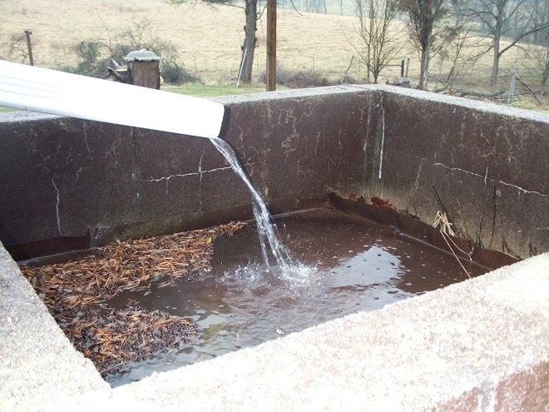
Whew!

