Slide 1
MICROSOFT NEWS RELEASE: It has come to our attention that a few copies of the Georgia edition of Windows XP may have accidentally been shipped outside Georgia. If you have one of the Georgia editions you may need some help understanding the commands. The Georgia edition may be recognized by looking at the opening screen.
Other features: Instead of an error message you get a winder covered with a garbage bag and duct tape.
OK = ats aww-right cancel = hail no reset = awa shoot yes = shore no = Naaaa find = hunt-fer it go to = over yonder back = back yonder help = hep me out here stop = ternit off start = crank it up settings = sittins programs = stuff that does stuff documents = stuff I done done Also note that winders XP does not recognize capital letters or punctuation marks.

Slide 3
Redneck Pruning What Not To Do!!!
Keith Mickler University of Georgia Cooperative Extension

Slide 4
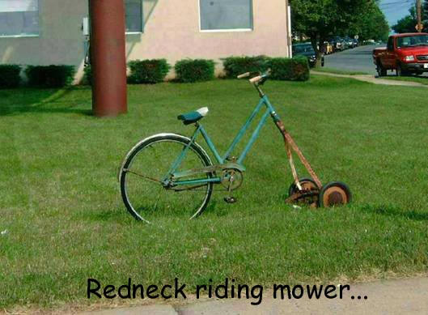

Slide 5
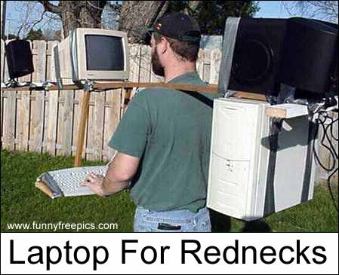

Slide 6
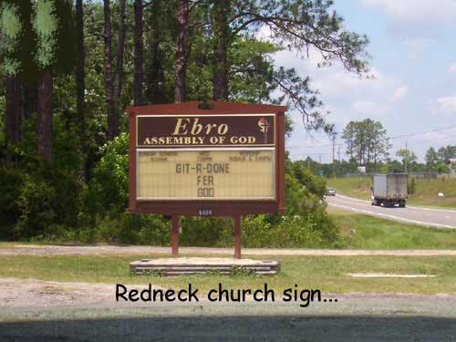

Slide 7
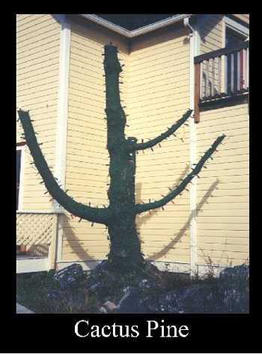
This is what the Dirt Doctor saw at the Radio Station just before going on the air. This is an example of BAD PRUNING. One of the worst parts people "are charged" for this service to damage their trees.

Slide 8
Don’t be a Redneck Just Prune Correct!!!
Removing Large Branches:
Improperly made Cuts:
Don’t Top:

Slide 9
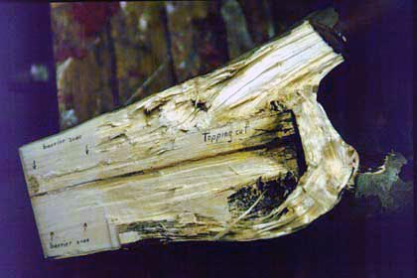

Slide 10
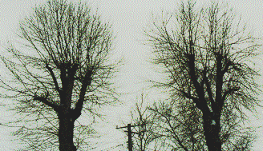
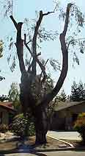
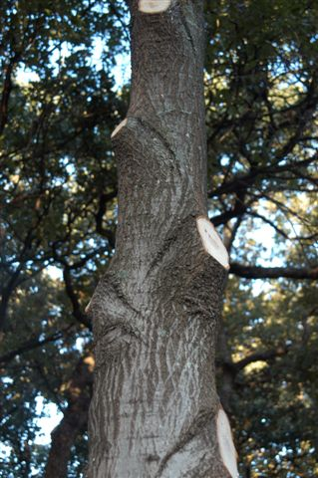
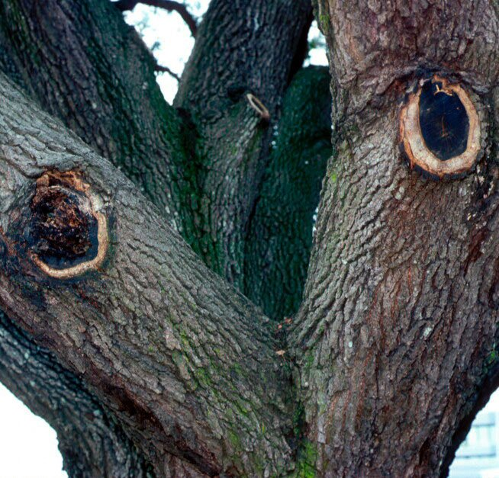

Slide 11
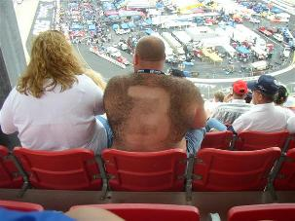

Slide 12
You know you’re a redneck if:

Slide 13
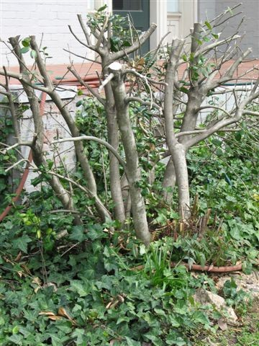
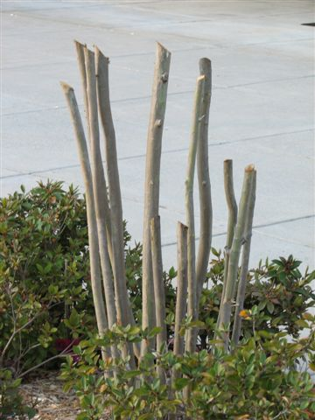
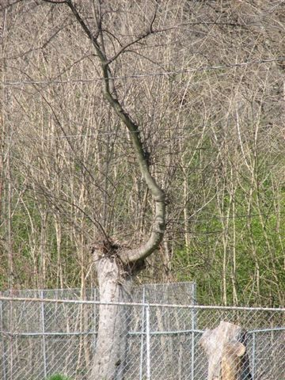
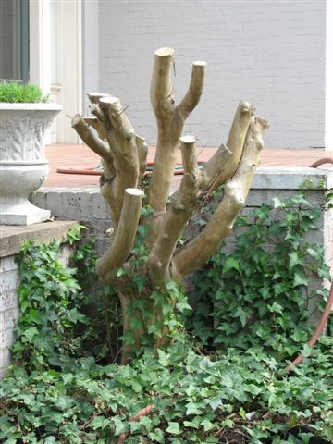
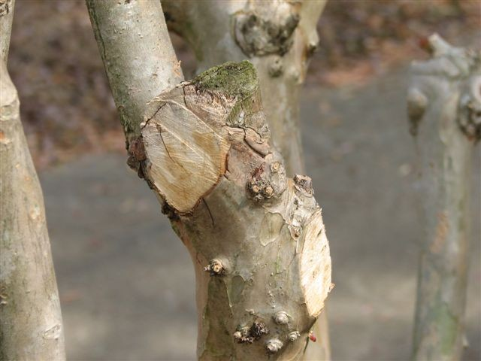

Slide 15
Is this any way to treat our trees!!!

Slide 16
Quote by Rex Bishop Horticulture Instructor at North Metro Tech. “The more you prune the more you have to prune”!
Quote by Larry Sagers, Extension Agent with Utah State University. “Pruning is not a solution for planting the wrong tree or shrub in the wrong spot”!
Quote from Larry Williams, Extension Agent with The University of Florida.
“Don’t prune your toe nails in Publix, it really grosses out the other customers and makes the store manager very angry”!

Slide 17
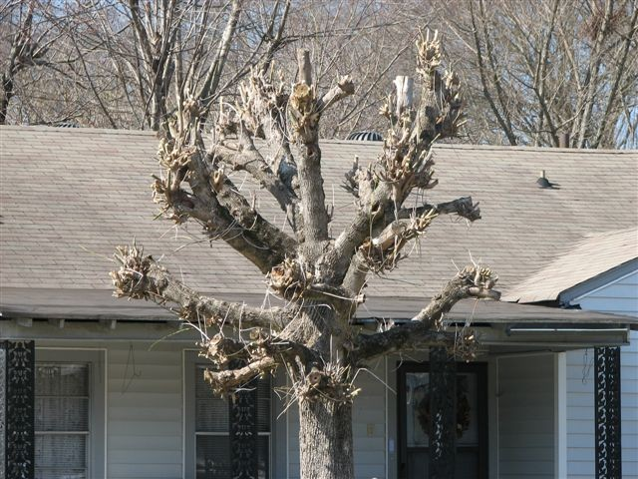
Pruning
Use A Systematic Approach
To Tree Care

Slide 18
Introduction
A tree has 5 major periods
Why prune?
When to prune
How to prune
Correct methods of pruning on shrubs
Correct methods of pruning on trees
Correct methods of pruning on evergreens
Pruning tools

Slide 19
Growth Periods
Throughout a 1 year cycle, a tree has five major periods. The tree’s stored energy fluctuates as a result of what occurs during these periods.

Slide 20
Period One (February - March)
The tree is waking up for the year
Growth is beginning but very little photosynthesis is taking place
The tree is running on reserve energy from the previous year

Slide 21
Period Two (April)
Leaf formation is the major activity
Because photosynthesis is minimal the tree must take a great deal of energy out of its energy reserves
The tree is at its lowest energy level
Insects and pathogens are becoming active

Slide 22
Period Three (May - July)
Photosynthesis increases dramatically. New leaves produce energy.
Most energy is being used up in leaf formation
All the tree’s growth occurs within 6-8 weeks after full leaf extension

Slide 23
Period 4 (August - September)
The tree begins storing energy
Much of the seasonal growth is complete

Slide 24
Period 5 (October - January)
This is the dormant period or when the tree is at rest
Leaves fall
The tree idles through winter

Slide 25
Why Prune?
Pruning reduces or maintains the size of a tree or shrub
Pruning removes dead, diseased, or broken branches
Pruning stimulates future flower and fruit development
Pruning old, established trees or shrubs helps to rejuvenate them
Pruning decreases danger of injury and/or damage to property
Pruning shapes plants into an unnatural form

Slide 26
When to Prune?
If a tree or shrub flowers before the end of June, prune immediately after flowering
If a tree or shrub flowers after June 30th, prune in the winter or immediately before new growth starts
Evergreens may be pruned at any time of the year when the wood is frozen
Avoid late summer pruning (August - September)

Slide 27
How to Prune?
Always thin a shrub or tree, and allow it to develop its natural shape
Do not leave stubs
Establish alternate branches, and do not remove a central leader on trees
Leave limbs which have strong, wide crotch angles
Use the double cut method when removing large limbs (over 2” dia.)
Do not pollard a mature tree

Slide 28
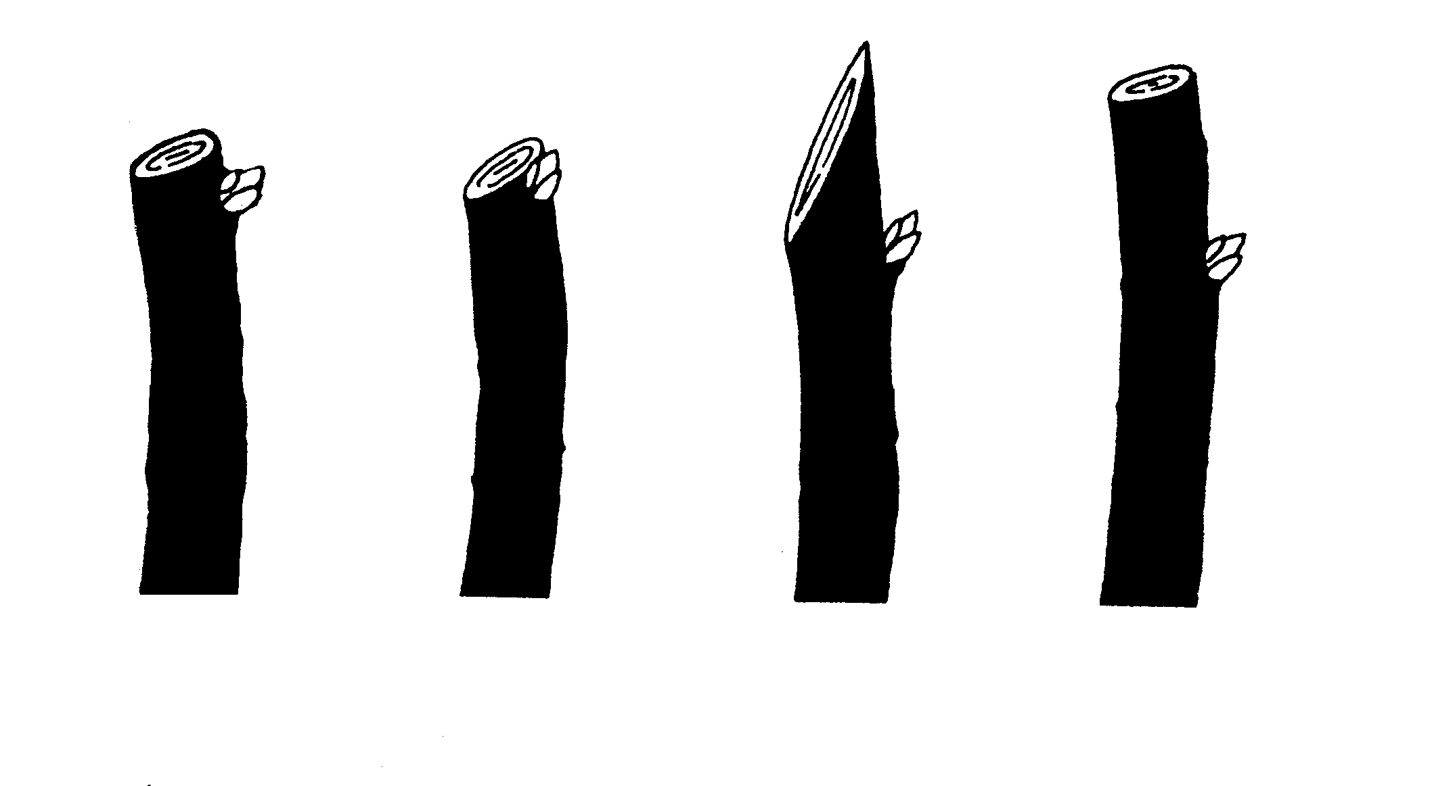
Pruning cuts
Leave at least 1/4” of the branch above the bud. (Far left is correct)

Slide 29
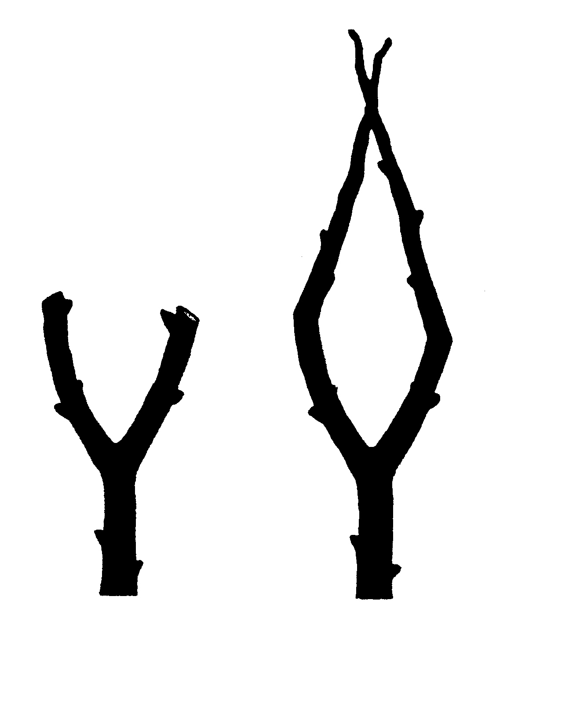
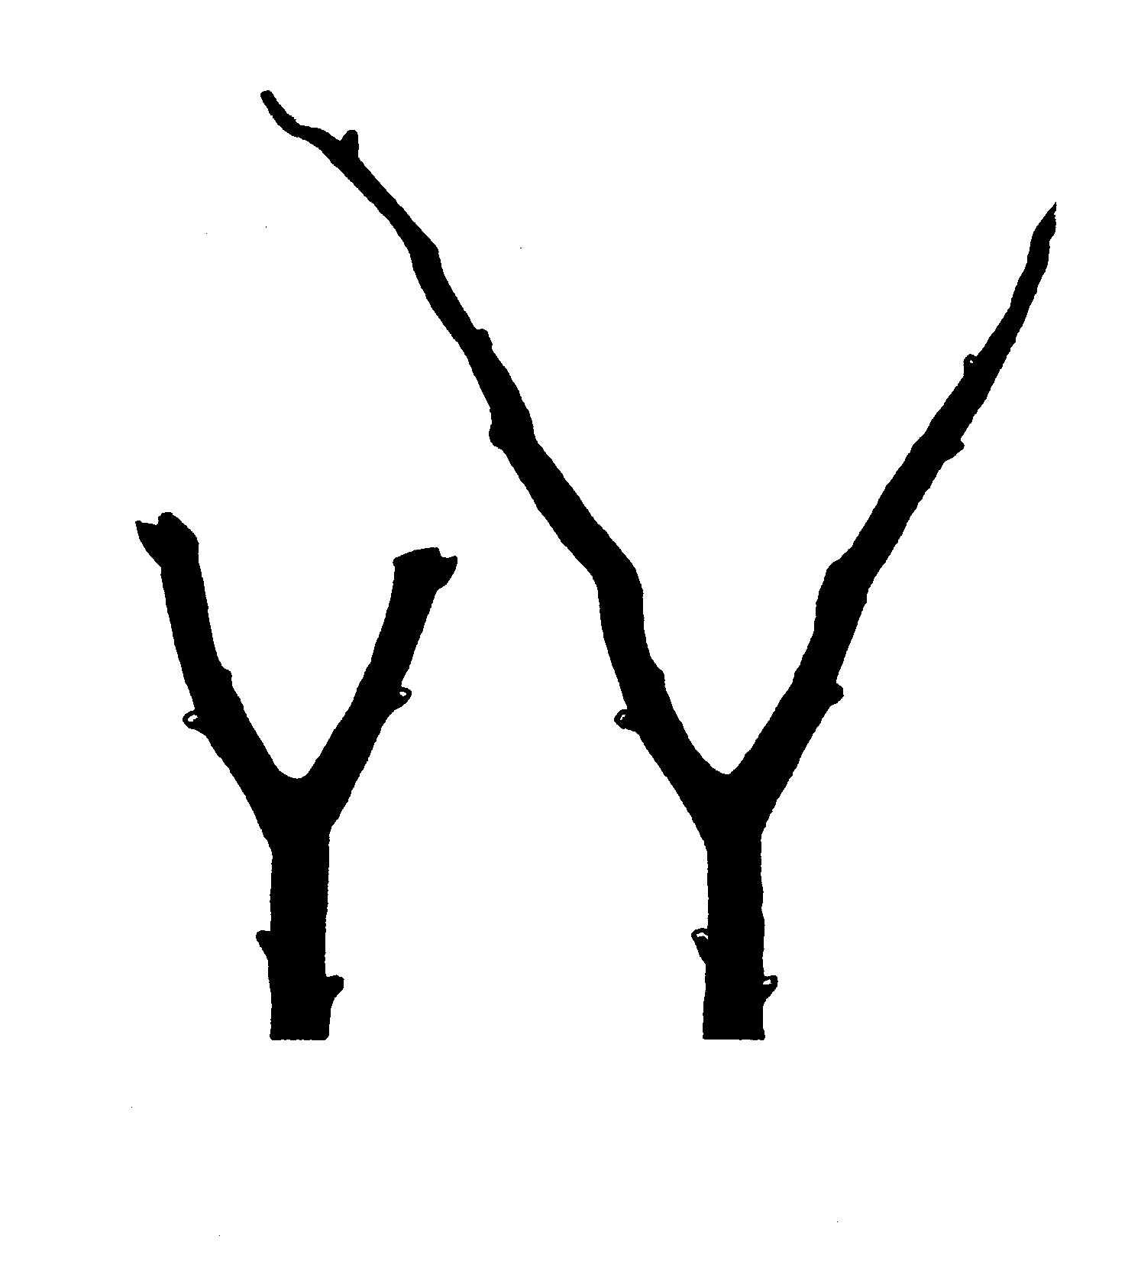
Pruning branches
Wrong way Right way

Slide 30
Pruning large limbs
To remove branches 3” or larger - use a 3-cut procedure.
Make an undercut first
Second cut off limb from top
3rd cut limb close to collar

Slide 31
Pruning hedges
Right way Wrong way

Slide 32
Renewal pruning

Slide 33
Recovery method for Crape Murder

Slide 34
Removing spent blooms
Old Crape Myrtle blooms are removed above newly forming buds or just below old blooms

Slide 35
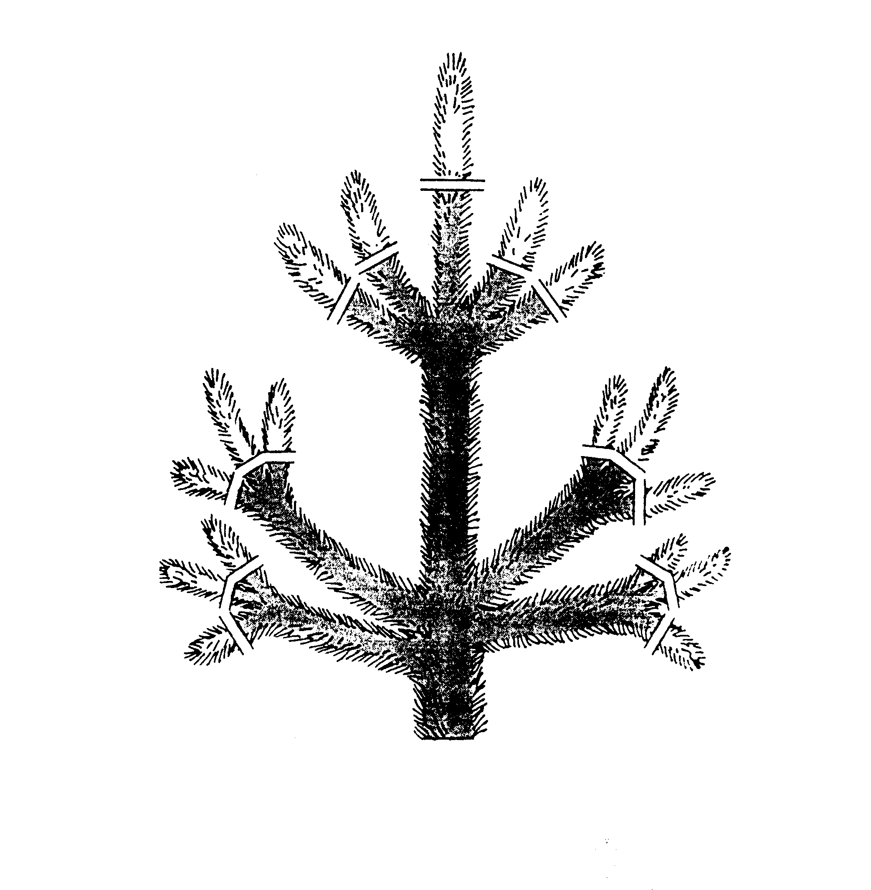
Pruning evergreens
Remove candles on top and sides of white pines to maintain a compact appearance.

Slide 36
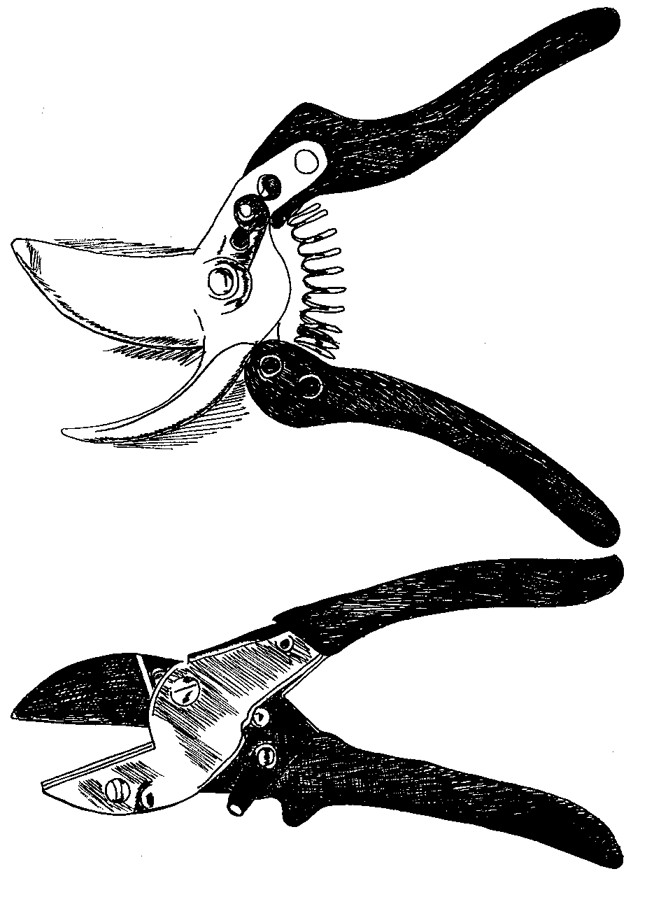
Pruning tools
Scissors
Anvil

Slide 37
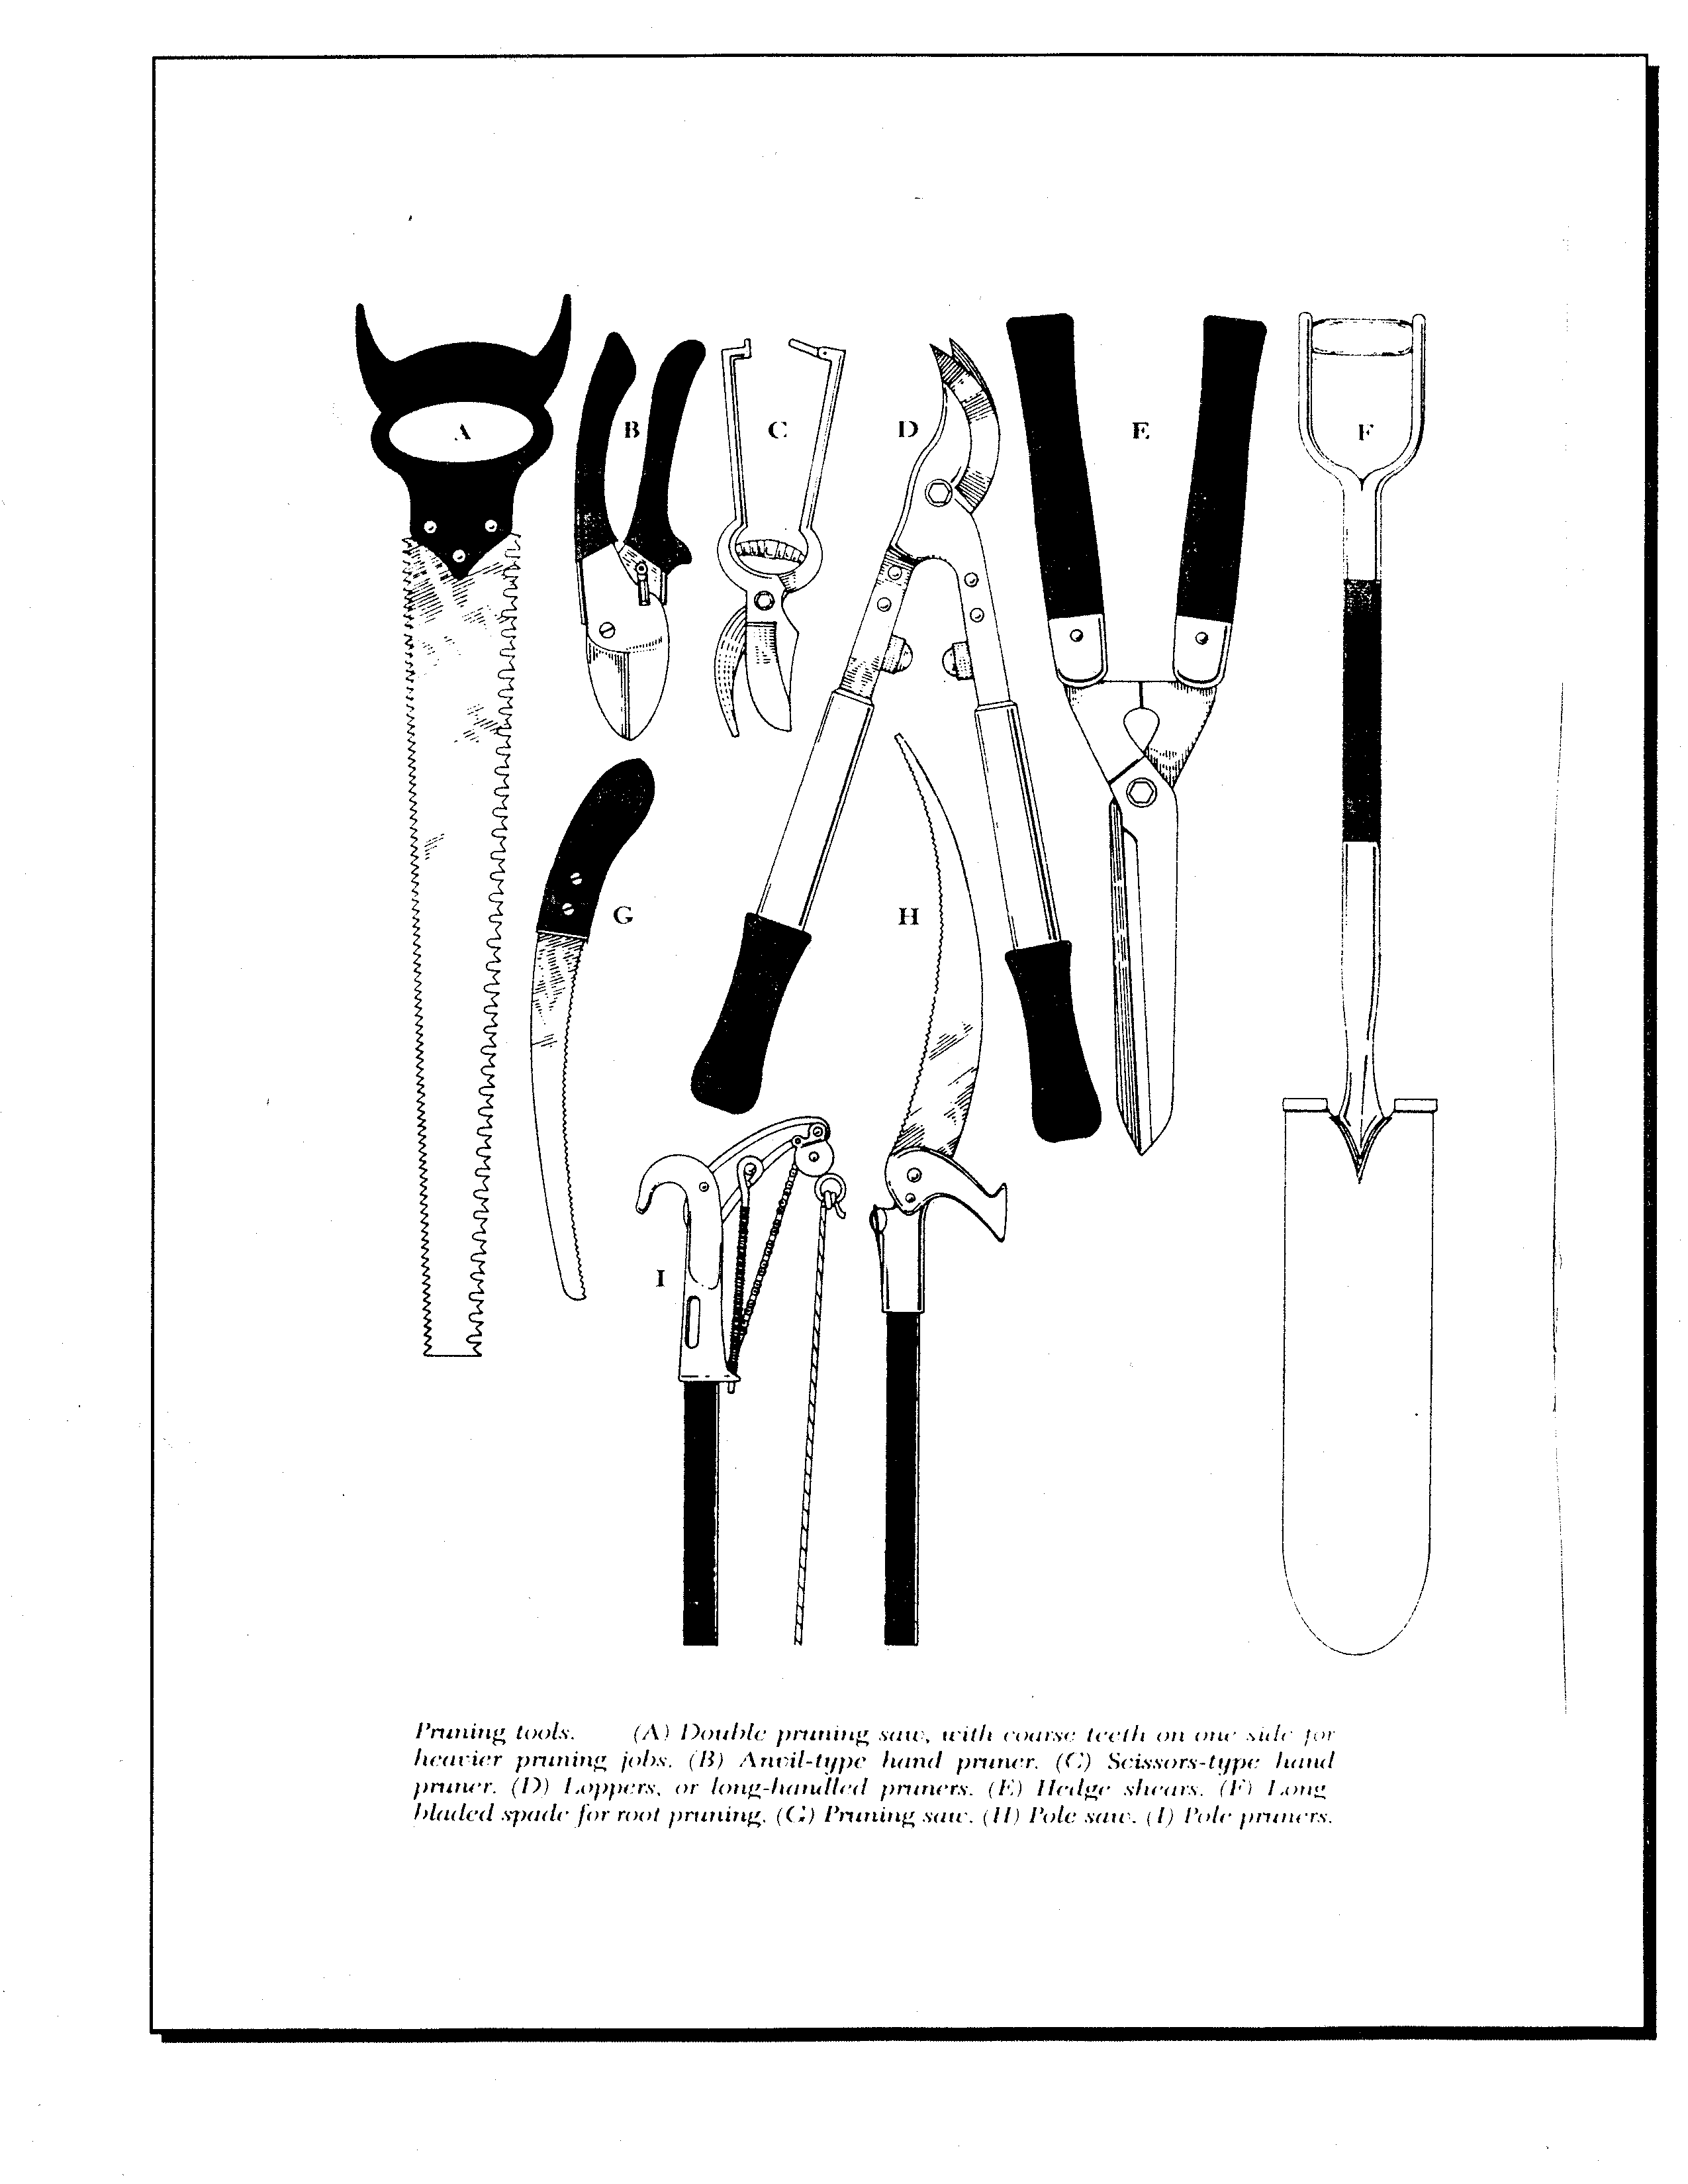
Pruning tools

Slide 38
Crape “Murder”
By
Dr. Gary W. Knox
University of Florida
Extension Specialist

Slide 39
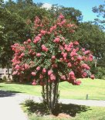
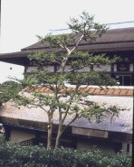
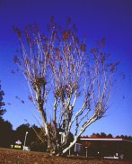
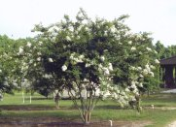
What’s the
“right” way
to prune?

Slide 40
Crape “Murder”:
Crape Myrtle
Growth, Flowering and Maintenance as affected by Three Pruning Methods

Slide 41
Plants Used:
Natchez (L. indica x fauriei)
Carolina Beauty (L. indica)

Slide 42
Plants Used:
All trees pruned to thin main stems and remove crossing branches in March 1998
Pruning treatments applied March 1998, 1999, 2000 and 2001

Slide 43
Questions to Answer:
How much work does each pruning method require?
How much after-care is needed during the summer?
What is the impact on flowering and growth?

Slide 44
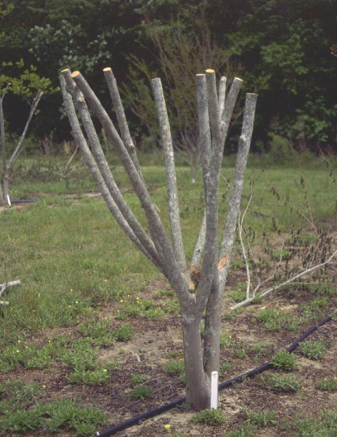
Pruning Treatments:
Topped “crape murder” Year 1

Slide 45
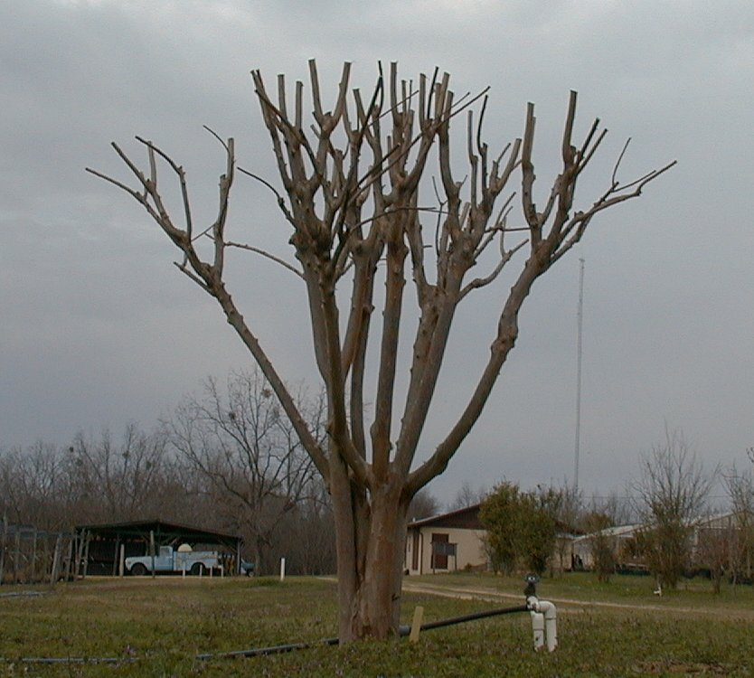
Pruning Treatments:
Topped “crape murder” Year 3

Slide 46
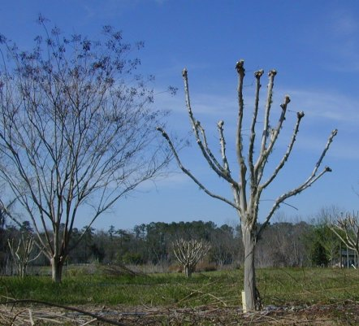
Pruning Treatments:
Pollarded
Year 1

Slide 47
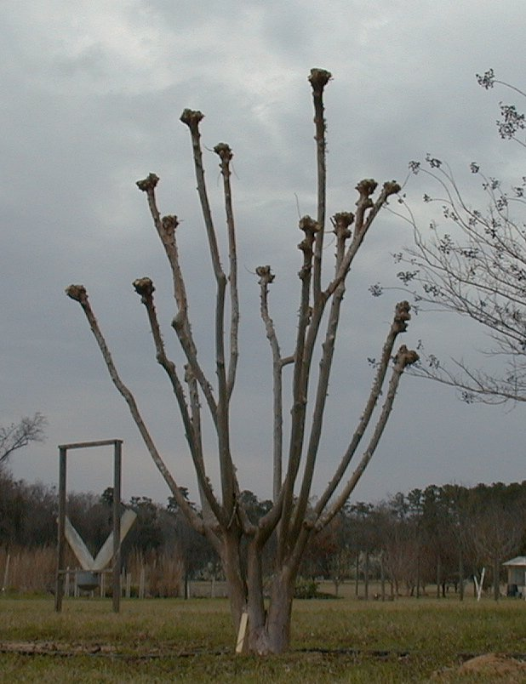
Pruning Treatments:
Pollarded
Year 3

Slide 48
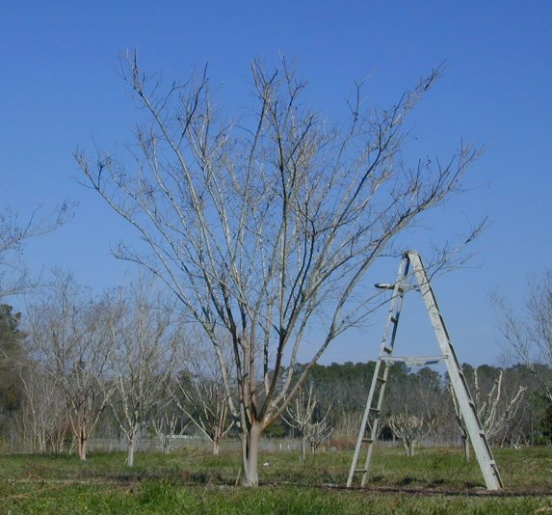
Pruning Treatments:
Pencil- pruned

Slide 49
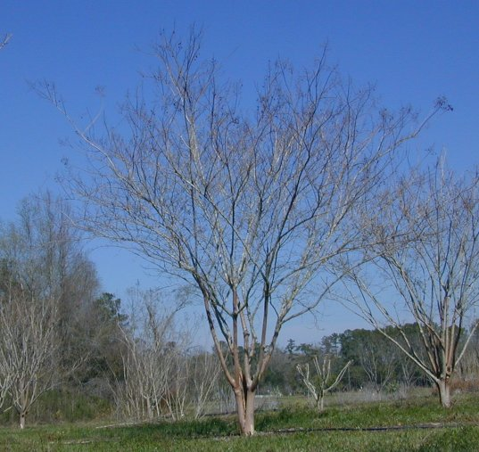
Pruning Treatments:
Unpruned

Slide 50
Pruning Treatments:
Topped “crape murder”
Pollarded
Pencil-pruned
Unpruned

Slide 51
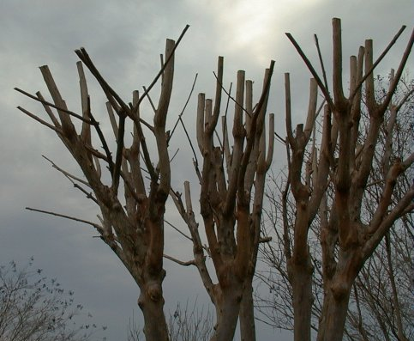
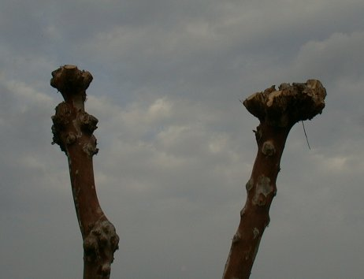
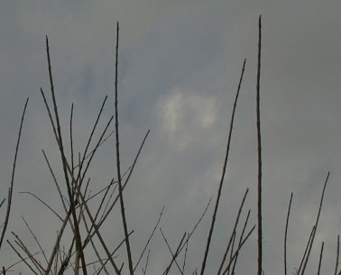
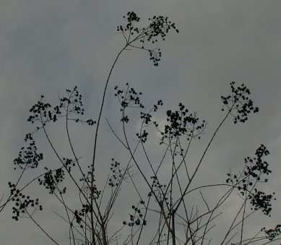
Pollarded
Topped
Pencil-pruned
Unpruned

Slide 52
How much work does each pruning method require?
Data collected:
Time to perform pruning
Number of cuts made
Average diameter of pruning cuts

Slide 53
Time and Number of Cuts for each Pruning Treatment, 1999
Data for both cultivars

Slide 54
How much after-care is needed during the summer?
Data Collected:
Number of stem, basal and root sprouts in June/July and August/September
Time required to remove sprouts

Slide 55
Number of Sprouts and Time to Remove Sprouts by Pruning Treatment, 1998
Sprout pruning performed July and September 1998; Data for both cultivars

Slide 56
Number of Basal, Root and Stem Sprouts, September 1998
Data for both cultivars

Slide 57
What is the impact on flowering and growth?
Data Collected:
Date of first flower and duration of flowering
Number of flower panicles per week
Size of flower panicles at peak bloom
Regrowth

Slide 58
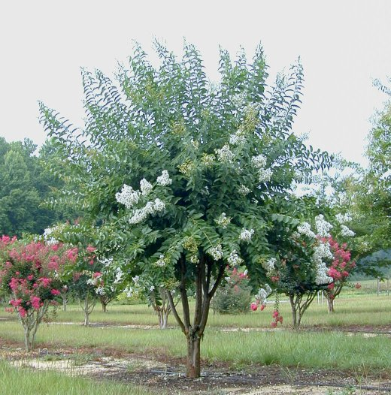
Topped Natchez

Slide 59
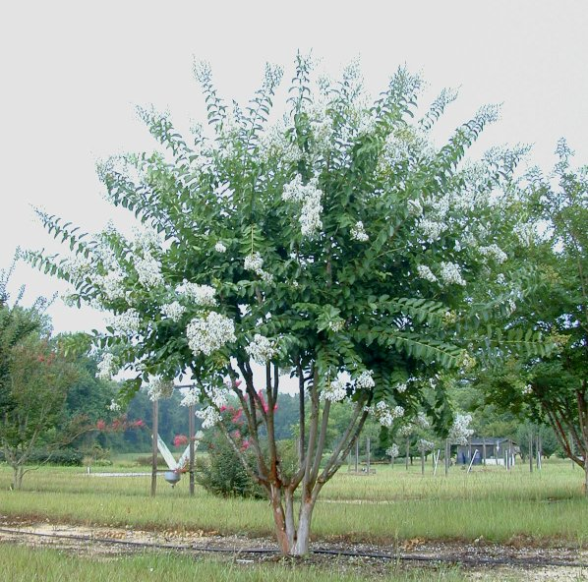
Pollarded Natchez

Slide 60
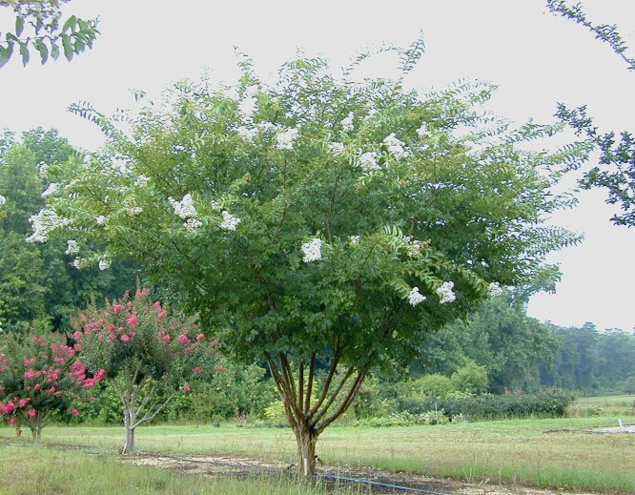
Pencil-pruned Natchez

Slide 61
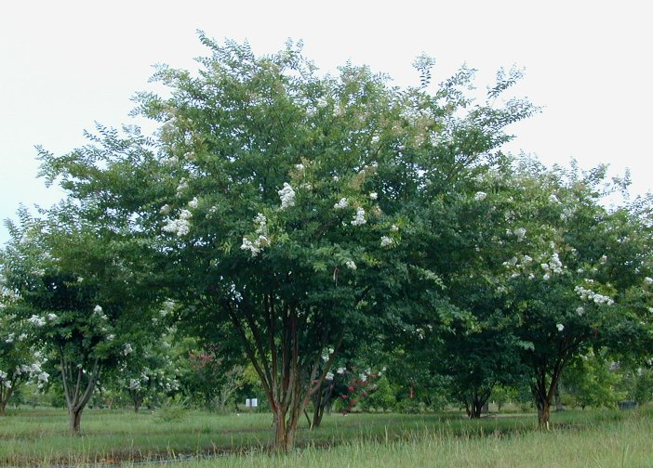
Unpruned Natchez

Slide 62
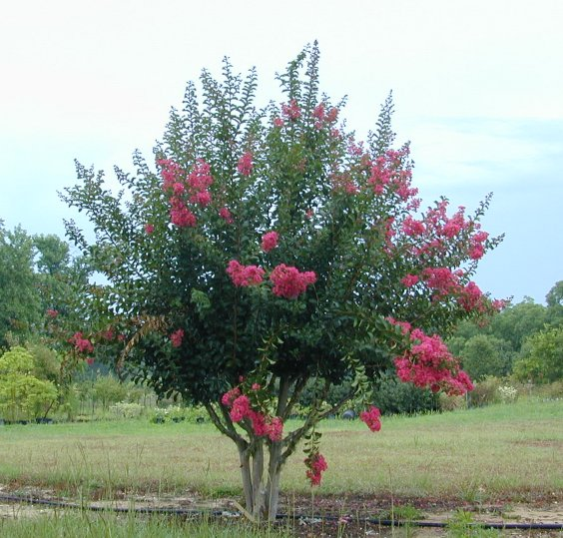
Topped Carolina Beauty

Slide 63
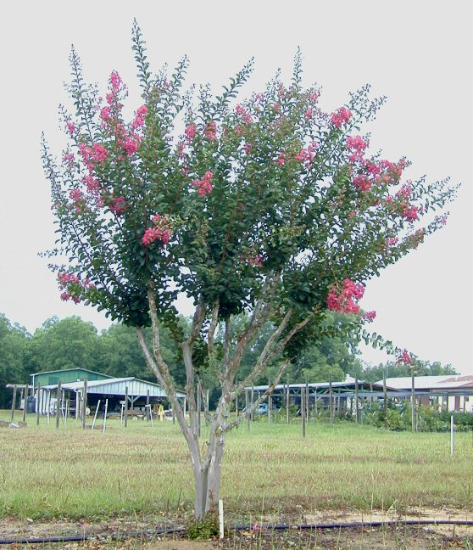
Pollarded Carolina Beauty

Slide 64
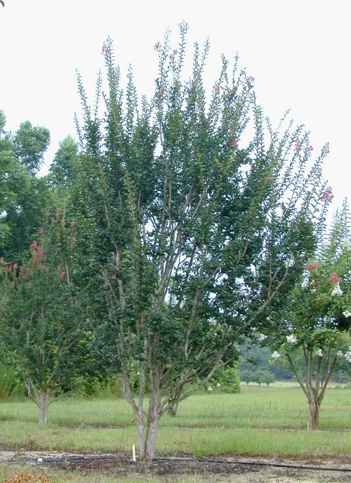
Pencil-pruned Carolina Beauty

Slide 65
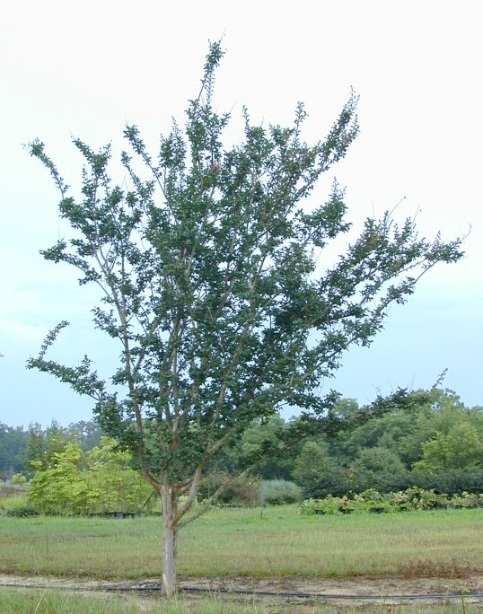
Unpruned Carolina Beauty

Slide 66
Topped
Pollarded
Pencil-pruned
Unpruned

Slide 67
Topped
Pollarded
Pencil-pruned
Unpruned

Slide 68
pencil
pruning
control
Natchez - Summer 1999
Number of flower panicles
topped
pollard

Slide 69
pencil
pruning
control
Carolina Beauty - Summer 1998
Number of flower panicles
topped
pollard

Slide 70
Natchez
Flower size (cm³)

Slide 71
Carolina Beauty
Flower size (cm³)

Slide 72
Generalizations Thus Far:
Unpruned trees require the least overall “work”
Pencil-pruning and Pollarding take more time than Topping
Topping and Pollarding stimulate more sprouts; I.e., the harder you prune, the more you stimulate sprouting

Slide 73
Generalizations Thus Far:
The harder you prune, the more you delay flowering
Natchez: Hard pruning reduces number of flowers and slightly increases flower size
Carolina Beauty: Pruning had no clear effect on number of flowers; topping reduced flower size

Slide 74
What’s the “right” way to prune?
It depends on:
Amount of time available for winter pruning
Skill of the the worker
Desired plant size
Preferred winter appearance
Preferred summer appearance

Slide 75
Topped
Pollarded
Pencil-pruned
Unpruned

Slide 76
What’s the “right” way to prune?
Recommendations:
To avoid constant, severe pruning, plant the right-sized cultivar for the plant’s location in the landscape
To minimize plant structural damage and risk of disease, leave plants unpruned
Otherwise prune according to your preferences for winter appearance and summer appearance

Slide 78
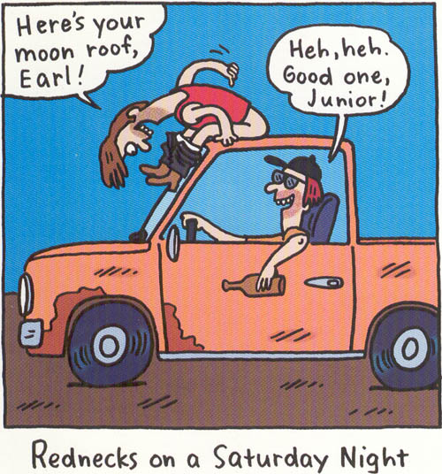
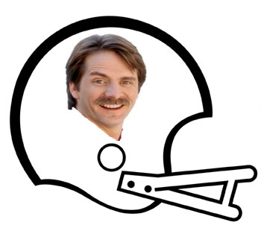
More REDNECK Pics
Redneck ATV Transporter
Redneck RV

Slide 79
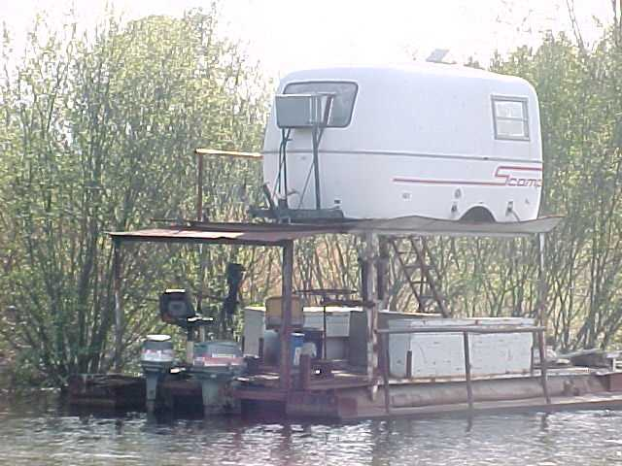
Redneck Limo
Redneck RV
Redneck Houseboat

Slide 81
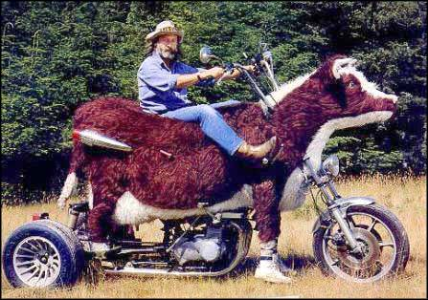
What kind of motorcycle is this?

Slide 82
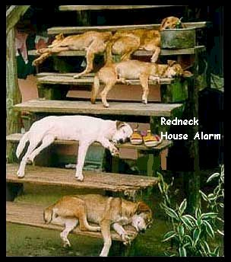
What do we call this?

Slide 83
What do you call this?

Slide 84
Here’s your sign!!! What’s this thing?

Slide 85
Why Fat Boys Don’t Exercise!!!

Slide 86
Thank you! Questions?

Slide 87
