Slide 2
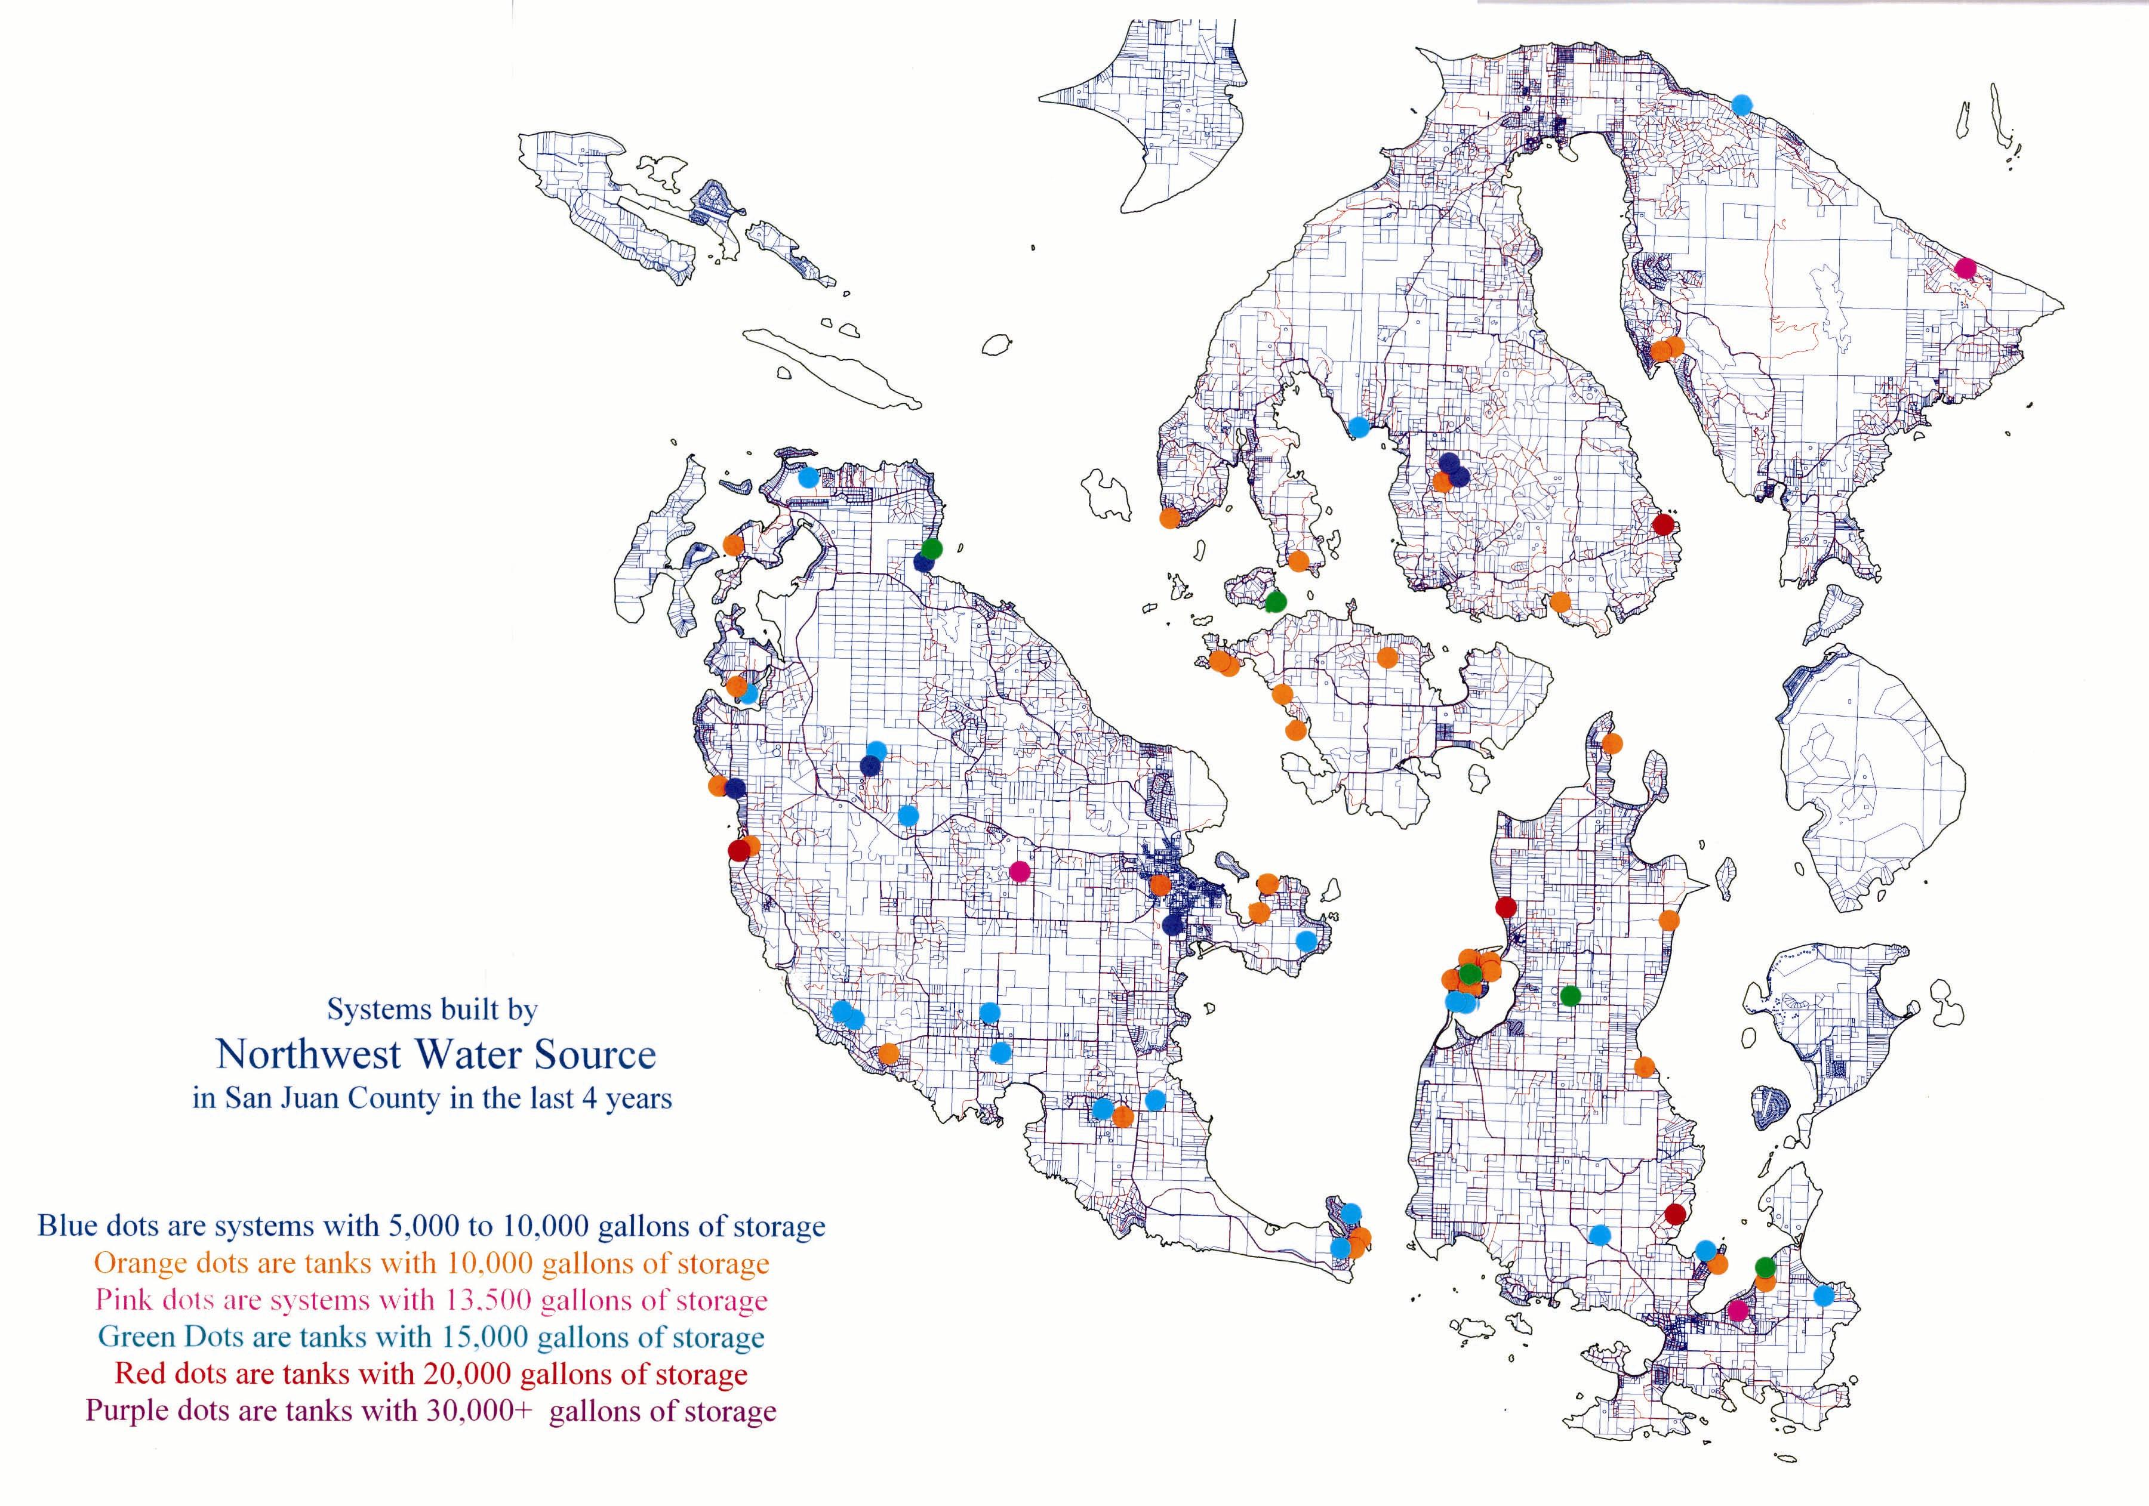

Slide 3
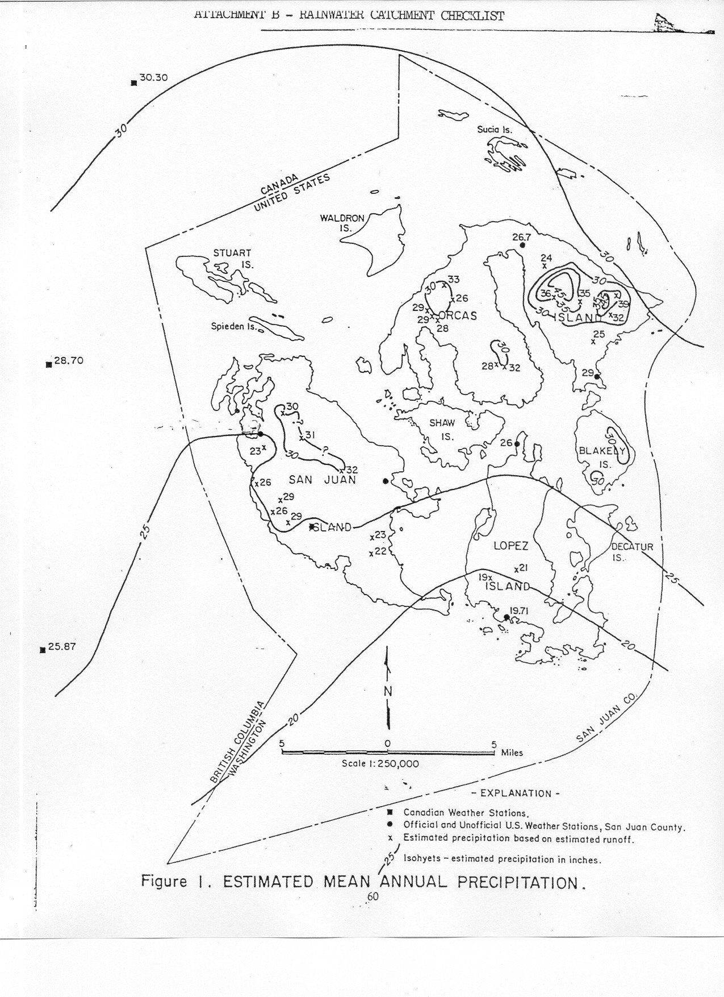

Slide 4
Siting of installations

Slide 5
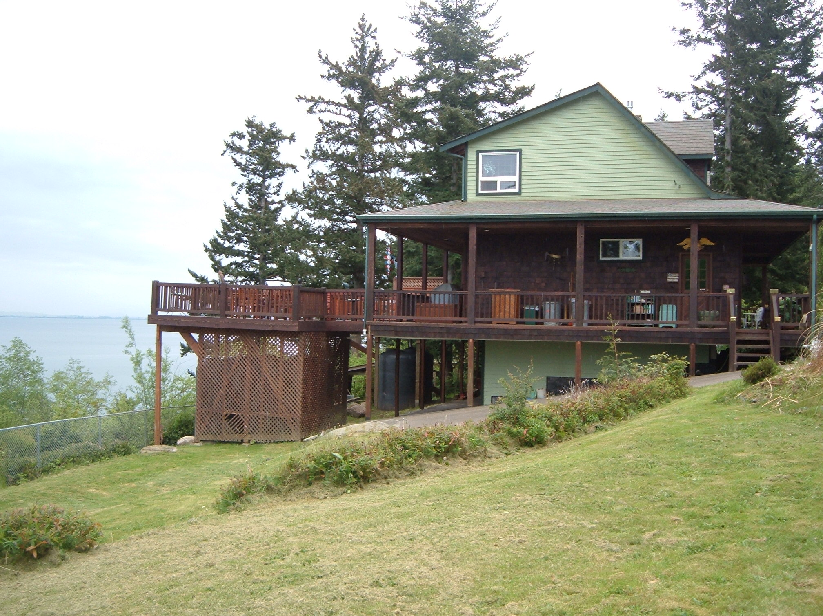
Guemes Is. Wa., 9000 gal

Slide 6
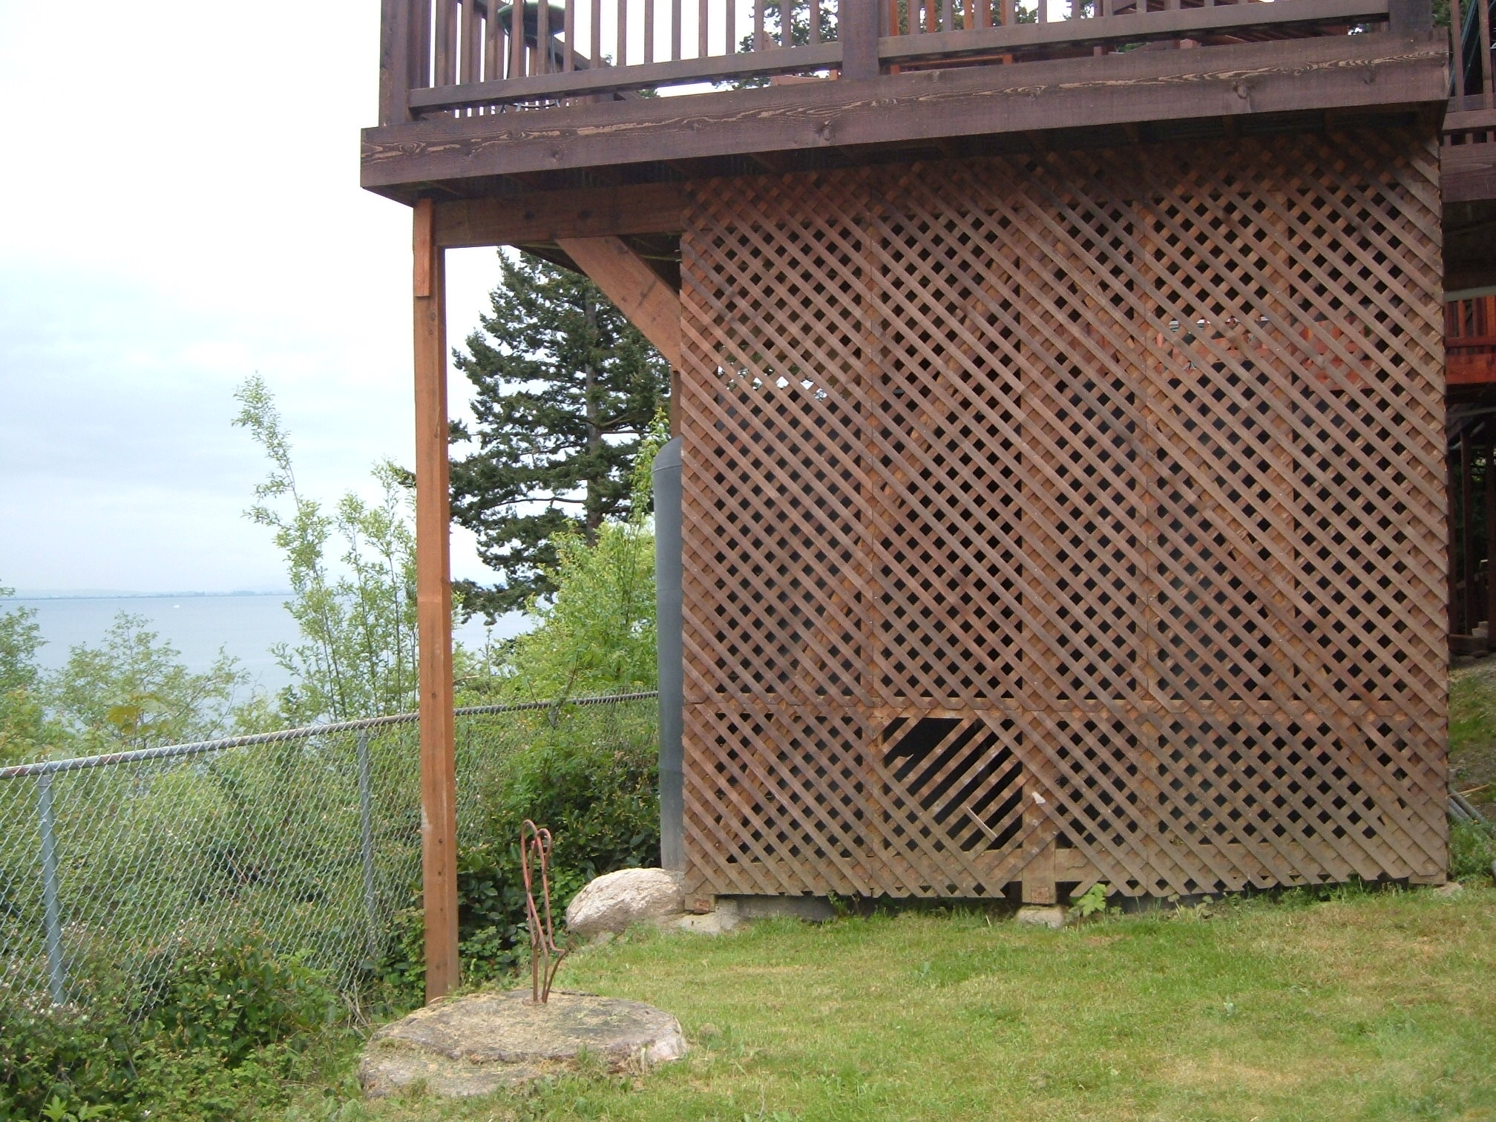
4@1440 gallon tanks under deck

Slide 7
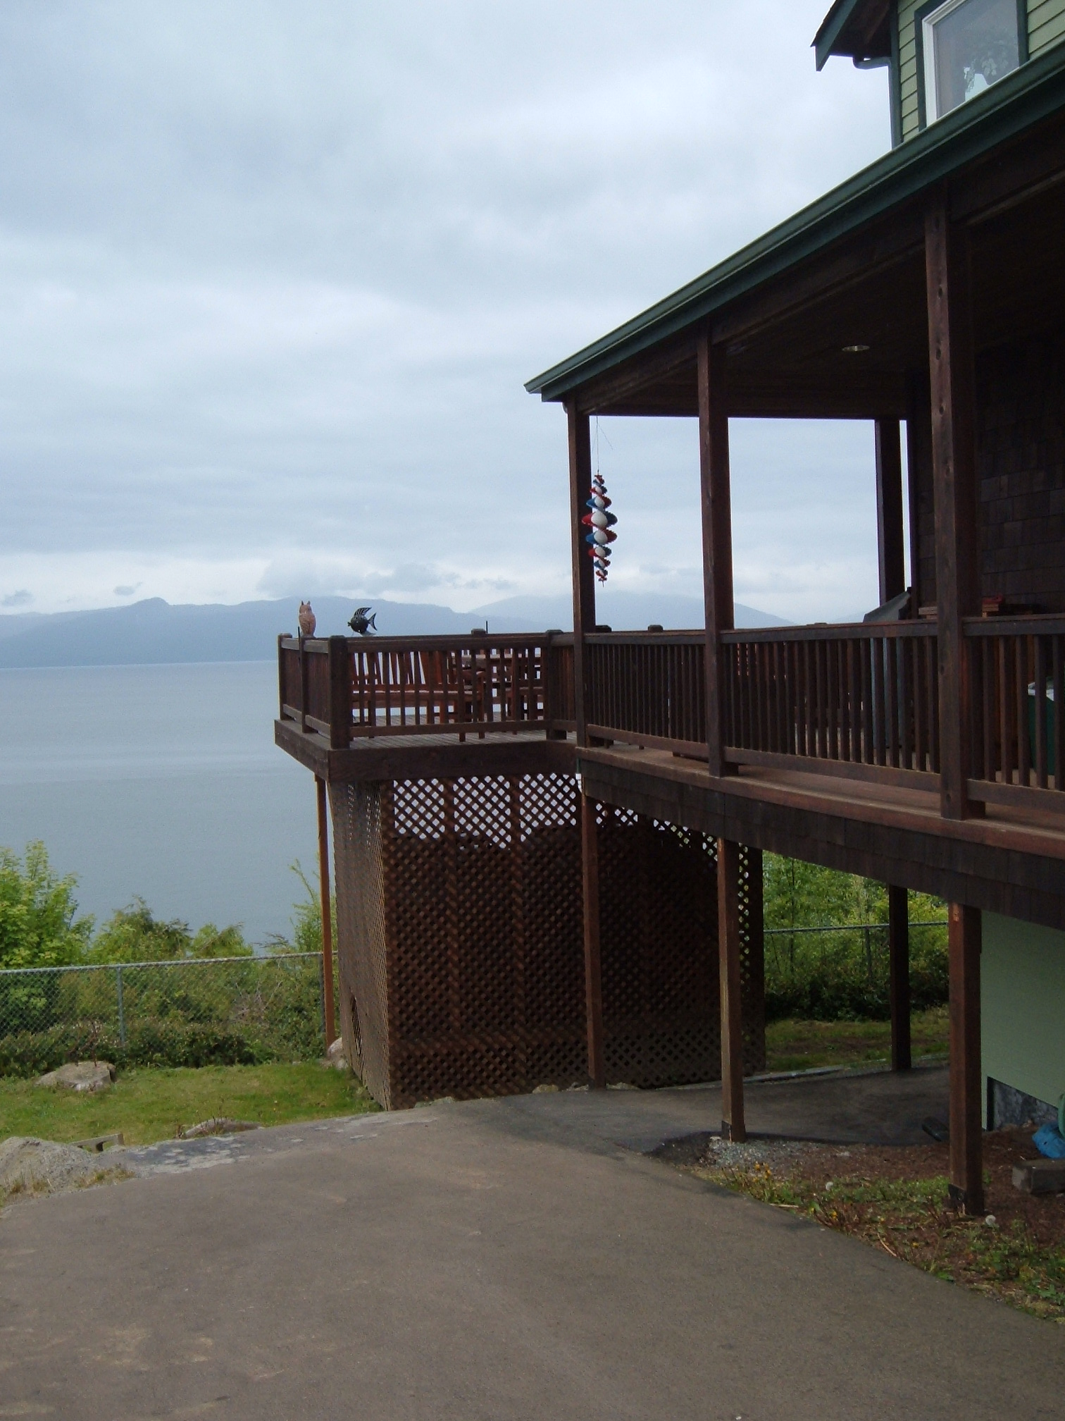

Slide 8
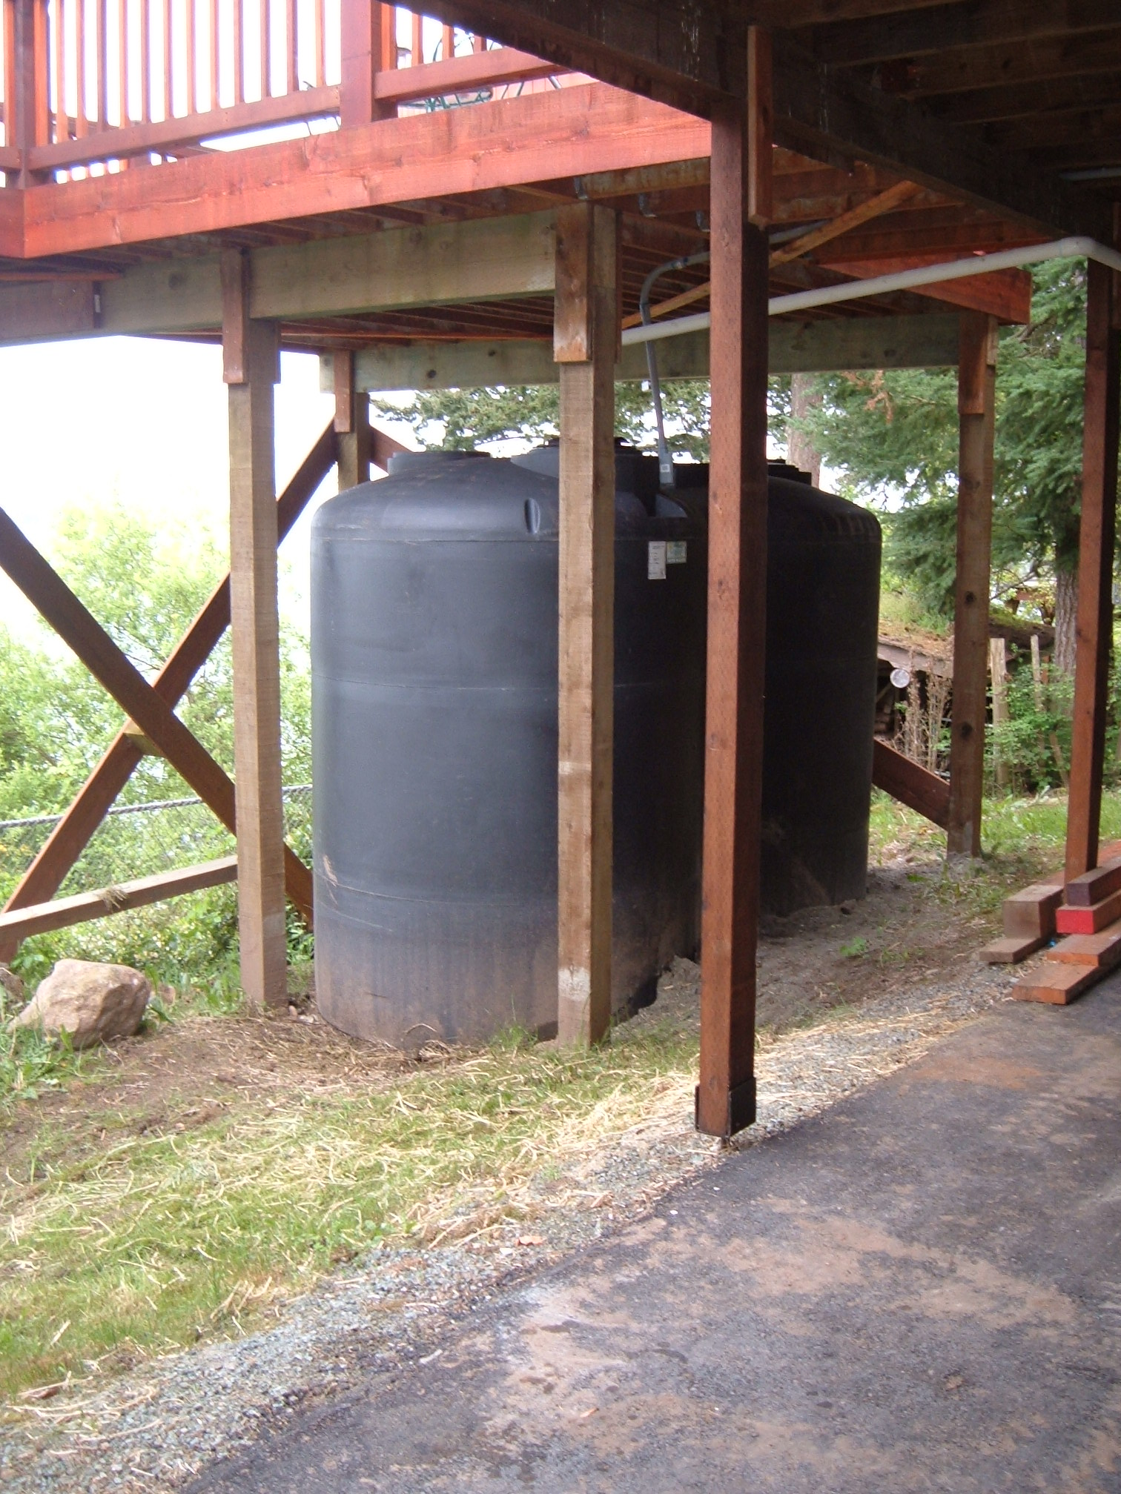
2 additional 1440 gal tanks under other end of deck

Slide 9
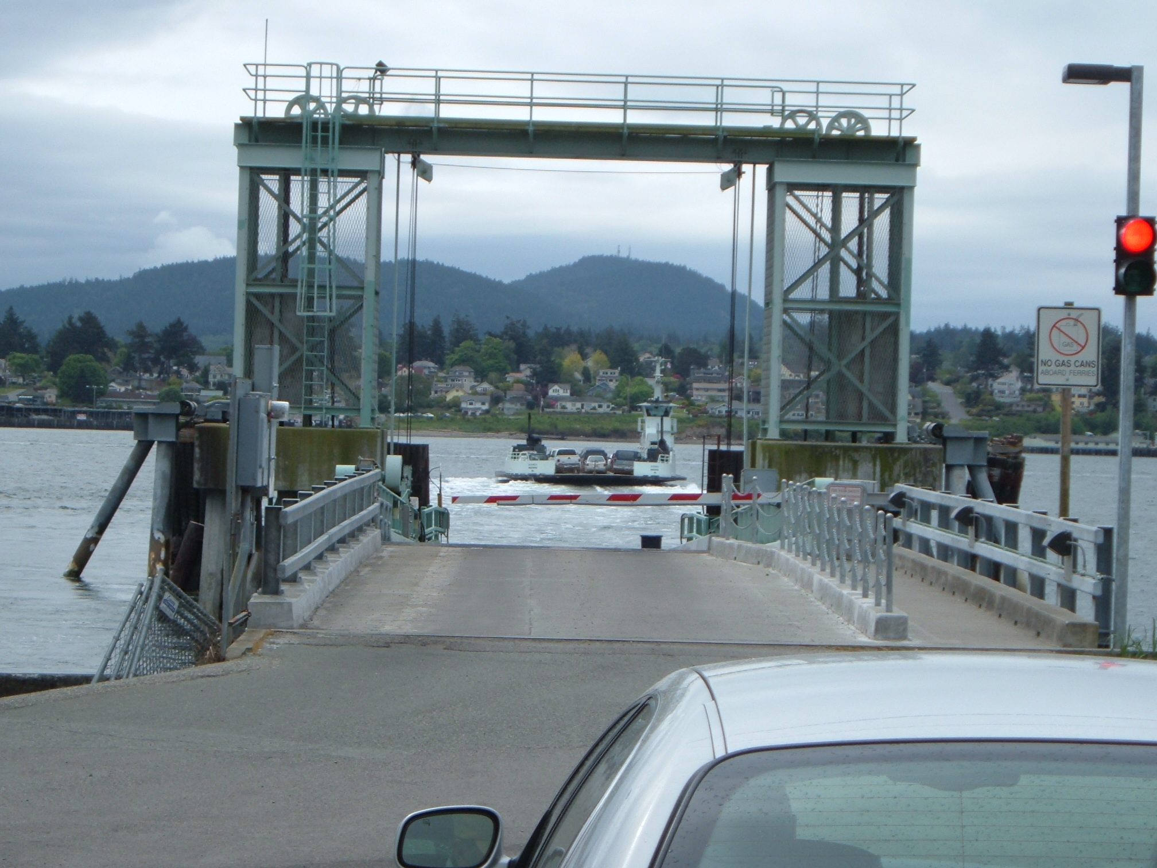
Sometimes logistics add challenges

Slide 10
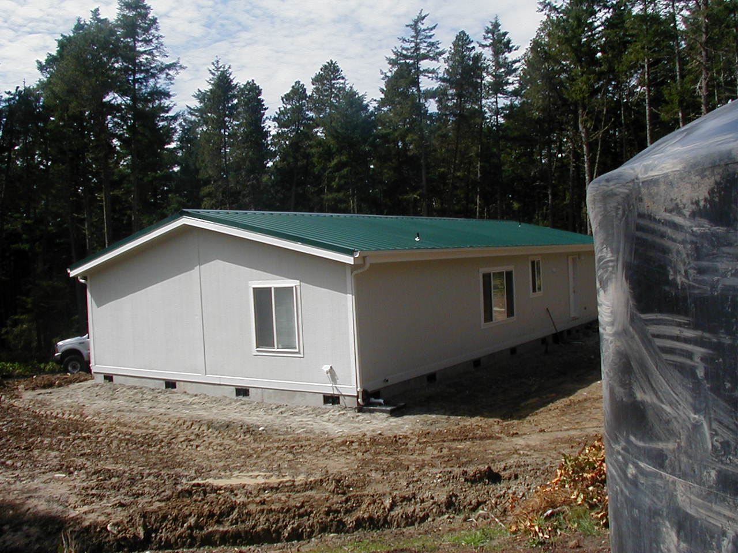
Manufactured home
Lopez Island

Slide 11
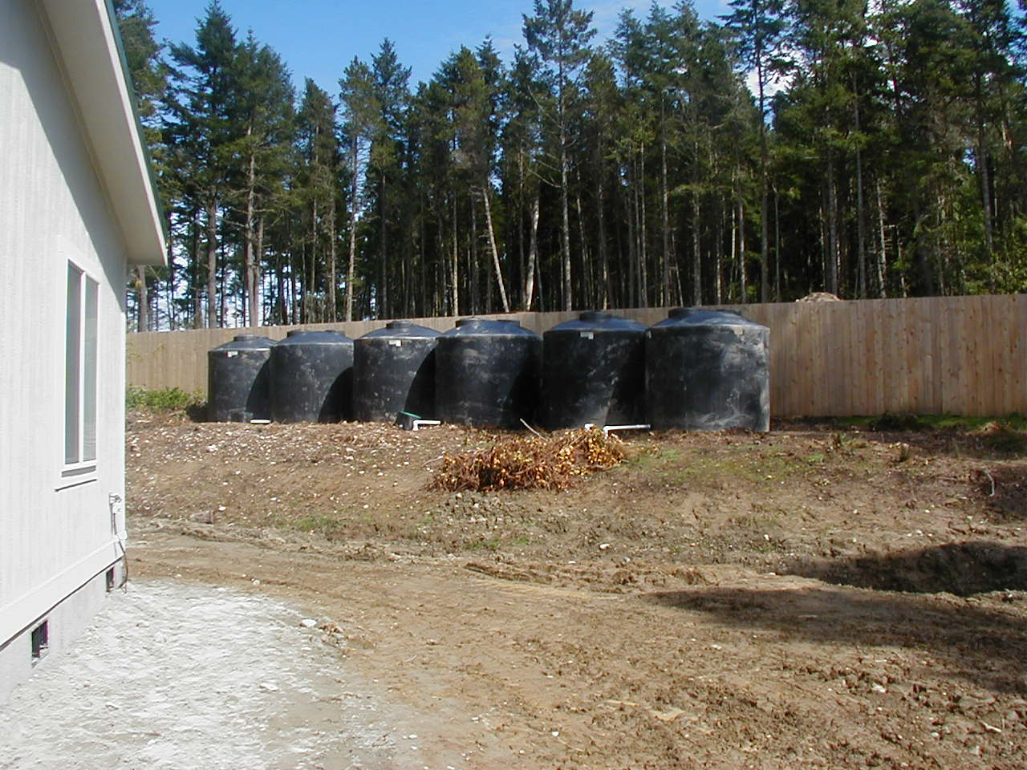
14040 gallons storage, Manufactured home
Lopez Island.

Slide 12
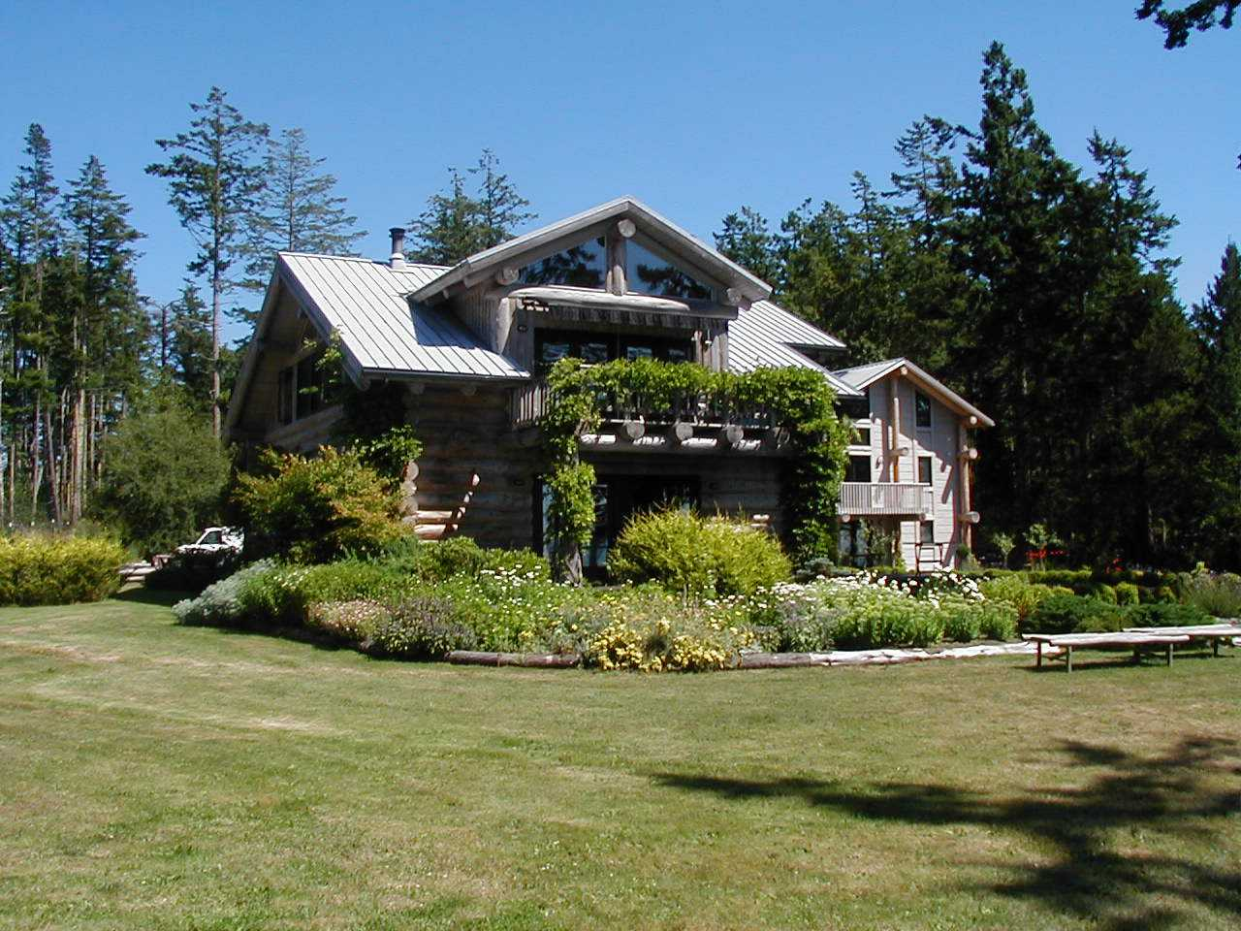
5000 sq. ft., Lopez Island

Slide 13
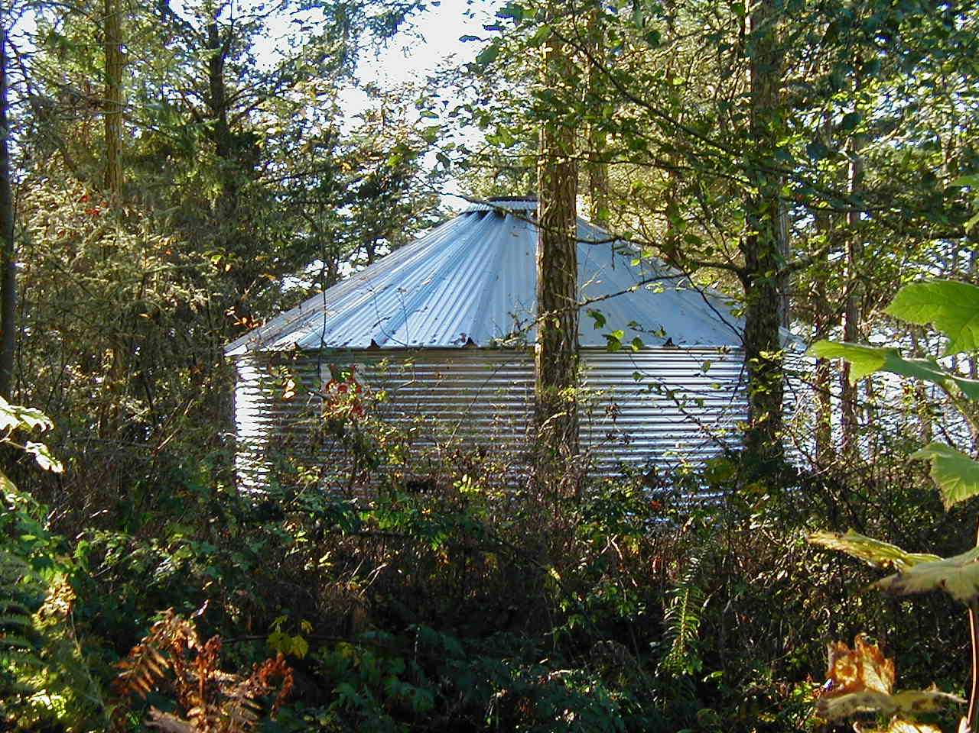
20,000 gallons

Slide 14
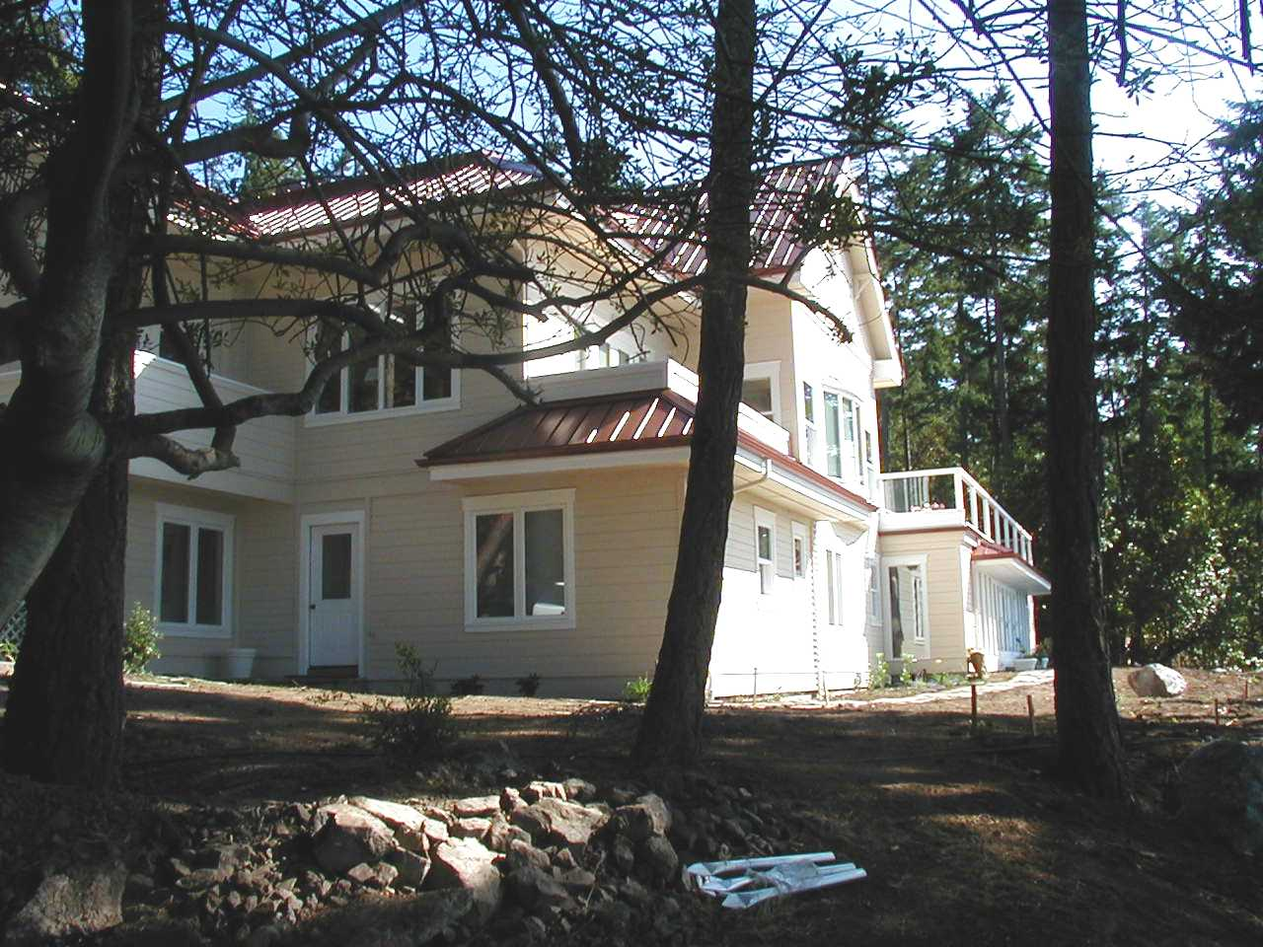
6,500 sq. ft., San Juan Island

Slide 15
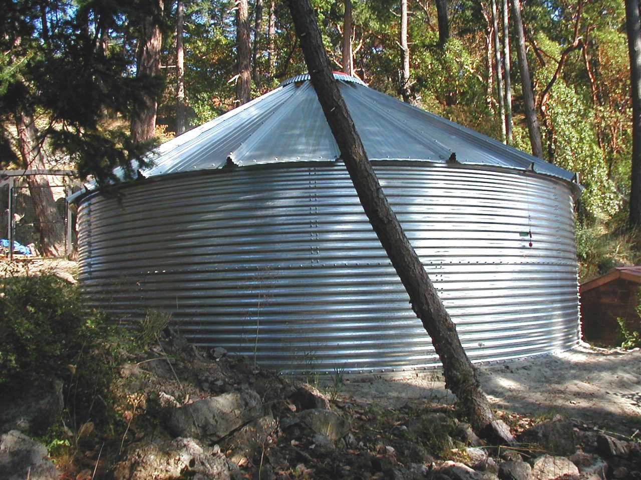
20,000 gallons

Slide 16
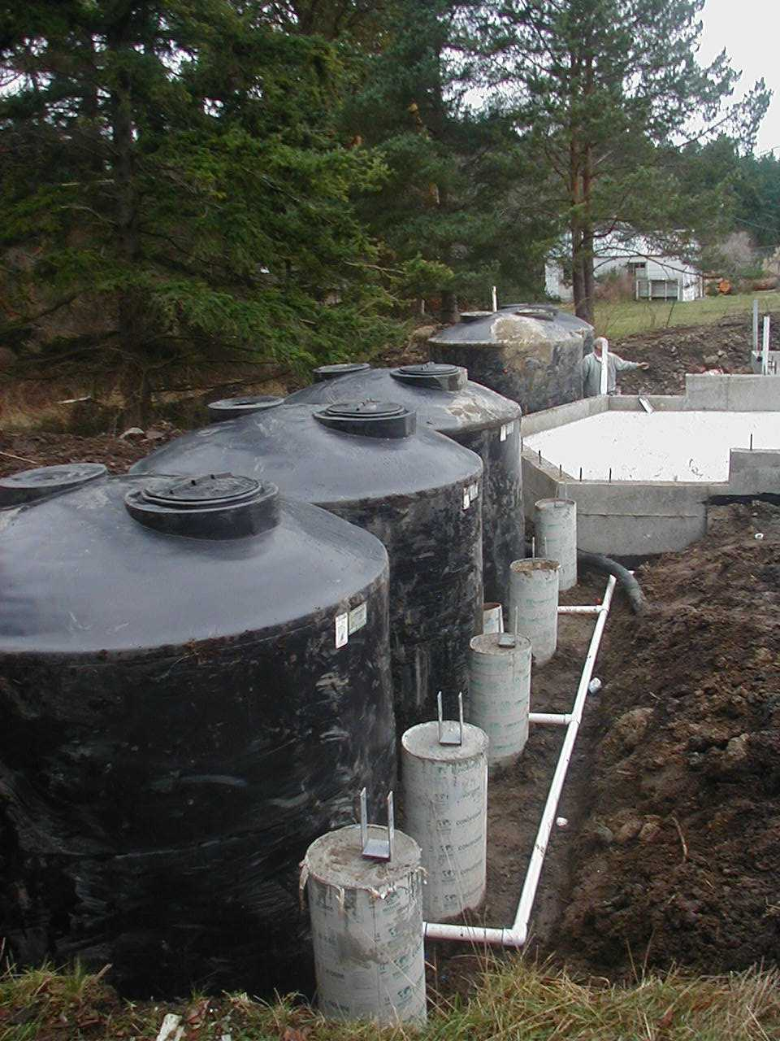
11,700 gallons, new construction
located under future deck

Slide 17
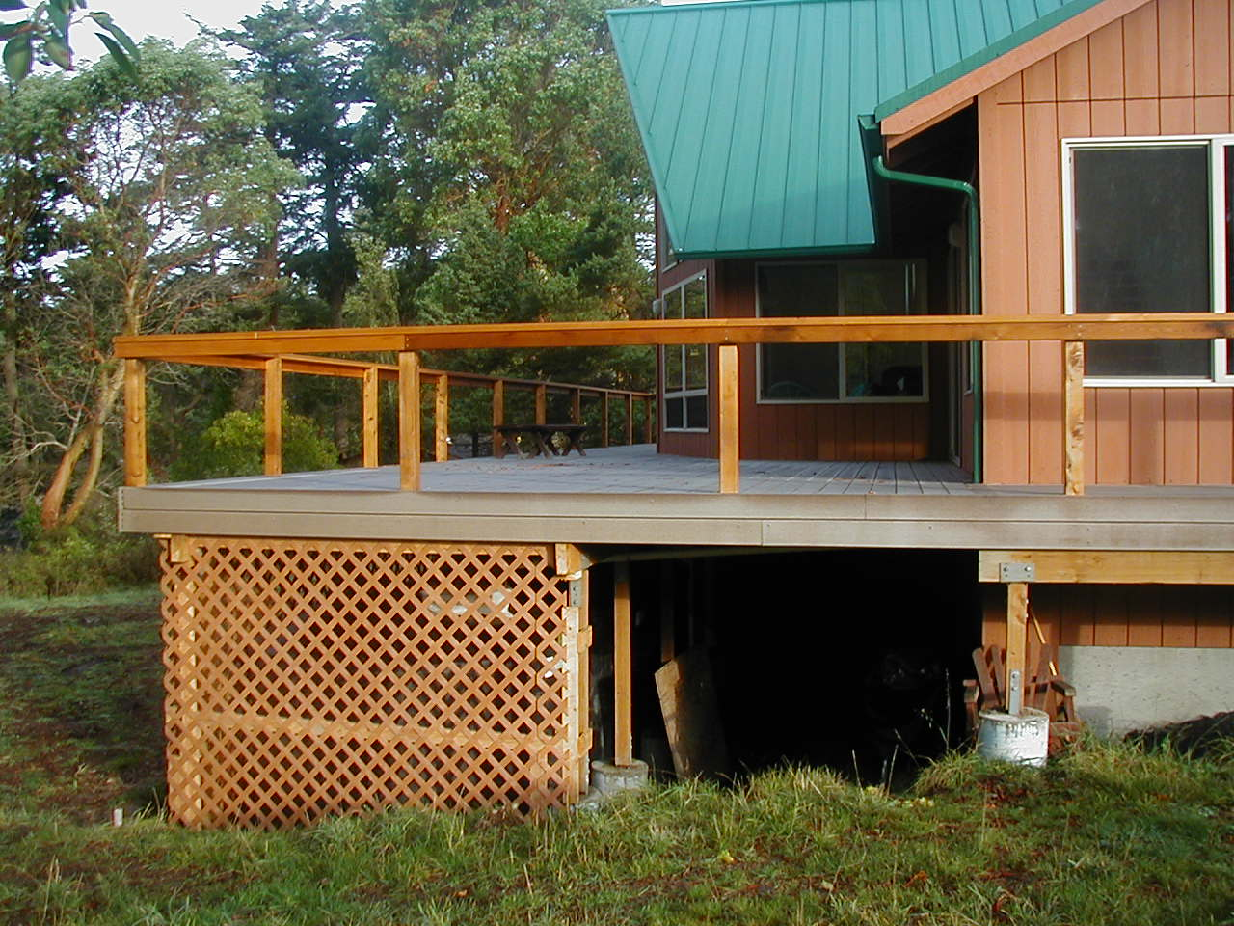
located under new deck

Slide 18
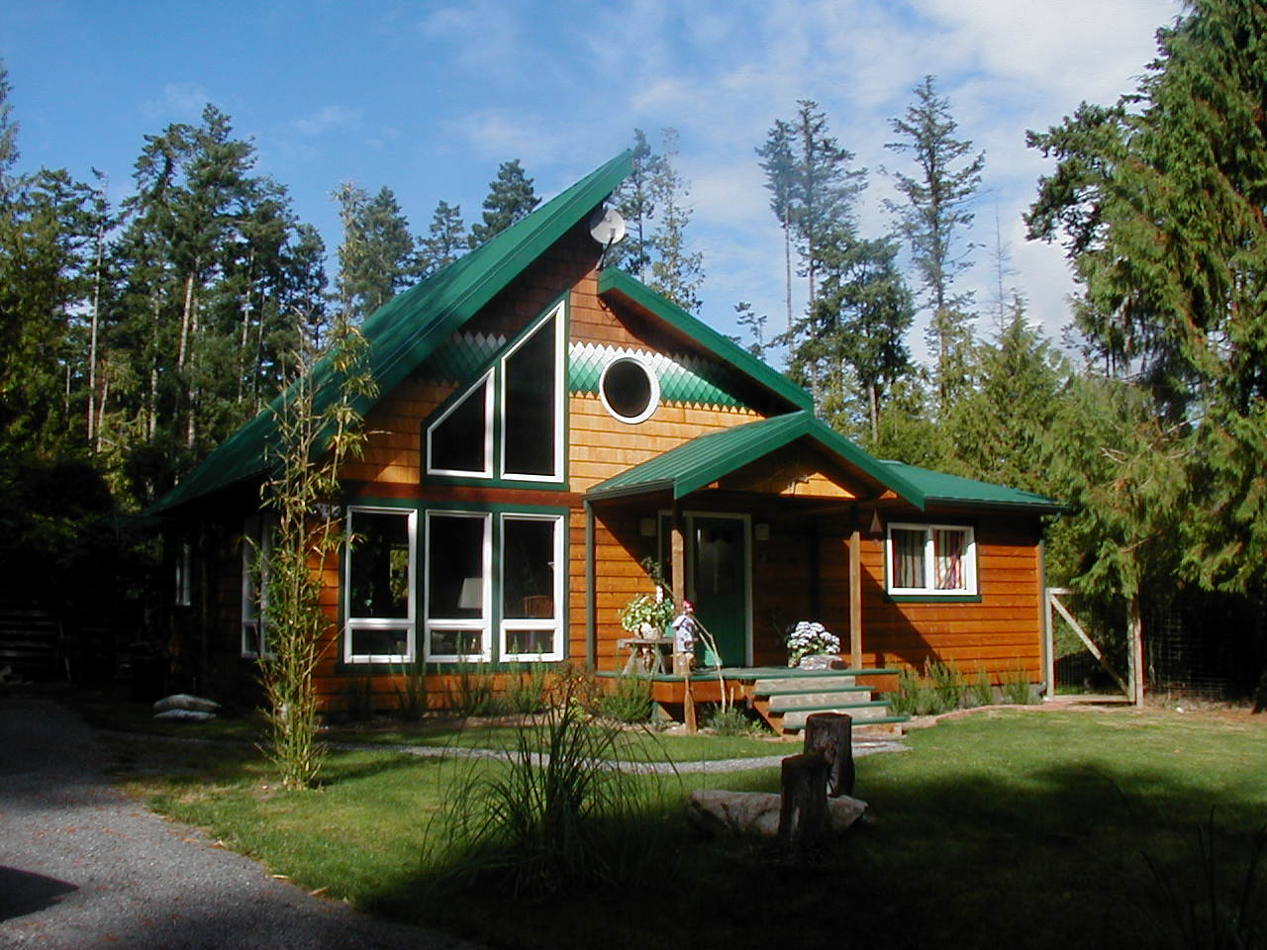
Forest Cabin Shaw Island
Tanks to right in blackberries

Slide 19
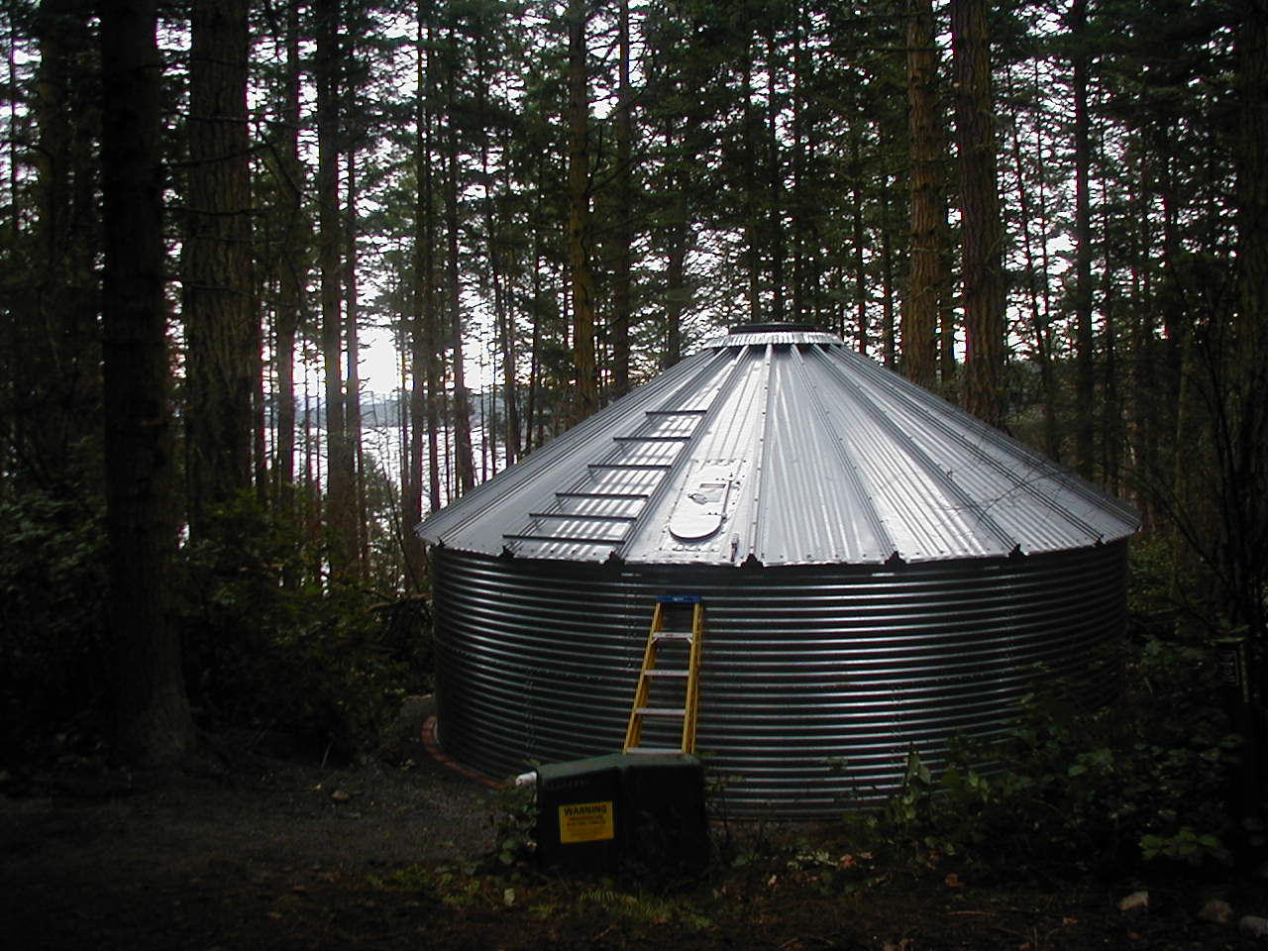
30,000 gallons storage
Lopez Island

Slide 20
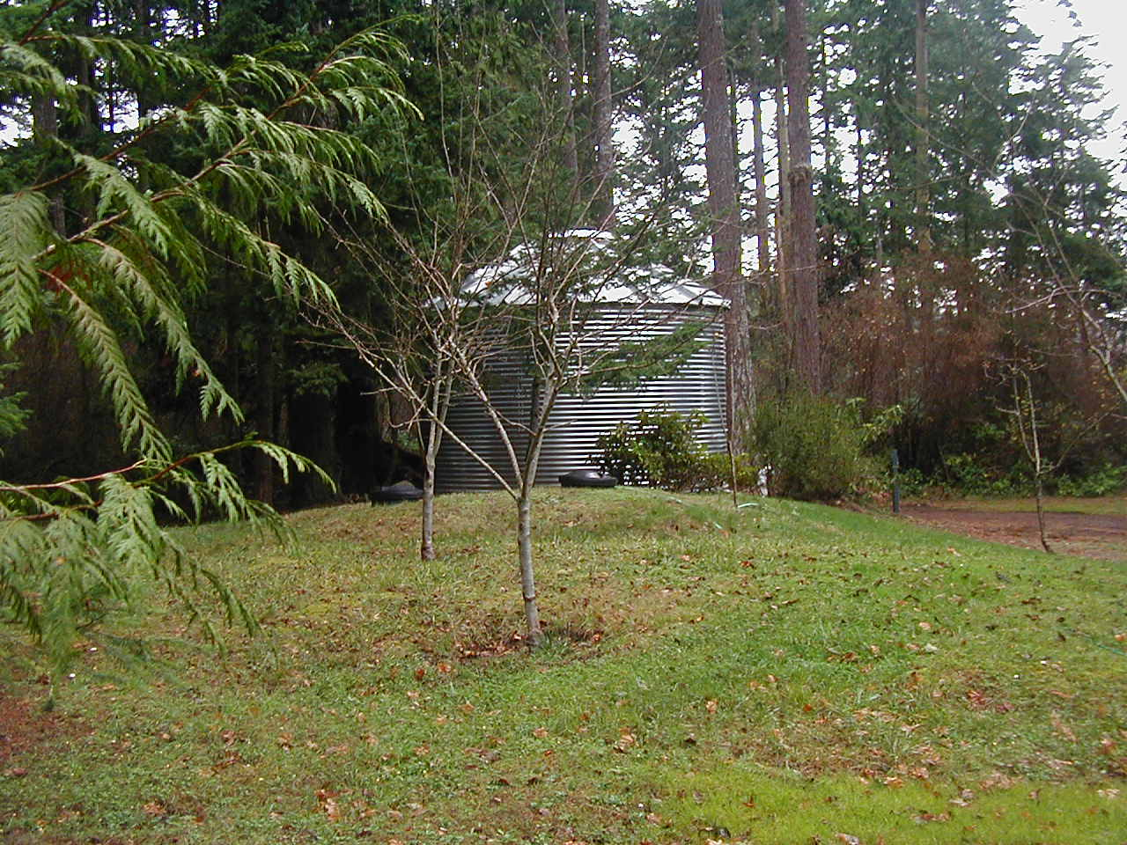
15,000 gallon tank San Juan Is.

Slide 21
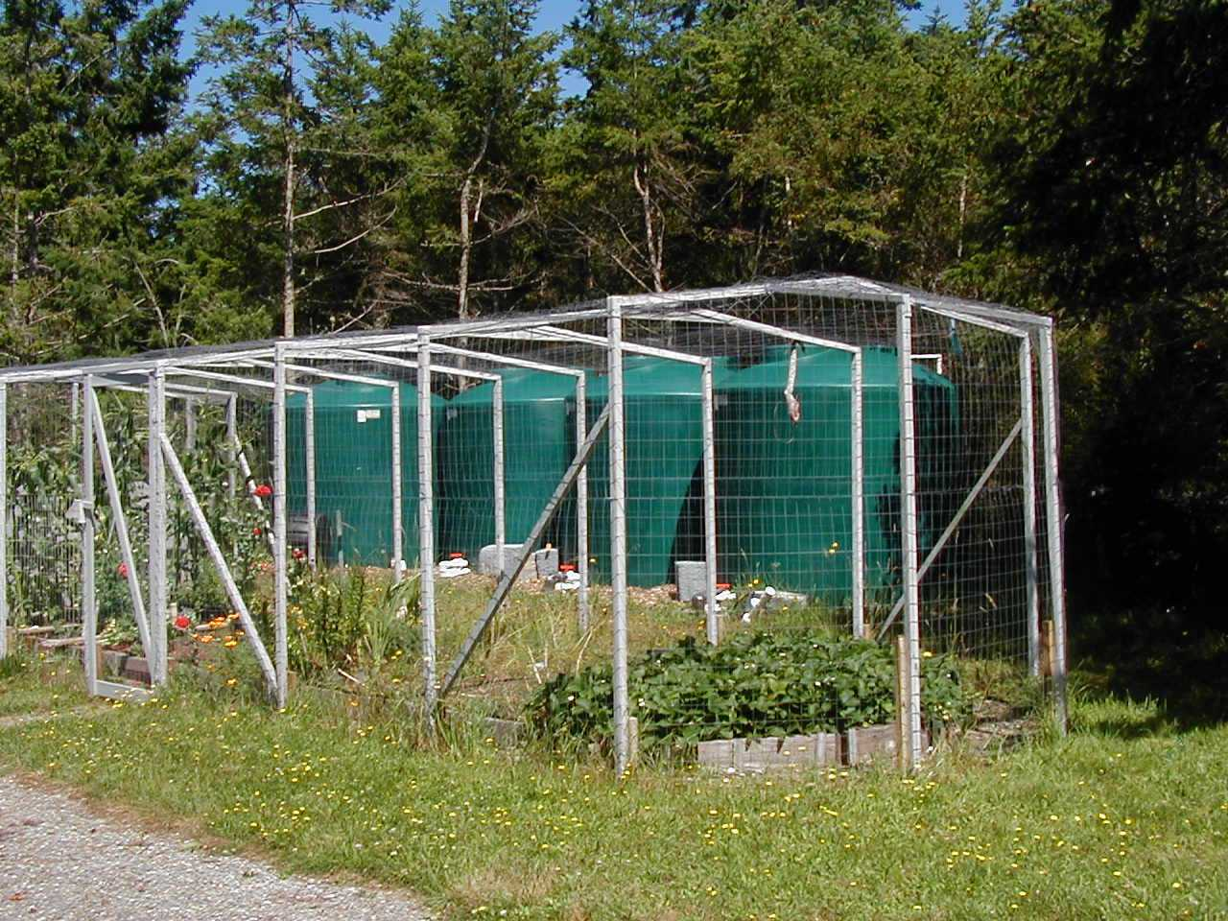
4 @2340 gallon tanks
9600 gallons

Slide 22
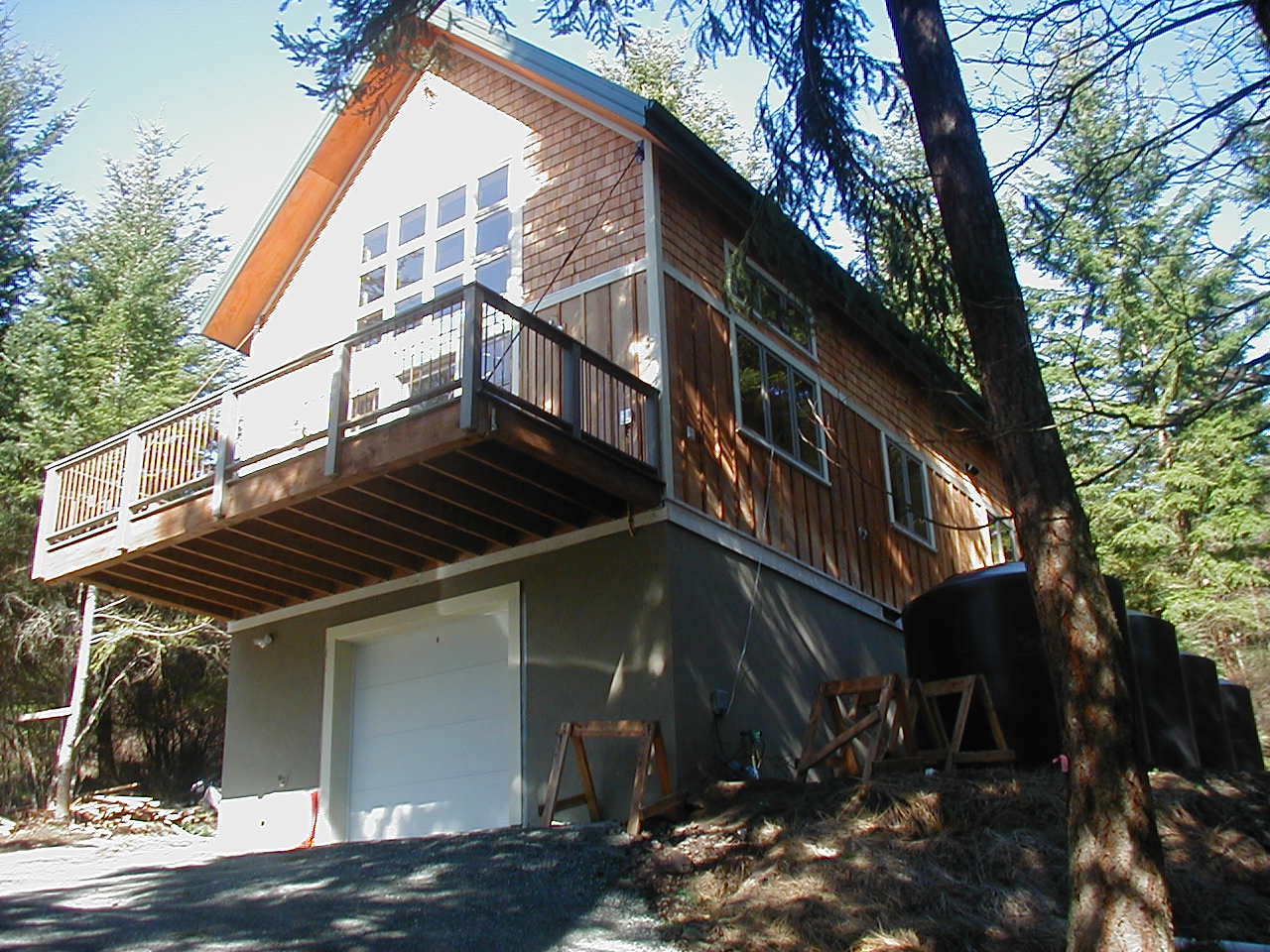
As seen in July 2003 Sunset Magazine
Orcas Island rental cabin

Slide 23
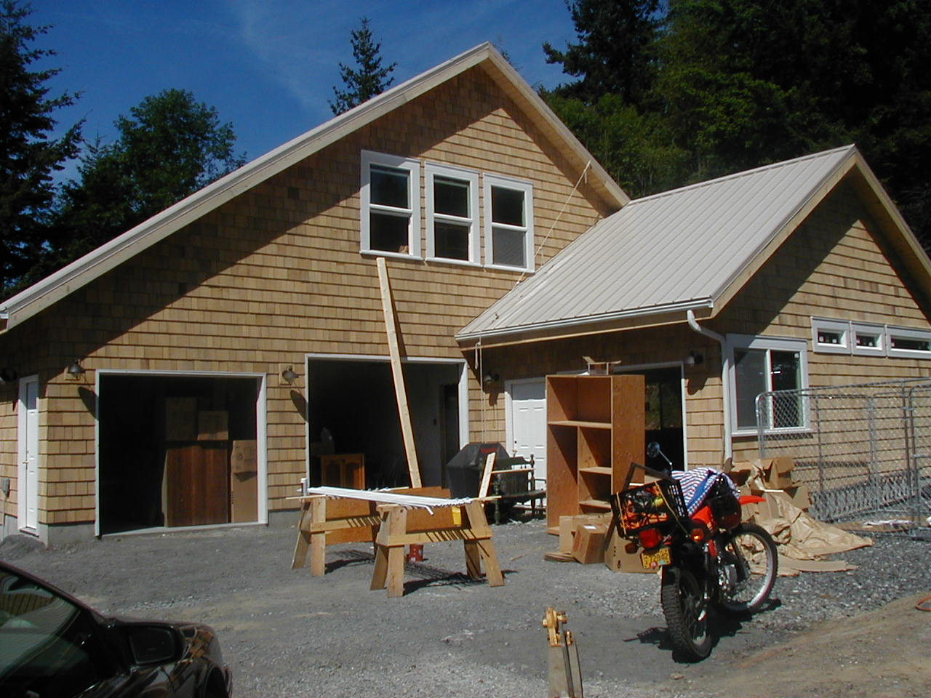
New construction
Orcas Island

Slide 24
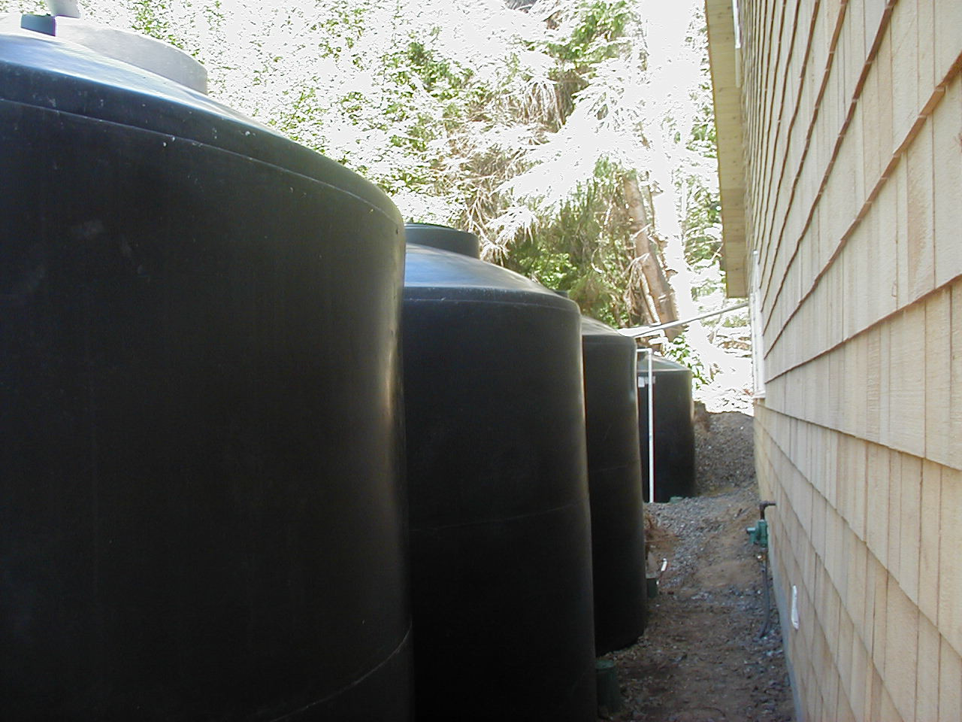
new construction
catchment required for
building permit

Slide 25
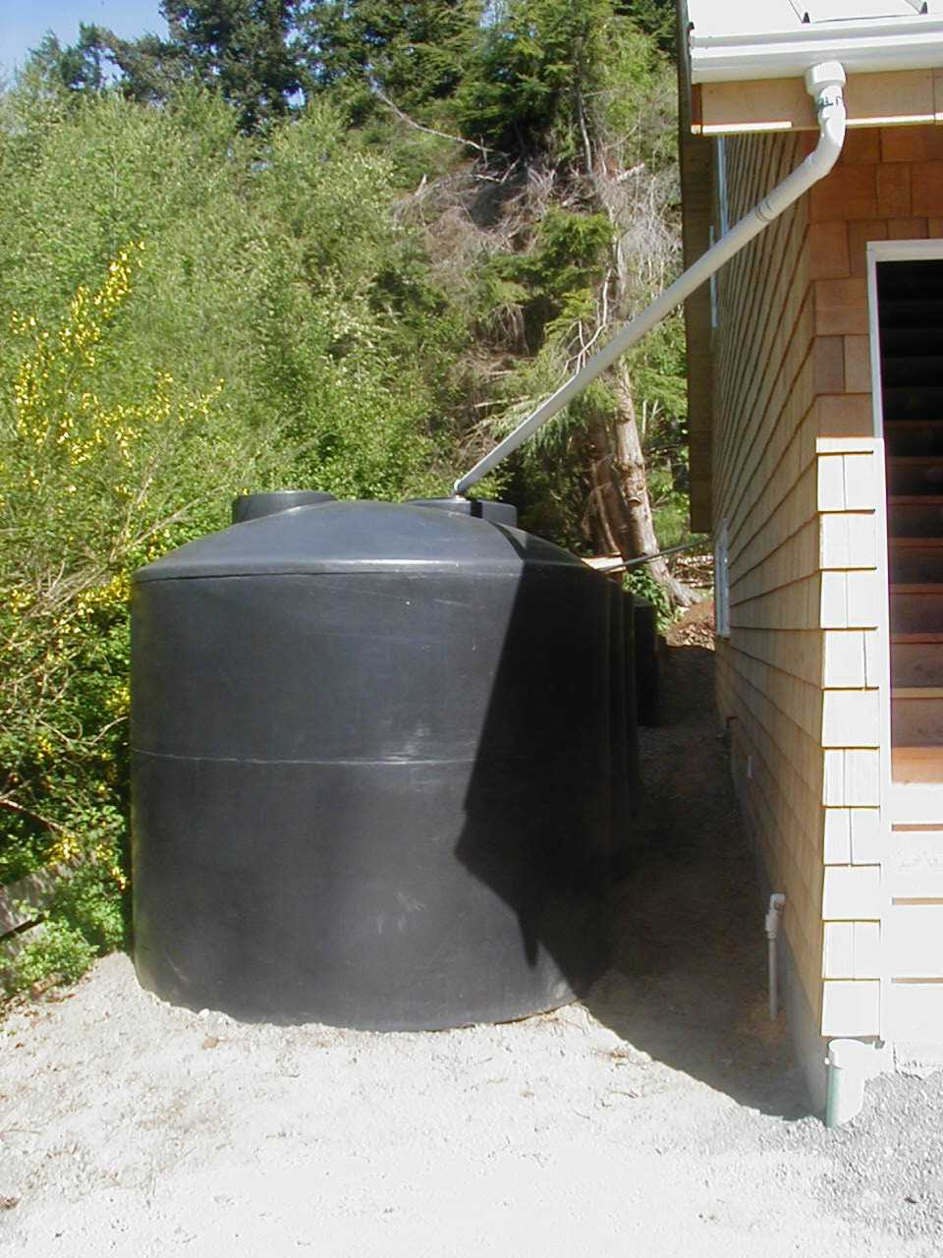

Slide 26
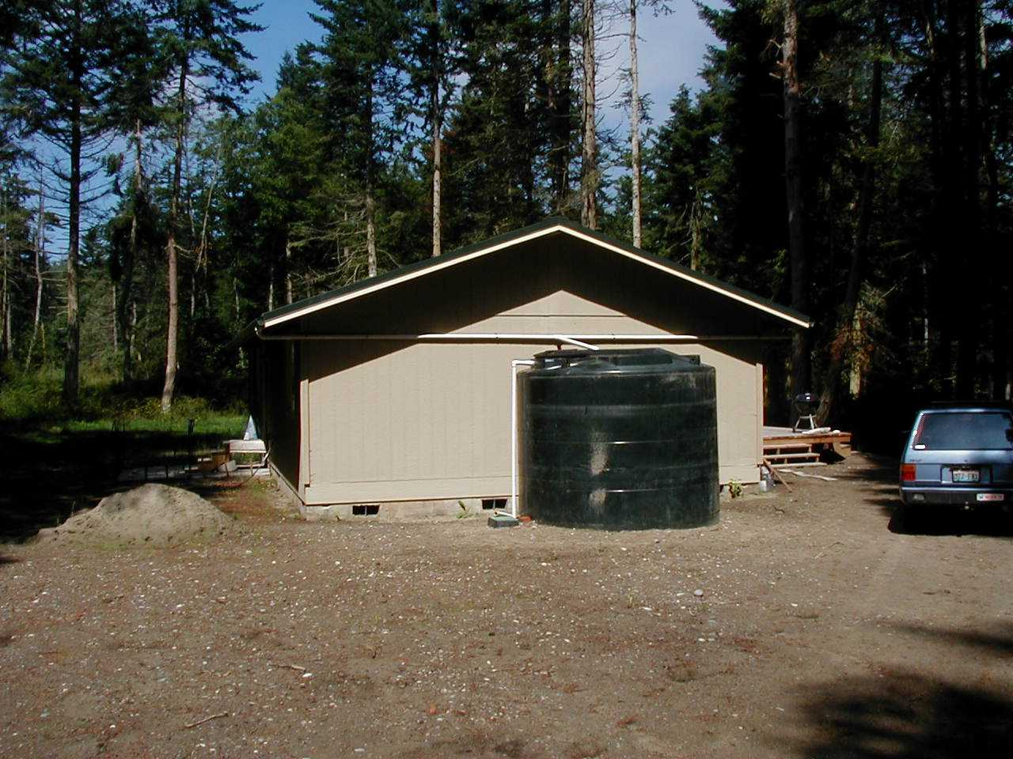
4000 gallon tank

Slide 27
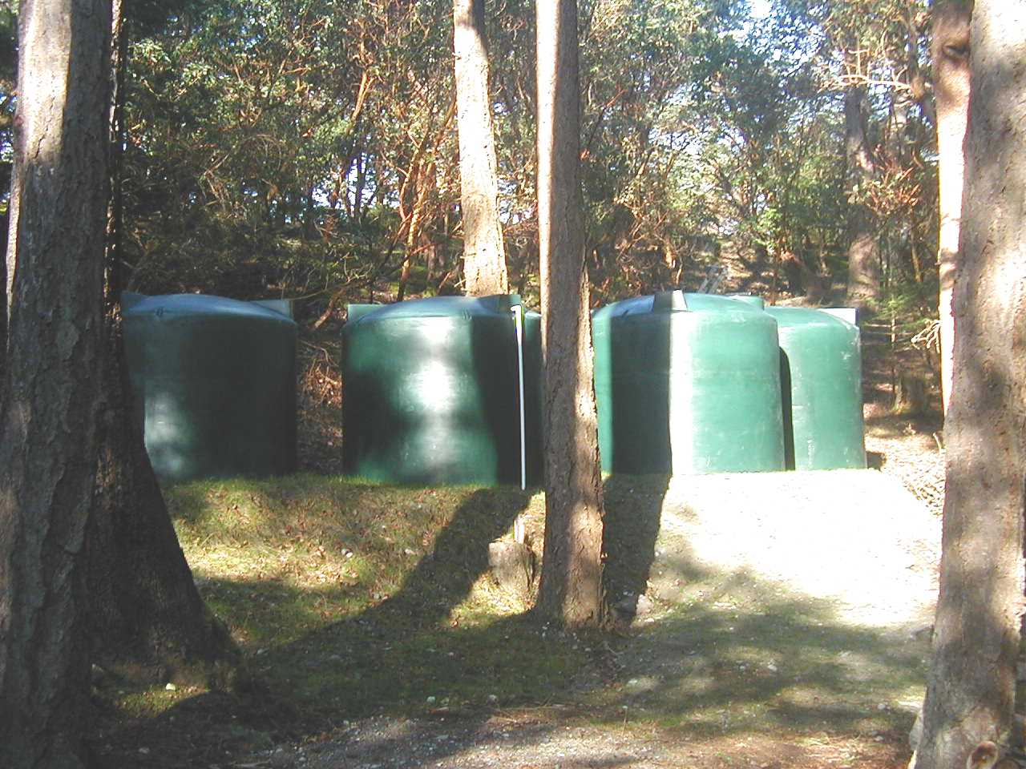

Slide 28
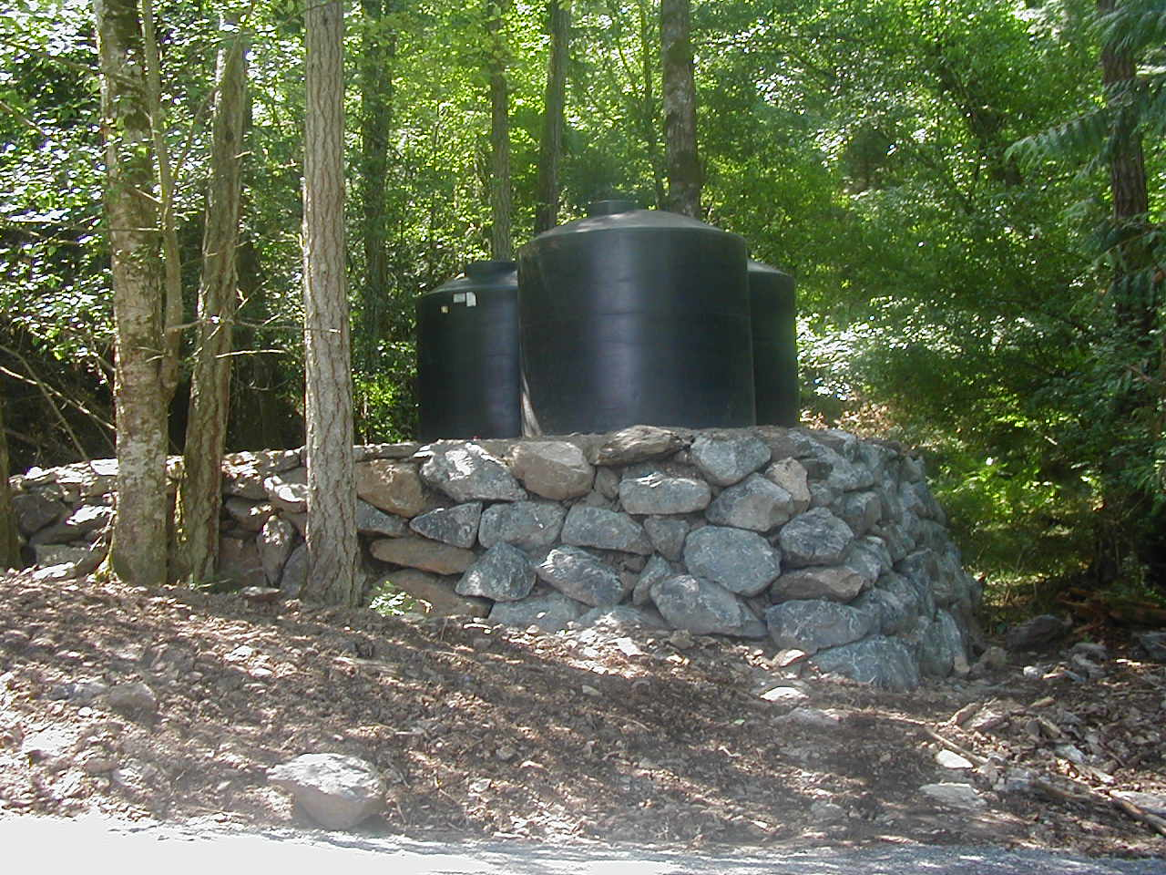
Very overbuilt pad

Slide 30
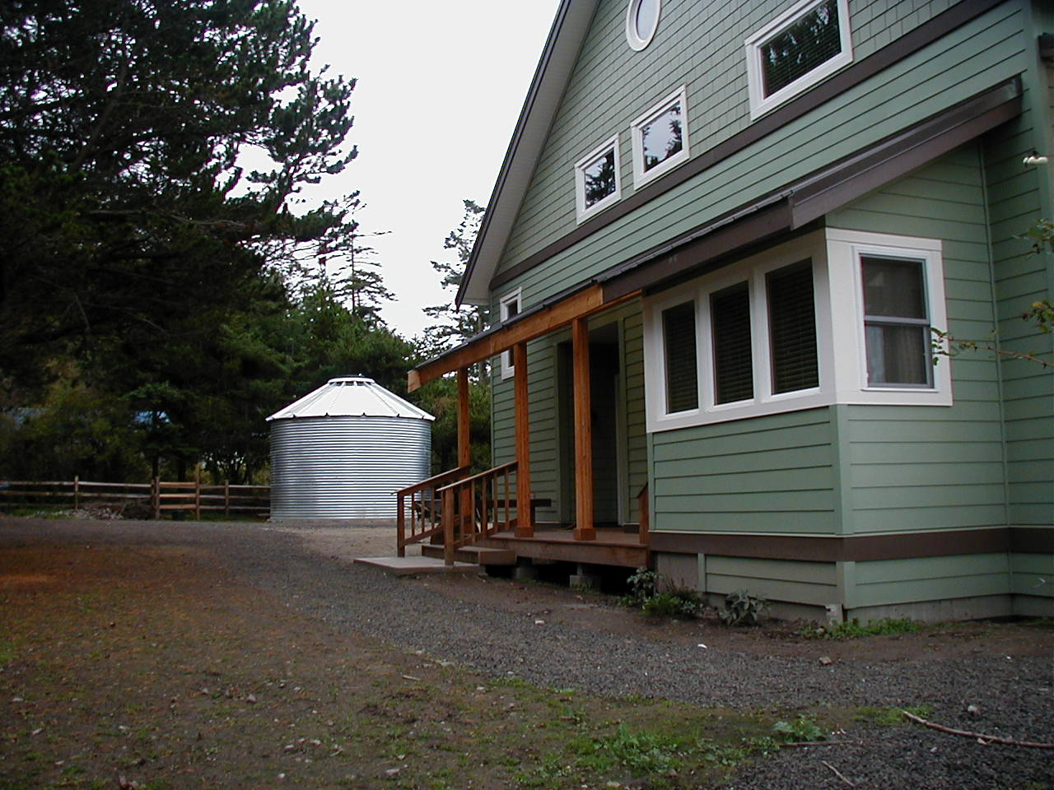
15,000 gallon tank adjacent to new home. Required for permit

Slide 31
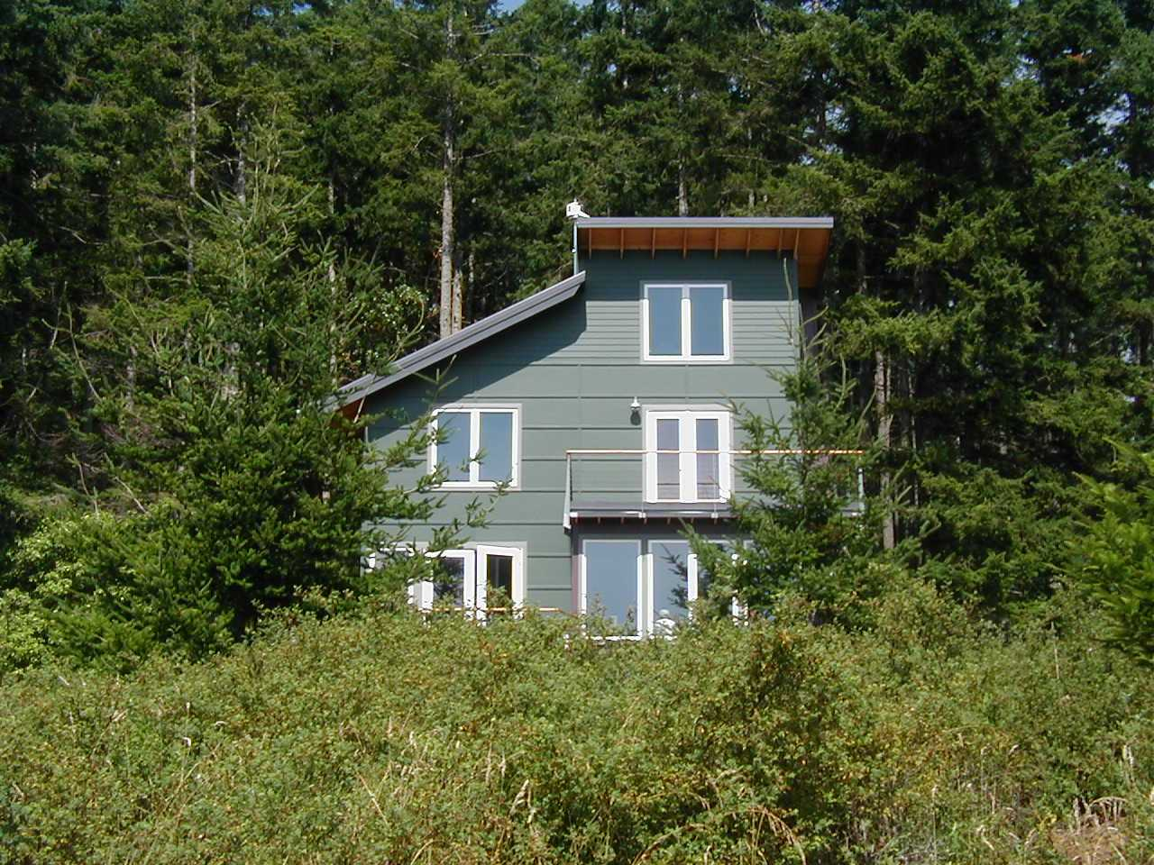
Small water front home tanks located behind in forest

Slide 32
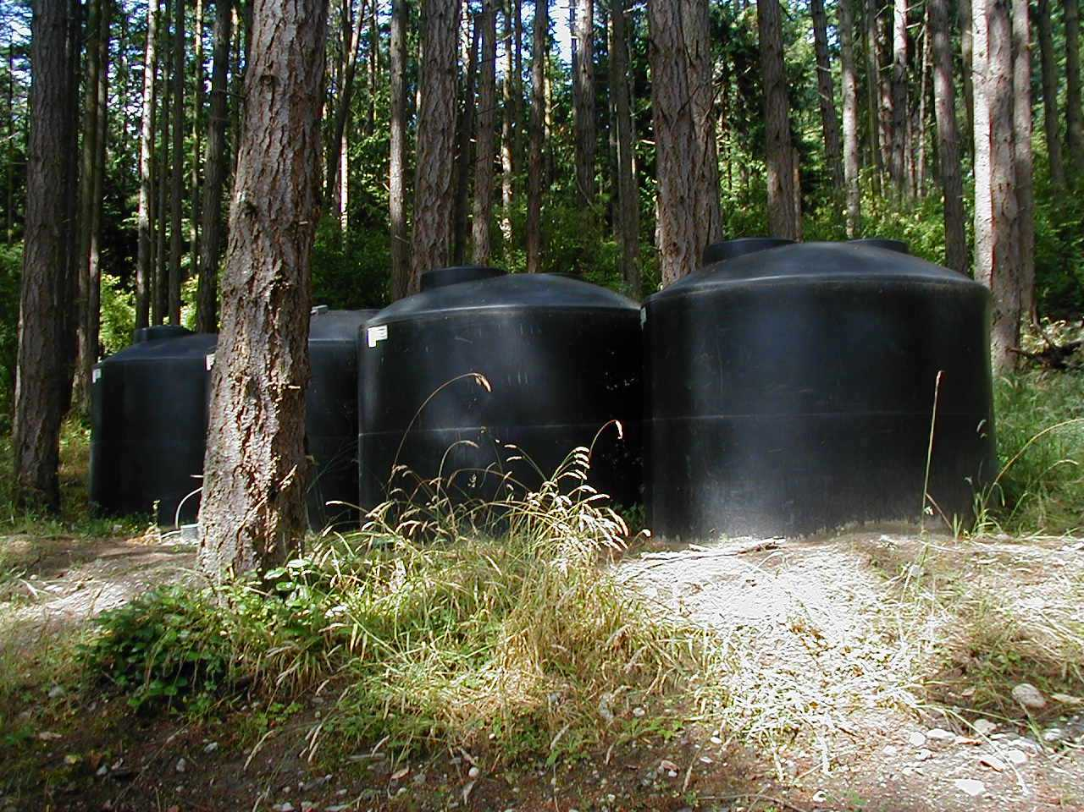
4@2340 gallon tanks behind house

Slide 33
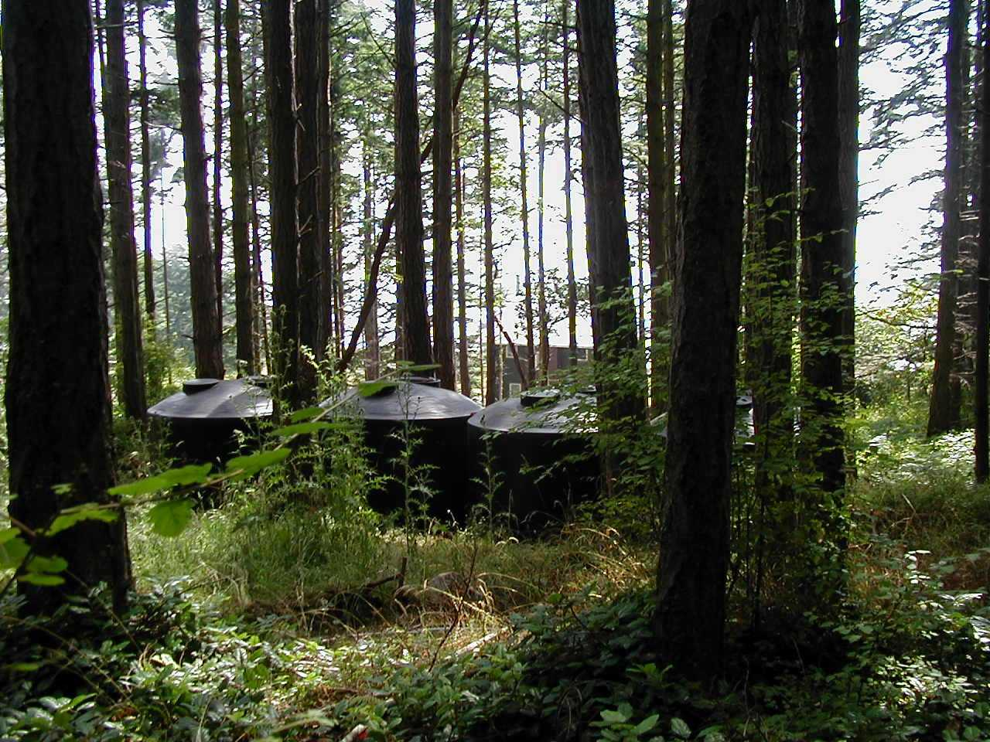
Opposite view from tanks to house in distance

Slide 34
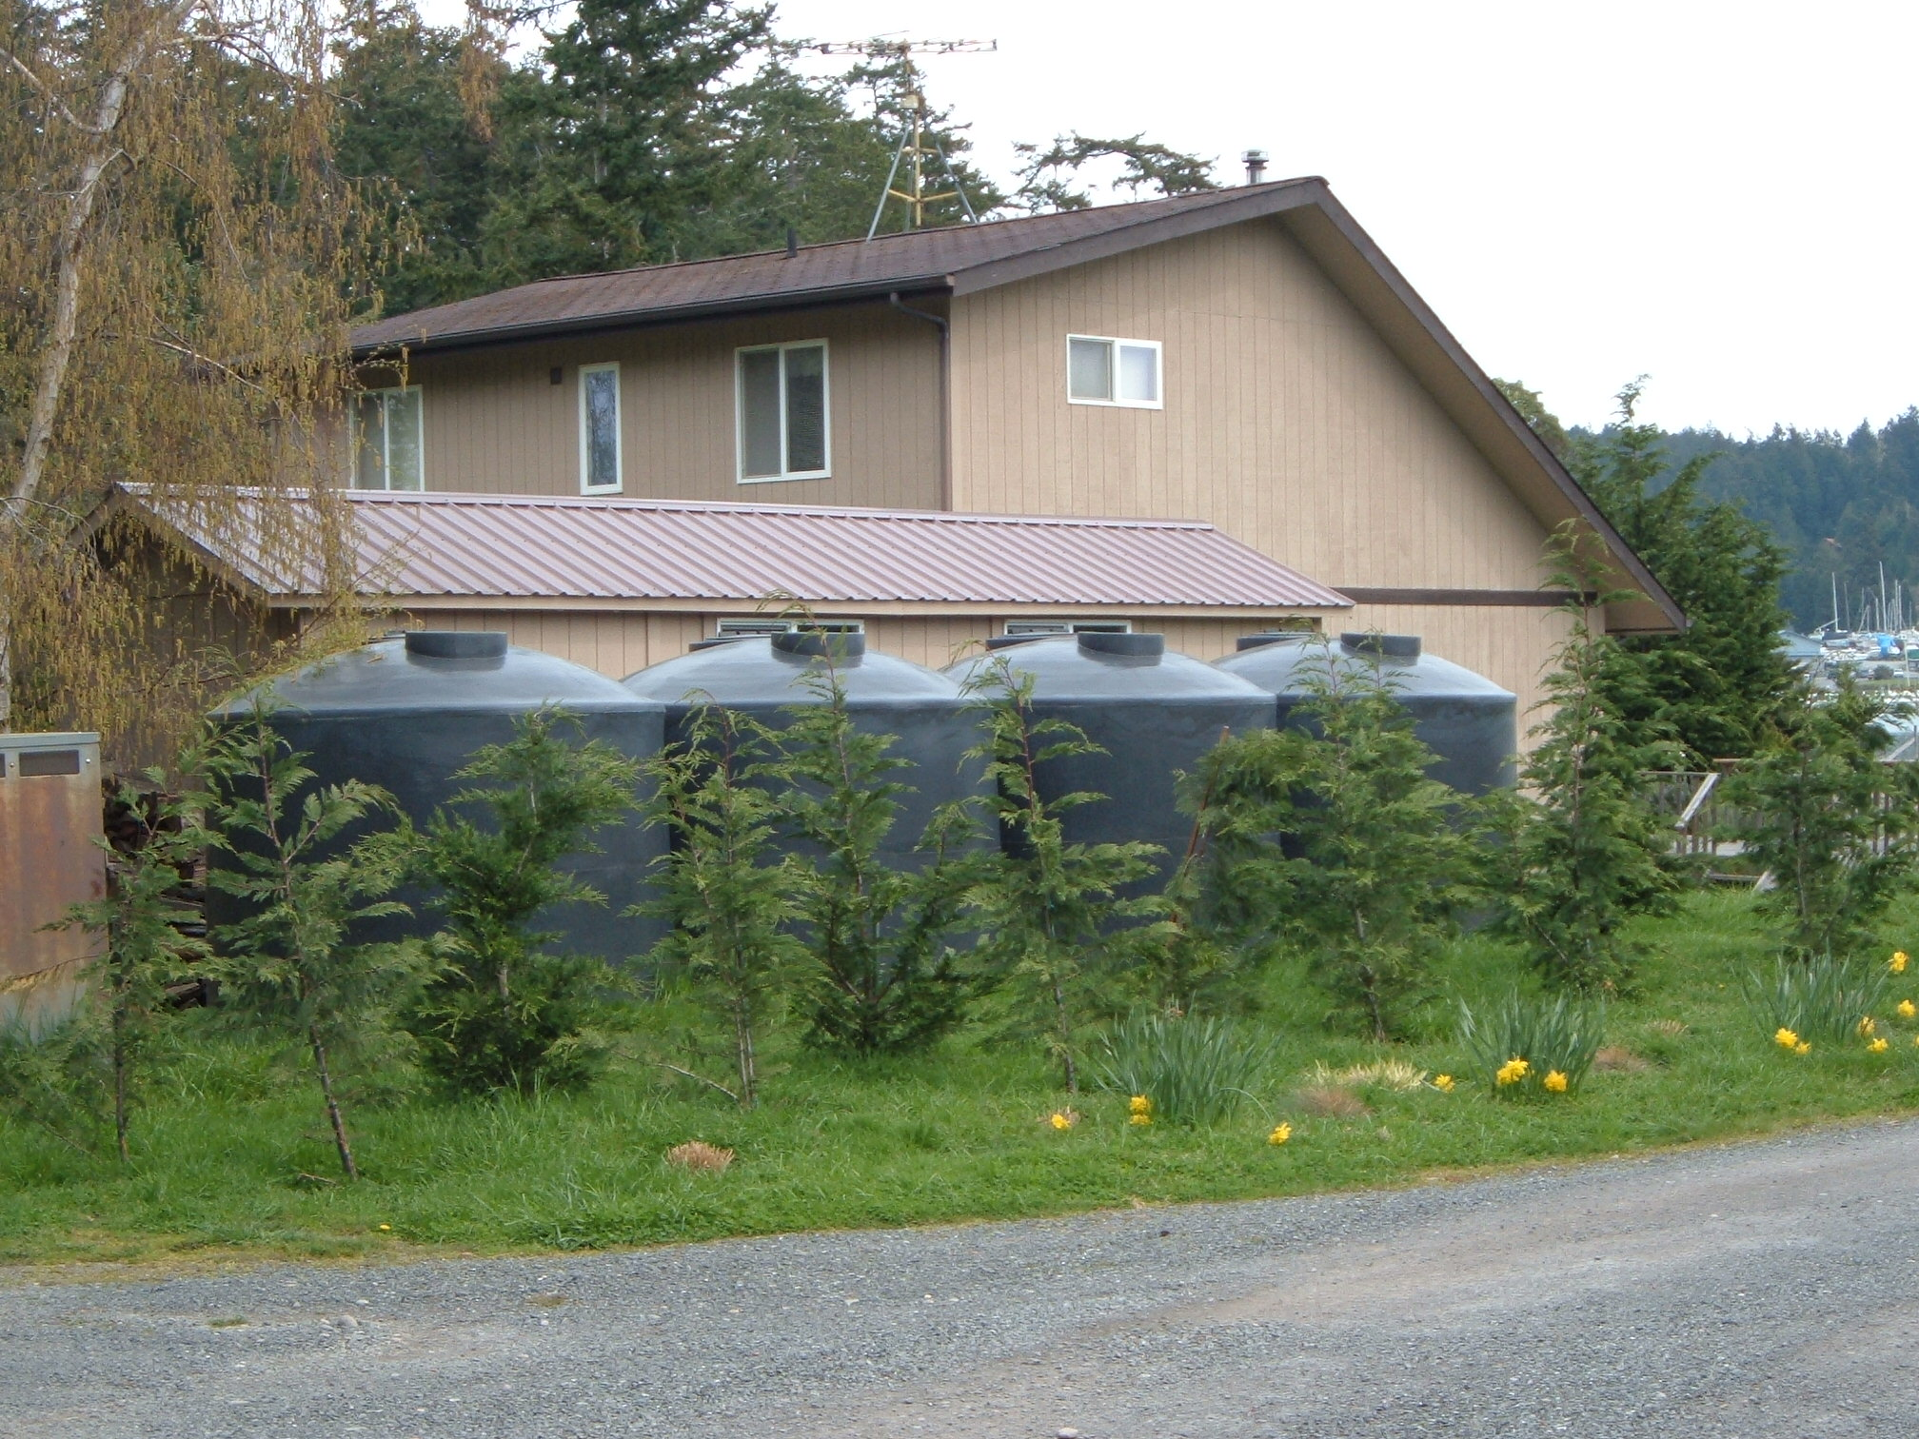
4@2340 gallon tanks saltwater intruded well

Slide 35
Building lot too small for well and septic. Catchment tanks in basement

Slide 36
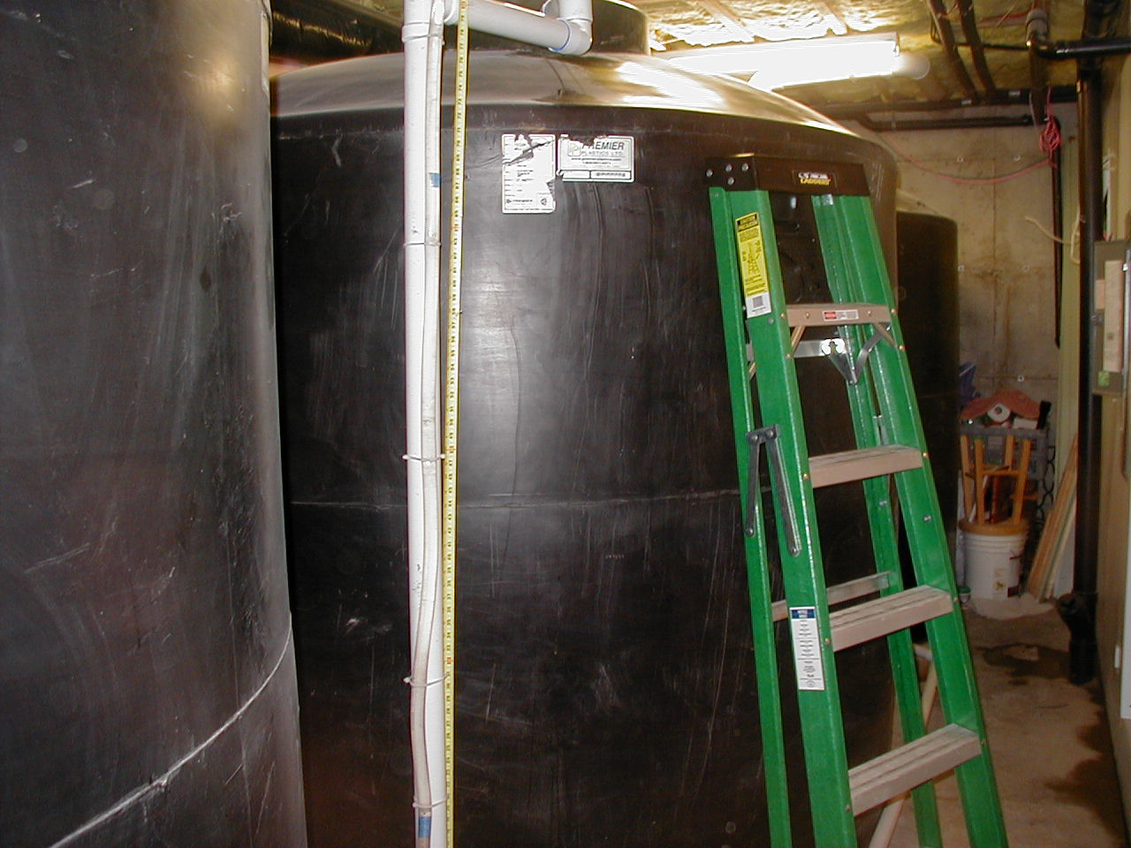

Slide 37
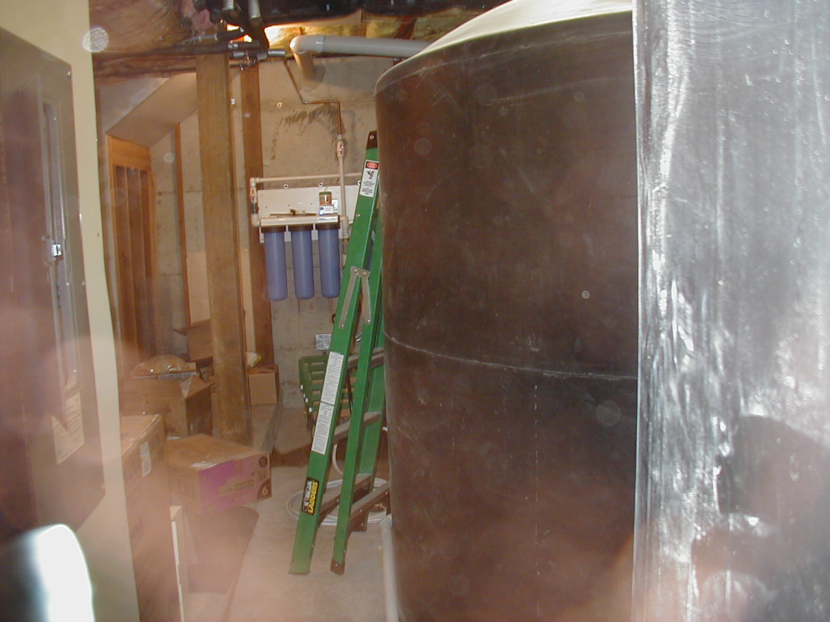

Slide 38
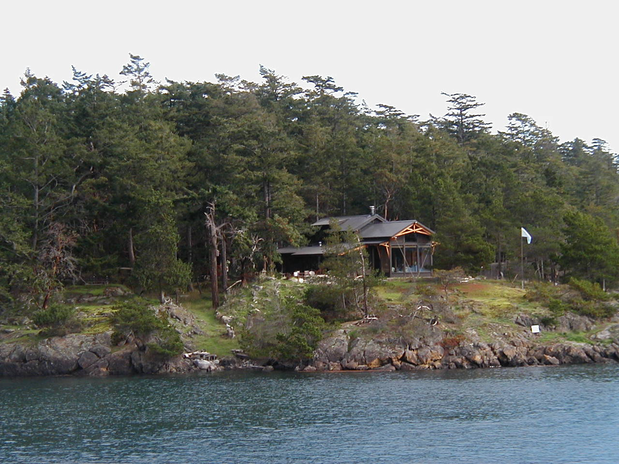

Slide 39
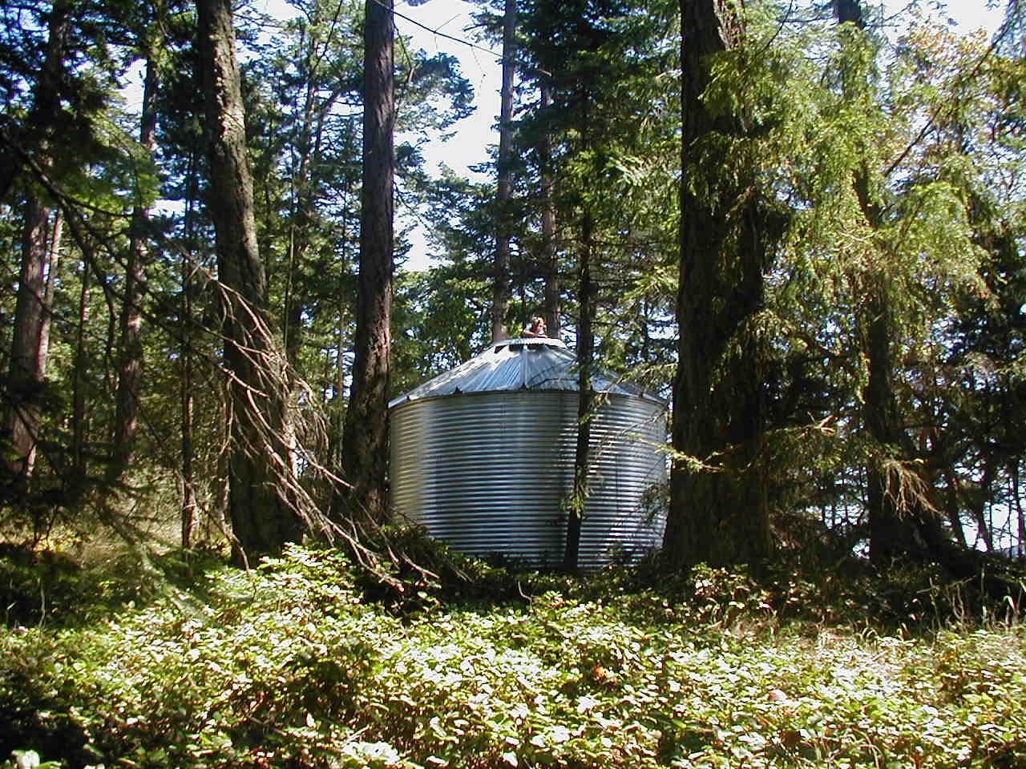

Slide 40
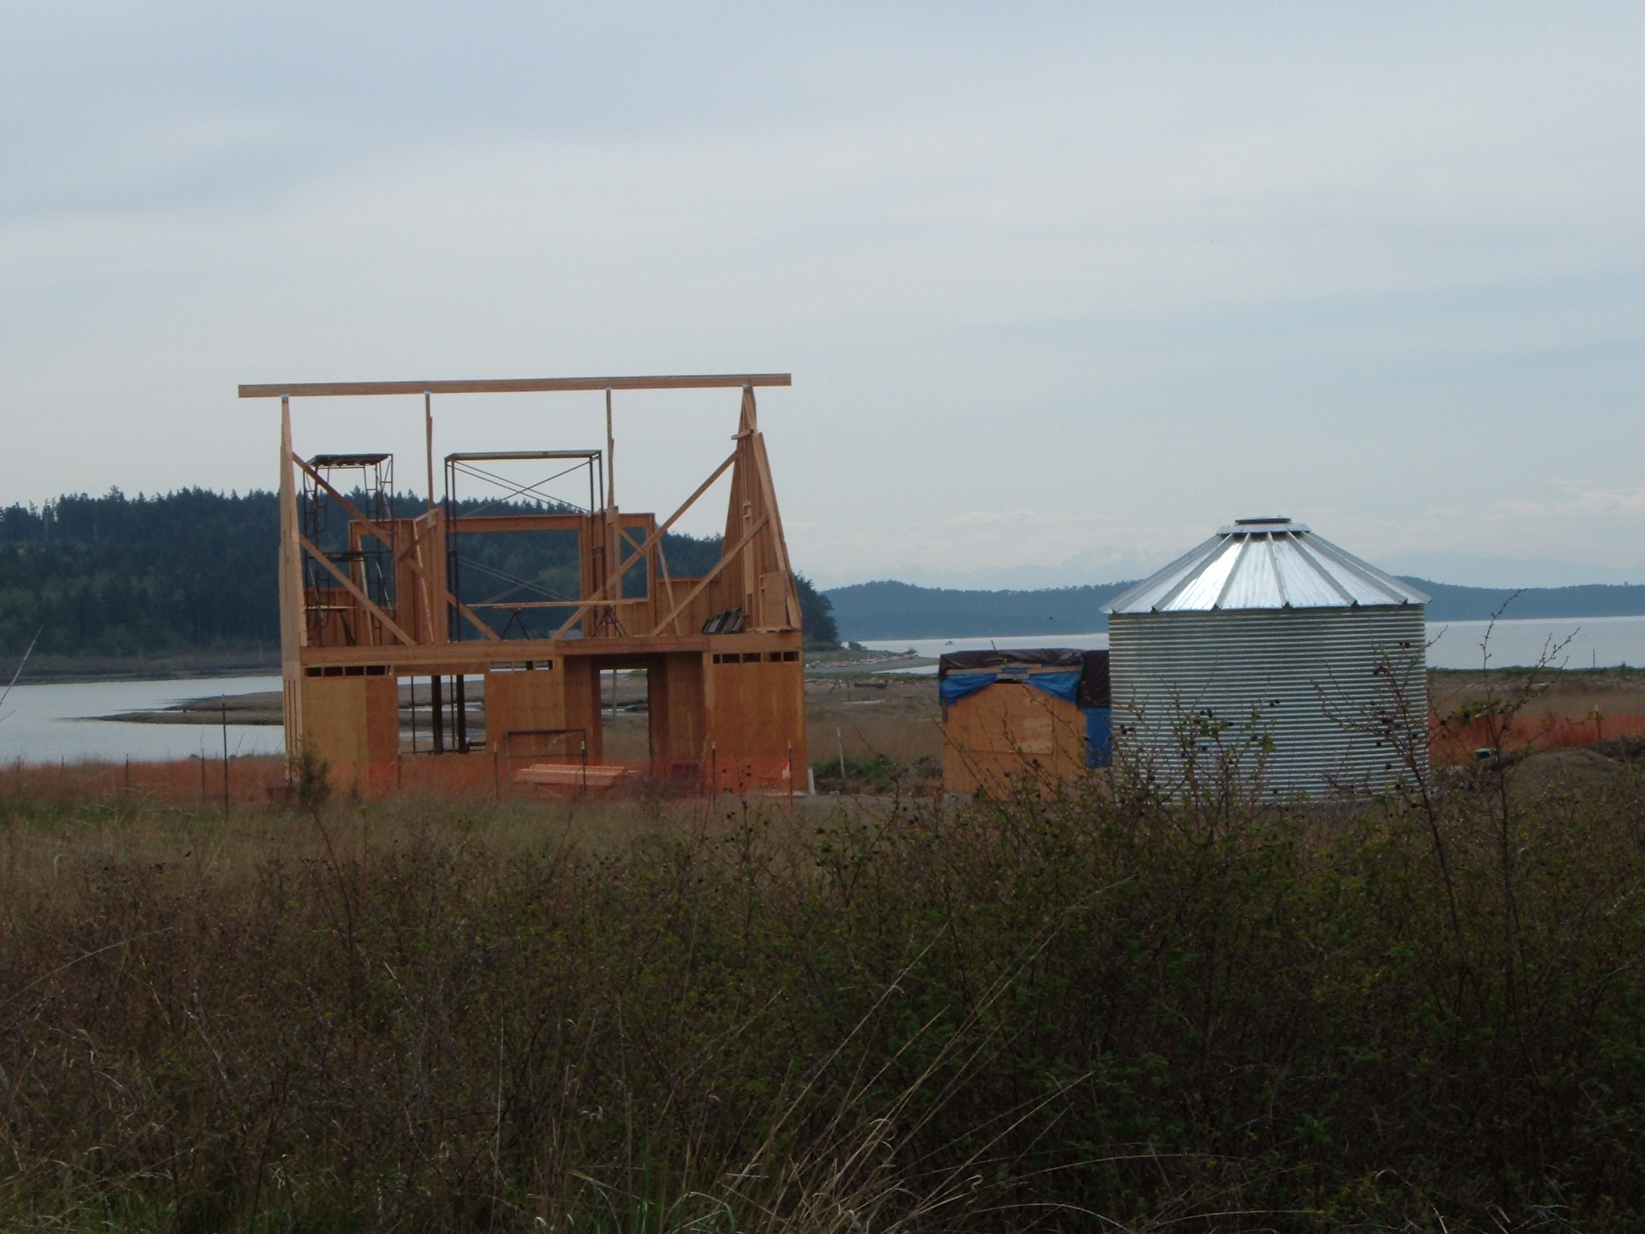
New construction lopez Is. Catchment required for permit salt water intruded well

Slide 41
Above ground tanks
Roto Molded Plastic

Slide 42
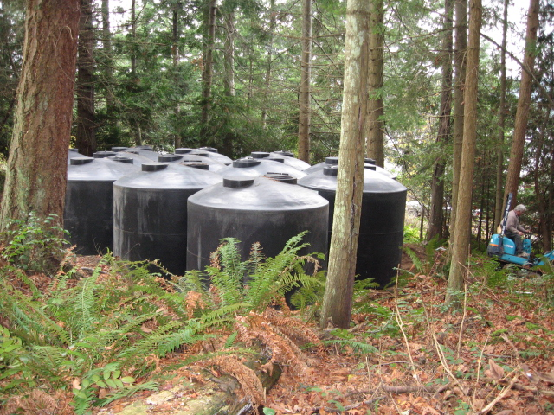
12@2340 tanks in final installation for irrigation

Slide 43
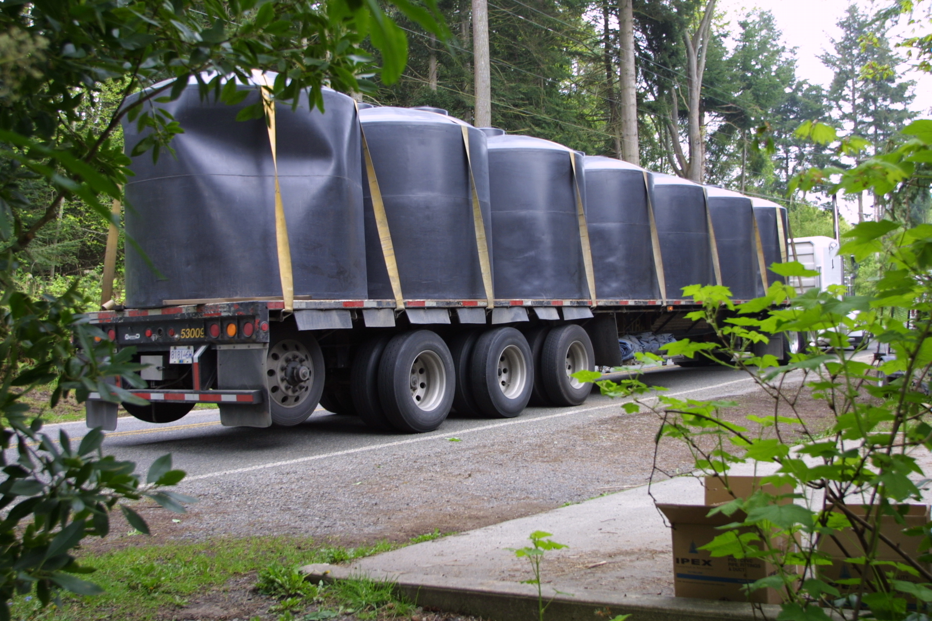

Slide 44
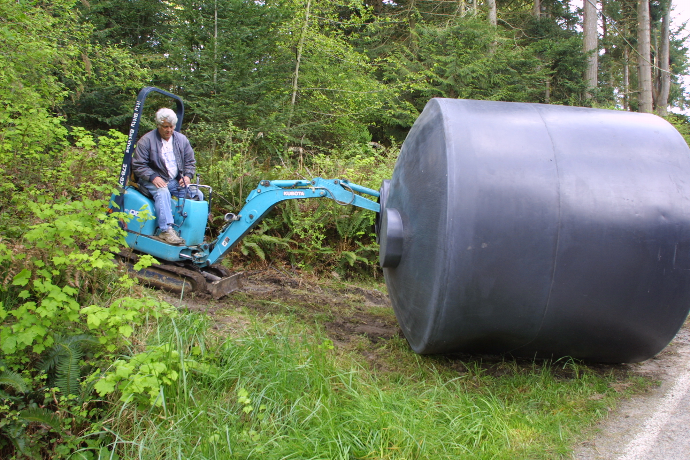
Backwoods installation

Slide 45
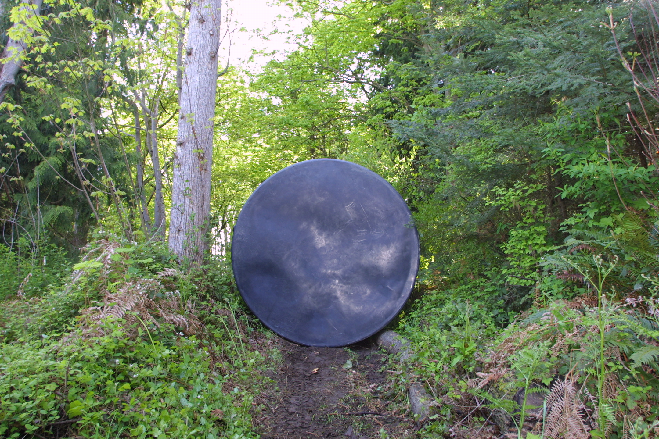
The beaten path

Slide 46
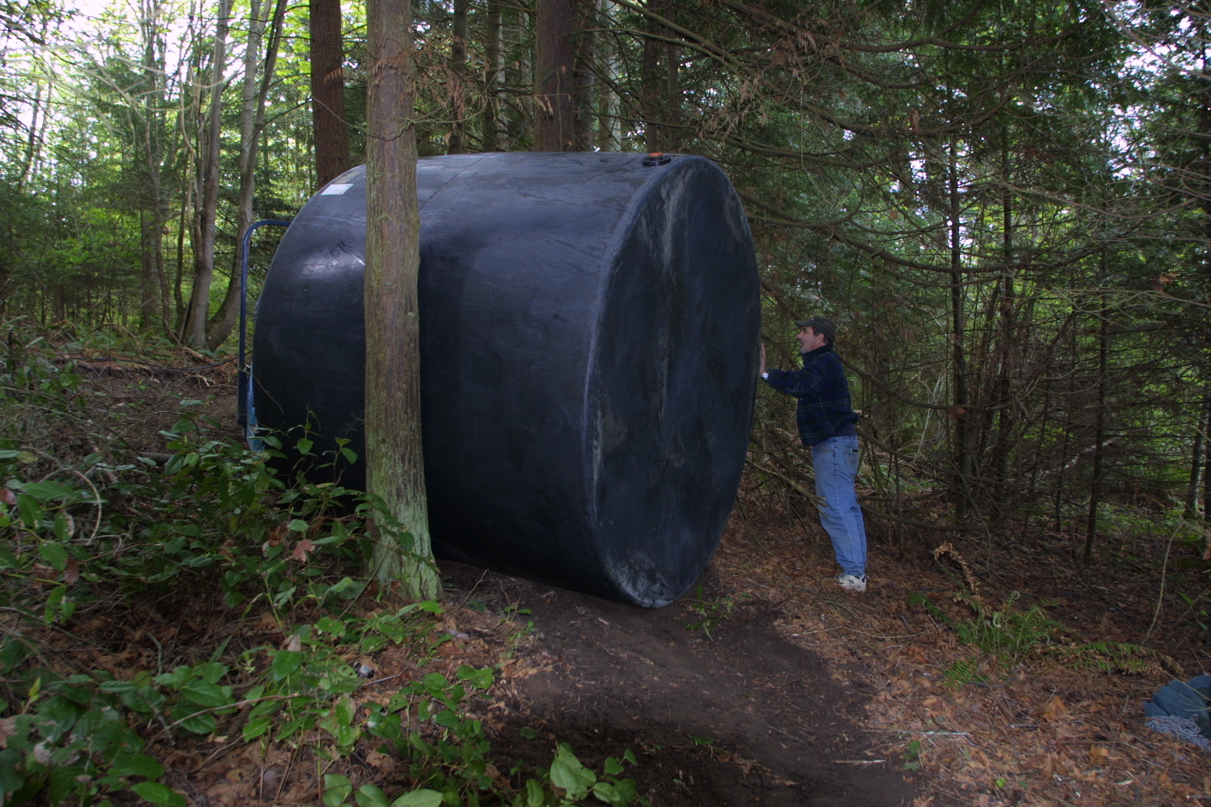
Tight squeeze

Slide 47
Galvanized Steel Poly Liner

Slide 48
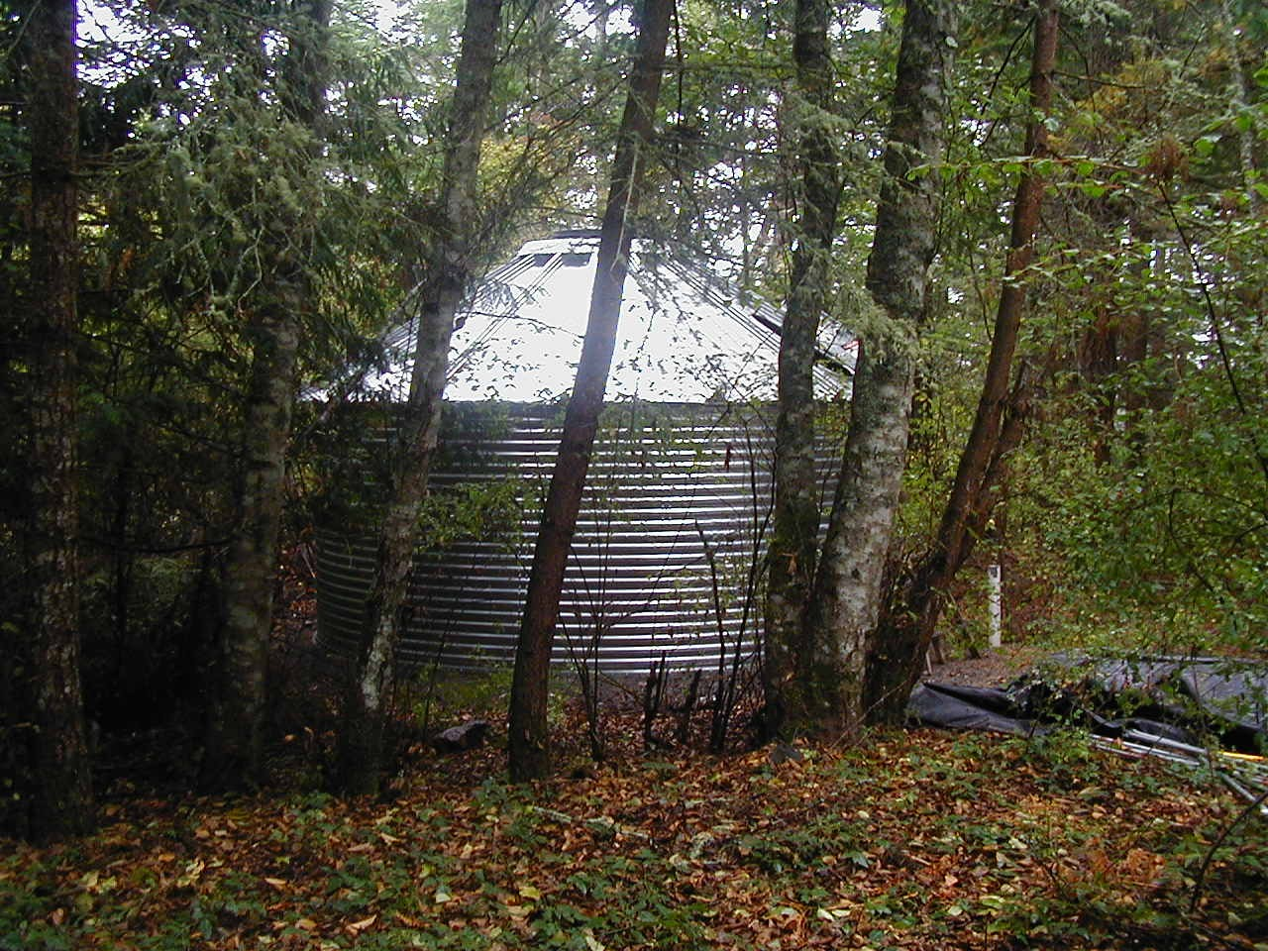
10,000 gallons 5meters wide x 2 meters high

Slide 49
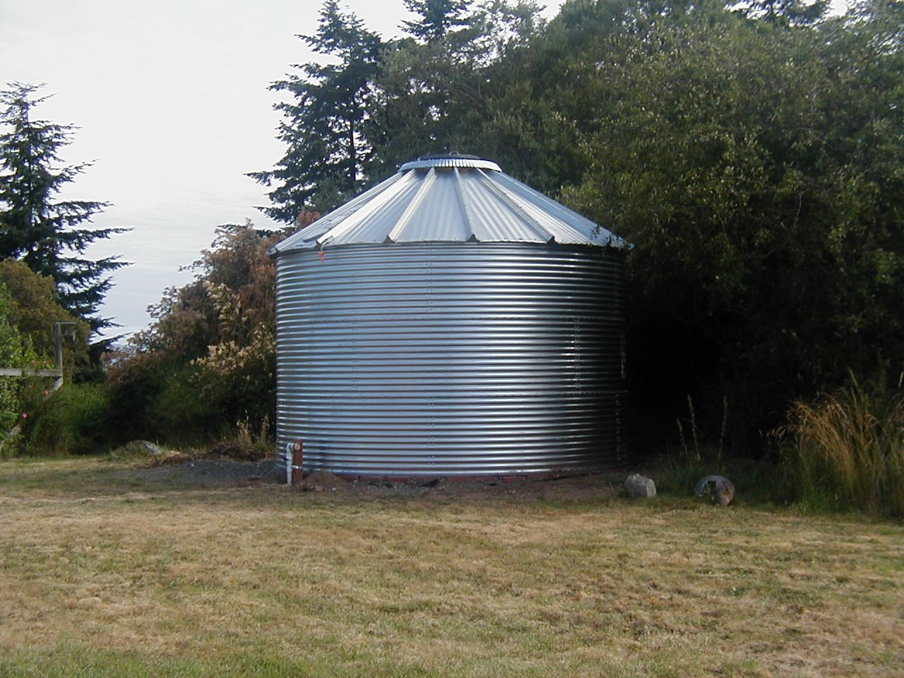
15,000 gallons 5 meters wide x 3 meters high

Slide 50
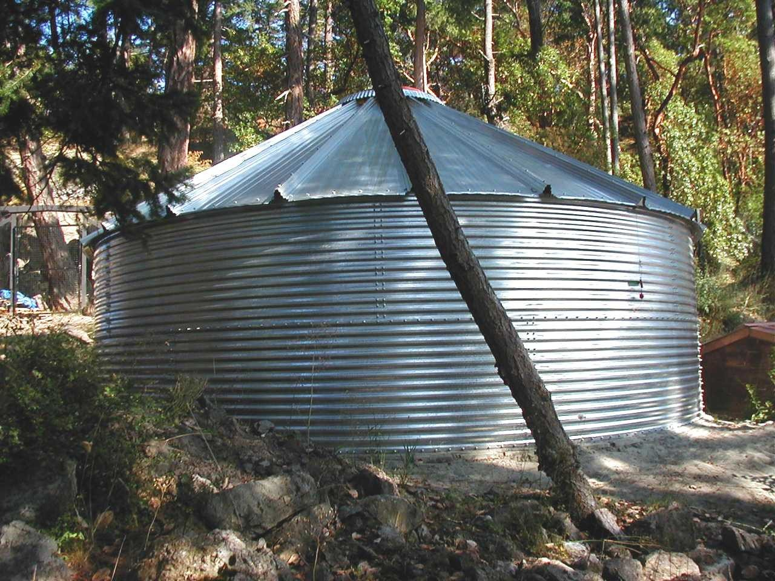
20,000 gallons 7 meters wide x 2 meters high

Slide 51
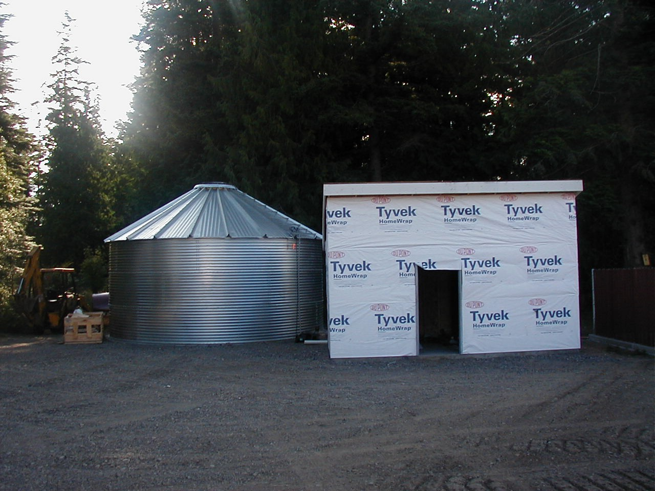
30,000 gallons 7meters wide x 3 meters high

Slide 52
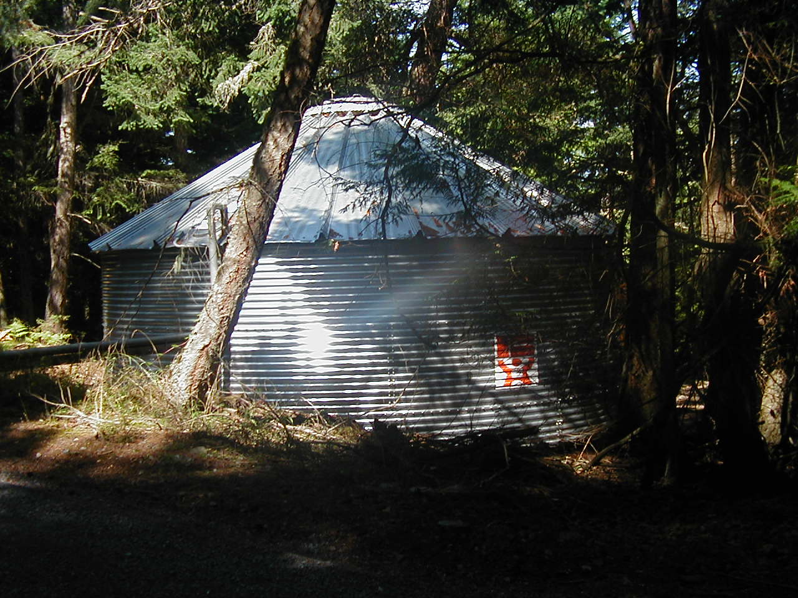
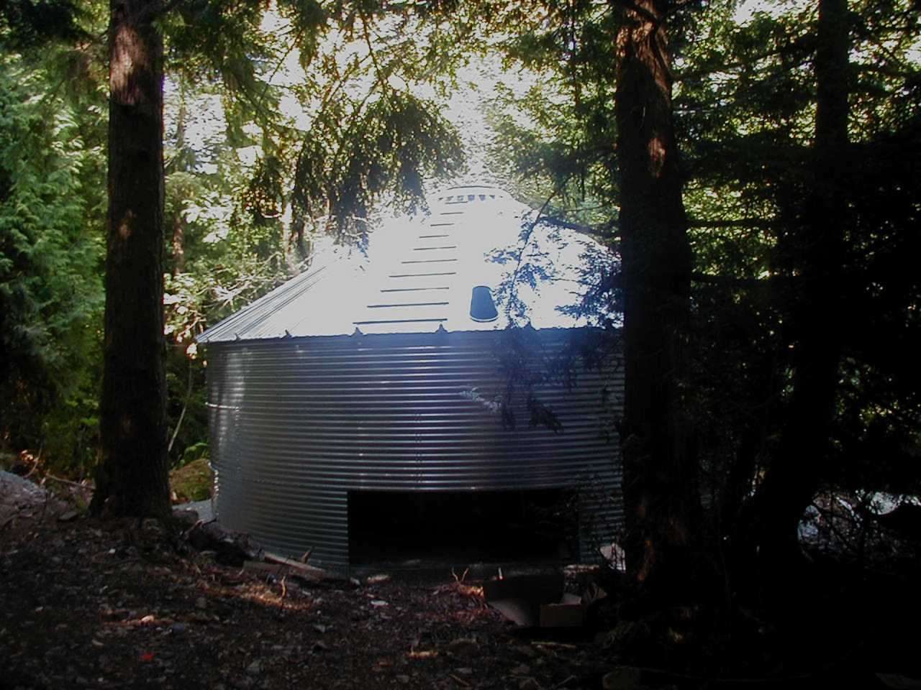
50,000 gallons 9 meters wide x 3 meters high

Slide 53
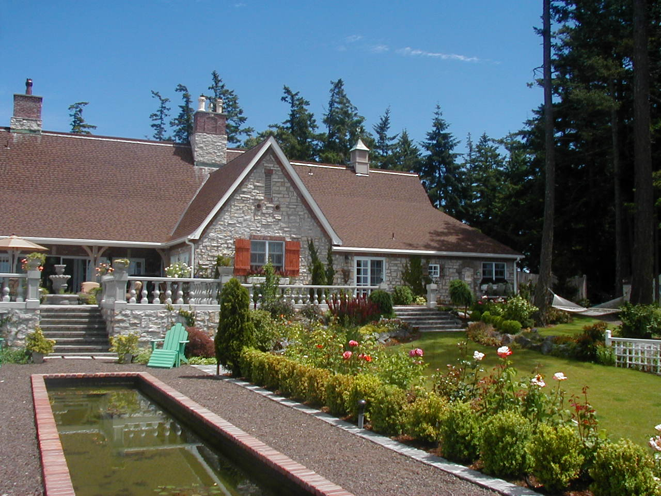
She can’t live with “only” 50,000 gallons

Slide 54
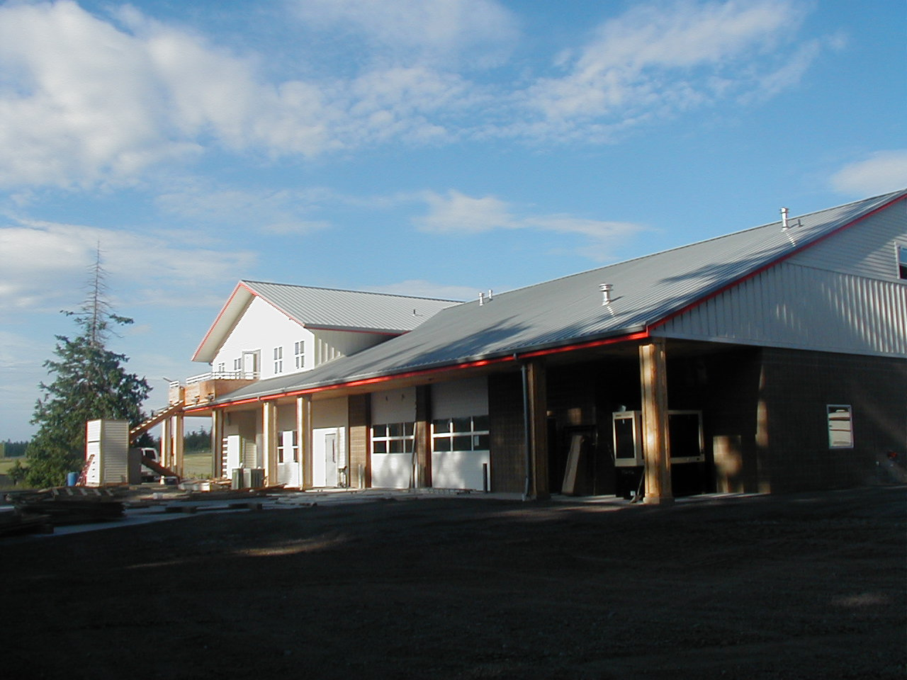
San Juan fire district #3 9000 square foot fire station

Slide 55
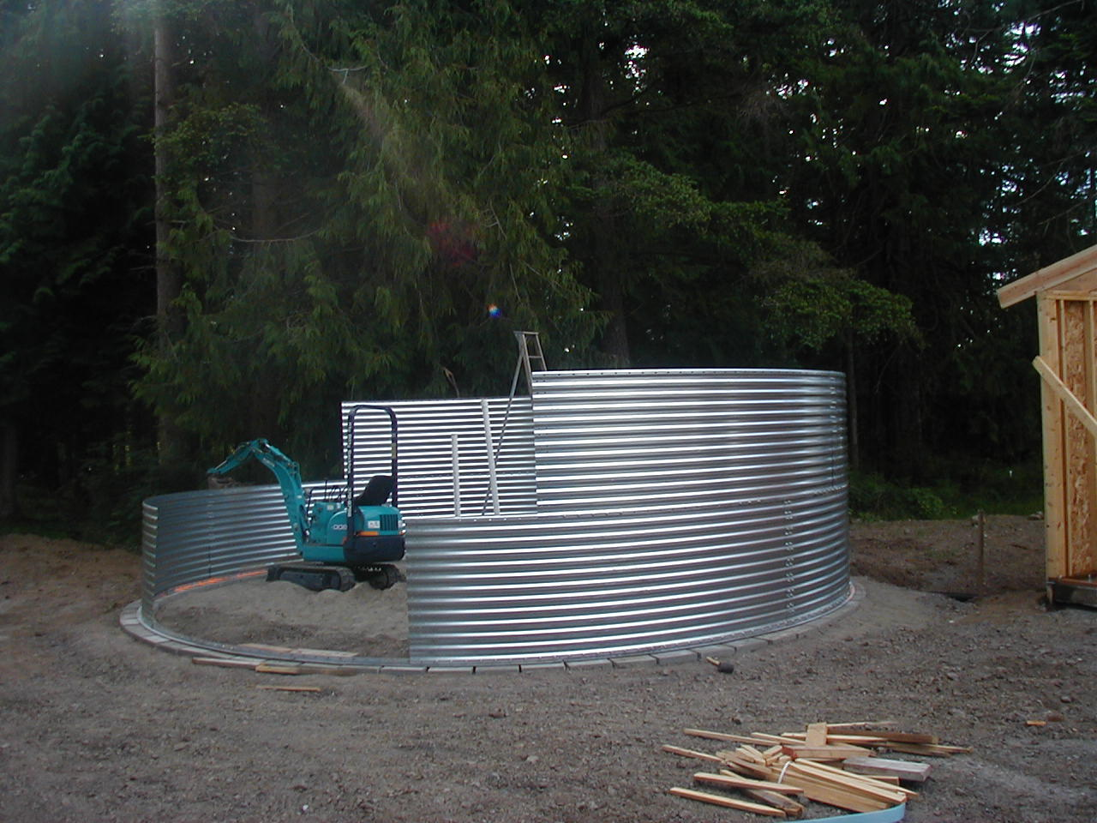
30,000 gallon storage tank for Fire District #3
Primary supply is rooftop, secondary is well.
15,000 gallons reserved for fire sprinklers
15,000 gallons reserved for filling tank truck

Slide 56
Adjacent to pump house

Slide 57
Early gravel and paver foundations

Slide 58
Now county requires engineered foundation

Slide 59
Top Ring

Slide 60
Add roof

Slide 61
Finish roof

Slide 62
Jack up top ring and roof

Slide 63
Add second ring

Slide 68
Install liner

Slide 69
How not to collect

Slide 70
10,000 gallon storage Crane Island

Slide 71
20,000 gallon storage shaw island

Slide 72
Poly Box Tanks

Slide 73
Waterfront home, low bank. Box tanks under deck

Slide 76
Wall Tanks

Slide 80
Good roof design for snow load

Slide 81
Poor roof design for snow load

Slide 82
Note how manways are away from wall of tank and span of roof between manways is short. Good snow support

Slide 83
Top view

Slide 84
Underground storage

Slide 86
1600 gallon underground tank

Slide 88
Our most exciting installation big toys

Slide 90
first of 9, 1500 gallon buried cisterns

Slide 91
13,500 gallons total capacity
tanks manifolded together at bottom

Slide 92
Pea gravel fill over tanks

Slide 93
Rebuild patio

Slide 94
Finished patio looking north

Slide 95
Finished patio looking south

Slide 96
Kilroy was here

Slide 97
12,500 gallons, san juan island

Slide 99
Gravity Collection

Slide 106
Pumped Collection

Slide 107
250 gallon underground transfer tank

Slide 108
250 gallon ball/transfer tank
buried in the only soil
we could find

Slide 109
30,000 gallon tank located 130 feet above residence

Slide 110
60 gallon collection/transfer tank

Slide 111
60 gallon collection/transfer tank

Slide 112
Canadian/American cross border wars

Slide 113
Transfer Pumps for Pumped Collection

Slide 116
NSF approved roof coating

Slide 118
Potable roll on roof coating
NSF approved Standard 42
Shaw Island

Slide 119
Pressure Pumping Systems

Slide 123
Disinfection

Slide 127
System layout

Slide 128
Early system, too much filtration

Slide 129
Simple System

Slide 130
Simple system, insulated enclosure

Slide 131
Simple system in storage shed

Slide 132
Simple system with pressure tank

Slide 133
Pumping
Filtration
Ultra Violet

Slide 134
Diabolically complicated layout. Its what the owner wanted

Slide 135
Page two

