Slide 1
ARCSA Tapping Into Rainwater Nuts and Bolts
Athens, Georgia
Billy Kniffen
Texas Cooperative Extension - ARCSA

Slide 3
MARIETTA, GA — xxxx x xxxxxxx, a Wealthy Atlanta Investor,
issued a written statement this week apologizing for the fact that his large home had been consuming a large amount of water during the severe Southeast drought to flush the home’s nine toilets, maintain its swimming pool, and irrigate its four surrounding acres, a November 15 New York Times story said.
Carlos had topped the list of residential water users in Cobb County as a result, using 440,000 gallons in September, or about 14,700 gallons a day that month,
In his statement, Carlos said, according to the story, “I honestly didn’t realize the extent of my water use and regret I didn’t act sooner.” Carlos’s monthly bill water bills have averaged about $1,200.
The water system spokesman, Robert Quigley, told reporters that Carlos had broken no laws, a loophole, which Carlos apparently took advantage of, allowed property owners to use a professional landscaping service to water new plants for the first 15 days after planting.

Slide 4
Bottled Water
April 28 report in The Atlanta Journal-Constitution.
The report said per-capita consumption of bottled water in 2007 compared with 2006 was up 7.1 percent, to 22.5 gallons, with beer rising by 1.4 percent, to 22.2 gallons per person last year.
Soft drinks kept hold of the No. 1 spot, at 49.3 gallons per person in 2007, down 3.3 percent over 2006
It said that per-person consumption of bottled water has doubled in the past 10 years.

Slide 5
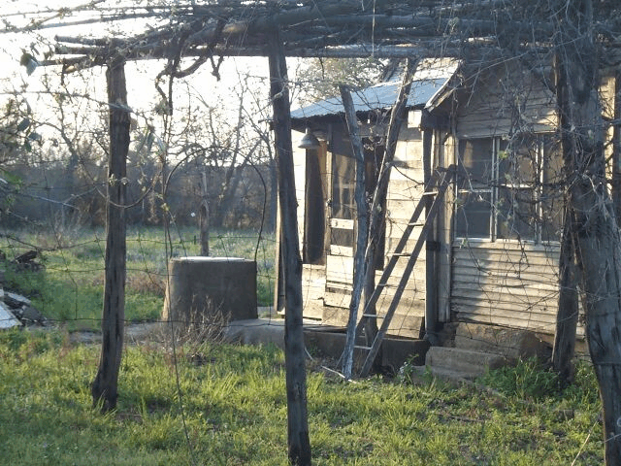
Many Early American Settlers Depended on Rainwater Capture

Slide 6
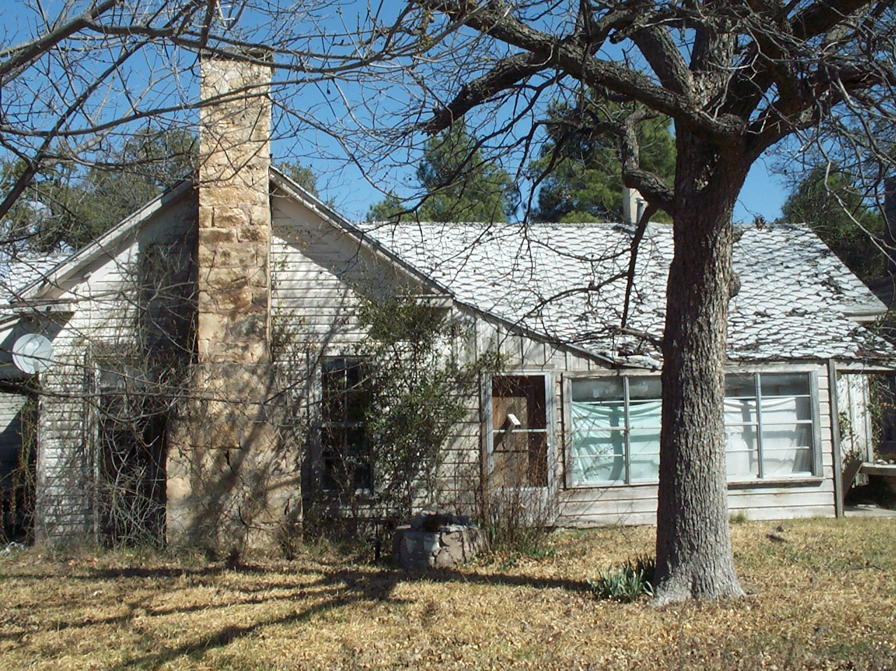
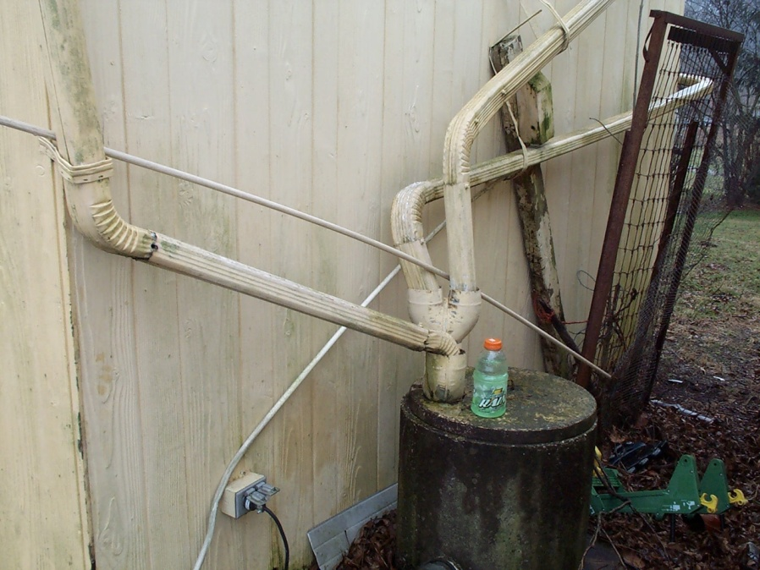
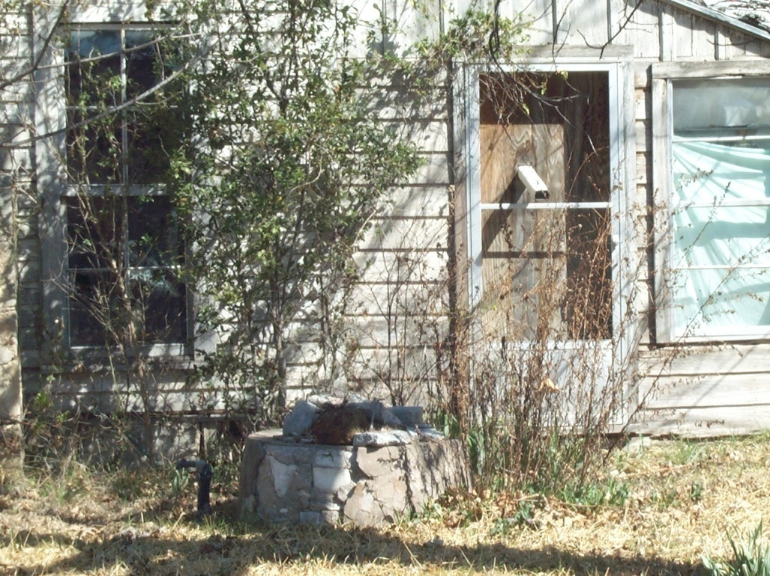
Some More Innovative
Than Others

Slide 7
Rainwater Uses:
Supplement landscape water needs
Attract and provide water for wildlife,
birds and butterflies
Add interest, soothing sound and beauty
Provide water for nurseries/special needs
And--
Notes:
Listed are a number of ways you can use rainwater – just as you would using any other source of water. But this water is free of minerals which build up over time in hot water heaters, screens, appliances of other unwanted places.
The picture to the left is of a water guzzler with a deer stopping by to get a drink. The roof is 4’ by 8’ and the water runs into a 50 gallon barrel. A pet watering pan is attached by way of a facet and water hose.
The picture to the right is at the entrance of Lady Bird Johnson Wildflower Center. The sound and sight of running water draws us in with an enticing welcome.

Slide 8
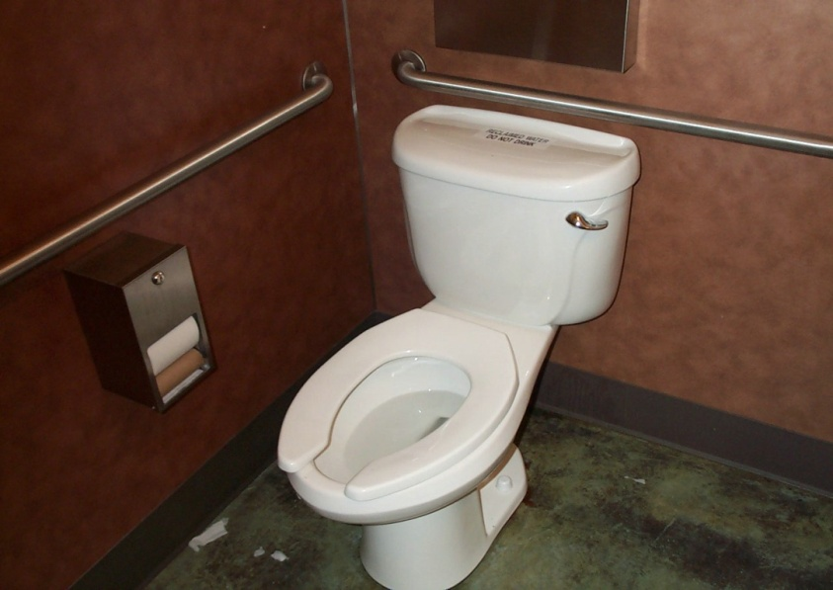
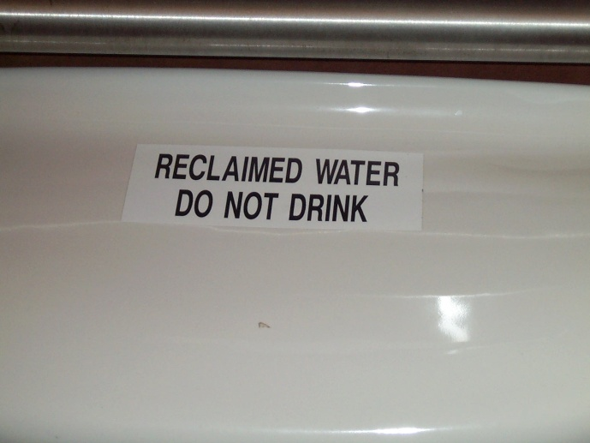
Rainwater Uses:
Non-Potable Uses:
Flushing toilets and laundry
Potable Uses:
Treated and used for all in-home use
Notes:
Listed are a number of ways you can use rainwater – just as you would using any other source of water. But this water is free of minerals which build up over time in hot water heaters, screens, appliances of other unwanted places.
The picture to the left is of a water guzzler with a deer stopping by to get a drink. The roof is 4’ by 8’ and the water runs into a 50 gallon barrel. A pet watering pan is attached by way of a facet and water hose.
The picture to the right is at the entrance of Lady Bird Johnson Wildflower Center. The sound and sight of running water draws us in with an enticing welcome.

Slide 9
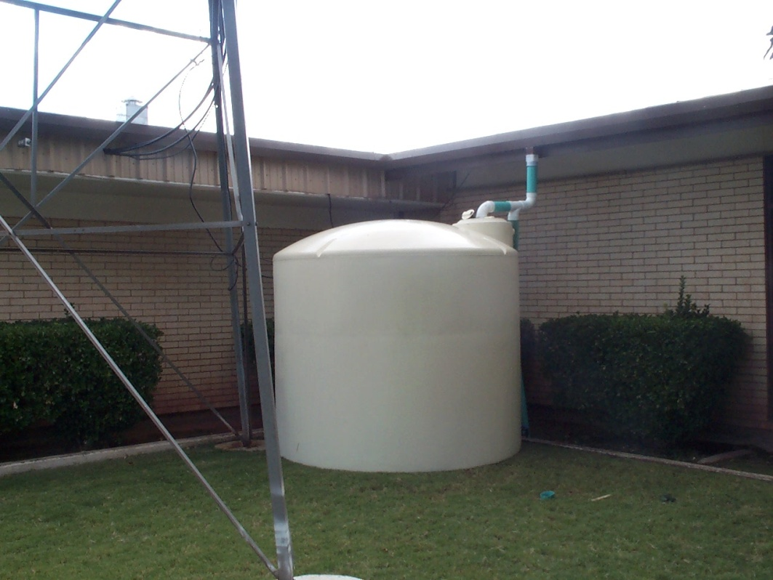
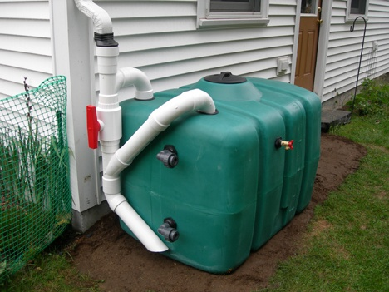
How to Collect Rainwater
.623 gallons per square foot roof per 1” rain
Round down to .55 g. or .5 g. but using .6 gallons:
2,000 sq. foot roof X 1" rain = 1,200 gal. water
1,200 gal. X 30" rainfall per year= 36,000 gal/yr
Notes:
The main key in figuring how much water you can collect is based on the .6 gallons of water (.623 but rounded down due to evaporation, roof absorption and loss) per square foot of roof. The footprint of the roof – not the actual square feet of tin. A steep roof would have more surface area than the area rainfall is landing on.
The picture to the left is at a Kyle Elementary school with a 2500 gallon poly tank attached directly to the downspout. The water is used for drip irrigation on the area being developed into a native prairie garden.
The picture on the right is at a nature center in Austin and the galvanized tank is used for drip irrigation.

Slide 10
Complex /Active/Roof-based Rainwater Harvesting
Notes:
Most of the talk will be geared to a complex system that will include a roof of some kind, a gutter, downspouts, storage and delivered for its designed purpose - irrigation, wildlife, pets, livestock or in-home use.

Slide 11
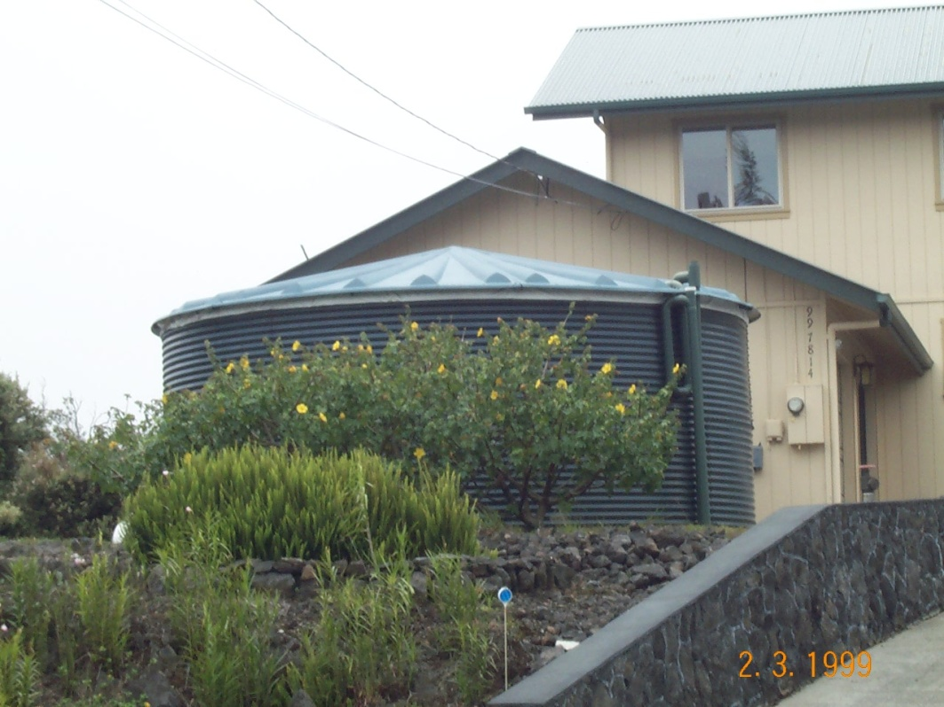
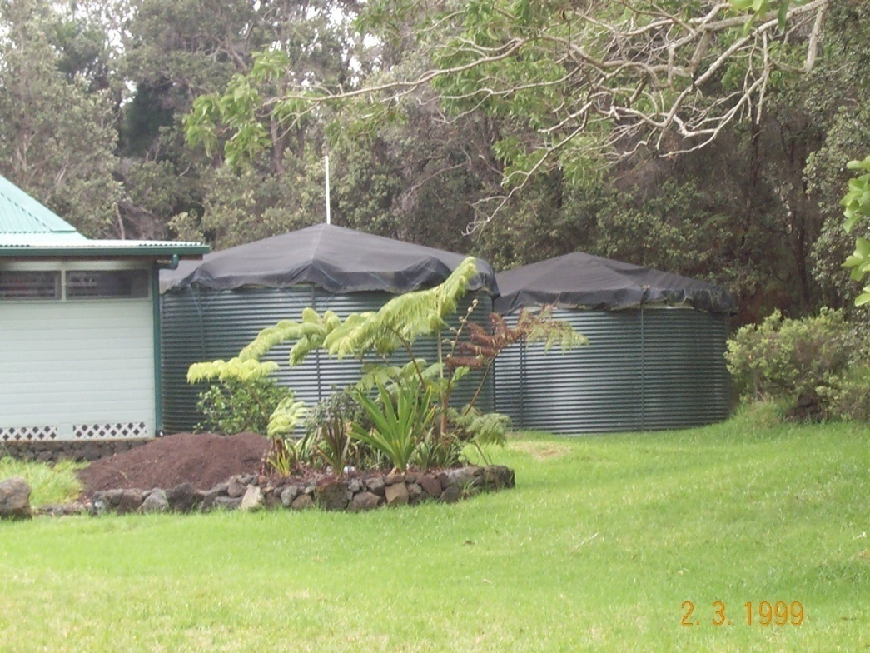
Rainwater capture is
currently being used
on many Islands
and in many countries

Slide 12
Questions To Ask First
Why do I want to collect rainwater
What are my alternatives
Do I have the money
Does it rain enough – rainfall patterns
Do I have the space
Are there restrictions
Do I install it myself or hire someone
How hard can it be?
Where can I find a contractor?
Can I get a loan – or sell my home on RWC

Slide 13
Will I Have Enough Water?
Is there a backup?
How long is a standard/serious dry spell?
How much will I catch per 1” rainfall?
How much do I need per month?
Is the rainwater also for my landscape?
For traditional turf landscape – probably not
For drip irrigation only
Will I use my gray water for inside/outside use
How much storage do I need total?

Slide 14
Usage Needs
In-home usage average 70 gallons per person per day (AWWA)
Many on rainwater use about 25 gallons per day (TCEQ Figures 50)
Why
Use water conservative techniques
Washing machines
Facet aerators
Toilets, etc.
Water conscious
Be Realistic with each family

Slide 15
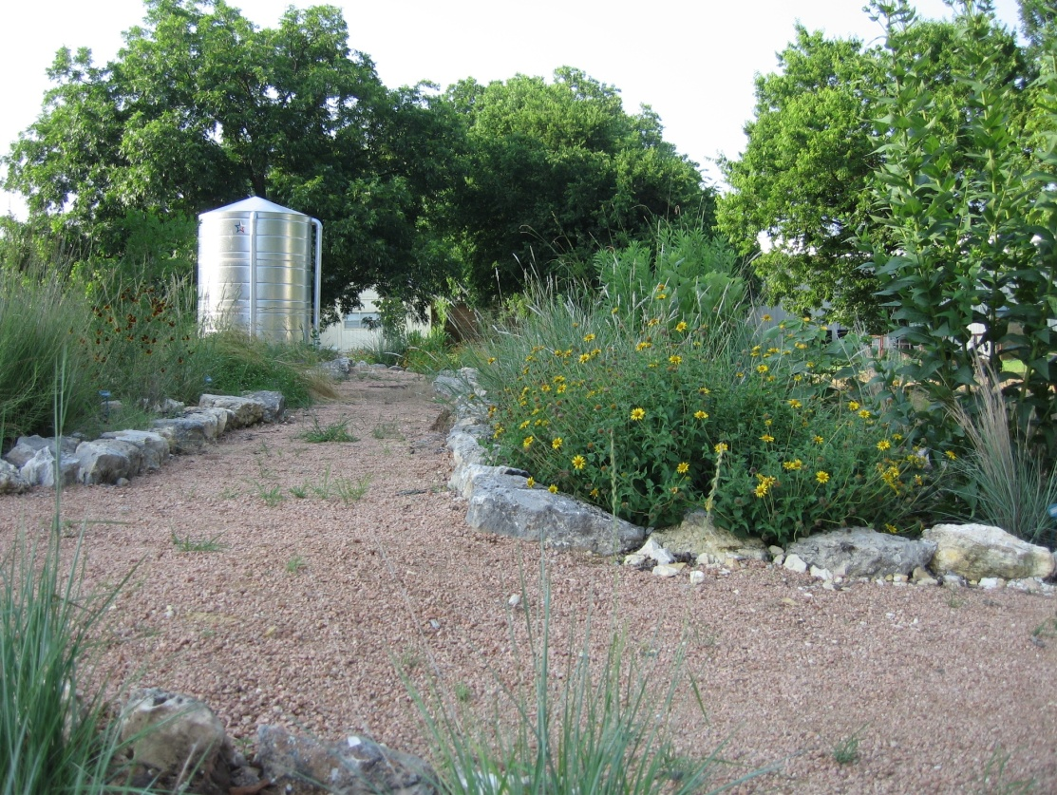
The Further West You Go (for the most part)
Longer periods between rainfall events
Less total rainfall
Larger roof area needed
Greater storage
capacity needed

Slide 16
Rainfall Per Month “Texas Manual on Rainwater Harvesting”
Maximum per month
Minimum per month
Average per month
Median per month
Average annual rainfall

Slide 17
Annual Rainfall for Athens http://www.srh.noaa.gov/ffc/html/rainresrc.shtml
Athens
1996 45.49 2002 46.32
1997 56.80 2003 50.11
1998 50.20 2004 43.08
1999 41.45 2005 58.41
2000 35.45 2006 40.20
2001 39.72 2007 31.51
2008 Jan-2.60 Feb.-3.56 March-3.48 April-3.00 So far in 2008-12.64
1971-2000 30 yr avg 4.69 4.39 4.99 3.35 3.86 3.94 4.41 3.78 3.53 3.47 3.71 3.71 47.83
Jan Feb Mar Apr May Jun Jul Aug Sep Oct Nov Dec Annual

Slide 18
Online Calculator http://rainwaterharvesting.tamu.edu/

Slide 19
Online Calculator
http://rainwaterharvesting.tamu.edu/
User Defined Site Information:
Square Footage of Catchment Area =
Coefficient for Catchment Surface =
Available Storage =
Month Yield =
Demand =
Cumulative Storage
Monthly - January February March April May June
July August September October November December

Slide 20
How Much Storage Do I need?
As much as you can afford?
I have not heard anyone say they have too much
Realistic - based on catchment area
Currently
Needed to meet the demand
If not enough water
Backup supply
Add more roof area
Reduce demand

Slide 21
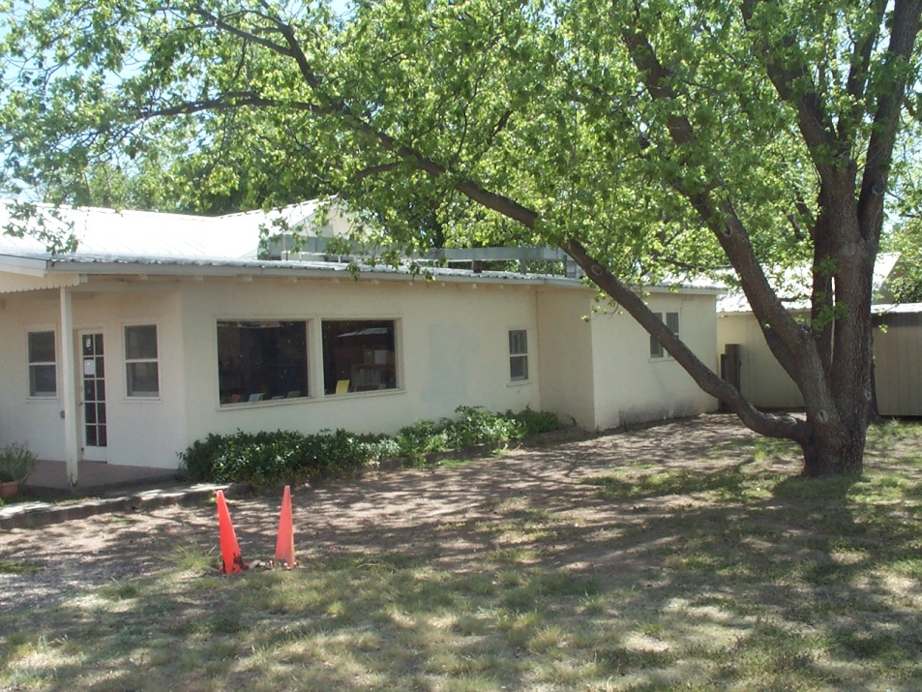
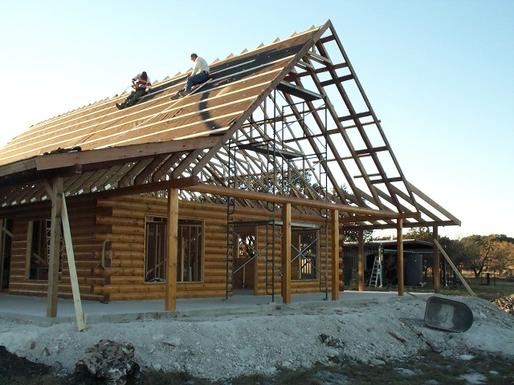
New Construction VS Retrofit

Slide 22
New Construction
Consider Storage location
Lay piping down while other pipes are laid
For non-potable uses – lay separate line to toilets (Mark pipes – color or labeled)
Add additional hot water heater/solar heater for clothes washer
Mark outside facets
If all potable use – use alternatives to copper
Plan gutters, downspouts, piping
Plan filters, sanitation where easy to get to
Consider gray water

Slide 23
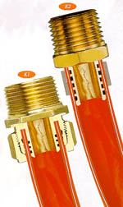
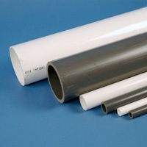
PVC schedule 40 is for socket fittings only. For UV resistance of PVC pipe and fittings, paint with a white water based latex paint. Aluminum-Plastic Composite Water Piping Multipurpose pressure piping that can be used for hot and cold water distribution indoors and outside Composite piping is approved by all national code bodies. Copper – more likely to erode with lower pH

Slide 24
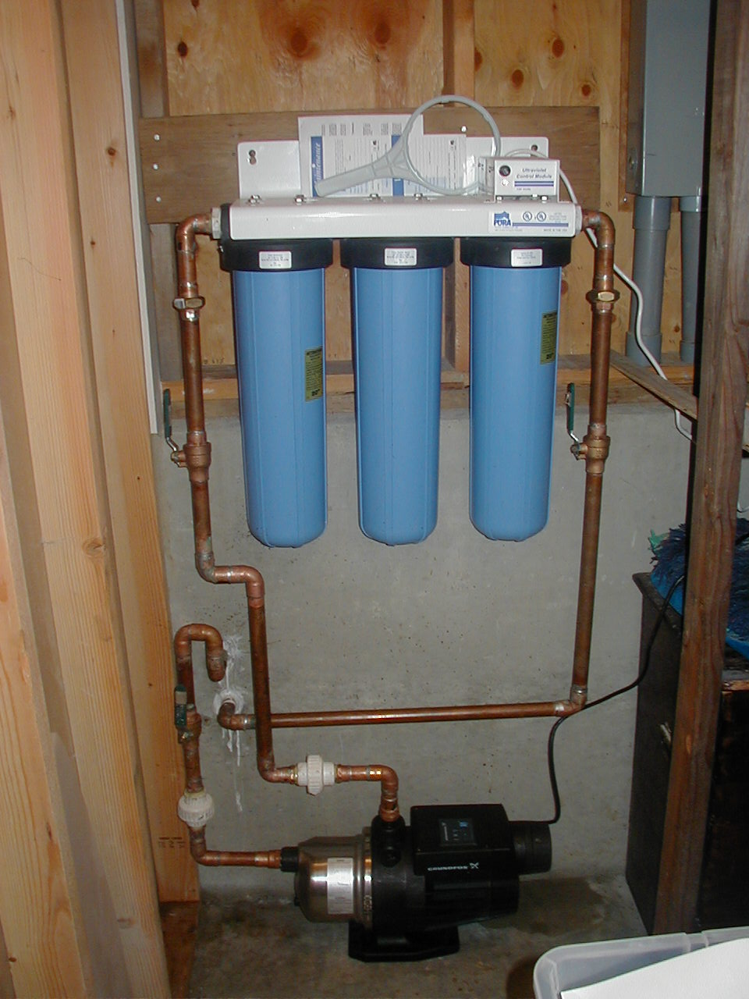
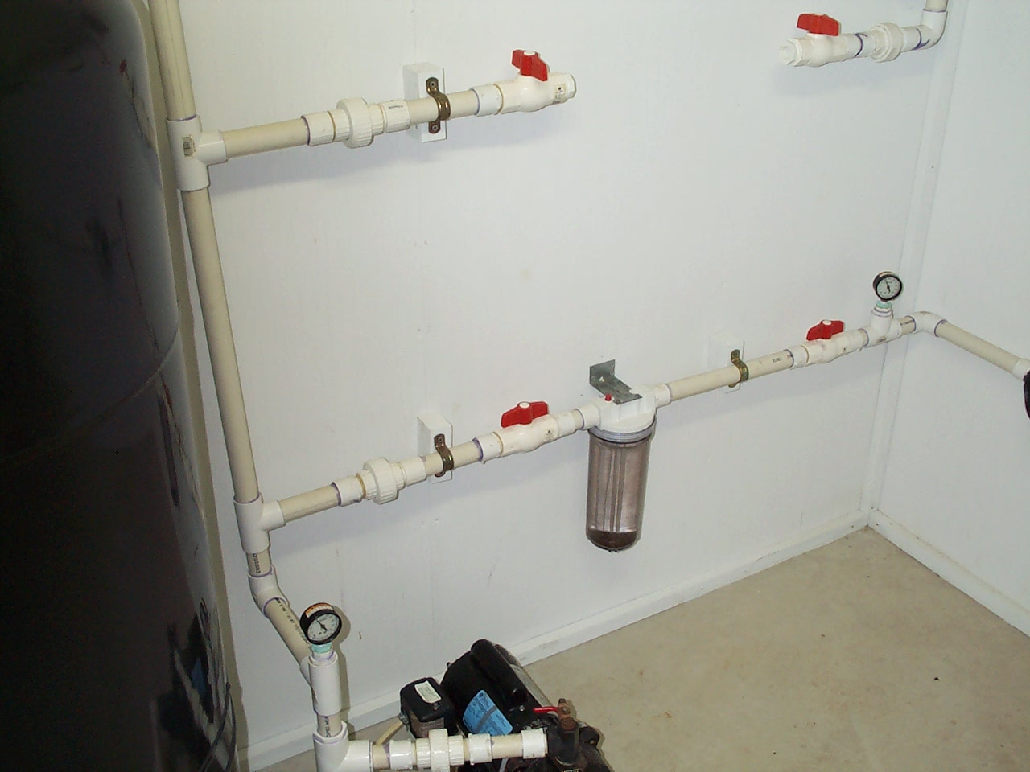

Slide 25
Retrofit
Consider gutters, downspouts, storage location, existing pump house and lines
Trenching – consider existing water, electric and sewer lines
Potable vs. non-potable use
Non-potable – commode – separate lines
Washing machine – separate hot water heater
Shower required to be potable
Consider gray water for commodes
Consider outside use only

Slide 26
Facts Gathered – Ready to Start
I know how much storage I need
New/retrofit
Potable or non-potable
Restrictions on size of tank, location
How much money is budgeted
Who is doing it

Slide 27
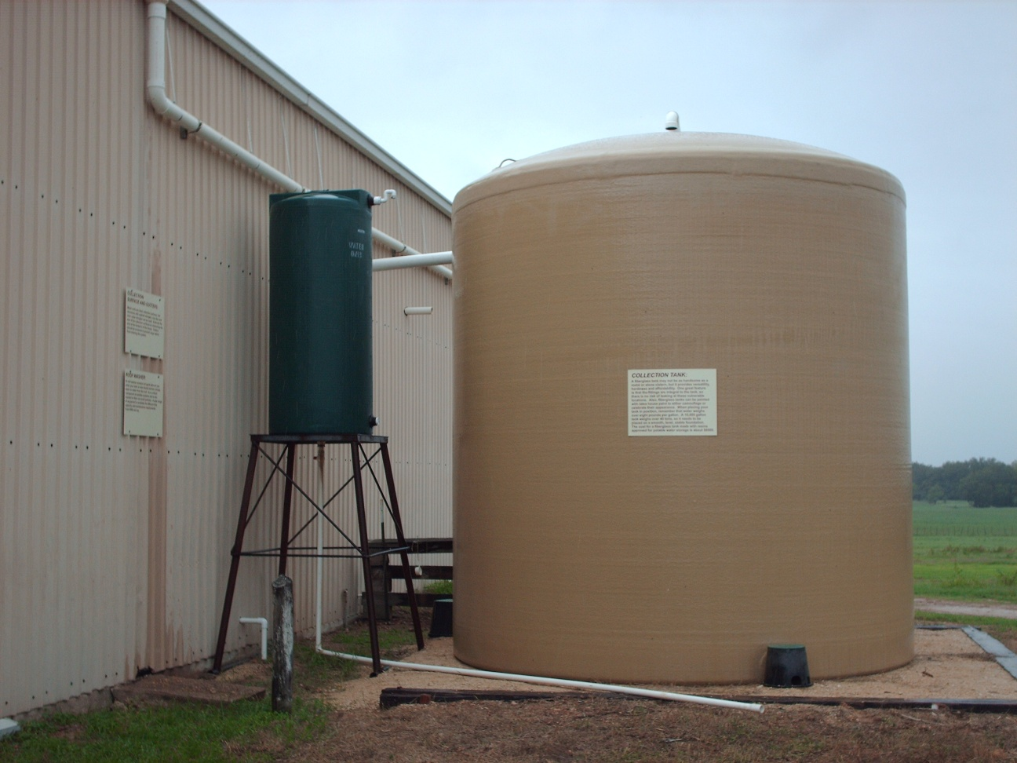
Roof
Gutters and downspouts
Storage tanks
Filters and sanitation
Maintenance

Slide 28
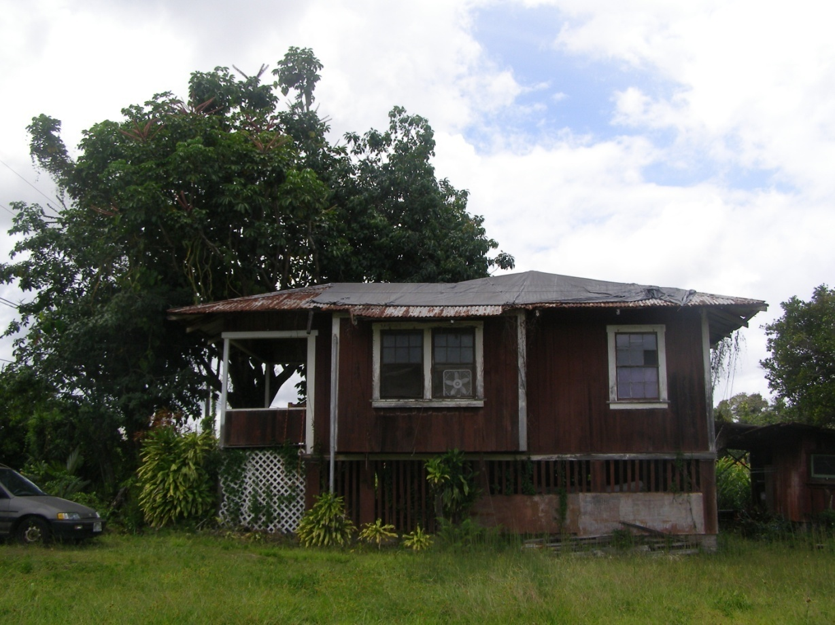
Roofs and Collection Surfaces
Notes:
The roof can be of many sizes, design and material. For outside use, any roof material is ok. But the slicker the roof surface, the less dust, debris and foreign material will be held of growing there. For in-home use, tin is best.

Slide 29
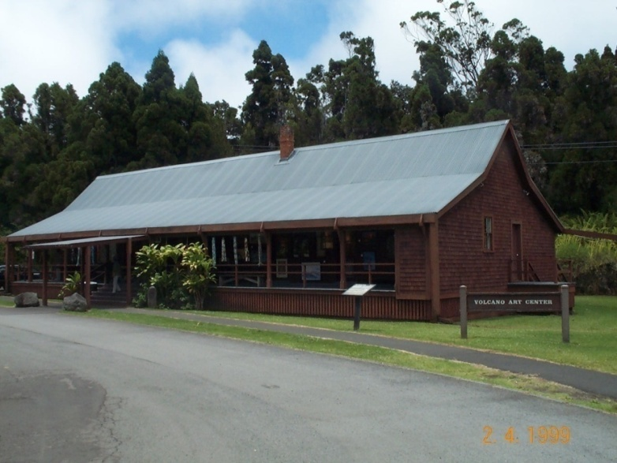
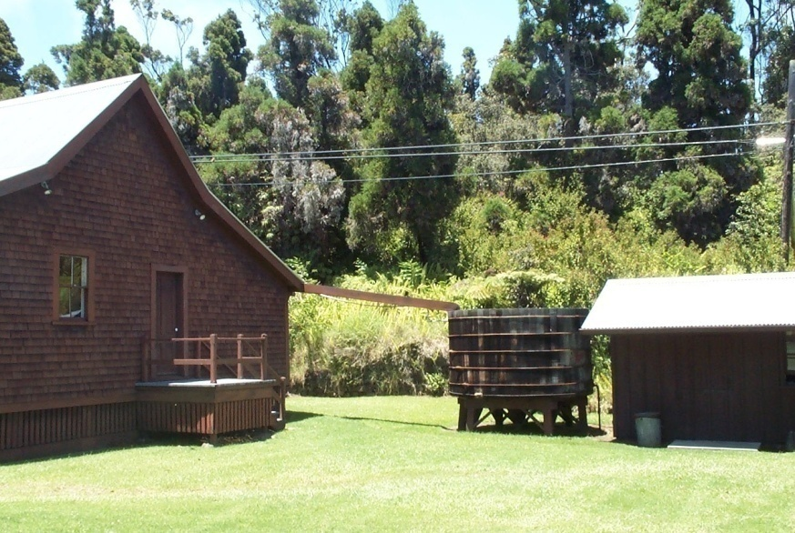
Roof Material
Galvalume - NSF approved for drinking water
Galvanized – increased zinc
Watch for lead nails - soldering
Composition roof – leach oils, some have been impregnated with zinc/copper to control mold

Slide 30
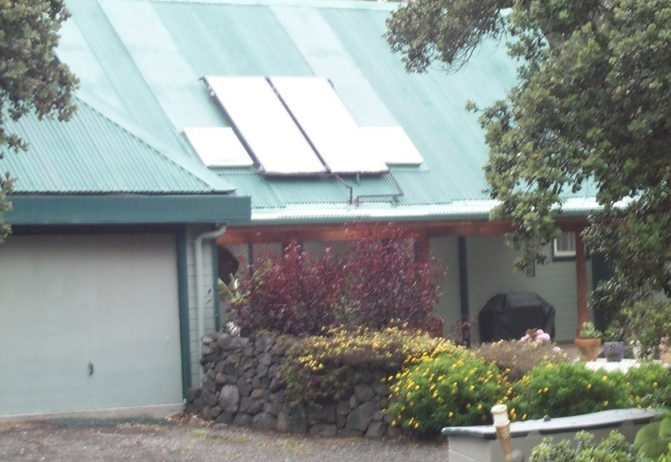
Roofs and Collection Surfaces
Wood shingles – absorbs water and stays moist longer
Tile roofs – absorb more water
Solar panels – great surface
Acrylic coating over old tin
Older Roofs - lead

Slide 31
Roof Sealants or Paints
NSF protocol P151
(designed specifically for testing rainwater harvesting systems)
Or ANSI/NSF Standard 61
Designed for general materials in contact with potable surfaces

Slide 32
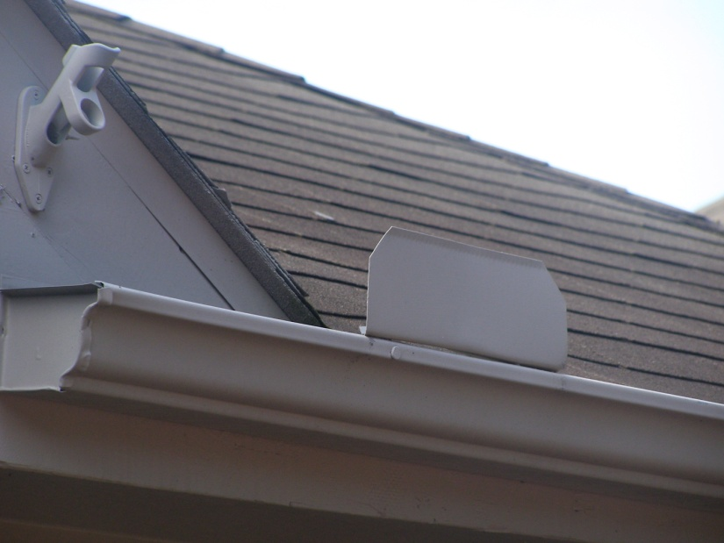
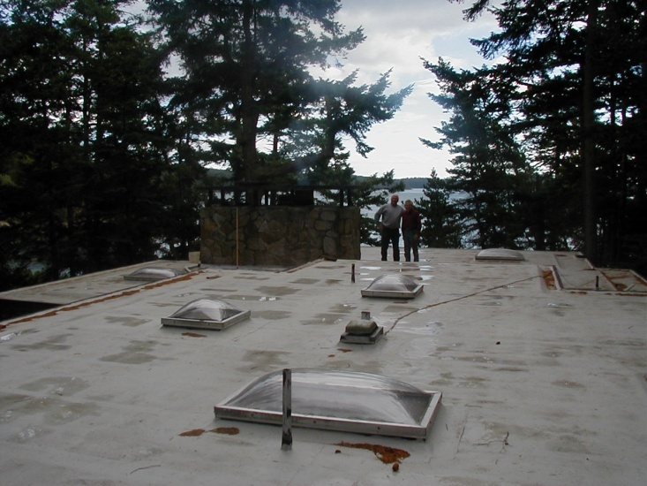
Roof Slope
Steep roof
Water comes off faster
Cleans contaminants faster
Gutter must stop and transport it faster
Flat roof
Water moves slower
Contaminants very slow to run off

Slide 33
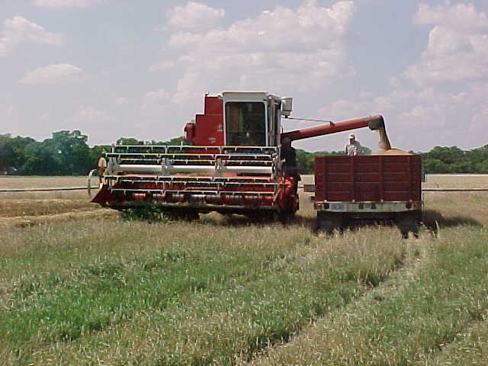
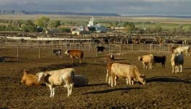
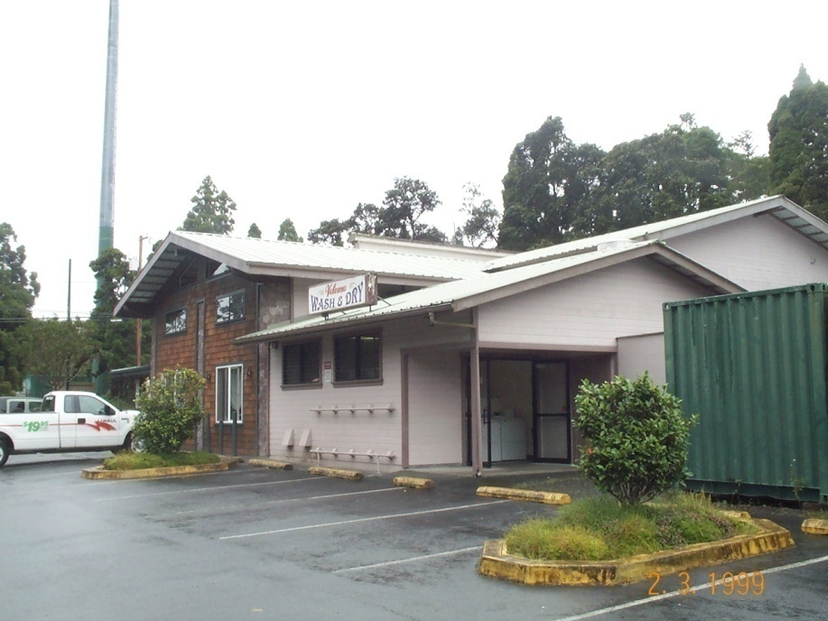
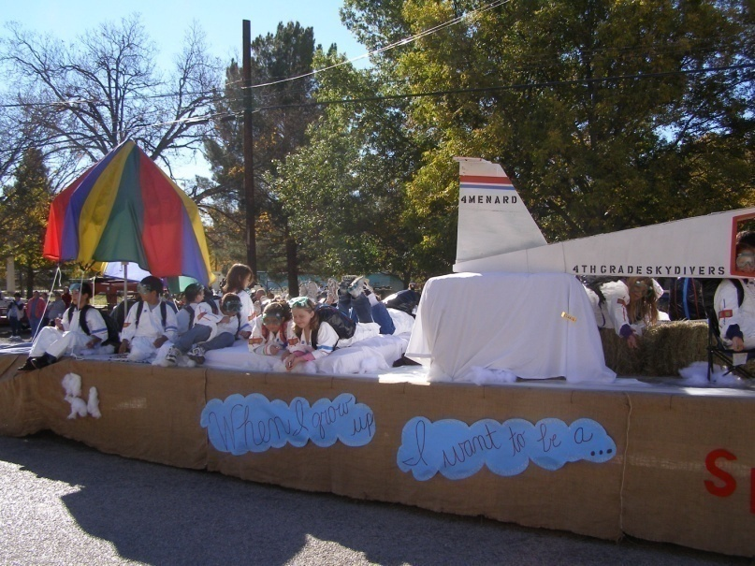
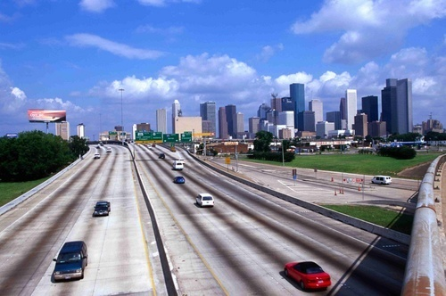
Who are your neighbors?

Slide 34
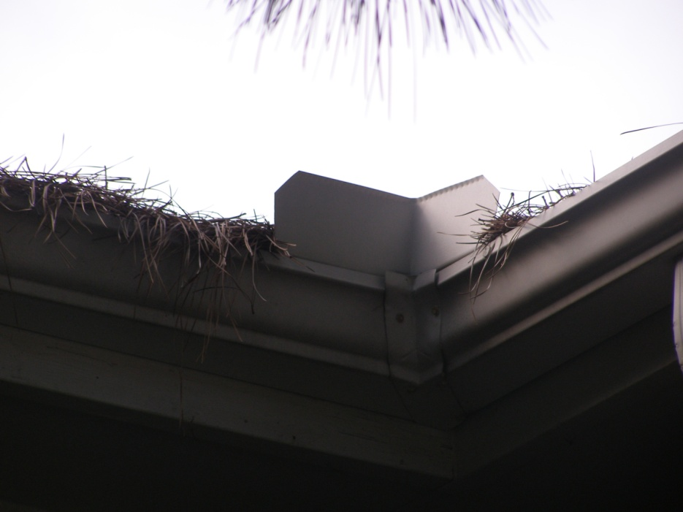
Amount Of Water To Divert
Slick steep roof – 1 gallon per 100 square feet
Less slope or porous roof – 2 gallons per 100 square feet
More or less depending on location and possible contaminants

Slide 35
Smog vs Dust Humid Areas vs Arid Areas Heavy Rains vs Light Showers Trees vs. No trees

Slide 36
Green Roofs – Runoff For Non-potable Uses

Slide 37
Greenhouse as Roof – Non-potable

Slide 38
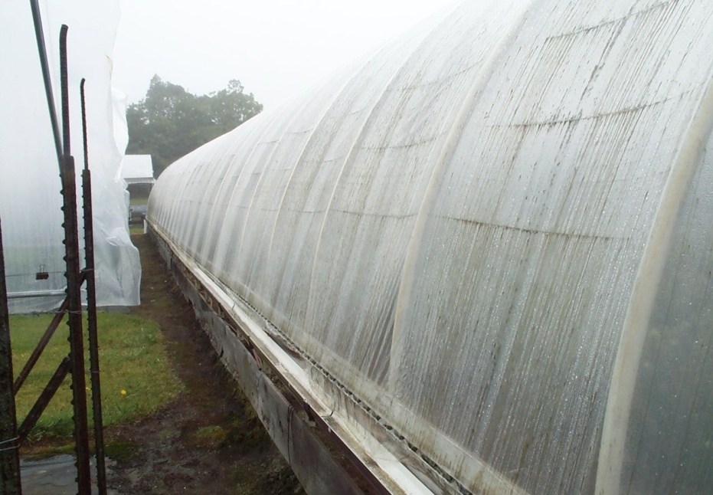
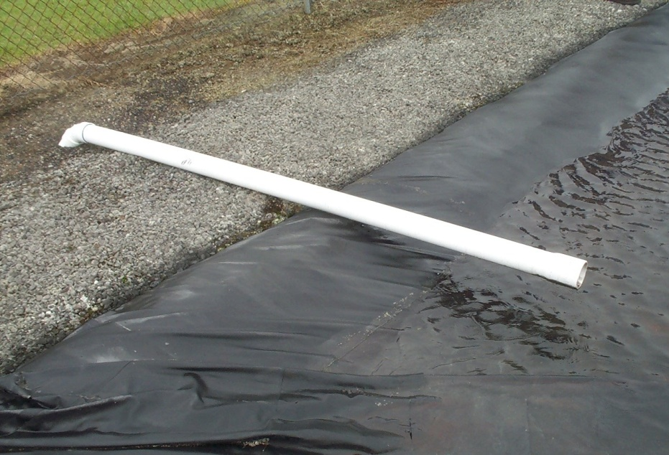
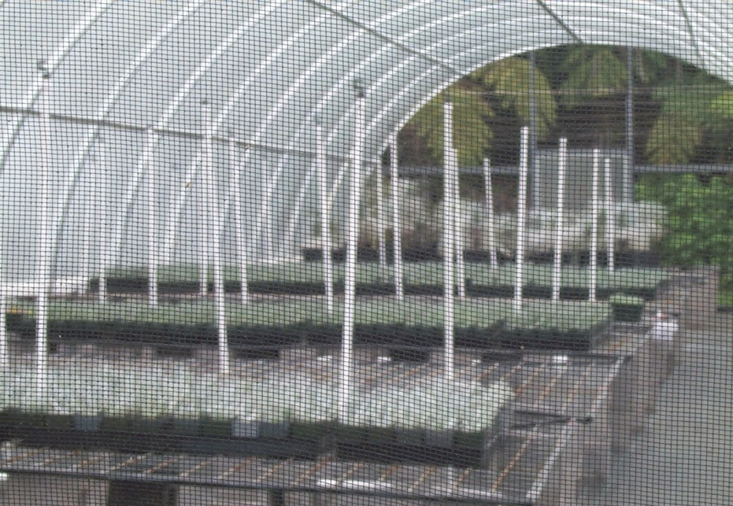

Slide 39
Gutters And Down Spouts

Slide 40
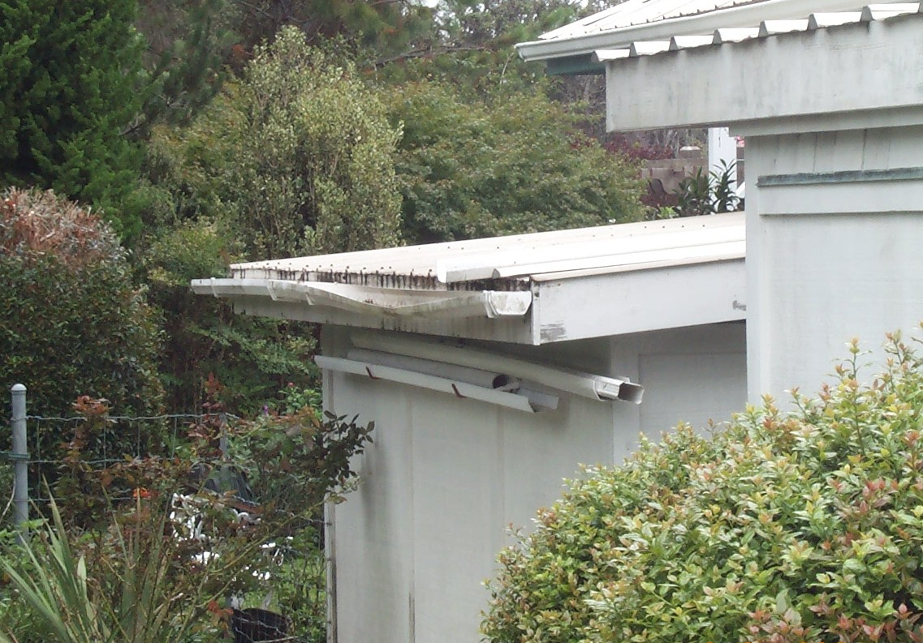
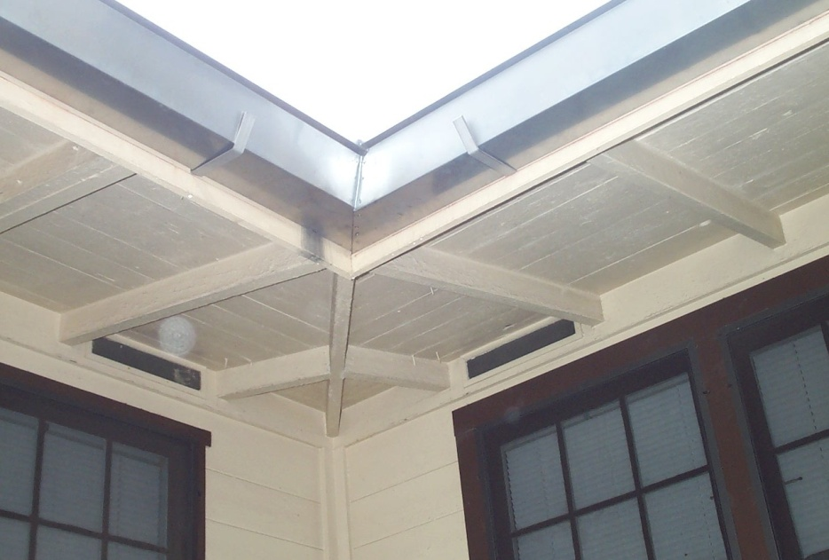
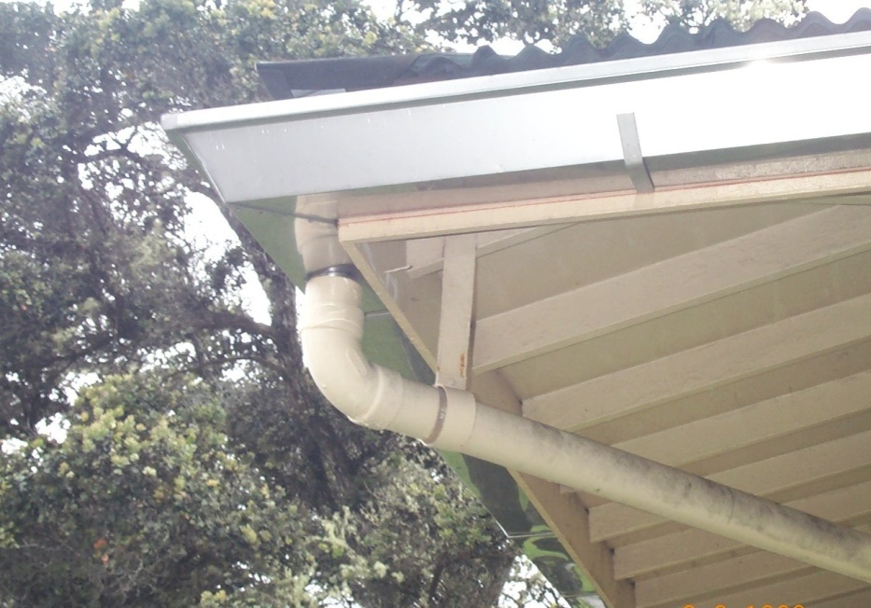

Slide 41
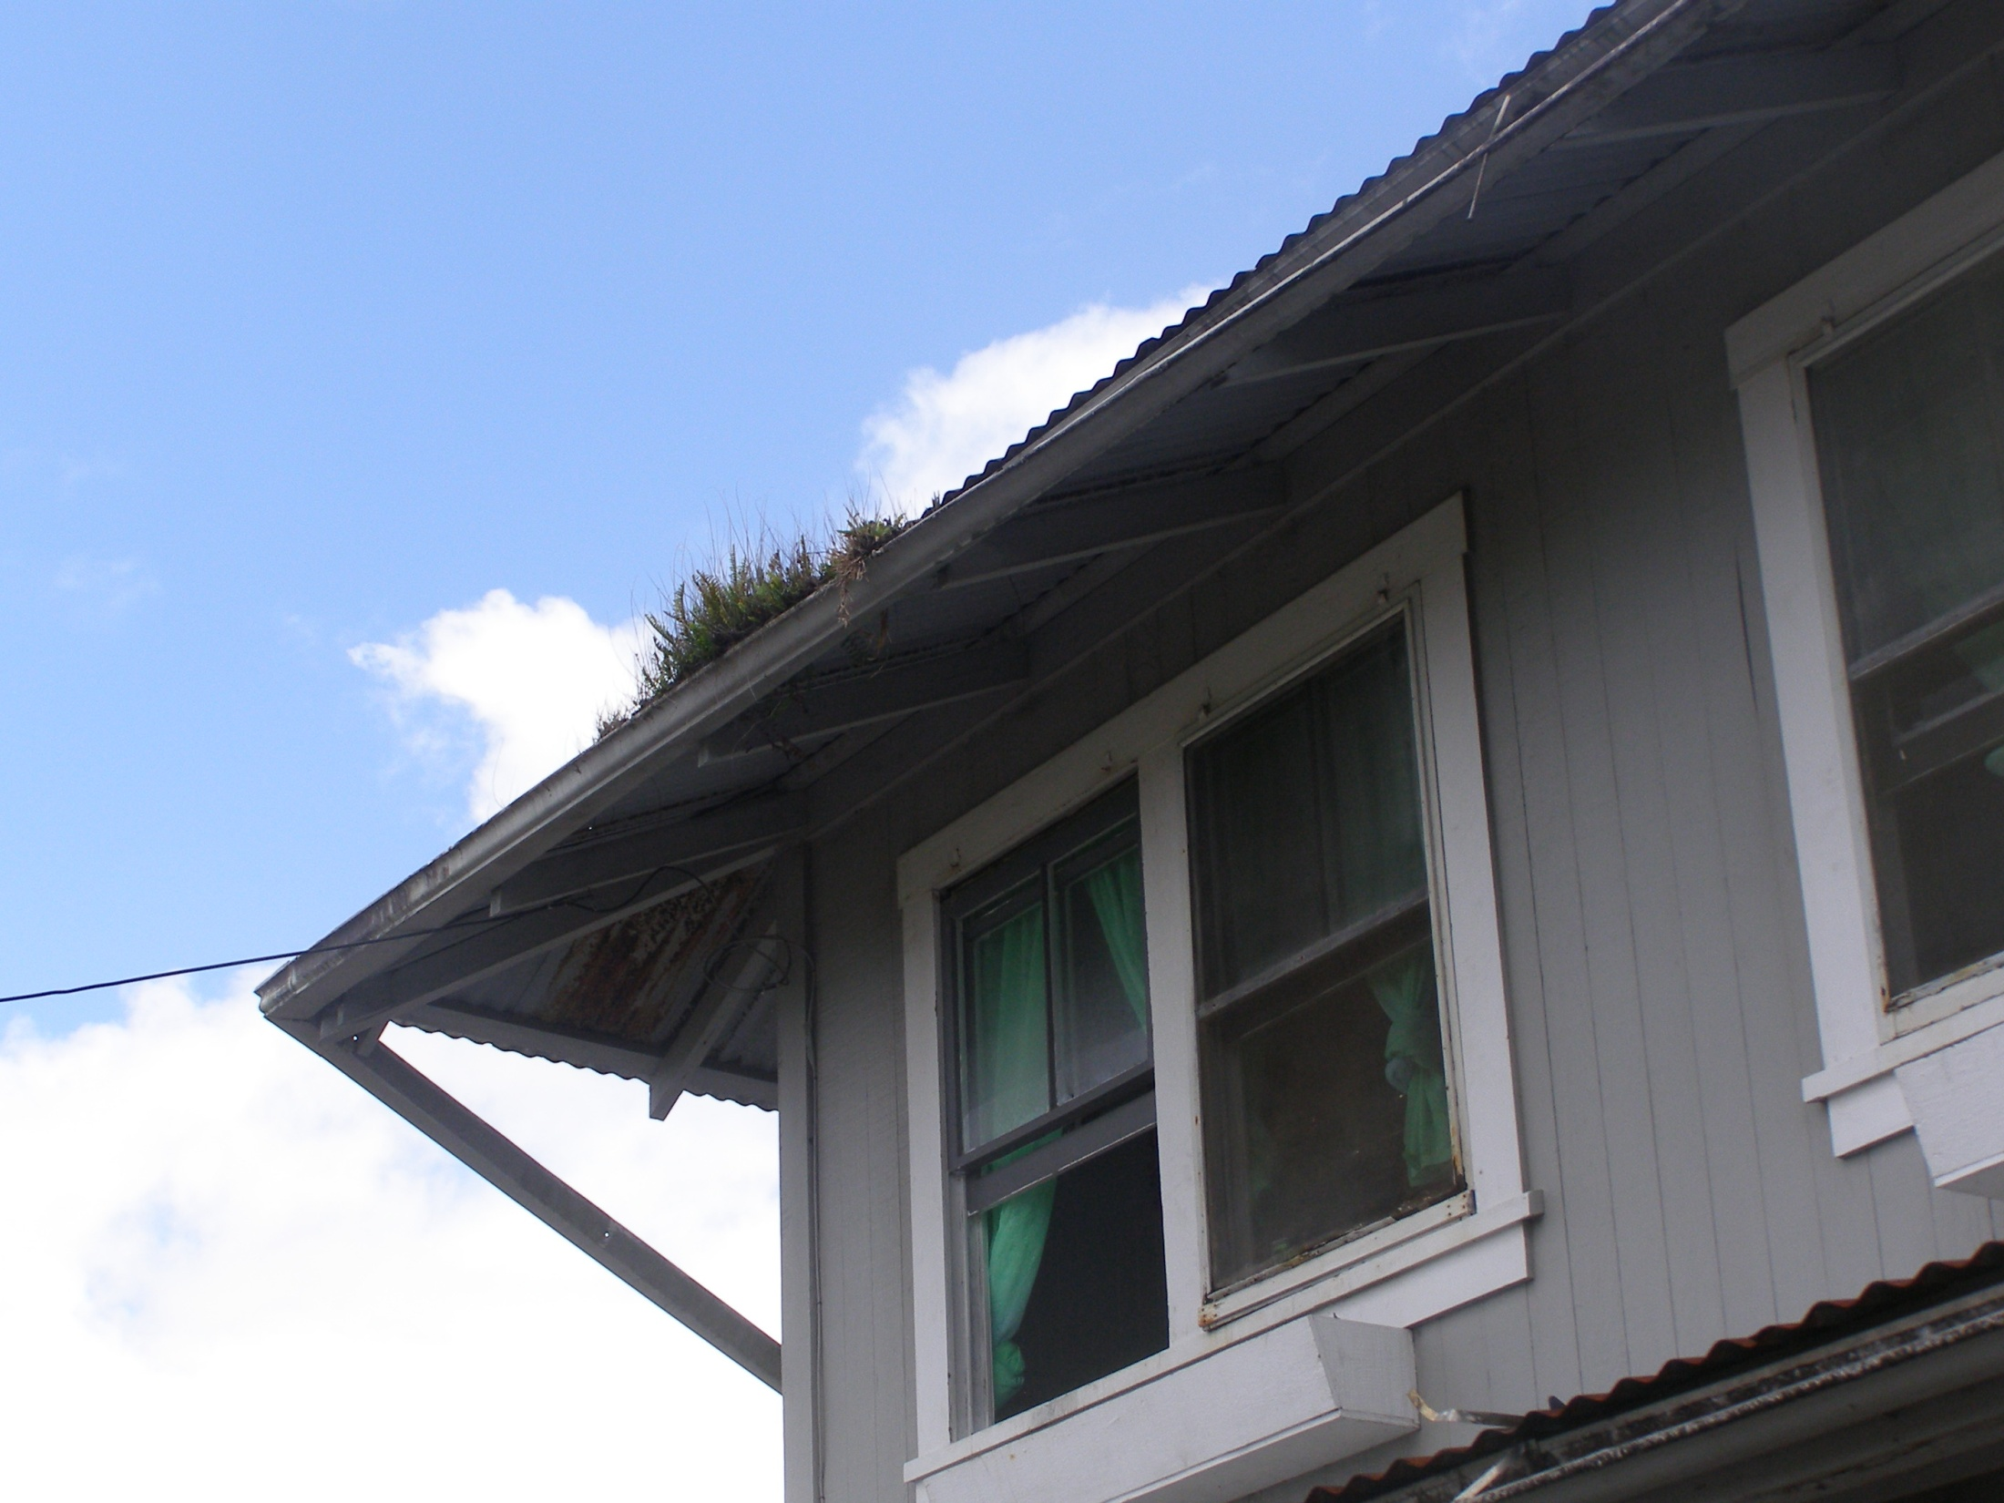

Slide 42
Birds and Other Critters
The Quality Of water Going Into The Tank – Improves The Quality of Water at the Tap.

Slide 43
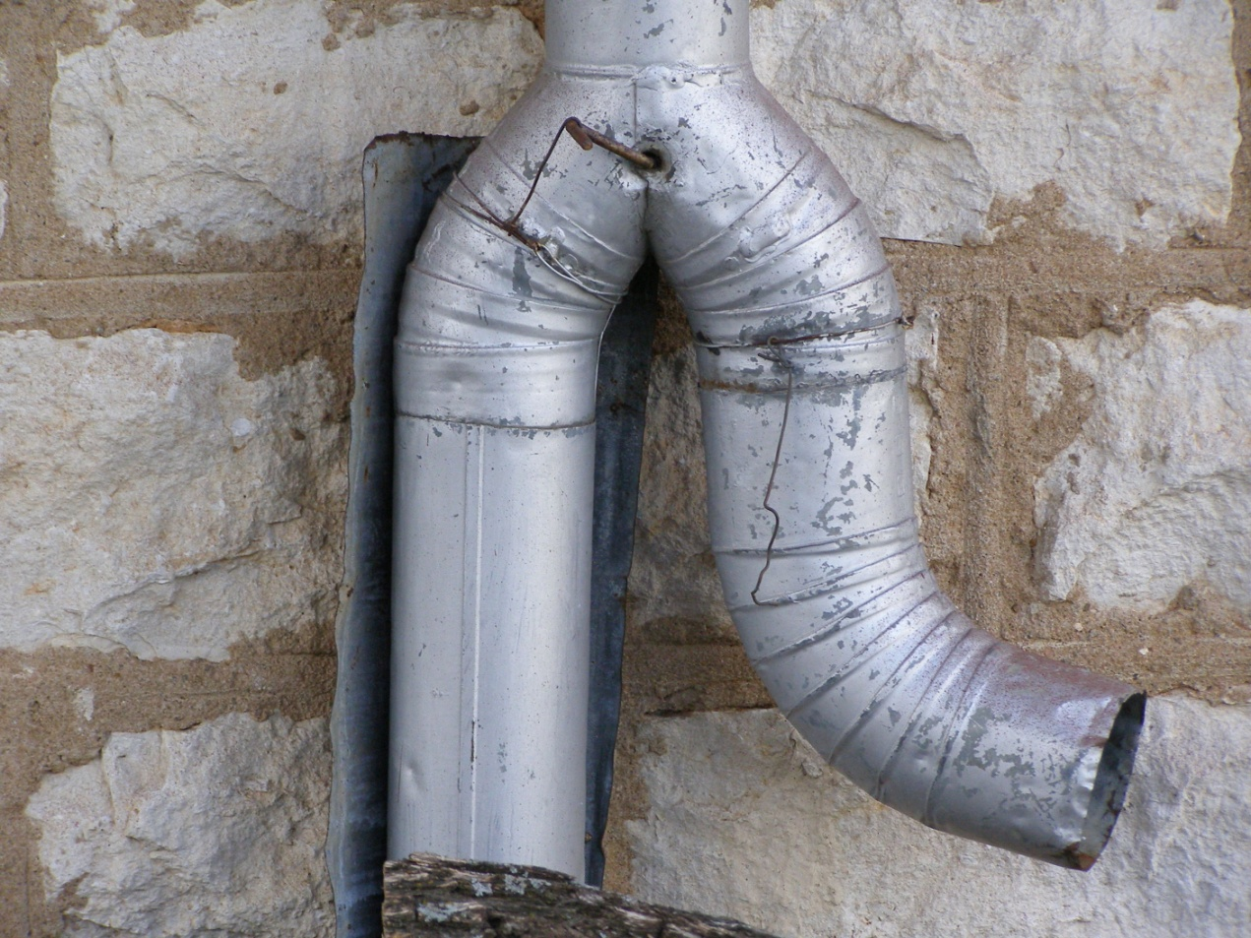
First Flush – Water Diverters

Slide 45
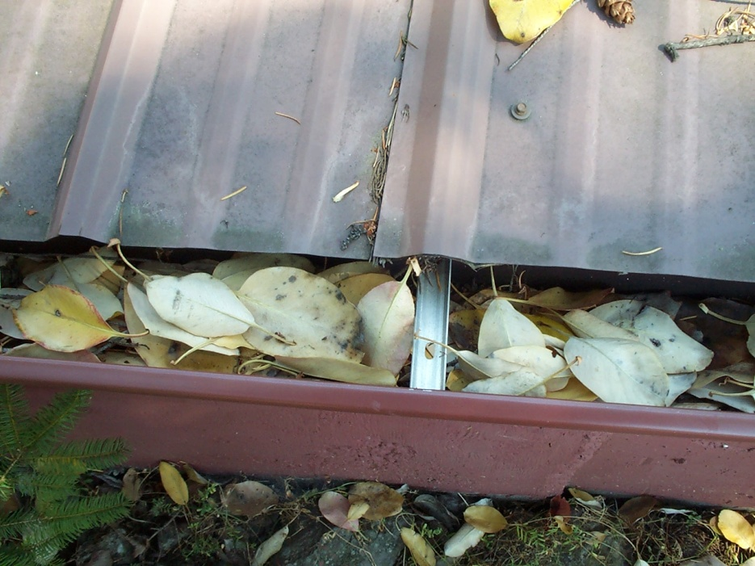
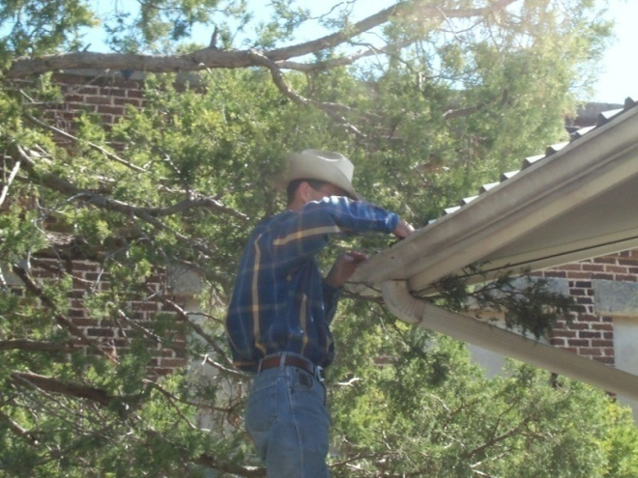
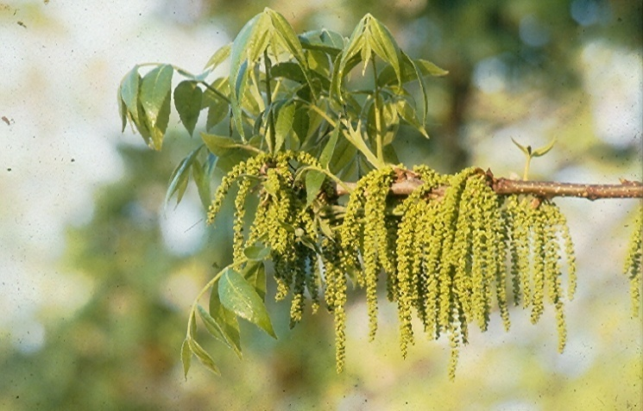
Trees and Leaves
Leaves
Leaf guards - Screen
Pollen and Catkins
Increase first flush
Don’t catch it at all if you do not need it
Prune trees

Slide 46
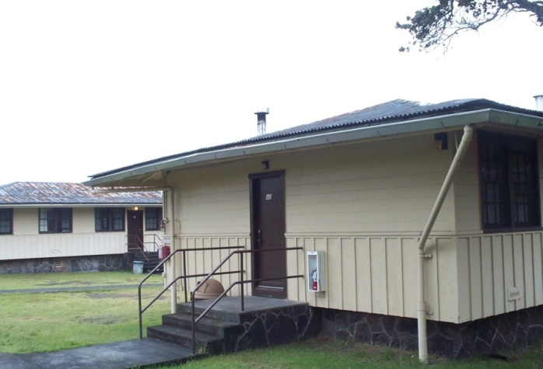
Gutters
Materials – vinyl, seamless aluminum gutters, galvanized steel, stainless steel, copper
Slope towards the downspout
Valleys
Number of downspouts – varies with size and surface area – 1 per 1,000 square feet surface
Stainless steel gutters slope to
each end to the downspouts

Slide 47
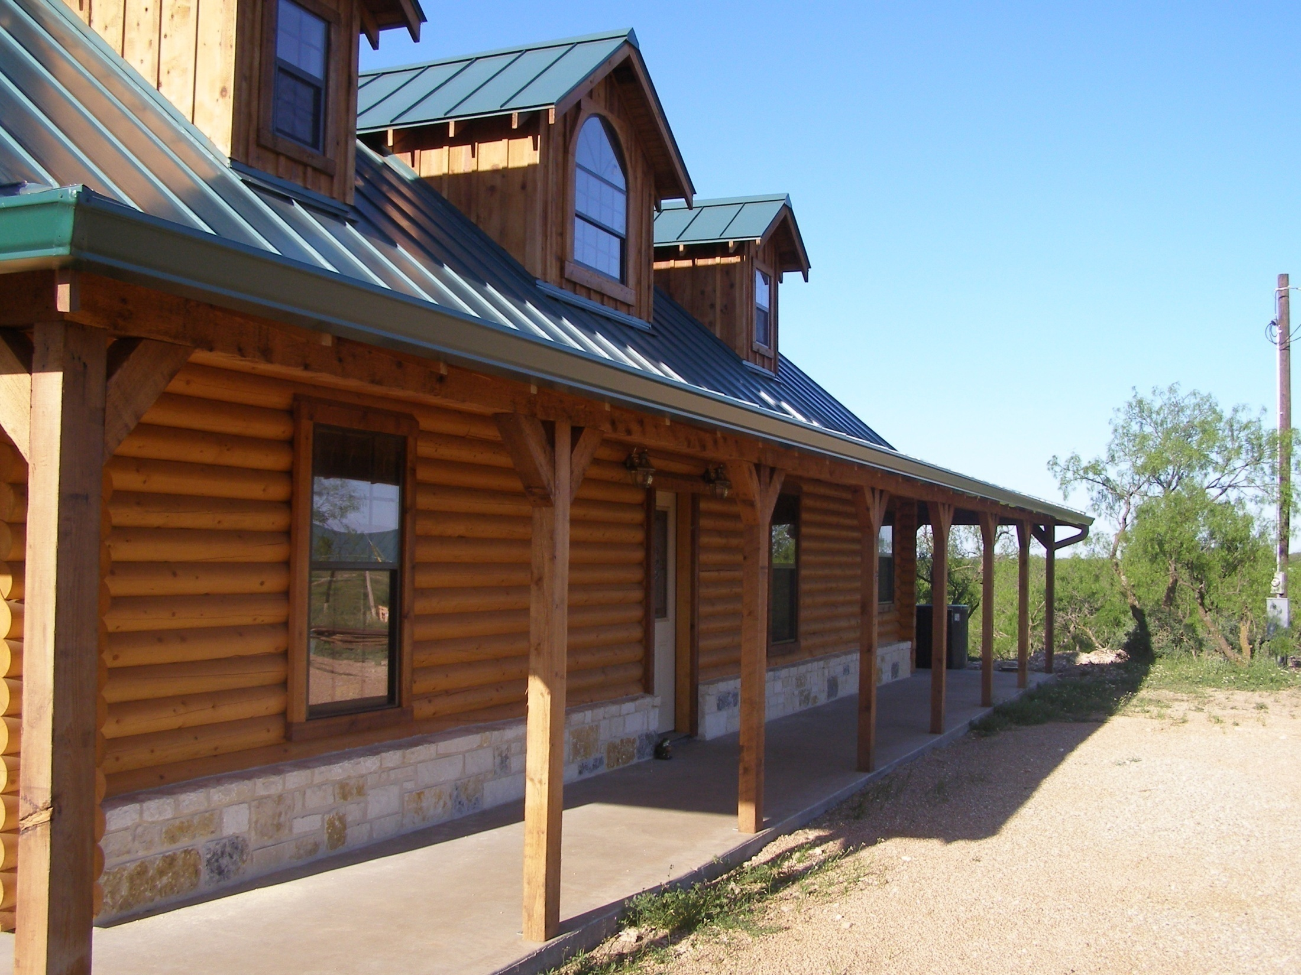

Slide 48
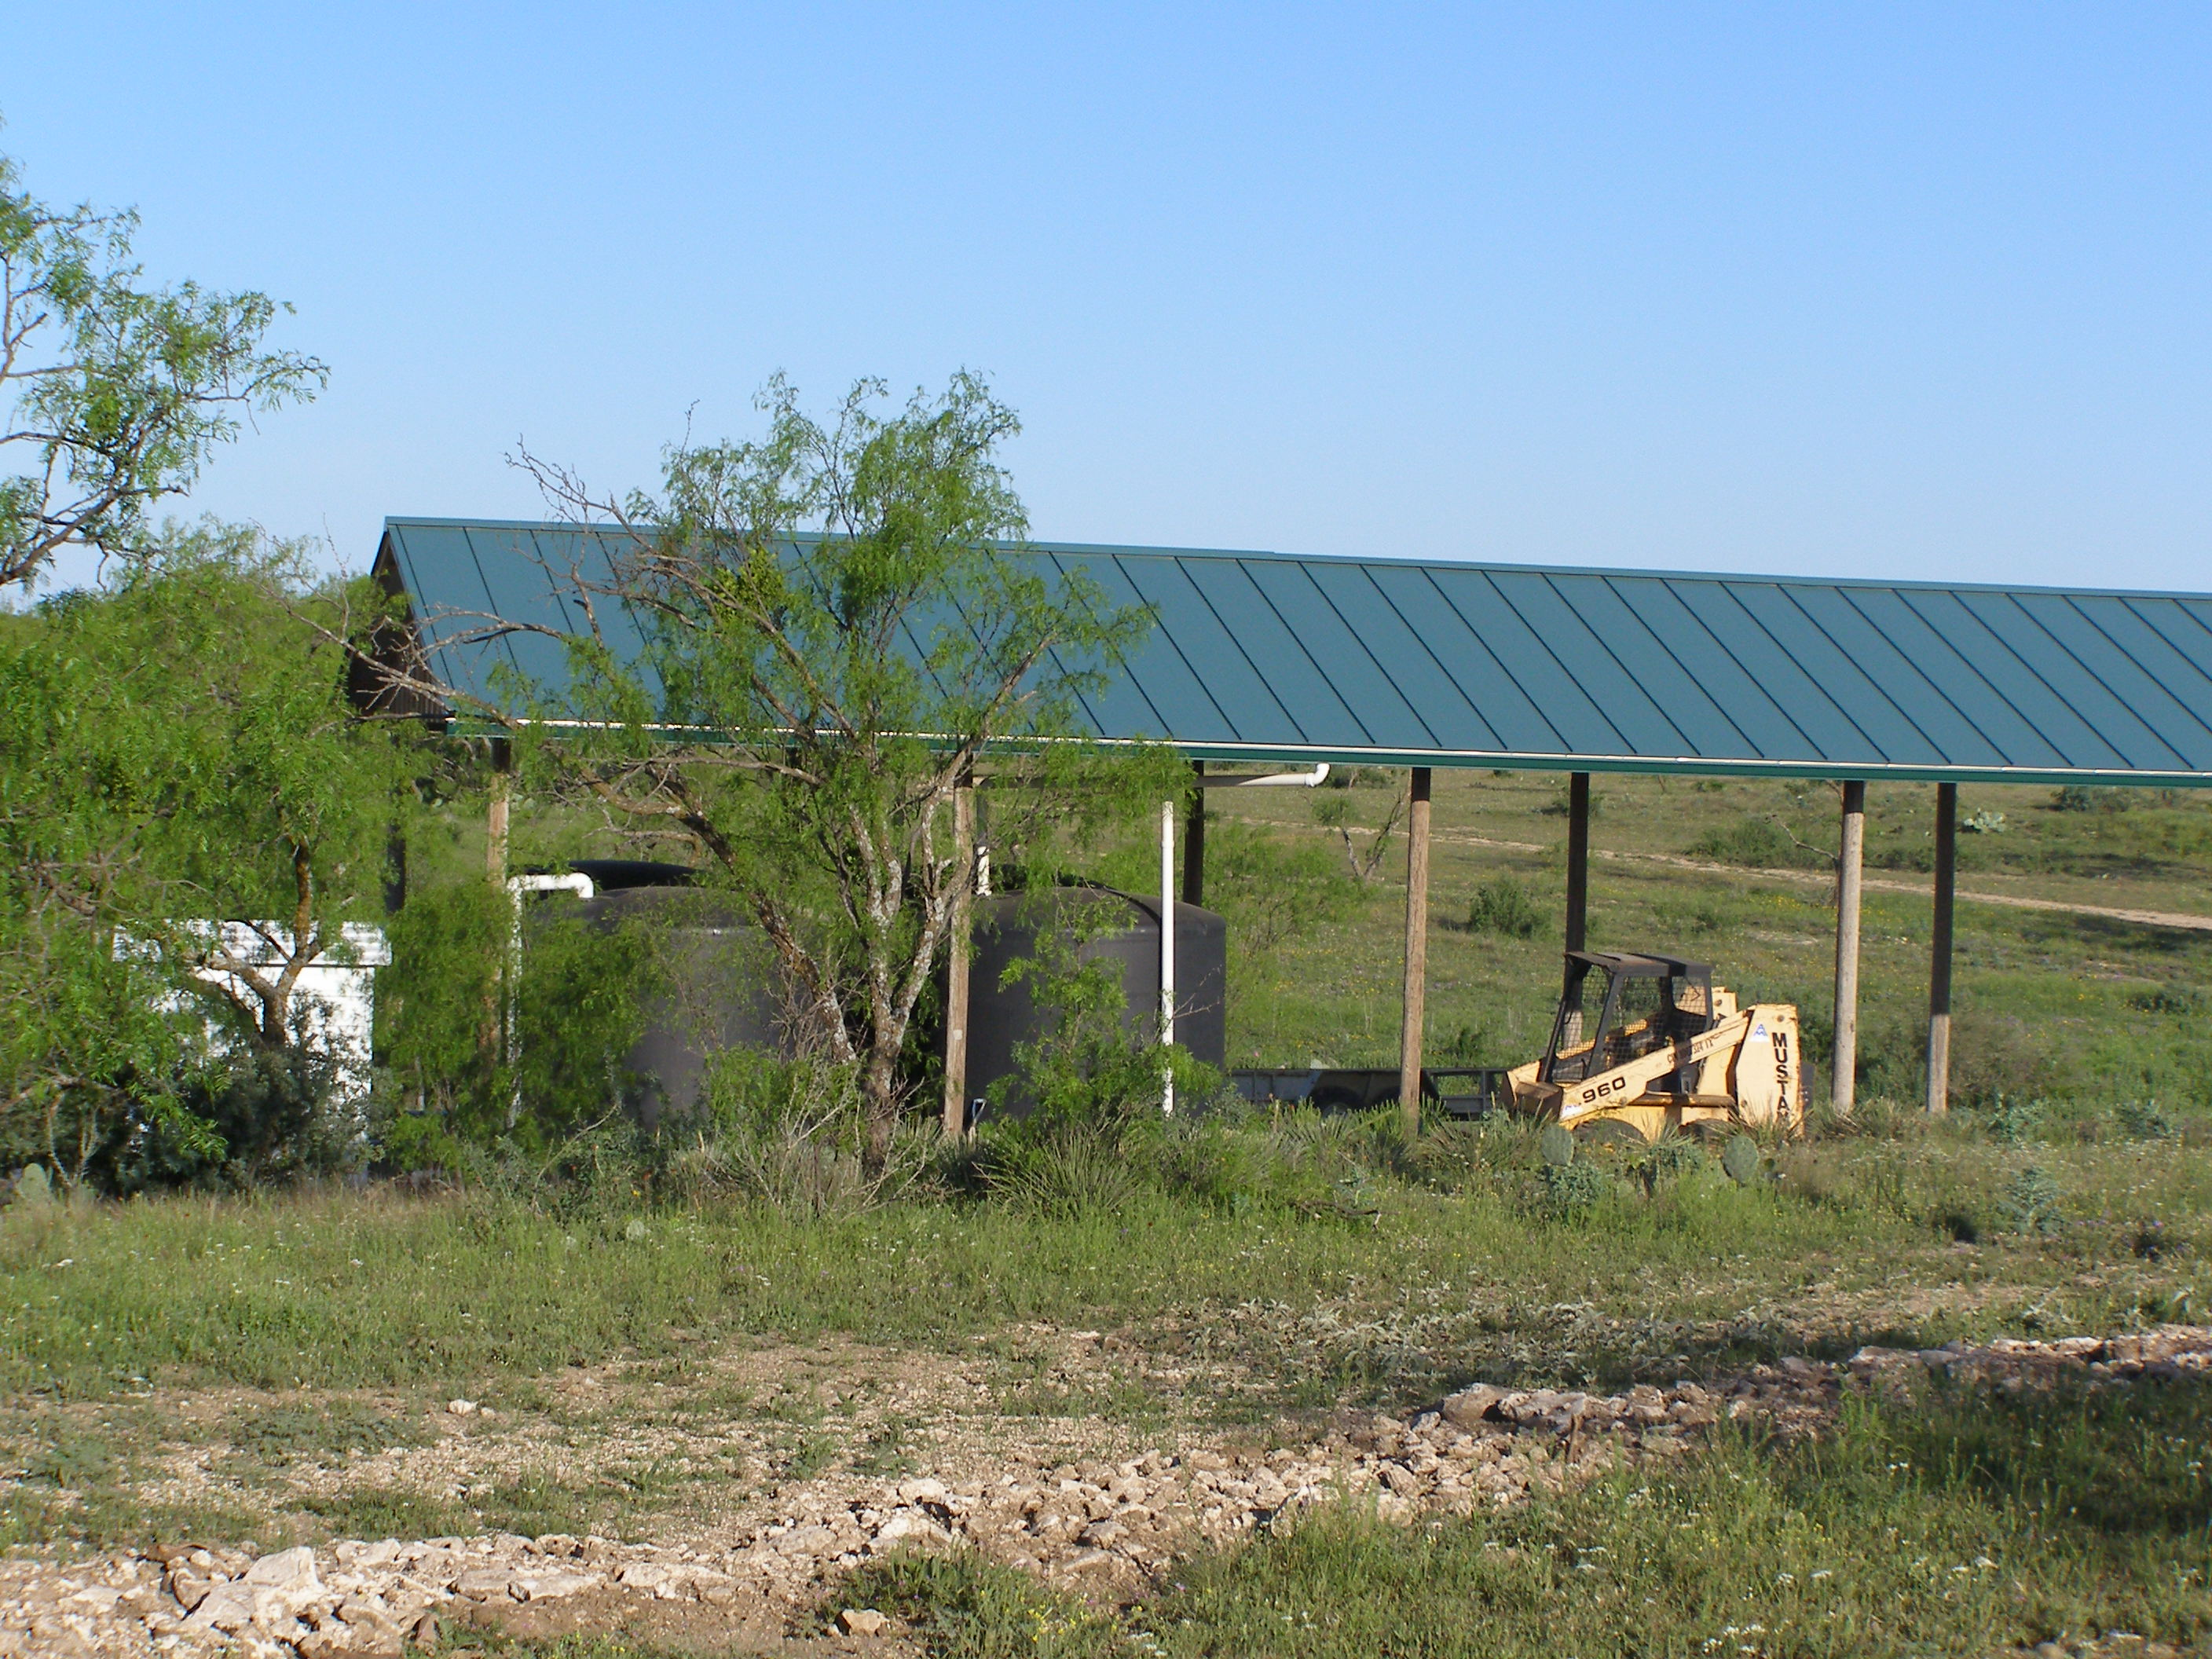

Slide 49
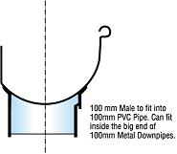
Weight – 8.33 lb/gallon 7.5 gallons per cubic foot

Slide 50
Gutter Slope Towards The Downspout-To Prevent Standing Water Tilted Out – To prevent Water From Seeping into the Walls

Slide 51
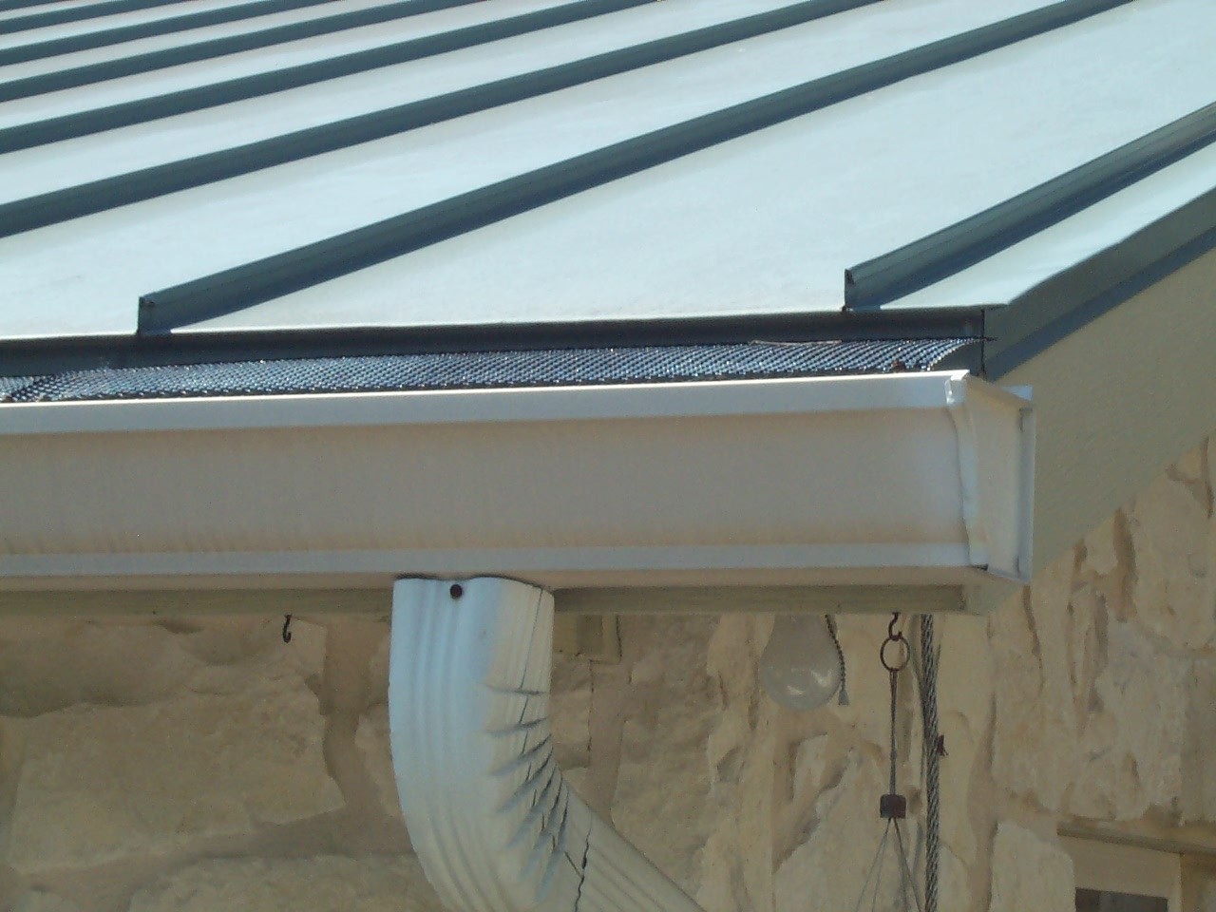
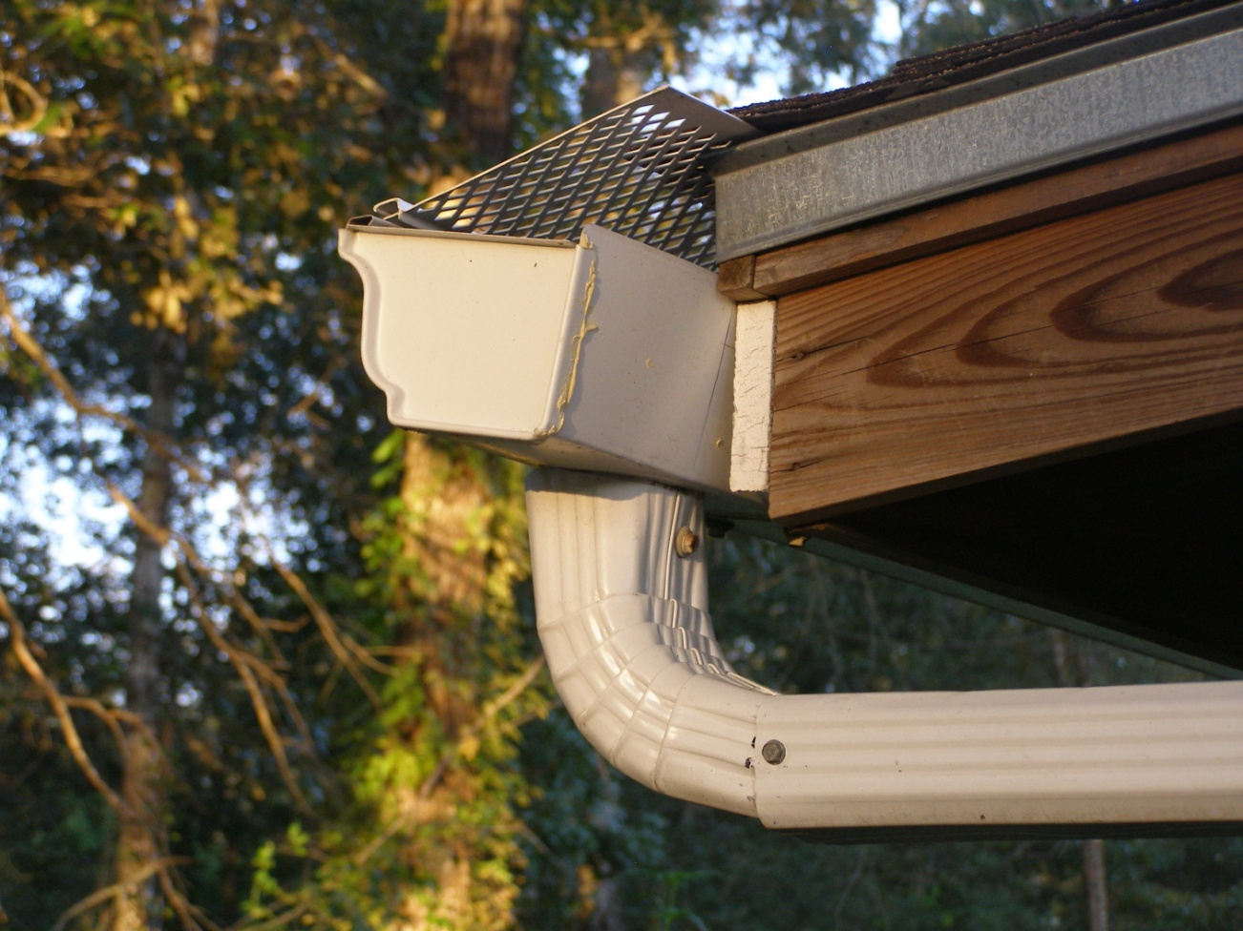
Leaf Guards

Slide 52
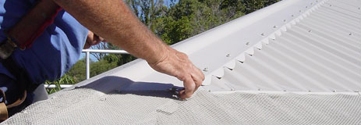
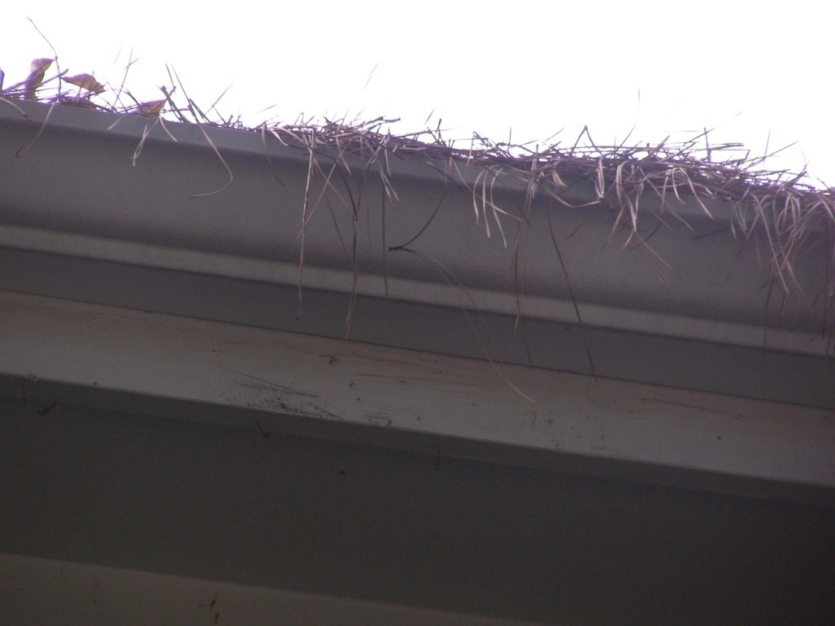

Slide 53
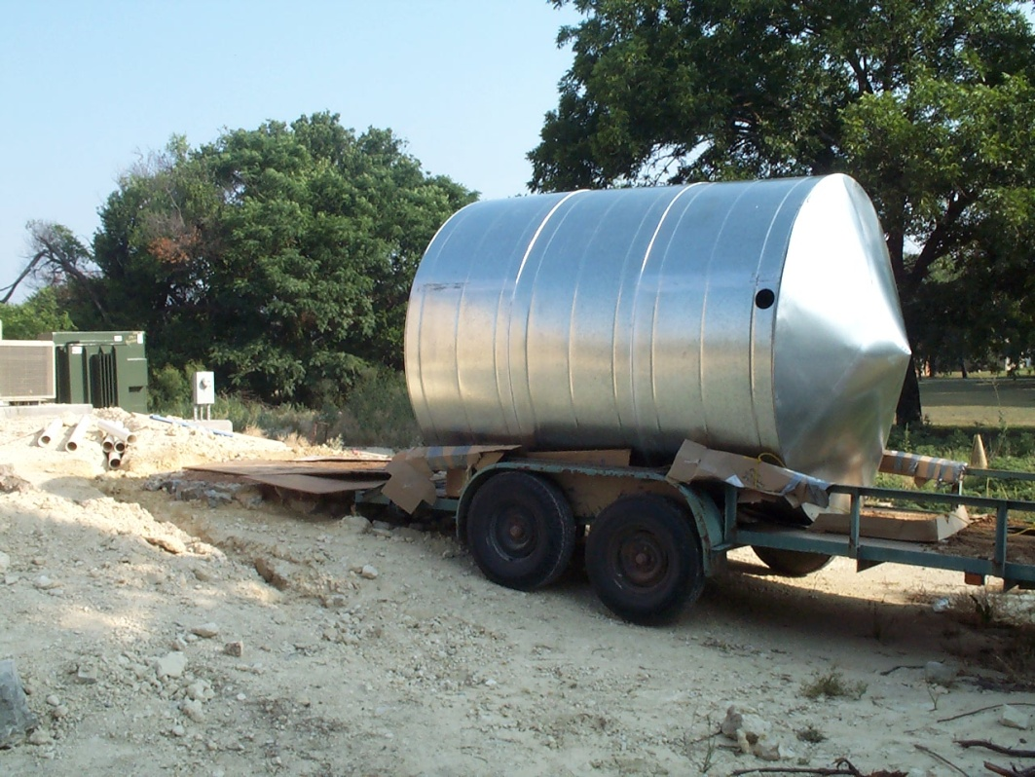
Site Preparation

Slide 54
Pad Preparation
Tank pads – level, no rocks or roots
Sand, fine gravel, soil
Do not let base wash or erode away
Gravity feed from the gutters or
Collect into smaller storage and pump into larger storage
Longer distances – more resistance/friction - larger pipe needed

Slide 55
Location Dictates $
Soil or rock type – trenching, leveling digging
Storage under the porch, patio, basement
Smaller sizes, or gahnite or poured cement
Requires excavation or professional
Under ground – special designed tanks
In a barn, outside, next to the house

Slide 56
Sight Selection for Tanks
Consider :
soil (or rock)
Elevation – gravity flow or pump water to storage tanks
Distance tanks will be from the house
Distance to electricity, filters, freeze protection
Restrictions in subdivisions
Screening, rain barns
One large tank or several smaller ones

Slide 57
Youth Livestock
Show Facilities
10,000 Gallons

Slide 58
Study site – slope, places for storage – Above or below ground -Rocks – Clay soils

Slide 59
Dry Systems

Slide 60
Dry System –Wall School
Notes:
The 3000 gallon collection tank at this elementary was installed and within a week there came a major rain filling the tank. This water is being used for the landscape project.

Slide 61
Wet Systems

Slide 62
Who Knows Type System

Slide 64
Sand Filters

Slide 70
Notes:
The cleaner the water is going into the tank, the cleaner it will stay. Roof washers, filter baskets, screen mesh, filters with chambers, settling tanks all catch leaves, bugs and other debris.

Slide 71
Leaf Trap With Screen
Stay Away From Electricity

Slide 72
First Flush – Roof Washers

Slide 74
German Model of Rainwater Collection
Pre-filtering to remove larger than 1/90 of an inch
Calming the inlet of water to prevent stirring of sediment
Use a floating intake in order to draw water near the surface
Construct overflow that helps skimming the surface

Slide 83
Downspout connection – “Doggie Proof”
Copper gutter – paint the inside with marine epoxy paint
Above ground high enough to keep surface water and soil from running in

Slide 84
Storage Containers

Slide 85
Concrete Tanks

Slide 86
Commercial Size Tanks

Slide 87
Concrete In The Basement

Slide 88
Above ground Steel tank with Poly liner……10,000 gallons

Slide 89
Above ground Steel tank with poly liner ……20,000 gallons

Slide 93
Cisterns Camouflaged

Slide 99
Below ground Poly Tanks 1500 gallons each

Slide 100
Overflow Pipe
The overflow allows water to run out of the tank when it is full rather than backing up into the gutter

Slide 101
Looped Overflow - Hawaii

Slide 102
Hiding Tanks

Slide 109
Holding Tank Bellow Grade and Pumped to Larger Collection Tank

Slide 112
The Cleanest Water is Just Below the Water Surface

Slide 116
BRAE Complete Systems

Slide 117
4 Steps to High Quality Cistern Water (WISY – Germany)
1. Pre-filtration – exclude particles greater than 1/90 inch in size
2. Calming Inlet – to not disturb bottom sediment
3. Utilizing The Cleanest Water – floating suction filter
4. Overflow – allow for skimming

Slide 119
Now That You Have It Stored: The Other Parts
Gate valve and facets
.434 lb/sq@ Pressure per column ft.

Slide 120
HB 4 - Sec. 341.042. STANDARDS FOR HARVESTED RAINWATER.
(a) The commission shall establish recommended standards relating to the domestic use of harvested rainwater, including health and safety standards for treatment and collection methods for harvested rainwater intended for drinking, cooking, or bathing.
(b) The commission by rule shall provide that if a structure is connected to a public water supply system and has a rainwater harvesting system for indoor use:
(1) the structure must have appropriate cross-connection safeguards; and
(2) the rainwater harvesting system may be used only for nonpotable indoor purposes.
(c) Standards and rules adopted by the commission under this chapter governing public drinking water supply systems do not apply to a person:
(1) who harvests rainwater for domestic use; and
(2) whose property is not connected to a public drinking water supply system.

Slide 121
Air Gap Is needed If You Add Water Other Water Source

Slide 122
Reduced-Pressure Back Flow Assembly (RPBA)
Public water Systems
May Require air gap,
Require RPBA or both

Slide 123
Pump and Pressure Tank
Shallow well pump
and Pressure tank

Slide 124
Jet Pump – on demand pump
Submersible Pump
Pressure Tanks

Slide 125
Combination of Filtration and UV Light

Slide 126
pH and Turbidity

Slide 127
Charcoal Filters

Slide 128
Present Uniform Color Code
Black pipe ----- Sewer Water
 | RED Electric Power Lines, Cables, Conduit and Lighting Cables
 | YELLOW Gas, Oil, Steam, Petroleum or Gaseous Materials
 | ORANGE Communication, Alarm or Signal Lines, Cables or Conduit
 | BLUE Potable Water
 | GREEN Sewers and Drain Lines
 | PURPLE Reclaimed Water, Irrigation and Slurry Lines
 | PINK Temporary Survey Marking
 | WHITE Proposed Excavation

Slide 129
UNTREATED RAINWATER DO NOT DRINK
On White PVC or other Pipe
Label every 2 feet down the pipe between the untreated-water storage tank and the last treatment unit
And every non-potable facet

Slide 130
Yellow Labels on White pipe, facets etc.

Slide 131
ANSI/NSF Standard 53 and Standard 61
Series of Filters – 80 – 20 – 5 – 1 micron
Membrane filter or cartridge filter 3-5 micron or smaller
Carbon Filter to remove taste and odor
Ultraviolet light

Slide 132
One System may Not Fit All

Slide 133
Toilets, Laundry, Outside Use

Slide 134
Lower Line For Non-potable Use

Slide 135
Hunters Cabin
Notes:
Many hunting cabins are built in locations where water may not be available. This hunting cabin was built , gutters installed and a 1000 gallon collection tank provides water for the hunters. But the ground is too rocky and it is too expensive to install a septic system so the hunters have to still use the outhouse.

Slide 136
Menard Multi-Purpose Building
30,000 Gallons

Slide 138
Youth Livestock
Show Facilities
10,000 Gallons

Slide 139
Menard Library

Slide 140
My Home and Barn 5000 sq. foot of roof 5000 x .6 gallons/foot = 3,000 gallons of water per 1” rain

Slide 141
16,500 gallons Storage Capacity

Slide 143
Filtration
- 80 Micron Filter
20 Micron Filters
5 Micron Filter
- UV Light

Slide 144
UV Light

Slide 145
Water Usage – Inside The Home
19 gallons per person per day
2 people – 38 gallons per day
1,140 gallons per month
38 x 365 days = 13,870
13,870 / 3,000 = 4.62” per year

Slide 146
Water Usage – Outside The Home
September – 82 gallons per day
Use for May – September (5 months)
82 x 30 x 5 = 12,300 gallons
12,300 + 13,870 = 26,170
26,170 / 3,000 = 8.72 inches per year
Drought of Record – 1951 = 7.64”
1953 = 9.22”

Slide 147
Incentive Programs
State of Texas
No Sales Tax on Supplies
Hays and Kendall Counties
Reduces Permit Fee $300
Not Charged on Property Tax

Slide 148
Santa Fe County Ordinance
Laws & Regulations Rain harvesting is being looked at more closely due to the results of recent studies showing the effectiveness of storm water and gray water management. Santa Fe County, New Mexico, was the first municipality in the United States to create an ordinance requiring any new structure, 2500 heated s.f. or more, to have a rain harvesting system. This ordinance applies to both commercial and residential projects, with commercial projects requiring a higher percentage of total capture as well as larger storage reservoirs.
Currently, the State of New Mexico Legislature has seen movement suggesting such action on a state wide level, it is probable some type of regulation and/or requirement could be seen on a state level. Other counties are considering the same position towards rain harvesting as well as other states in the region.

Slide 149
HB 645 – 2003 Texas Legislature
Prevents homeowner associations from implementing new covenants banning outdoor water-conserving measures
Composting
Water efficient landscapes
Drip irrigation
Rainwater harvesting installations
H.A’s can require screening or shielding to obscure view of tanks

Slide 150
Rainwater Harvesting Potential and Guidelines for Texas
Report to the 80th Legislature
Texas Rainwater Harvesting Evaluation Committee
Texas Water Development Board
Texas Commission on Environmental Quality
Texas Department of State Health Services
Texas Section of the American Water Works Association
Conservation and Reuse Division
http://www.twdb.state.tx.us/iwt/rainwater/docs/RainwaterCommitteeFinalReport.pdf

Slide 151
Harvesting, Storing, and Treating Rainwater for Domestic Indoor Use
Texas Commission on Environmental Quality
January 2007
www.tceq.state.tx.us/publications
http://www.tceq.state.tx.us/comm_exec/forms_pubs/pubs/gi/gi-366.html
GI-366

Slide 152
HB 4 - SECTION 11. Section 447.004, Government Code
is amended by adding Subsection (c-1) to read as follows:
(c-1) The procedural standards adopted under this section must require that on-site reclaimed system technologies, including rainwater harvesting, condensate collection, or cooling tower blow down, or a combination of those system technologies, for nonpotable indoor use and landscape watering be incorporated into the design and construction of:
(1) each new state building with a roof measuring at least 10,000 square feet; and
(2) any other new state building for which the incorporation of such systems is feasible.

Slide 153
Rainwater Harvesting -
For The Next Generation

