Slide 1
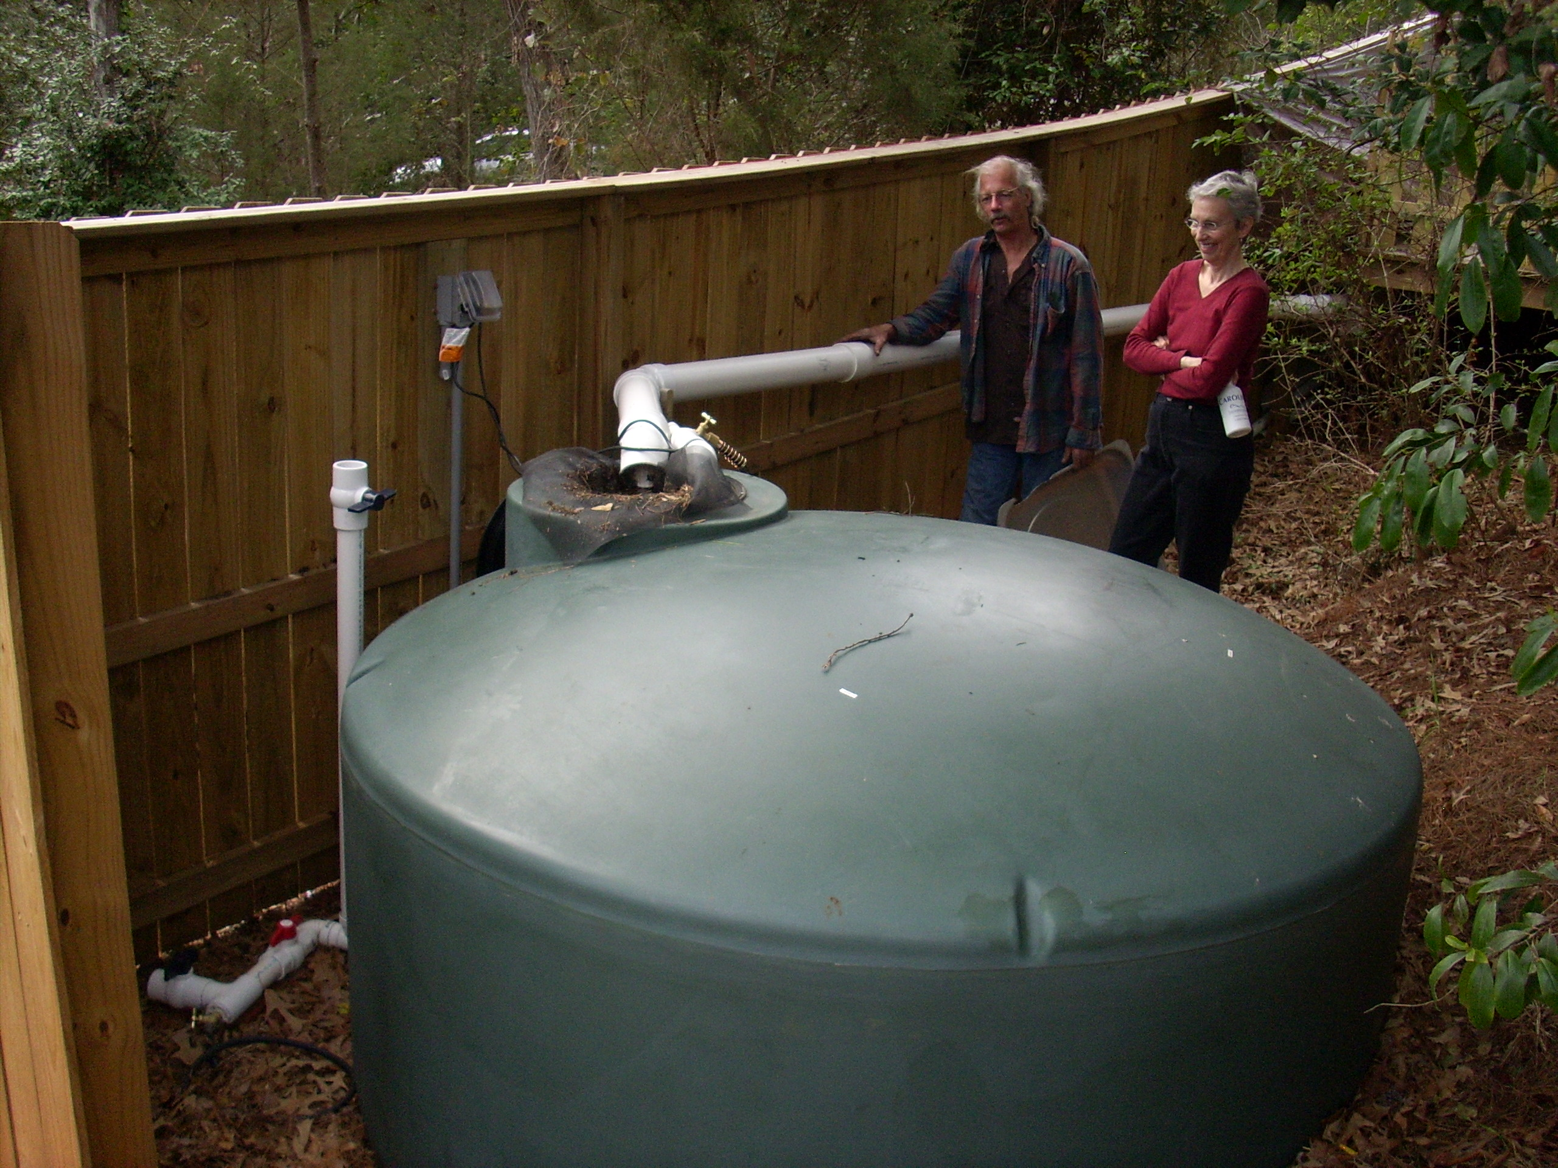
2008 Rain Harvest Workshop
Frank Henning
UGA Watershed Extension Agent

Slide 2
Workshop Support
Notes:
Thanks to USDA CSREES Water Quality Program

Slide 3
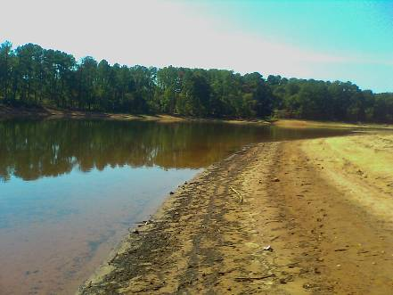
Georgia’s Water
9.5 million people depend on a clean water supply.
The population is increasing by more than 2.2 % a year making GA the 5th fastest growing state in the nation.
http://drought.unl.edu/gallery/2007/Georgia/LakeHartwell2.htm
© 2006 National Drought Mitigation Center

Slide 4
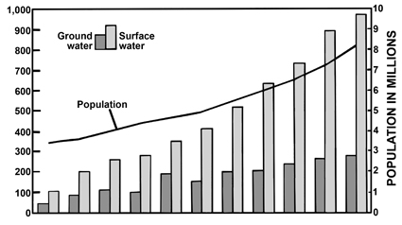
Georgia’s Growth & Water Use
1950 - 2000
- GA Water Use increased 20% between 1990 – 2000 (EPD, 2007)
- 16% increase in population projected for 2000 – 2010 (Bachel, 2003)

Slide 5
Urban Areas
1/2 population in
12 urban counties
2/3 population
in 40 counties

Slide 6
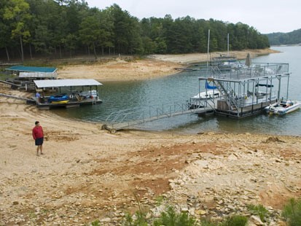
Water Restrictions
Georgia one of the fastest growing states
Demand for water is increasing
Water is not unlimited
Lack of water can harm
-wildlife
-landscapes
-business

Slide 8
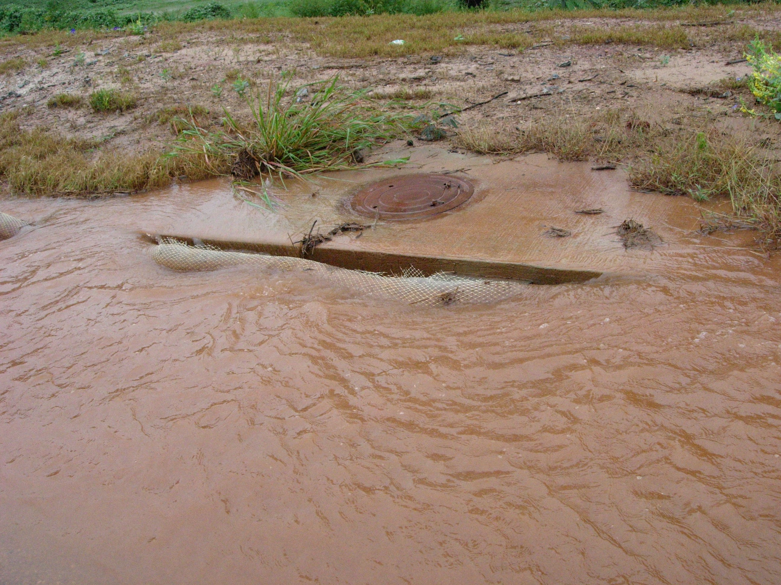
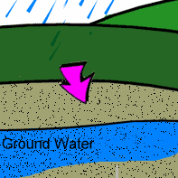
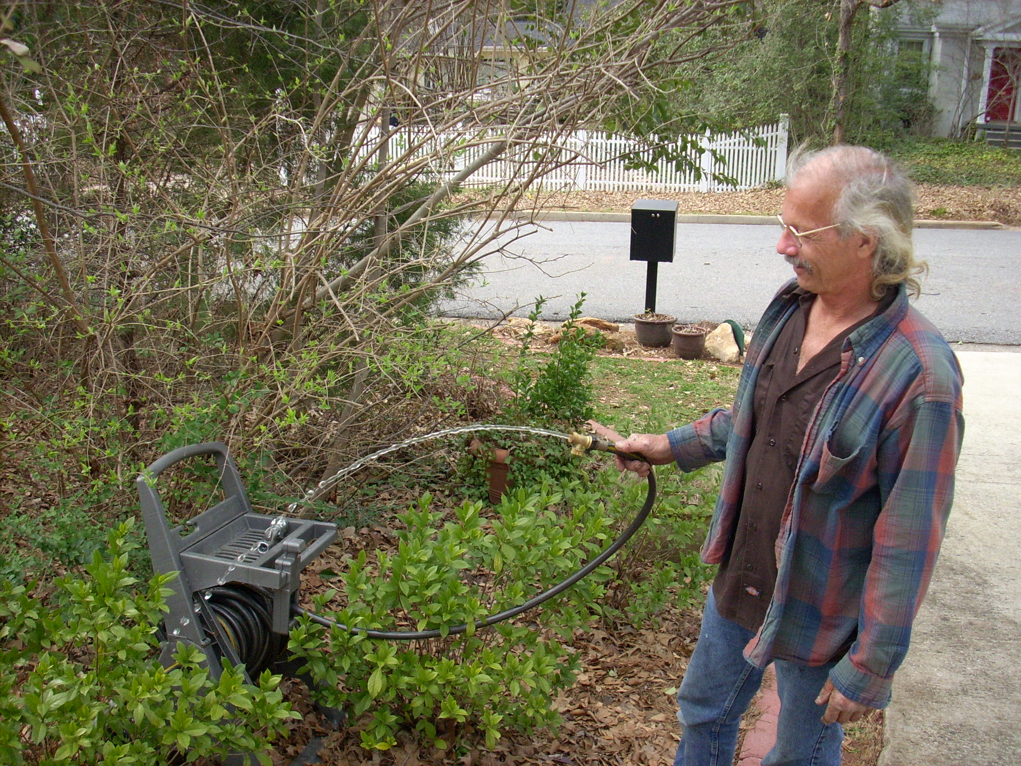
Environmental Benefits
reduce erosion
increases infiltration
reduce water use

Slide 9
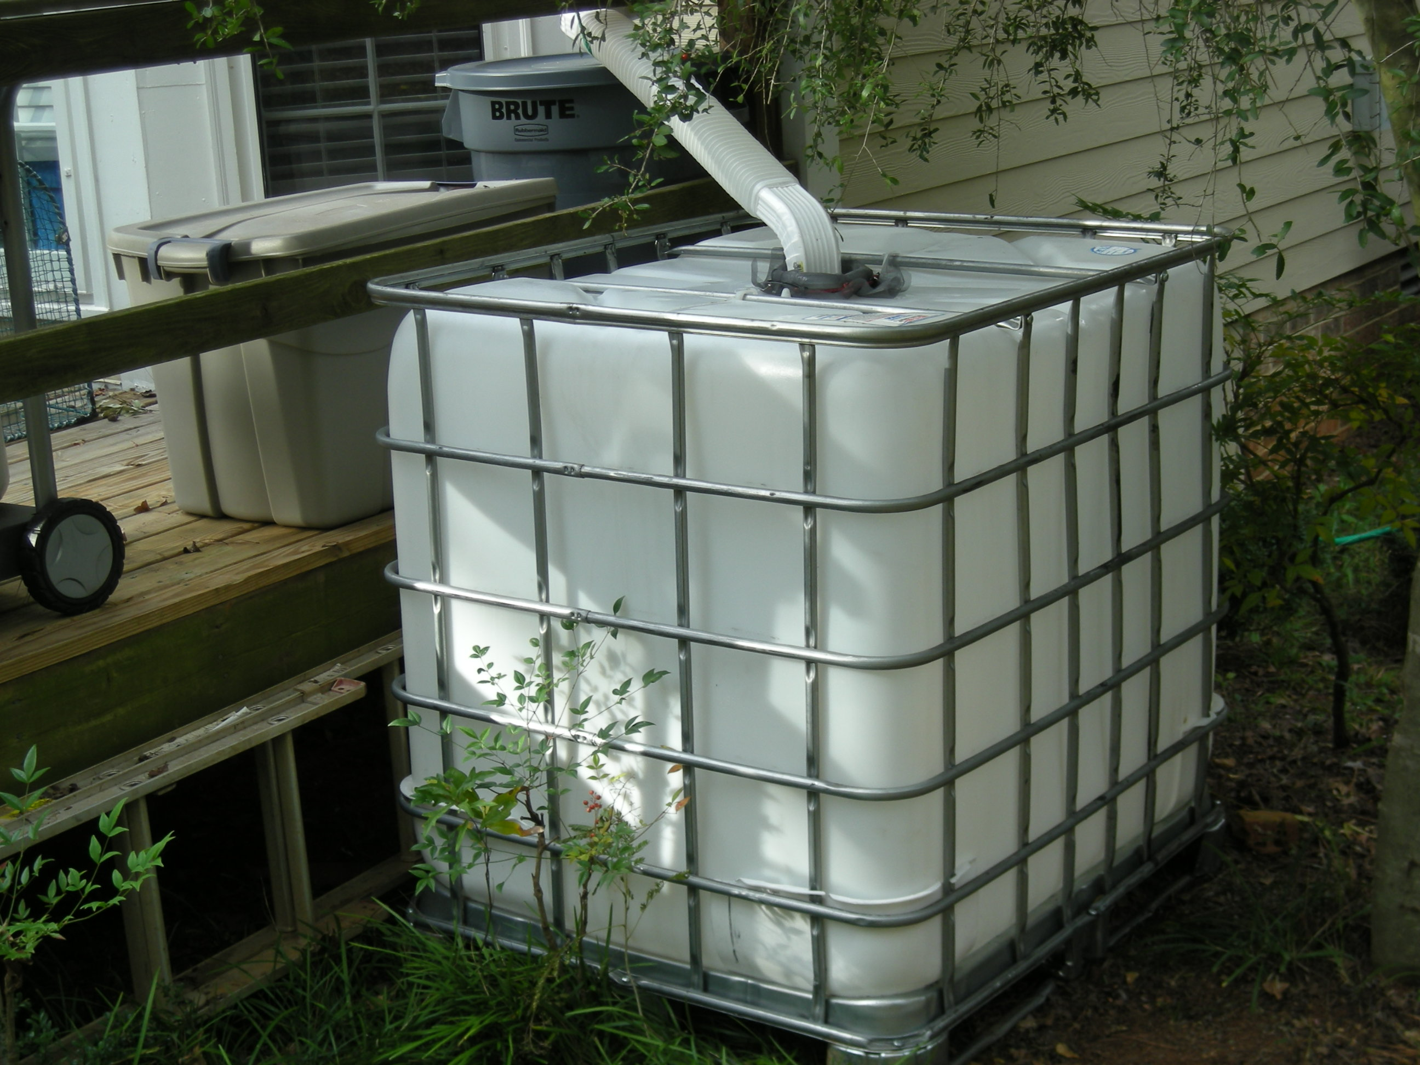
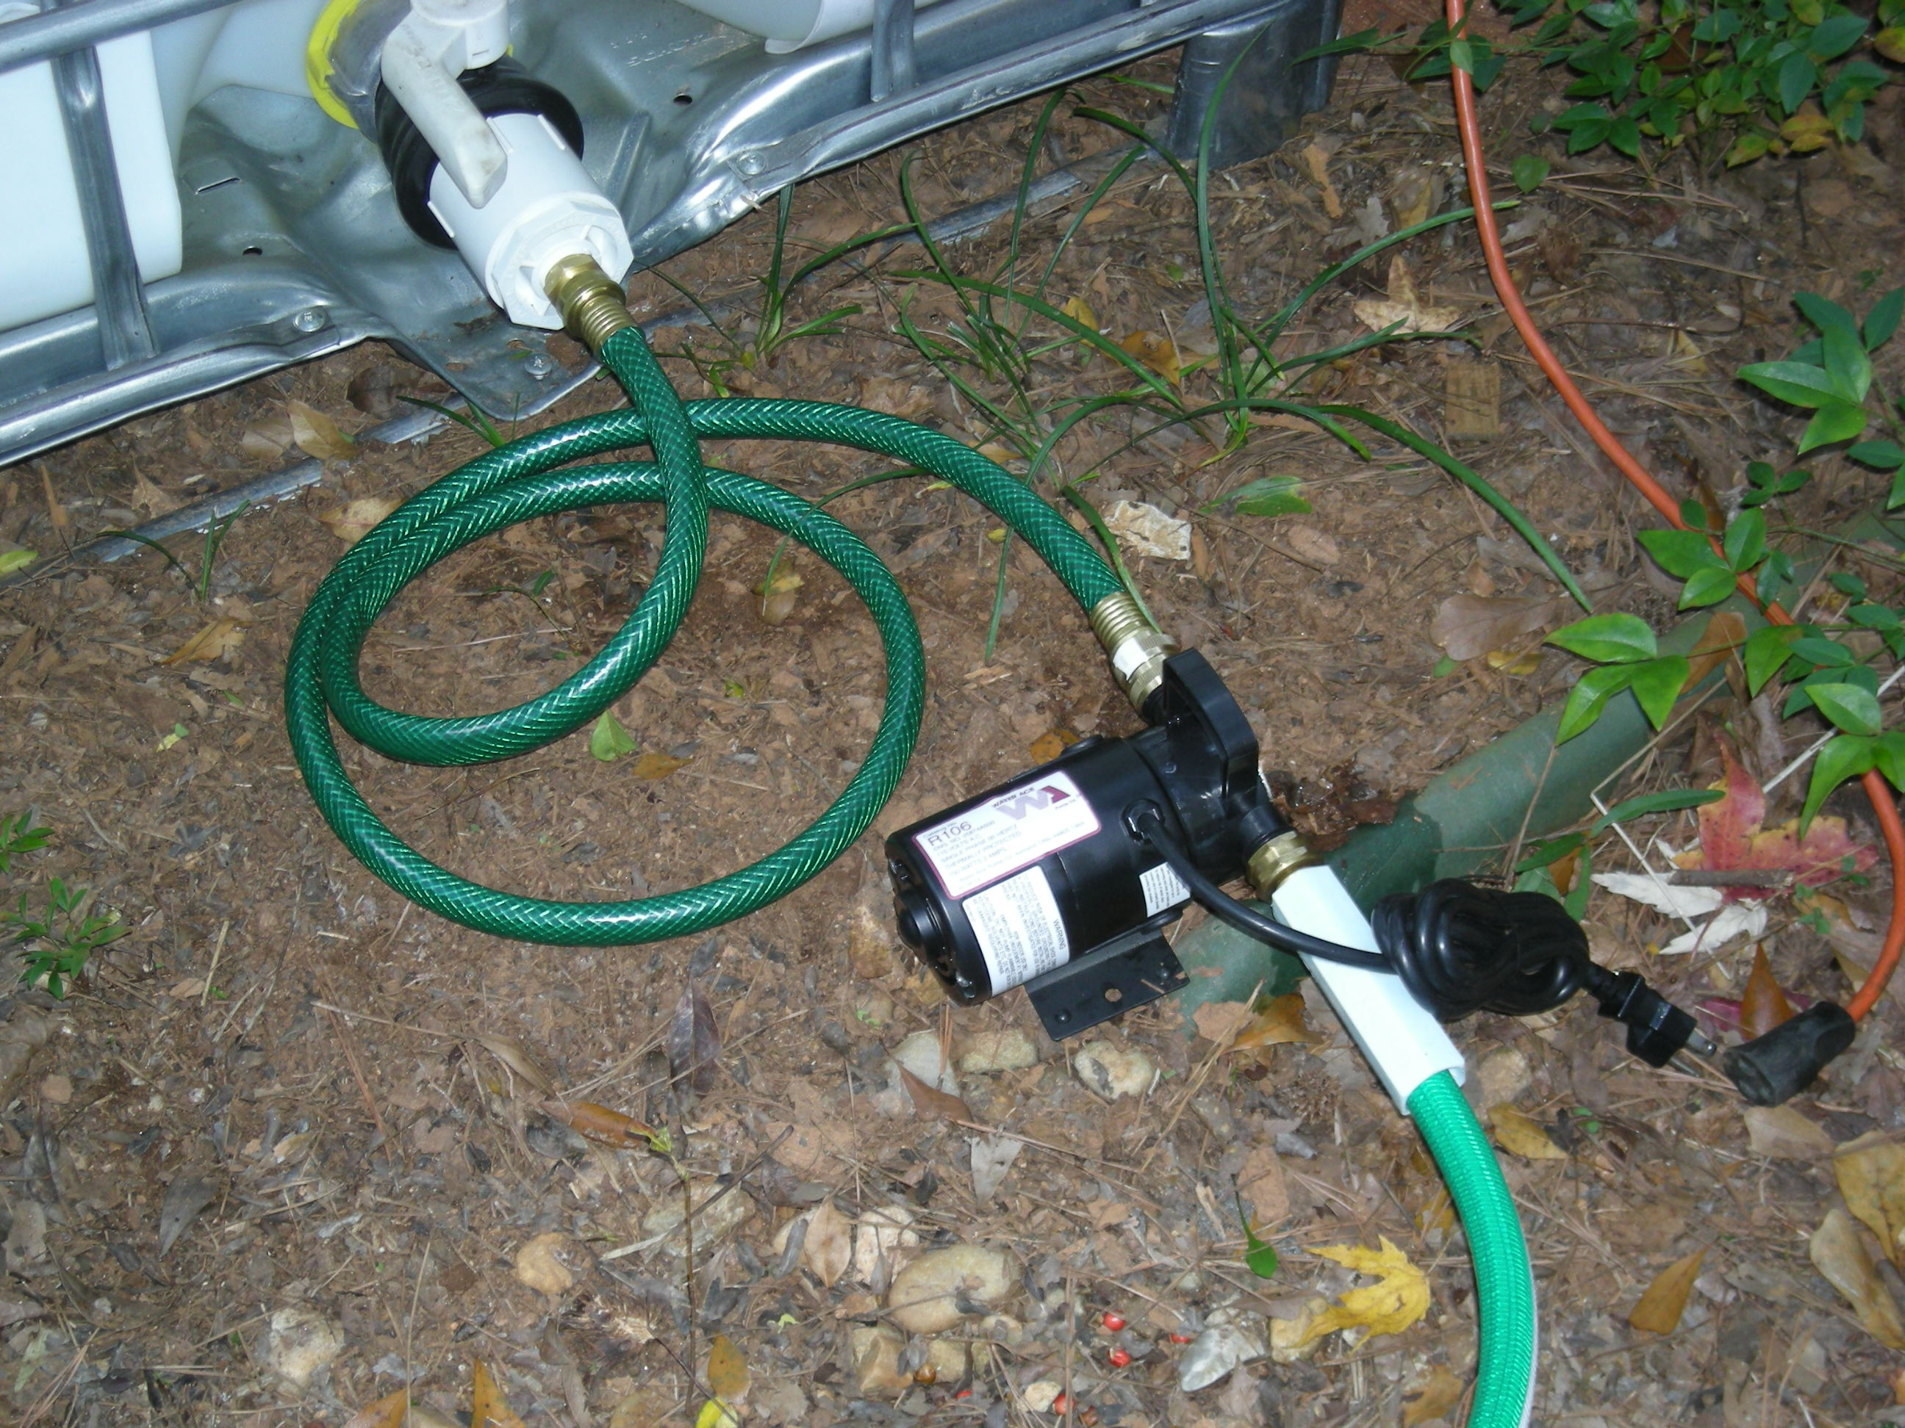
Rainwater & Condensate Water
Irrigation is not restricted (ban proof)
Large quantities can be harvested
- May be enough to meet landscape needs

Slide 10
Irrigating with Harvested Water
Frank Henning
UGA Watershed Extension Agent

Slide 11
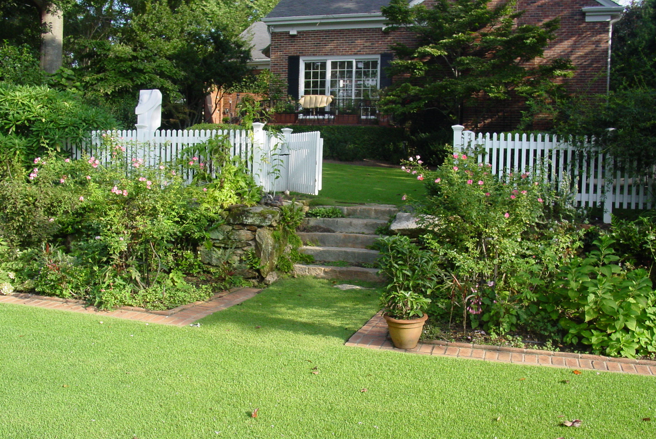
1. How much water is needed for irrigation?
2. How much water can be harvested?
3.How much water can be stored?
?
?
?
needs
supply
storage

Slide 12
Rules of thumb for irrigation
Shrubs:
-Simple - apply one gallon of water per foot of plant height (daily, weekly, or monthly)
-Scientific – ET or soil moisture
Lawns
up to once a week - one inch per
application
Trees
up to once a week, one inch of water
under entire canopy

Slide 13
Area based
water use
Low
Low
H
H
Lawn
25’ x 40’ = 1,000 ft²
1” per week = 624 gal.
~2500 gal./month
Do we need to water lawns?
Notes:
Even a small lawn that is only 1,000 square feet may need nearly 2,500 gallons of irrigation each month. Are we interested in storing 2,500 gallons of water for every 1,000 square feet of lawn area. Will turf survive without supplemental irrigation? Can we live with dormant turf?

Slide 14
Drought Tolerance of Turfgrasses
Hybrid bermudagrass
Zoysiagrass
St. Augustinegrass
Centipedegrass
Tall Fescue
Most
Least
Notes:
14
As you can see not all turfgrass species are created equally. In Georgia we are lucky to be in a transition area where many different species of turf can be grown. Please consider choosing a turfgrass based on its drought tolerance.

Slide 15
7’
7’
Water use based on
Plant Height
3’
4’
3’
6’
Ornamentals
50’ of plant = 50 gal.
4’
3’
50 gal./week
~200 gal./ month
6’
7’
*Can we harvest & store 200 gal. per month?
Notes:
If you add the height of all the woody plants in this landscape that need irrigation the total sum is 50 feet. In your landscape you may have drought resistant plants that only need to be watered every other week, once a month or not at all. However, if we use our rule of thumb on this landscape and provide 1 gallon of water per foot of plant height we would apply 50 gallons of water per week, or 200 gallons per month. Can we store 200 gallons of water.

Slide 16
Landscape Irrigation Needs
Plant | Plant height | Irrigation events / month | *Total monthly Irrigation
Ex) Hydrangea | 5’ | 4 | 20 gal
1. Camellia | 7 | 1 | 7
2. Holly | 7 | 1 | 7
3. Azalea | 4 | 4 | 16
4. Yew | 3 | 1 | 3
5. Buddleia | 6 | 1 | 6
6. Spirea | 3 | 1 | 3
7. Spirea | 3 | 1 | 3
8. Hydrangea | 4 | 4 | 16
9. Azalea | 6 | 4 | 24
10. Viburnum | 7 | 1 | 7
11.
12.
13.
14.
15.
Total | 50 | xxx | 92
Landscape Plant Map
House
* 1 gallon of irrigation per foot of plant height, applied x times per month

Slide 17
How much Rainwater can be harvested?
Draw house footprint
Divide roof into areas that go to each gutter (delineate catchments)
Measure each catchments dimensions (length & width)
Calculate catchment area for each gutter

Slide 18
Roof area calculations:
Area = Length x Width
Example:
50’
Yellow roof area
Length = 50’
Width = 15’
50 x 15 = 750 sq. ft.
15’
Notes:
You can connect rainbarrels together or simply divert excess water

Slide 19
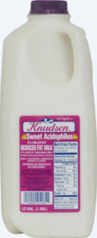
How much water is available
To harvest?
25’
For every inch of rainfall:
624 gallons per
1,000 square feet
40’
0.624 gallons per
square foot
>

Slide 20
Harvesting Potential for 1 inch rain
Square feet of roof catchment area | 50’ * 15’ 750 ft²
Multiply by 0.624 gal/ft² (converts ft² to gallons per inch of rain) | 750 ft² *0.624 gal/ft² = 468 gallons
*Multiply by roof harvest potential (0.75 to 0.95)ª | 468 * 0.75 = 351 gal 468 * 0.95 = 445 gal
Storage conversion Ex.) 55 gallon barrel | 351 / 55 = 6.4 445 / 55 = 8.1 rainbarrels
ª 75% - 95% harvest potential for rooftops, Arizona Dept. of water resources data

Slide 21
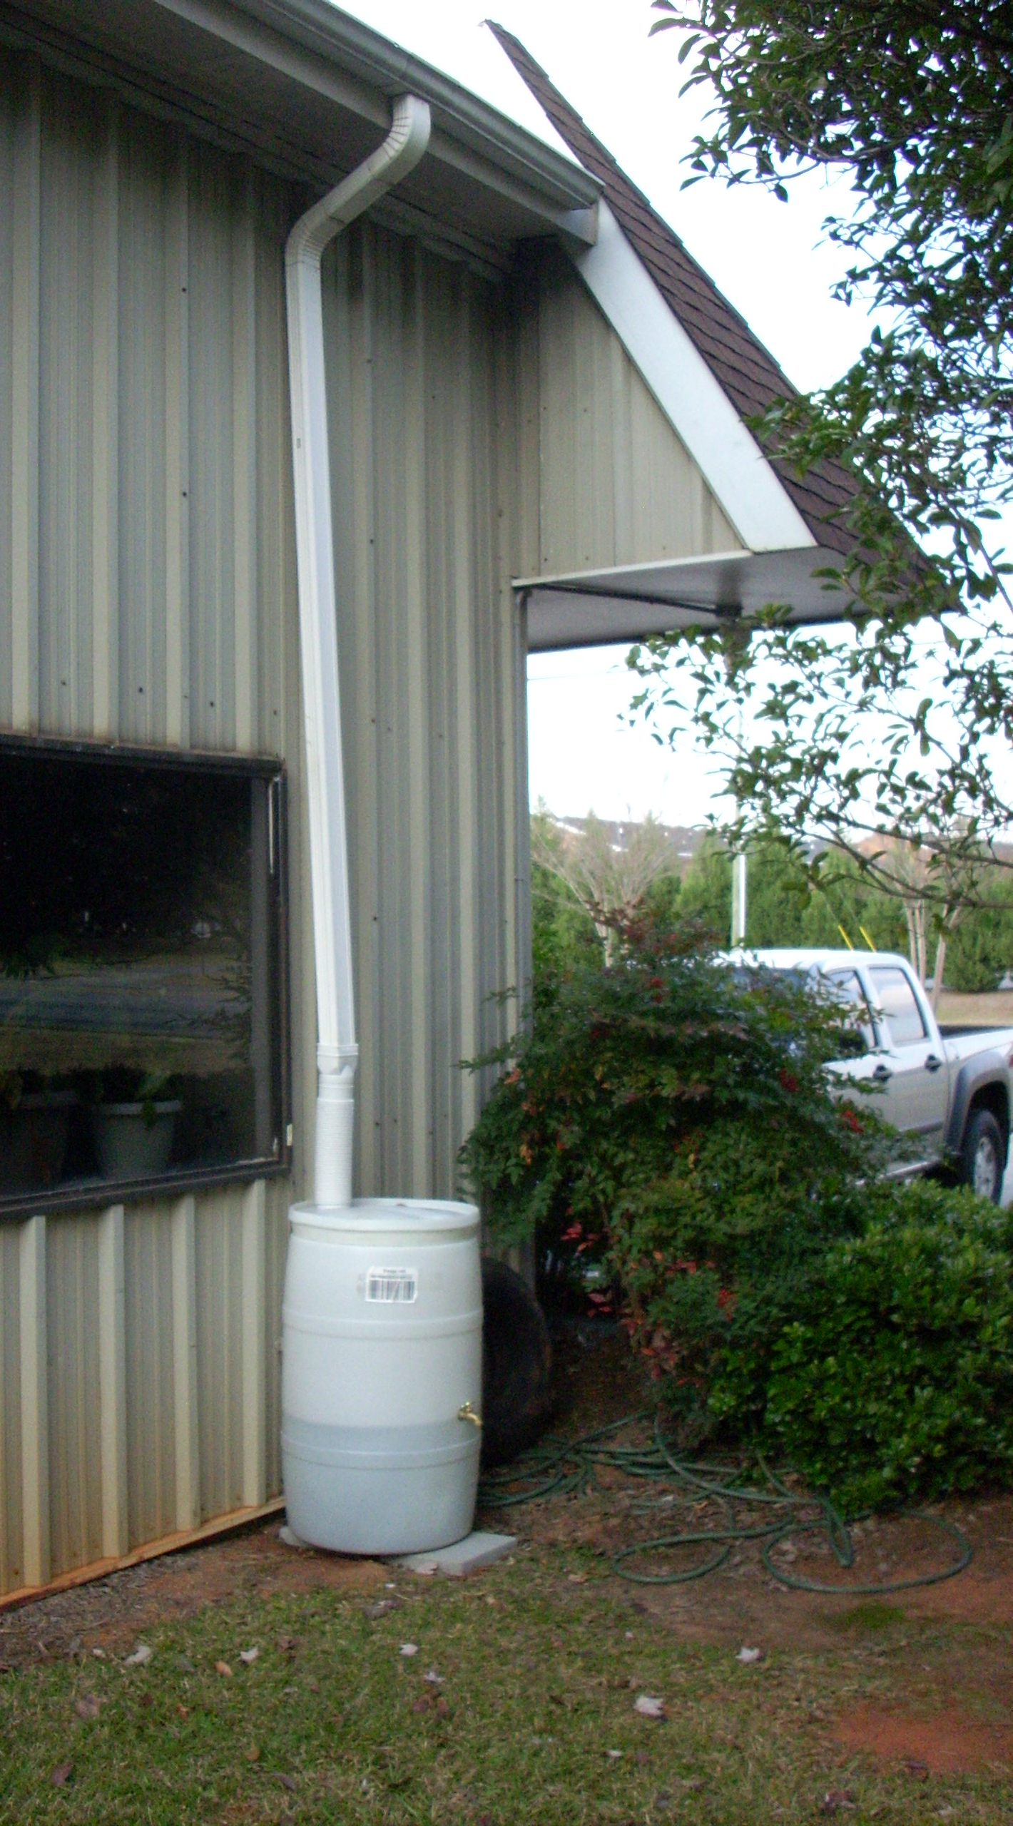
Drought Year Rainfall (2007) Athens, GA
April | 1.8 inches
May | 0.55
June | 2.23
July | 3.04
August | 1.31
September | 2.15
October | 1.61
November | 2.12
Notes:
2007 was a 150 year drought and during the growing season there was still over an inch of rain each month except May.

Slide 22
Rainfall on a 20 x 50’ roof area (1,000 ft²)
Athens, GA 2007 (drought year)
Month | Rainfall | 624 (gal/in) |  | Volume (2007)
 | 2007 | 75% | 95% | 75% | 95%
April | 1.8” | 468 | 593 | 842 | 1067
May | 0.55” | 468 | 593 | 257 | 326
June | 2.23” | 468 | 593 | 1044 | 1322
July | 3.04” | 468 | 593 | 1423 | 1802
Aug | 1.31” | 468 | 593 | 613 | 777
Sept | 2.15” | 468 | 593 | 1006 | 1275
Oct | 1.61” | 468 | 593 | 753 | 954
Nov | 2.12” | 468 | 593 | 992 | 1257
ª
ªRain harvest potential from rooftops, Arizona Dept. of water resources

Slide 23
275 gallons
- Inexpensive
Unactractive
Algae?
Time and Labor
55 gallons

Slide 24
- 1200 gallons ($400+)
Opaque
Attractive

Slide 25
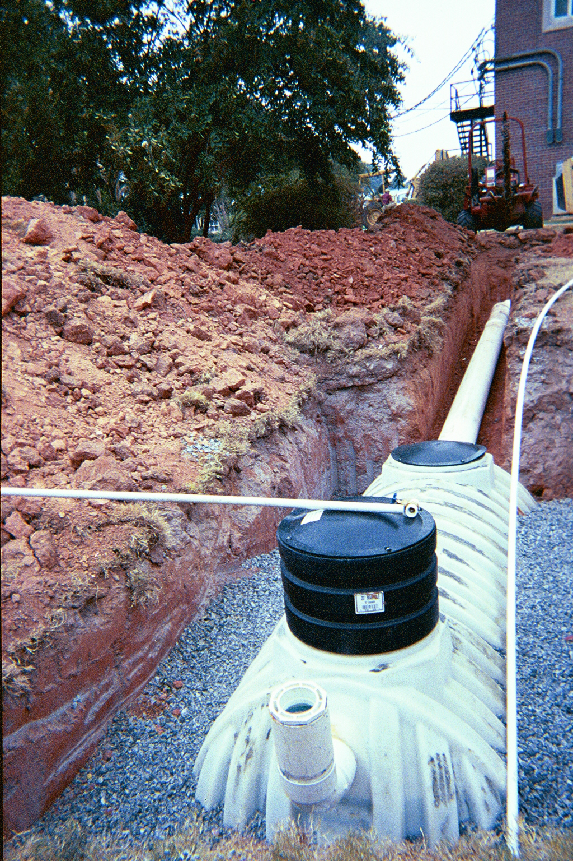
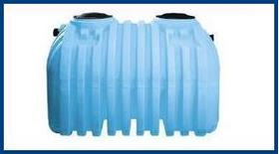
Buried Tanks
- Septic tanks (baffles)
- More expensive
- $1,000/1000 gallon
Excavation required
Pump
Floatation prevention

Slide 26
Value of Harvested Rain Water Athens-Clarke County
 | Utility Costs $ / 100 cu. ft. (748 gallons) | 1,000 ft² $ / inch of rain | Rainfall 2007 inches | 2007 $/ growing season
Water | $2.10 | $1.75 | 14.3 | $ 25.03
Sewer | $1.82 | $1.52 | 14.3 | $ 21.74
Total | $3.92 | $3.27 | 14.3 | $ 46.77
~ 10 year return on a system that costs $500

Slide 27
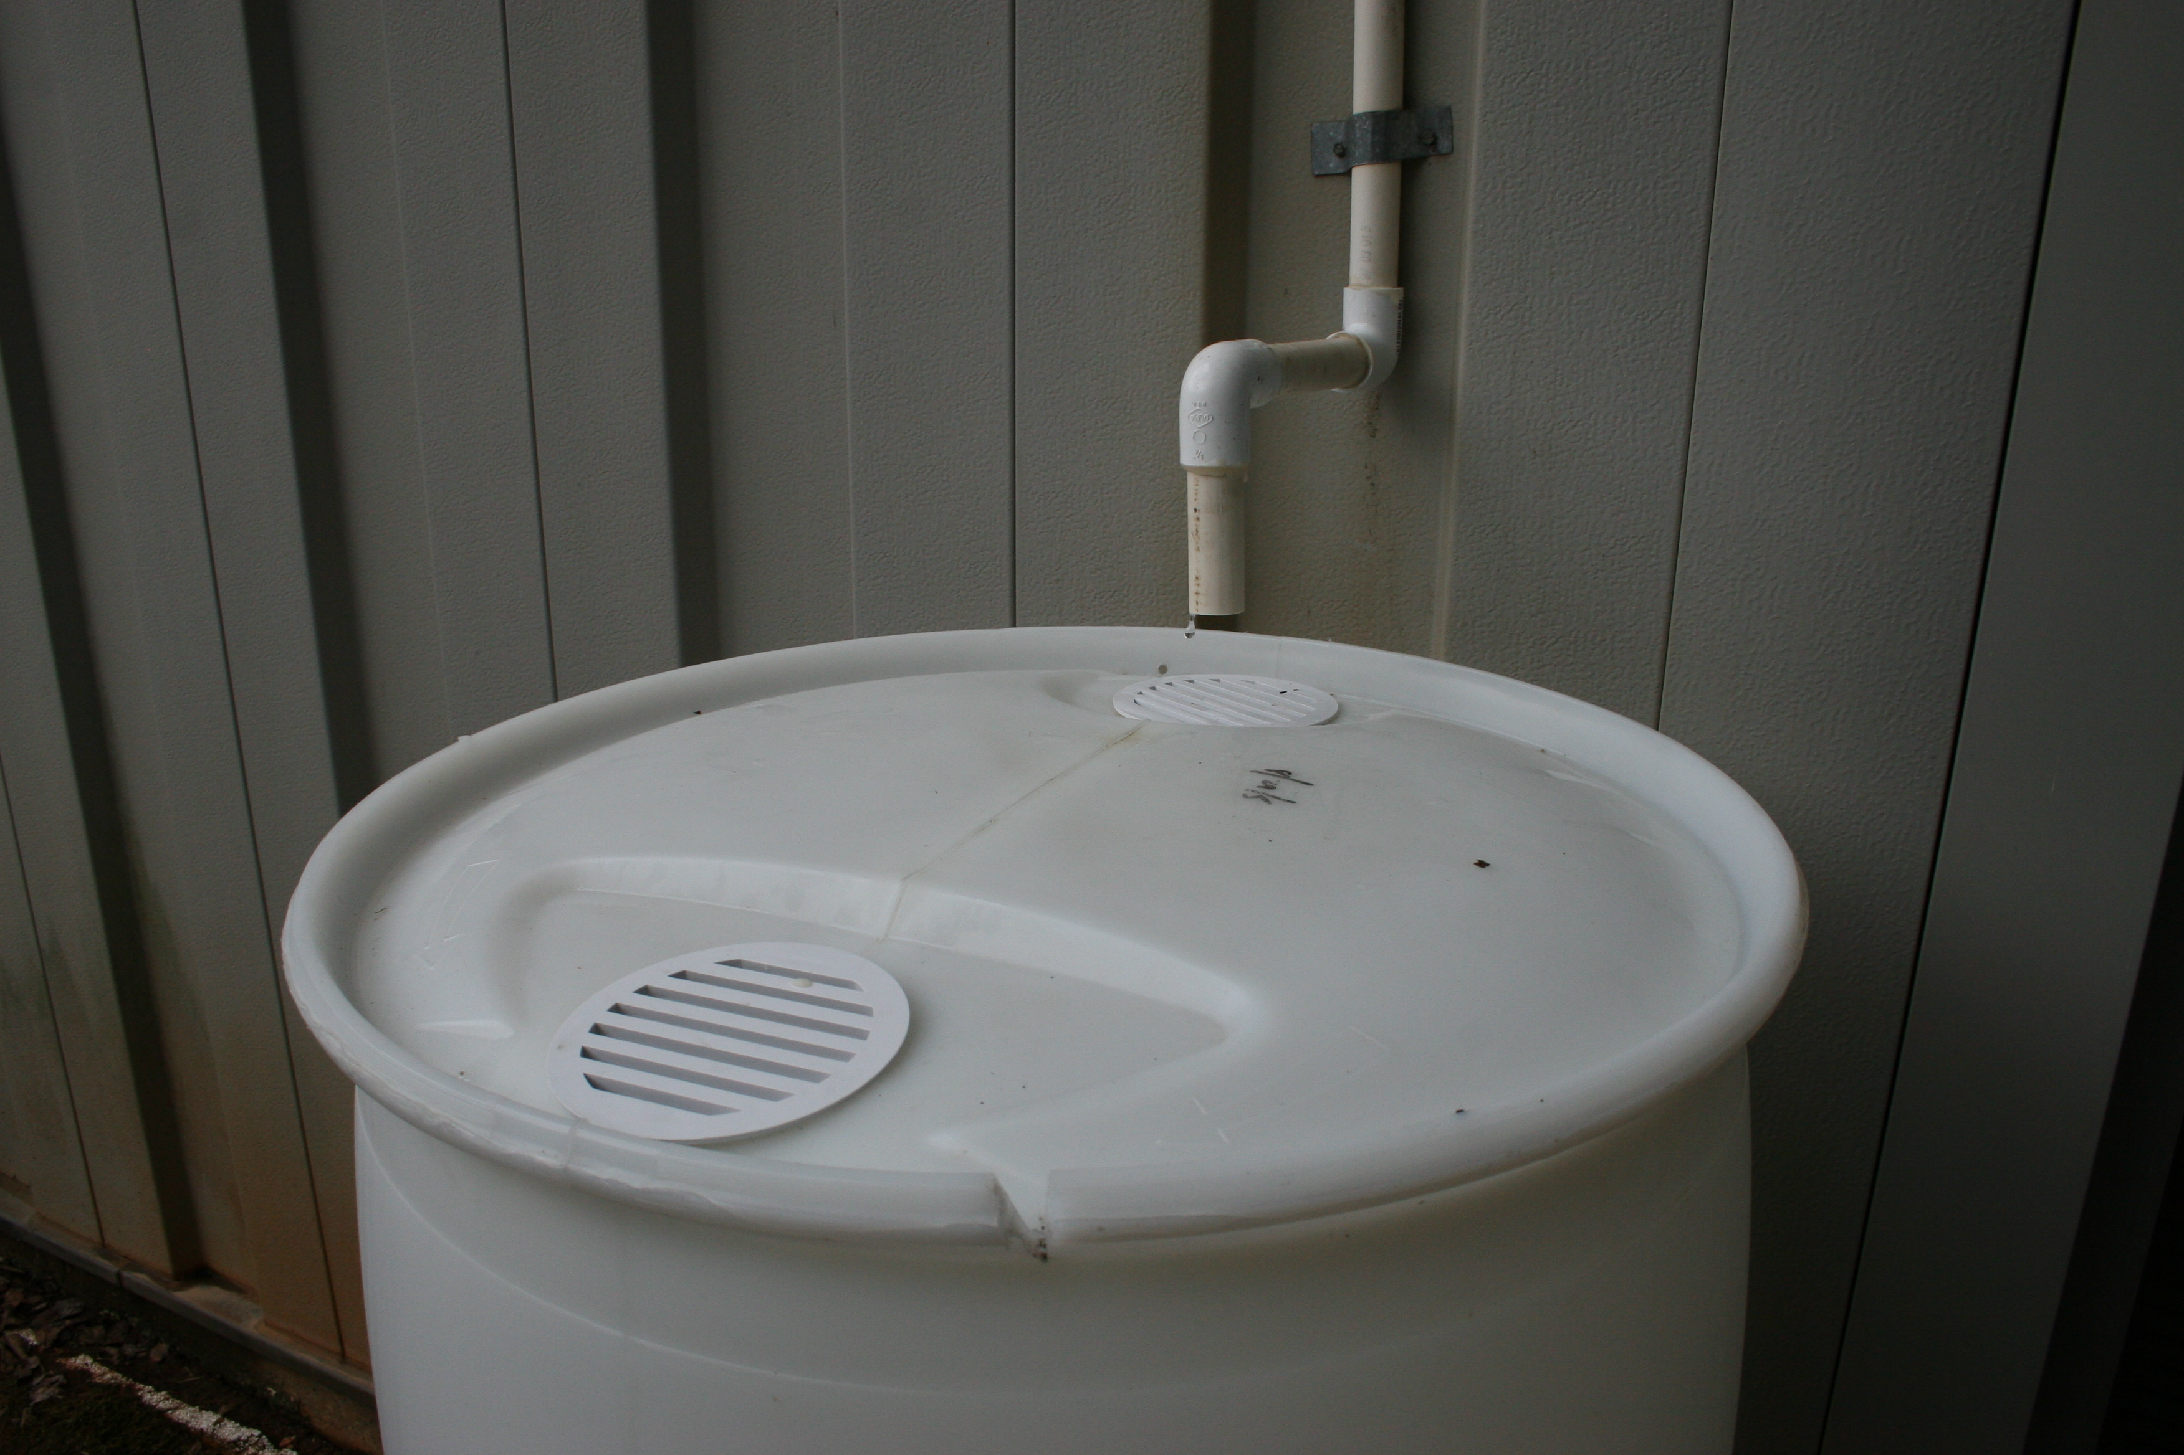
Condensate from Air Conditioners and Dehumidifiers
Home AC can produce over 5 gal./day

Slide 28
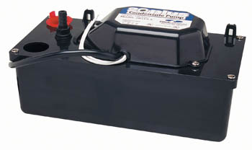
Condensate Harvesting Potential
AC production | Example: 7 gpd
Multiply by 7 to convert to gallons per week | 49 gal. per week
Multiply by 4 to convert to gallons per month | ~200 gal. per month
Condensate pump
-$50
-25 gal/hr
-15 feet of head
Need ~7 gal/day to get 200 gal/month

Slide 29
Value of Harvested Condensate Athens-Clarke County, 10 gpd drip
 | Utility Cost $ / 100 cu. ft. (748 gallons) | Gallons/ season | 2007 $/ growing season
Water | $2.10 | 2400 | $ 6.74
Sewer | $1.82 | 2400 | $ 5.84
Total | $3.92 | 2400 | $ 12.58
< 10 year return on $100 investment

Slide 30
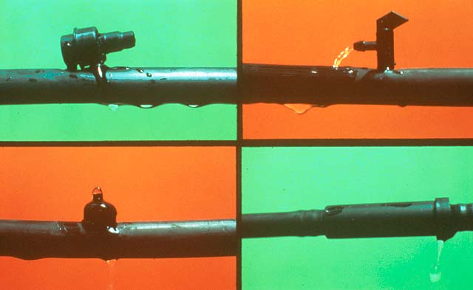
Irrigating With Harvested Water
Conserve by watering individual plants
Notes:
4. PRAYER FOR RAIN. Periodic drought makes the problem even more pronounced, causing reservoir and river levels to drop and often forcing water authorities and elected officials to place restrictions or bans on outdoor water use in an effort to conserve available water supplies.

Slide 31
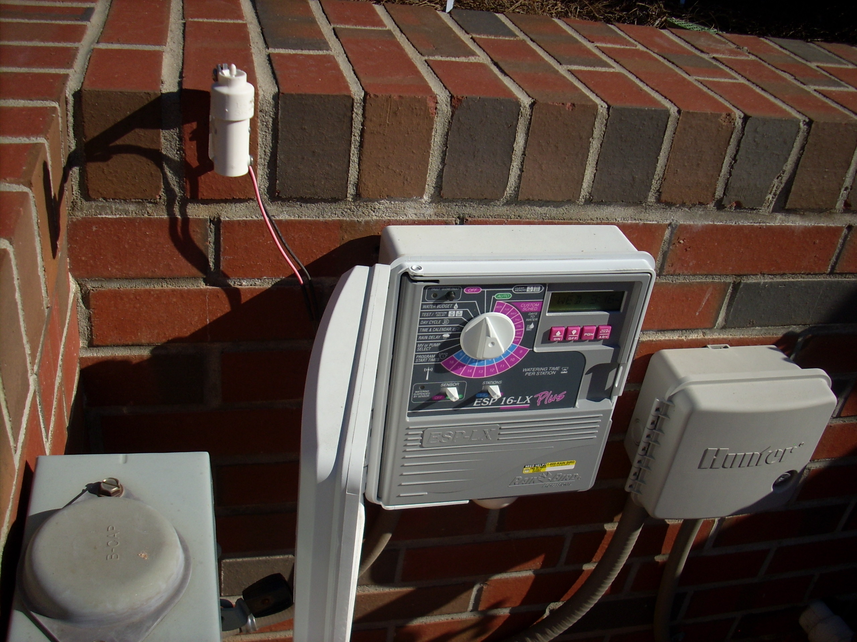
Irrigation Controller

Slide 32
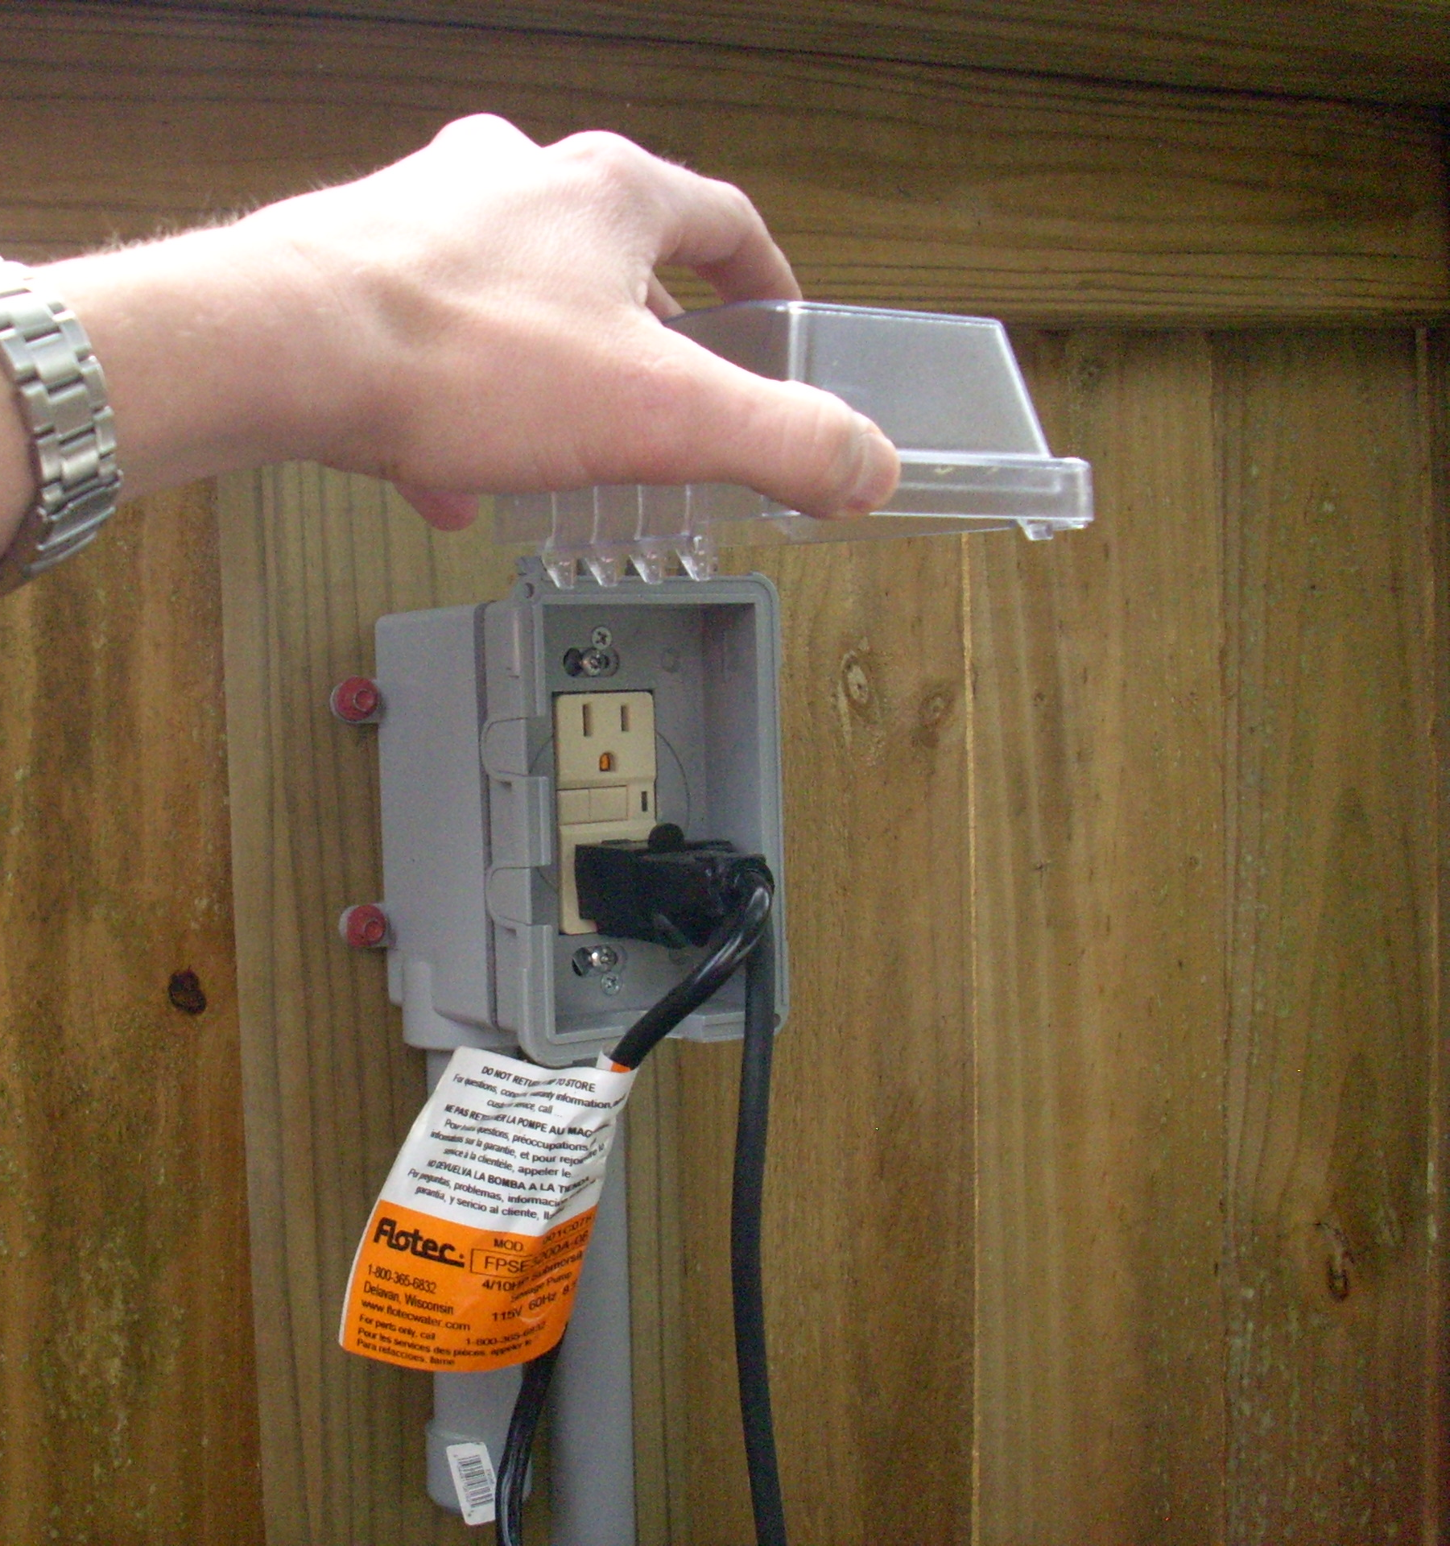
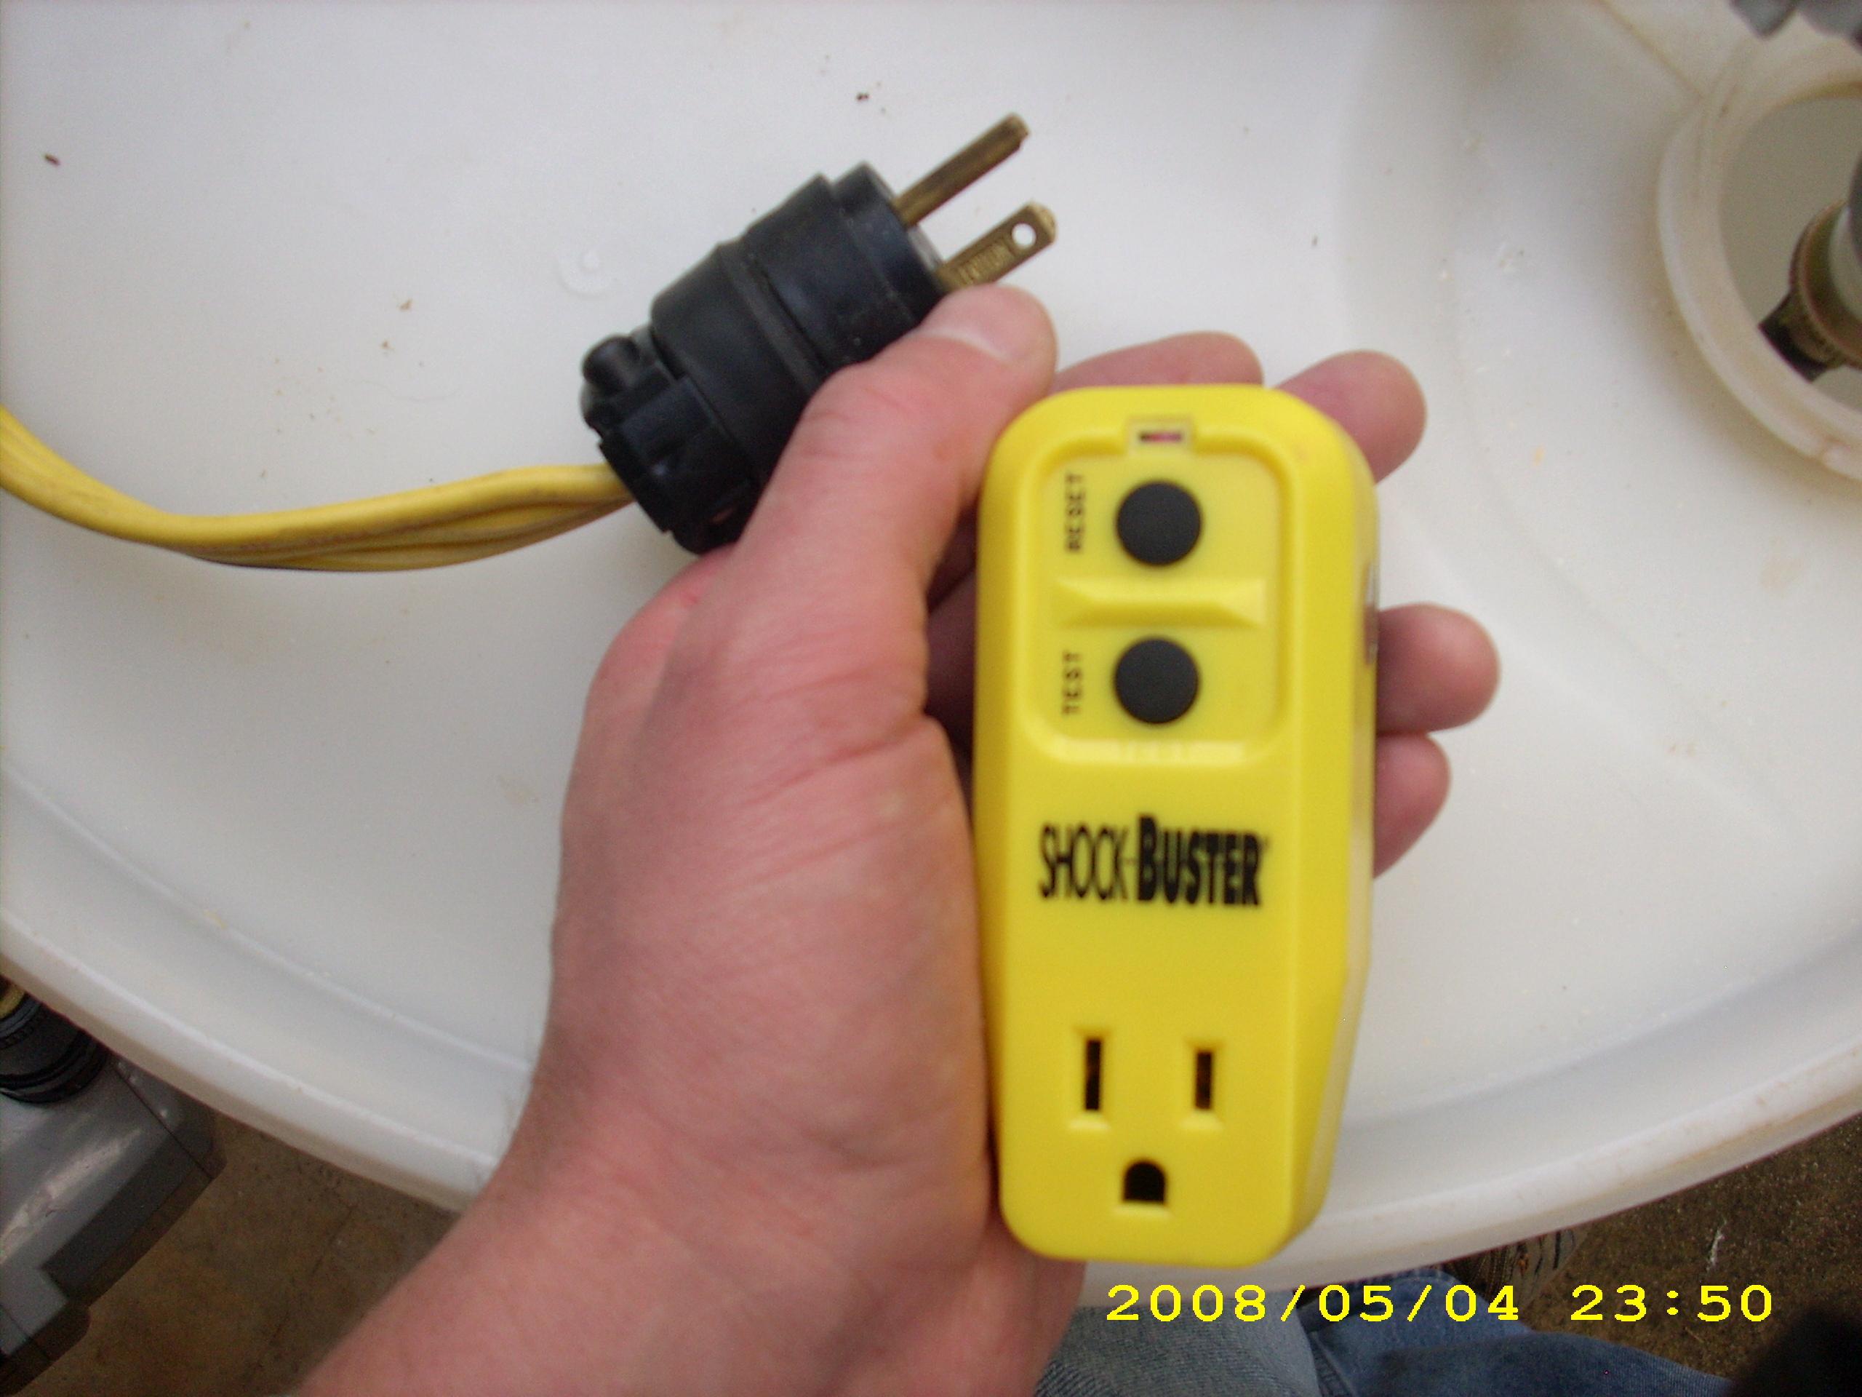
GFCI

Slide 33
NC State Cistern Pump Publication

Slide 34
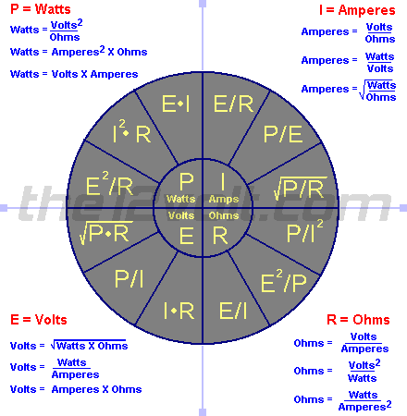
Understanding Electricity
Ohm’s Law
Watts = Volts x Amperes
230 Volt, 5 Amp pump = 1150 Watts
115 Volt, 5 Amp pump = 575 Watts
24 Volt, 5 Amp pump = 120 Watts
12 Volt, 5 Amp pump = 60 Watts

Slide 35
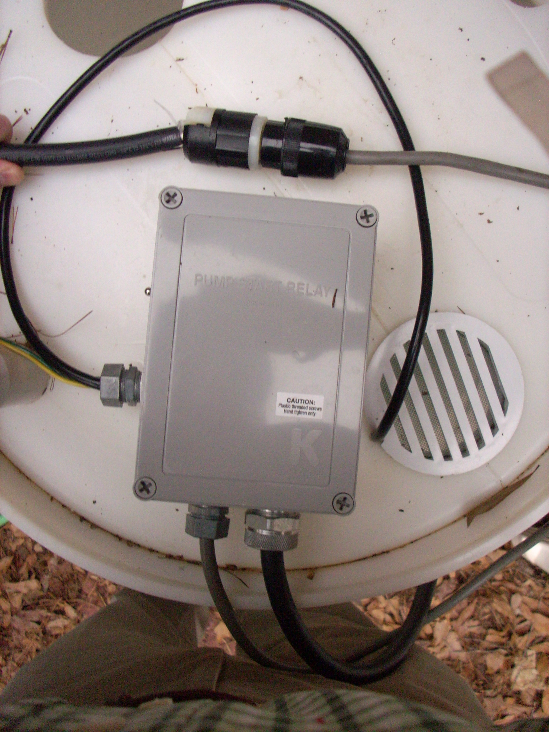
Pump Relay
- 24 VAC from irrigation controller “flips switch”
Can be used to control AC or DC pumps
Can install an outlet for “plug-in” pumps

Slide 36
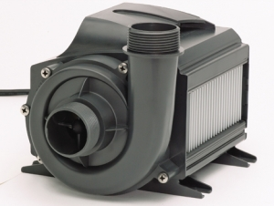
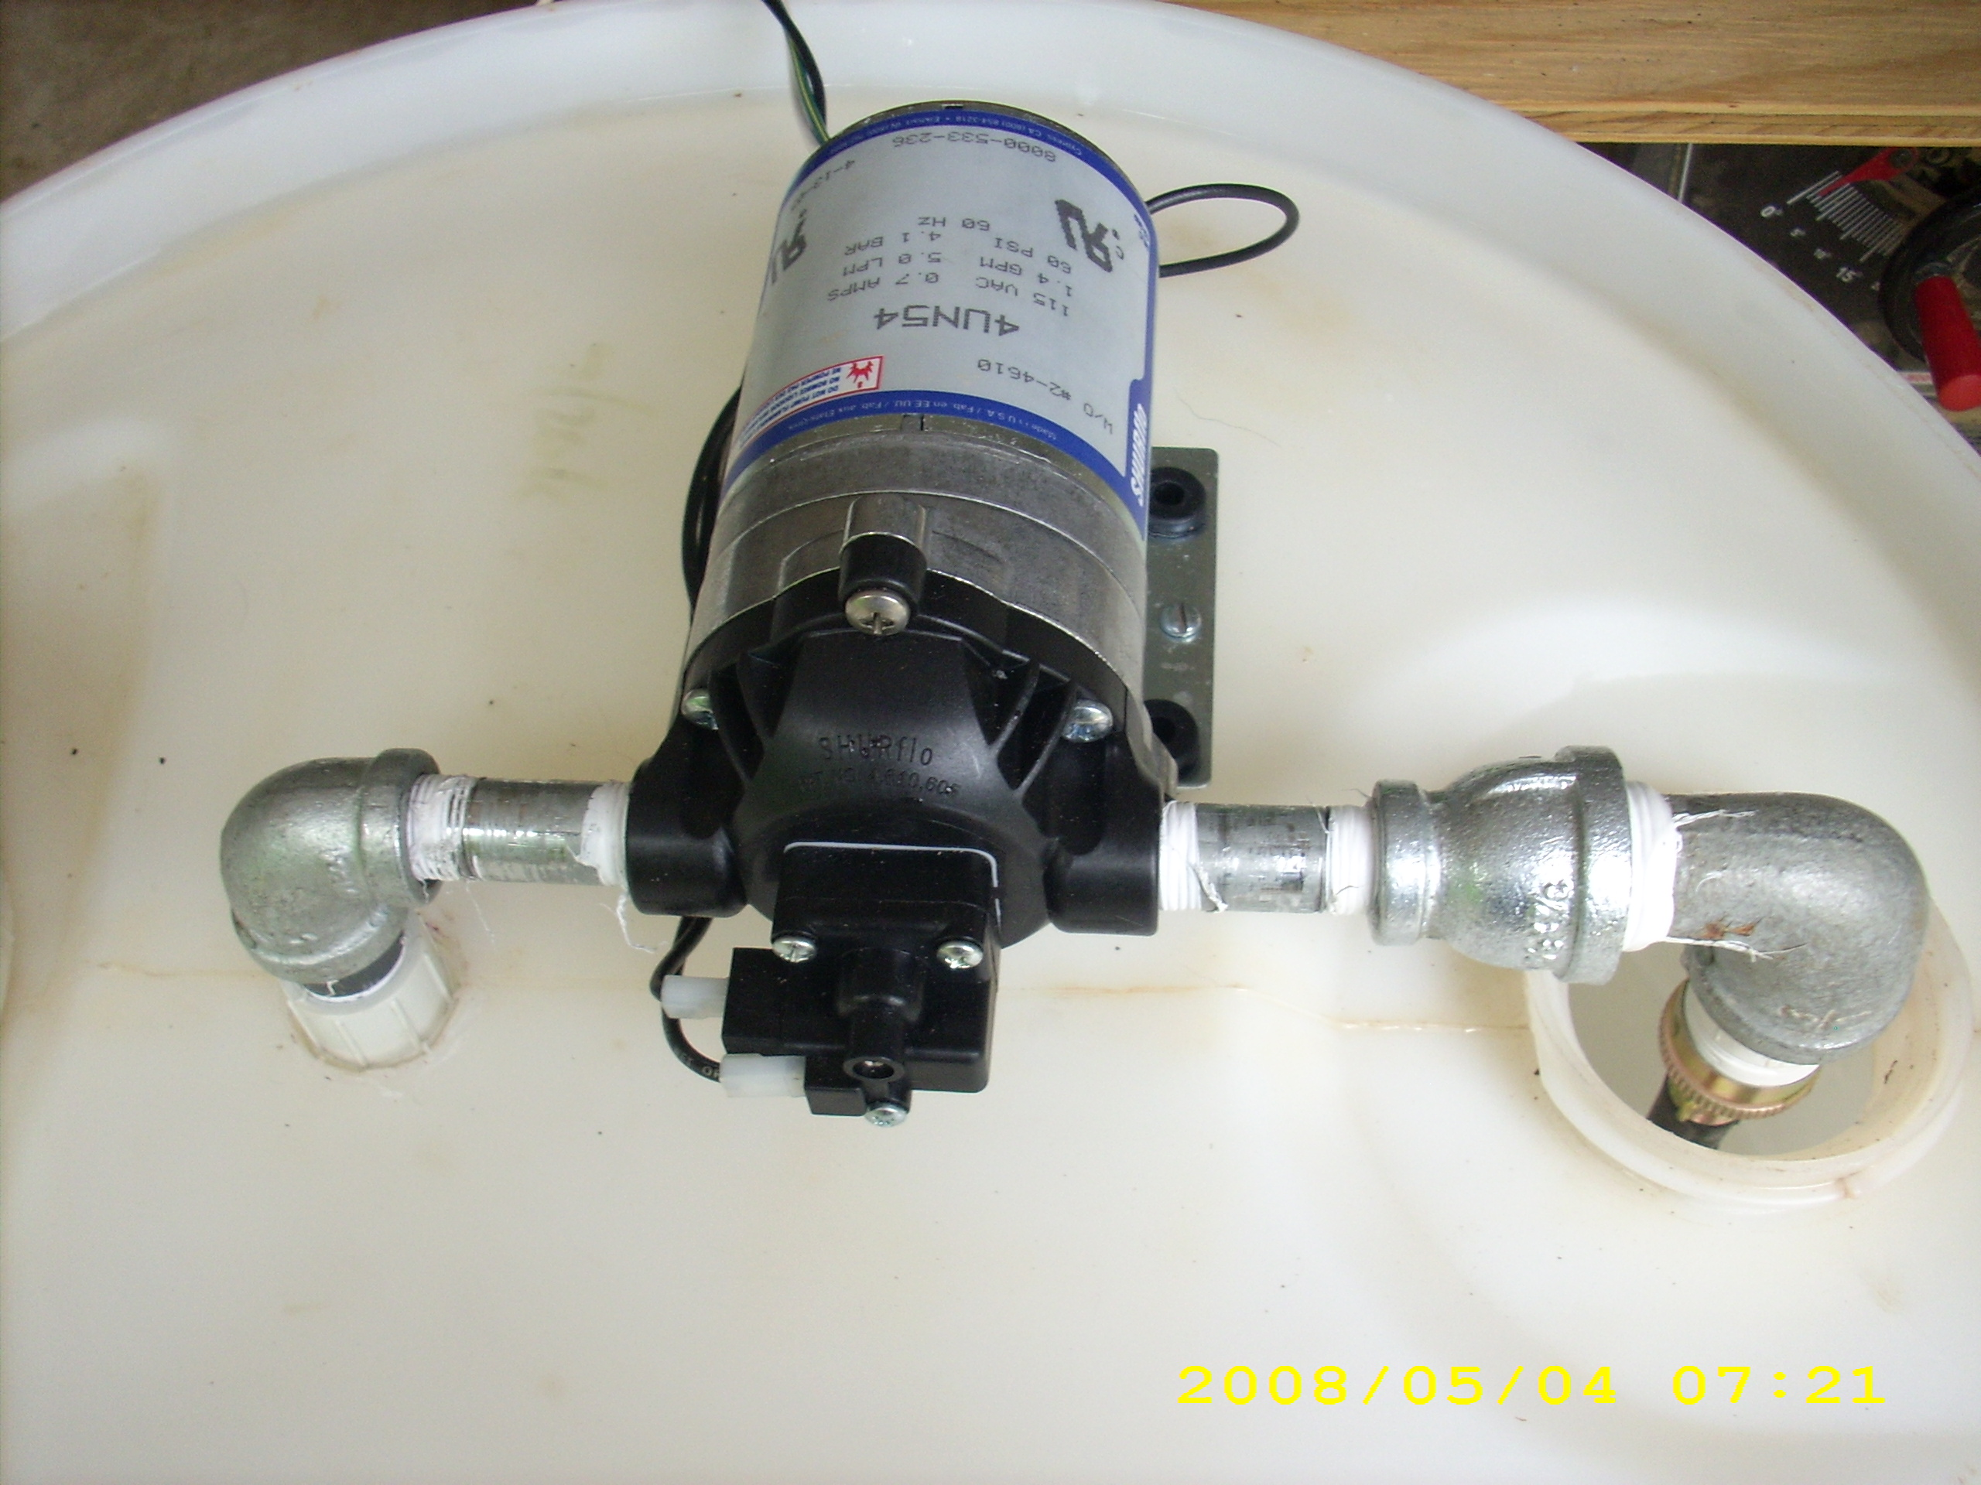
Pumps
Centrifugal
230VAC
Magneto drive
115 VAC
Piston Pump
115 VAC
- May need intake screen
May need to divert some water back to reservoir to cool pump (prevent deadhead)
Consider pressure
Loose 1 psi for every 2.31 feet of head
Drip irrigation may require certain pressure (25psi)
Notes:
Doesn’t take a big pump to deliver 50 gallons of water in an hour, once per week

Slide 37
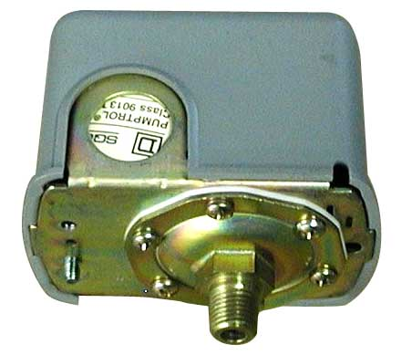
Pressure Switch

Slide 38
Thermal Shutoff

Slide 39
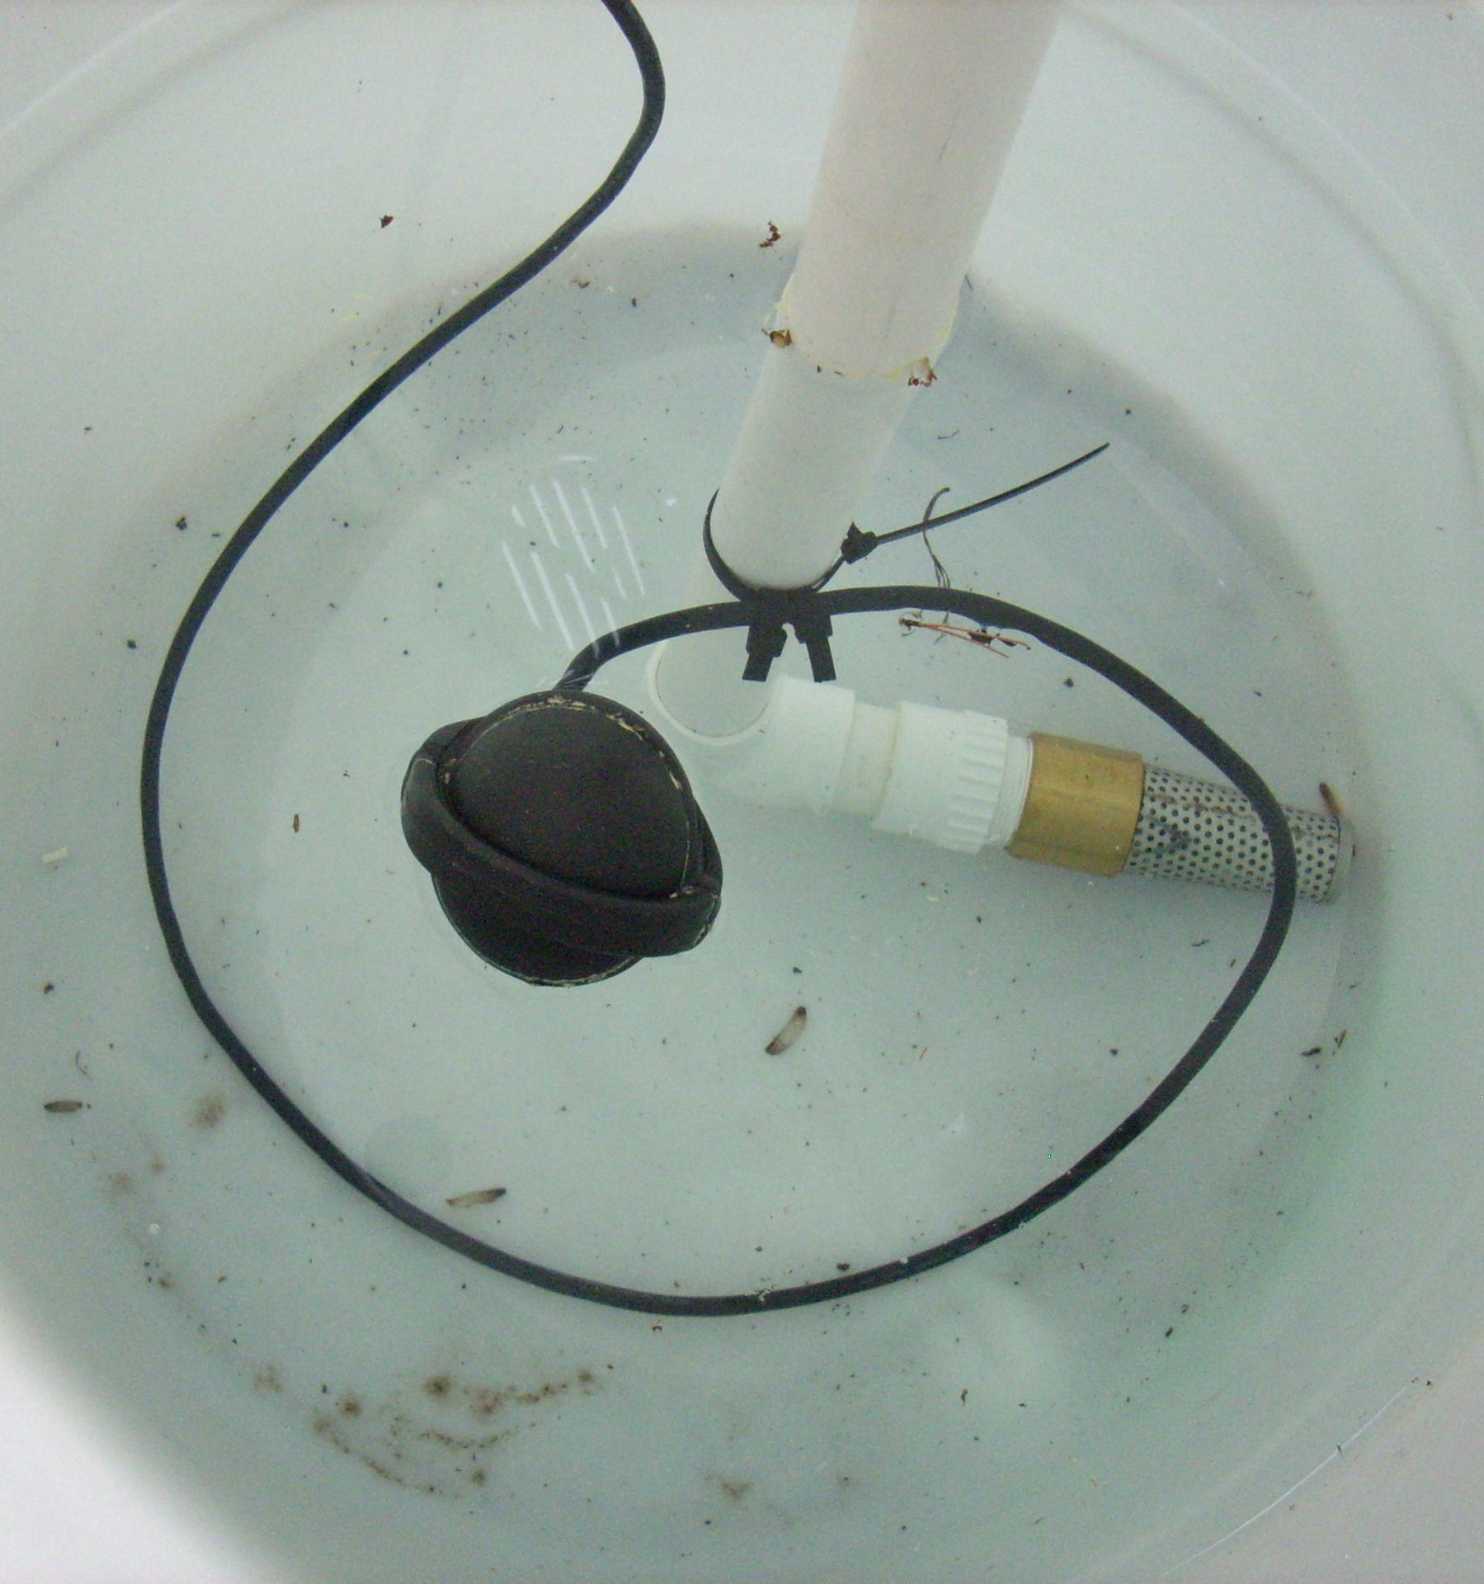
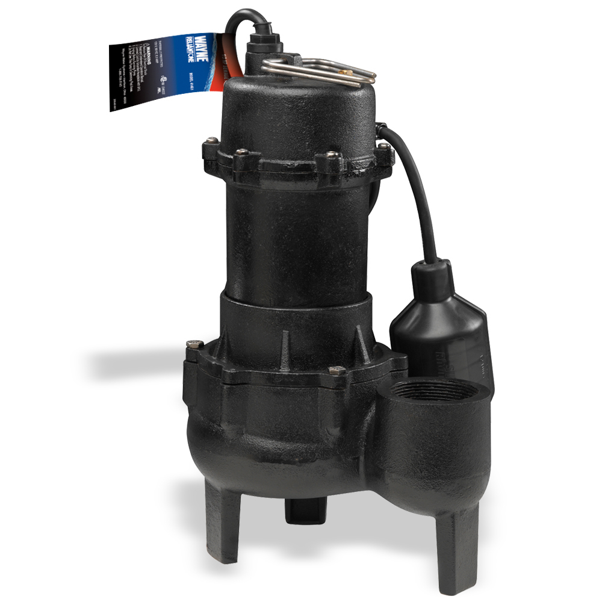
Float switch
- Shuts off pump when reservoir is empty
- Some pumps incorporate this feature

Slide 40
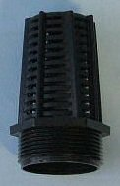
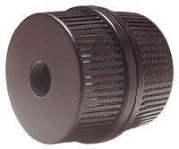
Foot valve
Intake screen

Slide 41
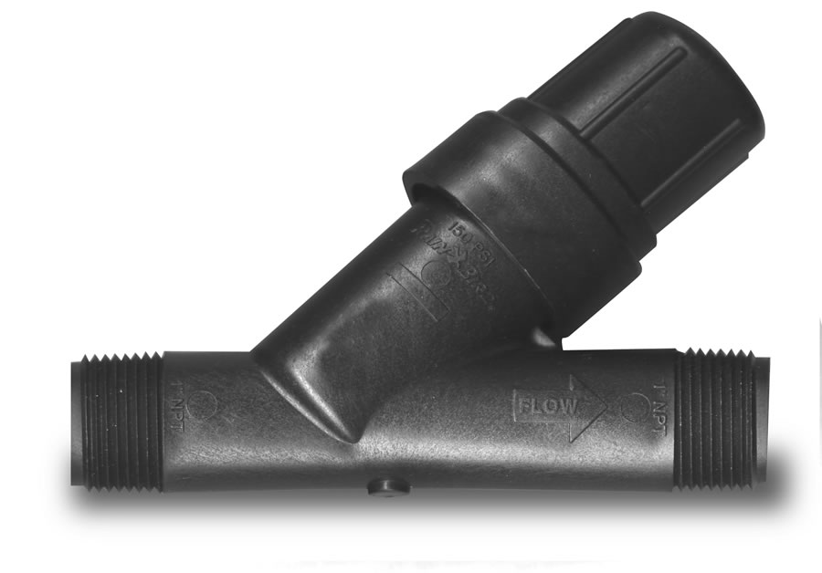
Irrigation Filter

Slide 42
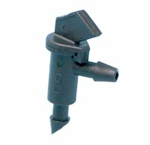
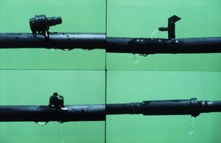
Emitters
- Many shapes and styles
Flow rate 0.5 – 10 gal./hr
Pressure compensating
(designed for ~25+ psi)

Slide 43
Irrigation Example:
- 25 plants (average height 2 feet tall)
- Plant requirement – 2 gallons each
- Total requirement: 25 x 2 = 50 gallons
50 gph/60 min = less than 1 gallon per minute

Slide 44
- 115 VAC
7.2 Amps
828 Watts
366 gph @ 30psi
Recirculation may
be needed
- Pressure regulator

Slide 45
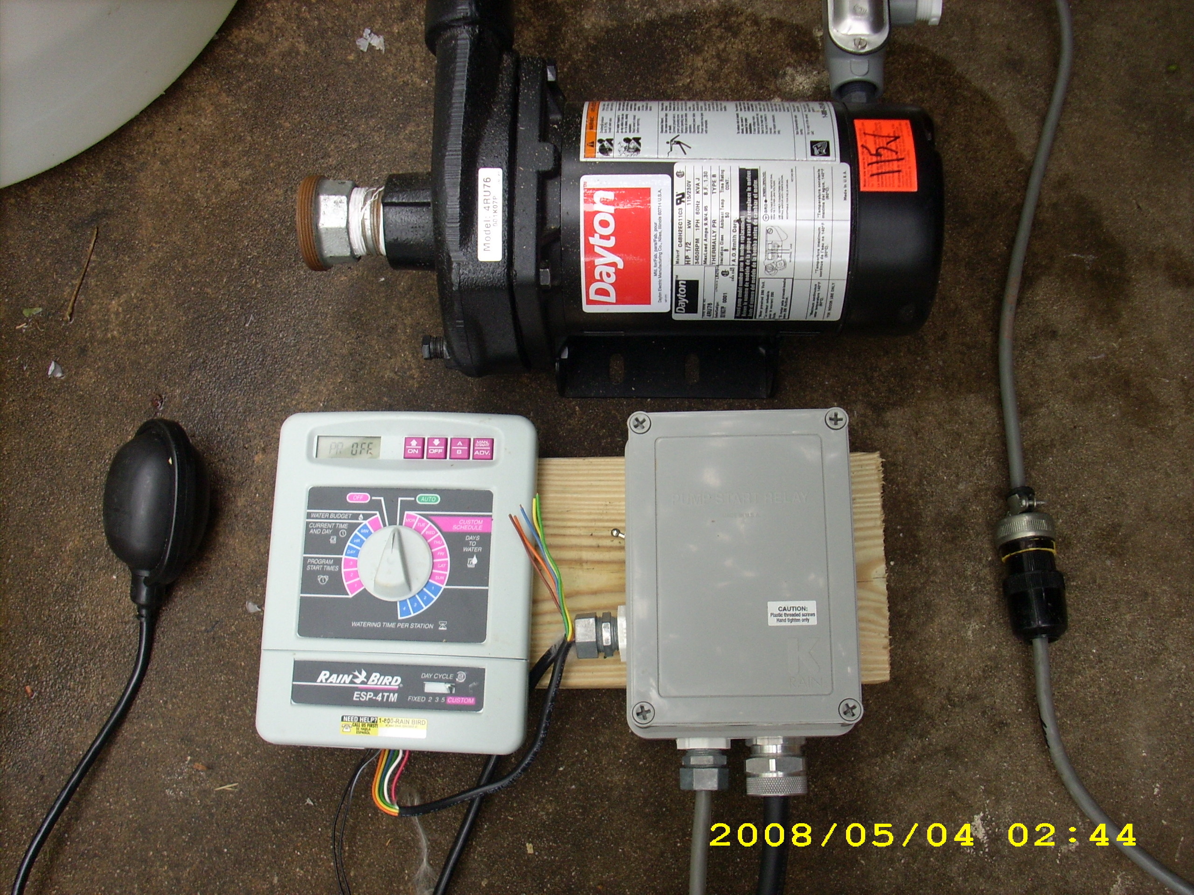
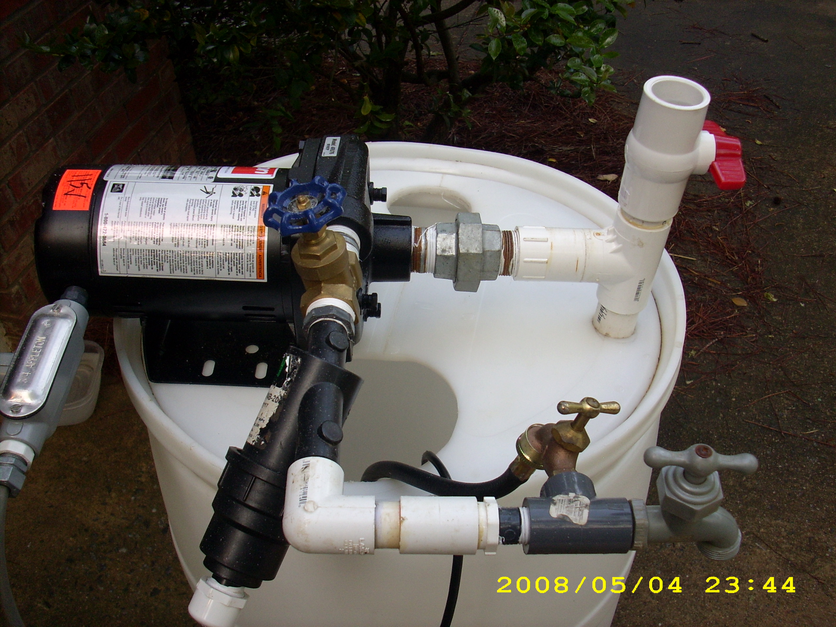
Example #1

Slide 46
Most pumps are water cooled
Require 2+ GMP flow
2 gpm = 120 gph
May need to recirculate some water
Ex. 1.7 gpm, need ~.05gpm

Slide 47
Small AC Pump Example
Volts: 115 VAC
Amps: 0.7 amps
Watts: 80.5 watts
PSI: On @ 0 psi; Off @ 60 psi
Flow: ~1 gallon per minute, or 60 gallons per hour

Slide 48
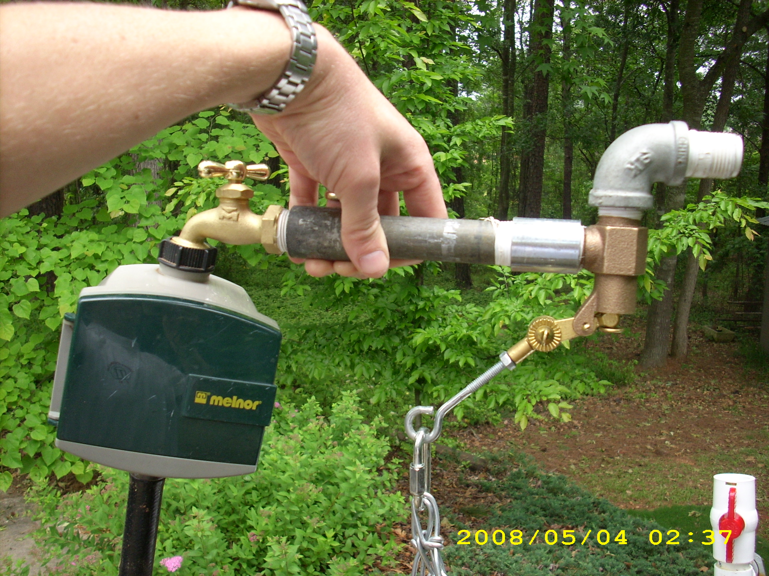
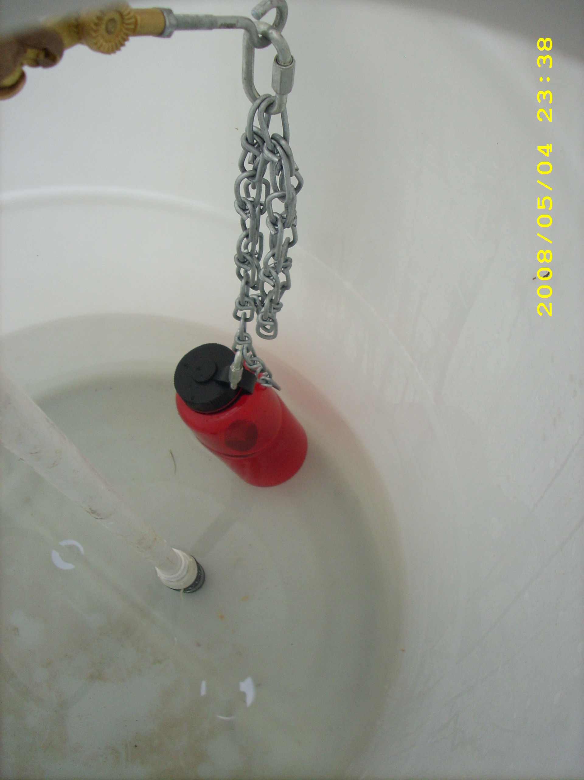
Mechanical Shutoff
60 psi cutoff
Water-level shutoff
Hose-end timer

Slide 49
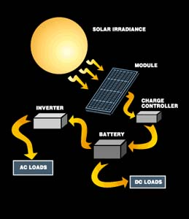
Pumping with Solar Electricity
SUN

Slide 50
DC Pump Example #1
Volts: 12 VDC
Amps: 1.9 amps
Watts: 22.8 Watts
PSI: On @ 20 psi; Off @ 35 psi
Flow: ~1gallons per minute, or 60 gallons per hour

Slide 51
DC Pump, Example #2
Volts: 12 VDC
Amps: 3 amps
Watts: 36 watts
PSI: On @ 20 psi; Off @ 35 psi
Flow: 3.2 gallons per minute, or 192 gallons per hour

Slide 52
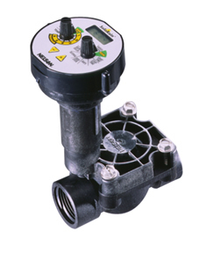
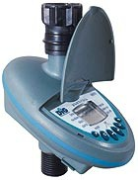
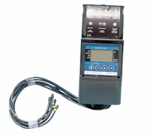
Battery Operated Timers
Hose end
In-line
Multi-zone
Cutoff pump at 35psi

Slide 53
DC Float Switch
Prevents dry pumping
Option #1 - Electronic

Slide 54
Load
Pump energy requirement
Hours of pumping
Solar array size
Load
Available sunlight
Size/rating of solar panel
Losses
Battery Size
-Load
-Maintain reserve
-Cloudy days
-Temperature
Solar System
Design

Slide 55
Example Load Calculations
Pump :12VDC, 1 gpm, 2 amp
Need 120 gallons of water once a week
Pump time:
100 gallons / 1 gpm = 120 minutes ~ 2 hrs/week
DC load:
2 amps * 2 hours = 4 amp hours per week (12 VDC)

Slide 56
Solar Array Sizing
1. Average amp hour per day: 4 / 7 = 0.57
2. Multiply #1 * 1.2 for losses = 0.68
3. Average Sun hours per day (Atl) = 4.74
4. Divide #2 / #3 = 0.14
5. Amps of solar module = 0.24
6. Total number of modules = 1

Slide 57
Watts = amps * volts
5 watts / 12 volts = 0.24 amps

Slide 58
Charge Controller

Slide 60
Battery Sizing
1. Max amp hours per day: 4
2. Continuous cloudy days 4
3. Multiply #2 * #3 = 16
4. Divide #3 / 0.8 to maintain battery reserve =
20 amp hour
5b. Multiply #4 * 1.19 to run pump in temperatures as low as 50 F = 24 AH

Slide 61
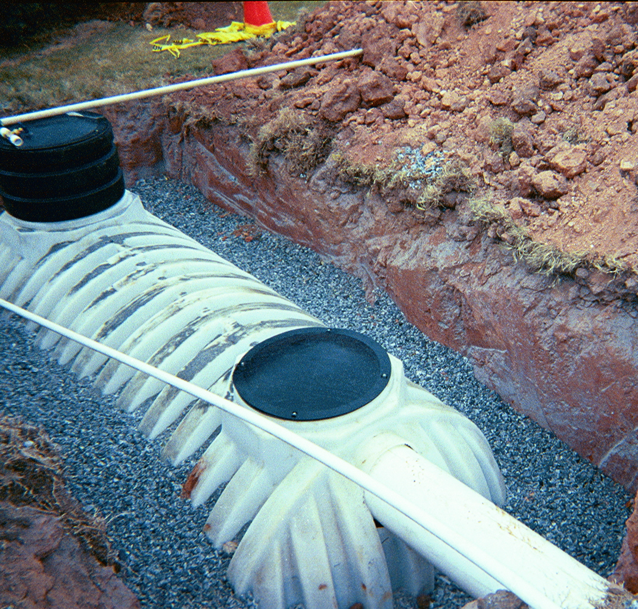
Water Ban Survival Guide
Landscape Design
Irrigation Design
Harvest Rainwater
Harvest Condensate

