Slide 1
Rain Gardens in Home Landscapes
Rose Mary Seymour
Engineering Extension Specialist
CAES-Griffin Campus
Ag Pollution Prevention Program
Sponsored by P2AD of Georgia

Slide 2
Outline of Rain Garden Presentation
Why Do We Want to Create Rain Gardens in Our Landscapes?
  Discussion on stormwater and how it contributes pollution to streams and other water bodies
  Solutions to stormwater pollution include beneficial uses of stormwater on-site to reduce stormwater volumes
Build Your Own Rain Garden
  Define terms, benefits and purpose
  How to design a simple rain garden
Notes:
This PowerPoint presentation is a combination of 2 shorter presentations.
The first presentation is about stormwater as a pollution source for streams and water bodies. It provides a background on why rain gardens in our landscapes have great environmental value.
The second presentation gives a thorough definition of what rain gardens are and what purpose they serve. It then gives step by step instructions on how to design a rain garden for a specific site, and then finally discusses appropriate plants to use in rain gardens.

Slide 3
Why Do We Want to Create Rain Gardens in Our Landscapes?
Notes:
This is the title for the first part of this presentation.

Slide 4
Development Impacts on the Water Cycle
10%
55%
50%
15%
Notes:
In an undisturbed environment, water falls to the ground, either hitting the surface and running off or percolating through the soil into the groundwater. Through both routes, water makes its way to our streams, ponds, wetlands, rivers, lakes and oceans.
As we develop and alter the landscape, however, this natural cycle is disturbed, impacting both water quantity AND water quality.
- increased runoff
more frequent flooding
more severe flooding
- decreased infiltration
less groundwater recharge
decrease in base flow to streams
- more pollution generated from our uses of the land and delivered to our waterways

Slide 5
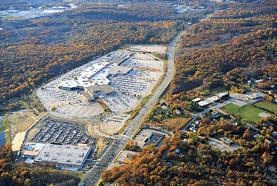
Impervious surfaces
Inhibit recharge of groundwater
Prevent natural processing of
pollutants in soil, plants
Provide a surface for accumulation of pollutants
Provide an express route for pollutants to waterways
Notes:
The chief cause of pollution carried through stormwater is impervious surfaces. Impervious surfaces
transport pollutants,
impede or prevent infiltration,
increase the volume of runoff generated.
Also, increasing amounts of impervious surface cover indicates more intensive & polluting land uses.

Slide 6
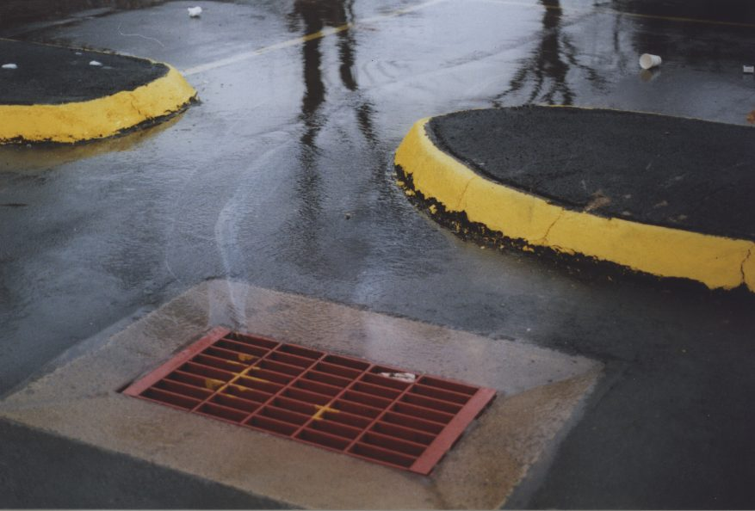
Polluted Runoff is the #1 Water Quality Problem in the U.S.*
* USEPA
Notes:
Nonpoint Source Pollution - Oily water running to storm drain
..."nonpoint source pollution" or polluted runoff, which is created when water washes over the land and picks up all sorts of diffuse pollutants along the way, whether it is oil from our cars, fertilizers from our lawns and parks, or garbage carelessly tossed on the ground. Non point pollution sources must be reduced and eliminated differently than pollutants that come from one specific source that we can control such as treatment plant effluent or industrially produced pollutants.
EPA has recently declared stormwater pollution to be the #1 water quality problem in the US.

Slide 7
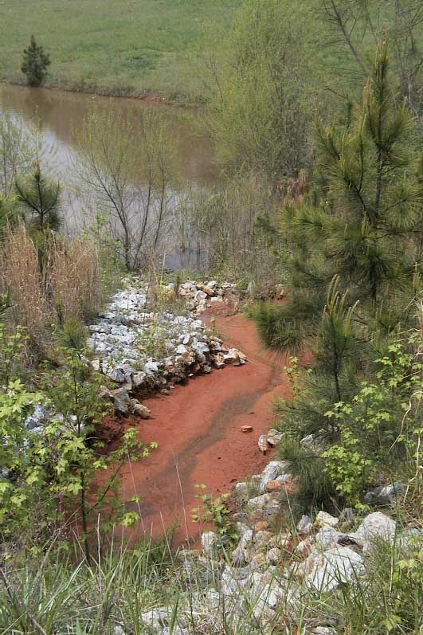
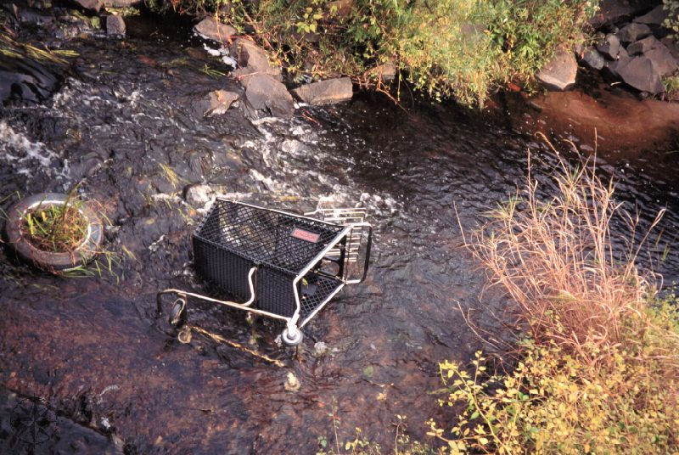
Pollutants To Streams That Result from Development of Land
Nutrients
Pathogens
Sediment
Toxic contaminants
Debris
Thermal Stress
Notes:
The Major Pollutants transported to streams in Urban Stormwater
There are a variety of pollutants that can get into our waters. Many officials know about sediment because there has been a lot of guidance and regulation on sediment and erosion control already; however, it's important to know that sediment is just one of several nonpoint pollutants and what we do to control sediment and erosion does not necessarily control for other pollutants as well.
Typical nutrients in stormwater runoff are particularly nitrogen and phosphorus sources which can be from fertilizers, animal waste and leaks from septic systems or sewer lines.
Pathogens come from animal waste washed off of impervious surfaces, both domestic and wild animal wastes, and from failed septic systems or leaking sewer lines.
Toxic contaminants include hydrocarbons such as fuels and lubricants from cars as well as metals that wash off of streets and parking lots.
Debris is any kind of litter. Organic materials such as yard waste and leaves washed into streams can reduce the oxygen content of waters by feeding microbial activity in the water. Other litter leaches toxics and metals as it degreades and breaksdown in the water stream.
Thermal stress is considered a pollutnat because as warmer water holds less oxygen. When stormwater heated up by hot impervious surfaces mixesinto cooler stream waters, the water in the stream rises and the oxygen content of the water decreases causing stress and even death in severe cases of the aquatic biota in the streams.

Slide 8
Storm Hydrograph
Short, high volume peak discharge
Increased total runoff volume
Baseline peak discharge
Higher base flows
Pre-development
Post-development
Notes:
Storm Hydrograph
While stormwater carries pollutants into the stream, the increase in stormwater volume changes the dynamics of water flow in local streams. The graph here shows typical changes that impervious surfaces cause in the flow of streams.
The storm hydrographs that you see here show what a person would see if they stood at a spot by a stream and watched the stream flow rise and fall as a result of a full storm event. To the left the hydrograph starts before the stormwater reaches the stream. As a storm occurs the water in the stream rises as can be seen in the two storm hydrographs here. Then when a storm stops, the stream water level and flow will gradually fall back down to the original stream level before the storm.
The two lines in this graph show how impervious surfaces change the flow regime in streams nearby. The blue (or green) hydrograph is for a stream that is in an area with no development such as undisturbed woodlands. The red hydrograph is for the same stream after impervious surfaces have been created in the watershed of this stream. You can see from the difference in the hydrograph shapes the major impacts that increased stormwater volume from impervious surfaces cause
Increased peak volume of stormwater
Increased total volume of stormwater
Peak flow comes faster and with more energy
Low flow rates are reduced

Slide 9
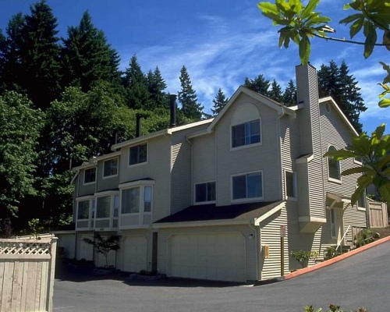
Traditional Drainage Systems
collect, concentrate, convey
Notes:
Traditional Drainage Systems
The traditional methods of dealing with stormwater can be summarized in the 3 words…collect, concentrate, convey. This approach achieves the primary goal of preventing flooding locally due to increased stormwater from impervious surfaces. Until recently (the last 10-20 years), flooding was the only consideration of managing stormwater. However, during the last 20 years there has been a change in the goals of managing stormwater to include reducing the increased peak flows and higher flow rates in streams and better treatment of pollutants.
However, the quick conveyance of stormwater to streams that the traditional drainage systems provided does not create any means for reducing pollutants in the stormwater.

Slide 10
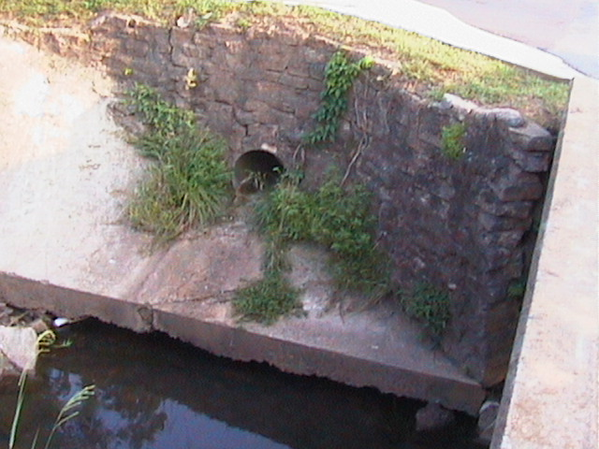
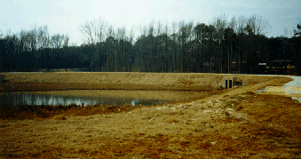
The Traditional Approach
Methods:
Conveyance and detention
Goal:
Minimize flooding
Other Issues:
  Hydrologic regime disrupted
  Little water quality control
  Flooding sometimes becomes worse
Notes:
To reduce peak flows and high flow rates, detention ponds were created. However, they often did not create the kind of hydrologic improvements in streams that they were intended to do. Detention basins with fast pipe conveyance to them do not provide adequate pollutant removal for many situations.
Detention basins do reduce the amount of suspended solids such as sediment, metal dust and other trash in stormwater. They also provide adequate treatment of bacteria in highly contaminated situations. However, they do nothing to reduce nutrients and other dissolved toxic contaminants and the smaller organic matter in stormwater.

Slide 11
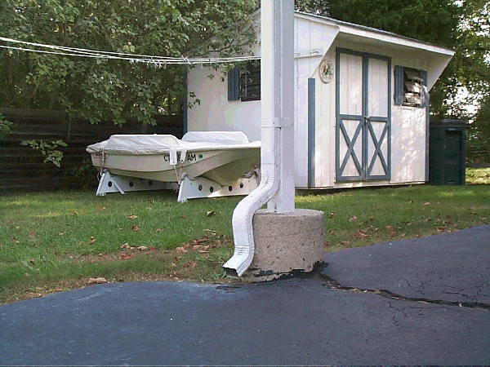
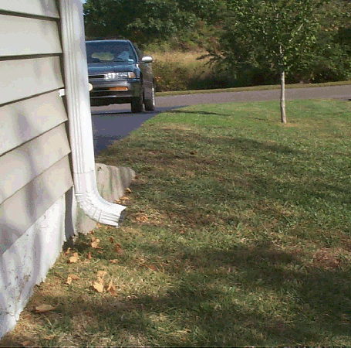
Better Site Design Practices
Connected
Disconnected
Notes:
Better Site Design Practices
So to improve water quality as well as reduce stormwater volumes, a new approach to managing stormwater is focused on better site design that reduces the connection of impervious surfaces to break down the collection and concentration for conveyance of stormwater off of impervious surfaces.
Better site design includes
Disconnecting impervious surfaces by separating these surfaces with green spaces and soil that allow some infiltration of the stormwater on-site.
Designing greenspaces on a site to capture or filter stormwater
These pictures show the simple differences that better site design requires such as having downspouts spill into a greenspace such as turfgrass (picture on the right) rather than spilling onto another impervious surface like the driveway in the picture on the left.

Slide 12
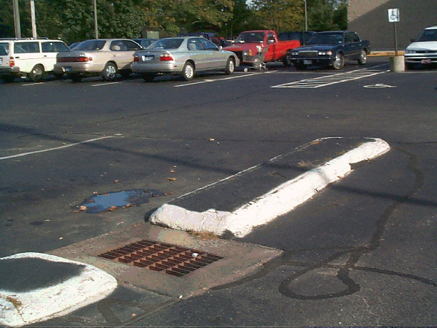
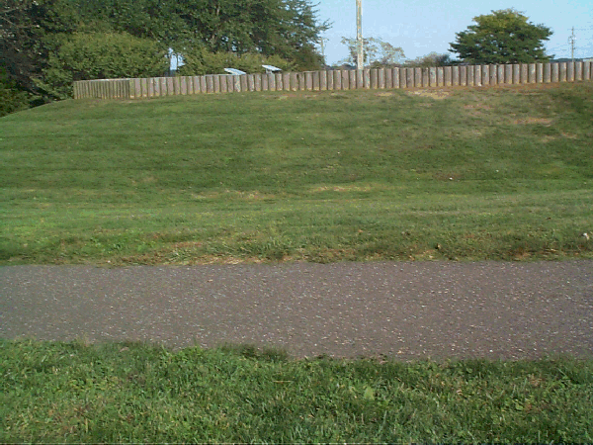
Better Site Design Practices
Connected
Disconnected
Notes:
The picture on the left where the parking lot spaces and islands are impervious and are directly connected to the storm drain, a situation that embodies the traditional collect, concentrate convey paradigm.
The picture on the right has an asphalt walkway that slopes down from its center so that stormwater collecting on the walkway flows into the turfgrass on either side of it to be filtered by the turfgrass and infiltrated into the soil. A storm drain is not needed for minimal slopes in this picture.

Slide 13
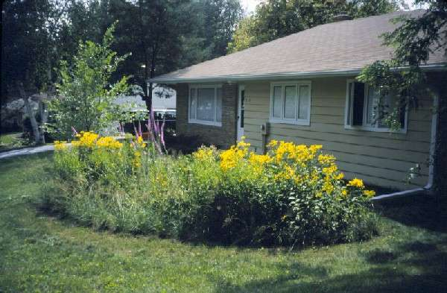
On-site vs. Regional Approaches
On-site: Manage stormwater as close to the source as possible
A residential “rain garden”
Regional: Rely on
large, regional detention facilities
North Griffin Regional Detention Pond
Notes:
Another critical component of better site design is keeping as much stormwater as possible and as is safe on the original site to allow it to be infiltrated into the soil on-site.
The more stormwater that can be retained and dealt with on-site, the less large regional detention facilities that will be required for good regional stormwater management.

Slide 14
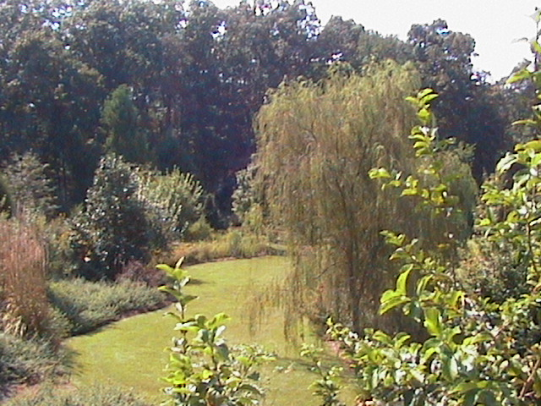
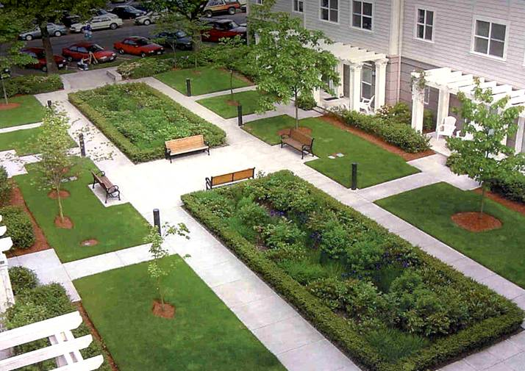
Greenspace & Water Quality
Greenspaces:
Promote infiltration
Decrease runoff
Provide buffers
Filter pollutants
WHERE
Between impervious surfaces and streams
Between impervious areas
Notes:
Better site design for stormwater management requires that we have more greenspaces to
Promote infiltration
Decrease runoff
Provide buffers
Filter pollutants
To be effective, greenspaces along streambanks such as riparian buffers are important, but rain gardens provide a valuable tool for keeping stormwater on-site separating and disconnecting impervious areas. The picture to the left shows two rain gardens in the midst of intensive impervious spaces. The two rectangles in the center of the picture are actually rain gardens. The second picture shows that all kinds of plants from turfgrass to willow trees not only create aesthetcally pleasing landscapes but they are tools for reducing water quality impacts from stormwater.

Slide 15
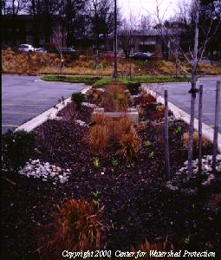
Importance of Infiltration
Preserves natural hydrology
  Reduces runoff and flooding
  Maintains base flows
Cleans water, removing pollutants
Inexpensive water quality control
Notes:
Infiltration is the most valuable part of better site design. The more we can enhance infiltration of stormwater on site, the less costly the total stormwater management bill can be. Infiltration is an inexpensive way to reduce runoff and flooding, maintain base flows in streams and remove pollutants through the filtering through the soil.
Rain gardens provide infiltration on-site while also creating a beautiful green component of the landscape.

Slide 16
Lets Talk About How to Make A Rain Garden
Notes:
This is the transition slide from the first part to the detailed discussion of designing and building a rain garden.

Slide 17
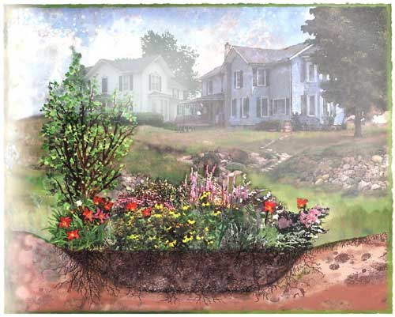
Build Your Own Rain Garden

Slide 18
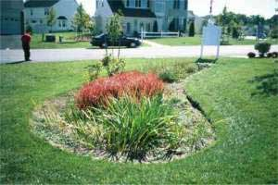
What is a Rain Garden?
An area in a man-made landscape that captures a shallow amount of water and holds it for a short time period
Runoff water is captured and infiltrated into the soil in an indented area where plants and soils utilize and filter the water
An attractive addition to a landscape
Notes:
The definition of a rain garden is given in the slide. The highlighted words of the first bullet highlight the fundamental things that make a rain garden different from other landscape design features.
The rain garden is man-made and is designed to deal with a particular amount of stormwater.
A rain garden captures only a shallow amount of water. It is not like a pond of water feature.
The shallow amount of water does not persist for a long time like a wetland.
The rain garden is an indented area to capture stormwater.
The soil, mulch and plants of the rain garden provide filtering and treatment of the water to remove pollutants and utilize some of the water for the plants.
The rain garden should be attractive and fit seamlessly and naturally into the surrounding landscape and site.

Slide 19
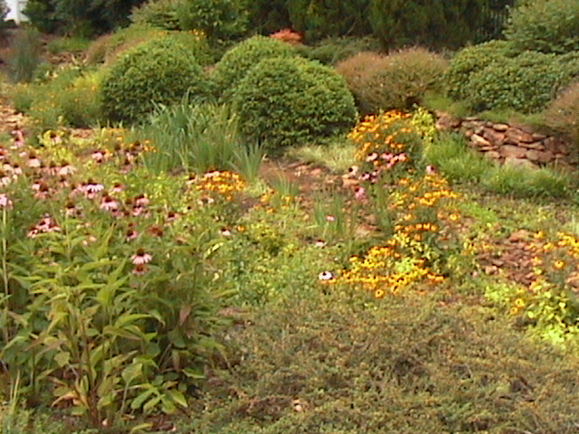
Purpose of a Rain Garden
Captures runoff from impervious areas such as roofs, driveways, patios
Reduce runoff leaving landscape to become stormwater
Notes:
The primary purposes of the rain garden in a landscape are
Capturing stormwater runoff from impervious surfaces on-site
Reducing the amount of runoff leaving the site

Slide 20
Other Facts About Rain Gardens
Ponding should last no more than 48 hours after rain stops
Typical depths for rain gardens range from 4 to 12 inches with 6 to 8 inches recommended
Should not increase mosquito numbers
Will attract water loving critters such as frogs, toads and snakes
Notes:
Other Facts About Rain Garden
Other characteristics of a well-designed rain garden are
The ponding of water should last no more than 48 hours after rain stops
Typical depths for rain gardens range from 4 to 12 inches with 6 to 8 inches recommended
Rain gardens also
Should not increase mosquito numbers.
Will attract water-loving creatures such as frogs, toads and snakes.

Slide 21
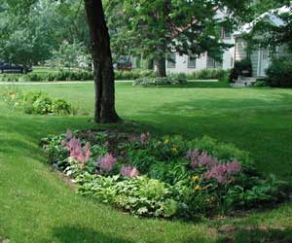
Benefits of Rain Gardens
Low maintenance, low water use, beautiful landscape feature
Increases infiltration of rainwater in landscapes with impervious surfaces
  - infiltrates as much as 30 % more water than a flat or sloped lawn area
Reduces flooding risks
and stream bed destruction
downstream
Can provide a different kind of
habitat in the landscape

Slide 22
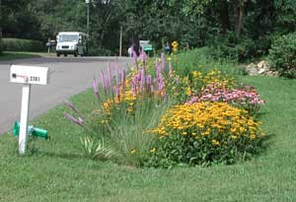
Planning Your Rain Garden
Location
Size
Plant Mix
Notes:
Planning Your Rain Garden
When a homeowner is ready to create a rain garden in their landscape. There are 3 critical issues that need to be settled before hand. The location should be chosen. The size of the rain garden needs to be decided, and the plants that will be placed in the rain garden are chosen.

Slide 23
Locating the Rain Garden in a Landscape
At least 10 ft from a building foundation
Near patio, driveways roads
Area that water will naturally move to –low area
Easy viewing from inside
Fitting into the rest of the landscape
Notes:
Locating the Rain Garden in a Landscape
Considerations on where to place a rain garden are depend on the natuiral elevations of the land as well as how the rain garden will fit into the rest of the landscape.
Rain gardens should not be right up against a buildin g foundation as the infiltrated water is not god for the foundation. However, for surfaces in the outdoors like driveways and patios, a rain gartden can be right next to these.

Slide 24
Locations to Avoid
Next to a building foundation
Over a septic system
Where water stands for long periods already
  High seasonal water table area
Inside the dripline of any large trees
Slopes greater 12%
Notes:
Locations to Avoid for Rain Gardens
A rain garden should not be installed on top of a septic tank or on top or within 10 ft of the septic system drainage field. The septic tank should not have standing water over it in the event that it needs to be serviced. The septic drainage field has enough water to contenc with from the septic system and should not have the burden of additional infiltrated water from a rain garden.
If there is a seasonally high water table in the landscape, a rain garden should not be located over that area. A sign that there is a seasonally high water table is a location where water stands for long periods after rain has ceased and where wetland type plants volunteer.
Placing a rain garden within the dripline of a large tree is damaging to the tree as well as a lot harder to dig and prepare. This should be avoided.
For areas with slopes greater than 12%, professional help should be hired to create a rain garden as this sloping land will require special erosion control materials during establishment of the rain garden plants and because it requires more careful design.

Slide 25
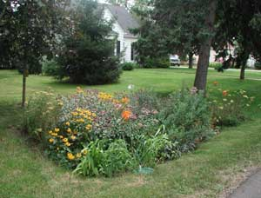
Rain Garden Size
Depends on
  Area of drainage (impervious area)
  Depth of ponding of rain garden
  Soil and Slope of location
Notes:
Rain Garden Size
Once the location for the rain garden is established, the next step is to determine what size the rain garden should be. The sizing of the rain garden depends on 4 things- area of drainage, depth of ponding, soil and slope of location.
A rain garden’s depth should be 4 to 12 inches with the 12 inch depth being an extreme that is suitable for special high infiltrating soils. Most rain gardens will have a depth of 6 to 8 inches. For soils with really low permeabilities, a depth of 4 to 6 inches may be more appropriate and the rain garden needs to be larger in area.

Slide 26
Sizing a Rain Garden
Determine drainage area
Figure out the size of the area that will have runoff going to the rain garden
For a house, draw a footprint
Break whole roof into areas going to each gutter
Figure areas for each gutter
Notes:
Determine the impervious drainage area for the rain garden
This can be done with careful measurements of the roof areas of a home or building. The area of roof contributing to each downspout should be determined. Then the distances from roof ridge to roof edges can be measured. Using these measures the area drained can be calculated. The angles of the roof make no difference in the area drained. The area being measured is the “bird’s eye view” area or the footprint of the structure that the roof area covers.
Once you know the drainage area, you need to determine the infiltration ability of the soil.

Slide 27
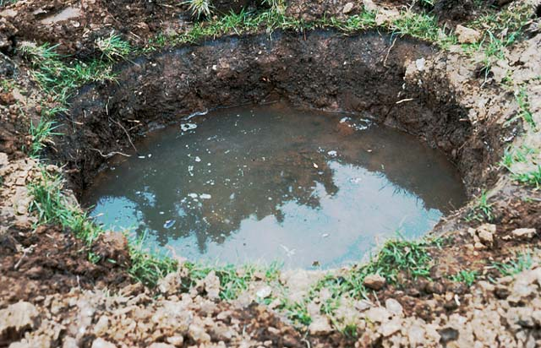
Soil Permeability Testing
Dig a hole 6 inches deep and wide
Fill hole with water
Check back after 12 hours - if water has not infiltrated into soil around hole, the soil or location is not suitable for a rain garden
If water is standing in the hole after 12 hours
  Soil has permeability unsuitable for a rain garden
  Or a perched or high water table is preventing infiltration
Notes:
Soil Permeability Testing
Test the soil for its permeability. A six inch depth of water should infiltrate into the soil in 12 hours or less to be able to use the native soils in the base of the rain garden. If the water infiltrates rapidly into the soil, the size of the rain garden can be smaller. For slower infiltration of the water, the rain garden size will need to be larger.

Slide 28
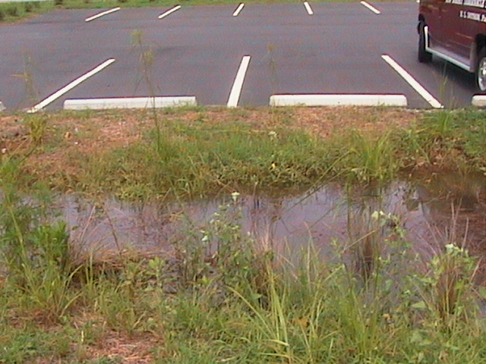
Problem Soils
If soils are high in clay or have been compacted during development, they may not have the capacity to infiltrate well
The rain garden area soil can be removed and replaced with a better draining soil
Notes:
Problem Soils
For soils that do not have suitable permeability, a rain garden can still be created. To do this, the native soil will need to be excavated and a more permeable soil mix placed into the area beneath the rain garden.

Slide 29
Problem Soils
Ideal rain garden soil mix – 50-60% sand, 20-30% topsoil, 20-30% compost
  No more than 10% of mix should be clay
Be careful of the nutrient content of composts…lower nutrient concentrations is better for the rain garden soil
Notes:
A rain garden soil mix as given above should be put in place 3 to 4 feet deep below the surface of the rain garden to provide good infiltration and an area that will hold most of the water that flows into the rain garden so that it can slowly seep out into the surrounding soils.
The compost used in the rain garden mixed should be mature, well-composted materials, not just any kind of fresh organic matter. More mature composts will have lower nutrient content and will release the nutrients slowly.

Slide 30
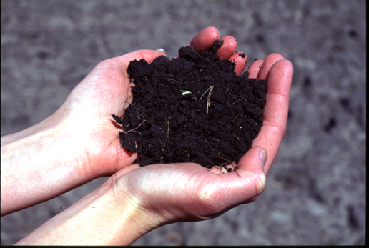
Soil Chemistry Test
Take 2 cups of soil and request a standard soil test from the local county extension agent
  Results indicate whether pH or nutrients need adjusting for good plant health
  Takes about 2 weeks and will cost an analysis fee
Notes:
Soil Chemistry Test
While the soil is being tested for infiltration, it is also good to have a chemical analysis carried out for nutrient content of the soil to make sure that plants can be established well in the soil.

Slide 31
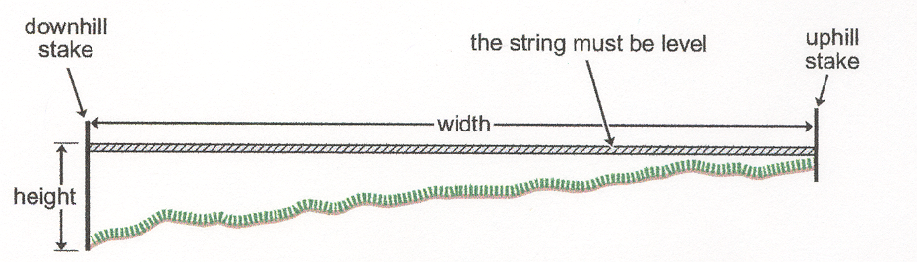
Deciding the Size
A rain garden on a steeper slope can be smaller and deeper than a rain garden on a flatter slope
Measuring Slope
Notes:
Deciding Size
The steeper the slope of the land in the location of a rain garden, the deeper the rain garden should be. For flatter sloped areas, (less than 4% slope) the rain garden can be 4 to 6 inches deep. For slopes between 5 and 7%, the rain garden can be 6 to 7 inches deep. For 8 to 12% slopes, the rain garden should be 8 inches deep.
To get an estimate of the slope of the land will require 2 stakes, a string and a level. Place the two stakes in the ground at a good distance apart along the slope. Tie the string to the uphill stake at the ground level. Then bring the other end of the string down to cross the downhill stake. Use the level to establish the string in a level position and in this position mark the spot where the string crosses the downhill stake. Measure from the ground to the mark on the stake and the distance between the two stakes. With these 2 measurements in the same units, i.e. inches, divide the height by the width. You should get a number less than 1 which is the slope in a fractional form. Multiply that number by 100 to get the percent slope. For example, 100 ft width between stakes and 12 inches height on the downhill stake gives a 1% slope (100X12)/12 = .01 => .01 X100 = 1%

Slide 32
Deciding the Size
Sandy soils – 5-8% of runoff area
Clay soils – 10-15% of runoff area
Example – Area = 1800 sq.ft
  Sandy soil - .06 X 1800 = 108 sq.ft
  Clay soil - .12 X 1800 = 216 sq.ft
If the area of the rain garden needs to be > 300 sq ft, consider making two smaller ones or bring in the earth moving equipment

Slide 33
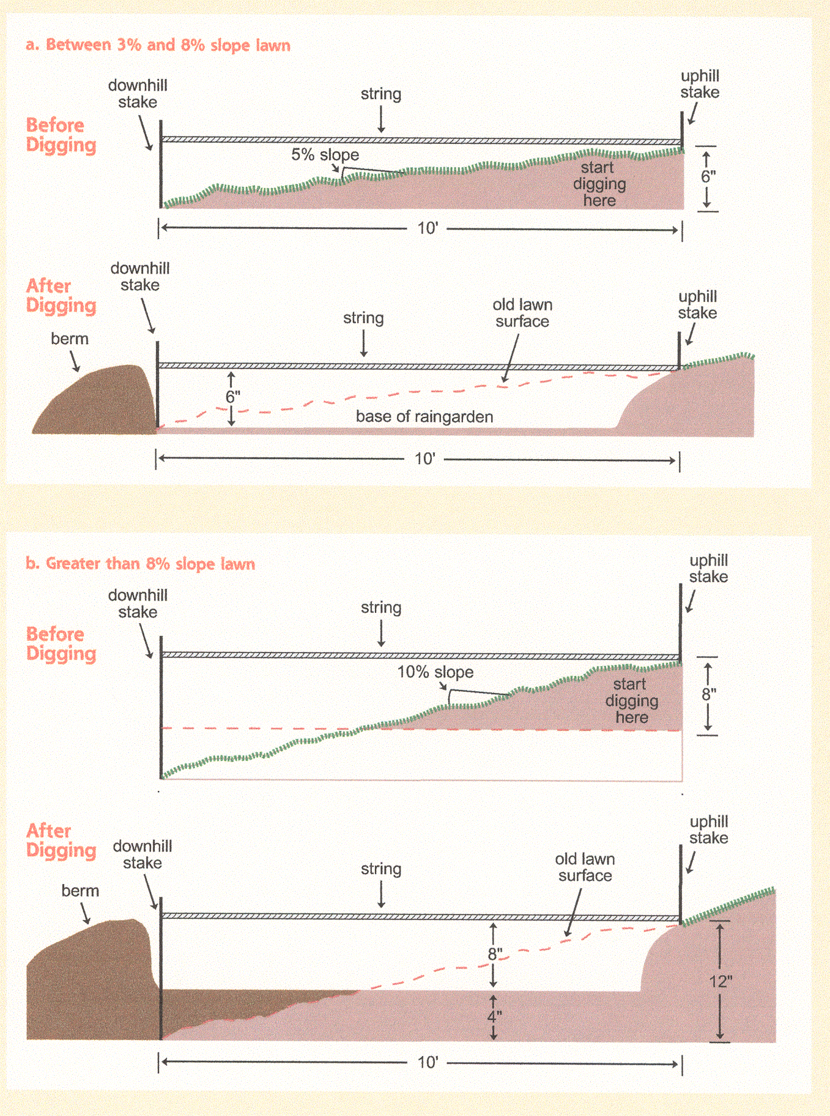
Installing the Rain Garden

