Slide 1
PRUNING
Lunch N Learn Series
March 15, 2007
Frank Funderburk
CEC Peach County

Slide 2
WHY PRUNE?
Number one reason---reduce size
Direct Growth
-topiary
-espalier
Increase Flowering
-crape myrtle
Disease/Insect Management
-removal of diseased or insect infested stems
-timing of new growth

Slide 3
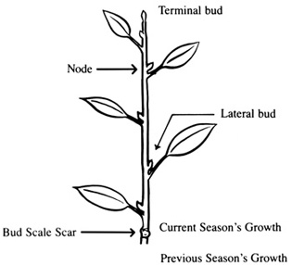
What happens when you prune?
Hormones
-apical dominance
-auxin produced
Regrowth
-usually within 4 weeks
-local in effect

Slide 4
Nuts and Bolts of Pruning
Technique
-thinning vs heading

Slide 5
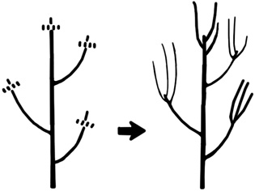
Heading Cuts

Slide 6
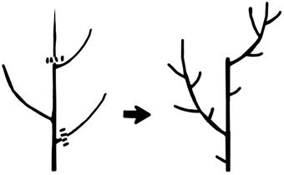
Thinning Cuts

Slide 7
Nuts and Bolts of Pruning
Technique
-thinning vs heading
-slope cut near node

Slide 8
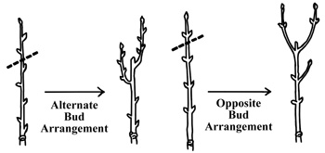
Slope Cut

Slide 9
Nuts and Bolts of Pruning
Technique
-thinning vs heading
-slope cut near node
-trees

Slide 10
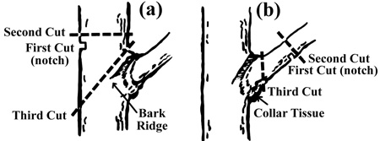
Tree Limb Pruning

Slide 11
Nuts and Bolts of Pruning
Technique
-thinning vs heading
-slope cut near node
-trees
Wound Dressing
Timing
        -not September-December
        -flowering plants ????
Renewal Pruning
-Mid-March
Tools

Slide 12
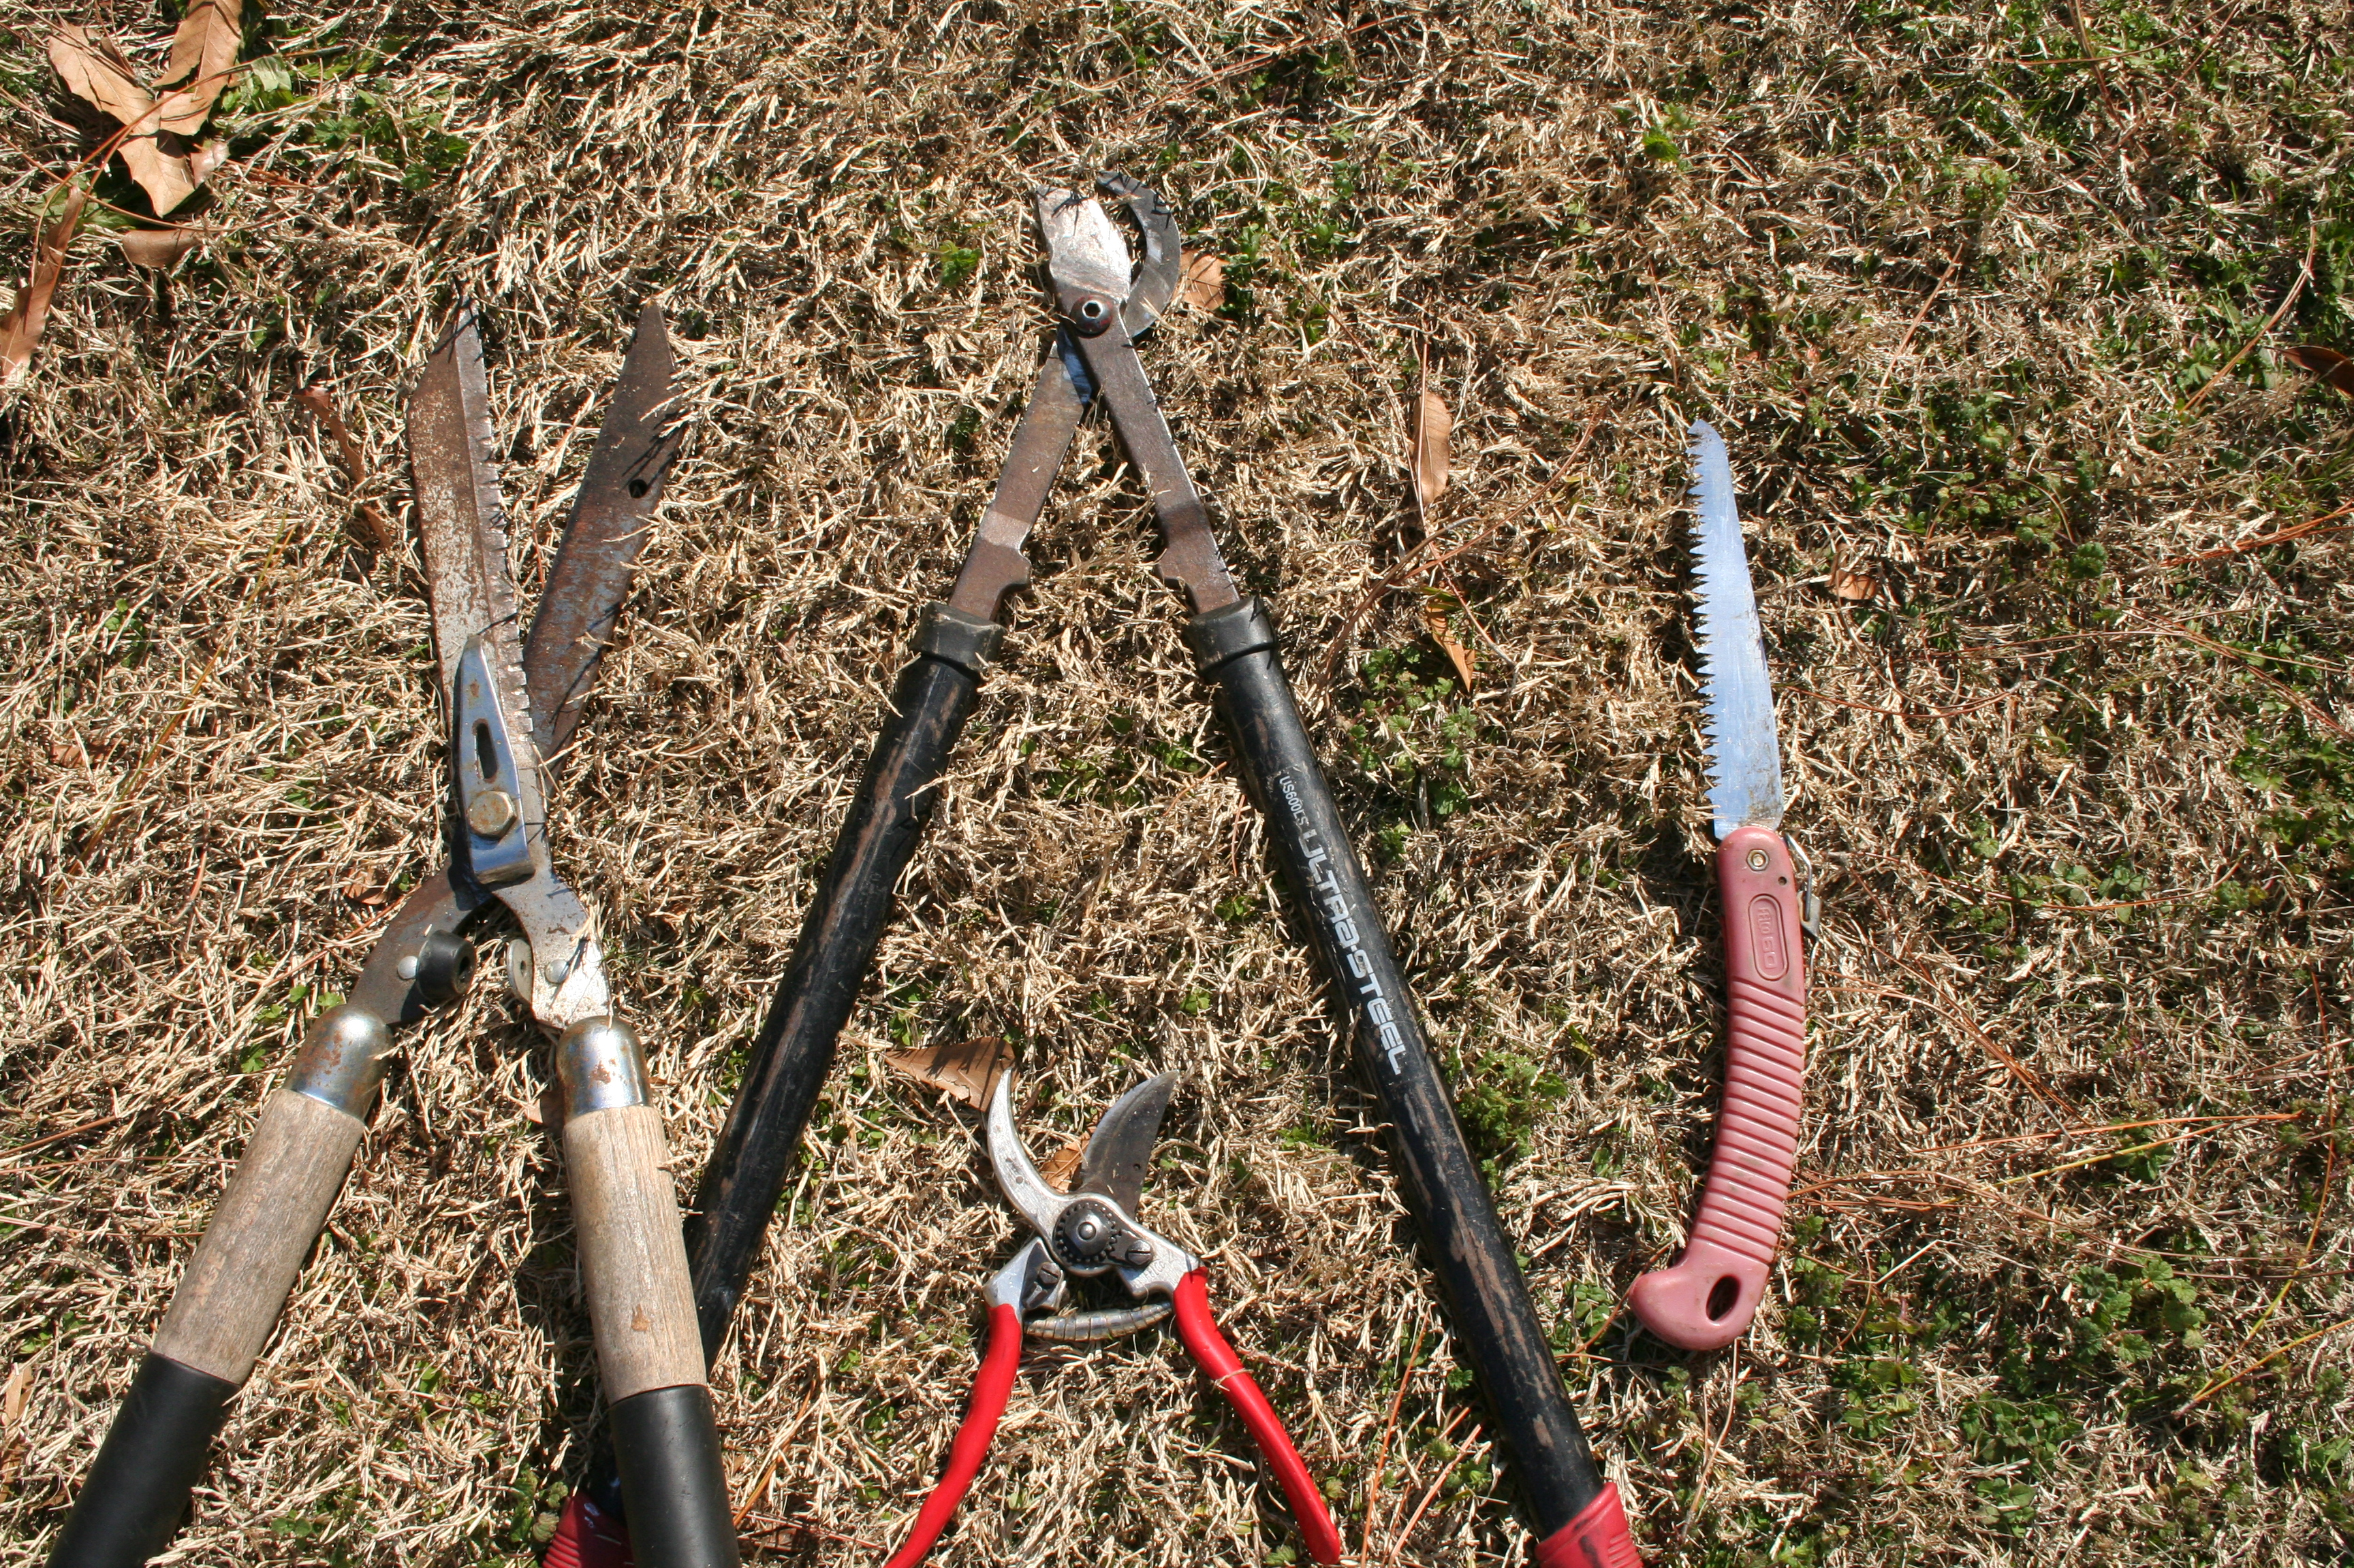

Slide 13
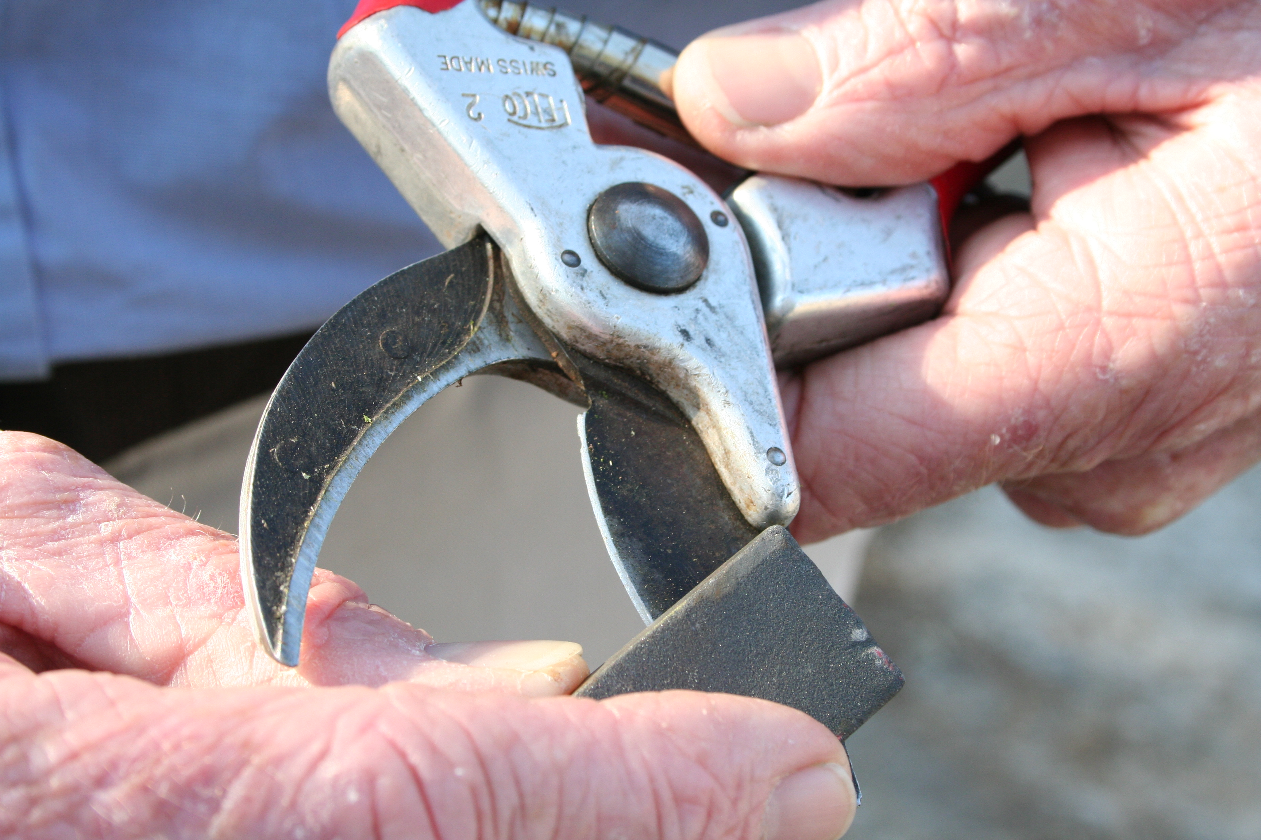

Slide 14
EXAMPLES

Slide 15
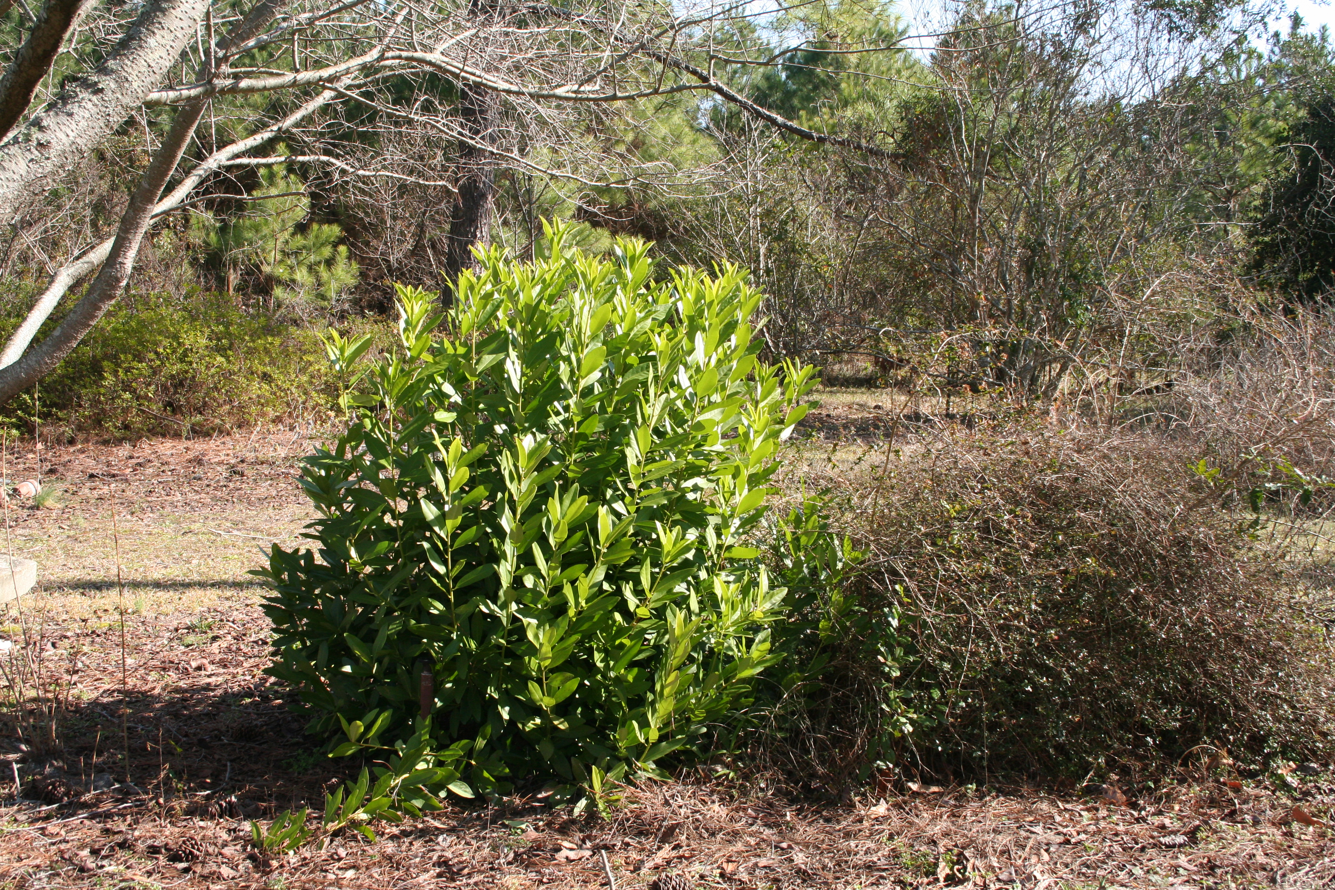

Slide 16
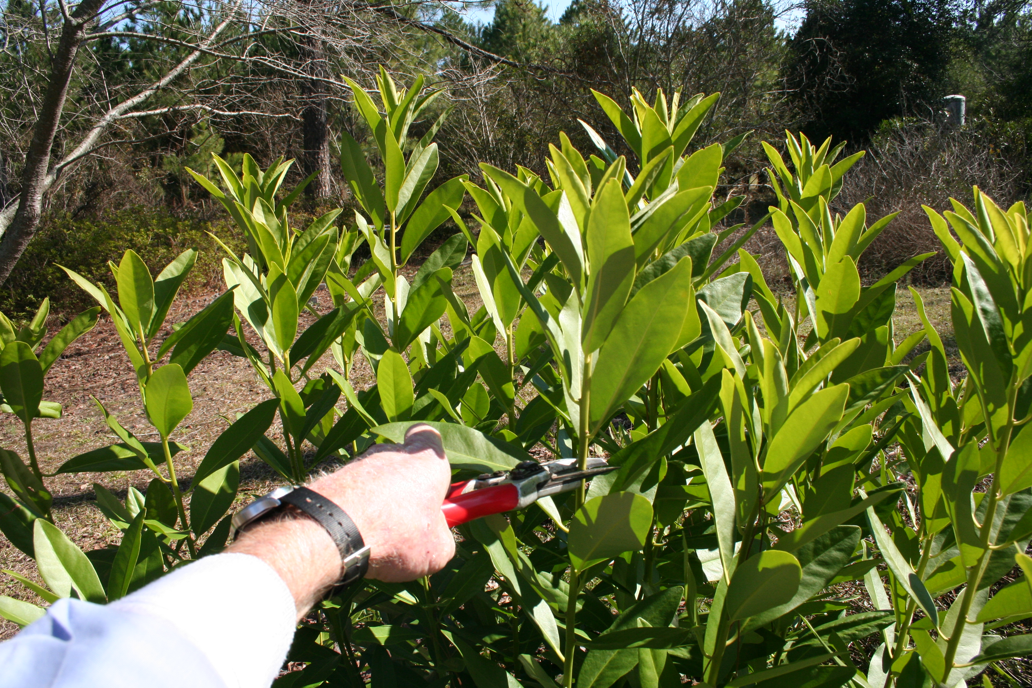

Slide 17
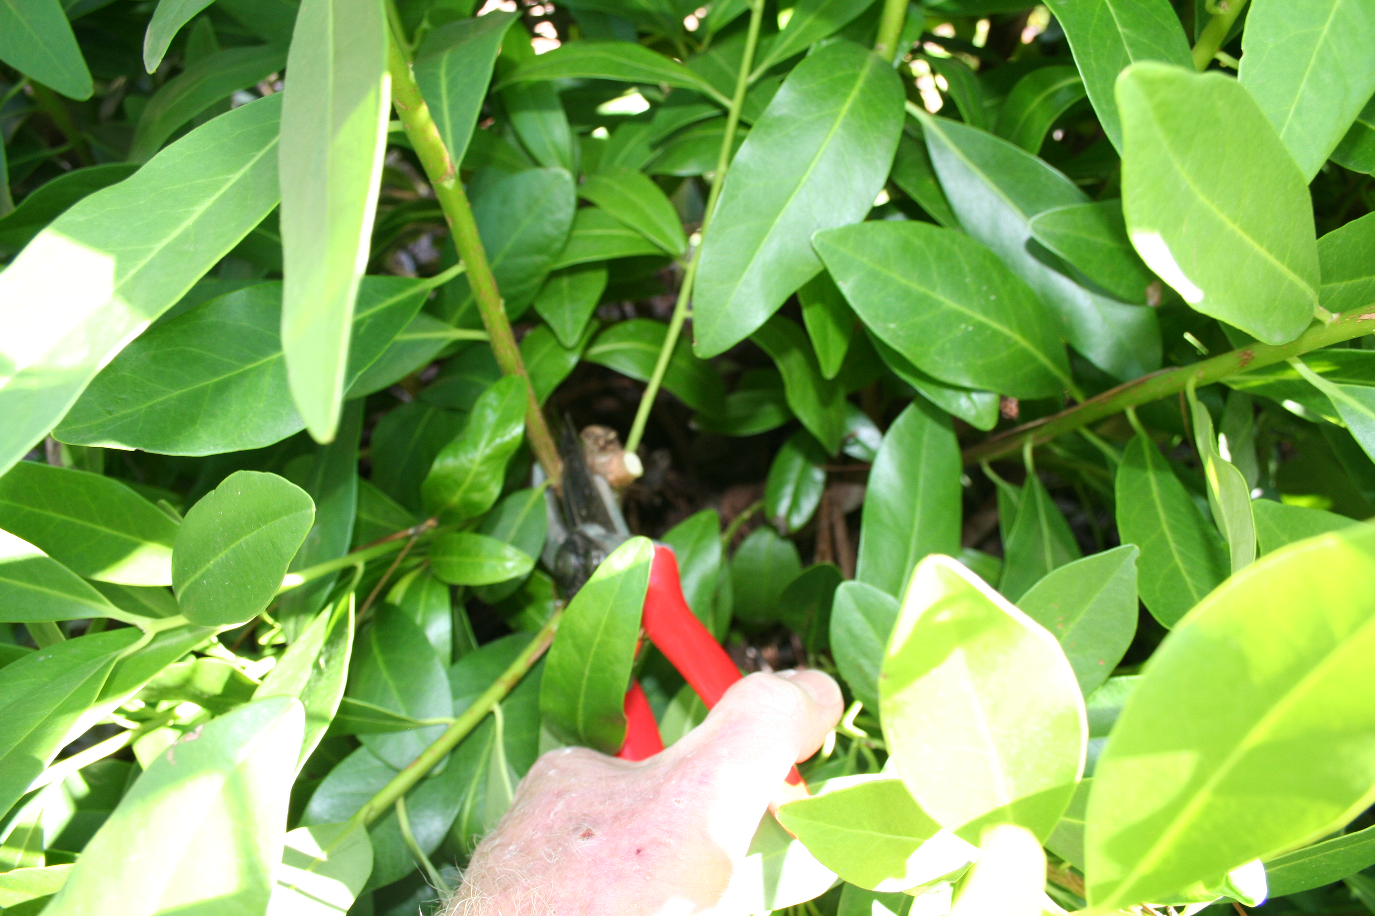

Slide 18
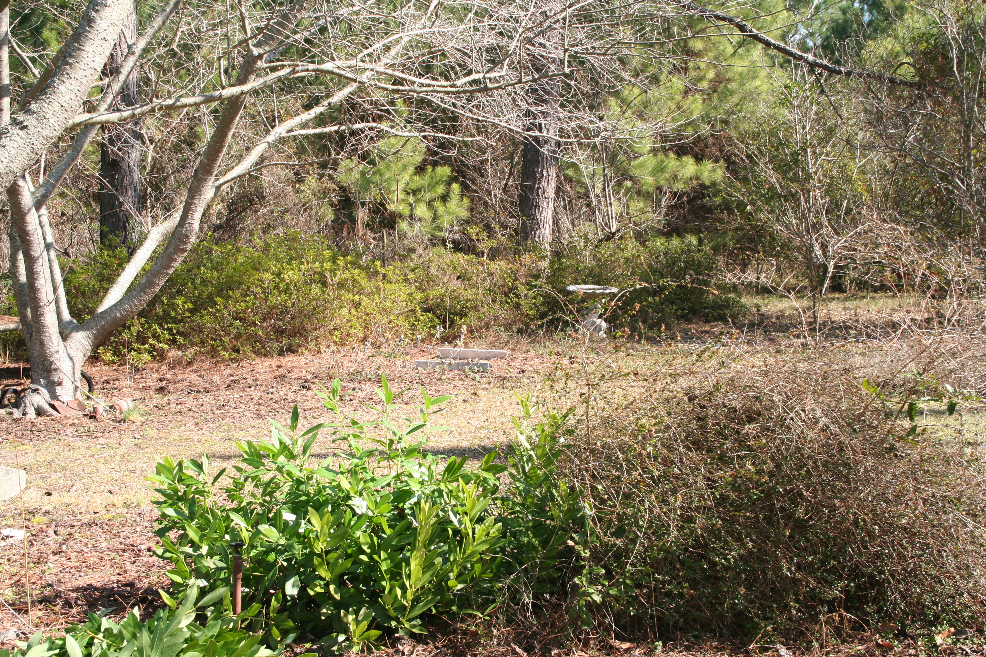

Slide 19
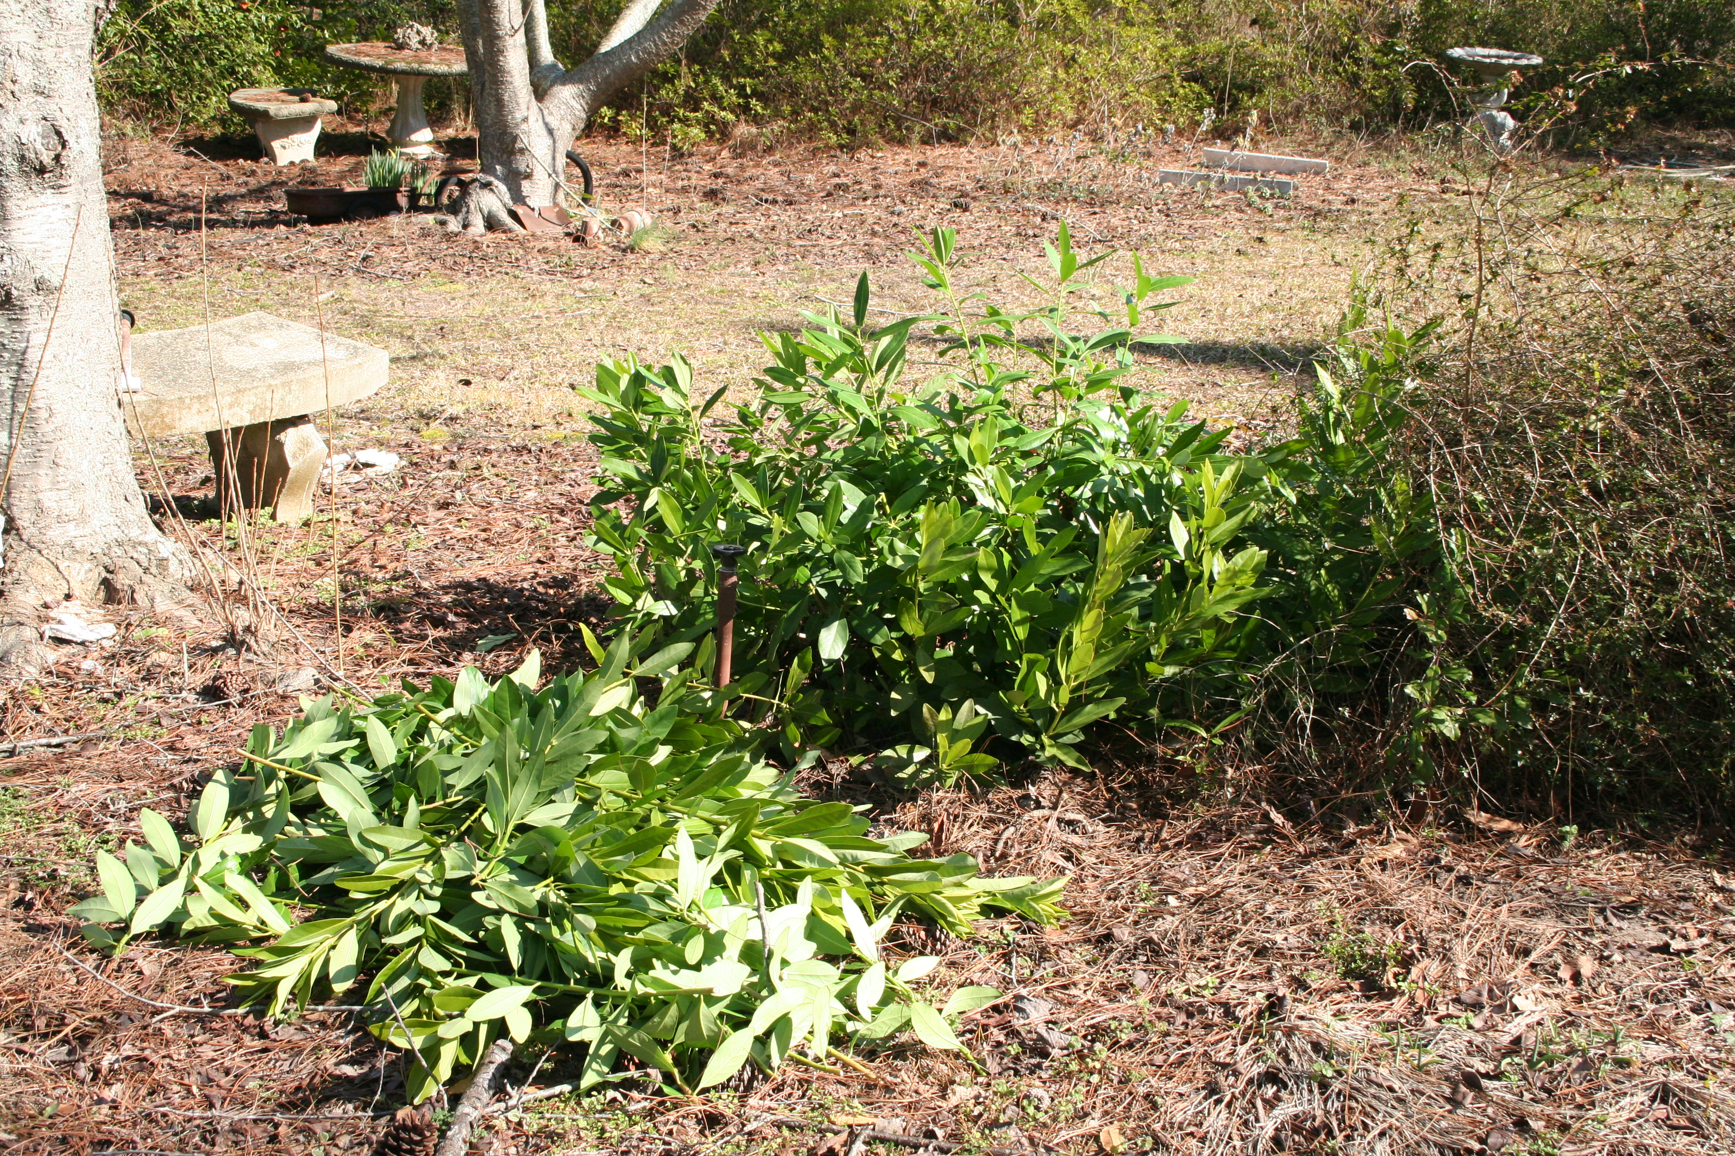

Slide 20
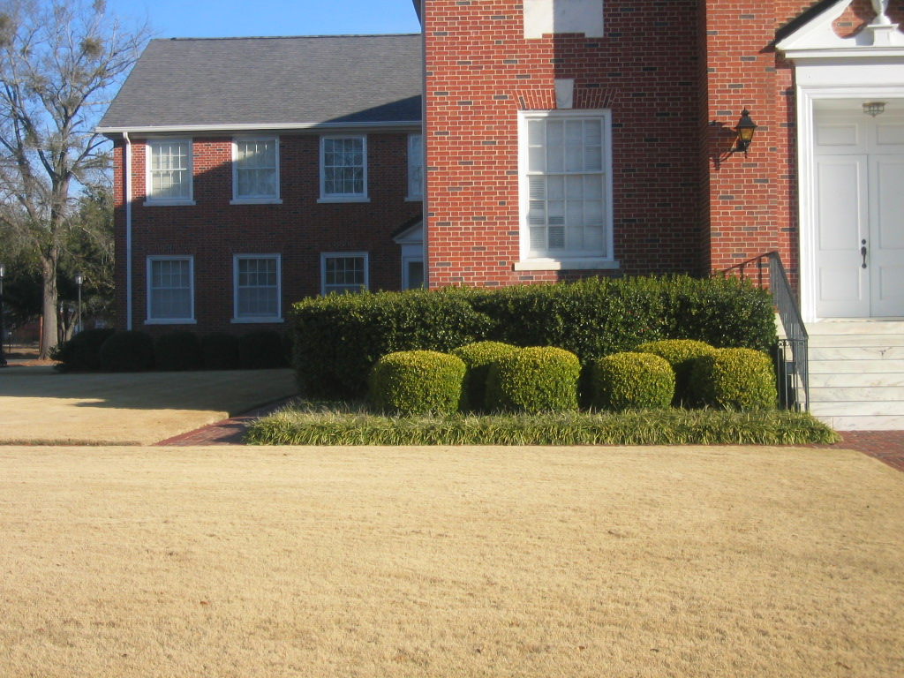
Shearing or Heading

Slide 21
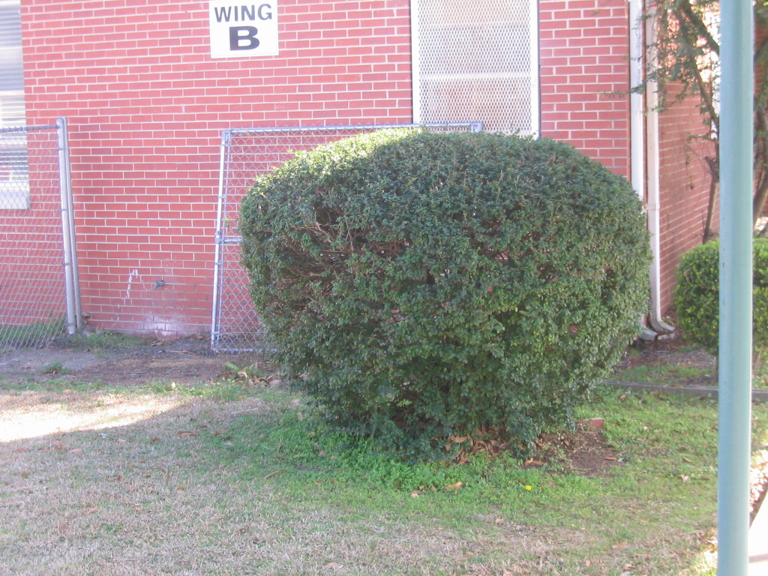

Slide 22
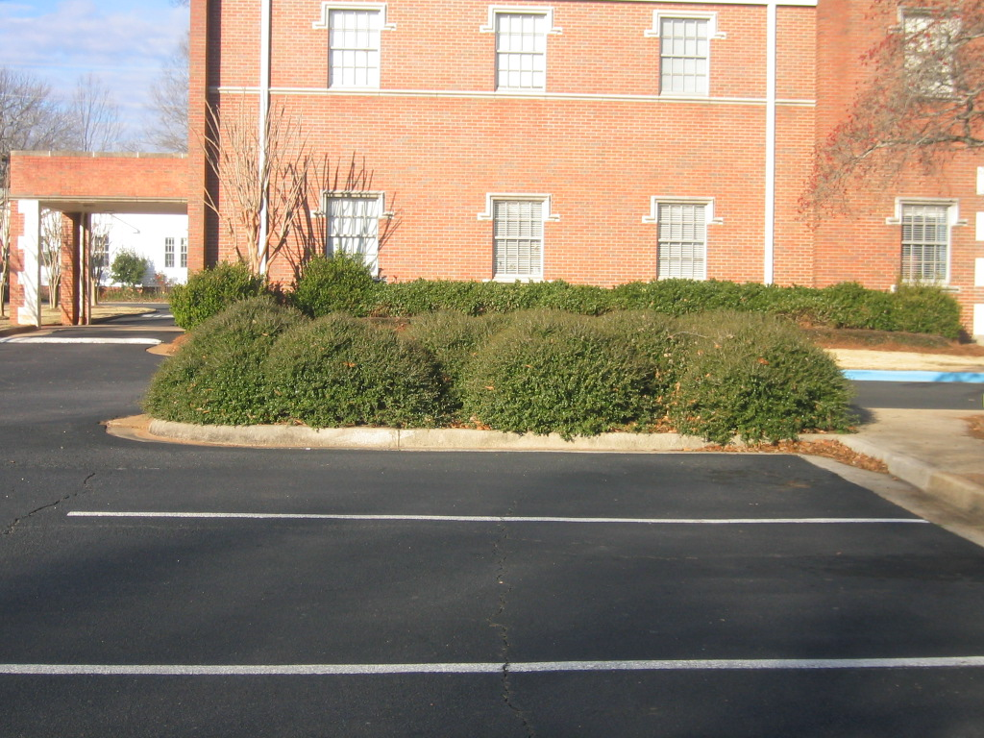

Slide 23
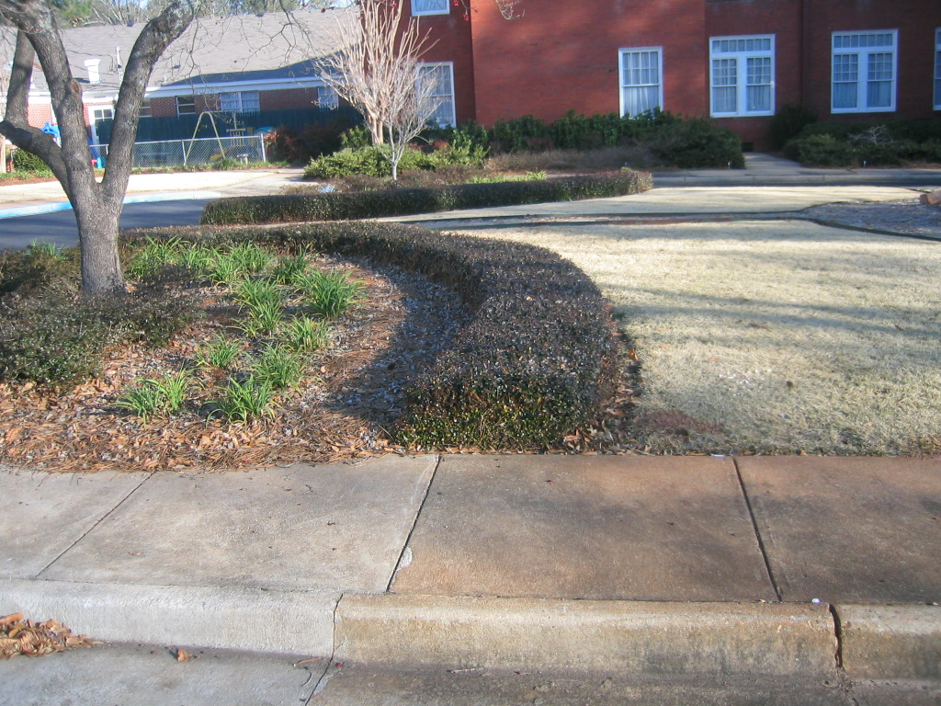

Slide 24
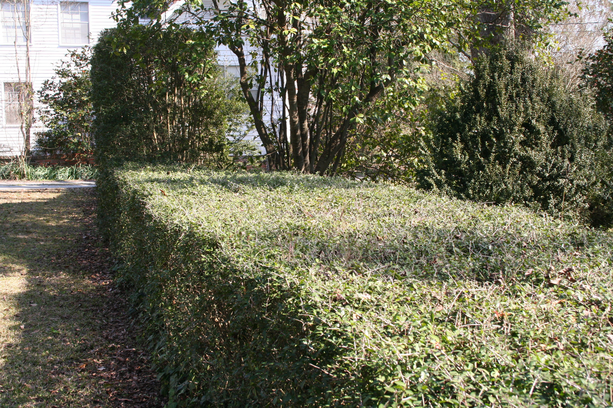

Slide 25
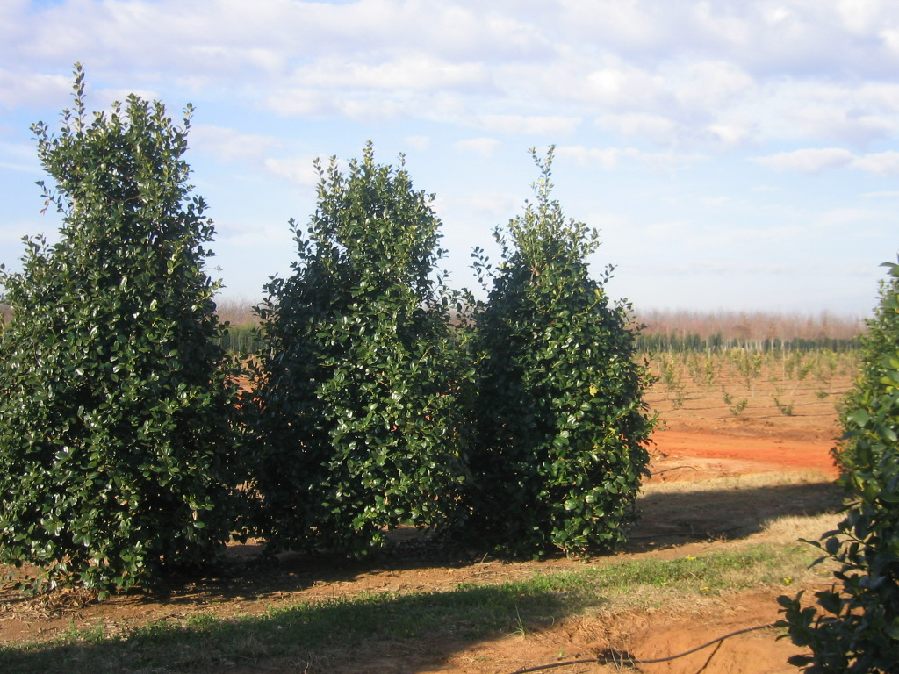

Slide 26
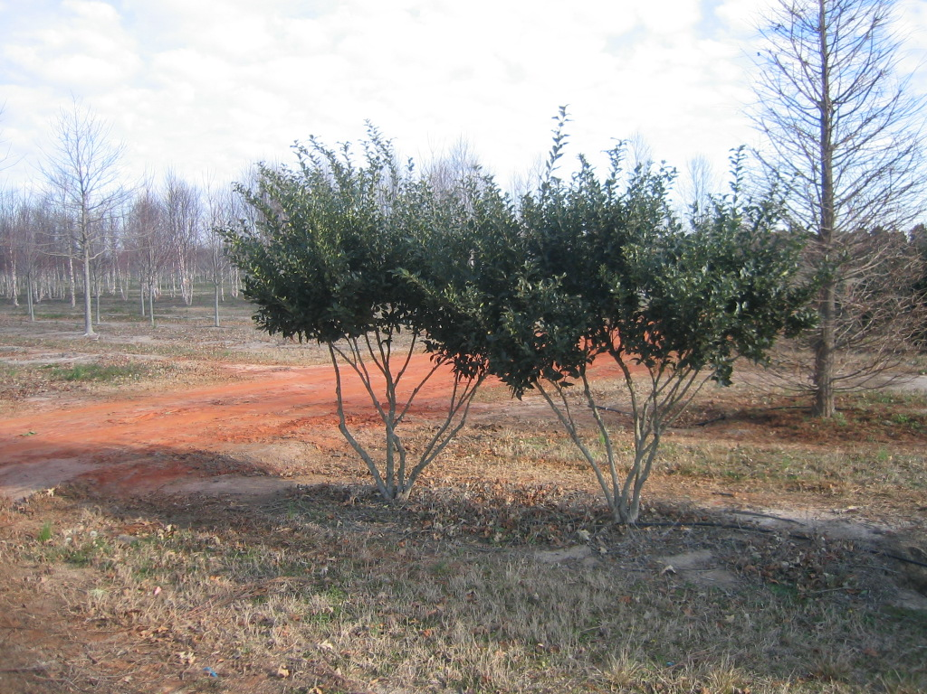

Slide 27
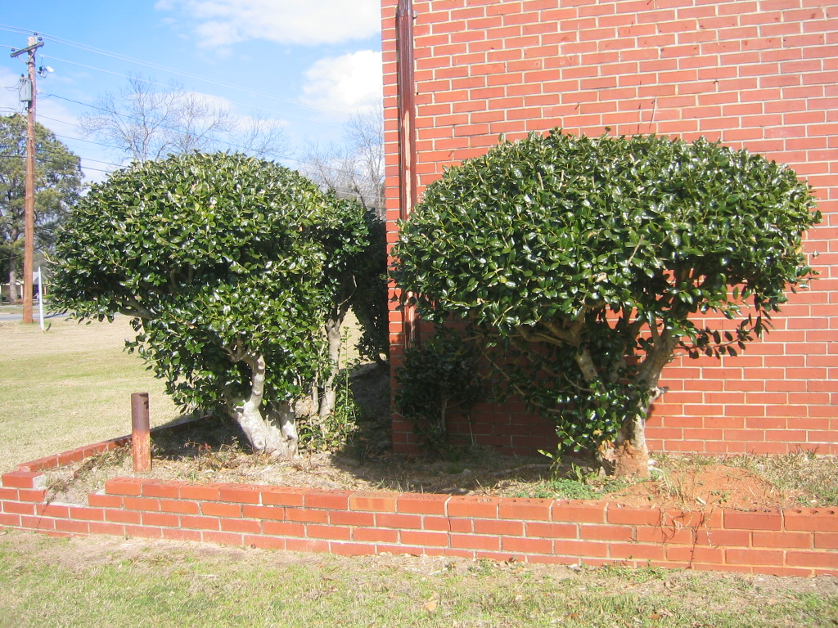

Slide 28
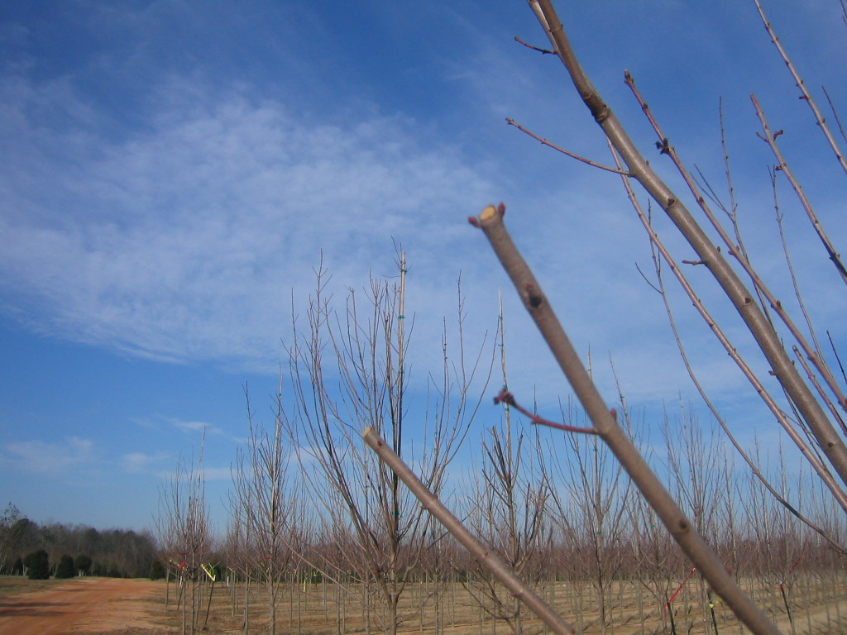

Slide 29
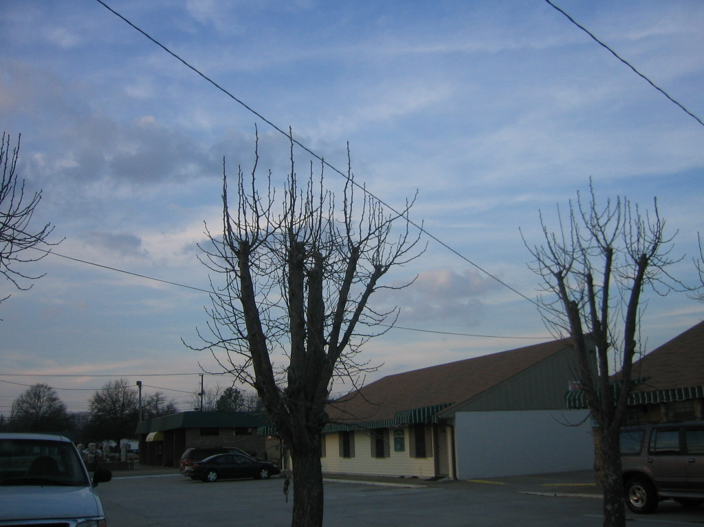

Slide 30
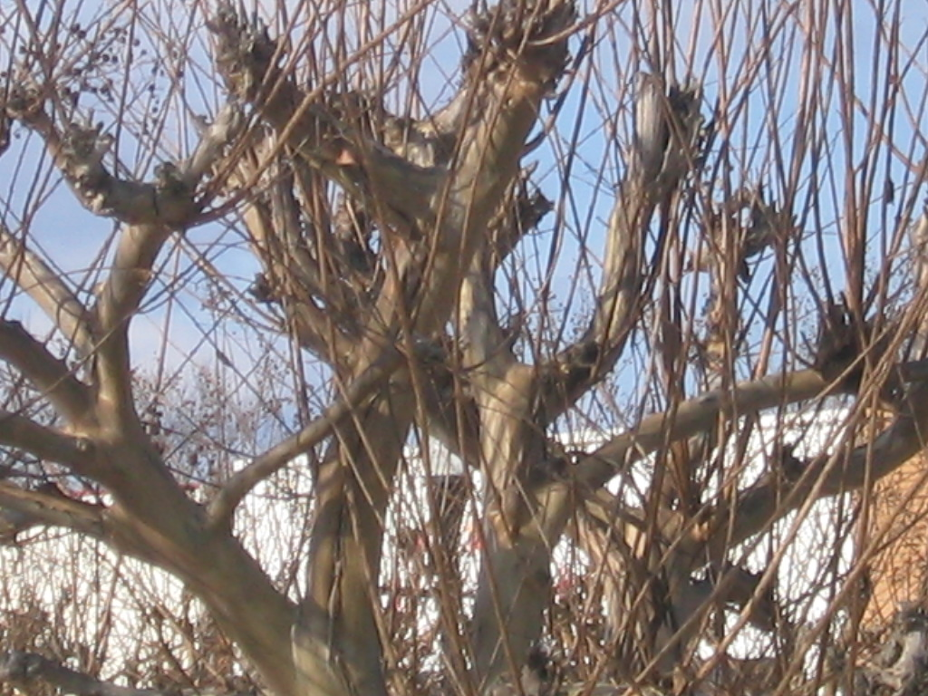

Slide 31
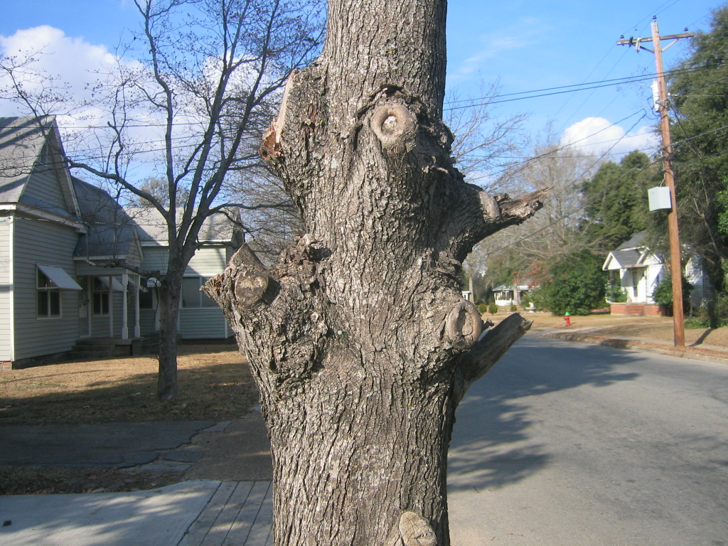

Slide 32
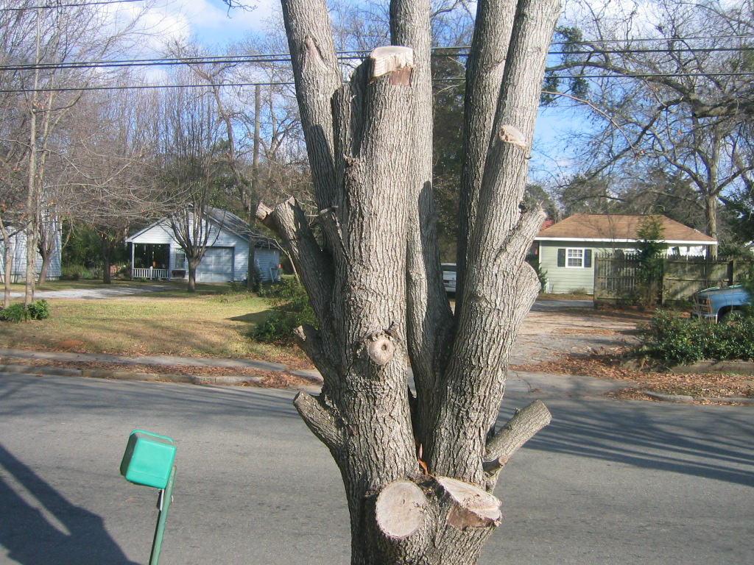

Slide 33
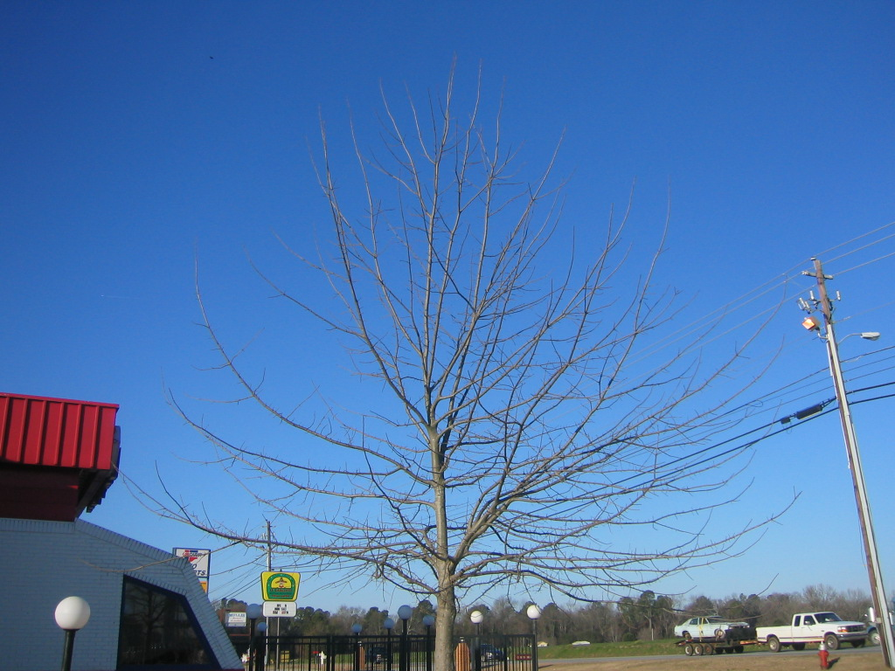

Slide 34
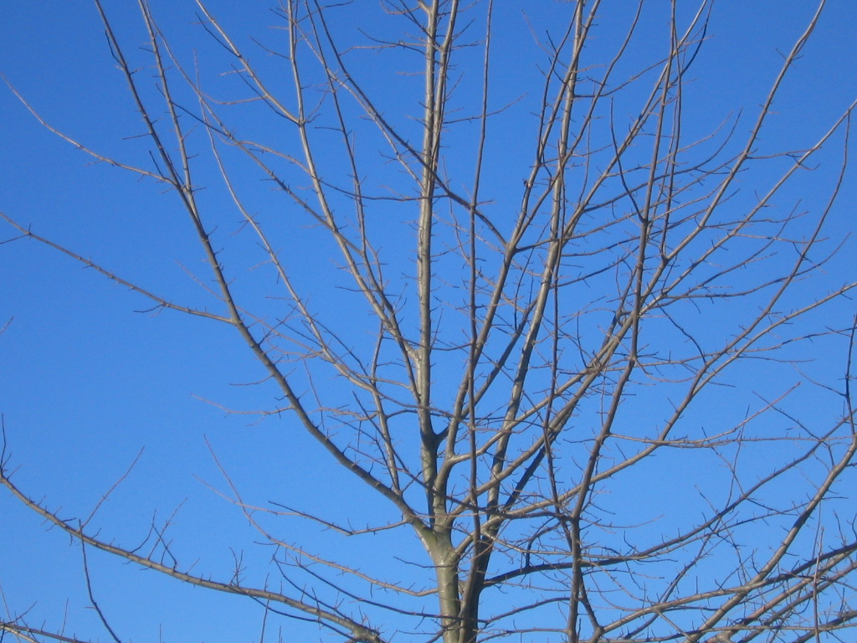

Slide 35
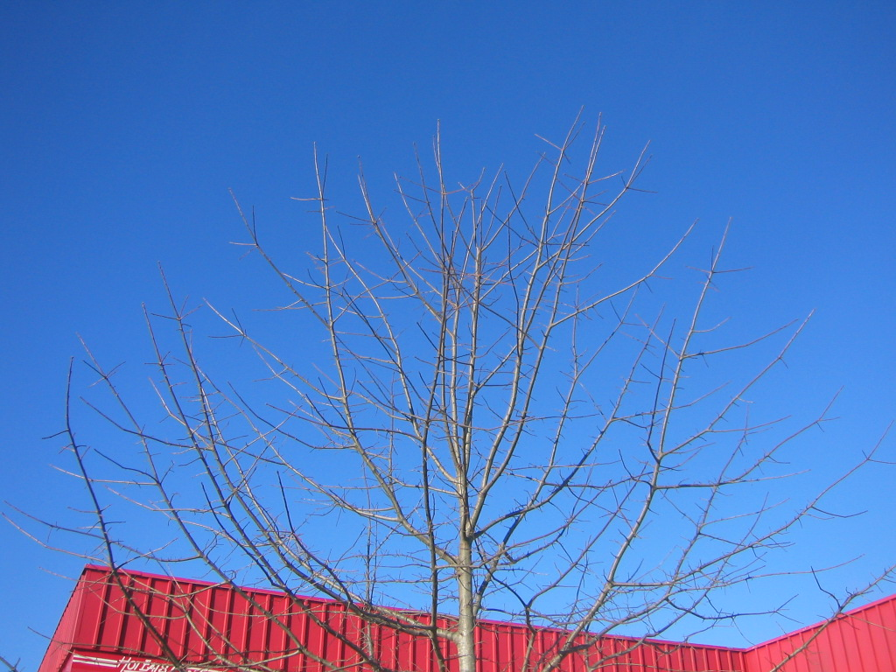

Slide 37
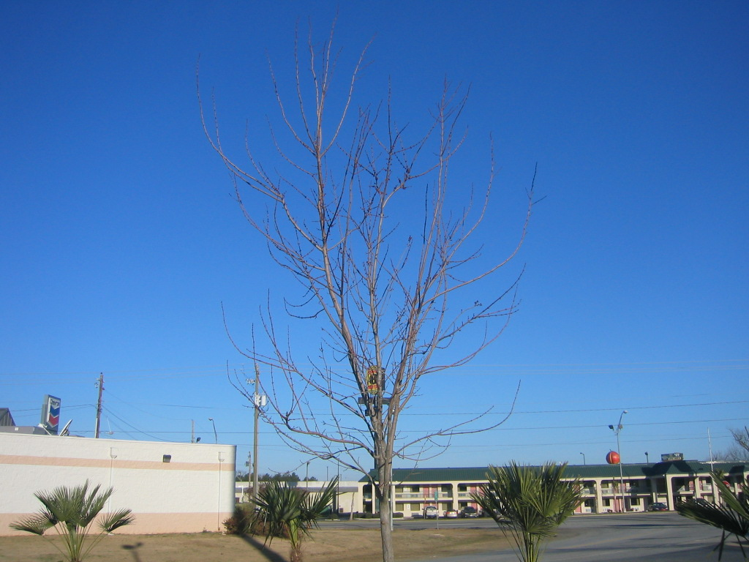

Slide 39
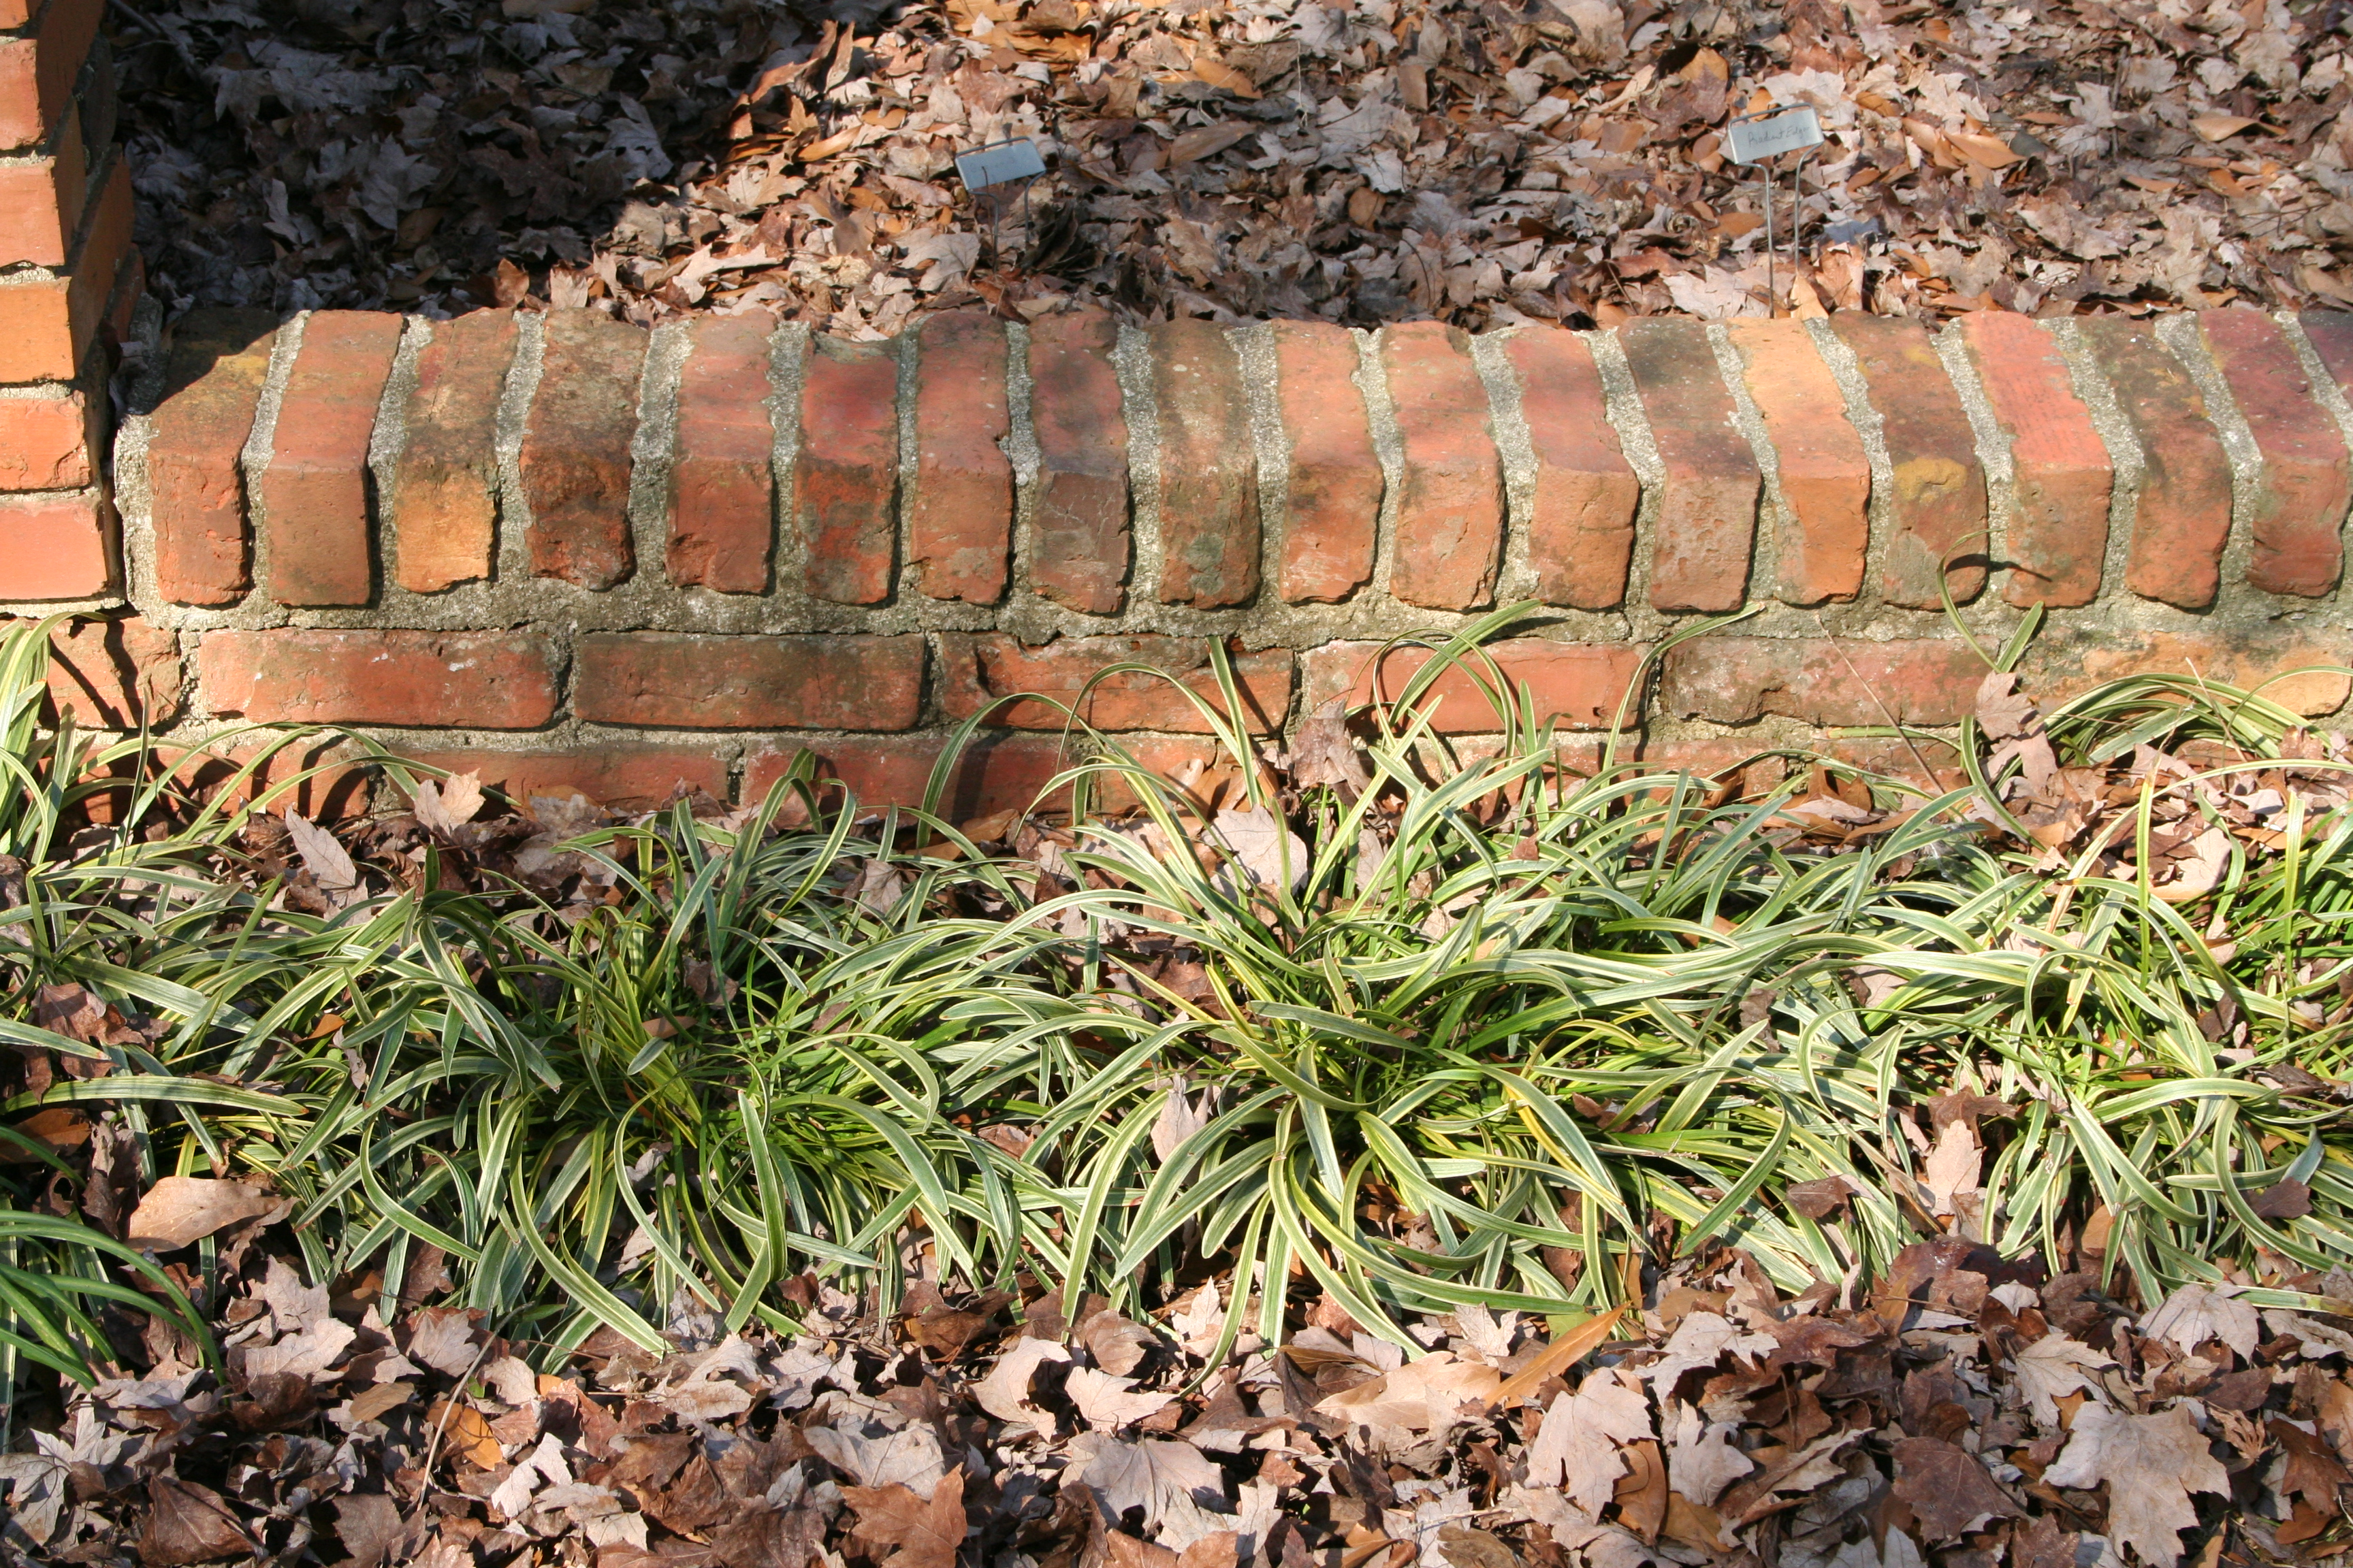

Slide 40
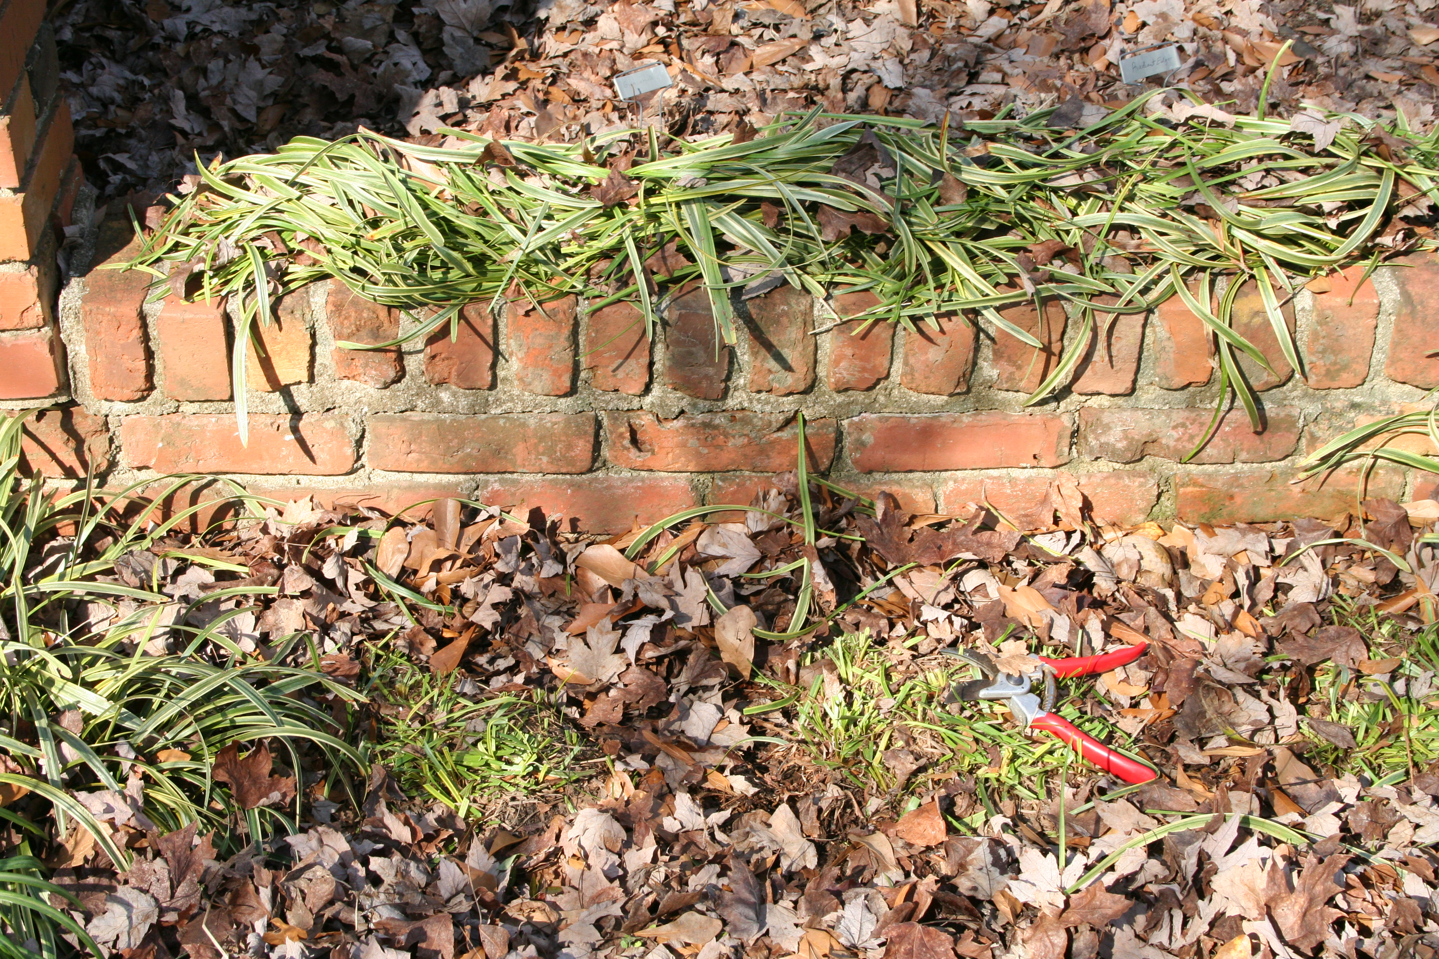

Slide 41
Remember
Right plant in right location
Pruning is local in effect
Thinning cuts are best
Do not prune in the fall
Use three cut method when pruning trees
Wound dressings are not necessary
Prune spring flowering plants after bloom
Prune trees early in life to set up growth
Keep pruning tools sharp and clean

