Slide 1

Notes:
1. UGA Logo

Slide 2

http://www.caes.uga.edu/extension/
Notes:
2. UGA Cooperative Extension Web address

Slide 3

Notes:
3. Georgia Master Gardener Logo

Slide 4
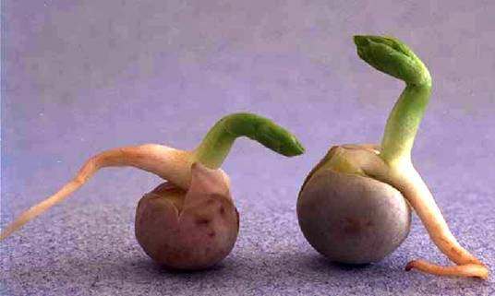
Propagation of Ornamental Plants
Notes:
4. Plant propagation is the creation of new plants from existing ones. Many of us have always wanted a garden or houseful of plants, but we could never afford more than a few. This presentation is designed to help you learn about different methods of plant propagation and help you start your own collection of plants.

Slide 5
Learning objectives
Basic principles of sexual plant propagation
How plants are asexually propagated
Techniques for stem, leaf and root cutting propagation
Notes:
5. Understand basic principles of sexual plant propagation.
Be familiar with how plants are asexually propagated.
Be familiar with techniques for stem, leaf and root cutting propagation.

Slide 6
Learning objectives
Basics of seed germination
Layering, grafting and budding as methods for plant propagation
Notes:
6. Know basics of seed germination.
Be familiar with layering, grafting and budding as methods for plant propagation.

Slide 7
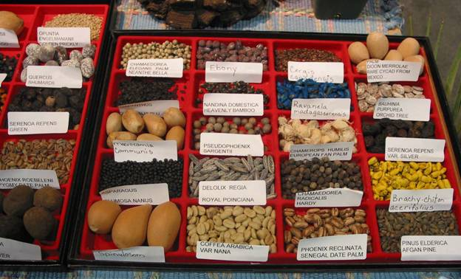
Seed Propagation
Notes:
7. Plants can be propagated in two ways: one, by seed or sexual propagation two, vegetatively, or asexual propagation.

Slide 8
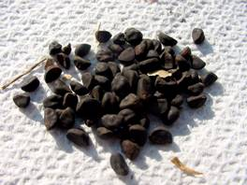
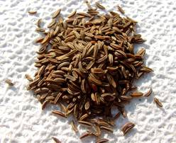
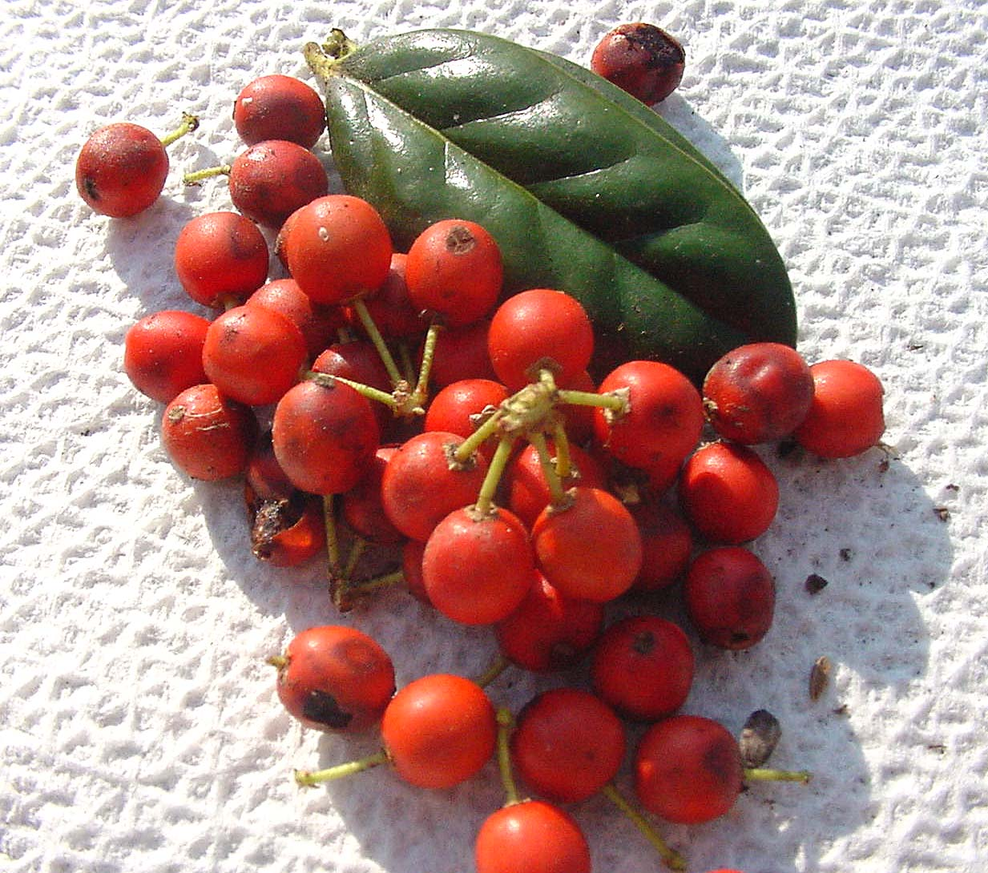
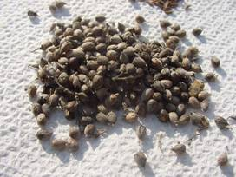
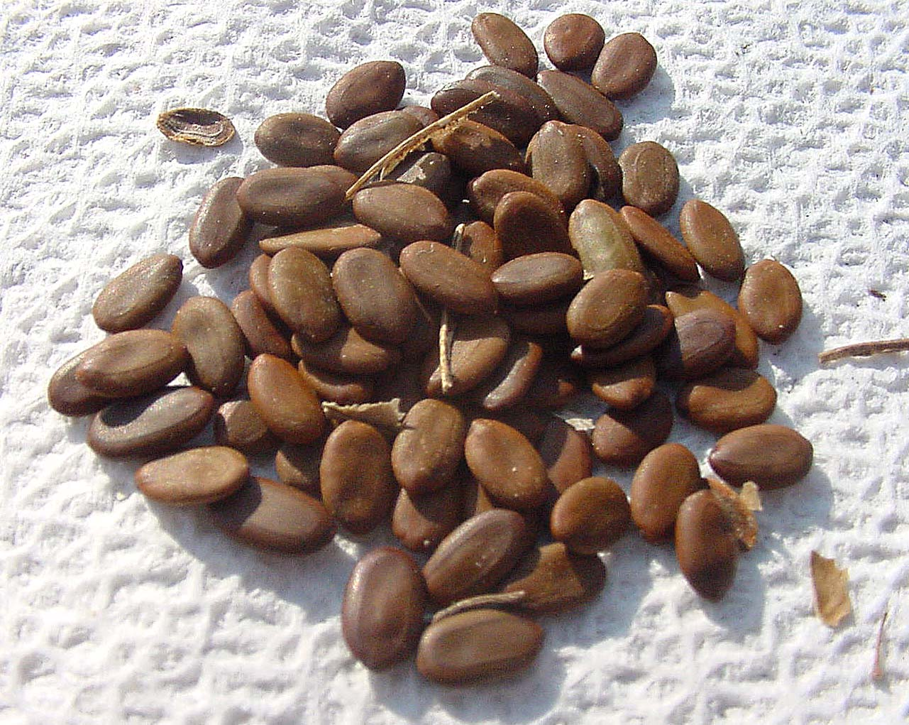
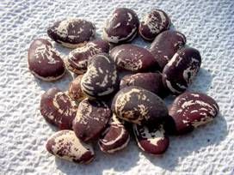
No Two Seeds Are Alike
Notes:
8. First let’s look at seed propagation. Seeds are infinite in variety, size, and shape. Orchid seeds contain over one million seeds in one ounce. In contrast, Double coconut, the world’s largest known seed, may weigh more than fifteen pounds.

Slide 9
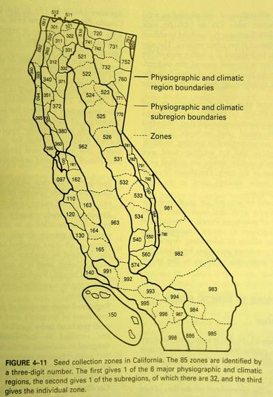
Seed Collecting
Provenance: A seed’s origin, in terms of climate and geographic location. This can have profound effects on seed germination and plant survival.
Example: Hemlocks grown from southern North Carolina seed sources are more heat tolerant than Hemlocks grown from Pennsylvania seed sources.
Notes:
9. You may want to collect your own seed or purchase commercial seed. Provenance indicates a seed’s origin, in terms of climate and geographic location. This can have profound effects on seed germination and plant survival.

Slide 10
Seed Collecting
Seeds collected from hybrids rarely look
like the parent plant due to the random
re-assortment of genetic material, and
the random sources of pollen. Native species tend to be more stable, but also have variation between generations.
To get a clone, try vegetative propagation!
Notes:
10. A seed carries genes from both parent plants, and appearance of resulting plants reflects the gene combination. When both parents come from the same species, the offspring resembles this species. If, however, parents belong to two different species, the offspring looks like a mixture of the species. This unique appearance results only if the cross is achieved every time a seed is produced. Hybrid seeds are a result of such crosses.

Slide 11
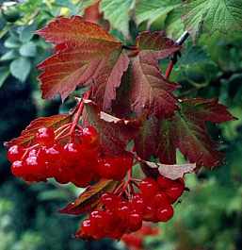
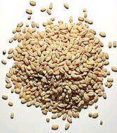
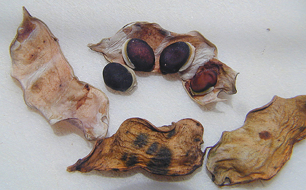
Three Types of Seed Sources
Fleshy Fruits: Berries, Figs
Dry Fruits: Grains, Grasses
Dry Seeds / Dehiscent Pods: Cones/Pods
Notes:
11. Seeds develop from fruits, and upon ripening, these can remain fleshy, such as berries, or dry out and become part of the seed coat, such as grains and grass seed. Thirdly, the fruit may dehisce, or open and release the seeds. In gymnosperms, seeds are exposed to the environment upon ripening.

Slide 12
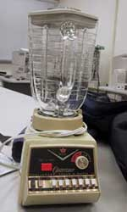
Extraction Methods
  Fermentation
  Flotation
  Blender Separation
  Gravity Separators
  Hand Separation
  Sifting
Notes:
12. There are different methods to extract seeds from their fleshy or dry coats. Among the natural method of removing the fleshy coats is fermentation, which allows for softening of the fruit tissues. Dry fruit can be submerged and the empty husks will float. You can use a kitchen blender to remove the fruit parts. You also can use a gravity separator, or remove the seed by hand, which may work for small quantities of seed. Lastly, husks can be removed by sifting.

Slide 13
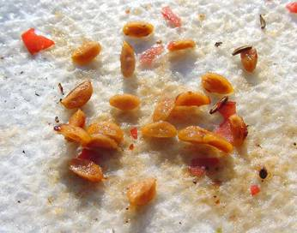
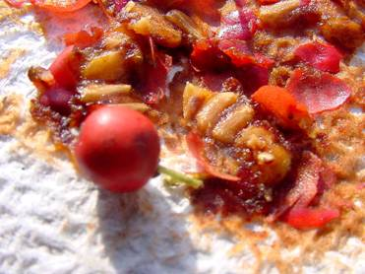
Fleshy Berry Seed
Notes:
13. For the fleshy berry seed, such as that of Burford holly, you can use fermentation, blender, or remove the coat by hand. One berry contains numerous seeds, which you can easily extract by crashing the berry on a paper towel.

Slide 14
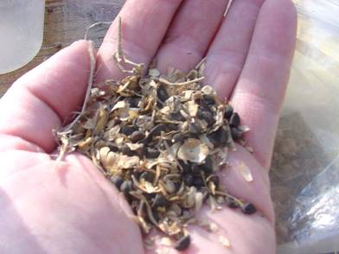
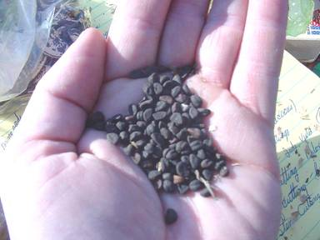
Seed Cleaning / Separation
Cleaning seed reduces
disease and weed seed
from growing along with
your selection.
For many dry seed, simply
crush dried material and
blow gently, transferring
the seed from hand to hand.
Notes:
14. When you collect seeds, make certain they are completely mature. Leave the fruit on the plant until they are dry, crisp, papery, or stiff. Usually the ripe seeds are exposed. The best time to gather seeds is in the afternoon on a sunny, dry day, as wet seeds often mold in storage. Clean the seeds by pouring them from one jar to another in front of a low-speed fan; this removes any dry plant parts. After cleaning, spread the seeds on newspapers to dry for one to two weeks. They can then be stored in small, dry bags or placed in jar or other airtight container. Store the jars in a cool, dry basement, the vegetable crisper of your refrigerator, or an interior closet.
Cleaning seed reduces disease and weed seed from growing along with your selection. For many dry seed, simply crush dried material and blow gently, transferring the seed from hand to hand.

Slide 15
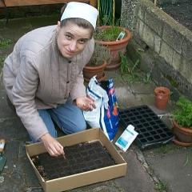
Handling Tiny Seeds
Some seeds can be
smaller than the head of
a pin. They can also
be very expensive. A
very careful approach
is often needed to be
efficient and successful
when planting tiny seeds.
Notes:
15. Some seeds can be tiny, such as begonia and orchid seeds. A very careful approach is often needed to be efficient and successful when planting tiny seeds.

Slide 16
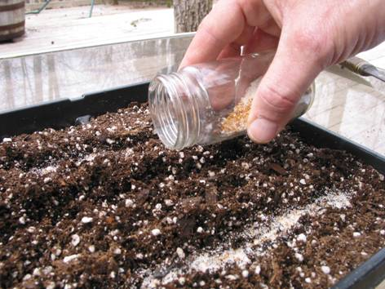
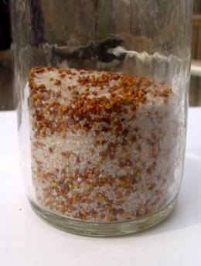
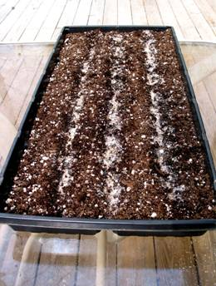
Handling Tiny Seeds
Mix Seed with Sand
Notes:
16. An easy way to handle small seeds is by mixing them with clean sand and dispersing them by gently tapping the jar and pouring them into prepared rows on a surface of the soil.

Slide 17
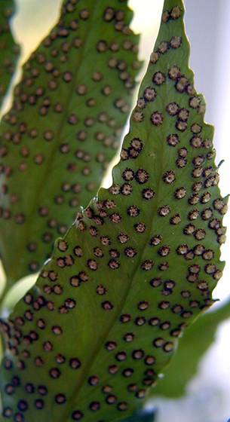
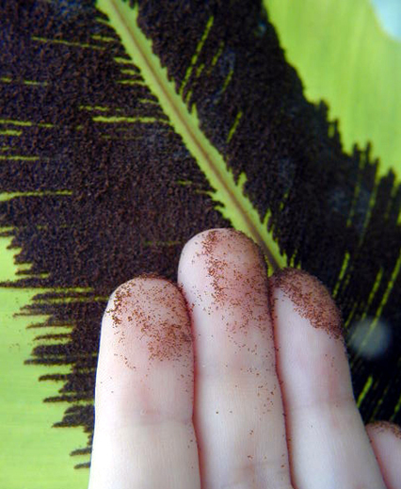
Ferns
Ripe spores
Notes:
17. Ferns are propagated from spores, which are extremely small, almost powder-like. Ripe spores are brown and located on the underside of the fronds, where the fern fruiting structures, called sori are. The Leather leaf fern (pictured in photos one and two), has round fruiting structures, while Bird nest fern (right) has fruiting structures, arranged in rows on either side of the midrib. To collect the spores, hold a white sheet of paper underneath the frond and tap gently. Scatter the spores on the surface of a sterilized medium, usually one high in organic matter such as peat moss. It takes several weeks, sometimes months, for the young plants to germinate and reach sufficient transplanting size.

Slide 18
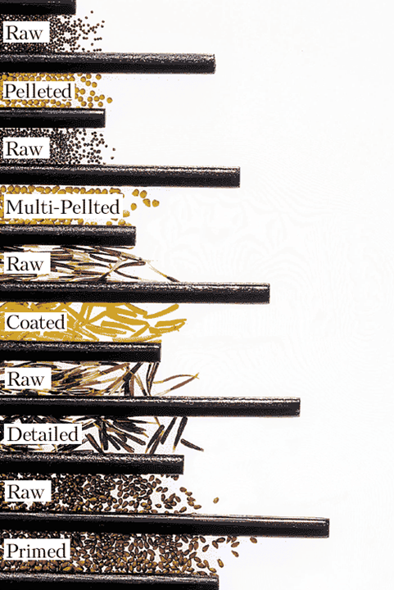
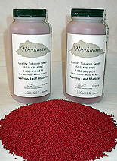
Enhanced
Seed
Park’s
Seed
Notes:
18. When purchasing commercial seed you have an option of selecting seeds that have been treated in a certain way, in order to increase germination and/or achieve uniform germination, and/or improve seedling survival.

Slide 19
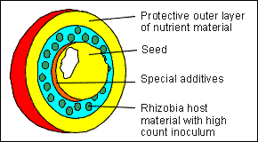
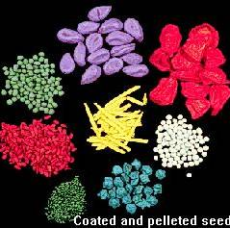
Seed Coatings
  Fungicides / Rhyzobia
  Polycoating
  Pre-germinated
Notes:
19. Seeds can be coated with fungicides or beneficial soil organisms, which serve to protect the young seedling after germination. The seed may have several coats of different materials, including nutrients. Seeds also may be pre-germinated, that is, they have been exposed to conditions favorable for germination, which would initiate the germination process, then they have been dried to stop it. All this has been aimed at improving germination.

Slide 20
Seed Deterioration
Seeds lose half their storage life for
every 1% increase in seed moisture
between 5 and 14%.
Seeds lose half their storage life for
every 5 degrees C increase in storage
temperature between 0ºand 50ºC.
Notes:
20. Seed storage is critical, especially when it comes to amount of moisture in the seed and temperature.

Slide 21
SEED STORAGE
Recalcitrant Seed
Tropical – Store warm and moist (ASAP)
Coffee, Cocoa, Mango
Subtropical – Store cool and moist (ASAP)
Maple, Oak, Elm, Poplar
Notes:
21. For storage purposes, seed scientists divide seeds into three standard categories based on their tolerance to drying and low temperature. These categories are called orthodox, recalcitrant, and intermediate.
Recalcitrant seeds will die if dried below a critical moisture level, and cannot tolerate low temperatures. They are usually short-lived and therefore not easy to store.

Slide 22
Orthodox Seed
Short-Lived – Store dry and cold (Under 1 yr)
Vinca, Pansy, Begonia
Medium - Lived -- Store dry and cold (2-5 years)
Marigold, Petunia, Coleus
Long - Lived – Store dry and cold (5-200 years)
Morning Glory, Zinnia, Hollyhock
Notes:
22. Orthodox seeds can be dried to very low moisture levels. Once desiccated, they withstand freezing. They are straightforward to store and, under proper conditions, often can be stored for a long time. Most temperate crop seeds are orthodox.
Intermediate seeds can tolerate some combinations of desiccation and low temperatures, but tolerate freezing poorly. There is in fact a gradient from orthodox to recalcitrant, with no sharp boundaries between the categories.

Slide 23
Seed Storage
1 Year or Less | 5 – 10 Years | 10-20 Years
Iberis | Cosmos | Albizzia
Phlox | Dianthus | Robinia
Delphinium | Calendula | Tilia
Parsley | Petunia | Elaeagnus
Onion | Viola | Koelreuteria
Notes:
23. Plants differ in their seed viability for extended periods of time.

Slide 24
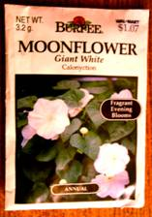
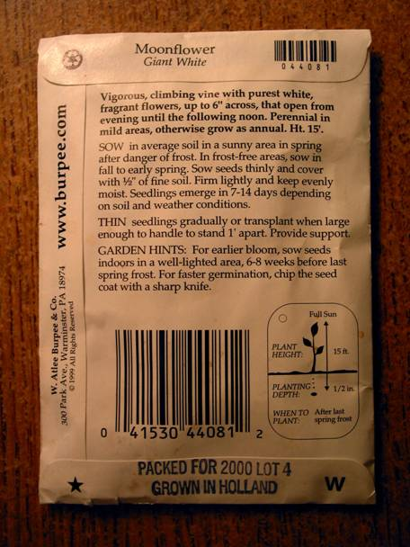
Important Information
Directions
Planting Depth
Expiration Date
Source
Notes:
24. When purchasing seeds, make sure you read the label carefully as it contains important information, such as how to plant the seed, how long can you store the seeds, where was the seed produced…

Slide 25
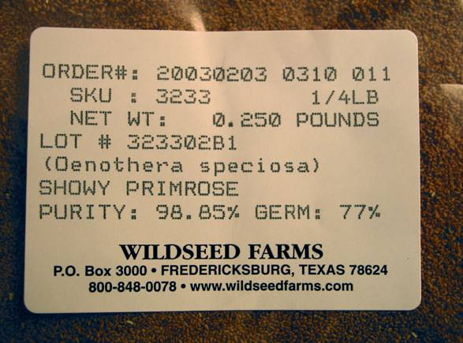
More Information
Lot Number
Germination
Percentage
Scientific Name
Notes:
25. …also germination percentage and other information.

Slide 26
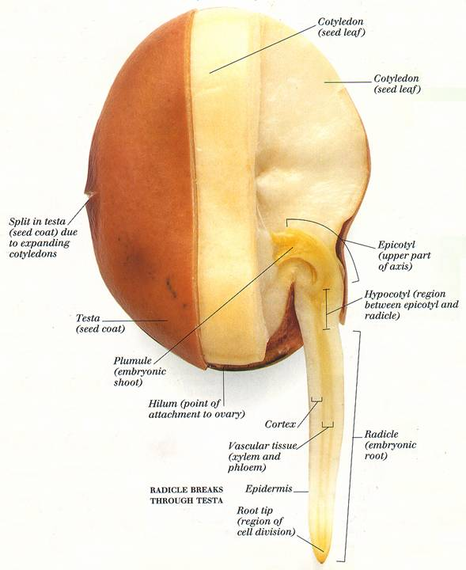
Notes:
26. Seed is composed of a seed coat, also called testa, cotyledons, seed leaves which are sources of food for the developing young embryo, the embryo itself, which consists of a shoot, epicotyl, hypocotyl, and radicle, the embryo root. Upon imbibing water, the seed coat swells and raptures, allowing for water to enter into the seed. The water triggers a chain of reactions, which bring about development of the embryo and eventual emergence from the seed coat.

Slide 27
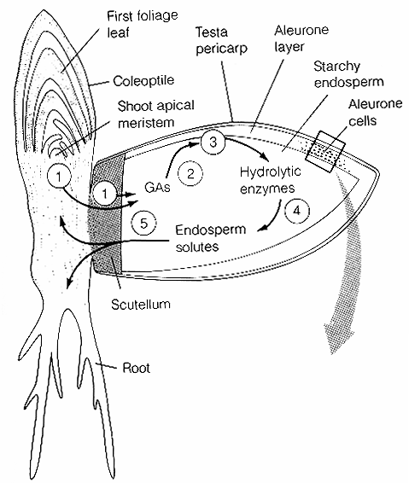
1. Imbibed water stimulates Gibberellin synthesis.
2-3. Gibberellins diffuse to the aleurone layer and stimulate the synthesis of enzymes.
4-5. Enzymes break down the starch and the sugars are transported to the developing embryo.
Notes:
27. This diagram shows the sequence of events, which occur in the seed. Water stimulates production of the hormones gibberellins, which then diffuse to the aleurone layer, and stimulate the synthesis of various enzymes. Enzymes are released into the endosperm, where starch is stored and break it down to simple sugars, which are then transported to the developing embryo.

Slide 28
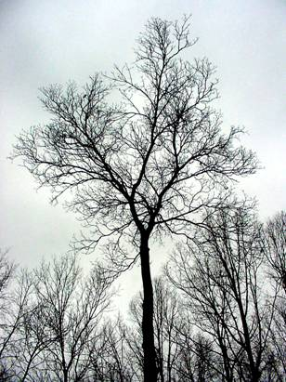
Seed and Plant Dormancy
Dormancy is the condition
in which seeds will not
germinate even when
most of the environmental
conditions are favorable
for germination.
There are many types of dormancy!
Notes:
28. Some seeds germinate readily, and are said to be non-dormant, while others do not germinate, and are said to be dormant.

Slide 29
Terms To Know
Recalcitrant Seed – seeds are able to germinate without desiccating. They
lose viability after drying and must
be planted quickly. Oak, Maple, Coffee
Orthodox Seed –seeds desiccate
after reaching full development to allow
the seed to be quiescent or dormant until
conditions are right to germinate. Beans
Notes:
29. It is important to know if your seeds are dormant and which treatment will break that dormancy and allow them to germinate.

Slide 30
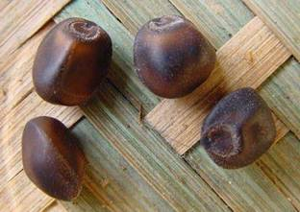
Advantages of Seed Dormancy
Favors seedling survival
Creates a seed bank
Seed dispersal (birds)
Synchronizes germination with seasons
Notes:
30. Seed dormancy is nature's way of setting a time clock that allows seeds to initiate germination when conditions are normally favorable for germination and survival of the seedlings. Many trees and shrubs have dormant seeds.

Slide 31
Types of Dormancy in Seed
Quiescent – seeds are able to germinate upon
imbibition of water at permissive temperatures.
Primary Dormancy – seeds cannot germinate
even if immediate conditions are right. This form of
dormancy delays germination until season, or other
macro-environmental issues are right for survival.
Secondary Dormancy – an additional level of
protection to prevent germination. Can be induced under
very unfavorable conditions such as drought or cold, etc.
Notes:
31. Seeds are said to be quiescent when they are able to germinate upon absorption of water. Primary dormancy develops when the seed is attached to the plant and exists when first harvested. If a seed is not exposed to sufficient moisture, proper temperature, oxygen, and for some species light, the seed will not germinate. In this case, the seed's dormancy is due to unfavorable environmental conditions. Secondary dormancy is a condition that prevents germination after the seed has been detached from the plant and is exposed to specific unfavorable conditions.
Note that when seeds ripen they may be dormant or not dormant. If they are dormant, they are referred to as having primary dormancy. Some seeds are not dormant when mature and they are known as quiescent. They germinate readily when given the proper environmental conditions. Seeds that do not have primary dormancy often acquire dormancy as they dry.

Slide 32
Primary Dormancy in Seed
Exogenous Dormancy - imposed by factors outside the embryo Seed coat
Endogenous Dormancy - imposed by factors within the embryo Underdeveloped embryo
Double (Combinational) Dormancy – two kinds of dormancy Seed coat and underdeveloped embryo
Notes:
32. In exogenous dormancy the hard seed coat, which is impervious to water and gases, is the reason for the dormancy. The seed will not germinate until the seed coat is broken or scratched to make it permeable to water. In endogenous dormancy the embryo itself is not well developed. Lastly, a combination of two types of dormancy may exist.

Slide 33
Exogenous Dormancy
Physical – Impermeable seed coat:
Scarification
Mechanical – Seed covering restricts radicle:
Removal
Chemical – Inhibitors in seed coat:
Removal / Leaching
Notes:
33. External or exogenous dormancy may be due to physical factors, such as an impermeable seed coat. Examples are legumes. In this case, a process of scarification will remove the dormancy. In nature, this often occurs by fall seeding. Scarification can be forced, rather than waiting for nature to change the seed coats. The seed coat may restrict the radicle from emerging, thereby inhibiting germination. This type of dormancy occurs in olive. In nature, coats are softened by environmental agents such as acid in guts of birds, microorganisms in warm, moist soil, or forest fires.
The seed coat also may contain substances, which inhibit germination. This occurs in fleshy fruits, hulls, and capsules of many dry fruits. Examples are apples, citrus, grapes, desert plants. In nature, this type of dormancy is overcome by heavy rains, which can leach the inhibitors. Horticulturally, leaching with running water, while changing water every few days; chilling for a few days; excising the embryo; and/or using hormones, can overcome chemically-related exogenous dormancy.

Slide 34
Endogenous Dormancy
Morphological - Underdeveloped embryo:
Warm Stratification
Physiological
  Non-Deep – After Ripening: Dry storage
        Photo-dormant: Exposure to red light
  Intermediate – Embryo/coat separation:
  Cold Stratification
  Deep – embryo dormant:
  Cold Stratification
Notes:
34. Internal seed dormancy may be due to morphological or physiological factors. The embryo may not be well-developed at the time of ripening, and may need additional growth after the seed is separated from the plant. Morphological dormancy occurs in several herbaceous plants such as Ranunculus, popp, also woody plants such as holly. In this case warm stratification is needed.
Physiological factors can be non-deep dormancy, which is short-termed and disappears with storage. Photodormancy is imposed by the inner membranes of freshly harvested seed and is typical of herbaceous plants such as annuals and veggies. It can be overcome by exposing the seed to red light. Why red light, will become clear in the next few slides. Intermediate dormancy is caused by the embryo-seed coat separation and can be overcome by cold stratification. Typical of conifers.
Lastly, deep physiological dormancy is caused by the embryo itself. Characteristic of many temperate trees and it can be overcome by cold stratification.

Slide 35
Double Dormancy
Morpho-physiological – Some combination of underdeveloped embryo and physiological dormancy
Cycles of warm and cold stratification.
Exo-Endodormancy – Combination of exogenous and endogenous dormancy conditions
Sequential combinations of dormancy releasing treatments, e.g. scarification followed by cold stratification.
Notes:
35. Double dormancy is due to some combination of underdeveloped embryo and physiological dormancy. Examples are Viburnum, Lilium, Peony. Require chilling period for embryo, followed by warm period for root, then a second cold period for shoot growth. Trillium and other native perennials have that type of dormancy.
Exo-endodormancy as the name implies is caused by both external and internal factors. This type can be overcome by sequential scarification and stratification treatments.

Slide 36
Secondary Dormancy
Thermodormancy - High temperatures induce dormancy
      Growth regulators or Cold stratification
Conditional – Change in ability to germinate is related to time of year
      Chilling or Warm stratification
Notes:
36. Thermodormancy is an imposition of new dormancy mechanism during unfavorable conditions. The critical point is that this dormancy occurs after the seed has been separated from the plant. Prevents germination during unfavorable conditions in seed that have overcome primary dormancy. Example, Maple seeds germinate in spring, but if there is insufficient water or too high temperatures, a secondary dormancy will set in that then requires chilling for the seed to germinate.

Slide 37
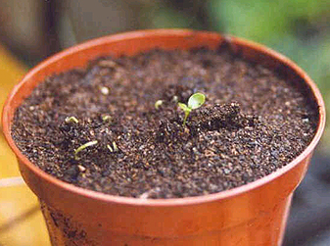
Photodormancy
Photodormancy: A type of dormancy
where the ability of the seed to germinate
is controlled by the wavelength and
duration of light received by the embryo.
Lettuce,
Butterfly weed,
Tobacco
Notes:
37. Photodormancy is a type of dormancy where the ability of the seed to germinate is controlled by the wavelength and duration of light received by the embryo. Examples are lettuce, butterfly weed and tobacco.

Slide 38
Photoperiodism:
Response to the duration and timing of day and night
Photodormancy and Photoperiodism Are Under the Control of a Pigment - Phytochrome
Notes:
38. The role of light is an important one in a plant’s life cycle. Plants perceive and respond not only to light intensity but also to light quality.
Photodormancy and photoperiodism (sensitivity of a plant to the duration and timing of day and night) are under the same control mechanism.

Slide 39
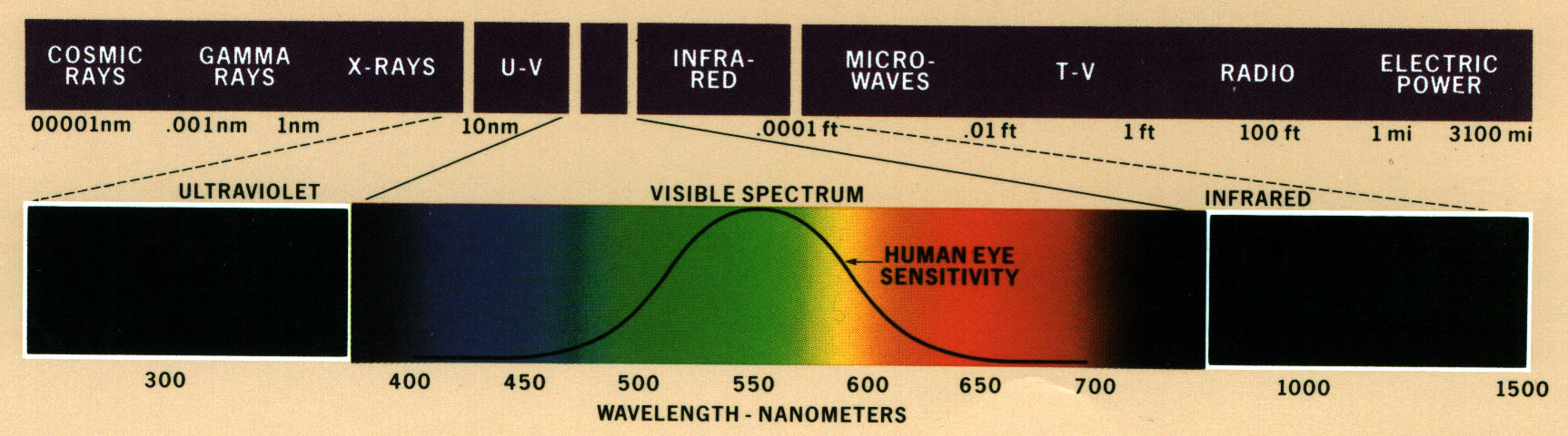
What Is Phytochrome?
Phytochrome is a pigment found in some plant cells that controls plant development. This pigment has two forms or “phases” it can exist in; P-red light sensitive (Pr) and P-far red light sensitive (Pfr) forms.
If a photoperiodic plant is exposed to light at the 740 nm wavelength, Pfr is converted to Pr.
If a photoperiodic plant is exposed to light at the 660 nm wavelength, Pfr is converted to Pr.
The actual plant response is very specific to each species!
Notes:
39. The mechanism by which plants perceive the quality or wavelength of light is the pigment phytochrome. Phytochrome exists in two forms: Pr, which is sensitive to red light (around 660 nanometers) and Pfr, which is sensitive to far-red light (around 740 nanometers). If a photoperiodic plant is exposed to light at the 740 nm wavelength, Pfr is converted to Pr. If a photoperiodic plant is exposed to light at the 660 nm wavelength, Pfr is converted to Pr.

Slide 40
Which Wavelengths Are Photoperiodic?
The length of the night period plays a major role in determining which wavelength will be effective, as the phytochrome pigment tends to revert to Pr during long periods of darkness.
Thus the length of exposure to light in a building, or if outdoors, the seasonal light changes, affect how long the plant perceives each form of phytochrome.
Here!
Notes:
40. The length of the night period plays a major role in determining which wavelength will be effective, as the phytochrome pigment tends to revert to Pr during long periods of darkness. Thus the length of exposure to light in a building, or if outdoors, the seasonal light changes, affect how long the plant perceives each form of phytochrome.

Slide 41
phytochrome
Bright Sun
660 nm
740 nm
Red Light
Pr
Pfr
(Fast)
Far Red Light
Dark
Reversion
Quiescence
(Slow)
Germination
Long hours of bright spring sun stimulate
formation of Pfr and germination begins.
Notes:
41. Long hours of bright spring sun generate wavelengths in the 660 region, which is absorbed by the Pr form of hytochrome, converting it to the Pfr form. In turn, Pfr form stimulates germination.

Slide 42
phytochrome
Far Red Light
660 nm
740 nm
Red Light
Pr
Pfr
(Fast)
Far Red Light
Dark
Reversion
(Slow)
Germination
Quiescence
Far-red light, such as is found under a vegetative canopy, prevents germination.
Seeds wait for sun.
Notes:
42. Far-red light, such as is found under a vegetative canopy, prevents germination by converting the Pfr form into Pr.

Slide 43
phytochrome
660 nm
740 nm
Red Light
Pr
Pfr
(Fast)
Far Red Light
Darkness
Dark
Reversion
Quiescence
(Slow)
Germination
Darkness maintains Pr and quiescence. Buried seed
won’t germinate until brought to the surface.
Notes:
43. Darkness maintains Pr and quiescence. Buried seed won’t germinate until brought to the surface.

Slide 44
Light Requirements for Germination
Species | Light/Dark
Ageratum | Light
Aster | Either
Begonia | Light
Centaurea | Dark
Cosmos | Either
Dahlia | Either
Dianthus | Either
Geranium | Light
Impatiens | Light
Larkspur | Dark
Species | Light/Dark
Marigold | Either
Nicotiana | Light
Pansy | Dark
Petunia | Light
Phlox | Dark
Portulaca | Dark
Snapdragon | Light
Verbena | Dark
Vinca | Either
Zinnia | Either
Notes:
44. Plants differ in their requirements for light during germination. The table lists the light requirements for germination of selected herbaceous ornamental plants. Some species require light, some need dark, and others germinate under either light or dark conditions.

Slide 45
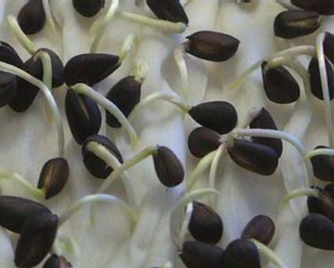
Preconditioning Seeds
(for more uniform germination)
Methods:
Mechanical Scarification
Soaking in water
Acid Scarification
Moist Chilling / Freezing
Notes:
45. To induce more uniform germination, seeds can be preconditioned. The methods used are: mechanical scarification, soaking in water, acid scarification, moist chilling or freezing.

Slide 46
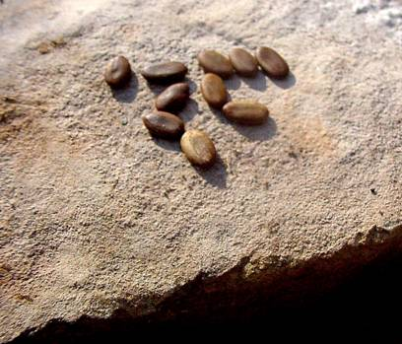
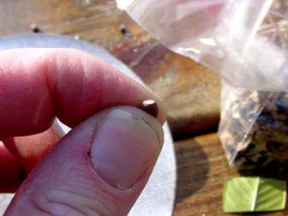
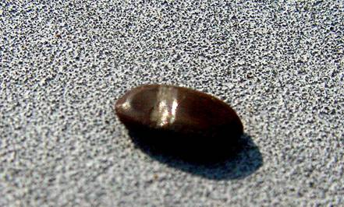
Mechanical Scarification
Notes:
46. Mechanical scarification is way to weaken the seed coat. File the seed coat with a metal file, rub with sandpaper, nick with a knife, or crack gently with a hammer.

Slide 47
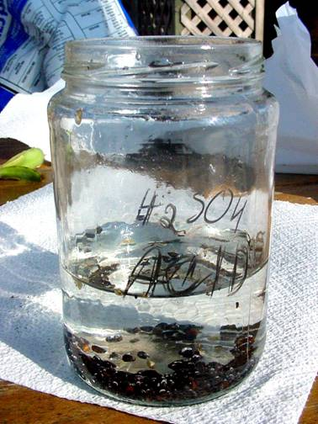
Acid Scarification
An alternative to scraping the seed coat is to use acid to etch through the coat. There
are many reference books that advise which acid and how long to treat.
Tip: use vinegar as a safer alternative to acid.
Notes:
47. Commercial growers scarify seeds by soaking them in concentrated sulfuric acid. Sulfuric acid, however, can be very dangerous if not used with extreme caution. Vinegar is safer to use. Place the seeds in a glass container and cover with vinegar. Stir the seeds gently and soak for 10 minutes to several hours, depending on the species. Various reference books provide information on soaking time. When the seed coat has been thinned, remove the seeds, wash, and sow.

Slide 48
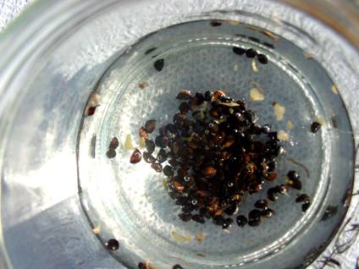
Hot Water Scarification
Water temperature should be over 110^{O}F
Let soak for a few
hours. Stir often.
Do not re-heat
the water.
Plant ASAP.
Notes:
48. A third method is hot water scarification. Bring water to a boil, remove the pot from the stove, and place the seeds into the water. Allow the seeds to soak until the water is at room temperature. Remove the seeds from the water and sow. Following scarification, the seeds should be dull in appearance, but not deeply pitted or cracked. Sow as soon as possible because scarified seeds do not store well.

Slide 49
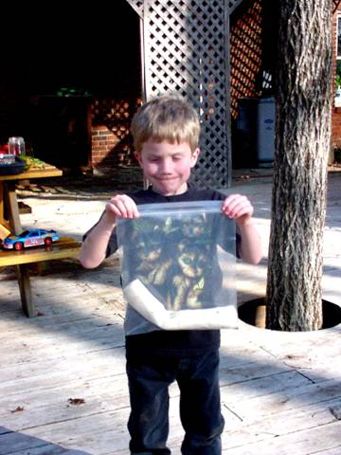
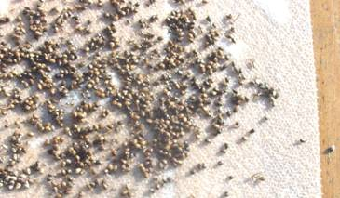
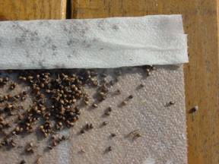
Moist Stratification
Cold or Warm
Notes:
49. Cold stratification (moist-prechilling) involves mixing seeds with an equal volume of a moist medium (sand or peat, for example) in a closed container and storing them in a refrigerator (approximately 40ºF). Alternatively, you can wrap the seeds among moist paper towels. Periodically, check to see that the medium is moist but not wet. The length of time it takes to break dormancy varies with particular species; check reference books to determine the recommended amount of time. This type of dormancy may be satisfied naturally if seeds are sown outdoors in the fall. Warm stratification is similar except temperatures are maintained at 68ºF to 86ºF, depending on the species.

Slide 50
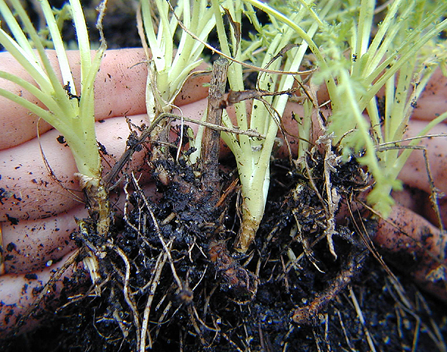
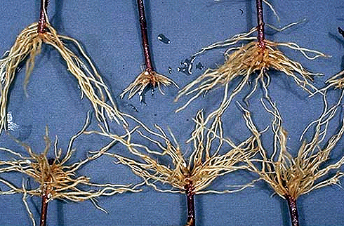
Vegetative Propagation
Notes:
50. Let’s now look at vegetative propagation. Vegetative propagation is done by removing and planting part of a plant and generating a complete replica. The offspring is identical to the parent because there is no mixing of the gene pools as in seed propagation. Also with vegetative propagation a larger plant can be obtained in a shorter period of time.
The vegetative plant part is placed under conditions favorable for rooting. Size of the plant part varies from as large as the mature plant (e.g. division), to as small as a piece of the leaf. The plant part must develop its own roots to allow for water and mineral absorption.

Slide 51
Why Vegetative Propagation?
Maintain specific characteristics (cloning)
  true-to-type plants
Cost
  break-even point for cuttings is 50-60% (90% or higher for grafting)
Avoid graft/bud incompatibilities
Notes:
51. Vegetative propagation may be done for several reasons. It is the only way to reproduce an exact replica of the parent plant. Vegetative propagation produces a clone, which is genetically and physically identical to the parent plant. Commercially, nurserymen can generate higher profits with cuttings compared to grafting. Lastly, it can be used to avoid graft or bud incompatibility with the stock.

Slide 52
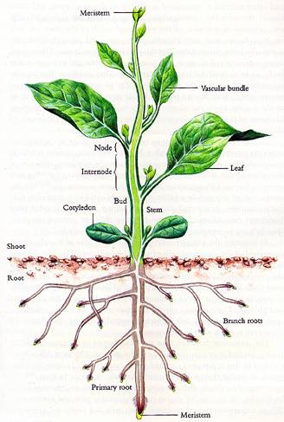
What is a ‘cutting’?
any vegetative portion of the plant
Notes:
52. “Cutting” is a general term applied in vegetative propagation, it can be any portion of the vegetative plant body. In most plants, the areas which contain meristems (growing points), have to be included in the cutting. The meristems are found at the shoot tip and the tips of side branches, and also the root tips. However, not all plants can be propagated by root cuttings.

Slide 53
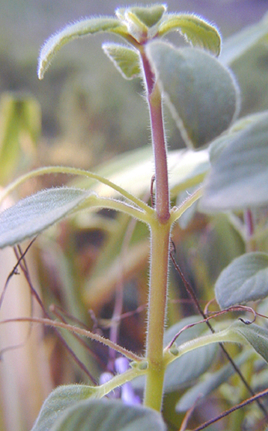
apical bud
stem
node
leaf
axillary buds
herbaceous plants
Notes:
53. A typical herbaceous stem has an apical bud from which the plant grows in height. The nodes are places on the stem where leaves are attached. Axillary buds are found at each node.

Slide 54
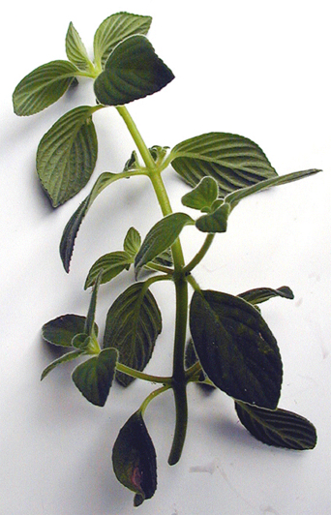
tip cutting
one-node cutting
Types of Cuttings
stem cutting
herbaceous plants
Notes:
54. Shoot cuttings may be made from: tip cuttings, which consist of the apical bud and the first one or two nodes on the stem, or they may be made from a stem section containing a single node or several nodes.

Slide 55

woody plants
softwood cuttings
taken early in the growing season
Notes:
55. Woody plants have different types of shoot cuttings, depending on the season. Softwood cuttings are taken early in the growing season; they are the emerging shoots of shrubs, trees and evergreens. The wood is still green and easily bruised with a fingernail. They root faster compared to other types but need to be kept cool and moist because once cut, they loose water quickly. Examples of woody plants that can be propagated by softwood cuttings are beautyberry, crape myrtle, butterfly-bush.

Slide 56


semi-hardwood (greenwood) cuttings
taken in the summer (mid-July to early September)
Notes:
56. Semi-hardwood or greenwood cuttings are taken later in the growing season. This category applies to broadleaf evergreens such as rhododendron, photinia, holly, magnolia, and camellia taken in summer. The growth flush is completed, the wood is firm and leaves are mature.

Slide 57



woody plants
taken in the dormant season
hardwood cuttings
Notes:
57. Hardwood cuttings are taken later in the dormant season. This category applies to deciduous and broadleaf and needle evergreens. Generally, last season’s growth is collected in fall through winter.

Slide 58
Taking & Treating Cuttings
Notes:
58. It is helpful to know some basic rules of taking and treating cuttings.

Slide 59


Cut the woody stem at an angle
Notes:
59. When taking the cutting, make a slanting smooth cut with a sharp knife or clippers. Remove any flower buds.

Slide 60


Make the angled cut on the side of the closest bud.
Scratch/scrape the stem on the other side.
Notes:
60. The angled cut serves to increase the surface area of the cut. Wound the lower half-inch of stem on the opposite side of the last node. The scraping of the stem exposes the cambial layer, underneath the bark, to the rooting hormones. This layer also generates the roots.

Slide 61


Remove bottom leaves and/or cut bottom leaves in half to reduce transpiration.
Notes:
61. Remove bottom leaves and/or cut bottom leaves in half to reduce transpiration. Some leaves should be left, because they are source of internal hormones to help initiate roots.

Slide 62
The Science behind…
Notes:
62. To understand root formation, we need to look in some detail at the science behind.

Slide 63

Wounding induces hormones to form in the cutting at the wound site.
callus
adventitious roots
Notes:
63. Wounding induces hormones to form in the cutting at the wound site. These hormones in turn cause cells to proliferate and form a dense mass of tissue, called callus. Callus is required for adventitious roots to develop.

Slide 64

Adventitious Roots Are Two Types
Preformed & wound-induced
Notes:
64. There are two types of adventitious roots: preformed, as in this Obedient Plant or wound-induced. Adventitious root formation is a prerequisite to successful cutting propagation.

Slide 65
Plant Growth Substances (Hormones)
Adventitious root formation involves plant hormones.
Hormones occur naturally within plants.
Root-promoting hormones are present in buds.
Rooting hormones are synthetic chemicals that stimulate adventitious root formation.
Notes:
65. Although factors, which trigger adventitious root formation are still unknown, we know plant hormones play a role. Hormones occur naturally in plants. They regulate plant’s physiological processes. Some hormones are involved in the formation of adventitious roots and are present in buds. Scientists have isolated and identified these substances. Synthetic rooting hormones are root-promoting chemicals that stimulate adventitious root formation.

Slide 66
Plant Rooting Response to
Growth Regulators
Three classes:
Plants that have all essential endogenous root substances plus auxins. Cuttings rapidly form roots.
Plants that have all essential endogenous root substances but no auxins. When cuttings are treated with auxins they rapidly form roots.
Plants that lack an endogenous root substance(s) and/or lack the sensitivity to respond to this substance(s), even though natural auxins may or may not be present in abundance. External application of auxins has little or no effect.
Notes:
66. Plant rooting response to growth regulators falls into one of three classes…

Slide 67
Auxins such as indole-3-acetic acid (IAA), indolebutyric acid (IBA), and naphtaleneacetic acid (NAA) have greatest effect on initiating roots in cuttings
Not a universal response across plant species:
  difficult-to-root species
  mixtures of root-promoting substances are sometimes more effective than either component alone
    IBA + NAA are better than either one alone
For general use in rooting stem cuttings of the majority of plants, IBA and /or NAA are recommended.
Notes:
67. Auxins such as indole-3-acetic acid (IAA), indolebutyric acid (IBA), and indole-acetic acid naphtaleneacetic (NAA) have greatest effect on initiating roots in cuttings. The response, however, is not universal across plant species. Some are difficult to root and require special combination of hormones. Two hormones are sometimes more effective than either one alone, a synergistic effect.

Slide 68
Rooting Hormones Concentrations
Generally
  auxin concentrations of 500 to 1,250 ppm are used to root the majority of softwood and herbaceous cuttings
  auxin concentrations of 1,000 to 3,000 ppm with a maximum of 5,000 ppm are used to root semi-hardwood cuttings
  auxin concentrations of 1,00 0 to 3,000 ppm with a maximum of 10,000 ppm are used to root hardwood cuttings
Notes:
68. Generally…

Slide 69



Rooting Hormones
Powder Formulations
Liquid Formulations
Notes:
69. Rooting hormones are available as powder or liquid formulations. Some of the popular brands are Rootone, Rhizopon, Dip’n Grow, and Hormex. Rooting hormones are available from most garden stores. You can also mix your own concentration and formulation.

Slide 70



excessive hormones, only callus formed
Notes:
70. Rooting hormones are especially helpful when propagating woody plants. Woody cuttings will root more uniformly and sometimes faster when treated with rooting hormones. However, more does not necessarily mean better, so make sure that you use the recommended concentration for a species. Also, shake off any excess powder from the cutting. Too much hormone has been shown to inhibit adventitious root formation.
The picture in the middle shows callus formation on the cutting. Although callus usually precedes root formation, such extensive callus may not be a good sign. A possible cause is insufficient rooting hormone application when the cutting was stuck, or too much hormones. The picture on the right shows roots protruding from the mass of callus. This cutting has successfully rooted.

Slide 71
Methods of Vegetative Propagation
Plantlets
Divisions
Layering
Root cuttings
Shoot cuttings
Notes:
71. Plants may be vegetatively propagated from: plantlets, divisions, layering, root cuttings, or shoot cuttings. Shoot cuttings may be tip, stem, or leaf cuttings. Vegetative propagation generates a complete replica of the parent plant. Sometimes, however, when the parent plant contains tissues and cells with differing genetic makeup, the new plant generated from that tissue might look different than the parent plant. An example is a chimeral African violet propagated from leaf cuttings may generate two or more distinct flower color forms from a single leaf. Chimeral plant contains cells with differing genetic makeup.

Slide 72


Strawberry begonia
Saxifraga
Plantlets
Notes:
72. One of the simplest vegetative propagation techniques involves removing plantlets from the mother plant. Plantlets are miniature, but complete plants, which grow by the side of, or on the top of the mother plant. Other names for them are “runners” or “suckers.” The strawberry begonia shown produces small plantlets at the ends of thin stems. Once the plantlet comes into contact with the soil, it roots.

Slide 73

Kalanchoe
Notes:
73. Some Kalanchoes have plantlets that develop roots while they are still attached to the mother leaf. When these plantlets come in contact with the potting soil, roots quickly grow and anchor the young plant.

Slide 74


Yarrow, Achillea
Divisions
Notes:
74. Division is one of the surest and easiest methods of plant propagation. It is done almost exclusively to herbaceous plants. It is important to divide plants when they are dormant in spring or fall. A good general rule to follow is to divide early-blooming species in the fall, and late-blooming species in the spring. Bearded Iris may be divided from July to September. Oriental poppy and Madonna lily should be separated when the foliage becomes yellow. An exception is Primrose can be divided immediately after the flowers fade in the spring before growth starts, or early in the fall. Greenhouse and houseplants can be divided in the spring, when their new growth is about to begin.
Yarrow can be easily propagated by division. Simply pull out a clump and gently tease apart the individual shoots. You’ll be surprised how many they are!

Slide 75

Bulbs, Corms, Tubers, Rhizomes, Rootstocks
Notes:
75. Commercial catalogs often lump bulbs, corms, tubers, rhizomes, and rootstocks together under the category “bulbs”. Botanically speaking, each of these structures is different.

Slide 76


Iris
Rhizome
Notes:
76. Tall Bearded Irises are rhizomatous plants. They can be increased by dividing the rhizomes between July and October. Dig up the rhizomes by inserting a spade about 10 inches away from the leaves and lifting the whole plant. The rhizome appears underneath the leaves and looks like a brown stem with roots.

Slide 77


Notes:
77. Separate the individual plants by cutting through the rhizome. Cut the leaves to within a third of their length. They are now ready for planting to their new location.

Slide 78



Gladiolus
Notes:
78. The first step in propagating Gladiolus is to dig up the old corms after the leaves have died.

Slide 79


Daughter corm
Cormel
Mother corm
(from previous year)
Old corm
Notes:
79. On these freshly dug Gladiolus corms one can see a new daughter corm, an old mother corm, and one much smaller corm, called a cormel. Growth of leaves and flowers occurs at the expense of the corm’s food reserves. After flower initiation, one or two new corms develop and the mother corm eventually withers. The small cormels can be removed from the daughter corm and planted separately. They will flower in a few years.

Slide 80


Cross vine, Bignonia
Shoot Cuttings
Notes:
80. Cross vine is propagated by shoot cuttings. Take at least two-node cutting as the lower node should be beneath the surface. Remove the lowermost leaves, as they tend to rot once under the soil line.

Slide 81


Dianthus
Notes:
81. Similarly, Dianthus is propagated by shoot cuttings. A one-gallon pot can generate many cuttings. As cuttings are small, take several in a clump and stick together to encourage larger growth.

Slide 82



Salvia
Notes:
82. Salvias are easily propagated by stem cuttings. Make sure you cut away any flower or seed heads, as they draw energy to themselves instead of to making roots. Again, at least one node should go below the soil.

Slide 83


Creeping Raspberry
Rubus
Stem Cuttings
Notes:
83. The Creeping Raspberry is propagated by stem cuttings, which creep along the soil surface. A small 3-inch piece of stem with two to three nodes is sufficient for propagation. Simply layer it in fresh soil and new roots will develop from the nodes, anchoring it.

Slide 84



Leaf Cuttings
Notes:
84. Some plants can be propagated from leaf cuttings, such as Mother-in-law’s tongue, Sansevieria, African violets, and many succulents, such as Jade plant, and Christmas cactus. Leaf cuttings generally do not need misting to form roots, in fact, they tend to rot if placed under excessive moisture.

Slide 85

adventitious buds
Notes:
85. The ability of plants to propagate via leaf cuttings is related to a quality called adventitious buds. Not all plants have these small, dormant meristematic areas in their leaves, most plants don’t. Under favorable conditions the adventitious buds within the tissues of the leaf “awaken” and prompt development of an entire miniature plant. If the baby plant is separated from this leaf and the leaf is placed back under favorable conditions, another plant will form. This is because the meristematic areas are numerous.

Slide 86


Woody Plants
Notes:
86. Many woody ornamental plants are propagated from cuttings. However, two things are crucial to success: taking the cuttings at the right time and providing a suitable environment for root initiation and development.

Slide 87

Loropetalum
Notes:
87. Loropetalum, for instance, is propagated from the flexible young growth, or semi-hardwood. The best time to take semi-hardwood cuttings is from June to September. In the spring, the growth is often too tender and succulent and will not propagate well.

Slide 88


Notes:
88. If you’re working with larger branches, use only the semi-hardwood cuttings. Make the cutting about 6 inches long and remove the leaves from the lower half to one-third of the stem.

Slide 89

Azalea
Notes:
89. Another woody plant commonly propagated by semi-hardwood cuttings is Azalea. Take 4- to 6-inch cuttings from the upper part of the plant.

Slide 90



Holly
Notes:
90. Holly is also propagated from semi-hardwood cuttings.

Slide 91


Juniper
heel
Notes:
91. Juniper cuttings are made using a slightly different technique. Select a side branch that is 5 to 6 inches long. While holding the main stem firmly with one hand, tear away the side branch and make sure that a small piece of the main stem is still attached to it. This is called a ‘heel’ cutting.

Slide 92

Notes:
92. Close up of two Juniper cuttings.

Slide 93

Ground-Layering
Notes:
93. Some woody plants are propagated by ground-layering.

Slide 94


Notes:
94. Ground-layering is done outside, in the landscape. It works best with plants that have arching branches that can be brought down in contact with the ground. This Oak leaf hydrangea had a branch that was perfectly positioned for ground-layering. First, the soil is improved for ground layering by mixing sand and an organic source such as peat moss.

Slide 95

Rooting hormone
Toothpick
Tongue
Notes:
95. Then, a slit is cut in the stem of the selected branch at the point where roots are wanted. The ‘tongue’ made by cutting into the stem is held open by a toothpick, and the wound is dusted with a rooting hormone using a soft brush. The toothpick keeps the tissues separated, otherwise, they may close and heal the wound, without forming any roots.

Slide 96



Notes:
96. The shoot is placed in a 2-inches deep trench and covered with soil. Finally, the layer is watered and a rock is put over it to keep the layer in place and to help conserve moisture in the soil.

Slide 97

Soils and Growing Media For Propagation
Any substance providing air/water relationships (25 to 40% air space)
  Soil, sand, pumice, bark
Notes:
97. Let us take a brief look at substrates for plant propagation. Any substance which provides air/water relationships of 25 to 40% air space is suitable, including soil, sand, pumice, and bark.

Slide 98

Soils
Garden soil (homemade mixes)
Sterilize before use
Sieve moist soil through a ¼-inch sieve, place a layer up to 3-inch deep in a baking tray, bake for 30 min @ 400 ⁰F
In a microwave (seal in a pierced roasting bag) heat on high for 10 min
Notes:
98. Homeowners often use homemade mixes, made of garden soil.

Slide 99

Media components -- Sand
Sharp builders sand (particle diameter 0.5–2 mm)
Sterilize before use
No buffering capacity, pH varies with source and can change with the water, no nutrients, no water-holding capacity
Suitable with peat, perlite, and other components
Notes:
99. If you want to mix a soilless media, here’re some of the components. Inorganic components, such as sand, should be sterile.

Slide 100

Media components -- Perlite
Crushed aluminum-silica volcanic rock, heated rapidly to 1800 ⁰F
Sterile, lightweight & chemically inert
No nutrients, low water-holding capacity, pH 7-7.5
Horticultural grade (#2) best
Notes:
100. Perlite is sterile, lightweight and chemically inert. For propagation, use horticultural grade #2.

Slide 101

Media components -- Vermiculite
Clay mineral w/ high potassium and magnesium, heated to 1400 ⁰F
Sterile & lightweight
High water– and nutrient holding capacity; pH 7-7.5
Use coarser grades
Notes:
101. Vermiculite is also sterile and lightweight; best to use for propagation mixes are coarse grades.

Slide 102


Media components – Scoria & Pumice
Scoria is a naturally occurring volcanic rock, crushed and screened for size.
Pumice is a white, natural glass.
Similar qualities to perlite
Scoria
Pumice
Notes:
102. Scoria is a naturally-occurring volcanic rock, which has been crushed and screened for size. Pumice is a white, natural glass. Both are similar to perlite.

Slide 103

Media components -- Peat
Sphagnum moss peat, hypnaceous moss, reed and sedge peats, and humus or muck peat
Relatively sterile & lightweight (when dry)
High water– and nutrient holding capacity; pH 3-4.5
Different sizes used (fine – seed, shredded form is most common)
Excellent when mixed w/ sand and perlite
Notes:
103. Peat can come from several types of plants, all collectively called peat. Peat moss is excellent when mixed with sand and perlite; the peat provides water and nutrient-holding capacity, while the perlite provides aeration.

Slide 104

Media components -- Bark
Hardwood and pine bark
Milled, w/ 70-80% of the particles in the 1/40 to 3/8-inch size, and 20-30% of the particles less than 1/40-inch size
High nutrient holding capacity; pH 3.5-4.0
Alone or mixed w/ others 3 Bark: 2 Peat: 2 Perlite
Notes:
104. Organic components include bark, which can be hardwood or pine bark.

Slide 105


For most plants:
  2 coarse perlite: 1 peat ( by volume)
Notes:
105. For most plants a good propagation mix is 2 parts coarse perlite and one part peat.

Slide 106

Propagation Systems
Notes:
106. Let us now look briefly at propagation systems.

Slide 107

Mist Systems –
Purpose and Components
Mist keeps the leaves wet to maintain a favorable water status and cools leaves
The objective is NOT to water the cuttings
Cutoff valve
Pressure regulator(s)
Filter
Solenoid valve
Mist nozzles
Notes:
107. In cutting propagation, mist is needed to keep leaves wet to maintain a favorable water status and to cool the leaves. The objective is not to water the cuttings, but to minimize transpiration and loss of moisture from the plant tissues. A mist system is composed of a cutoff valve, pressure regulator, filter (to screen small particles), solenoid valve and mist nozzles.

Slide 108

Mist Control Systems
Timer (install away from mist)
    Simple, malfunctions are obvious
    Use a timer designed for mist systems
    Turn the system off at night (some have a photocell built-in, or you can use a second timer)
Notes:
108.You also need a timer, which should be installed away from the mist. It is important to use a timer designed for mist systems as it can be set for short durations, such as 20 seconds every 10 minutes.

Slide 109
Bottom Heat
Why?
Temperature controls development
Cool tops, warm roots
Optimal root zone temperature: 65 - 75 EF (depending on species)
Thermostat placement is crucial!
How?
Commercially available propagating mats
Heat tape (soil heat cable) and thermostat
Warm water pipes (can be buried)
Notes:
109. Bottom heat is helpful, especially when propagating during the cold months. Temperature controls plant development and if the roots are cold, they will be slow to develop. This is true for both seed and vegetative propagation. Optimal root zone temperature is 10 to 15 degrees higher than the air temperature; generally 65 to 75 degrees Fahrenheit. The thermostat placement should be positioned close to the roots.
You can make your own propagation box, with heating cable and thermostat, or you can purchase one.

Slide 110



Soil heat cable
Notes:
110. This is an example of a home-built propagation box, using a soil heating cable and a thermostat. A smaller plastic box accommodates one standard size seeding tray. A digital thermostat with a timer is connected to it.

Slide 111



Propagation mat
Notes:
111.Propagation mats are easier to keep clean and can accommodate larger propagation benches.

Slide 112

Propagation mat
Notes:
112. Several propagation trays can be heated with this propagation mat. These products are available through horticultural supply catalogs.

Slide 113

Tips For Success
Notes:
113. Before we finish our presentation let’s look at some common sense tips that can save you some headaches and increase your chances of success when propagating plants.

Slide 114


Maintain
Clean & Organized Environment
Notes:
114. Maintaining a clean and organized environment is one of the keys to success with plant propagation!

Slide 115

Use Healthy, Pest-Free Plants
Notes:
115. Do not use cuttings from plants that are infected with pests. This picture shows mealybugs on a geranium cutting. Mealybugs are among the most feared pests, especially in the home, because they are difficult to spot and control. Before you take a cutting, inspect the plant very carefully.

Slide 116

Notes:
116. This picture shows aphids on China doll leaf. Although much easier to kill than mealybugs, aphids can still be a nuisance. Be especially careful when you share cuttings with friends. Discard any plant material that appears unhealthy or shows pest infestation.

Slide 117

Use Healthy, Disease-Free Plants
Notes:
117. Likewise, do not use cuttings from diseased plants. This ivy suffers from a root disease. Propagating it will very likely spread the disease to the new cuttings.

Slide 118
Questions?
Notes:
118. DISCUSSION QUESTIONS
1. What are the methods of plant propagation?
2. What are the different types of seed dormancy?
3. What are the three standard categories of seeds based on their tolerance to drying and low temperature?
4. What are the methods used to overcome seed dormancy imposed by hard seed coat?
5. How does the mechanism of regulation work in photodormant seeds?
6. What are the types of herbaceous cuttings?
7. What are the types of woody cuttings?
8. What are rooting hormones?
9. How should you treat cuttings of woody plants?
10. What are the most common soilless growing media components?
11. Why is bottom heat needed?

Slide 119
Bodie V. Pennisi, Paul A. Thomas, Melvin R. Hall, and John M. Ruter
Horticulturists
Copyright©, 2003
The University of Georgia
Department of Horticulture
Notes:
119. Credit slide

