Slide 1
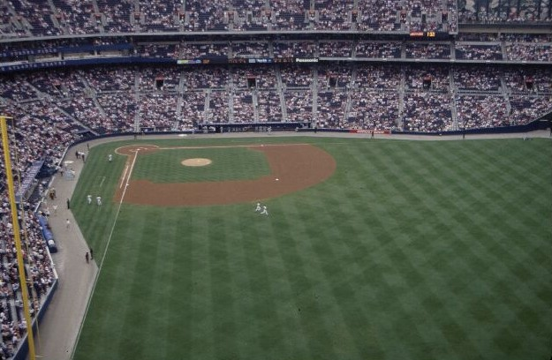
Prioritizing Sports Turf Practices
Clint Waltz, Ph.D.
Extension Turfgrass Specialist
The University of Georgia

Slide 2
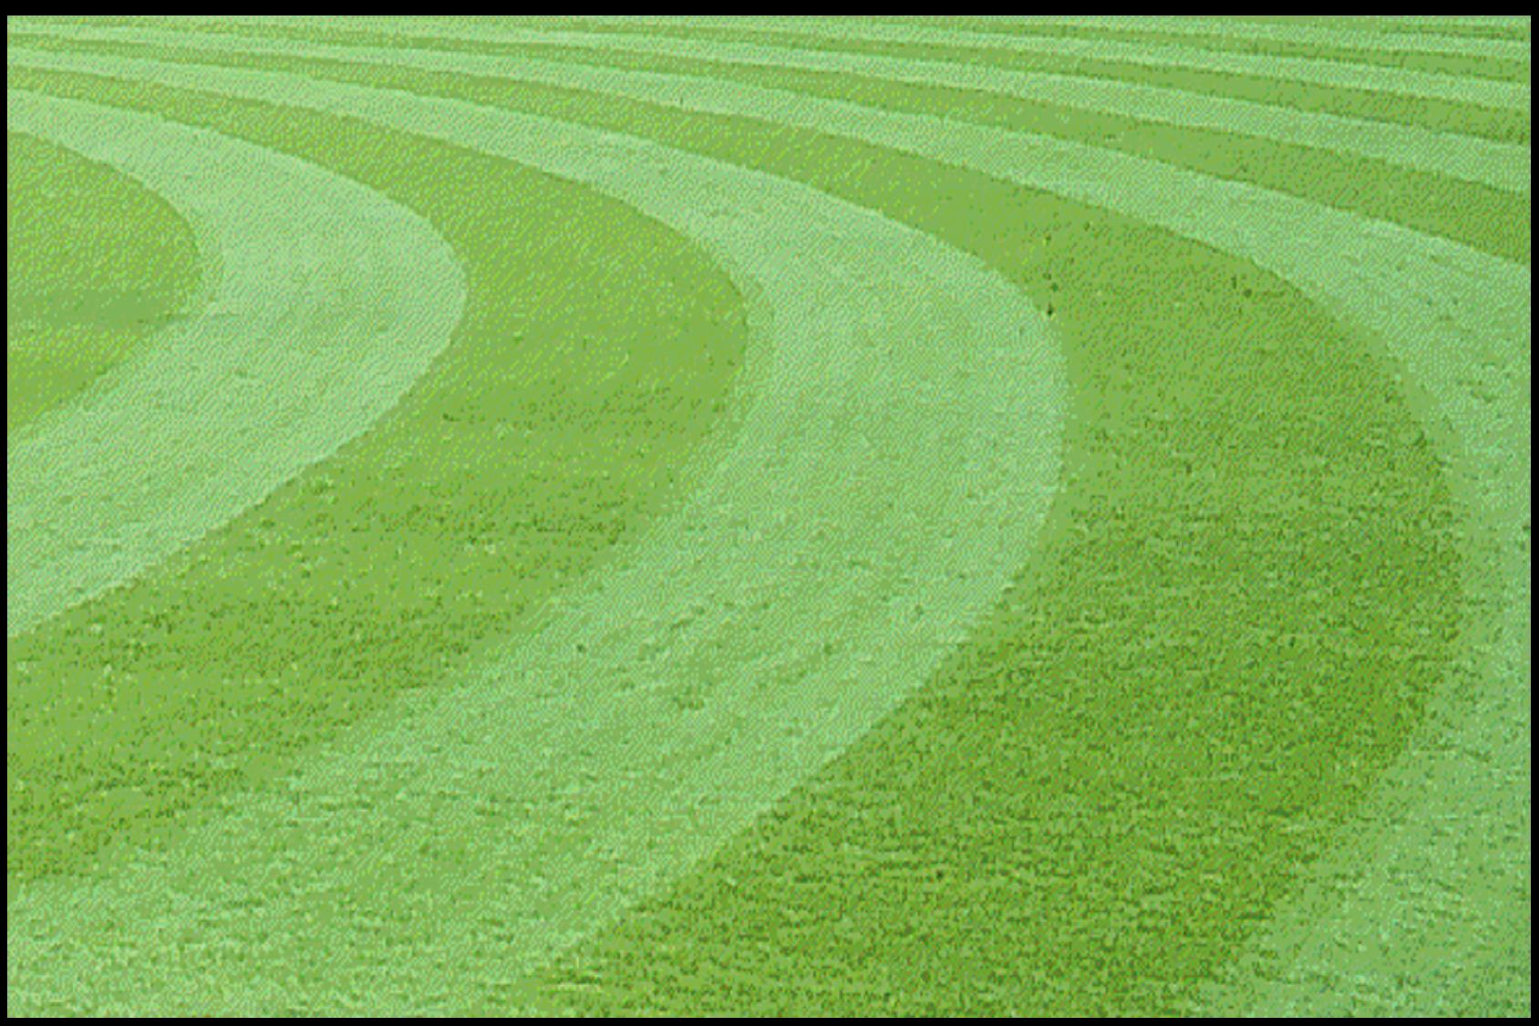
Sports Fields

Slide 3
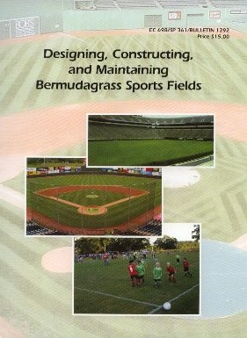
Designing, Constructing, & Maintaining Bermudagrass Sports Fields
For Sale Publication - Order information
www.GeorgiaTurf.com
Ag. Business Office
Room 215, Conner Hall
Athens, GA 30602
(706) 542-8999 or 8575
www.caes.uga.edu/publications/for_sale.html

Slide 4
Design & Construction Considerations

Slide 5
Sports Turf Field Success Formula
Limited Usage
Proper design and construction
Vigorous
maintenance
Water management

Slide 6
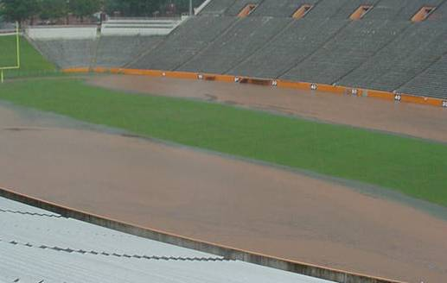
Three Most Important Factors!
DRAINAGE
DRAINAGE
DRAINAGE

Slide 7
drainage tile
12 to 18-inch crown
160 - feet

Slide 8
Tile Line
Tile Line
(hash mark)
1 to 2% slope
1 to 2% slope
To
Outlet
18-inch center crown
Tile Line
center area flat
(no slope)
“Hip Roof”
Drainage Design
“Turtle-Back“
Drainage Design

Slide 9
warning track
drainage tile line
surface catch basins (drains)
outfield turf
1 to 2% grade
1 to 2% grade
drainage tile line
skinned area
10 to 12" fall
10 to 12" fall
drainage tile line
90 ft
90 ft
infield
turf
"hip"
area
"hip"
area
6 to 8" fall
6 to 8" fall
6 to 8" fall
8 to 12" fall
8 to 12" fall

Slide 10


Sand Rootzones: USGA
Turfgrass
12” Sand
Rootzone
4” Diameter Round Drain in Gravel Trench
Subsoil
Turfgrass
12” Rootzone Mix
4” Pea Gravel Layer
4” Diameter Round Drain in Gravel Trench
Subsoil

Slide 11
Sand Rootzones: Sand Cap
Turfgrass
4” Sand
Rootzone
4” Diameter Round Drain in Gravel Trench
Subsoil
Turfgrass
4” Sand
Rootzone
Subsoil

Slide 12
Challenge of Sports Turf Managers
Provide a field with beautiful green grass that is almost always playable and safe under heavy field usage (abuse)

Slide 13
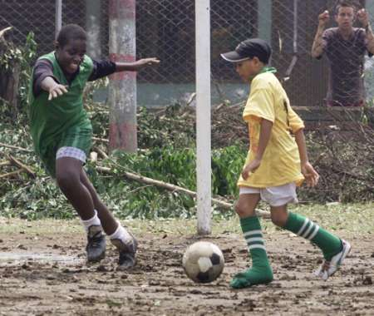
Is this field safe?
Notes:
Good slide of field worn to the dirt.

Slide 14
Budget plays a vital role in the degree of success and determines one’s expectations

Slide 15
Sports Turf Field Success Formula
Limited Usage
Proper design and construction
Vigorous
maintenance
Water management

Slide 16
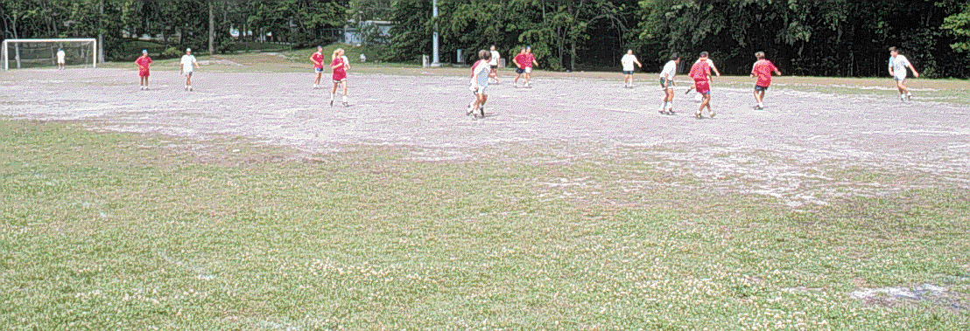
Regulating Field Use

Slide 17
Wear: Usage Maxims
(200 – 400 – 600 Rule)
200 – to sustain good field conditions use should not exceed 200 hours / year
400 – some fields can handled between 400 to 600 hours of use / year
600 - 600 hours / year is extreme and poor conditions can be expected

Slide 18
Bermudagrass

Slide 19
Bermudagrass Cultivars
Vegetative
‘Tifway’ / 419, ‘TifSport’ & ‘Tifton 10’
  Shade – ‘Celebration’
Certified grass
  encourage the consumer
Putting green cultivars
  ‘Tifdwarf’, ‘TifEagle’, ‘Mini Verde’

Slide 20
Bermudagrass Cultivars
Seeded
‘Princess 77’, ‘Riviera’, ‘Sahara’
Availability
Seeding rate – 1 lb / 1000 ft²
Cost
  $30 / lb for 1000 ft²
  $75 / pallet for 500 ft² pallet = $150 / 1000 ft²

Slide 21
Turfgrass Cultivars
New or Old
Supply
Find local grower
  costs – drop charges, fuel sur-charge
www.GeorgiaTurf.com
  Turfgrasses link

Slide 22
2006 Turfgrass Costs
 | On-the-farm |  |  |  | Delivered to Atlanta*
Turfgrasses | 2005 | 2006 | Change |  | 2005 | 2006 | Change
 | --- Cents / ft² --- |  | % |  | --- Cents / ft² --- |  | %
Bermudagrass | 11.4 | 12.4 | 8.8 |  | 15.4 | 16.3 | 5.8
Zoysiagrass | 24.4 | 21.4 | -12.3 |  | 30.6 | 32.4 | 5.9
Centipedegrass | 15.1 | 14.8 | 2.0 |  | 19.8 | 20.3 | 2.5
Tall Fescue | 18.0 | 20.6 | 14.4 |  | 23.1 | 25.0 | 8.2
St. Augustinegrass | 21.9 | 24.9 | 13.7 |  | 28.0 | 31.0 | 10.7
* Delivered price includes freight and pallets.

Slide 23
2006 Bermuda Supply
* Projected supply for the first 5 months of the calendar year.

Slide 24
Bermudagrass Cultivar Water Usage
a
ab
a
a
a
c
a
a
cd
ab
d
b
Baldwin et al., 2006

Slide 25
Bermudagrass Cultivar Water Usage
a
a
ab
a
a
ab
ab
bc
ab
bc
b
c
Baldwin et al., 2006

Slide 26
Bermudagrass Cultivar Water Usage
a
a
a
ab
ab
a
a
b
a
a
a
b
Baldwin et al., 2006

Slide 27
Bermudagrass Cultivar Water Usage
a
a
a
a
b
a
a
b
ab
a
ab
b
Baldwin et al., 2006

Slide 28
Bermudagrass Cultivar Water Usage
a
ab
b
c
Baldwin et al., 2006

Slide 29
Timing N Fertilization
Warm-season Grasses
Soil Temperatures
  Active root growth
  65° F
  Consistently – multiple days
  4-inch depth
  www.GeorgiaWeather.net
  Combination products

Slide 30
Bermuda Fertilization
Common concerns
  Don’t fertilize late in the season!
    succulent turf
    winter injury
    delay spring green-up
    susceptible to fall diseases

Slide 31
Bermuda Fertilization
New Thoughts
Fertilization
  balanced ratios of N & K
  late season applications do not affect freeze tolerance
Caveat
  soluble N at 0.5 to 1.0 lb N / 1000 ft²
  2 to 4 weeks prior to hard frost
  not in areas with historical SDS

Slide 32
Bermuda Fertilization
 | Turf Color
N Rate | (1-9, 6=acceptable) |  | GH Regrowth
(lbs N / 1000 ft²) | Oct. 16 | Oct. 23 | (%)
NTC | 4.4 b | 4.3 c | 28.6 a
2.5 | 5.3 a | 4.9 b | 24.7 a
5.0 | 5.3 a | 6.3 a | 26.1 a
N applied Aug. 30 & Sept. 27 in Blacksburg, VA. (Ervin et al., 2004)

Slide 33
Bermuda Fertilization
 |  | Turf Color |  |  |  | Rhizome TNC
N Rate |  | (1-9, 6=acceptable) |  |  |  | (g/kg)
(lbs N / 1000 ft²) |  | Oct. 17 | Oct. 31 | Apr.6 |  | Dec. | Mar
NTC |  | 5.3 | 5.8 | 6.3 |  | 14.2 | 14.6
1.0 |  | 6.2* | 7.1* | 6.9* |  | 14.4 | 14.2
2.0 |  | 6.3* | 7.3* | 6.8* |  | 13.2 | 13.6
N applied 2nd week Oct. in Starkville, MS. (Ervin et al., 2004)

Slide 34
Construction Considerations

Slide 35
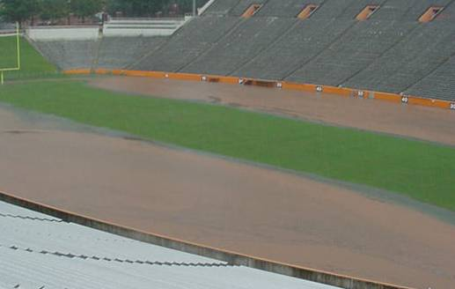
Most Important Factors!
DRAINAGE
DRAINAGE
DRAINAGE

Slide 36
Soil Compaction
&
Wear

Slide 37
Soil Compaction
Generally the most common problem on sports facilities and is a natural result from field use and maintenance.

Slide 38
How do fields become hard?
Traffic
Wear - removes biomass that provides cushion and impact absorption
Compaction - packing of soil particles into a given volume, resulting in a denser soil with decreased pore space

Slide 39
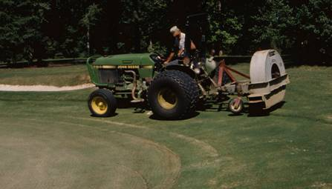
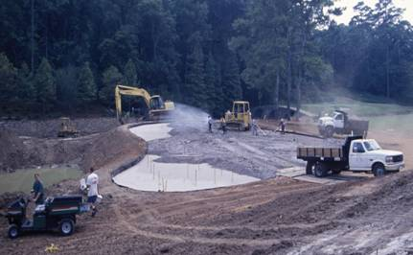
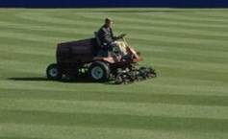
Traffic Types
Equipment Traffic
  Maintenance
  Construction

Slide 40
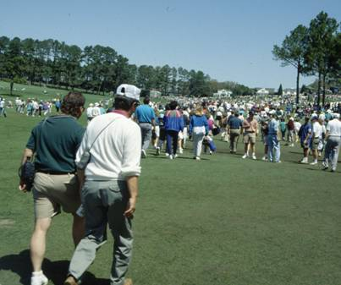
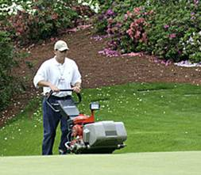
Traffic Types
Foot Traffic
  Maintenance
  Athletic event
  Practice
  Band

Slide 41
Wear: Mowing Height
Proper Mowing Height - bermudagrass
  Raising from ½- to 1-inch
    improved impact adsorption
  > 1½-inch
    shoot density declines
    blades more prone to wear
    fewer plant to recover

Slide 42
Aeration
The process of improving soil air exchange enhancing water and nutrient penetration into the soil, and reducing soil compaction.

Slide 43
Core Cultivation
One of the most important management practices for maintaining high quality playing fields, and often one of the least appreciated or used practices.
If used correctly, core cultivation truly relieves soil compaction, other cultivation practices are generally for thatch control and establishment.

Slide 44
Principles of Aerification
Step One:
  Identify Problem Correctly
Step Two:
  Determine most effective means of alleviating problem

Slide 45
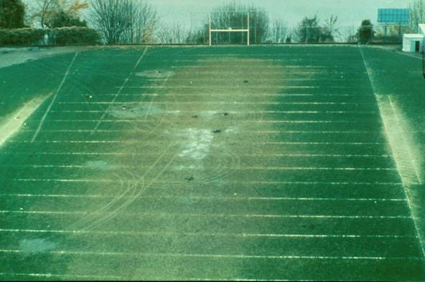
Soil Compaction: Locations
Player benches
B/t hash-marks
Sidelines
On-deck circles
Path to “Home”
Goal mouths
Common worn areas of football fields

Slide 46
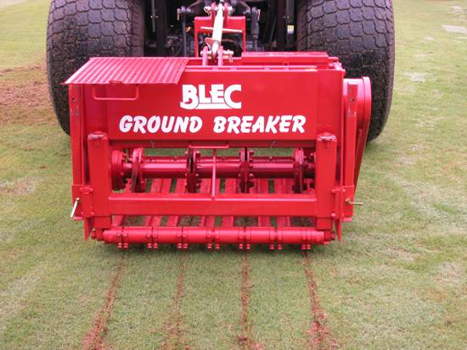
Aeration Methods
Core
Solid Tine
Deep Time
Deep Drilling
Grooving
Slicing
Continuous Grooving

Slide 47
Tine Size & Surface Area
Tine Size (in) | Spacing (in - sp) | Holes / ft² | SA / Tine (in²) | SA Affected (%)
1/4 | 1.25 | 100 | 0.049 | 3.41
1/4 | 2.5 | 25 | 0.049 | 0.85
1/2 | 1.25 | 100 | 0.196 | 13.64
1/2 | 2.5 | 25 | 0.196 | 3.41
5/8 | 2.5 | 25 | 3.07 | 5.33
Oatis, 2003

Slide 48
Mowing, Fert., & Coring
Mow | Fert. | Coring | % Turfgrass Cover |  |  | Cost
(x/wk) | (lbs. N) | (x/yr) | Oct. 1 | Oct. 15 | Nov. 16 | (season)
1 | 5 | 0 | 75 | 78 | 33 | $2,716
2 | 5 | 2 | 87 | 83 | 45 | $5,207
1 | 7 | 0 | 80 | 85 | 37 | $2,886
2 | 7 | 2 | 88 | 88 | 50 | $5,377
Michigan State Univ., 2002

Slide 49
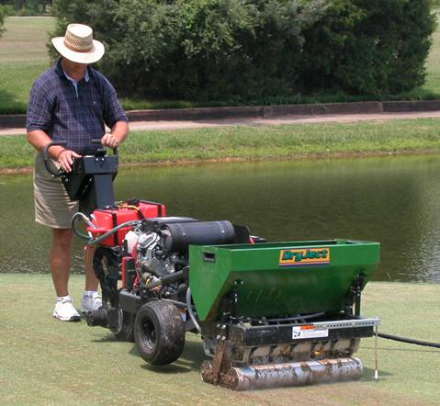
Aeration Methods
Spiking
Sub-Aerification
High pressure water/air injection
Aerify & Backfill in one process

Slide 50
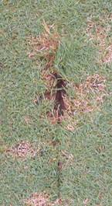
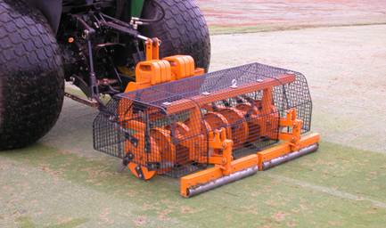
Slicing / Spiking
Forgotten practice
Often as possible
Opens the soil
  Infiltration
  Gas exchange
  stimulates growth
  soil-to-seed contact

Slide 51
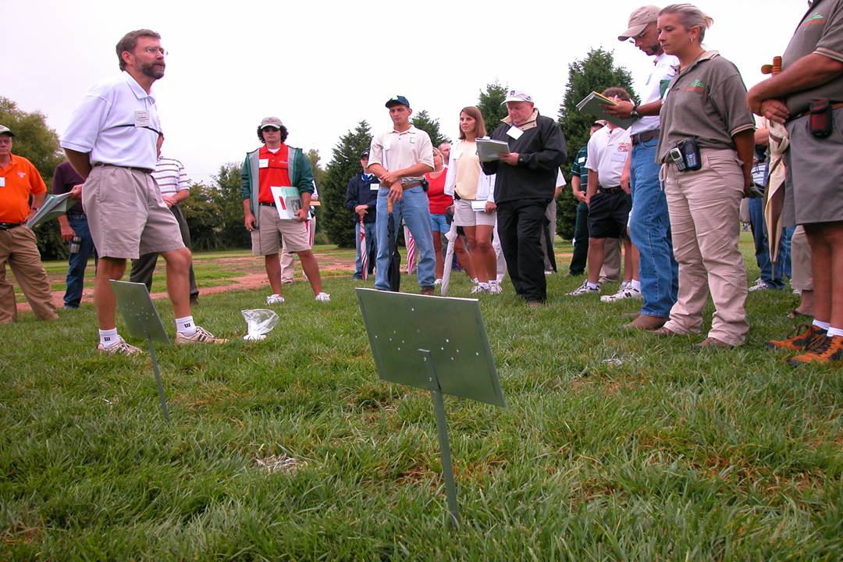
Important Dates in 2006
Southeastern Turf Conference – May 1 & 2
N. Ga. Turfgrass Field Day – May 24
UGA Turfgrass Field Day – August 15
GSPA Field Day – November 1
Turfgrass Institute – December 5 & 6

Slide 52
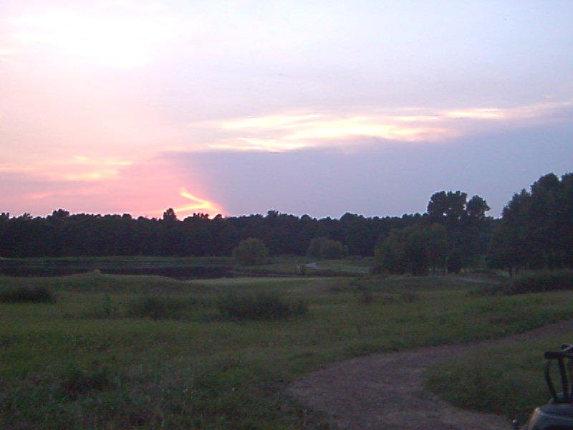
Thank You
Visit
www.Georgiaturf.com
and
www.Turfgrasswater.com

Slide 53
Factors Influencing Aeration
Frequency & Intensity of Field Use
Soil Texture & Structure
Soil Moisture at the Time of Use
Turfgrass Cover
Turfgrass Species/Cultivar

Slide 54
Benefits of Aerification
Relieve soil compaction
Aid in thatch control
Improve soil air exchange
Enhance water & nutrient penetration
Disrupt undesired soil layer
Aid in modifying soil with topdressing
Enhance water & nutrient uptake

Slide 55
Benefits of Aerification
Increase pesticide effectiveness
Reduce runoff & puddling
Increase soil temperature
Reduce effects of localized dry spots
Reduce surface hardness
Stimulate new growth
Improve heat & drought tolerance

Slide 56
Soil Compaction: Soil Pores
Well sorted
Loose packed
Well graded
Loose packed
Well sorted
Tight packed

Slide 57
Soil Compaction: Components
Soil Compaction
Soil Texture (%)
Sand (2.0 – 0.05 mm)
Silt (0.05 – 0.002 mm)
Clay (<0.002 mm)
Pressure Applied
Foot traffic
Equipment traffic
Water Content
allows soil particles to move easier while pressing together

Slide 58
Soil Texture: Relative BD
Textural Class | Bulk Density (g/cm⁻³)
Sands or Compacted Clay | 1.4 – 1.8 | More Compacted
Loam | 1.2 – 1.6
Loose silt loams or clay | 1.0 – 1.4
Organic soils | 0.2 – 1.0 | Less Compacted
McCarty, 2001

Slide 59
Soil Compaction: Soil Pores
Pore Class | Diameter (mm) | Characteristics & Function
Macropores | +5 – 0.08 | Water drains by gravity Transmits air Large enough for plant roots
Micropores | 0.08 - <0.0001 | Retain water after drainage Water moves by capillary action Root hairs can penetrate Too small for large molecules & microorganisms

Slide 60
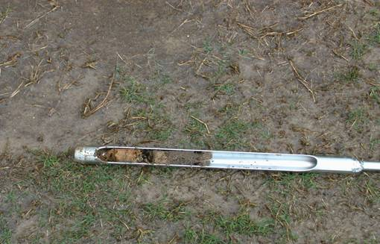
Soil Compaction: Direct
Increases soil bulk Density
  Reduces Pore Space
  Altered pore size distribution
Limits Air, Water, & Nutrient Movement
  Reduces infiltration
  Reduces percolation
Increases CO₂ Levels
Standing water due to compaction

Slide 61
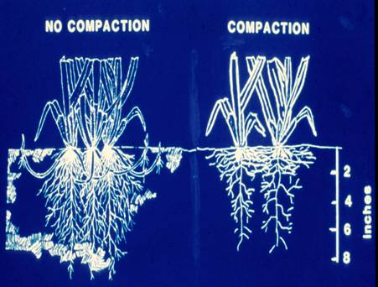
Soil Compaction: Indirect
Thins Turf
  Reduced Turf Quality
Increases Water Runoff
Reduces Field Resilience
  Increases Risk of Injury
Increases Weed Growth

Slide 62
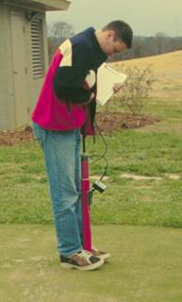
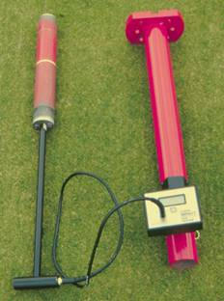
Soil Compaction: Measurement
Bulk Density
  Laboratory
  Destructive
  g cm⁻³
Surface Hardness
  Clegg Impact Soil Tester
  deceleration
  gmax = 70 - 120
Clegg Impact Soil Tester

Slide 63
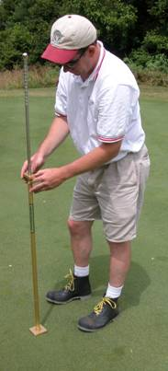
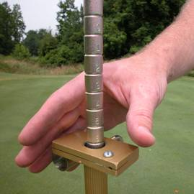
Soil Compaction: Measurement
Water Infiltration
  Double ring infiltrometer
  in / hr
Soil Strength
  penetrometer
  psi
  scaled (Turf Tec)
Turf Tec Penetrometer

Slide 64
Gas Movement
Gas exchange - occurs through diffusion and its efficiency depends on a continuous network of macropores from the surface and down through-out the rooting depth.
Oxygen diffusion – 10,000 times slower through water than through air
Compacted soil – a soil devoid of macropores will reduce the oxygen diffusion rate

Slide 65
Drawbacks to Aerification
Turf injury increasing potential for turf loss during stress
Disruption of the turf surface
Increase desiccation and/or injury
Reduced soil strength
Creation of a localized soil compaction zone
Greater potential for water loss

Slide 66
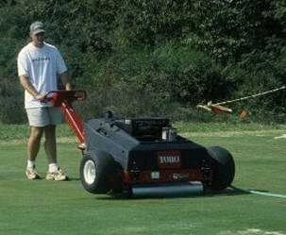
High Pressure Injection
Minimal surface disruption
Often as possible
Opens the soil
Original HPI: Hydroject

Slide 67
Penetration Factors
Soil Type
Soil Moisture
Tine Diameter
Weight & Power of Aerator

Slide 68
Scheduling Factors
Considerations
Location
Species/Cultivar
Intensity of Use
Timing - prior to or during early season root growth

Slide 69
Timing Factors
Stage of plant growth
Effect on playing surface
Scheduling
Remember:
The larger the space (core hole) the longer the growing period needed for recovery

Slide 70
Scheduling Factors
Caution:
Avoid coring if possible when grasses are dormant because this may encourage cool-season weed competition.
Remember:
Repeated aeration to the same depth can cause a “Cultivation Pan”.

Slide 71
Cultivation Time Frames
Cool-season
Mid Spring
To
Late Fall
Warm-season
Early Spring
To
Mid Summer

Slide 72
Tine Types
Type Action
Hollow Removes
Open/Spoon Divots
Solid Lifts, Cracks, & Shatters

Slide 73
Best Practices
Twice a Year - minimum
  late-spring
  early-fall
Water 12 to 24 hours Before
Remove Cores
Topdress

Slide 74
Usage Maxims
(200-400-600 Rule)
Generally advise that a field not be used in excess of 200 hours per year in order to sustain good field conditions
Under some circumstances, fields have successfully handled between 400 to 600 hours of use per year with good field conditions
Beyond 600 hours, you are expecting miracles and will be playing on dirt
Notes:
After a few years, some general guidelines I use related to field use (and overuse). I often get the question . . . “how much can my field be used”.

Slide 75
Topdressing

Slide 76
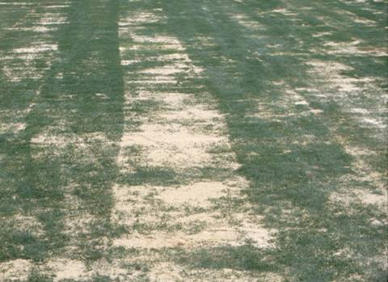
Topdressing: Sand
Keep pores open
Helps with thatch

Slide 77
Soil Properties
Physical
Chemical
Biological
Climate
Temperature
Moisture
Light
Wind
Gases
Management
Mowing
Fertilization
Irrigation
Pesticides

Slide 78
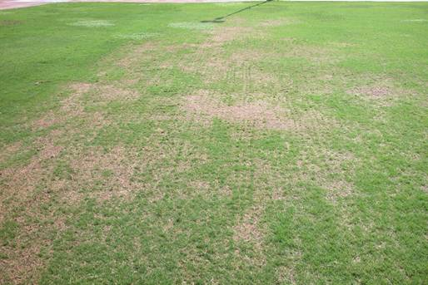
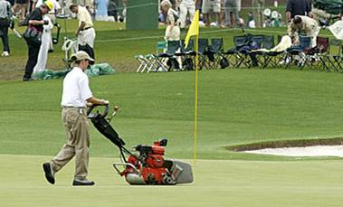
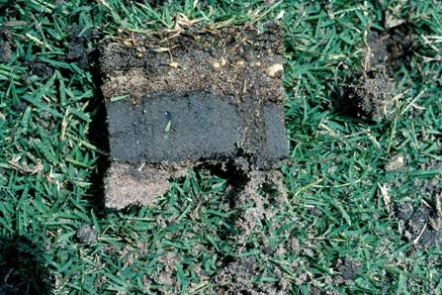

Slide 79
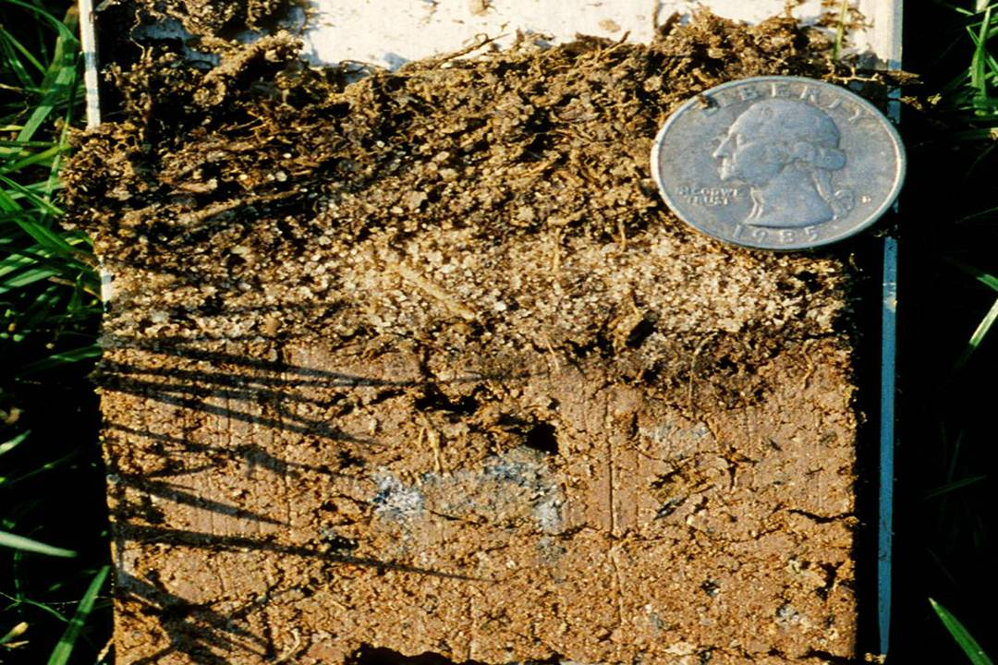

Slide 80
Slicing / Spiking

Slide 81
High Pressure Injection

Slide 82
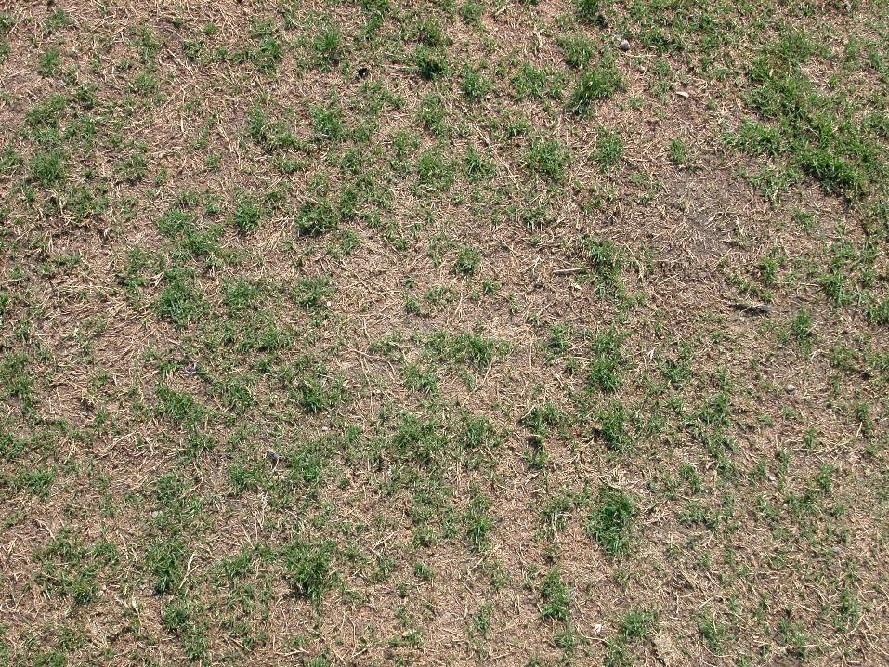

Slide 83
Core Surface Area Calculations
Tine Diameter = 1 inch
Tine Radius = 1 in. / 2 = 0.5 inch
1 inch
Area of Spacing = 5 in x 5 in = 25 inch2
5 inch
Area of Core = πr2
Area of Core = 3.141*(0.5 in)2
Area of Core = 3.141*0.25 in2
Area of Core = 0.785 in2
5 inch
Surface Area Affected = Area of Core/Area of Spacing
Surface Area Affected = 0.785 in2 / 25 in2
Surface Area Affected = 0.031 in2 or 3.1%

Slide 84
Tine Spacing: 5x5 inches
Tine Size Diameter (in.) | Spacing (in.) | # of Holes / sq. ft. | Surface Area Impacted / tine (sq. in.) | Surface Area Impacted (%) | # of Passes to remove 20%
1/2 | 5x5 | 5.76 | 0.196 | 0.79% | 25.5
3/4 | 5x5 | 5.76 | 0.442 | 1.77% | 11.3
1 | 5x5 | 5.76 | 0.785 | 3.14% | 6.4

Slide 85
Tine Spacing: 5/8 inch
Tine Size Diameter (in.) | Spacing (in.) | # of Holes / sq. ft. | Surface Area Impacted / tine (sq. in.) | Surface Area Impacted (%) | # of Passes to remove 20%
5/8 | 4x4 | 9 | 0.307 | 1.92% | 10.4
5/8 | 5x5 | 5.76 | 0.307 | 1.23% | 16.3
5/8 | 6x6 | 4 | 0.307 | 0.85% | 23.5

Slide 86
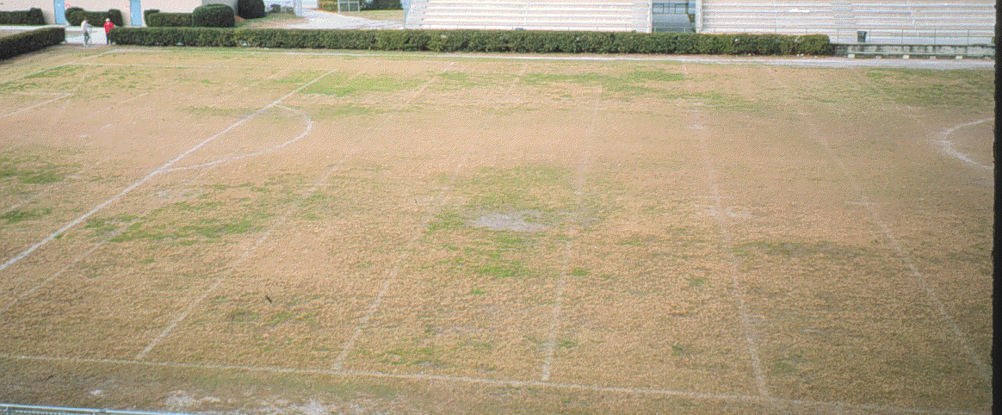
Renovation ?

Slide 87
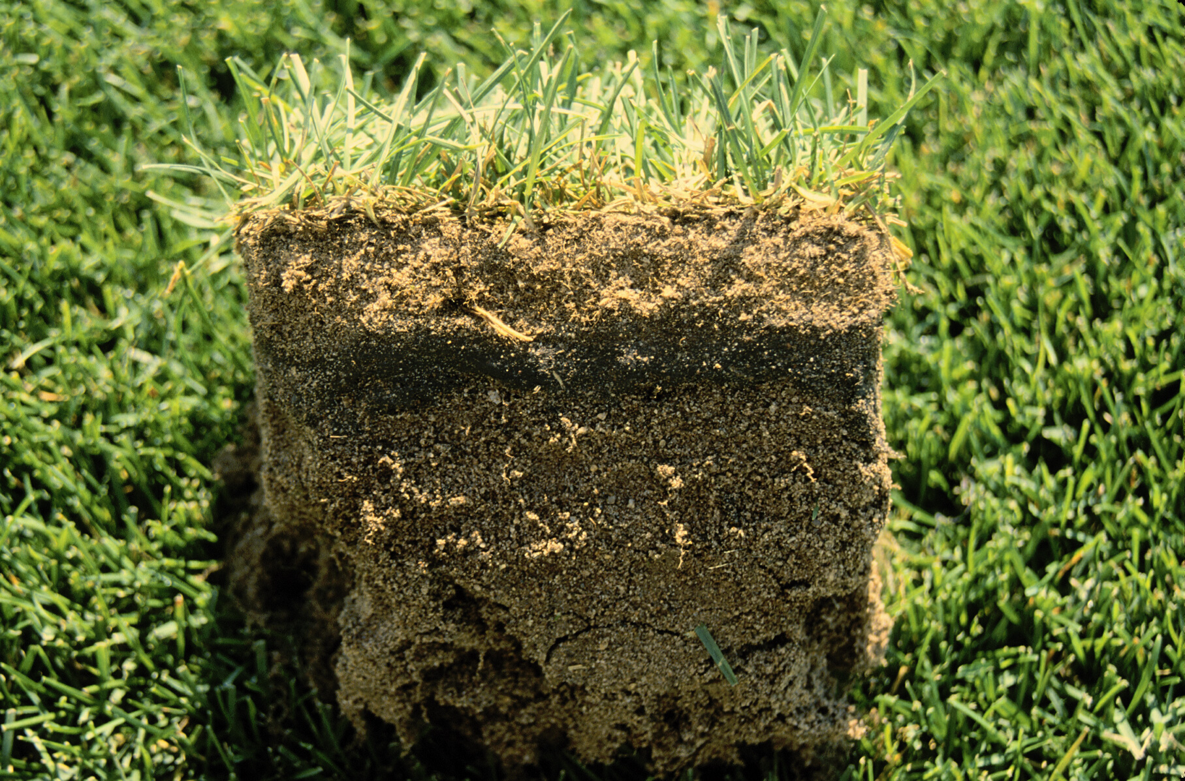
Cultural Practices
Thatch
  Spongy collection of living & dead material
  Not all bad
    natural cushion (endure wear & tear)
    retains moisture
    insulates soil from temp. extremes
Thatch
Sod layer
Rootzone
Kentucky Bluegrass

Slide 88
Green-up Problems
Possible Causes
  Thatch
    Likely above 2” HOC
    Excessive nitrogen
    Excessive irrigation
    Increase disease incidences
Thatch
Sod layer
Rootzone
Kentucky Bluegrass

Slide 89
Advantages of Thatch
Approx. ½ inch
  Adds resiliency to the turf
  Increases wear tolerance
  Increases impact absorption

Slide 90
Disadvantages of Thatch
Greater than ½ inch
  Harbors insects & disease
  Limits root penetration
  Reduces water infiltration
  Limits seed establishment
  Affects field performance

Slide 91
Thatching of Common Grasses
Thatching Tendency | Turfgrass
Moderate to Heavy | Bermudagrass Zoysiagrass Kentucky Bluegrass
Low to Moderate | Buffalograss
 | Creeping Red Fescue
Low (or nonthatching) | Tall Fescue Perennial Ryegrass
Puhalla et al., 1999

Slide 92
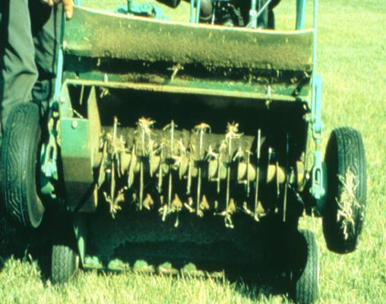
Thatch Management
Reduction
  Actively growing
  Removal
    Aerification
    Vertical mowing
    Topdressing

Slide 93
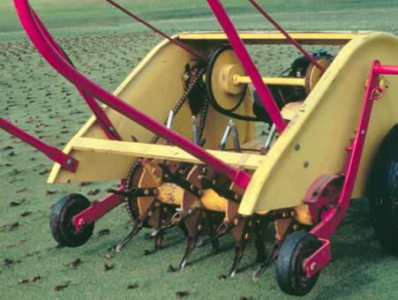
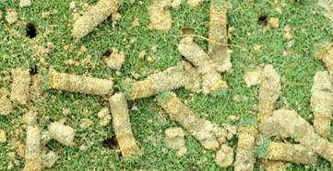
Cultural Practices
Aerification
  When - turf actively growing
  Remove thatch and organic layer
  Equipment -
    solid vs. hollow tines
    rental

Slide 94
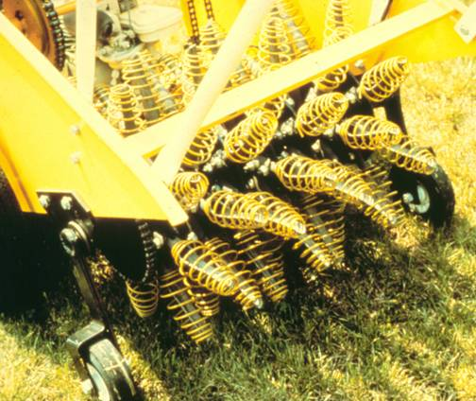
Core Aerification
Common Questions
  Solid or Hollow?
    Hollow increased macropores
  Duration?
    3 weeks

Slide 95
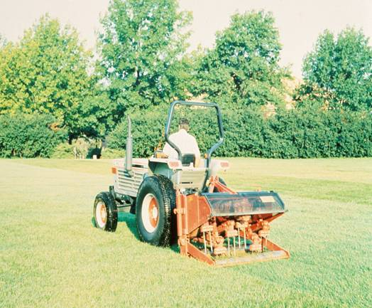
Core Aerification
3 times per year
  Spring Green-up
  Early Summer
  After Playing Season

Slide 96
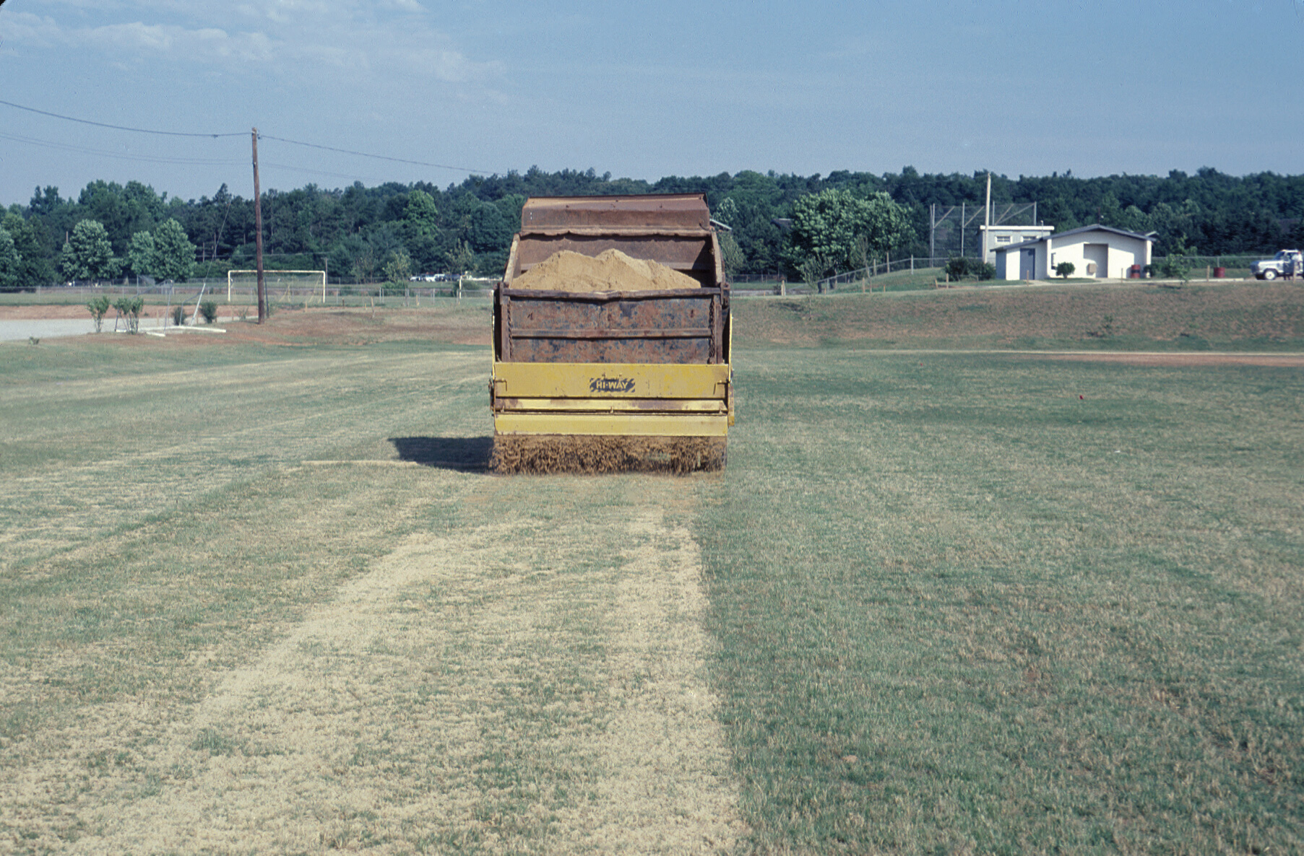
Topdressing
Reasons
  Thatch management
  Surface leveling
  Soil amendment
  Improve drainage
  Assist in overseeding

Slide 97
Topdressing
Procedures
  Light & frequent
    1/16 to 3/8”
  Reaching soil surface
    mow turf low
    broom or rub-in

Slide 98
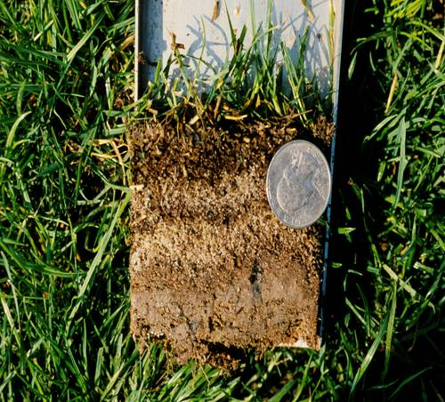
Topdressing
Material
  Similar to existing
    Chemically
    Physically
  Prevent layering

Slide 99
Overseeding WEAKENS the permanent turfgrass and will delay its green-up and growth in the spring

Slide 100
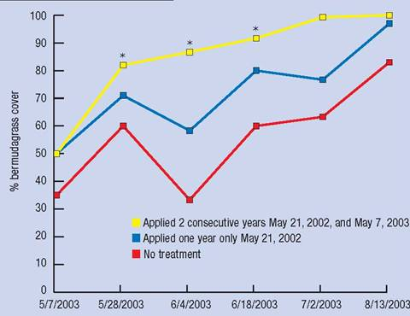
Overseeding Transition
Transition early
  Improved bermudagrass cover
  Consecutive years
  Herbicide aids
    sulfonylureas
    pronamide - restricted
Revolver – 17 fl oz / A
Gelernter and Stowell, 2005

Slide 101
Overseeding Turfgrass Selection
        Annual Ryegrass
        Intermediate Ryegrass
        Perennial Ryegrass

Slide 102
Bermudagrass Water Usage
a
a
b
c
c
b
Baldwin et al., 2006

Slide 103
Bermudagrass Water Usage
b
b
ab
a
b
ab
Baldwin et al., 2006

Slide 104
Bermudagrass Water Usage
a
cd
d
ab
bc
a
Baldwin et al., 2006

