Slide 1
Notes:
1. UGA Logo

Slide 2
www.ugaextension.com
Notes:
2. UGA Cooperative Extension Web address www.ugaextension.com

Slide 3
Notes:
3. Georgia Master Gardener Logo

Slide 4
Plant Physiology
Definition
The Early Years
Environmental Effects on Plant Growth
Light
Photosynthesis/Respiration
Phototropism/Photoperiodism
Other
Notes:
4. Introduction: (#) We will begin this unit by defining what plant physiology is. (#) Then we’ll talk about some early pioneers that set the stage for our understanding of plant physiology. (#) Next we’ll talk about some environmental effects on plant growth and how they influence the physiology of the plant in such dynamic processes as photosynthesis and respiration and light induced responses of plants, such as phototropism and photoperiodism. We’ll also examine the effects of light on other growth processes, such as seed germination.

Slide 5
Plant Physiology
Essential life processes that determine how plants grow and develop
The Early Years
Van Helmont
Joseph Priestly
Notes:
5. Definition: Can anyone provide, in their own words, a definition for plant physiology? What do you think plant physiology is? (Take a few minutes and stimulate audience response). (#) There are many definitions for plant physiology. It is described as the essential life processes that determine how plants grow and develop. It’s all those so-called “behind the scenes” physiological reactions that determine plant growth. (#) There were two early pioneers of plant physiology that laid the groundwork for our understanding of plant physiology: (#) Van Helmont and (#) Joseph Priestly.

Slide 6
Van Helmont Experiment
6 oz.
163 lbs.
199 lbs.
12 oz.
5 years
200 lbs.
Conclusion: Plants don’t consume soil
Notes:
6. Van Helmont Experiment: Until Van Helmont in the late 17th century showed otherwise, it was thought that plants grew by consuming soil. Van Helmont, a French chemist, proved this theory wrong with a very simple experiment.(#) He planted a willow tree seedling in a container. (#) He weighed the seedling before planting and found it to weigh 6 ounces. (#) He weighed the container and soil and found it to weigh approximately 200 lbs. (#) He kept the plant in the container for five years, adding only water for sustenance. (#)(#)(#) Then he re-weighed the tree and found it had gained 162 lbs, 12 ounces in mass, while the soil had lost only 4 ounces in weight. (#) So he concluded from this that plants do not consume soil but derive their nutrition from the water applied to them. Although today we know this is not entirely true, Van Helmont’s research challenged other scientists to explain what these growth factors really were.

Slide 7
Joseph Priestly Experiment
Notes:
7. Joseph Priestly Experiment: About 100 years after Van Helmont, Joseph Priestly did another simple experiment that led to a major discovery. (#) He placed a mouse in a bell jar and sealed out the outside atmosphere. (#) The mouse soon died. (#) Similarly, he placed a plant in a bell jar and sealed out the outside atmosphere. (#) It also withered and died.

Slide 8
Joseph Priestly Experiment
Photosynthesis
Light
6Co2
+ 6H2O
C6H12O6
+ O2
+ energy
Chlorophyll
Notes:
8. Joseph Priestly Experiment (continued): Then, as you might expect, (#)(#)(#) he put the mouse and plant together in a sealed bell jar and found that they both survived longer than when they were alone in the bell jar. He concluded from this study that there is some symbiotic relationship between plants and animals. Although he was unable to explain, at the time, what was being exchanged between plants and animals, we know today that plants give off oxygen that animals utilize and animals breath out carbon dioxide that plants utilize. So plants and animals have a shared co-existence on earth and help support each other. (#) This laid the groundwork for our present day understanding of photosynthesis, which can be summarized and simplified with the following equation: It’s the process by which (#) carbon dioxide and (#) water combine, (#)(#) in the presence of light,(#) with chlorophyll as the light receptor, (#) to produce a carbohydrate, (#) give off oxygen (#) and store energy. Light energy is converted into chemical energy as it is absorbed by the chlorophyll pigment.

Slide 9
light
6 Co₂ + 6H₂O
C₆H₁₂O₆ + O₂ + energy
Chlorophyll
(ATP)
Photosynthesis
Respiration
Glucose
Sucrose
Starch
Amino Acids
Oils
ATP
Photosynthesis: A Building Up Process
Respiration: A Break-down Process
Notes:
9. Photosynthesis: It was not until World War II that scientists began to unravel the mysteries of photosynthesis. (#)(#) Photosynthesis is an energy generating process. (#) Light energy is used to make an energy generating molecule called ATP. The ATP and hydrogens from water combine with carbon dioxide to form a simple sugar (C₆H₁₂O₆). (#) The plant then breaks down this sugar(#), via respiration, to make glucose, sucrose, starch, amino acids or oils or whatever growth substances the plant needs at the time. (#) (#) Glucose also is broken down via respiration to produce additional ATP to drive other biochemical processes within the plant. Looking at the two processes another way,(#) photosynthesis is a building up of energy (#) and respiration is a break-down process whereby the products of photosynthesis are broken down and re-combined with other substances from the atmosphere and soil to form plant growth substances.

Slide 10
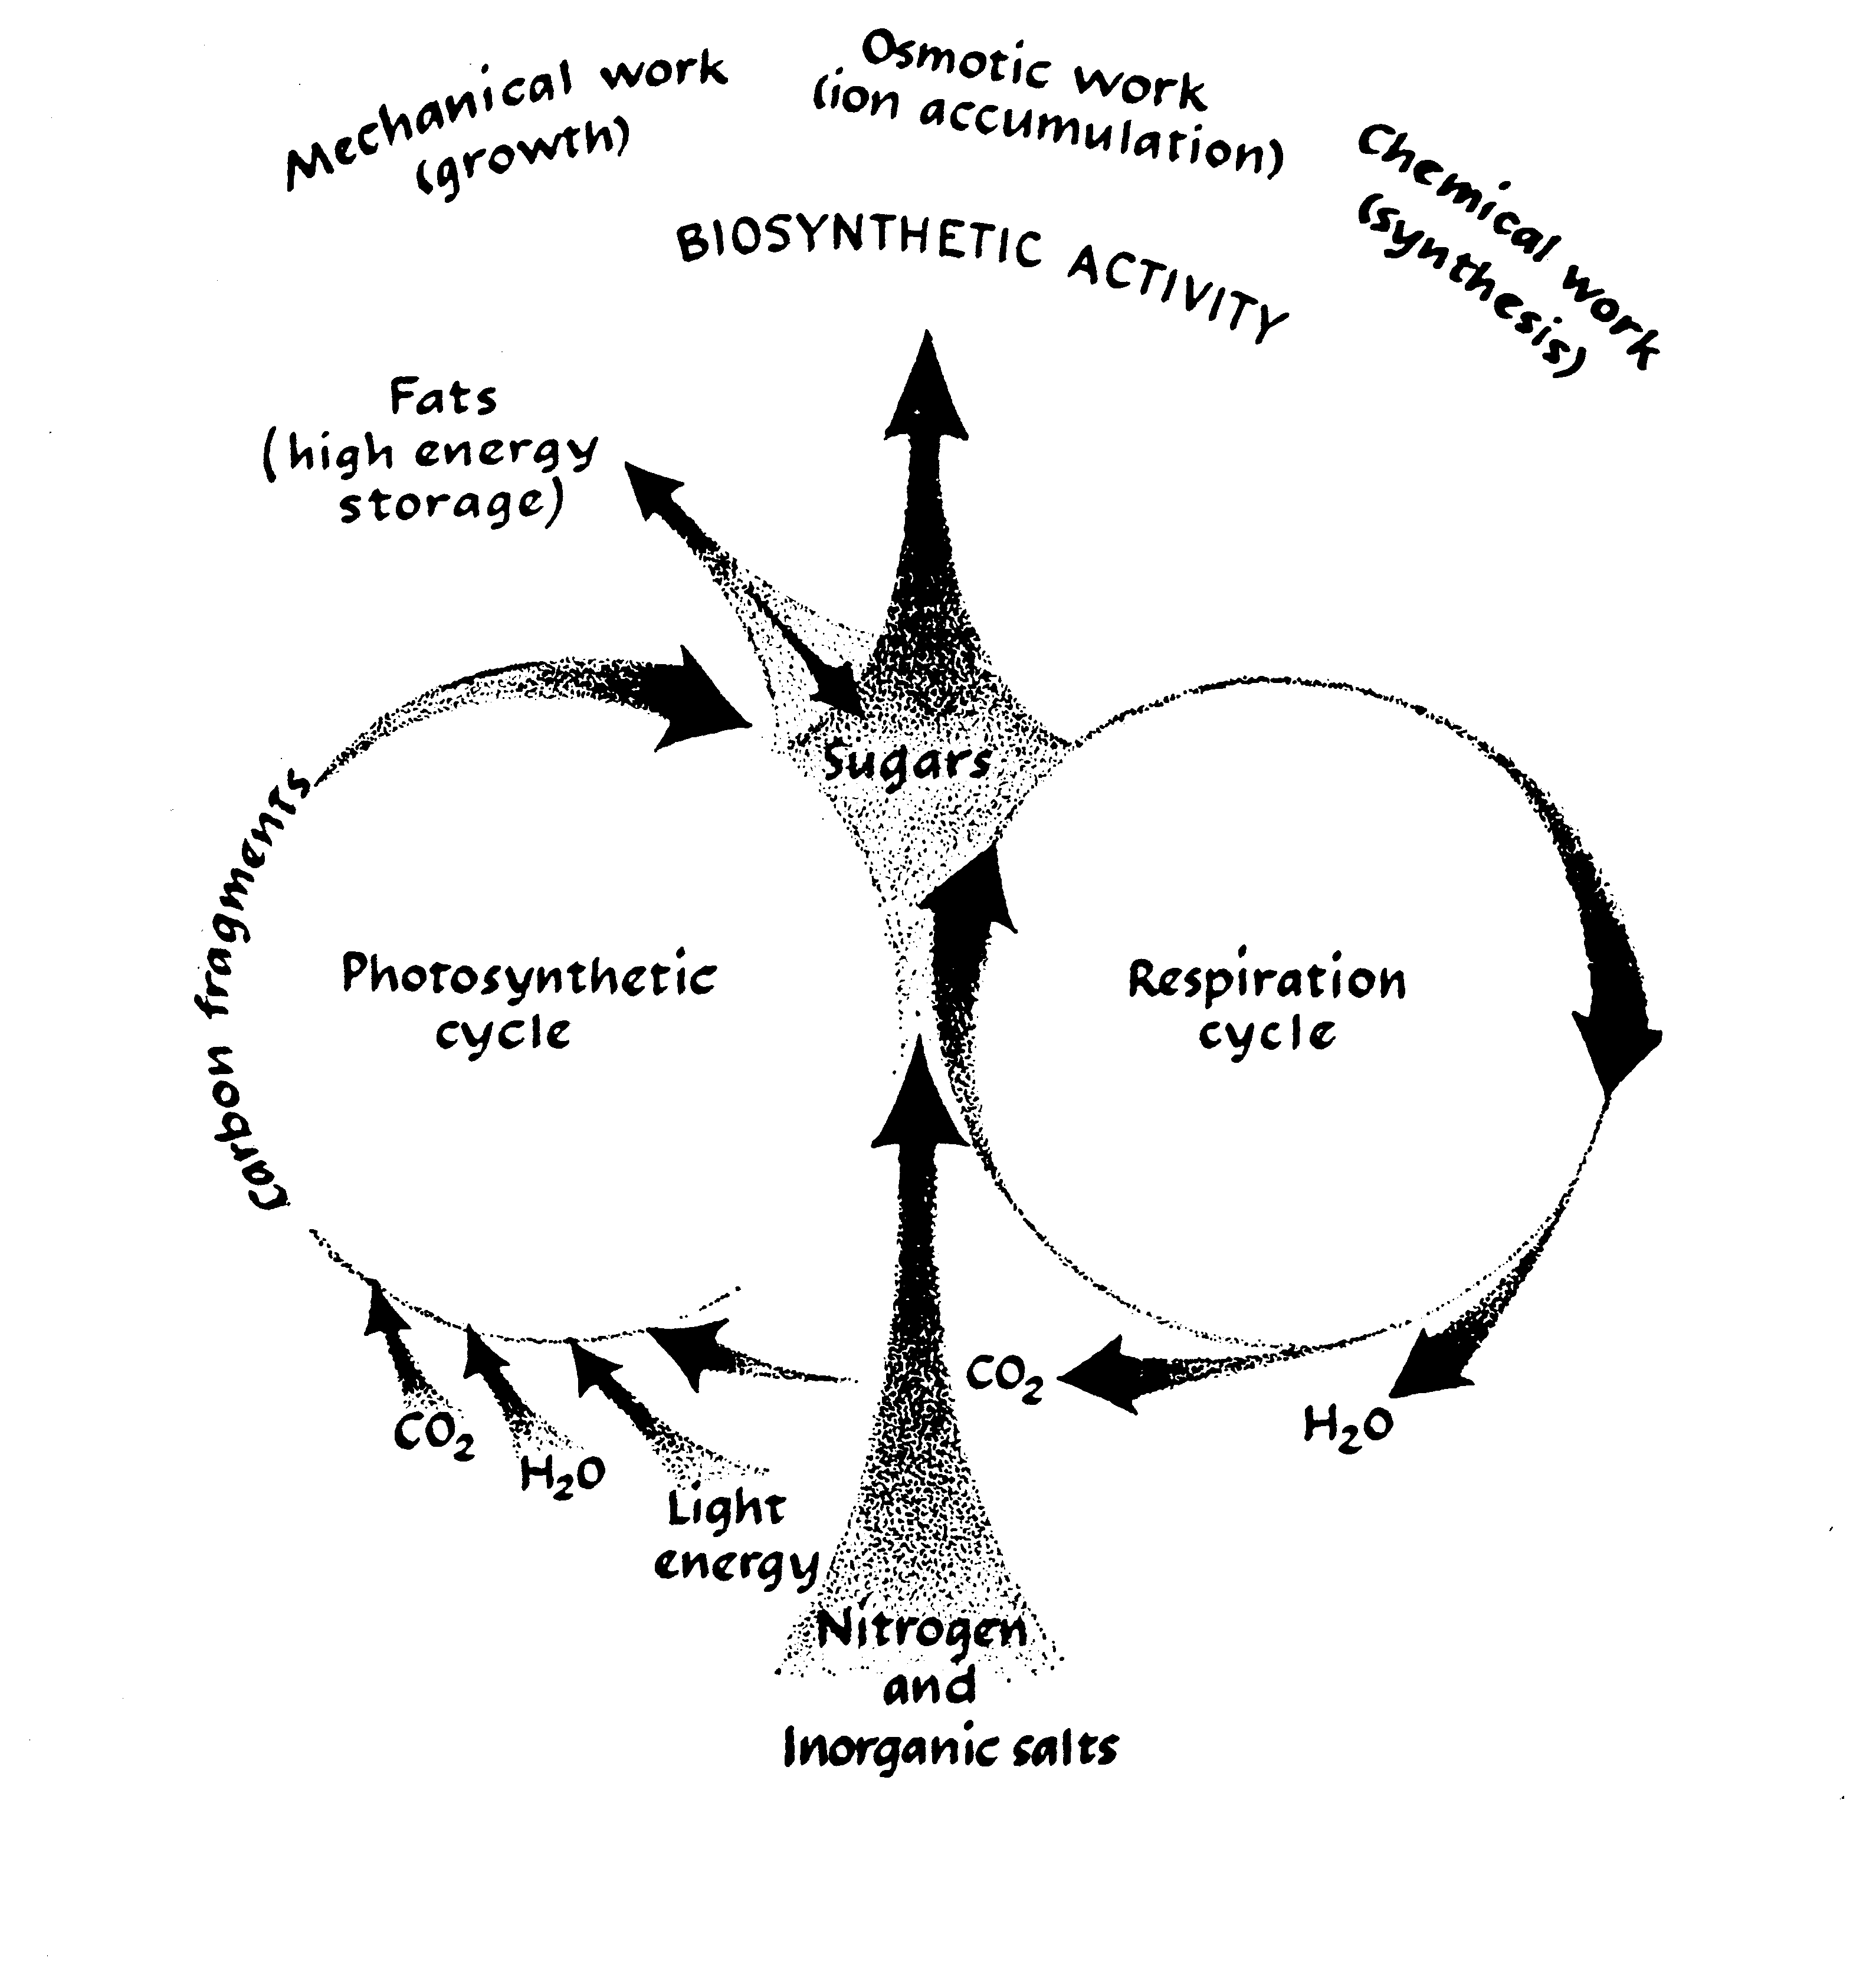
Notes:
10. Chart contrasting photosynthesis and respiration: This chart again summarizes what is happening during photosynthesis and respiration. Note the nitrogen and inorganic salts entering from the roots and combining with the sugars and taking part in all sorts of biosynthetic activity in the plant. Also note how water and carbon dioxide generated during respiration are recycled back into photosynthesis. Excess water is excreted by the plant through the leaves and stems.

Slide 11
Photosynthesis vs. Respiration
Photosynthesis
Occurs only in light
Occurs only in cells containing chlorophyll
Produces energy (ATP)
Increases dry weight
Respiration
Occurs in light or dark
Occurs in all living cells
Uses energy (ATP)
Decreases dry weight
Notes:
11. Differences between photosynthesis and respiration: Now let’s look at some of the differences between photosynthesis and respiration. (#) First, photosynthesis occurs only in the light. It occurs only in cells containing chloroplasts, it produces energy, and it increases dry weight. (#) Respiration, on the other hand, occurs in both light and dark, so when the plant shuts down its photosynthesis at night, respiration still goes on. Respiration occurs in all living cells, not just those containing chlorophyll. Respiration uses energy to manufacture food substances. As a result, dry weight decreases.

Slide 12
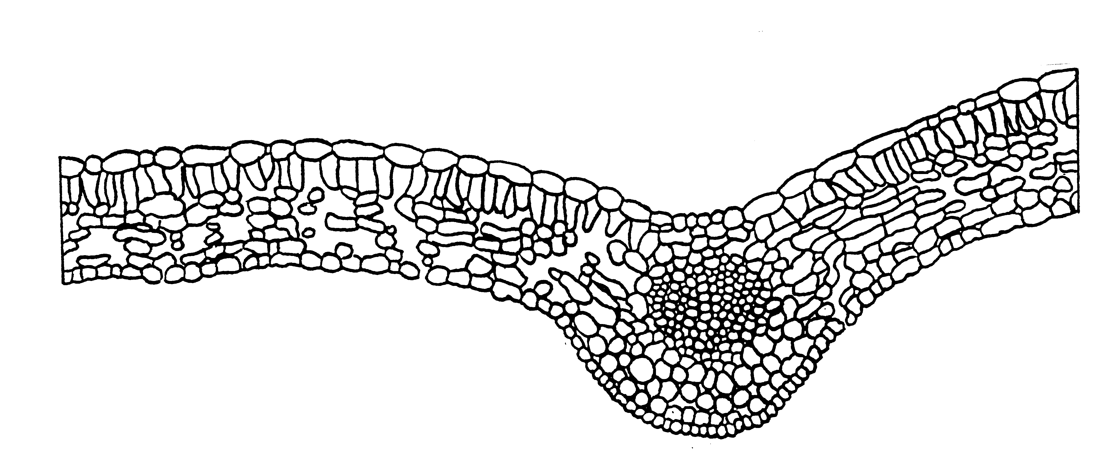
Cross-section of Leaf
Notes:
12. Cross section of a leaf: Now let’s focus on the leaf and where photosynthesis occurs. If we cut a leaf and look at it under a microscope, this is the way it might look. Note the vein in the center through which water and nutrients are moving upward from the root. Plants also have an upper and lower epidermis, just like we have skin.

Slide 13
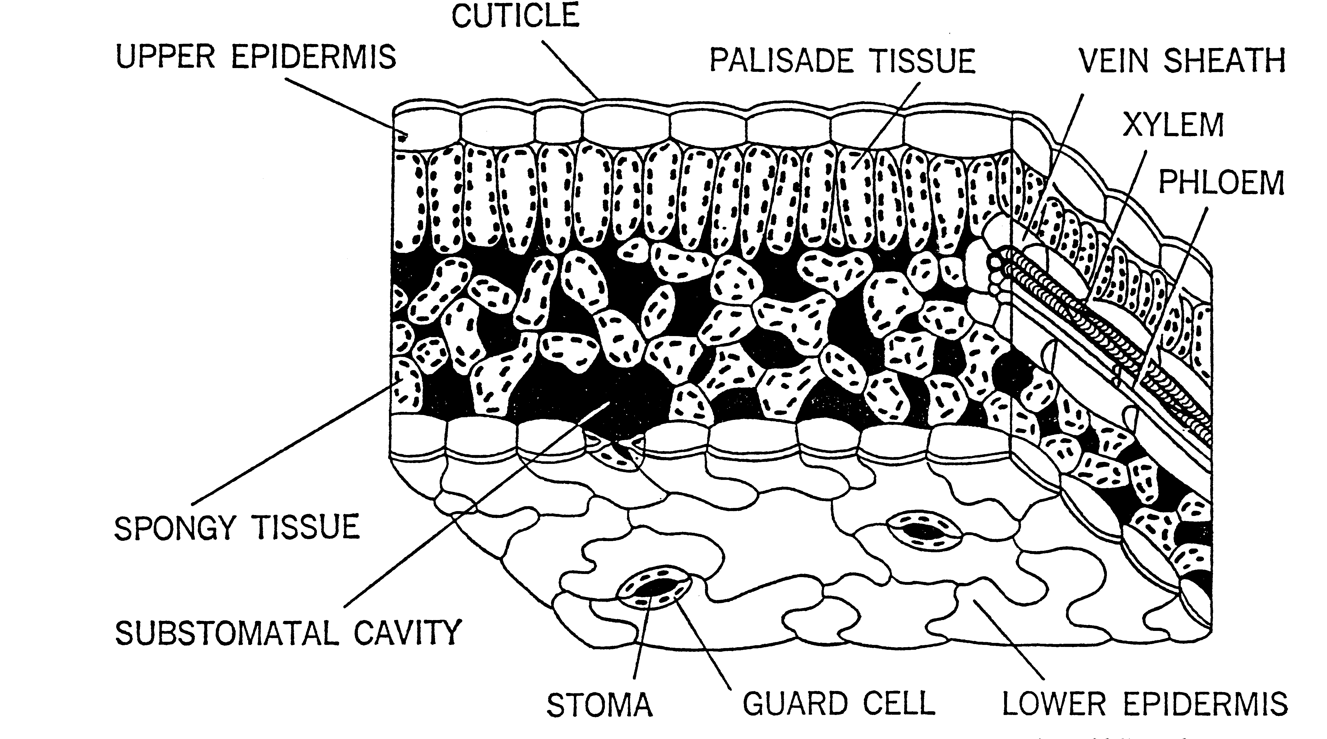
Notes:
13. Closer cross-section of the leaf. If we examine the leaf closer, we see a number of closely spaced cells just under the upper epidermis. These cells, called palisade cells, contain numerous chloroplasts (the black dots on the diagram) that house the chlorophyll molecule. The chloroplasts are arranged near the upper surface where they can most efficiently trap light. The spongy tissue lower in the leaf also contain chloroplasts, although they are not as numerous.

Slide 14
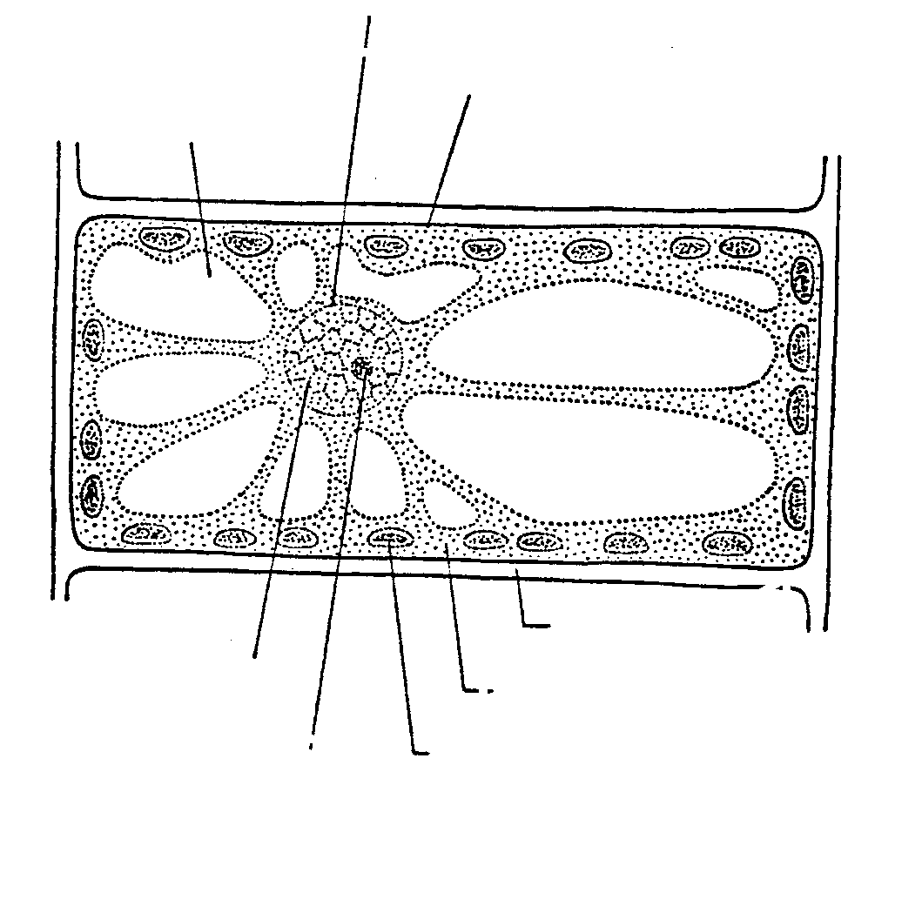
NUCLEAR MEMBRANE
PLASMA MEMBRANE
VACUOLE
CELL WALL
NUCLEUS
CYTOPLASM
NUCLEOLUS
CHLOROPLAST
Notes:
14. Close-up of cell containing chloroplasts. Looking a little closer at a single cell, note how the cholorplasts line up along the cell wall, again, where they can most efficiently trap light as it passes through the leaf.

Slide 15
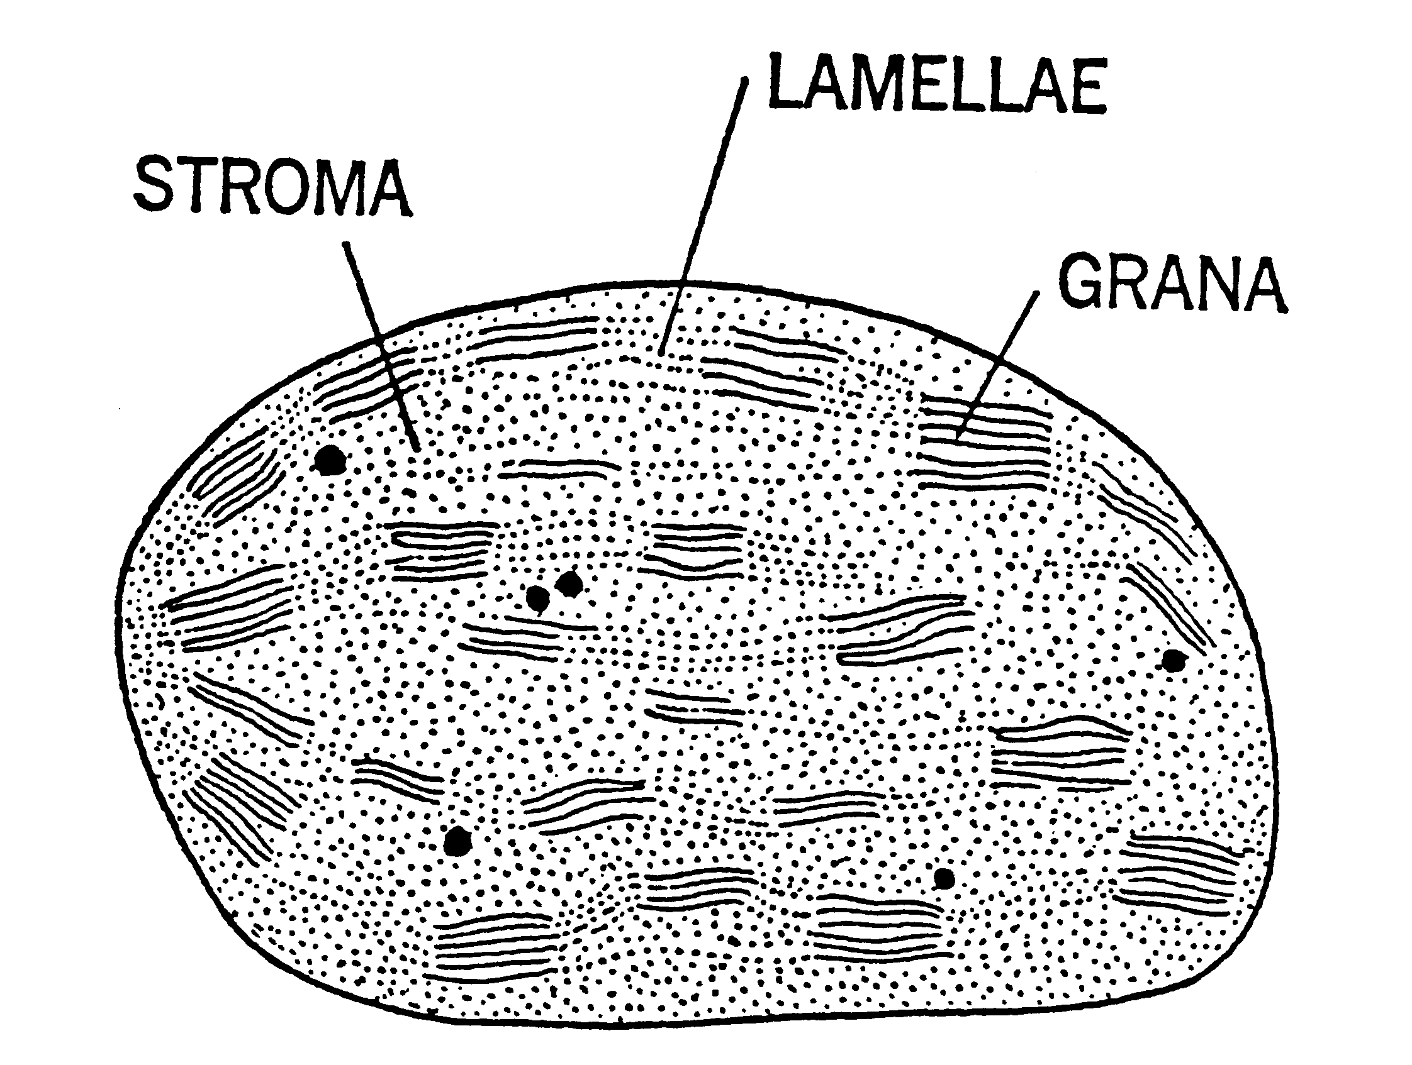
Chloroplast
Notes:
15. Close-up of chloroplast. Chloroplasts have a very complex structure, consisting of stroma, lamellae and grana. Chlorophyll is a component of the grana where the conversion of light energy to chemical energy occurs.

Slide 16
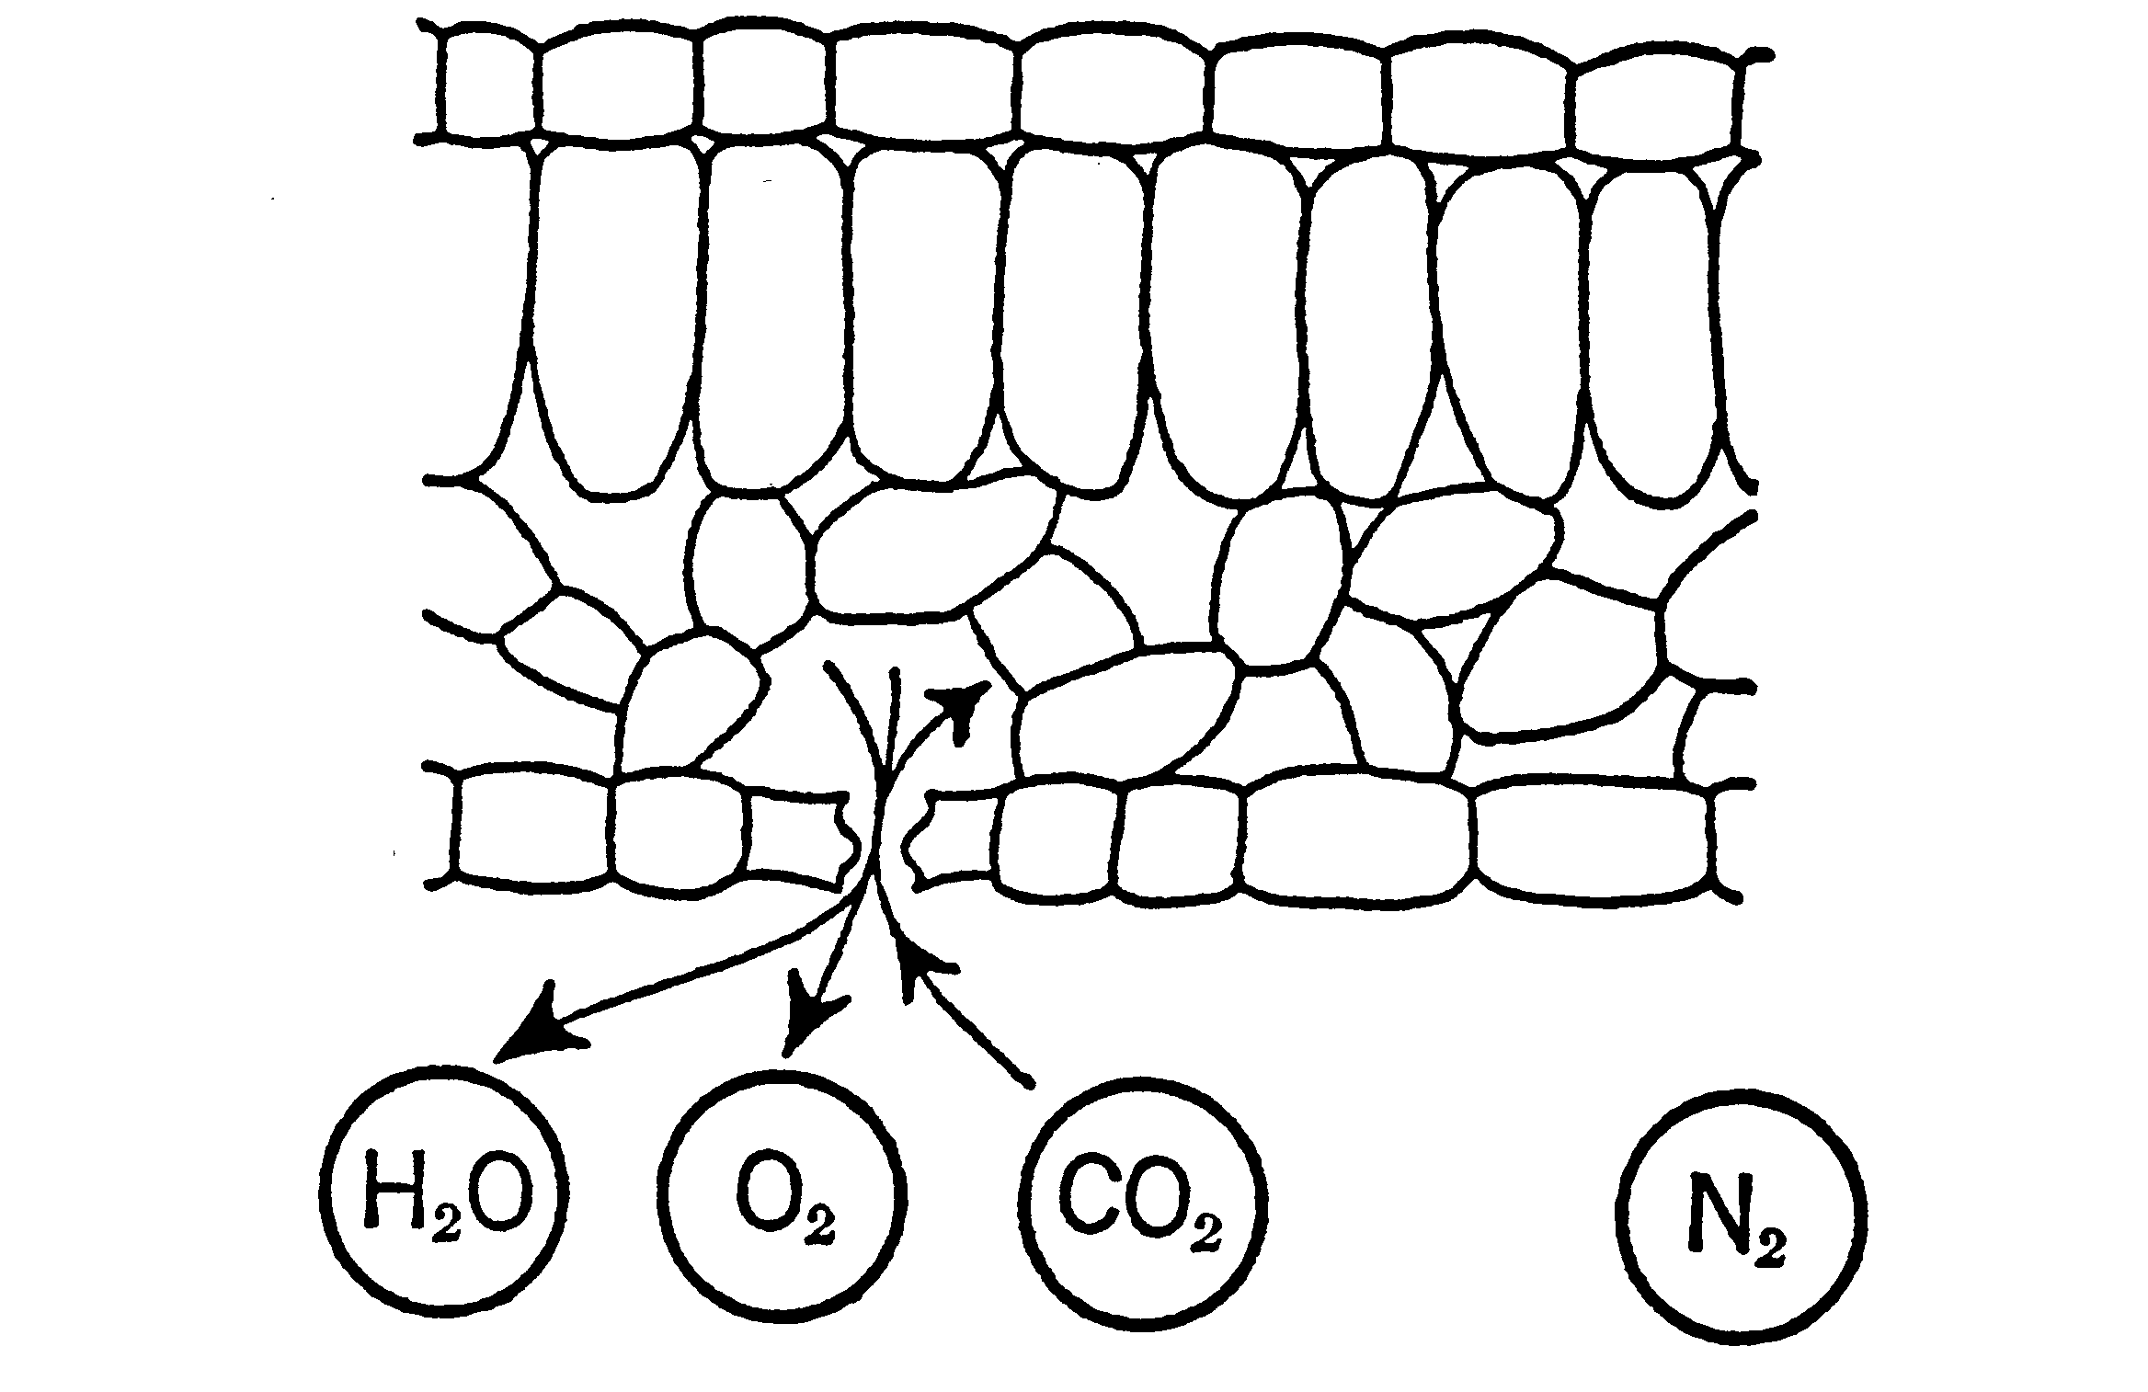
Gas and Water Exchange
Through Stomata (Stomate, singular)
Notes:
16. Stomate on the leaf. The stomata (plural) on the leaf epidermis are the pores through which gases and water move in and out of the leaf. Just as we perspire, plants transpire and lose moisture through their leaf surfaces. This has a cooling effect on the plant.

Slide 17
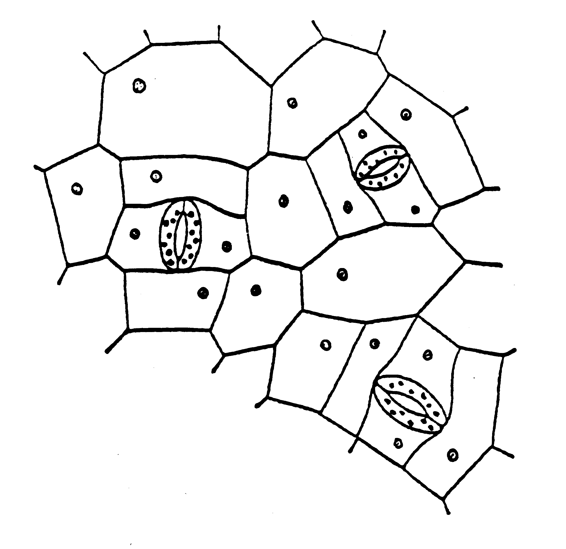
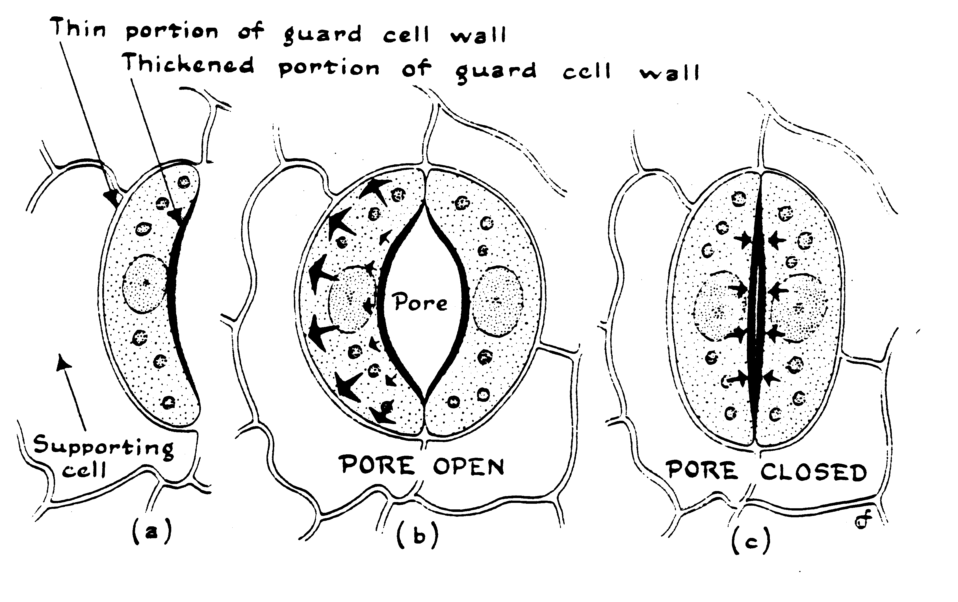
Stomata on the
Leaf Surface
Notes:
17. Stomata on the leaf - opening and closing. The opening and closing of the stomata are governed by guard cells containing chloroplasts. The guard cells swell and shrink in response to changes in osmotic pressure. In general, the stomata are open during the day and closed at night. An exception might occur on a hot, dry, windy day when the stomata close to prevent excess water loss.

Slide 18
Number of Stomata Per Square Inch of Leaf Surface
Plant | Upper Epidermis | Lower Epidermis
Apple | None | 250,000
Bean | 26,000 | 160,000
Corn | 39,000 | 64,000
Black Oak | None | 375,000
Orange | None | 290,000
Pumpkin | 18,000 | 175,000
Sunflower | 55,000 | 100,000
Notes:
18. Number of stomata on leaf surface. There may be thousands of stomata per square inch of leaf surface. Some plants have stomata only on the lower epidermis while some have them on both the upper and lower epidermis. The number of stomata per leaf is genetically determined.

Slide 19
Atmospheric elements (carbon, hydrogen, and oxygen) and water vapor move in and out of leaf through the STOMATA
Water and nutrients (N, P, K, Ca, Mg, Fe etc.) move upward in the plant to areas undergoing respiration and food manufacture via the XYLEM
Carbohydrates, starch, water, proteins, amino acids, oils etc. move to areas where needed for growth or to the root for storage via the
PHLOEM
Notes:
19. Movement of substances within the plant. Atmospheric elements and water move in and out of the plant via the stomata. (#) Water, as well as nutrients, also move internally in the plant via a vascular transport system called the xylem. (#) On the other hand, growth substances produced by the plant during respiration are transported to other areas, such as developing leaves, fruit, flowers or roots via another vascular transport system called the phloem.

Slide 20
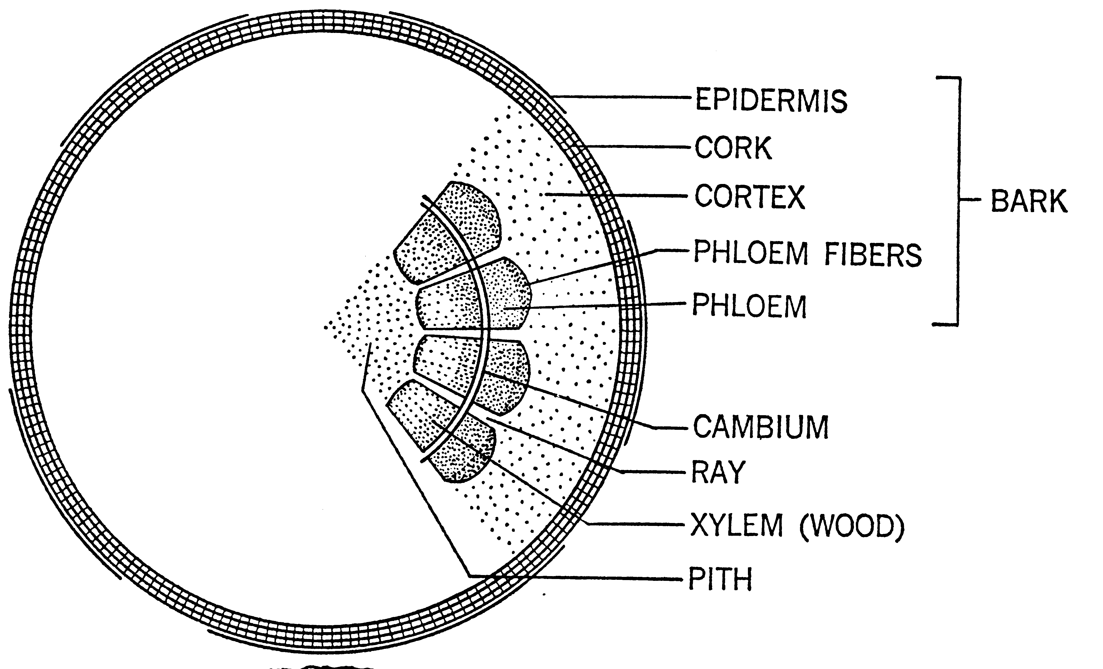
Cross-section of a Woody Plant
Notes:
20. Cross-section of a woody plant. On a woody plant, the xylem is the heartwood (sapwood) or internal part of the stem. It is generated to the inside of the cambium, the area of the stem undergoing rapid cell division and growth. As the plant ages and stems become woody, the xylem often consists of dead cells that simply serve as the aquaducts for transporting water and nutrients upward. On the outside of the cambium is the phloem which transports the food substances throughout the plant. As the plant ages, the phloem becomes the bark. When a tree is girdled and bark is removed to the cambium, the phloem tissue is removed. This prevents the movement of food substances downward in the plant to the root. The tree continues to absorb water and nutrients to sustain the top, but because food can no longer reach the roots, the roots gradually deplete their food reserves, waste away and shut down. Then the tree dies, sometimes several months after the injury occurred.

Slide 21
Light
All life on earth depends directly or indirectly on radiant energy from the sun.
Each year 3.5 million kilowatts of electrical energy strike the earth.
Light influences all biological processes.
Light regulates the earth’s temperature.
Light provides the energy for rain, wind and ocean currents.
Light travels 93 million miles from the sun to earth at a speed of 186,000 miles per second.
Notes:
21. Environmental Effects on Plant Growth: Light -Facts about light. Now let’s look at some environmental factors and their effect on plant growth. Light is an environmental factor that has one of the most pronounced effects on plant growth and life in general, so we will spend a considerable amount of this session talking about light and its many effects on plants. First, let’s review some of the basic facts about light (read and discuss list).(#)(#)(#)(#)(#)(#)

Slide 22
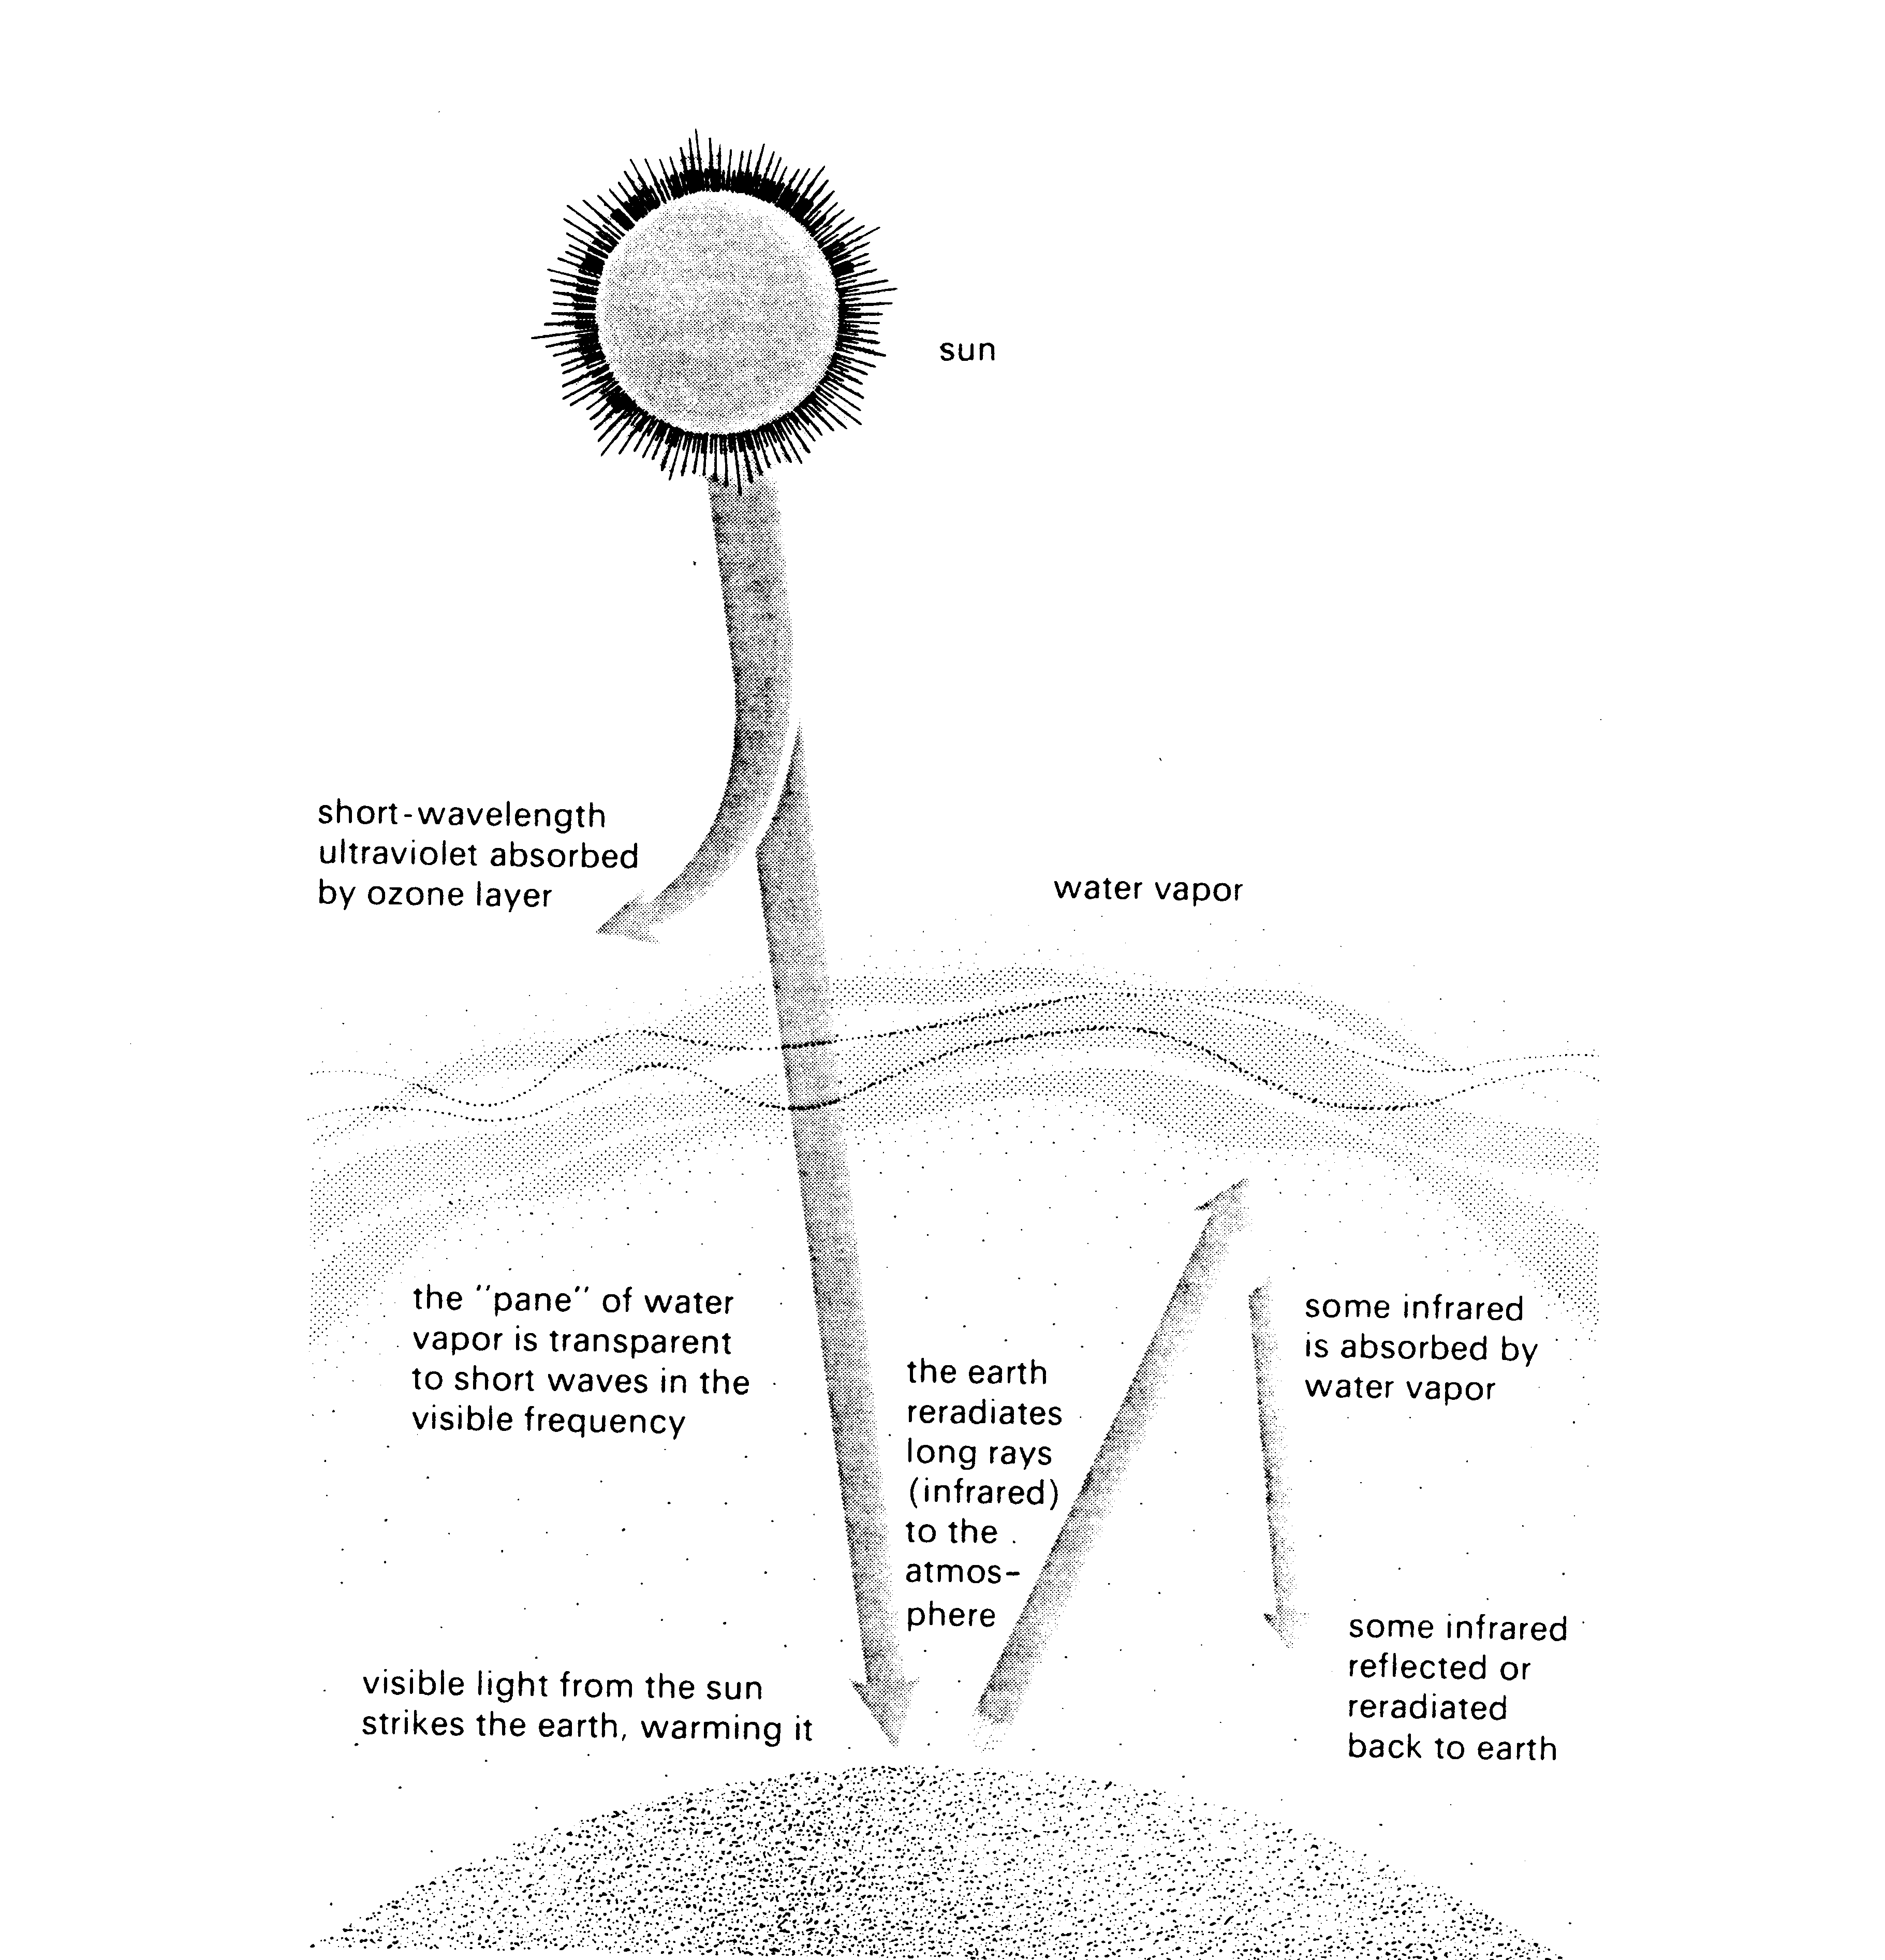
80% of light from the sun is absorbed or scattered by the upper atmosphere
Light from the sun is emitted in a series of wavelengths. Wavelengths of similar proportion combine into pulses of light called photons.
Of the 20% of light reaching the earth’s surface, about 98% is absorbed by the earth and re-radiated as heat energy
Only 1 to 2% of the light from the sun is used by plants in photosynthesis
Notes:
22. Light energy from the sun. Light energy from the sun is emitted in a series of wavelengths. Wavelengths of similar frequency combine to form pulses or photons of light energy. (#) Fortunately, about 80% of the light energy from the sun is prevented from reaching the earth by the upper atmosphere. Many of the extremely penetrating rays, such as cosmic, x-rays and some ultraviolet rays are reflected back into space.(#) Only about 20% of the sun’s radiant energy reaches the earth’s surface. About 98% of this energy is absorbed by the earth or re-radiated back as heat energy.(#) Only about 1 to 2% of the sun’s radiant energy is actually used by plants in photosynthesis.

Slide 23
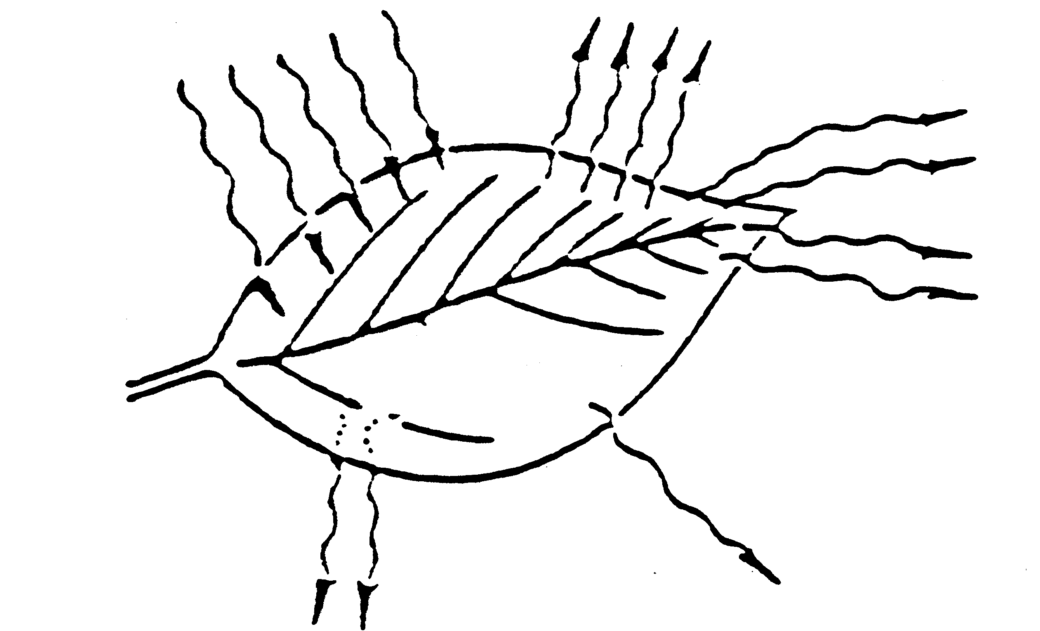
Light strikes leaf
100%
Reflected light
10-15%
Most of absorbed energy lost in heat and in evaporation of water
Absorbed light
80-85%
Only 0.5-3.5% of total light energy used in photosynthesis
Transmitted light
5%
Notes:
23. Light striking leaf surface. Of the 1 to 2 % of the light reaching the leaf surface, 80 to 85% of the light is absorbed by the leaf, then re-radiated as heat energy or reflected back from the leaf. About 5% of the light striking the leaf passes through the leaf and is not utilized. Only ½ to 1% of the light reaching the leaf is actually used to drive the photosynthetic mechanism. Chlorophyll is a very efficient light receptor that transforms light energy into chemical energy.

Slide 24
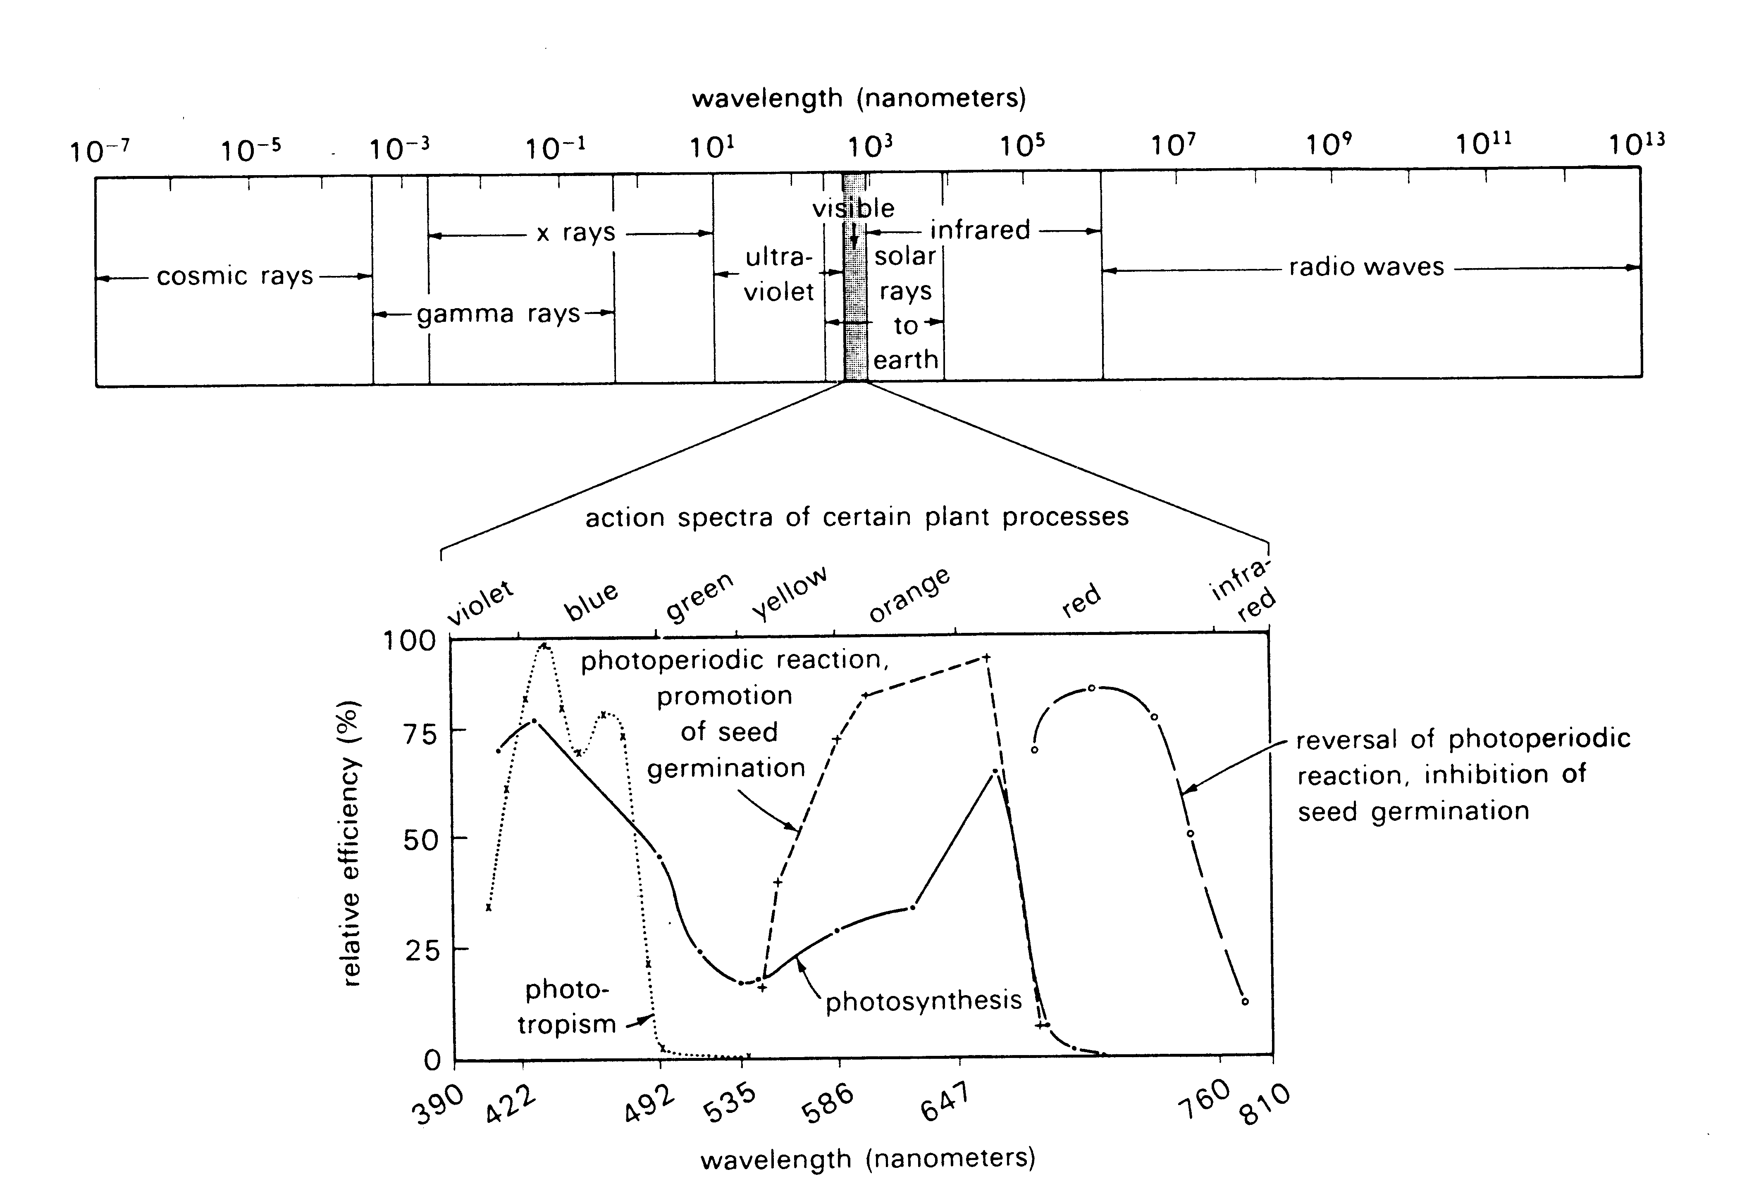
The Electromagnetic Spectrum
Notes:
24. Electromagnetic spectrum. You may recall studying the electromagnetic spectrum in high school biology class. Light energy from the sun is emitted in various wavelengths, ranging from the very short and penetrating cosmic rays to gamma rays, x-rays and ultraviolet rays to the very long radio waves. It is only a narrow band of this electromagnetic spectrum that is visible light. If this visible light is passed through a prism, we find it is broken out into a series of colored wavelengths, ranging from violet on one end to infra-red on the other. Scientists during the middle part of the past century made a very interesting discovery - that plants absorb light primarily in two regions of the visible spectrum - the red area and the blue area (point out peaks on the graph).

Slide 25
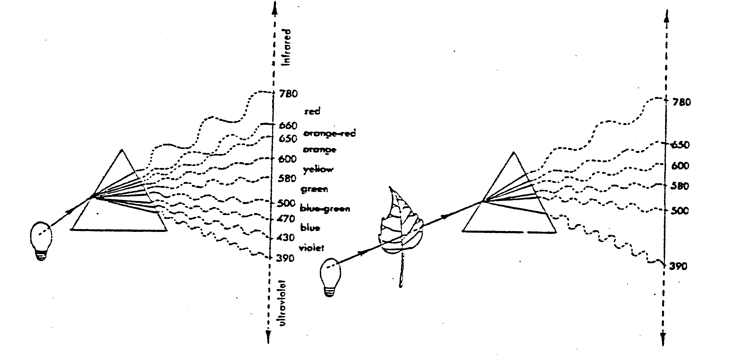
Plants absorb light in two regions
of the visible spectrum:
RED and BLUE
This is the basis for Gro- Lights or
Full-Spectrum Lights for Plants
Notes:
25. Light wavelength absorption. In one study, when light was passed through a leaf, then through a prism, it was observed that the blue and red regions of the spectrum were missing. (#)Therefore, the plants were absorbing these light frequencies. This was a breakthrough discovery because scientists learned that they could enhance growth by giving plants light energy in both the blue and red regions of the spectrum.(#) This was the basis for the development of so-called “plant gro-lights” or “full spectrum lights”. These bulbs are specially manufactured to emit light in both the red and blue regions of the spectrum. On a comparison basis, standard flourescent bulbs emit light primarily in the blue region of the spectrum, while incandescent bulbs emit light primarily in the red region of the spectrum. It’s difficult to grow plants under either of these bulbs alone. Often a combination of the two provide the best growth

Slide 26
Measuring Light Foot Candles (fc)
A foot candle is the amount of light (illuminance) from a standard candle received on a 1 square foot surface that is 1 foot from a candle.
Notes:
26. Measuring light. Today, we use a rather primitive Old English unit to measure light intensity. It’s called a FOOT CANDLE. (#) A foot candle is defined as the unit of light, or illuminance, emitted by a candle on a 1 foot square surface that is 1 foot from a candle.

Slide 27
Plants: 50 to 1,000 ft. candles
Average Light Intensities
for Various Locations
Sunny day - 10,000 fc
Cloudy day - 500-2,000 fc
Conference room - 20-30 fc
Reading in home - 20-30 fc
Stores - 30-100 fc
Church chapels - 5-10 fc
Notes:
27. Various light intensities. On a bright sunny day, light intensity outdoors is in the range of 10,000 foot candles. On a cloudy day, light intensity may be between 500 to 2,000 foot candles. A conference room may be lit with 20 to 30 foot candles of light energy while stores may have 30 to 100 foot candles of light energy. Church chapels are often dimly lit.(#) Plants vary greatly in their light requirement. Most require between 50 and 1,000 ft. candles of light for optimum growth.

Slide 28
Seed Germination
Two 40 watt bulbs placed
6 inches from the seedlings provides 1,000 ft. candles
Notes:
28. Seed germination with light. Generally to geminate seedlings indoors and to prevent the seedling from stretching, at least 1,000 foot candles of light energy are needed. This can be achieved by placing two 40-watt full-spectrum bulbs about 6 inches from the seedlings.

Slide 29
Placement of Medium-light Plants Under Various Lamps for Maximum Growth
Type of lamp | Distance: plant to lamp | Footcandles
Cool white | 11.75 in. | 285
Warm white | 11.75 in. | 285
Gro-Lux Plant Light | 7.88 in. | 130
Mercury (400w) | 4 ft. 11 in. | 300
Incandescent, standard | 11.75 in. | 97
Source: H. M Cathey
Notes:
29. Light levels of various bulbs. Various charts and tables are available which show the level of foot candle energy emitted by different bulbs. This assists flower growers and interior plant managers in determining the distance the bulbs should be from the plants to deliver various light intensities

Slide 30
Recommended Light Intensities for Maintenance and Growth of Selected Foliage Plants (foot candles)
Species | Maintenance | Optimum Growth
Asparagus fern | 100-500 | 200-400
Shefflera | 150-200 | 200-400
Parlor Palm | 50-75 | 75-100
Ty Plant | 75-100 | 100-150
Dracaena marginata | 100-150 | 200⁺
Weeping Fig | 100-150 | 150-400⁺
Boston Fern | 50-100 | 150-200⁺
Notes:
30. Light levels for maintenance vs. optimum growth. Growers of foliage plants have tables available to them that show the light requirements of various plants. The light intensity required for maintenance is lower than that required for optimum growth. Foliage plants produced outdoors in central Florida are usually light acclimated before they are sold by gradually reducing the light level they are provided several weeks before they are sold. This slows their growth and makes them better able to adapt to interior light levels, which are usually much lower than the light levels where they were produced.

Slide 31
Low Light Foliage Plants (50 to 100 fc)
Chinese evergreen
Cast iron plant
Parlor palm
Jade plant
English ivy
Birdnest sansevieria
Snake plant
Bamboo palm
Notes:
31. Low light foliage plants. Foliage plants have been categorized as to whether they require low light, medium light or high light levels. Here are a few foliage plants known to adapt well to low light levels in the range of 50 to 100 ft. candles

Slide 32
Medium Light Foliage Plants
(100 to 200 fc)
Wandering Jew
Rex Begonia
Schefflera
Areca Palm
Dracaena
Weeping Fig
False Aralia
Boston Fern
Philodendron
Aluminum Plant
Spider Plant
Pothos
Nephytis
Christmas Cactus
Notes:
32. Medium light foliage plants. Here are some common foliage plants that require medium light levels, in the range of 100 - to 200 ft. candles for best growth. When provided lower light levels, they grow and flower poorly.

Slide 33
High Light Foliage Plants
(200+ fc)
Zebra Plant
Norfolk Island Pine
Croton
Ti Plant
African Violet
Cactus
Gloxinia
Geranium
Notes:
33. High light foliage plants. A few foliage plants require rather high light intensities, greater than 200 ft. candles, to grow and flower well in interior environments. African violets, for instance, require plenty of bright light, but not direct sunlight, so they are usually placed in a north facing window. Gloxinia and zebra plants are difficult to re-flower unless they are provided light intensities over 200 ft. candles. At lower light levels they will remain vegetative.

Slide 34
Light Adaptability of Woody Ornamentals
Adapted to Shade
Flower Well in Shade
Flower Poorly in Shade
Aucuba
Azalea
Camellia
Cleyera
Gardenia
Hosta
Nandina
Yew
Azalea
Hosta
Camellia
Dogwood
Gardenia
Rose
Clematis
Forsythia
Hydrangea
Hibiscus
Flowering Cherry
Notes:
34. Light requirements of woody ornamentals. Like foliage plants, woody ornamentals vary greatly in their light requirements. (#) Some plants are well adapted to lower light levels of a shaded area and will flower well in the shade, (#) (#)while others flower poorly in shade. This variation in light requirement is genetically determined by the plants evolution in its native environment. That’s why we should always try to approximate the growing conditions of a plants native environment.

Slide 35
Effects of Light on Plants
Very High Light:
Leaves smaller/thicker
Chlorosis (overall yellowing)
Brown Spots
Very Low Light:
Leaves larger/thinner
Greater internode length - stretching
Notes:
35. Light level effect on plants. Light level influences plant morphology. For instance, (#) leaves given high light levels will become smaller and thicker. Chlorosis (yellowing) and brown spots may also occur. A dracaena (corn plant) set outside in direct sun will often develop brown spots on its leaves when moved back inside. (#) Under low light levels leaves become large and thin so they can more efficiently trap light. A classic example is a dogwood tree. When you see dogwoods in their native habitat growing as an under-story plant under taller trees, their leaves will be large and thin and they are arranged in flat planes so they can efficiently trap the filtered sunlight. In full sun, however, dogwood leaves become smaller and thicker and you’ll often notice them pointing downward to escape intense sunlight. Have you heard of shade-cured tobacco? Tobacco grown under shade cloth develops larger and thinner leaves - these supposedly make the best cigars. Still another symptom of too little light is internode stretching. You may have tried to start vegetable transplants indoors in late winter. If they do not receive enough light, the young seedlings will stretch and become spindly. (Suggestion: Collect and show branches from a Dwarf Yaupon Holly - one in the shade and another in the sun. This plant is able to adapt to shade or full sun by changing its leaf morphology - shade leaves will be larger and thinner than those in full sun).

Slide 36
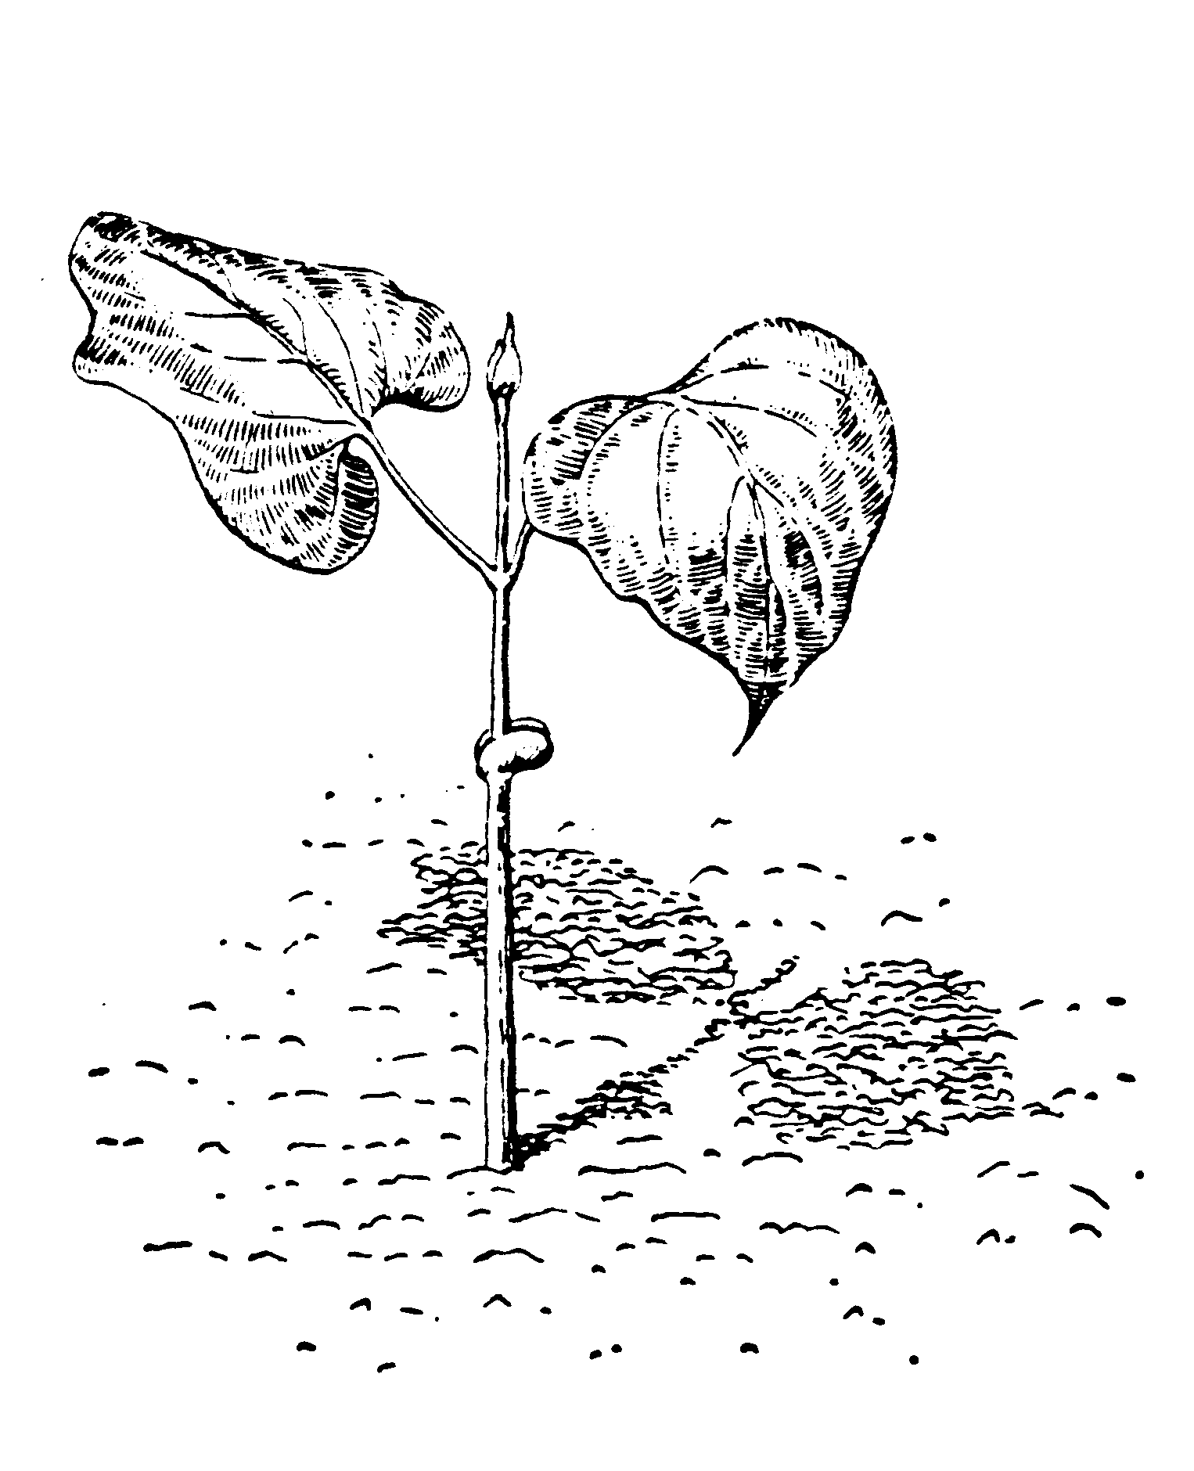
ETIOLATION
Whitish, spindly stems.
Leaves not fully expanded.
Root system develops poorly.
All tissue highly succulent.
Notes:
36. Etiolation. Stretching of seedlings in response to insufficient light is called etiolation. Stems become whitish and spindly, leaves do not fully expand, the root system develops poorly and the tissue becomes very succulent. Increasing light intensity by moving plants to an outdoor greenhouse or hotbed or by providing supplemental light from full-spectrum bulbs will help avoid this problem.

Slide 37
Phototropism
A change in the manner of growth of a plant in response to non-uniform illumination. An auxin-related response causing bending toward the strongest light.
Notes:
37. Phototropism. Now let’s talk about another light effect on plant morphology - PHOTOTROPISM.. (#) Phototropism is the movement of plants in response to a non-uniform moving light source. You may be familiar with the way sunflowers or chrysanthemums tend to rotate their flowers and follow the sun throughout the day. This is phototropism.

Slide 38
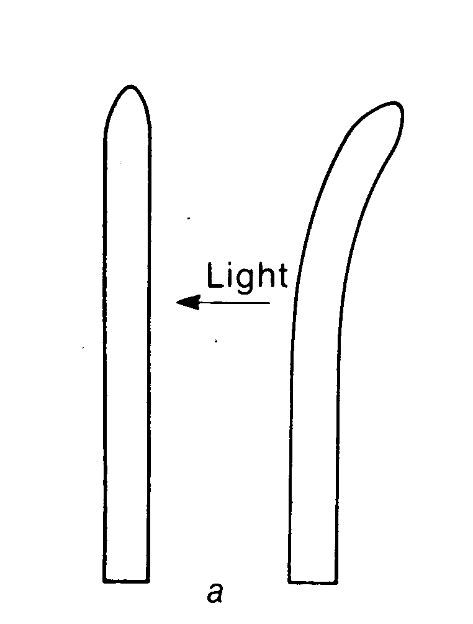
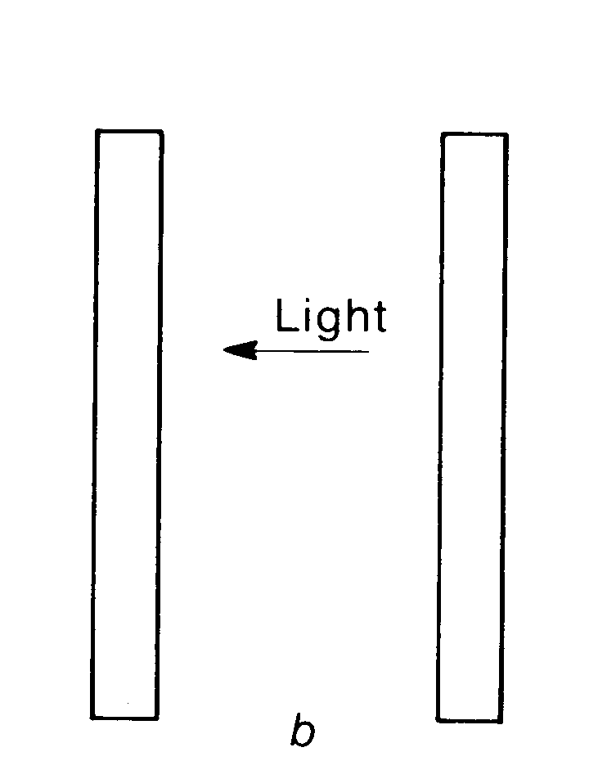
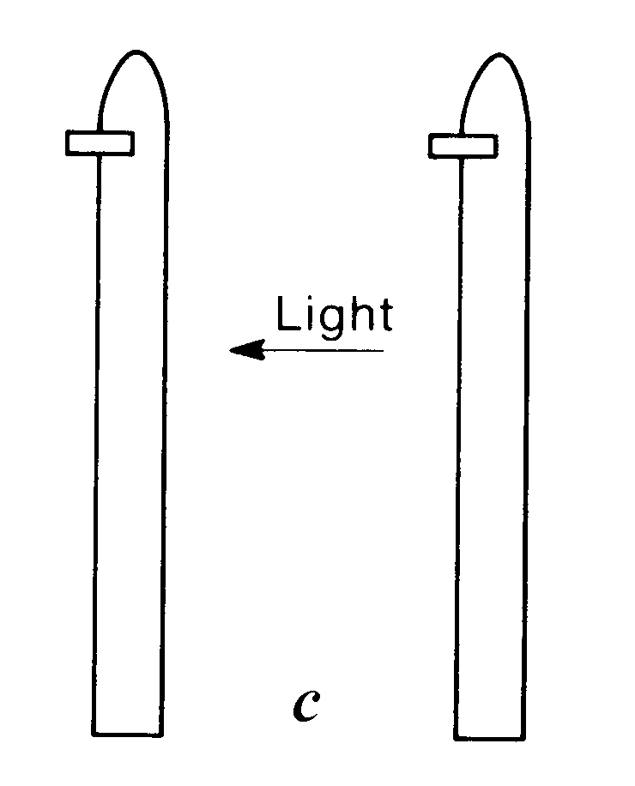
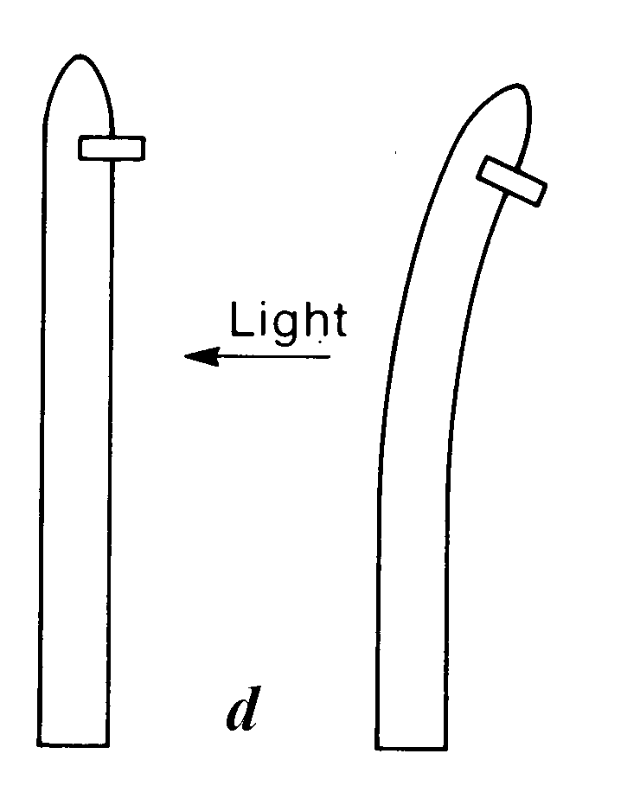
Phototropism: F.W. Went Expt. - 1928
Auxin produced in the tip moves downward on the side of the stem opposite the illuminance, causing cell elongation
Light Receptor
Beta carotene
or Riboflavin
Notes:
38. Phototropism experiment. The mechanism for phototropism was explained by F.W. Went in a 1928 experiment with oat seedlings. (#) He discovered that when oat seedlings were lighted from one direction, they bent toward the light source (#) (a). If he removed the terminal part of the seedling, it did not bend toward the light (b). Therefore, he concluded that there is some sort of stimulus produced in the terminal buds of plants that governs their movement toward light. (#) He next inserted a small mica chip into the stem a short distance back form the tip on the side opposite the light source and found that the seedling would again not bend toward the light (c). (#) However, when the mica chip was inserted into the stem on the side of the light source, it bent toward the light (d). He concluded that there was some stimulus produced in the terminal bud that moved downward in the stem on the side opposite the light source. The stimulus caused the cells along the side of the stem opposite the light source to elongate and push the plant toward the light. (#) It was later discovered that this stimulus was auxin, a natural plant growth hormone produced in the terminal bud of plants. (#) It is thought that the light receptor that drives this reaction is either Beta Carotene or Riboflavin.

Slide 39
Photoperiodism
The response of plants to the
lengths of day or night
Discovered 1906: Garner and Allard Maryland Mammoth Tobacco
In the field: Grew 10 to 15 feet tall –would not flower until late fall or winter
Notes:
39. Photoperiodism. Another light effect that has had a pronounced effect on the floriculture industry is call PHOTOPERIODISM, the response of plants to lengths of day and night. (#) It was discovered in 1906 by Garner and Allard, researchers at the U.S. Agricultural Research Station in Beltsville, MD. (#) They observed that a variety of tobacco, called Maryland Mammoth, flowered only in late fall or winter.

Slide 40
Photoperiodism
In the greenhouse, the tobacco would not flower by changing temperature or fertilizer level or with supplemental lighting.
Discovery:
A dark period 4 pm to 9 am is necessary for flowering.
Notes:
40. Photoperiodism (cont.). They tried to force the plant to flower in a greenhouse by changing the temperature, the amount of fertilizer or by changing light level. But the plant remained vegetative and would not flower. (#)Then they discovered that if they pulled black cloth over the plant at 4 pm in the afternoon and gave it a long period of uninterrupted darkness, it would flower. They concluded that the length of the night influenced floral initiation. This discovery was a major breakthrough for the floriculture industry, because many plants could now be flowered out of season by changing the length of day and night. Soon cook-book formulas were developed for major floriculture crops that showed the critical night length and duration required for floral initiation.

Slide 41
Three Photoperiodic Responses of Plants
Short Day Plants
Long Day Plants
Day Neutral Plants
Notes:
41. Three photoperiodic responses. Plants could now be categorized into three photoperiodic groups: Short day plants, long day plants and day neutral plants

Slide 42
Three Photoperiodic Responses
Short Day Plants: Initiate flower buds when day length is shorter than the critical day length or when the dark period is longer than the critical night length.
Poinsettia
Chrysanthemum
Aster
Goldenrod
Ragweed
Christmas Cactus
Variegated Spider Plant
Notes:
42. Short day plants. Short day plants initiate floral buds when the day length is shorter than some critical minimum and the night length is longer than a critical night length. The night length is most critical. Plants must be provided a period of uninterrupted darkness that exceeds the critical minimum in order to initiate floral organs. (#) Some plants known to be short day or long night plants include poinsettias, chrysanthemums, aster, goldenrod, ragweed, christmas cactus and variegated spider plant.

Slide 43
Three Photoperiodic Responses
Long Day Plants: Initiate flower buds when the day length is longer than the critical day length or when the dark period is shorter than the critical night length.
Hollyhock
Radish
Beets
Spinach
Iris
Red Clover
Notes:
43. Long day plants. Other flowering plants, classified as long-day plants, require a night period of uninterrupted darkness shorter than some critical minimum. (#) Examples are hollyhock, radish, beet, spinach, iris and red clover.

Slide 44
Three Photoperiodic Responses
Day Neutral: Flower over a wide range of photoperiods.
Cabbage Hyacinths
Carrots Daffodils
Tulips Tomatoes
Most woody ornamentals are day neutral
Notes:
44. Day neutral plants. Then there are a number day neutral plants that flower over a wide range of photoperiods. (#) Examples include cabbage, carrots, tulips, hyacinths, daffodils and tomatoes. That’s why you can grow tomatoes in a greenhouse in winter. They flower during the short days of fall and winter as well as the long days of summer, provided temperature is sufficient. The length of the photoperiod has no effect on their flowering and fruiting. (#) Most woody ornamentals are day neutral.

Slide 45
Chrysanthemum: Short Day Plant
Initiate flowers when daylength is 14 hours or less or the length of the dark period is 9 ½ hours or more
9 ½ hours or more
14 ½ hours or less
light
dark
15 hours
9 hours
light
dark
9 hours
15 hours
light
dark
9 hours
7 hours
1 hr.
7 hours
light
dark
light
dark
9 hours
4 hours
1 hr.
10 hours
light
dark
light
dark
10 ft. candles of light = 60 watt bulbs, 4 feet apart, 4 feet above plants
Notes:
45. Chrysanthemum lighting regime. Once the critical night length was determined for our major floriculture crops, growers were provided cook-book production schedules they could use to force plants to flower or to keep them vegetative. For instance, chrysanthemum is a short day plant. It has a critical night length that must equal or exceed 9 ½ hours in order to initiate flower buds. (#) So if it were provided 14 ½ hours of light (#) and 9 ½ hours of darkness, what would it do? (Flower). (#) If it were given 15 hours of light (#) and 9 hours of dark, what would it do? (Remain vegetative because the critical night length is shorter than the critical minimum). What if the plant were given 9 hours of light (#) and 15 hours of dark? (Flower). (#) How about 9 hours of light, (#) 7 hours of dark, (#) 1 hour of light in the middle of the night, (#) then 7 more hours of darkness? (It would remain vegetative because the length of any one dark period was less than the 9 ½ hour critical minimum). (#) Finally, what if the plant were given 9 hours of light, (#) 4 hours of darkness, (#)1 hour of light (#) then 10 hours of darkness? (It would flower because the one dark period exceeds the critical minimum for flower initiation). (#) It was found that as little as 10 foot candles of light flashing for a few brief seconds is enough to interrupt the floral initiation process. (Suggestion: discuss Christmas cactus: They are short day plants - keep them outdoors as long as possible in the fall, then move them into a room where they get no supplemental lighting at night if you want to initiate flower buds. Passing cars or streetlights can interrupt the flowering response. Once flower buds are initiated, you can move the plant into other rooms of the house where it is lighted at night, because the supplemental light will not inhibit flowering once the buds are set).

Slide 46
Effect of Light on Seed Germination
Common Name
Lettuce
Ageratum
Coleus
Dusty Miller
Gomphrena
Pansy
Petunia
Snapdragon
Light Requirement
Light
Light
Light
Dark
Dark
Dark
Light
Light
Notes:
46. Light effect on seed germination. Still another effect on light on plants occurs during seed germination. Some seeds require light to germinate while others require darkness. Lettuce seed, for instance, requires light for best germination, so it is barely covered with soil when planted. Pansy seed, on the other hand, requires darkness for germination, so it is best to cover the seeding flat with a moist folded newspaper to block out light while the seeds geminate. Once the seeds germinate, remove the newspaper and provide the seedlings normal light levels. This light response, like others, is genetically determined. Most seed catalogs and seed packets list the light requirement of seeds during germination. For best results, know whether the seed you purchase requires light or darkness for germination.

Slide 47
Notes:
47. Let’s take a break. Now we come to your favorite part of today’s program

Slide 48
Temperature
Governs the rate of photosynthesis and respiration.
Influences fall color - sugars to starch, chlorophyll ceases function and carotenoids (orange) and anthocyanins (red) become evident.
Influences leaf fall and dormancy.
Influences fruiting plants. Many horticultural plants have a cold or chilling requirement. (peaches 350-1200 hours below 45 degrees F).
Influences hardiness (flowers<roots<leaves<stems).
Notes:
48. Environmental Effects on Plant Growth: Temperature Now let’s discuss another environmental factor that has a pronounced effect on plant physiology and plant growth - Temperature.
Temperature .............. (read list).(#)(#)(#)(#)(#)

Slide 49
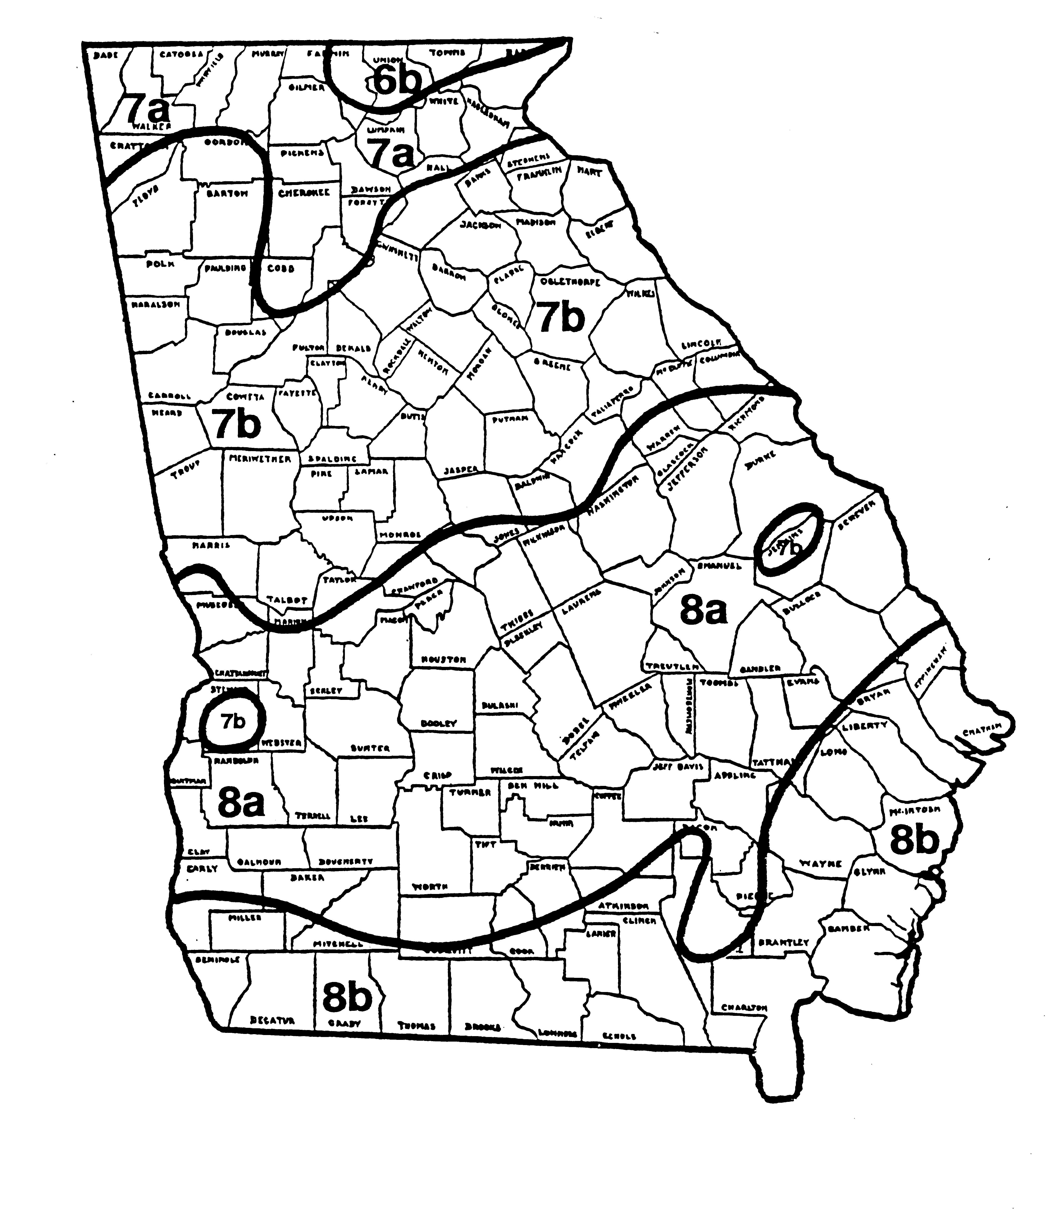
Plant Hardiness Zones
Range of Average Annual Minimum Temperatures for Each Zone
Zone Range in Degrees F
6b 0 to –5
7a 5 to 0
7b 10 to 5
8a 15 to 10
8b 20 to 15
Notes:
49. Cold Hardiness Map. Temperature influences the cold hardiness of a plant and its ability to withstand the average minimum temperature of a region. Although winter hardiness is genetically determined, it is influenced by the duration of cool temperatures. Cool temperatures also acclimate plants and prepare them for winter dormancy. Many woody plants, for example, need 2 to 4 weeks of cool temperatures to achieve maximum hardiness. This chart shows the cold hardiness zones of Georgia, based on the average minimum temperature in a region. You should not attempt to grow plants rated for hardiness zone 8 in zone 7 because they often will be damaged or killed by winter cold. Zone 6 plants are fine for zone 7, provided they are also heat hardy and adapted to the soils of the area. Most good plant books list the most northern cold hardiness zone recommended for the species described.

Slide 50
Root Killing Temp. of Selected Landscape Plants
Species
Southern Magnolia
Flowering Dogwood
Boxwood
Japanese Andromeda
Horizontal Juniper
ºF
23
20
15
10
0
Notes:
50. Root Hardiness. Roots do not go dormant like the top and do not become cold hardy. They continue to grow all winter long. This is of particular concern to growers of container ornamentals. During the cold winter months, nurserymen will jam containers together and put a border row of pots filled with sand along the perimeter to help shield the roots from freezing temperatures. Garden center managers will often bury pots in piles of sawdust for extra protection. Some growers cover entire blocks of plants with white plastic to protect them from freezing. This chart shows the root killing temperatures for several of our common ornamental plants. Fortunately, our soils in the South seldom freeze due to their large mass, but when roots are above ground in containers, they are most vulnerable to freeze injury

Slide 51
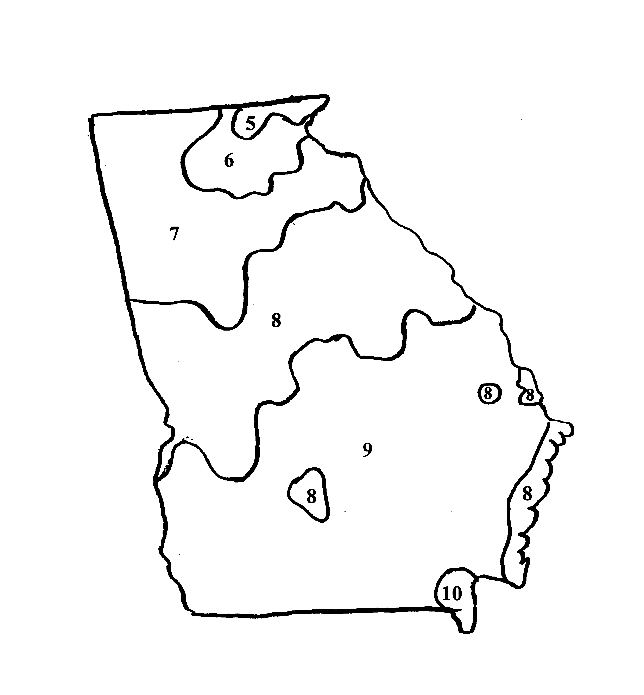
Heat Zone Map For Georgia
Ave. no. of days per year above
86 degrees F
Zone Ave. No. Days
5 30 – 45
6 45 – 60
7 69 – 90
8 90 – 120
9 120 - 150
Notes:
51. Heat Hardiness Map. Recently, a heat zone map has been developed for the U.S. based on historical data and number of days above 86 ºF. in various regions. Heat hardiness helps us determine how far south a particularly plant species will grow. An example is Colorado Blue Spruce. This plant is extremely cold hardy, but the north Georgia mountains are the southern limit of its heat hardiness. So heat zones, although adding confusion to the plant selection process, will ultimately help us fine tune our plant selections for each region of the country

Slide 52
Heat-Zone Map of U.S. Full –color Poster - $14.95 each Available from:
American Horticultural Society
Gardener’s Information Service
7931 Boulevard Dr.
Alexandria, VA 22305-1300
www.ahs.org
Notes:
52. Heat Zone Wall Chart. You can obtain a copy of the heat zone map for the U.S. from the American Horticulture Society in Alexandria, VA. It can also be downloaded from their web site at www.ahs.org

Slide 53
Water The lifeblood of plants Water is essential for:
Chemical reactions in the plant
Translocation of nutrients
Transpiration
Notes:
53. Environmental Effects on Plant Growth: Water - the lifeblood of plants. Now let’s move on to a discussion of another major environmental factor that influences plant physiology and plant growth - WATER. Water has many functions in the plant. (#)It is the substance in which most chemical reactions take place. (#) It is responsible for the translocation of nutrients and food substances within the plant, (#)and it helps cool the plant via transpiration. Just as we perspire, plants transpire moisture through their leaf surfaces. Moisture cools the plant as it evaporates from the leaf surfaces.

Slide 54
Water The lifeblood of plants
Land plants require about 400 pounds of water for each pound of dry matter processed.
An apple tree needs 50 gallons of water per bushel of apples.
Fresh apple =84% water
Banana=75% water
Peach=87% water
Notes:
54. Amount of water in plants. Water is a major component of plants. It’s estimated that land plants require about 400 lbs. of water for each pound of dry matter they produce. (#)An apple tree needs about 50 gallons of water for each bushel of apples it produces. (#) In fact, fruit are largely water: an apple is about 84% water, a banana 75% water and a peach 87% water.

Slide 55
Rates of Water Loss per Day in Mid-summer
Plant
A single corn plant
A single giant ragweed plant
A single young 10-ft apple tree
A 12-foot columnar cactus
A coconut palm in moist tropics
A date palm in a desert oasis
Water Loss (in quarts)
3-4
6-7
10-20
0.02
70-80
400-500
Notes:
55. Water loss from plants. Plants vary tremendously in the amounts of water they funnel through their systems each day. Here are some estimated daily water use figures for various plants on a mid-summer day. Temperature, of course, influences the rate of water loss

Slide 56
Estimated Water Losses from Single Plants During a Growing Season
Plant | Days | Water Loss (Gallons)
Tomato | 100 | 30
Corn | 100 | 50
Sunflower | 90 | 125
Giant ragweed | 90 | 140
Mature apple tree | 188 | 1,800
Coconut palm, moist tropics | 365 | 4,200
Date palm | 365 | 35,000
Notes:
56. Water loss from plants. Plants vary tremendously in the amounts of water they funnel through their systems each day. Here are some estimated daily water use figures for various plants on a mid-summer day. Temperature, of course, influences the rate of water loss

Slide 57
Water Movement in Plants
How does water reach the top of our
tallest trees?
Root pressure – not found in many species.
In those species where it has been found, only enough pressure has been measured
to push water to a height of 64 feet.
Notes:
57. Water movement up a tall tree. Have you every wondered how water moves to the top of some of our tallest trees, like the Sequoias or Redwoods of California? (#) Root pressure has not been found in many tree species, and in those it has been found, only enough pressure has been measured to push water to a height of 64 feet

Slide 58
Water Movement in Plants
Water is pulled up in the xylem by a transpiration-cohesion-tension mechanism.
Transpirational loss of water causes additional water to be pulled up through the xylem to replace the water lost.
Notes:
58. Transpiration-Cohesion-Tension. The fact is that water isn’t pumped up in a tree, it’s pulled up in the plant via a transpiration-cohesion-tension mechanism. As transpiration occurs and water is lost, additional water is pulled upward through the xylem to the plant part where transpiration is occurring. This may be developing leaves, fruit, flowers or stems.

Slide 59
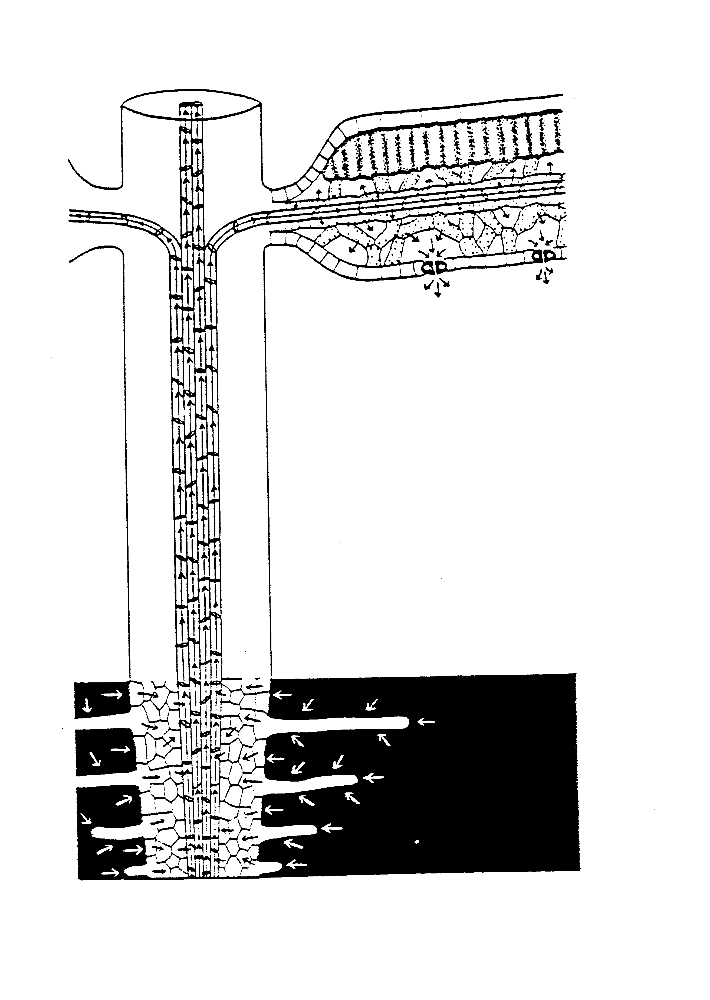
Transpiraton
Cohesion/Tension
Water is pulled upward in the plant by a vapor pressure deficit established through the transpiration of water from the leaves.
o
o
H
H
H
Notes:
59. (#)Transpiration Cohesion/Tension. Water molecules tend to cohere or link together to form long chains. As transpiration occurs, the remaining water molecules near the site of transpiration are placed under increased tension. This establishes a vapor pressure deficit within the plant and pulls additional water upward to relieve the tension.

Slide 60
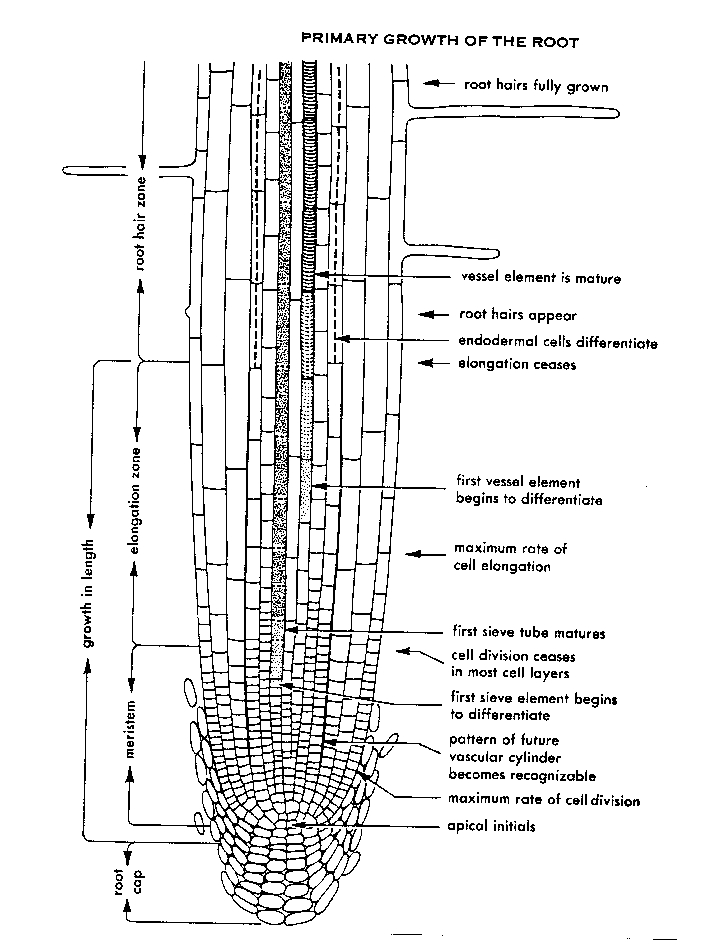
Water moves into the plant via intercellular spaces between the root cells. It then moves into the vessel elements of the Xylem and is pulled upward in the plant
Notes:
60. Diagram of the root. Water moves into the root through the intercellular spaces between the root cells. The fine, white roots growing from the primary and secondary roots most actively absorb water and nutrients. Root hairs tend to anchor the plant and are not principally responsible for water absorption. The water moves into the internal portion of the root, called the Xylem. In old woody plants, the xylem is simply dead cells called vessel elements that serve as the duct system through which the water moves. As water moves inward, it transports with it nutrient elements that are involved in food production and in all sorts of chemical reactions in the plant.

Slide 61
Sixteen Essential Nutrients
for Plant Growth
Atmospheric Nutrients
C - Carbon H – Hydrogen
O - Oxygen
Primary Nutrients
N – Nitrogen P – Phosphorus
K - Potassium
Secondary Nutrients
Ca – Calcium Mg - Magnesium
S - Sulphur
Micro Nutrients
Fe – Iron Cu – Copper Zn – Zinc B – Boron
Mn – Manganese Mo – Molybdenum Cl - Chlorine
Notes:
61. Environmental Effects on Plant Growth: Nutrient Elements-Sixteen essential nutrients for plant growth. The last environmental influence on plant physiology and plant growth and development that we will discuss in this session is the nutrient content of the soil. There are sixteen elements known to be essential for plant growth. (#) These include the atmospheric elements - carbon, hydrogen and oxygen; (#) the primary plant nutrients - nitrogen, phosphorous and potassium; (#) the secondary plant nutrients - calcium, magnesium and sulfur; (#) and the minor or micro-nutrients required in small quantities but still essential. These include iron, copper, zinc, boron, manganese, molybdenum and boron. All of these sixteen nutrients are essential for some life process in the plant, and no other nutrient element can substitute for them. Each plays a unique role in the life processes of the plant.

Slide 62
Each Nutrient Has An Important Function In Plants
Nitrogen
An essential component of proteins, amino acids, chlorophyll and many other organic compounds
Phosphorus
A component of phosphorylated sugars (ATP, DPM, DNA)
Sulphur
A component of proteins and many other substances
Notes:
62. Nutrient function: (#) Nitrogen, for instance, is an essential component of proteins, amino acids, chlorophyll and many organic acids. (#) Phosphorous is heavily involved in the energy producing compounds in the plant and it plays an important role in DNA manufacturer. (#) Sulfur is a component of many proteins and other organic compounds.

Slide 63
Each Nutrient Has An Important Function In Plants
Calcium
Necessary in calcium pectate in cell walls
Iron
A constituent of important enzymes
Magnesium
A part of the chlorophyll molecule
Trace or minor elements are essential in many chemical reactions
Notes:
63. Nutrient function (cont.). (#) Without calcium the plant would not be able to stand upright. Calcium is a key player in calcium pectate formation which makes cell walls rigid and strong. (#) Iron is a component of many enzymes that drive chemical reactions, and magnesium is a component of the chlorophyll molecule. (#) Without magnesium, there would be no chlorophyll to drive photosynthesis. (#) Each of the trace elements also serves some essential function in various chemical reactions within the plant. When one of the trace elements is deficient, the plant often becomes anemic looking.

Slide 64
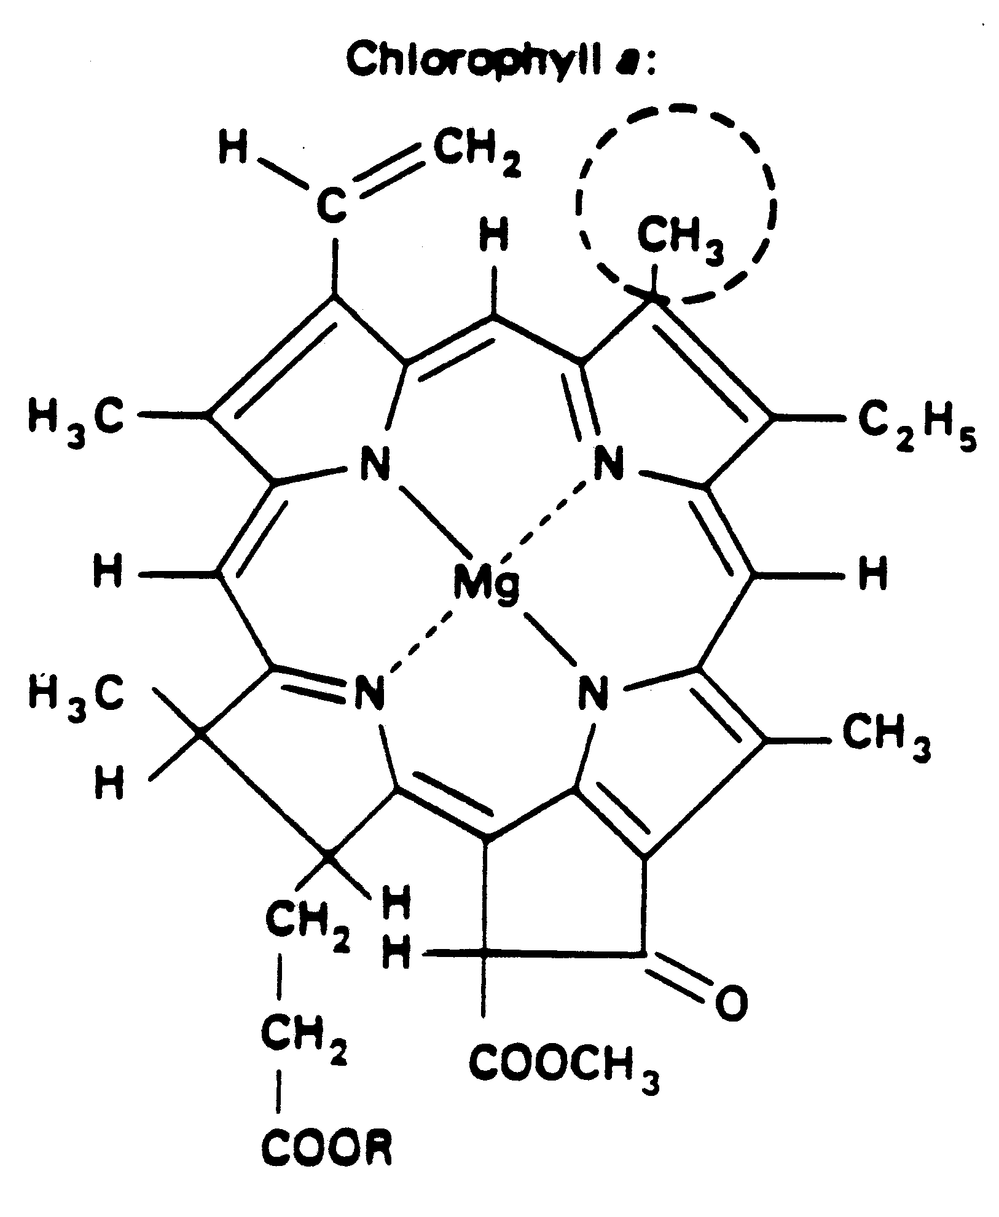
The Chlorophyll Molecule
Notes:
64. The chlorophyll molecule. This is the chemical structure of the chlorophyll molecule. Note the key role magnesium plays in the formation of this molecule. Nitrogen, carbon, hydrogen and oxygen are also key ingredients of this important molecule. Much of the hydrogen and oxygen comes from water, and much of the carbon comes from atmospheric CO₂.

Slide 65
Forms of Elements Used By Plants
Nitrogen
Phosphorus
Potassium
Iron
Molybdenum
Manganese
Copper
Carbon
NH4⁺, NO2⁻, NO₃⁻
HPO₄⁻⁻. H₂PO₄⁻
K⁺
Fe⁺⁺, Fe⁺⁺⁺
MoO₄⁻⁻
Mn⁺⁺, Mn⁺⁺⁺⁺
Cu⁺, Cu⁺⁺
CO₃⁻⁻, HCO₃⁻
Notes:
65. Forms of nutrient elements absorbed by plants. Nutrient elements are held in the soil and soil solution in combination with other elements, such as hydrogen and oxygen. These complexes are called “ions”. Some ions are positively charged while others are negatively charged. Some nutrient elements move directly into the plant, while others are absorbed as ionic complexes

Slide 66
Forms of Elements Used By Plants
Calcium
Magnesium
Sulfur
Zinc
Boron
Chlorine
Water
Ca⁺⁺
Mg⁺⁺
SO₃⁻⁻, SO₄⁻⁻
Zn⁺⁺
BO₃⁻⁻⁻
Cl⁻
H⁺, OH⁻
Notes:
66. Forms of nutrient elements absorbed by plants (cont.). The rate of movement of nutrient elements into the plant are influenced by a number of factors, including their availability in the soil solution, how tightly they might be held by the soil particles and the pH of the soil

Slide 67
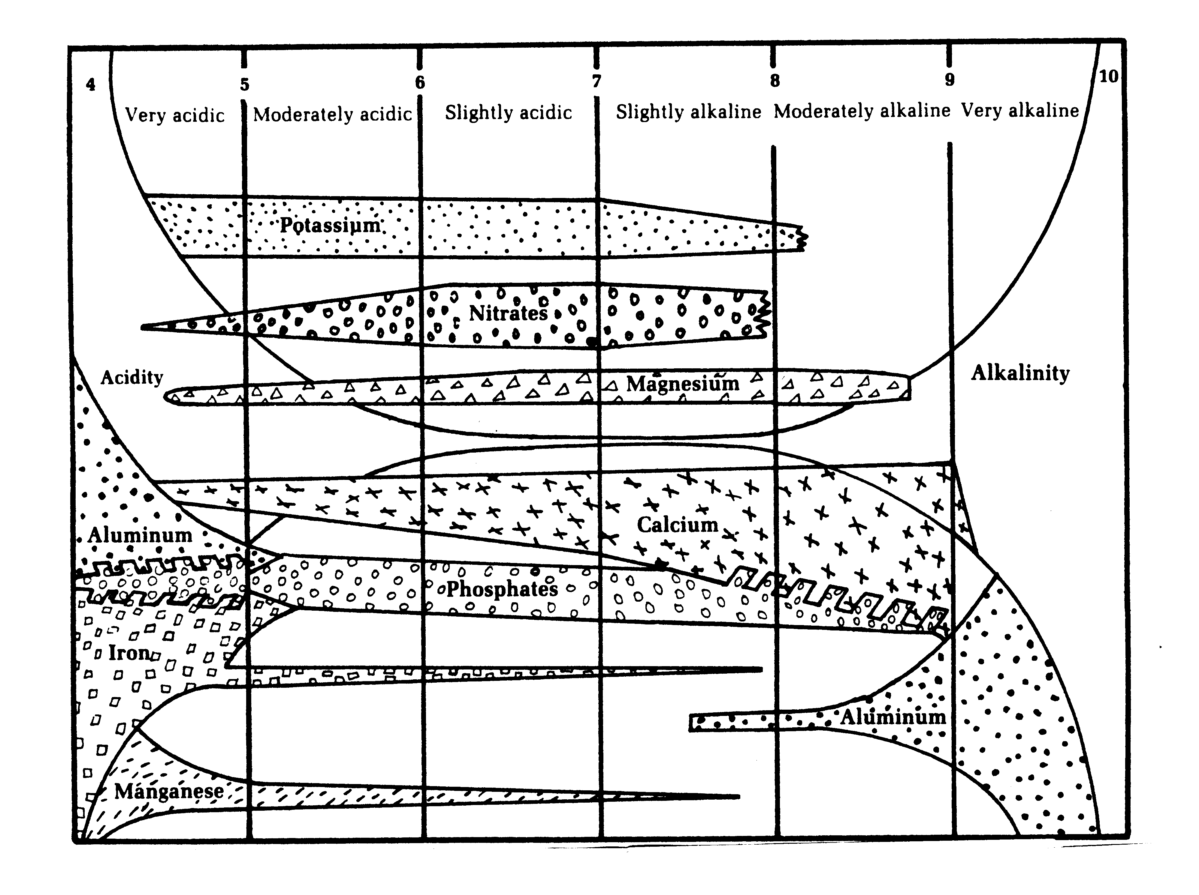
pH Effect on Nutrient Availability
Notes:
67. Soil pH effect on nutrient availability. Soil pH has a pronounced effect on nutrient availability in the soil solution. (#)(#) The greatest number of essential nutrients are available at a pH range between 5.2 and 6.5. Above and below this range, some nutrients may be tightly held by the soil particles and rendered unavailable to the plant. Look at iron and manganese, for instance. These nutrients are likely to be deficient in the plant when the soil pH rises above 6.5. At a pH above 8.0, many minor nutrients become deficient while aluminum may reach toxic levels.

Slide 68
Let’s Put
it All
Together
Notes:
68. Putting it all together. Now let’s summarize today’s program by putting it all together.(#)(#)

Slide 69
Water and nutrients move into the plant primarily through the intercellular spaces between the root cells. They move into the internal vascular system called the xylem and are pulled upward in the plant via cohesion and tension resulting from transpirational water loss through the stomata.
Water and nutrients take part in the food manufacturing process during respiration. Photosynthesis produces the energy for this to occur.
Notes:
69. Summary. Read statements and ask if there are any questions

Slide 70
Growth substances, such as amino acids, proteins and oils, are transported to other areas of the plant (ie. developing fruit, flowers, leaves or roots) via the phloem.
Carbon dioxide, oxygen and water vapor move in and out of the plant via the stomata or breathing structures on the leaves.
Light and temperature have a pronounced effect on the rate of photosysthesis and respiration.
Notes:
70. Summary. Read statements and ask for questions.

Slide 71
Please Answer the Following Questions
The pigment responsible for photosynthesis is ____________.
The catalyst for photosynthesis is _______.
Arrange the following to describe photosynthesis:
Water, Carbohydrates, Light, Oxygen, Energy, Carbon Dioxide
The process by which carbohydrates are broken down and combined with nutrient elements to form growth substances is called ___________.
Describe two symptoms of insufficient light on plants.
Notes:
71. Post-test. Now let’s test your recall by answering the following questions. (Your option as to whether you want participants to record their answers on paper of simply responding as a group to each question). Read each question and ask for a response.
Answers:
1. Chlorophyll
2. Light
3. Water, carbon dioxide, light, carbohydrates, oxygen, energy.
4. Amino acids, proteins
5. Respiration
6. Internode stretching, spindly, succulent growth, large leaves, thin leaves

Slide 72
6. Poinsettias require a long night period in order to initiate flowers. They are referred to as _____ ______ plants.
7. What is the unit used to measure light?
8. In what regions of the visible spectrum do plants absorb light most efficiently?
9. What are full-spectrum light bulbs?
10. Define the following:
Phototropism
Photoperiodism
11. Define etiolation.
12. Water enters the plant primarily through the ______.
Notes:
72. Post-Test.
7. Short day
8. Foot candle
9. Red and blue
10. Phototropism: the bending toward light
Photoperiodium: the effect of night length on floral initiation.
11. A low-light response resulting in smaller leaves, weak stems and internode stretching.
12. Root hairs

Slide 73
Water and nutrients move within the plant via the ______ while growth substances move via the _______.
14. The loss of water through the leaves is called __________.
15. List two functions of water in plants.
16. How does water move to the top of a tree 250 feet tall?
What is the most desirable pH range for ornamental plants? Why?
List three primary nutrients:
List one secondary nutrient:
List three micronutrients:
Notes:
73. Post-test.
13. Xylem, phloem
14. Transpiration
15. Takes part in chemical reactions, transports nutrients, cools the plant via transpiration.
16. Pulled up via diffusion pressure deficit established when water vapor is lost through the stomata.
17. 5.2 to 6.5
18. Primary: N, P, K
Secondary: Ca, Mg, S
Micro: Fe, Mn, Mo, B. Cl, Zn, Cu

Slide 74
Define plant hardiness.
20. In what hardiness zone do you live?
Notes:
74. Post-test.
19. The ability of a plant to adapt to temperature extremes in a geographical area, including winter cold and summer heat.
20. Zone may vary by location of training

Slide 75
Trade Papers
and
Check Your
Answers
Notes:
75. Answers

Slide 76
Answers
1. The pigment responsible for photosynthesis is
chlorophyll
2. The catalyst for photosynthesis is
light
3. Arrange the following to describe photosynthesis:
Water, Carbohydrates, Light, Oxygen, Energy, Carbon Dioxide
Carbon Dioxide, Water, Light, Carbohydrates, Oxygen, Energy
4. The process by which carbohydrates are broken down and combined with nutrient elements to form plant growth substances is called
respiration
Notes:
76. Post-test. Now let’s test your recall by answering the following questions. (Your option as to whether you want participants to record their answers on paper of simply responding as a group to each question). Read each question and ask for a response.
Answers:
1. Chlorophyll
2. Light
3. Water, carbon dioxide, light, carbohydrates, oxygen, energy.
4. Respiration

Slide 77
5. Describe two symptoms of insufficient light on plants.
Thinner leaves, larger leaves, internode stretching
Poinsettias require a long night period in order to
initiate flowers They are referred to as plants.
short day
7. What is the unit used to measure light?
Foot candle
8. In what regions of the visible spectrum do
plants absorb light most efficiently?
red and blue
9. What are full-spectrum light bulbs?
Bulbs that emit light in the red and blue regions of the
spectrum
Notes:
77. Post-Test.
5. Thinner leaves, larger leaves, internode stretching
6. Short day
7. Foot candle
8. Red and blue
9. Bulbs that emit light in the red and blue regions of the spectrum

Slide 78
10. Define the following:
Phototropism: the bending of plants toward light
Photoperiodism: the flowering response of plants to the length of the dark period
11. Define etiolation.
Internode stretching due to insufficient light
12. Water enters the plant primarily through the
intercellular spaces between the root cells
Water and nutrients move within the plant via the
xylem
while growth substances move via the
phloem
Notes:
78. Post-test.
10. Phototropism: the bending toward light
Photoperiodism: the effect of night length on floral initiation.
11. A low-light response resulting in smaller leaves, weak stems and internode stretching.
12. intercellular spaces between the root cells
13. Xylem, phloem

Slide 79
14. The loss of water through the leaves is called
transpiration
15. List two functions of water in plants.
Involved in chemical reactions, transports nutrients
16. How does water move to the top of a tree 250 feet tall?
It is pulled upward in the plant to replace water that is transpired
What is the most desirable pH range for ornamental plants? Why?
5.2 to 6.5 because the widest range of nutrients are available in this range
Notes:
79. Post-test.
14. Transpiration
15. Takes part in chemical reactions, transports nutrients, cools the plant via transpiration.
16. Pulled up via diffusion pressure deficit established when water vapor is lost through the stomata.
17. 5.2 to 6.5

Slide 80
18. List three primary nutrients:
nitrogen, phosphorous, potassium
List one secondary nutrient:
calcium
List three micronutrients:
iron, manganese, zinc
Define plant hardiness.
The ability of a plant to adapt to temperature extremes in a region
20. In what hardiness zone do you live?
Many possible answers
Notes:
80. Post-test.
18. Primary: N, P, K
Secondary: Ca, Mg, S
Micro: Fe, Mn, Mo, B. Cl, Zn, Cu
19. The ability of a plant to adapt to temperature extremes in a region
20. (Many possible answers)

Slide 81
Author:
Dr. Gary L. Wade
Extension Horticulturist
The University of Georgia
College of Agricultural
and Environmental Sciences
Special appreciation to Sharlys Crisafulli ,
Clarke County Master Gardener, for helping edit and
format this presentation
Notes:
81. Credit slide

