Slide 1
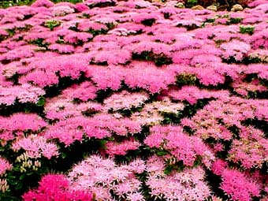
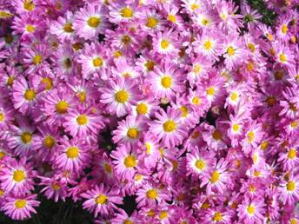
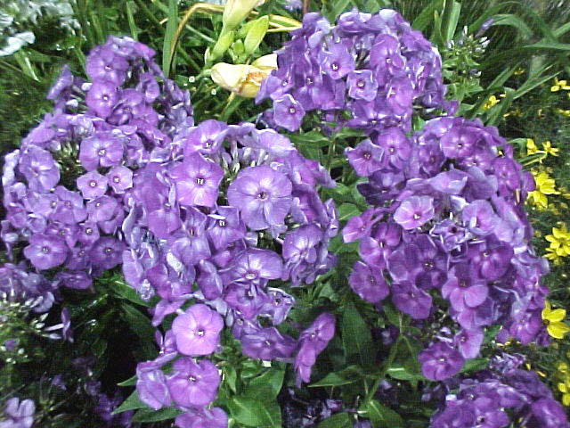
Part 2: Perennials For Georgia Gardens
Paul A. Thomas and Bodie V. Pennisi
The University of Georgia
College Of Agricultural and Environmental Sciences
Department of Horticulture
Notes:
Note to the presenter: We are providing an exceptionally long set of PowerPoint slides. The presenter should review the slide set, download it on a computer, and reduce the program to the time period allotted. This gives Agents, speakers, and others who are using this material the ability to customize the type of plants and scope of the talk. This program is designed to be interactive. By this we mean that the participants in the classroom are expected to share their own gardening experiences with the presenter, and each other, as the talk progresses. This is why we list the cultural aspects in a list on the slide. This talk will quickly become a very boring review of one flower after another if the speaker just reads the slides and does not allow experiences to be shared. Involve your audience! Most, if not all, of your student gardeners have experience in this area. A word of caution, the presenter must act as mediator and make sure that the length of question/answer time does not interfere with the overall schedule. Alternatively, questions and comments may be reserved for the end of the lecture and addressed as time permits.
The presenter should review this text, then review the “terms” provided on the slides with the audience to be sure everyone understand the ‘jargon’. Proceed to the script entries provided for the flower slides which contains tips and specific suggestions for each recommended plant. The reviewer should quickly mention these points and then ask the audience to share their experiences growing that specimen. Encourage participants to keep comments short and to the point. This is a two-hour program on perennials (one minute per slide average).

Slide 2
Terms To Review
Perennial: A plant which completes its life cycle in two or more years and can withstand both summer and winter conditions.
Tender Perennial: Tender perennials are annuals which happens to over-winter. This definition is very weather dependent. Some tender perennials are annuals 7 out of 10 years!
Annual: A plant which completes its life cycle in less than one year. Annuals are unable to withstand both summer’s heat and winter’s cold.
Notes:
Review Terms: On Slide

Slide 3
Terms To Review
Pinch at Transplant: Removal of top ¼ inch (+flowers) of the terminal growth. This promotes early branching and yields a very nice looking perennial.
Inconspicuous Bloom: Blooms not seen, are very small or are unimportant. Usually these plants are selected for their foliage or form.
Drought-Tolerant: Plant recovers and continues to grow and blooms after prolonged drought.
Notes:
Review Terms: On Slide

Slide 4
Terms To Review
Biennial: A plant which completes its life cycle in two years, etc. Usually requires one winter season.
Deer Resistant: A plant not preferred by deer. However, in drought, there are no guarantees. Desperate deer will eat almost any plant.
Bloom Period: An average time for the appearance of blooms. This is strongly affected by weather, light levels and soil conditions.
Notes:
Review Terms: On Slide

Slide 5
Terms To Review
Dead-heading: Removal of spent flowers before seed develops. Usually allows additional flowers to form and bloom.
Random Seeding: Seeds randomly broadcast on an open, prepared seed bed in fall or spring,
Light Requirement: Sun, partial shade, shade: Light requirements are fairly stringent for perennials. For best performance and flowering, choose the brightest light acceptable for that species.
Notes:
Review Terms: On Slide

Slide 6
Fertility Terms To Review
Low One application of 1 lb of 10-10-10/100 sq. ft. at transplant or before spring regrowth. Best for early spring flowering perennials or aggressive species.
Moderate Two applications of 1 lb of 10-10-10/100 sq. ft. per season. Once at transplant or in early spring, and once mid- season followed by significant irrigation.
Heavy Three /four applications of 1 lb of 10-10-10/100 sq. ft.
per season. At transplant or early spring, then 3 - 4 week intervals. Best for late blooming perennials, and vines that grow all summer, or groundcover-like perennials that you intend to have spread quickly. Water in thoroughly!
Notes:
Review Terms: On Slide

Slide 7
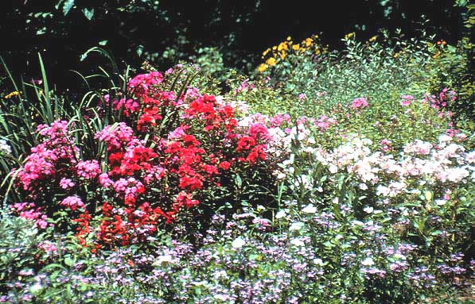
Pre-Planning An Installation
Is Essential For Perennials
Notes:
Pre-planning An Installation Is Essential For Success

Slide 8
Perennials Are Complex
Know the size of the plant!
Know the plant’s pH preference
Know the pests and diseases
Know the life-span of the plant
Know the bloom period
Notes:
Perennials Are Complex: Preplanning is the key to success when designing and installing a perennial bed. Know your plant’s requirements. Knowing the final size your perennial will assume can prevent disappointments should a vigorous plant overtake less vigorous specimens.
Knowing the soil type preference and the pH requirements for your perennial will assure the likelihood of survival year after year. Knowing pests and disease tendencies will help you plan for problems that may arise in the future or may allow you to avoid disease prone specimens.
Knowing the life span will help you plan replacements and establish where the plant will be placed. Most long-lived plants will be placed towards the back and side of the garden, or in the middle, so as to allow replacement of less long-lived specimens without disturbing the more permanent specimens. Knowing the bloom period is essential to planning a continuous bloom sequence. Careful choices of species and hybrids can assure the gardener a season-long color display.

Slide 9
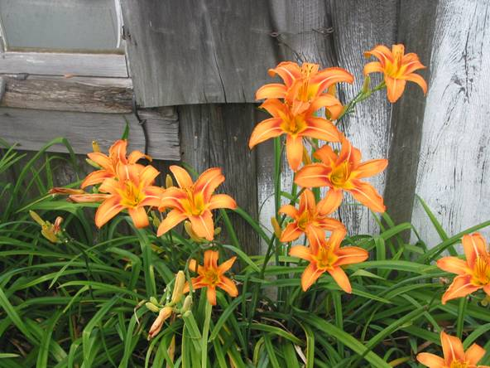
Fall Is For Planting!
Notes:
Fall Is For Planting: There are many reasons for planting in the fall. The most important reason is to give the new plants a chance to develop a great root system in the absence of high temperatures and evaporation rates. This may take several months, and by having this occur in the winter months, the plant is not stressed, and a well-developed root system will be better able to withstand dry periods and times of high water loss due to high evaporation in summer.

Slide 10
Evaporation Rates For Athens
*Average from 1953 to 1992
**Average from 1971 to 1992
Start Here!
Evaporative Water Loss - Inches
*
**
Notes:
Evaporation Chart: In Georgia, summer evaporation rates can be quite high and newly planted perennials may not be able to keep up with the heavy water demand. This may also cause a homeowner to use much more water than is necessary in a well-planned perennial planting. Note how the evaporation rates, and hence the water demand, drops off in October. This is the best time to plant!

Slide 11
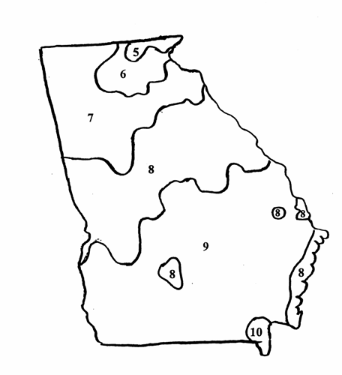
^{Heat Zone Map For Georgia}
^{Days above 90oF.}
^{Zone Ave. No. Days}
^{5 30 – 45}
^{6 45 – 60}
^{7 69 – 90}
^{8 90 – 120}
^{9 120 – 150}
^{10 150 – 175}
Notes:
Heat Zone Map: Some perennials are very sensitive to our long, summer heat waves. The USDA heat zone map gives a ranking of the amount of summer heat different regions of the U.S experience. As new publications become available, perennials will be listed with a heat tolerance code, similar to the USDA cold hardiness map zone codes.

Slide 12
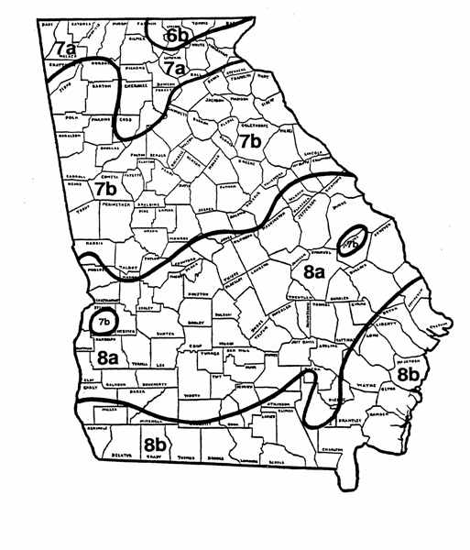
^{Cold} ^{Hardiness Zones}
Range of Average Annual Minimum Temperatures for Each Zone
^{Zone Range in Degrees F}
^{6b 0 to –5}
^{7a 5 to 0}
^{7b 10 to 5}
^{8a 15 to 10}
^{8b 20 to 15}
Notes:
Cold Hardiness Map: The Cold Hardiness Zone map defines areas of the U.S. by how cold they become. This guide is important in that it will help you select perennials that are tolerant of the amount of cold in your region. Most gardening books list the hardiness zones a given perennial will live in and successfully over-winter.

Slide 13
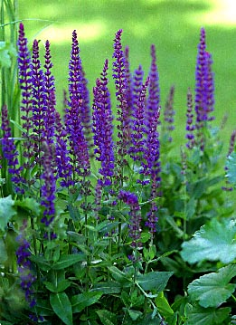
Soil Testing
Most perennials
prefer a soil pH
between 5.2 and 6.7
and a well drained
soil. Organic matter
is often added to
accomplish both
objectives.
Notes:
Soil Testing: Since perennials are expected to live in a certain area for a few years, it is very important to be sure the soil is amended to fit the needs of the plant. In addition to organic matter, pay attention to the pH of the soil. Too high or too low of a soil pH may affect nutrient uptake, stress the plant, and reduce the plant’s chances of surviving more than one year.

Slide 14
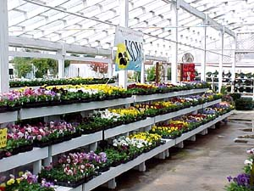
Select Plants Carefully
When You Buy
Overall Condition
Check Roots/
Buds/Flowers
Scout For
Insects/Disease
Notes:
Purchasing Perennials: Perennials can be a significant investment. Therefore, be sure to evaluate your selections not only on their flower characteristics, but also on their health. Is the plant leggy? Is the root system in good condition? Carefully remove the pot from the roots to inspect perennials in the garden center before you buy them. If the roots are mushy or dark brown, it would be best to select another plant. Also look for the presence of insects and signs of disease.

Slide 15
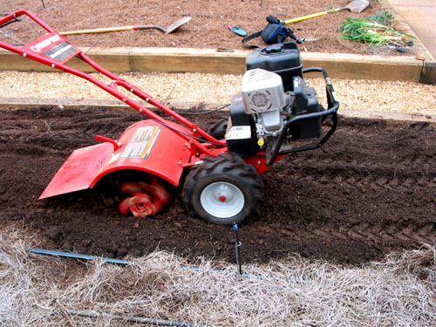
Just as with annuals, bed
preparation is essential !
Notes:
Bed preparation: Just like annuals, perennials require careful bed preparation to establish successfully. The same procedures of debris removal, amending, tilling, and adding fertility apply to perennials. A tilling depth of 12 to 18 inches is recommended for long-term perennial beds. Using a coarse grade compost or organic supplement may help the bed retain moisture longer. Coarse granite sand also is a good amendment for perennial beds if drainage needs to be improved.

Slide 16
How Much Mulch To Apply?
3 to 5 inches is sufficient in gardens!
One bale of pine straw covers 50 – 80 sq. ft., depending on the bale size
Nine, 3 cu. ft. bags of pine bark mulch will cover 100 sq. ft. to a 3-inch depth
Notes:
Mulch: How much mulch to apply depends upon your irrigation plans, your local soils, and the local weather. If you are designing a low water-use bed, 4 to 6 inches of pine straw or pine bark will do nicely. An average garden will require a 3 to 5 inch layer. If you plan to irrigate often, then 2 to 3 inches of mulch will do.

Slide 17
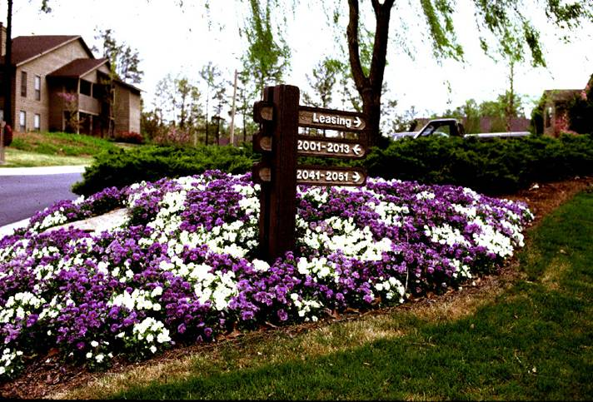
Weed Control - Landscape
Notes:
Weed Control: Because perennials live their lives in one place, seasonal weeds can be a problem. Weeds compete with perennials for water, nutrients, and sunlight. Mulching helps prevent weeds, but weekly hand weeding may also be necessary.

Slide 18
Pre & Post Emergent Herbicides
Pre-Emergent:
Betasan
Pendulum
Pennant
Surflan
XL
Post-Emergent:
Envoy
Vantage
Mulches & Covers:
Pine Straw
Pine Bark
Peanut Hulls
Compost
Non-Selective Herbicides:
Round-Up Pro
Reward
Scythe
Notes:
Herbicides: Post-emergent herbicides are applied after weeds appear. This table shows general herbicides suitable for most perennials. However, you should consult with your local County Extension Agent for recommendations, and always read the labels to be sure your perennials are listed as compatible with that product. When in doubt, find out!

Slide 19
Fertilization
Fertilizers only last so long!
Plants growing in shade require more fertilizer than those growing in sun, due to competition from tree roots
Plants growing in sandy soils require more frequent fertilization than those growing in clay soil
Rainfall dramatically affects fertility levels in long-term gardens !
Some plants like low fertility!
Notes:
Fertilization: There are a few things to keep in mind before adding fertilizer to your perennial beds. Fertility products can be formulated to deliver the plant food over a short-term or long-term period. Be sure you use the type that fits your needs. Spring growth may require fast acting fertilizer products, whereas summer fertilization may require slow-release. Remember that shade and sandy soils require much different levels of fertility than sunny garden soil.

Slide 20
Nitrogen Uptake Throughout the Year
% Nitrogen Uptake
40
DORMANT
DORMANT
RAPID SHOOT GROWTH
30
Bud Swell / Rossette Formation
20
GROWTH SLOWS
LEAF FALL
Perennials
10
JAN
FEB
MAR
APR
MAY
JUN
JUL
AUG
SEP
OCT
NOV
DEC
Notes:
Fertilization Usage: Perennials are much like shrubs in that they may require high levels of fertility early in spring or summer, when they put on growth, and low fertility the remainder of the year. The ability of a plant to take up nitrogen is also a function of season, once leaves are lost to frost, perennials do not need fertilizer.

Slide 21
Types of Fertilizer
Granular - General-purpose
(10-10-10, 16-4-8)
Slow-release
Organic
Liquid
Notes:
Types Of Fertilizers: The most common type of fertilizer applied to perennial beds in the spring is the common 10-10-10 or 8-8-8, however other analyses are sometimes more suitable for a given species. These are general-purpose fertilizers. For summer-long fertility, slow release and organic materials do a very good job of supplying fertility. For specific recommendations, contact your local county agent.

Slide 22
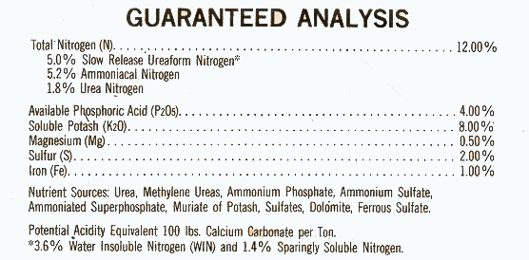
Get the most nutrients you can for your dollar!
Notes:
Reading A Fertilizer Bag: State law requires that product information and an accurate analysis be written on the bag of fertilizer. On the label you will be told the ratio of fertilizer elements, the potential acidity or alkalinity, and whether or not the product has trace elements.
Be sure you read the product label and understand it before using the product.

Slide 23
16-4- 8
10/16 = 0.6 lbs. per 100 sq. ft.
12-4-8
10/12 = 0.8 lbs. per 100 sq. ft.
2 cups = 1 lb.
Notes:
Rates of Fertilizer: For dry fertilizers, it is easy to determine how much nitrogen you are going to need to apply. First, divide the percentage of N on the bag into 10. The resulting number is the pounds of N to be applied per 100 sq ft.

Slide 24
50 ft.
5 ft.
5 ft. x 50 ft. = 250 sq. ft.
16 - 4 - 8 = 0.6 lbs./100 sq. ft.
250 sq ft x 0.6 / 100 sq ft. = Amt Apply
Amt to Apply = 1.5 lbs. (3 cups)
Notes:
Fertilizer Calculation: Next determine the square footage of your bed (our example is 5’ by 50’ or 250 sq ft). In this example, we multiply 250 sq ft. x 0.6 (the application rate per 100 sq ft.) then divide into 100. The resulting number is the amount of fertilizer to apply. You can then adjust this into cups by multiplying the amount by 2, which equal 3 cups in this example.

Slide 25
Nutrient Deficiencies
Purpling of lower leaves - phosphorus deficiency
Can be caused by cold, keeping plants too wet.
Use a general fertilizer, do not direct supplement!
Chlorosis or yellowing upper leaves - iron deficiency,
pH is too high!
Iron sulfate can be added in increments to reduce pH.
Overall yellowing of lower leaves – magnesium deficiency
Magnesium deficiency is very common in Georgia!
Use magnesium sulfate to increase Mg!
Notes:
Nutrient Deficiencies: There are often times when perennials show signs of nutrient-related problems. Periods of excessive rain or drought can affect levels of nutrients and nutrient uptake. In winter, some perennials that have evergreen foliage can become purple or bronzed. This may be a perfectly normal condition in the dead of winter, but a warning sign of deficiencies in late spring. In summer, pale yellow leaves and weak, off-green growth may be signs of underfertilization or depleted fertility. Calcium and magnesium may be depleted. Only a soil test and a foliage test will determine the right ratio of nutrients to add to correct the problem.

Slide 26
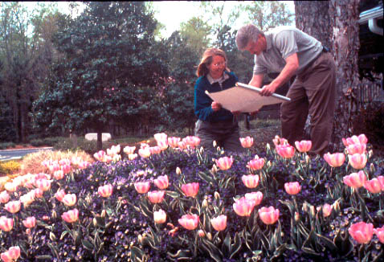
Planning Maintenance Is The Key!
Notes:
Planning Maintenance: Perennial bed maintenance can be labor and time intensive. Smart gardeners will do a few small tasks each day. Weeding and removing dead leaves and spent flowers will not be such a chore if these tasks are dealt with often.

Slide 27
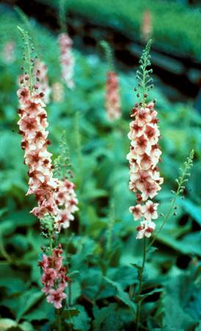
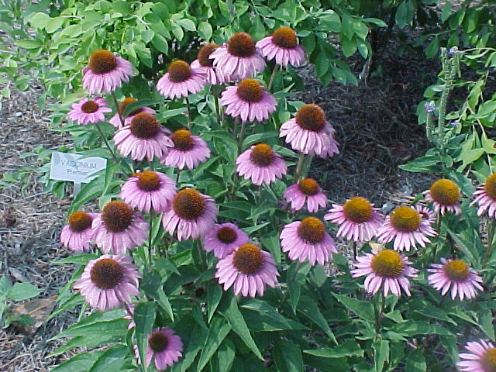
Deadheading
Echinaceae
Removing Spent Flowers
Is Essential For Some Perennials
Verbascum
Notes:
Deadheading: Removing spent flower heads is very important to most perennials. For example, Echinaceae species will stall and not rebloom mid-summer if the spent flowers are not removed. This is because too much food reserves go into the seeds, and our hot summers use up a great deal of sugars with respiration. Removing the flower head before it goes to seed saves photosynthate for growth. Many perennials, such as Coreopsis, will simply stop growing and stop putting up new flowers if they are not deadheaded. For continuous bloom, and less disease, remove spent flowers regularly.

Slide 28
Renovating Perennial Beds
Perennial beds need to be renovated about
every three years in Georgia:
Soil compaction (from rain/people)
Loss of organic material
Dense growth of the perennial
Overall performance decline
Notes:
Renovating Beds: In Georgia, it is recommended that perennial beds be dug up and renovated every three years. This is a lot of work, but essential. Renovation reduces soil compaction, adds back organic matter, increases plant spacing, and improves air circulation, thereby reducing disease and invigorating the planting.

Slide 29
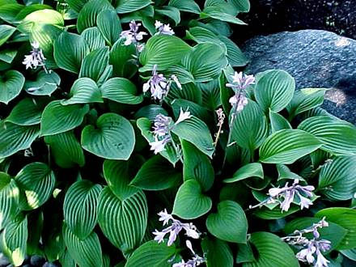
Most perennial beds are renovated by
complete removal of established plants,
division, soil amending, and replanting
Notes:
Renovating: As with initial planting, the same procedures of removing the plants, dead leaves, and mulch, then adding compost and amendments is followed. Replanting is usually attempted the same day or the very next day. Large gardens may require renovation in sections.

Slide 30
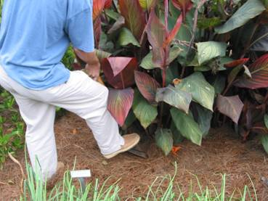
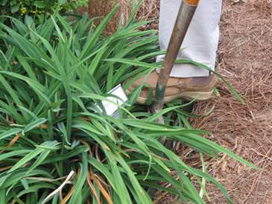
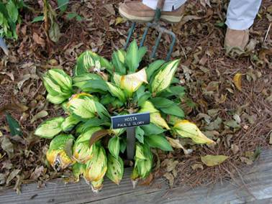
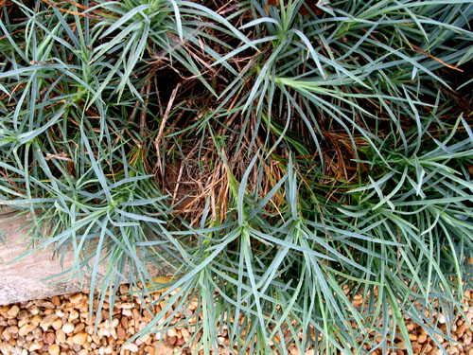
Methods For Division
Notes:
Methods of division: There are many methods to propagate perennials. In this presentation, we will focus on the aspects of division as they relate to the renovation of beds.

Slide 31
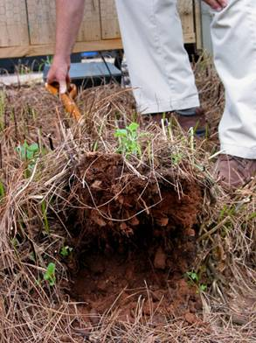
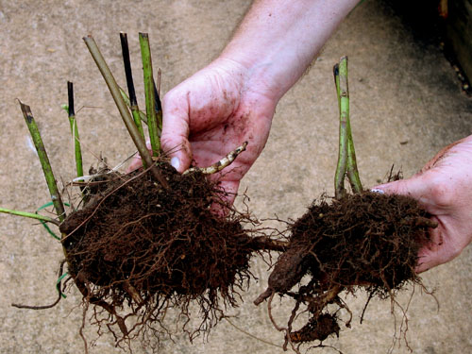
Fibrous Root Perennials
Dig up colony
Divide section of colony with
new growth or runners.
Notes:
Fibrous roots. Many perennials form colonies of plants that have interconnecting fibrous root systems. Examples are Phlox, Salvia, Helianthus, and Eupatorium. The only reliable method is to identify groups of growing points, and then divide the clump with a shovel. Lift large sections of the root mass with a pitchfork or shovel. Large clumps can then be pulled apart to obtain individual sections with growing points as seen here.

Slide 32
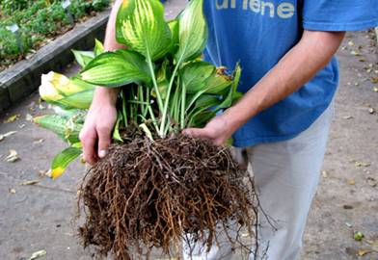
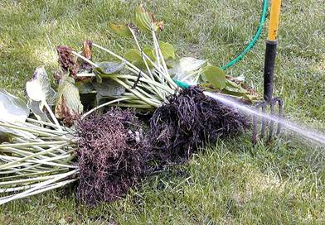
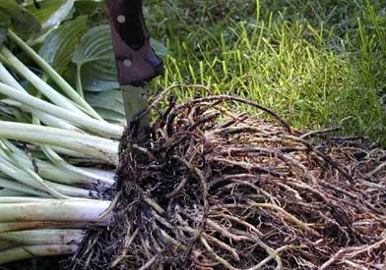
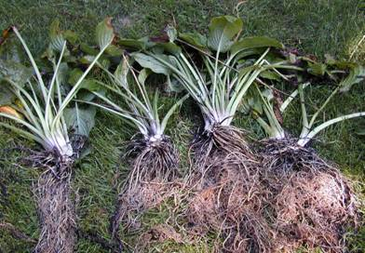
Dividing Hostas
Dig colony
Wash Roots
Divide Plantlets
Separated plants
Notes:
Dividing Hostas: Hostas are particularly easy to divide, as the individual plants form separately and are easily separated. Lift the entire colony. Remove soil from the roots by applying a spray of water. Clumps can be hand-pulled apart.

Slide 33
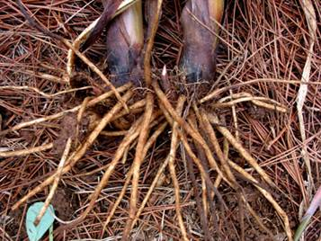
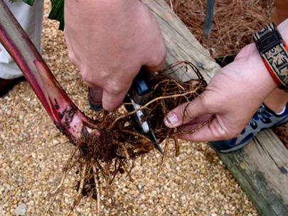
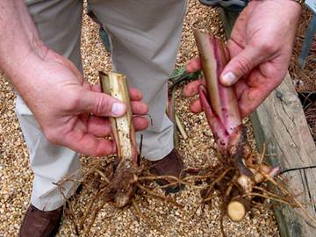
Dividing
Rhizomatous
Perennials
Dug roots are
separated into
small clusters
Divide growing
points
Separated sections
Notes:
Dividing Rhizomatous Perennials: Many perennials, such as Iris, Canna, Daylily, and Blue Anise Sage, have rhizomes. These must be lifted, washed, and then hand cut. Each section of root must have a new eye or growth area.

Slide 34
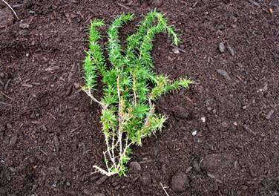
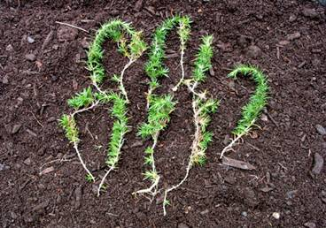
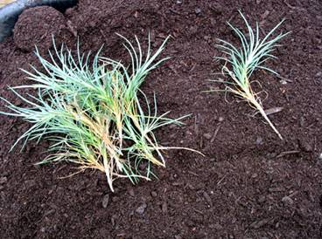
Dividing Spreading Perennials
Phlox subulata
Dianthus ‘Bath’s Pink’
Notes:
Spreading Perennials: Spreading perennials can often be divided as large clumps. Each clump is planted as a unit. Some perennials, such as Thrift and Dianthus, can also be propagated by making individual stem cuttings. Section clusters are removed from the outer areas of the colony, reducing its size. The sections are then pulled apart into individual stem pieces. A rooting hormone may expedite root formation when applied to the base of the stems, but many perennials do not need a rooting hormone if cuttings are taken early spring or mid-fall.

Slide 35
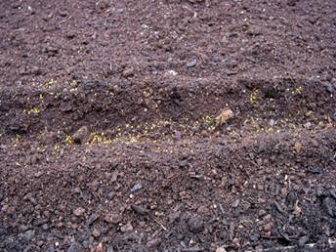
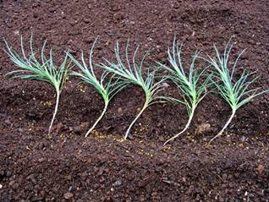
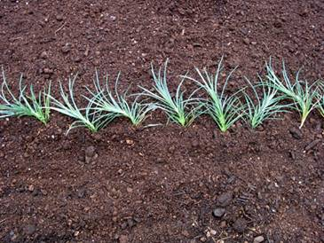
Multiplying
Spreading
Perennials
Furrow w/fertilizer
Many perennials
may require a rooting
powder to be applied to the base of the cutting to promote faster rooting.
Space divisions
Cuttings Planted
Notes:
Spreading Perennials: The individual sections are then placed in prepared soil, and the lower one-third of the stem buried. Cuttings are then watered thoroughly and kept moist for the next few weeks. If this procedure is followed in fall, each stem will root and form a new plant by spring. These can be re-dug in mid-summer and transplanted. Shown here are Dianthus.

Slide 36
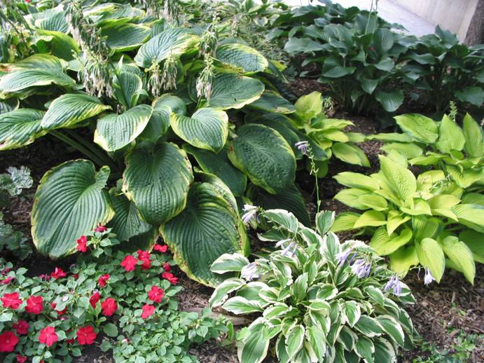
The End Result!
Notes:
The End Result: The resulting additional plants will provide an endless supply of new material to keep your perennial garden fresh and healthy.

Slide 37
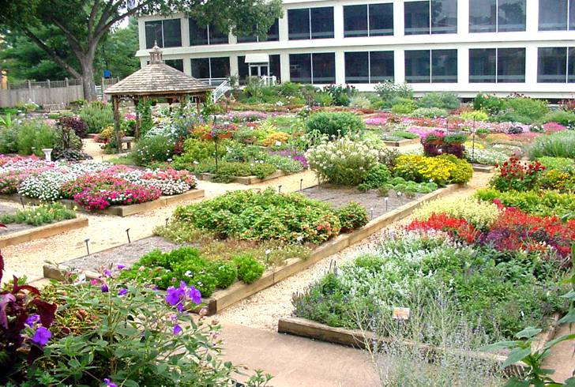
Selecting Perennials
Notes:
Selecting Perennials: There are over 2300 species of perennials from which to choose, thus providing a wide variety of characteristics useful in garden design. One way to keep up with new selections is to visit the University of Georgia Trial Gardens located on campus in Athens.

Slide 38
Selection Considerations
Most perennials do not live forever. In Georgia, most perennials live two to five years before perishing by disease, adverse weather or old age.
Plants such as Hosta, Lantana ‘Miss Huff’, Ruellia, Tritoma, Iris, Thrift, Daylillies and Soapwort are examples of very long-lived perennials. Coreopsis, Rudbeckia, Echinacea, Scabiosa, some Salvias and some Phlox are good examples of short-lived perennials.
Notes:
Considerations: On slide

Slide 39
Selection Considerations
Perennials are not low maintenance, in fact, they are second only to roses in terms of yearly maintenance efforts.
Perennials require watering, fertilizing, shaping, deadheading, fall mulching, spring cleaning, dividing, replacing, and insect, disease, and weed control.
Some perennials grow best when divided every few years. Perennial bed renovation should be considered every 3 to 5 years for optimal growth.
Notes:
Considerations: On slide

Slide 40
Selection Considerations
Many perennials start small and get large, or form big colonies. Planning for growth is essential.
Long-lived, vigorous species tend to “grow-over” less vigorous or short-lived species.
Within two or three years your garden can appear completely different due to this competition. Always leave room for new growth when placing perennials.
Notes:
Considerations: On slide

Slide 41
Selection Considerations
Some perennials are vigorous, aggressive, or even invasive. Containers and in-ground barriers can contain “running” or aggressive species.
Reseeding is a major problem with only a few perennials. Removing spent flowers before they set seed prevents reseeding problems.
Notes:
Considerations: On slide

Slide 42
Avoid Invasive Plants!
Use Native Plants
Whenever Possible!
Notes:
Invasive Plants: There are quite a few perennials that are so vigorous that they can become invasive. Lythrum salicaria, Solidago species, and Physostegia virginiana can be invasive in cultivated gardens, as can Monarda and Oenothera. Many of these are native species to nearby states, but not native to Georgia. Plants from other countries may also escape cultivation and become truly invasive and damaging to local environments. Be sure the plants you select are not invasive.

Slide 43
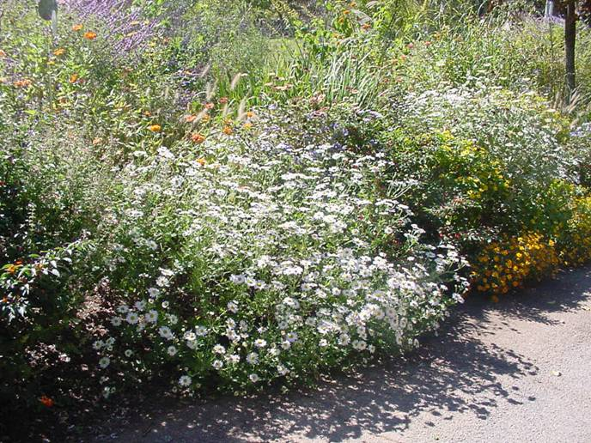
Perennials For Sunny Locations
Notes:
Perennials For Sunny Locations

Slide 44
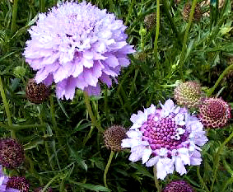
Pincushion Flower
Characteristics:
Nectar source
Mounding
15 - 18 inches tall
Location:
Full sun
Plant Spacing:
8 inch centers
Care and Feeding:
Moderate fertility
No drought
Bloom Period:
April – June
Culture Concerns:
Mites
Well-drained soils
Scabiosa caucasica
Notes:
Scabiosa caucasica: Pincushion Flower is becoming a very popular perennial. However, it is a short-lived specimen poorly adapted to drought and heat; furthermore, it is likely to succumb to heavy soils in a wet winter. To be successful, well-drained soils and a constant attention to this plant’s water requirements are essential. Deadheading in summer helps to keep the plant vigorous.

Slide 45
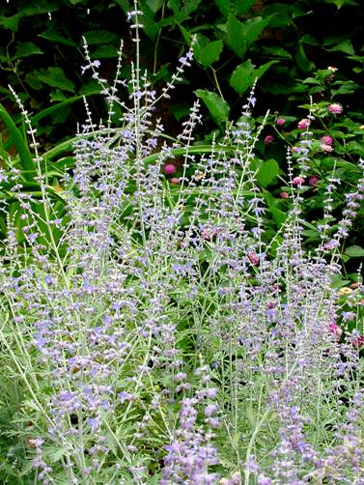
Russian Sage
Characteristics:
Nectar source
26 - 40 inches tall
Location:
Full sun
Plant Spacing:
10 - 15 inch centers
Care and Feeding:
Moderate fertility
Bloom Period:
June - September
Culture Concerns:
Do not crowd with other plants
Perovskia atriplicifolia
Notes:
Perovskia atriplicifolia: Russian Sage is a good plant for dry sunny places, if well established before summer heat. Fall planting is essential in well-drained soils. Single plants do not look showy due to the diffuse nature of the flowers. Professional landscapers use 10 to 12 plants on 10-inch centers for a strong color effect.

Slide 46
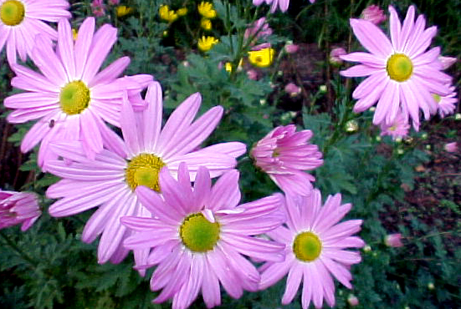
Perennial Chrysanthemum
Characteristics:
Mounding
Fall blooming
24 - 36 inches tall
Location:
Full sun
Plant Spacing:
15 inch centers
Care and Feeding:
Heavy fertility
Drought tolerant
Deer tolerant
Bloom Period:
August-September
Culture Concerns:
Stalls in drought
Dendranthemum x morifolium ‘Ryan’s Daisy’
Notes:
Dendranthemum ‘Ryan’s Daisy’: This is but one of the many truly perennial chrysanthemums. Unlike garden mums, these perform reliably every season. However, you must trim or pinch them back in late May, late June, and if weather is optimal, again in late July. This will develop a bushy plant. If not pinched, the plant will yield tall, floppy stems that lay on the ground just before blooms open. Fertilize every three weeks until the first of August, then stop fertilizing altogether. Water when plants become droopy.

Slide 47
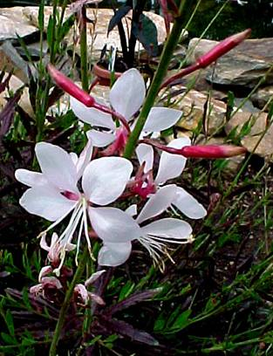
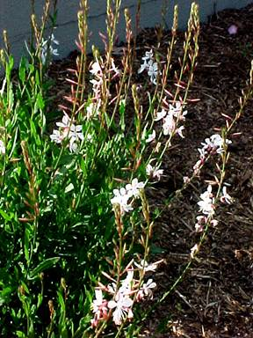
Whirling Butterflies
Characteristics:
Nectar source
Drought tolerant
24 - 36 inches tall
Location:
Full sun
Plant Spacing:
8 inch centers
Care and Feeding:
Moderate fertility
Deer tolerant
Bloom Period:
June – August
Culture Concerns:
Trim no more than the top ½ of spent flower stalk.
Gaura lindheimeri
Notes:
Gaura lindheimeri: Gaura is a good perennial for hot, dry places, but it does have some quirks. For best results, Gaura requires well-drained soils. In fact, it does best on top of soil mounds or raised beds. The other issue is deadheading. If you take off all of the flower stem just after the flowers are spent, diseases often destroy the plant. So remove no more that the top half of the flower stem. Then let the plant dry out for a few days, and then water and fertilize. The next flush of flowers will be better than the first, and so on. Best when massed in large groups.

Slide 48
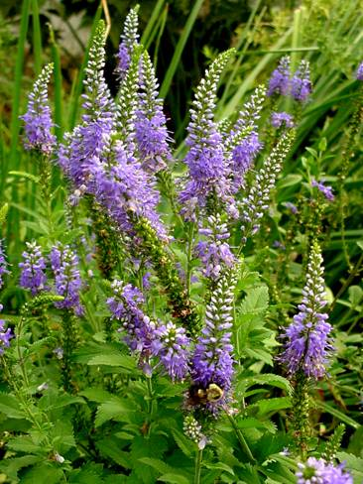
Speedwell
Characteristics:
Nectar source
18 - 30 inches tall
Location:
Full sun
Plant Spacing:
8 inch centers
Care and Feeding:
Moderate fertility
No drought
Bloom Period:
June – September
Culture Concerns:
Deadheading is required
Veronica alpina
Notes:
Veronica alpina: There are many good cultivars of Speedwell. They are upright and will branch heavily if pinched. Loved by bees, Veronica blooms all summer, and returns year after year if planted in well-drained soils. Deadheading in August will generate an October flush of flowers.

Slide 49
Summer Phlox
Characteristics:
Nectar source
Fragrant flowers
22 - 40 inches tall
Location:
Full sun
Part shade
Plant Spacing:
8 inch centers
Care and Feeding:
Moderate fertility
No drought
Bloom Period:
May – July
Culture Concerns:
Mildew
Deer
Phlox paniculata ‘The King’
Notes:
Phlox paniculata: If you have a location free of deer, and you are willing to water frequently, Summer Phlox is an outstanding perennial. Divide and plant them in fall and fertilize in March before the plants re-grow. Deer wait until just before the nectar-swollen flower buds are open to graze the entire crop down to the ground. Next to Hosta, this is their all-time favorite perennial. If chewed, Phlox will re-branch and re-bloom. Mildew is a problem, as is full sun and no water. If you have no deer, the summer will be spent with fragrance, butterflies, and the colors of van Gogh.

Slide 50
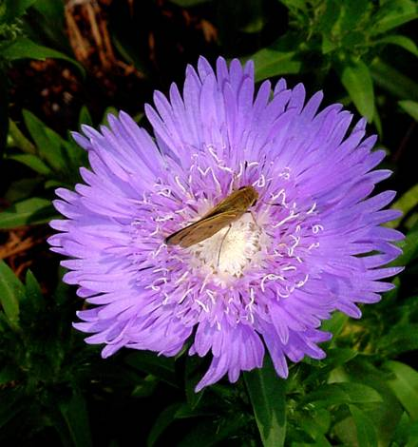
Stoke’s Aster
Characteristics;
Nectar source
20 - 25 inches tall
Location:
Full sun
Partial shade
Plant Spacing:
12 inch centers
Care and Feeding:
Moderate fertility
No drought
Bloom Period:
May - June
Culture Concerns:
Well-drained soils
Stokesia laevis ‘Blue Danube’
Notes:
Stokesia laevis: Stoke’s Aster is a tough and long lasting perennial. The blue or white flowers appear in May and last two to three weeks. Medium green foliage is all that is left for the rest of the season. These plants can get large and spread slowly. They work well just in front of bushes or against retaining walls, but they will disrupt the flow of color mid-summer if placed near the front of the garden.

Slide 51
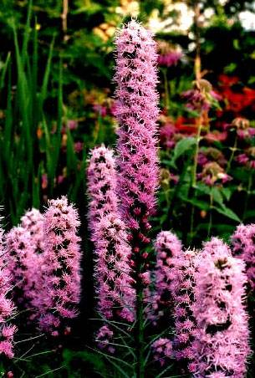
Gay Feather
Characteristics:
Nectar source
Drought tolerant
24 - 36 inches tall
Location:
Full sun
Plant Spacing:
6 inch centers
Care and Feeding:
Moderate fertility
Well-drained soils
Bloom Period:
May– June
Culture Concerns:
Scout for bulb rot
Divide @ 3 years
Liatris spicata
Notes:
Liatris spicata: A native plant that has been hybridized, it will grow just fine in Georgia. The plant grows from a corm-like structure. It spreads slowly if planted in good soil. The colonies of interconnected corms must be dug and divided every three years. Why? As the colony gets older, it only takes one old, diseased corm to succumb and then transfer the disease via shared roots. This will wipe out the entire group. The only way to prevent this is dividing every three years in fall during dry weather. Then, if an old corm dies, other groups will remain viable.

Slide 52
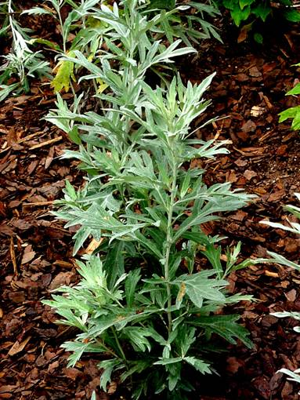
Silver King
Characteristics:
High contrast
Drought tolerant
Silver foliage
20 - 40 inches tall
Location:
Full sun
Plant Spacing:
8 inch centers
Care and Feeding:
Moderate fertility
Deer tolerant
Bloom Period:
Inconspicuous
Culture Concerns:
Spreads rapidly
Artemesia ‘Silver King’
Notes:
Artemesia ludoviciana: Many gardeners loath Silver King Artemesia as it is very invasive. However, unlike other Artemesias, this specimen is both drought and flood resistant. It is very good for hot, dry locations where no watering is possible, and where soil fertility is poor. In conjunction with fall planted Kniphofia uvaria (Red Hot Poker), and Helianthus giganteus or H. angustifolia, one can have beauty in desolate spots. In this environment, it is a wonderful perennial.

Slide 53
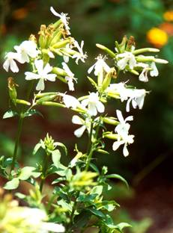
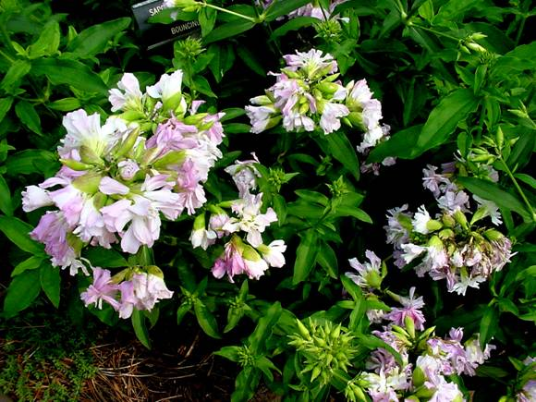
Soapwort
Characteristics:
Nectar source
Fragrant flowers
Drought tolerant
12 - 18 inches tall
Location:
Full sun
Plant Spacing:
12 inch centers
Care and Feeding:
Moderate fertility
Deer tolerant
Bloom Period:
June – August
Culture Concerns
Requires trimming to look neat
Single flowered form
Double flowered form
Saponaria ocymoides
Notes:
Saponaria ocymoides: Soapwort is an old-fashioned plant with fragrant flowers and a tenacity to survive that rivals dandelions. It is not the most beautiful plant in mid-summer, but its fragrant flowers and durability make it a gem for sunny, tough places. The double flowering form is a bit less tolerant of drought. Trim it back in July and fertilize it for a second flush of growth.

Slide 54
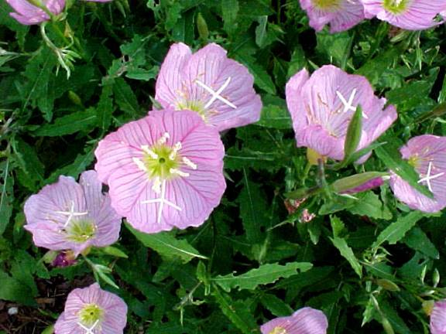
Showy Evening Primrose
Characteristics:
Spring color
10 - 14 inches tall
Drought tolerant
Location:
Full sun
Plant Spacing:
6 inch centers
Care and Feeding:
Moderate fertility
Deer tolerant
Bloom Period:
April-May
Culture Concerns:
Spreads rapidly
Oenathera speciosa
Notes:
Oenothera speciosa: A widespread perennial that survives our roadsides and old foundations. One must be careful to plant this spring flowering perennial where it can spread without consequence. Drought tolerant and persistent, it makes a nice color display in April and May

Slide 55
Peony
Characteristics:
Fragrant flowers
24 - 30 inches tall
Location:
Full sun
Part shade
Plant Spacing:
18 inch centers
Care and Feeding:
Moderate fertility
No drought
High organic soils
Bloom Period:
June – August
Culture Concerns:
Keep moist in hot weather. Do not plant deep in clay.
Paeonia spp.
Notes:
Paeonia hybrida: Peonies are difficult to grow in much of Georgia. They must be planted shallow, and underlain with good, organic soils that drain well. They will not perform well in shade or in areas that are bone dry all summer. Removal of flowers before the senescence seems to improve vigor.

Slide 56
Shasta Daisy
Characteristics:
Spring color
18 - 24 inches tall
Location:
Full sun
Plant Spacing:
8 inch centers
Care and Feeding:
Low fertility
No drought
Deer tolerant
Bloom Period:
June – August
Culture Concerns:
Gets leggy if over fertilized
Chrysanthemum superbum
Notes:
Chrysanthemum superbum: Shasta Daisies are beautiful perennials if grown properly. Avoid fertilizing after March because it will cause long, floppy growth just before blooming. This plant does not respond well to trimming, so the best course of action is to fertilize it in October and again in late February. Deadheading improves the plant’s survival in dry, hot summers.

Slide 57
Garden Asters
Characteristics:
Nectar source
Late summer bloom
20 - 36 inches tall
Location:
Full sun
Plant Spacing:
36 inch centers
Care and Feeding:
Heavy fertility
No drought
Deer tolerant
Bloom Period:
August-September
Culture Concerns:
Do not crowd
Aster ‘Country Gardens’
Notes:
Aster novae-angliae ‘Country Gardens’: Garden Asters require space and a long growing season to support a bushy, intense flower display. There are many cultivars. Unfortunately, most do not live up to the expectations of most gardeners because they do not branch when planted close together. Leave three feet spacing between plants and use cultivars, such as ‘Country Garden’, which has an awesome flower display. Good colonies of Aster can be divided every three to five years.

Slide 58
New York Aster
Characteristics:
Nectar source
Fall blooming
40 - 54 inches tall
Location:
Full sun
Plant Spacing:
24 inch centers
Care and Feeding:
Heavy fertility
No drought
Deer tolerant
Bloom Period:
August-September
Culture Concerns:
Do not crowd young plants
Aster Novi-belgii
Notes:
Aster novi-belgii: New York Aster has been hybridized extensively, and there are over a hundred cultivars from which to choose. Some cultivars can get very large and bloom later than A. novae-angliae. Worse yet, some can be very invasive and require staking. It is best to say that Asters require some careful consideration before being placed in the garden.

Slide 59
Daylily
Characteristics:
Drought tolerant
15 - 20 inches tall
Location:
Full / part shade
Full sun if moist
Plant Spacing:
12 inch centers
Care and Feeding:
Heavy fertility
Deer tolerant
Bloom Period:
June – July
Culture Concerns:
Declines in heat
Hemerocallis spp.
Notes:
Hemerocallis hybrida: There are thousands of Daylily hybrids from which to choose, and they grow well in full sun if irrigation is possible. If not irrigated, they go dormant in summer. In shade, they can survive drought intact, but blooms are smaller and fewer. Water and fertilize in August to revitalize the foliage before frost. There are cultivars such as ‘Stella d’Oro’, which are described as ever-blooming. In the South, this means sporadic flowering at best.

Slide 60
Mexican Sage
Characteristics:
Nectar source
30 - 54 inches tall
Drought tolerant
Location:
Full sun
Plant Spacing:
8 - 12 inch centers
Care and Feeding:
Heavy fertility
Deer tolerant
Bloom Period:
August-September
Culture Concerns:
Do not crowd young plants
Salvia leucantha
Notes:
Salvia leucantha: Mexican Sage does very well in hot, dry, sunny locations, if established early in the spring. It blooms late in the summer, August 15 through late September. Intense plantings kept fertilized and watered will yield a spectacular flower display in fall.

Slide 61
Mexican Petunia
Characteristics:
Drought tolerant
36 - 54 inches tall
Location:
Full sun
Plant Spacing:
12 inch centers
Care and Feeding:
Moderate fertility
Deer tolerant
Bloom Period:
August- October
Culture Concerns:
Spreads slowly
Ruellia brittoniana
Notes:
Ruellia brittoniana: The Mexican Petunia is another late-blooming perennial. This one is long-lived, tall, and can spread like a slow freight train. Divide the plant every 5 years and enjoy the purple or pink flowers in August and September. It is relatively pest free and suffers from few diseases.

Slide 62
Garden Lilies
Characteristics:
28 - 60 inches tall
Fragrant flowers
Location:
Full sun
Plant Spacing:
8 inch centers
Care and Feeding:
Moderate fertility
No drought
Bloom Period:
June – August
Culture Concerns:
Well-drained soils
Lilium speciosum ‘Rubrum’
Notes:
Lilium speciosum: Lilies are the gems of the garden, and they do fairly well in Georgia gardens. There are hundreds of cultivars. Lilies need well-drained, high organic content soils to perform well in full sun. Water is essential, and drought can cause havoc. Staking is recommended, and care should be taken not to crowd the plants.

Slide 63
Ornamental Onions & Garlic
Characteristics:
Nectar source
Drought tolerant
10 - 48 inches tall
Location:
Full sun
Plant Spacing:
2-3 bulbs in small groups works best
Care and Feeding:
Moderate fertility
Deer tolerant
Bloom Period:
June – August
Culture Concerns:
Some species may reseed
Allium schoenoprasum
Notes:
Allium species: There are many Allium species and cultivars from which to choose. They are heat and drought tolerant, deer resistant, and have lovely blooms, usually in spring. A few species spread by re-seeding, while most reproduce from bulbs. Even chives, shown here, can be a beautiful perennial if grown in groups of 8 to 10. Fertilize in February and again in October for best results.

Slide 64
Perennials For Dry Sunny Places
Notes:
Perennials For Dry Sunny Places

Slide 65
False Indigo
Characteristics:
Drought tolerant
28 to 56 inches tall
Location:
Full sun
Plant Spacing:
12 inch centers
Care and Feeding:
Low fertility
Deer tolerant
Bloom Period:
June – July
Culture Concerns:
Comes up late in spring. Mark the site!
Baptisia australis
Notes:
Baptisia australis: This plant is perhaps the toughest specimen in the garden. It can handle anything our environment can throw at it. Flowers form in late spring then fade away like daffodils by mid-summer to escape the dry, hot part of the summer. The plants grow to be quite large, and emerge late, so most gardeners tend to forget how big they get. They crowd other plants in their shade. It is recommended you mark the site with something permanent so as not to forget they are there (or how large the plants can become by the end of a season). Some new cultivars have purple and white flowers, so there are more reasons to have this plant in your garden. Be sure to mark the site where it is planted to prevent over-planting.

Slide 66
Yellow Baptisia
Characteristics:
Drought tolerant
26 - 45 inches tall
Location:
Full sun
Plant Spacing:
8 - 10 inch centers
Care and Feeding:
Moderate fertility
Deer tolerant
Bloom Period:
June – July
Culture Concerns:
Comes up late – mark the site!
Baptisia tinctoria
Notes:
Baptisia tinctoria: This species has a yellow flower that is quite nice in June and July. You must grow them more densely than B. australis, to get a similar flower impact. They are also easy to grow and pest free. Like B. australis, you should mark the site where they grow to prevent over-planting in early spring because they come up very late in May.

Slide 67
Tickseed
Characteristics:
18 - 28 inches tall
Location:
Full sun
Plant Spacing:
8 - 12 inch centers
Care and Feeding:
Moderate fertility
No drought
Deer tolerant
Bloom Period:
May – June
Culture Concerns:
Mites
Deadheading required
Coreopsis grandiflora
Notes:
Coreopsis grandiflora: Tickseed is a popular, short-lived perennial, and people kill them by the millions. Like their prairie ancestors, modern hybrids are susceptible to spider mites in late spring, and they decline rapidly in drought. To successfully raise Tickseed in the South, one must keep them irrigated and well fertilized. Deadheading is an absolute must. Seeds developing during the hot, dry part of the summer will sap the strength from the mother plant. Nine out of ten years, the mother plant will die if not deadheaded. If you deadhead and care for it properly, it will live for four to five years before diseases catch up with it.

Slide 68
Swamp Sunflower
Characteristics:
Nectar source
Drought tolerant
72 - 96 inches tall
Location:
Full sun
Plant Spacing:
24 inch centers
Care and Feeding:
Moderate fertility
Deer tolerant
Bloom Period:
August-October
Culture Concerns:
Huge!
Spreads
Helianthus angustifolius
Notes:
Helianthus angustifolius: The Swamp Sunflower is a huge plant. Flower stalks may reach eight feet tall. This is a spreading beast in good garden soil, but it will survive the hottest summer you can imagine in Georgia if some irrigation is provided. The flowers are spectacular in August and September, and the plant has few pests or diseases. Great for low-care landscapes as it will stay small (4 to 5 feet) when neglected. Divide and transplant them in fall.

Slide 69
Red Hot Poker Plant
Characteristics
Nectar source
Drought tolerant
36 - 48 inches tall
Location:
Full sun
Plant Spacing:
12 inch centers
Care and Feeding:
Moderate fertility
Deer tolerant
Bloom Period:
June – July
Culture Concerns:
Seedling color varies. Colonizes
Kniphofia uvaria
Notes:
Kniphofia uvaria (Tritoma): Red Hot Poker is a proper name for this late spring blooming perennial. As tough as Baptisia, and very showy, one must establish it in fall to be successful. Be sure to select grown plants in bloom, known divisions, or tissue cultured plants because seedling color and flower shape can vary dramatically. Deer leave it alone!

Slide 70
Blue Sage
Characteristics:
Nectar source
Drought tolerant
24 - 54 inches tall
Location:
Full sun
Plant Spacing:
12 - 15 inch centers
Care and Feeding:
Heavy fertility
Deer tolerant
Bloom Period:
June – October
Culture Concerns:
Mid-summer and late summer trimmings help
Salvia guaranitica
Notes:
Salvia gauranitica: Blue Anise Sage, or Brazilian Sage, is a gem in the garden. It is a Georgia Gold Medal Winner. Tough and durable, it blooms from May until November and attracts hummingbirds and butterflies. It grows a thick storage root and persists even with tilling! Full sun is preferred. Mid-summer trimming, after the first flush of flowers, is essential for a glorious fall display.

Slide 71
Hardy Lantana
Characteristics:
Nectar source
Drought resistant
48 - 70 inches tall
Location:
Full Sun
Plant Spacing:
36 - 54 inch centers
Care and Feeding:
Heavy fertility
Deer tolerant
Bloom Period:
June – August
Culture Concerns:
Do not cut frosted branches until late spring, mound with leaves until April
Lantana camara ‘Miss Huff’
Notes:
Lantana camara ‘‘Miss Huff’: Miss Huff is the only truly hardy perennial lantana. This plant grows to become a 6-foot mound in good soil, and possesses thousands of Swallowtail attracting flower clusters all summer. It comes back to life late in the spring, so late that many gardeners mistakenly pull it up for dead in May. Planting on 36 to 48 inch centers is essential as this plant spreads rapidly. It will overcome all but Helianthus and Artemesia. Do not cut back the stem until April to prevent cold injury, and mound up fall leaves in the bush during winter for a faster start. Be sure to remove those leaves and all debris to prevent summer leaf spot diseases. It is hardy to southern Illinois and Knoxville, TN.

Slide 72
Autumn Joy Sedum
Characteristics:
Nectar source
Drought tolerant
18 - 30 inches tall
Location:
Full sun
Plant Spacing:
8 - 10 inches
Care and Feeding:
Moderate fertility
Deer tolerant
Bloom Period:
July - August
Culture Concerns:
Well-drained soils
Sedum ‘Autumn Joy’
Notes:
Sedum spectabile ‘Autumn Joy’: Most sedums do well in Georgia if given dry, sunny. Sedum ‘Autumn Joy’ is a special plant. It grows into well-behaved mounds of blue green foliage, topped with large clusters of pink flowers in August. Few pests and almost no diseases affect this plant; however, deer have a keen interest in this plant. Plants can be divided every four years or so, in early spring.

Slide 73
Goldenrod
Characteristics:
Nectar source
Drought tolerant
24 - 56 inches tall
Location:
Full sun
Plant Spacing:
6 inch centers
Care and Feeding:
Low fertility
Deer tolerant
Bloom Period:
July – September
Culture Concerns:
Can be invasive
Solidago ‘Peter Pan’
Notes:
Solidago ‘Peter Pan’: Peter Pan is one of the few Goldenrods that stays short and is moderately well behaved. All Goldenrods will form runners and spread given enough time. Goldenrods come into bloom mid August and, if planted densely, put on a good show. Do not fertilize after the first week in May or the plants will get leggy, floppy stems. Any other Solidago you wish to plant should be thoroughly researched as some can be horridly aggressive, with runners growing 6 to 8 feet in a season.

Slide 74
Bearded Iris
Characteristics:
Drought tolerant
28 - 40 inches tall
Location:
Full sun
Plant Spacing:
6 inch centers
Care and Feeding:
Moderate fertility
Deer tolerant
Well drained soils
Bloom Period:
June – August
Culture Concerns:
Rhizome rot
Rhizome borers
Iris ssp.
Notes:
Iris ssp. German Irises are easy to grow and have showy blooms that appear in May. They are easy to establish if you have well-drained soils and plant them shallow, with a portion of the rhizome above ground. Coat hangers can be bent into AU@ and used as stakes to hold the rhizomes in place until rooted. Iris borers can be a problem in large colonies. Some folks claim blue and pink colored Irises turn white in Georgia clay. In truth, white flowers result from reseeding, with the dominant white form winning out genetically.

Slide 75
Butterfly Weed
Characteristics:
Nectar source
Drought tolerant
18 - 30 inches tall
Location:
Full sun
Plant Spacing:
10 inch centers
Care and Feeding:
Moderate fertility
Deer tolerant
Bloom Period:
June – August
Culture Concerns:
Comes up late – mark location.
Well-drained soils
Asclepias tuberosa
Notes:
Asclepias tuberosa: Butterfly Weed is a native perennial that is a must-have in Georgia gardens. It is the native food source for the Monarch caterpillar, and provides nectar to over 70 species of Georgia butterflies. It is best grown from seed sown in fall and left exposed to the winter sun. The seeds need infrared light to germinate. You cannot transplant Asclepias from fields or roadsides in spring, summer, or fall as the root system will not re-develop in warm soils, and often rots within a few days. December is best, and then with a healthy ball of soil. Most roots are two to three feet deep in Georgia soils, so extraction is tough. Leave flowers on for seeds, and worry not if caterpillars chew it down. It will spring back and re-bloom even better a few weeks later. Fertilize in February and May.

Slide 76
South American Verbena
Characteristics:
Nectar source
Drought tolerant
36 - 48 inches tall
Location:
Full sun
Plant Spacing:
8 - 12 inch centers
Care and Feeding:
Moderate fertility
Deer tolerant
Bloom Period:
June – October
Culture Concerns:
Mites
May reseed
Verbena bonariensis
Notes:
Verbena bonariensis: South American Verbena is easy to grow from fall planted seed. It puts up wonderfully airy stems of nectar producing florets that attract butterflies and bees. Tough as nails when cared for, it often succumbs to wet feet in winter and shading from larger perennials. Plant 12 to 15 plants on 4 inch centers for best results, or spread seed densely in a 3'x3' bed area.

Slide 77
Rigid Verbena
Characteristics:
Nectar source
Drought resistant
12 - 15 inches tall
Location:
Full sun
Plant Spacing:
6 inch centers
Care and Feeding:
Low fertility
Deer tolerant
Bloom Period:
June – August
Culture Concerns:
Can be invasive
Verbena rigida
Notes:
Verbena rigida: Rigid Verbena grows easily along Georgia road sides, so being tough is not in question as it likes hot, dry locations. It can be mowed twice a summer and re-flushed with fertilization and frequent irrigation. The beautiful purple flowers attract Swallowtails and other butterflies. However, the plant is aggressive and sends out runners. It can be invasive in certain areas.

Slide 78
Purple Cone Flower
Characteristics:
Nectar source
Drought tolerant
24 - 36 inches tall
Location:
Full sun
Plant Spacing:
8 - 10 inch centers
Care and Feeding:
Heavy fertility
Deer tolerant
Bloom Period:
May – August
Culture Concerns:
Deadheading is essential
Echinacea purpurea
Notes:
Echinacea purpurea: Purple Coneflower is fantastically popular as a garden and medicinal plant. It=s a great butterfly plant, and it is drought tolerant. Well-drained soils and deadheading are required for them to survive the wet soils of winter. If allowed to self- seed over several generations, green-flowering mutants often appear and should be rogued out. Native species of Purple Coneflower have drooping petals, whereas modern hybrids have horizontally held petals. Unfortunately, deer love this plant too.

Slide 79
Three Lobed Coneflower
Characteristics:
Nectar source
Drought tolerant
Location:
Full sun
Plant Size:
36-50 inches tall
Care and Feeding:
Moderate fertility
Deer tolerant
Bloom Period:
July – September
Culture Concerns:
Mildew
Dies out in wet, warm weather
Rudbeckia triloba
Notes:
Rudbeckia triloba: Three-Lobed Coneflower is a perennial cousin of our annual Rudbeckia. It is a wonderful plant, worthy of any garden. Bright yellow flowers last most of the summer, and its height allows it to be a back-of-the-garden plant with fantastic color potential. It is difficult to grow from seed, so purchase 4-inch plants. Plant early and fertilize twice (before June). Cut back stems after seeds begin to develop, but leave 12 inches of stem attached so new rosettes can form at their base for next year.

Slide 80
Hardy Ice Plant
Characteristics:
Nectar source
Groundcover
Drought tolerant
4 - 6 inches tall
Location:
Full sun
Plant Spacing:
6 inch centers
Care and Feeding:
Moderate fertility
Deer tolerant
Bloom Period:
May– October
Culture Concerns:
Do not cover with mulch in winter
Delosperma cooperi
Notes:
Delosperma cooperi: The Hardy Ice Plant is an asset to gardeners with poor soils, dry locations, and slopes. This plant requires only a few inches of soil to do well. It blooms early in spring and then sporadically the rest of the summer. Fertilize in June and August, and do not worry when frost turns the turgid, green leaves to black mush. The tiny gray leaves at the ends of the stems will burst forth in spring on schedule.

Slide 81
Perennials For Shady Places
Notes:
Perennials For Shady Places

Slide 82
False Spirea
Characteristics:
Nectar source
24 - 30 inches tall
Location:
Partial shade
Plant Spacing:
12 - 18 inch centers
Care and Feeding:
Moderate fertility
No drought
High organic soils
Bloom Period:
May – June
Culture Concerns:
Mulch heavily
Keep moist
Astilbe x ardensii
Notes:
Astilbe x ardensii: False Spiraea is difficult to grow, but it makes an excellent shade garden plant if special care is given. Drip irrigation is required as these plants need water and cool roots. They must be kept moist in hot weather or they may expire quickly. In full sun, death can occur in a matter of hours. In shady locations, 4 to 6 inches of mulch is required over the drip lines to hold in the moisture and keep the soil cool. Dappled sunlight is required during April, May and June to facilitate good bloom production. Blooms may last a few weeks if conditions are right. Fertilize in March just after bloom. Deadhead immediately when the flowers fade.

Slide 83
Blackberry Lily
Characteristics:
Nectar source
Drought tolerant
18 - 28 inches tall
Location:
Partial shade
Plant Spacing:
8 inch centers
Care and Feeding:
Moderate. fertility
Deer tolerant
Bloom Period:
July– August
Culture Concerns:
Reseeds
Bellamcanda chinensis hybrid
Notes:
Bellamcanda chinensis : The Blackberry Lily is a naturalized plant from China that does well here at the edges of woods. It prefers highly organic soils and full sun. It is drought tolerant and tough. It re-seeds well, and if planted in dense groups, it can be very attractive by mid-summer. It has few pests and is deer tolerant. Butterflies love the flowers. The term Blackberry Lily comes from the seeds, which are revealed when the seedpod opens and the seeds are literally turned outside the pod shell. The seed cluster looks like a blackberry fruit. Plant seeds immediately upon harvest.

Slide 84
Bee Balm
Characteristics:
Nectar source
Drought tolerant
18 - 36 inches tall
Location:
Partial shade
Full sun if moist
Plant Spacing:
10 - 12 inch centers
Care and Feeding:
Moderate fertility
Deer tolerant
Bloom Period:
June – August
Culture Concerns:
Spreads quickly
Mildew
Monarda didyma
Notes:
Monarda didyma: Bee Balm is a good garden plant that can be gorgeous if planted in partial sun, watered, and fertilized in early spring. It is a good butterfly and hummingbird plant, and attracts bees as well. However, it has a bad reputation for running rampant in any garden and becoming a pest. Unless you have a lot of time to remove mats of runners, you may want to consider purchasing barriers or placing the plants in areas where it can spread without causing problems. Mildew is a problem with most cultivars.

Slide 85
Fragrant Solomon’s Seals
Characteristics:
Nectar source
20 - 24 inches tall
Location:
Full shade
Plant Spacing:
12 inch centers
Care and Feeding:
Moderate fertility
Deer tolerant
Bloom Period:
June – August
Culture Concerns:
Scalds in full sun
Polygonatum odoratum variegata
Notes:
Polygonatum odoratum: Solomon’s Seal is wonderful in the garden. It is tough, spreads slowly, and makes a nice colony of upright foliage. Most cultivars have fragrant flowers that appear in May or June. If given shade, the foliage stays beautiful all summer and fall. The variegated form adds color to an otherwise dark green area.

Slide 86
Coral Bells
Characteristics:
Purple foliage
15 - 20 inches tall
Location:
Full / partial shade
Plant Spacing:
12 inch centers
Care and Feeding:
Moderate fertility
No drought
Bloom Period:
June
Culture Concerns:
Bleaches in sun when dry
Heuchera americana ‘Purple Palace’
Notes:
Heuchera americana ‘Palace Purple’: Coral Bells is one of the perennial plants of the year. It has deep purple foliage when grown in shade. It forms a wonderful groundcover if planted on 12-inch centers. It requires frequent watering and organic soils to do well. If grown in a sunny location, the leaves tend to fade out, and the plant may fail to survive to the next spring. Drought is the enemy, especially if grown under trees. Fertilize in March and again after bloom in June.

Slide 87
Silver Coral Bells
Characteristics:
Silver foliage
14 - 18 inches tall
Location:
Full shade
Plant Spacing:
12 inch centers
Care and Feeding:
Moderate fertility
No drought
High organic soil
Bloom Period:
June
Culture Concerns:
Keep moist
Heuchera x brizoides ‘Jack Frost’
Notes:
Heuchera x brizoides ‘Jack Frost’: Silver Coral Bells is one of many Heuchera hybrids that have silvery foliage that compliments other shade garden plants very well. Again, full sun scalds the foliage and drought will do in this plant. These silver-foliage cultivars are vigorous and do well in Georgia gardens. There are numerous selections, and each has a different leaf pattern.

Slide 88
Woodland Phlox
Characteristics:
Nectar source
Spring color
12 - 18 inches tall
Location:
Full shade to Full sun
Plant Spacing:
12 inch centers
Care and Feeding:
Moderate fertility
Bloom Period:
May - June
Culture Concerns:
Mites
Keep moist
Phlox stolonifera
Notes:
Phlox stolonifera: Woodland phlox is wonderful in a shady garden. It also does well in full sun. It has blue flowers that appear in late April or May, and, if watered frequently in summer, it spreads by stolons to form a large colony in just a year or two. Best established in early spring, the plants require a bit of care the first year. In will bloom well in the second season. It attracts butterflies, brings bright color to dark areas, and is long lived.

Slide 89
Hosta
Characteristics:
Foliage effect
15 - 32 inches tall
Location:
Full shade
Plant Spacing:
15 - 18 inch centers
Care and Feeding:
Moderate fertility,
High organic soils
Bloom Period:
June – August
Culture Concerns:
Deer food!
Divide @ 5 years
Hosta ‘Patriot’
Notes:
Hosta ssp: There are so many Hosta hybrids that it would take hours just to list them. All do fairly well in Georgia if given shade, water, fertilizer, and highly organic soils. Any other combination yields small, unhappy plants. New cultivars, such as ‘Patriot’, have excellent variegation and are quite stunning in groups. Divide them every 5 to 6 years. Hosta are favorite forage for seer. A plan to prevent foraging is recommended.

Slide 90
Bleeding Hearts
Characteristics:
Spring flower
Unusual flowers
18 to 30 inches tall
Location:
Full shade
Plant Size:
12 inch centers
Care and Feeding:
Moderate fertility
No drought
Bloom Period:
June – August
Culture Concerns:
High organic soil
Keep moist
Dicentra spectabilis
Notes:
Dicentra spectabilis: A typical spring ephemeral, Bleeding Hearts are difficult to grow unless you have well-drained, highly organic soils, and you are willing to irrigate from April to June if drought persists. Plant them shallow in heavy soils and keep them moist during the first five weeks. After blooms and foliage recede in summer, it can withstand drought. Fertilize before emergence in March and again in September, assuming you marked the spot where it grows. Avoid purchasig plants with yellowing, mottled leaves. This is a symptom of a common virus.

Slide 91
Lenten Rose
Characteristics:
Spring blooms
15 - 24 inches tall
Location:
Full to partial shade
Plant Spacing:
12 inch centers
Care and Feeding:
Moderate fertility
High organic soils
Bloom Period:
February-April
Culture Concerns:
Reseeds
Helleborus orientalis
Notes:
Helleborus orientalis: Lenten Roses are early flowering plants that bloom from February to March. Selections with much improved flower colors and patterns are now available on the market. Lenten Rose spreads slowly, like a ground cover, by reseeding. Once blooms are faded, the plants dark green foliage persists the rest of the season, and is fairly drought resistant.

Slide 92
Virginia Blue Bells
Characteristics:
Nectar source
Spring bloom
12 - 14 inches tall
Location:
Full /part shade
Plant Spacing:
8 inch centers
Care and Feeding:
Low fertility
No drought
Bloom Period:
June – August
Culture Concerns:
High organic soils
Mertensia virginica
Notes:
Mertensia virginica: Virginia Blue Bells are ideally suited for shady, tree-covered gardens. Their natural habitat is woodlands. Plant mature specimens purchased from nurseries in the fall. Keep them moist during dry fall periods, and fertilize them in February. After that, only water is needed. The baby-blue flowers go well with Hellebores and Heuchera. They spread slowly and are well-behaved. Like daffodils, they recede once hot weather arrives.

Slide 93
Native Columbine
Characteristics:
Nectar source
15 - 24 inches tall
Location:
Partial shade
Plant Spacing:
4 inch center or
random seeding
Care and Feeding:
Moderate fertility
No drought
Deer tolerant
Bloom Period:
April-May
Culture Concerns:
High organic soil
Leaf miners
Aquilegia canadensis
Notes:
Aquilegia canadensis: The Native Columbine is easy to start from seed. Just clear leaves away in November and spread harvested seeds liberally. Plants bloom in April and May and provide wonderful color until June. They re-seed, so a perpetual colony is possible if leaf litter is kept down. Raking will help maintain a good colony.

Slide 94
Lily-Of-The-Valley
Characteristics:
Nectar source
Fragrant
8 – 12 inches tall
Location:
Full shade
Plant Spacing:
6 inch centers
Care and Feeding:
Moderate fertility
No drought
Deer tolerant
Bloom Period:
May - June
Culture Concerns:
High organic soil
Convallaria majalis
Notes:
Convallaria majalis: Lily-of-the-Valley is an old-fashioned plant with incredibly beautiful flowers and sweet fragrance. In Georgia they require full shade, good soil, and irrigation during their growing season from May until July. However, they are very slow growing, so planting 8 buds per square foot is required for a nice ground cover effect. This can be expensive.

Slide 95
Blue Stars
Characteristics:
Nectar source
24 - 40 inches tall
Drought tolerant
Location:
Full to partial shade
Plant Spacing:
12 inch centers
Care and Feeding:
Low fertility
Deer tolerant
Bloom Period:
April-June
Culture Concerns:
Stake young plants
Divide @ 5 years
Amsonia tabernaemontana
Notes:
Amsonia tabernaemontana: Blue Stars is a native plant that has diminutive stature in the woods, but becomes a large beauty under the care of a good gardener. It grows well in full sun or full shade. Flowers are more spectacular the more sun the plant receives. Plant on 12-inch centers, fertilize in February, and remove dead stalks in September. This plant tolerates the worst conditions under trees and will grow in pure clay, so you can neglect it once established (2 years). Deer leave it alone too.

Slide 96
Spiderwort
Characteristics:
15 - 25 inches tall
Location:
Full to partial
shade. Full sun if moist.
Plant Spacing:
10 inch centers
Care and Feeding:
Heavy fertility
No drought
Deer tolerant
Bloom Period:
May– June
Culture Concerns:
Declines in heat
Tradescantia virginiana
Notes:
Tradescantia virginiana: There are many cultivars of our native Spiderwort, and given how easy they are to grow, they are worth knowing. Spiderwort prefers moist, sunny locations. Areas around air conditioners, down-spouts and garden areas you can water easily are perfect spots. Partial sun to full shade will do fine. They require heavy feeding and watering all summer or they will go dormant like daffodils and re-emerge in September. Divide the plant every three years.

Slide 97
Purple Oxalis
Characteristics:
Purple foliage
4 - 9 inches tall
Location:
Full sun
Plant Spacing:
Corm clumps on
4 inch centers
Care and Feeding:
Heavy fertility
Organic soils
Deer tolerant
Bloom Period:
April – December
Culture Concerns:
Keep moist
Mites
Oxalis regnellii
Notes:
Oxalis regnelii: Purple Oxalis is one of the best, shade tolerant perennials. It imparts colors from a deep green to an intense grape-purple. The flowers range from white to pink. It is easy to establish in fall, simply by placing the scaly bulbs just under the surface of the soil and keeping them moist and covering them with leaves. Remove the cover in March. During drought they go dormant, eventually rise from the soil, and often bloom again in September.

Slide 98
Rooftop Iris
Characteristics:
15 - 18 inches tall
Location:
Full shade
Plant Spacing:
12 inch centers
Care and Feeding:
Moderate fertility
No drought
Deer tolerant
Bloom Period:
May-June
Culture Concerns:
High organic soils
Iris tectorum
Notes:
Iris tectorum: The beauty of this iris in May is something to behold. It grows in deep to partial shade, and can turn a dark corner of the woods into a sparkling field of white. It will grow happily in Piedmont clay with no fertility and withstands drought and cold. Fertilize this plant, and it will multiply and increase the joy. The flowers are short-lived but worth having in the garden. It does well under trees if established with care.

Slide 99
Perennial Vines
Notes:
Perennial Vines

Slide 100
Silver Fleece Vine
Characteristics:
Trellis vine
5 - 8 feet / season
Drought tolerant
Location:
Full sun
Partial shade
Plant Spacing:
24 inch centers
Care and Feeding:
Low fertility
Deer tolerant
Bloom Period:
June – August
Culture Concerns:
Spreads rapidly
Polygonum aubretii
Notes:
Polygonum aubertii: The Silver Fleece Vine is an aggressive, long-lived plant often used on fences, trellises, and railings where the soil is poor and the growing conditions worse. It sends up clouds of delicate white flowers from May until September. It grows quickly and may require cutting back every three to five years. Deer hate it.

Slide 101
Clematis
Characteristics:
Trellis vine
4 - 6 feet / season
Location:
Full sun
Partial shade
Plant Spacing:
12 inch centers
Care and Feeding:
Heavy fertility
No drought
Bloom Period:
May - June
Culture Concerns:
Declines in heat
Clematis ssp.
Notes:
Clematis hybrida: Deer love it. Our popular Clematis is available in many colors and varieties. All but a few are difficult to establish. However, once established, they hold their own. In late April, dig a deep hole and fill it with rich organic soils. Once your Clematis is planted; water it in and mulch it with 4 to 6 inches of compost, leaving a well where the stem rises up. Stake it and direct the stake towards a trellis or railing. Water regularly. Fertilize two weeks after planting, then every three weeks until July. Then stop fertilizing. If watered weekly from then on, your vine will survive the summer and bring you years of color.

Slide 102
Summer Sweet
Characteristics:
Nectar source
Drought resistant
10 - 12 feet/season
Location:
Full sun to
full shade
Plant Spacing:
24 inch centers
Care and Feeding:
Low fertility
Deer tolerant
Bloom Period:
August-September
Culture Concerns:
Cut back to thumb wood each winter
Clematis paniculata
Notes:
Clematis paniculata: Deer hate it. This is a long-lived native vine that is everything a hybrid Clematis is not. It is an aggressive vine that spreads 10-12 feet in a season. Summer Sweet blooms in late August. It is so easy to establish, that some gardeners literally rip the large roots out of the ground and transplant them with the cut end exposed to sun. New shoots emerge quickly. It is a pleasant green vine throughout most of the summer. Flowers are borne so profuse that they hide the vine. The plant is tough as nails. It can be cut back to within a foot of the ground and will spring back each year as if nothing happened. Re-seeding can be an issue, making the plant quite invasive if not carefully tended. Aphids, when they find it, are a problem unless the lady bugs get there too.

Slide 103
Summer Jasmine
Characteristics:
Nectar source
Trellis vine
Hedge mound
6 - 8 feet/ season
Location:
Full sun
Plant Spacing:
8 inch centers
Care and Feeding:
Heavy fertility
Deer tolerant
Bloom Period:
June – July
Culture Concerns:
Zone 6 or higher
Trachelospermum asiaticum
Notes:
Trachelospermum asiaticum: Summer Jasmine is a traditional evergreen vine used on patios and mailboxes throughout the South. Its dark green leaves are elegant, and the flowers are very fragrant. When planted on a trellis near the house, the fragrance can be intoxicating at night. It is easily propagated from stem cuttings and easily grown once established, making it a perfect specimen for a Georgia garden. It can get quite large. Happily, deer do not bother this plant.

Slide 104
Hummingbird Honeysuckle
Characteristics:
Nectar source
Trellis vine
Drought tolerant
4 - 6 feet/season
Location:
Full sun
Partial shade
Plant Spacing:
10 inch centers
Care and Feeding:
Moderate fertility
Deer tolerant
Bloom Period:
May- June
Culture Concerns:
Trim @ 3 years to keep shape/vigor
Lonicera sempervirens
Notes:
Lonicera sempervirens: Another native that is fairly deer resistant. The Woodbine, or Trumpet Honeysuckle, is a good hummingbird attracting perennial vine. It will grow well in partial shade or full sun if watered. It can look ratty if not trimmed every year or so, as dead wood does persist. Colors range from deep red to a peachy orange, as seen in this slide. Long-lived and tough, this is a plant that belongs near the barn, the garage or somewhere away from the house.

Slide 105
Trumpet Vine
Characteristics:
Nectar source
Drought tolerant
8 - 10 feet/season
Location:
Full sun
Plant Spacing:
24”-36” inch centers
Care and Feeding:
Moderate fertility
Deer tolerant
Bloom Period:
July- August
Culture Concerns:
Trim to thumb wood @ 3 years & every year after
Campsis radicans
Notes:
Campsis radicans: Trumpet Vine is a tough, aggressive, native vine. It can be a weed if not handled properly. Once established, treat it like a grape vine by cutting it back every year to thumb-sized wood. It will bloom profusely each year if pruned, fertilized, and watered. Remove seed pods in mid-summer to prevent seed dispersal and invasion into other areas. New cultivars are emerging which will likely increase the plant’s popularity.

Slide 106
Cross Vine
Characteristics:
Trellis vine
Location:
Full sun
Plant Spacing:
8 inch centers
Care and Feeding:
Heavy fertility
Deer tolerant
Bloom Period:
May-June
Culture Concerns:
Prune @ 3 years and every other year there after
Anisostichus capreolata
Notes:
Anisostichus capreolata: Cross Vine is a native vine that deer will not eat. It grows rapidly and aggressively. Flowers display patches of showy orange, yellow, and deep reds. It blooms only when the vine reaches the top of whatever it’s growing on, whether that is an oak tree 60 feet tall or a roof. On fences and trellises, it blooms within two years. It needs full sun to bloom profusely, but it will also bloom in partial shade.

Slide 107
Perennial Ground Covers
Notes:
Perennial Groundcovers

Slide 108
Verbena canadensis
Characteristics:
Nectar source
5 - 8 inches tall
Location:
Full sun
Plant Spacing:
8-12 inch centers
Care and Feeding:
Heavy fertility
Deer tolerant
Bloom Period:
March – October
Culture Concerns:
Water and fertilize in summer heat. Trim when leggy.
Verbena canadensis ‘Homestead Purple’
Notes:
Verbena canadensis: Rose Verbena, made famous by Drs. Dirr and Armitage, is an easy-care ground-covering verbena that establishes quickly in March and provides deep purple color all spring. Flowering declines mid-summer unless watered and fertilized. You can take a paper plate, place it over the plant’s center and trim the stems that protrude. This will regenerate a flush of color in late August and September. Thrips, mites, and whiteflies can be a problem.

Slide 109
Bugle Weed
Characteristics:
Nectar source
Spring flowers
Location:
Full sun to
Full shade
Plant Spacing:
4-6 inch centers
Care and Feeding:
Low fertility
No drought
Deer tolerant
Bloom Period:
April-May
Culture Concerns:
May melt out in summer heat
Ajuga repens
Notes:
Ajuga repens: Bugle Weed is an heirloom plant that spreads rapidly and has few problems over-coming Georgia’s environmental challenges. In March and April, it bursts forth with sky blue flowers that Swallowtail butterflies love. The foliage of the cultivar ‘Bronzed Beauty’, shown here, is typical of the nice rosettes that form. It is easily propagated and maintained if watered and fertilized during the hot mid-summer.

Slide 110
Variegated Bugle Weed
Characteristics:
Nectar source
Spring flowers
Location:
Full sun
partial shade
Plant Spacing:
4 - 6 inch centers
Care and Feeding:
Low fertility
No drought
Deer tolerant
Bloom Period:
April-May
Culture Concerns:
Melts out in summer heat
Ajuga repens ‘Gaiety’
Notes:
Ajuga repens ‘Gaiety’: Gaiety is a variegated variety of Ajuga that is not quite as vigorous as the green form. It also needs more sunlight and water, and is more susceptible to diseases than the green form. When grown in well-drained soils in partial sun, it does just fine.

Slide 111
Pigsqueak
Characteristics:
8 - 10 inches tall
Location:
Full shade
Plant Spacing:
6 - 8 inch centers
Care and Feeding:
Moderate fertility
No drought
Well drained soils
Bloom Period:
April-May
Culture Concerns:
Declines in heat
Bergenia cordifolia
Notes:
Bergenia cordifolia: Pigsqueak is rarely used in Georgia because it is often lost the first season. Gardeners seldom give it time to get established in areas where the light levels are sufficient to maintain growth. Partial sun, or dappled sunlight under oaks is exactly where the plant likes to be. It must be kept moist and free of leaves and weeds that can cover it up. For the effort, it has wonderful pink to purple flowers in May and June and displays waxy, robust foliage all season long. This is a handsome ground cover worth the extra effort of establishment. The name comes from the fact that two of its leaves rubbed together make a squeak like a baby pig. Warning: Kids love this!

Slide 112
Kamtschatka Stonecrop
Characteristics:
Nectar source
Drought tolerant
6 - 8 inches tall
Location:
Full sun
Plant Spacing:
4 - 6 inch centers
Care and Feeding:
Low fertility
Deer tolerant
Bloom Period:
June
Culture Concerns:
Well-drained soils
Sedum kamtschaticum
Notes:
Sedum kamtschaticum: This is a solid Garden Sedum that forms a great 6-inch tall groundcover in full sun or partial shade. Yellow blooms in May are quite profuse when grown in sunlight. It is easy to establish in March, and it will require very little care once established. Fertilize after bloom, and water in thoroughly.

Slide 113
Monkey Grass
Characteristics:
Nectar source
Border planting
Drought tolerant
12 - 15 inches tall
Location:
Full sun
partial shade
Plant Spacing:
5 - 8 inch centers
Care and Feeding:
Moderate fertility
Deer tolerant
Bloom Period:
July- August
Culture Concerns:
Slow growing, but the species can become invasive over time
Liriope muscari
Notes:
Liriope muscari: Lily Turf is a tough, traditional plant that many gardeners do not consider a perennial. Yet, its flowers are beautiful in August, rivaling other perennials at that time of year. It is easy to divide and re-establish, and needs only fertilizer in early spring before new shoot emergence to do well. The variegated forms are showy and do well in small colonies. The plant is quite invasive from seed and is currently listed on the Invasive Exotics List.

Slide 114
Perennial Plumbago
Characteristics:
Drought tolerant
12 - 14 inches tall
Location:
Full sun
Plant Spacing:
6 inch centers
Care and Feeding:
Moderate fertility
Deer tolerant
Bloom Period:
June – August
Culture Concerns:
Spreads rapidly
Ceratostigma plumbaginoides
Notes:
Ceratostigma plumbaginoides: Perennial Plumbago makes a great groundcover in full sun. It sports sky-blue flowers all summer, and its foliage turns bright red and orange in fall. It can tolerate dry soils and grows around rock and gravel. However, it can be invasive in good garden soil. Start plants in March or April, and water thoroughly during establishment.

Slide 115
English Daisies
Characteristics:
Nectar source
4 - 6 inches tall
Location:
Full sun
Plant Spacing:
6 inch centers
Care and Feeding:
Heavy fertility
Deer tolerant
Bloom Period:
June
Culture Concerns:
Spreads rapidly
Bellis perennis
Notes:
Bellis perennis: English Daisies are available in many colors and sizes and have many uses in the landscape. Use them for walkway borders, specimen plants in large containers, and rock garden focal points. At first glance, one might think this delicate plant could not possibly survive, much less be invasive in the garden. In rock gardens and poor soils it does well, sporting pink and yellow daisy-like flowers in May. In good garden soil, they come up everywhere! However, they are easily divided and controlled. Drought may kill this plant.

Slide 116
Candytuft
Characteristics:
Spring flower
Drought tolerant
8 - 12 inches tall
Location:
Full sun
Plant Spacing:
6 inch centers
Care and Feeding:
Moderate fertility
Deer tolerant
Bloom Period:
March-April
Culture Concerns:
Trim flat before mid summer growth flush
for even blooms
Iberis sempervirens
Notes:
Iberis sempervirens: Candytuft is a traditional perennial that blooms in early March. An evergreen plant most of the year, one is greeted with a display of titanium white flowers in early March. This is a very tough perennial that is long-lived and deer resistant. To get a catalog-perfect display of white flowers, the plant needs to be trimmed evenly just after flowering, given a crew cut, so that all new growth will be about the same height. Some irrigation in August is helpful. Fertilize in February and again in June.

Slide 117
Chameleon Plant
Characteristics:
Groundcover
6 - 8 inches tall
Location:
Full/partial shade
Plant Spacing:
8 inch centers
Care and Feeding:
Low fertility
No drought
Deer tolerant
Bloom Period:
Inconspicuous
Culture Concerns:
Can be invasive in moist sites
Houttuynia cordata ‘Chameleon’
Notes:
Houttuynia cordata: Some garden pros hate Chameleon Plant, other swear by it. It is a vigorous, low-growing, variegated groundcover that tolerates shade well, and can take over any site that has some moisture in the soil year-round. A mud-puddle will become a carpet of gold and green! In dry areas it declines and fades away. Where it grows, it is very aggressive, overcoming Crabgrass, Dandelions, and Thistles. Only Kudzu can cover up this plant. For poor, wet ground, this is a great plant. It does not climb, and to the chagrin of some, deer don’t bother it.

Slide 118
Thrift
Characteristics:
Nectar source
Drought tolerant
3 - 6 inches tall
Location:
Full sun
Plant Spacing:
4 inch pots on
8 - 10 inch centers
Care and Feeding:
Heavy fertility
Well-drained soils
Bloom Period:
March-April
Culture Concerns:
Mites
Phlox subulata
Notes:
Phlox subulata: Old-fashioned Thrift is one of the most popular and common perennials grown in Georgia. It tolerates drought, mowing, and total neglect, and still blooms every March. It is easy to start from a cutting, but it can take a full year to produce a mature, blooming specimen. Mites can devastate this perennial, and only frequent irrigation will control the population once established. Fertilizing three times a summer and watering often will cause rampant growth, which is exactly what you want to grow a large colony quickly.

Slide 119
Cheddar Pinks
Characteristics:
Nectar source
Drought tolerant
Good winter foliage
8 - 12 inches tall
Location:
Full sun
Plant Spacing:
4 inch pots on
8 - 10 inch centers
Care and Feeding:
Moderate fertility
Deer tolerant
Well-drained soils
Bloom Period:
May-June
Culture Concerns:
Root rots in summer
Dianthuis gratianopolitanus
Notes:
Dianthus gratianopolitanus: The most popular cultivars of this group are Dianthus ‘Baths Pink’ and ‘Mountain Mist’. This perennial spreads quickly and forms a nice, blue-green-gray groundcover. The flowers range from deep pink to white and are fragrant. Butterflies love them and deer leave it alone. Perhaps the only downfall of the plant is that (after a few years) the plant becomes susceptible to root rots. Plant them in well-drained soils, take cuttings yearly, and relocate colonies to avoid root rot problems.

Slide 120
Obedient Plant
Characteristics:
Drought tolerant
36 - 54 inches tall
Cut flower
Location:
Full sun
Plant Spacing:
8 - 12 inch centers
Care and Feeding:
Low fertility
Deer tolerant
Bloom Period:
July - August
Culture Concerns:
Aggressive growth
Physostegia virginiana
Notes:
Physostegia virginiana: Obedient Plant is not often considered a groundcover, but that is exactly what it is. It is anything but obedient, taking yards, rather than feet, in good soil. It grows to 3 to 4 feet tall in poor soil and sports bluish-pink flowers, occasionally white, and blooms last from July to September. In good soil, tall stems (6 feet high) are not uncommon. If a thick, tall, flowering ground cover that tolerates drought is what you want, this is your selection.

Slide 121
Golden Yarrow
Characteristics:
Nectar source
Drought tolerant
15 - 20 inches tall
Location:
Full sun
Plant Spacing:
6 - 8 inch centers
Care and Feeding:
Low fertility
Deer tolerant
Bloom Period:
June - July
Culture Concerns:
Aggressive, gets leggy if fertilized
Achillea filipendula
Notes:
Achillea filipendula: Fernleaf Yarrow is another perennial that is usually not thought of as groundcover. It grows rampantly in good soil, taking every inch it can. If planted in pure Georgia Piedmont clay, it will spread one foot per year, once established. Fertilize it at your own risk. Fertility causes floppy stems that lie on the ground just as they bloom. Without fertilizer, the stems remain erect. A native of the prairie states, this plant has few pests, and deer leave it alone. To many, it is a noxious weed. However, the new pastel pink and red colors now on the market may change your opinion.

Slide 122
Unusual Perennials
Notes:
Unusual Perennials

Slide 123
Crinum Lily
Characteristics:
Nectar source
Drought tolerant
36 - 50 inches tall
Location:
Full sun
Plant Spacing:
Bulbs on 8” centers
Care and Feeding:
Heavy fertility
Well drained soils
Deer tolerant
Bloom Period:
June – July
Culture Concerns:
Clean debris away in winter – requires well-drained sites
Crinum ssp.
Notes:
Crinum ssp.: Crinum Lilies are a favorite specimen plant on many Georgia farms and rural homes. They form an upright mound of long leaves and have showy blossoms in May or June. A few cultivars bloom in July. Crinums are established by planting bulbs in the fall and allowing the foliage to remain all winter. Do not mulch or cover the new plants. Planting in well-drained soil is essential, as is frequent irrigation, which will prevent this plant from declining in drought. The leaves that remain after bloom may look untidy. This can be improved by cleaning out the underlying older leaves and deadheading the spent stalks. Deer leave it alone.

Slide 124
Joe Pye Weed
Characteristics:
Nectar source
Drought tolerant
24 - 54 inches tall
Location:
Partial shade
Full sun
Plant Spacing:
12 - 18 inch centers
Care and Feeding:
Moderate fertility
No drought
Deer tolerant
Bloom Period:
July - August
Culture Concerns:
Young plants may need staking
Eupatorium purpureum
Notes:
Eupatorium purpureum: Joe Pye Weed is a native plant that has received some attention from breeders. There are many selections, and some are fantastic. This is a vigorous, tall-growing plant that sports large sprays of pink to purple flowers in mid- to late summer. It is ignored by deer and handles drought very well. Tiger Swallowtail butterflies love this plant. Establish as gallon plants in fall for best results.

Slide 125
Tibouchinia Athens Blue
Characteristics:
Hardy to zone 7
48 - 60 inches tall
Location:
Full sun
Requires irrigation
Plant Spacing:
12 inch centers
Care and Feeding:
Heavy fertility
Deer tolerant
Bloom Period:
August - October
Culture Concerns:
Mulch heavily in winter.
Tibouchina grandiflora ‘Athens Blue’
Notes:
Tibouchina ‘Athens Blue’: This plant has perennialized Athens for many years, but many people continue to think of the plant as an annual. Selected by Dr. Armitage, this vigorous plant requires two things: well drained soils (almost sandy) and full sun. If allowed to dry down after the frost, then mulched heavily, it will return to grow bigger and better. This selection comes up slowly in spring, so it misses the ‘last frost syndrome’ we Southerners sometimes experience. Begin fertilizing after green shoots appear. Georgia’s native Giant Sulfur butterflies will thank you in August.

Slide 126
Bethlehem Sage
Characteristics:
Great foliage
12 - 15 inches tall
Location:
Part-full shade
Plant Spacing:
14 inch centers
Care and Feeding:
Moderate fertility
No drought
Organic soils
Well-drained soils
Bloom Period:
June
Culture Concerns:
Do not mulch heavily
Pulmonaria saccharata
Notes:
Pulmonaria saccharata: Bethlehem Sage is a fairly new perennial that is going to become popular as folks become familiar with it. This plant has leopard-spotted foliage that stays nice all summer. In spring, it has sky-blue flowers that fit perfectly into a woodland setting. It goes well with small-leafed ferns and other woodland plants, such as Heuchera. It does require good, organic soils, good drainage, and moist conditions. Fertilize it early in February and again in July. It spreads slowly. Plant Bethlehem Sage in groups of 10 for best effect.

Slide 127
Japanese Aster
Characteristics:
Very floriferous
15 - 30 inches tall
Location:
Full sun
Plant Spacing:
10 inch centers
Care and Feeding:
Moderate fertility
Well-drained soils
Bloom Period:
June – August
Culture Concerns:
Do not mulch heavily
Kalimeris pinnatifida
Notes:
Kalimeris pinnatifida: Japanese Aster is a Georgia Gold Medal Winner. It is drought resistant once established, and it will provide a huge display of white flowers all summer. It is easy to establish if you purchase gallon-sized plants. Fertility should be applied as shoots emerge in spring and again in June.

Slide 128
Blue Nile Lily
Characteristics:
Great flowers
20 - 25 inches tall
Location:
Part - full sun
Near foundations
Plant Spacing:
14 inch centers
Care and Feeding:
Moderate fertility
No drought
Organic soils
Well-drained soils
Bloom Period:
May-June
Culture Concerns:
Mulch heavily
Agapanthus praecox
Notes:
Agapanthus praecox: If you are interested in a challenge, Agapanthus will provide it. This perennial is susceptible to wet feet and freezing temperatures. It has, however, been grown successfully on sufficient numbers of south-facing foundations, south-facing patios, and other protected places. The flowers are spectacular blue and graceful. In California, this is a ‘must have’ plant. If you wish to try this an a perennial, be sure it is in any soil at least 2 feet deep, and apply mulch at least 6 to 8 inches in late November. Be absolutely sure to cover the ground above the entire bulb with a thick layer of mulch. Remove mulch in April after chance of frost. Leaf litter is not the best mulch as it stays too wet. Bark chips do nicely as they trap warmer air and allow drainage and drying. Survival is a roll of the dice.

Slide 129
Garden Dahlia
Characteristics:
Large flowers
12 - 25 inches tall
Location:
Full sun
Plant Spacing:
12 inch centers
Care and Feeding:
Moderate fertility
No drought
Organic soils
Well-drained soils
Bloom Period:
June - September
Culture Concerns:
Mulch heavily or lift
tubers in North Georgia
Dahlia ssp.
Notes:
Dahlia ssp. : This is a wildly popular plant due to its huge, colorful flowers. Dahlia tubers are established in spring followed by a strict regime of water, fertilizer, and disbudding the rest of the summer. Staking the large blooms is essential, and removing spent blooms will prevent disease. If over-watered, Dahlias rot faster than bruised summer peaches. Mulch in summer is essential, and tubers should be dug in the northern part of the state for winter storage. It is recommended you read up on this plant before planting.

Slide 130
Coral Vine
Characteristics:
Decorative foliage
3 - 5 feet / season
Location:
Part - full sun
Plant Spacing:
14 inch centers
Care and Feeding:
Moderate fertility
No drought
Organic soils
Well drained soils
Bloom Period:
July - August
Culture Concerns:
Spindly in low light
Antigonon leptopus
Notes:
Antigonon leptopus: The Coral Vine is a great example of a beautiful vine that is misunderstood. Considered invasive in Florida, it rarely receives press coverage elsewhere, where it is not invasive. It does well in north Georgia if placed in sandy, well-drained soils, and if mulched heavily in winter. Fertility is needed early and in mid-summer for good growth. The pink flowers are butterfly magnets and disease free if not exposed to drought. Its habit is similar to silver fleece vine. A very worthy vine if cared for properly.

Slide 131
Harlequin Glory Bower
Characteristics:
Drought tolerant
60 - 120 inches tall!
Location:
Full sun - part shade
Plant Spacing:
4 foot centers
Care and Feeding:
Moderate fertility
Well-drained soils
Bloom Period:
July – August
Culture Concerns:
Spreads by runners. Can
get tree-like when mature
Clerodendrum trichotomum
Notes:
Clerodendrum trichotomum: The last perennial we will cover here is actually considered a small tree by some. Glory Bower is a traditional long-lived plant found in old Georgia homesteads that can take any environmental challenge. The flowers are pink and red and profuse! Butterflies love this plant. The summer flower displays that occur when it is established in full-sun are spectacular. It gets huge. However, it can be trimmed back easily. Consider it to be the size of a large fig tree with similar habit. However, it will flower as a young plant, and it can be mowed or trimmed each year to form a neat colony. Deer do not even approach it, as the leaves smell awful.

Slide 132
Cuphea ‘Georgia Scarlet’
Happy Gardening!
Notes:
The End! We hope this has introduced you to the world of perennials and the hundreds of choices you may make while planning your garden. Happy Gardening.

Slide 133
Questions?
Notes:
DISCUSSION QUESTIONS
1. Give three examples of cool season annuals.
2. Why is good soil preparation important when planting a perennial bed?
3. Give three examples of spring-flowering bulbs that can be grown in full sun
4. What is the definition of deadheading plants?
5. What are the consequences of improper spacing?
6. When is the best time to water “established” perennials?
7. Why is Spring too late to plant most species of flowering bulbs?
8. Give three examples of summer flowering bulbs.
9. When is the best time to plant perennials and why?
10. What is the main advantage to mulching annuals, perennials and bulbs?

