Slide 1
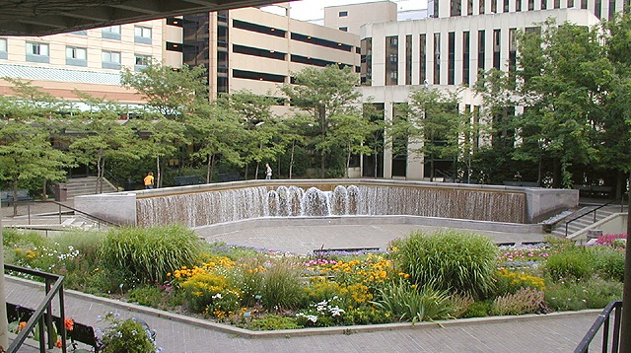
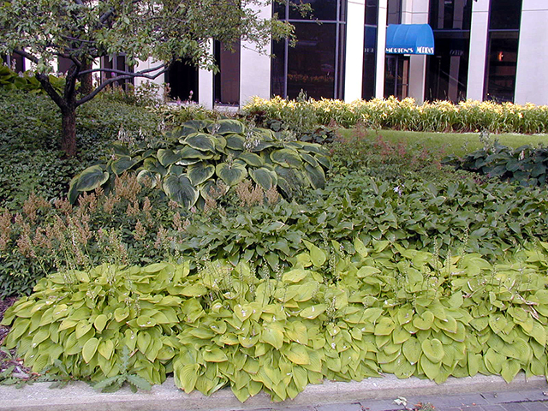
Perennials 101
Notes:
Note to the presenter: We are providing an exceptionally long set of PowerPoint slides. The presenter should review the slide set, download it on a computer, and reduce the program to the time period allotted. This gives Agents, speakers, and others who are using this material the ability to customize the type of plants and scope of the talk. This program is designed to be interactive. By this we mean that the participants in the classroom are expected to share their own gardening experiences with the presenter, and each other, as the talk progresses. This is why we list the cultural aspects in a list on the slide. This talk will quickly become a very boring review of one flower after another if the speaker just reads the slides and does not allow experiences to be shared. Involve your audience! Most, if not all, of your student gardeners have experience in this area. A word of caution, the presenter must act as mediator and make sure that the length of question/answer time does not interfere with the overall schedule. Alternatively, questions and comments may be reserved for the end of the lecture and addressed as time permits.
The presenter should review this text, then review the provided “terms” provided on the slides with the audience to be sure everyone understand the ‘jargon’. Proceed to the script entries provided for the flower slides which contains tips and specific suggestions for each recommended plant. The reviewer should quickly mention these points and then ask the audience to share their experiences growing that specimen. Encourage participants to keep comments short and to the point. This is a two-hour program on perennials (one minute per slide average).

Slide 2
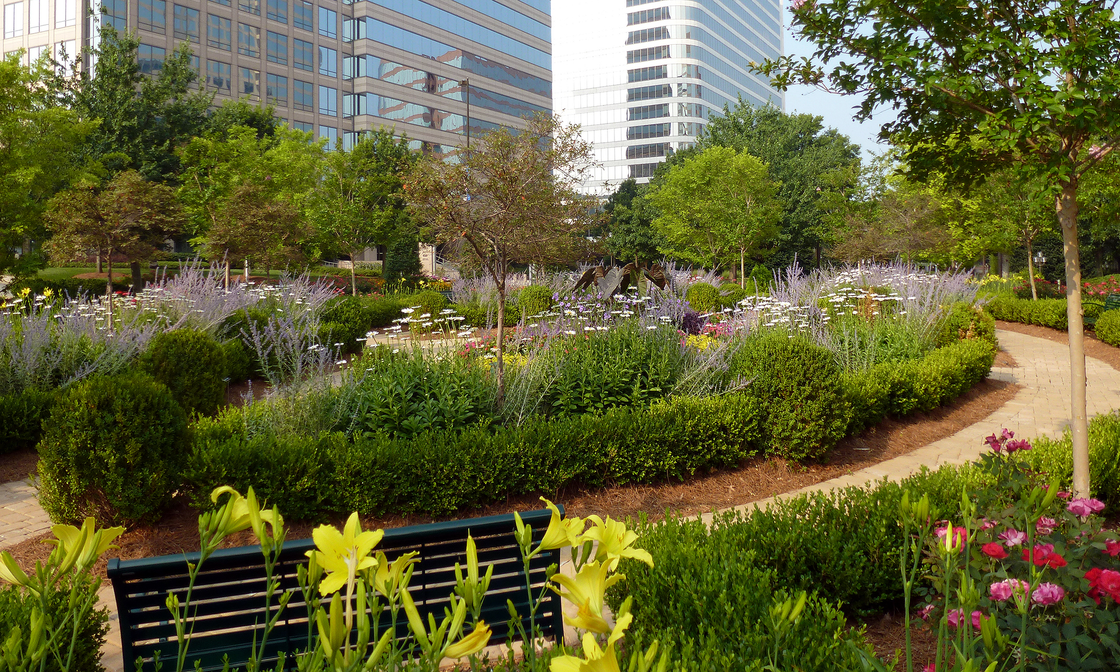

Slide 3
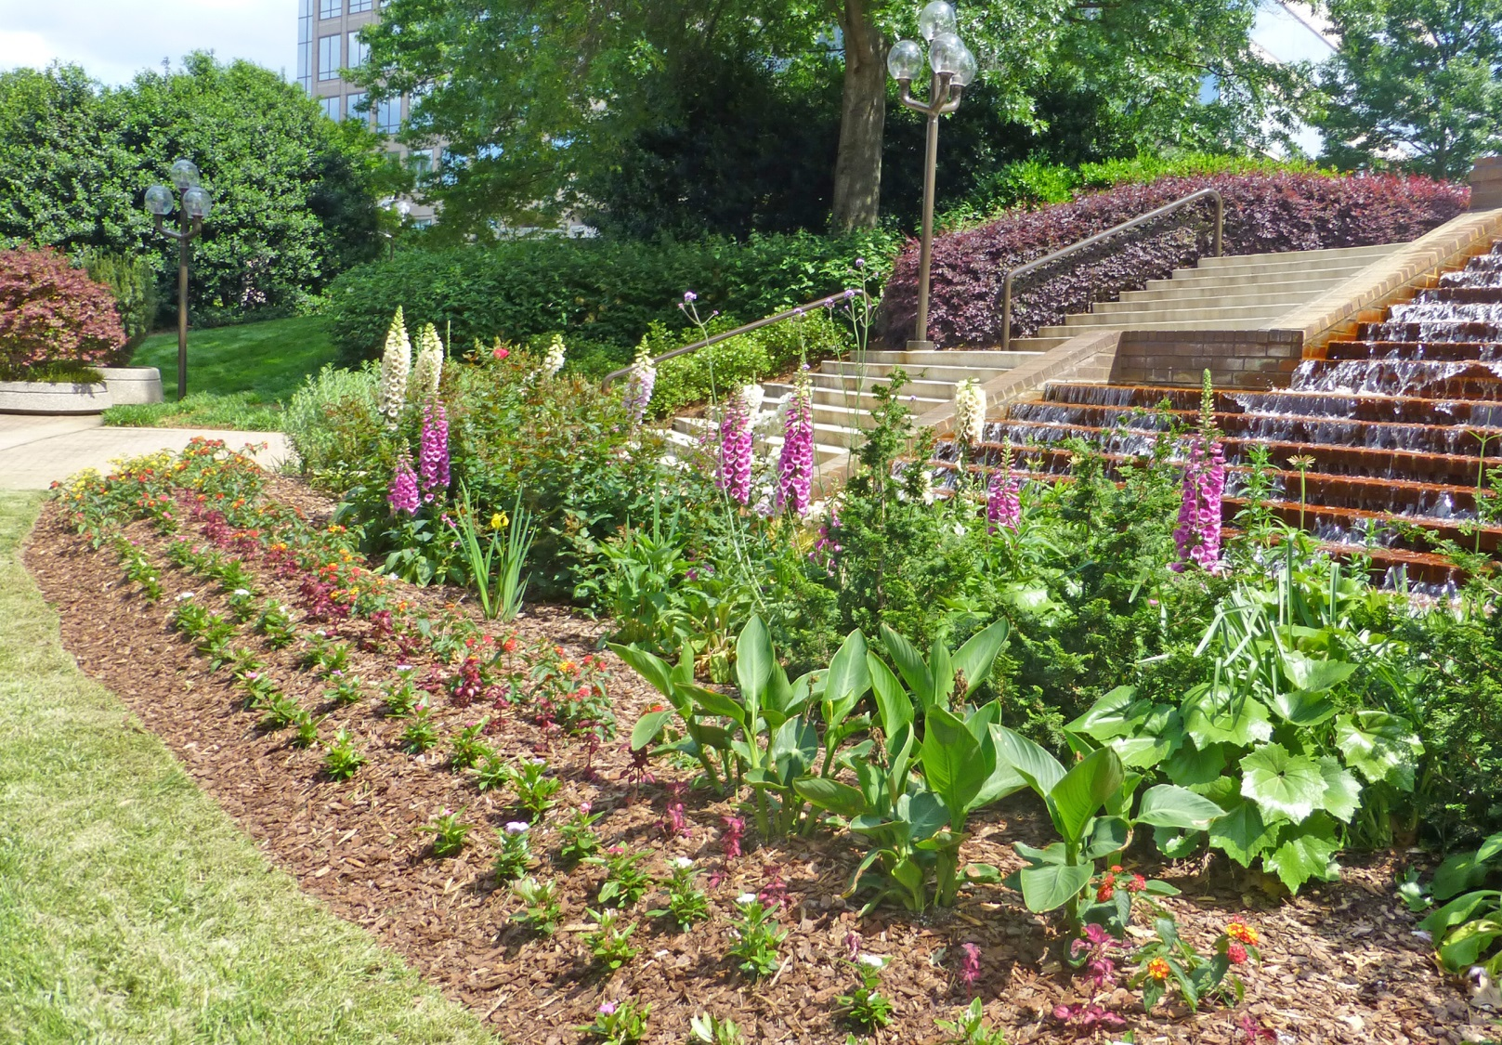
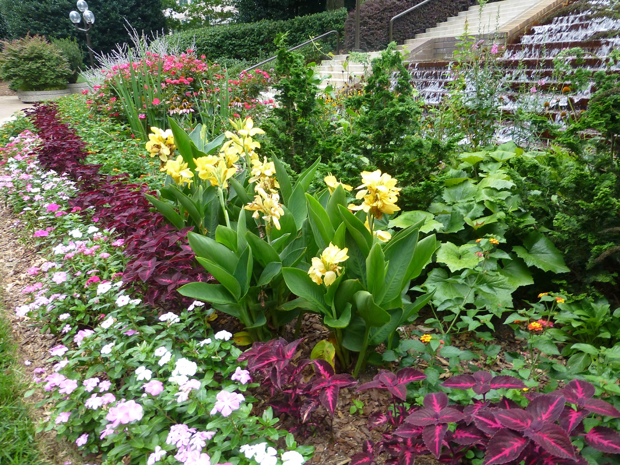

Slide 4
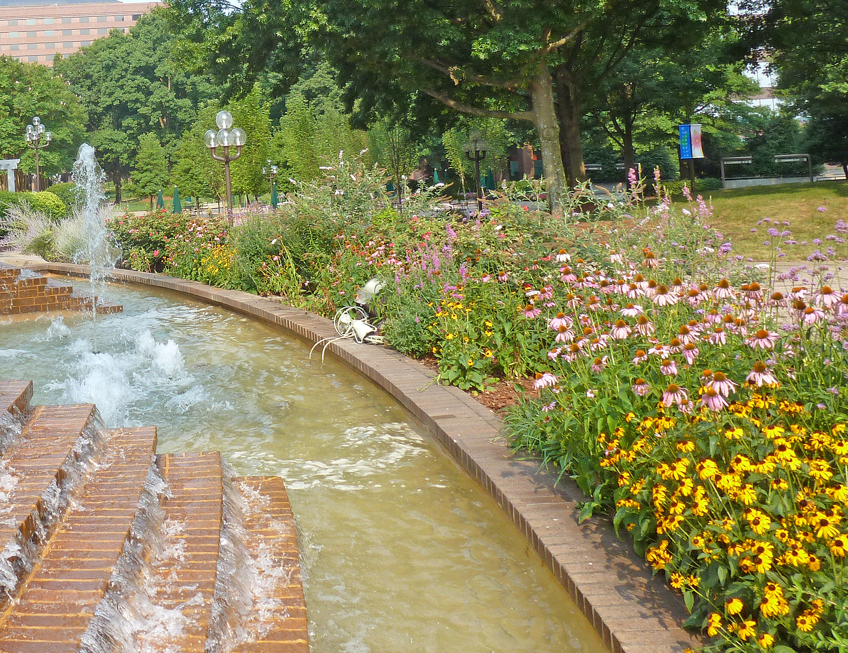

Slide 5
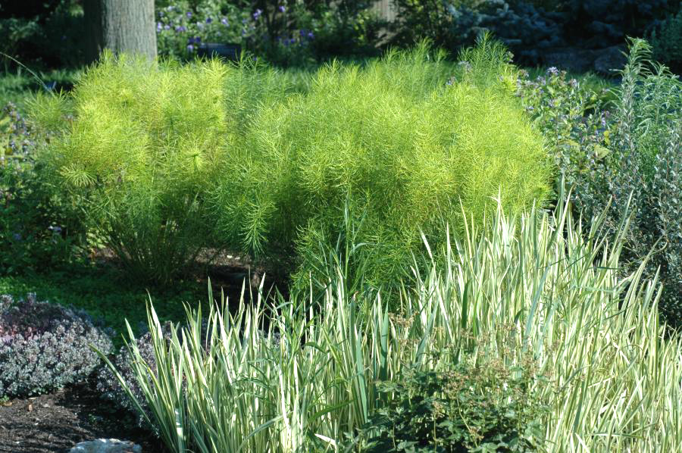
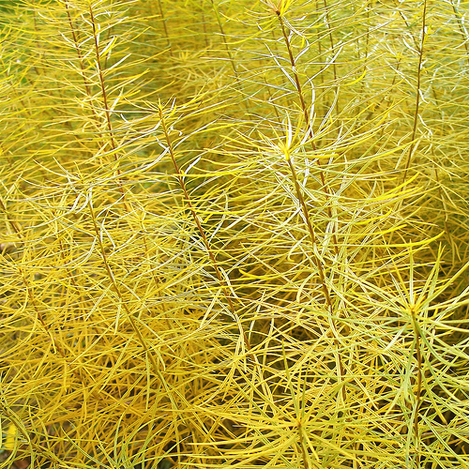
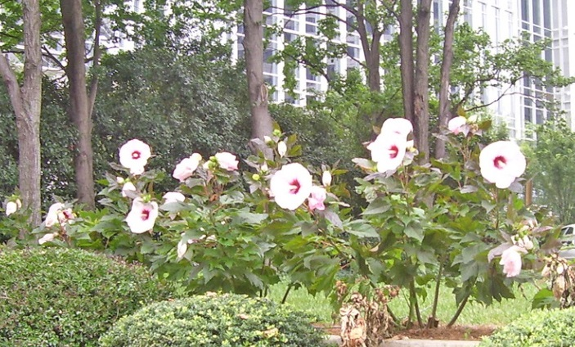
Amsonia hubrictii
Iris pallida Aureo-variegata
Hibiscus
Notes:
A. hubrictii, Iris pallida Aureo-variegata

Slide 6
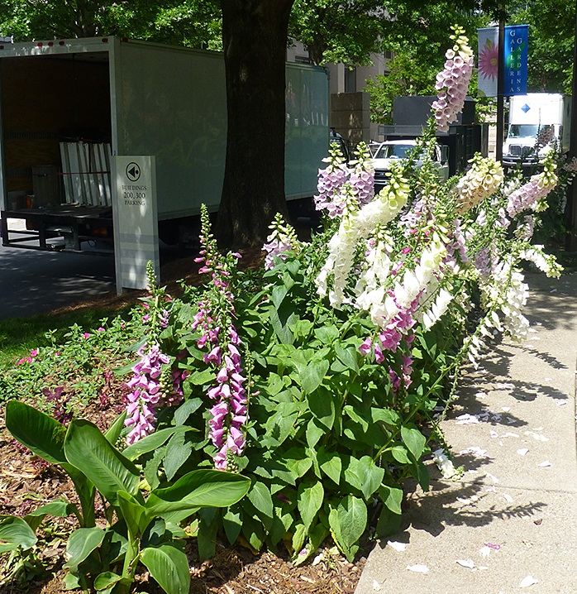
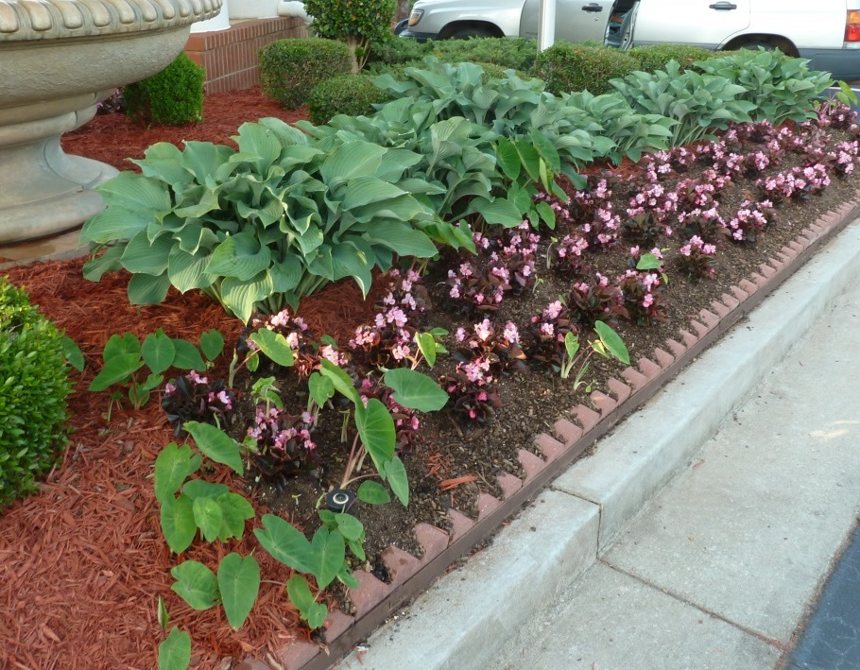
Terms
Annual:
Botanically, a plant which completes its life cycle within one year.
Gardener’s definition: annual is a plant unable to withstand both summer’s heat and winter’s cold.
Biannual:
A plant which completes its life cycle in two years
Tender Perennial:
An annual which happens to over-winter. This definition is very weather dependent. Some tender perennials are annuals 7 out of 10 years!
Perennial:
A plant which completes its life cycle in two or more years and can withstand summer and winter conditions.
Notes:
Review Terms: On Slide

Slide 7
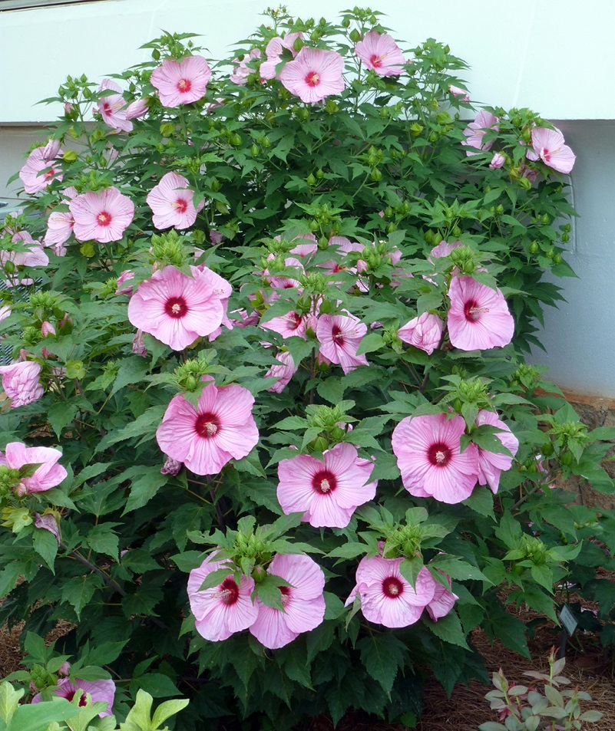
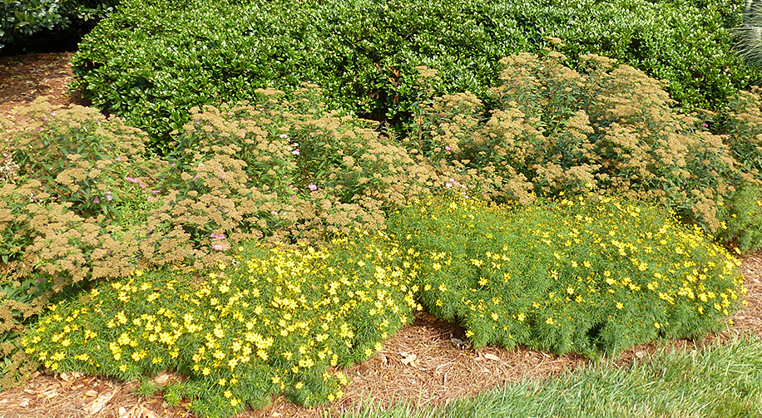
A Perennial Plant:
May be herbaceous (non-woody stems)
Coreopsis, Achillea, Echinacea, Liatris, Phlox
May have woody stems:
Rosemary, hardy Hibiscus

Slide 8
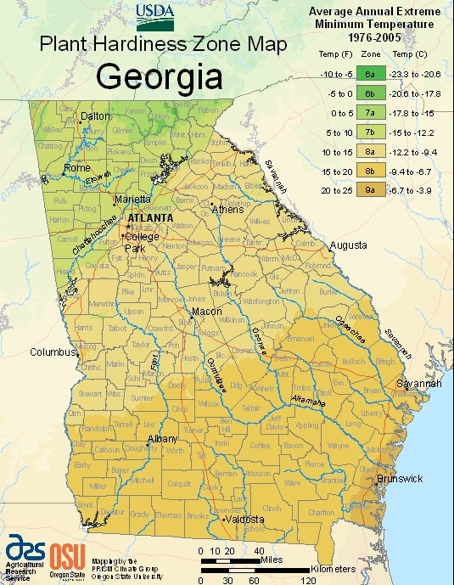
Georgia Hardiness Zones
Guidelines to evaluate geographical limits of adaptability
Based on average minimum winter temps
Many other factors play a role – summer temps during the night, humidity, rainfall
Notes:
Georgia has a diverse range of cold hardiness zones, ranging from zone 6a in the northeast corner of the state to zone 9a in the southern coastal part of the state. The average minimum temperature range for each of these zones is shown here.

Slide 9
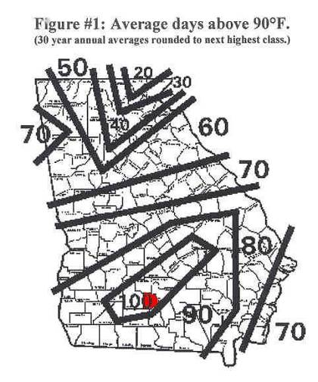
Georgia Heat Zones
Heat tolerance is more difficult to evaluate than cold tolerance.
Plants respond to cold by dying, to heat by slowly dying.
High night temps increase respiration; for every 16F⁰ rise in temp, respiration doubles
Plant uses up stored reserves leading to reduced vigor, weak stunted plants and small foliage
Fall planting
Notes:
The effects of heat damage are more subtle than those of extreme cold, which can kill a plant quickly. Heat damage can first appear in many different parts of the plant: flower buds may wither, leaves may droop or become susceptible to pests, chlorophyll may disappear so that leaves appear white or brown, or roots may cease growing. Plant death from heat is slow and lingering. Plants growing in Georgia face a challenging combination of high summer temperatures over the 24 hour cycle, in addition to high humidity. The figure shows average days with temperatures above 90 degrees Fahrenheit. Clearly, the Coastal Plains experience more days compared to more northern regios.

Slide 10
On Plant Growth in Georgia…
Plants flower earlier, are taller, and may have weaker stems due to accumulated heat
Tall forms tend to collapse without support, and dwarf selections are usually more effective
Fertilizer may not need to be applied as generously, particularly for tall plants as additional growth is not desired
Leggy, lanky growth and fewer flowers result if too much nitrogen is applied

Slide 11
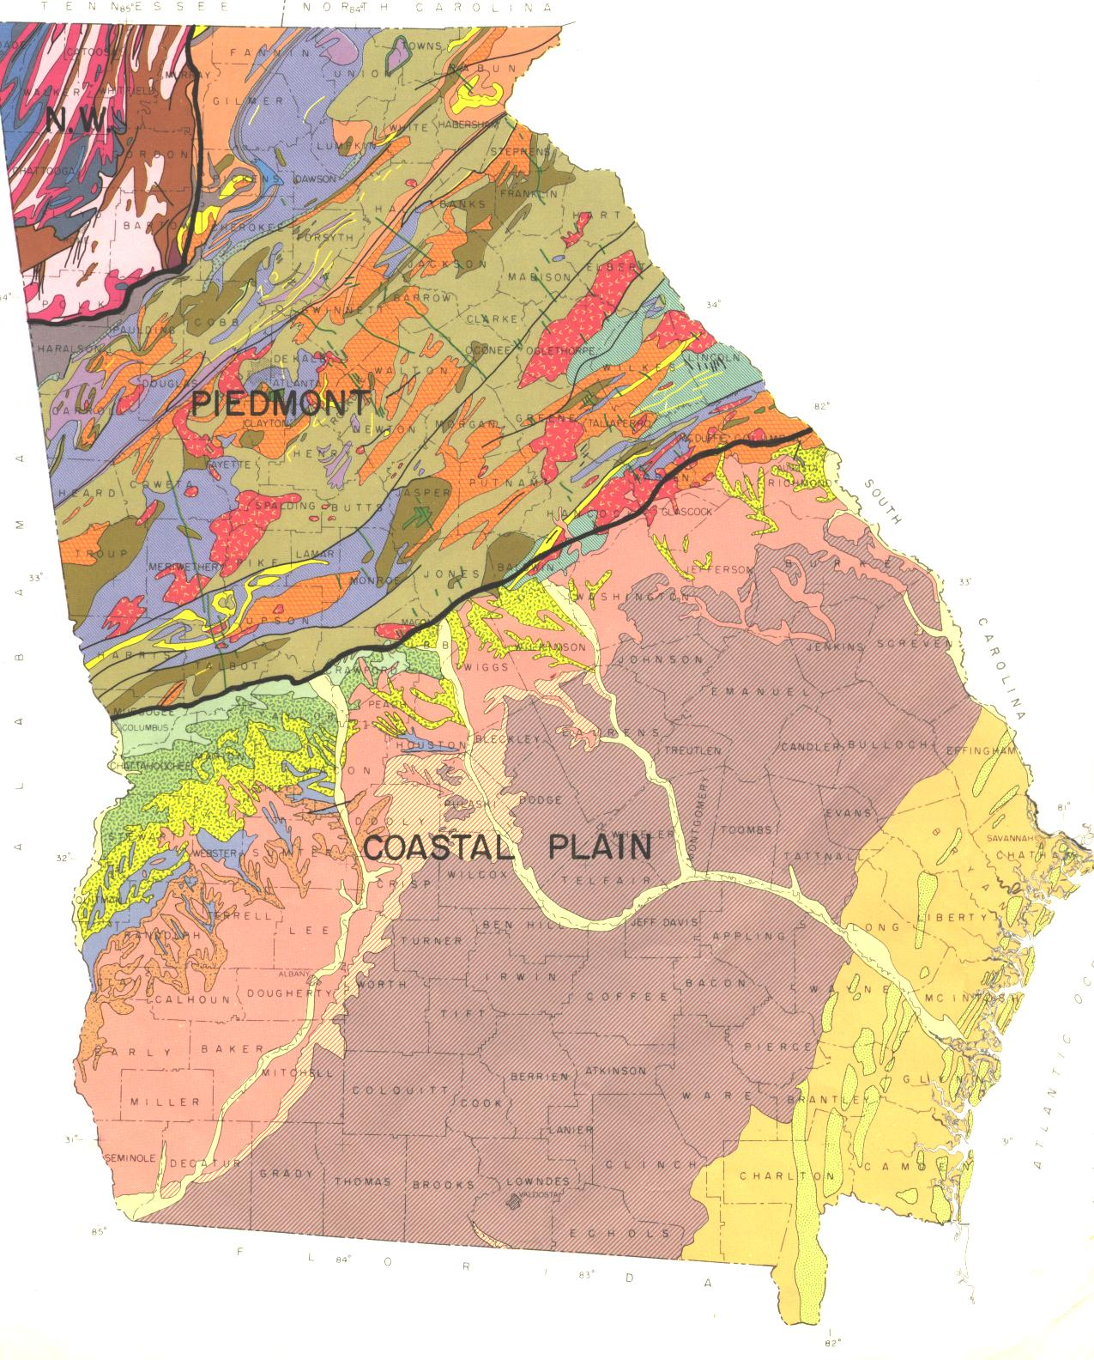
Drainage is Everything!
Coastal Plains: sandy, well-drained soils, poor in organic matter (few exceptions)
Mountain Region: clay-loam, clay soils, retaining water well; organic matter present in some
Piedmont Region: clay soils, retaining water well; organic matter present in some
Major survival problem is inadequate drainage !
Amend with organic matter to prevent root rots.
www.dot.ga.gov
Notes:
The soils in Georgia are varied; generally the Coastal Plains have sandy, well-drained soils, poor in organic matter, while the Piedmont and Mountain regions have heavier clay, or clay-loam soils, which retain water well, with organic matter present in some. The complex interplay between air temperatures in winter and summer with various soils, have a huge impact on plant growth and survival. This is the reason why some species do well in one region, but poorly in other.

Slide 12
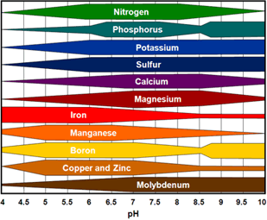
Soil
Most perennials prefer a soil pH between 5.2 and 6.7
Optimal for nutrient uptake
Too high pH – Fe, Mn become deficient
Too low pH – toxicities
Soil test
Organic matter
Notes:
Soil Testing: Since perennials are expected to live in a certain area for a few years, it is very important to be sure the soil is amended to fit the needs of the plant. In addition to organic matter, pay attention to the pH of the soil. Too high or too low of a soil pH may affect nutrient uptake, stress the plant, and reduce the plant’s chances of surviving more than one year.

Slide 13
Nutrition
Heavy:
3-4 applications: 1 lb of 10-10-10/100 sq.ft./ season
Moderate:
2 applications: 1 lb 10-10-10/100 sq.ft./ season one at transplant and one mid-season
Low:
1 application: 1 lb 10-10-10/100 sq.ft. at transplant or in early spring before growth resumes
Notes:
Review Terms: On Slide

Slide 14
Nitrogen Uptake Throughout the Year
% Nitrogen Uptake
40
DORMANT
DORMANT
RAPID SHOOT GROWTH
30
Bud Swell / Rossette Formation
20
GROWTH SLOWS
LEAF FALL
Perennials
10
JAN
FEB
MAR
APR
MAY
JUN
JUL
AUG
SEP
OCT
NOV
DEC
Notes:
Fertilization Usage: Perennials are much like shrubs in that they may require high levels of fertility early in spring or summer, when they put on growth, and low fertility the remainder of the year. The ability of a plant to take up nitrogen is also a function of season, once leaves are lost to frost, perennials do not need fertilizer.

Slide 15
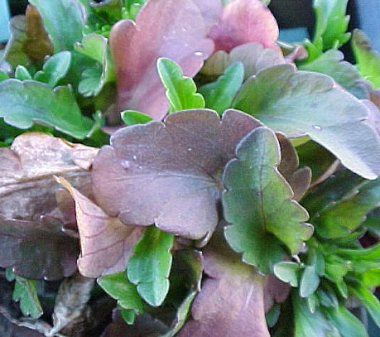
Common Nutrient Deficiencies
Purpling of lower leaves - Phosphorus deficiency
can be caused by cold, keeping plants too wet
use a general fertilizer, do not direct supplement!
Chlorosis or yellowing upper leaves - Iron deficiency
pH is too high - Iron sulfate added in increments
Overall yellowing, lower leaves – Magnesium deficiency
Mg deficiency is very common in Georgia – MgSO4
Notes:
Nutrient Deficiencies: There are often times when perennials show signs of nutrient-related problems. Periods of excessive rain or drought can affect levels of nutrients and nutrient uptake. In winter, some perennials that have evergreen foliage can become purple or bronzed. This may be a perfectly normal condition in the dead of winter, but a warning sign of deficiencies in late spring. In summer, pale yellow leaves and weak, off-green growth may be signs of underfertilization or depleted fertility. Calcium and magnesium may be depleted. Only a soil test and a foliage test will determine the right ratio of nutrients to add to correct the problem.

Slide 16
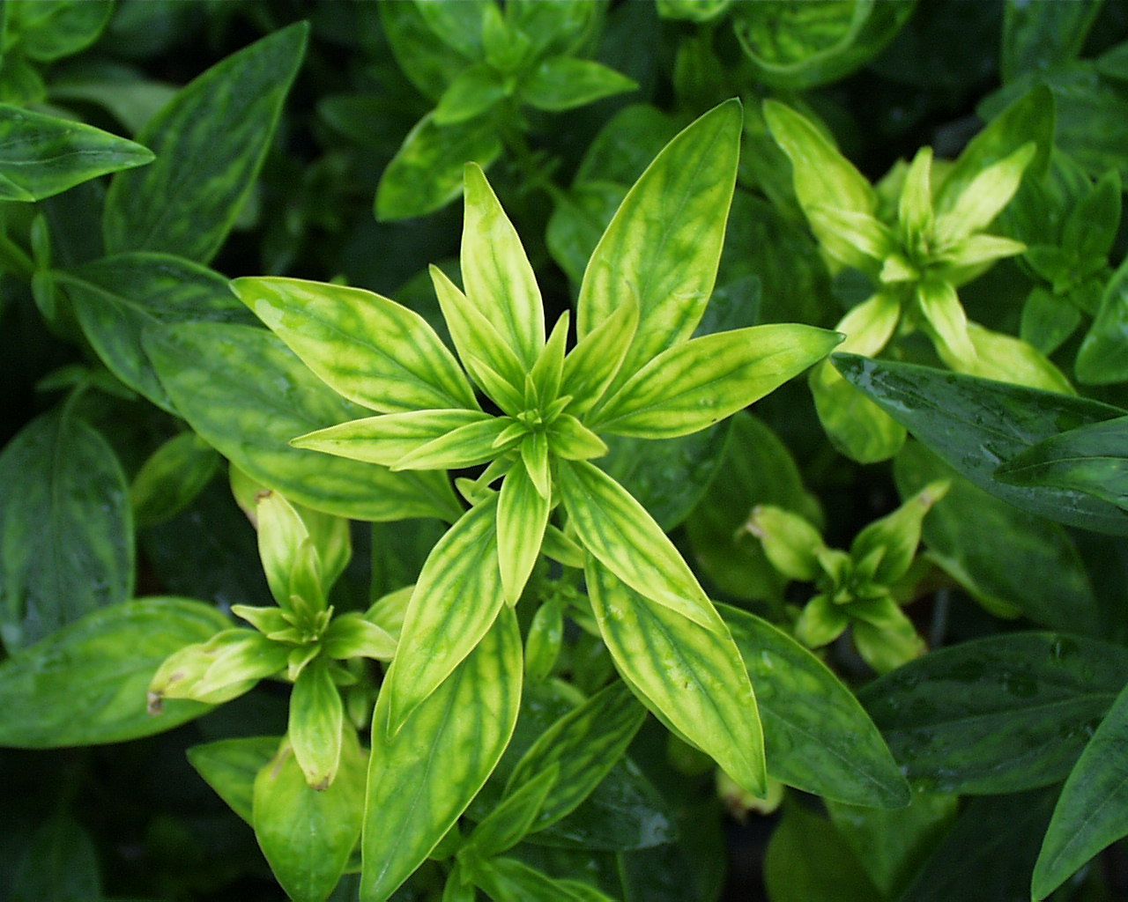
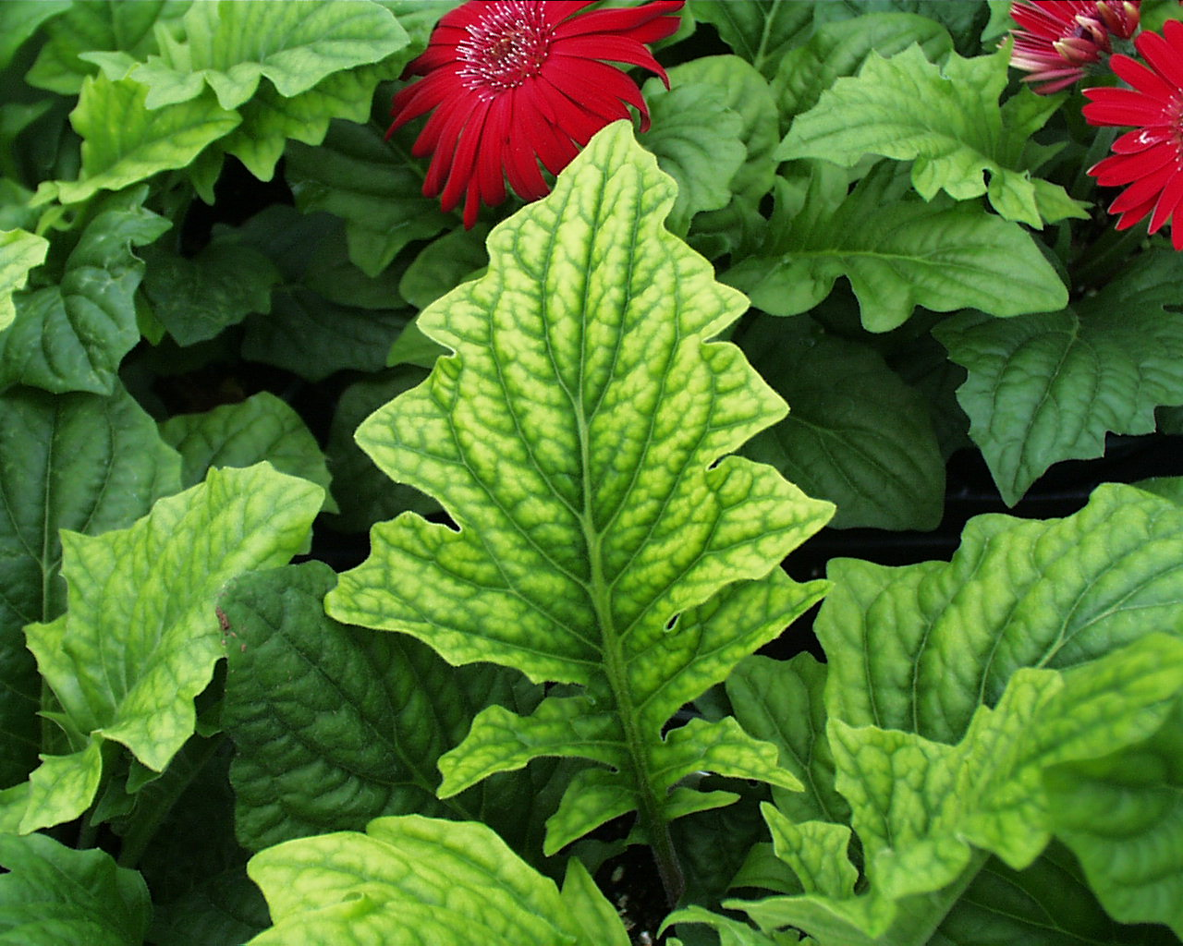
Fe deficiency:
tips and foliage chlorotic
Mg deficiency:
Lower leaves with interveinal chlorosis
Notes:
76. Symptoms associated with iron deficiency. A typical symptom of minor element deficiency is chlorotic young foliage.

Slide 17
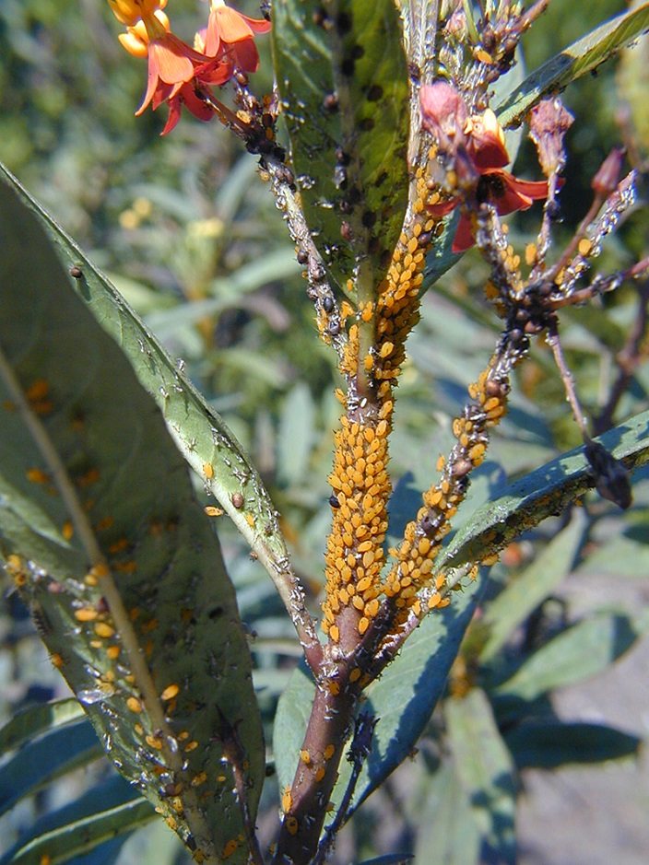
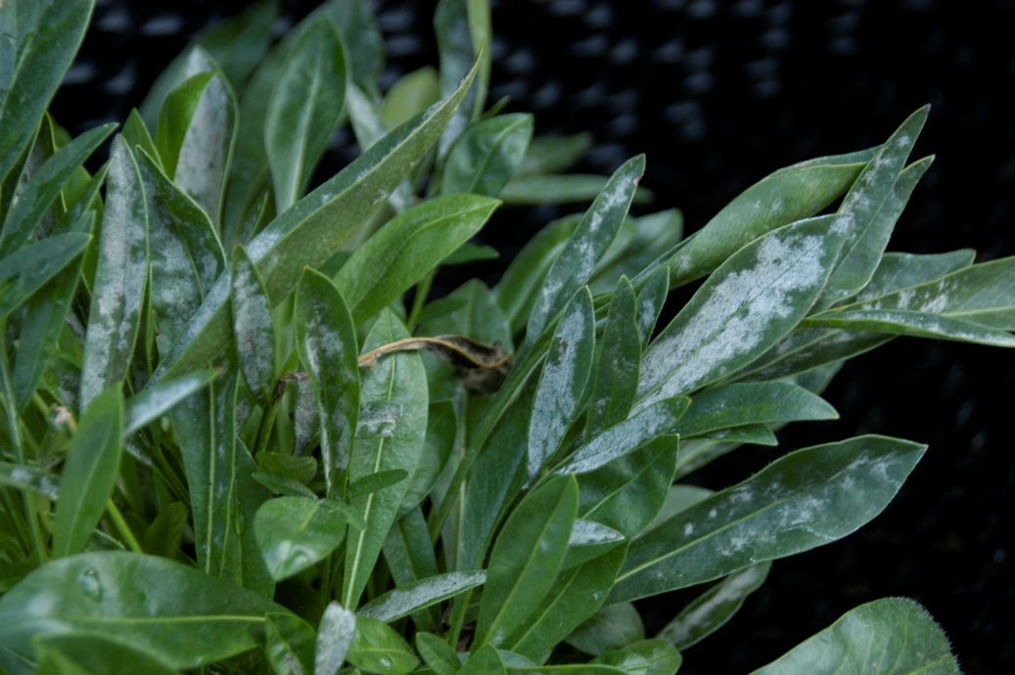
Perennials Are Complex
Know the size and habit!
Know the pests and diseases
Know the life-span
Know the bloom period
extension.udel.edu
Notes:
Perennials Are Complex: Preplanning is the key to success when designing and installing a perennial bed. Know your plant’s requirements. Knowing the final size your perennial will assume can prevent disappointments should a vigorous plant overtake less vigorous specimens.
Knowing the soil type preference and the pH requirements for your perennial will assure the likelihood of survival year after year. Knowing pests and disease tendencies will help you plan for problems that may arise in the future or may allow you to avoid disease prone specimens.
Knowing the life span will help you plan replacements and establish where the plant will be placed. Most long-lived plants will be placed towards the back and side of the garden, or in the middle, so as to allow replacement of less long-lived specimens without disturbing the more permanent specimens. Knowing the bloom period is essential to planning a continuous bloom sequence. Careful choices of species and hybrids can assure the gardener a season long color display.

Slide 18
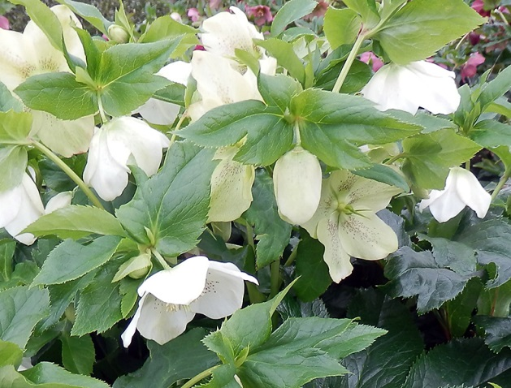
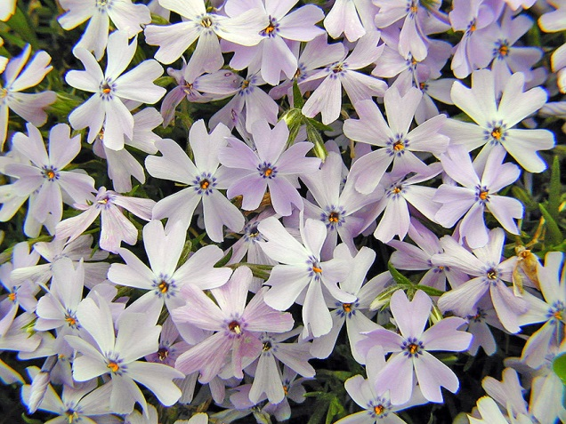
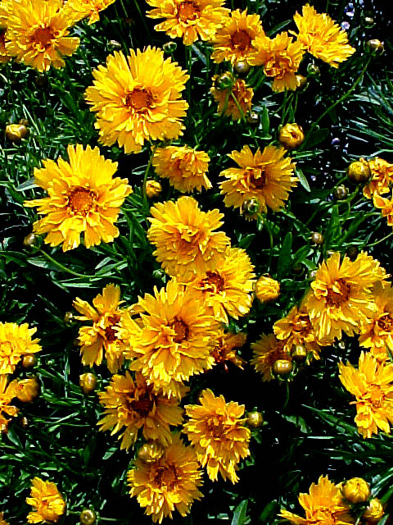
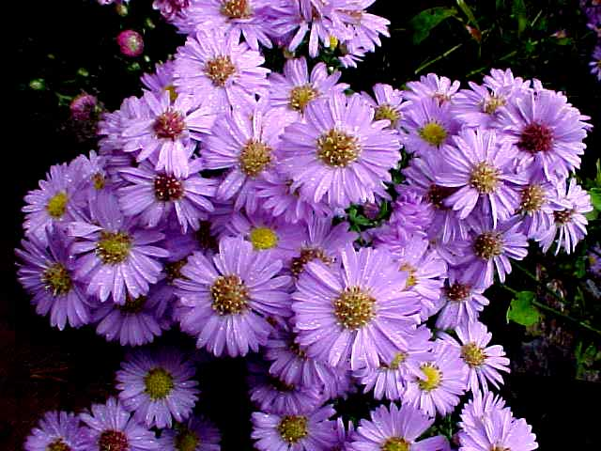
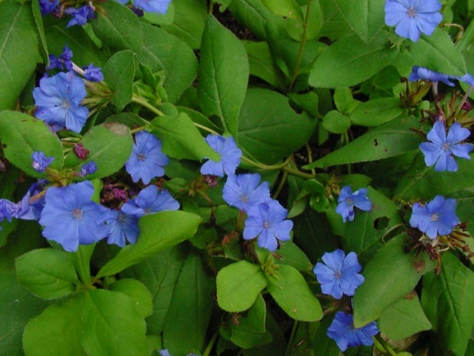
Jan/Feb/March
Apr/May/Jun
Jul/Aug
Sep/ Oct
Nov/ Dec
Notes:
Perennials Are Complex: Preplanning is the key to success when designing and installing a perennial bed. Know your plant’s requirements. Knowing the final size your perennial will assume can prevent disappointments should a vigorous plant overtake less vigorous specimens.
Knowing the soil type preference and the pH requirements for your perennial will assure the likelihood of survival year after year. Knowing pests and disease tendencies will help you plan for problems that may arise in the future or may allow you to avoid disease prone specimens.
Knowing the life span will help you plan replacements and establish where the plant will be placed. Most long-lived plants will be placed towards the back and side of the garden, or in the middle, so as to allow replacement of less long-lived specimens without disturbing the more permanent specimens. Knowing the bloom period is essential to planning a continuous bloom sequence. Careful choices of species and hybrids can assure the gardener a season long color display.

Slide 19
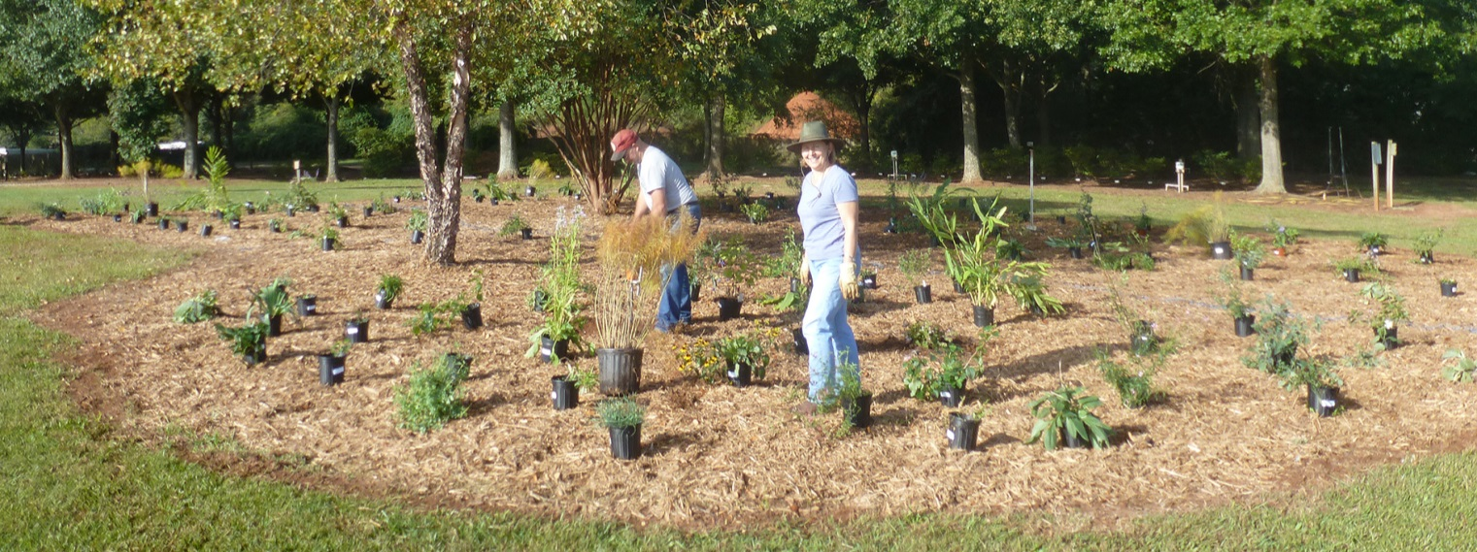
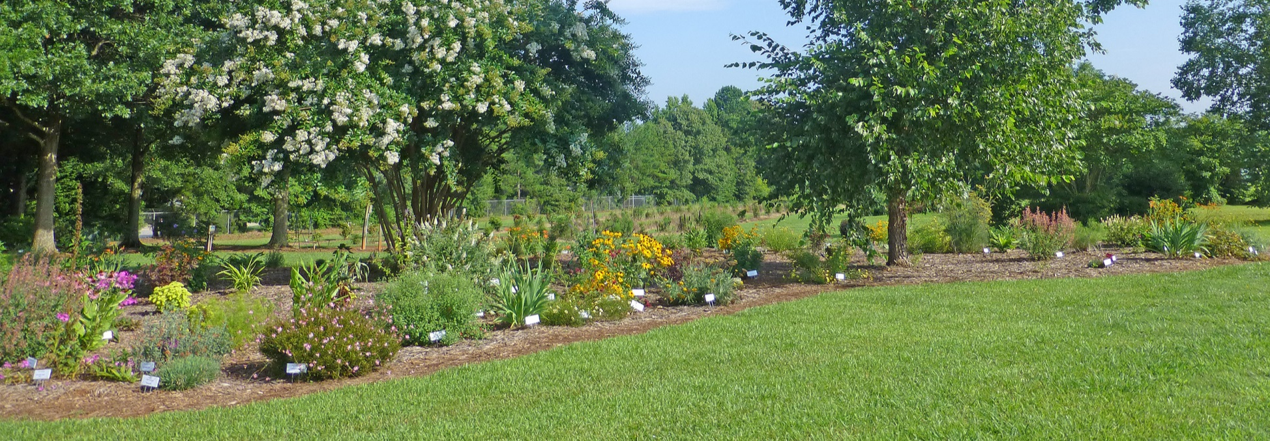
Pre-Planning an Installation Is Essential!
Oct 2012
May 2013
July 2013

Slide 20
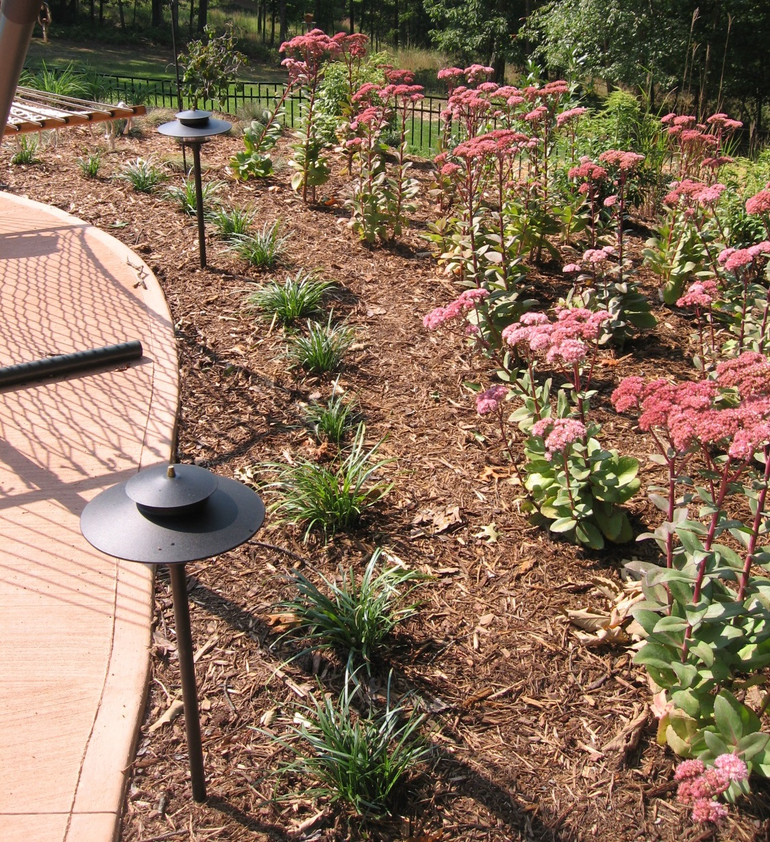
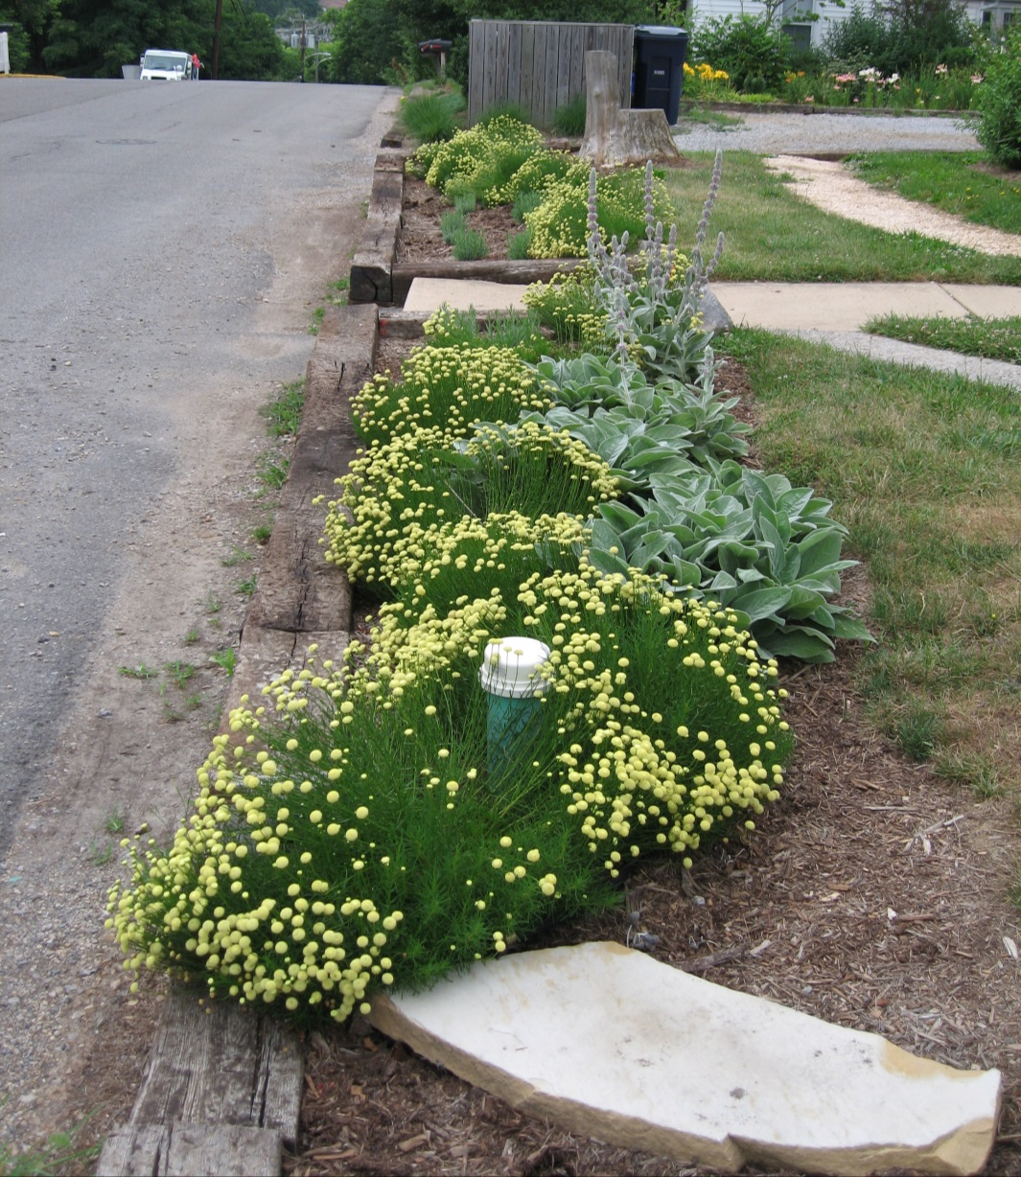
Manage customer expectations

Slide 21
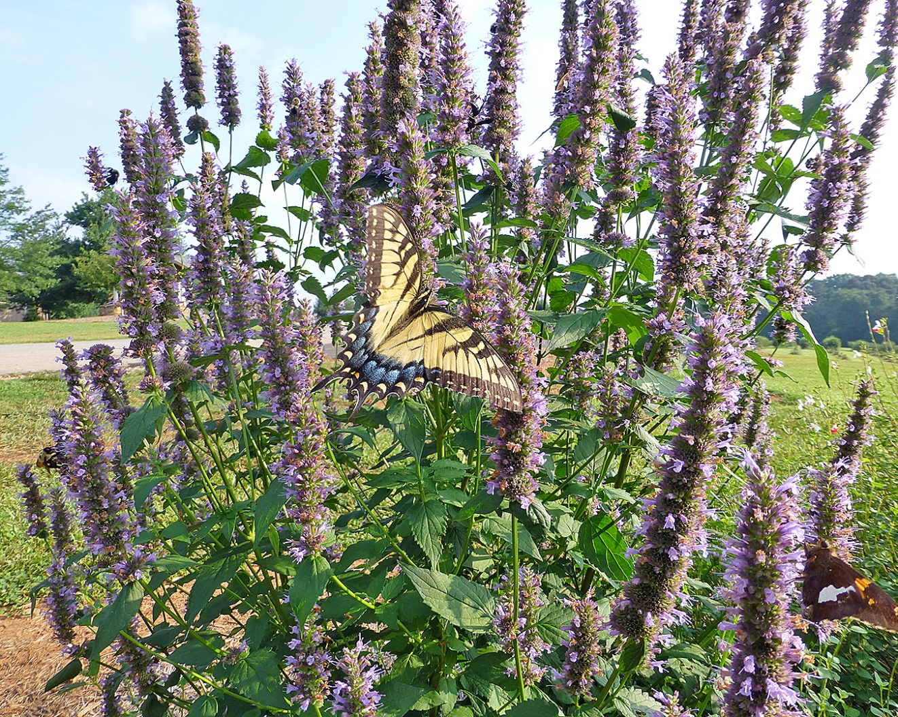
Ask specific questions!
Customer:
I want flowers and butterflies!!
You:
Flowers also attract bees … are you allergic to bee stings?
Or plain do not want bees buzzing around?

Slide 22
Selection Considerations
Most perennials do not live forever. In Georgia, most perennials live two to five years:
very long-lived perennials
e.g. Hosta, Lantana ‘Miss Huff’, Iris, Thrift, Daylilies and Soapwort
short-lived perennials
e.g. Coreopsis, Rudbeckia, Echinacea, Scabiosa, some Salvias and some Phlox
Notes:
Considerations: On slide

Slide 23
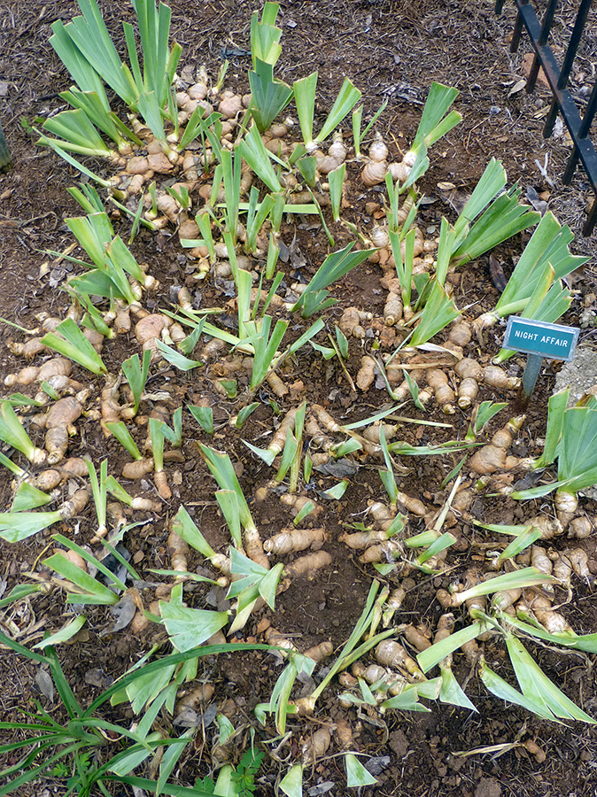
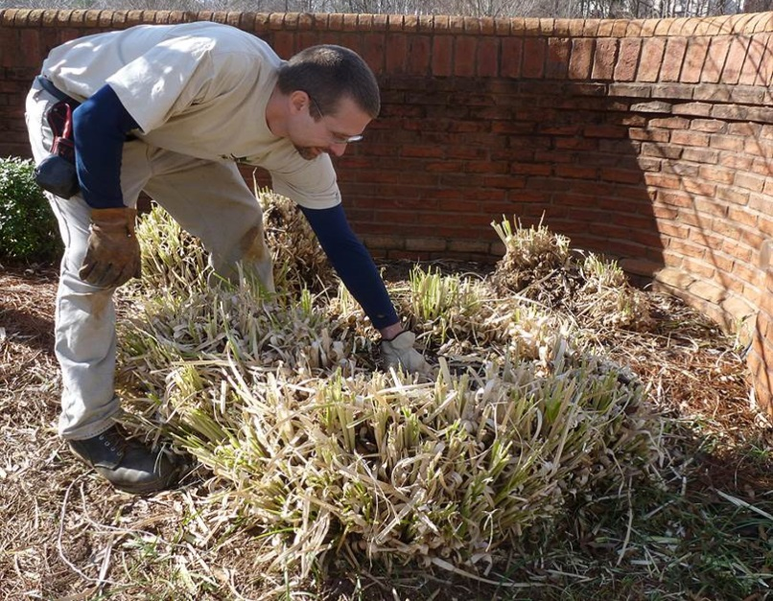
Selection Considerations
Perennials are not low maintenance - they require watering, fertilizing, shaping, deadheading, fall mulching, spring cleaning, dividing, replacing, and, insect, disease and weed control.
Some perennials grow best when divided every few years. Perennial bed renovation should be considered every 3 to 5 years.
Notes:
Considerations: On slide

Slide 24
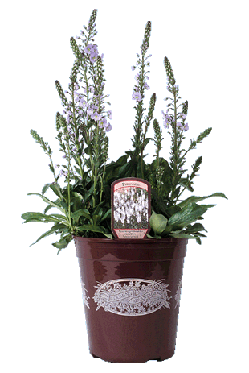
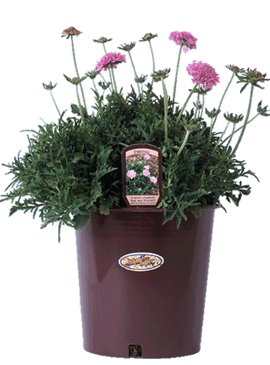
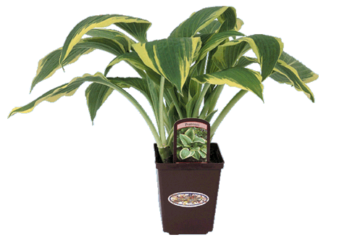
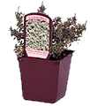
Product sizes
3.5”-4”
Quart
1 Gallon (or old “trade” gallon)
2 Gallon

Slide 25
Evaporation Rates For Athens
Fall Is For Planting!
Start Here!
Evaporative Water Loss - Inches
*
**
Notes:
Evaporation Chart: In Georgia, summer evaporation rates can be quite high and newly planted perennials may not be able to keep up with the heavy water demand. This may also cause a homeowner to use much more water than is necessary in a well-planned perennial planting. Note how the evaporation rates, and hence the water demand, drops off in October. This is the best time to plant!

Slide 26
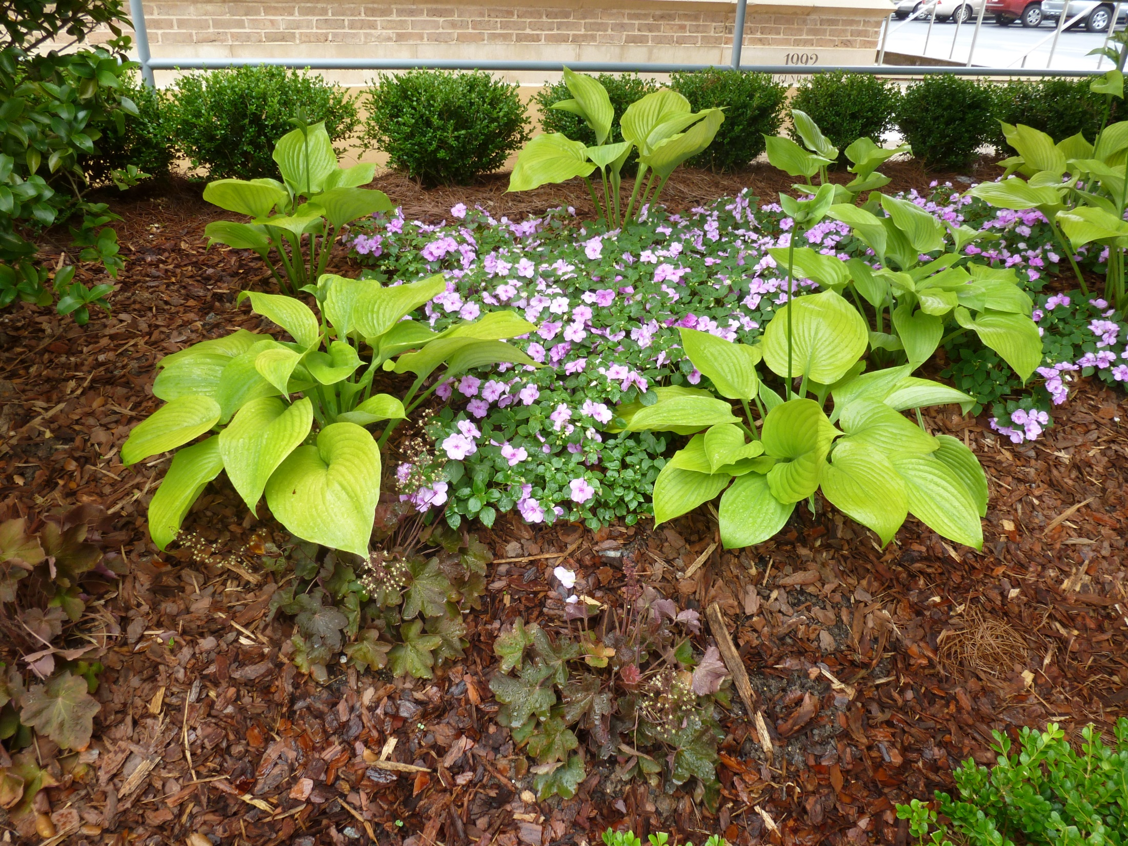
Right Plant in the Right Place!

Slide 27
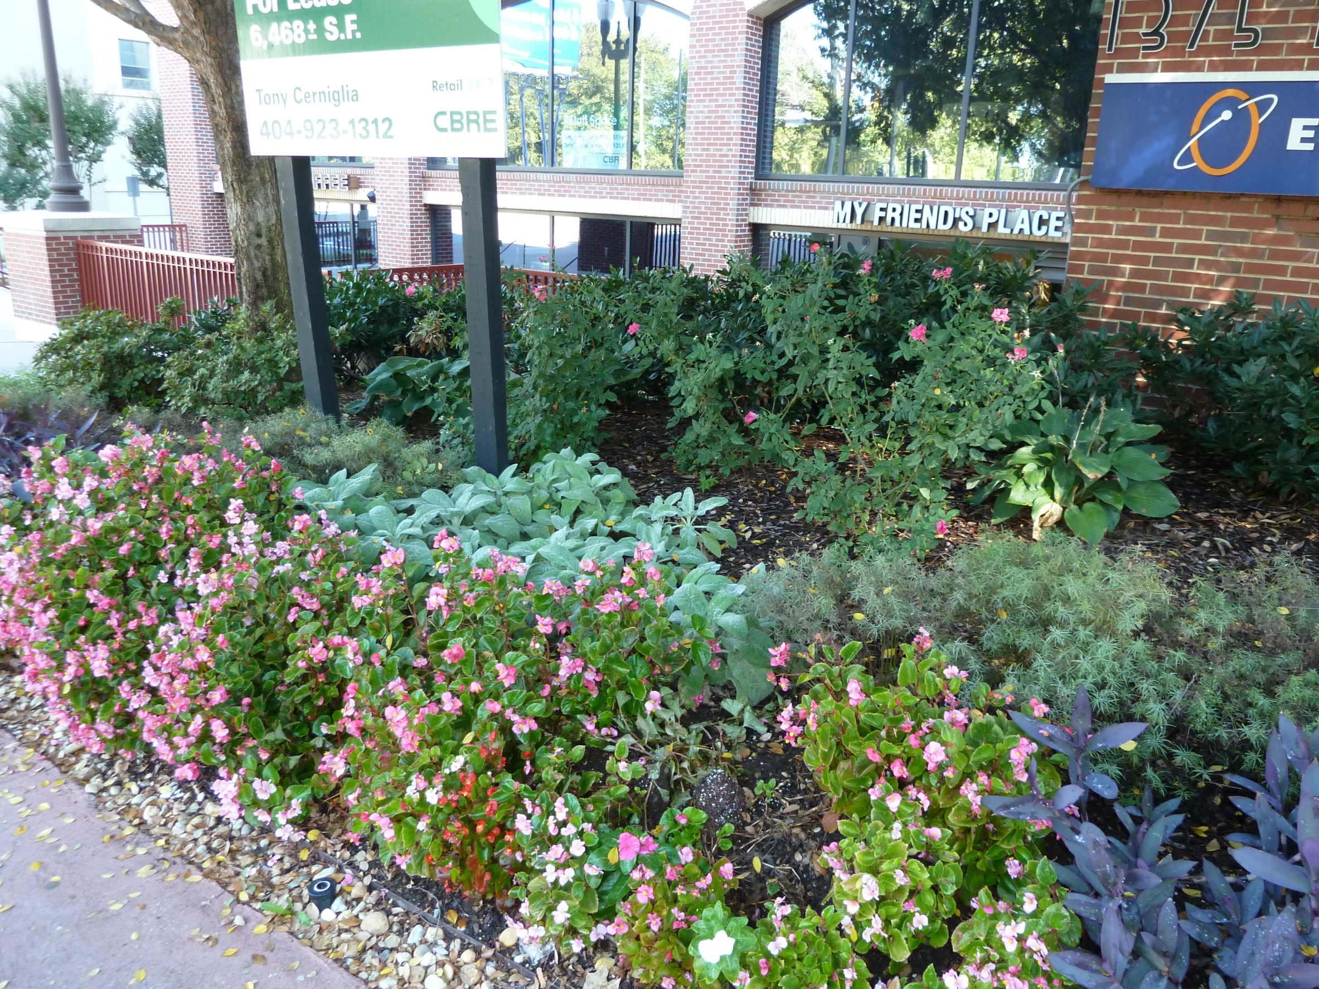
Shade
X
X

Slide 28
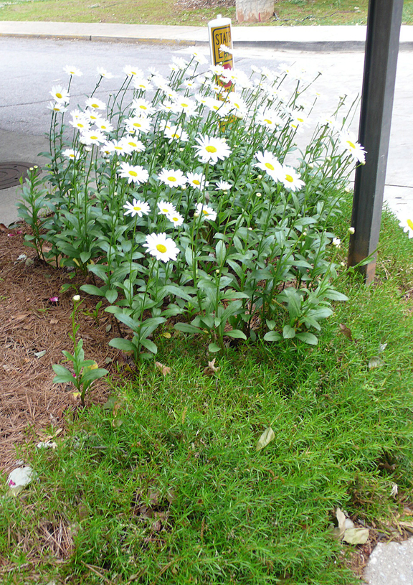
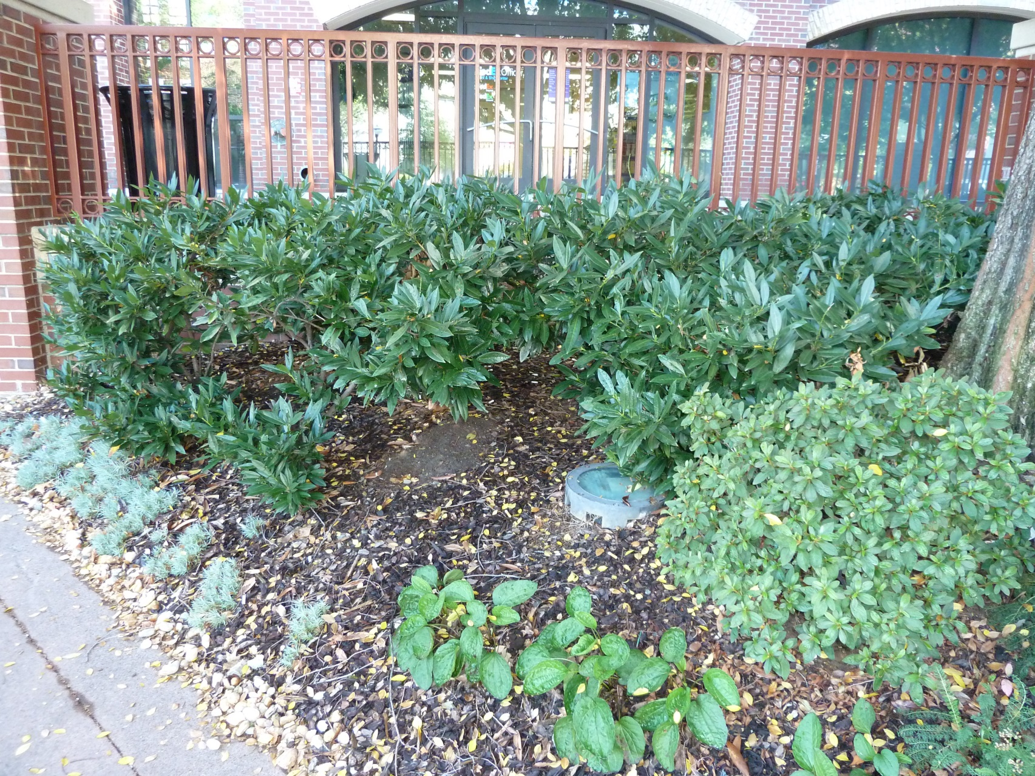
X
X

Slide 29
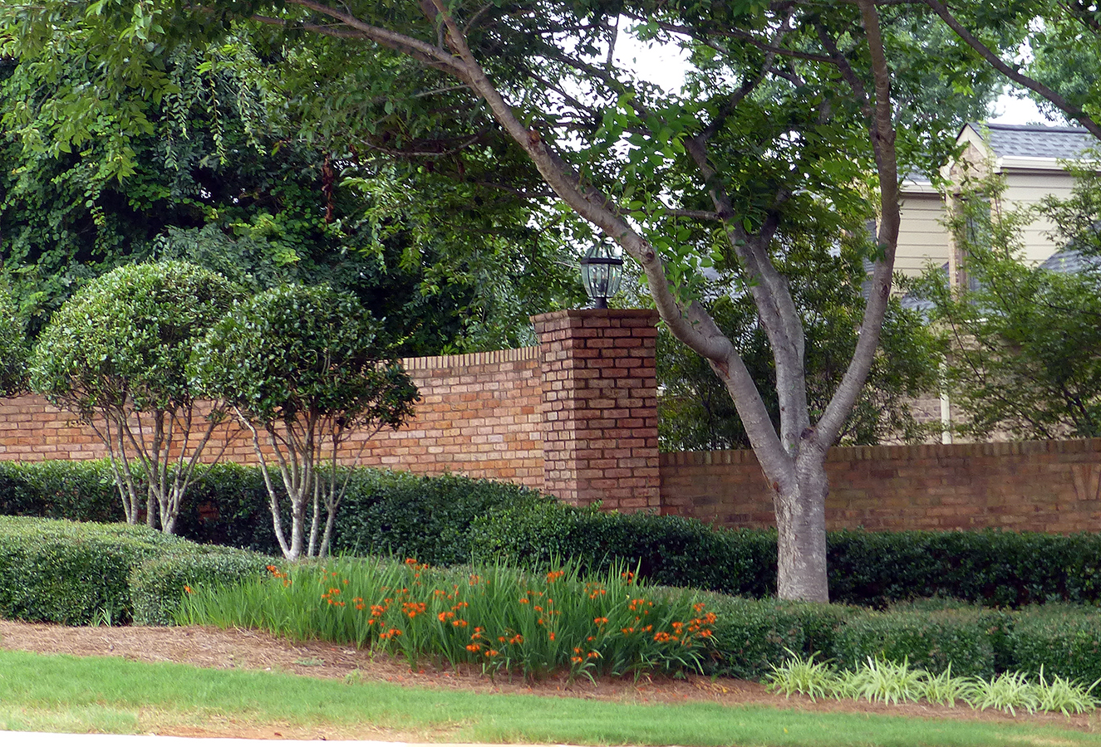
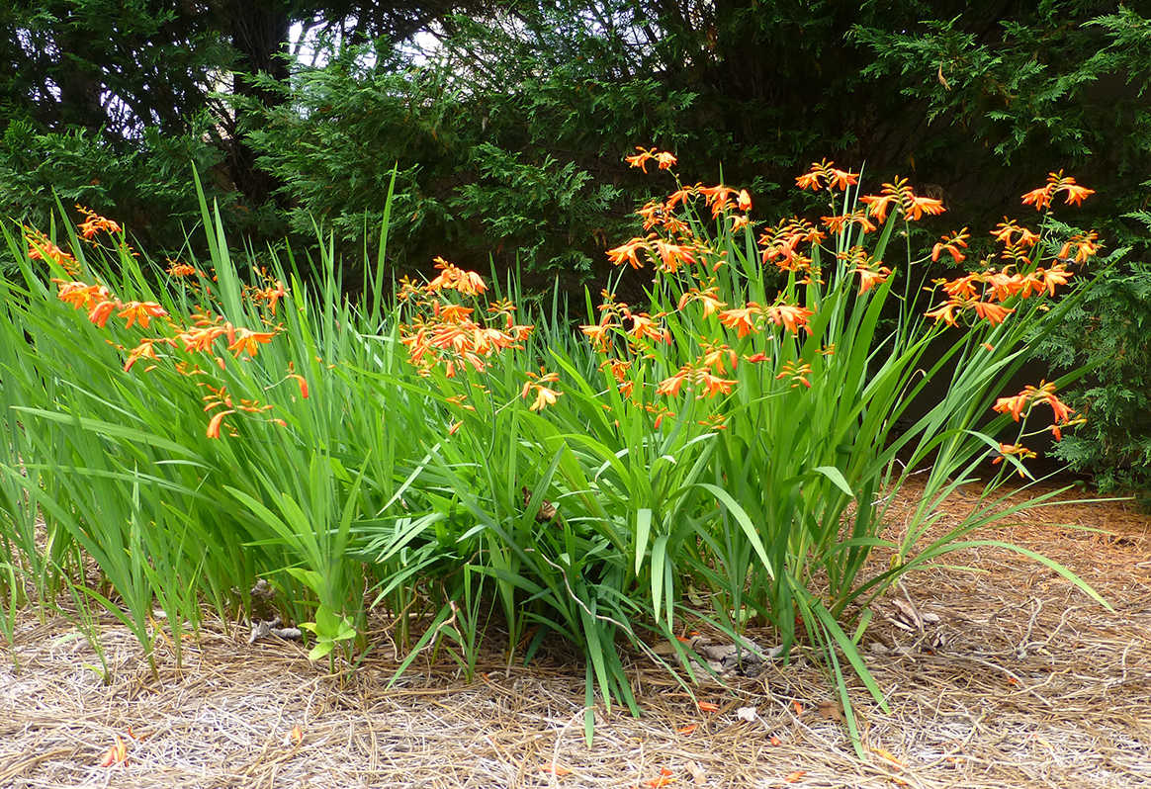

Slide 30
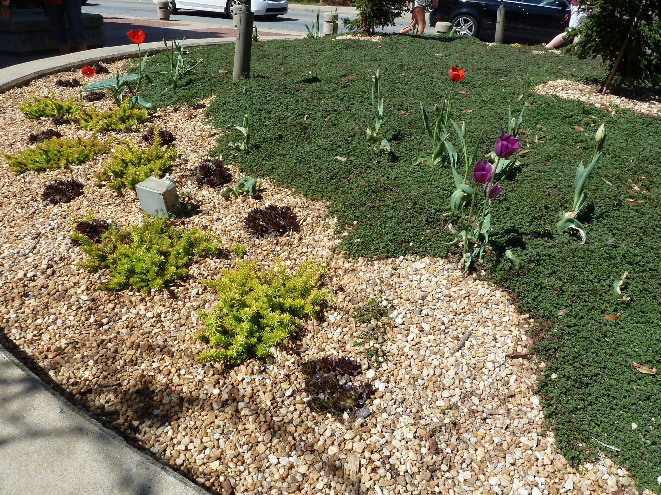
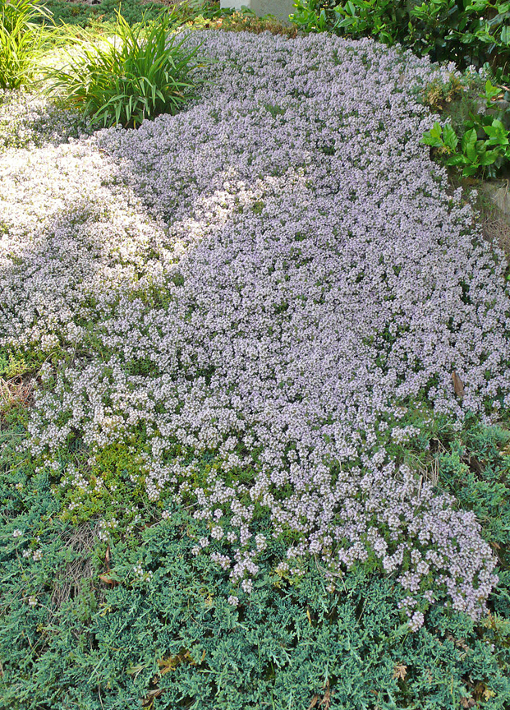
Dry Sun

Slide 31
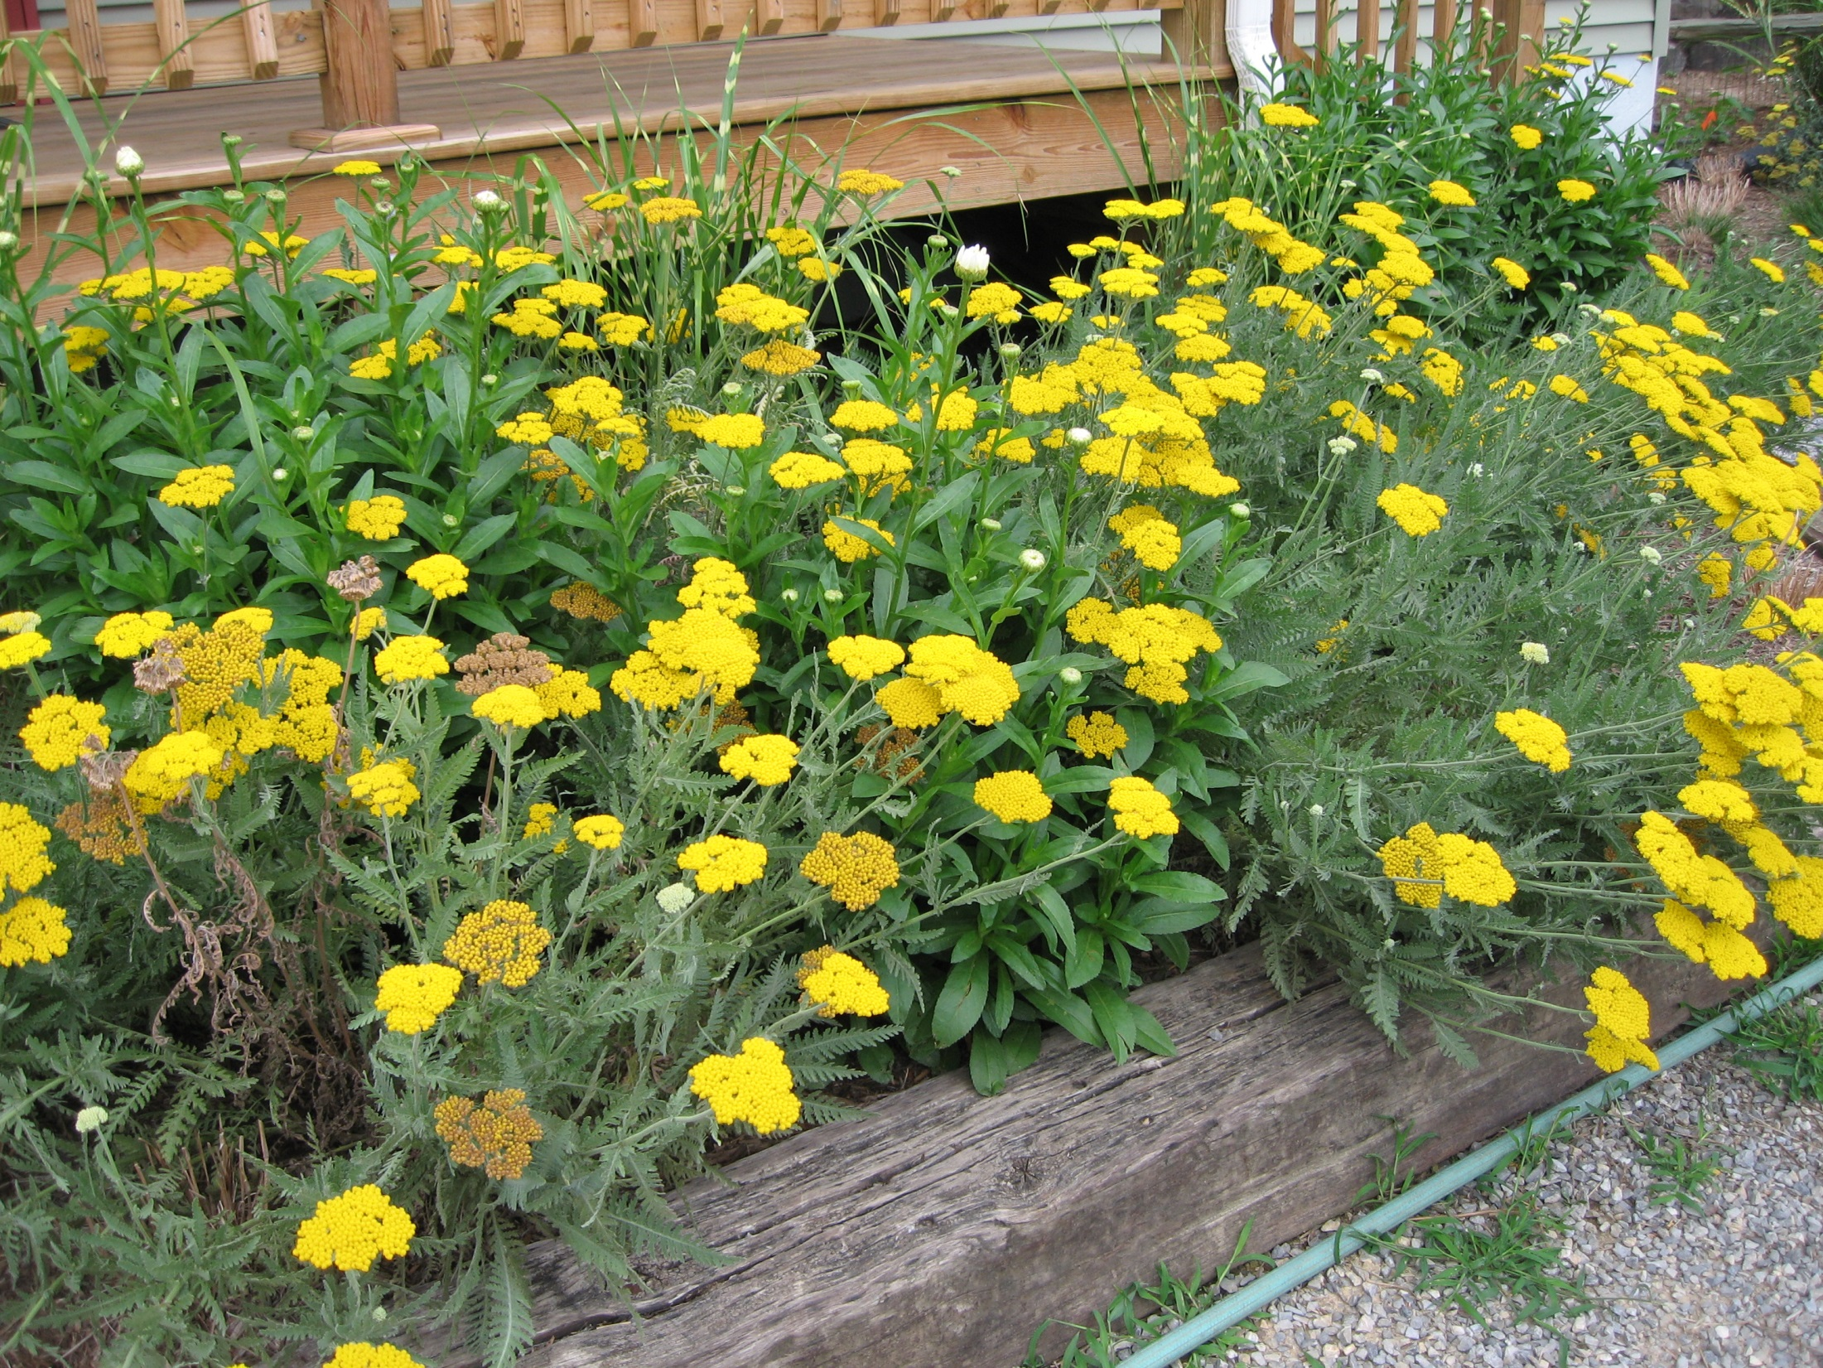

Slide 32
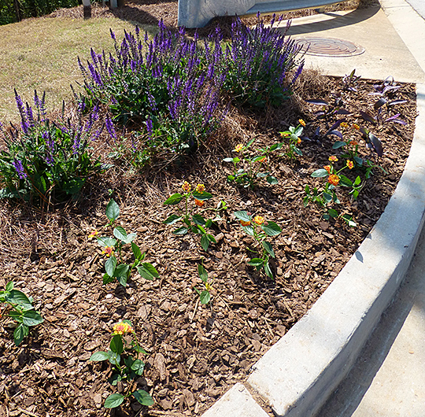
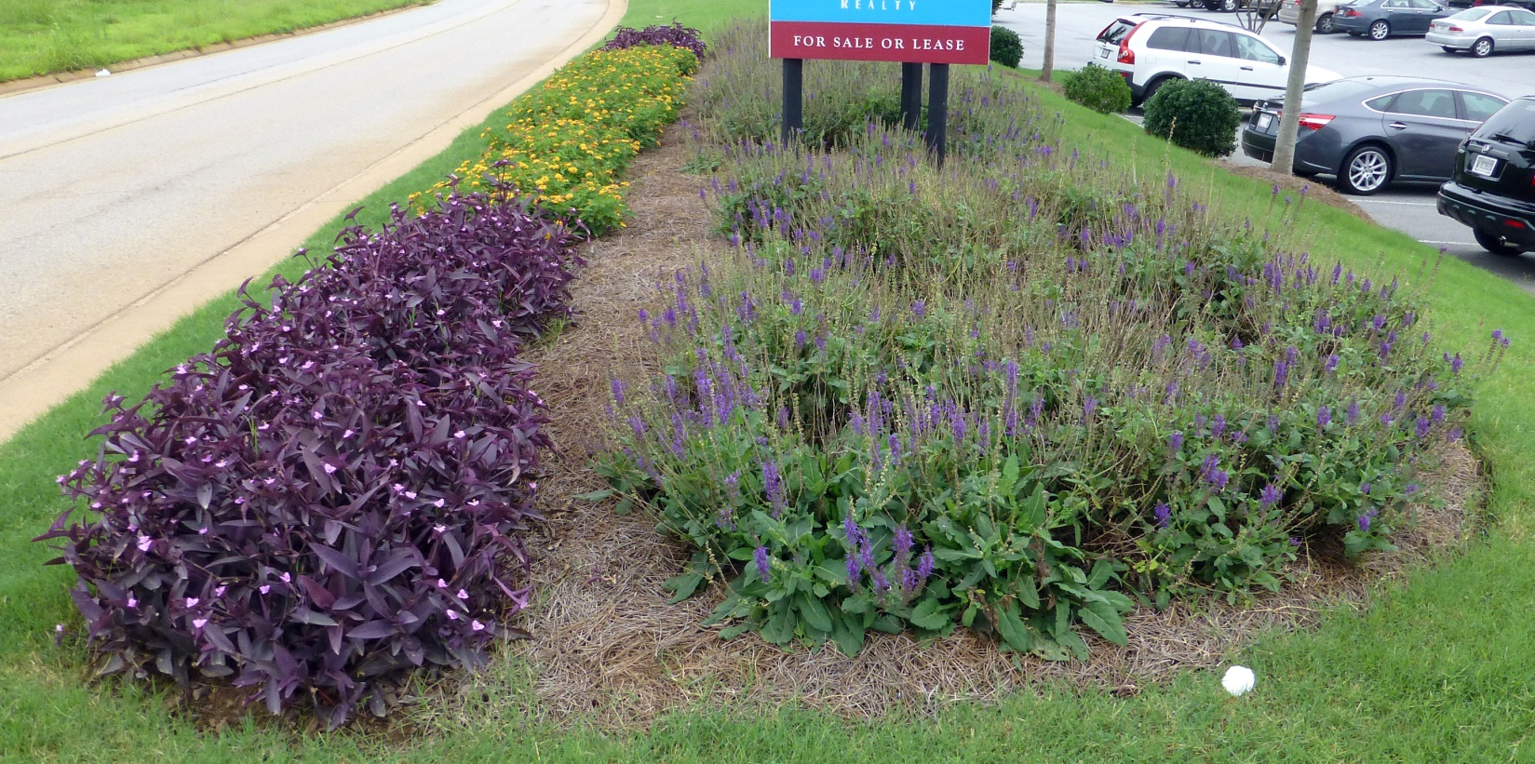
Deadheading makes all the difference for some…

Slide 33
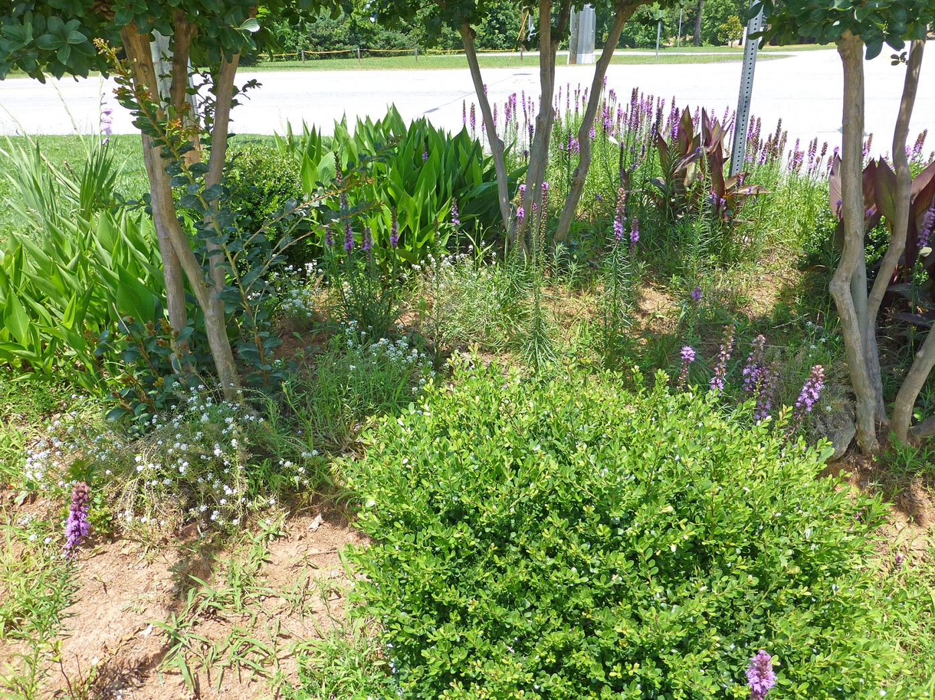
Deadheading also removes the source of those pesky seedlings later…

Slide 34
Leaving the seedheads (and foliage) on the grasses for winter interest

Slide 35
Pre-emergent herbicide is a must in roadside medians and other hard to reach places

Slide 36
Use knowledgeable staff to maintain residential accounts with many species
(train your staff on what’s a weed and what’s an ornamental!)

Slide 37
Beware of plant thugs…

Slide 38
Plant Selection/Arrangement
Group plants in bed by growth rates to facilitate division process
Plant groups of each species/cultivar rather than spotting single plants here and there
Arrange plants so certain areas of the bed are in bloom at same time
Plan for year round appeal
Add annuals/bulbs/shrubs for color/texture

Slide 39
Rudbeckia interplanted with daffodils

Slide 40
Perennials that need staking

Slide 41
Types of Perennial Gardens
Perennial Island Bed:
Freestanding garden usually kidney shaped and often raised to promote drainage.
Viewed from all sides.
Perennial Border:
May be double or single with a backdrop of a wall or woody shrubs.
Generally viewed from one side
Naturalized area:
Established in an area of native plants – e.g. woodland garden, natural stream.

Slide 42
Design Considerations
Notes:
P Heavy Metal

Slide 44
Red
Most Drama
Yellow
Blue
Red Salvias
Rudbeckia
Blue Salvias

Slide 46
Hot Colors Dominate (use sparingly)
Cool Colors Recede (use grouped together in a mass)
Two-Color Complementary Schemes:
Violet Yellow
Orange Blue
Red Green

Slide 47
Design Considerations
Place plants according to their mature size or their 3 year size
Many perennials will be spaced 18” apart
Place plants in triangle formations to maximize flowering and foliage effect
Photo by Dr. Ellen Vincent, Clemson University

Slide 48
Design Considerations
When creating a vibrant color border, surround the bold colors with white or silver to avoid a harsh gaudy look
Photo by Dr. Ellen Vincent, Clemson University

Slide 49
Generally, taller plants are placed toward the back of the perennial border and throughout the center of the island bed but…

Slide 50
… but there might be other considerations e.g. visibility

Slide 51
… speaking of Creeping jenny
Some types of variegated plants often revert back to the green form which is more vigorous and can take over.
Lysimachia nummularia ‘Aurea’

Slide 53
Russian iris | Iris ensata Thunb.
sweet iris | Iris pallida Lam.
yellowflag iris | Iris pseudacorus L.
Siberian iris | Iris sibirica L.
www.eddmaps.org/species
Beware of Invasives!!!

Slide 56
Sooo Many Plants, Sooo Little Time!
Bear’s breeches; Oyster plant
Acanthus spp.
‘Summer Beauty’

Slide 57
Daylily
Characteristics:
many hybrids
Location:
Full / part shade
Full sun if moist
Care and Feeding:
Heavy fertility
Bloom Period:
June – July
Culture Concerns:
Declines in heat
Hemerocallis hybrida
Notes:
Hemerocallis hybrida: There are thousands of Daylily hybrids from which to choose, and they grow well in full sun if irrigation is possible. If not irrigated, they go dormant in summer. In shade, they can survive drought intact, but blooms are smaller and fewer. Water and fertilize in August to revitalize the foliage before frost. There are cultivars such as ‘Stella d’Oro’, which are described as ever-blooming. In the South, this means sporadic flowering at best.

Slide 58
Russian Sage
Characteristics:
Nectar source
26 - 40 inches tall
Deer tolerant
Location:
Full sun
Care and Feeding:
Moderate fertility
Bloom Period:
June - September
Culture Concerns:
Do not crowd with other plants
Perovskia atriplicifolia
Notes:
Perovskia atriplicifolia: Russian Sage is a good plant for dry, sunny places if well established before summer heat. Fall planting is essential in well-drained soils. Single plants do not look showy due to the diffuse nature of the flowers. Professional landscapers use 10 to 12 plants on 10-inch centers for a strong color effect.

Slide 59
Shasta Daisy
Characteristics:
Spring color
Deer tolerant
18 - 24 inches tall
Location:
Full sun
Care and Feeding:
Low fertility
No drought
Bloom Period:
June – August
Culture Concerns:
Gets leggy if over fertilized;
deadhead
Chrysanthemum superbum
Notes:
Chrysanthemum superbum: Shasta Daisies are beautiful perennials if grown properly. Avoid fertilizing after March because it will cause long, floppy growth just before blooming. This plant does not respond well to trimming, so the best course of action is to fertilize it in October and again in late February. Deadheading improves the plant’s survival in dry, hot summers.

Slide 60
Coneflower
Characteristics:
Nectar source
Drought tolerant
Deer tolerant
Location:
Full sun
Care and Feeding:
Moderate fertility
Bloom Period:
July – September
Culture Concerns:
Mildew
Dies out in wet, warm weather
Rudbeckia triloba
Notes:
Rudbeckia triloba: Three-Lobed Coneflower is a perennial cousin of our annual Rudbeckia. It is a wonderful plant, worthy of any garden. Bright yellow flowers last most of the summer, and its height allows it to be a back-of-the-garden plant with fantastic color potential. It is difficult to grow from seed, so purchase 4-inch plants. Plant early and fertilize twice (before June). Cut back stems after seeds begin to develop, but leave 12 inches of stem attached so new rosettes can form at their base for next year.

Slide 61
Gay Feather
Characteristics:
Nectar source
Drought tolerant
Deer tolerant
24 - 36 inches tall
Location:
Full sun
Care and Feeding:
Moderate fertility
Well drained soils
Bloom Period:
May– June
Culture Concerns:
Scout for bulb rot
Divide @ 3 years
Liatris spicata
Notes:
Liatris spicata: A native plant that has been hybridized, it will grow just fine in Georgia. The plant grows from a corm-like structure. It spreads slowly if planted in good soil. The colonies of interconnected corms must be dug and divided every three years. Why? As the colony gets older, it only takes one old, diseased corm to succumb and then transfer the disease via shared roots. This will wipe out the entire group. The only way to prevent this is dividing every three years in fall, during dry weather. Then, if an old corm dies, other groups will remain viable.

Slide 62
Mexican Heather
Characteristics:
Nectar source
30 - 54 inches tall
Drought tolerant
Deer tolerant
Location:
Full sun
Care and Feeding:
Heavy fertility
Bloom Period:
August-September
Culture Concerns:
Do not crowd young plants
Salvia leucantha
Notes:
Salvia leucantha: Mexican Sage does very well in hot, dry, sunny locations, if established early in the spring. It blooms late in the summer, August 15 through late September. Intense plantings kept fertilized and watered will yield a spectacular flower display in fall.

Slide 63
Blue Sage
Characteristics:
Nectar source
Drought tolerant
Deer tolerant
24 - 54 inches tall
Location:
Full sun
Care and Feeding:
Heavy fertility
Bloom Period:
May – November
Culture Concerns:
Mid-summer and late summer trimmings help
Salvia guaranitica
Notes:
Salvia gauranitica: Blue Anise Sage, or Brazilian Sage, is a gem in the garden. It is a Georgia Gold Medal Winner. Tough and durable, it blooms from May until November and attracts hummingbirds and butterflies. It grows a thick storage root and persists even with tilling! Full sun is preferred. Mid-summer trimming, after the first flush of flowers, is essential for a glorious fall display.

Slide 64
False Indigo
Characteristics:
Drought tolerant
28 to 56 inches tall
Deer tolerant
Location:
Full sun
Care and Feeding:
Low fertility
Bloom Period:
June – July
Culture Concerns:
Comes up late in spring. Mark site
Baptisia australis
Notes:
Baptisia australis: This plant is perhaps the toughest specimen in the garden. It can handle anything our environment can throw at it. Flowers form in late spring then fade away like a daffodil by mid-summer to escape the dry, hot part of the summer. The plants grow to be quite large, and emerge late, so most gardeners tend to forget how big they get. They crowd other plants in their shade. It is recommended you mark the site with something permanent so as not to forget they are there (or how large the plants can become by the end of a season). There are some new cultivars having purple and white flowers, so there’re likely more reasons to have one in your garden.

Slide 65
Purple Cone Flower
Characteristics:
Nectar source
Drought tolerant
Deer tolerant
24 - 36 inches tall
Location:
Full sun
Care and Feeding:
Heavy fertility
Bloom Period:
May – August
Culture Concerns:
Deadheading is essential
Echinacea purpurea
Notes:
Echinacea purpurea: Purple Coneflower is fantastically popular as a garden and medicinal plant. It’s a great butterfly plant, and it is drought tolerant. Well-drained soils and deadheading are required for them to survive the wet soils of winter. If allowed to self-seed over several generations, green-flowering mutants often appear and should be rogued out. Native species of Purple Coneflower have drooping petals, whereas modern hybrids have horizontally held petals.

Slide 66
Hardy Ice Plant
Characteristics:
Nectar source
Groundcover
Drought tolerant
Deer tolerant
4 - 6 inches tall
Location:
Full sun
Care and Feeding:
Moderate fertility
Bloom Period:
May– October
Culture Concerns:
Do not cover with mulch in winter
Delosperma cooperii
Notes:
Delosperma cooperii: The Hardy Ice Plant is an asset to gardeners with poor soils, dry locations, and slopes. This plant requires only a few inches of soil to do well. It blooms early in spring and then sporadically the rest of the summer. Fertilize in June and August, and do not worry when frost turns the turgid, green leaves to black mush. The tiny gray leaves at the ends of the stems will burst forth in spring on schedule.

Slide 67
Perennial Plumbago
Characteristics:
Drought tolerant
12 - 14 inches tall
Deer tolerant
Location:
Full sun
Care and Feeding:
Moderate fertility
Bloom Period:
June – August
Culture Concerns:
Spreads rapidly
Ceratostigma plumbaginoides
Notes:
Ceratostigma plumbaginoides: Perennial Plumbago makes a great groundcover in full sun. It sports sky-blue flowers all summer, and its foliage turns bright red and orange in fall. It can tolerate dry soils and grows around rock and gravel. However, it can be invasive in good garden soil. Start plants in March or April, and water thoroughly during establishment.

Slide 68
Garden Asters
Characteristics:
Nectar source
Late summer bloom
20 - 36 inches tall
Deer tolerant
Location:
Full sun
Plant Spacing:
3ft centers
Care and Feeding:
Heavy fertility
No drought
Bloom Period:
August-September
Culture Concerns:
Do not crowd
Aster ‘Country Gardens’
Notes:
Aster novae-angliae ‘Country Gardens’: Garden Asters require space and a long growing season to support a bushy, intense flower display. There are many cultivars. Unfortunately, most do not live up to the expectations of most gardeners because they do not branch when planted close together. Leave three feet spacing between plants and use cultivars, such as ‘Country Garden’.

Slide 69
Characteristics:
Foliage effect
15 - 28 inches tall
Location:
Full shade
Care and Feeding:
Moderate fertility
High organic soils
Bloom Period:
June – August
Culture Concerns:
Deer food!
Divide @ 5 years
Hosta
Hosta ‘Patriot’
Notes:
Hosta hybrida: There are so many Hosta hybrids that it would take hours just to list them. All do fairly well in Georgia if given shade, water, fertilizer, and highly organic soils. Any other combination yields small, unhappy plants. New cultivars, such as ‘Patriot’, have excellent variegation and are quite stunning in groups. Divide them every 5 to 6 years.

Slide 70
Fragrant Solomon’s Seals
Characteristics:
Nectar source
20 - 24 inches tall
Deer tolerant
Location:
Full shade
Care and Feeding:
Moderate fertility
Bloom Period:
June – August
Culture Concerns:
Scalds in full sun
Polygonatum odoratum ‘Variegatum’
Notes:
Polygonatum odoratum: Solomon’s Seal is wonderful in the garden. It is tough, spreads slowly, and makes a nice colony of upright foliage. Most cultivars have fragrant flowers that appear in May or June. If given shade, the foliage stays beautiful all summer and fall. The variegated form adds color to an otherwise dark green area.

Slide 71
Heuchera
Characteristics:
Foliage
15 - 20 inches tall
Location:
Full / partial shade
Care and Feeding:
Moderate fertility
No drought
Bloom Period:
June
Culture Concerns:
Bleaches in sun when dry
‘Caramel’
‘Citronelle’
‘Georgia Peach’
Heuchera hybrids
Notes:
Heuchera americana ‘Palace Purple’: Coral Bells is one of the perennial plants of the year. It has deep purple foliage when grown in shade. It forms a wonderful groundcover if planted on 12-inch centers. It requires frequent watering and organic soils to do well. If grown in a sunny location, the leaves tend to fade out, and the plant may fail to survive to the next spring. Drought is the enemy, especially if grown under trees. Fertilize in March and again after bloom in June.

Slide 72
Lenten Rose
Characteristics:
Spring blooms
15 - 24 inches tall
Location:
Full to partial Shade
Care and Feeding:
Moderate fertility
High organic soils
Bloom Period:
February-April
Culture Concerns:
Reseeds
Helleborus orientalis
Notes:
Helleborus orientalis: Lenten Roses are early flowering plants that bloom from February to March. Selections with much improved flower colors and patterns are now available in the market. Lenten Rose spreads slowly, like a ground cover, by reseeding. Once blooms are faded, the plants’ dark green foliage persists the rest of the season, and is fairly drought resistant.

Slide 73
Candytuft
Characteristics:
Spring flower
Drought tolerant
8 - 12 inches tall
Deer tolerant
Location:
Full sun
Care and Feeding:
Moderate fertility
Bloom Period:
March-April
Culture Concerns:
Trim flat before mid summer growth flush
for even blooms
Iberis sempervirens
Notes:
Iberis sempervirens: Candytuft is a traditional perennial that blooms in early March. An evergreen plant most of the year, one is greeted with a display of titanium white flowers in early March. This is a very tough perennial that is long-lived and deer resistant. To get a catalog-perfect display of white flowers, the plant needs to be trimmed evenly just after flowering, given a crew cut, so that all new growth will be about the same height. Some irrigation in August is helpful. Fertilize in February and again in June.

Slide 74
Thrift
Characteristics:
Nectar source
Drought tolerant
3 - 6 inches tall
Location:
Full sun
Care and Feeding:
Heavy fertility
Well drained soils
Bloom Period:
March-April
Culture Concerns:
Mites
Phlox subulata
Notes:
Phlox subulata: Old-fashioned Thrift is one of the most popular and common perennials grown in Georgia. It tolerates drought, mowing, and total neglect, and still blooms every March. It is easy to start from cuttings, but it takes one summer. Mites can devastate this perennial, and only frequent irrigation will control the population once established. Fertilizing three times a summer and watering often will cause rampant growth, which is exactly what you want to grow a large colony quickly.

Slide 75
Cheddar Pinks
Characteristics:
Nectar source
Drought tolerant
Deer tolerant
Good winter foliage
8 - 12 inches tall
Location:
Full sun
Care and Feeding:
Moderate fertility
Well drained soils
Bloom Period:
May-June
Culture Concerns:
Root rots in summer
Dianthuis gratianopolitanus
Notes:
Dianthus gratianopolitanus: The most popular cultivars of this group are Dianthus ‘Baths Pink’ and ‘Mountain Mist’. This perennial spreads quickly and forms a nice, blue-green-gray groundcover. The flowers range from deep pink to white and are fragrant. Butterflies love them and deer leave it alone. Perhaps their only downfall is that (after a few years) the plant becomes susceptible to root rots. Plant them in well-drained soils, take cuttings yearly, and relocate colonies to avoid root rot problems.

Slide 76
Resources:
ugatrial.hort.uga.edu
Armitage. A. 2008. Herbaceous Perennial Plants. 3rd ed.
Total Management of Herbaceous Perennials.
Univ. of Maryland Extension Bulletin 359

