Slide 1
PSI (Plant Scene Investigation)
Becoming a plant identity detective
Todd Hurt
CEA Cherokee County

Slide 2
Identifying Landscape Plants
Common Names
Scientific Names → Ultimately based on fruit and flower characteristics
However, we may identify plants by:
Leaf → form, arrangement, odor, petiole, margin, venation, texture etc.
Bark → color, texture, etc.
Bud → size, shape, number, etc.
Whole plant characteristics → form, branching habit, and location

Slide 3
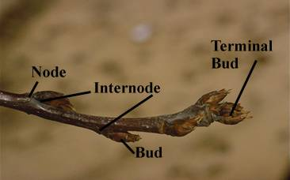
Plant Identification
Bud - A compressed, undeveloped shoot. Buds may be lateral or terminal.
Node - point on the stem where leaf or bud is borne. The space between two nodes is an internode

Slide 4
Leaf Characteristics
Deciduous or Evergreen
Alternate, Opposite, Whorled, Fascicled
Simple or Compound
Leaf Venation, Lobing, Shape, & Margins

Slide 5
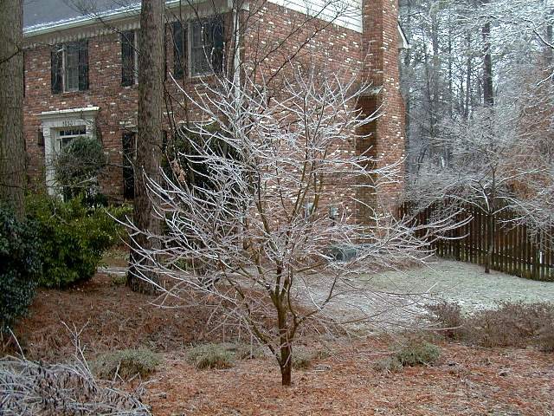
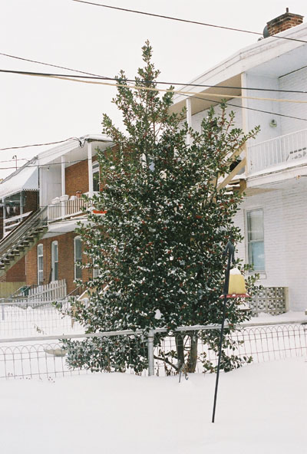
Leaf Characteristics
Deciduous
Evergreen

Slide 6
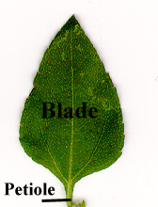
Plant Identification
Simple Leaf
Petiole - the stalk of a leaf. A leaf without a petiole is sessile
Blade - the flat, expanded portion of the leaf

Slide 7
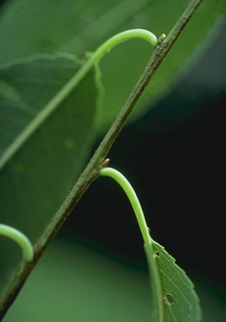
Plant Identification
Leaf arrangement
Alternate - leaves
arranged one per node
Notes:
The spermatophytes provide most of our familiar cultivated plants
Gymnosperms are cone-bearers,
Seed enclosed in an ovary borne in a flower

Slide 8
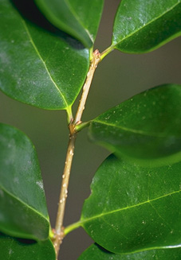
Plant Identification
Leaf arrangement
Opposite - leaves
arranged two per node
Notes:
The spermatophytes provide most of our familiar cultivated plants
Gymnosperms are cone-bearers,
Seed enclosed in an ovary borne in a flower

Slide 9
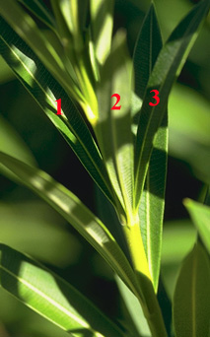
Plant Identification
Leaf arrangement
Whorled - arranged two
or more per node
Notes:
The spermatophytes provide most of our familiar cultivated plants
Gymnosperms are cone-bearers,
Seed enclosed in an ovary borne in a flower

Slide 10
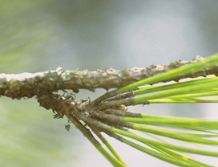
Plant Identification
Leaf arrangement
Fascicled - leaves grouped in small, tight bundles
Notes:
The spermatophytes provide most of our familiar cultivated plants
Gymnosperms are cone-bearers,
Seed enclosed in an ovary borne in a flower

Slide 11
Leaf Characteristics
Deciduous or Evergreen
Alternate, Opposite, Whorled, Fascicled
Simple or Compound
Leaf Venation, Lobing, Shape, & Margins

Slide 12
Simple vs. Compound Leaves
Simple - the blade is all in one piece, though it may be lobed, toothed, etc.
Notes:
The spermatophytes provide most of our familiar cultivated plants
Gymnosperms are cone-bearers,
Seed enclosed in an ovary borne in a flower

Slide 13
Simple vs. Compound Leaves
Compound - the blade is divided all the way to the midrib (rachis) into two or more pieces.
Notes:
The spermatophytes provide most of our familiar cultivated plants
Gymnosperms are cone-bearers,
Seed enclosed in an ovary borne in a flower

Slide 14
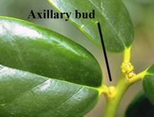
Simple vs. Compound
Axillary bud - the bud in the axil - the angle between the leaf and stem.
Notes:
Thallophyta and Bryophyta are the simplest plants . Thallophyta are not differentiated into roots, stems or leaves and lack conducting tissue. The Bryophyta may be differentiated into leaves and stems but lack true roots and conductive tissue.

Slide 15
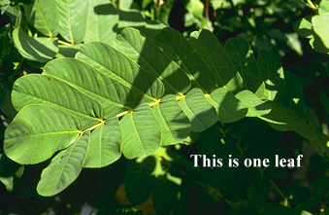
Compound leaves
Once pinnately compound - leaflets arranged along one undivided main axis. (odd or even number of leaflets)
Notes:
The spermatophytes provide most of our familiar cultivated plants
Gymnosperms are cone-bearers,
Seed enclosed in an ovary borne in a flower

Slide 16
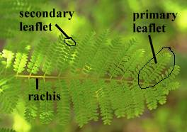
Compound leaves
Twice pinnately compound - main axis (rachis) with two or more branches and the leaflets arranged along the branches. The branch divisions are primary leaflets and the ultimate divisions are secondary leaflets. There can also be thrice-pinnately compound leaves,etc.
Notes:
The spermatophytes provide most of our familiar cultivated plants
Gymnosperms are cone-bearers,
Seed enclosed in an ovary borne in a flower

Slide 17
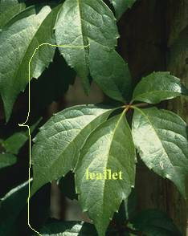
Compound leaves
Palmately compound -leaflets all arising from one point at the base of the leaf.
Notes:
The spermatophytes provide most of our familiar cultivated plants
Gymnosperms are cone-bearers,
Seed enclosed in an ovary borne in a flower

Slide 18
Leaf Characteristics
Deciduous or Evergreen
Alternate, Opposite, Whorled, Fascicled
Simple or Compound
Leaf Venation, Lobing, Shape, & Margins

Slide 19
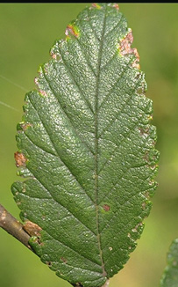
Leaf Venation, Lobing, Shape, & Margins
Leaf venation
Pinnate - with a main midvein and secondary veins arising from it at intervals
Notes:
The spermatophytes provide most of our familiar cultivated plants
Gymnosperms are cone-bearers,
Seed enclosed in an ovary borne in a flower

Slide 20
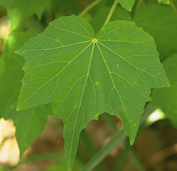
Leaf Venation, Lobing, Shape, & Margins
Leaf venation
Palmate - with the main veins all arising from one point at the base of the leaf.
Notes:
The spermatophytes provide most of our familiar cultivated plants
Gymnosperms are cone-bearers,
Seed enclosed in an ovary borne in a flower

Slide 21
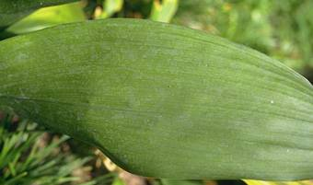
Leaf Venation, Lobing, Shape, & Margins
Leaf venation
Parallel - with all the main veins parallel (usually also parallel to the sides of the leaf.)
Notes:
The spermatophytes provide most of our familiar cultivated plants
Gymnosperms are cone-bearers,
Seed enclosed in an ovary borne in a flower

Slide 22
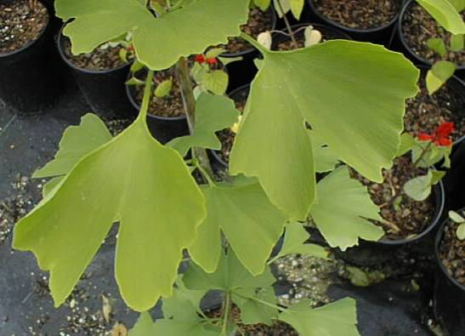
Leaf Venation, Lobing, Shape, & Margins
Leaf venation
Dichotomous - with each vein branching in two again and again (e.g. Ginkgo)
Notes:
The spermatophytes provide most of our familiar cultivated plants
Gymnosperms are cone-bearers,
Seed enclosed in an ovary borne in a flower

Slide 23
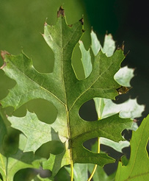
Leaf Venation, Lobing, Shape, & Margins
Leaf lobing
Pinnately lobed - with the lobes arising along the length of the mid-line of the leaf.
Palmately lobed - with the lobes all arising from one point at the base of the leaf.
Notes:
The spermatophytes provide most of our familiar cultivated plants
Gymnosperms are cone-bearers,
Seed enclosed in an ovary borne in a flower

Slide 24
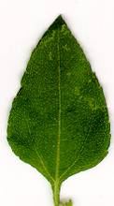
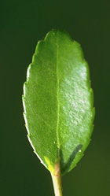
Leaf Venation, Lobing, Shape, & Margins
Leaf shapes
Ovate - egg-shaped with the larger end at the bottom.
Elliptic - shaped like an ellipse, tapered at both ends and with curved sides.
Notes:
The spermatophytes provide most of our familiar cultivated plants
Gymnosperms are cone-bearers,
Seed enclosed in an ovary borne in a flower

Slide 25
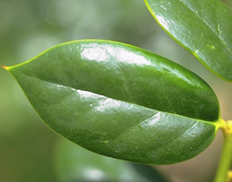
Leaf Venation, Lobing, Shape, & Margins
Leaf shapes
Oblong - tapered to both ends, but with the sides more or less parallel.
Lanceolate - shaped like the tip of a lance, broadest at the base and tapered to a long point.
Notes:
The spermatophytes provide most of our familiar cultivated plants
Gymnosperms are cone-bearers,
Seed enclosed in an ovary borne in a flower

Slide 26
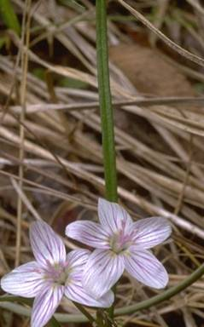
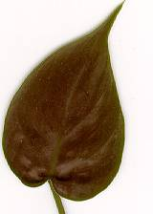
Leaf Venation, Lobing, Shape, & Margins
Leaf shapes
Linear - very long and thin, with the sides parallel
Cordate - heart-shaped with the wide part at the bottom
Notes:
The spermatophytes provide most of our familiar cultivated plants
Gymnosperms are cone-bearers,
Seed enclosed in an ovary borne in a flower

Slide 27
Leaf Venation, Lobing, Shape, & Margins
Leaf margins
Entire - smooth, with no teeth or lobes
Notes:
The spermatophytes provide most of our familiar cultivated plants
Gymnosperms are cone-bearers,
Seed enclosed in an ovary borne in a flower

Slide 28
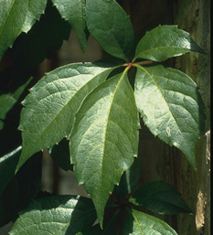
Leaf Venation, Lobing, Shape, & Margins
Leaf margins
Serrate - with sharp, forward-pointing teeth
Notes:
The spermatophytes provide most of our familiar cultivated plants
Gymnosperms are cone-bearers,
Seed enclosed in an ovary borne in a flower

Slide 29
Leaf Venation, Lobing, Shape, & Margins
Leaf margins
Doubly serrate - with teeth which have smaller teeth on them
Notes:
The spermatophytes provide most of our familiar cultivated plants
Gymnosperms are cone-bearers,
Seed enclosed in an ovary borne in a flower

Slide 30
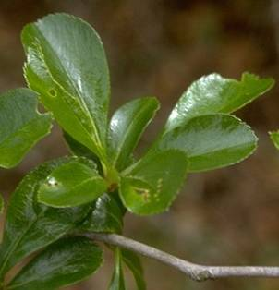
Leaf Venation, Lobing, Shape, & Margins
Leaf margins
Serrulate - with very tiny sharp teeth
Notes:
The spermatophytes provide most of our familiar cultivated plants
Gymnosperms are cone-bearers,
Seed enclosed in an ovary borne in a flower

Slide 31
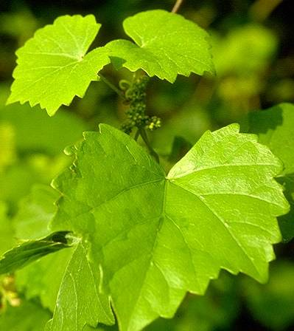
Leaf Venation, Lobing, Shape, & Margins
Leaf margins
Dentate - with teeth which point outwards
Notes:
The spermatophytes provide most of our familiar cultivated plants
Gymnosperms are cone-bearers,
Seed enclosed in an ovary borne in a flower

Slide 32
Leaf Venation, Lobing, Shape, & Margins
Leaf margins
Crenate - with low, rounded scallop-like teeth
Notes:
The spermatophytes provide most of our familiar cultivated plants
Gymnosperms are cone-bearers,
Seed enclosed in an ovary borne in a flower

Slide 33
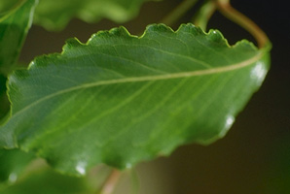
Leaf Venation, Lobing, Shape, & Margins
Leaf margins
Undulate - waving up and down
Notes:
The spermatophytes provide most of our familiar cultivated plants
Gymnosperms are cone-bearers,
Seed enclosed in an ovary borne in a flower

Slide 34
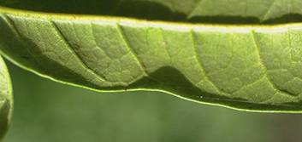
Leaf Venation, Lobing, Shape, & Margins
Leaf margins
Revolute - turned under
Notes:
The spermatophytes provide most of our familiar cultivated plants
Gymnosperms are cone-bearers,
Seed enclosed in an ovary borne in a flower

Slide 35
Leaf Venation, Lobing, Shape, & Margins
Leaf margins
Lobed, parted, divided, cut, etc. - A number of terms describe the various degrees of lobing.
Notes:
The spermatophytes provide most of our familiar cultivated plants
Gymnosperms are cone-bearers,
Seed enclosed in an ovary borne in a flower

Slide 36
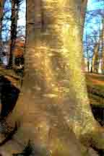
Bark Color and Texture

Slide 37
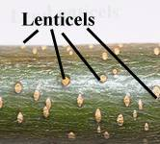
Bark and Twigs
Lenticel - a "breathing pore" in the skin or bark of a stem.

Slide 38
Twigs & Buds

Slide 39
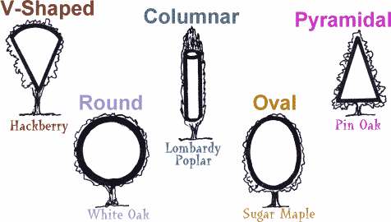
Forms

Slide 40
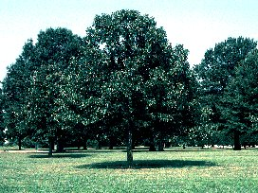
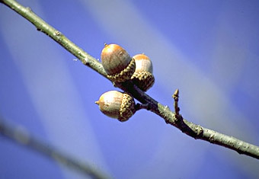
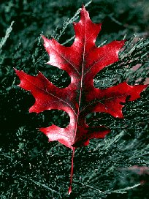
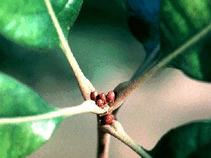
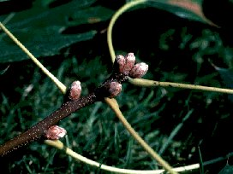
Putting it all Together

Slide 41
Putting it all together
Evergreen or Deciduous
Leaf Arrangement
Compound or Simple
Leaf Venation
Leaf Lobing
Leaf Shape
Leaf Margin
Bark
Twigs and Buds
Plant Forms

Slide 42
Special Thanks to:
David Berle, Assistant Professor Horticulture, University of Georgia for most of this slide set.
Modifications and additions by Todd Hurt, CEA Cherokee County

