Slide 1
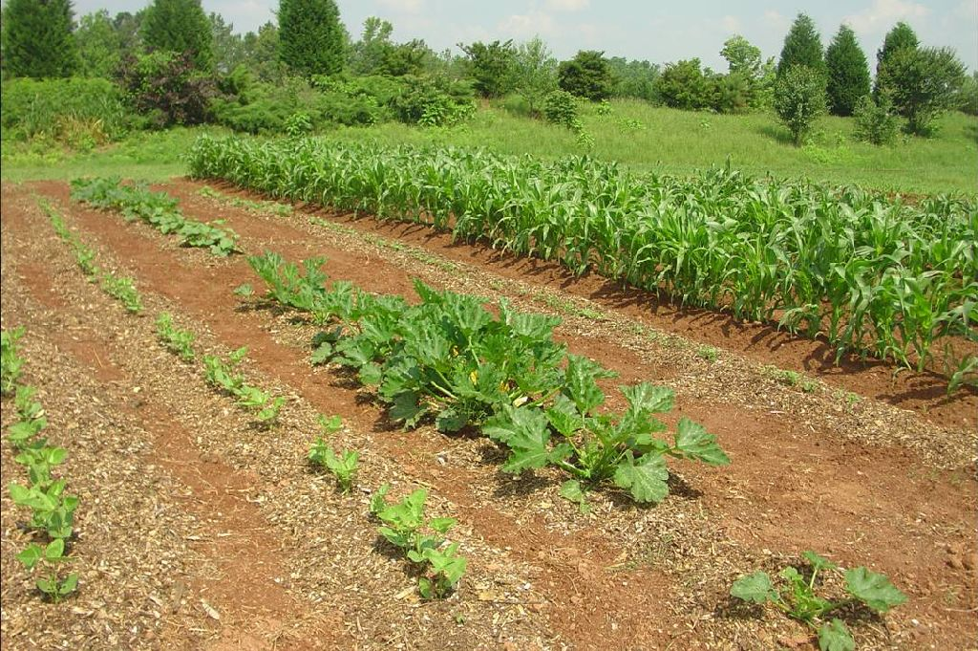
Organic Gardening

Slide 2
Modified Organic Gardening
Most Homeowners should use a balanced approach.
Be willing to accept some damage.
Be willing to use synthetic fertilizers to supplement organic.
Be willing to spend more time conditioning soil and scouting garden for problems.

Slide 3
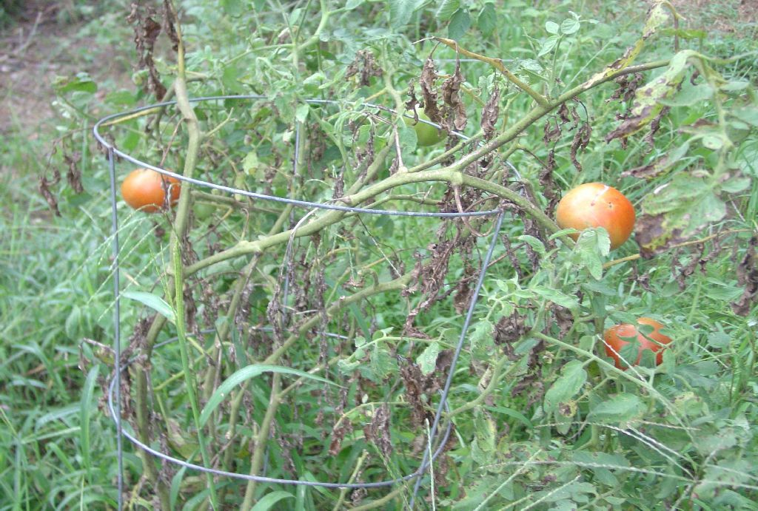
Diseased but not Dead!

Slide 4
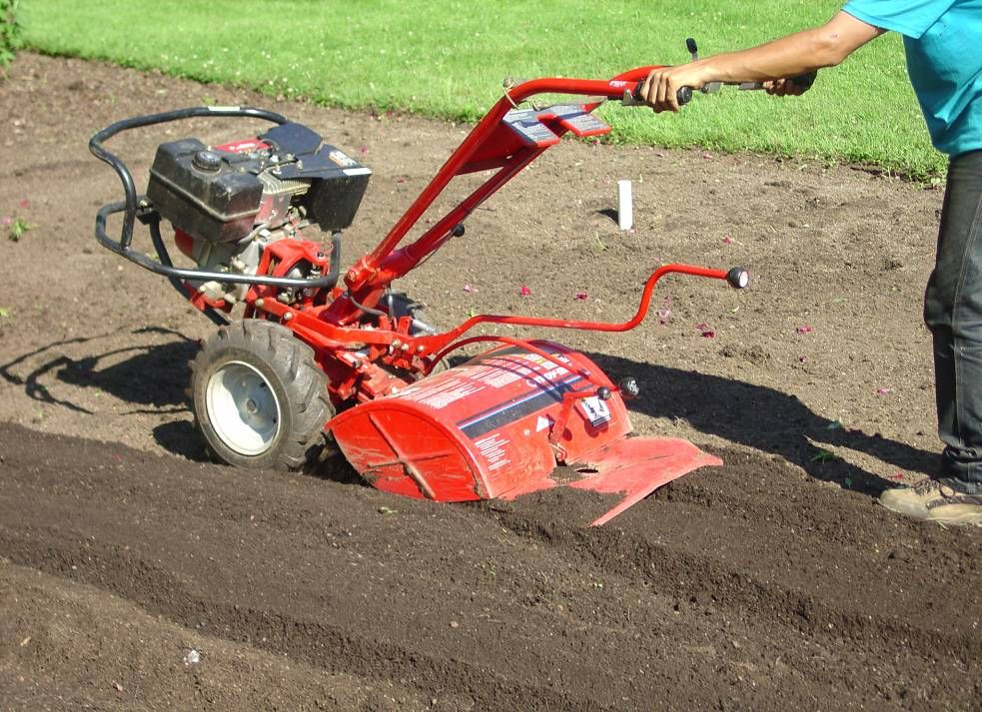
Soil- Most Important Component
Can’t emphasis enough to homeowners that soil is the key!
A healthy, organic, well drained soil should produce good plants.

Slide 5
Be Generous in Organic Amendments
You can’t use too much.
Minimum of 4 inches.- Find a reliable, cheap source.- know the history.
Look at amendments more for their soil building capacity , than fertilizer.

Slide 6
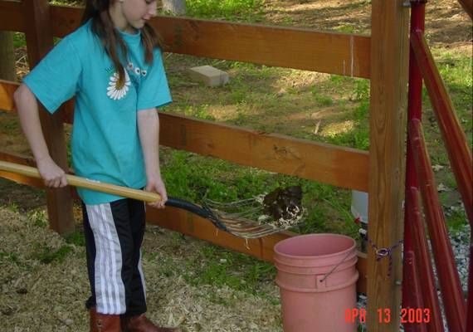

Slide 7
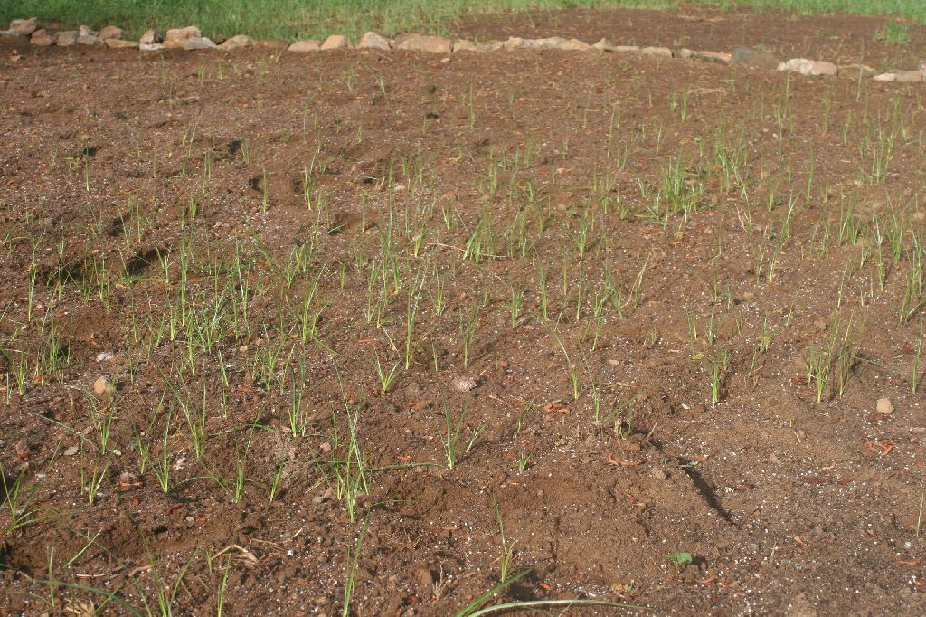
Weeds?
Herbicides?

Slide 8
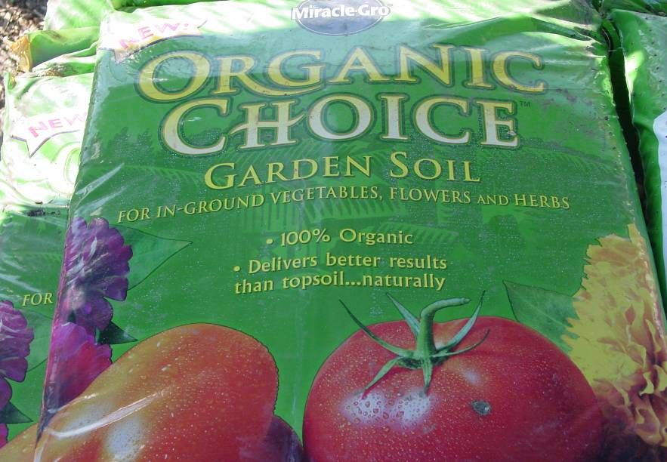
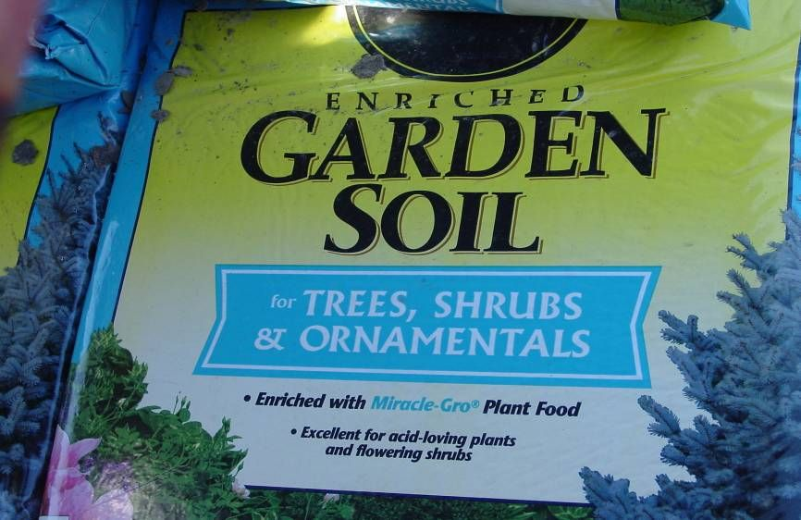
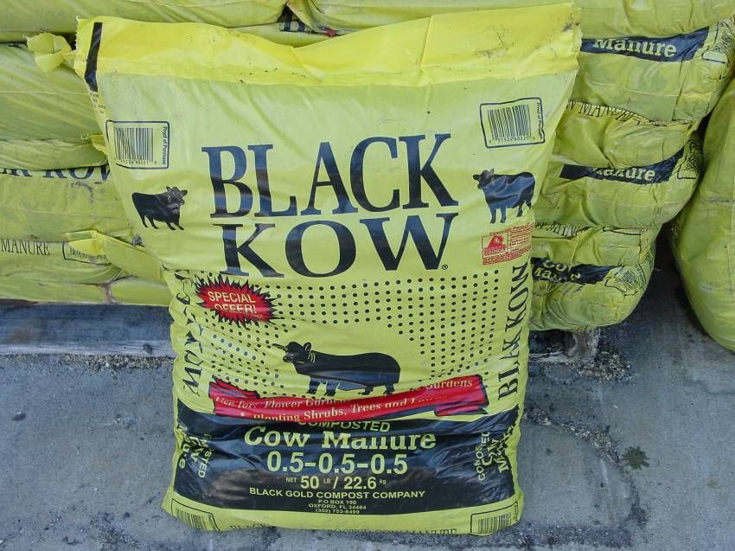
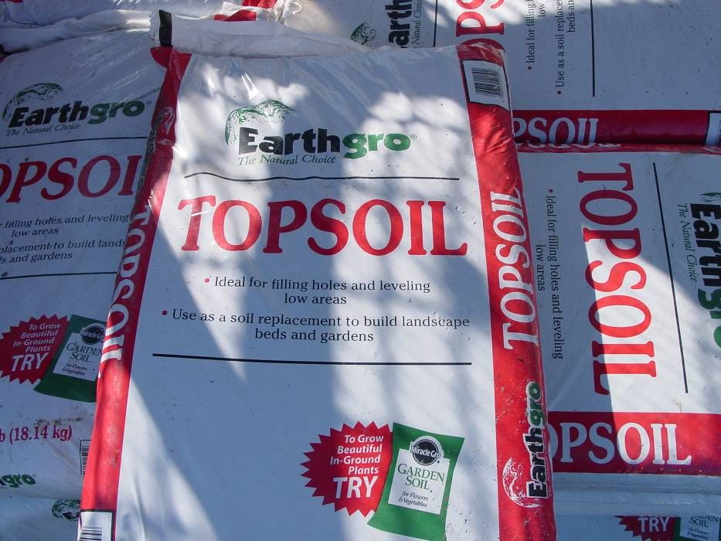

Slide 9
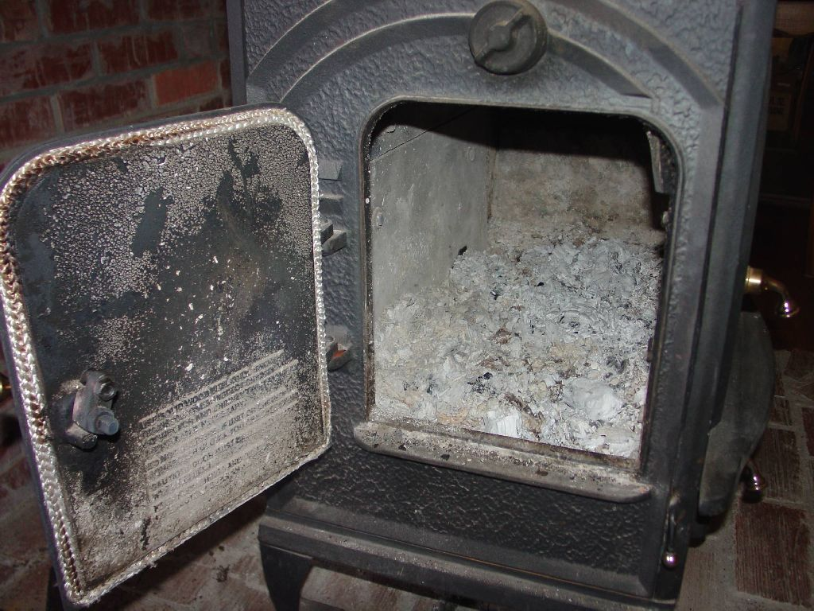

Slide 10
pH Level
ALKALINE
8.0
7.0
6.0
5.5
4.0 -
IDEAL
ACID
VERY ACID
Notes:
Plants differ in their needs or tolerance of soil acidity. Unsuitable soil pH can stunt plant growth, cause fruiting problems, necrosis or death of leaves and other plant parts.

Slide 11
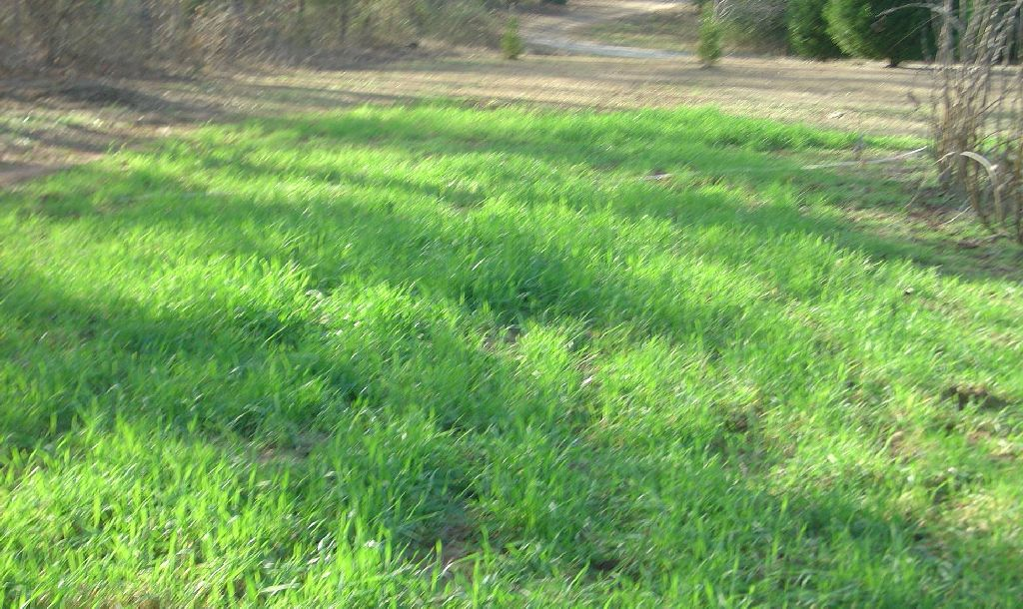
Use Cover Crops

Slide 12
Encourage Healthy Plants

Slide 13
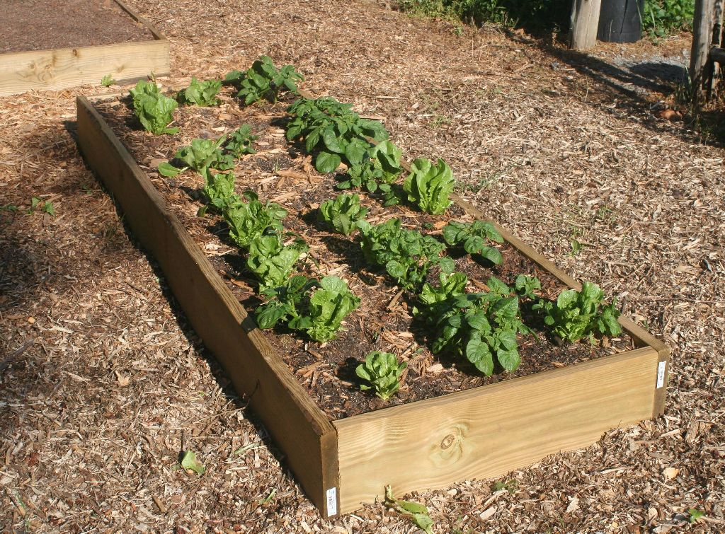

Slide 14
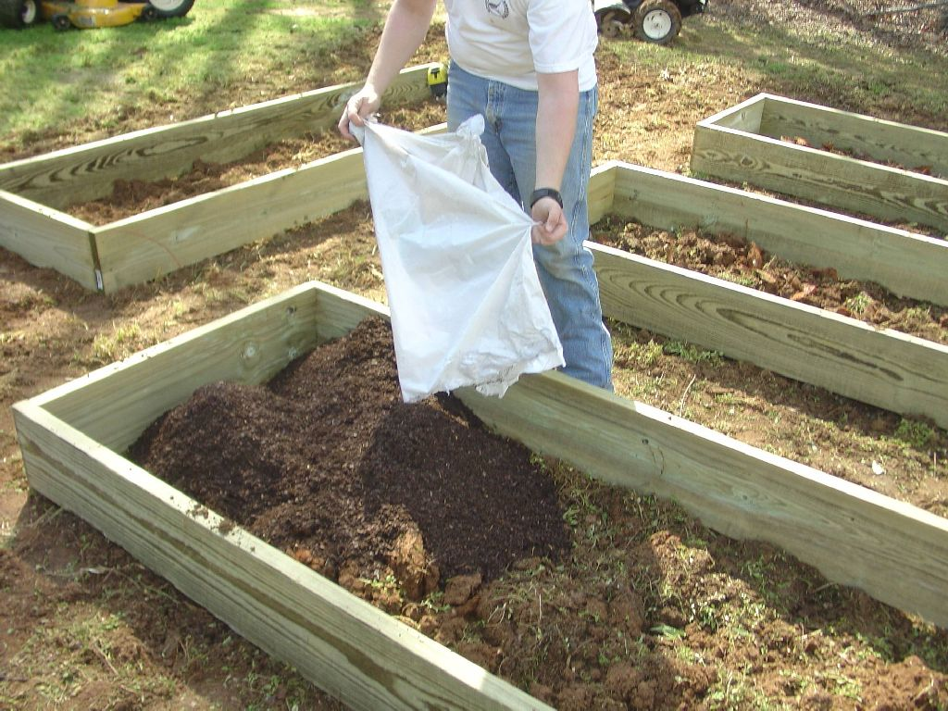

Slide 15
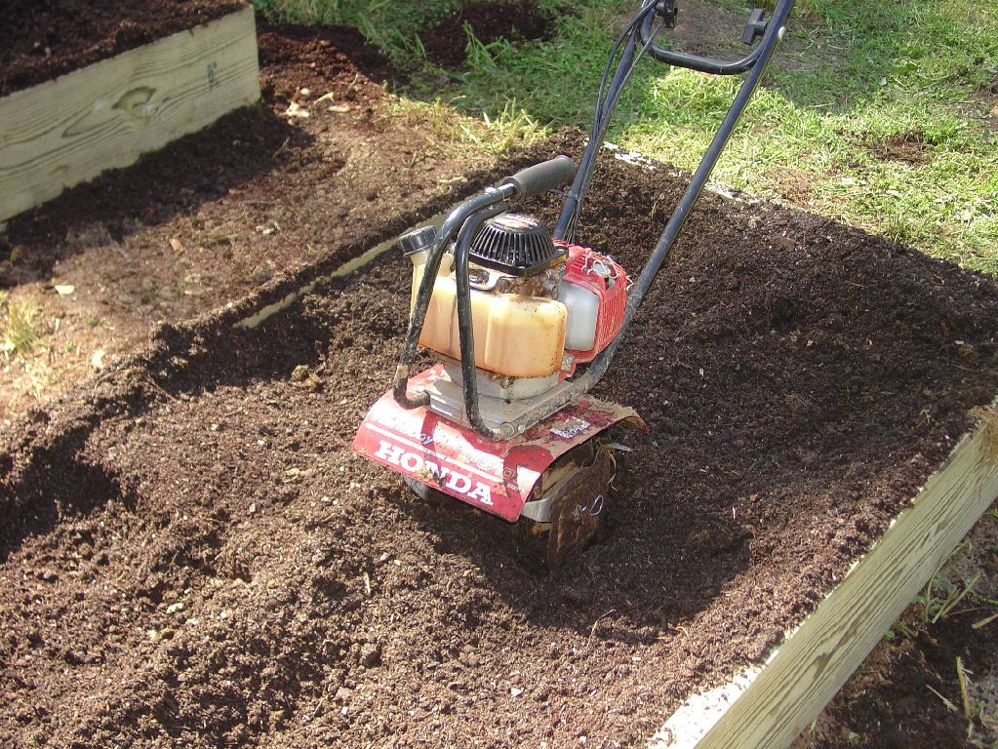

Slide 16
Advantages of Raised Beds
Improved drainage
Fewer diseases
Fewer weeds
Easier to maintain
Neat orderly appearance

Slide 17
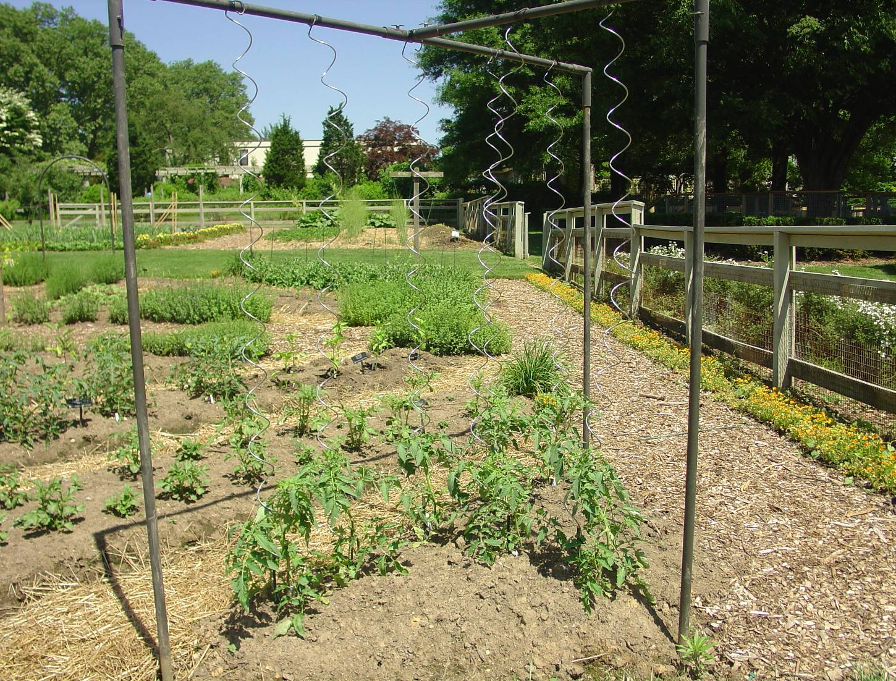
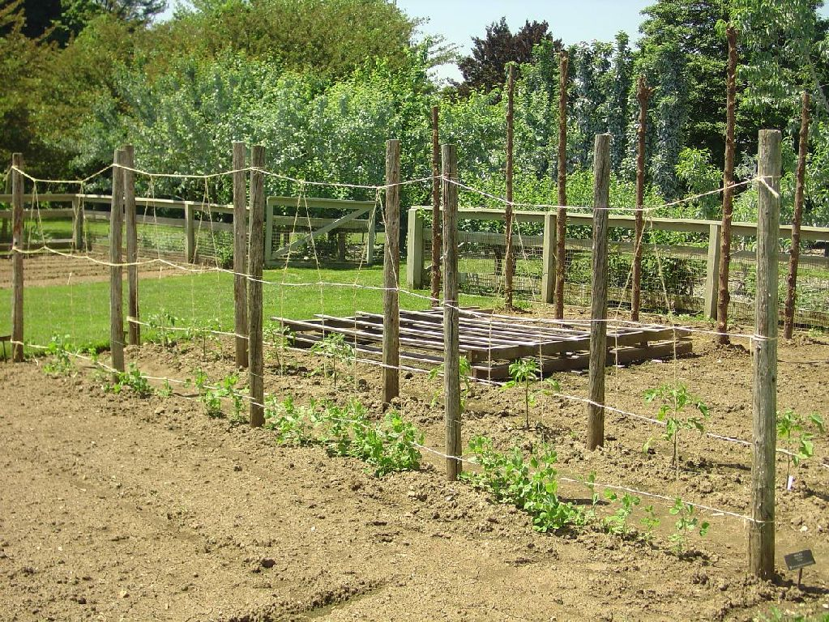

Slide 18
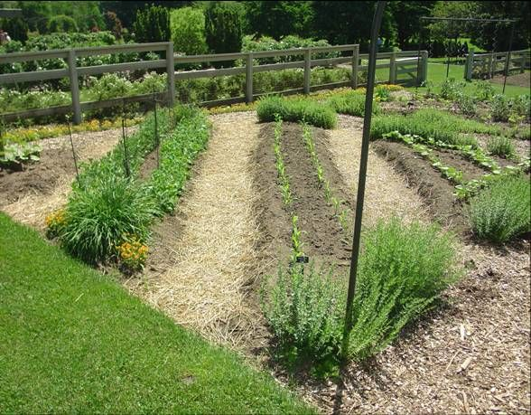
Keep Paths Clean

Slide 19
Crop Rotation
Don’t plant anything from the same group (family) in the same location or soil two years in a row.
Group 1
Lima Beans
Pole Beans
Field Peas
Peas
Group 2
Potatoes
Eggplants
Tomatoes
Peppers
Group 3
Brussels
sprouts
Cauliflower
Collards
Lettuce
Radishes
Rutabaga
Spinach
Turnips
Group 4
Cantaloupe
Cucumber
Honeydew
melons
Pumpkins
Squash
Watermelons
Group 5
Sweet Corn
Group 6
Beets
Carrots
Garlic
Onions
Shallots

Slide 20
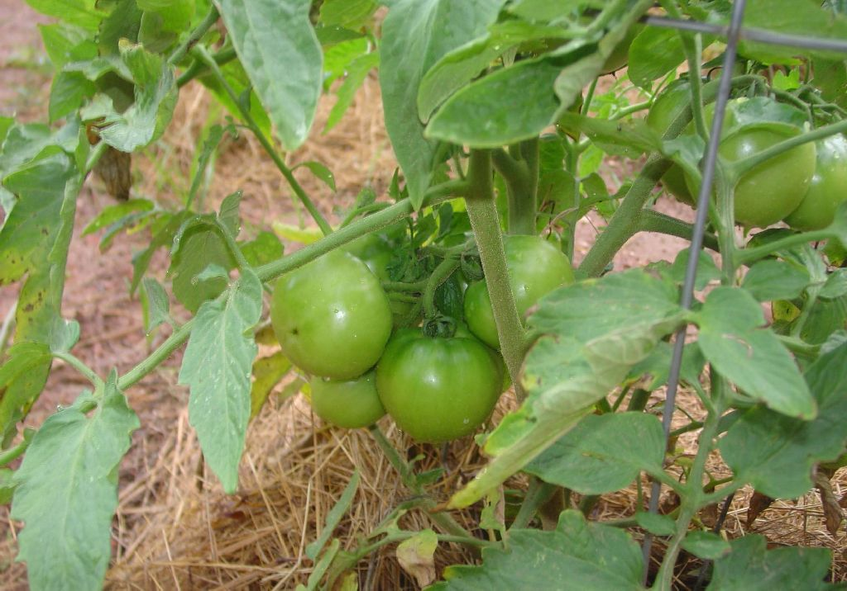
Resistant Varieties
What does resistant mean?
What about Flavor?

Slide 21
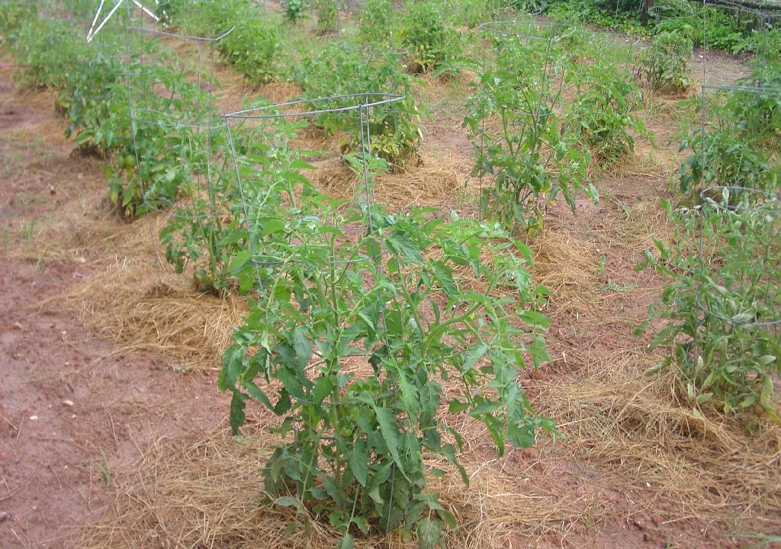
Ventilation

Slide 22
Keep Things Clean!
Remove old crops after they are finished.
Pick off damaged or diseased leaves or fruit.
Remove plants with viruses immediately.
Do not smoke or use tobacco near garden.
Turn garden soil frequently.
Use only fresh certified seed or transplants.

Slide 23
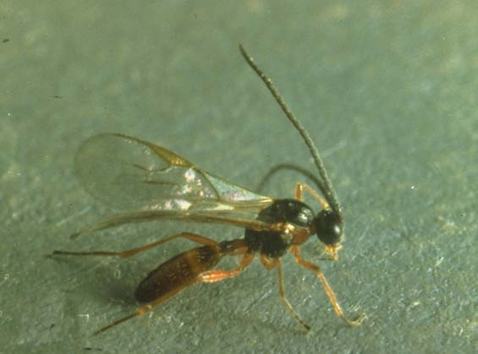
Encourage Beneficial Insects 95%

Slide 24
Purchase Beneficial Insects?

Slide 25
Keep Out Critters

Slide 26
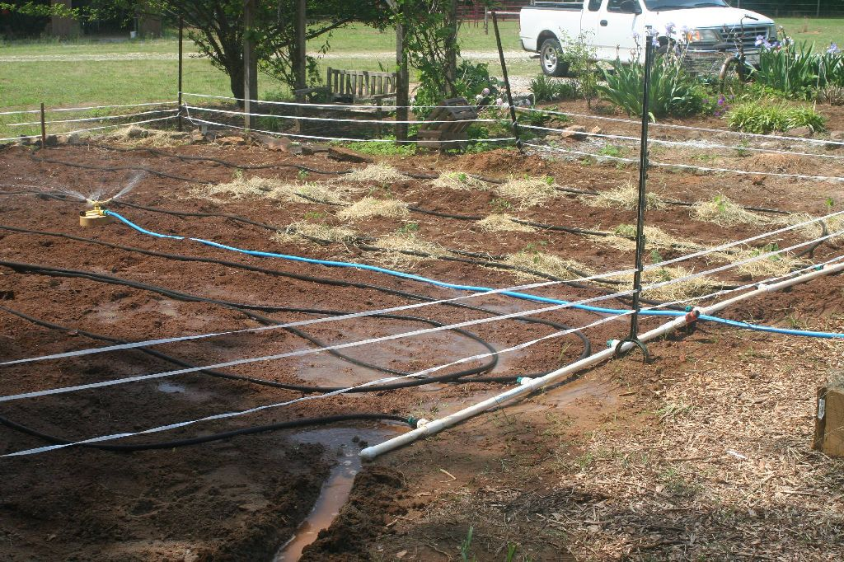

Slide 27
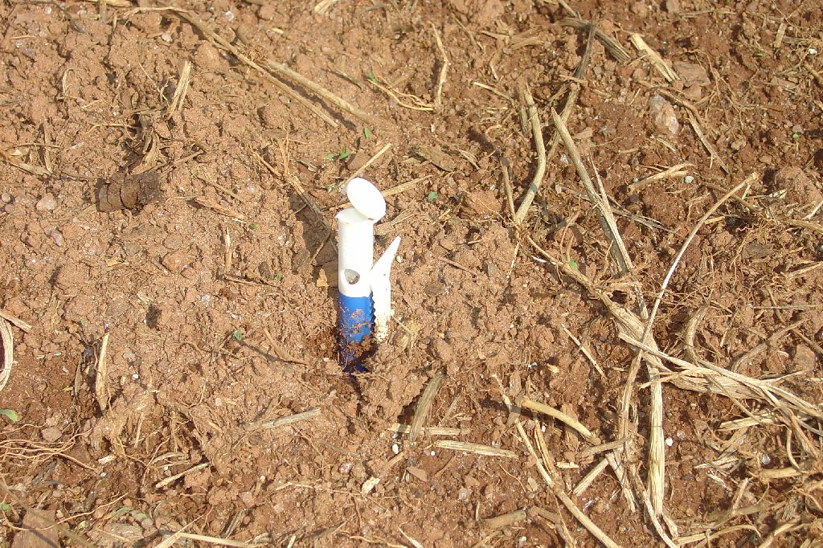
Repellants

Slide 28
Always Start with Healthy Plants

Slide 29
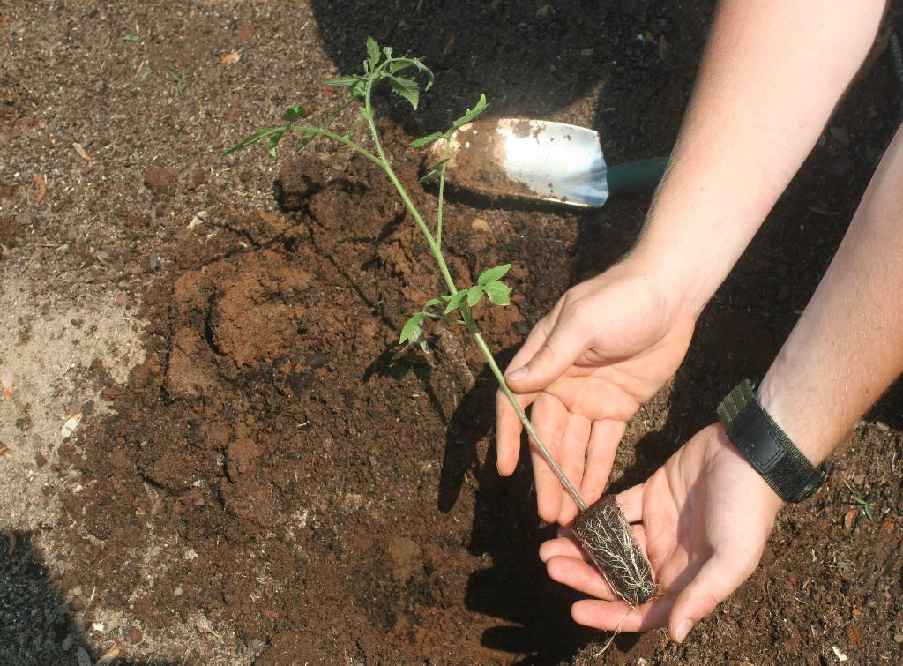

Slide 30
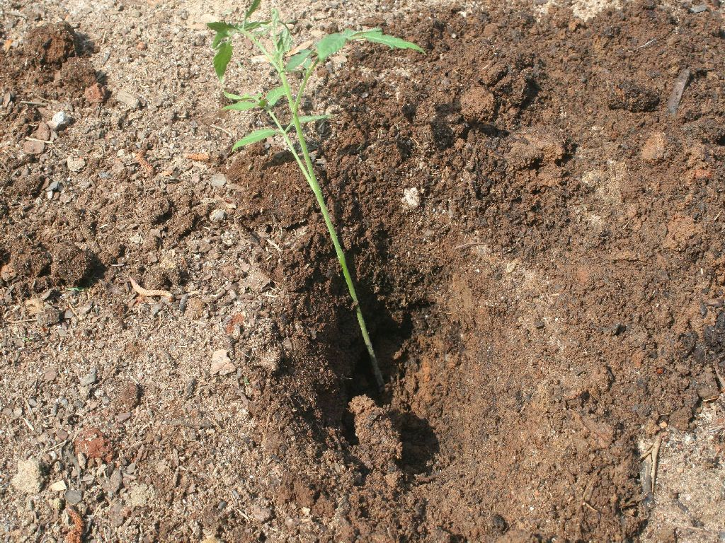

Slide 31
Use Tin Foil or Paper Cup as Barrier

Slide 32
Control Weed Competition

Slide 33
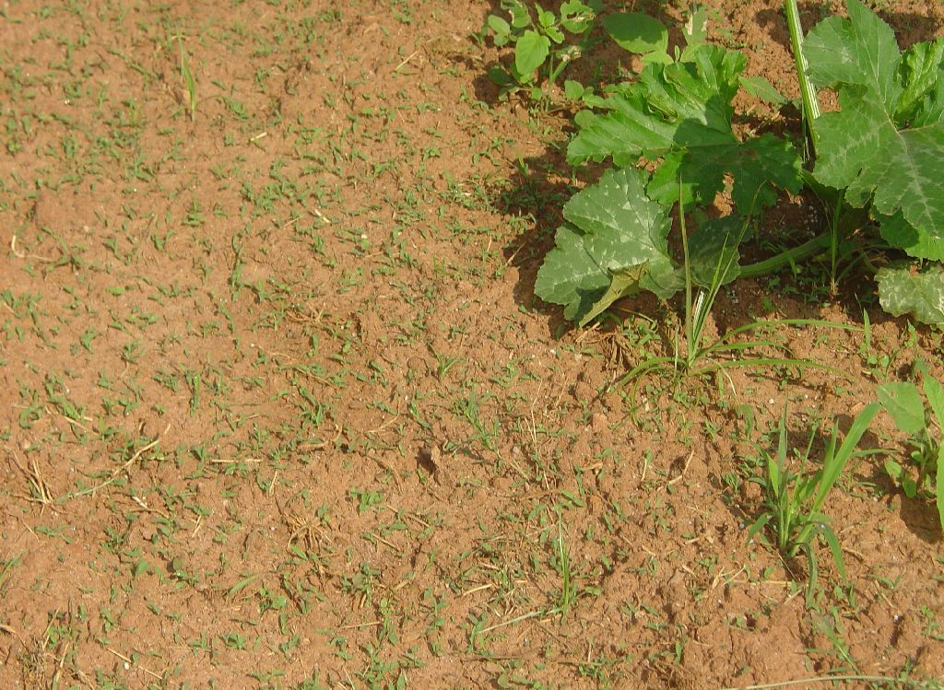
Attack Weeds
When Young

Slide 34
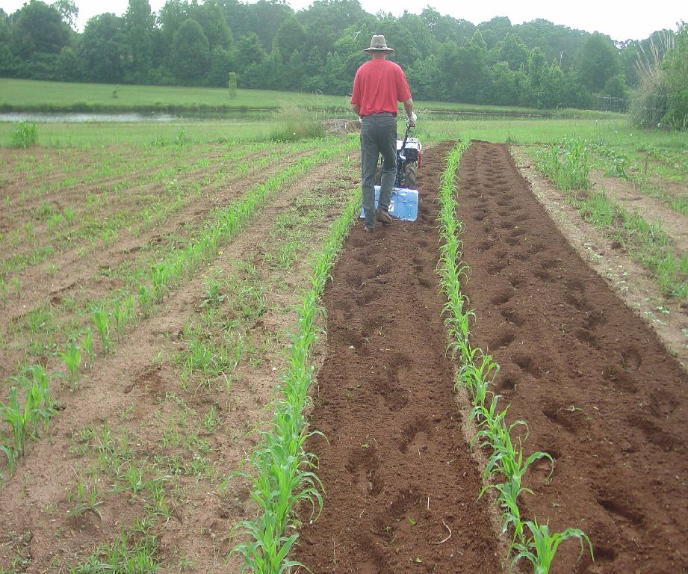

Slide 35
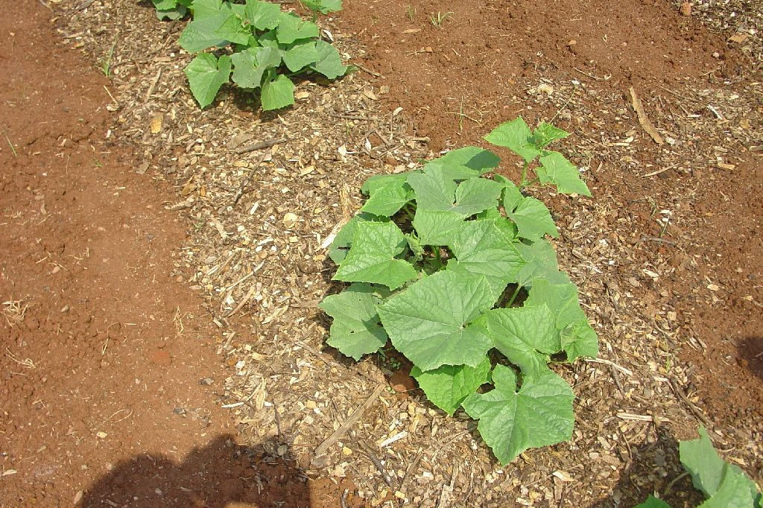

Slide 36
Only work the garden with a tiller or spade when soil moisture is right!

Slide 37
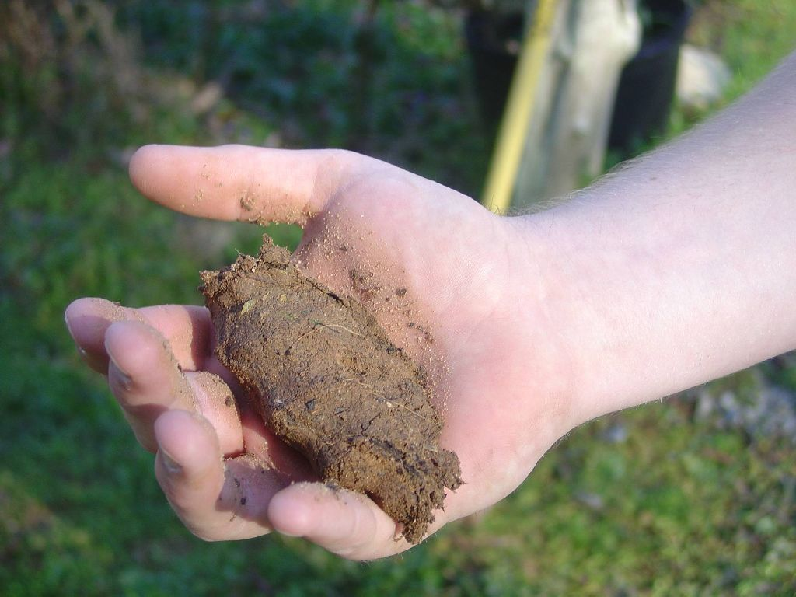

Slide 38
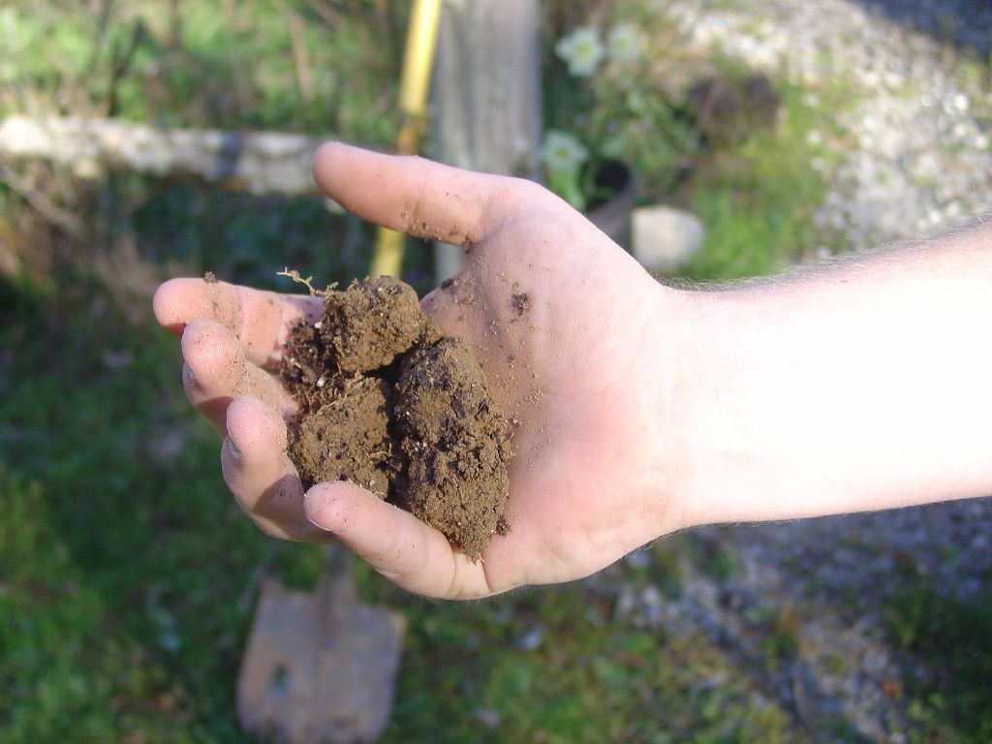

Slide 39
Keep Plants Dry on Top

Slide 40
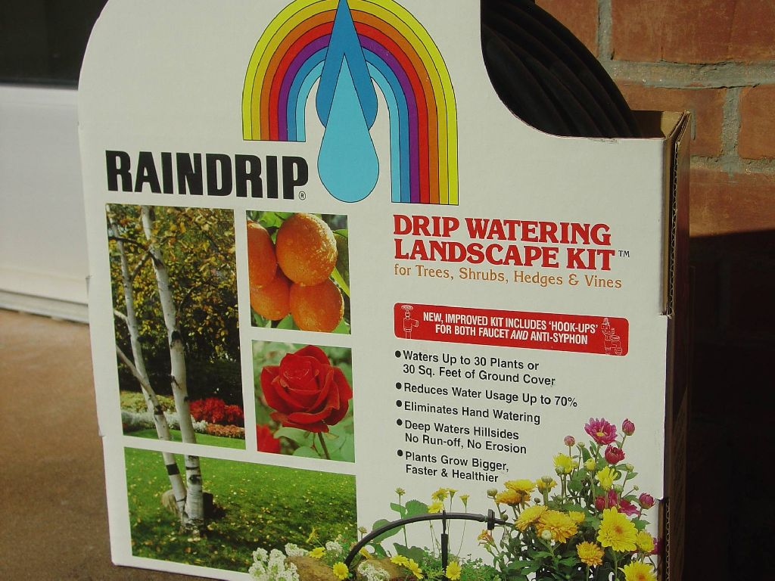

Slide 41
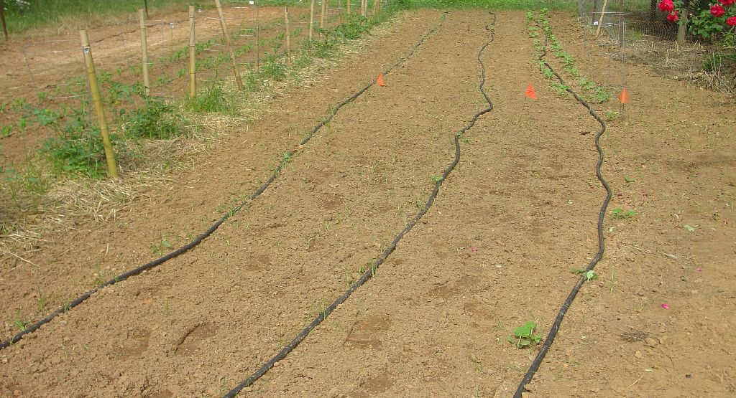
No more than 100’

Slide 42
Other Pest Management Strategies

Slide 43
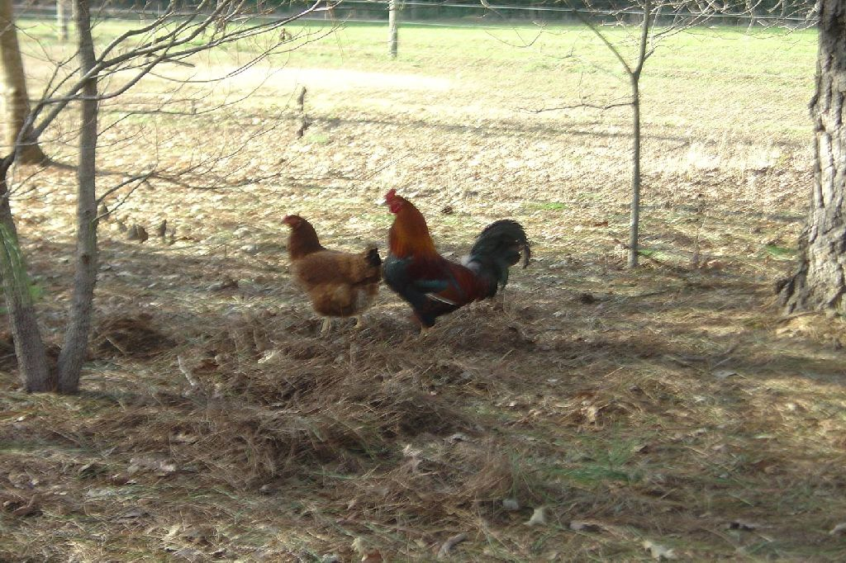
Organic Insect Control

Slide 44
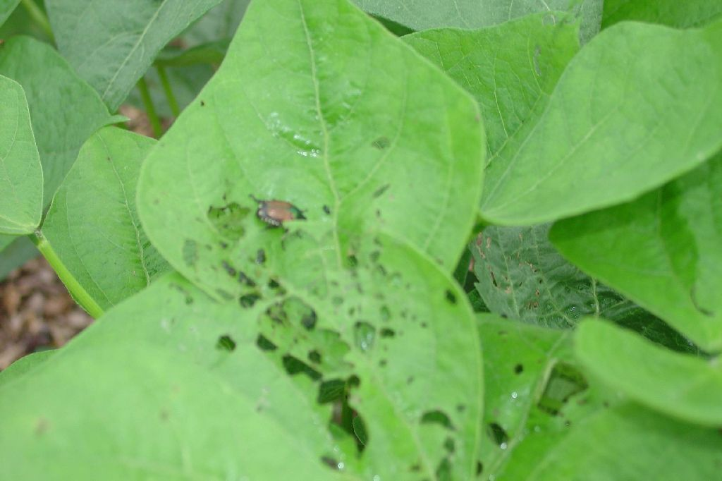
Scout Frequently and Hand -Pick

Slide 45
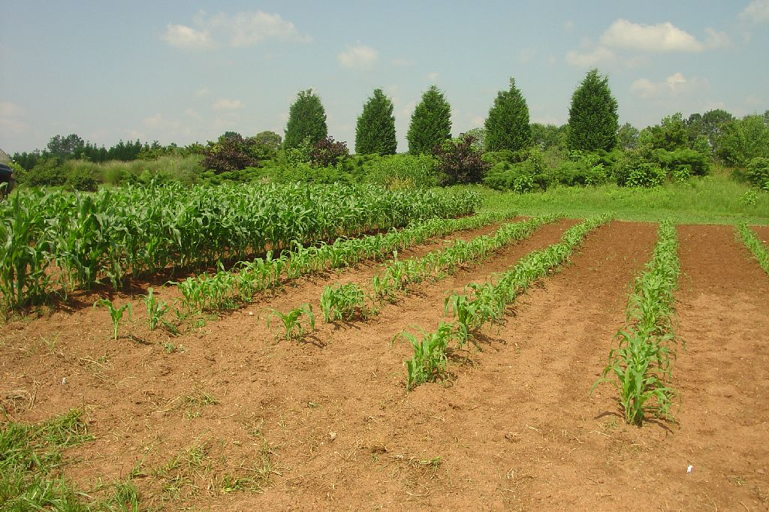
Stagger Planting Times

Slide 46
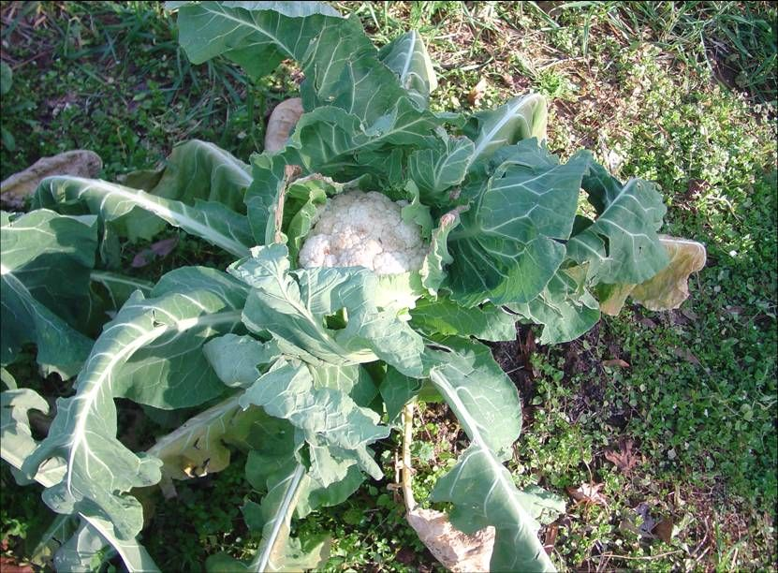
Harvest on Time

Slide 47
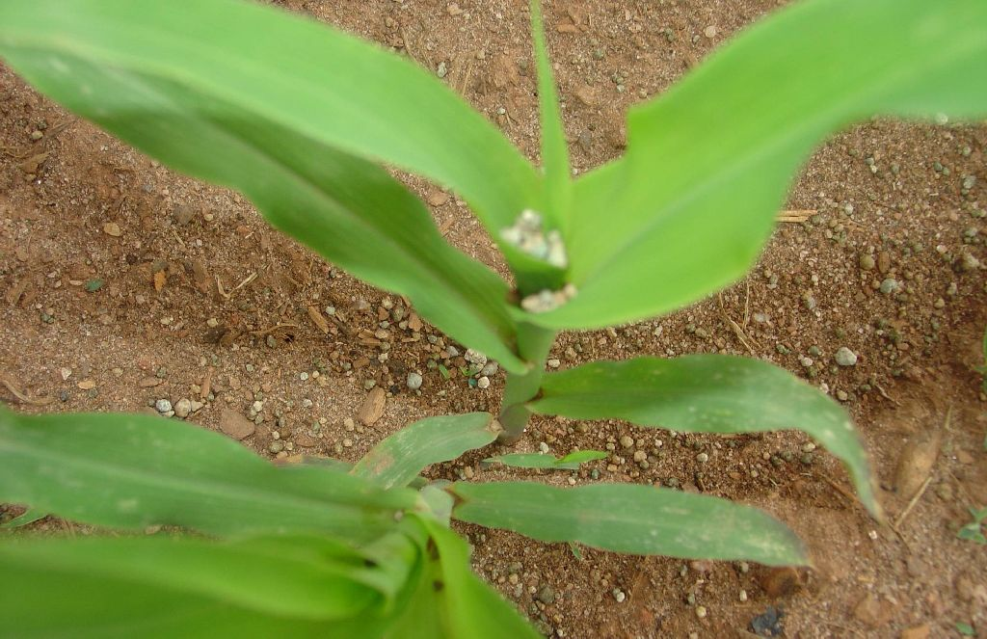
Details Matter

Slide 48
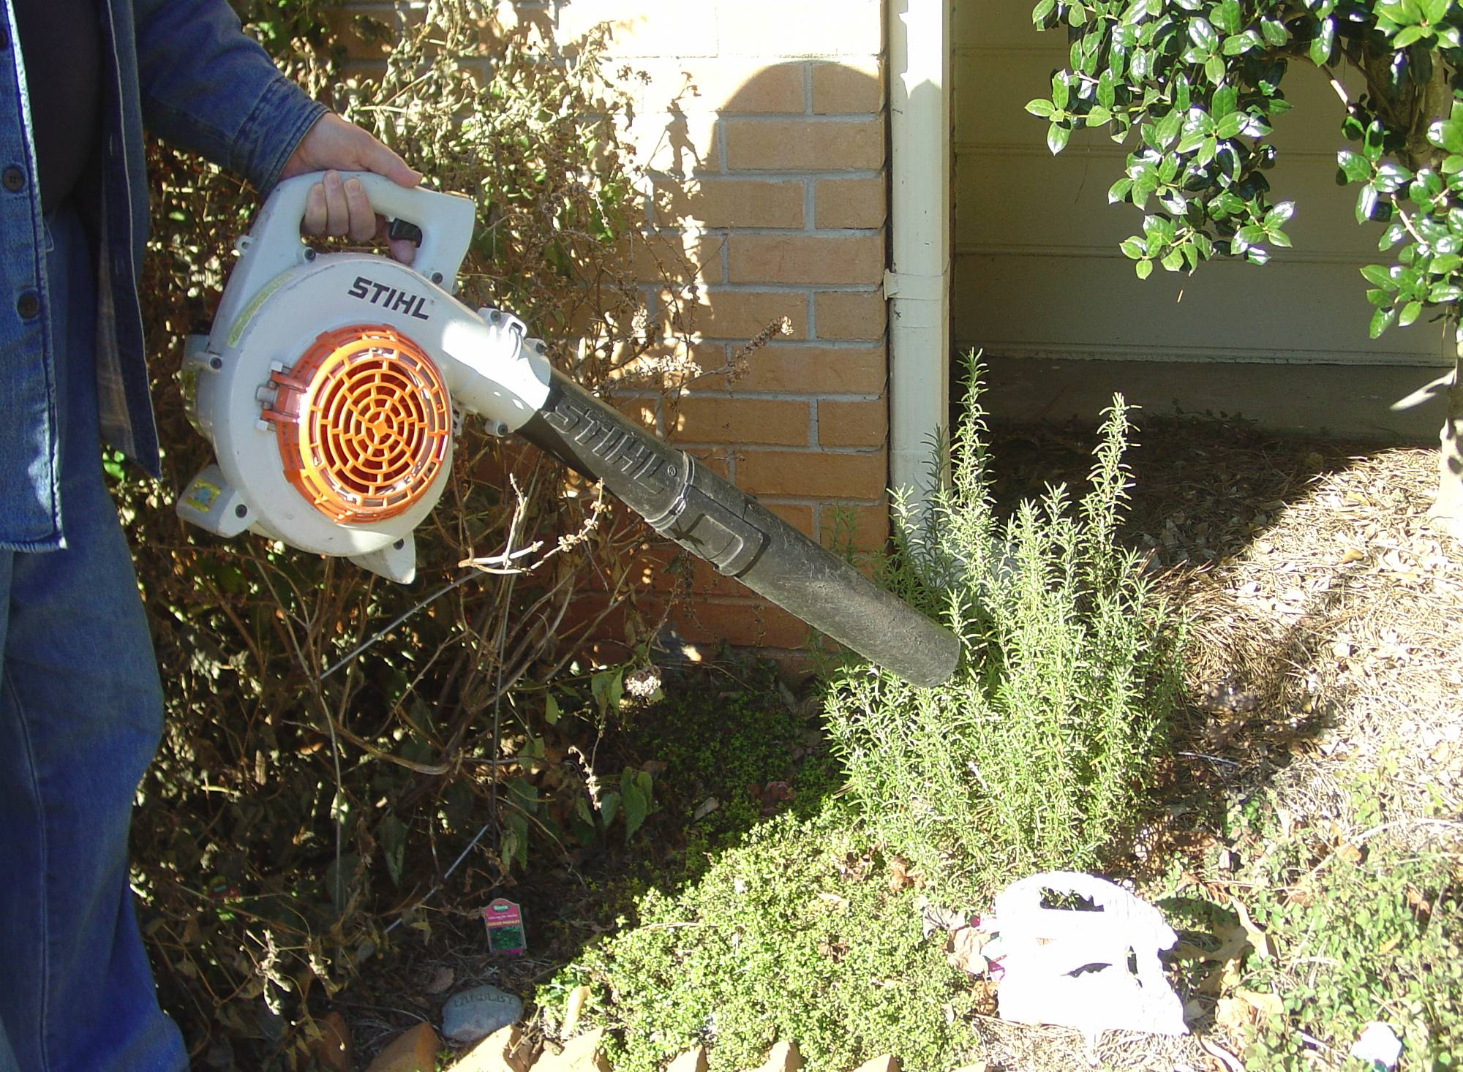
Organic Blowing

Slide 49
Myths and Truths of Organic Gardening
Jerry Baker “recommendations.”
Old Timer’s Tricks-Home Remedies.

Slide 50
Organic Fertilizers are Better

Slide 51
N is N

Slide 52
What’s in that manure?
Nutrient Content of Dry Animal Manures
Organic Fertilizer | N | P₂O₅ | K₂O
 | percent
Broiler Litter | 3.1 | 3.0 | 2.0
Cattle Manure | 1.5 | 1.5 | 1.2
Hog Manure | 2.0 | 1.4 | 1.8
Horse Manure | 1.7 | 0.7 | 1.8
Poultry Manure | 4.3 | 3.7 | 1.9

Slide 53
So How Much do I need?

Slide 54
General Pest Control
Soil Solarization
Try In the summer months using two layers of plastic. Wet thoroughly before covering.

Slide 55
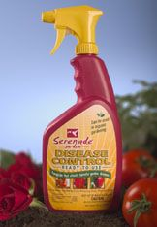
Fungicide & bactericides
Bacillus subtilis
Serenade
Fungicidal & bacterial activity
Originally isolated from peach
Does not work on onions
Fixed Copper (e.g. copper sulfate)
Bordeaux mixture
(copper sulfate & lime)
Elemental sulfur

Slide 56
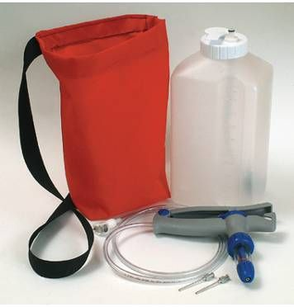
Organic Insecticides
Bacillus thuringiensis
Controls various caterpillar insects & Colorado potato beetle
Strain specific
Must be consumed
Bt or Dipel

Slide 57
Organic Insecticides
Beauveria bassiana
Mycotrol®, BotaniGard®22WP
Fungus
Whiteflies, aphids, thrips
Horticultural oils
Neem extract
Pyrethrins
Diatomaceous earth
Spinosad
Affects insect nervous system
Insecticidal Soaps

Slide 58
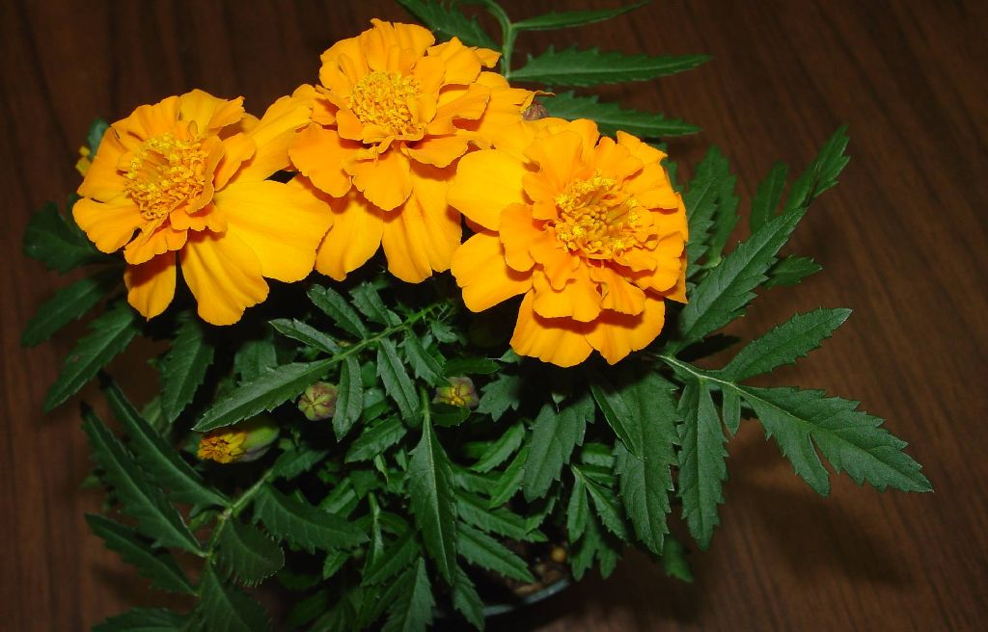
Repellent or Trap Plants

Slide 59
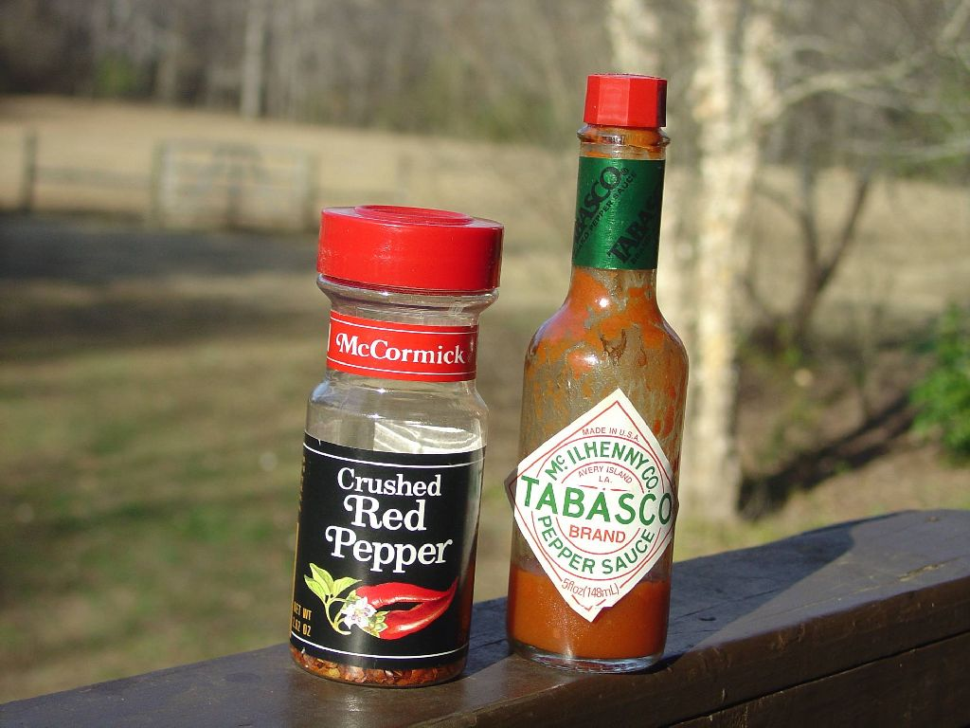

Slide 60
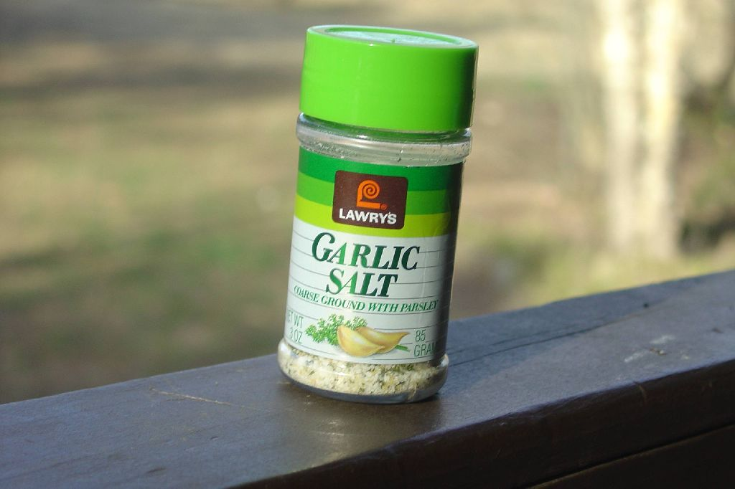

Slide 61
Corn Gluten Meal
Corn gluten meal is an all-natural plant product, rich in nitrogen, consisting of a dried protein separated from corn during the manufacture of starch for the food industry.
May have weed controlling properties.
50 lb bag, 2,500 sq.ft .$25.95

Slide 62
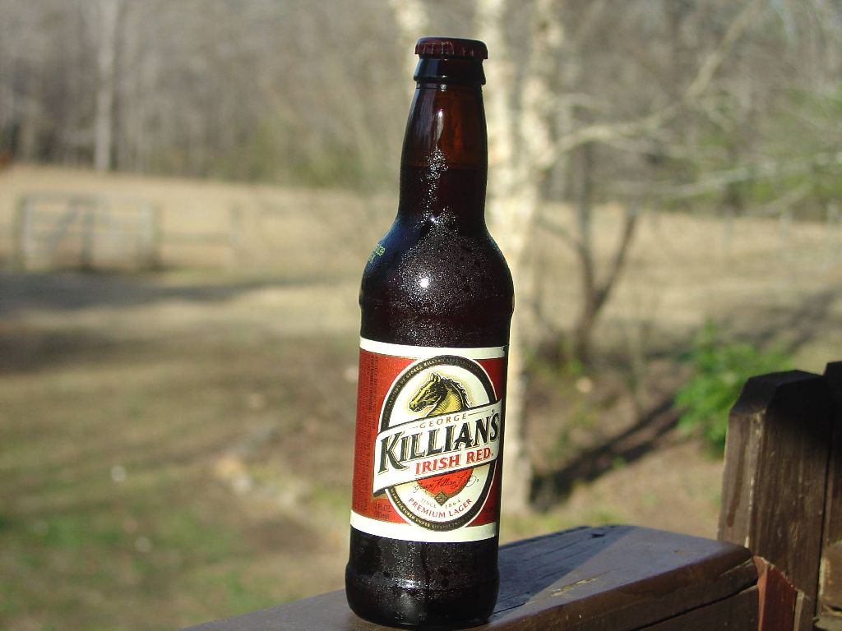

Slide 63
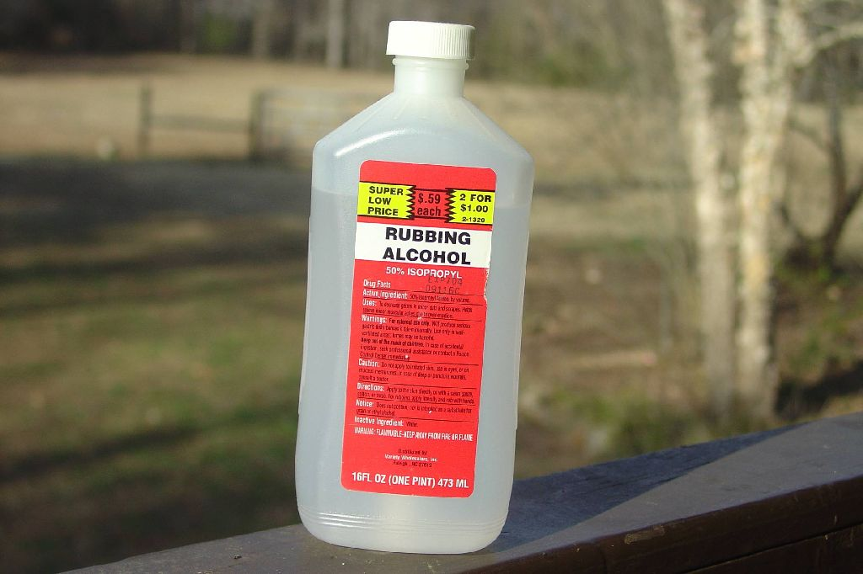

Slide 64
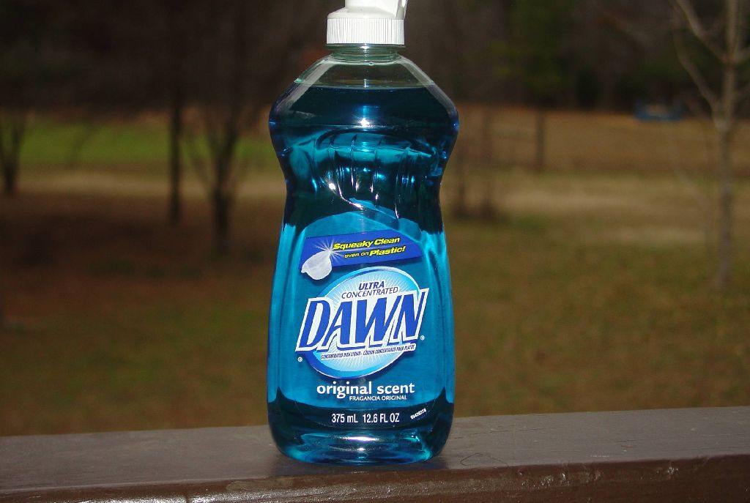

Slide 65
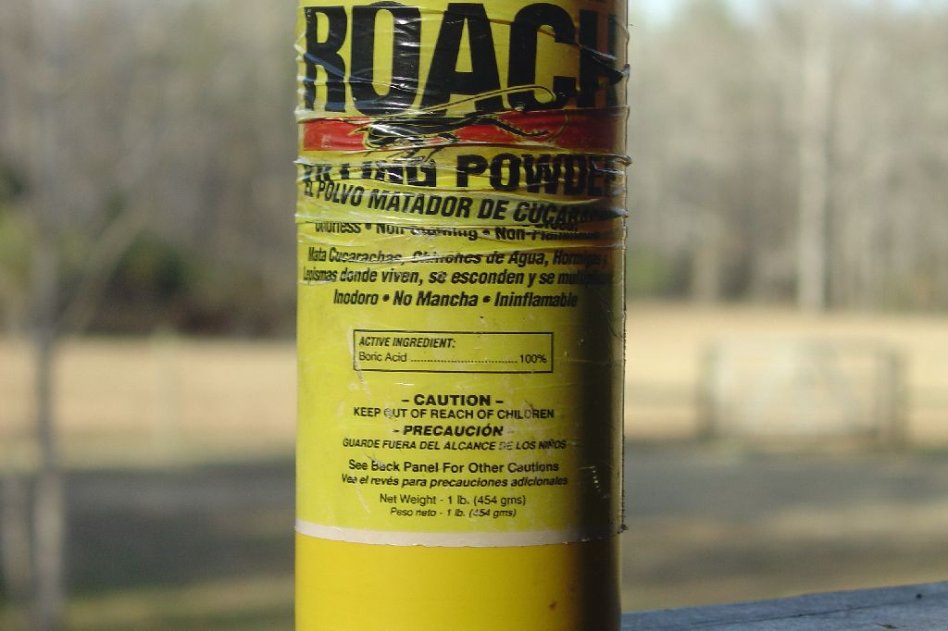

Slide 66
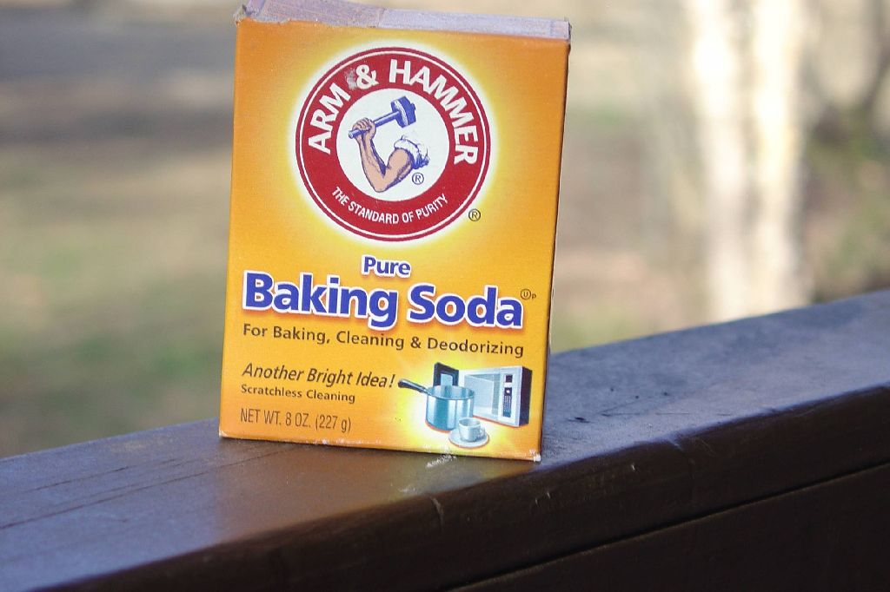

Slide 67
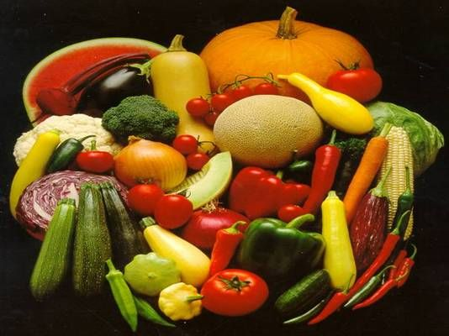
Organic Alternatives for the Home Garden
Questions
George Boyhan & Bob Westerfield
Department of Horticulture
University of Georgia

