Slide 1
Operation and Maintenance of Rainwater Harvesting Systems

Slide 2
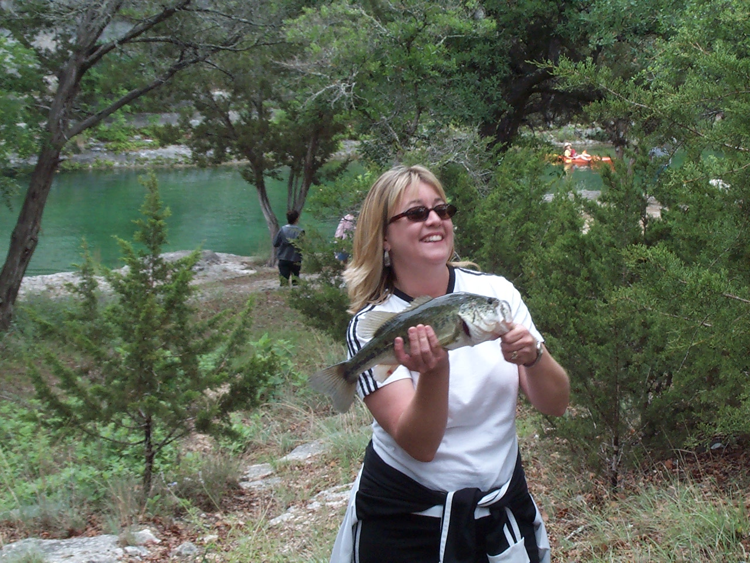
You Are Your Water Supply Maintenance Guy

Slide 3
Some Locations Require Constant Care

Slide 4
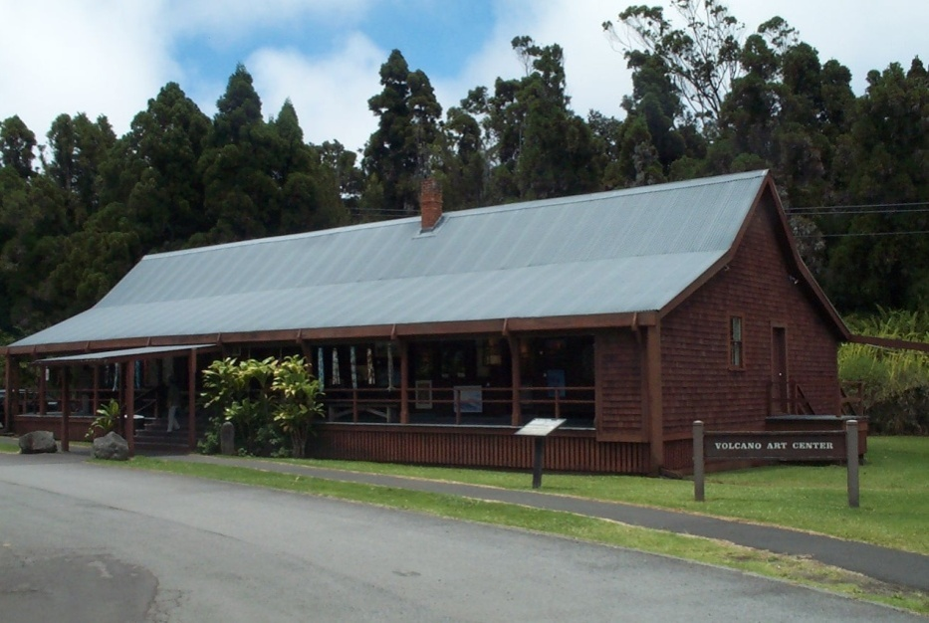
House Built Around 1860 Still On Rainwater

Slide 5
Liability Exposure
There is inherent liability exposure where in-home potable collection systems are installed
Following manufacturer recommendations are necessary
Following EPA Recommendations reduce that exposure
But once completed…….

Slide 6
There are no statutes or regulations at the state or federal level currently that regulate the potable and non-potable indoor use of domestic well water systems
Private rainwater harvesting systems that provide water to individual homes to be similar to the regulatory status of private wells that serve individual homes in Texas.

Slide 7
TCEQ Recommendations: Test Your Water
Non-potable use:
Total coliforms – less than 500 cfu/100 ml
Fecal coliforms – less than 100 cfu/100 ml
Potable use:
Turbidity below 1 NTU
Disinfect – zero coliforms
No Giardia, Cryptosporidium, or viruses
Recommend testing quarterly
Approved labs on website?

Slide 8
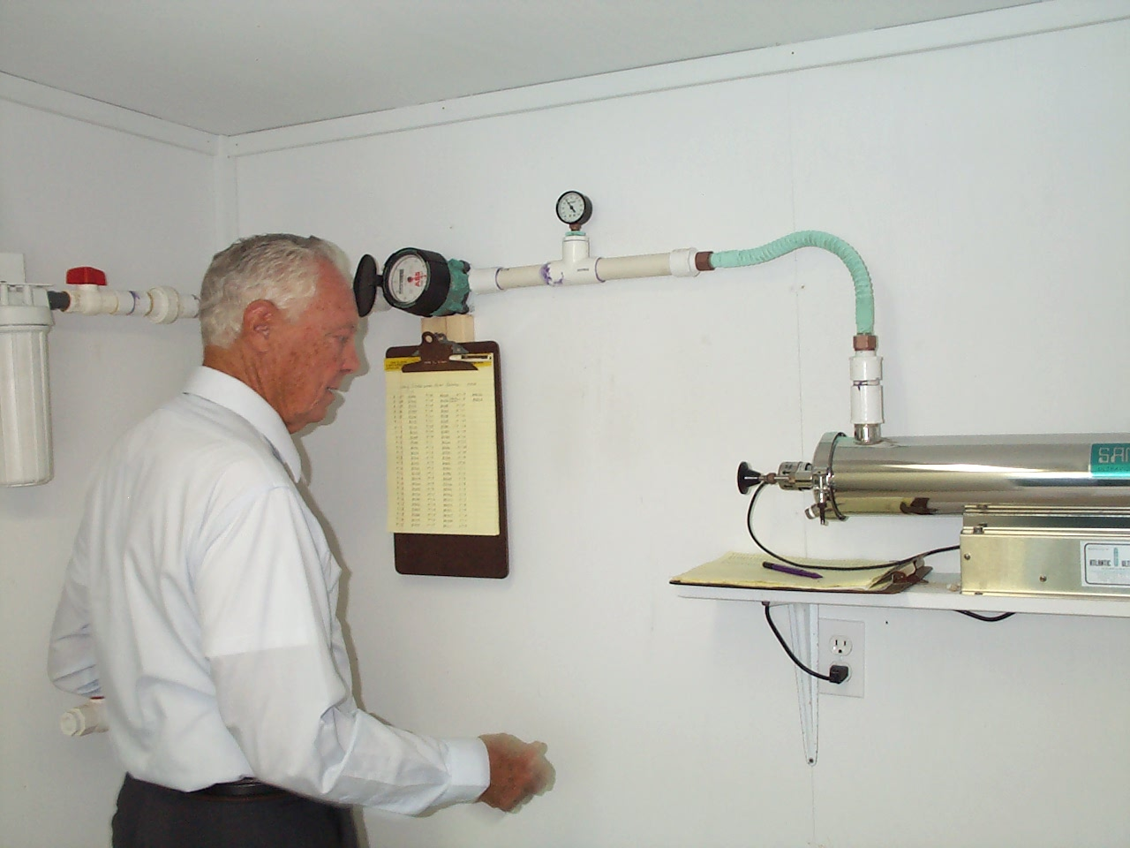
System Maintenance
Develop a maintenance checklist
Develop and use a schedule for maintaining system
Keep a Diary of maintenance –and Usage

Slide 9
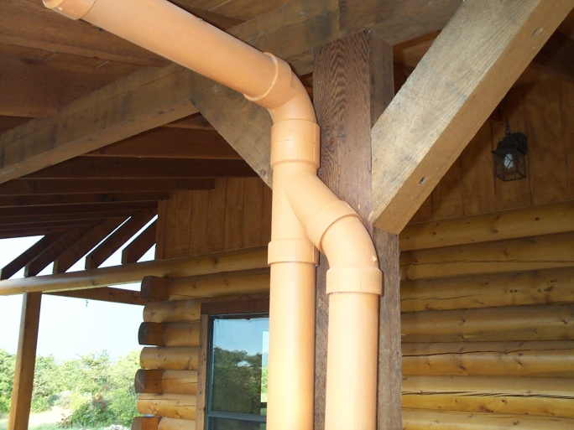
System Maintenance
An ongoing process to be improved and expanded over time.
additional roof where water can be harvested
Increased storage capacity
Improved filtration systems
Inspect your water harvesting system before each rainy season (and, ideally, after every rainfall) to keep the system operating optimally.

Slide 10
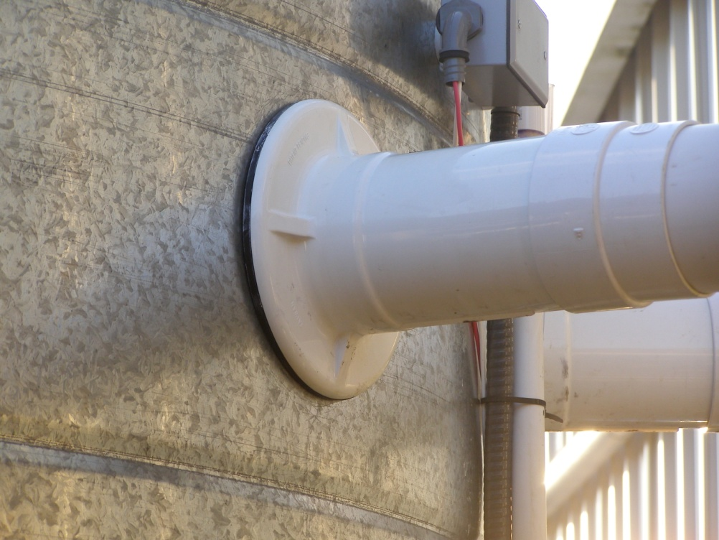
6 Big Things:
Clean and Maintain Gutters
Clean and Maintain Filters
Check First Flush
Monitor Water Levels
Change Out
UV Light, supplies
Check for Leaks

Slide 11
Roof Maintenance

Slide 12
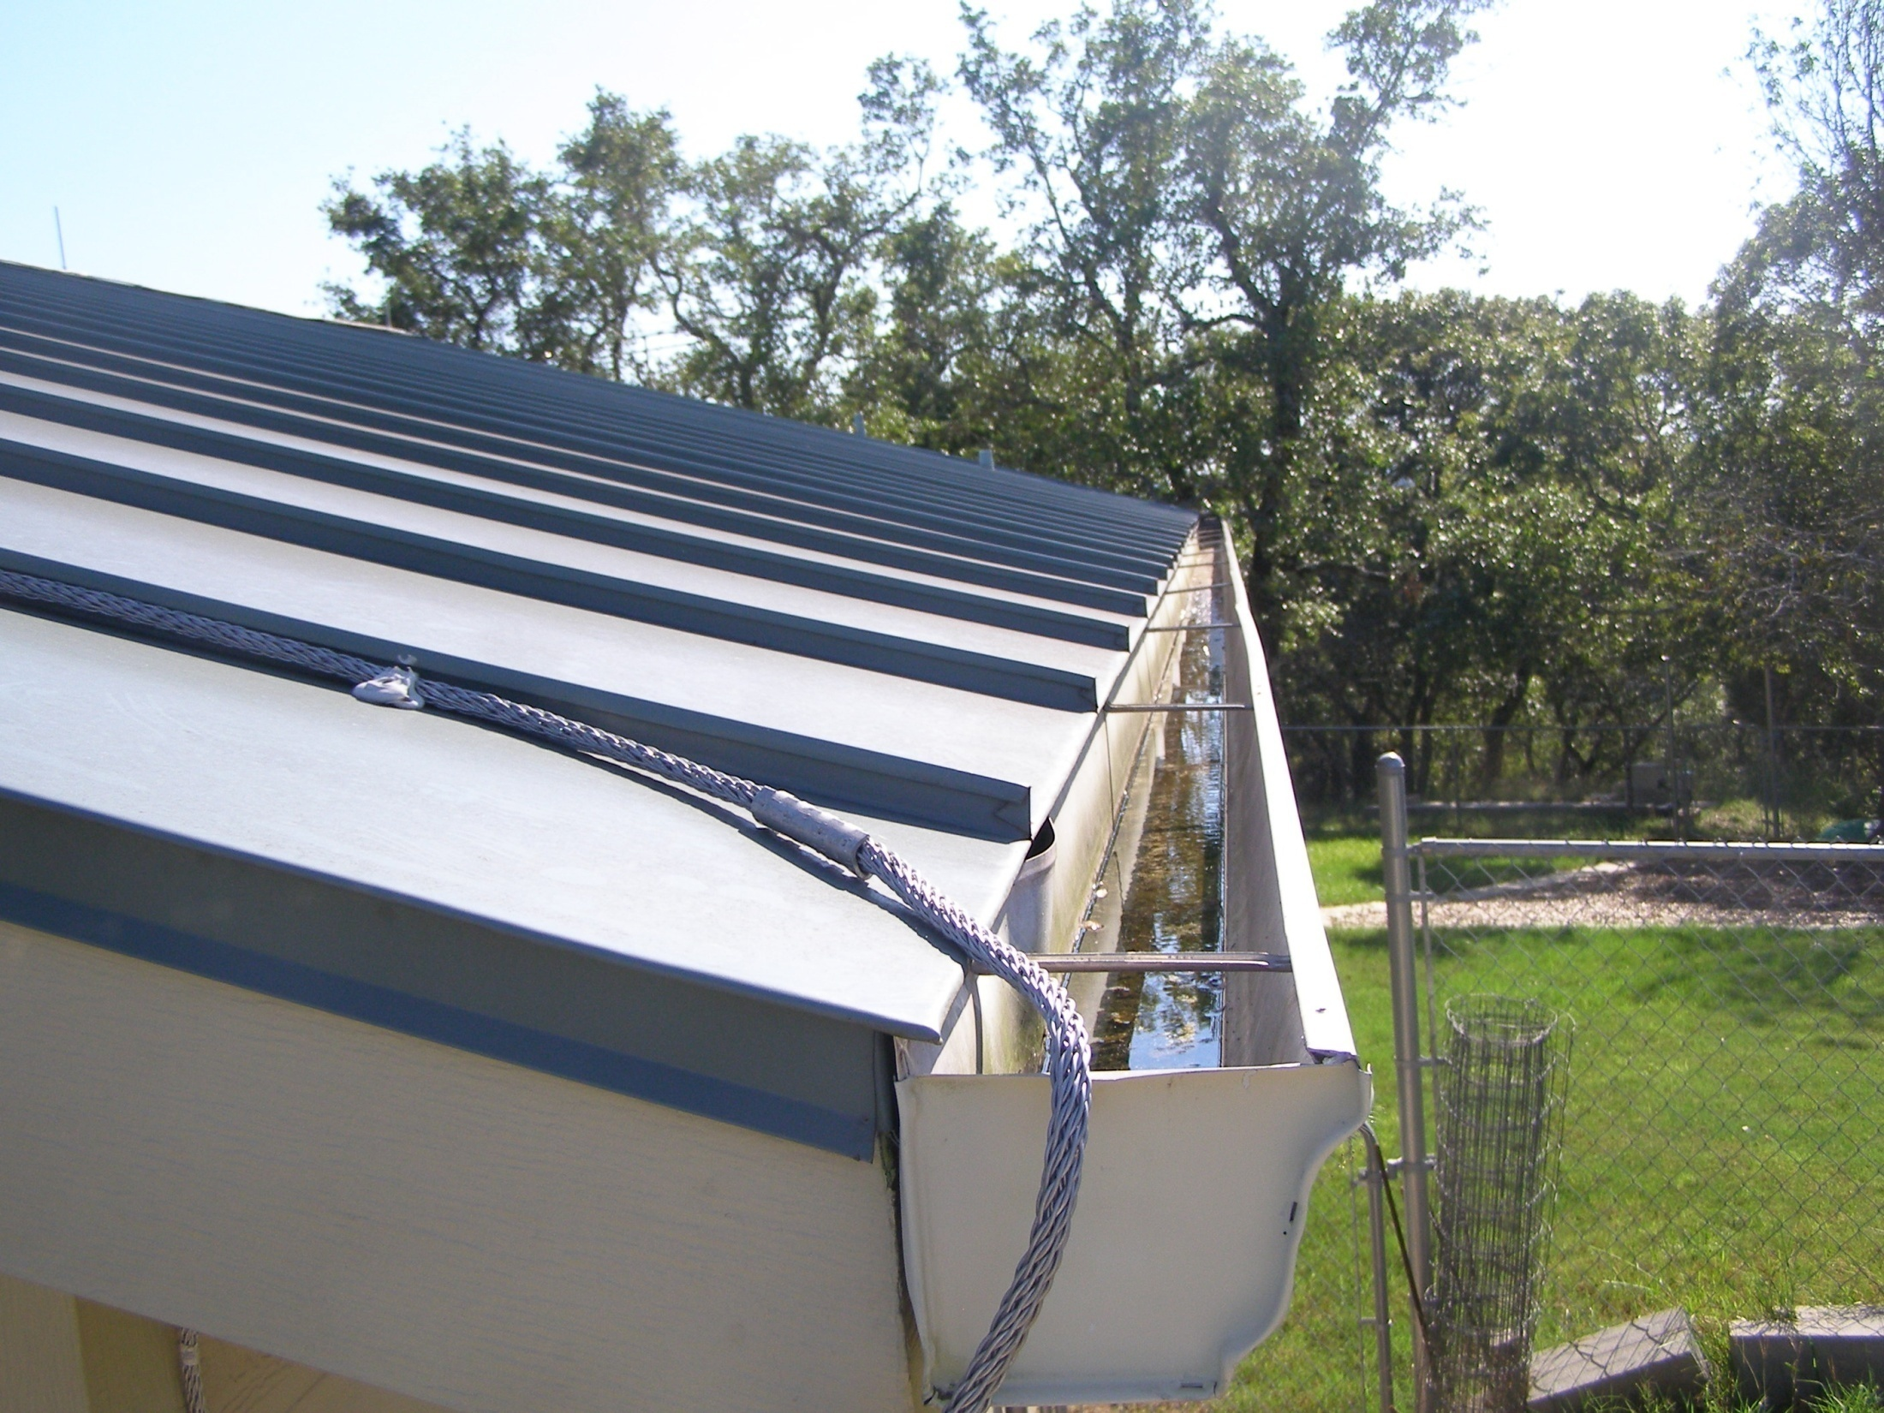
Check, Clean and maintain Gutters, Leaf Guards, Screens and First Flush

Slide 13
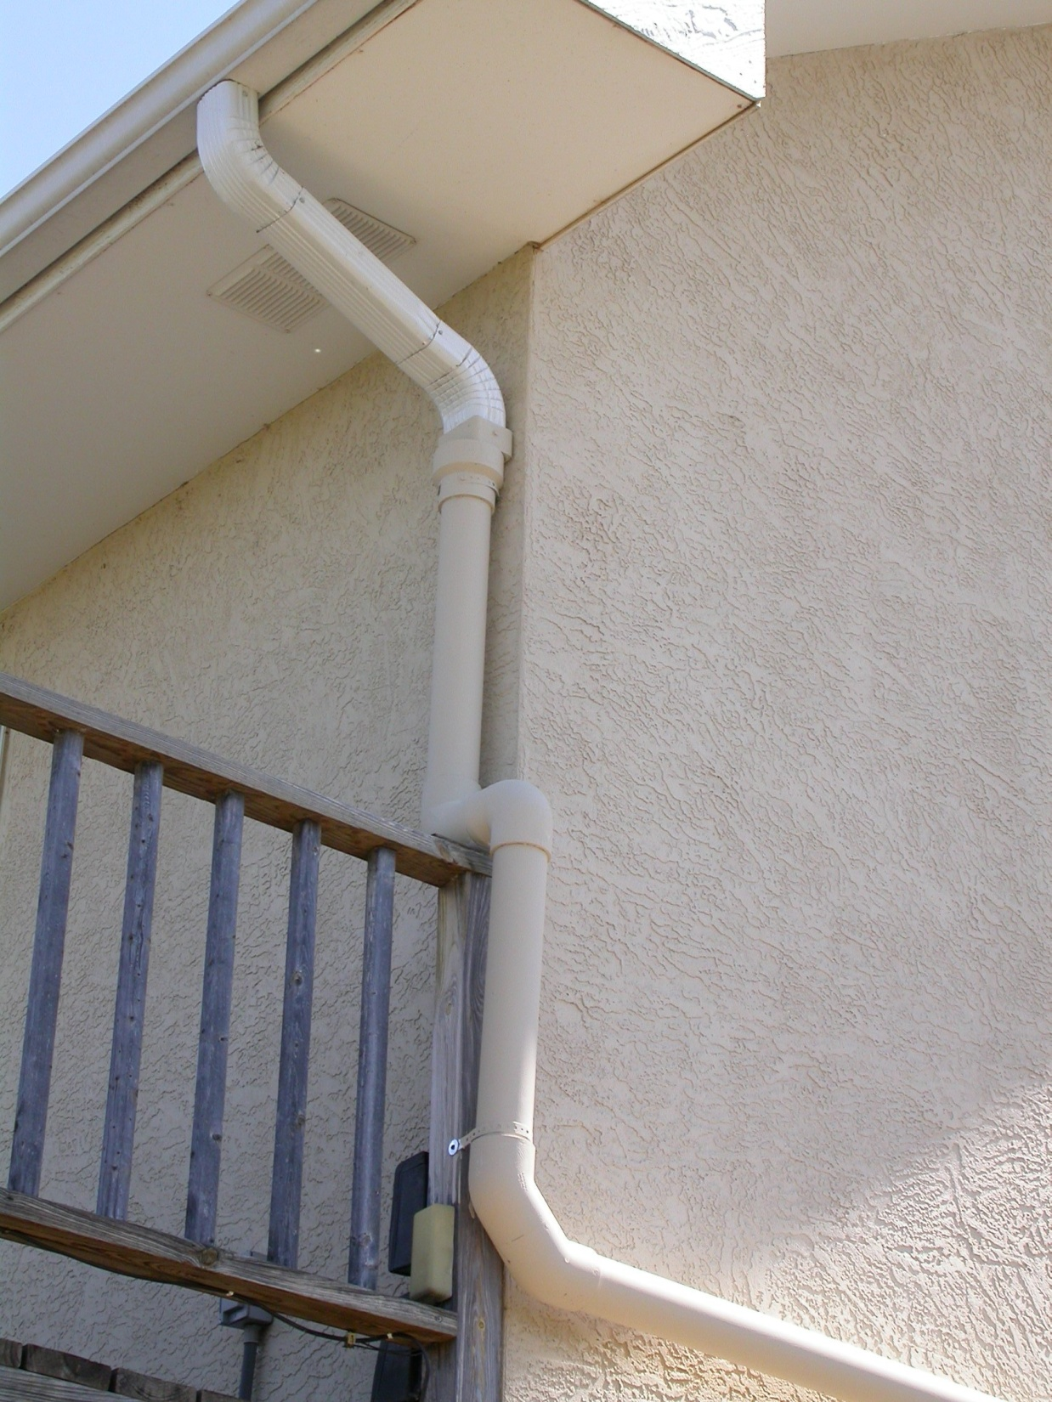

Slide 14
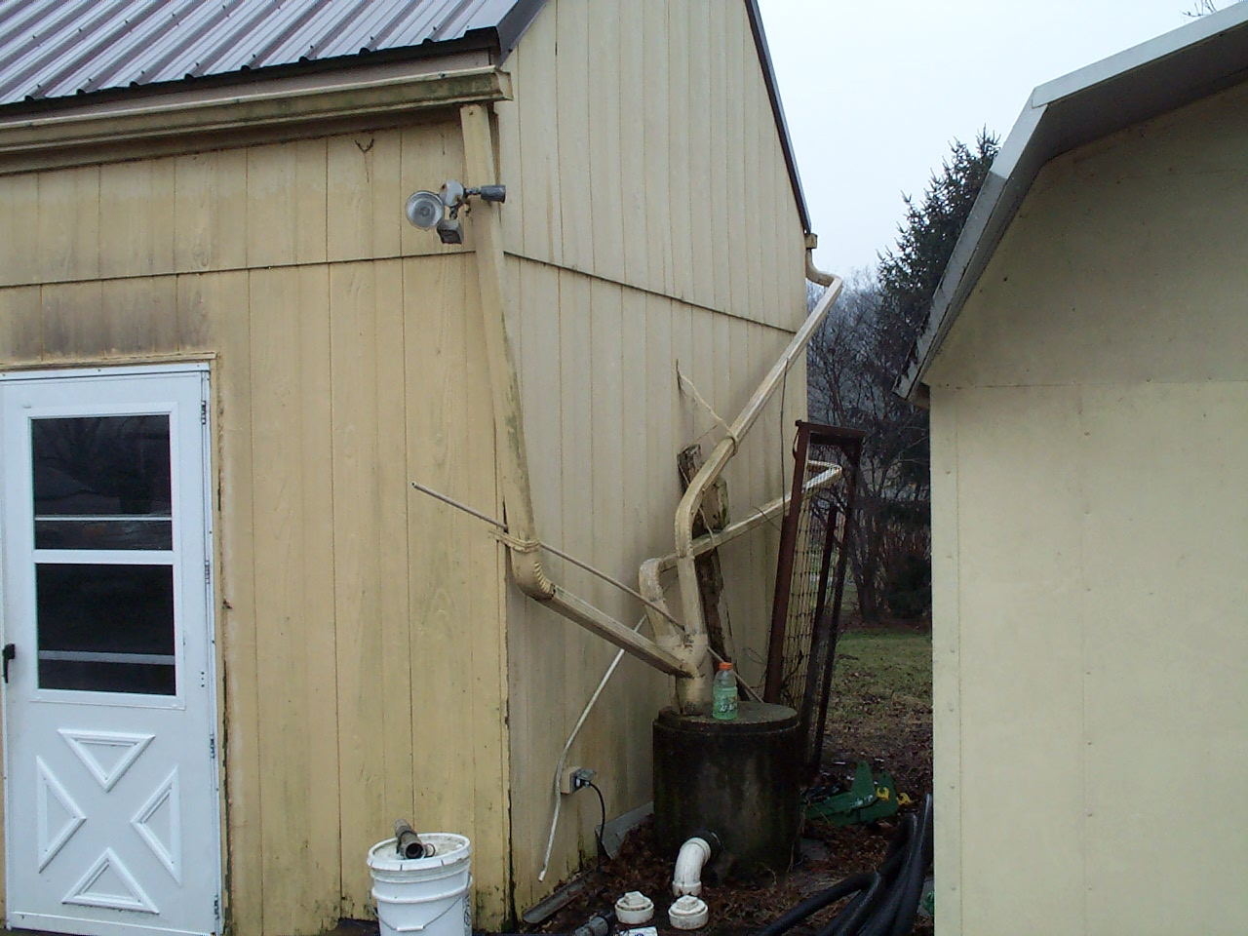

Slide 15
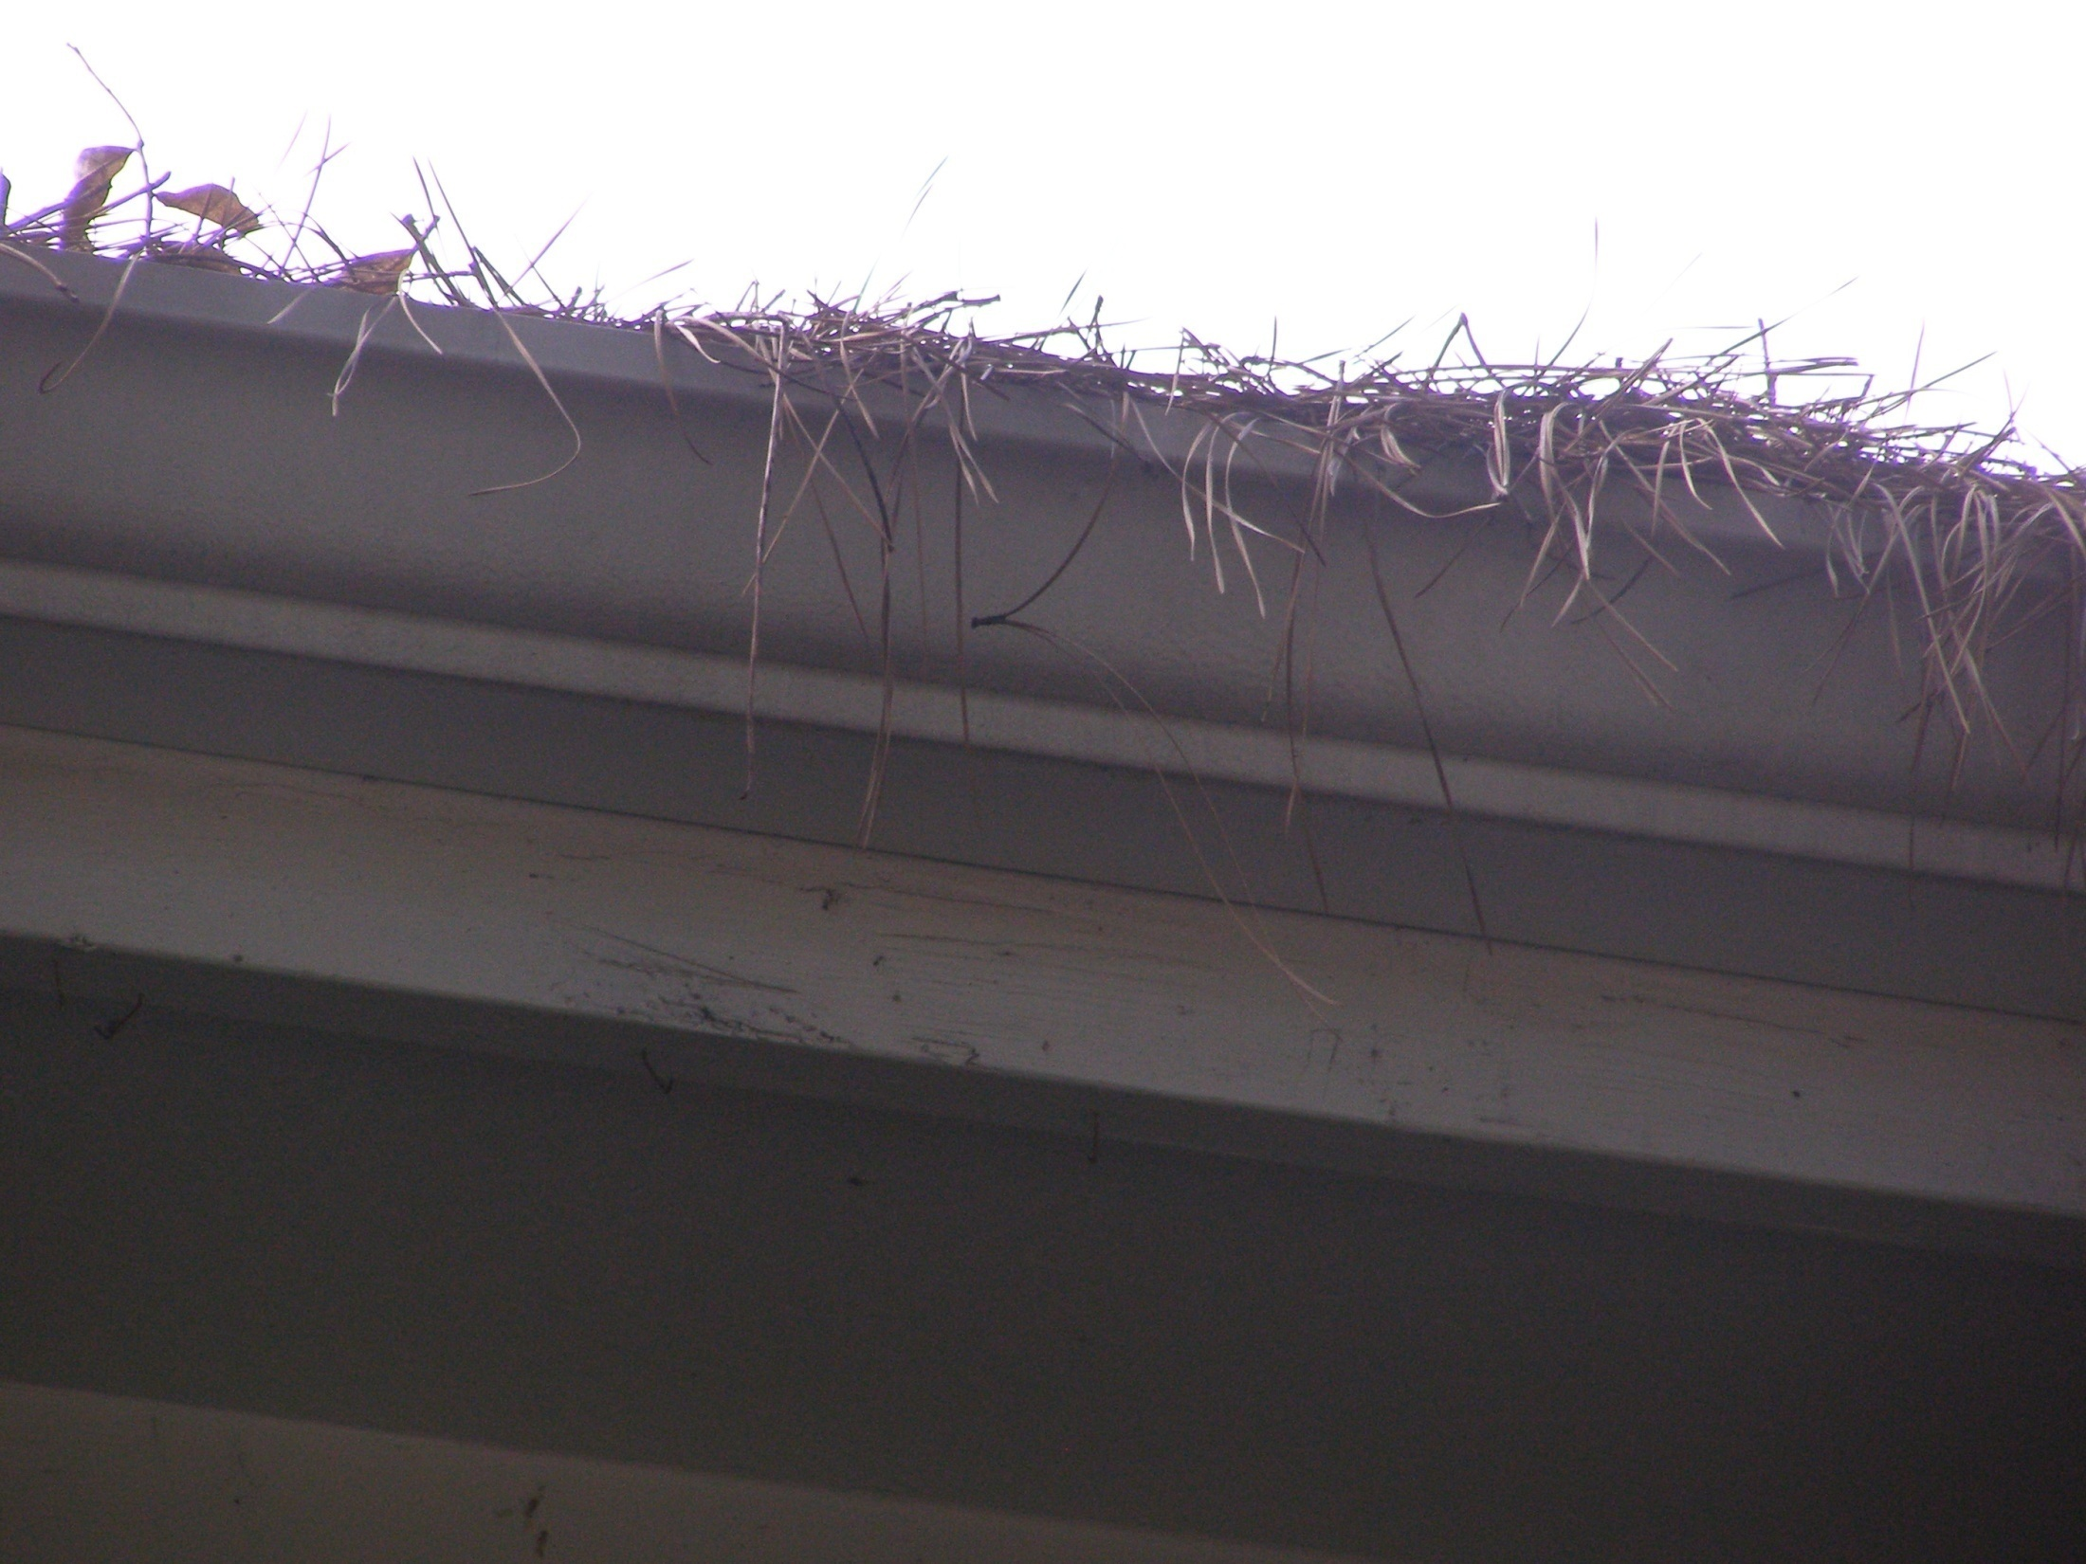

Slide 16
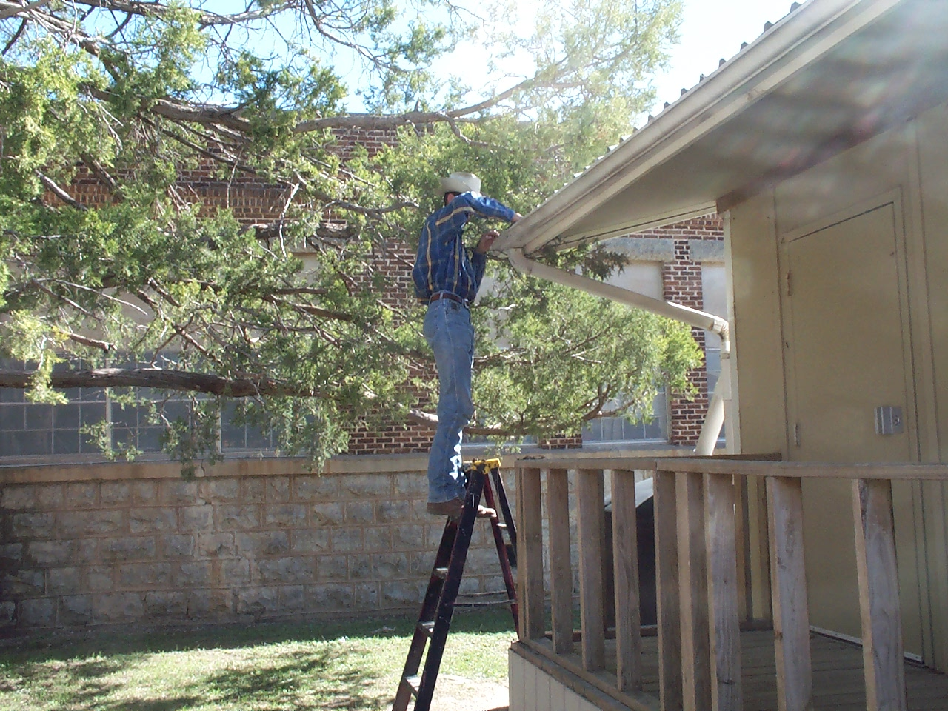

Slide 17
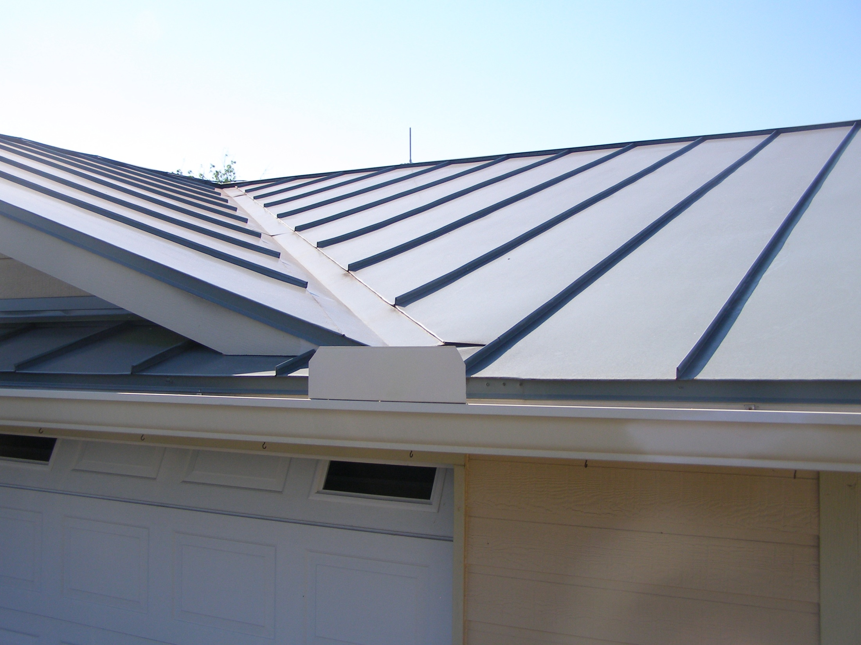

Slide 18
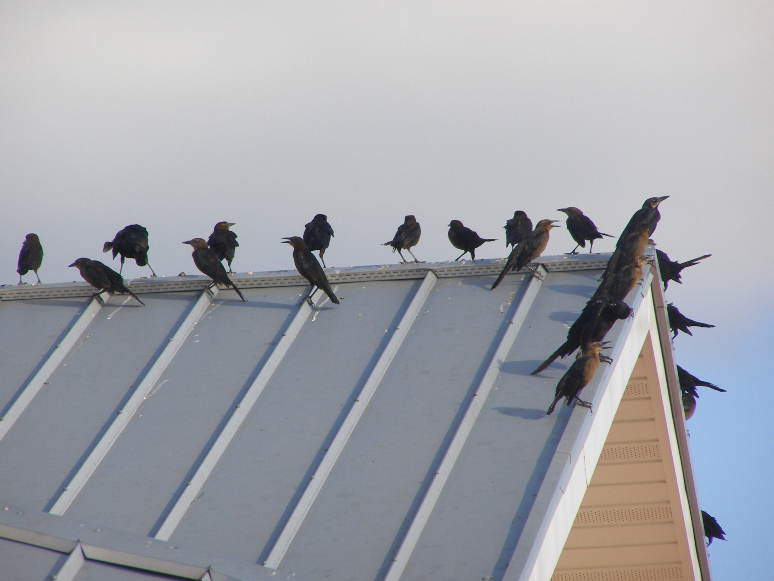

Slide 19
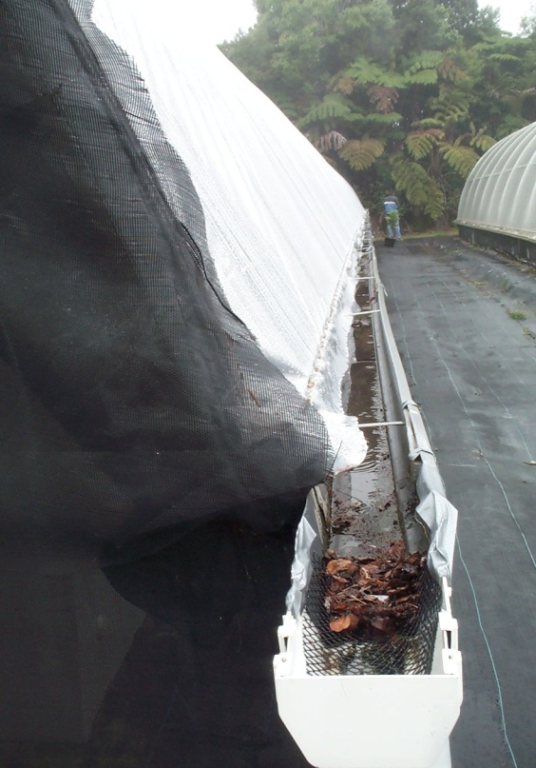
Keep Your System in Top Condition:
Keep limbs and debris away from your roof
Keep debris out of gutters and downspouts
Keep roof washers/diverters/screens clean
Inspect tanks, lines, connections for leaks
Keep area clean and free of trash or vegetation

Slide 20
Replace Bulbs Annually Or By Manufacturer Instructions

Slide 21
Make Sure All Parts Are Working Like They Are Supposed To

Slide 22
Freeze Concerns
Don’t Let Your Frog Freeze

Slide 23
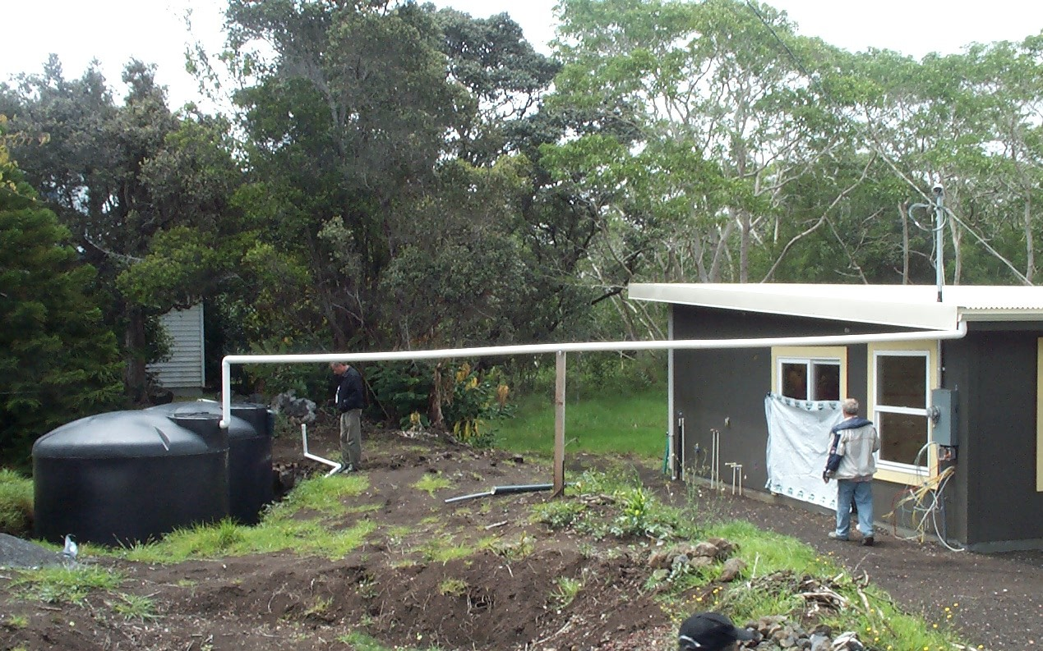
Insulation
Protect your plumbing as you would
any other plumbing
Tanks can be buried below the freeze
line in colder climates

Slide 24
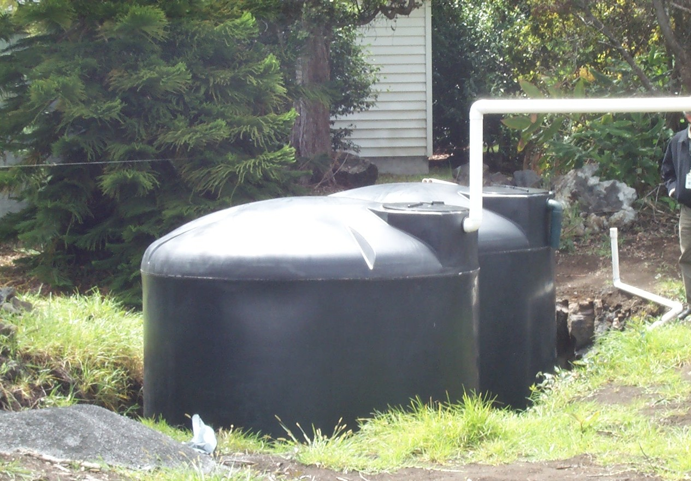
But Empty Tanks Float

Slide 25
Tanks Insulate Greenhouse

Slide 26
Be Conscious of Septic Systems or Possible Contamination

Slide 27
Fix The Gutter

Slide 28
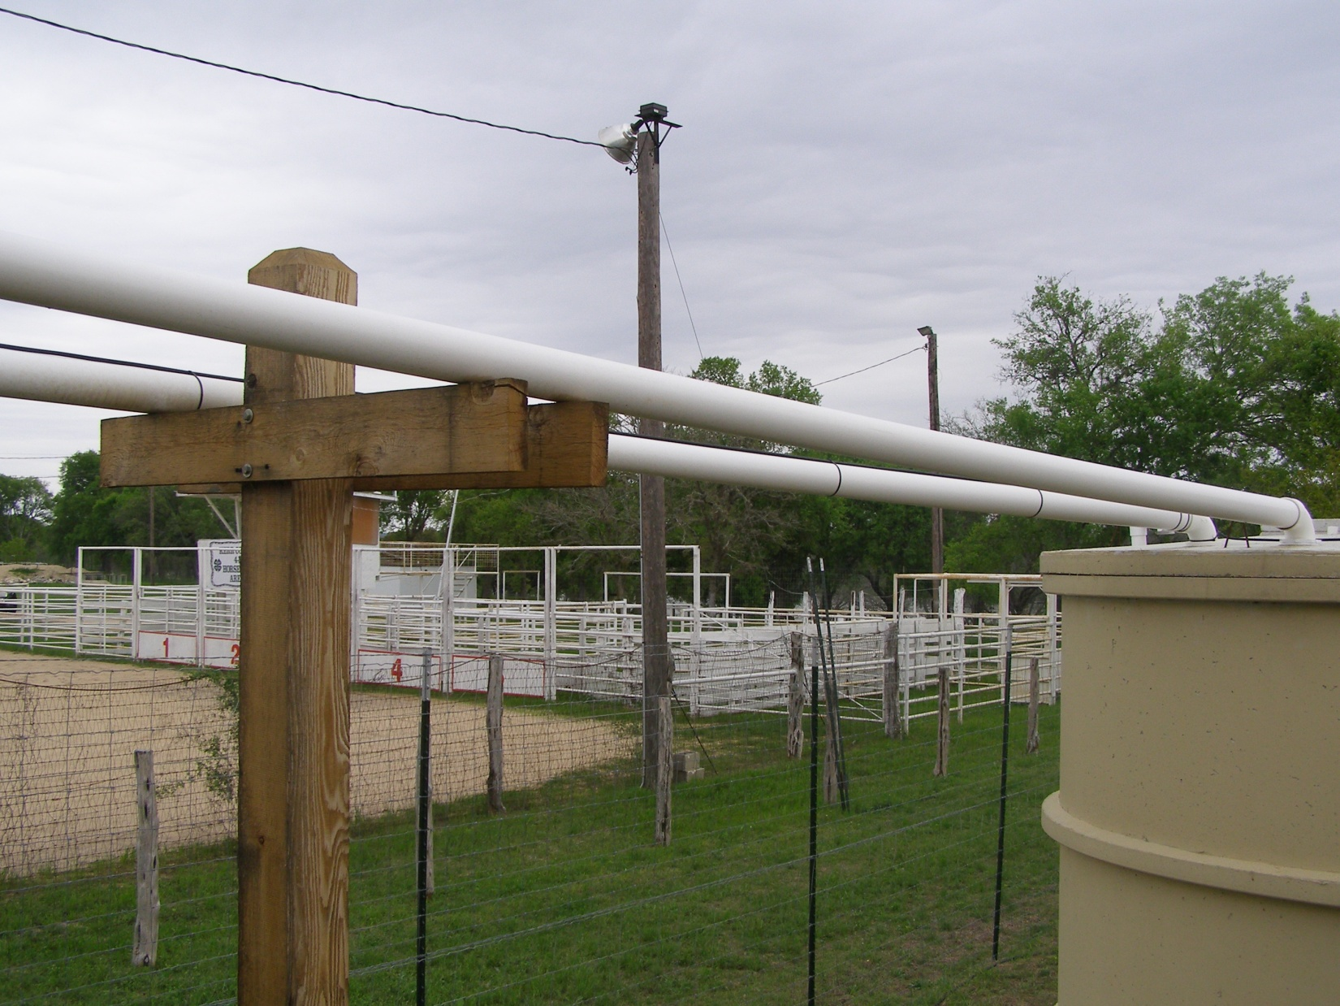
Drains For Pipes – Create Dry Line

Slide 29
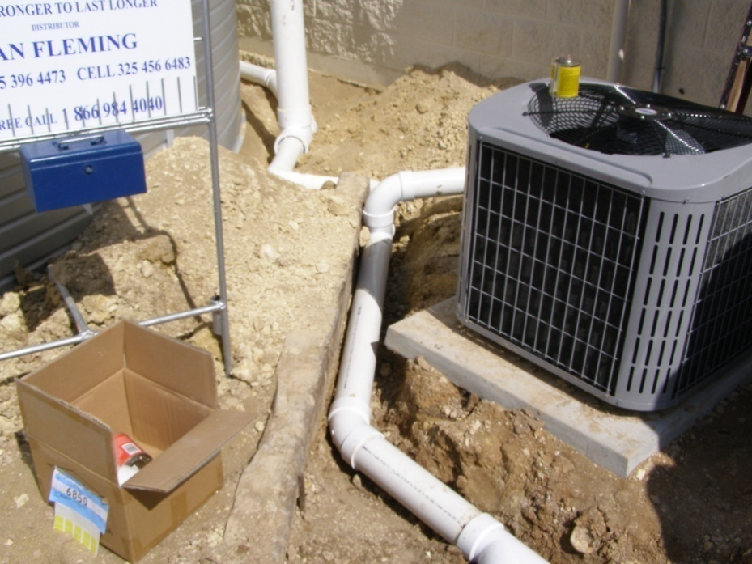
Once Lines Are Buried Do Not Mess Them Up

Slide 30
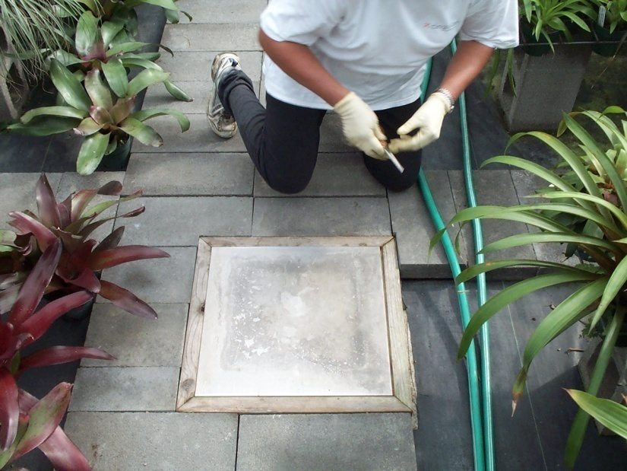
Storage Tanks Under Ground Are Not As Easy To Check

Slide 31
Swelling and Shrinking May Shift Your House – foundation - Tanks

Slide 32
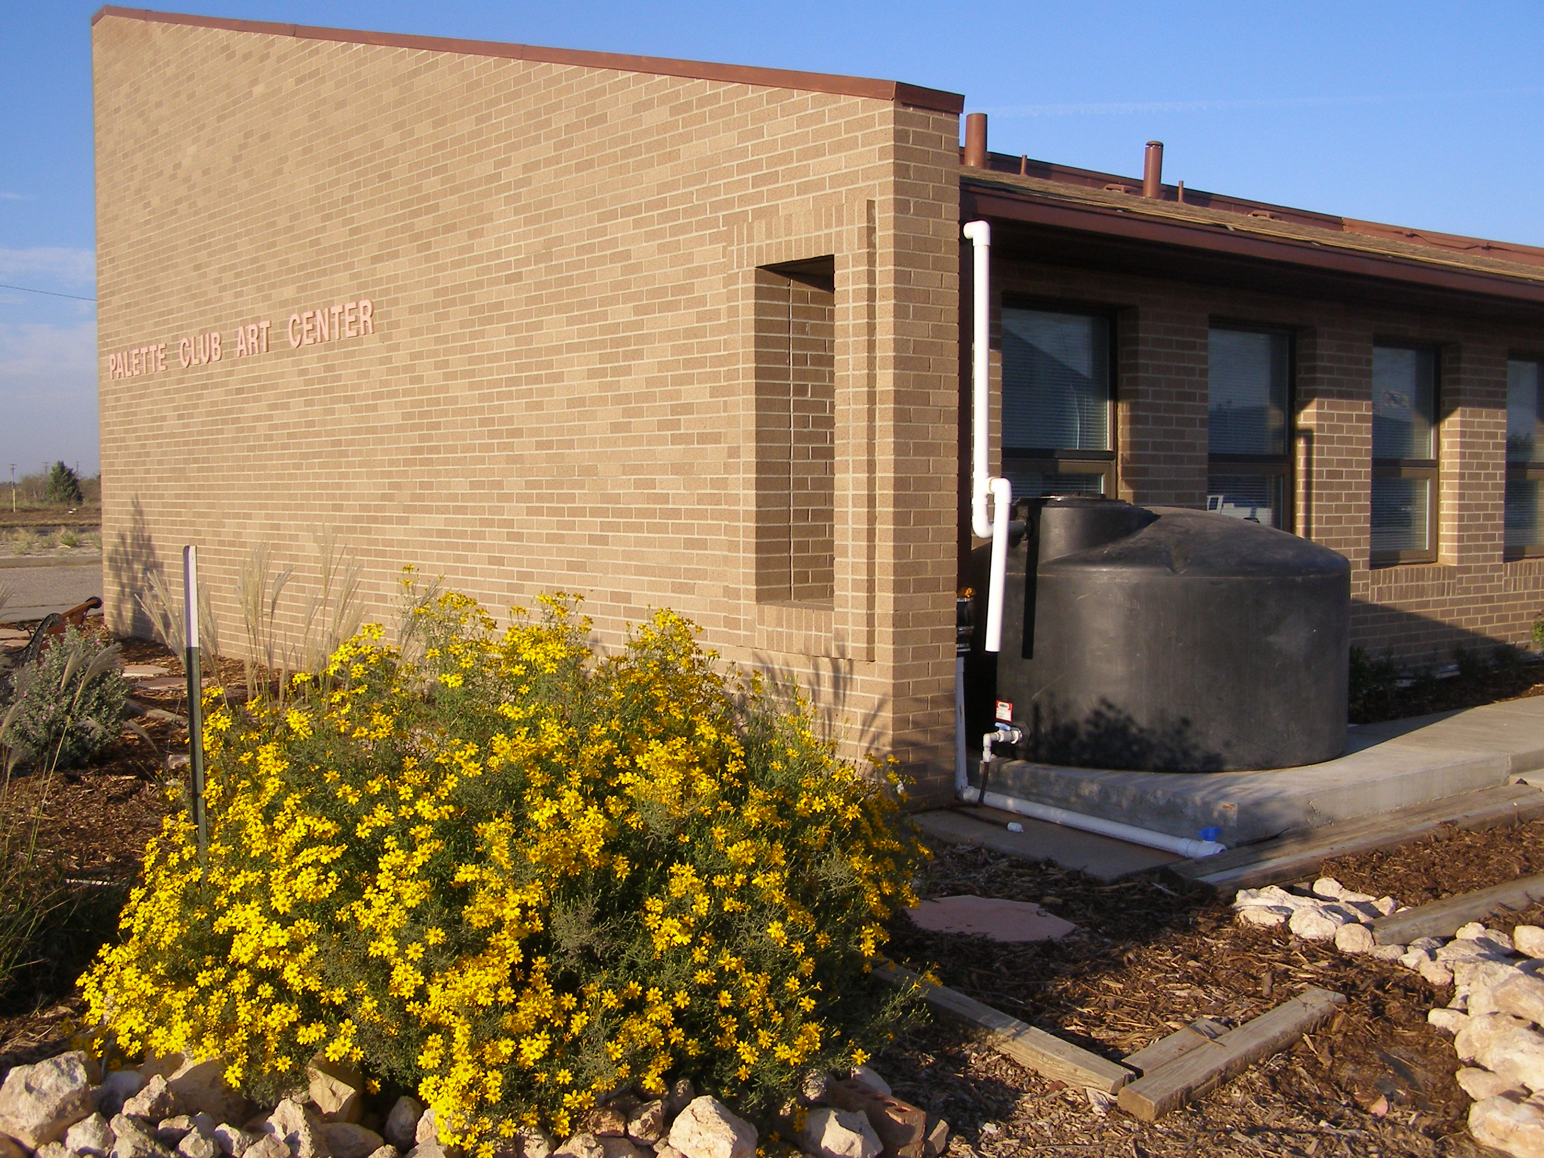

Slide 33
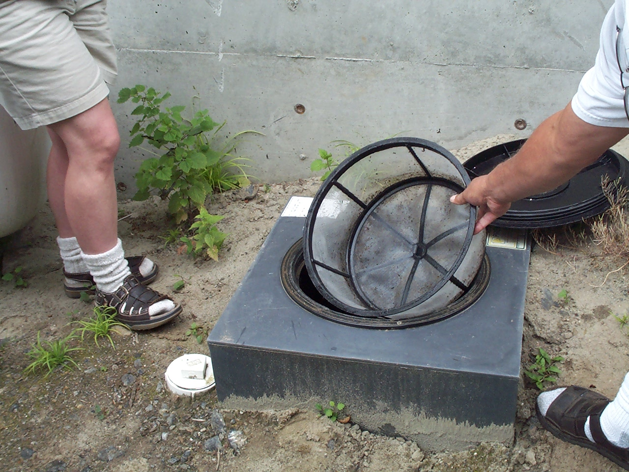

Slide 34
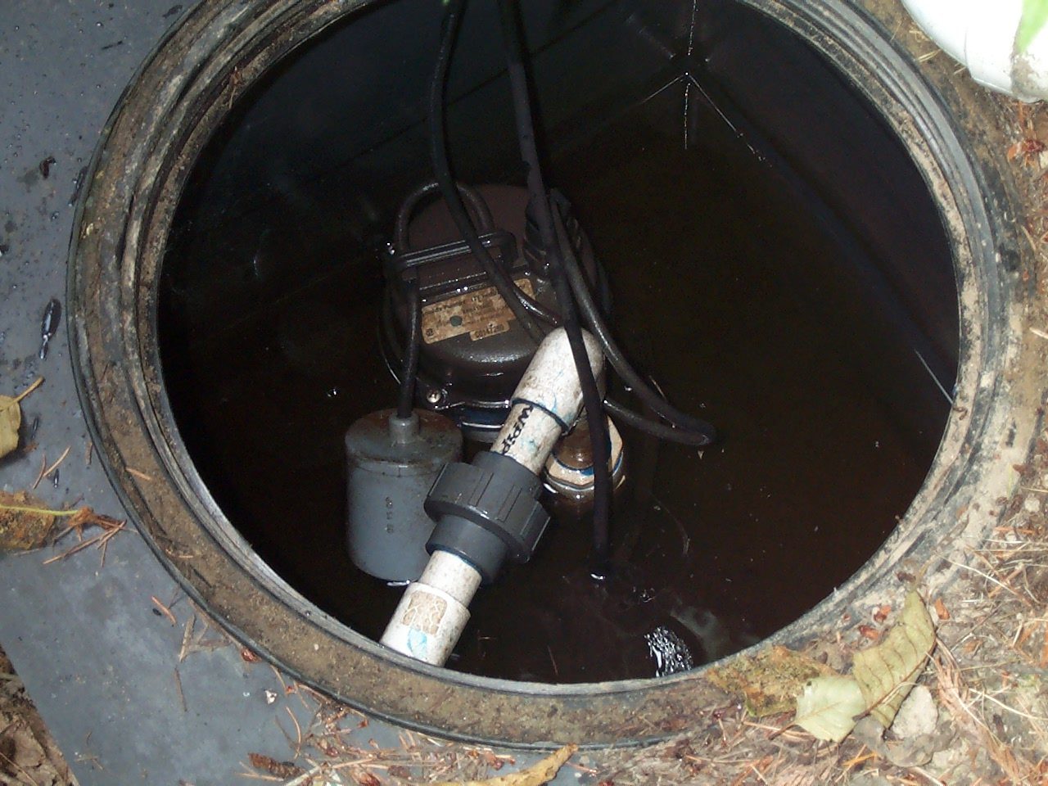
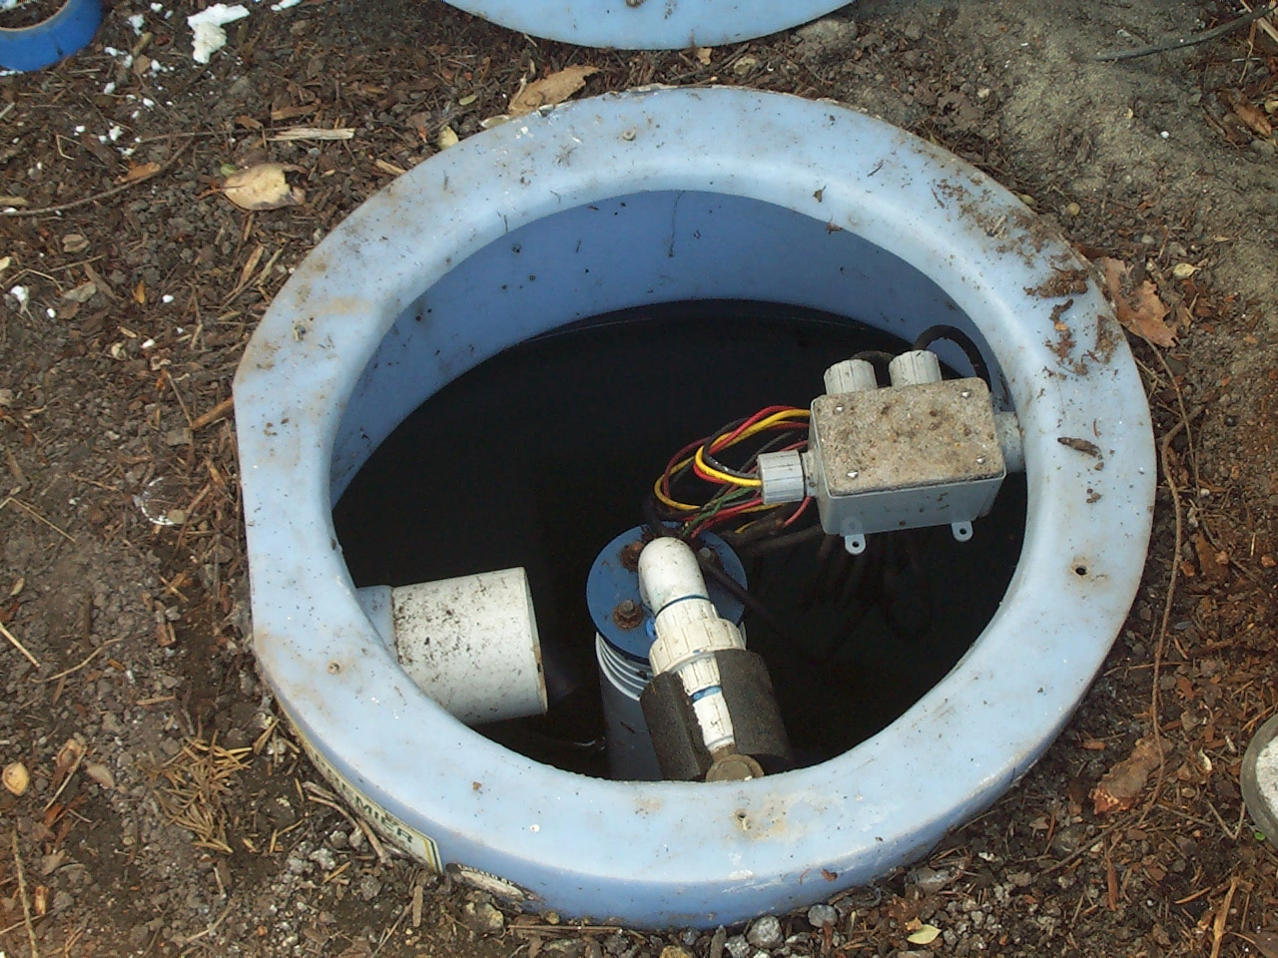

Slide 35
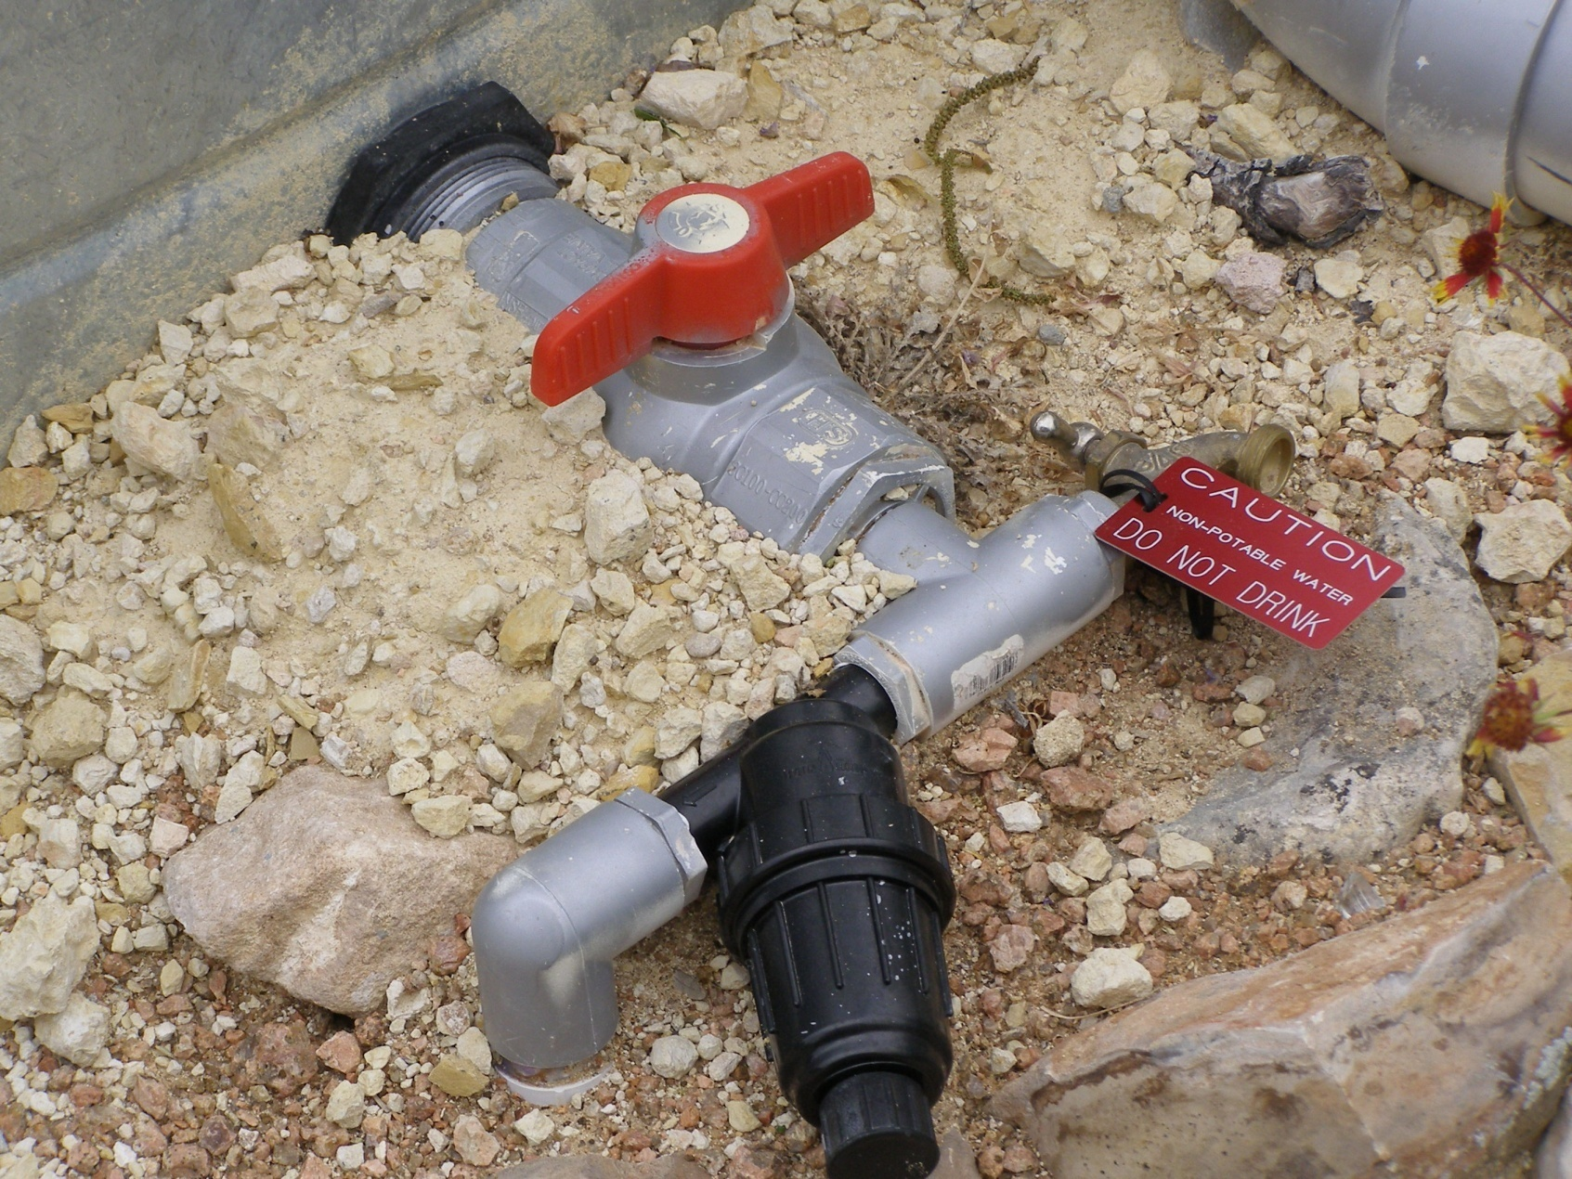
Label Pipes and faucet

Slide 36
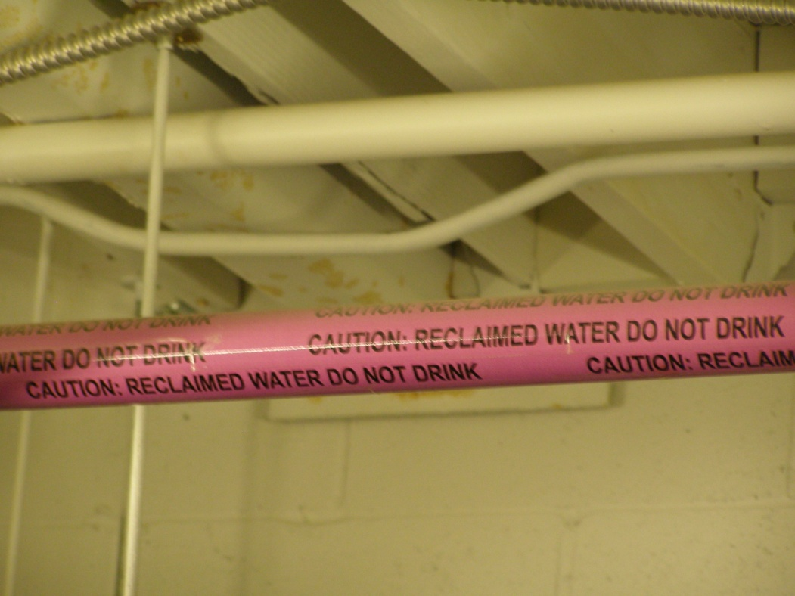
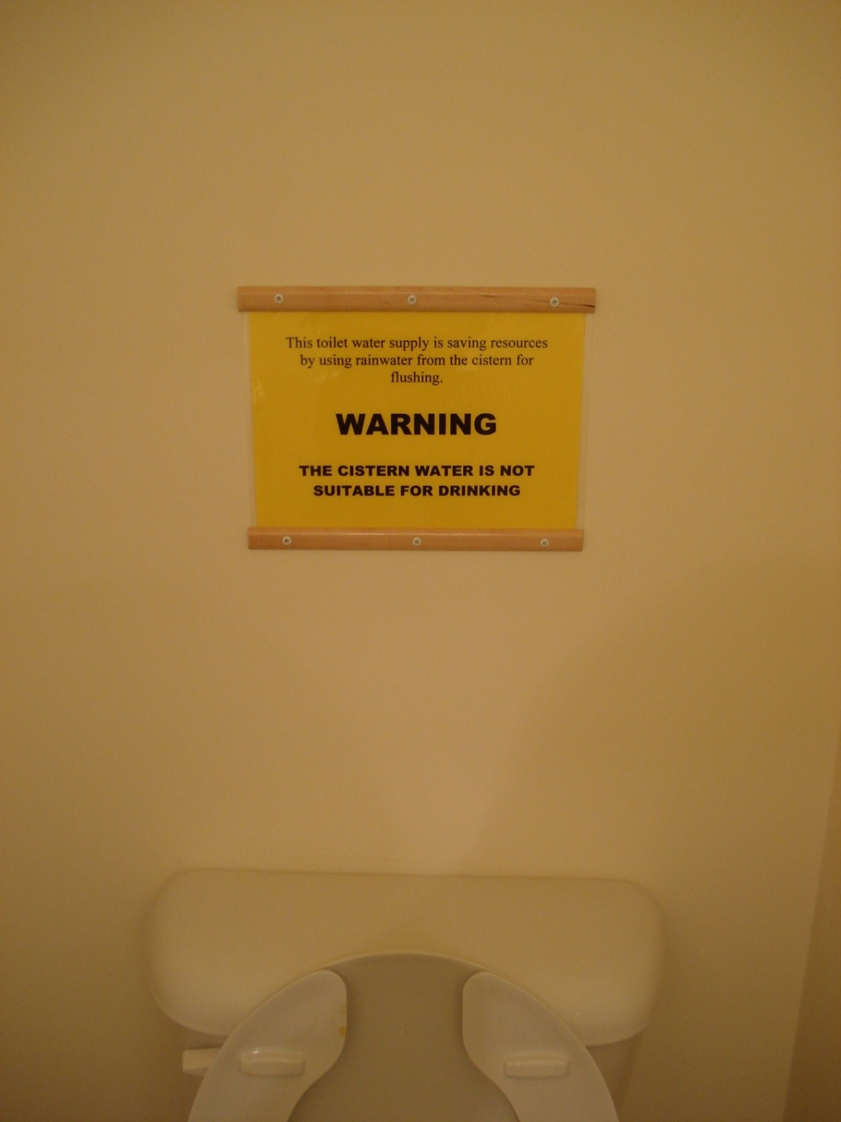
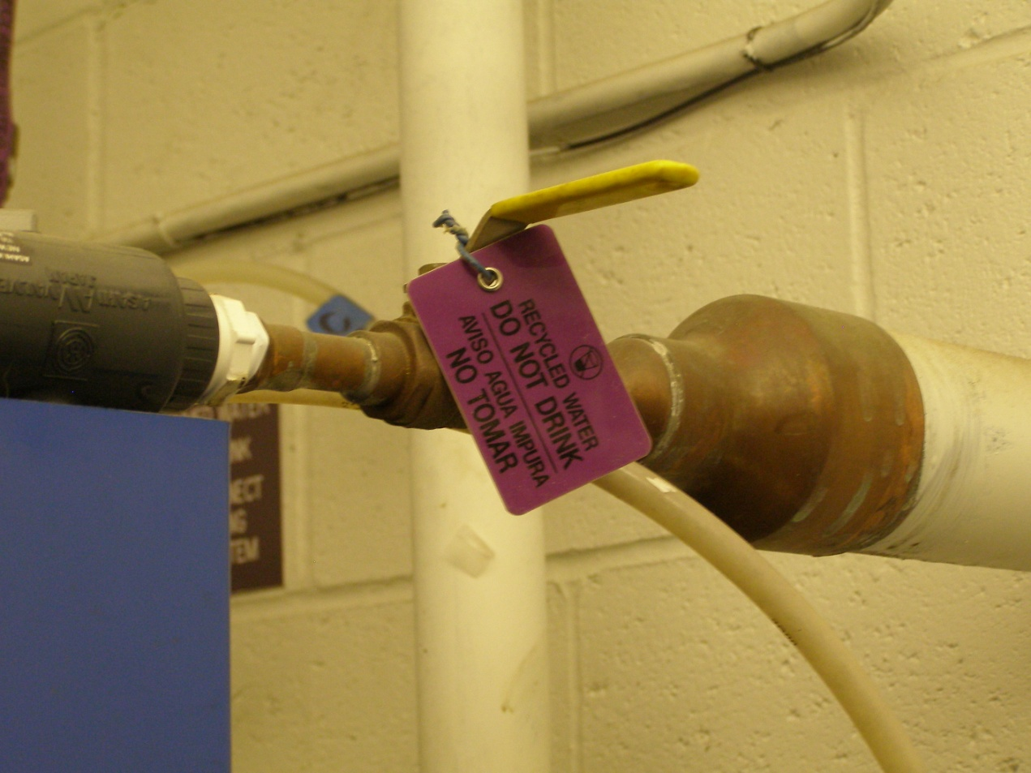

Slide 37
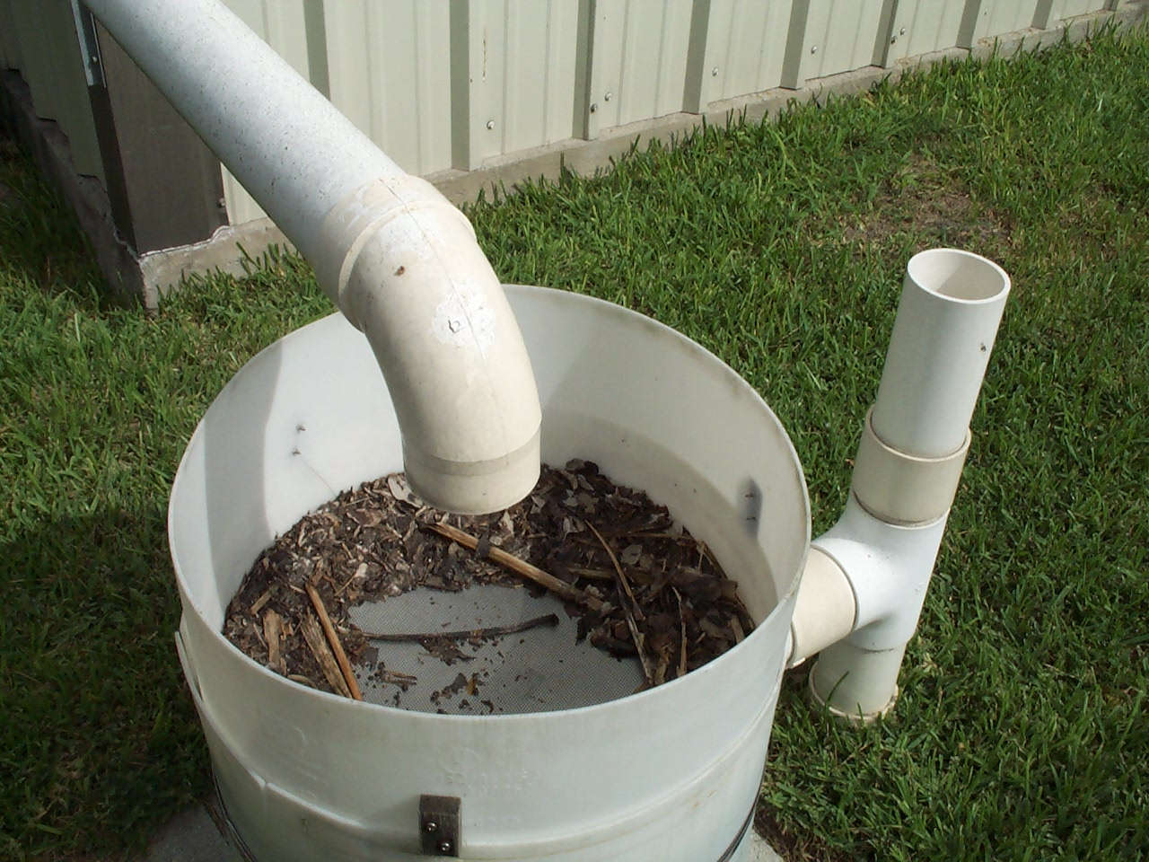

Slide 38
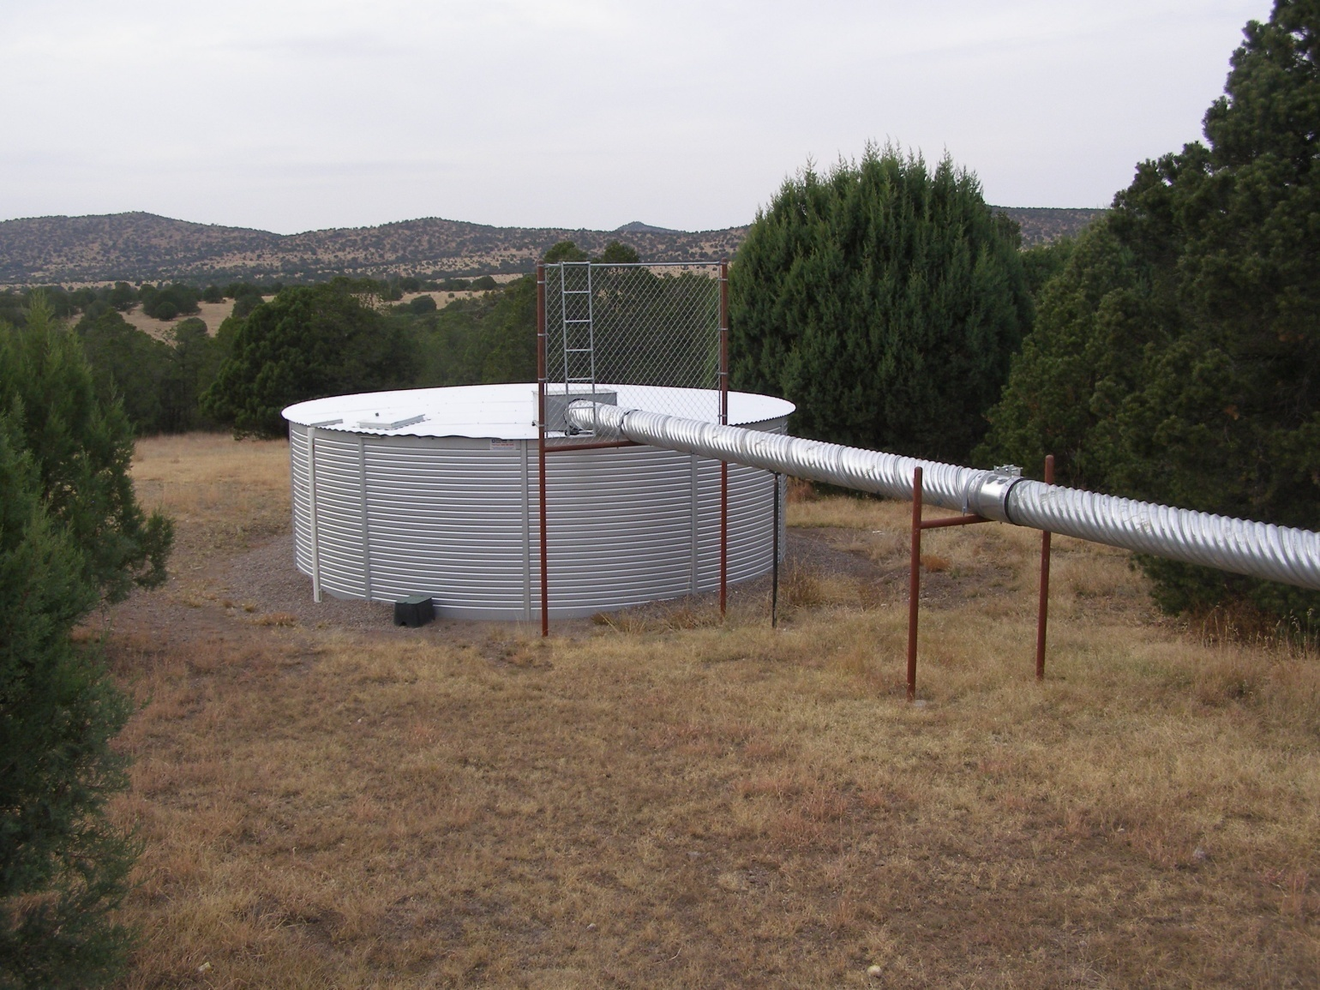
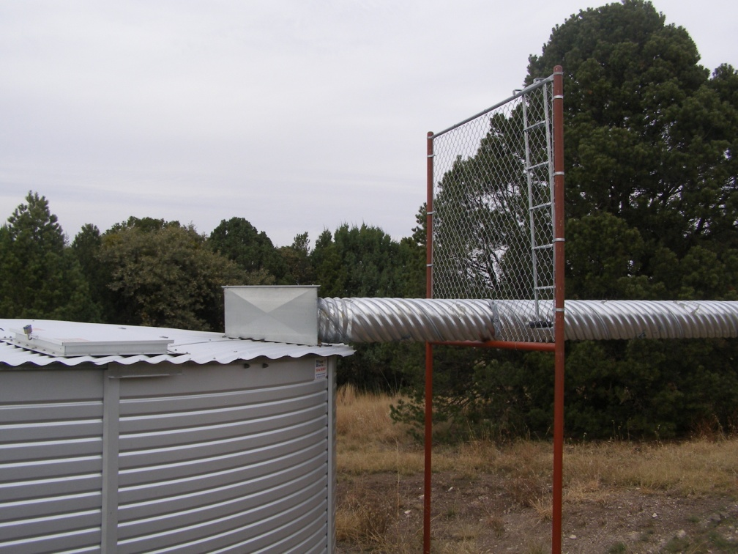
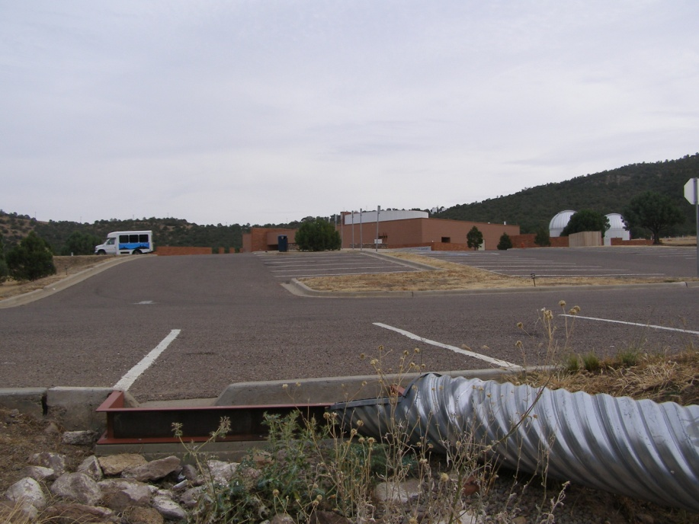

Slide 39
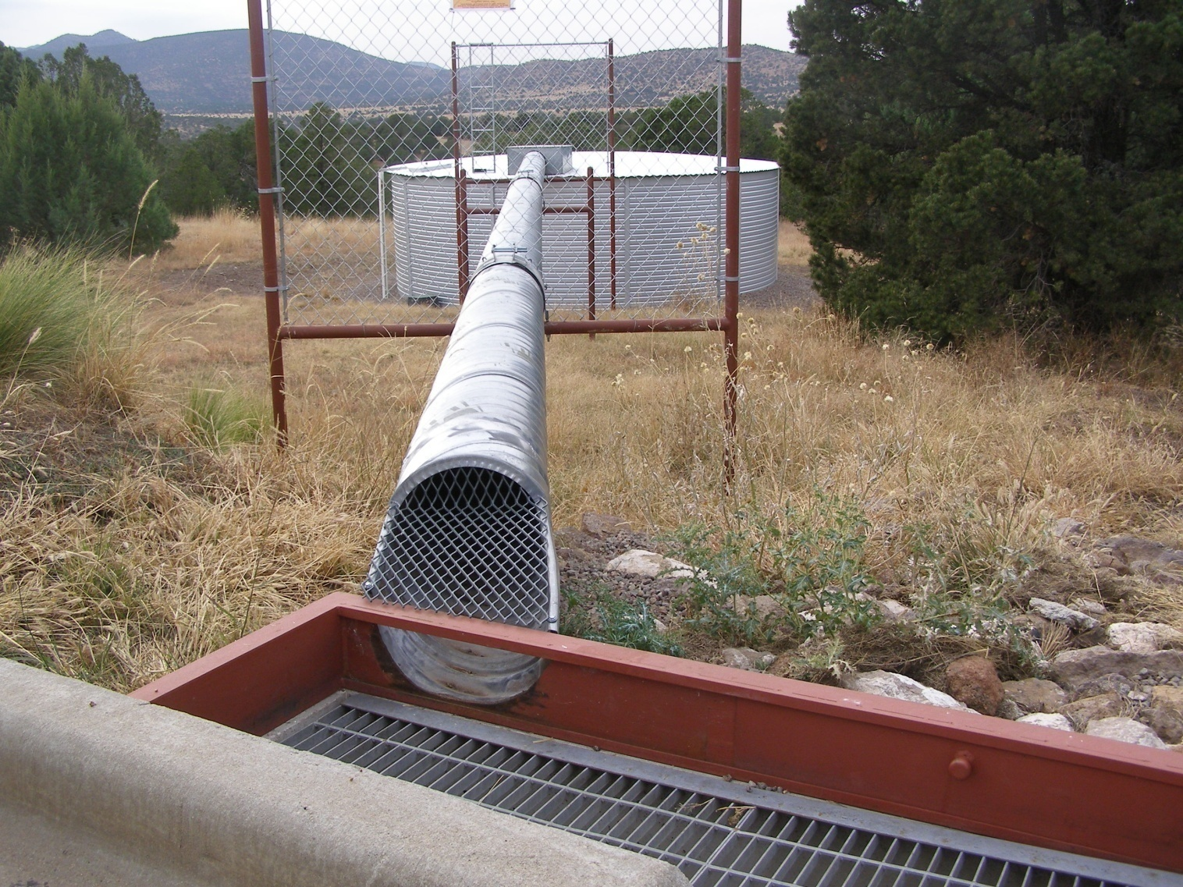
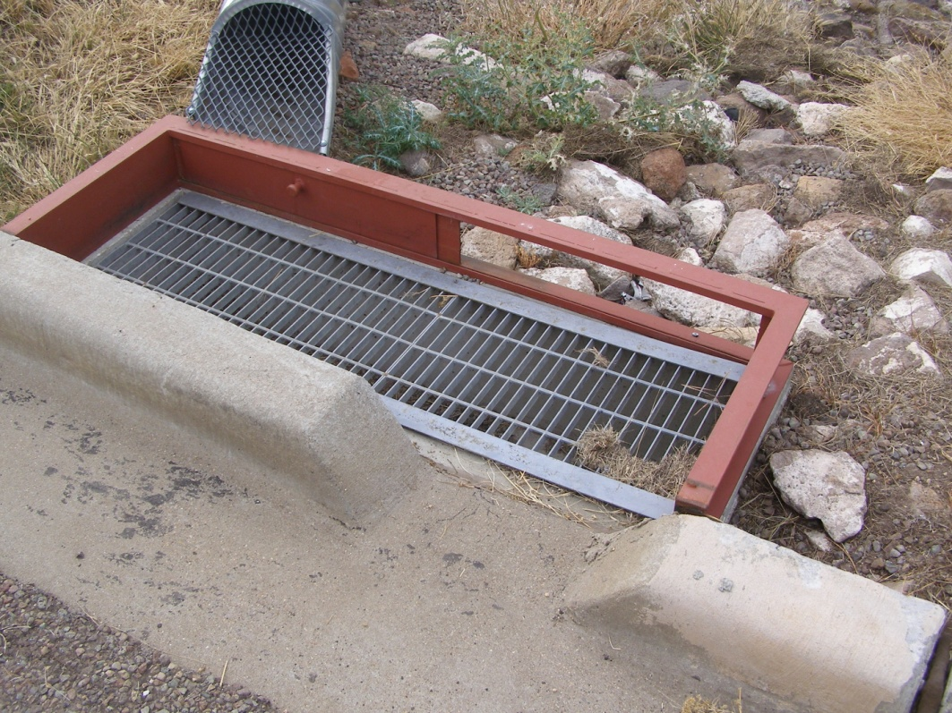

Slide 40
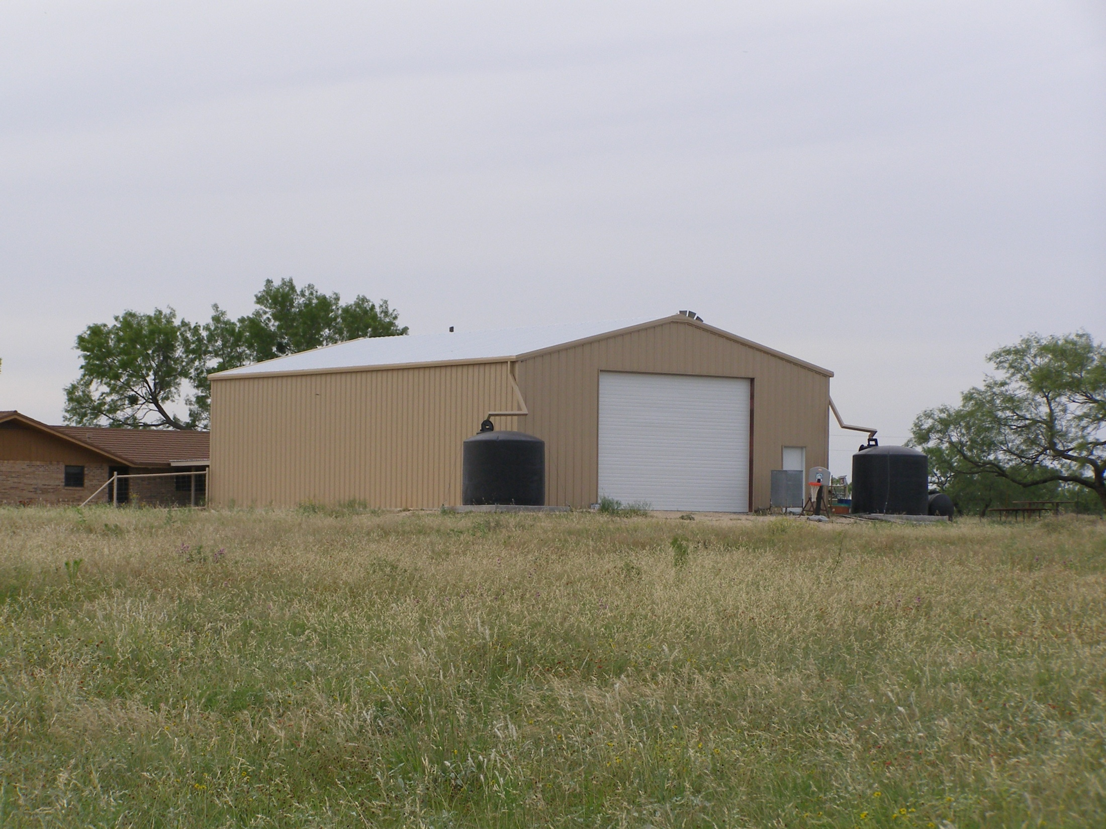

Slide 41
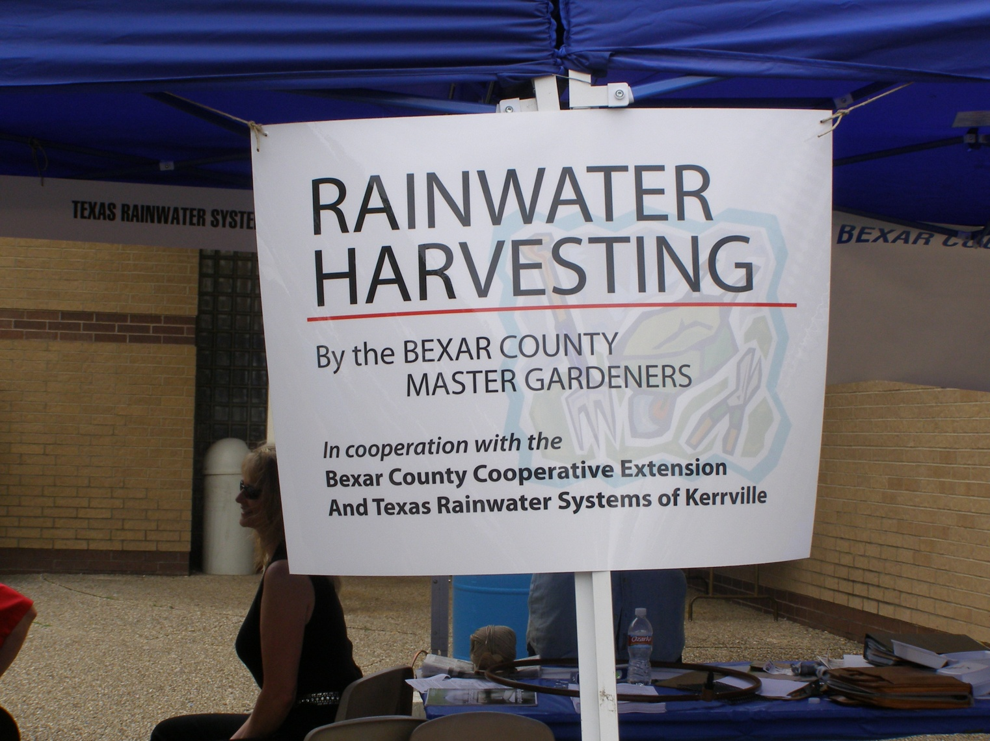
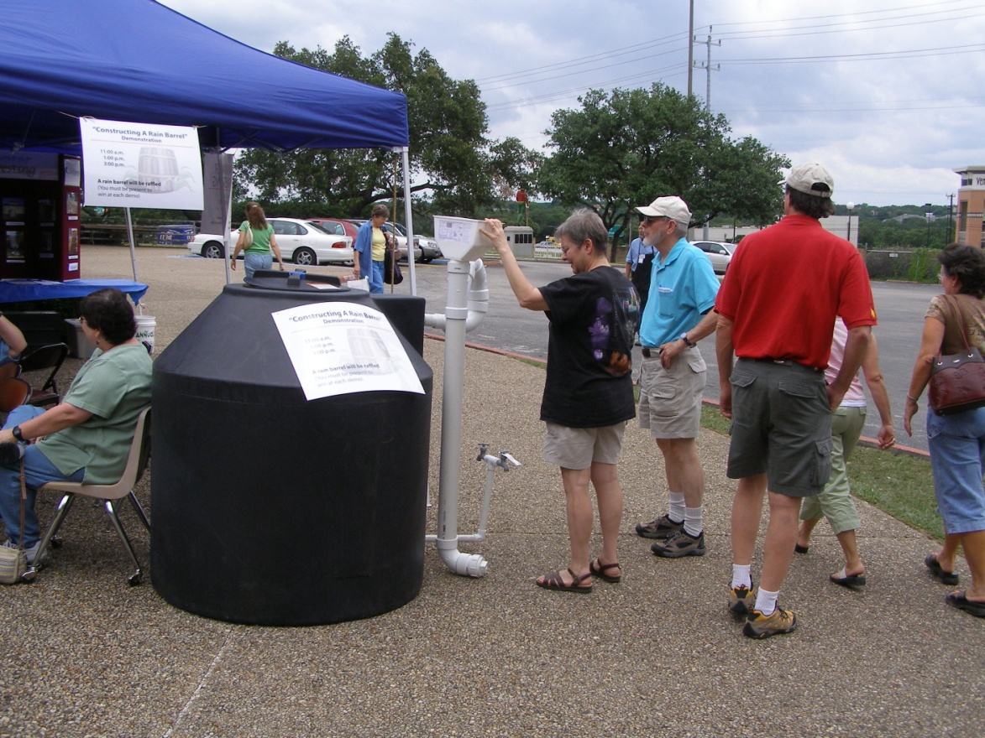

Slide 42
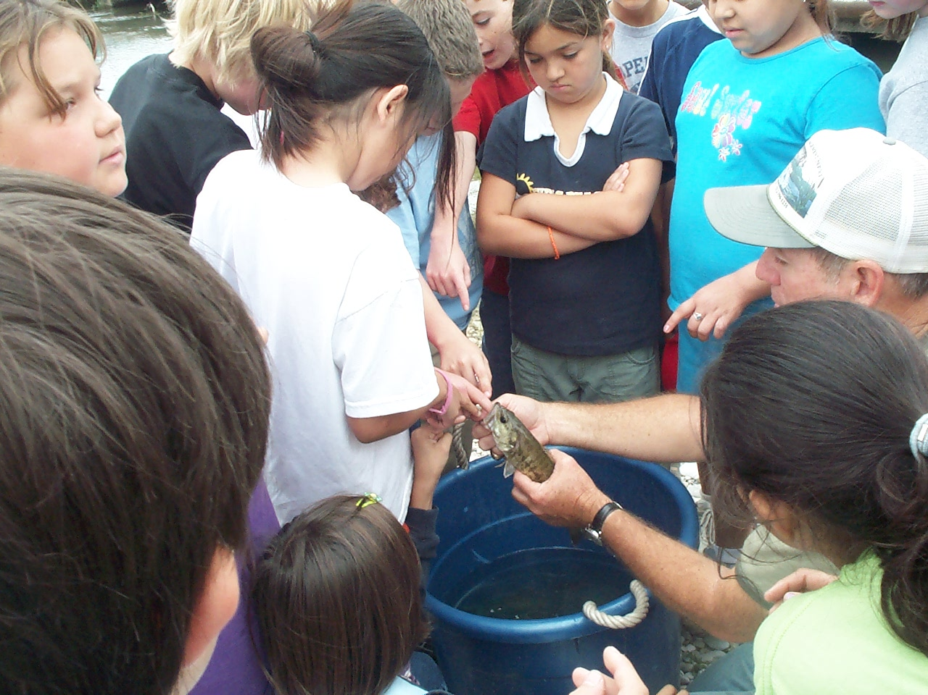
Pass Your Knowledge on to Others

Slide 43
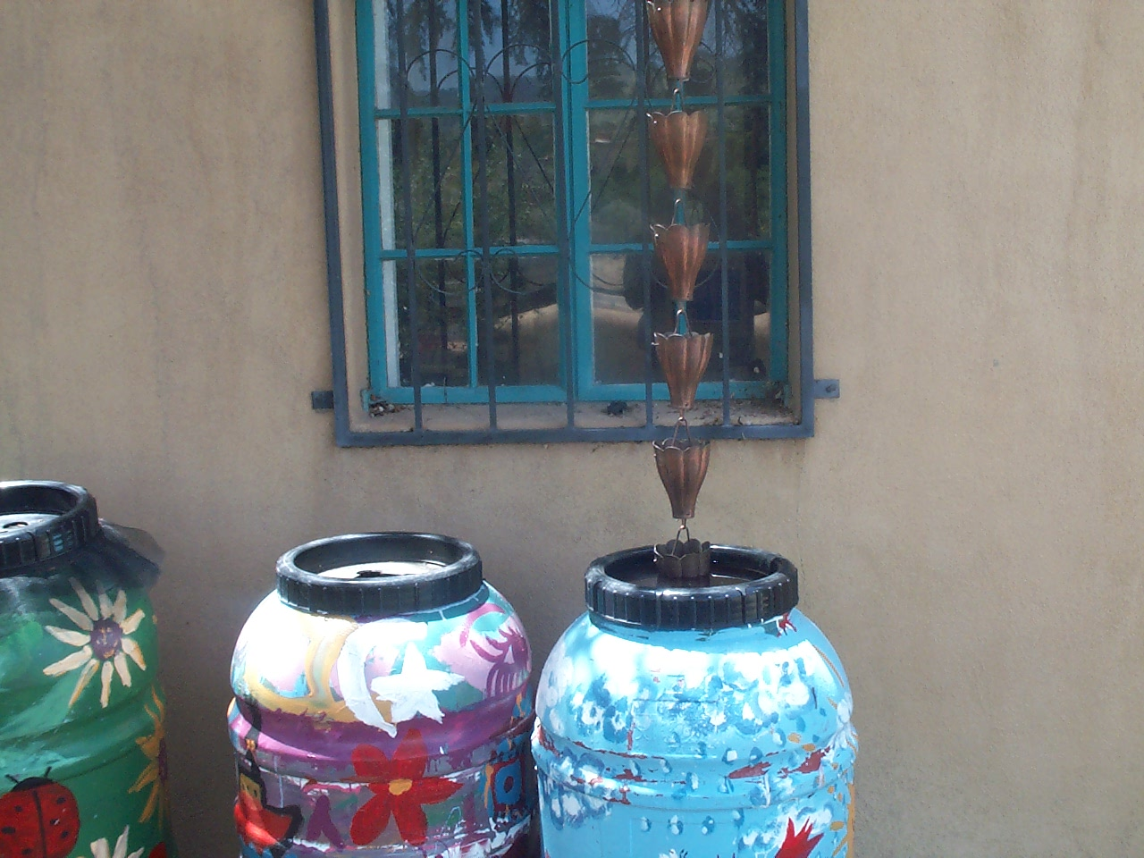
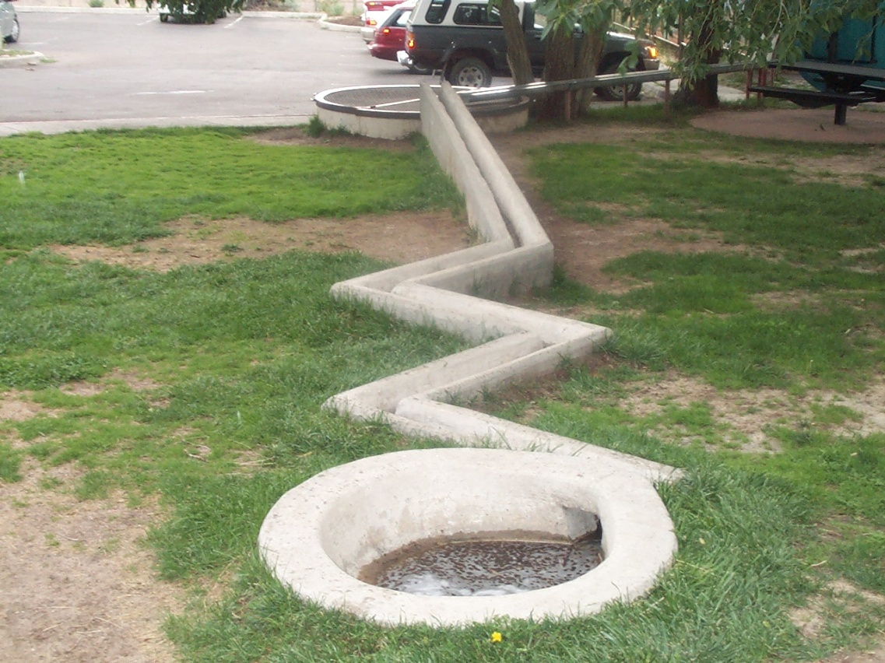

Slide 44
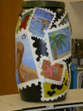
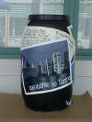
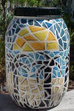
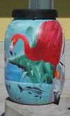

Slide 45
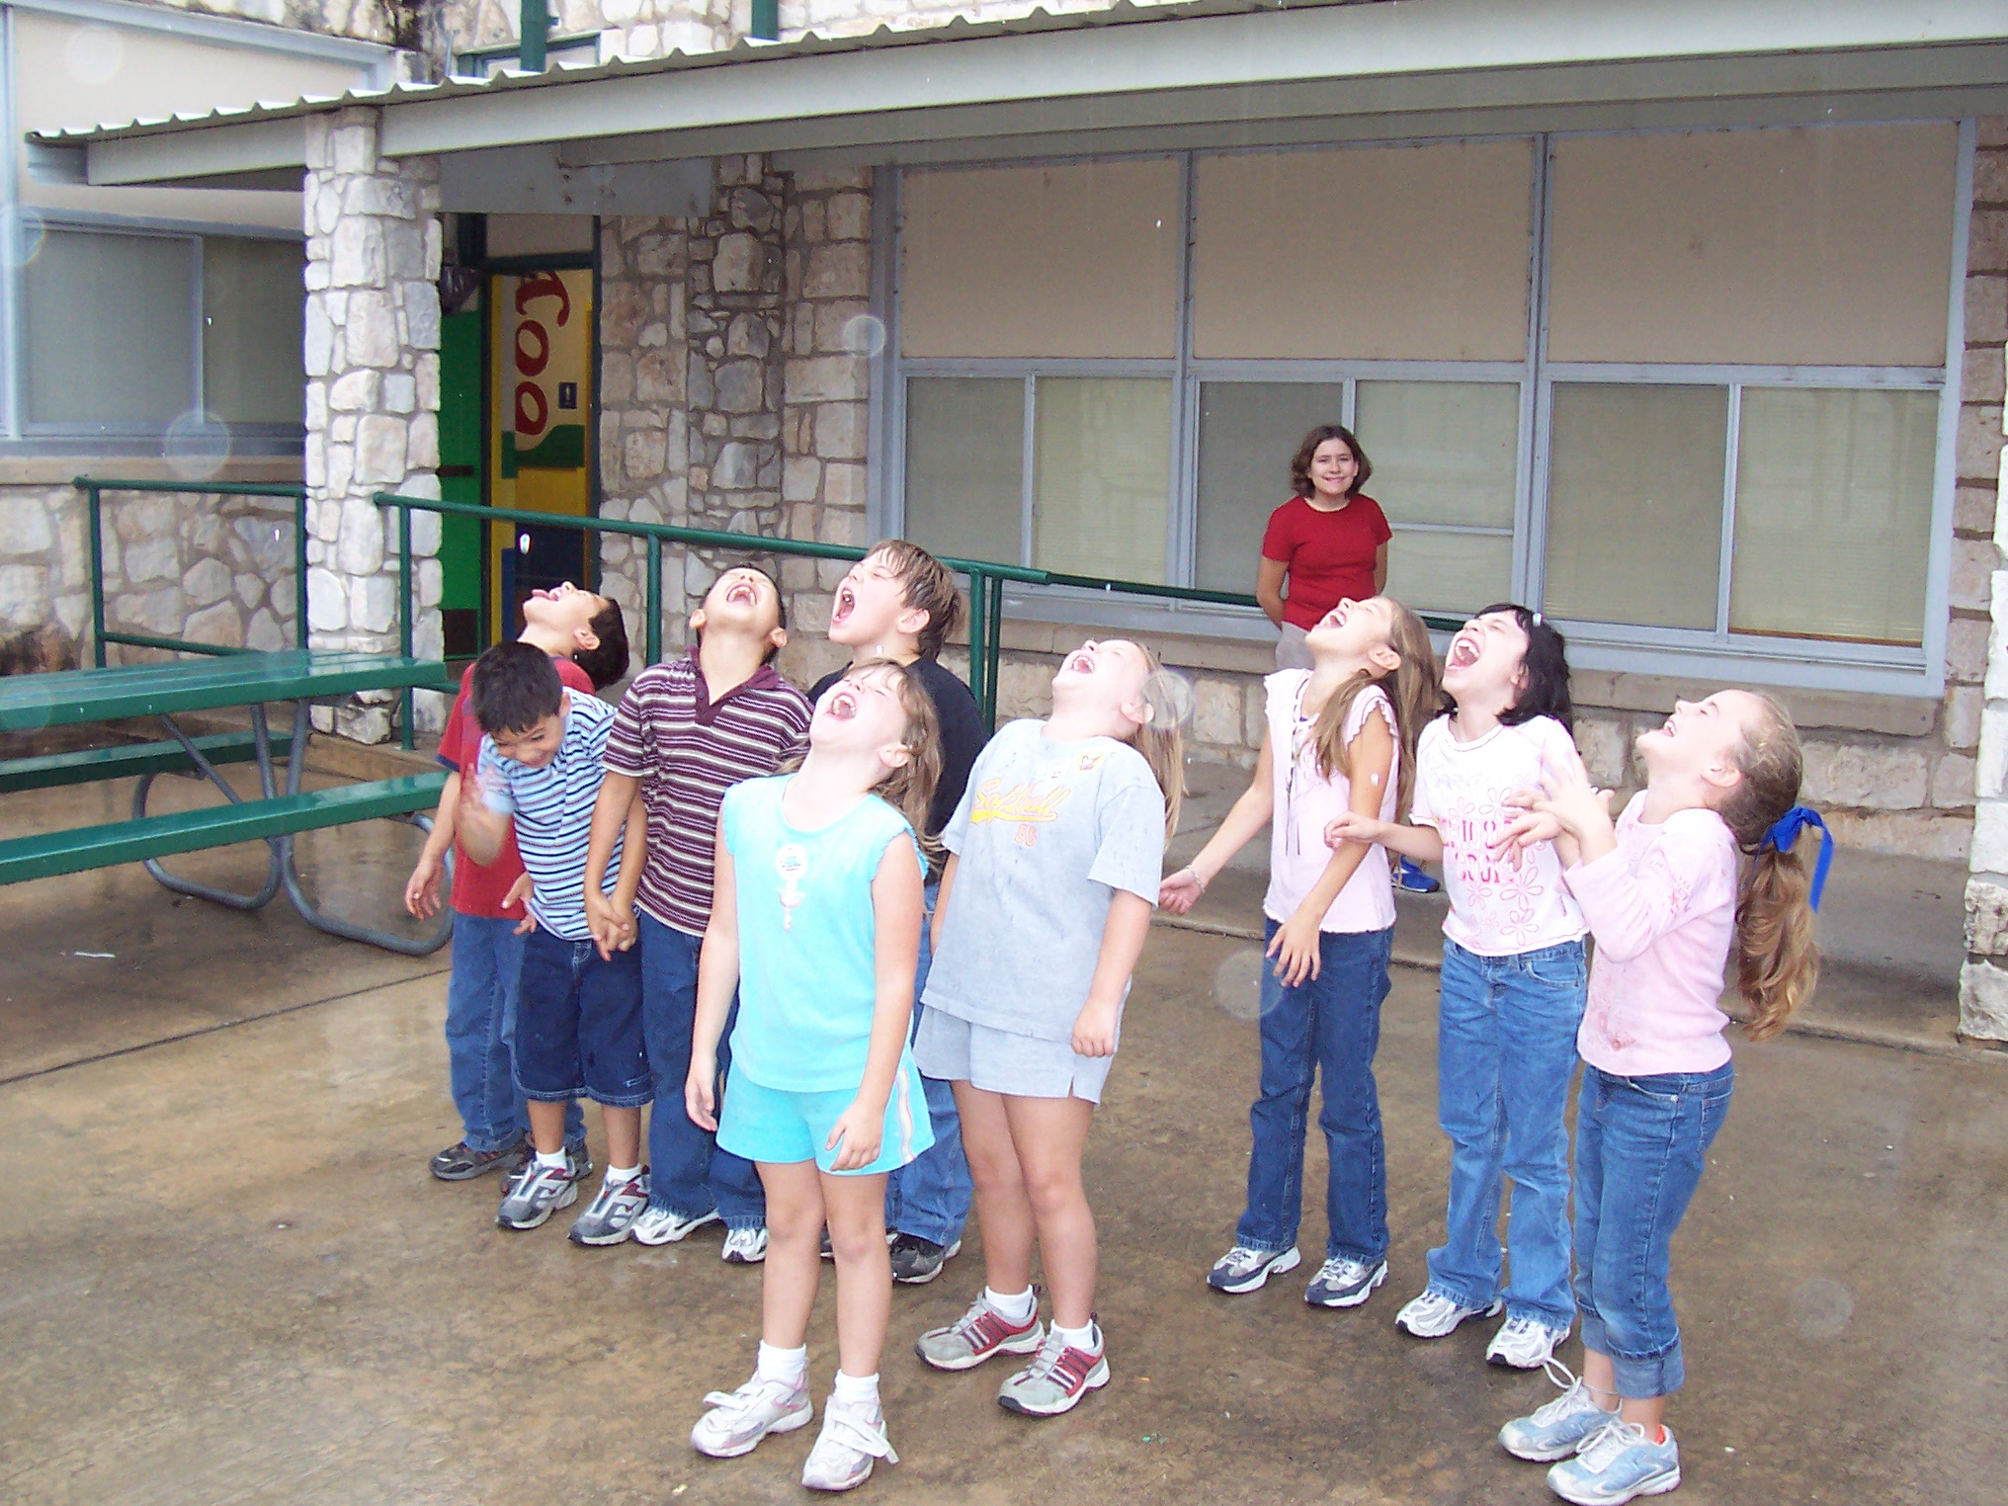

Slide 46
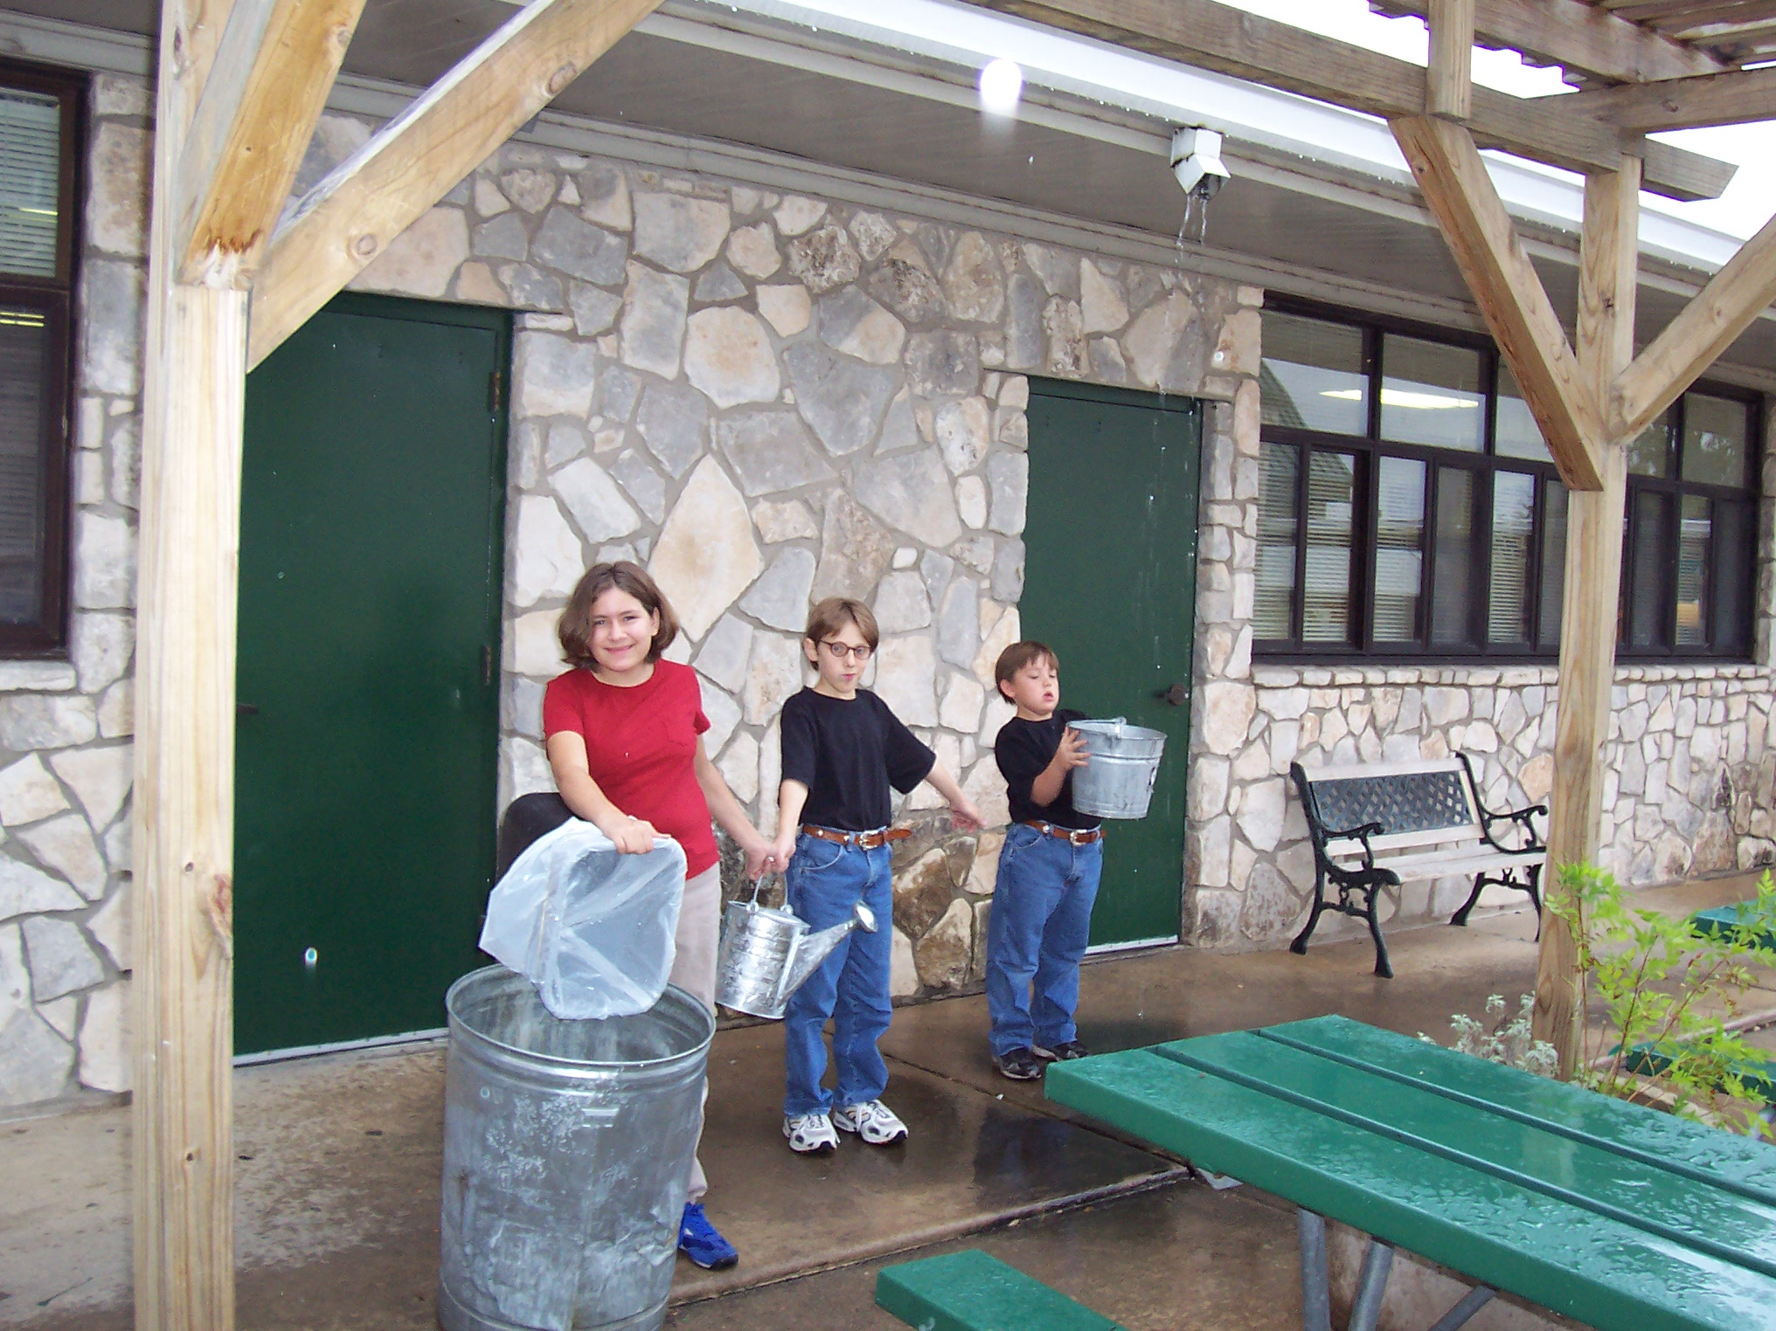

Slide 47
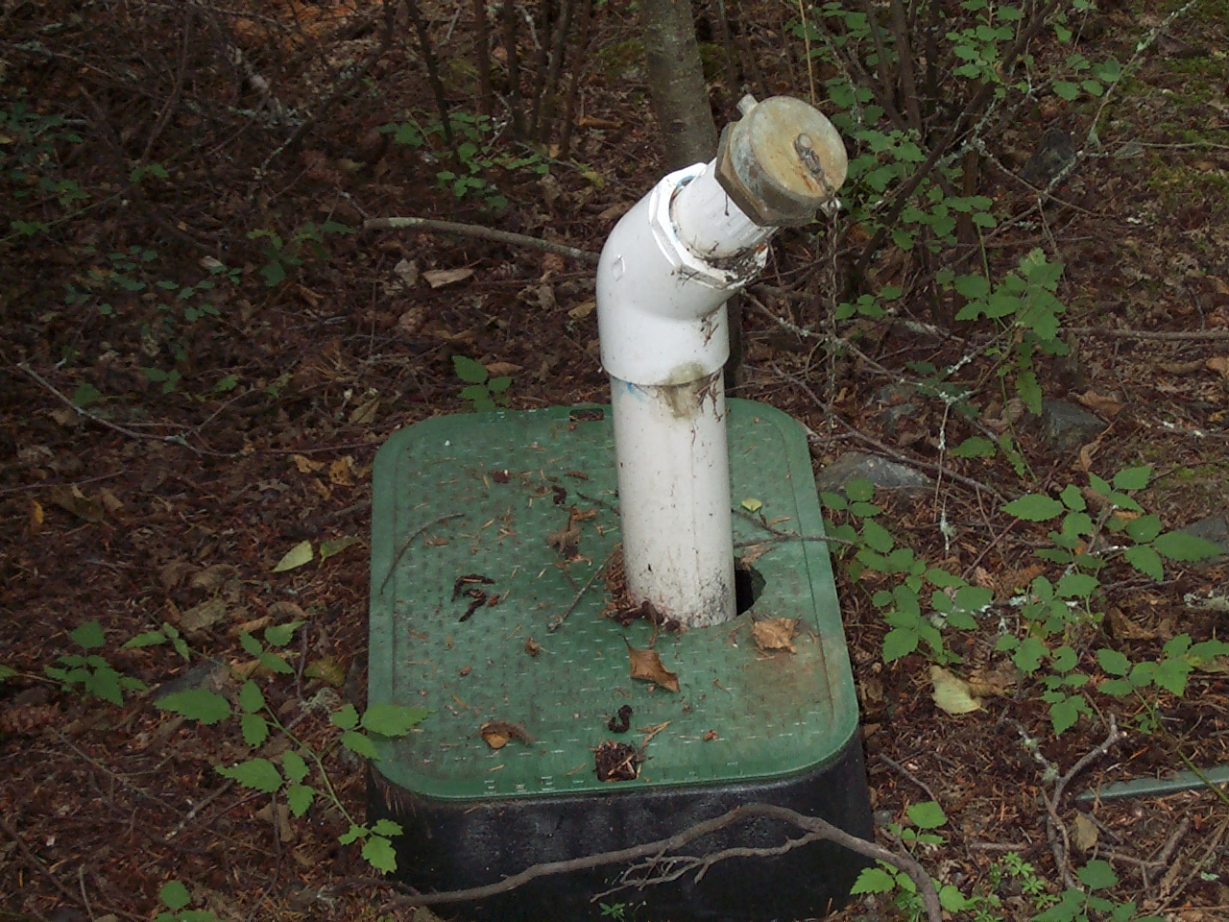

Slide 48
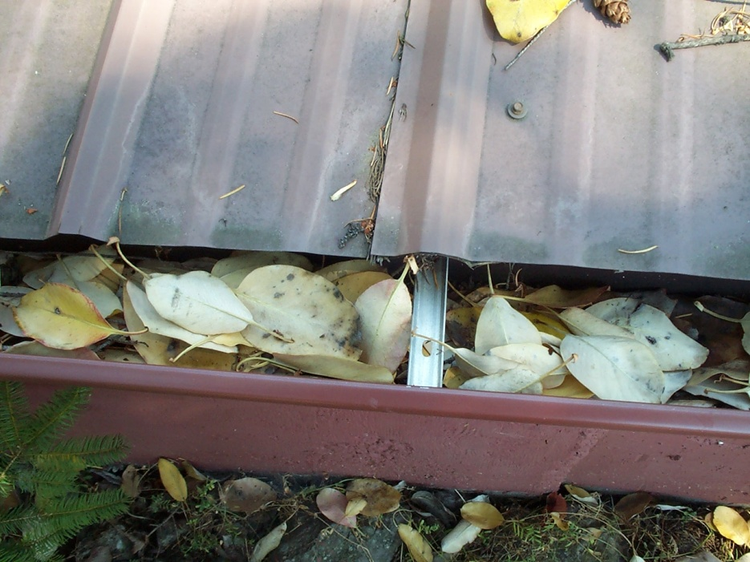
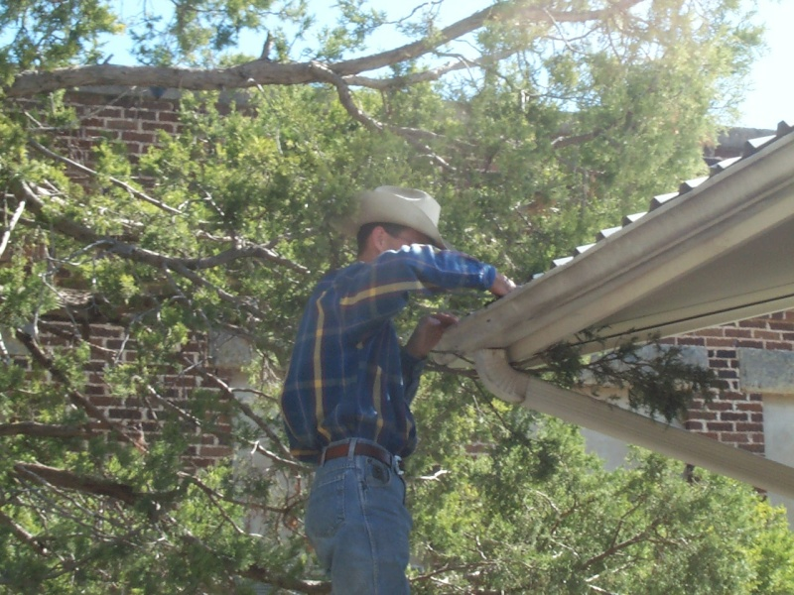
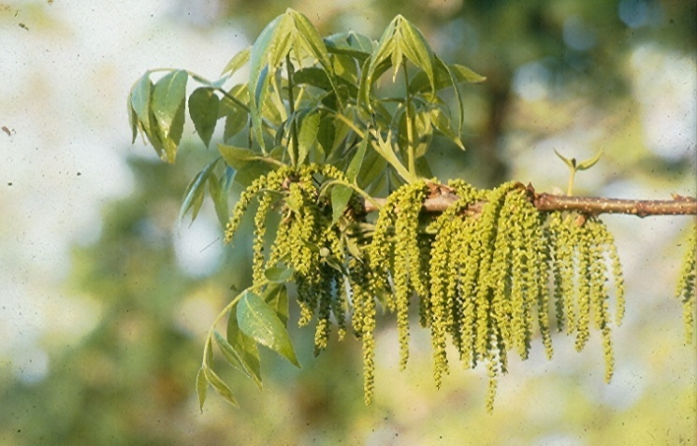
Trees and Leaves
Leaves
Leaf guards
Screen
Pollen and Catkins
Increase first flush
Don’t catch it at all if you do not need it
Prune trees

Slide 49
I like Open Gutters

Slide 50
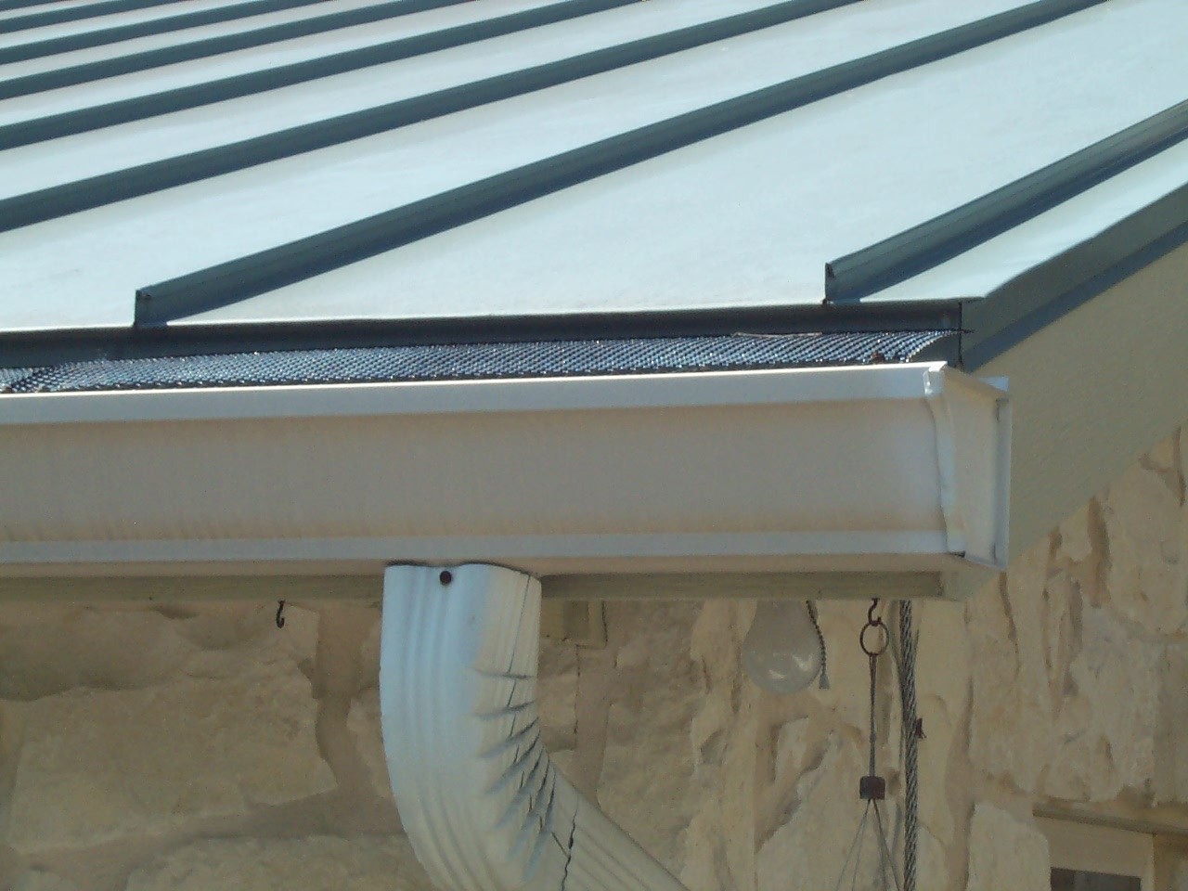
Leaf Guards

Slide 51
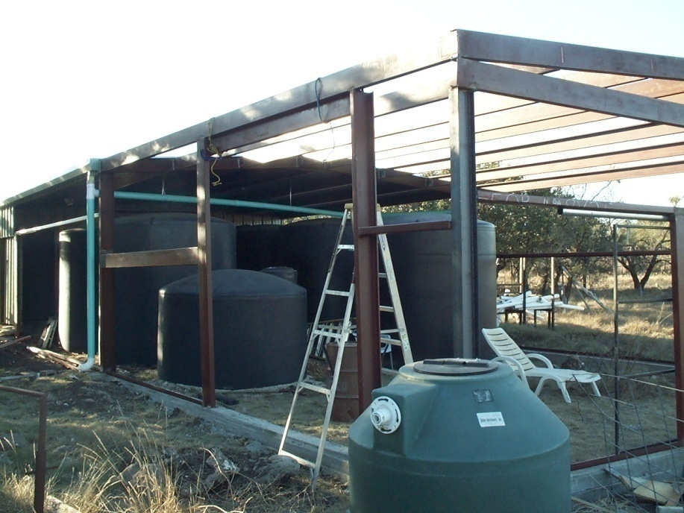
Cover It Up

Slide 52
Paint Your Tanks To Make Them Cooler and Last Longer

Slide 54
Toilets, Laundry, Washing Vehicles – Use Water Twice

Slide 56
ARCSA Accredited Rainwater Professional
ARCSA application completed and approved
Pay $120 fee
100 question test – passing grade of 70
Attend approved ARCSA workshop
Once accredited –
Obtain CEUs
Maintain membership

Slide 57
Continuing Education Credits
Currently all names will stay on the web list for free as long as they:
Attend and turn in to ARCSA 3 Continuing Education Units (CEU’s) Annually
Maintain ARCSA Membership
Maintain Professionalism

Slide 58
The American Rainwater Catchment Systems Association
hereby certifies that
BILLY KNIFFEN
has successfully demonstrated knowledge of the
rainwater catchment systems design and construction industry and
has passed the ARCSA endorsed written exam and field workshop process that is required
to be awarded the title of
ARCSA Accredited Rainwater Professional
_________________________________________ ____________________________
Tim Pope, Dennis Lye,
President 2007 Vice President 2005-

Slide 59
ARCSA Rainwater Catchment Systems Accredited Professionals
ARCSA members who have completed the certification course:

Slide 60
my Almond-Laechelin, Texas
E.W. "Bob" Boulware, Design-Aire Engineering, Indiana
Dale Branum, TLC Landscapes, Texas
Aldo Cantu, Sr., A's Pest & Lawn Solutions, Texas
Aldo Cantu, Jr., A's Pest & Lawn Solutions, Texas
John W. (Bill) Carter, Texas Commission on Environmental Quality, Texas
Colin Chatfield, Pioneer Water Tanks, Texas
James P. Champion, Texas
Wayne R. Classen, Classen Construction, Texas
Marilyn Crenshaw, The Green Architect, California
Cado Daily, University of Arizona Cooperative Extension, Arizona
Rick Daniel, Rainwater Harvesting Solutions, Texas
Mary Fernandez, Bexar County Master Gardeners, Texas
Dan Fleming, Texas
Phil Gagorik, Hawaii Volcanoes National Park, Hawaii
Harold Hart, Pural Water Specialty Co., Inc., Hawaii
Rusty Hendrickson, Ranch Tech, Texas
John Holmgreen, SparkleTap Water Company, Texas
Fouad Jaber, Texas A&M University, Texas
T. Barnabas Kane, T. Barnabas Kane and Associates, Arizona
Lou Kellogg, Texas
John C. Kight, Texas
Mark Kight, Hill Country Water Solutions, Texas
Heather Kinkade-Levario, ARCADIS/Forgotten Rain, Arizona
Clair Klock, Clackamas Soil and Water Conservation District, Oregon
Billy Kniffen, Texas Cooperative Extension, Texas
Dr. Hari J. Krishna, Texas Water Development Board, Texas
Robert Laechelin, Texas
Stefan Larsson, Big Island Catchment Cleaning, Hawaii
Phil Lebkuecher, Texas
Scott Leonard, Paliuli Home Inspection, Hawaii
Jeffrey Lux, Lux Inspections/Housemaster, Hawaii
Harvey Mabry, Wimberly H2O, Texas
Patricia Macomber, University of Hawaii at Manoa, Hawaii
Sylvan Magnus, Arizona
Bobby Markowitz, Earthcraft Design, California
Scott Mathers, Ocotillo Home & Energy, California
Chris Maxwell-Gaines, Innovative Water Solutions, Texas
Ross McGerty, Kaala Builders, Hawaii
Justin Mechell, Texas Cooperative Extension, Texas
Keith Miller, Bowerbird Construction, Inc., Texas
Beth Mortenson, Catch the Rain, LLC, Texas
Eric Okazaki, Pural Water Specialty Co., Inc., Hawaii
Ramiro Ortiz, Texas
Cynthia Owens, Full Circle, Texas
David Owens, Full Circle, Texas
Tim Pope, Washington
Jack Schultz, PE, Solar Utilities Company, California
Bert Shimasaki, Pural Water Specialty Co., Inc., Hawaii
Christina Swan, Contra Costa Water District, California
Joe Wheeler, Rainfilters of Texas, LLC, Texas
Phil Lebkuecher, Texas
Scott Leonard, Paliuli Home Inspection, Hawaii
Jeffrey Lux, Lux Inspections/Housemaster, Hawaii
Harvey Mabry, Wimberly H2O, Texas
Patricia Macomber, University of Hawaii at Manoa, Hawaii
Sylvan Magnus, Arizona
Bobby Markowitz, Earthcraft Design, California
Scott Mathers, Ocotillo Home & Energy, California
Chris Maxwell-Gaines, Innovative Water Solutions, Texas
Ross McGerty, Kaala Builders, Hawaii
Justin Mechell, Texas Cooperative Extension, Texas
Keith Miller, Bowerbird Construction, Inc., Texas
Beth Mortenson, Catch the Rain, LLC, Texas
Eric Okazaki, Pural Water Specialty Co., Inc., Hawaii
Ramiro Ortiz, Texas
Cynthia Owens, Full Circle, Texas
David Owens, Full Circle, Texas
Tim Pope, Washington
Jack Schultz, PE, Solar Utilities Company, California
Bert Shimasaki, Pural Water Specialty Co., Inc., Hawaii
Christina Swan, Contra Costa Water District, California
Joe Wheeler, Rainfilters of Texas, LLC, Texas

Slide 62
Maintenance Worksheet

Slide 63
American Rainwater Capture Systems Association Hawaii, Texas, Washington, Arizona Chapters

