Slide 1
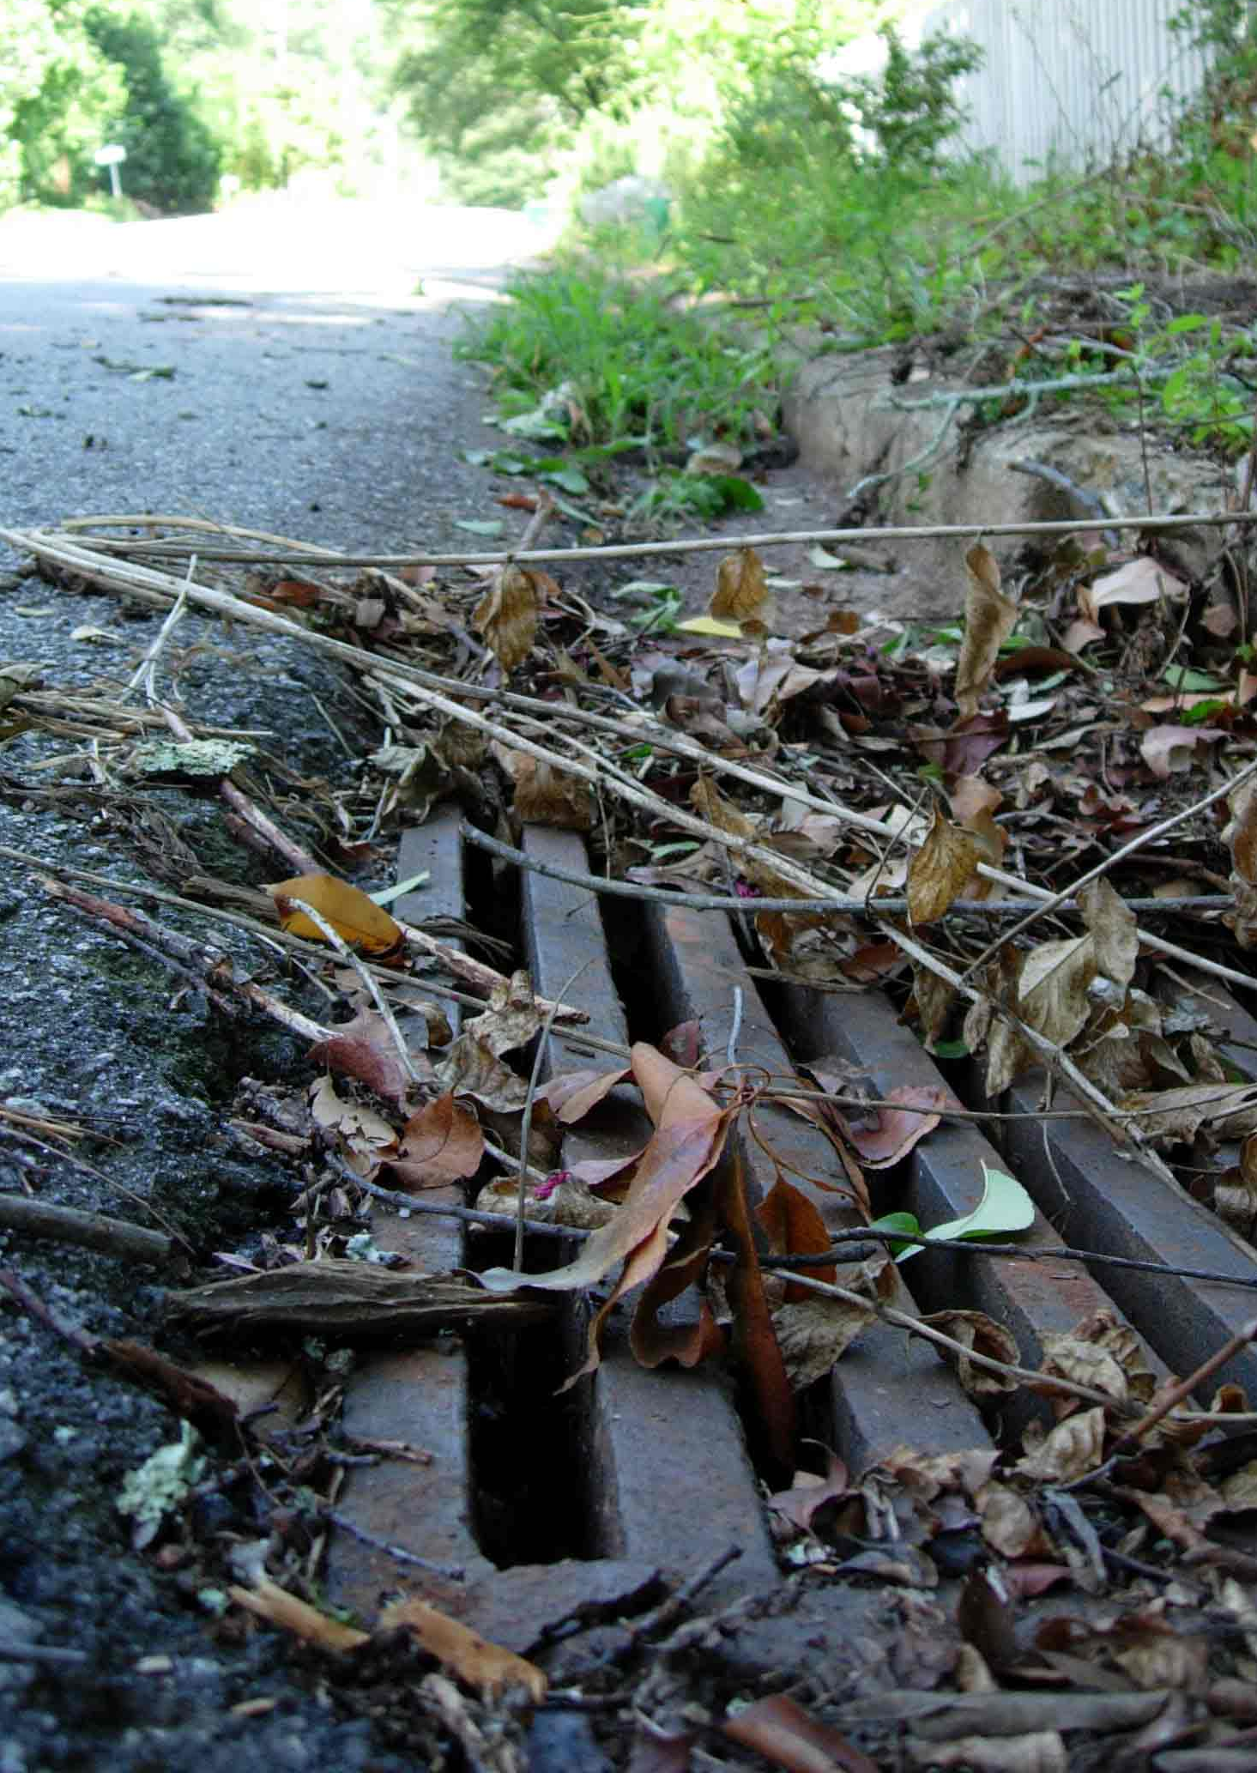
Non-Point Source Pollution
Motor Oil • Sediment • Cooking Grease • Pet Waste Excess Fertilizer • Yard Waste • Litter • Pesticides Household Hazardous Waste • Detergents • Metals
Notes:
Point vs. Non-Point Pollution. Point vs. Non-Point Pollution. Pollution that does not come from a single identifiable source.
Motor Oil • Sediment • Cooking Grease • Pet Waste Excess Fertilizer • Yard Waste • Litter • Pesticides Household Hazardous Waste • Detergents • Metals

Slide 2
Georgia Soil and Water Conservation Commission
Notes:
A beautiful North Georgia stream.

Slide 4
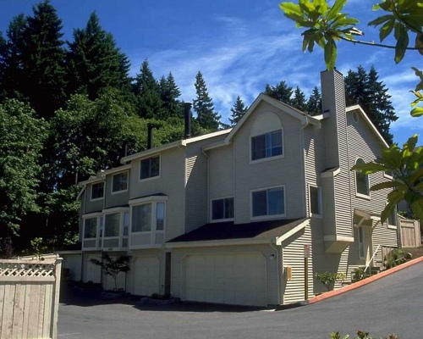
Howeowner Stormwater
Collect, Concentrate, Convey
Notes:
Traditional Drainage Systems
The traditional methods of dealing with stormwater can be summarized in the 3 words…collect, concentrate, convey. This approach achieves the primary goal of preventing flooding locally from increased stormwater. Until recently (the last 10-20 years), flooding was the only consideration for managing stormwater. However, during the past 20 years, there has been a change in the goals of managing stormwater to include treatment of pollutants and reduction of increased peak stream flows and stormwater flow volumes into streams.

Slide 5
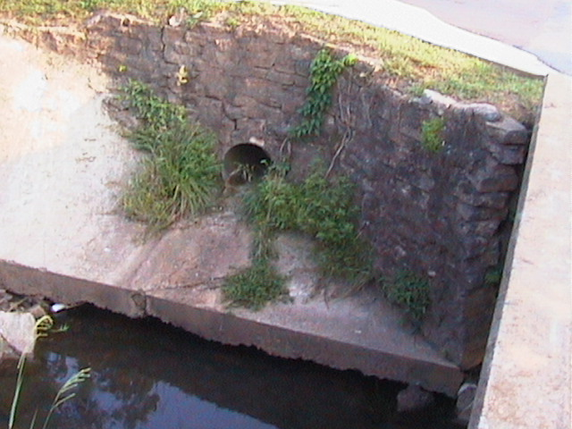
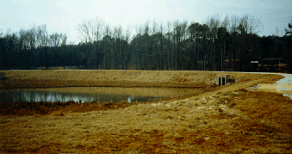
The Traditional Approach
Methods:
Conveyance and detention
Goal:
Minimize flooding
Other Issues:
  Downstream hydrology disrupted
  Little water quality control
  Flooding sometimes becomes worse
Detention Pond
Notes:
Traditionally, to reduce peak flows and high flow rates, detention ponds were used. While some detention basin designs reduce suspended solids such as sediment, metal dust and other trash in stormwater, other detention designs provide almost no treatment for pollutants. More current design standards are requiring that detention basins provide a certain amount of pollutant treatment as part of their design now.
However, they often do not create the kind of hydrologic improvements in streams that was intended. Research has shown that when there are several detention ponds along the length of a waterway, the design specifications for the individual detention ponds results in a higher peak flow and total volume flow downstream where all of the ponds have a combined influence. While design methods are changing today to better deal with this reality, older pond designs can make downstream conditions worse than before the pond was in place. Thus, flooding can increase directly downstream of a highly developed area.
The reality is that a detention pond cannot create the same hydrologic results as infiltration does on a site. An alternative to having all stormwater rapidly routed into a detention pond is to create landscape conditions that allow for more infiltration.

Slide 6
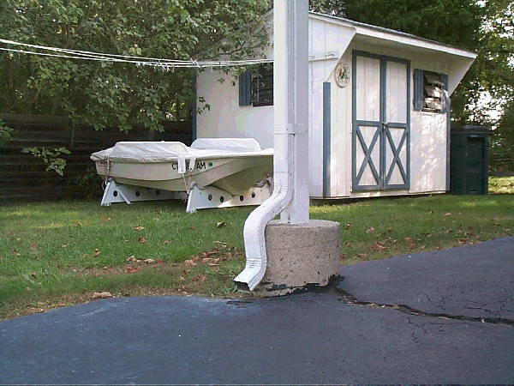
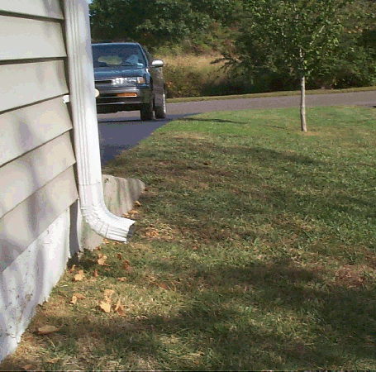
Better Site Design Practices
Connected
Disconnected
Notes:
Better Site Design Practices
To improve water quality as well as reduce stormwater volumes, a new approach to managing stormwater focuses on better site design. Better site design principles include
reducing connections between impervious surfaces,
reducing the concentration of stormwater and
allowing for more stormwater to infiltrate on site.
Better site design reduces the amount of stormwater that has to be managed downstream and off-site. These pictures show the simple changes that can be made for better site design such as downspouts spilling into a green space such as turfgrass (picture on the right) rather than spilling onto another impervious surface like the driveway in the picture on the left.

Slide 7
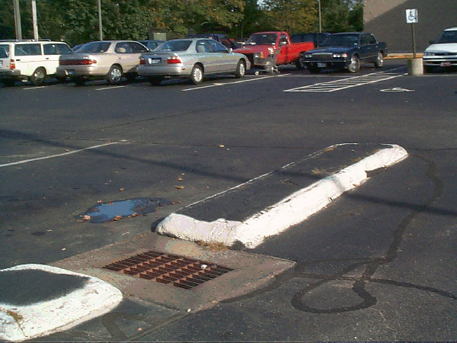
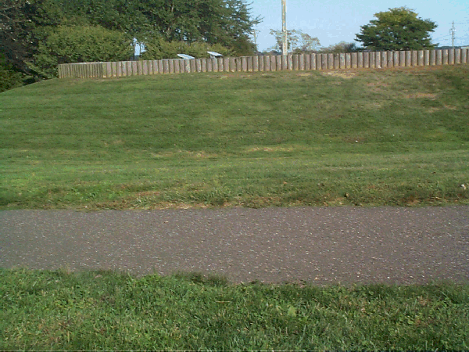
Better Site Design Practices
Connected
Disconnected
Notes:
The picture on the left where the parking lot spaces and islands are impervious and are directly connected to the storm drain, a situation that embodies the traditional collect, concentrate and convey paradigm.
The picture on the right has an asphalt walkway that slopes down from its center so that stormwater collecting on the walkway flows into the turfgrass on either side of it to be filtered by the turfgrass and infiltrated into the soil. A storm drain is not needed for minimal slopes in this picture.

Slide 8
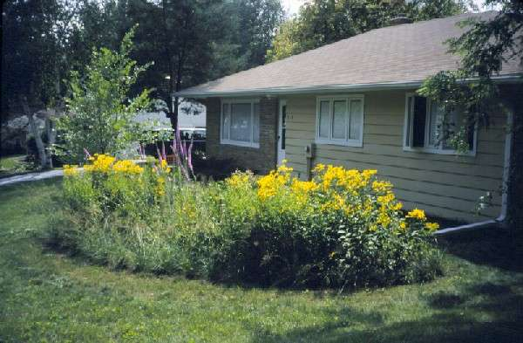
On-site vs. Regional Approaches
On-site: Manage stormwater as close to the source as possible
A residential “rain garden”
Regional: Rely on
large, regional detention facilities
Detention Pond
Notes:
Better site design also relies on keeping as much stormwater as possible on-site without causing flooding to allow it to be infiltrated into the soil. Stormwater retained and dealt with on-site, requires fewer regional detention facilities for good regional stormwater management.

Slide 9
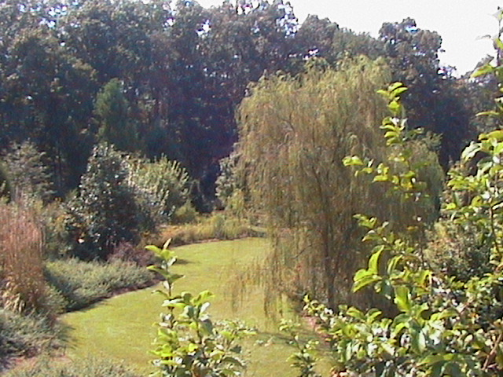
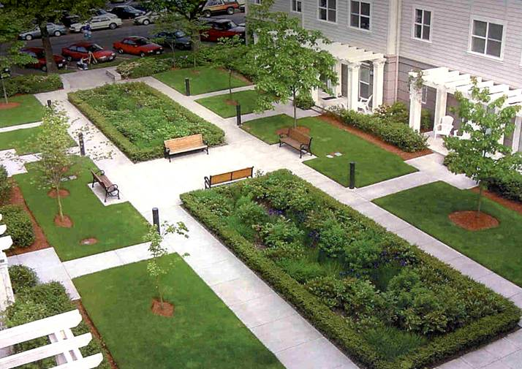
Green Space & Water Quality
Green spaces:
Promote infiltration
Decrease runoff
Provide buffers
Filter pollutants
Save on stormwater fees
Notes:
Better site design for stormwater management requires that we have more green spaces to
Promote infiltration of stormwater
Decrease runoff from highly impervious sites
Provide buffers between natural waterways and polluted impervious areas
Filter pollutants before they reach natural waterways.
The picture to the left shows two rain gardens in the midst of intensive impervious spaces. The two rectangles in the center of the picture are actually rain gardens. The picture on the right shows that all kinds of plants, from turfgrass to willow trees, create aesthetically pleasing landscapes and can potentially reduce water quality impacts from stormwater.

Slide 10
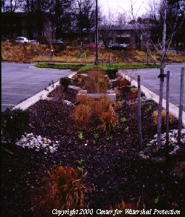
Importance of Infiltration
Preserves natural hydrology
  Reduces runoff and flooding
  Maintains base flows
Cleans water, removing pollutants
Inexpensive water quality control
Notes:
The more we can enhance infiltration of stormwater on-site, the less costly the total stormwater management bill can be. Infiltration is an inexpensive way to reduce runoff and flooding, maintain base flows in streams, and remove pollutants through the filtering provided by soils, mulches and plants. Rain gardens provide infiltration on-site while also creating a beautiful green component of the landscape.

Slide 11
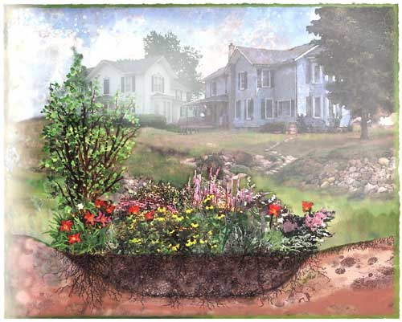
Build Your Own Rain Garden
Notes:
This slide is the transition from the first part of this presentation about stormwater and its impacts in urban places to the second part of the presentation. This part of the presentation will discuss the procedure and considerations for a homeowner to design a rain garden for their own landscape.

Slide 12
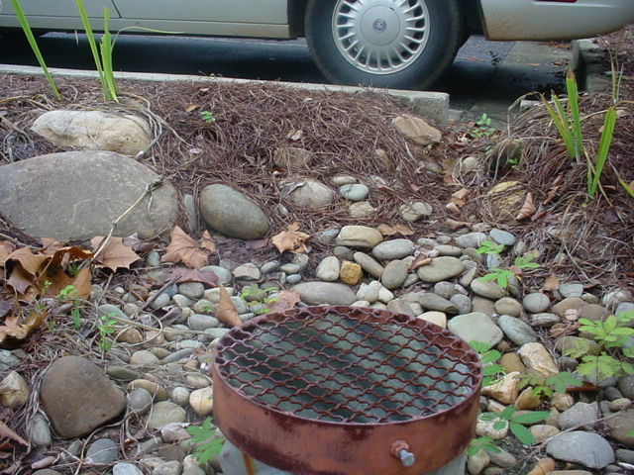
What is a Rain Garden?
A constructed depression that captures a shallow amount of water and holds it for a short time period
Runoff is captured and infiltrated into the soil in where plants and soils utilize and filter the water
It’s a garden
Notes:
May have to change some peoples mindset. Some people will insist that water must run off property as quick as possible

Slide 13
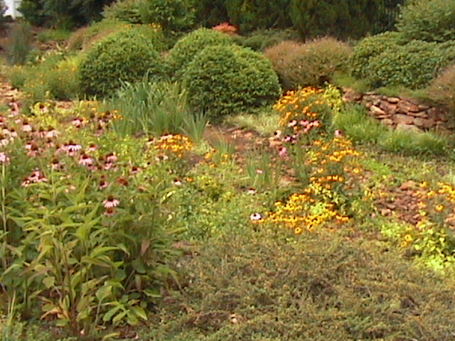
Purpose of a Rain Garden
Captures runoff from impervious areas such as roofs, driveways, patios
Reduce runoff leaving the site
Notes:
The primary purposes of the rain garden in a landscape are
Capturing stormwater runoff from impervious surfaces on-site
Reducing the amount of runoff leaving the site

Slide 14
Other Facts About Rain Gardens
Ponding should last no more than 48 hours after rain stops
Typical depths for rain gardens range from 4 to 12 inches with 6 to 8 inches recommended
Will not increase mosquito numbers
Will attract water loving critters such as frogs, toads and snakes
Notes:
Other Facts About Rain Garden
Other characteristics of a well-designed rain garden are
The ponding of water should last no more than 48 hours after rain stops
Typical depths for rain gardens range from 4 to 12 inches with 6 to 8 inches recommended
Rain gardens also
Should not increase mosquito numbers.
Will attract water-loving creatures such as frogs, toads and snakes.

Slide 15
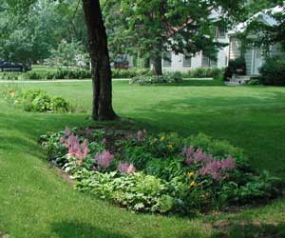
Benefits of Rain Gardens
Low maintenance, low water use, beautiful landscape feature
Increases infiltration of rainwater in landscapes with impervious surfaces
  - infiltrates as much as 30 % more water than a flat or sloped lawn area
Reduces flooding risks
and stream bed destruction
downstream
Can provide a different kind of
habitat in the landscape

Notes:
Properly designed rain gardens will be low maintenance, low water use and an attractive landscape feature. Perennials plants are planted in rain gardens. Annual plants cannot handle the extremes of wetness and dryness that are going to occur. The stormwater that is infiltrated into the rain garden provides most of the water needed for the plants. Only in long, dry periods or during the first year or two of establishment should plants in a rain garden need additional water.
Compared to a flat graded area of turfgrass, the concave shape of the rain garden will increase the amount of water infiltrated. Some studies have shown an increase in infiltration with rain gardens of about 30 %.
Because the rain garden captures some stormwater on-site, it reduces the runoff leaving the site thus reducing the risk of flooding and streambed destruction downstream of the site.
Rain gardens create a different kind of feature or habitat in the landscape if desired. Plants can be chosen that will turn a rain garden into a butterfly garden or the rain garden can be designed to provide lots of food for birds in the winter, by the mix of plants and the location that is chosen.

Slide 16
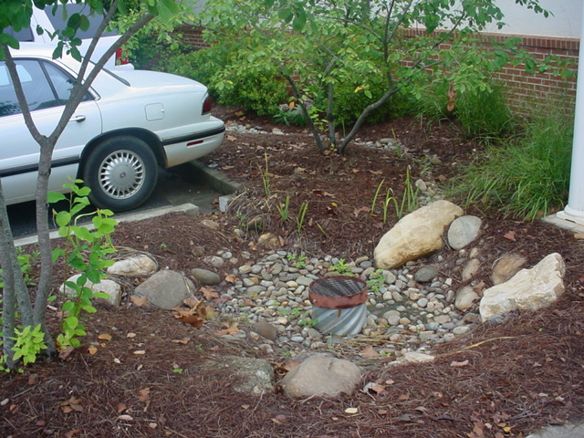
Planning Your Rain Garden
Location
Size
Plant Mix

Notes:
Planning Your Rain Garden
When a homeowner is ready to create a rain garden, there are 3 critical issues that need to be settled before installation.
The location should be chosen.
The size of the rain garden needs to be decided, and
The kind of plants to be used in the rain garden are chosen.

Slide 17
Locating a Rain Garden in a Landscape
At least 10 ft from a building foundation
Near patio, driveways roads
Area that water will naturally move to –low area
Fitting into the rest of the landscape
Notes:
Locating the Rain Garden in a Landscape
Rain gardens should not be placed against a building foundation because the infiltrated water is not good for the foundation.
However, a rain garden can be placed next to impervious surfaces like driveways and patios to capture the runoff from these areas.
Considerations on where to place a rain garden depend on the topography of the land and how the rain garden will fit into the rest of the landscape.
The location of the rain garden must be downstream of where the runoff begins, so placing rain gardens in lower areas that water will naturally move to often will work.

Slide 18
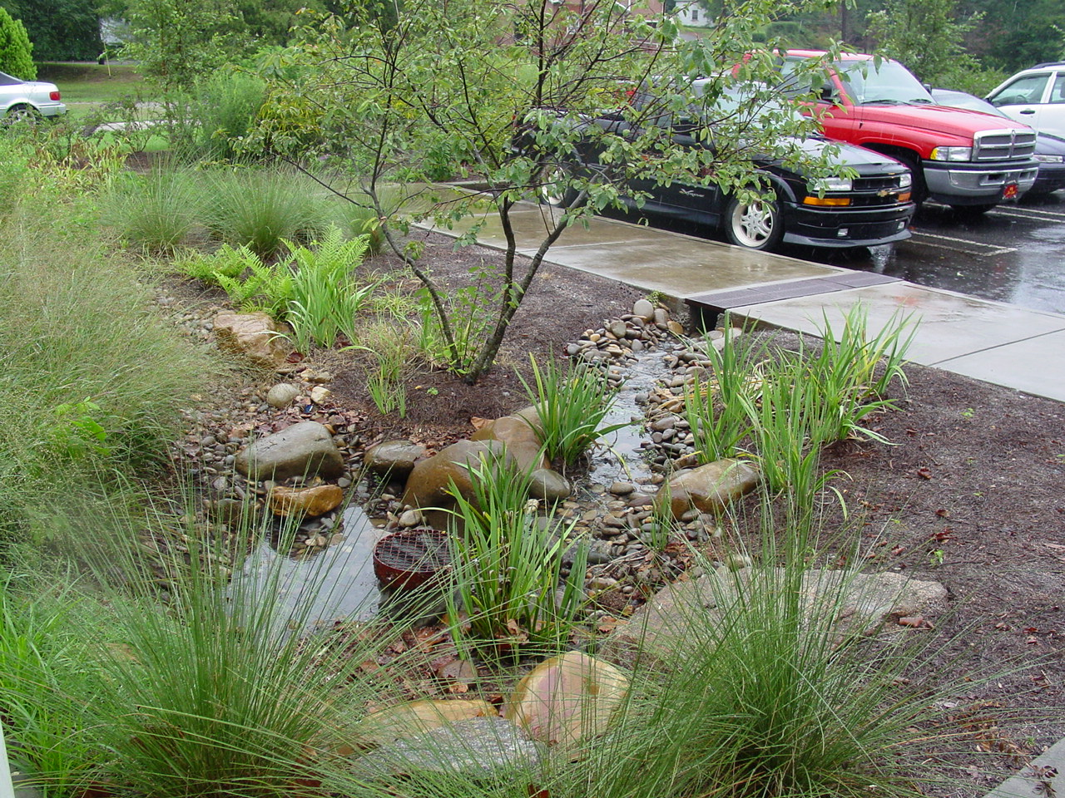
Raingarden Concepts

Slide 19
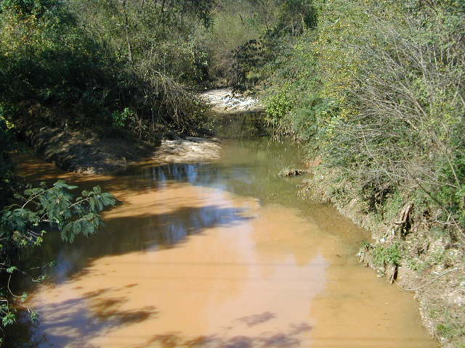
Environmental Benefits
Captures runoff from impervious areas
Reduces runoff leaving landscape
  +30% more infiltration than a lawn
Filters pollutants
Reduces flooding risks &
stream bed destruction
downstream

Slide 20
Garden Benefits
Low maintenance, low water use, beautiful landscape feature
Different kind of habitat
in the landscape
Wildlife
Cool factor

Slide 21
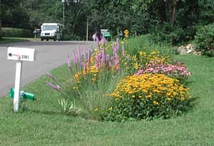
Planning a Home Rain Garden
Location
Size
Plants

Slide 22
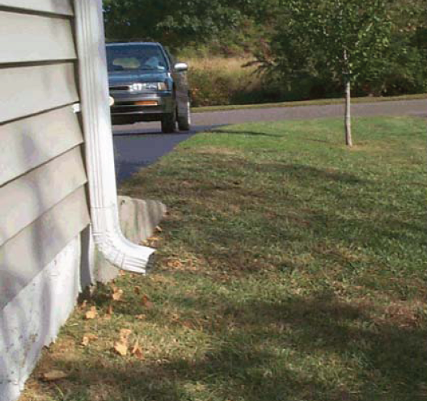
Locating Raingardens
At least 10 ft from a building foundation
Near patio, driveways roads
Area that water will naturally move to
(water flows downhill)
Easy viewing
Fit into the landscape

Slide 23
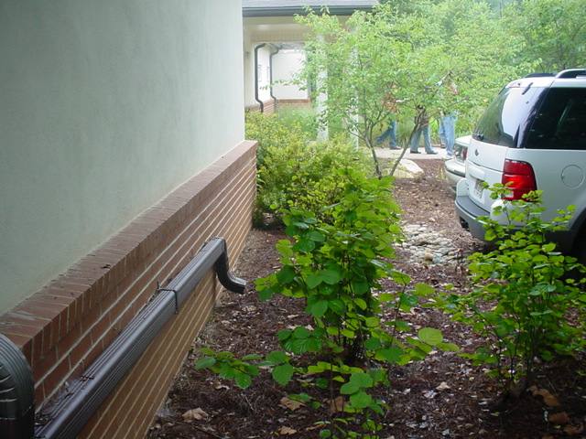
Locations to Avoid
Next to a building foundation
Over a septic system
Where water stands for long periods
  High seasonal water table area
Poor soils
Slopes greater 12%
Over utilities (call before you dig)
1-800-282-7411
Inside the dripline of any valued trees

Slide 24
Protect Tree Roots
Tolerance | Age | Dist. ft./DBH
Good | Young (<20%) | 0.50
 | Mature (20-80%) | 0.75
 | Overmature (>80%) | 1.00
Moderate | Young | 0.75
 | Mature | 1.00
 | Overmature | 1.25
Poor | Young | 1.00
 | Mature | 1.25
 | Overmature | 1.50
Arboriculture 3rd edition, Harris et al., 1999

Slide 25
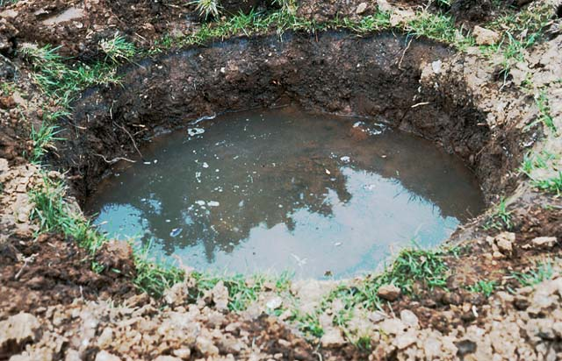
Problem Soils
If soils are high in clay or have been compacted during development, they may not have the capacity to infiltrate well
The rain garden area soil can be removed and replaced with a better draining soil (>0.5 inch/hour)
Should drain <48 hrs.

Slide 26
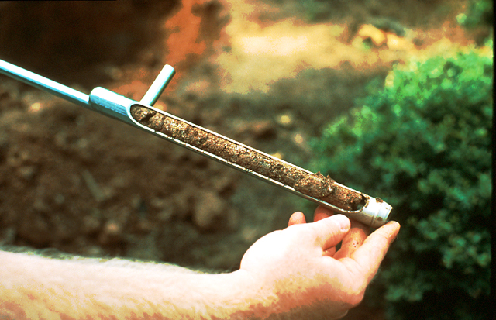
Soil Testing
Infiltration Test
  Dig a hole 6-8 inches
  deep and wide
  Fill hole with water
  & let it drain out
  Refill hole, if water does not drain in 12 hours, not a good location for a rain garden
Soil Chemistry Test
  Take 1 cups of soil to UGA Extension
    Results will tell whether lime is needed to adjust pH and whether fertilizer is needed
    ~$6 fee - takes 1-2 weeks for results

Slide 27
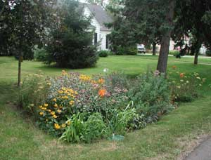
Rain Garden Size
Depends on
  Area of drainage
  Depth of ponding of rain garden
  Soil and Slope of
  location

Slide 28
Deciding the Size
Figure out the size of the area that will have runoff draining into the rain garden
For a house, draw a footprint
Break roof into areas that go to each gutter
Figure roof area for each gutter

Slide 29
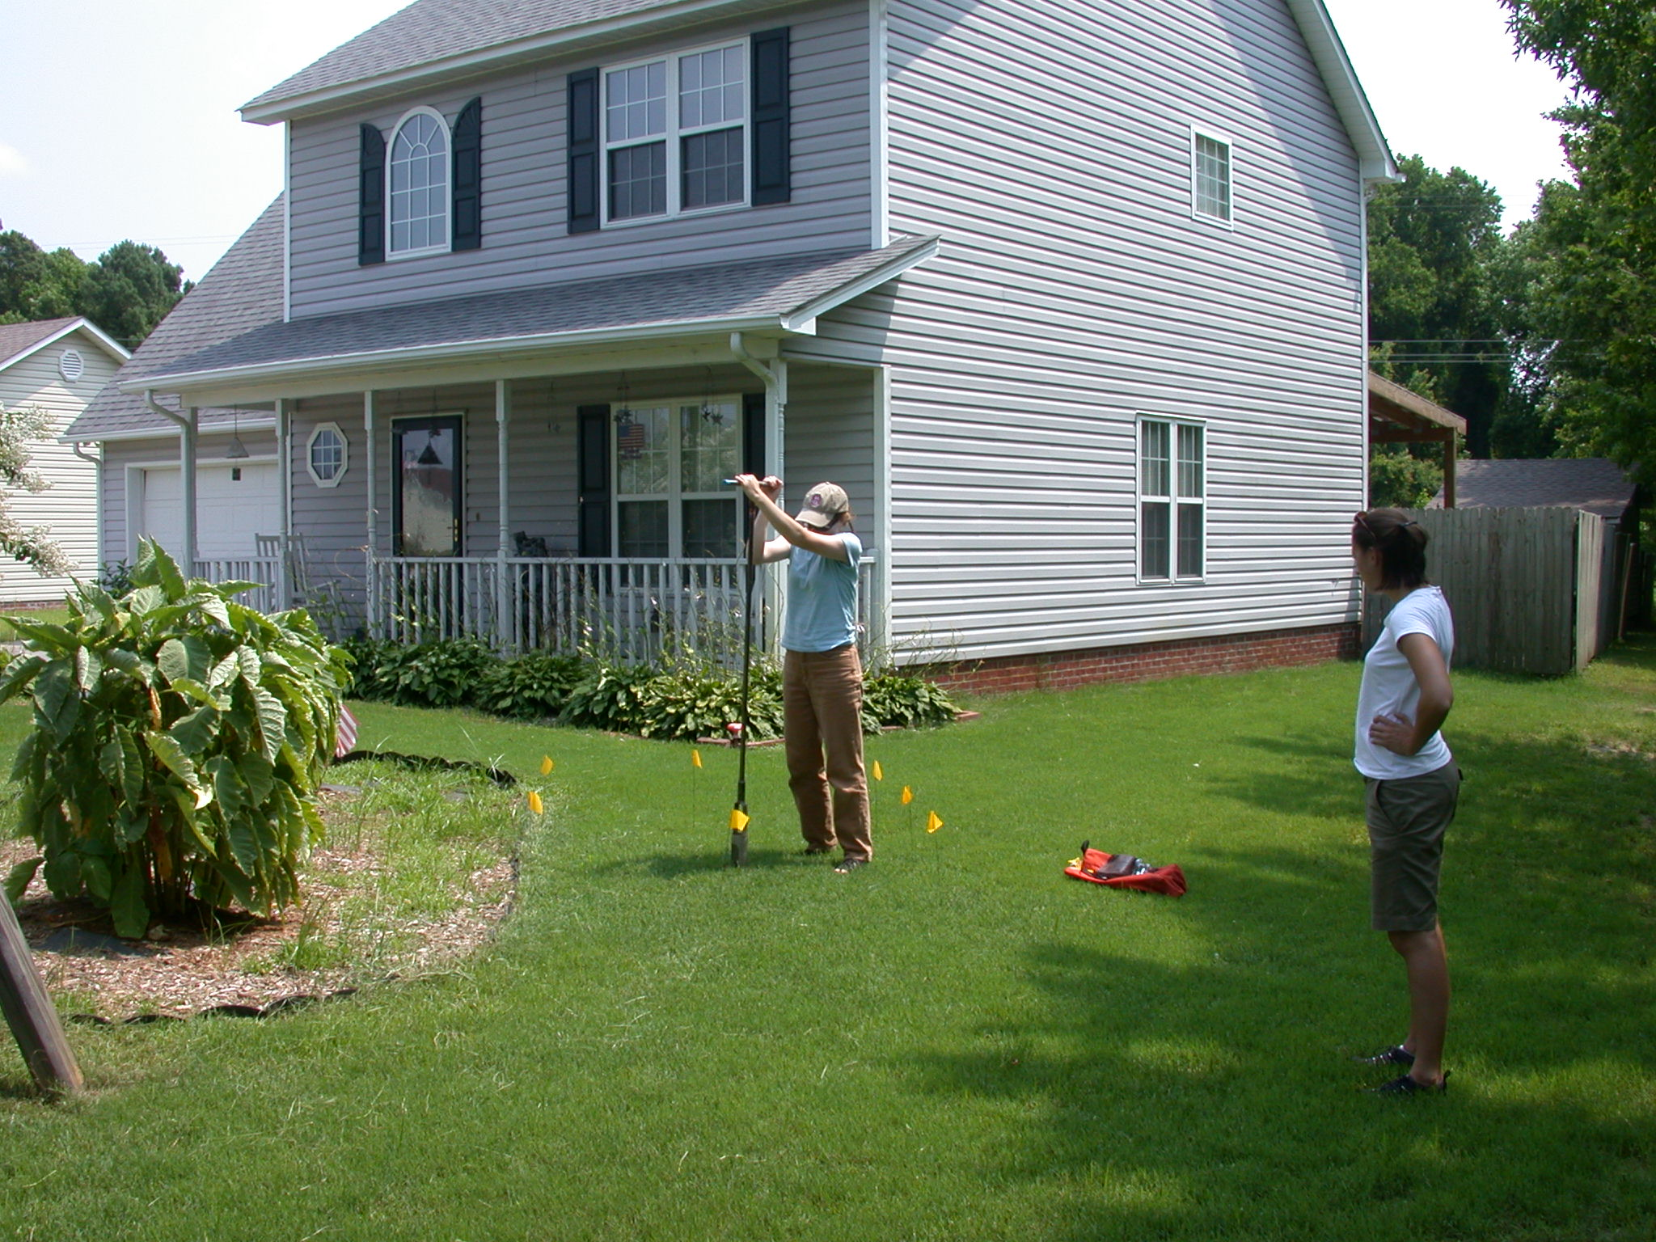
Deciding the size
Sandy soils – 5-8% of runoff area
Clay soils – 10-15% of runoff area
Example – Area = 1800 sq.ft
  Sandy soil: .065 X 1800 = 117 sq.ft
  Clay soil: .125 X 1800 = 225 sq.ft
If the area of the rain garden needs to be
> 300 sq ft, consider making two smaller gardens or use earth moving equipment

Slide 30
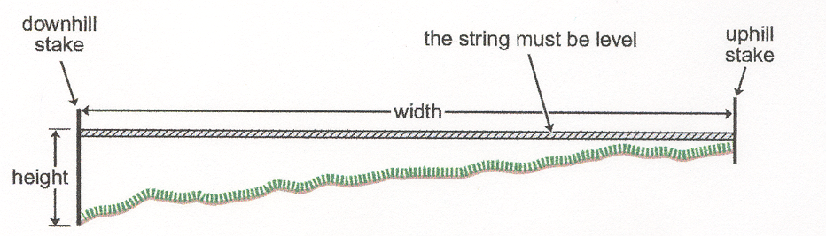
Deciding the size
A rain garden on a steeper slope can be smaller and deeper than a rain garden on a flatter slope
Measuring Slope

Slide 31
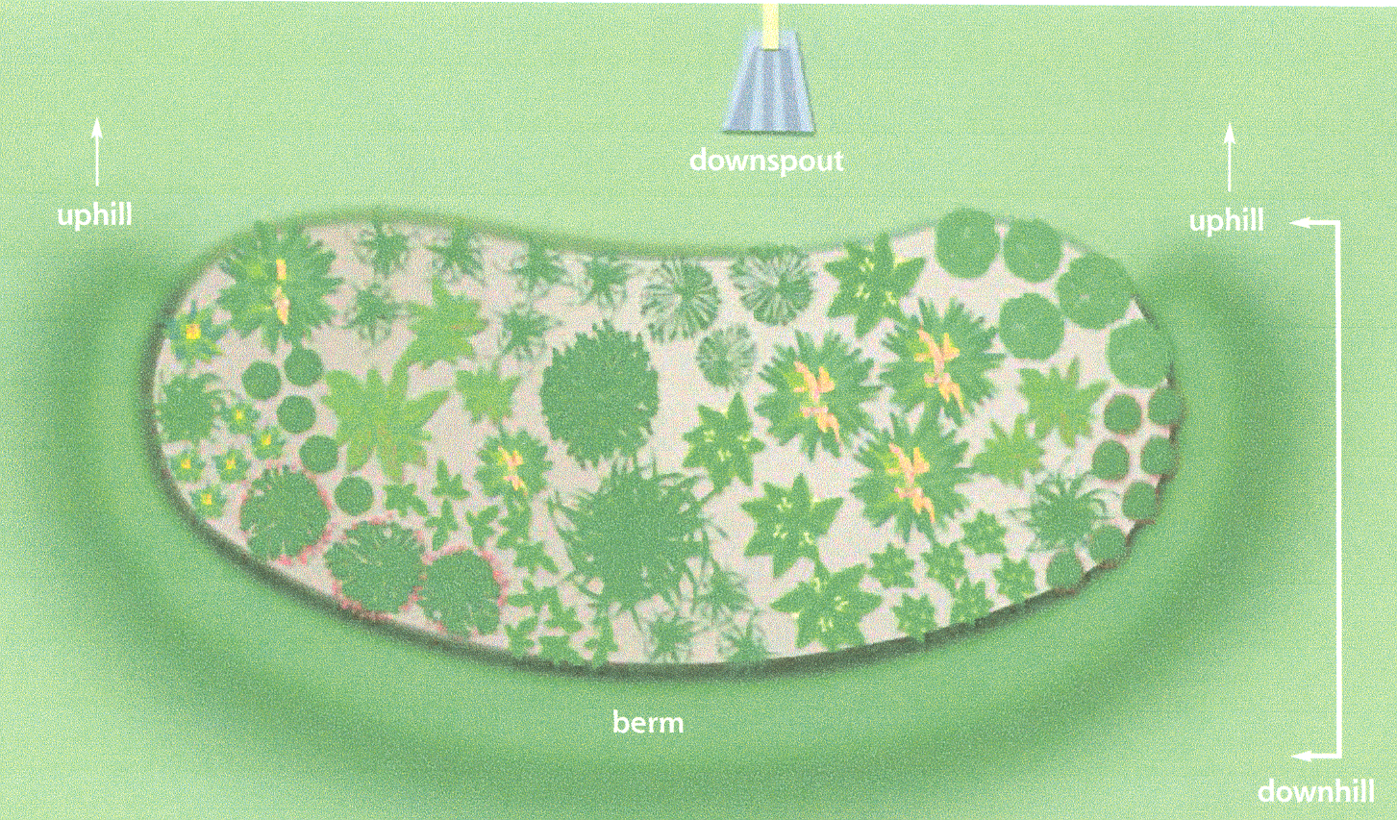
Rain Garden Design
Rain gardens are usually not square or a perfect circle
The long length should be perpendicular to the major slope
The shorter length should go down the major slope

Slide 32
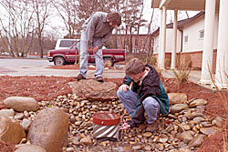
Rain Garden Design
Where will excess storm water go
Don’t send overflow onto your neighbors property
Rite of way
Call before you dig

Slide 33
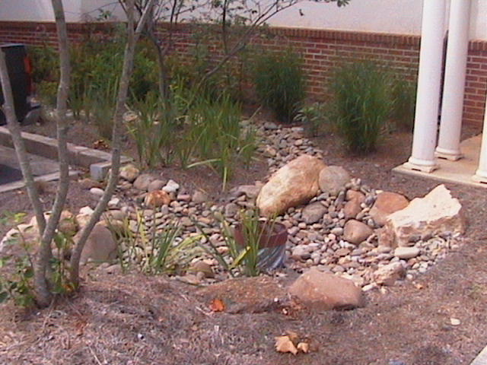
Overflow
Always have an overflow method for larger storms
  Lower area in the berm somewhere
  Drain pipe within rain garden

Slide 34
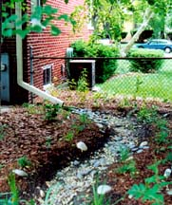
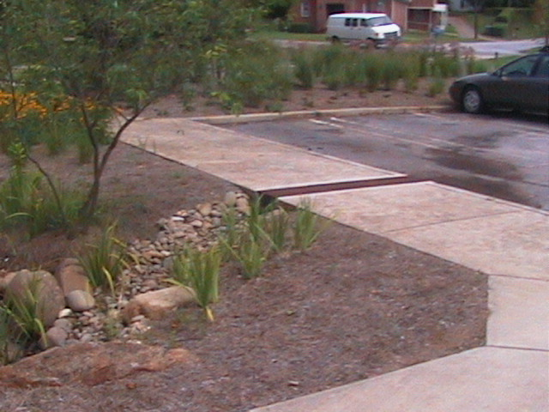
Connecting the
Rain Garden
Create a shallow wide swale or bury a corrugated drain pipe to carry flow from gutter into the rain garden
Line swales with turfgrass or stone to prevent erosion

Slide 35
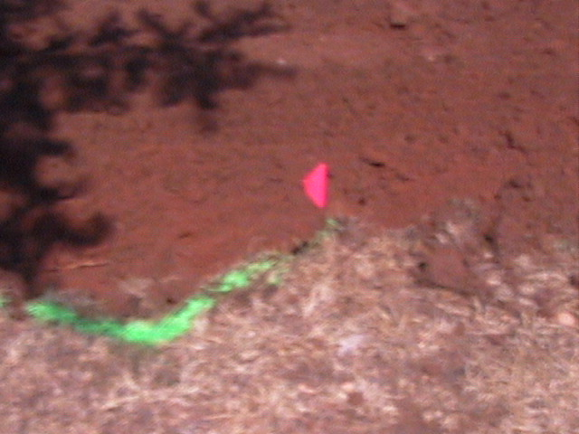
Installing the Rain Garden
Layout edge of rain garden with rope or garden hose
Set aside the top 4-6 inches of soil (topsoil), excavate the hole then use the top soil to backfill the planting area.
Move the soil in the rain garden area down to the bottom edge of
the rain garden

Slide 36
Installing the Rain Garden
Pointers
  Bottom of the rain garden should be level
  Top of berm should be about the same elevation as the uphill edge

Slide 37
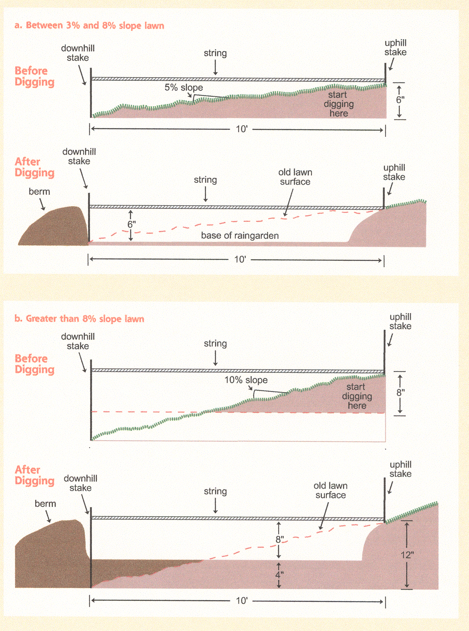
Installing the Rain Garden

Slide 38
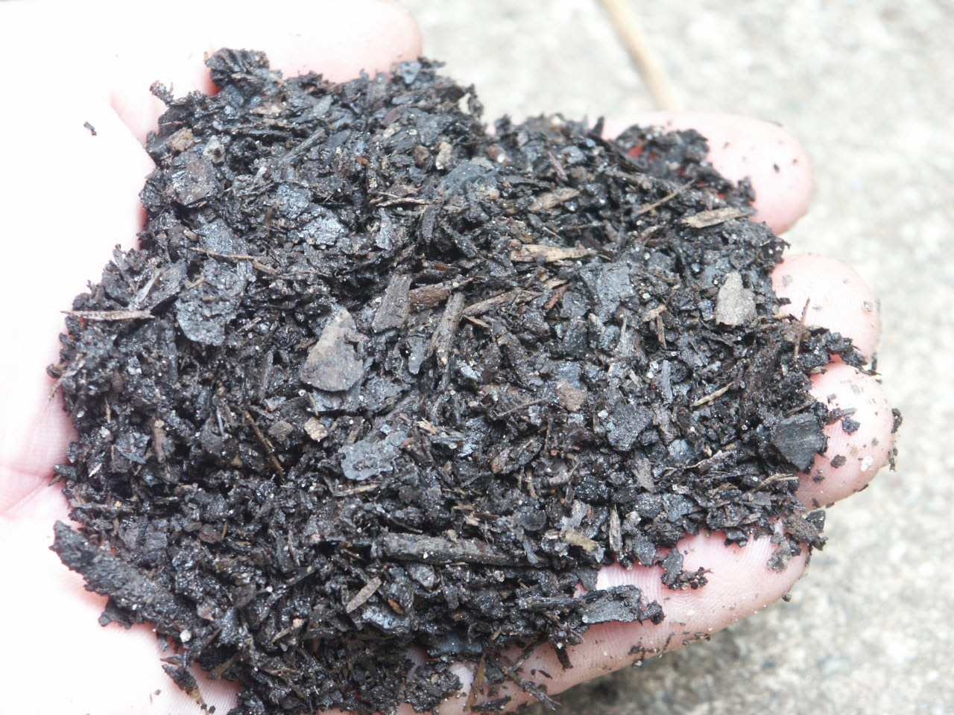
Rain Garden Soil
Ideal rain garden soil mix – 50-60% sand, 20-30% topsoil, 20-30% compost
  No more than 10% of mix should be clay
  Infiltration >0.5 inch/hour
Be careful of the nutrient content of
compost

Slide 39
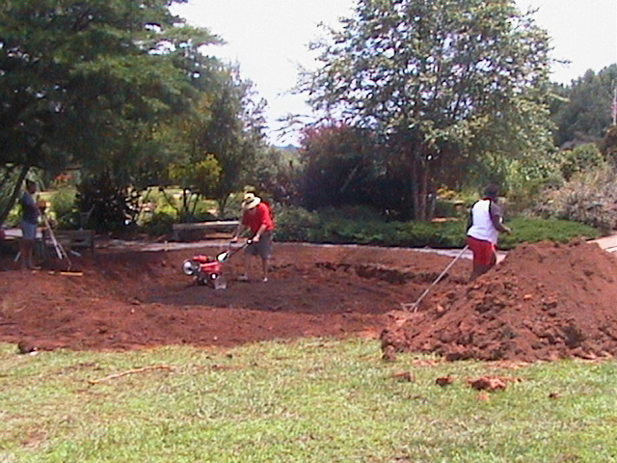
Rain Garden Soil
Prepare the soil for planting
  Add lime and fertilizer as recommended by soil test
  Spread 2 to 4 inches of compost and mix or till it into the whole area of the rain garden

Slide 40
Rain Garden Plants
A wide variety of plants in both size texture and color makes for an interesting rain garden
Rain gardens can be designed to attract butterflies and birds with the right plant choices
Mix trees, shrubs, perennials, ornamental grasses and turfgrasses
Plants must be tolerant of wet and dry conditions
Consider deer tolerance and light requirements

Slide 41
Trees for Rain Gardens
Red Maple
River Birch
Crape Myrtle
Black Gum
Bald Cypress
Green Ash
Willow Oak
Serviceberry
Hornbeam
Sweetbay Magnolia
Dahoon Holly
Winter King Hawthorn
Sugar Hackberry
Fringetree
Gingko
Persimmon
Loblolly Pine

Slide 42
Shrubs for Rain Gardens
Winterberry
Arrowwood
Buttonbush
Summersweet Clethra
Wax Myrtle
Chokeberry
American Beautyberry
Bottlebrush Buckeye
Inkberry
Oakleaf Hydrangea
Virginia Sweetspire

Slide 43
Herbaceous Plants for Rain Gardens
Asters
Blackeyed Susan
Lobelia
Cardinal Flower
Goldenrod
Ironweed
Joe Pye Weed
Rose or Swamp Mallow
Swamp Milkweed
Royal Fern
Cinnamon Fern
Netted Chain Fern
Broad Beech Fern
Canna Lilies
Yellow Flag Iris
St. Johns Wort
Foam Flower
White Arrow Arum
Jack-in-the-Pulpit

Slide 44
Groundcovers
Daylily
Asiatic jasmine
Liriope
Big periwinkle (Vinca major)
Thrift (Phlox subulata)

Slide 45
Ornamental Grasses
River Oats (Chasmanthium latifolia)
Maiden grass (Miscanthus spp.)
Muhly grass (Muhlenbergia capillaris
Panic grass/Switch grass (Panicum virgatum)
Indian grass (Sorgastrum nutans)

Slide 46
Maintenance
No special maintenance required...
Routine periodic landscaping maintenance
  Weeding
  Pruning
  Replacing plants
  Plant Division
  Replacement of mulch

Slide 47
Sizing Raingardens
20’
20’
20’
20’
50’
10’
15’
15’
Break roof up into drainage areas
10-15% of runoff area for clay soils
How big does your ringarden need to be?
Answer ______________________________
1” of rain on 1000 ft² = 624 gallons
How much water water will a 1” rain produce
Answer_______________________________

Slide 48
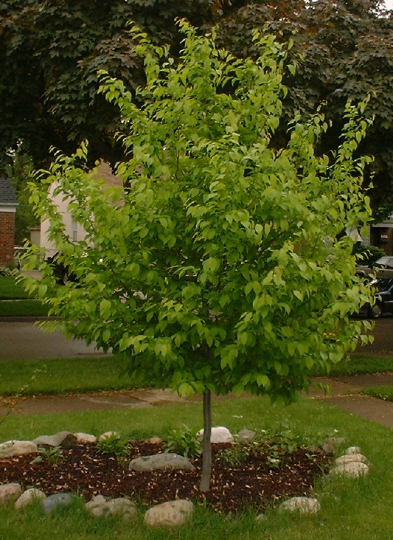
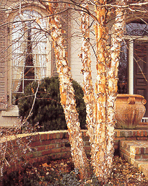
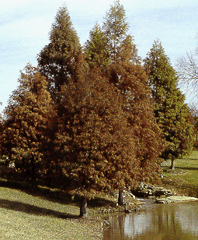
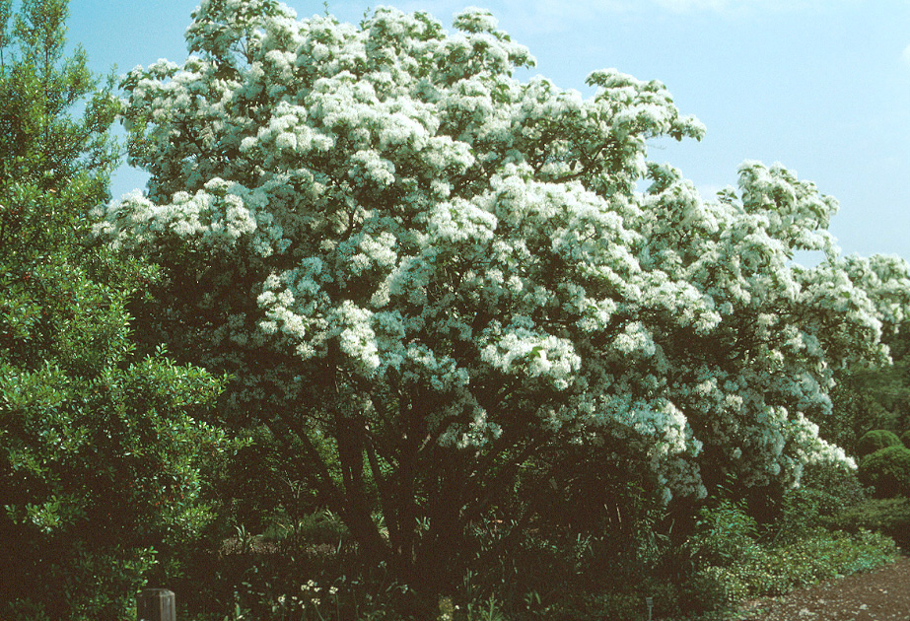
River Birch
Bald Cypress
Hornbeam
Fringetree

Slide 49
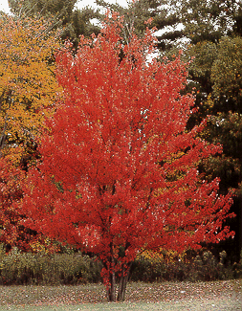
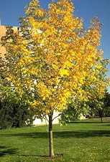
Red Maple
Gingko

Slide 50
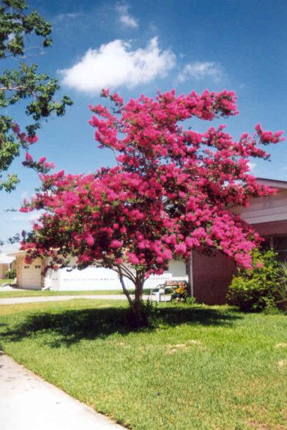
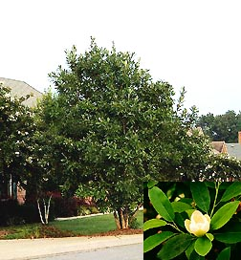
Crape Myrtle
Sweetbay Magnolia

Slide 51

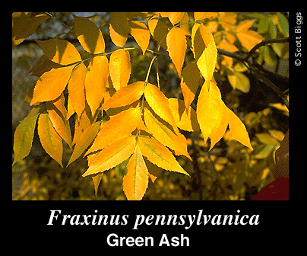
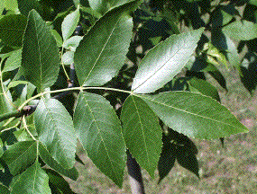

Black Gum
Green Ash

Slide 52
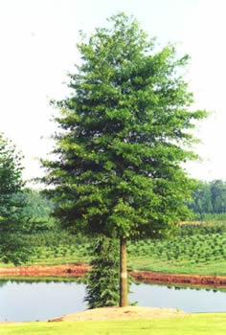
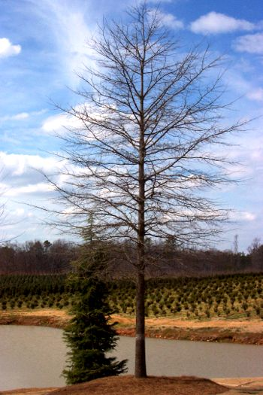
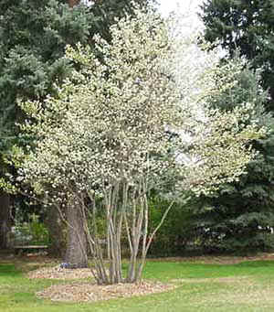
Willow Oak
Serviceberry

Slide 53
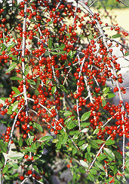


Yaupon Holly
Inkberry
Waxmyrtle

Slide 54


Arrowwood Viburnum
Bottlebrush
Buckeye

Slide 55





Oakleaf Hydrangea
American Beauty Berry

Slide 56




Virginia
Sweetspire
Spice Bush
Winterberry
Buttonbush

Slide 57



Canna Lilies
St. Johns Wort
Ironweed

Slide 58



Swamp
Milkweed
Cinnamon Fern
Royal Fern

Slide 59




Asters
Joe Pye
Weed
Blackeyed Susan
Liriope

Slide 60


Northern Sea Oats
Miscanthus
Notes:
Upland Sea Oats (Chasmanthium latifolium) is a native, deciduous, clump forming, perennial grass. The summer foliage will reach a height of 2 to 3 feet and is topped with inflorescences reminicent of the Coastal Sea Oats. This plant performs well in moist or dry sites and will tolerate light shade to full sun.

Slide 61

Bioretention Area

Slide 62

Functional Components
Filter Fabric

Slide 63

Underdrain

Slide 64





Slide 65

Stormpond Management
Detention Ponds – The Good

Slide 66


The Bad

Slide 67



The Ugly

Slide 68

Dam Top and Slopes/Faces
Prevent Erosion
    Stabilizing exposed soil and dirt with grass and other vegetation that has a substantial root system and holds the soil in place.

Slide 69


Principle, Emergency, and WQ Spillways
Prevent stormwater from being unintentionally held, instead of being released at the designed controlled rate and prevent structural damage.
    Water that is being held longer than 24-48 hours is creating a possible safety issue.

Slide 70

Principle, Emergency, and WQ Spillways

Slide 71


Principle, Emergency, and WQ Spillways
Remove any material such as sediment, leaves, limbs, or anything that will restrict or stop the flow of water.

Slide 72


Principle, Emergency, and WQ Spillways
Remove any large debris to prevent runoff from being route in alternate direction.
  Used in high water elevations to discharge water out of facility and prevent structural damage.

Slide 73


Inlets
Prevent stormwater from entering at an uncontrolled rate and remove large floatable debris.
    Runoff entering at uncontrolled rate increases the risk of erosion
    Removing floatable material at this point reduces the chance of your outlet structure from being clogged or restricting it’s flow.

Slide 74


Inlets

Slide 75

Vegetation Management

Slide 76


