Slide 1
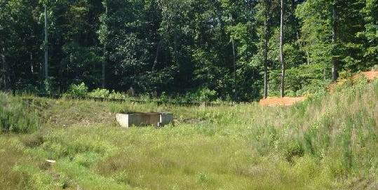
BMP MAINTENANCE AND INSPECTIONS

Slide 2
What are BMP’s?
Best Management Practices (BMP’s), are used to reduce pollution in stormwater runoff, thereby protecting area waterways. These practices are often permanent facilities designed to handle stormwater runoff for a specific area.

Slide 3
What are some common types Of BMP’s?

Slide 4
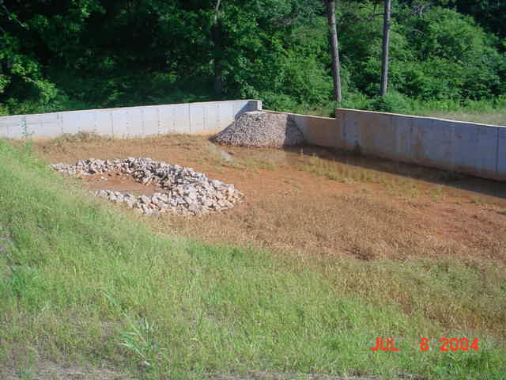
Detention Ponds

Slide 5
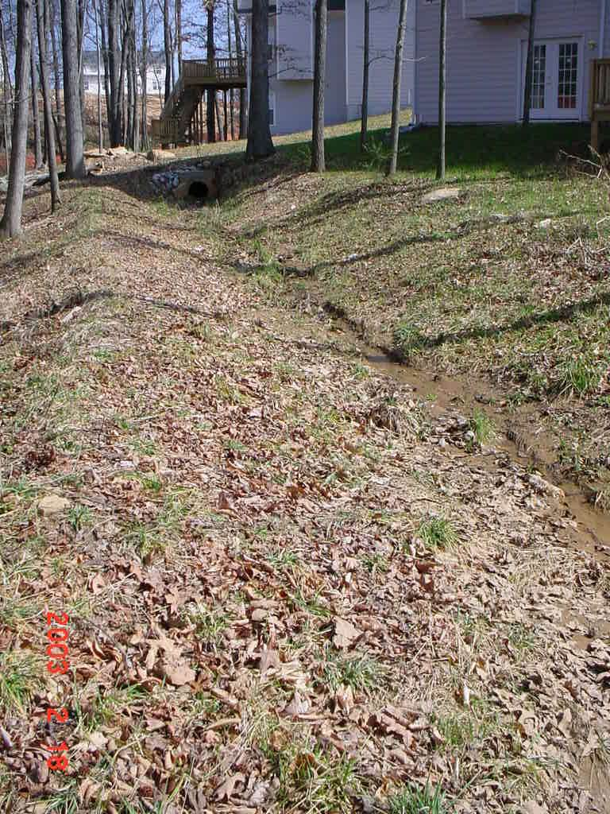
Grass Swales

Slide 6
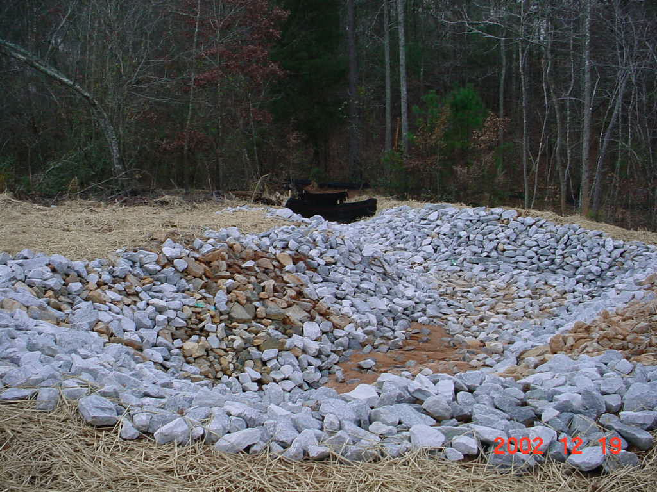
Level Spreaders

Slide 7
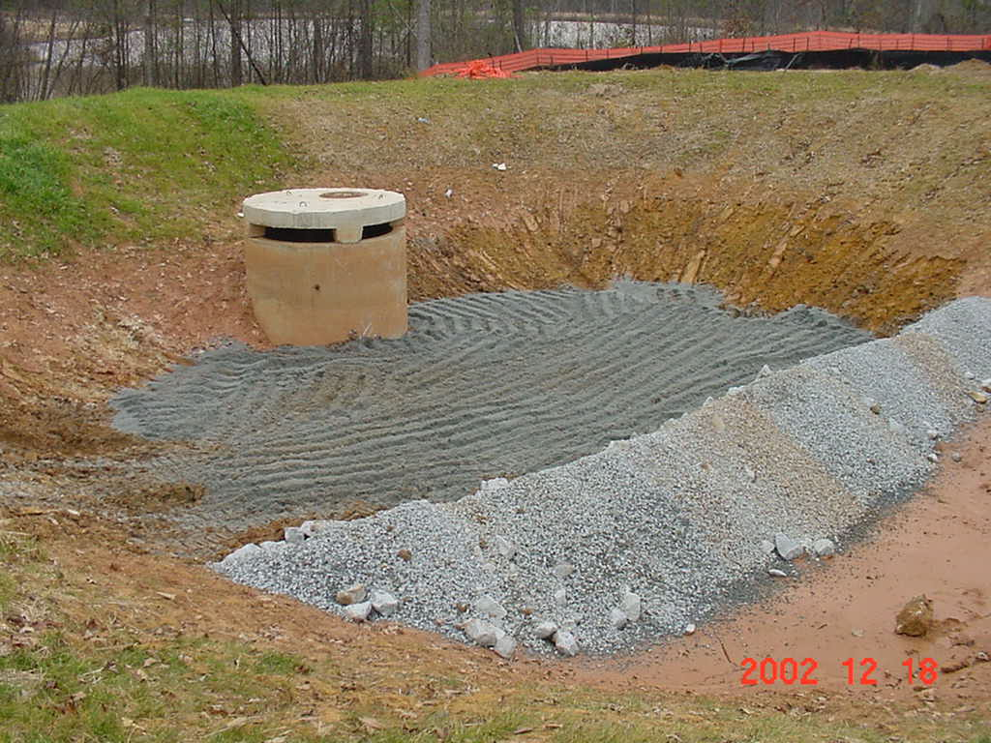
Sand Filters

Slide 8
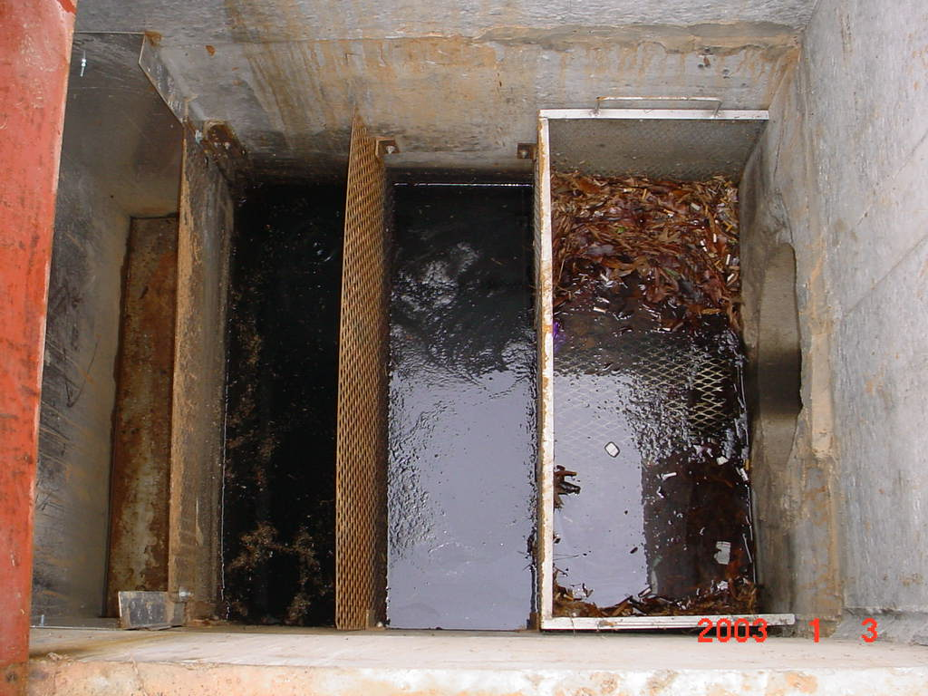
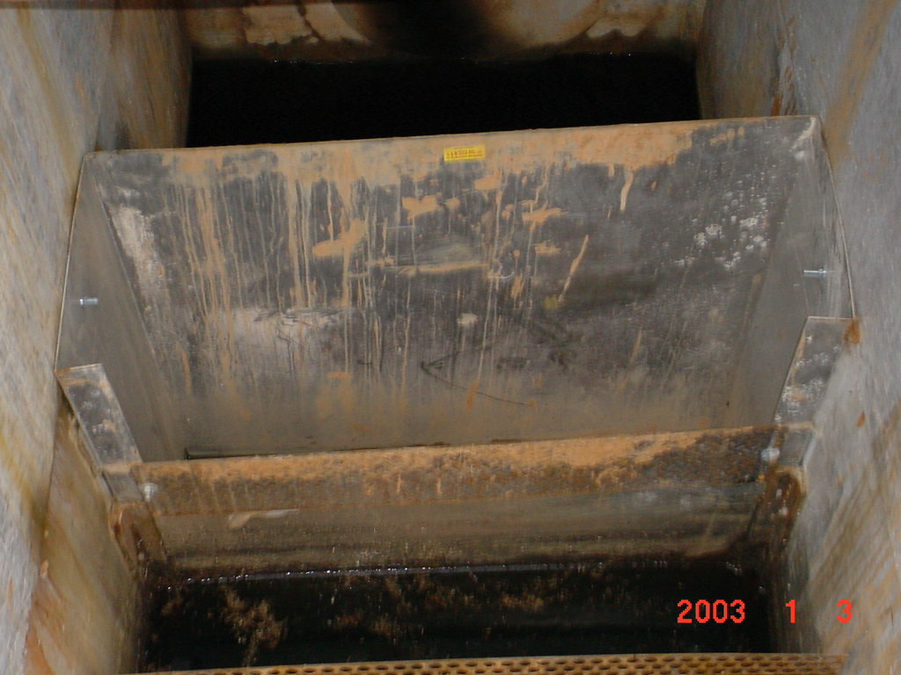
Oil/Grit Separators

Slide 9
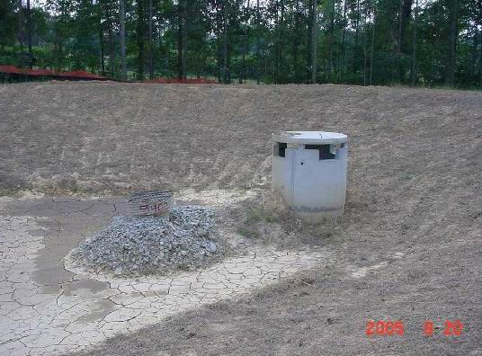
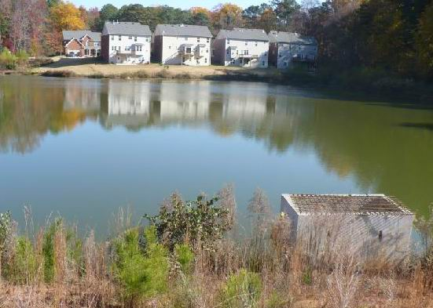
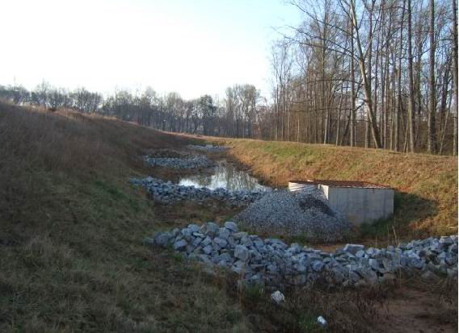
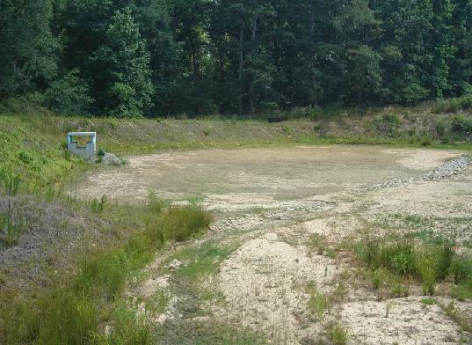
BMPS DISCUSSED TODAY WILL BE DETENTION PONDS

Slide 10
Getting to Know Your BMP
Inlet Structures- Headwall and Forebay
Outlet Structures
Retro-fit
Channel Protection Pipe
Water Quality Pipe
Outlet Pipe

Slide 11
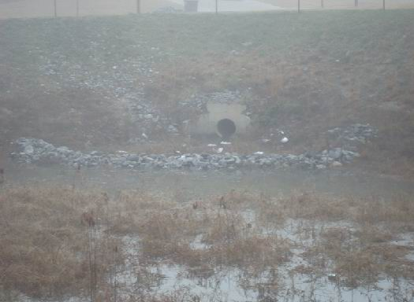
Inlet Structures
Inlet Headwall
Forebay

Slide 12
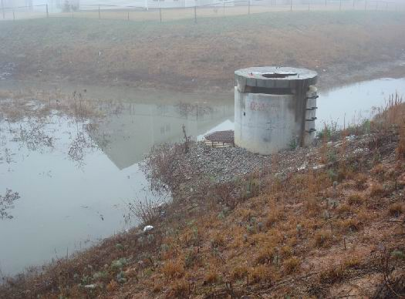
Outlet Control Structure
Outlet Control Structure
Half-round filter pipe
Retro-fit
Filter stone

Slide 13
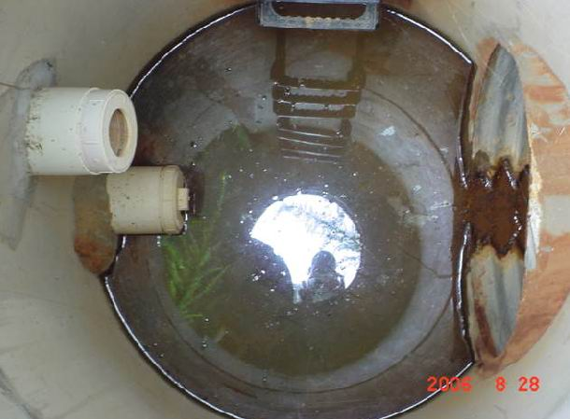
Inside Outlet Control Structure
Water Quality Pipe
Channel Protection Pipe
Outlet Pipe

Slide 14
Common Found during
BMP Inspections
PROBLEMS

Slide 15
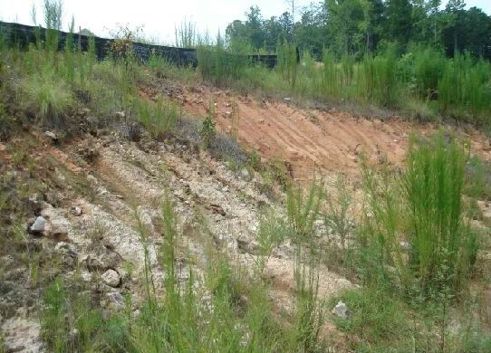
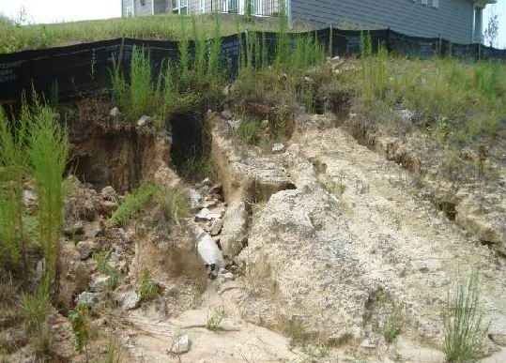
REPAIR EROSION RILLS AND GULLIES
EROSION IS WASHING SILT INTO BMP
NO VEGETATION GROWING TO KEEP DIRT ON THE SLOPES

Slide 16
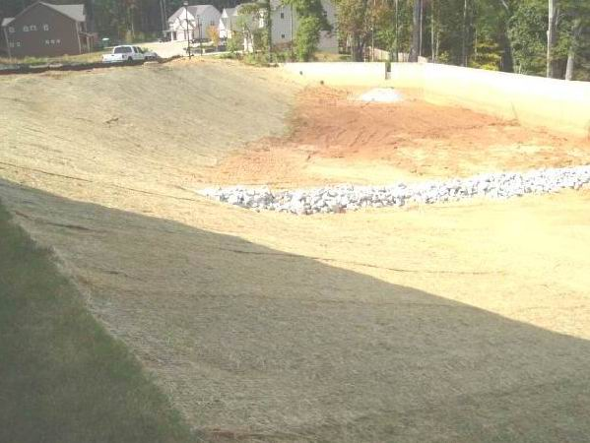
WORK WAS COMPLETED
EROSION WAS REPAIRED WITH EROSION MAT
ALSO THE SLOPES WERE RESEEDED AND COVERED

Slide 17
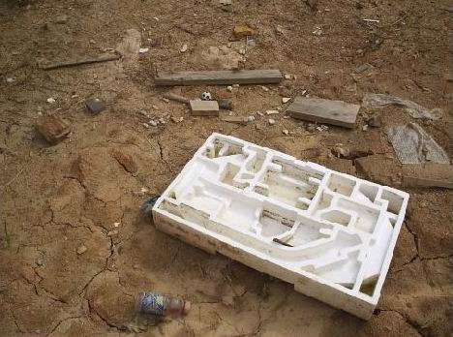
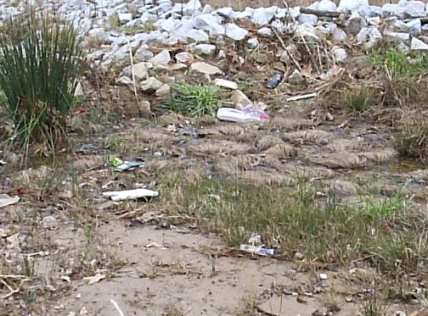
REMOVE TRASH AND DEBRIS
BMPS COLLECT TRASH FROM THE STREET
MAKE COMMUNITY AWARE THAT DRAINS LEAD TO BMP NOT THE SEWER
EXCESSIVE TRASH CAN GET INTO STREAMS AND WATERWAYS
BMPS ARE NOT DUMP SITES

Slide 18
Access Easements Must Be Kept Clear
Every Access Easement is shown on the final plat
This is the area that is required to be kept cut back
Growth in the bottom of the pond is good, when controlled
Location of Easements

Slide 19
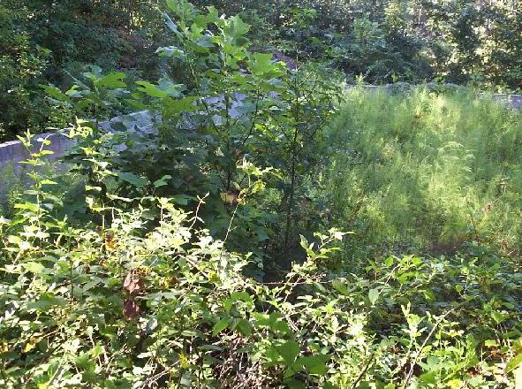
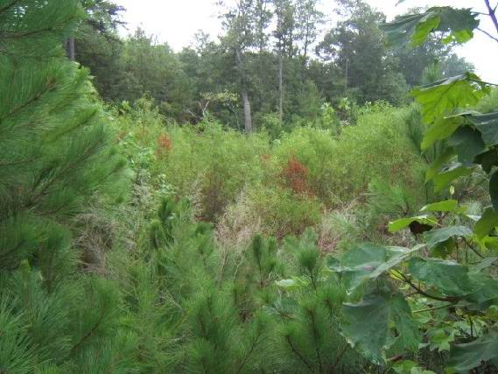
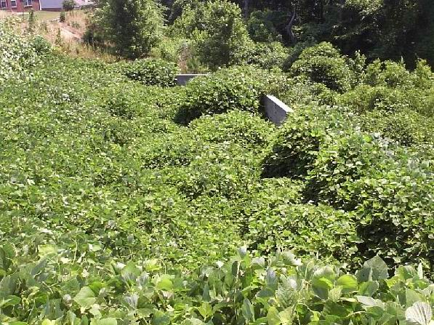
Cut tall vegetation

Slide 20
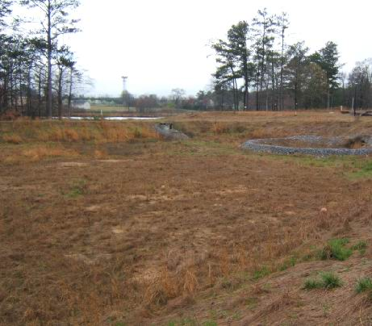
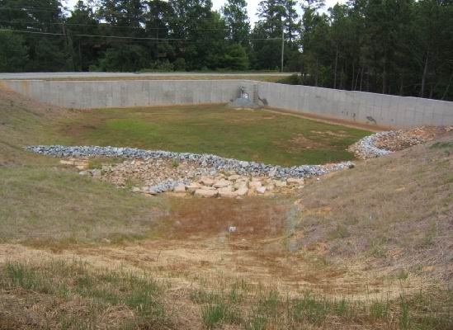
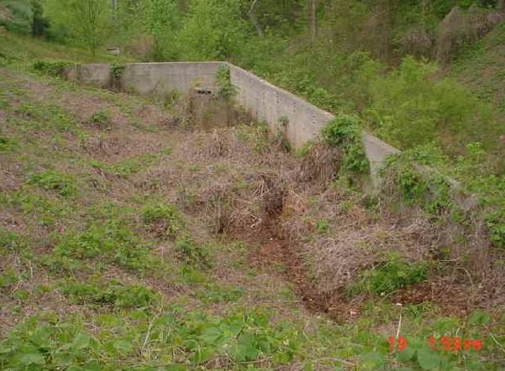
Keep the Access Easement Clear

Slide 21
KEEPING FILTERSTONE CLEAN
THE FILTERSTONE HELPS KEEP SILT AND POLLUTANTS IN THE BMP
THE STONE NEEDS TO BE CLEANED/REPLACED REGULARLY
CLOGGED FILTERSTONE= FULL POND

Slide 22
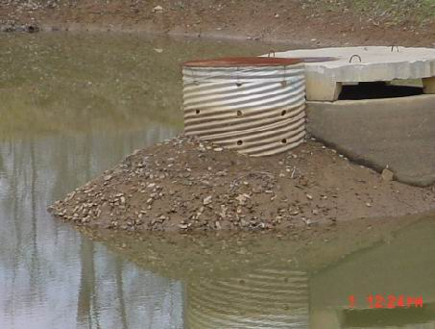
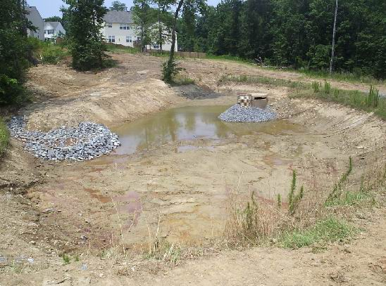
BEFORE AND AFTER PICTURES

Slide 23
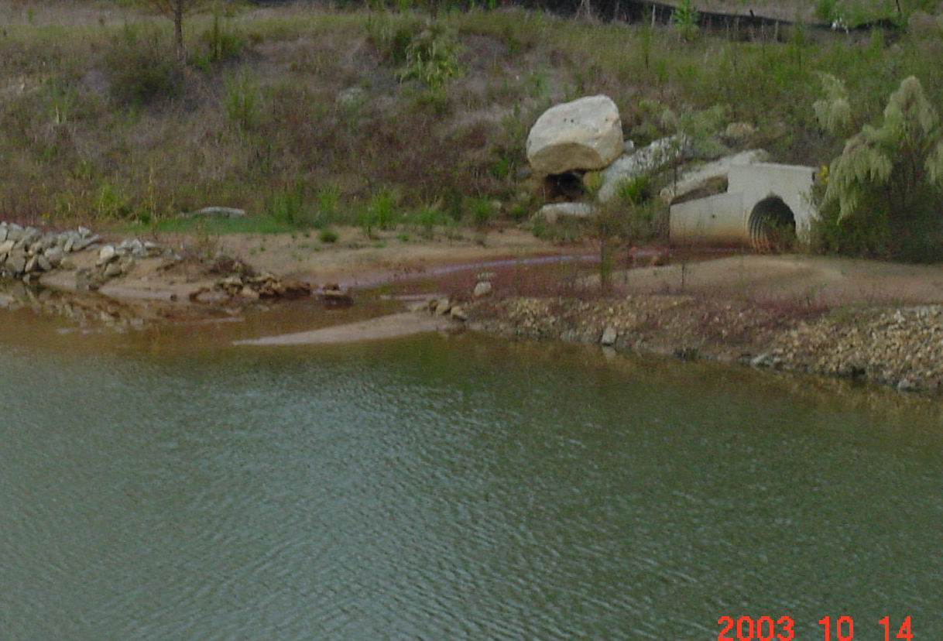
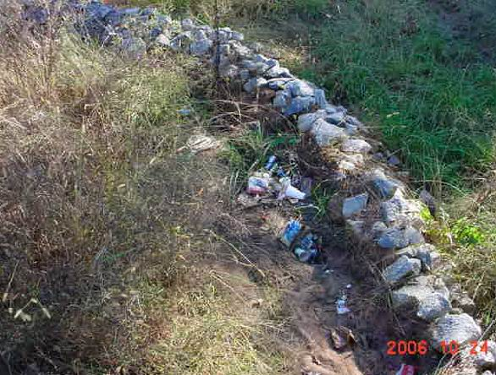
REPAIR THE FOREBAY
FOREBAYS HELP SLOW DOWN VELOCITY OF THE WATER
FOREBAYS ALSO CATCH MOST TRASH
FOREBAYS ALSO COLLECT SILT

Slide 24
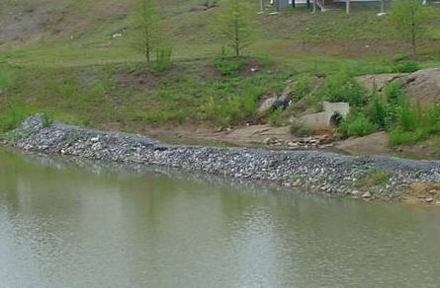
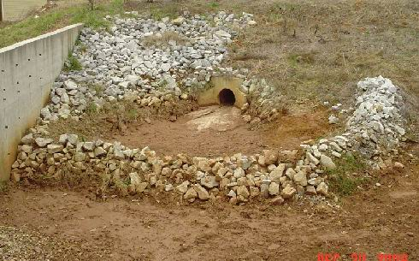
FOREBAYS WERE REPAIRED
FOREBAYS CAN BE REPAIRED WITH EXISTING ROCK
DRY CONCRETE MIX CAN HELP KEEP ROCK TOGETHER
MOST FOREBAYS CAN BE CLEANED BY HAND IF DONE EARLY ON

Slide 25
Gwinnett County BMP Inspection Process

Slide 26
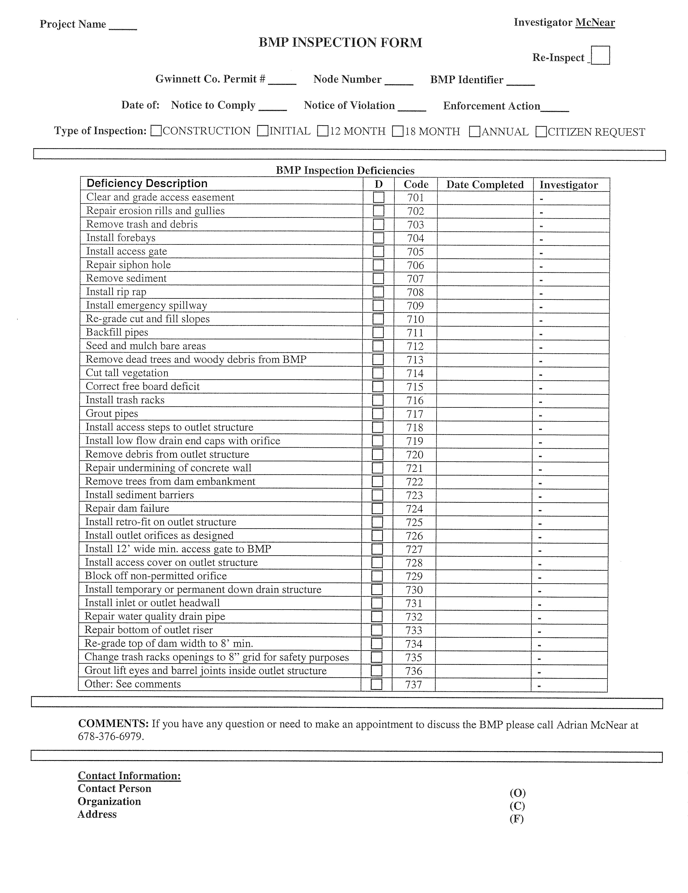
Example
Report

Slide 27
BMP FACILITIES INSPECTION
ANNUAL- CONDUCTED EVERY 12 MONTHS AFTER BOND RELEASE DATE.
Annual inspections are required for BMPs with a recorded maintenance agreement.
Maintenance agreements were required by Gwinnett County after 1999

Slide 28
Enforcement
First notice: Notice to Comply (NTC) Requests that the work be completed within 14 Days.
Second Notice: Notice of Violation (NOV) Requests that the work be completed within 14 Days. Fines can be imposed if not addressed

Slide 29
PREVENTIVE MAINTENANCE
KEEP VEGETATION CUT DOWN
KEEP TRASH OUT
REPAIR EROSION EARLY
ENCOURAGE HOA MEMBERS TO HELP OUT

Slide 30
COUNTY ASSISTANCE
THE COUNTY HAS A EROSION ASSITANCE PROGRAM
COUNTY CAN PROVIDE EROSION CONTROL MAT
COUNTY CAN PROVIDE RIP RAP FOR FOREBAYS

Slide 31
SERVICE REQUEST
CALL 678-376-7000 FOR ASSISTANCE WITH DRAINAGE COMPLAINTS
CALL IN REQUEST FOR RIP RAP OR EROSION MAT

Slide 33
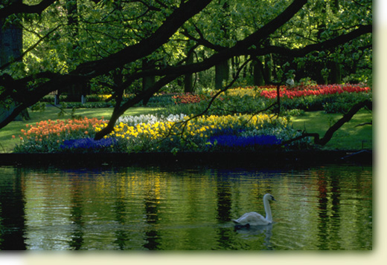

Slide 34
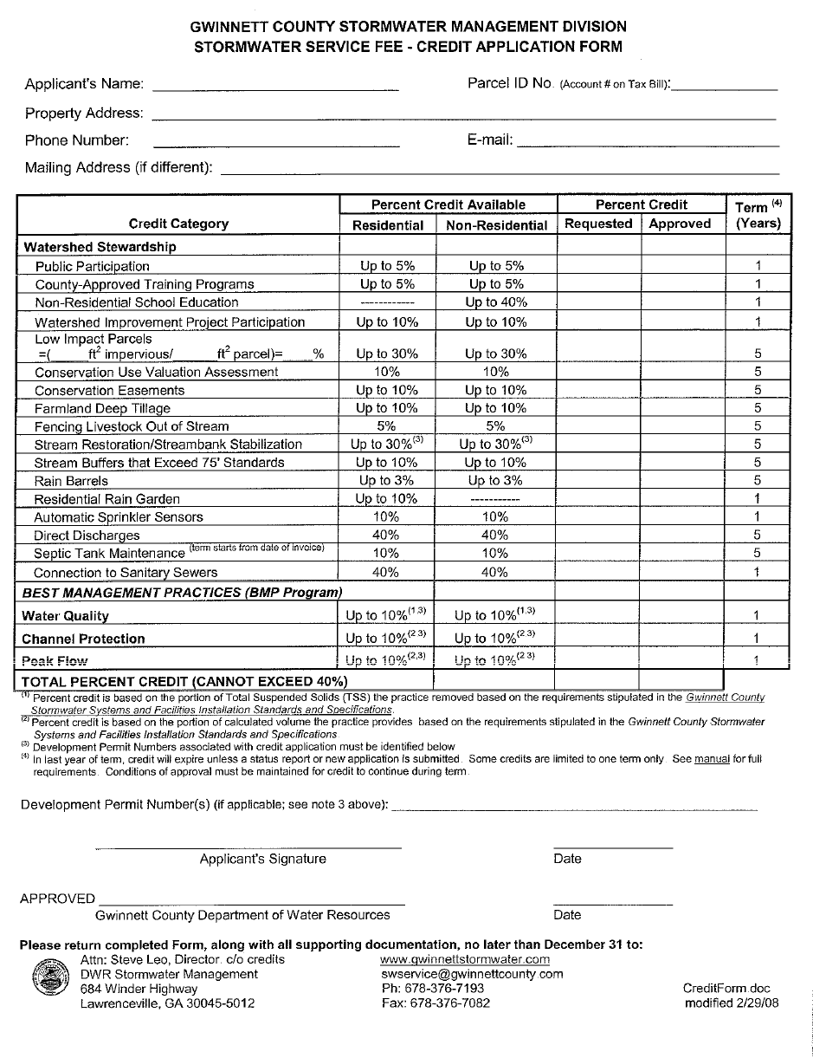
Where To Sign
List Date Here & Turn In Form
Sign Here

Slide 35
To Receive Credit
You must live within the City Limits of Lilburn or within Unincorporated Gwinnett County (outside City Limits).
Sign, Date & turn in the Stormwater Service Fee - Credit Application Form at the end of this workshop

Slide 36
Managing a Neighborhood Pond
Robert Brannen
Gwinnett Extension Service
Notes:
NOTE: If you are showing this slide set via a Power Point presentation, the symbol (#) throughout the script indicates when to press your mouse button to change the animation within a slide.
1. Title Slide

Slide 37
Neighborhood Ponds in Gwinnett County
Importance
Problems
Mosquitoes
Weeds
Fish
Wildlife
Pondscaping
Maintenance

Slide 38
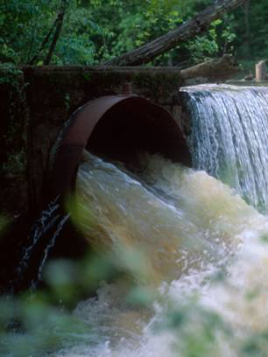
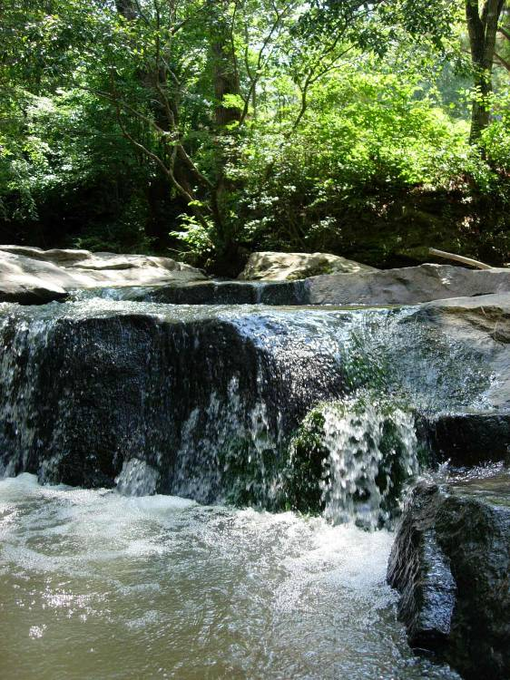
Stormwater Issues
Water that runs off of impervious surfaces such as roads, parking lots, or rooftops.

Slide 39
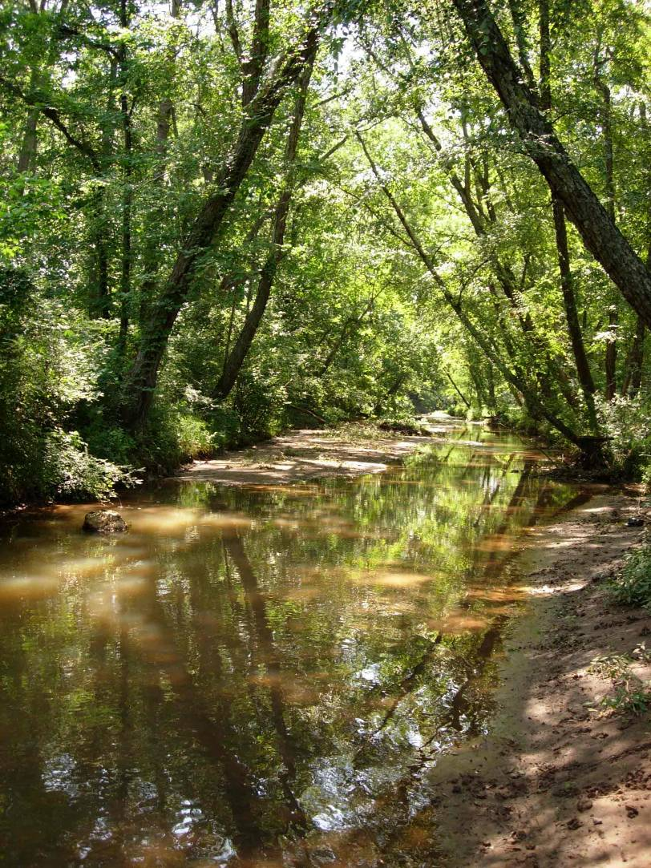
Why manage stormwater?
To prevent flooding during heavy rains.
To keep our rivers and streams healthy.
To meet state and federal requirements.
To provide for future growth and development.

Slide 40
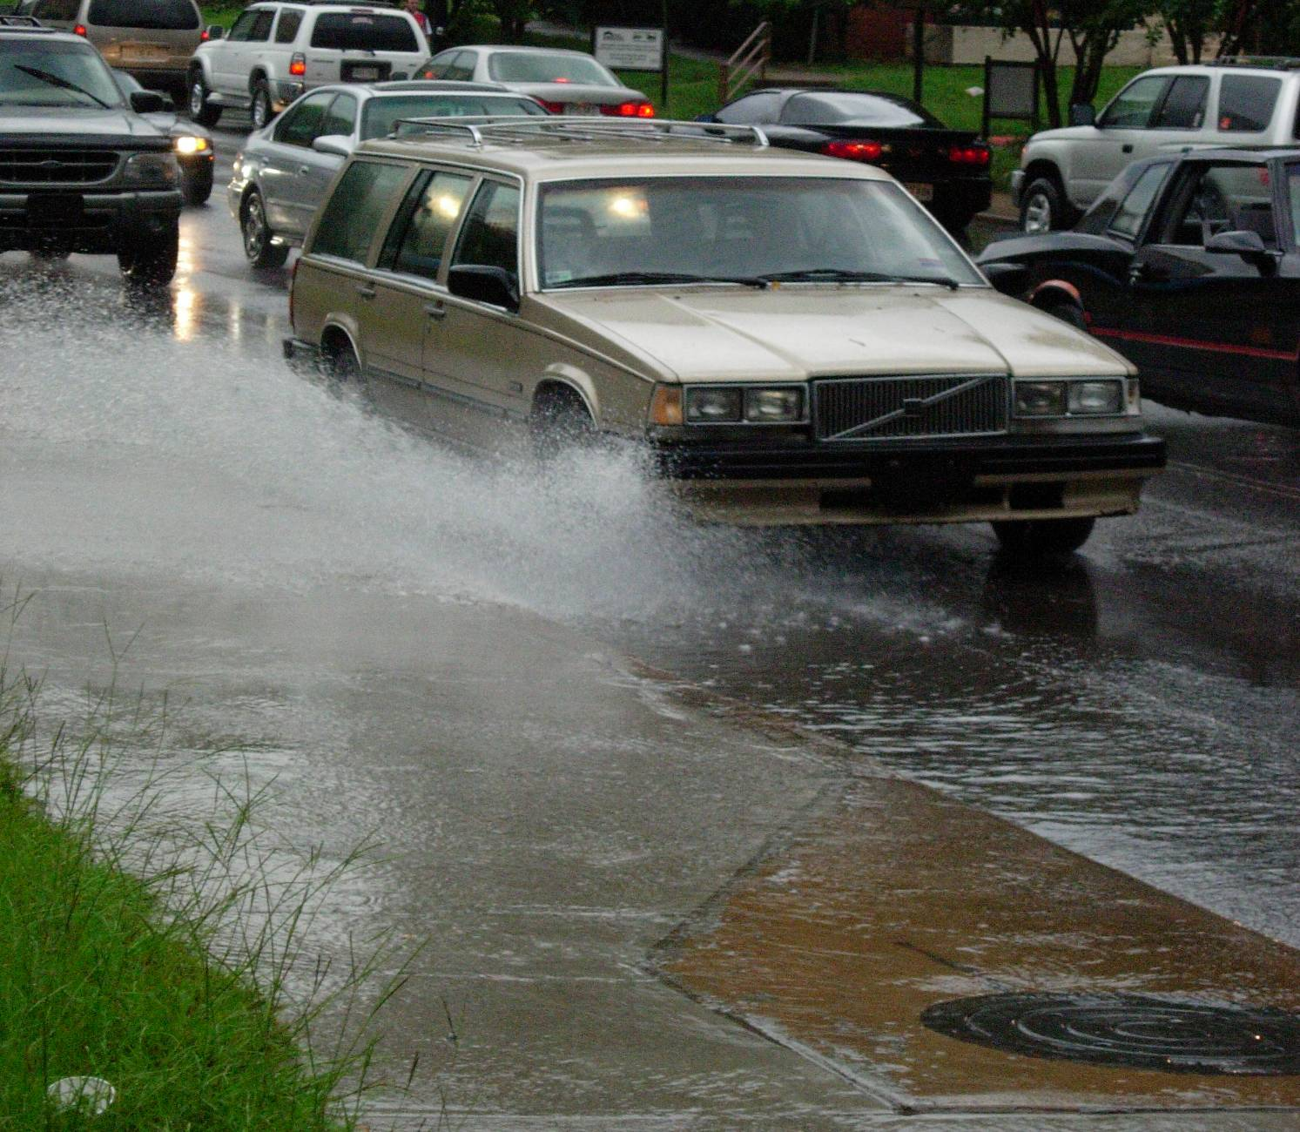
Problems

Slide 41
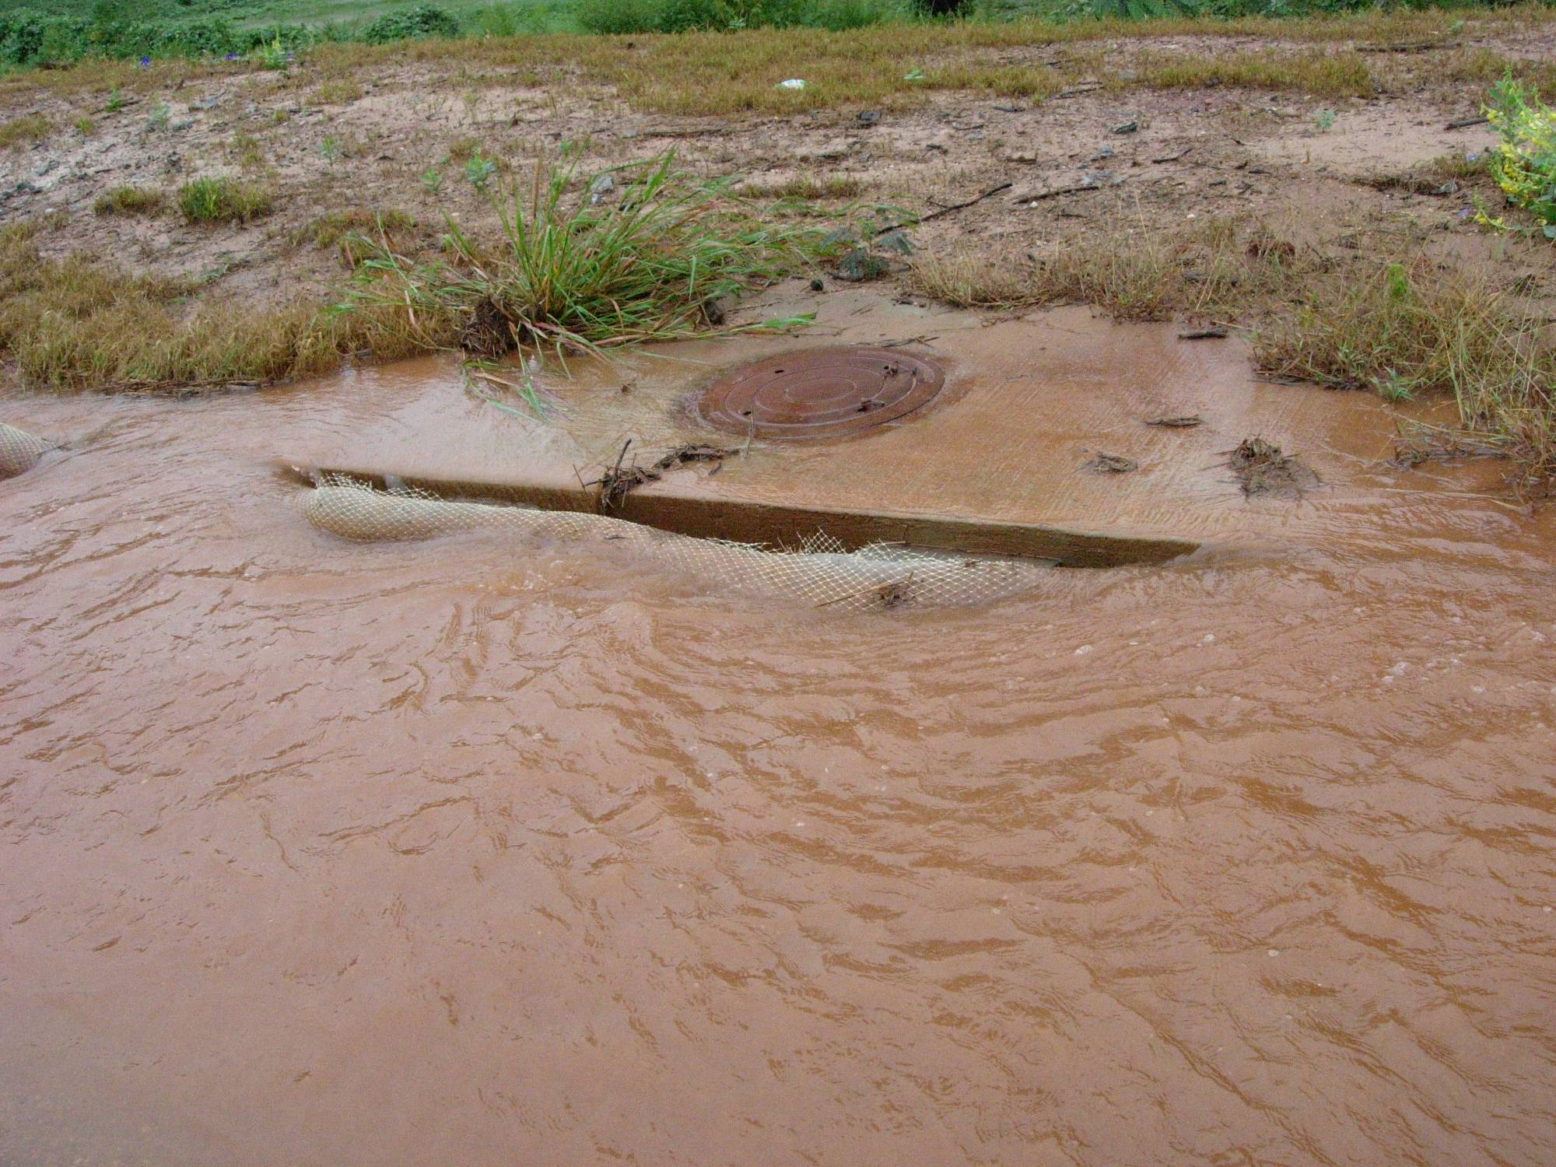

Slide 42
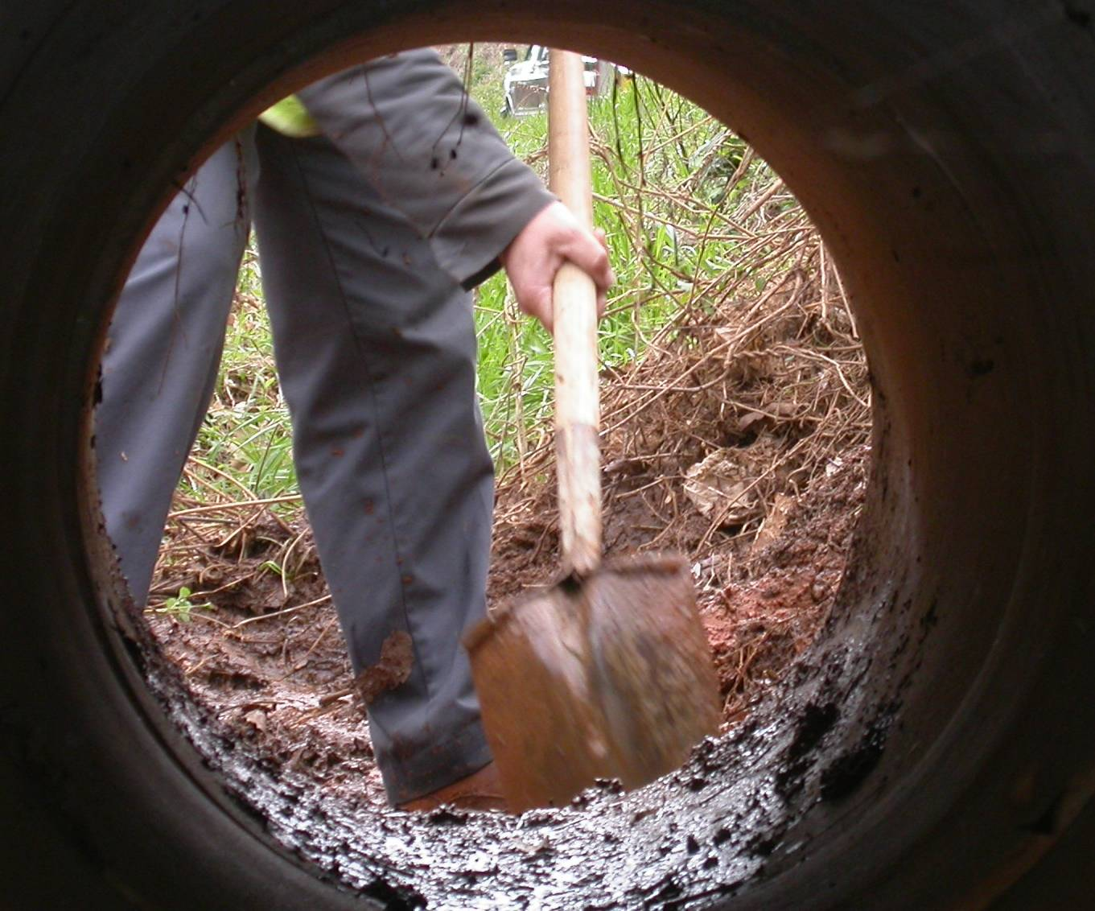

Slide 43
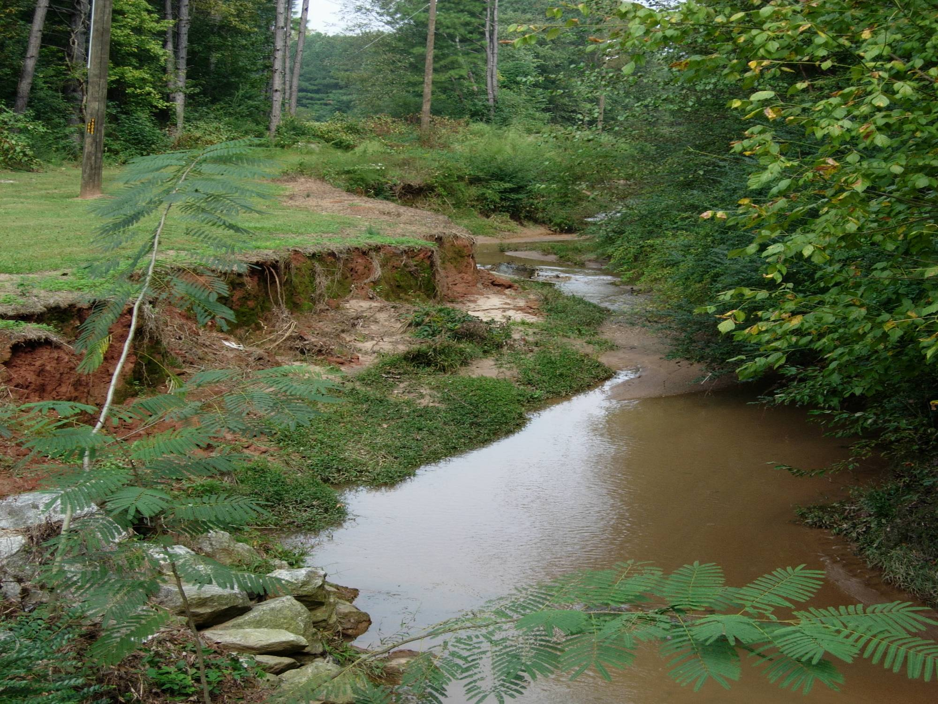

Slide 44

Most storm water detention ponds
are semi-permanent
aquatic systems that dry out only under drought conditions.
Detention pond?
Notes:
Often, during the rainy season the water levels in these ponds remain at or near the outflow structures. Under these conditions, storm water entering a detention area displaces an equivalent amount of water that usually overflows to an adjacent man-made or natural drainage system. The detention pond acts as a sink or trap where pollutants picked up by the initial surge of storm water settle out before leaving the detention pond. These ponds are usually referred to as "wet-detention systems."

Slide 45
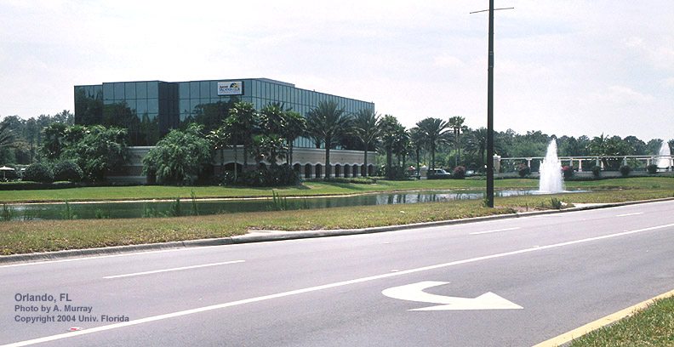
Notes:
When land is alter to build homes and other developments, the natural system of trees and plants over native soil is replaced with harder surfaces like sidewalks, streets, decks, roofs, driveways, and even lawns over compacted soils. As a result, less rainwater is soaked up and more rain water/storm water flows off the land at a faster rate. Water gathers oil, gas, pesticides, heavy metals, fertilizers, bacteria, and nutrients as it flows over roadways and parking lots. These pollutants could cause serious harm if they flowed directly into water bodies without any filtration or decomposition.

Slide 46
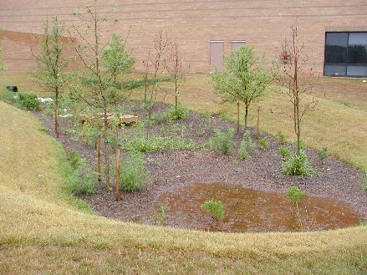

Slide 47
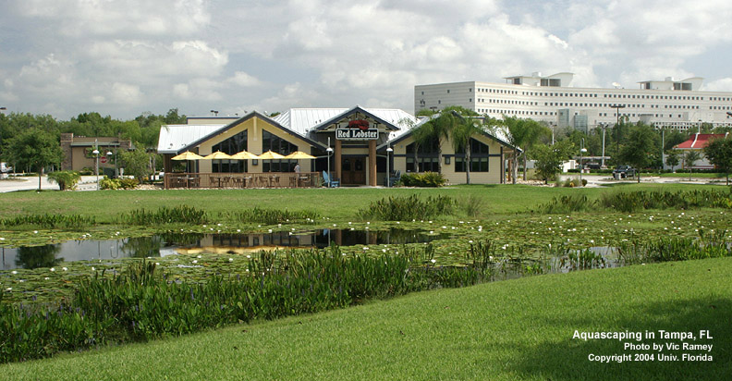
Catch and trap pollutants
Notes:
Many areas that are “flood-prone” are paved with asphalt or covered in concrete, thus preventing rainwater from absorbing into the ground to replenish our aquifers. After a heavy rain, retention ponds collect excess water as it runs off of the paved areas. Another function of retention ponds is to catch and trap pollutants, preventing their runoff into natural water bodies.

Slide 48
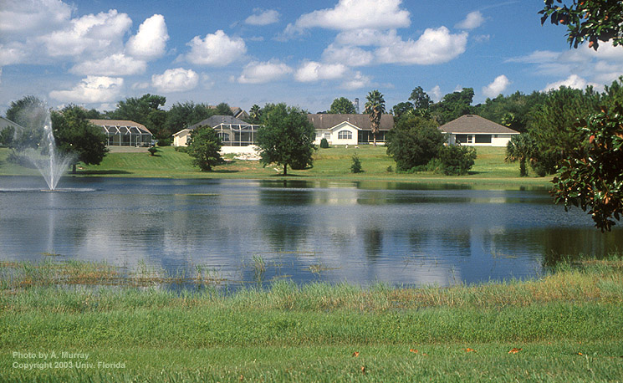
Routine maintenance will prolong the life of your detention pond, improve its appearance, prevent flooding and property damage and enhance local streams and lakes.

Slide 49
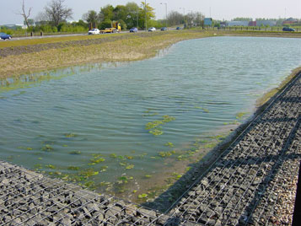
Ugly ?
Notes:
Though retention ponds are a necessary part of Georgia’s landscape, they often look unnaturally bleak. What's more, these man-made ponds are easily invaded by non-native plants, and are further uglified by algae blooms, but there are ways to make these ponds more visually appealing while maintaining their utilitarian functionality.

Slide 50
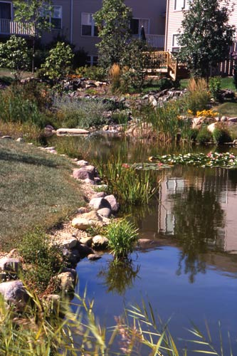
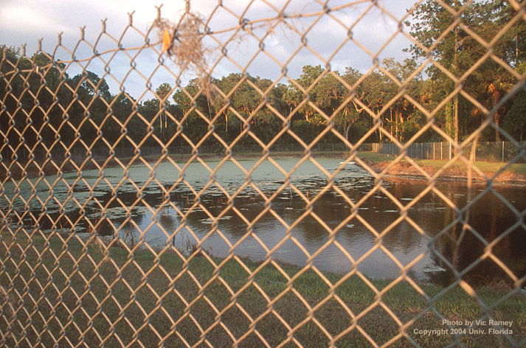
Missed opportunity
Transformed pond
Notes:
Instead of settling for generic, uninspiring retention ponds surrounded by chain-link fencing, aquascaping with Georgia’s native aquatic plants offers a glimmer of beauty that stands out against the gray and black of roads, parking lots and urban development.

Slide 51
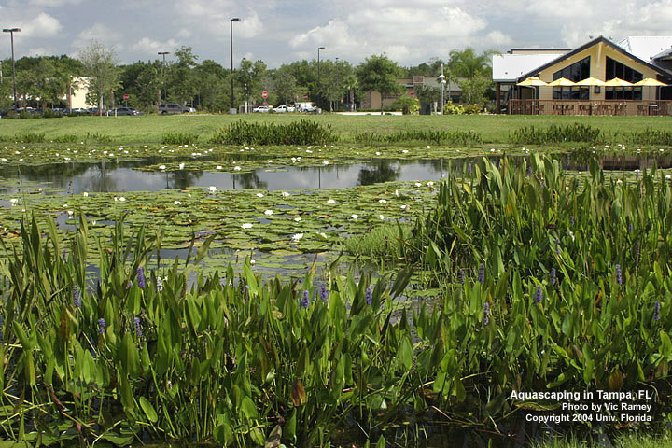
Wildlife habitat and “eye-candy”
Notes:
The aquascaped retention pond in a shopping center provides wildlife habitat and eye-candy in a high-traffic urban setting.
Retention and storm water management ponds are a permanent fixture on much of our landscape. Without them, Georgia would not be able to support its growing population safely or efficiently.

Slide 52
Safety, Signage, and Fencing
Ponds, which are readily accessible to populated areas, should incorporate all possible safety precautions, i.e., graduated slide slopes, vegetative and barrier plantings, and safety shelves.
Detention ponds should have signage placed for maximum visibility from adjacent streets, sidewalks, and paths.
Fencing or other barriers should be placed around spillway structures.
Access to and along shorelines may be effectively limited to desired locations by planting thorny decorative shrubs.

Slide 54
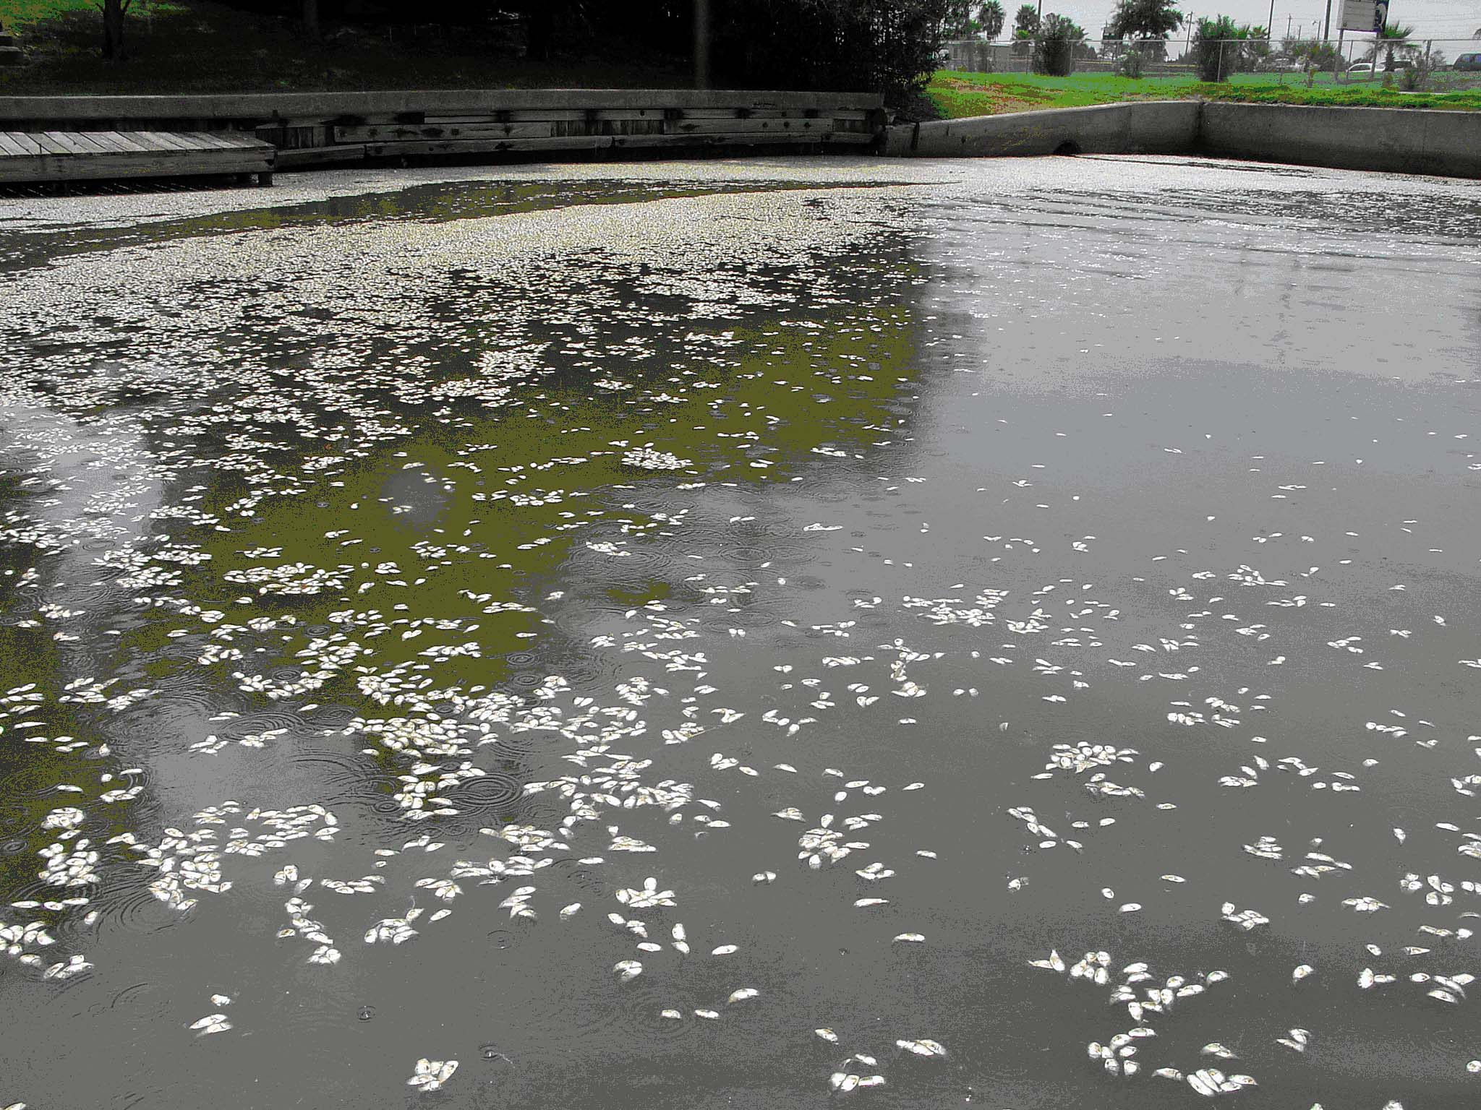
The Oxygen Cycle
Notes:
During winter, contribution of oxygen from photosynthesis by green plants and algae is greatly reduced. This is caused by the normal fall die-off of plants and algae due to cold water. Additionally, those green plants that remain produce less oxygen because their metabolism slows in cold water. This does not mean that oxygen levels are much lower in winter. In fact, the reverse is true. In unfrozen ponds, high oxygen levels will occur during winter because the oxygen needs are less in cold water. Aquatic animal (primarily fish) metabolism and oxygen-consuming decomposition processes are greatly reduced in cold water. Also, cold water contains more oxygen than does the warm water of summer. The strong winter winds also keep the pond water circulating and continually add oxygen during winter. These factors combine to prevent winterkill in unfrozen ponds even though plants are contributing little oxygen during winter. Problems, if they are to occur, will happen once ice forms on the pond.

Slide 55

Troubleshooting Pond Problems
Notes:
Our next section will focus on pond problems.

Slide 56

Assessing Pond Problems
Is it really a problem
Ask Questions
Walk the Pond
Ask for More Information
Don’t Be Afraid to Call for help
What are the alternatives and their costs.
Notes:
As a county agent or consultant you’re often put in a situation where you don’t always have all the information you need.
A main point to stress is to stay confident while you gather information. Don’t give your recommendation until you’ve thoroughly investigated the situation, the history and the pond. Sometimes it pays to get another opinion. In fish kill situations you’re often stuck figuring out where to go from here…not on saving the fishes. Once they start dying there’s little you can do.
Finally be confident when you give your answer. Any indecision in your recommendation will cause you to lose confidence with the pond owner.

Slide 57


Pond Volume
Shallow Pond
Deep Pond
Notes:
The more water volume (i.e., gallons) in a pond, the less likely the pond will experience winterkill. This is why fish over-winter better in larger and/or deeper ponds. A one-acre pond that averages 6 feet deep will have more winter oxygen available than a one-acre pond that averages only 3 feet in depth.
Decomposition—An important factor is the amount of decaying organic matter that is present on the bottom. Dead aquatic vegetation and tree leaves account for most of the organic matter undergoing decay during winter. A pond bottom covered with these materials is more likely to experience winterkill than a pond lacking such materials. This is why ponds having a very dense aquatic plant community in summer are the very ponds most susceptible to winterkill during harsh winters.
Fish Biomass—The amount of fish (numbers and pounds) in the pond during winter also influences oxygen decline under the ice. Even though fish metabolism has slowed during winter, they still require oxygen. A pond that contains many pounds of fish will experience a faster decline in oxygen than a pond with fewer pounds of fish. This is why fish farmers closely monitor ponds in winter as they are maintaining fish biomass at levels that greatly exceed a normal pond.
Worst Case Scenario—Pond owners should be most concerned during a harsh winter in which ice cover persists, there is considerable snow cover on the ice, the pond is small and shallow, and the pond contained a large amount of aquatic plants the previous summer. Less ice and snow, fewer aquatic plants the previous summer, and the deeper the pond, the less likely a winter fish kill will occur.

Slide 58

Clearing Muddy Ponds
Step # 1 - Find the Cause
Undesirable Species
Poor Watershed Management
Undesirable Water Source
Step # 2 - Evaluate Solutions
Total Renovation of Population
Watershed Vegetation
Chemical Alternatives
Step # 3 - Implement Management Plan
Establish vegetation in the watershed
200-500 lb Gypsum, Lime, Fertilizer
Notes:
Muddy water is often a problem that requires a good bit of scouting on the part of the pond owner. Unfortunately for many it involves dealing with upstream land owners. Whenever muddy water is of concern I’d advise the pond owner to seek to reestablish vegetation around the pond and upstream in the watershed. He/she can also investigate whether or not fishes like speckled cat are becoming a problem. There’s also a slight chance the muddy water can be attributed to overstocking of channel or blue catfish.

Slide 59
Things Not to Do Near a Pond
DO NOT mow surrounding vegetation too close to the surface; height should be 4 to 6 inches to maintain healthy grasses
DO NOT clean equipment or conduct maintenance on equipment in the detention pond, or near a storm drain or other stormwater
conveyance feature
DO NOT leave grass clippings or trimming residue in the pond;
collect and dispose
DO NOT apply landscaping chemicals in pond area, or in areas where the residue could make it into the pond during a storm event
NO NOT attempt to clean up any unidentified or possibly hazardous materials found in or around pond during inspections; notify supervisor immediately upon discovery of hazardous materials

Slide 60
Mosquitoes
Detention ponds for holding storm water runoffs
usually do not produce mosquitoes
in sufficient numbers to cause a problem.
What is the number one breeding ground for mosquitoes in residential neighborhoods?
Shade is also a factor
Notes:
Exceptions may occur when ponds become nearly dry due to a lack of rainfall. Under these conditions wastewater Culex may invade the system. A similar type of invasion can occur in detention ponds that receive both storm and wastewater. Wide fluctuations in water levels, especially when they are frequent events, may make the detention system a suitable habitat for floodwater mosquitoes, such as Aedes vexans and Psorophora columbiae . Floating and rooted aquatic plants may foster the growth of populations of Mansonia dyari , M. titillans and Coquillettidia perturbans .
Although storm water entering retention systems is supposed to percolate into the ground within 72 hours, retention areas often remain wet for longer periods. Floodwater mosquitoes are normally the first to appear in retention areas. Later in the rainy season, it is not uncommon to find Culex , especially if grass cuttings have been accumulating in these areas. Overall, abundant populations of pest and disease-vectoring mosquitoes are much more frequently associated with retention systems than they are with detention systems. Moreover, it is much easier to achieve long-term mosquito abatement in detention ponds than it is in retention areas. Retention systems tend to be more effective for recharging the aquifer and for improving water quality than are detention systems. Therefore, water management experts often recommend the installation of retention systems for new developments. The use of detention with filtration is generally not recommended because it is often difficult to properly design, construct and maintain such a system.

Slide 61
Mosquito Control
Mosquitoes can be controlled with larvicides.
Notes:
For a larvicide operation to be effective, it must be supported with a quality inspection program. The widespread occurrence of potential mosquito breeding sites greatly increases the costs and man-power needs of inspection programs. Perhaps, through educational programs directed at the general public, we could generate more service request for the control of mosquito larvae and fewer for adult mosquito control

Slide 62


Slide 63

Got a Weed Problem?
Notes:
Let’s talk about weeds for a while.

Slide 64

Control of Weeds
-Identify the plant pest
Algae
Floating Weeds
Emersed Weeds
Submerged Weeds
-Know total pond acreage, average depth, flow rates
-Select labeled treatment
Timing of
Applications is Critical!
Notes:
Now let’s move into control. First thing folks need to do is have the plant properly identified. Whether you do it yourself, ask an agent or a pond consultant know what you are dealing with before you make decisions.
Next thing you want to do is assess the overall situation. How big is your pond? How many acres are affected? What’s your flow rate? What’s the season? What other weeds are in the pond? How fast do you want it controlled?

Slide 65
Plant Identification
Weed Management Techniques
Herbicide Recommendations
Ornamental Propagation Techniques
http://aquaplant.tamu.edu
Notes:
First thing I’d like to show you are some great resources for weed control information. My favorite is Aquaplant.

Slide 66


394 Weeds Covered
Photographs
Line Drawings
Identification Characteristics
http://aquat1.ifas.ufl.edu/
Notes:
Next is Florida’s Extension site.

Slide 67

Algae – Planktonic & Filamentous
Check Water Hardness/Alkalinity
Slow/Filter Runoff
Fertilization Problems?
Overstocking/Overfeeding?
Notes:
Algae is a common problem in ponds. First step I suggest in any algae control program is to identify the source. In some situations there is no easy fix. First thing a pond owner needs to do is look into potential sources from: runoff, overstocking, overfeeding, improper fertilization or low water hardness. Sometimes fixing the source is better than spot treating the problem. It also leads to better long term control.

Slide 68
Duckweed & Watermeal
Complete eradication critical. One patch can lead to reinfestation.
Sonar AS ( Fluridone) - ½ to 1 quart per acre.
Diquat, Reward - 3/4 gallon plus 8 ounces of surfactant per 50 gallon tank mix.
Diquat treatment requires professional experience.
Notes:
No other weeds cause more headaches for pond owners than these two. In most situations fluridone is your best option. Consultants and folks with experience can get by with diquat, but you’ve gotta be persistent and make sure to hit each and every piece of weed with the herbicide.

Slide 69


Watershield – Dollar Bonnet
Seeds & Leaves Highly Prized Forage of Waterfowl.
Slimy stems, bottoms & large tuberous root make control difficult.
EXCELLENT CONTROL
Navigate or Aqua-Kleen = 2 4-D
Habitat = imazapyr. Use Adjuvent
GOOD CONTROL
Rodeo, Aquamaster, Eraser AQ, Touchdown Pro, and AquaNeat = glyphosate. Add surfactant
Sonar or Avast = floridone
Notes:
Watershield is a weed that commonly sneaks up on folks. One summer they’ve got a small patch that’s fun to fish, the next year they’ve got extensive areas covered. This weed is tough to control b/c it has a large tuberous root system. In most cases habitat has proven slow, but most effective in controlling watershield.

Slide 70


American Lotus
EXCELLENT CONTROL
Navigate or Aqua-Kleen = 2 4-D
Renovate = triclopyr. Add surfactant
GOOD CONTROL
Aquathol, Aquathol K, and Aquathol Super K = dipotassium salts of endothall.
Hydrothol 191 = alkylamine salt of endothall.
Reward = diquat. Add surfactant
Notes:
Lotus has become common in areas where water gardens abound. The weed is fairly easy to control with Renovate or Navigate.

Slide 71


Alligator Weed
Grass Carp – low preference
EXCELLENT CONTROL
Habitat = imazapyr. Use Adjuvant
Renovate = triclopyr. Add surfactant
GOOD CONTROL
Navigate or Aqua-Kleen = 2 4-D
Rodeo, Aquamaster, Eraser AQ, Touchdown Pro, and AquaNeat = glyphosate. Add surfactant
Sonar or Avast = floridone
Notes:
Folks in GA don’t tend to see a lot of Alligator weed. Some DNR professionals at a recent update felt that it was desirable for habitat purposes. If it is not wanted it is easily eliminated with Habitat or Renovate.

Slide 72

Egeria
Anacharis in the tropical fish trade. Whorled oval leaves in 4's.
Grass Carp - High Preference
EXCELLENT CONTROL
Diquat plus Cutrine Plus, K-Tea, Captain, and Clearigate = chelated or compound copper herbicides
Aquathol, Aquathol K, and Aquathol Super K = dipotassium salts of endothall.
Hydrothol 191 = alkylamine salt of endothall.
GOOD CONTROL
Sonar or Avast = floridone
Notes:
Egeria is seldom seen as a large problem in GA. It’s a weed that grass carp show high perference for. It appears similar to hydrilla that we’ll cover shortly. In some situation chemical control is necessary for a quick fix.

Slide 73


Hydrilla
Rooted plant or floating mat. Upper leaves whorls of 3 while lower leaves are small and opposite. Serrated leaf margins -underside leaf toothed.
Grass Carp - High Preference
EXCELLENT CONTROL
Diquat plus Cutrine Plus, K-Tea, Captain, and Clearigate = chelated or compound copper herbicides
Sonar or Avast = floridone
GOOD CONTROL
Reward = diquat. Add surfactant
Aquathol, Aquathol K, and Aquathol Super K = dipotassium salts of endothall.
Hydrothol 191 = alkylamine salt of endothall.
Cutrine Plus, K-Tea, Captain, and Clearigate = chelated or compound copper herbicides
Notes:
No other weed draws more attention on GA reservoirs than hydrilla. It’s all a matter of preference whether this weed is a curse or a blessing. As you can see you have many options for control using either herbicides, grass carp or both. Notice the serrated margins set this weed apart from Egeria.

Slide 74

Fanwort – Cabomba
Grass Carp - Moderate Preference
EXCELLENT CONTROL
Aquathol, Aquathol K, and Aquathol Super K = dipotassium salts of endothall.
Hydrothol 191 = alkylamine salt of endothall.
Sonar or Avast = floridone
GOOD CONTROL
Reward = diquat. Add surfactant
Notes:
A gift much like egeria was from the tropical fish trade, Cabomba is a weed that grass carp can typically take care of at rates of 15-20 per acre. Other options include chemicals in the endothal category.

Slide 75


Parrot’s Feather
Grass Carp - Low Preference
EXCELLENT CONTROL
Navigate or Aqua-Kleen = 2 4-D
Diquat plus Cutrine Plus, K-Tea, Captain, and Clearigate = chelated or compound copper herbicides
Sonar or Avast = floridone
GOOD CONTROL
Reward = diquat. Add surfactant
Habitat = imazapyr. Use Adjuvant
Renovate = triclopyr. Add surfactant
Notes:
Parrot’s feather is a tough weed to control. In most situations consultants look to Habitat or Renovate. Reward proves somewhat effective, while Navigate and Aqua-Kleen offer the best control. It’s best to catch this one early. 2-4D is a great product, but it’s expensive to use in this situation.

Slide 76




Giant Salvinia & Azollo
EXCELLENT CONTROL
Sonar or Avast = floridone
GOOD CONTROL
Navigate and Aqua-Kleen
= 2 4-D
Reward = diquat. Add surfactant
Notes:
Giant Salvinia and Azollo look a lot like duckweed in ponds. They’re just as tough to kill, but more chemical options are available. Floridone is still the best option, but diquat is a lot less expensive.

Slide 77

White Water Lily
Important Wildlife Forage.
Cover & Habitat for Fish & Invertebrates.
EXCELLENT CONTROL
Navigate and Aqua-Kleen = 2 4-D
GOOD CONTROL
Renovate = triclopyr. Add surfactant
Rodeo, Aquamaster, Eraser AQ, Touchdown Pro, and AquaNeat = glyphosate. Add surfactant
Sonar or Avast = floridone
Notes:
Often a gift from neighboring water gardens the water lily is often viewed as a blessing or a curse. Depending on your stance you can gain control with many products as listed here:

Slide 78

Water Hyacinth
EXCELLENT CONTROL
Habitat = imazapyr. Use Adjuvent
Navigate and Aqua-Kleen = 2 4-D
Reward = diquat. Add surfactant
Renovate = triclopyr. Add surfactant
GOOD CONTROL
Rodeo, Aquamaster, Eraser AQ, Touchdown Pro, and AquaNeat = glyphosate. Add surfactant
Notes:
Nearing the end of our list are the water hyacinth. This weed causes extensive damage to waterways in Florida. Recent reports of it gaining winter hardiness in GA have some folks worried. Many chemical options abound. Try to catch this one early and often to maintain control.

Slide 79


Soft Rush
Rodeo, Aquamaster, Eraser AQ, Touchdown Pro, and AquaNeat = glyphosate.
2 - 3 ounces per gallon in tank.
Spray to wet on a sunny day.
Notes:
The following plants are some that DNR folks wish pond owners would learn to live with. They seldom creep further in from the shoreline. It provides a great buffer plant to keep things from running into the pond and also takes up space in shallow water where other more noxious weeds could take it’s place and cause problems.

Slide 80

Cattails
Spread by creeping rootstalks
& seeds.
EXCELLENT CONTROL
Rodeo, Aquamaster, Eraser AQ, Touchdown Pro, and AquaNeat = glyphosate. Add surfactant
Habitat = imazapyr. Use Adjuvant
GOOD CONTROL
Reward = diquat.

Slide 81

Chemical Weed Control
Aquatic Label
Active Ingredient
Immediate Impact
# of Applications
Potential Problems
Notes:
Often you find yourself in a situation where the client wants immediate results. In this situation chemical control is your best option. First thing you want to do is make sure you’re selecting the right product for the job and that you’re not going to cause problems through your application.

Slide 82
Common Names & Active Ingredients
Bluestone - Copper Sulfate (Contact Herbicide)
Cutrine Plus, K-Tea, Captain, Algae Pro, Clearigate, Komeen, Nautique = Liquid Chelated Copper (Contact Herbicide)
Navigate (Granular) = (2-4 D Systemic Control)
Weed Rhap Weedar 64 (Liquid) = (2-4 D Systemic Control)
Aquathol, Hydrothol = endothol (Contact Herbicide)
Rodeo, Aquamaster, Aquaneat = Glyphosate (Systemic Control)
Reward = Diquat (Contact Herbicide)
Sonar, Avast = Floridone (Systemic Control)
Contact your County Extension Agent
Notes:
Aquatic herbicides are constantly changing. More and more companies are getting into the act. As an extension agent I mostly recommend folks to look for a particular active ingredient when selecting a herbicide.

Slide 83

Labels & MSDS Sheets
http://aquat1.ifas.ufl.edu/guide/labmsds.html
Notes:
Another FL site is great for getting you label information quickly and easily for aquatic herbicides.

Slide 84

Herbicide Modes of Action – Systemic
Systemic herbicides are absorbed and move within the plant to the site of action. Systemic herbicides tend to act more slowly than contact herbicides
Sonar and Avast = fluridone
Navigate and Aqua-Kleen = 2 4-D
Habitat = imazapyr.
Renovate = triclopyr
Rodeo, Aquamaster, Eraser AQ, Touchdown Pro, and AquaNeatare = glyphosate
Notes:
Just like in the landscape there are different modes of action for herbicides. Systemic herbicides move slowly through the plant and kill it at the root.

Slide 85

Herbicide Modes of Action - Contact
Contact herbicides act quickly and kill all plants cells that they contact.
Reward = diquat.
Aquathol, Aquathol K, and Aquathol Super K = dipotassium salts of endothall.
Hydrothol 191 = alkylamine salt of endothall.
Cutrine Plus, K-Tea, Captain, and Clearigate = chelated or compound copper herbicides.
Copper Sulfate or "blue stone"
Notes:
Contact herbicides burn down emerged vegetation.

Slide 86


Prices of Chemicals
Sonar - $625 / qt
2, 4-D - $50 / gal
Reward - $130 / gal
Rodeo - $120 / gal
Aquathol - $75 / gal
Granular 2, 4-D $130 / 50 lb
Quantity discounts?
Price of chemical often decides which treatment alternative is best
Notes:
First thing I do when I’m shopping for a herbicide is to look at the price. Why pay for sonar at $625 when you can get by with Aquathol at $75.
Check out your options – you’ll be surprised at how much money you can save clients.

Slide 87

Shading Out Unwanted Vegetation
Proper Pond Construction
Dyes
Fertilization
Doesn’t Fix Everything

Slide 88
Species Common to Georgia
Triploid Grass Carp
Stocked for Vegetation Control
Greatest Impact at
12-24" in Length
Metabolism Slows with Age
~ 7 Years of Productivity
5 Per Acre Preventative
10-20 Per Acre Corrective
Notes:
Next is to decide your options? Will Grass carp eat it?

Slide 89


Vegetation Control with Grass Carp
5 per acre preventative
6-10 light infestations
10-20 heavy infestations
20+ severe infestations
$6-7 each, plus delivery?
Control limited to plant species preferred by the Triploid Grass Carp
Notes:
Remember that grass carp stocking rates are based on the amount of weed and the type of weed. Also remember that once they get to the size that Jay’s holding they do you little to no good for tackling weed problems.

Slide 90
Neighborhood Pond Maintenance
Keep the pond healthy
Keep the pond attractive
Reduce time spend on maintenance
Keep costs down

Slide 91



Recently cut pond

Slide 92


Slide 93


Slide 94


Slide 95


Slide 96


Slide 97



Slide 98


Slide 99
Ornamental Maintenance
Turf:
Establishment
Plant in fall or early spring
Spacing depends on size of mature plant
Fertilizer
Apply 400 lbs of 10-10-10 per acre per year
(10 lbs per 1000 square feet)
Herbaceous Ornamentals
Lime
- Apply 1 ton every 4 – 6 years or as per soil test Lime

Slide 100

Turf Maintenance
Mowing
- Remove ⅓ – ½ top growth
Fertilizer
Apply 400 lbs 10-10-10 per acre
(10 lbs/1000 square feet)
In 6 – 8 weeks apply an additional
90 lbs of 34-0-0 per acre
(2 lbs/ 1000 square feet)
Lime
- Apply 1 ton every 4 – 6 years or as per soil test

Slide 101

Stocking Your Pond
What Type of Fishing Do You Desire?
Who Will Be Fishing?
How Many Anglers?
How Many Fish do You Eat?
Notes:
Today’s angler has a lot of options to consider when stocking their pond. There are many questions to ask yourself like the ones you see here.

Slide 102

Common Species to Georgia
Largemouth Bass
Swingle standard
Excellent fishing
value
Easily managed
using harvest manipulation
50 Per Acre
Notes:
Moving into stocking the first thing you need to consider is a top predator. In the southeast that fish is most commonly the Largemouth Bass. Typical stocking rates are noted on each slide.

Slide 103


Common Species to Georgia
Fathead Minnows
Initial Pond Stocking
3-5 lbs per acre
Eliminated quickly
Get Bass off to Quick Start, Protects the Bluegill
Notes:
If you’re stocking a new pond you’ve also got the option to consider fathead minnows. Fatheads provide a good jump start for your bass. They stay small so they typically don’t survive in the pond after the first two years. A typical stocking rate is 3-5 lbs per acre.

Slide 104

Undesirable Fishes in GA Ponds
Carp, Speckled, Bullheads or Mud Cats
Muddy Water
Poor Fishing
Undesirable Species
Notes:
The final category of fishes most likely comes from streams feeding into your pond. Trash fish such as speckled cats, bullheads or carp can cause many problems in ponds. #1 they tie up biomass in forms that you typically don’t enjoy casting to. #2 they typically cause muddy or turbid water conditions.
If you’ve got problems with these invaders your best option is most likely to drain, renovate, and restock.

Slide 105
Pondscaping for Your
Detention Pond
Notes:
Aquascaping is the practice of using aquatic and wetland plants to landscape in and around water. Its main purpose is to beautify. However, aquascaping also attracts wildlife, especially water birds.

Slide 106


Slide 107

Beautify and enhance value
Notes:
Aquascaping may be used in a variety of settings, such as in projects to beautify natural and man-made lakes and water retention ponds, especially in urban areas. The aquascaped shoreline enhances the value of lakeside home sites.

Slide 108
Incorporating
Natural Landscaping
Notes:
As sites are developed within a community, the amounts of impervious surfaces are increased considerably. When storm water lands on an impervious surface is becomes runoff and flows towards a lower point or detention basin. By incorporating Natural Landscaping into a development, this runoff can be held and filtered better than it would be with turfgrass or another type of landscaping. Natural landscaping can mitigate the adverse impacts development may have on the environment b y maintaining and/or restoring the site’s capacity to control storm water prior to development.
Each detention basin or naturally landscaped area incorporated in developments should be designed with the aid of a trained professional. Storm water detention areas will vary between developments based on each development’s topography and soil penetration characteristics.

Slide 109
Using Native Plants
Notes:
This detention pond illustrates how native plants can be incorporated around a detention pond, while still leaving residents the opportunity to enjoy the pond with recreational activities such as canoeing or fishing. Native landscaping does not prohibit the use of the pond, but enhances it.

Slide 110
‘Naturally’ (Native) landscaped areas are lower maintenance then manicured/traditionally landscaped areas
spot herbicide treatments
timely mowing events
weeding and planting
additional native species
Notes:
The maintenance performed is much less costly than the maintenance for other types of landscaping over time. Native plants are considered a low-maintenance species. Once established, they can grow and flourish without irrigation and fertilization – just as they once did in the wild. Landscaping maintenance procedures for naturally landscaped areas include, but are not limited to: spot herbicide treatments, mowing, prescribed burns ???, and planting additional seeds.

Slide 111

Ornamental Grasses
River Oats (Chasmanthium latifolia)
Maiden grass (Miscanthus spp.)
Muhly grass (Muhlenbergia capillaris
Panic grass/Switch grass (Panicum virgatum)
Indian grass (Sorgastrum nutans)

Slide 112


Ornamental
Groundcovers
Daylily
Asiatic jasmine
Liriope
Big periwinkle (Vinca major)
Thrift (Phlox subulata)
Iris

Slide 113



Herbaceous Ornamentals
- Use plants suited to wet and dry conditions
- Base planting on mature plant size
- Plant in fall or early spring
Fertilize in early spring
May need water during
establishment

Slide 114


Slide 115


Slide 116
Notes:
Ornamental and Retention Ponds
Bridging the Gap Between
Functional and Beautiful
by Ed Beaulieu
The finished product will serve its purpose and look beautiful.
Thousands upon thousands of ponds are being built across the country. Some ponds are strictly ornamental, while others are put to work, having a utilitarian purpose other than beauty. I’ve been working at Aquascape Designs, Inc., the country’s largest water garden builder, for over 10 years now and have built every kind of pond, from small, backyard paradises to large, commercial retention ponds. I’m also a firm believer in the fact that retention ponds don’t have to look like a big, swampy hole in the ground. In fact, they can be both functional and beautiful. This article is designed to break down the barriers of ornamental and utilitarian ponds.
First, we need to understand the differences between these various types of ponds.
Ornamental ponds are typically small – less than 1,000 square feet. They thrive on pristine water quality, lush plant growth, and are home to ornamental pond fish such as koi and goldfish.
Retention ponds are found throughout America. These ponds are created for storm water management. They vary in size with an average of about one acre. Water quality and aesthetics are of little importance.
Golf course ponds are used in storm water management and, more importantly, for irrigation of the property. These ponds are designed to blend into the surrounding landscape, creating visual interest and strategic difficulties throughout the fairways.
Aquaculture ponds are designed to optimize aquatic animal growth. They require high water quality and aeration to ensure a healthy harvest.
Let’s Consider a Hybrid
What I’m proposing is a hybridization of these ponds, using ideas and technology from the different aquatic disciplines. What I want to see throughout America are retention ponds that are built to hold storm water, integrated into the surrounding property like a golf course pond, and planted with lush aquatic vegetation like a water garden.
Aeration systems that are borrowed from aquaculture will revitalize the anaerobic depths of stagnant ponds. Waterfalls and large bog filters incorporated into the design, will beautify and create a park-like setting. Instead of creating ponds out of sheer necessity, let’s create them as an aesthetic asset of the property’s design, which includes storm water management and irrigation.
This sounds great, but where do we start? If you’re lucky enough to be involved in the planning stages, the pond can be more carefully thought out so that all criteria are met. Unfortunately, there is a large number of ponds in existence that need help.
I usually start with the structural work first, creating contours and stonework. This sets the stage for introducing planting beds that are both aquatic and terrestrial. The perimeter can be altered to create a more interesting, naturalistic shape by creative rock placement and some re-grading of the pond’s edges.
The new edges are designed to recreate a natural pond’s marginal zone. It will be necessary to drain the pond down to the safety ledge, which is approximately 3’. Using boulders to build retaining walls, line the back of the walls with a geotextile and backfill with soil or gravel. Simply slant the planting bed from the shoreline to a depth of 12” at the top of the boulder wall.
The edges can then be planted with a variety of marginal aquatic plants. The plants are chosen for their ability to remove nutrients from the water, their interesting foliage, and their colorful flowers. We can create a seamless transition from aquatic to terrestrial perennial beds. Other edges can be rocky with boulder outcroppings, or beaches can be created by using smooth river rock and gravel. On large ponds, I prefer a combination of edge treatments.
Water lily pockets are placed in large groupings to create a more dramatic display. If possible, lower the pond’s water level to approximately 3’ to expose the pond’s bottom. Create a lily pocket by digging into the bottom sediment (in a liner pond place a ring of boulders on the liner and add a layer of landscape fabric), fill with soil, plant the lilies and cover the soil with gravel.
Large lily pockets should be spaced a good distance from each other.
Finishing It Off
We will finish the first phase of our pond face-lift with the addition of an aeration system. A small compressor is placed on shore. The compressor will push air through a weighted piece of 1/2” poly pipe. The poly pipe is connected to a manifold, which is attached to the air diffuser.
There are several different types of diffusers on the market; the basic concept is to create small bubbles of air. As the bubbles rise to the surface, they take surrounding water with them. The water on the pond’s bottom is brought to the surface and exposed to the atmosphere, where it can absorb oxygen.
The continuous cycling of an aerator will efficiently oxygenate the entire pond. The increased oxygen levels will speed up the aerobic digestion of organic wastes and create a better habitat for all forms of aquatic life.
In the process, we’ve made some dramatic changes in the structural rebuilding phase. We’ve changed the pond’s contours, installed aquatic plants, and aerated the water, giving the pond a new look, as well as a foundation to start its reestablishment as a healthy aquatic feature. Now that we’ve created the structure, it’s time to give it some heart, soul, and character.
Pumps and Pipes
Retention ponds are not only large, but usually dirty as well. Mud, gunk, and algae can clog small pipes and elbows. I use 3” pipe as a starting point and go up from there, depending on the water volume. I keep elbows to a minimum to keep head pressure low and the slope flowing freely. The large pipes can handle plenty of water—9,500 GPH is common. We’ll even custom order pumps to 60,000 GPH, depending on the design.
I’m a proponent of multiple pumps. They’re readily available, easy to install, and eliminate the problem of a total shut-down during maintenance. If one pump needs to be serviced, the others will continue working, keeping the filters alive, and your clients happy. Think of them like kidneys and lungs; ideally you have two of them, but you can survive on one. In natural ponds, skimmers do not work because of fluctuating water levels.
A wet well is the preferred method—it’s more professional, works better, hides everything, and is easy to service. I use a Snorkel™ Vault set into the shoreline of the pond to house the pump. This provides protection and easy access to the pump for service. A Centipede™ Module extends off the bottom of the vault as an intake. The open spots in the intake allow for sufficient water flow, while helping to prefilter out larger debris that could potentially clog the pump. Small boulders are stacked around the intake in order to further prefilter the water. The location of the intake at the bottom allows for a few feet of water fluctuation in the pond without starving the pump of water (see diagram 5).
On large liner ponds, wet wells can be used in conjunction with skimmers. The skimmers are used to keep the surface clear and the wet wells are utilized for their large pumping capacities and low maintenance. The structure is placed on top of the liner and plumbed accordingly.
On larger ponds and streams, use larger boulders for the waterfall and stream and take the viewing area into consideration.
Streams and Waterfalls
Streams and waterfalls are extremely important to the design and function of large ponds. First of all, they increase the viewing area of a water feature by adding height in the waterfalls and sound from the crashing water. They oxygenate the water and remove large amounts of sediment from the pond. The oxygen rich water is an ideal place for colonies of beneficial bacteria that will consume unwanted nutrients.
A waterfall and stream can be created at the outflow of a constructed wetland filter. The water flows through this patented natural filter, stripping it of sediment and nutrients as it passes through several layers of aggregate and aquatic plants. The vault has an easy access lid that allows the sediment loads to be pumped out on an as needed basis. This feature significantly reduces the need for costly and invasive dredging or excavation of sediment loads in the retention pond. The constructed wetland filter is modular and can be constructed in a variety of shapes and sizes. Like ornamental ponds, you can set the filter away from the pond and the water can twist, turn and tumble its way down a stream before entering the pond, or you can simply construct it into the margin of the pond and tap into the incredible filtration capabilities of the wetland filter.
Always take the viewing areas into consideration when designing streams and waterfalls. Will they be viewed from 20 feet or 200 feet?
On larger ponds and streams, I’ll typically use larger boulders. When working with large rocks safety is my number one priority.
When laying out my streambed, I’ll pick out the areas where large rocks will be placed. Make sure you leave enough room in the stream to accommodate the stones. You don’t want to choke the stream down, so over-dig to compensate. After the liner is installed, position the boulders and then backfill with soil. You can also fill the void between the boulders and liner with smaller stones and gravel. Black foam should be used to divert the water as necessary. The finishing touches will remain the same.
As you can see, we can transform ordinary retention areas into extraordinary water features. By following the same concepts used for smaller water features and incorporating a few specialized techniques, any pond can become a showplace.
For more information contact Ed Beaulieu, V. P. Construction, Aquascape Designs, Inc., 1200 Nagel Blvd., Batavia, IL 60510, (866)877-6637, (630)326-1800, e-mail: tech@aquascapedesigns.com, website: www.aquascapedesigns.com.

Slide 118

Native or aquatic wetland plants
Notes:
Given Georgia’s abundance of native aquatic plants, and except for the actual hard labor involved, it is not so difficult to create a beautiful and unique man-made pond that also achieves its intended water management functions. There are literally hundreds of native aquatic and wetland plants to choose from, many of which are structurally interesting, amazingly colorful, and highly beneficial to wildlife.

Slide 119
Aquatic Environment Plants
Blue flag iris
Common arrowhead
Bristly-sedge
Common water plantain
Common rush
Common hop sedge
Common burr reed
Porcupine sedge
Pickerel weed
Long bracted tussock sedge
Three-square bulrush
Sweet flag
Swamp loosestrife
Swamp dock

Slide 120
Non-Aquatic Environment Plants
Sweet black eyed Susan
Swamp rose mellow
Prairie cordgrass
Obedient plant
New England aster
Fowl manna grass
Dark green rush
Cup plant
Common fox sedge
Common bur-reed
Broad leaved wooly sedge
Blue flag iris
Autumn sneezeweed
Woundwort
Tall coreopsis

Slide 121
Notes:
Native or naturalized ponds with native landscaping is encouraged. These ponds improve quality, provide enhanced aquatic habitat, and offer opportunities for stormwater to infiltrate into the ground via natural landscaping.

Slide 122
Wildlife and Insects
Notes:
Detention ponds that are properly maintained will consist of a healthy, balanced animal community that may include birds, mammals, fish and insects. Unhealthy ecosystems may occur in basins that are not maintained and can lead to unbalanced populations of nuisance animal species.

Slide 123


Slide 124

Wildlife around the pond
Notes:
While the main goal of aquascaping retention ponds is to beautify the constructed pond and its shoreline and to hide the runoff areas, aquascaping also aids in pollutant filtration, controls erosion of the pond banks, attracts wildlife and increases much-needed wildlife habitat in urban settings, and helps control invasive non-native plants. Even though most retention ponds cannot be used for recreational purposes, aquascaping allows these wet places to contribute to the aesthetic value of their surrounding areas. A lush pondscape breaks up the seemingly endless view of concrete and asphalt in highly developed areas.

Slide 125



Turtles
No evidence of impact on fish populations
Easily trapped and removed
Notes:
Turtles are often a concern for many pond owners. Dr. Whit Gibbons always stressed that they have no impact on fish populations. In my opinion the only problem they can cause is problems w/ them stealing pellets or ending up on your hook. If they are considered undesirable trapping is an easy option.

Slide 126


Slide 127

Native Plantings to Attract Wildlife

Slide 128



Choosing a Pond Consultant
Bonded & Insured
Qualifications
References
Proper Equipment
Local
Notes:
Often we run into situations where we just can’t do the work ourselves. Today’s pond owner has a number of options when it comes to pond management.
When selecting a consultant always follow the list above for good tips.

Slide 129

North Georgia Pond Consultants
Aquascape Environmental - Woodstock, GA – 678 445 0077
www.aquascape.net
Aquatic Environmental Services - Ball Ground, GA -770 735 3523
www.lakework.com
Lake Specialists and W/L Specialists -Kennesaw, GA – 770 924 1626
Pond Doctors - Winterville, GA 706 548 3637
Professional Ponds - Gainesville, GA 678 207 7631
www.proponds.com
Notes:
In North Georgia the list is growing quickly.

Slide 130
Additional Pond Consultants
Applied Aquatics – Warm Springs, GA – 706 328 4434
Aquatic Solutions – Newnan, GA – 770 251 3623
Custom Outdoors – Albany, GA – 229 343 1491
Estate Management Services – Brunswick, GA – 888 307 6637 or 912 261 8882 –www.ponds.org
Outdoor Direction – Pine Mountain – 706 663 5996
Peters Construction Company – Rutledge, GA 706 557 7283
Southeastern Lake Management – Sharpsburg, GA – 770 304 2008
Southeastern Pond Management – Auburn, AL – 334 826 9416 – www.sepond.com
Southeastern Wildlife Services – Pine Mountain – 706 663 4210
Wayne Thomaston – Macon, GA – 478 788 6276
Ultimate Pond Care Services, Owen & Williams Fish Farm – Hawkinsville, GA 478 892 3144 – www.owenandwilliams.com
Notes:
The list for consultants grows larger each year. If you’re hunting for work to be done I’d suggest getting several quotes to make sure you’ve got the most competitive bid for your project.

Slide 131
Managing a
Neighborhood Pond
Robert Brannen
Gwinnett Extension Service
Notes:
NOTE: If you are showing this slide set via a Power Point presentation, the symbol (#) throughout the script indicates when to press your mouse button to change the animation within a slide.
1. Title Slide

Slide 132


Slide 133

Recreation and
Wildlife
Notes:
A wet retention pond can serve as a recreational area. Retention ponds are often used as part of the landscape in golf courses or public parks. It could also be made into an attractive and useful space if a lake walk or jogging trail was built around it. In addition, the area could be wildscaped with native flora and fauna which would encourage wildlife, and also allow the area to be used as a teaching tool about Texas ecology, similar to an outdoor classroom.

