Slide 1
“MySpace, Your Space, Out of Space!”
Exploring Social-Networking Websites, Blogging, and MySpace.com

Slide 2
19-year old Taylor Behl
Went missing last year after meeting a man on MySpace.com
Notes:
This is Taylor Behl. A freshman at Virginia Commonwealth University, she went missing just two weeks after the start of classes last year. The person accused of her murder met the victim on MySpace.com. In fact, MySpace was the last site that Taylor visited before she went missing.
34-year old Jose Merino was arrested last January for the rape of a 13-year old girl. Merino frequently visited MySpace.com to lure potential victims.
A 21-year old Rhode Island man was arrested last month for allegedly trying to rape a 17-year old high school student.
In Hawaii, a 33-year old man was arrested for during an arranged meeting with a 15-year old girl. This is the second time within a month
2 teenage boys were arrested for posting a video where they allegedly firebombed an empty airplane hanger. They posted the video on MySpace.
1 out of 5 teens are solicited for sex online, according to the US department of justice.
(CLICK)

Slide 3
Notes:
MySpace.com is a social-networking site.
It’s a place online that allow youth and teens—anyone, in fact, to create a a personal blog or web diary; post pictures, and videos; and send comments and messages to friends they know; and yes, even with friends they don’t.
But MySpace.com is not the only social-networking website out there.
(CLICK)

Slide 4
Social-Networking Websites
Notes:
In the world of social-networking sites, there is MySpace. But there is also LiveJournal, Xanga, and Facebook, and Friendster. And they’re the most popular thing on the net.
(CLICK)

Slide 5
Today, membership has reached over 78 million, worldwide
Notes:
But MySpace.com is by far the most popular. And when I say popular, I mean popular.
When MySpace started 3 years ago, it had only a few thousand members, most of them in California. In just two years, membership exploded to over 30 million, worldwide.
As of last month, MySpace boasted over 50 million users.
Today, MySpace membership has reached over 70 million.
MySpace.com gets more Internet hits than Google and MSN. In the Internet, MySpace is second only to Yahoo!
(CLICK)

Slide 6
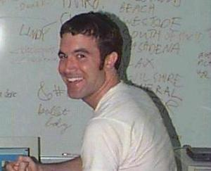
“If it was a cool thing to do online, you should be able to do it on MySpace.”
--Tom Anderson
Started in July of 2003
Tom Anderson, founder
Notes:
Started in July of 2003 by 29-year old Tom Anderson, MySpace.com began as a method for independent bands to enlarge their fan bases.
It has quickly transformed into a site providing profiles, blogs, instant messaging, music downloads, photo galleries, classifieds, chat rooms and user forums.
Immediately appealing to teens and college students because of its music, and multiple ways to communicate with friends, MySpace quickly became the premiere site for social networking.
"The idea,” says Anderson, “was that if it was a cool thing to do online, you should be able to do it on MySpace,“
(CLICK)

Slide 7
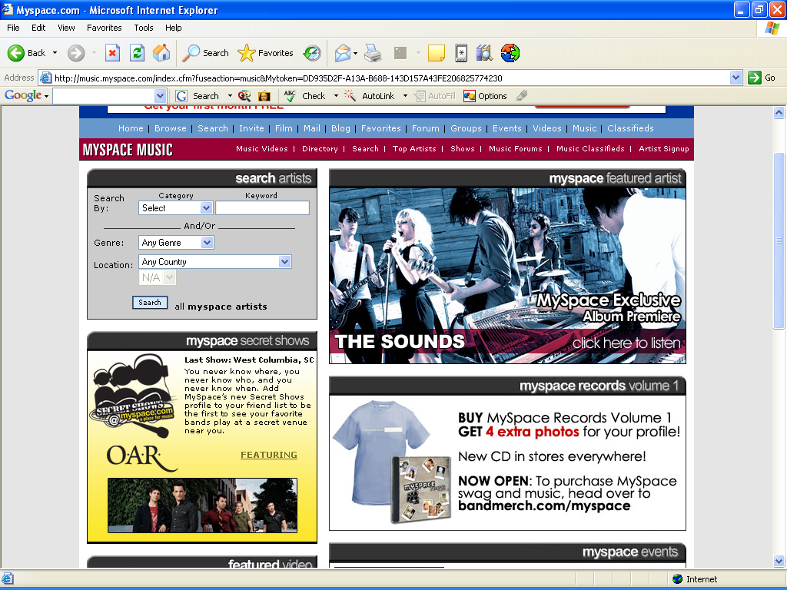
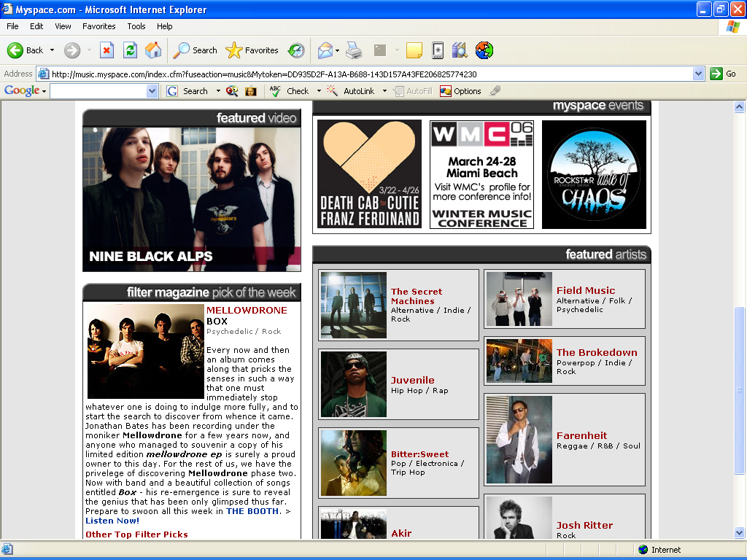
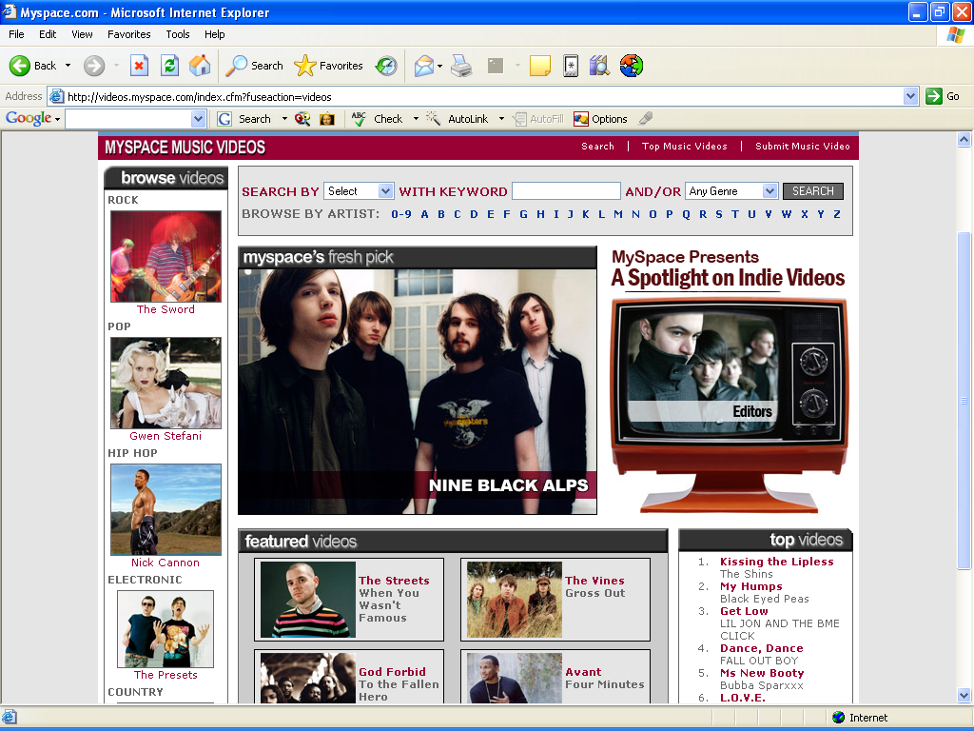
Notes:
MySpace Music is one of the site’s most prominent features. After all, MySpace began as a way for bands to hype themselves and reach their fan base.
Some say that MySpace has surpassed MTV in getting music out to the masses.
MySpace has been influential in the career of one of today’s biggest bands, Hawthorne Heights.
Through their MySpace page, Hawthorne Heights allows their fans to download their songs, view music videos, and send fan mail.
On tour, each band member spends four to five hours every day, answering fan messages and adding new friends.
Members of Hawthorne Heights say that when you respond to a message or comment, you’ve made a fan for life.
MySpace’s music feature has in fact become so popular that they’ve created their own independent record label, called MySpace Records.
Through MySpace, Hawthorne Heights has turned their fans into fanatics.
(CLICK)
(CLICK)

Slide 8
Blogs
Online diary or journal
“Blogosphere” is the collective term for all the blogs on the Internet
Many people use blogs—not just teens
Teens, however, make up for more than 50% of the blogs in the blogosphere
Notes:
Another popular feature of MySpace, in fact all social-networking sites is blogging, or posting a blog.
Blog…short for “Web Log”….online Diary or Journal….in these…teens write about anything they want.
Blogs aren’t just for teens.
It was in the blog “The Drudge Report,” authored by online journalist Matt Drudge, that the story of President Clinton and Monica Lewinsky first appeared.
Even though blogs have gotten a lot of mainstream attention…
Members of the blogosphere are very wary of mainstream media and companies who try to capitalize on the blogging community by trying to get them to buy or endorse a product.
This is because blogs and blogging is inherently counter culture. Bloggers fancy themselves modern day pamphleteers, getting their word to the masses.
The first bloggers were the ones who yearned to speak about their passions and interests, but lacked any form of traditional mass media to do so. The didn’t have a newspaper column, or their own radio or television show.
As strange as it sounds, given the worldwide population, the blogosphere is a very close-knit community—everyone looking out after each other.
Blogs are for everyone, but most of the blogs in the blogosphere are authored by teens.
In a study conducted by MSNBC, it was found that over 50 percent of all blogs are written by people under 18.
(CLICK)

Slide 9
Teen Blogs
A true online diary or journal
Self-Publicizing Generation
Bloggers get feedback from their friends on what they write
Teachers use blogs in the classroom
Notes:
The Teen Blogosphere is full of blogs that are truer to online diaries or journals. Think of everything that someone would write in a journal—what they did that day; random thoughts, poems, songs, short stories—all of it appears in teen blogs.
Now you might be asking yourself, “the things in journals are pretty personal. Why would you want that stuff on the Internet?”
It’s true, some of what’s written is awfully personal. And teens know that.
In a generation that has grown up watching The Real World, Road Rules, Survivor, and other reality shows that make celebrities out of regular people, just for being themselves…
publicizing yourself and everything about yourself for public consumption is completely natural to today’s teens.
Steven Johnston, author of Everything Bad is Good For You, says that this new generation sees the screen as something they project their identity onto, a place to work through the story of their lives as they unfold.
And in the words of one teenager, “It’s all just a way of putting myself out there.”
In fact, many teens write blogs and anxiously wait for their friends to respond. It gives them validation that what they’re feeling or going through isn’t unique; they have friends out there who are feeling and going through the same thing.
Teen blogs have been viewed largely as a good thing by educators. “At least they’re writing,” says one professor who has been studying youth blogs.
There are instances across the country of teachers using blogs in the classroom, to illicit student response. Oftentimes, a student who doesn’t feel comfortable sharing his or her opinions in front of the class will write a very detailed, poignant blog about the day’s lesson.
Teen Blogs can be healthy and positive, but still, blogging isn’t the most popular feature of MySpace.
(CLICK)

Slide 10
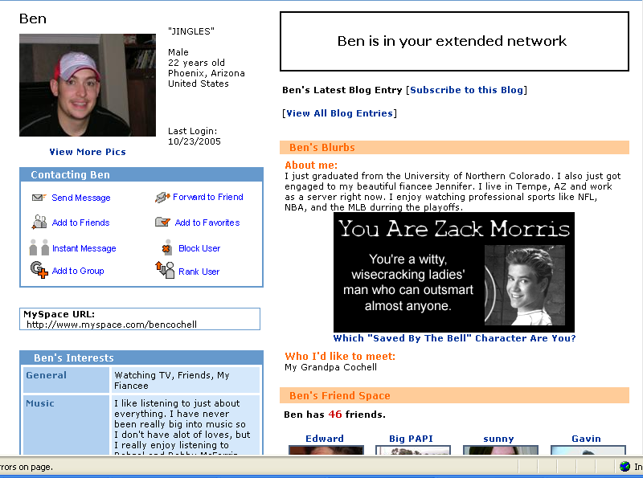
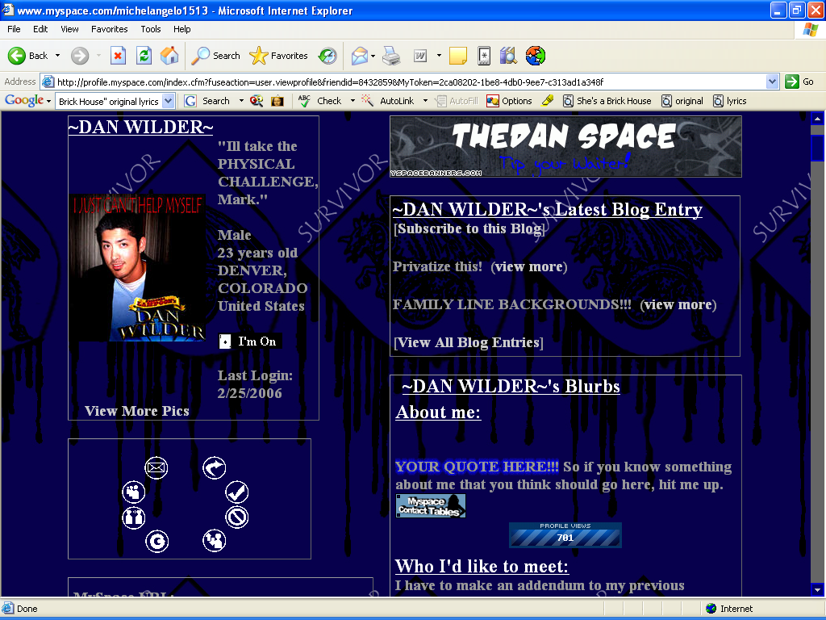
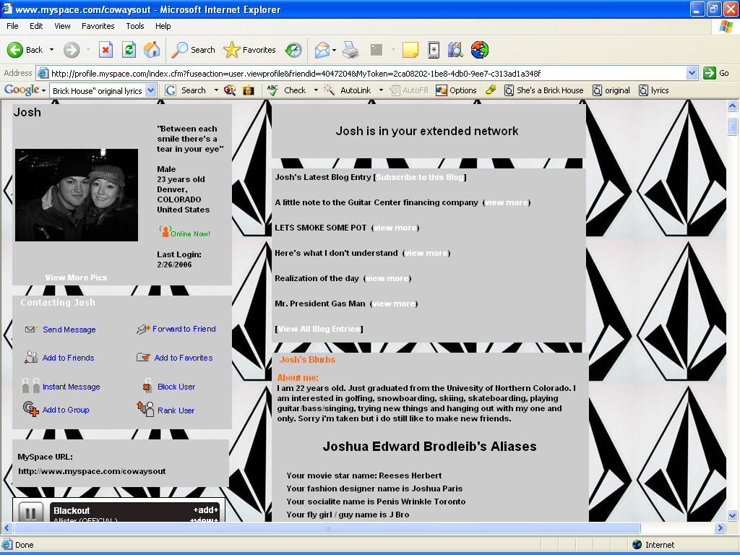
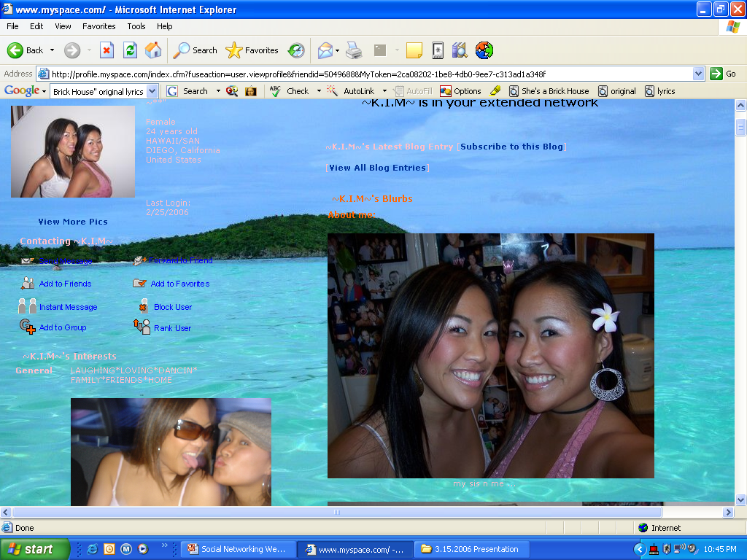
Notes:
The most popular feature of MySpace is being able to create your page.
Through MySpace, users can literally project their own personality on the Internet.
Your MySpace page is YOURS. It becomes a reflection of yourself.
From your homepage, you can show people what your hobbies and interests are, favorite movies, TV shows, books. You can even write an “About Me” blog, which is like a snapshot of who you are.
But in case you don’t want to write a snapshot, you can always just post one.
All social networking sites, allows users to post pictures of themselves as their Profile Pic.
And that’s where the controversy and the danger begins.
(CLICK)

Slide 11
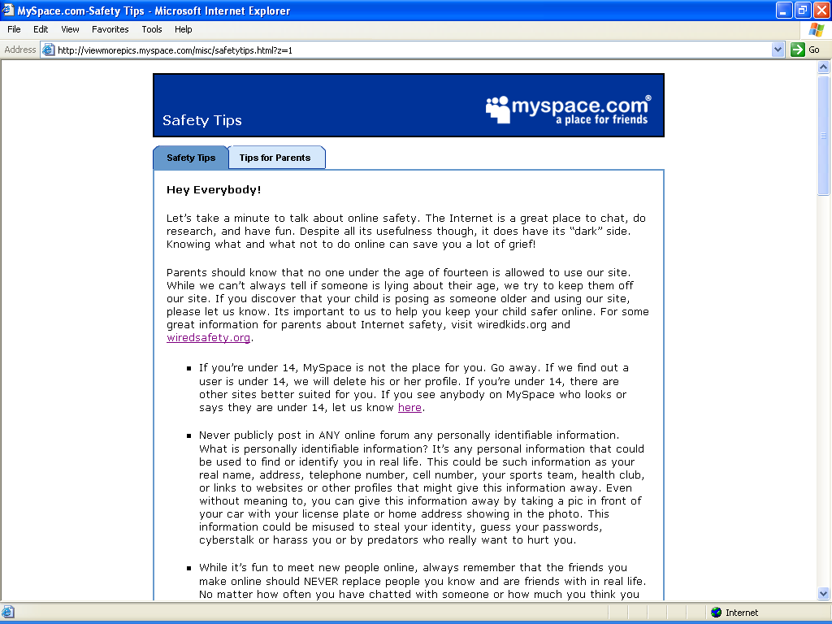
Notes:
Myspace.com is a place for music, trends, and friends. But only if you’re old enough.
MySpace.com restricts anyone under the age of 14 from joining, in fact they say so very clearly.
(CLICK)

Slide 12
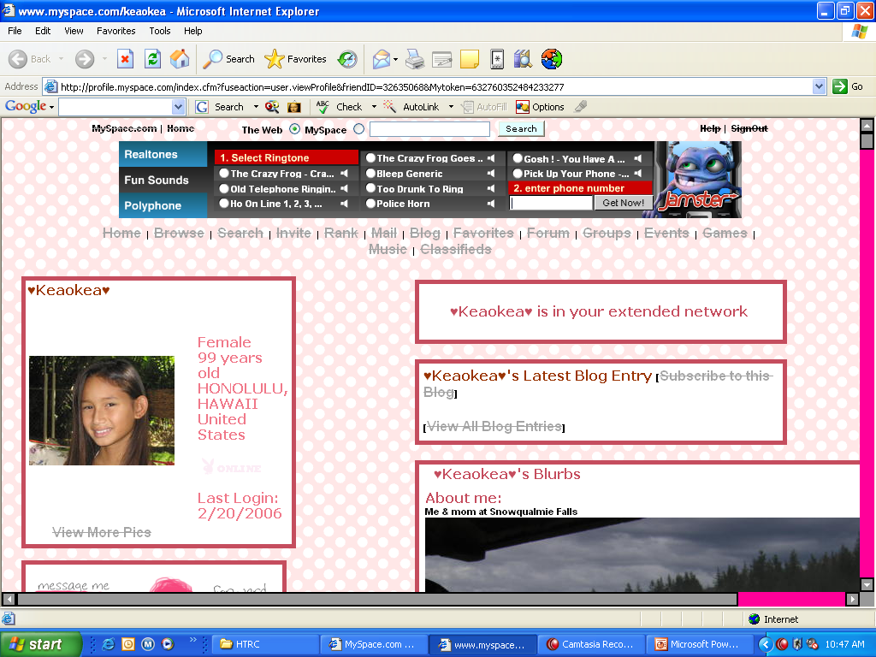
Notes:
But if you were to lie about your age, MySpace can’t stop you.
You’ll see here a page that’s pretty nice. Pretty background, pretty theme, the user even has hearts in her profile name. And her age is over 14. But 99?
Just by looking at her picture, you can clearly see that this girl is NOT 99 years old.
I wish I could say that this is an isolated instance, that you won’t find many people lying about their age to join MySpace. But this is VERY common.
In browsing through MySpace in just one hour, I found literally dozens of pages whose age says they’re 80 years old or older…but whose pictures show high school, middle school, and even elementary school children.
If you think this is dangerous because many children don’t often know how to navigate the Internet with safety, you’re absolutely right.
(CLICK)

Slide 13
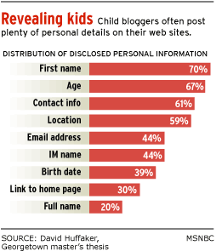
Many teens don’t know what information is okay to post on the Internet.
Notes:
A recent survey conducted by MSNBC found that 70 percent of children post their first name on their pages, 67 percent post their age, 61 percent post their contact information, and 59 percent post their actual location.
Let’s go back to that 99 year old girl’s page, to see if she knew what information was okay to post.
(CLICK)

Slide 14
CYBER-BULLYING
Cyber-bullying (online bullying) is the use of
electronic information and communication devices such as
e-mail, instant messaging, text messages, mobile phones,
pagers and defamatory websites to bully or otherwise
harass an individual or group through personal attacks or
other means, and it may constitute a computer crime.
Notes:
Too Much Information or Inappropriate Pictures aren’t the only dangers of MySpace, however. Cyber bullying also occurs.
Cyber bullying is online harassment, through e-mail, instant messaging, comments, or other forms of electronic communication.
Cyber bullies are not who you would expect them to be.
Technology leveling the playing field
The nerd is harassing the jock!
Because most cyber bulling is out of school, educators find themselves at a crossroad.
The acts of cyber bulling are bound only by the imagination of the aggressor and their access to technology
(Break for audience interaction)
Has anyone ever encountered being cyber bullied.
For more information on cyber bullying, check out Wiredsafety.org. They have created a new site called StopCyberbullying.org, which addresses harassment among children and teens.
(CLICK)

Slide 15
This presentation is provided by the New Communities Project, a collaborative USDA/Children, Youth, and Families At-Risk (CYFAR) project of the University of Hawaii-Manoa, College of Tropical Agriculture and Human Resources, Cooperative Extension Service, and Hawaii’s 4-H Youth Development Program.

Slide 16
Contact Information
Carol Ikeda: cikeda@hawaii.edu
Gavin T. Maeda: gtmaeda@hawaii.edu
Myla Gumayagay: gumayagay@hawaii.edu
Christine Hanakawa: chanakaw@hawaii.edu

Slide 18
Teens as Targets
66% were female, 34% were male
97% of offenders were people youth first met online
65% of incidents happened in chatrooms
24% in instant messages
Notes:
Females were targeted at twice the rate of males,
but it is important to know that males can be victims
of sexual solicitation on the Internet.
Virtually all offenders of sexual solicitations and
approaches were persons the teens originally met
online.
In 65% of incidents, teens met the person who
solicited them in a chatroom; in 24% of episodes
the meeting occurred through Instant Messages.

Slide 19
Online Relationships
You MAY NOT KNOW THE TRUTH about people you first “meet” online
You can be lied to or betrayed
Time does not equal trust or knowing the person
It can be a crime for an adult to have sex with a teenager
Notes:
If someone you met online wants to meet with you in
person, don't be flattered; be suspicious. Any person
worth having as a friend would try to keep themselves
safe too by being cautious about meeting in person
with you.
Depending on each state’s law, it can be a crime for
an adult to have sex with a teenager.

Slide 20
Warning Signs
If someone tries to:
Isolate you from family and friends
Turn you against your parents
Make you keep everything secret
Send inappropriate material or talk about explicit subjects
Threaten you
Notes:
If you find yourself spending too much time on the
computer, you may be getting caught up in something
that's not good for you. You should not neglect your
family, friends, or other activities that you enjoy.
Any person who cares about you would not turn you
against your parents or make you keep everything a
secret. This person also would not send things to you
that make you feel uncomfortable.

Slide 21
Risks of Meeting Offline
Assault
Disease
Pregnancy
Abduction
Death
Notes:
Meeting in person with someone you don't really know
is not worth the serious risks.
Kacie Rene Woody met David Fuller, the man who
killed her, in a chatroom. Her body, along with the
body of David Fuller, was found in a van at a storage
garage. Both suffered from gunshot wounds. Police
suspect that the girl had been sexually assaulted.1
On the evening of December 3, her brother reported
her missing after he had not heard from her in four
hours. Investigators searched Kacie's computer, found
an alias Fuller had been using, and then traced him to
a motel. From there they discovered that he had rented a van and left a telephone number with the
rental agency that matched a number on the Woody's home telephone records.2
Inside her home it appears 13-year-old Kacie fought for her life, because, along with signs of a struggle,
police found a chair propped against a door.3 When police found her broken eyeglasses and realized
that she left the house without shoes, they were led to believe that Kacie did not invite Fuller and wasn't
aware that he was coming.4 Authorities said that Fuller had struck up an Internet relationship with
Kacie and might have tricked her into believing he was a teenager. Police spent most of December 4
searching for Kacie. After receiving a tip, they went to a storage facility where they heard a gunshot.
Police believe the shot that was heard was Fuller committing suicide.5
Authorities believe Fuller may have kidnapped other children prior to allegedly abducting Kacie and
were doubtful that this was Fuller's first time."6 Investigators are still trying to figure out Fuller's
movements prior to his showing up at Kacie's home.
These types of incidents are rare, but you do need to be aware of how dangerous the Internet could be.

Slide 22
Click here for video
Notes:
If you give out any bit of personal information, it may
be easy for someone to find you.
As we watch "Tracking Teresa," notice how a seemingly
insignificant piece of information can reveal a lot to
someone with harmful intent.
Before the presentation, identify and meet with three
student body officers. Ask them each to tell you
something about themselves that few people at school
know about, such as a place they've visited, a skill they
have, an embarrassing moment they've had, or a
contest they've won. After hearing the three stories,
choose the best one. Explain to the students that each of them will tell the student body this fact or
experience and talk about it for about a minute as if this is true about themselves.
Invite the three student body officers to join you at the microphone. Tell the students they are going to
have to guess which person is telling the truth. Allow each student body officer to share the prearranged
story. Then, have the audience vote for who they think is telling the truth by raising their hands. Let
the student body officers reveal whether the audience guessed correctly.
Explain even though it might seem like they know someone well online, they have no way of knowing
whether the person is telling the truth. This is why they must not give personal information even to
someone they have communicated with online for a long time. Point out even though the students see
each other every day, not all of them were able to correctly guess which of their classmates was telling
the truth. How can they expect to know when someone they communicate with online is telling the truth?

Slide 23
You can’t take it back
Don’t send pictures of yourself or others, you can’t control what others do with them.
Why?
What is on the internet may be out there forever
Can be copied or changed
May be able to be traced by law enforcement
You can be prosecuted for sending out pornographic pictures of other teenagers
Notes:
Sending pornographic pictures of anyone under the
age of 18 is a violation of federal law — according to
statute 18 USC 2252.
You should not send or post your picture online. It
been said that a picture is worth a thousand words,
but on the Internet a picture is FOREVER. You have
to assume that any picture you post online is going
to be there forever and that you can't ever get it back.
Think about it — is the picture you want to send to
someone a picture that you would want everyone in
your school to see? How would you feel if that picture
was posted on a sleazy web site, or stuck in some weird person's wallet? Wouldn't that freak you out?
Think about what a chatroom really is. Imagine yourself at a party with about 500 people in a pitch
black room. You cannot see what anyone looks like and the voices are distorted that you can't even
tell if someone is male or female. Would you walk around at that party giving out your picture, phone
number or home address? Of course not.

Slide 24
You Can’t Take it Back
Click here for video

Slide 25
Internet Safety Resources
http://www.cyfernet.org/cyfar06/complabFiles/MySpace,%20Your%20Space,%20Out%20of%20Space.ppt This is the link to the complete presentation by CYFAR
http://www.netsmartz.org/
Web Wise Kids http://www.wiredwithwisdom.org/

Slide 26
These presentations were modified for Extension use by:
The 2006 Urban Initiative Technology Committee with special thanks to:
Cheryl Varnadoe
Extension 4-H Specialist
Your 2006 Committee members:
Leonard Anderson
Willie Chance
Don Gardner
Todd Hurt
Lisa Jordan
Charles Phillips
Mark Zeigler

