Slide 1
Microbiological Examination of Water
January 17, 2007
Dr. Paul F. Vendrell

Slide 2
Agenda
Water-borne diseases
Pathogen indicators
Coliform
Streptococcus
Enterococcus
Enumeration Methods
Membrane filter
Multiple tube fermentation
Surface Water Standards
How much water can wild birds contaminate?
Survival and Transport

Slide 3
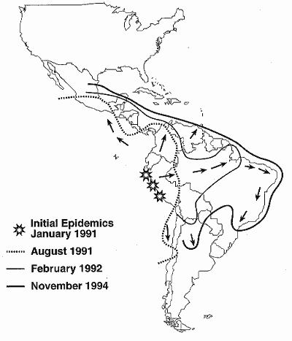
Water borne pathogens
1991 Cholera Epidemic 1,000,000 cases/10,000 deaths
Bacteria
Virus
Protozoa
Helmiths
Spirochete
Rickettsia
Algae

Slide 4
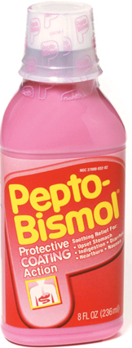
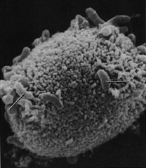
Bacteria
Enteritis, diarrhea, and dysentery
Campylobacter
Cholera
E. coli 0157:H
Salmonella
Shigella
Enteric fever
Typhoid
Paratyphoid
Paralysis
Botulism

Slide 5
Bacteria…….continued
Eye, ear, and skin infections
Miscellaneous bacteria
Urinary tract infections
E. coli
Others

Slide 6
Viruses
Enteritis, diarrhea, and dysentery
Rotavirus
Norwalk
Flu like (liver damage)
Hepatitis A
Hepatitis E
Paralysis
Polio

Slide 7
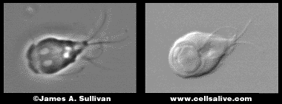
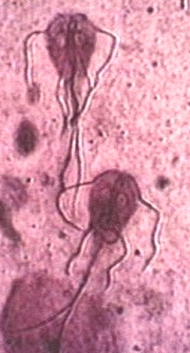
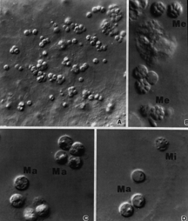
Protozoa
Giardia
Cryptosporidia
Amoeba

Slide 8
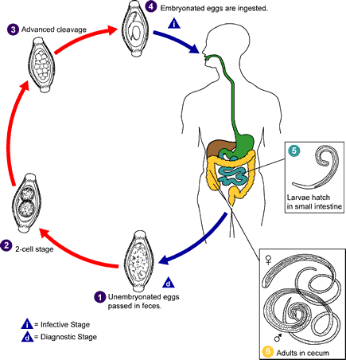
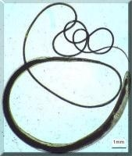
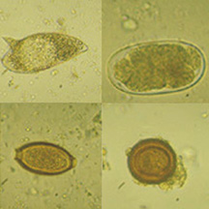
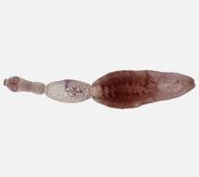
Helmith
Round worm
Tape worm
Hook worm
Whip worm

Slide 9
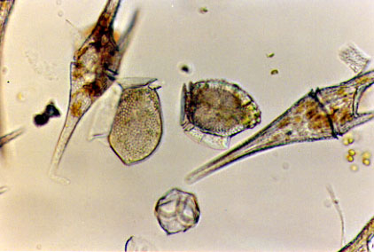
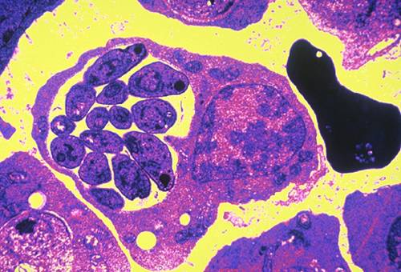
Others…..
Algae
Mycrocystis
Dinoflaggelates
Fungi
Water-related diseases
Malaria
Schistosomiasis
Yellow fever
Dengue fever

Slide 10
Problems
Numerous water borne pathogens
Individual pathogen numbers may be too low to detect in a reasonable sized water sample
Isolation and detection of some pathogens can take several days, weeks, or months
Absence of one particular pathogen does not rule out the presence of another

Slide 11
Indicator Organism Concept
Correlated to the presence of pathogens
Population large enough to isolate in small water samples (100 mL)
Rapid
Inexpensive
Safety, not culturing pathogens

Slide 12
Coliform Group (total coliform)
Enterobacteriaceae
Facultative anaerobe
Gram negative
Non-spore forming
Rod shaped
Ferment lactose
Produce gas and acid within 48 h @ 35 C
Coliform genera
Enterobacter
Klebsiella
Citrobacter
Escherichia

Slide 13
Coliform Group
Total coliform
Fecal coliform
All total coliform criteria
Grows at 44.5 C
Escherichia coli
Individual species
Enzyme specific
total coliform
fecal coliform
E. coli

Slide 14
Streptococcus and Enterococcus
Fecal Strep
S. faecalis
S. faecium
S. avium
S. bovis
S. equinus
S. gallinarum
Enterococcus
Fecal Streps that survive in 6.5% sodium chloride
S. faecalis
S. faecium
S. avium
S. gallinarum

Slide 15
Membrane Filter Methods
Filter water through a 0.45 μM membrane filter
Place membrane on selective media
Incubate
35 C total coliform
44.5 C fecal coliform
Count colonies

Slide 16
Multiple Tube Fermentation Methods
Serial dilution to extinction
Inoculate multiple tubes (5 or 10) of media with across the increasing series of dilutions
Incubate
35 C or
44.5 C
Count positive growth tubes
Use Most-Probable-Number (MPN) table to estimate density

Slide 17
Enzyme Substrate or Chromogenic Substrate Method
Used with the Presence-Absence, the Multiple Tube Methods, or Quanti-TraysTM
Total coliform have the enzyme
β-D-galactosidase which hydrolyses
ortho-nitrophenyl- β-D-galactopyranoside (ONPG)
Yellow when hydrolyzed
E. coli has the enzyme
β-glucuronidase which hydrolyses
4-methylumbelliferyl-β-glucuronide (MUG)
Fluoresces when hydrolyzed

Slide 18
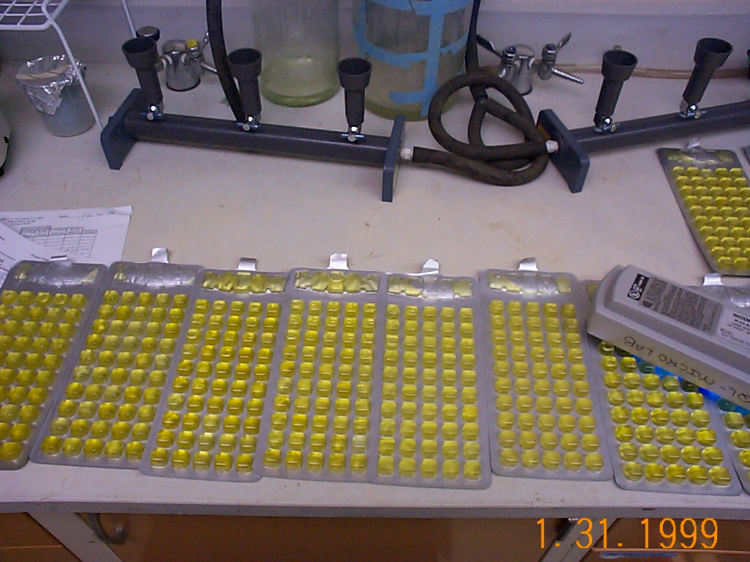
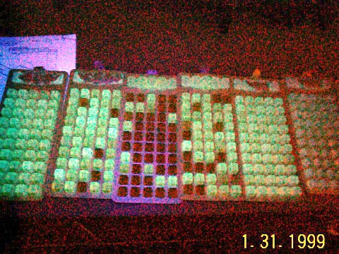
ONPG-Total Coliform
MUG- E. coli

Slide 19
Georgia EPD Fecal Coliform Standard for Water Contact Activities
Geometric mean (GM)
GM= (Y₁ * Y₂ * Y₃ * Y₄)^{1/4}
At least 4 samples
Over a 30-day period
At least 24 hours apart

Slide 20
Fishing and Drinking--Fecal Coliform Standards…cont.
May thru October
GM not to exceed 200 MPN/100-ml
No individual samples exceeding 4,000 MPN/100-ml
November thru April
GM not exceeding 1,000 MPN/100-ml
No individual sample exceeding 4,000 MPN/100-ml

Slide 21
EPAs E. coli Criteria
Illness Rate/1000 | Geometric Mean/100mL | Single Sample/100mL
8 | 126 | 235
9 | 206 | 300
10 | 206 | 383
11 | 263 | 490
12 | 336 | 626
13 | 429 | 799
14 | 548 | 1021

Slide 22
Look-out for that DIRTY-BIRD!!!
Gulls
Geese

Slide 23
Worse Case Gull and Goose Dropping
 | Dropping Weight (wet-g) | Fecal Coliform (CFU/wet-g) | Fecal Coliform Load (CFU)
Ring-Billed Gull | o.54 | 1.52 x 10⁹ | 8.21 x 10⁸
Canada Goose | 9.98 | 2.42 x 10⁷ | 2.41 x 10⁸
From: Alderisio, K. A. and N. DeLuca. 1999. Seasonal enumeration of fecal coliform bacteria from feces of ring-billed gulls (Larus delawarensis) and Canada Geese (Branta canadesis). App. Environ. Microbiology. p. 5628-5630.

Slide 24
How much water could one Gull dropping increase to 200 MPN/100 ml?
Gull
8.21 x 10⁸ Fecal Coliform/dropping
4.105 x 10⁵ liters
1.084 x 10⁵ gallons
3.99 acre inches
1.45 x 10⁴ feet³

Slide 25
How much water could one Goose dropping increase to 200 MPN/100 ml?
Goose
2.41 x 10⁸ Fecal Coliform/defecation
1.205 x 10⁵ liters
3.183 x 10⁴ gallons
1.17 acre inches

Slide 26
10 geese defecating during a day of feeding 123 acre feet @ 200/100mL

Slide 27
100 gulls defecating one time 33 acre feet @ 200/100 mL

Slide 28
Factors that determine the fecal coliform concentration in water
Survival/Die-off
Source
Transport

Slide 29
Factors Affecting Bacterial Survival/Die-off
Drying
Temperature
pH
uV Radiation
Competition
Predation
Toxic substance

Slide 30
Factors Effecting Transport
Precipitation
Slope
Runoff
Soil type
Surface features
Deposition proximity to water
Relationship with sediment

