Slide 1
Managing Soil Compaction in Turfgrass
Clint Waltz, Ph.D.
Extension Specialist
C&SS, University of Georgia

Slide 2
Soil Compaction
Generally the most common problem on sports facilities and is a natural result from field use and maintenance.

Slide 3
Soil Compaction
Reduces Pore Space
Limits Air, Water, & Nutrient Movement (Infiltration, Percolation)
Increases Water Runoff
Thins Turf
Increases Weed Growth

Slide 4
Soil Compaction
Increases Bulk Density
Increases CO₂ Levels
Reduced Turf Quality
Reduces Field Resilience
Increases Risk of Injury

Slide 5
Soil Compaction
Soil
Texture
Pressure
Applied
Water
Content

Slide 6
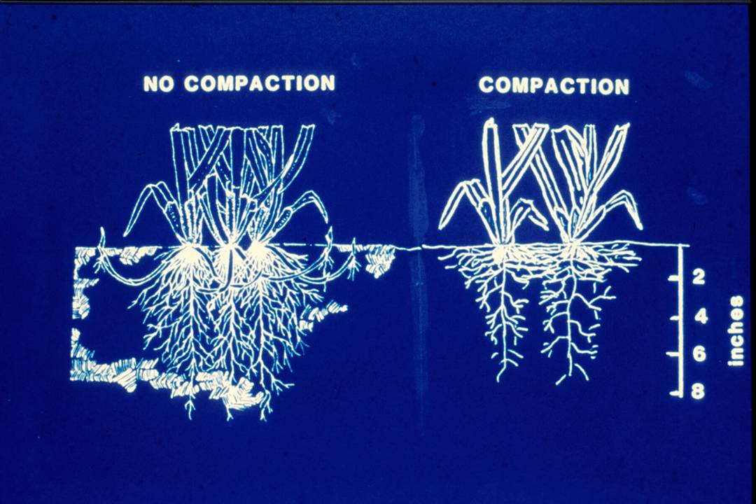

Slide 7
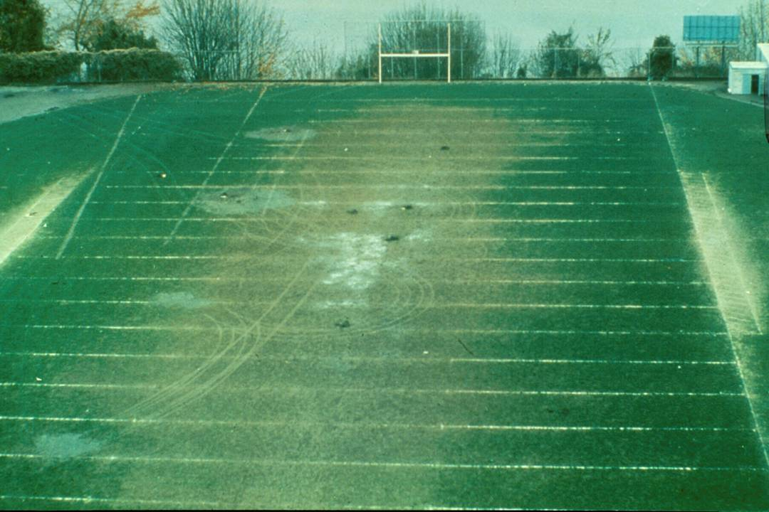

Slide 8
Aeration
The process of improving soil air exchange enhancing water and nutrient penetration into the soil, and reducing soil compaction.

Slide 9
Factors Influencing Aeration
Frequency & Intensity of Field Use
Soil Texture & Structure
Soil Moisture at the Time of Use
Turfgrass Cover
Turfgrass Species/Cultivar

Slide 10
Soil Properties
Physical
Chemical
Biological
Climate
Temperature
Moisture
Light
Wind
Gases
Management
Mowing
Fertilization
Irrigation
Pesticides

Slide 11
Benefits of Aerification
Relieve soil compaction
Aid in thatch control
Improve soil air exchange
Enhance water & nutrient penetration
Disrupt undesired soil layer
Aid in modifying soil with topdressing
Enhance water & nutrient uptake

Slide 12
Benefits of Aerification
Increase pesticide effectiveness
Reduce runoff & puddling
Increase soil temperature
Reduce effects of localized dry spots
Reduce surface hardness
Stimulate new growth
Improve heat & drought tolerance

Slide 13
Drawbacks to Aerification
Turf injury increasing potential for turf loss during stress
Disruption of the turf surface
Increased insect problems
Increase desiccation and/or injury
Reduced soil strength
Creation of a localized soil compaction zone
Greater potential for water loss

Slide 14
Principles of Aerification
Step One:
Identify Problem Correctly
Step Two:
Determine most effective means of alleviating problem

Slide 15
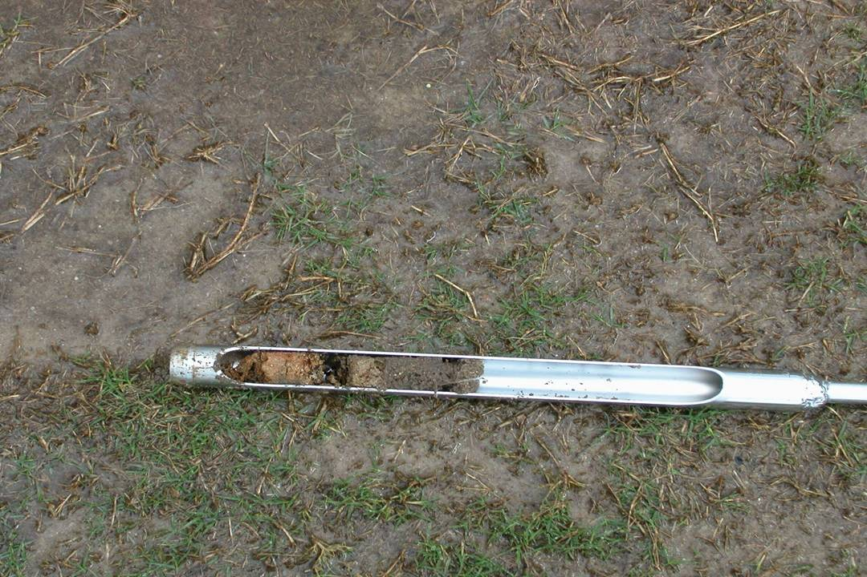

Slide 16
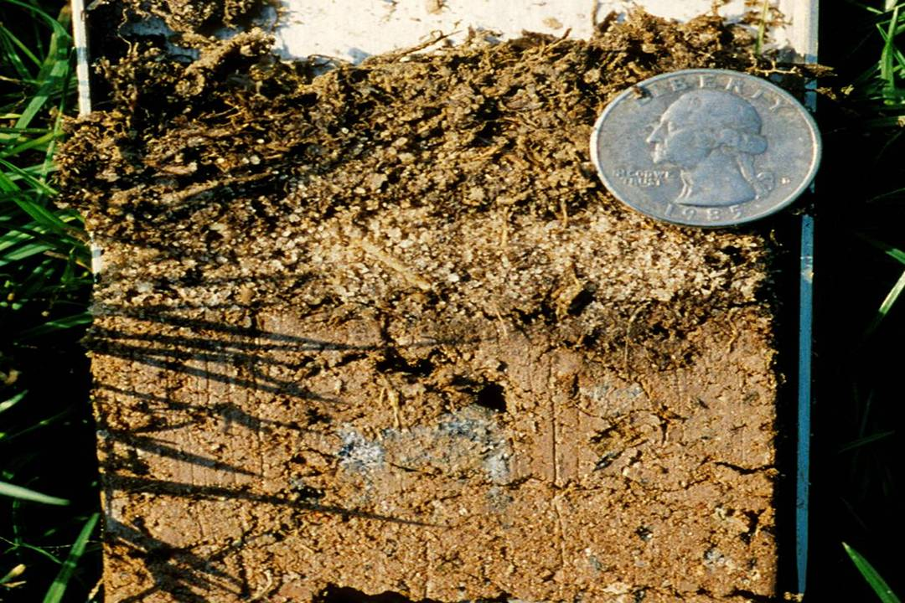

Slide 17
Aeration Methods
Core
Solid Tine
Deep Time
Deep Drilling
Grooving
Slicing
Spiking
Sub-Aerification
High pressure water/air injection

Slide 18
Penetration Factors
Soil Type
Soil Moisture
Tine Diameter
Weight & Power of Aerator

Slide 19
Scheduling Factors
Considerations
Location
Species/Cultivar
Intensity of Use
Timing - prior to or during early season root growth

Slide 20
Timing Factors
Stage of plant growth
Effect on playing surface
Scheduling
Remember:
The larger the space (core hole) the longer the growing period needed for recovery

Slide 21
Scheduling Factors
Caution:
Avoid coring if possible when grasses are dormant because this may encourage cool-season weed competition.
Remember:
Repeated aeration to the same depth can cause a “Cultivation Pan”.

Slide 22
Cultivation Time Frames
Cool-season
Mid Spring
To
Late Fall
Warm-season
Early Spring
To
Mid Summer

Slide 23
Core Aeration
One of the most important management practices for maintaining high quality playing fields, and often one of the least appreciated or used practices.

Slide 24
Tine Types
Type Action
Hollow Removes
Open/Spoon Divots
Solid Lifts, Cracks, & Shatters

Slide 25
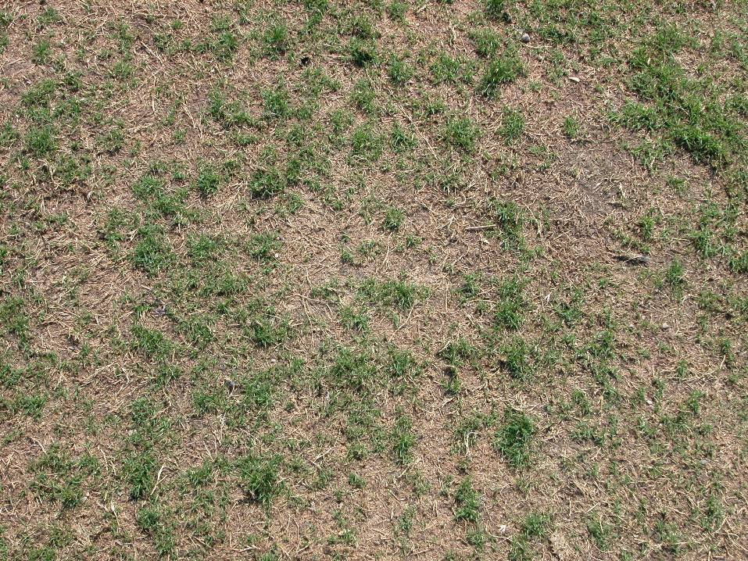

Slide 26
Core Surface Area Calculations
Tine Diameter = 1 inch
Tine Radius = 1 in. / 2 = 0.5 inch
1 inch
Area of Spacing = 5 in x 5 in = 25 inch2
5 inch
Area of Core = πr2
Area of Core = 3.141*(0.5 in)2
Area of Core = 3.141*0.25 in2
Area of Core = 0.785 in2
5 inch
Surface Area Affected = Area of Core/Area of Spacing
Surface Area Affected = 0.785 in2 / 25 in2
Surface Area Affected = 0.031 in2 or 3.1%

Slide 27
Tine Spacing: 5x5 inches
Tine Size Diameter (in.) | Spacing (in.) | # of Holes / sq. ft. | Surface Area Impacted / tine (sq. in.) | Surface Area Impacted (%) | # of Passes to remove 20%
1/2 | 5x5 | 5.76 | 0.196 | 0.79% | 25.5
3/4 | 5x5 | 5.76 | 0.442 | 1.77% | 11.3
1 | 5x5 | 5.76 | 0.785 | 3.14% | 6.4

Slide 28
Tine Spacing: 5/8 inch
Tine Size Diameter (in.) | Spacing (in.) | # of Holes / sq. ft. | Surface Area Impacted / tine (sq. in.) | Surface Area Impacted (%) | # of Passes to remove 20%
5/8 | 4x4 | 9 | 0.307 | 1.92% | 10.4
5/8 | 5x5 | 5.76 | 0.307 | 1.23% | 16.3
5/8 | 6x6 | 4 | 0.307 | 0.85% | 23.5

Slide 29
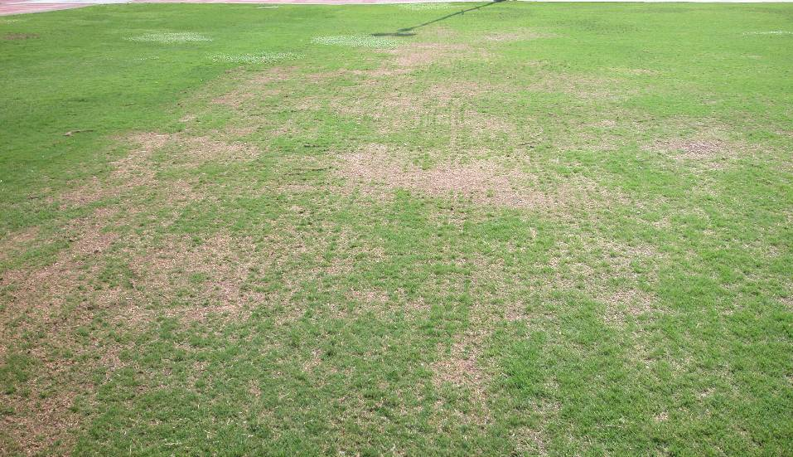

Slide 30
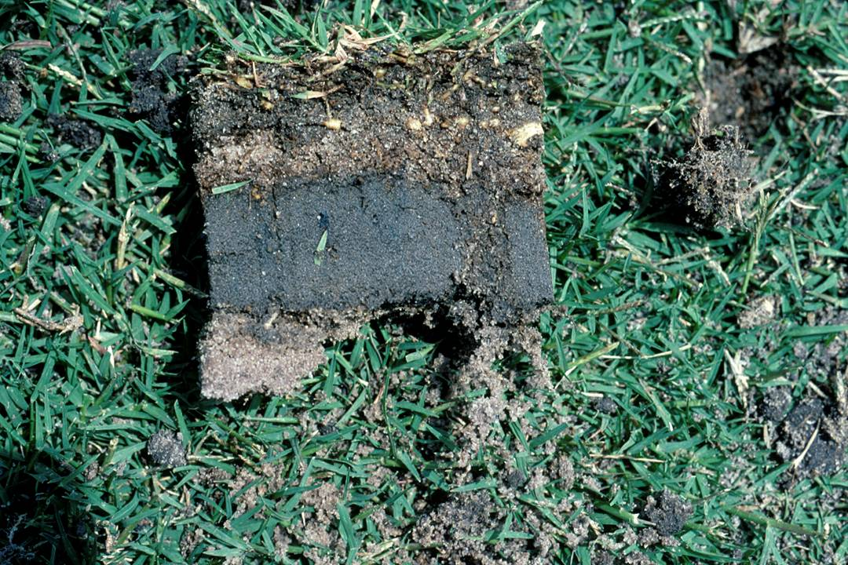

Slide 31
Best Practices
6 in. Spacing with 1 in. Tines
3 Passes in Differing Directions
Twice a Year (Spring & Fall)
Water 12 to 24 hours Before
Removing Cores
Top-dress with Sand

Slide 32
Topdressing

Slide 33
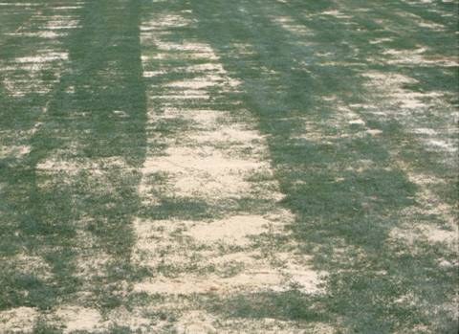
Topdressing: Sand
Keep pores open
Helps with thatch

Slide 34
Slicing / Spiking

Slide 35
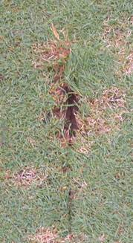
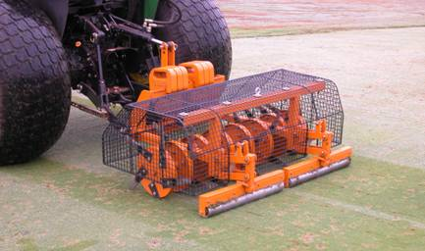
Slicing / Spiking
Forgotten practice
Often as possible
Opens the soil

Slide 36
High Pressure Injection

Slide 37
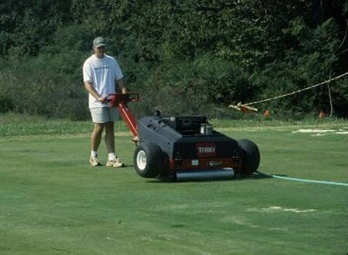
High Pressure Injection
Minimal surface disruption
Often as possible
Opens the soil

Slide 38
Important Dates in 2004
North Georgia Field Day
Gainesville - May 19, 2004
Turf Field Day
Griffin – August 12, 2004
Turfgrass Institute
Duluth – December 7 - 8

Slide 39
Thank You
Visit
WWW.Georgiaturf.com
and
WWW.Turfgrasswater.com

Slide 40
Renovation
and Management of Sports Turf Fields

Slide 41
Challenge of Sports Turf Managers
Provide a field with beautiful green grass that is almost always playable and safe under heavy field usage (abuse)

Slide 42
Budget plays a vital role in the degree of success and determines one’s expectations

Slide 43
Sports Turf Field Success Formula
Limited Usage
Proper design and construction
Vigorous
maintenance
Water management

Slide 44
Regulating Field Use

Slide 45
Usage Maxims (200-400-600 Rule)
Generally advise that a field not be used in excess of 200 hours per year in order to sustain good field conditions
Under some circumstances, fields have successfully handled between 400 to 600 hours of use per year with good field conditions
Beyond 600 hours, you are expecting miracles and will be playing on dirt
Notes:
After a few years, some general guidelines I use related to field use (and overuse). I often get the question . . . “how much can my field be used”.

Slide 46
Overseeding WEAKENS the permanent turfgrass and will delay its green-up and growth in the spring

Slide 47
Overseeding Turfgrass Selection
Annual Ryegrass
Intermediate Ryegrass
Perennial Ryegrass

Slide 48
Renovation ?

Slide 49
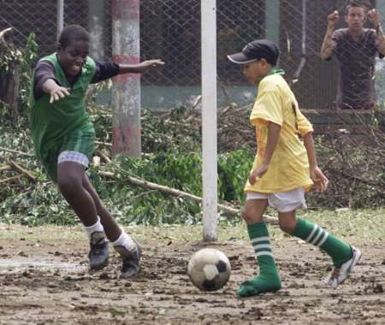
Is this field safe?
Is your field safe?
Notes:
Good slide of field worn to the dirt.

