Slide 1
Managing High Traffic Areas
Gil Landry
Center for Urban Ag.
UGA - Griffin

Slide 2
Soil Properties
Physical
Chemical
Biological
Climate
Temperature
Moisture
Light
Wind
Gases
Man
Use of the turf
Management practices
Mowing
Fertilization
Irrigation
Pesticides

Slide 3

THE END

Slide 4
Soil Properties
Physical
Chemical
Biological
Climate
Temperature
Moisture
Light
Wind
Gases
Man
Use of the turf
Management practices
Mowing
Fertilization
Irrigation
Pesticides

Slide 5
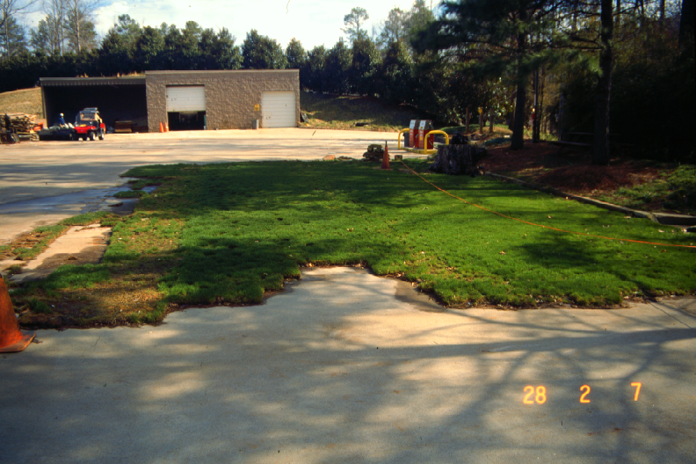
Sod on Concrete

Slide 6
Turfgrass Symptoms of
Soil Compaction
Shallow roots
Shoot growth declines
Tiller, rhizome, stolon, and leaf growth size, volume and number decline
Grass density thins

Slide 7
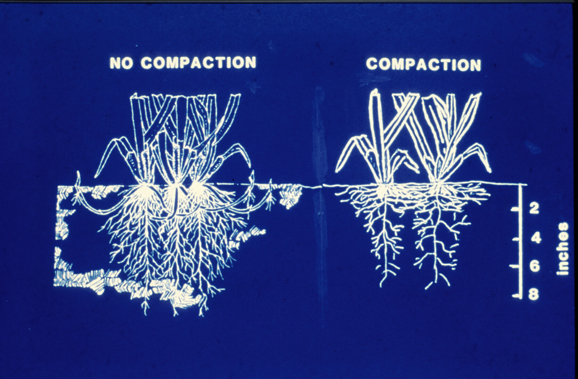
Turfgrass Symptoms of
Soil Compaction
Shallow roots

Slide 8
Turfgrass Symptoms of
Soil Compaction
Shallow roots
Shoot growth declines
Tiller, rhizome, stolon, and leaf growth size, volume and number decline
Grass density thins

Slide 9
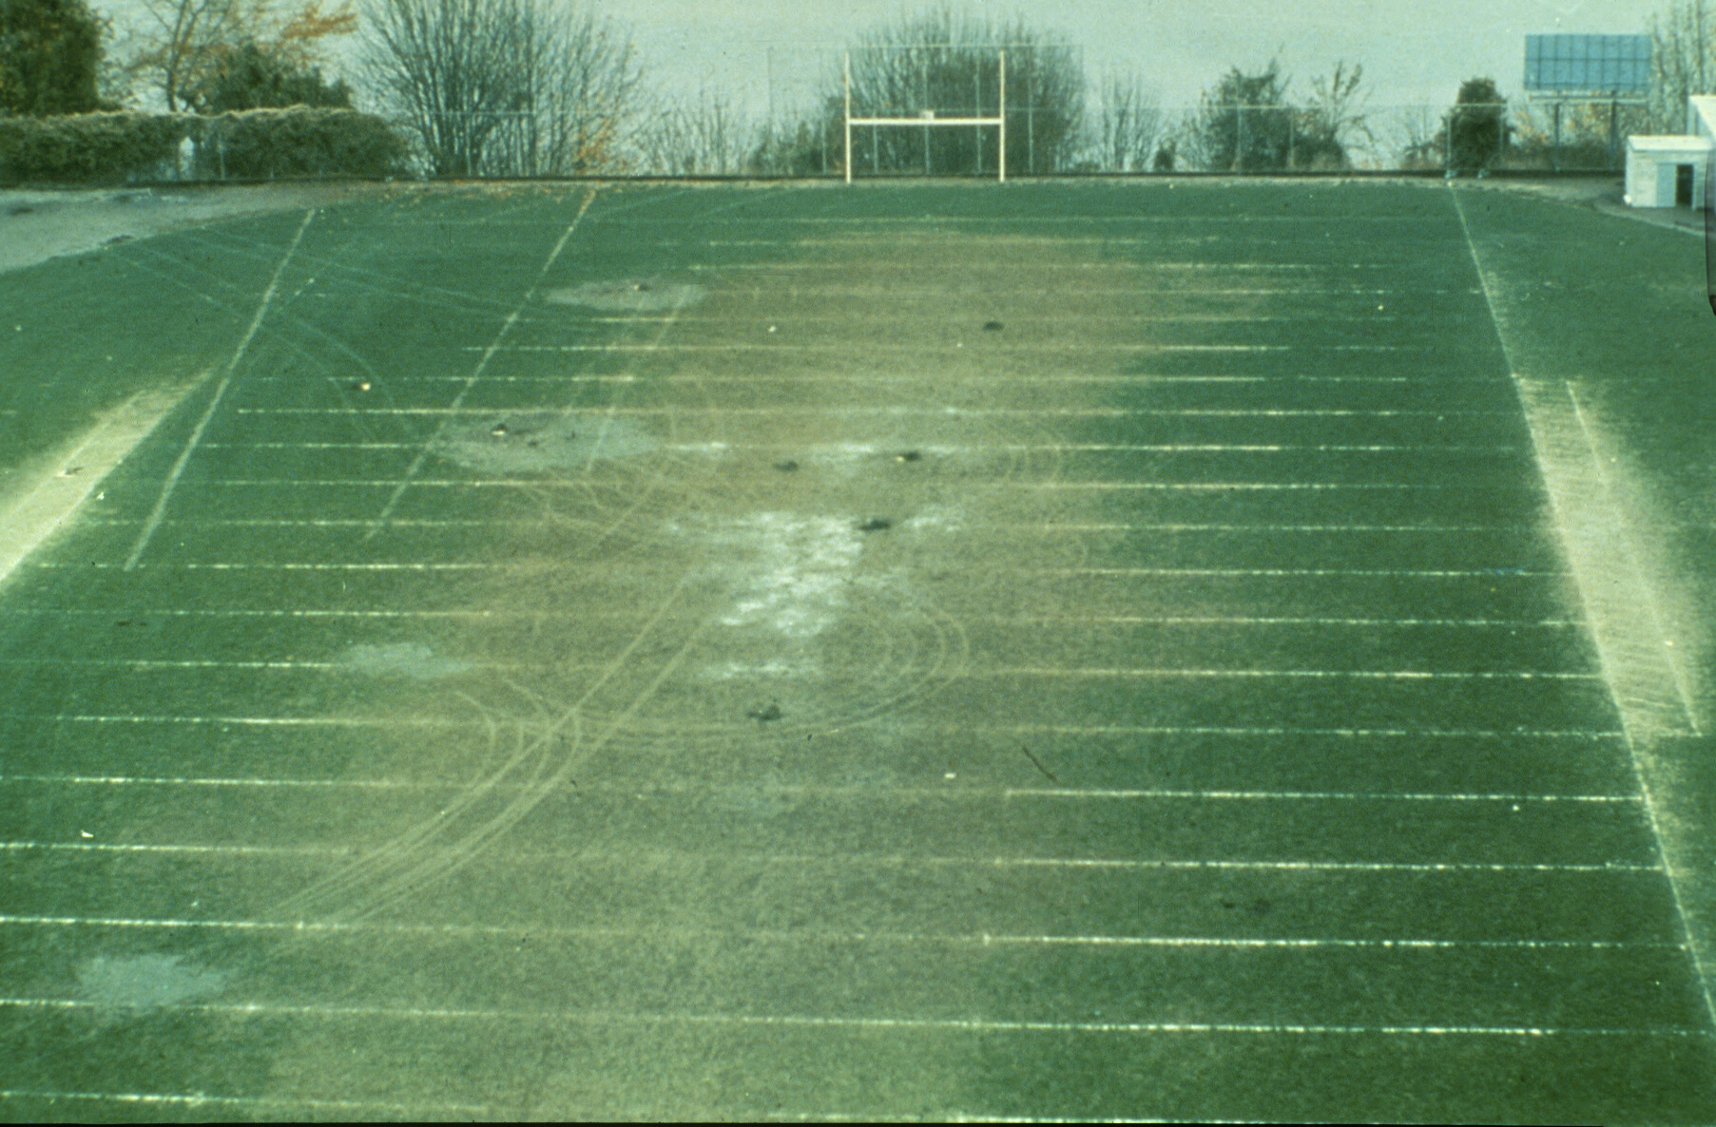

Slide 10
Turfgrass Symptoms of
Soil Compaction
Shallow roots
Shoot growth declines
Tiller, rhizome, stolon, and leaf growth size, volume and number decline
Grass density thins
Turf invaded by Compaction-adapted weeds

Slide 11
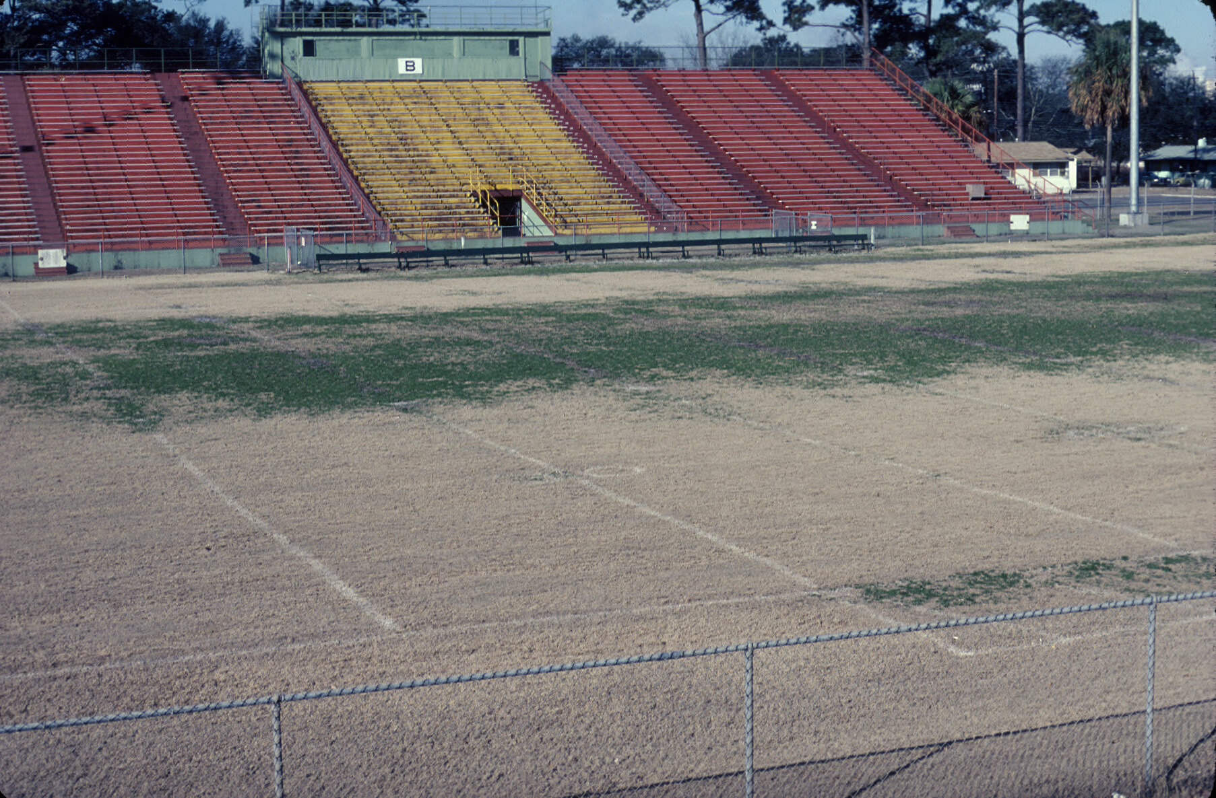

Slide 12
Turfgrass Symptoms of
Soil Compaction
Shallow roots
Shoot growth declines
Tiller, rhizome, stolon, and leaf growth size, volume and number decline
Grass density thins
Turf invaded by Compaction-adapted weeds
Infiltration decreases, Runoff increases

Slide 13
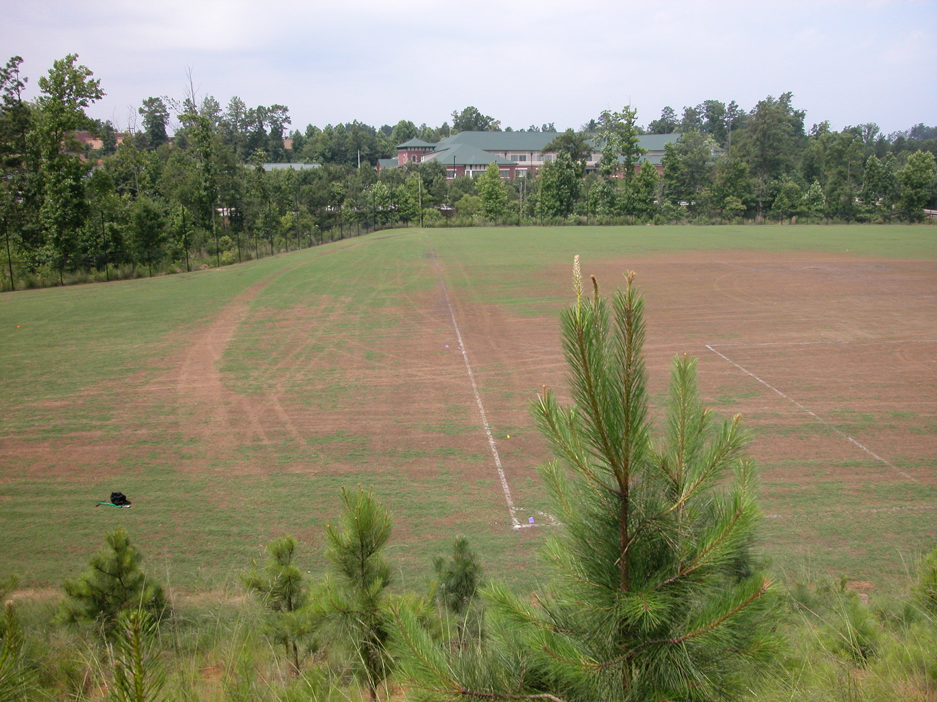
Prevention & Correction of Soil Compaction
Avoid repeated traffic over the same site

Slide 14
Prevention & Correction of Soil Compaction
Avoid repeated traffic over the same site
Increase mowing height where traffic is unavoidable

Slide 15
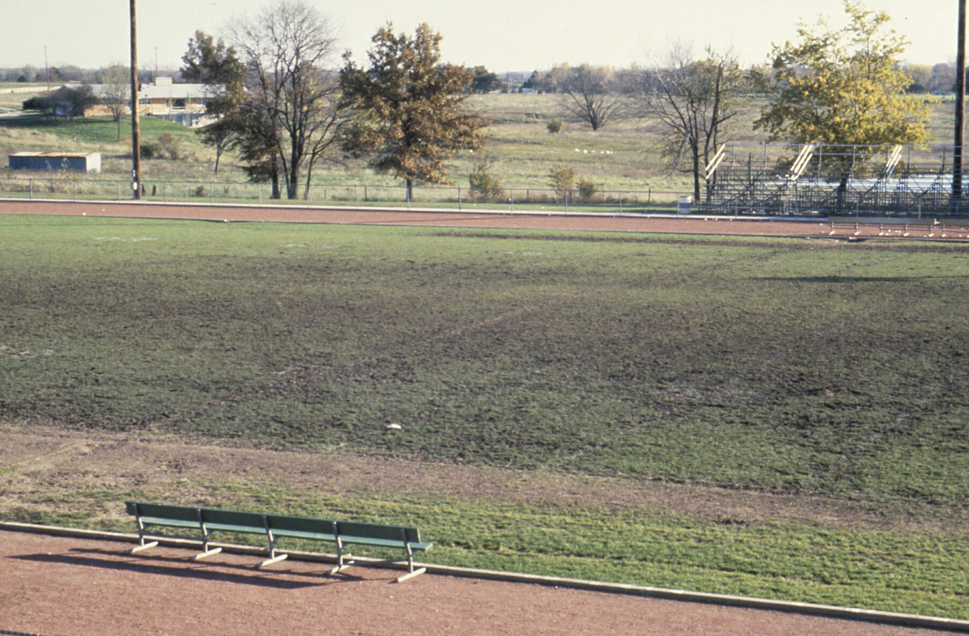
Prevention & Correction of Soil Compaction
Minimize traffic when soil is wet or near field capacity

Slide 16
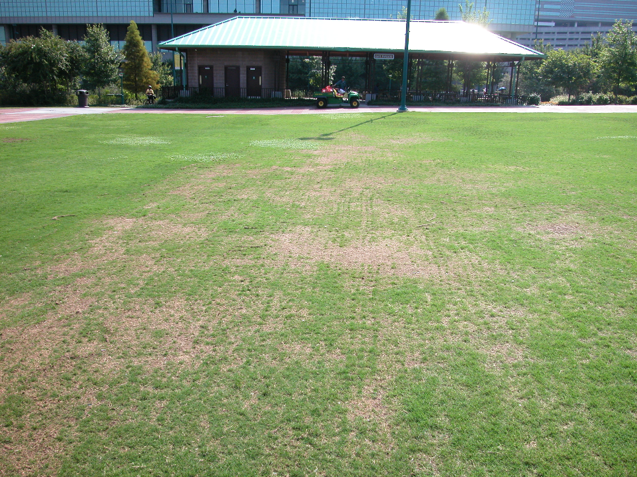

Slide 17
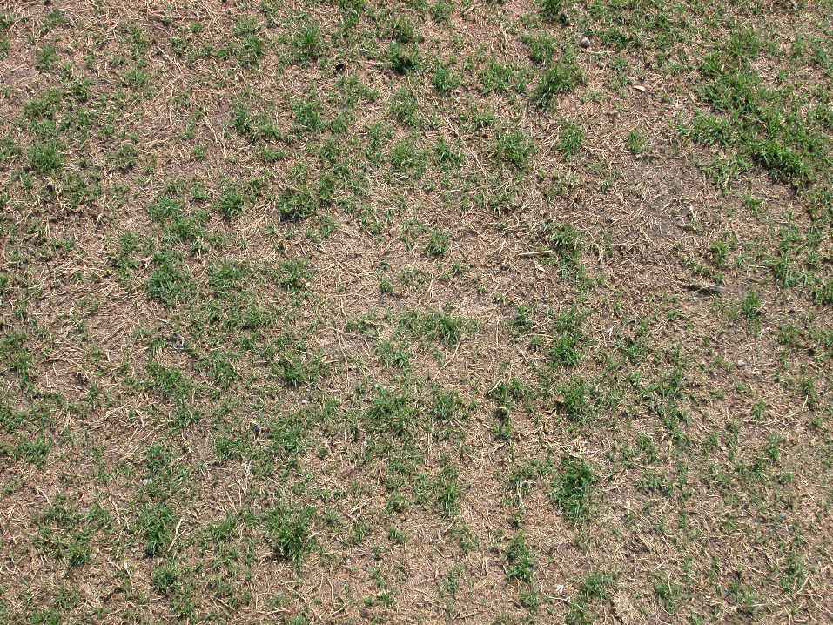

Slide 18
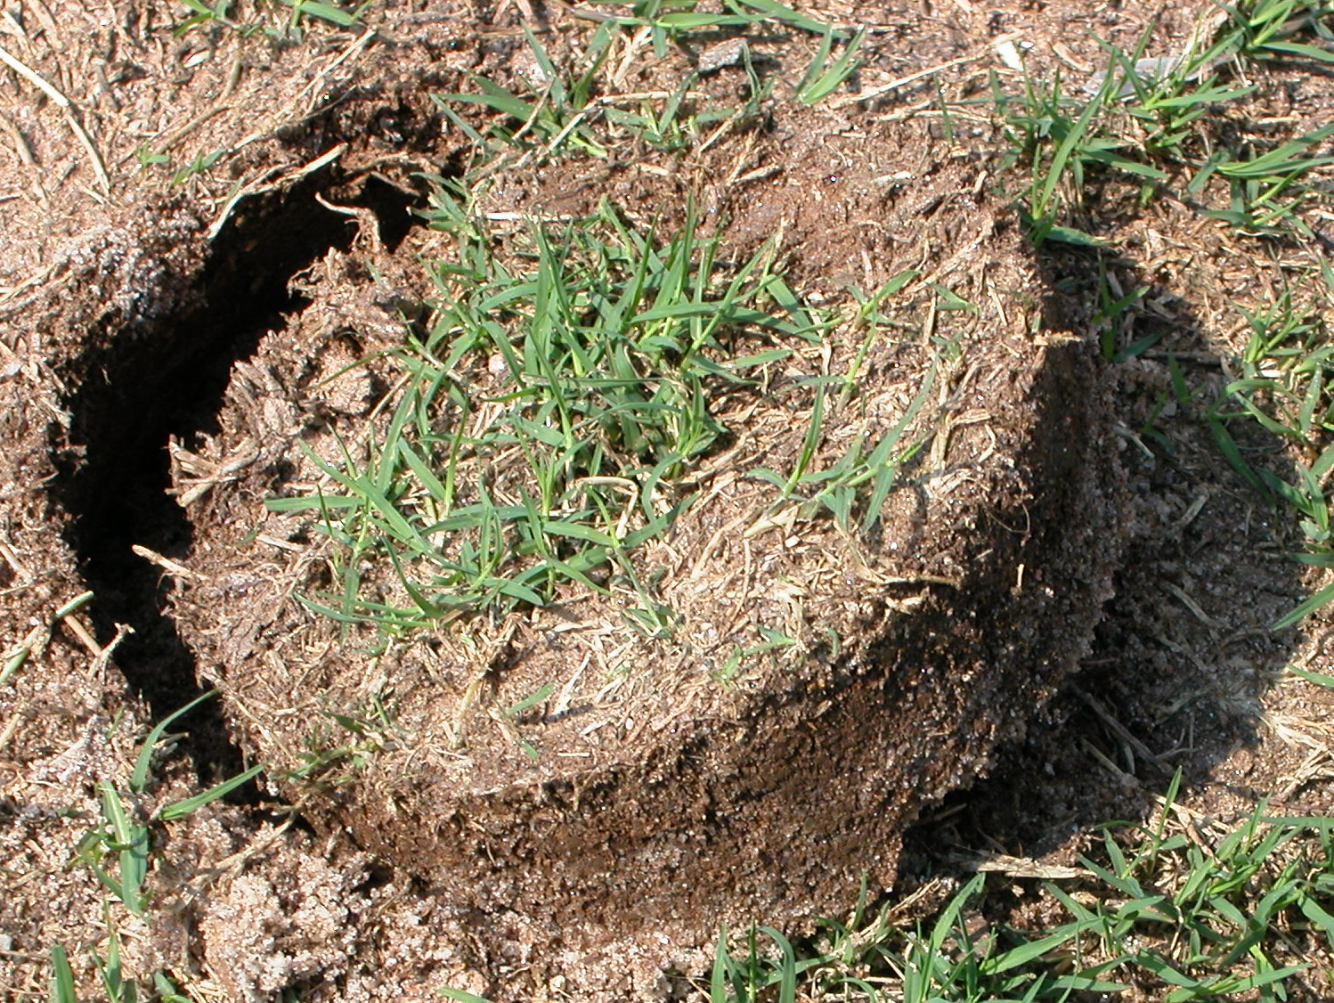

Slide 19
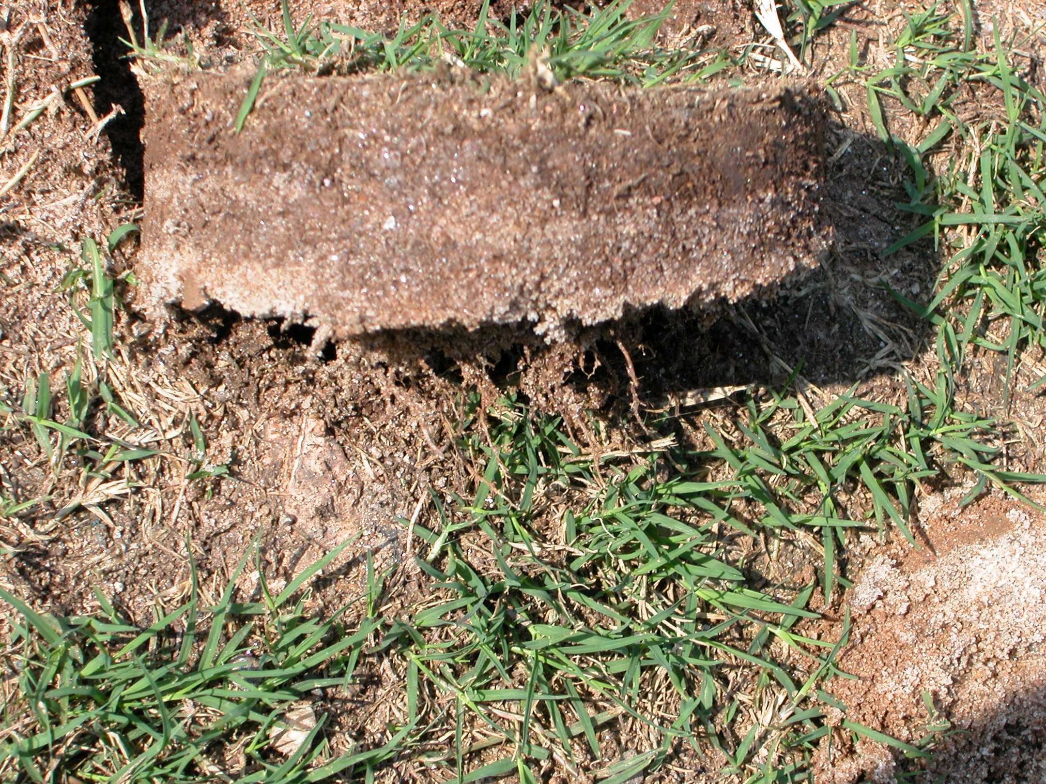

Slide 20
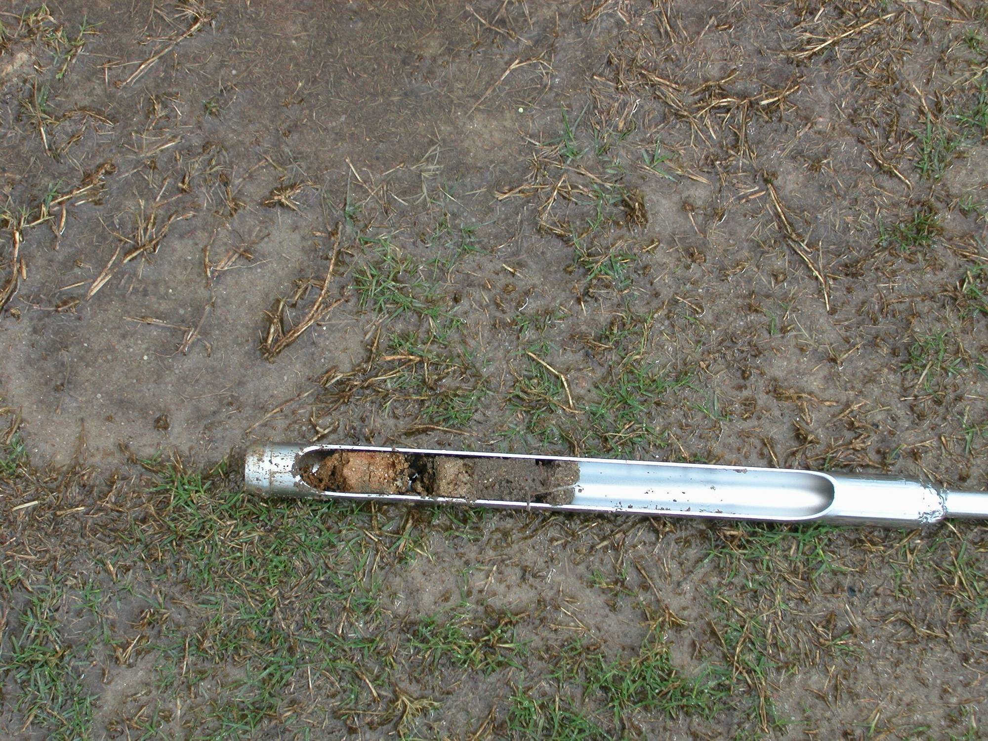

Slide 21
Prevention & Correction of Soil Compaction
Avoid repeated traffic over the same site
Increase mowing height where traffic in unavoidable
Minimize traffic when soil is wet or near field capacity
Allow 24 to 48 hrs between irrigation and field use (or as many hrs as possible)

Slide 22
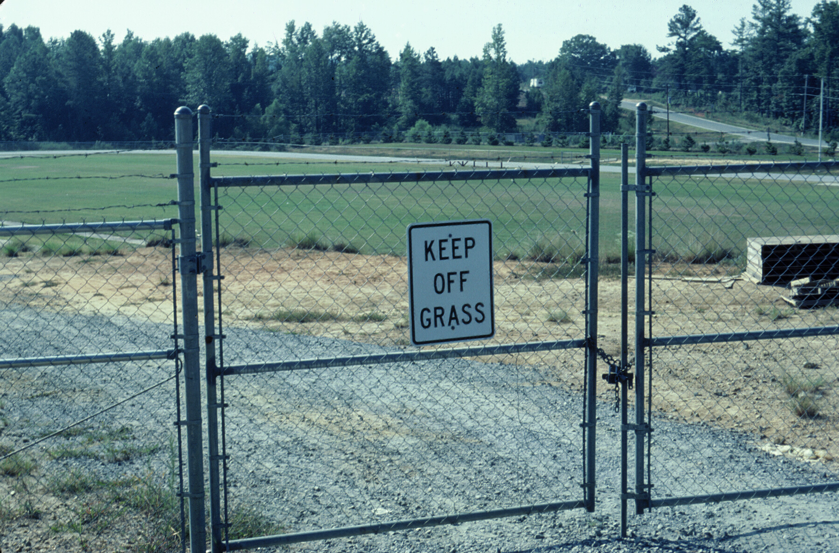

Slide 23
Prevention & Correction of Soil Compaction
Avoid repeated traffic over the same site
Increase mowing height where traffic in unavoidable
Minimize traffic when soil is wet or near field capacity
Allow 24 to 48 hrs between irrigation and field use (or as many hrs as possible)
Use Cultivation practices

Slide 24
Benefits of Aerification
Relieve soil compaction
Aid in thatch control
Improve soil air exchange
Enhance water & nutrient penetration
Disrupt undesired soil layer
Aid in modifying soil with topdressing
Enhance water & nutrient uptake
Increase pesticide effectiveness
Reduce runoff & puddling
Increase soil temperature
Reduce effects of localized dry spots
Reduce surface hardness
Stimulate new growth
Improve heat & drought tolerance

Slide 25
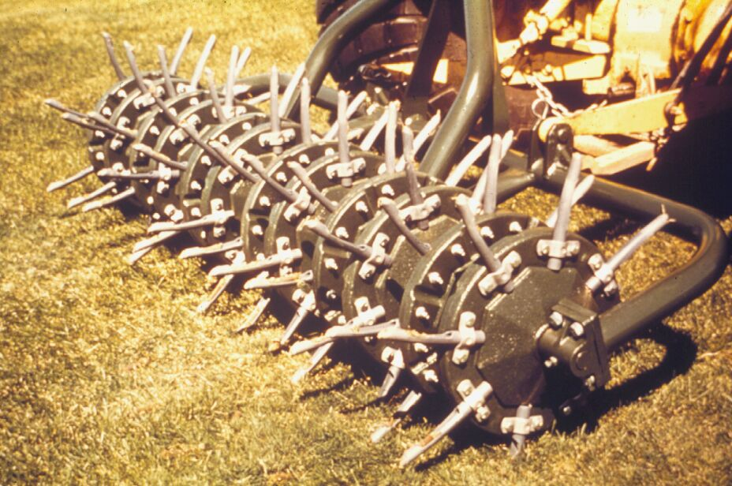
Hollow Tine Aerification is Still the Best Method

Slide 26
Coring Best Practices
6 in. Spacing with 1 in. Tines
3 Passes in Differing Directions
3x a Year (2x Spring & Fall)
Water 12 to 24 hours before
Topdress with Sand for sand profiles????

Slide 27
Core Surface Area Calculations
Tine Diameter = 1 inch
Tine Radius = 1 in. / 2 = 0.5 inch
1 inch
Area of Spacing = 5 in x 5 in = 25 inch²
5 inch
Area of Core = πr²
Area of Core = 3.141*(0.5 in)²
Area of Core = 3.141*0.25 in²
Area of Core = 0.785 in²
5 inch
Surface Area Affected = Area of Core/Area of Spacing
Surface Area Affected = 0.785 in² / 25 in²
Surface Area Affected = 0.031 in² or 3.1%

Slide 28
Tine Spacing: 5x5 inches
Tine Size Diameter (in.) | Spacing (in.) | # of Holes / sq. ft. | Surface Area Impacted / tine (sq. in.) | Surface Area Impacted (%) | # of Passes to remove 20%
1/2 | 5x5 | 5.76 | 0.196 | 0.79% | 25.5
3/4 | 5x5 | 5.76 | 0.442 | 1.77% | 11.3
1 | 5x5 | 5.76 | 0.785 | 3.14% | 6.4

Slide 29
Tine Spacing: 5/8 inch
Tine Size Diameter (in.) | Spacing (in.) | # of Holes / sq. ft. | Surface Area Impacted / tine (sq. in.) | Surface Area Impacted (%) | # of Passes to remove 20%
5/8 | 4x4 | 9 | 0.307 | 1.92% | 10.4
5/8 | 5x5 | 5.76 | 0.307 | 1.23% | 16.3
5/8 | 6x6 | 4 | 0.307 | 0.85% | 23.5

Slide 30
Coring 20% of Surface Annually
10 passes needed in a year
3 passes per coring
3 corings

Slide 31
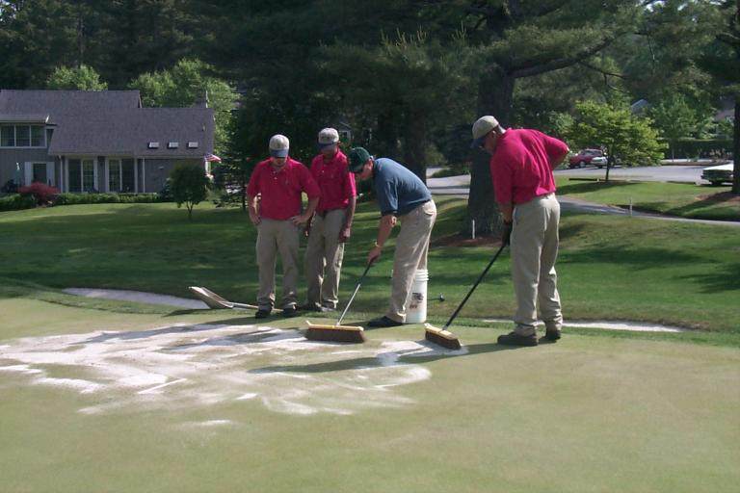
To Topdress or Not ?????

Slide 32
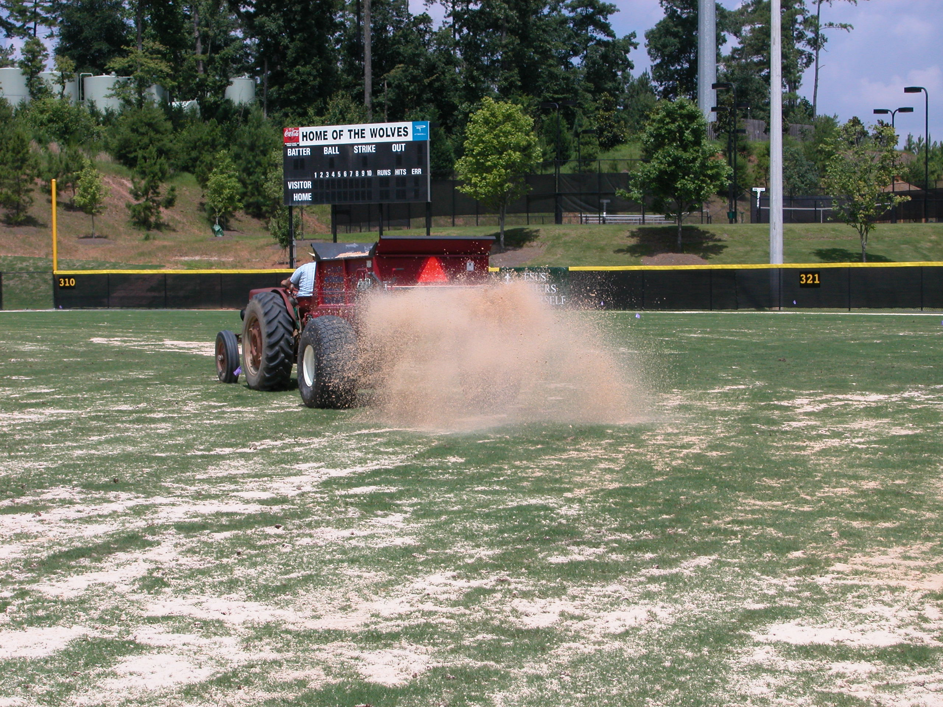
Maximizing Effectiveness
Smaller Diameter → Shorter Impact Time
Topdressing extends core hole effectiveness

Slide 33
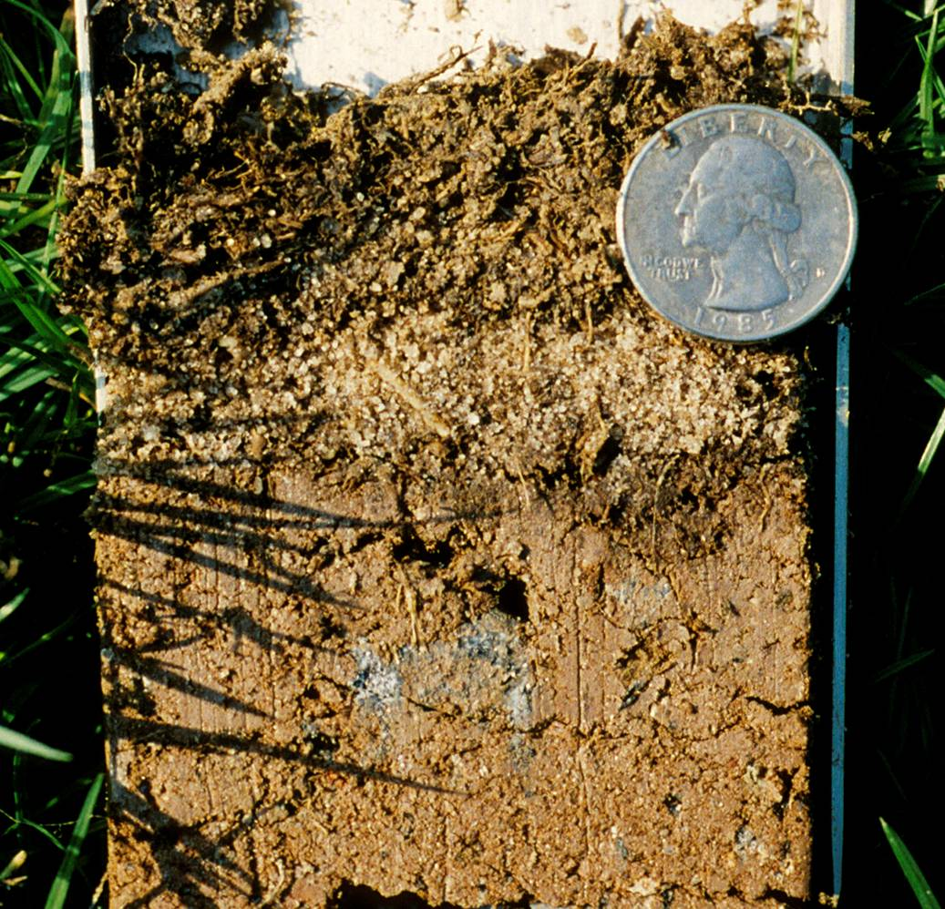

Slide 34
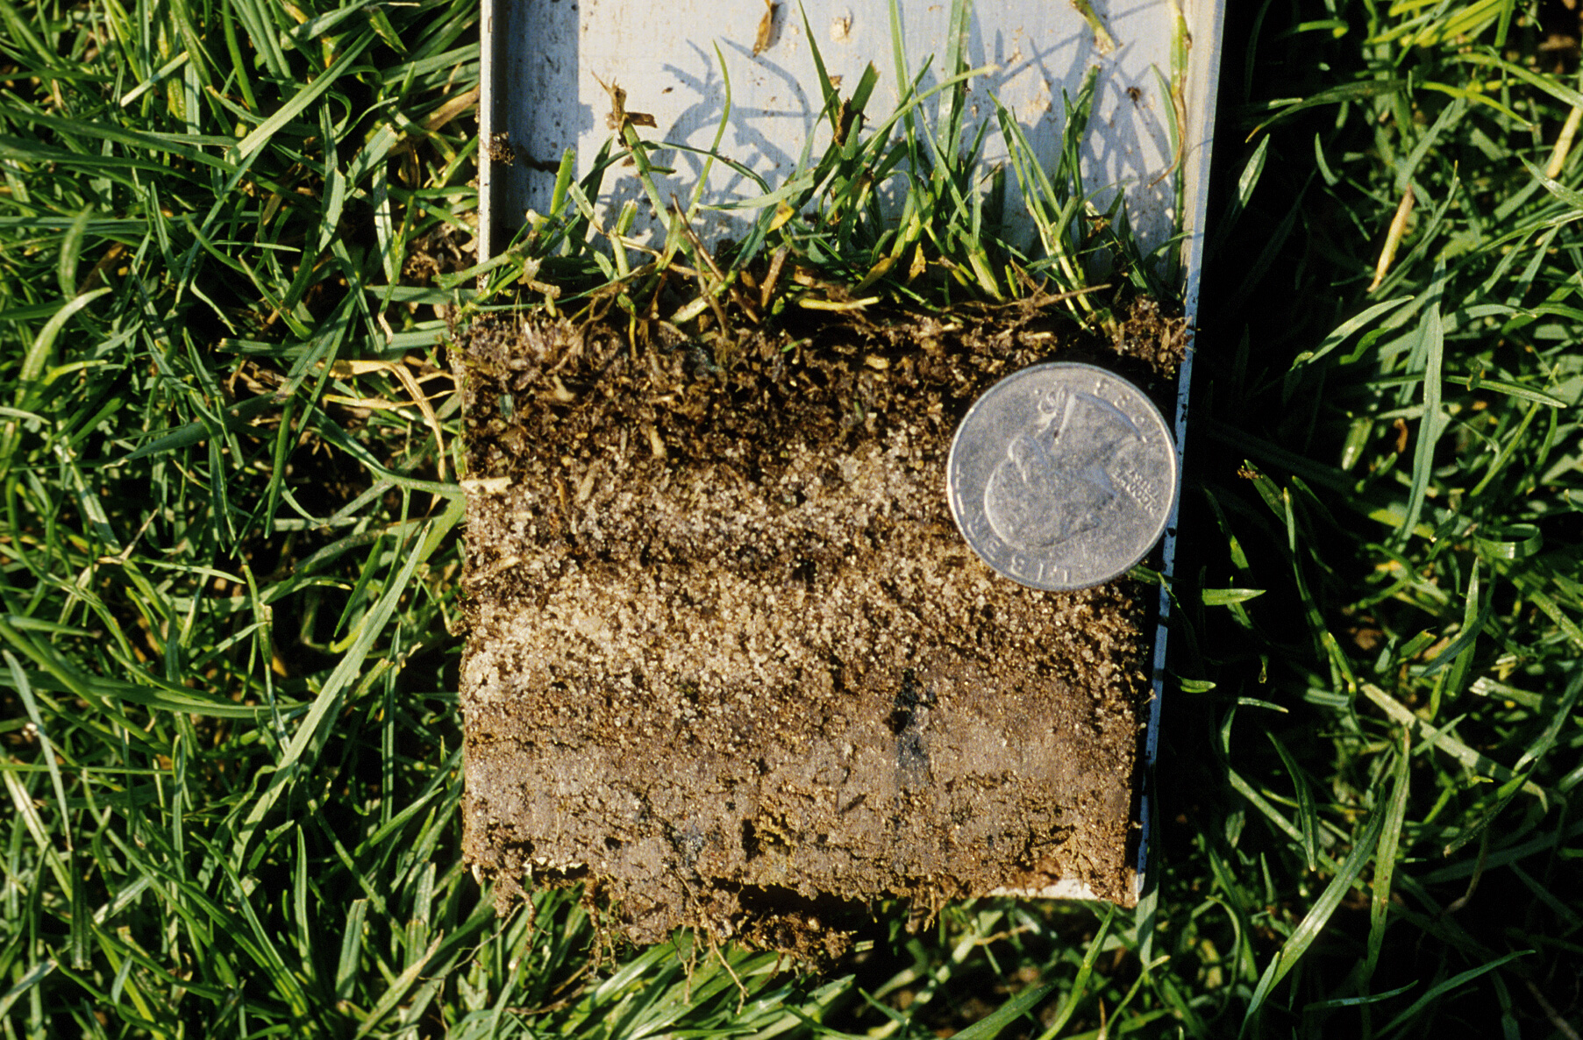

Slide 35
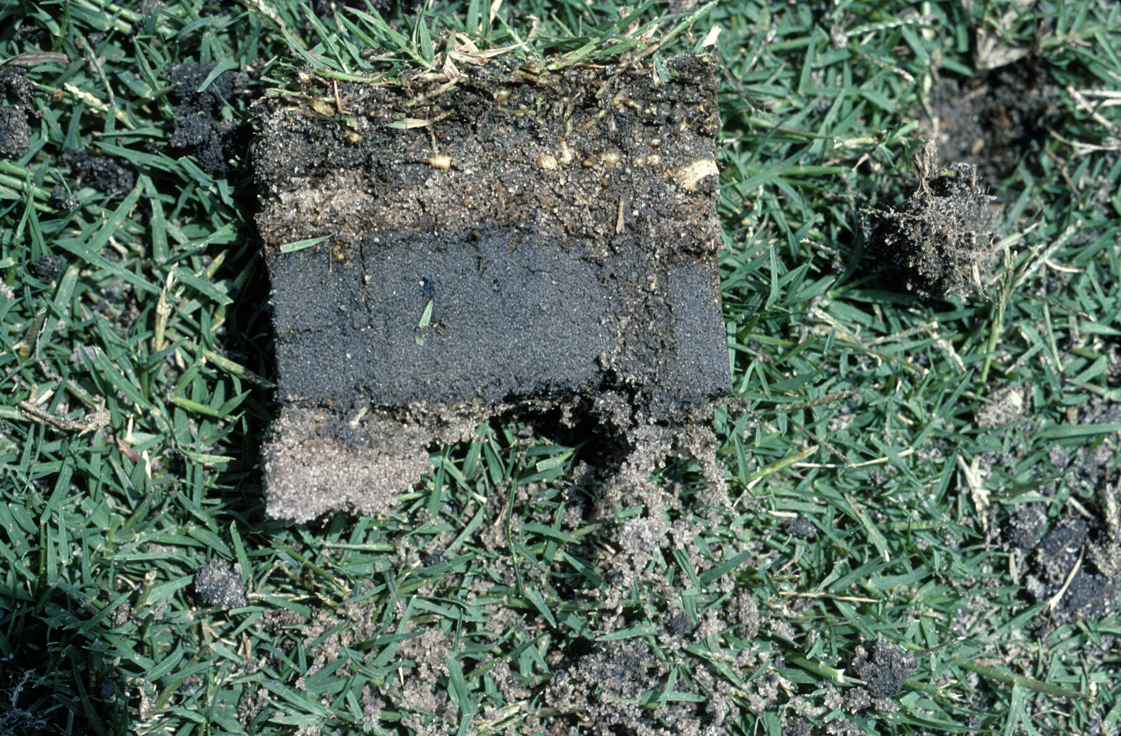

Slide 36
SEASONAL GROWTH PATTERNS OF GRASSES

Slide 37
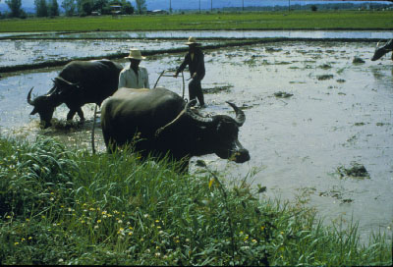
Notes:
Rice paddy; 1b

Slide 38
Increase Traffic Tolerance
Moderate nitrogen
High potassium
Increase cutting height
Moderate thatch
Adequate irrigation

Slide 39
